Slide 1
Timing Status Freiburg
17.12.2020

Slide 2
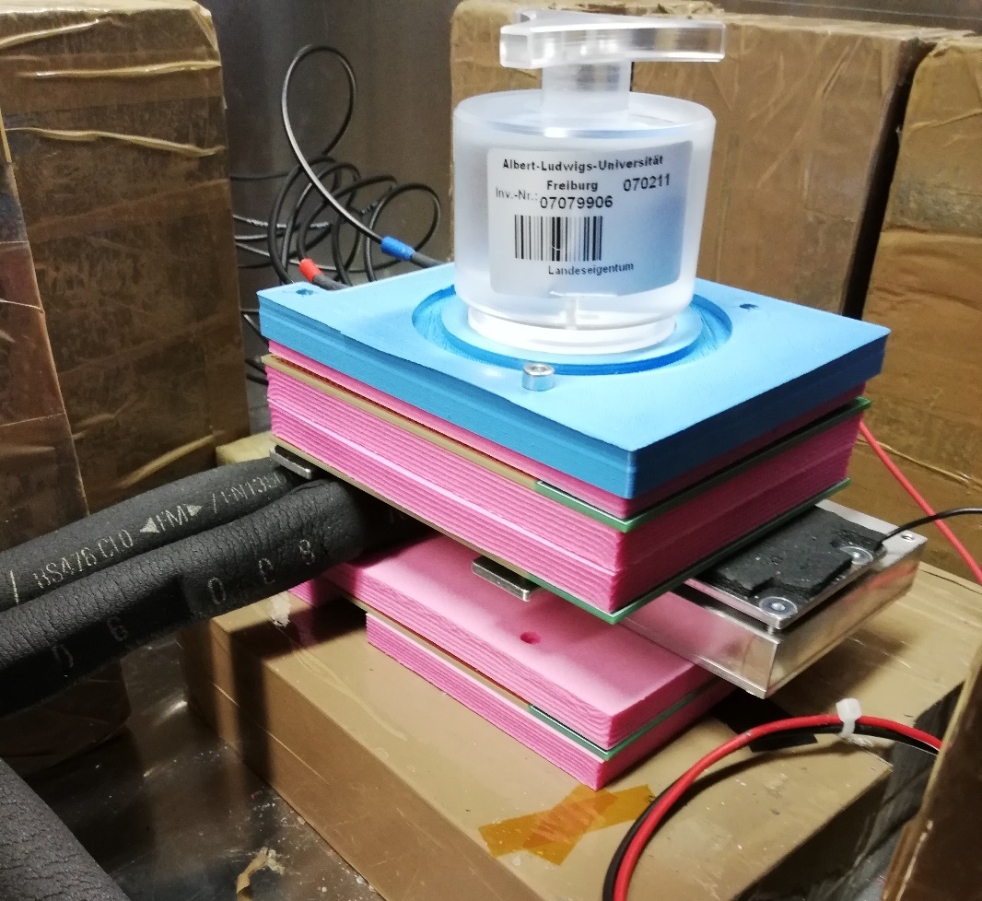
Timing Setup
Setup and some troubles
Particulars amplifiers used
Trigger on all three sensors (Pattern trigger)
Cooling not sufficient yet, needs to be improved
Alignment of the diode board needs to be fixed
We had a lot of noise issues, that are fixed now
Testing different LGADs for being the final reference sensor right now
LGAD
board
DUT
board
Diode
board
Chiller+Peltier+
Mounting Stage

Slide 3
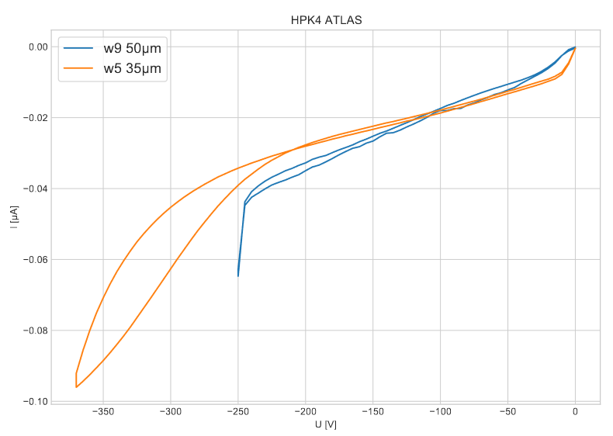
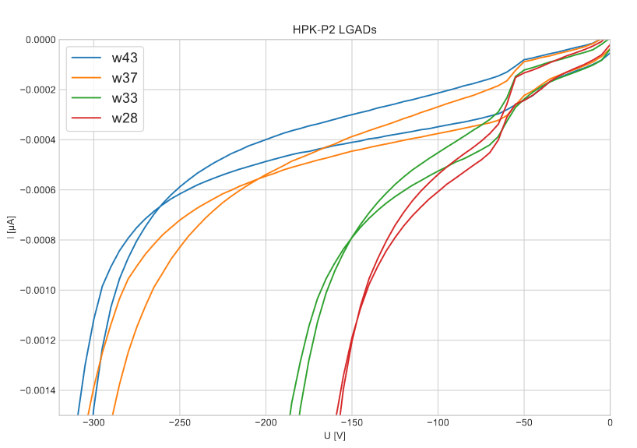
Samples
HPK LGADs, 35/50 µm active layer, different wafers
Sensor capacitance: 3.5-3.7 pF
Target Vbr between 160V and 240V

Slide 4
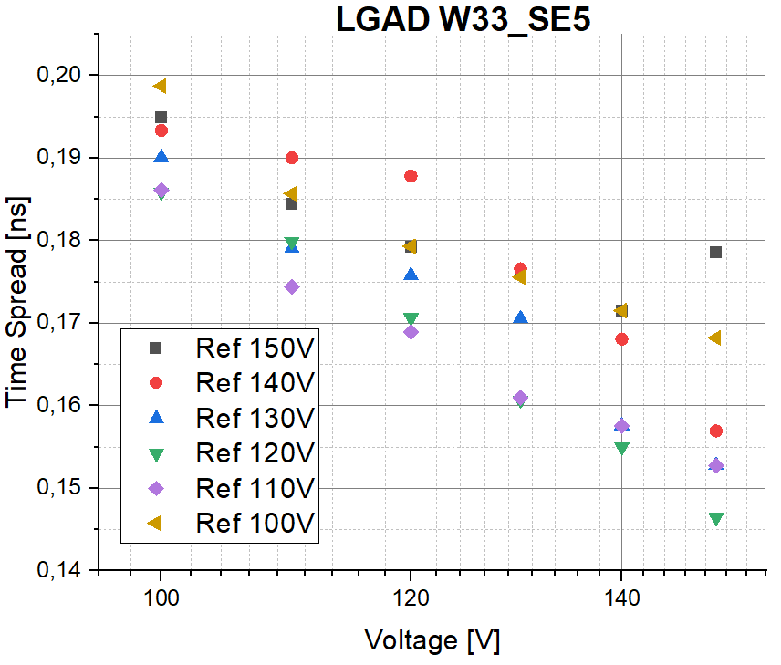
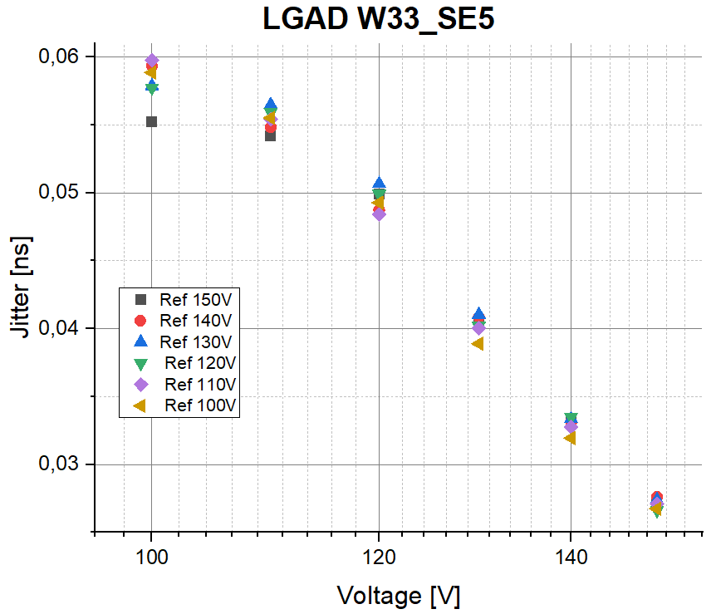
Timing measurements
Reference Sensor: W33 SE3 – 50 µm
DUT W33-SE5, 2x2 LGAD -50 µm
Jitter is stable & consistent, time spread depends on reference voltage – we chose 120V for
this sensor. Currently testing a 35 µm sensor as reference.
Values are too high compared with measurements in Ljubljana – possibly lacking resolution
of the oscilloscope

Slide 5
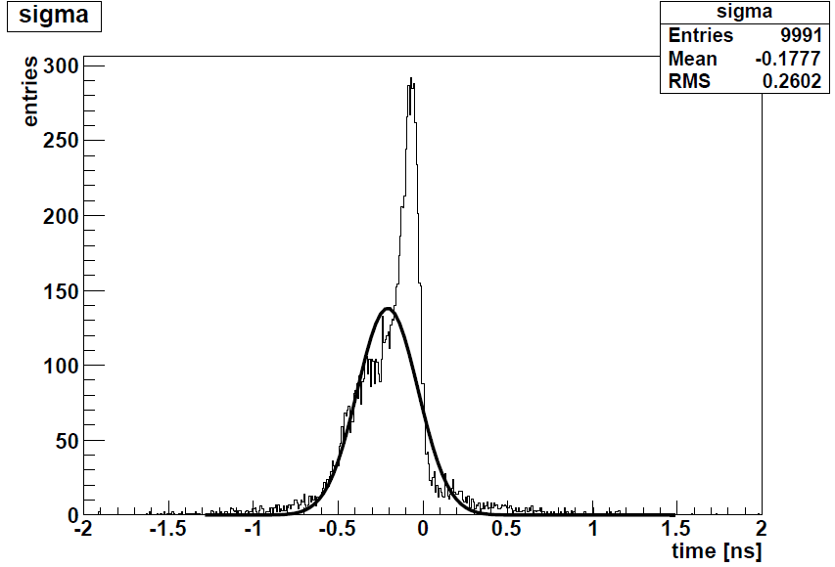
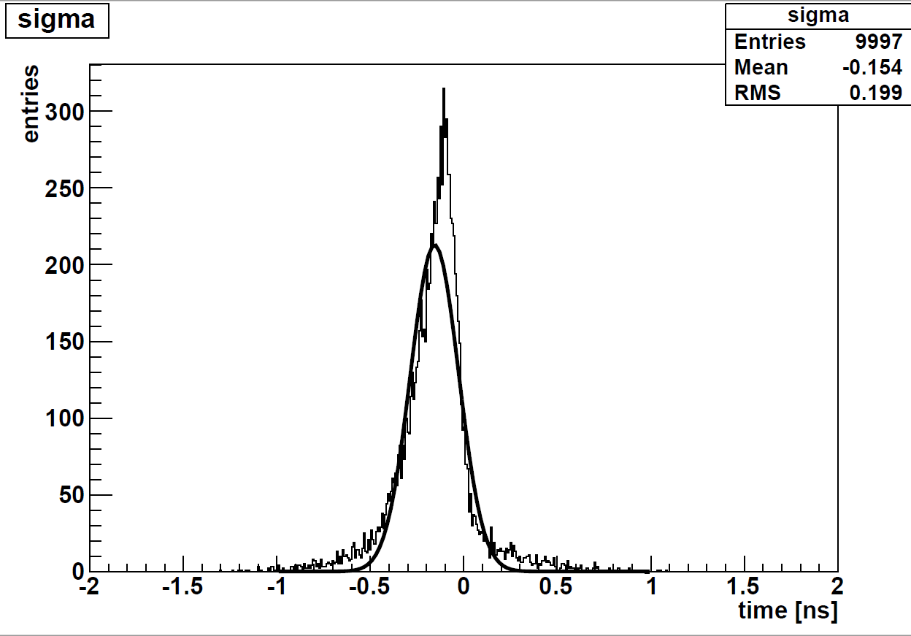
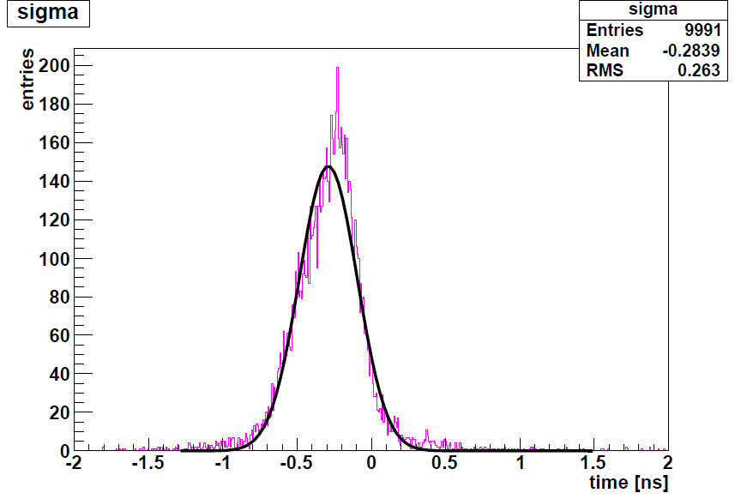
Time Spread
150V DUT, 150V Ref
Reference Sensor: W33 SE3 – 50 µm
DUT W33-SE5, 2x2 LGAD -50 µm
150V DUT, 125V Ref
100V DUT, 150V Ref

Slide 6
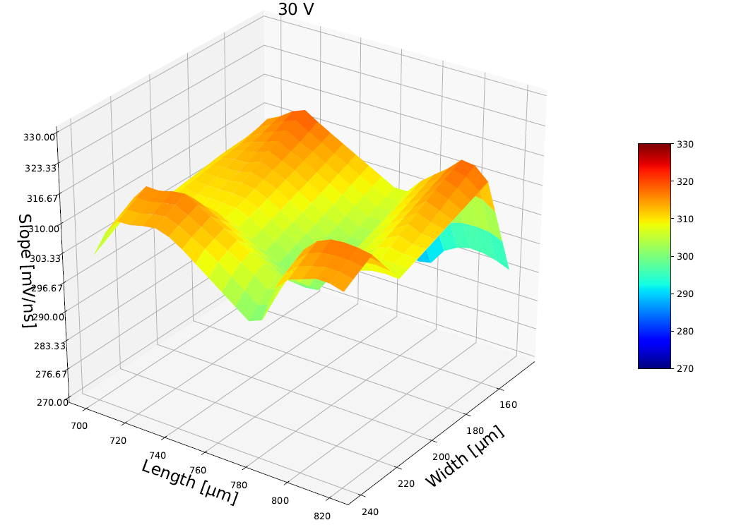
Top-TCT measurements
IR Laser, focus slightly beneath surface
3D sensor: Strip Sensor, 80x80 cell size
Junction column in (760,195)
Currently trying to improve the measurement by splitting and delaying the laser pulse
Time spread analysis with the trigger pulse is not always consistent yet
Need to improve positioning (so far positioning manually)
Slope of the pulses shows a sensor profile -> this type of measurement can be useful for timing measurements

Slide 7
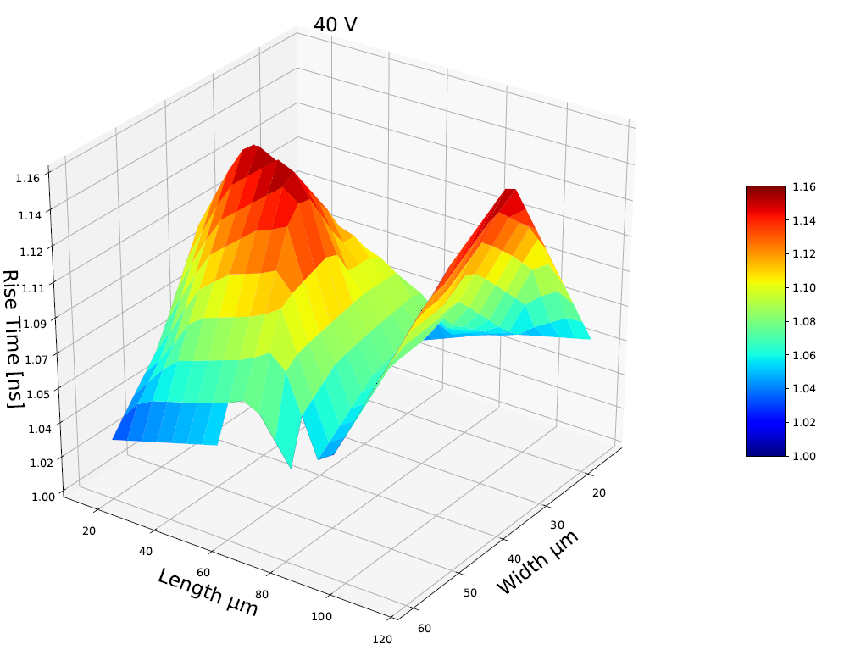
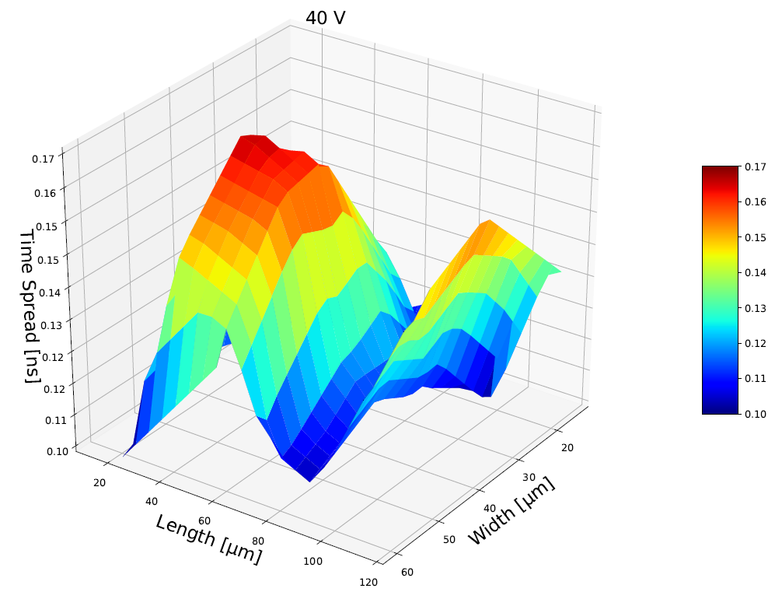
Top-TCT measurements
IR Laser, focus slightly beneath surface
3D sensor: Strip Sensor, 80x80 cell size
Ohmic column in the middle of the cell
Junction columns in (0,80),(80,80),(80,0),(0,0)

