Slide 1
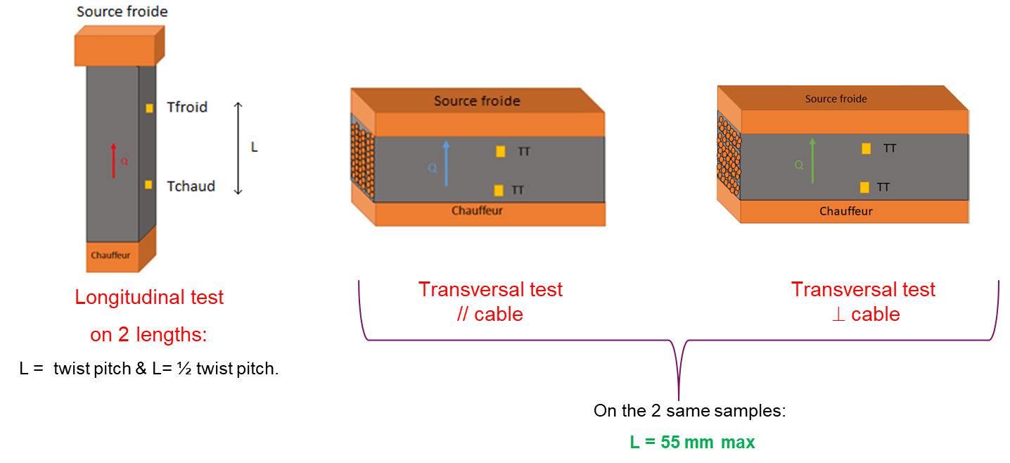
WP4 : High Field Magnet Materials and Technology
1- Dimensional changes of Nb₃Sn cables (QXF PIT) :
Measurement of the longitudinal contraction in coil configuration: 4 tests completed.
Still pending: Measurement of the cable thickness under 5 Mpa.
3- Measurement of the thermal conductivity on impregnated stacks of cables.
Adaptation for the transverse configuration done and qualification of the entire facility with instrumentation almost ready.
Measurements on 2 cables : 11T (twist pitch = 100) + QXF (twist pitch = 109).
Samples :
4 stacks 11T already reacted and impregnated / 2 samples L_{measurement} = 100 mm ready.
4 stacks QXF reacted.
3 types of tests, according to the direction of the heat flow:
New program: to be validated

