Slide 1
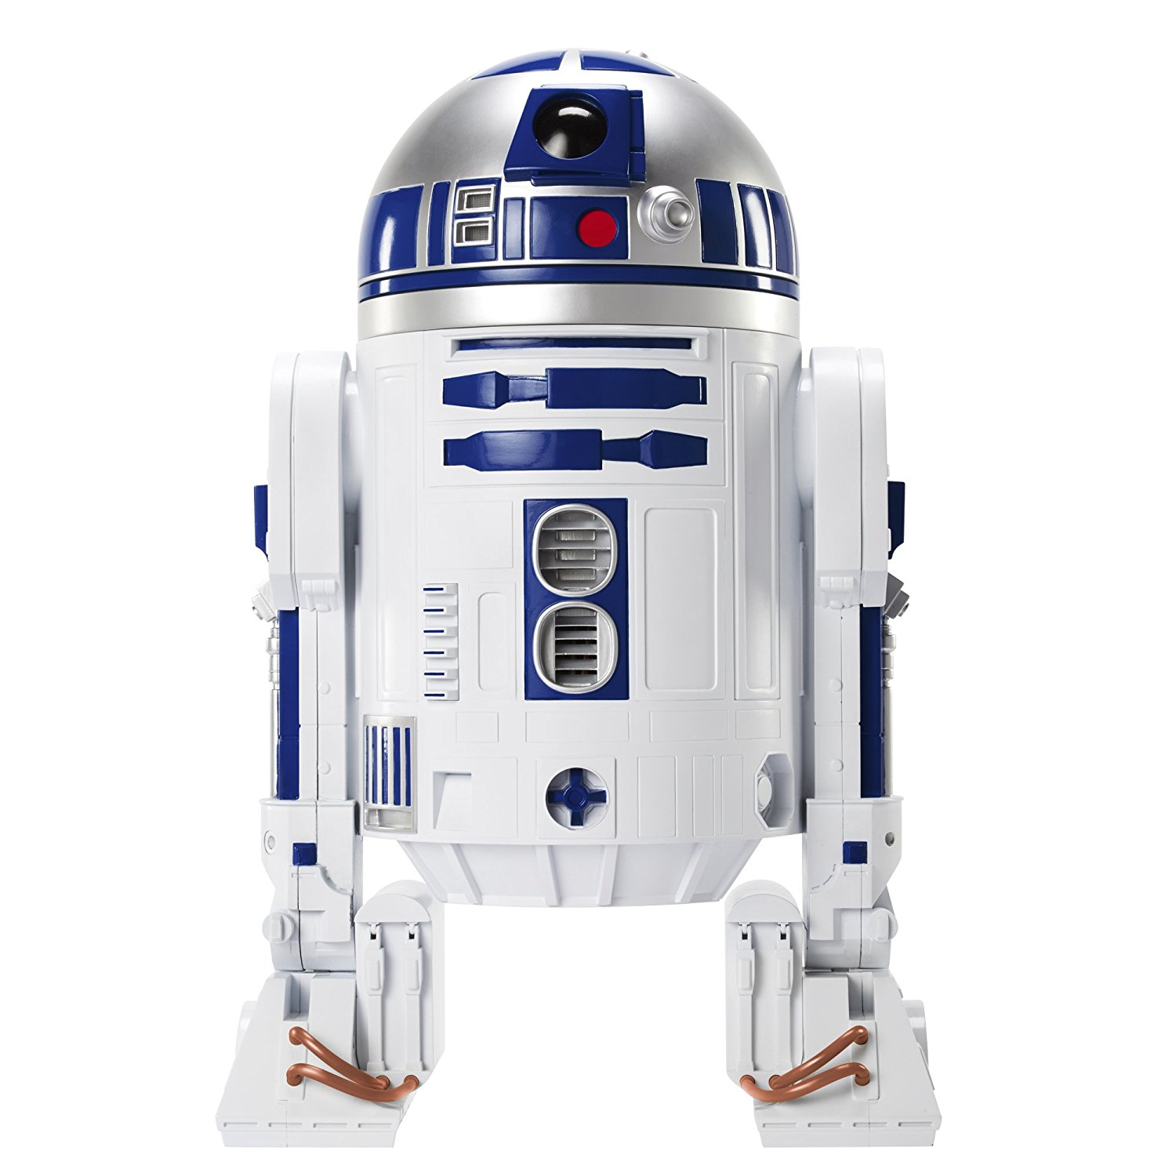

Status of R2D2
the Research Racetrack
Dipole Demonstrator
ADDENDUM FCC-GOV-CC-0121 - KE 3782
TM & © Lucasfilm Ltd.
All Rights Reserved
CEA: E. Rochepault, V. Calvelli, M. Durante, H. Felice, P. Mallon, P. Manil, G. Minier, G. Maitre, F. Rondeaux
CERN: S. Izquierdo Bermudez, J.C. Perez, D. Tommasini, J. Fleiter
27/11/2020

Slide 2
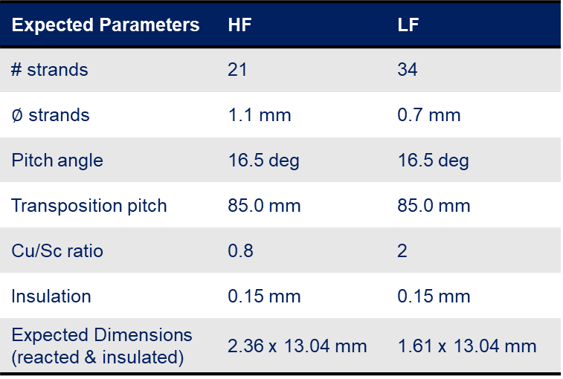
Conceptual design RD 2.1 – Conductor
Expected Parameters | HF | LF
# strands | 21 | 34
$∅$ strands | 1.1 mm | 0.7 mm
Pitch angle | 16.5 deg | 16.5 deg
Transposition pitch | 85.0 mm | 85.0 mm
Cu/Sc ratio | 0.8 | 2
Insulation | 0.15 mm | 0.15 mm
Expected Dimensions (reacted & insulated) | 2.36 x 13.04 mm | 1.61 x 13.04 mm
Conductor expected T1 2021 → TBC
LF cable very similar to the 11-T cable
HF cable new, 1.1 mm strand
→ risk of changes in dimensions, mitigated with dimensional margins
J_{c} and RRR extrapolated
→ risks of impact on the design, mitigated with design margins

Slide 3
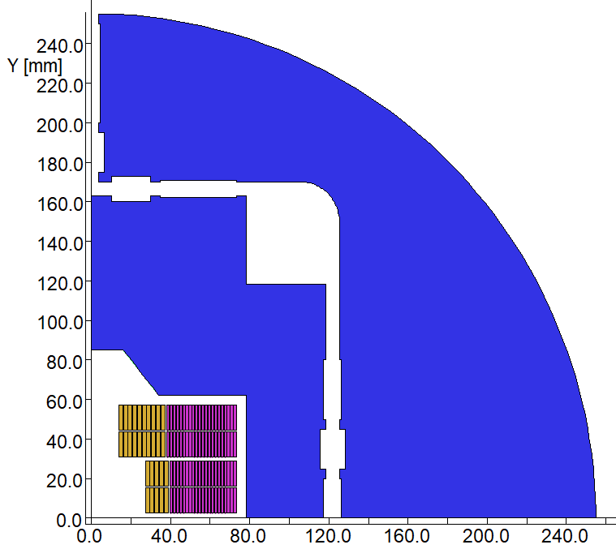
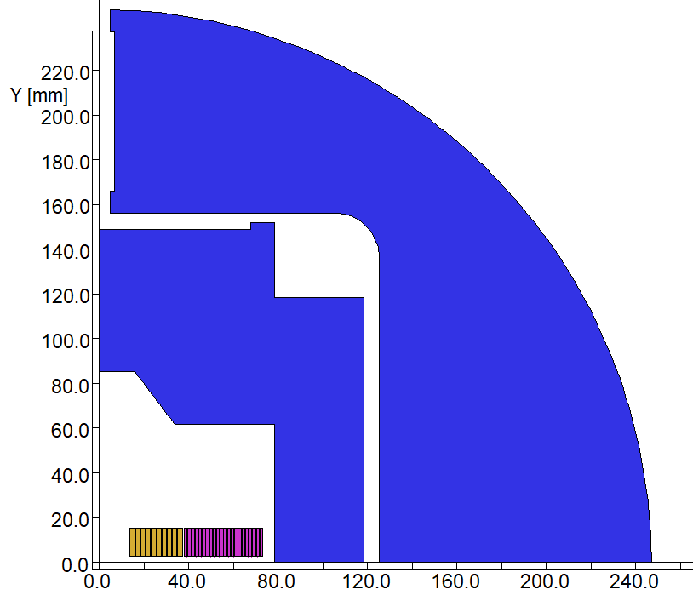
Conceptual design RD 2.1 – R2D2 in F2D2
V 4.8.15 | Nominal @ 1.9 K
I | 15917 A
LL margin HF / LF | 22.4 % / 14.0 %
B @ (0,0) | 11.46 T
B peak HF / LF | 12.61 T / 9.77 T
Original idea: layer 3 only, same structure
I_{R2D2} ~ 160% I_{F2D2}
→ protection issues → margin to 20%
Steep load-line
→ Stability issue → trade-off low J_{c}/high RRR
Grading not optimized
→ need to redesign the coil

Slide 4
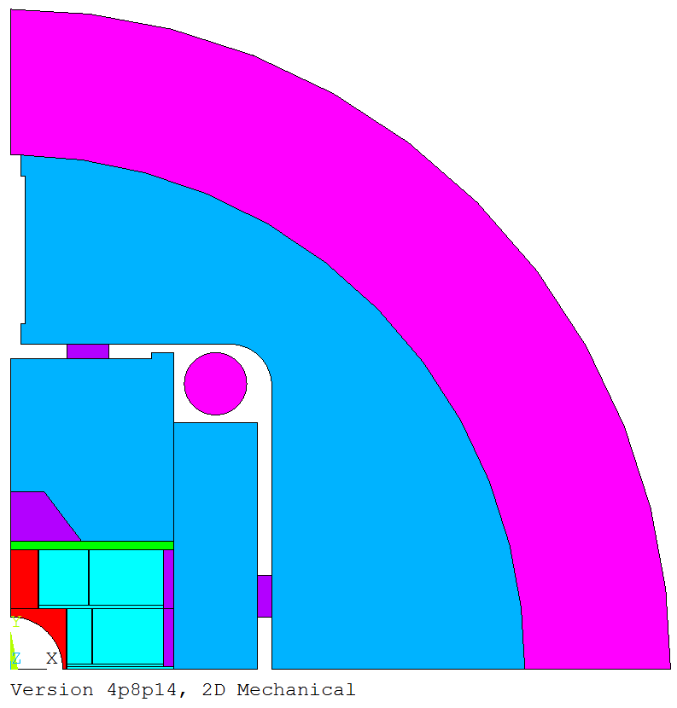
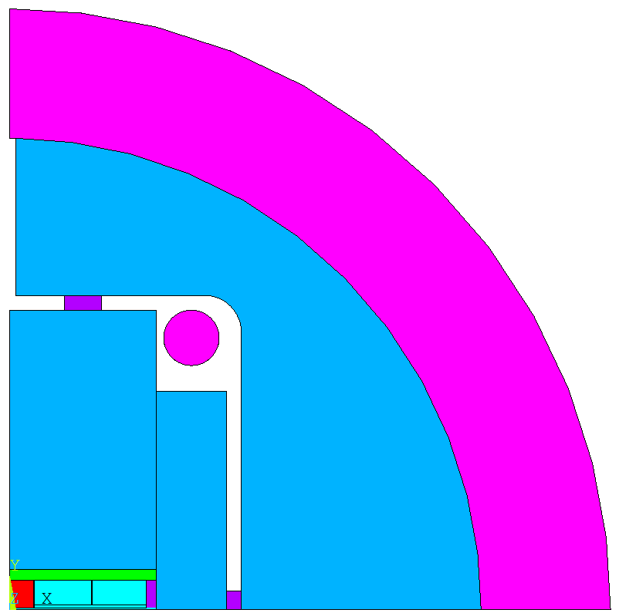
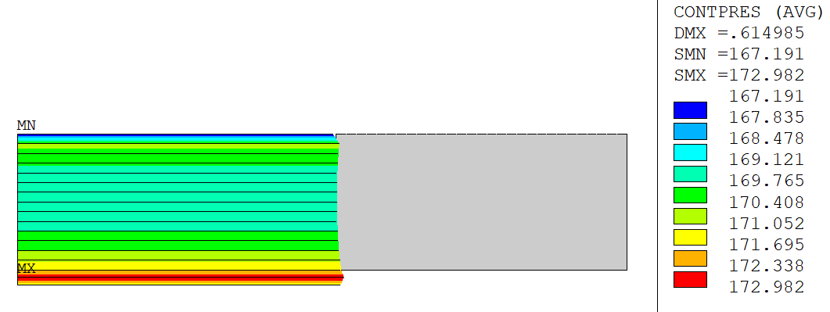
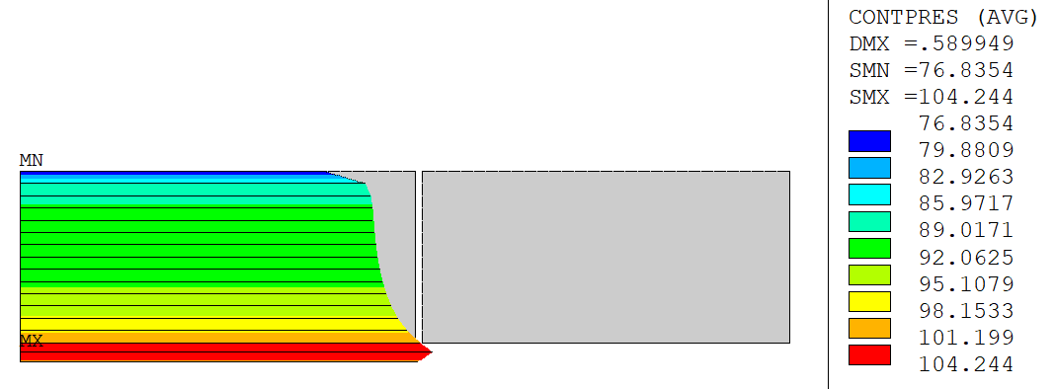
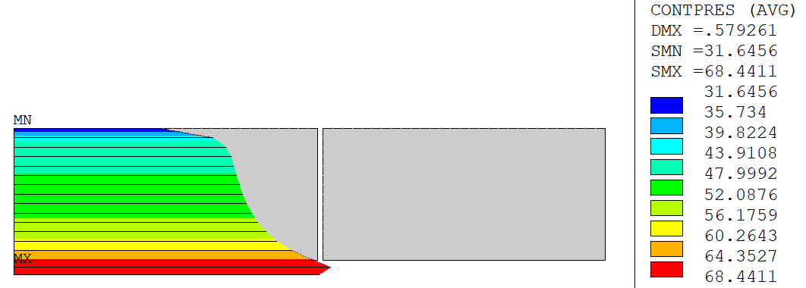
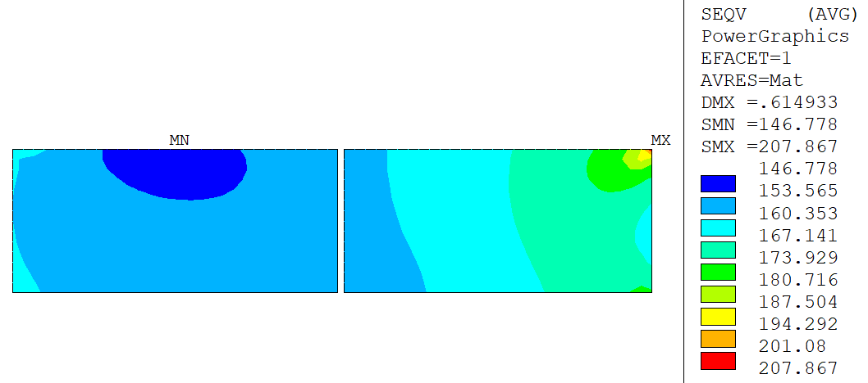
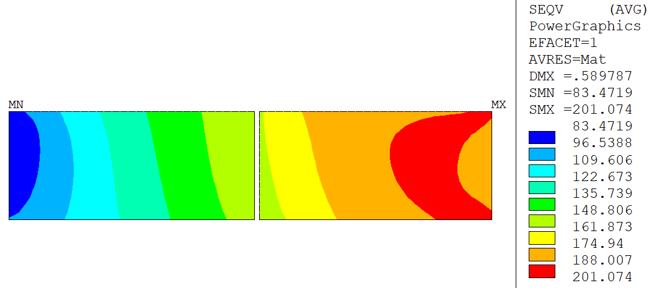
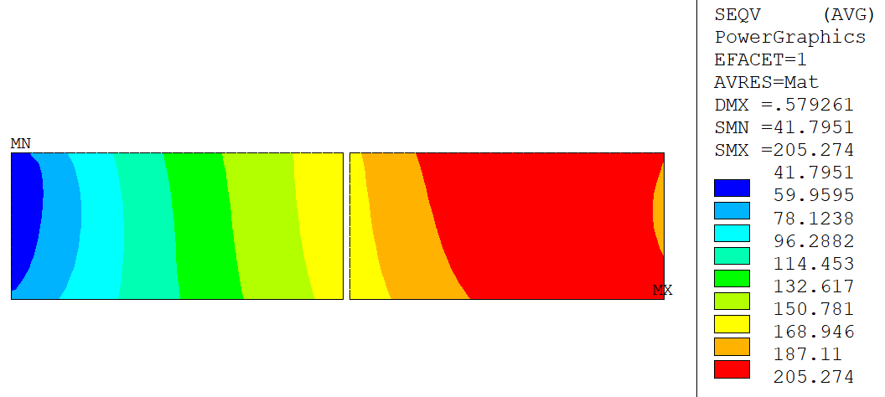
Conceptual design RD 2.1 – R2D2 in F2D2
Too much pre-load because of the thick shell
High peak stress
Need to redesign the structure
Different fillers and pads
→ Marginal cost saving
v6.9.16
0.10 mm Xinterf
0.05 mm Yinterf
+cool-down
Nominal:
13.38 kA, 11T
Short sample:
16.88 kA, 11T
208 MPa
201 MPa
205 MPa

Slide 5
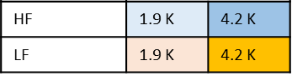
Conceptual design RD 2.1 – Preliminary protection
Hypothesis (Tiina’s spreadsheet):
  Adiabatic Regime
  Every coil has a quench heater
  No quenchback
  Rdump = 1000 V / I₀
  No Differential inductance
  Magnetoresistivity
  Detection delay = 20 ms
  Heater activation delay = 20 ms
  Max. hotspot 350 K
Additional difficulty of R2D2 due to a high J_{Cu}
→ Similar MIITS of F2D2 at 4.2 K
→ Does not seems possible to operate at SS 1.9 K
Detailed simulations with COMSOL ongoing
Limit zone
Design iterations
Safe zone

Slide 6
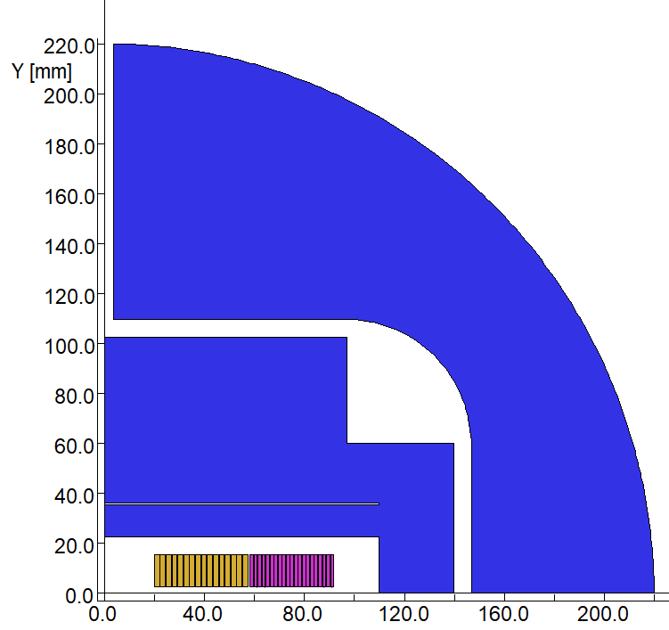
Conceptual design RD 2.1 – 2D Magnetic
Parameter | NOM 4.2 K | NOM 1.9 K | Ultimate | SS 4.2 K | SS 1.9 K | Unit
Current | 13772 | 15055 | 16500 | 17215 | 18819 | A
LL Margin HF LF | 20.0 20.5 | 20.9 20.0 | 4.2/1.9 K 4.2/12.9 4.5/11.3 | 0.0 0.7 | 0.9 0.0 | %
B (0,0) | 10.42 | 11.15 | 11.98 | 12.46 | 13.29 | T
B peak HF | 11.82 | 12.69 | 13.67 | 14.27 | 15.23 | T
B peak LF | 7.68 | 8.32 | 9.05 | 9.49 | 10.21 | T
Energy density | 474 | 553 | 649 | 725 | 818 | kJ/m
J_{Cu} HF J_{Cu} LF | 1472 1508 | 1627 1667 | 1827 1783 | 1853 1886 | 2034 2084 | A/mm²
Hotspot HF / LF | 104 / 141 | 135 / 203 | 210 / 350 | 260 K / 450 K | 580 / 1192 | K
11 T Nominal « guaranteed » (20 % margin, low J_{c})
12 T Ultimate achievable (350 K conservative)
Possibility to explore high MIITS above Ultimate

Slide 7
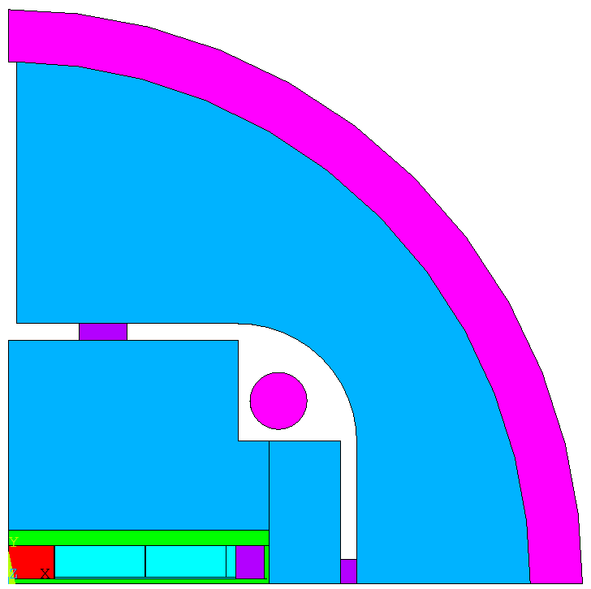
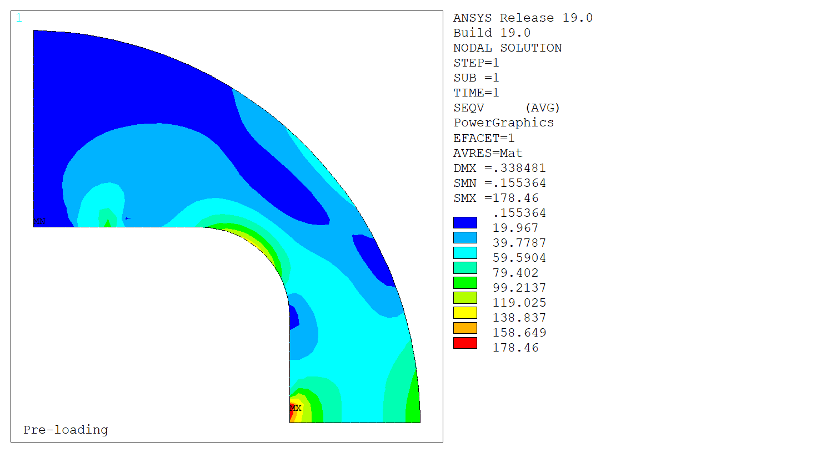
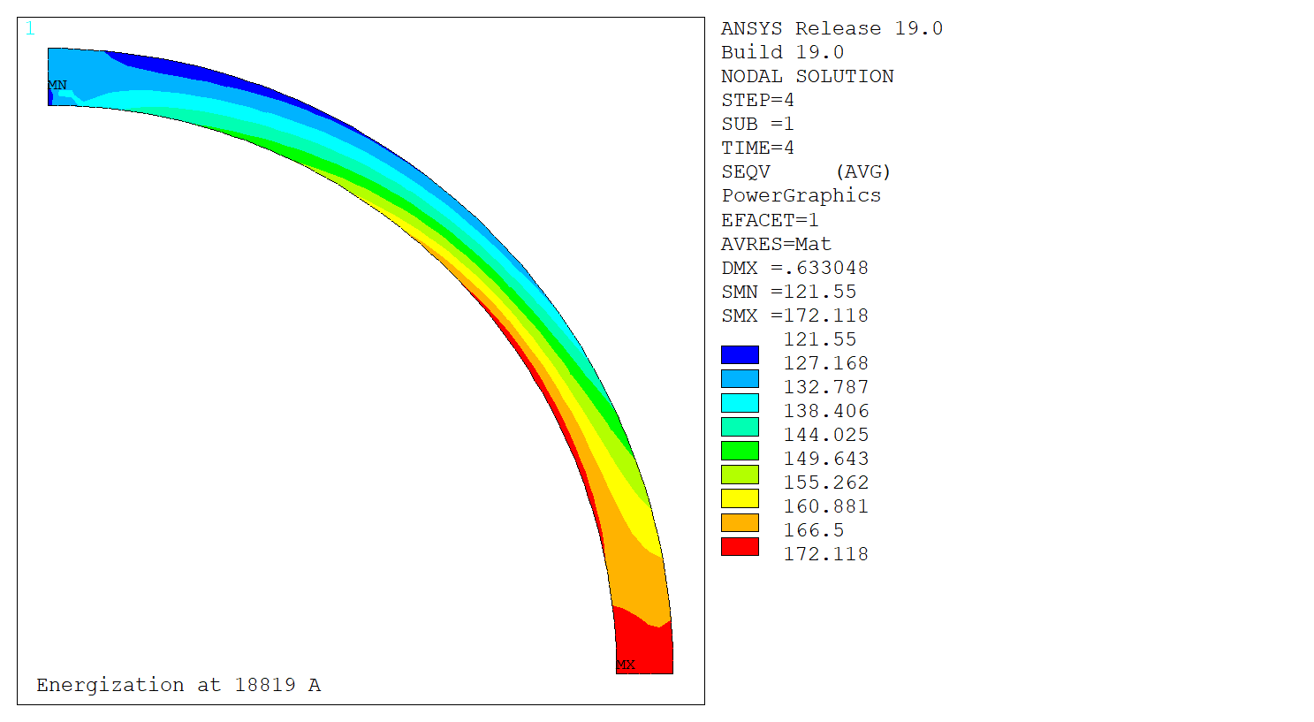
Conceptual design RD 2.1 – 2D Mechanical
Parametric analysis to select best Shell Vs yoke dimensions:
Shell Thick. (mm) | 26 | 22 | 20 | 22 | 22 | 22
Yoke Ext. Rad. (mm) | 190 | 190 | 190 | 195 | 210 | 220
Overall Rad. (mm) | 216 | 212 | 210 | 217 | 232 | 242
Yoke OK? | No | No | No | No | No | Yes
Coil Contact OK? | Yes | No | No | Yes | Yes | Yes
v6.9.16
v6.14.R2
Pre-loading
Structure allows both:
Low preload for nominal
High preload up to SS 1.9K
Structural components below limits at all steps
Energization at 18819 A

Slide 8
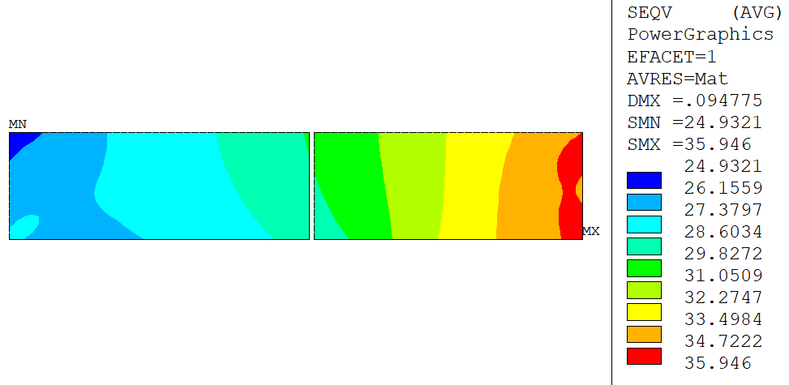
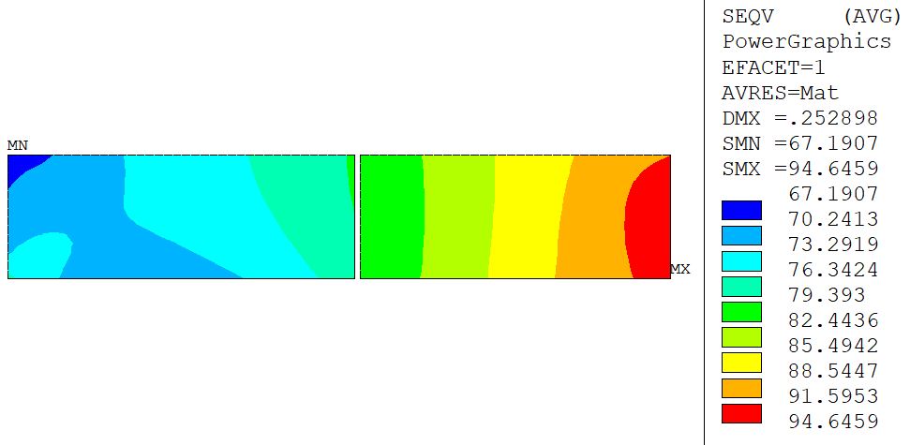
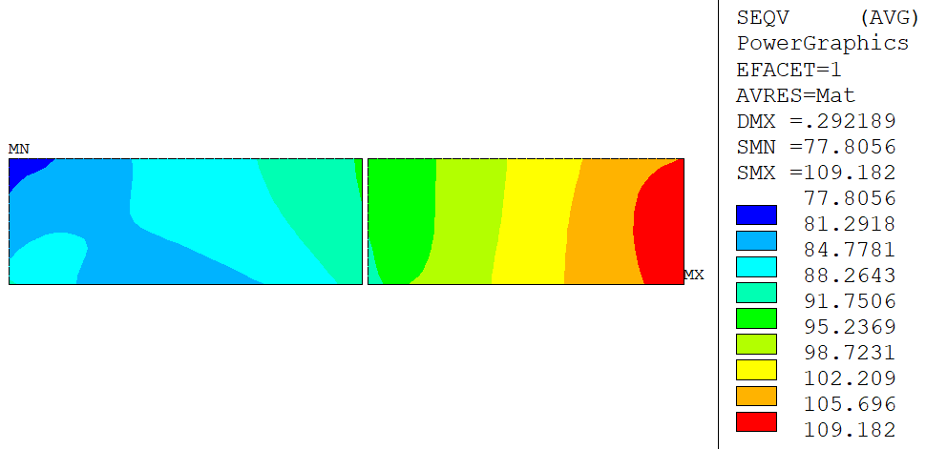
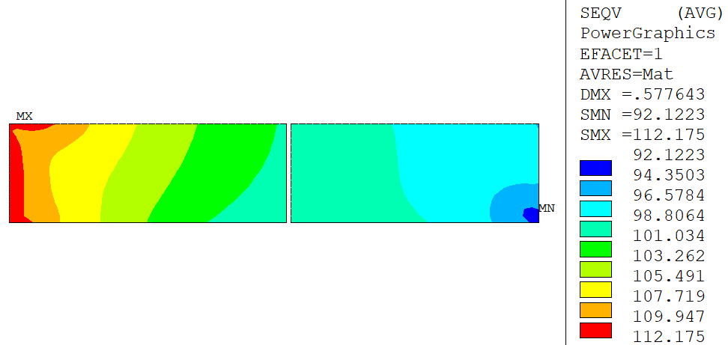
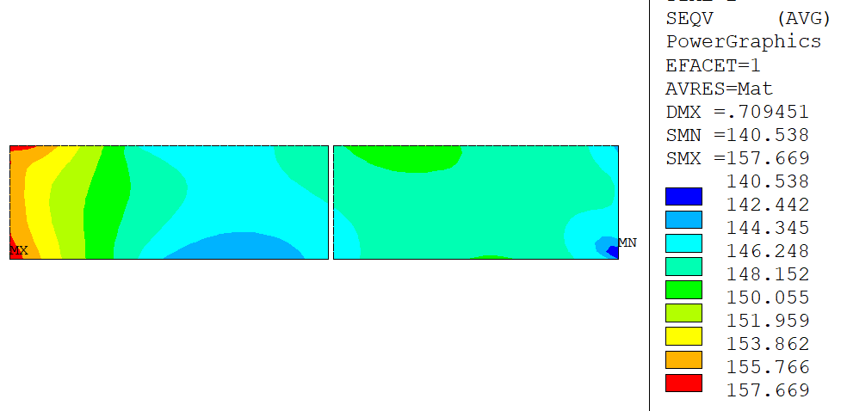
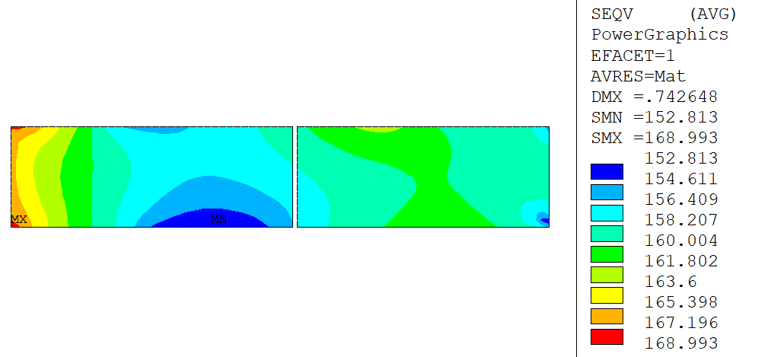
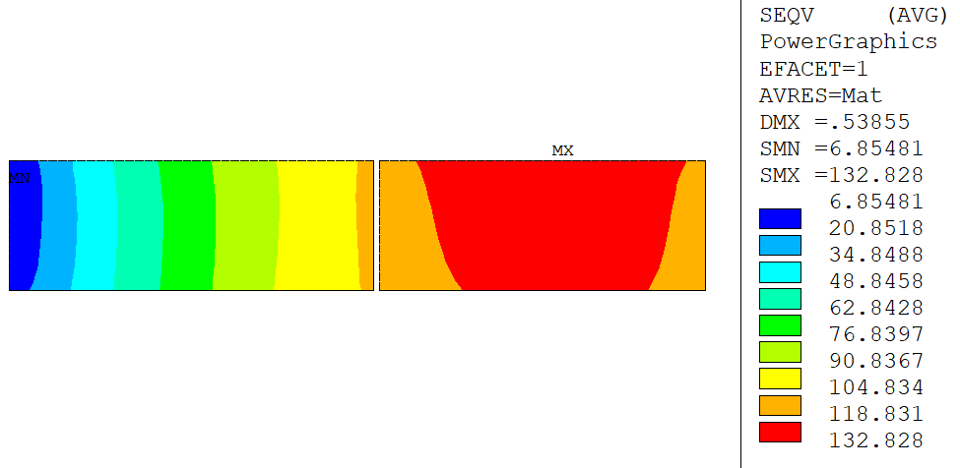
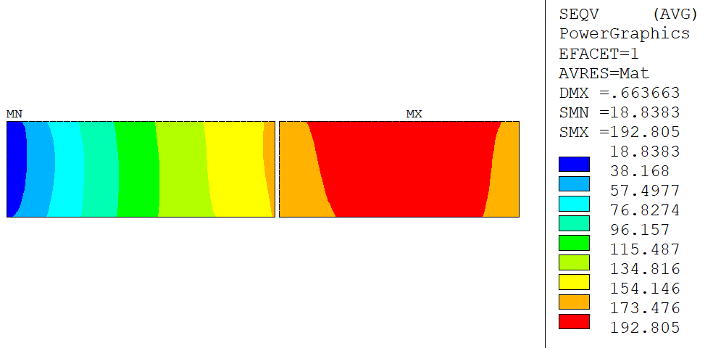
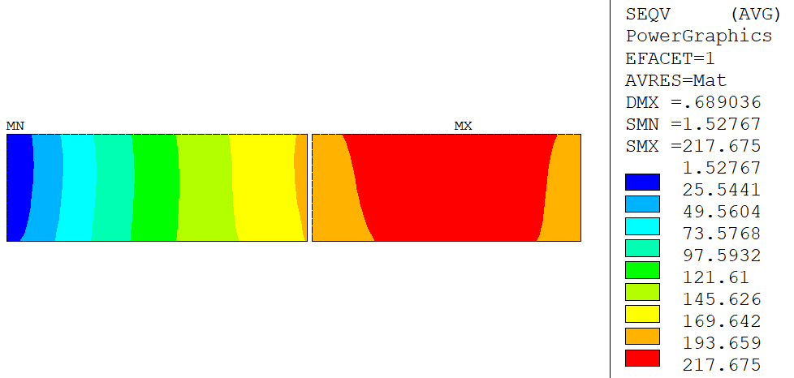
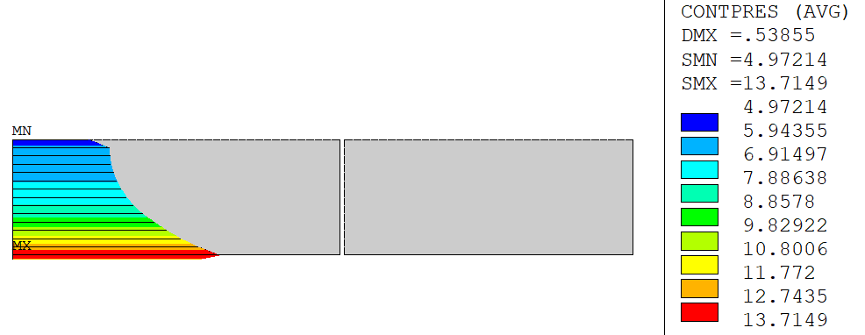
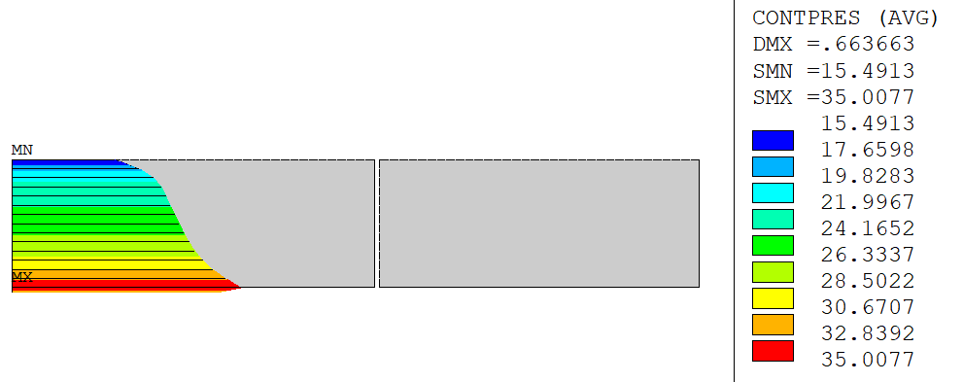
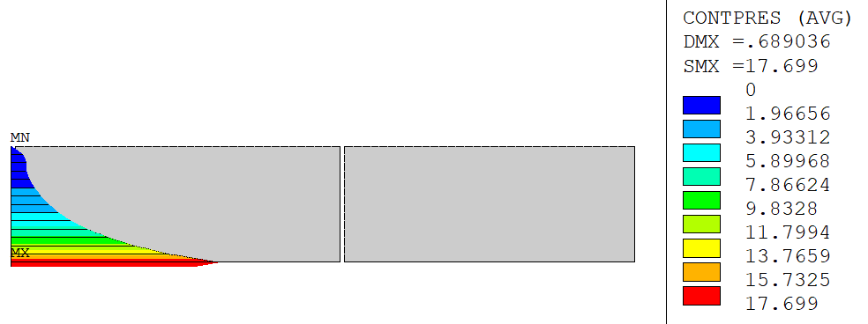
Conceptual design RD 2.1 – 2D Mechanical
Nominal 4.2 K
Ultimate
Short sample 1.9 K
36 MPa
95 MPa
109 MPa
Preload – 0.2 mm interf.
Preload – 0.6 mm interf.
Preload – 0.7 mm interf.
112 MPa
158 MPa
169 MPa
Cool-down to 4.2K
Cool-down to 1.9 K
Cool-down to 1.9 K
133 MPa
193 MPa
218 MPa
13772 A, 10.4 T
16500 A, 12.0 T
18819 A, 13.3 T
5 MPa
15 MPa
0 MPa

Slide 9
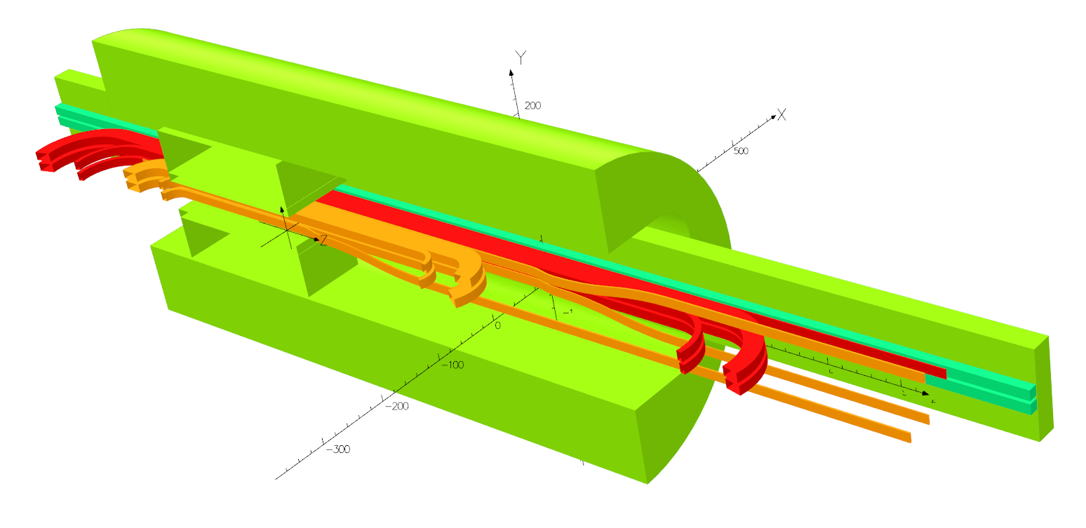
Conceptual design RD 2.1 – 3D Magnetic
Criteria:
B_{peak} spacer < B_{peak} center
B_{peak} center - B_{peak} spacer > 0,5 T if possible
Guarantee a minimum ‘good field’ length
Max. coil length 1300 mm
Return End

Slide 10
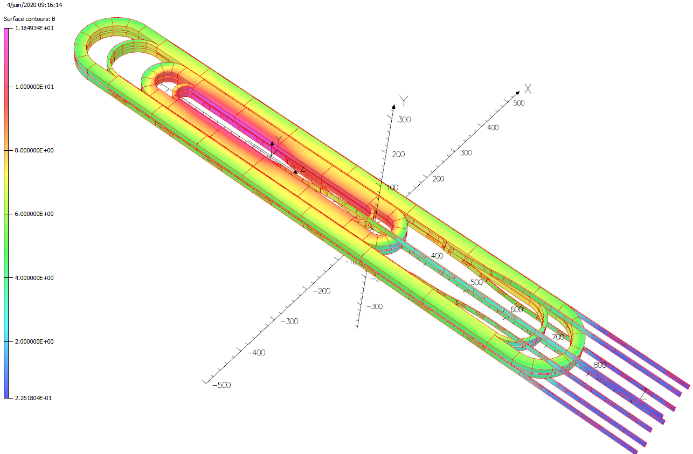
Conceptual design RD 2.1 – 3D Magnetic
Additional complexity due to racetracks
Need for spacers to decrease peak field in the ends
Not possible to optimize further the critical LF areas given the length constraint
130 mm ‘good field’ length
Location | Bpeak [T] | ΔB_{peak} [T]
SS, HF | 11,85 | 0
LE, HF | 10,26 | 1,59
RE, HF | 11,22 | 0,63
Outer lead HF | 7,26 | 4,59
Inner lead HF | 11,12 | 0,73
SS, LF | 7,75 | 0
RE, LF | 7,50 | 0,25
LE, LF | 7,66 | 0,09
Inner Lead LF | 7,51 | 0,24

Slide 11
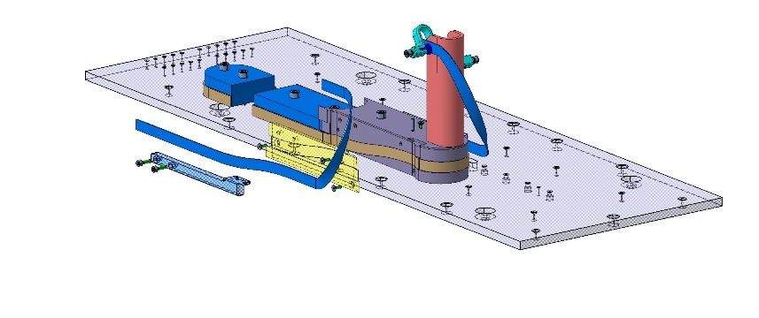
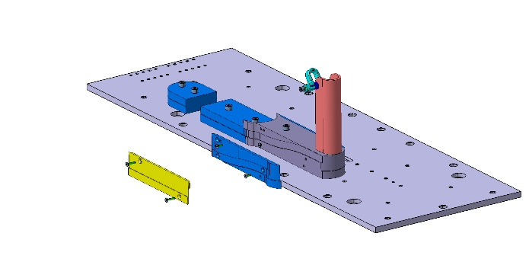
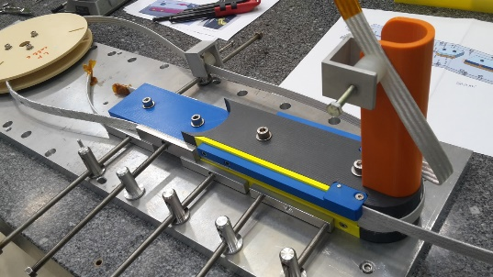
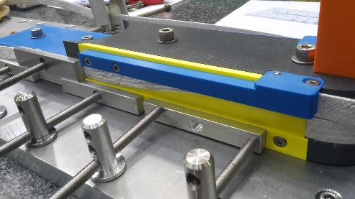
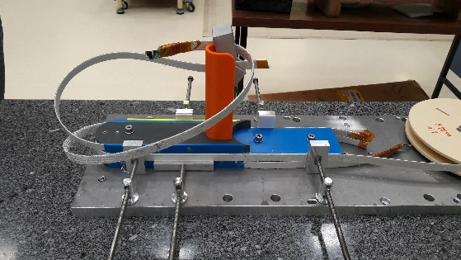
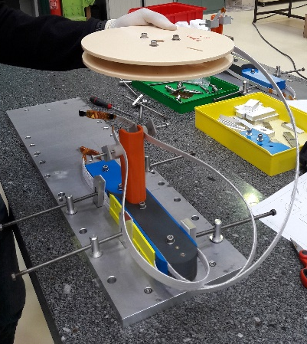
Mockups RD 2.1 – Layer jumps (F2D2)
Mock-up A
Mock-up B
Mock-ups made with a SMC 11T cable
Goals : validate concepts of exit jumps and develop procedures

Slide 12
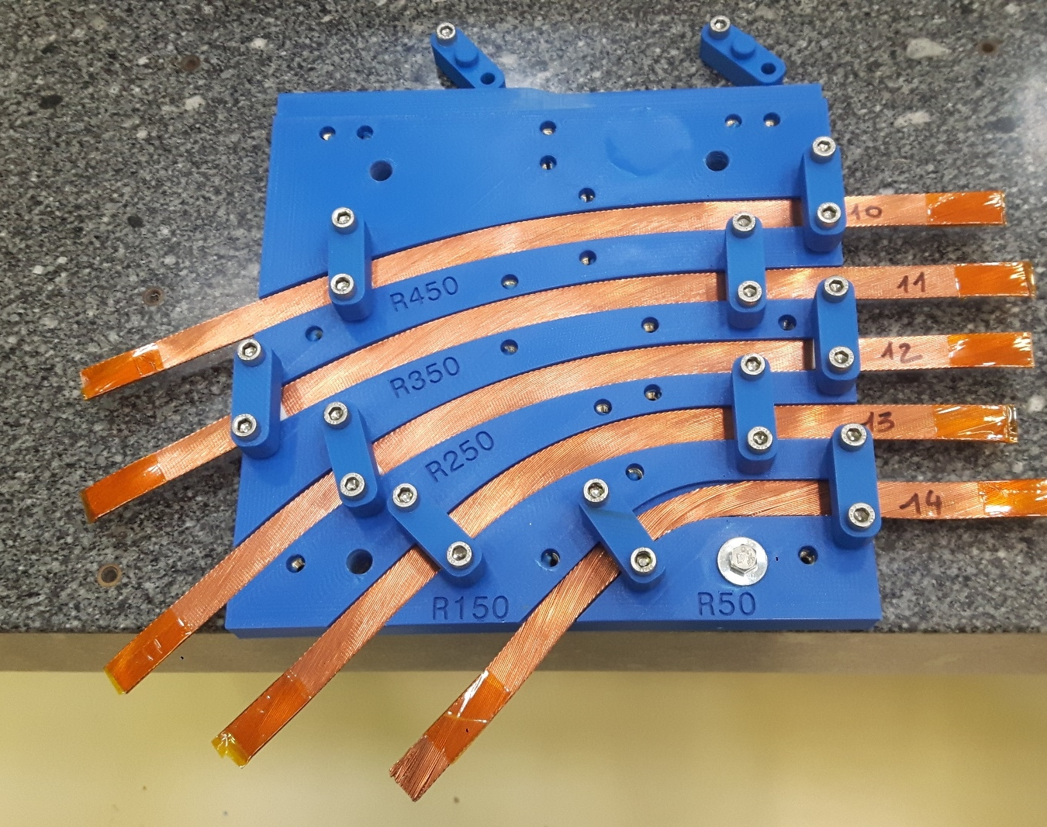
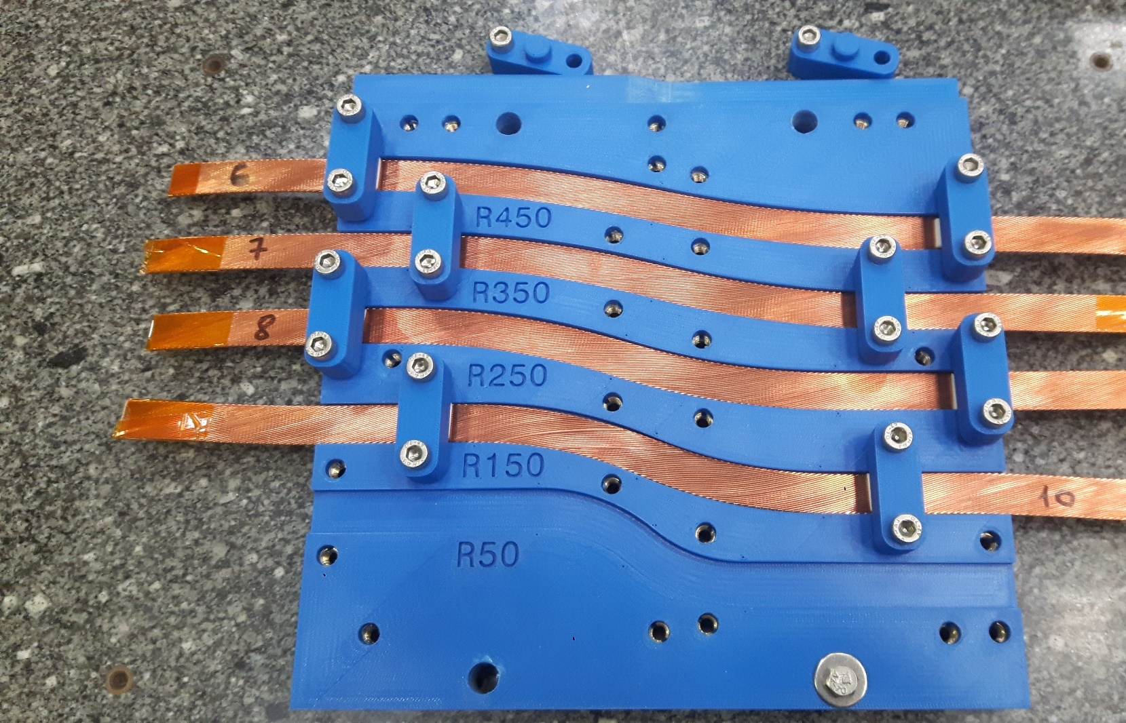
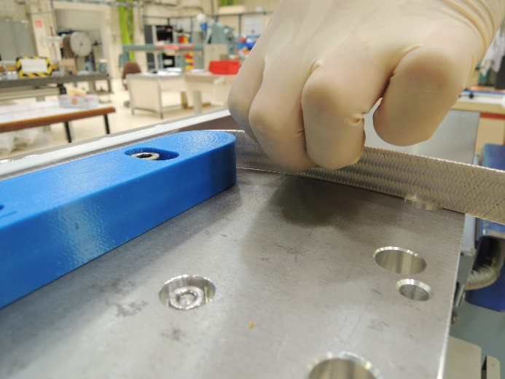
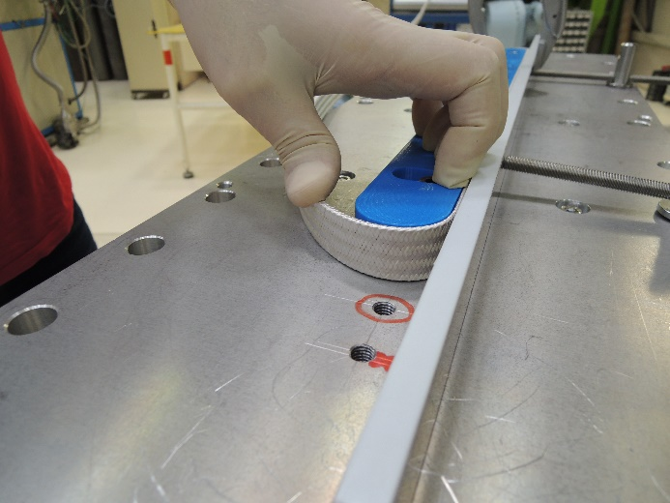
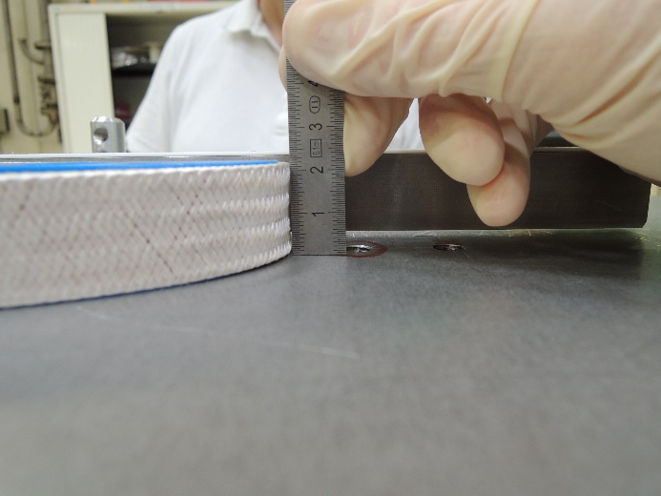

Mockups RD 2.1 – Bending tests
Hard-way: SMC 11T bare cable → Safe Radius 450 mm defined
EasyWay: FRESCA2 insulated cable → Safe Ratio ${R_{HF}/w}_{cbl,bare}=10$ defined
OK
OK
OK
OK
OK
NO
OK
COLLAPSE
NO
250 mm

Slide 13
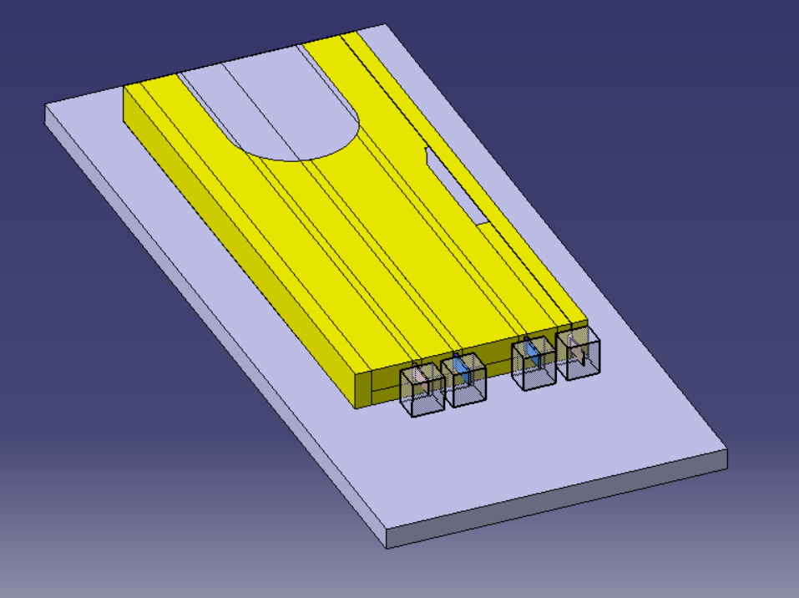
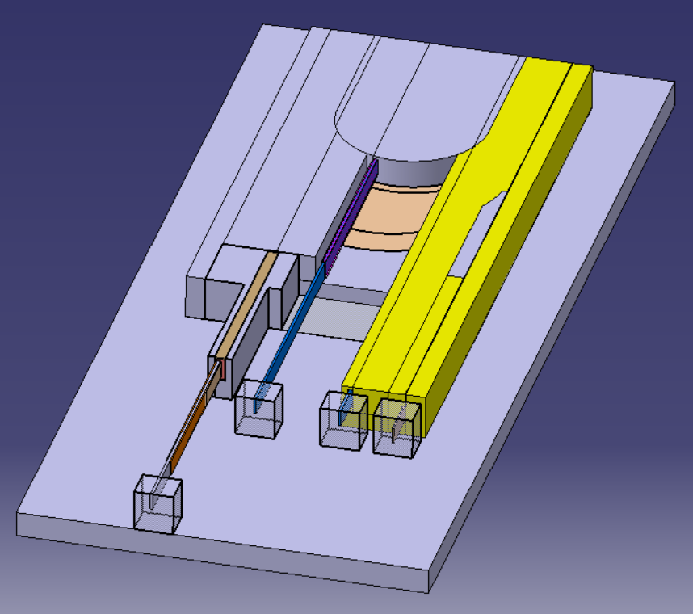
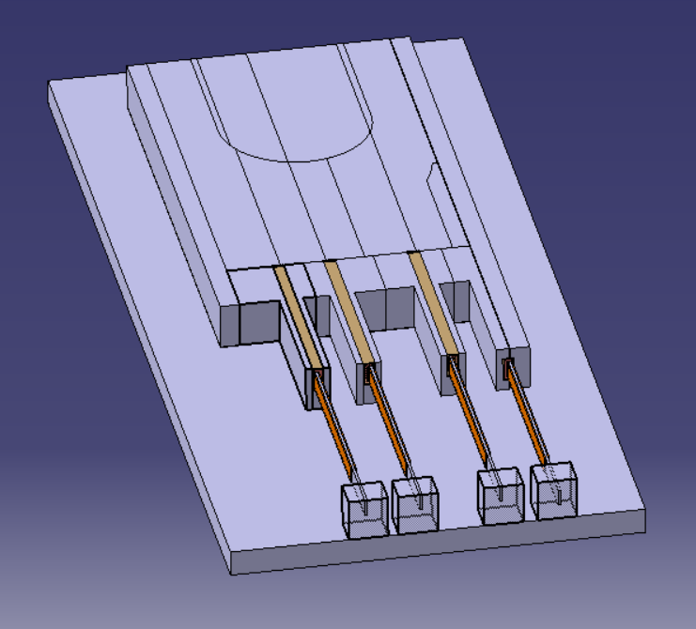
Mockups RD 2.1 – Splices
Goal: validate procedure with 3D printed components and tooling
Fast turnover to allow modifications in the design
Dimensions adapted to the 11-T cable
Engineering design almost complete
Fabrication foreseen December, tests in January

Slide 14
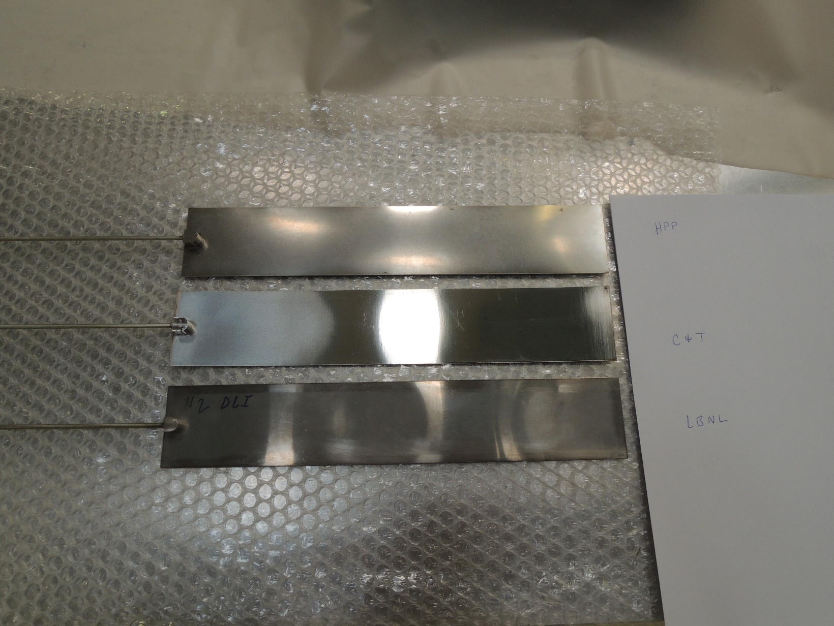
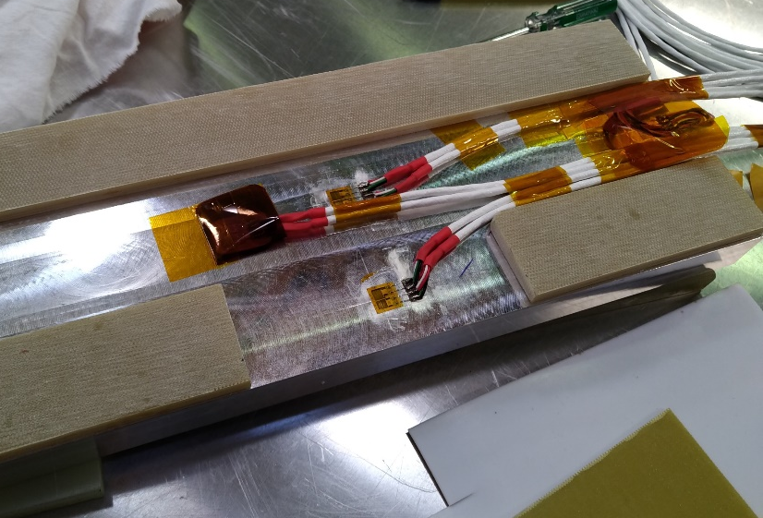
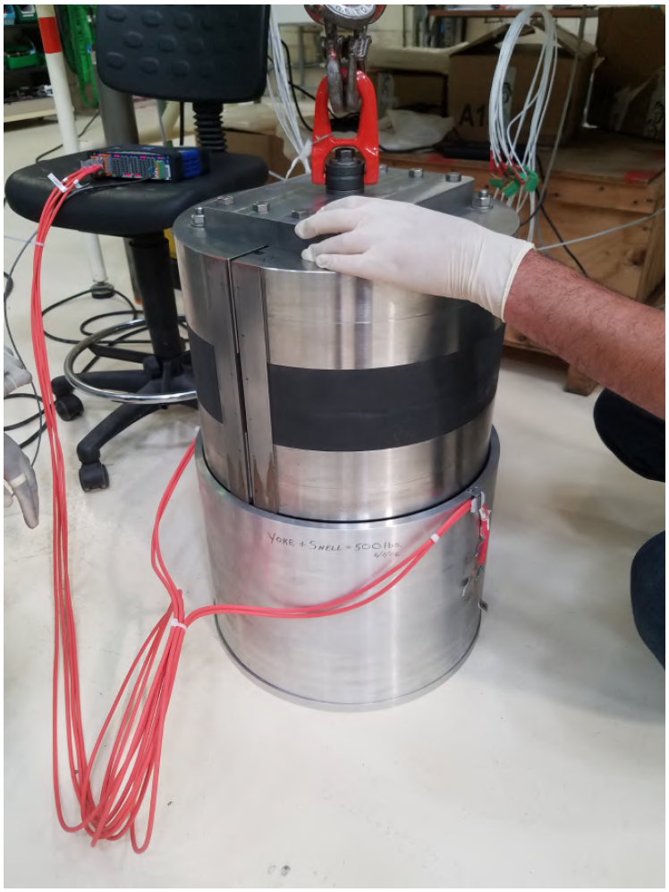
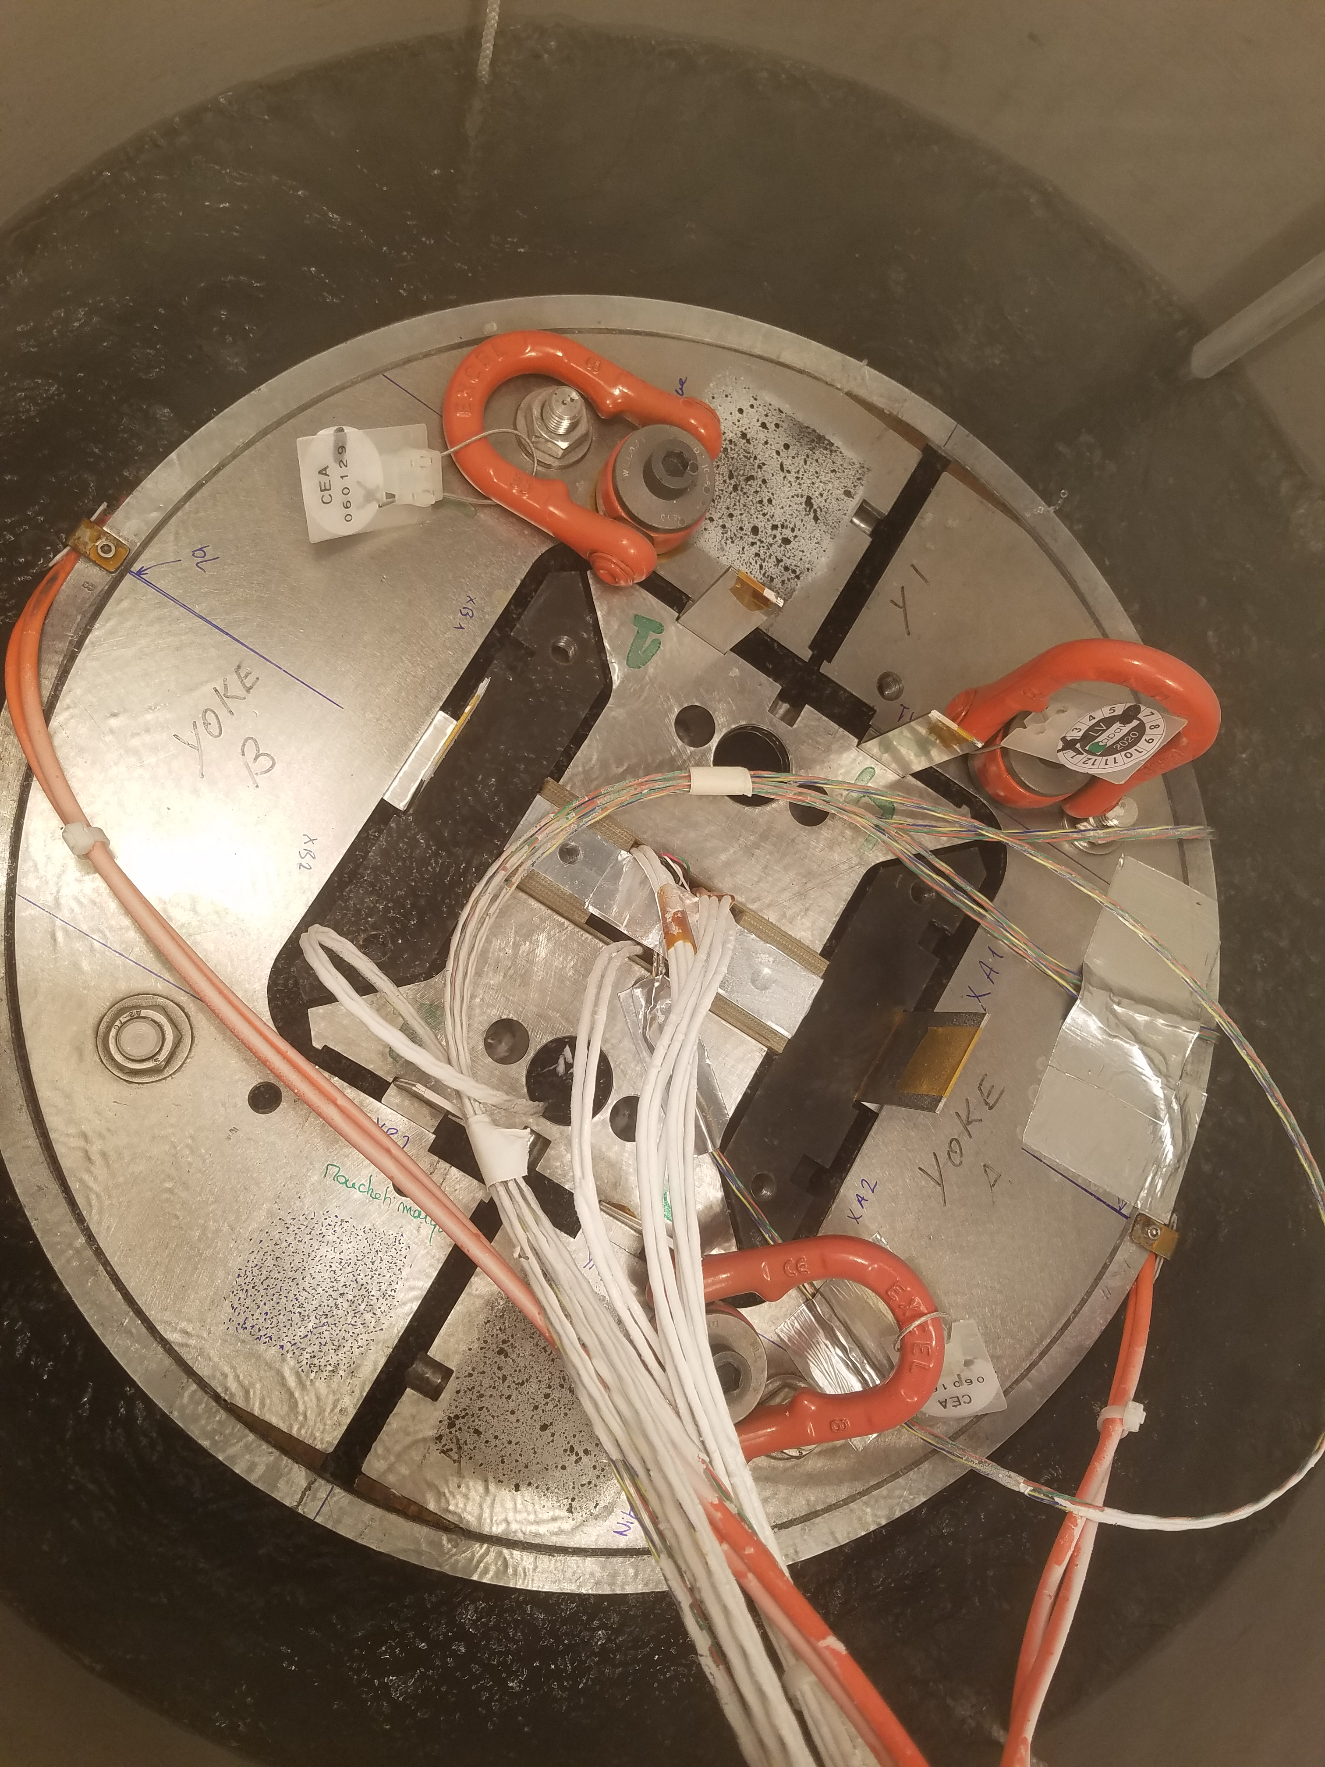
Mockups – Structure
HPP
C&T
LBNL
Goals:
Qualify bladder manufacturers
Validate Assembly procedures
Train on strain gauge implementation
Tests at cryogenic temperatures
Full test with dummy Al done
Full test with dummy Nb₃Sn foreseen

Slide 15





Enginnering design RD 2.2 - Coils
Detailed turn-by-turn model with inputs from models and mockups:
Minimum bending radius: ${R_{HF}/w}_{cbl,bare}=10$
Magnetic design
Mechanical/geometrical constraint
Project spec.
Ext. straight section 474 mm
Straight section 243 mm

Slide 16













Enginnering design RD 2.2 – Coil Components
Preliminary design only, detailed design ongoing.
Titanium
Stainless steel (SS)
Iron
Insulation filler
Insulation

Slide 17

Enginnering design RD 2.2 – Coil Components
External splice concept
Preliminary design of the splice area.
To be validated with mockups
Layer jump HF
forerunner
Layer jump LF forerunner
Exit jump HF
Straight exit LF
[2 coils represented here]

Slide 18

Enginnering design RD 2.2 – Winding tooling
Preliminary design only, detailed design ongoing.
To be validated with mockups

Slide 19


Enginnering design RD 2.2 – Reaction tooling
Split tooling to allow for coil contraction
Preliminary design only, detailed design ongoing.
To be validated with mockups

Slide 20


Enginnering design RD 2.2 – Structure
Simplified design imported from 3D magnetic model to check compatibility with coil components
Detailed design to be done
SS rails
Titanium post
& spacers
Iron yoke
Fillers (iron + ins.)
SS endshoe

Slide 21


SMC RD 2.2a
Goals:
validate coil manufacturing process on a small scale
Coil fabrication at CEA (1 coil foreseen, components for 2)
Assembly and tests at CERN
Status:
ULs and Components received at Saclay
Tooling ready for winding
Furnace calibration foreseen
CEA impregnation tooling
  → New design, under procurement
Instrumentation procedure under definition
Start manufacturing in January 2021

Slide 22
Conclusions
Rescoping from F2D2 to R2D2
  Reduced number and size of coils
  Fits cost and schedule
But: non-anticipated difficulties
  Peak field in the ends due to racetracks
  → Coil end optimization
  Difficult stability + protection due to high current
  → Additional Jc and operational margins
Planning and deliverables:
  Conceptual design almost complete (RD-2.1)
  Detailed design started (RD-2.2b)
  SMC fabrication ready to start (RD-2.2a)
Various Mockups to validate concepts (RD-2.1)
  Need for conductor

Slide 23
Backup slides

Slide 24

Courtesy H. Felice

Slide 25






Ideas on an integrated strategy
+Field
SMC 11T
Conductors
Pre-stress
Materials (Insulations etc.)
ERMC
(= ‘reduced’ RMM)
Demonstrate 16 T
+Grading
+Aperture
R2D2
Demonstrate Grading ≥ 12 T
RMM
Demonstrate
aperture =16 T
+Flared ends
+Flared ends
‘Reduced’ demo. (FD?)
Grading + Flared-ends ≥ 14 T
FRESCA2 (but 100 mm aperture)
Flared-ends + aperture ≥ 14 T
+Aperture
"Demonstrator" (F2D2?)
Grading + Flared-ends + Aperture = 16 T
+Grading

Slide 26
Ideas on an integrated strategy
+Field
SMC 11T
Conductors
Pre-stress
Materials (Insulations etc.)
ERMC
(= ‘reduced’ RMM)
Demonstrate 16 T
+Grading
+Aperture
R2D2
Demonstrate Grading ≥ 12 T
RMM
Demonstrate
aperture =16 T
+Flared ends
+Flared ends
‘Reduced’ demo. (FD?)
Grading + Flared-ends ≥ 14 T
Demonstrator1
Flared-ends
+ 50 mm aperture ≥ 14 T
*
+Aperture
"Demonstrator" (F2D2?)
Grading + Flared-ends + Aperture = 16 T
+Grading

Slide 27
Development plan toward 16 T Dipoles for FCC
1. SMC 11T (=Short Model Coil) [10]
Racetrack coils
No grading → Demonstrate field ≥ 12 T
[10] J.C. Perez et al., “Performance of the Short Model Coils Wound With the CERN 11-T Nb3Sn Conductor”, IEEE TAS 2015
+Grading
2. R2D2 (=Research Racetrack Dipole Demonstrator)
Racetrack + Grading ≥ 12 T
3. FD (=Flared Dipole)
Grading + Flared-end coils ≥ 14 T
+Flared ends
4. F2D2 (=FCC Flared-ends Dipole Demonstrator)
Reuse FD coils + structure
Grading + Flared-end coils + Aperture = 16 T
+Aperture

Slide 28
Development plan toward 16 T Dipole for FCC
1. SMC 11T (=Short Model Coil) [10]
Racetrack coils
No grading → Demonstrate field ≥ 12 T
Current collaboration agreement
+Grading
2. R2D2 (=Research Racetrack Dipole Demonstrator)
Racetrack + Grading ≥ 12 T
3. FD (=Flared Dipole)
Grading + Flared-end coils ≥ 14 T
+Flared ends
4. F2D2 (=FCC Flared-ends Dipole Demonstrator)
Reuse FD coils + structure
Grading + Flared-end coils + Aperture = 16 T
+Aperture

Slide 29
Development plan toward 16 T Dipole for FCC
1. SMC 11T (=Short Model Coil) [10]
Racetrack coils
No grading → Demonstrate field ≥ 12 T
+Grading
2. R2D2 (=Research Racetrack Dipole Demonstrator)
Racetrack + Grading ≥ 12 T
3. FD (=Flared Dipole)
Grading + Flared-end coils ≥ 14 T
+Flared ends
Future agreement to be discussed
4. F2D2 (=FCC Flared-ends Dipole Demonstrator)
Reuse FD coils + structure
Grading + Flared-end coils + Aperture = 16 T
+Aperture

Slide 30


New Organization
CEA Project leader
E. Rochepault
Former:
H. Felice
Former:
P. Mallon
Conceptual Design
E. Rochepault
Engineering Design
P. Manil
R&D and tests
M. Durante
Coil Manufacturing
F. Rondeaux
Magnet Assembly
E. Rochepault
Instrumen-tation
S. Perraud
Magnet Test
E. Rochepault
Conductor tests
M. Durante
Structure R&D
S. Perraud
Magnetic analysis
V. Calvelli
Magnetics
V. Calvelli
CAD
G. Minier
Protection
V. Calvelli
Drawings
G. Minier
Winding R&D
M. Durante
Procurement
F. Rondeaux
Procurement
S. Perraud
Protection
S. Perraud
Quench analysis
V. Calvelli
SMC
G. Maître
Procedures
F. Rondeaux
Procedures
S. Perraud
Mechanical
S. Perraud
Reaction R&D
M. Durante
Mechanics
E. Rochepault
Quality control
F. Rondeaux
Quality control
S. Perraud
Mechanical analysis
E. Rochepault
Impreg. R&D
M. Durante
Electrical
S. Perraud
Splice R&D
M. Durante
Manufacturing supervision
F. Rondeaux
Assembly supervision
S. Perraud
Magnetic
S. Perraud

Slide 31
New Organization
CEA Project leader
E. Rochepault
Conceptual Design
E. Rochepault
Engineering Design
P. Manil
R&D and tests
M. Durante
Coil Manufacturing
F. Rondeaux
Magnet Assembly
E. Rochepault
Instrumen-tation
S. Perraud
Magnet Test
E. Rochepault
Infrastructure
M. Durante
Conductor tests
M. Durante
Structure R&D
S. Perraud
Magnetic analysis
V. Calvelli
Magnetics
V. Calvelli
CAD
G. Minier
Procurement
LRI
Protection
V. Calvelli
Drawings
G. Minier
Winding R&D
M. Durante
Procurement
F. Rondeaux
Procurement
S. Perraud
Protection
S. Perraud
Quench analysis
V. Calvelli
SMC
G. Maître
Procedures
F. Rondeaux
Procedures
S. Perraud
Mechanical
S. Perraud
Reaction R&D
M. Durante
Quality
control
S. Roux
Mechanics
E. Rochepault
Quality control
F. Rondeaux
Quality control
S. Perraud
Mechanical analysis
E. Rochepault
Impreg. R&D
M. Durante
Electrical
S. Perraud
Splice R&D
M. Durante
Manufacturing supervision
F. Rondeaux
Assembly supervision
S. Perraud
Magnetic
S. Perraud

Slide 32
Simplified schedule
 | 2020 | 2021 |  |  |  | 2022 |  |  |  | 2023
 | T4 | T1 | T2 | T3 | T4 | T1 | T2 | T3 | T4 | T1 | T2 | T3 | T4
Conceptual Design | Méca+ quench
Engineering Design
R&D and tests |  | Tests Splices | Tests conducteur | Tests bobinage | Tests imprégnation | Cu coil
Coil Manufacturing | Fabrication SMC |  |  |  |  | Cu coil | Nb3Sn coils
Magnet Assembly |  |  | R&D structure |  |  |  | Test à froid |  |  | Assemblage
Instrumentation |  | Design QH |  |  | Implementation QH | Implementation SG |  |  |  |  | Instrum tests
Magnet Test |  |  |  |  |  |  |  |  |  | Analyse méca | Analyse méca+magn +quench
RD-2.1 Conceptual design report F2D2/R2D2
RD-2.2a
SMC coil
RD-2.2b
Engineering design report R2D2
RD-3.1
R2D2 Cu coil
RD-3.2
R2D2 Nb₃Sn coils
RD-4.1
R2D2 Magnet
RD-4.2b
Test reports
Internal review conceptual design R2D2
Coil fabrication readiness review
RD-4.2a
Manufacturing folder
Conceptual Design Review R2D2
Engineering design Review R2D2
Assembly readiness review

Slide 33
Budget following rescoping
Following rescoping: Re-estimate of costs components/tooling
Is conductor envelope still the same ?
  Transferable to tooling?
  additional conductor?
 |  |  |  | CERN
R2D2 components | CERN | 301 500 € |  | material total | Material budget | diff
R2D2 large tooling | CERN | 126 000 € |  | 877 500 € | 900 000 € | - 22 500 € | should cover SMC
F2D2 conductor | CERN | 450 000 €
R2D2 conductor | CERN | 150 000 €
R2D2 small tooling | CEA | 116 800 € |  | CEA
 |  |  |  | material total | contingency | TOTAL
Consumables | CEA | 8 000 € |  | 144 400 € | 50 000 € | 194 400 €
mock ups | CEA | 19 600 €

