Slide 1
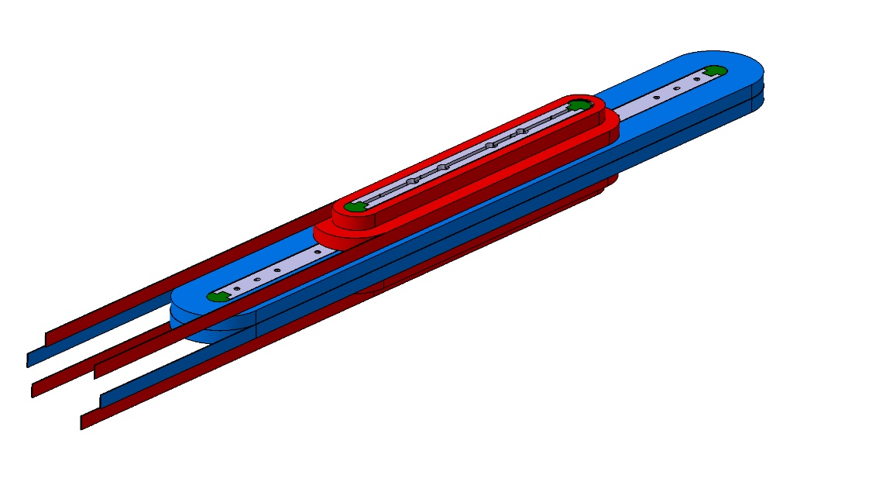
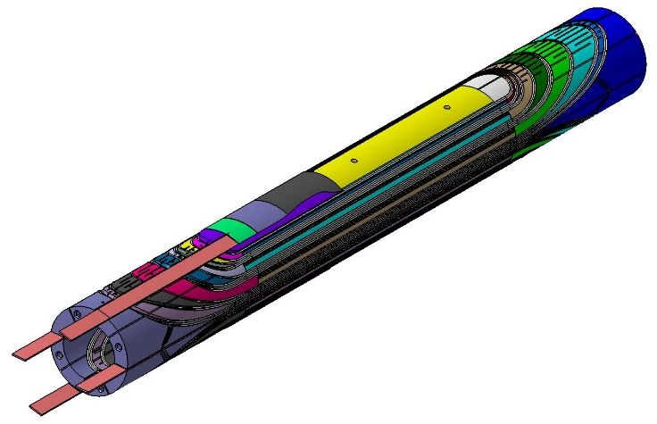
CEA HFM work - status and plan
27/11/2020
EuCARD2 HTS cosθ dipole EuCARD HTS Insert
Maria Durante, Michel Segreti, Thibault Lecrevisse, Clement Lorin - DACM/LEAS
Edouard Pepinter, Sébastien Somson, Yosri Rabti - LEAS 122 technical team
Olivier Tellier, Jean-François Millot - DIS/LCAP

Slide 2
Content
EuCARD2
  Design studies update
  Integration studies for tests in standalone and as an Insert
  Coils/dipole Realization status
  Tests preparation status and program
EuCARD Insert
  Recall of the Design studies and program
  EuCARD insert configuration and integration studies
  Central coil damage discovery and investigation
  Status and perspectives

Slide 3
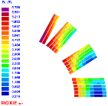
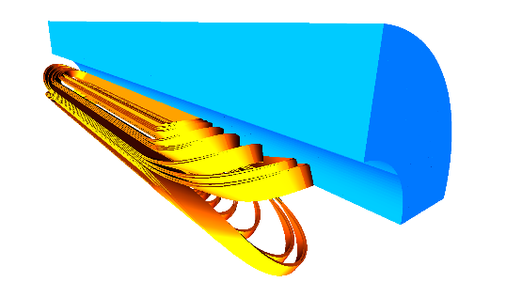
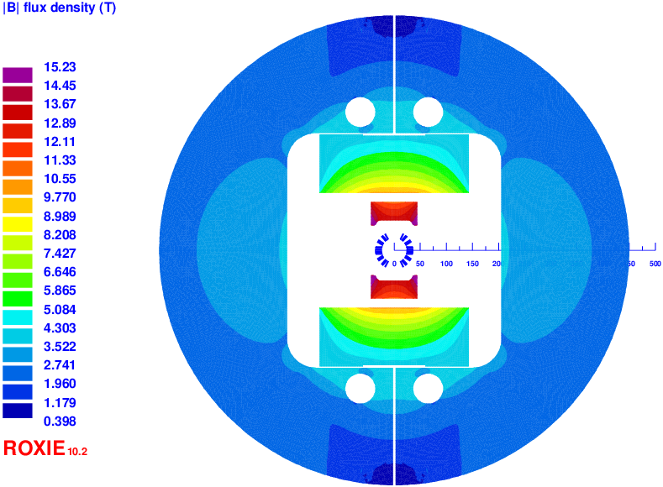
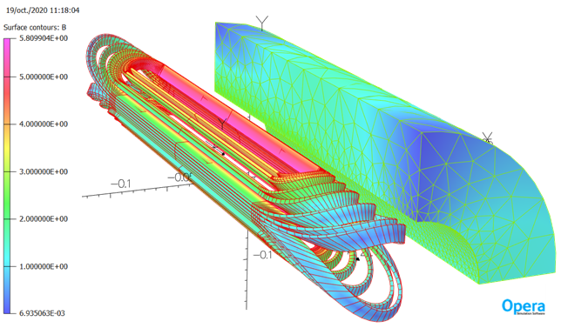
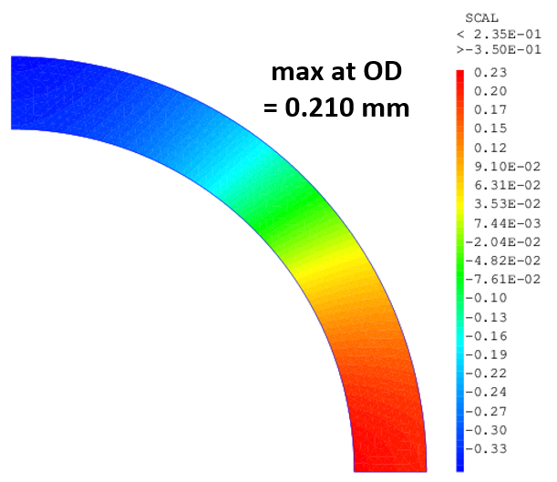
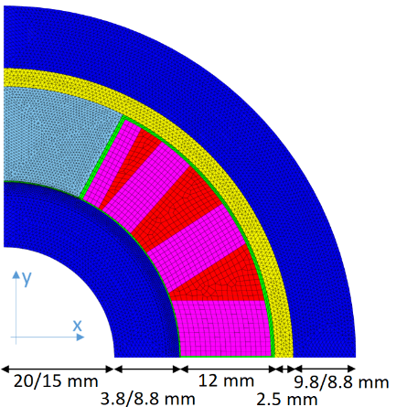
EuCARD2 cosθ dipole Design – Updated
EM design Roxie 2D and 3D, Opera 3D
  Based on Bruker tape performances
  Updating with performances estimated
  for SuperOx tape and cable
  Asymmetries Insert/FRESCA2 studies, Roxie 2D
  Default scenario studies, Roxie 2D
Mechanical model 2D CASTEM
  Updated with detailed components
  Different boundary conditions
Quench analysis on design B - by Janne Ruuskanen (TUT)
  Standalone (more risky, need for preliminary tests at 80 K)
  Insert configuration (need for separated protection circuits confirmed)
 | Stand-alone 98 mm OD | in Fresca2 13 + 2.6 T 96 mm OD
Operational current (KA) | 10.06 | 7.1
Central field (T) | 5 | 15.6
Peak field (T) | 5.8 | 15.8
Load line margin (%) | 34 | 10
Temperature margin (K) | 30 | 8
Self-inductance (mH/m) | 0.73 | 0.55
Mutual inductance (mH/m) | - | 1.77
Coil inner radius (mm) | 24 | 24
Inner tube thickness (mm) | 4 | 9
Bore radius (mm) | 20 | 15
Outer shell thickness (mm) | 9.8 | 8.8
Yoke thickness (mm) | 60 | -
External radius (mm) | 110 | 48
Fx per ½ coil (kN/m) | 417 | 1669
Fy per ½ coil (kN/m) | -192 | -95
Fz (kN) | 37 | 90
Insert azimuthal peak stress(MPa) | 97 | 235
Insert radial peak stress (Mpa) | 42 | 78
Inner tube Von Mises peak stress ( MPa) | 109 | 656
Outer tube Von Mises peak stress (MPa) | 218 | 559

Slide 4


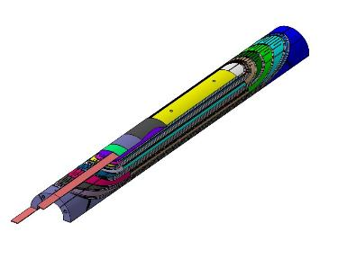
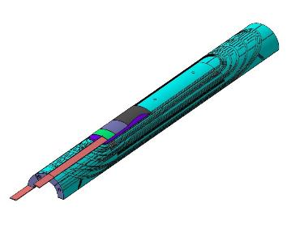
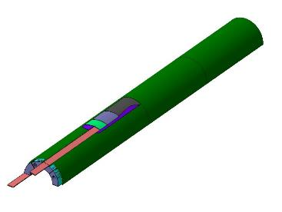
EuCARD2 cosθ dipole coils
Design B coil
  EuCARD2 « thin » cable : 12 x 1.0 mm² bare, 15 tapes 100 µm-thick
  Straight section = 200 mm
  Total length = 670 mm
  Cable unit length = 21 + 3 m
Validated on Superpower Roebel cable (tests by and with KIT)
SuperOx cable, 3UL, received between July 2018 – Mai 2019
SuperOx Roebel cable with insulated Cooper wire
Cable insulation : fiber glass sock
completed by impregnation with CTD101-K resin
End spacers 316L
3D printed
Instrumented trace (VTs)
670 mm
Angular wedges 316L
Glass Filled Nylon 12 Shells

Slide 5
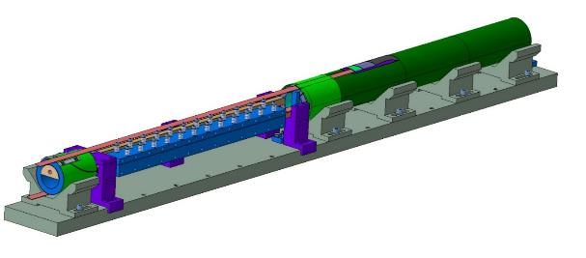
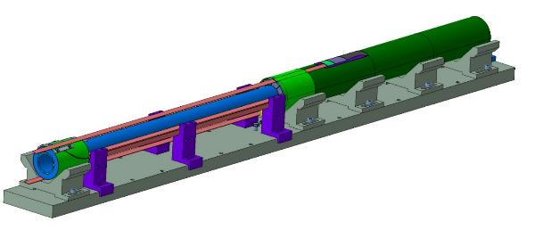
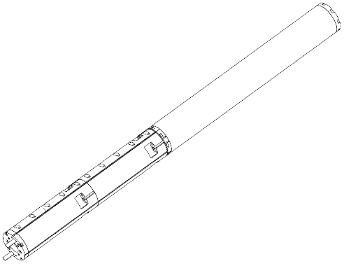
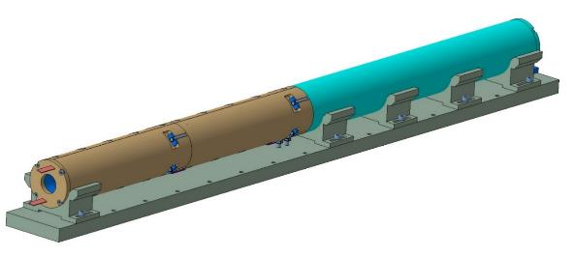
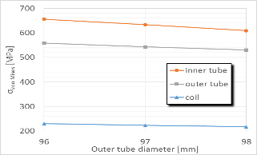
EuCARD2 cosθ dipole magnet
Coils
Outer tube (Nitronic 50) and 8 support structure pieces (316L)
All the structure parts already provided in 2019, 98 mm ext diameter
New structure 96 mm needed due to real FRESCA2 free bore diameter (<98.2 mm, against nominal 100 mm)
CASTEM 2D studies : done → No critical increase of stresses on the coil but lower margin
CAD studies : done → Call for tender for 96 mm structure pieces to be launched after first standalone tests
300 mm long internal joint
1294 mm
Von Mises stress at nominal field vs OD
684 mm

Slide 6
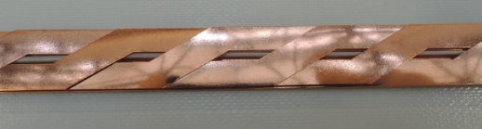

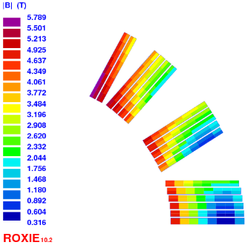
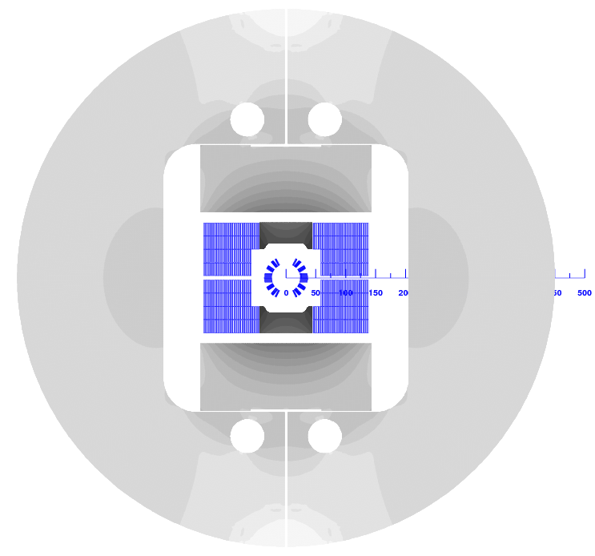
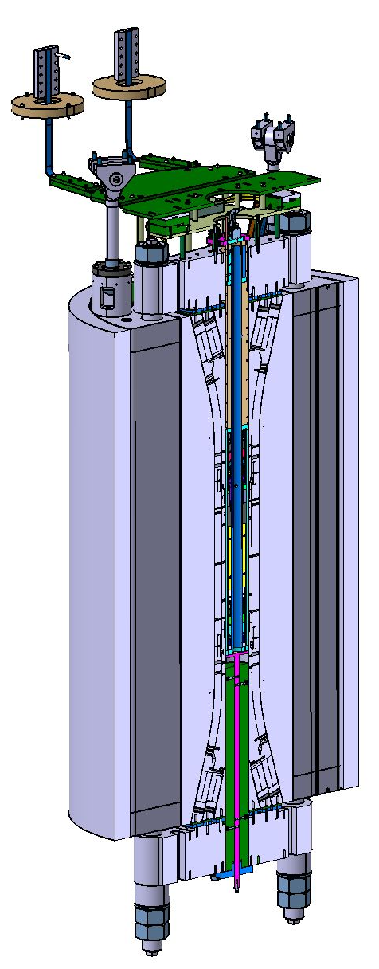
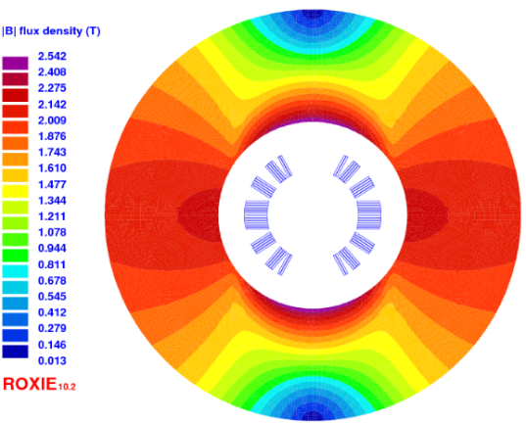
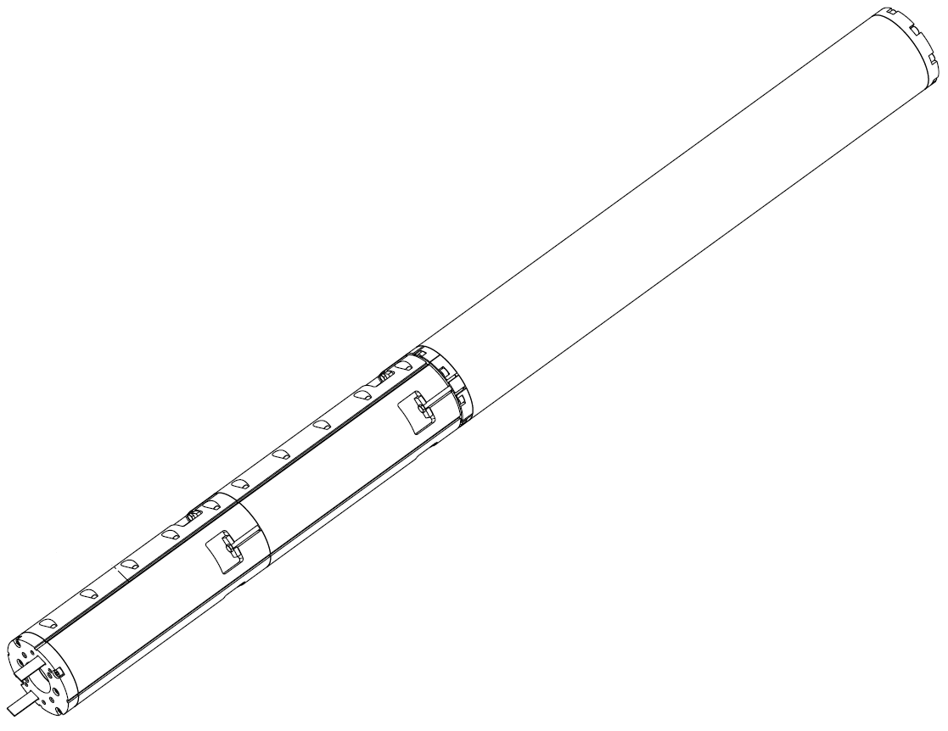
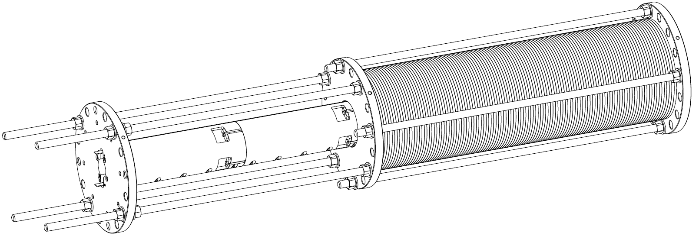
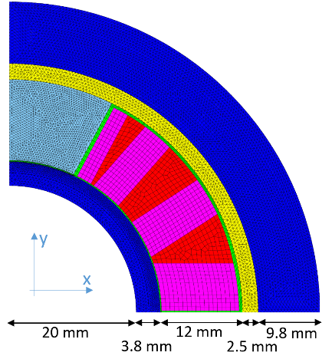
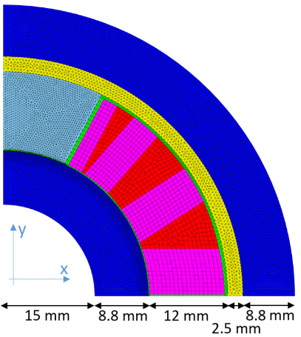
EuCARD2 cosθ Dipole
SuperOx Roebel cable with insulated Cooper wire
Stand-alone mode
  Iop = 10060 A
  Bop = 5 T*
  Bpeak = 5.8 T*
  Free bore = 40 mm
  Iron yoke Ø = 100/220 mm
  Magnet length = 1334 mm
1.0 mm + 2x125µm insulation,
17 turns
  Coil length 684 mm
Insert mode
Iop = 7100 A
Bop = 2.6 T* in 13T FRESCA2 background field
Free bore = 30 mm
  Insert length = 1294 mm
  Outer Ø = 96 mm
    *without taking into account SCIF reduction
  Outer Ø = 98 mm
Structure change
Tests : Nov. - Dec. 2020
Iron yoke
Tests : Avril 2021

Slide 7
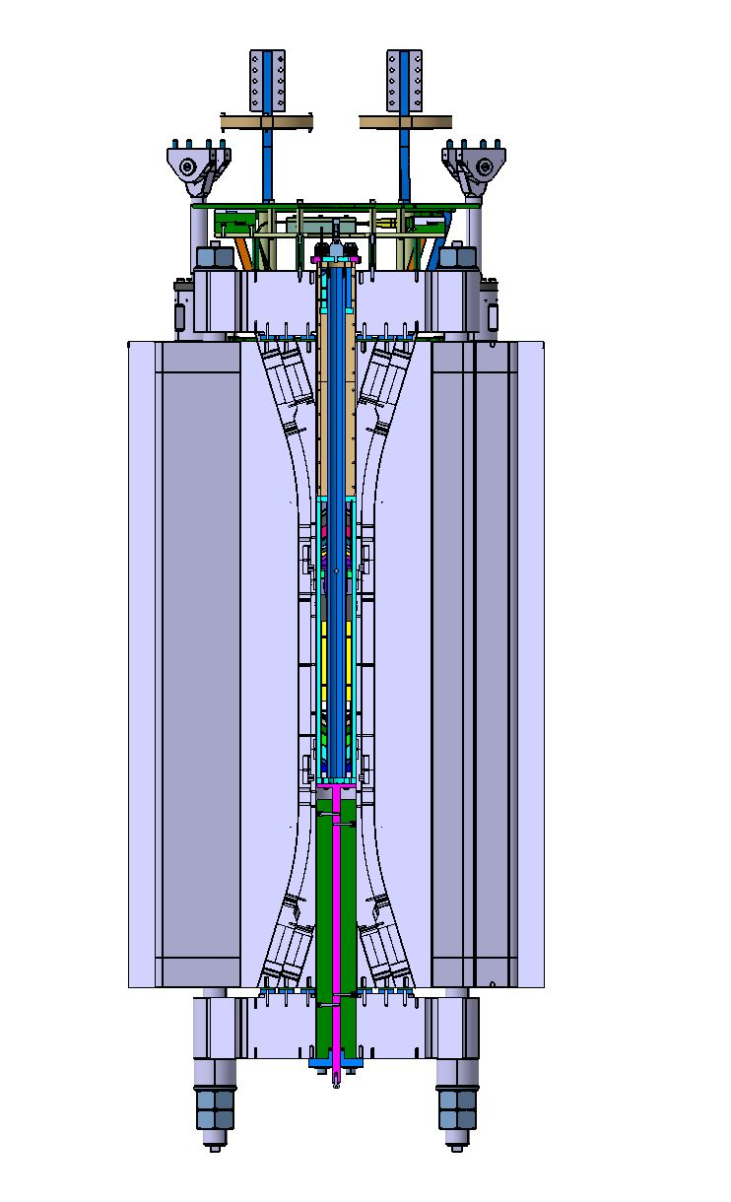
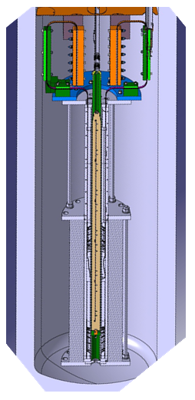
Integration studies and preparation
Stand-alone in diode cryostat
Integration studies done by CERN starting from our step of the magnet
Call for tender for supporting parts and copper stabilizer ongoing by CERN
Lead end length checked for the two configurations
As an Insert inside FRESCA2
Integration study proposal from CEA to be validated and completed (connection to current leads) by CERN
The manufacturing of Insert parts (96 mm mechanical structure and integration parts) will be started after first cold tests in stand-alone mode

Slide 8


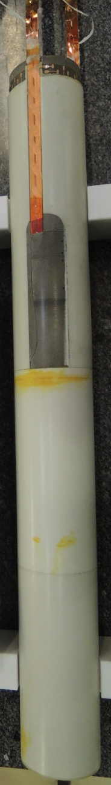
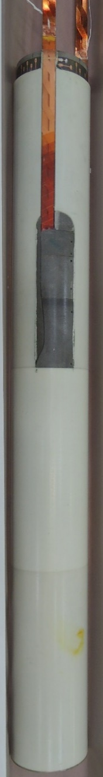
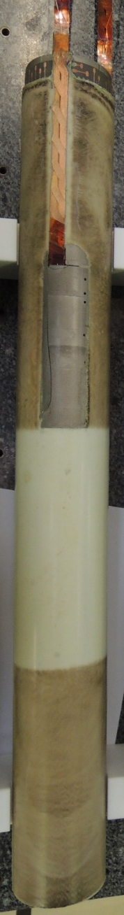
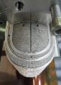


Superconducting Coils realization : March 2019 - July 2020
SCB01
inversed SC
Fθ on SC away from the substrat
SC layers under tensile stress
Electrical tests ok
Cu wire inside the cable insulated from the cable
SCB02
as designed
Fθ on SC towards the substrat
SC layers under compressive stress
Electrical tests ok
Cu wire inside the cable, insulated from the cable
SCB03
as designed, overheating
Fθ on SC towards the substrat
SC layers under compressive stress
Overheating up to 275°C during impregnation
Electrical tests ok
Cu wire in contact with cable
Substrat side
SC side
SC side
1st Assembly SCB02 + SCB03
SC side
Substrat side
Substrat side
2nd assembly
SCB01 + SCB02 still possible
SC layers
SC layers
SC layers
3rd assembly
SCB01 + SCB03 still possible but with unsoldered and resoldered internal joint

Slide 9
Choice of the coils for SMB01 assembly
After several discussions, SCB03 overheated-coil has been chosen to be assembled with SCB02 coil.
Against SCB01 coil : Fθ on SC away from the substrat
Delamination risk estimated high in the FRESCA2 background field, or in case of quench
Against SCB03 coil : tape performances degradation when submitted to similar overheating treatment
  CERN measurements on short length of untreated/treated extracted tapes (60 mm long) show an average Ic degradation of 35 % but very inhomogeneous for the 15 strands (from 22% to 63%)
  We know that cable works better than single tapes
  We do not know exactly the temperature cycle submitted to the coil
The risk of “no performances” with SCB01 seems higher than the risk of “decreased performances” with SCB03. A second assembly with SCB02, and SCB03 replaced by SCB01 is possible.

Slide 10
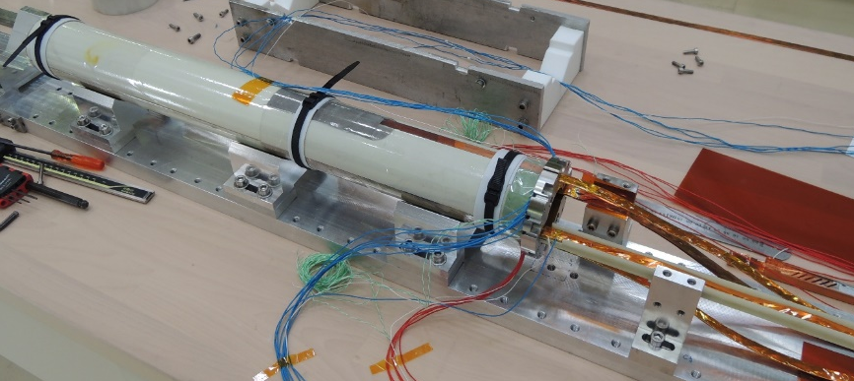
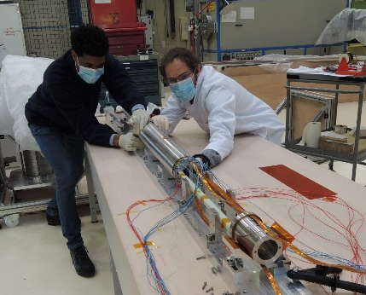
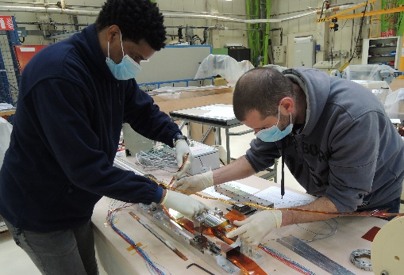
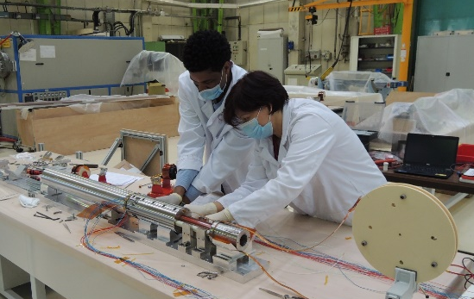
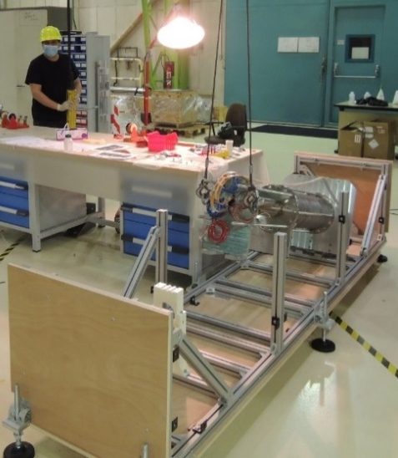
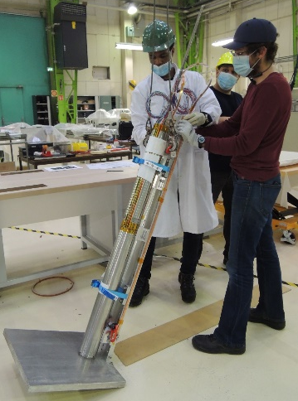
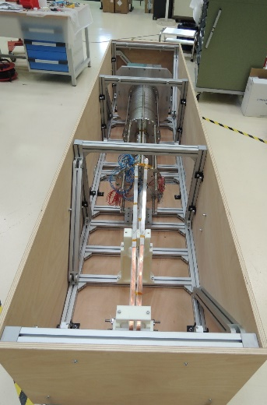
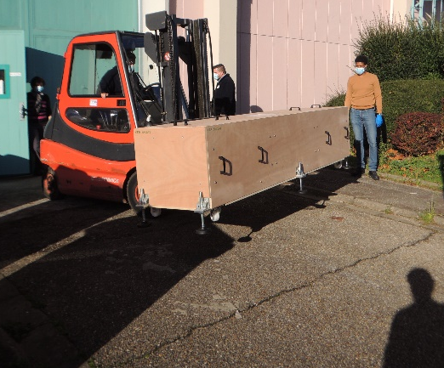
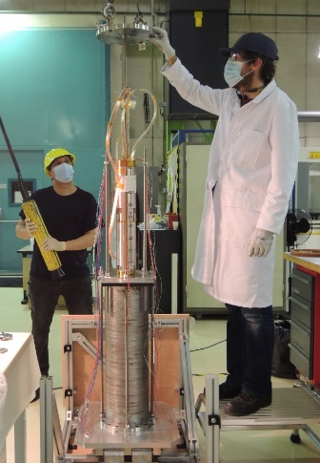
SMB01 magnet assembly sent to CERN
Assembly of coils SCB02 and SCB03 in stand-alone configuration - November 2020
Supercondcuting coils assembly
External tube insertion
Internal joint preparation
… with mechanical structure
The magnet has been delivered to CERN on November 13th ☺
First slot for standalone tests December 11th-14th
Tilting in vertical position
Ready to leave !
Insertion inside the yoke and tilting in the box
Conductor ends in place

Slide 11
EuCARD2 cosΘ Dipole - Realization and Tests - Status



…
…
…

EuCARD2 cosθ Ø98 mm Standalone configuration preparation
EuCARD2 cosθ Ø98 mm Standalone configuration transferred to CERN on November 13th
Studies for Integration in CERN Diode Cryostat made by CERN
Procurements for Integration in CERN Diode Cryostat made by CERN
Integration in CERN Diode Cryostat made by CERN (no travels due to COVID)
Preparation for Standalone tests inside Diode Cryostat at CERN - Tests by CERN team (no travels due to COVID)
Standalone tests in Diode cryostat starting December 11th - Tests by CERN team (no travels due to COVID)
→ A weekend to test the magnet before cryogenic shutdown
Standalone tests data analysis
Magnet sent back to CEA no later that end of February 2021
Studies for Integration of EuCARD2 cosθ inside FRESCA2 – to be validated with CERN
Change from Ø98 mm standalone to Ø96 mm Insert structure in March 2021
Magnet back to CERN by end of March 2021
Integration of EuCARD2 cosθ Ø96 mm in FRESCA2, made by CERN, with or without CEA team (COVID?)
Preparation for tests in FRESCA2 – tests performed by CERN, with or without CEA team (COVID?)
Tests in FRESCA2 at CERN in April 2021 → 2 weeks for integration, 2 weeks for tests…
Tests data analysis

Slide 12
Content
EuCARD2
  Design studies update
  Integration studies for tests in standalone and as an Insert
  Coils/dipole Realization status
  Tests preparation status and program
EuCARD Insert
  Recall of the Design studies and program
  EuCARD insert configuration and integration studies
  Central coil damage discovery and investigation
  Status and perspectives

Slide 13


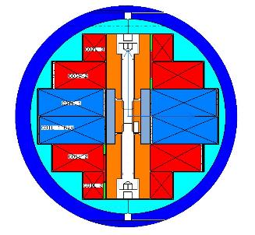
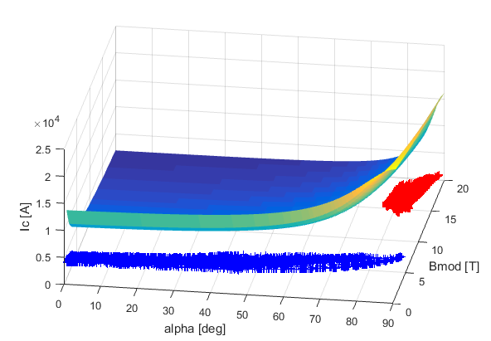
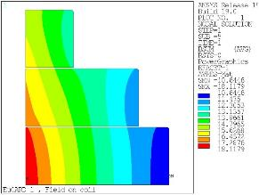
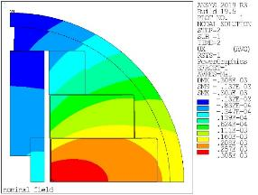
EuCARD block Insert
200 µm
HTS 1 µm
      Double YBCO layer tape
      SP BCSC12050-AP 2G (Super Power)
Iron pole
3
Pads, 316L
15 100-mm long parts
2 50-mm long parts
2
1
Outer tube, 4 mm thick
Nitronic 40 OD = 96 mm
Standalone
Insert with FRESCA2 background field
Glass epoxy inter-coil and coil/pad insulation
Compression plates, 316L
Maximum radial displacement of the outer tube
< 190 µm
Field in coil – Insert in FRESCA2
Peak field layer 1 : 18.12 T
Radial displacement at nominal field

Slide 14
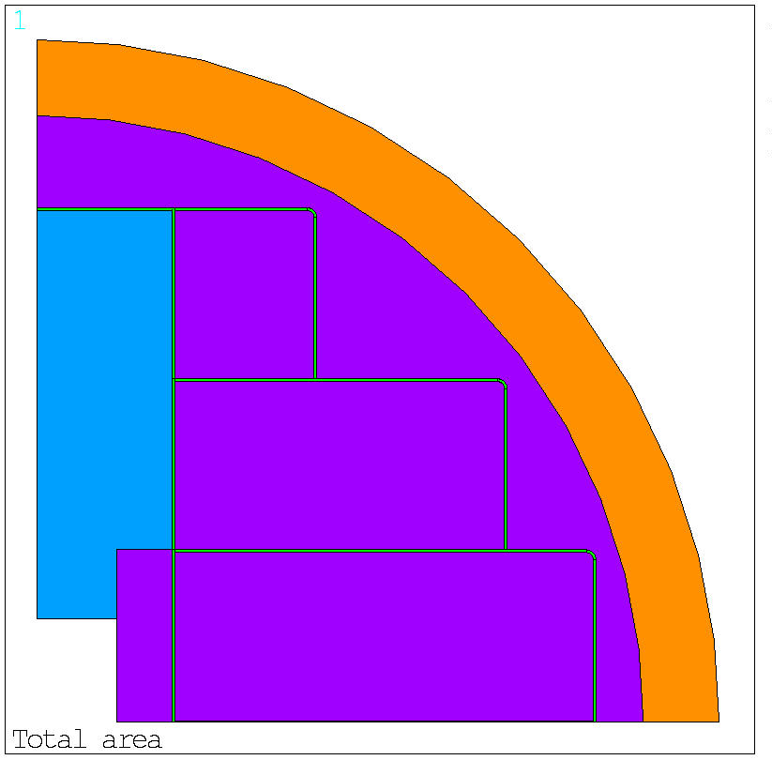
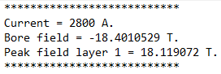
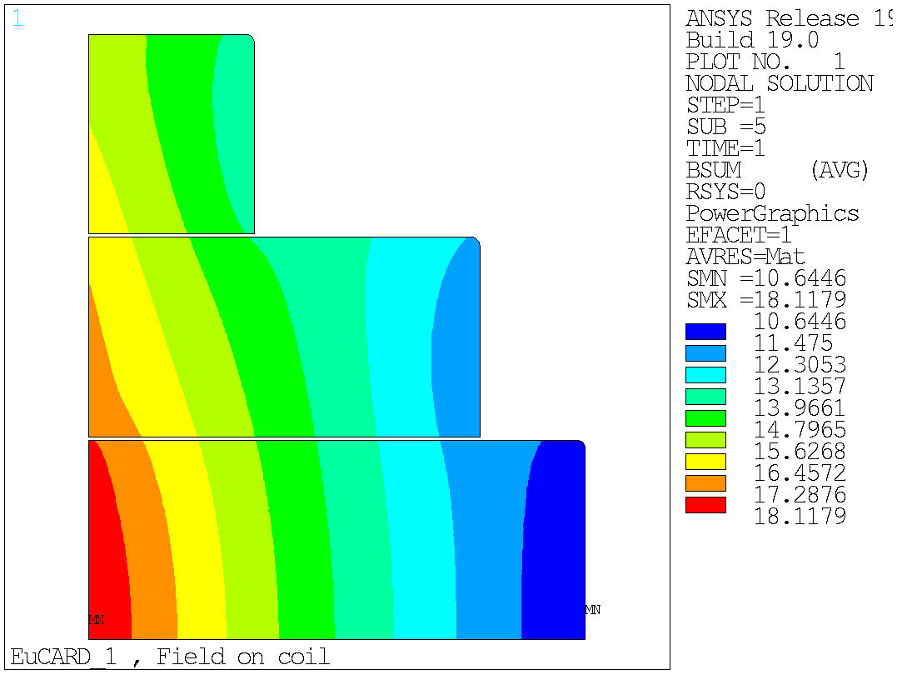
EuCARD Insert Design – last studies
Mechanical models - Ansys 2D and 3D - updated
Outer Diameter reduction studies 99 → 98 → 97 → 96 mm
Outer tube configuration studies
Iron pole failure
Default scenario studies, Roxie 2D
Asymmetries Insert/FRESCA2 studies, Roxie 2D
Pole-Plate: glued
Pole-Coil, Pole-Pad, Coil-Pad, Pad-Tube: separation & sliding with 0.2 friction coef.
Coil-Coil: sliding (no separation) with 0.2 friction coef. to converge
No SCIF
NITRONIC 40 TUBE
IRON POLE
COIL 3
316L PAD
COIL 2
316L PLATE
COIL 1

Slide 15
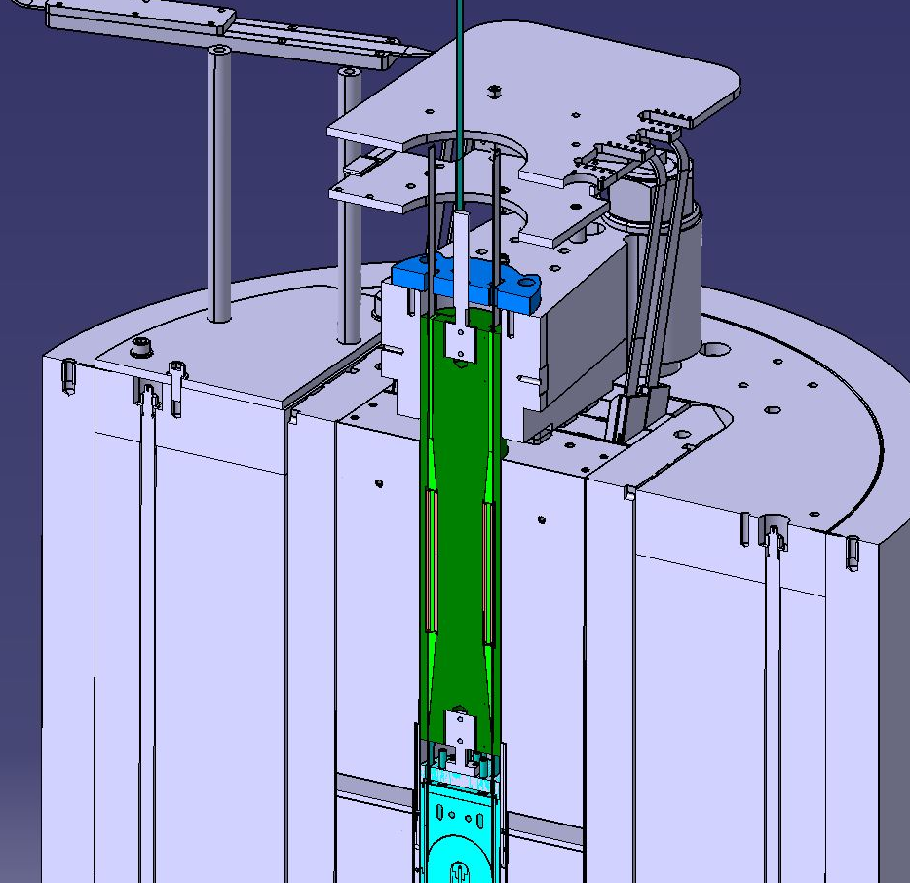
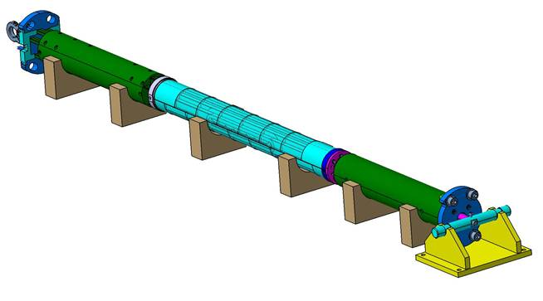
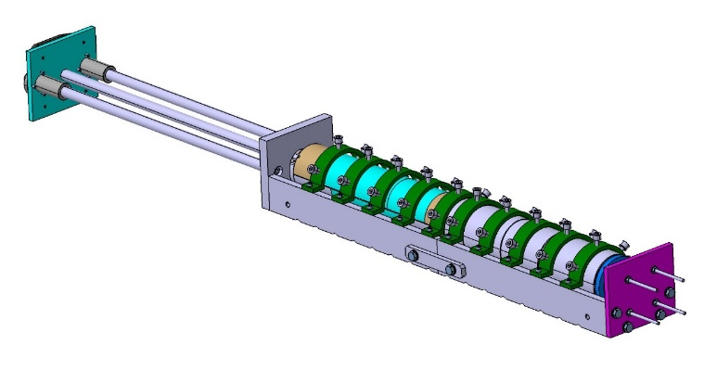



Insert Configuration and Integration studies
Insert configuration studies completed
Integration studies inside FRESCA2 completed
Insert configuration preparation process validation stopped once magnet central coil damage was discovered during standalone structure disassembling

Slide 16










EuCARD block Insert: Central coil highly damaged 1/2
Opening of the structure : burnt parts
Opening of the structure : insulation
Highly damaged winding : first view
Insulation break

Slide 17












EuCARD block Insert: Central coil highly damaged 2/2
Top layer
Bottom layer
8 Turns damaged per layer (on 30 turns) → damage level is lowering when going inside the winding

Slide 18
EuCARD block Insert – Status
…
…
…
EuCARD standalone test data analysis to be completed → report and paper
EuCARD insert configuration preparation
Assembly mock-up on hold, to finish → procedure and report
Structure change from standalone to insert configuration
EuCARD integration in FRESCA2 study completed → report to prepare
EUCARD insert integration in FRESCA2 following
EuCARD insert tests in FRESCA2 following
EUCARD insert tests in FRESCA2 data analysis
Stand-by after central coil damage discovery.
Tests in FRESCA2 cancelled.

Slide 19
EuCARD block Insert – and Then ?
Activities on EuCARD coils were stopped due to central coil damage
The magnet has already been tested in stand-alone mode. And the tests as an Insert inside FRESCA2 are no more possible.
Options for the following actions, once stand-alone tests results analysis completed :
Stop the activities on the magnet and on the coils
Use the coils for R&D programs (internal or incl. in next CERN-CEA HTS collaboration ?)
Repair and plan a test as an insert in another outsert (D1 ? Sultan ? …)
→ New assembly, so new standalone test needed

