Slide 1


Adjustable Permanent Magnets
Ben Shepherd
ASTeC, UKRI-STFC Daresbury Laboratory
Nanobeam Technologies workshop
1-3 February 2021

Slide 2

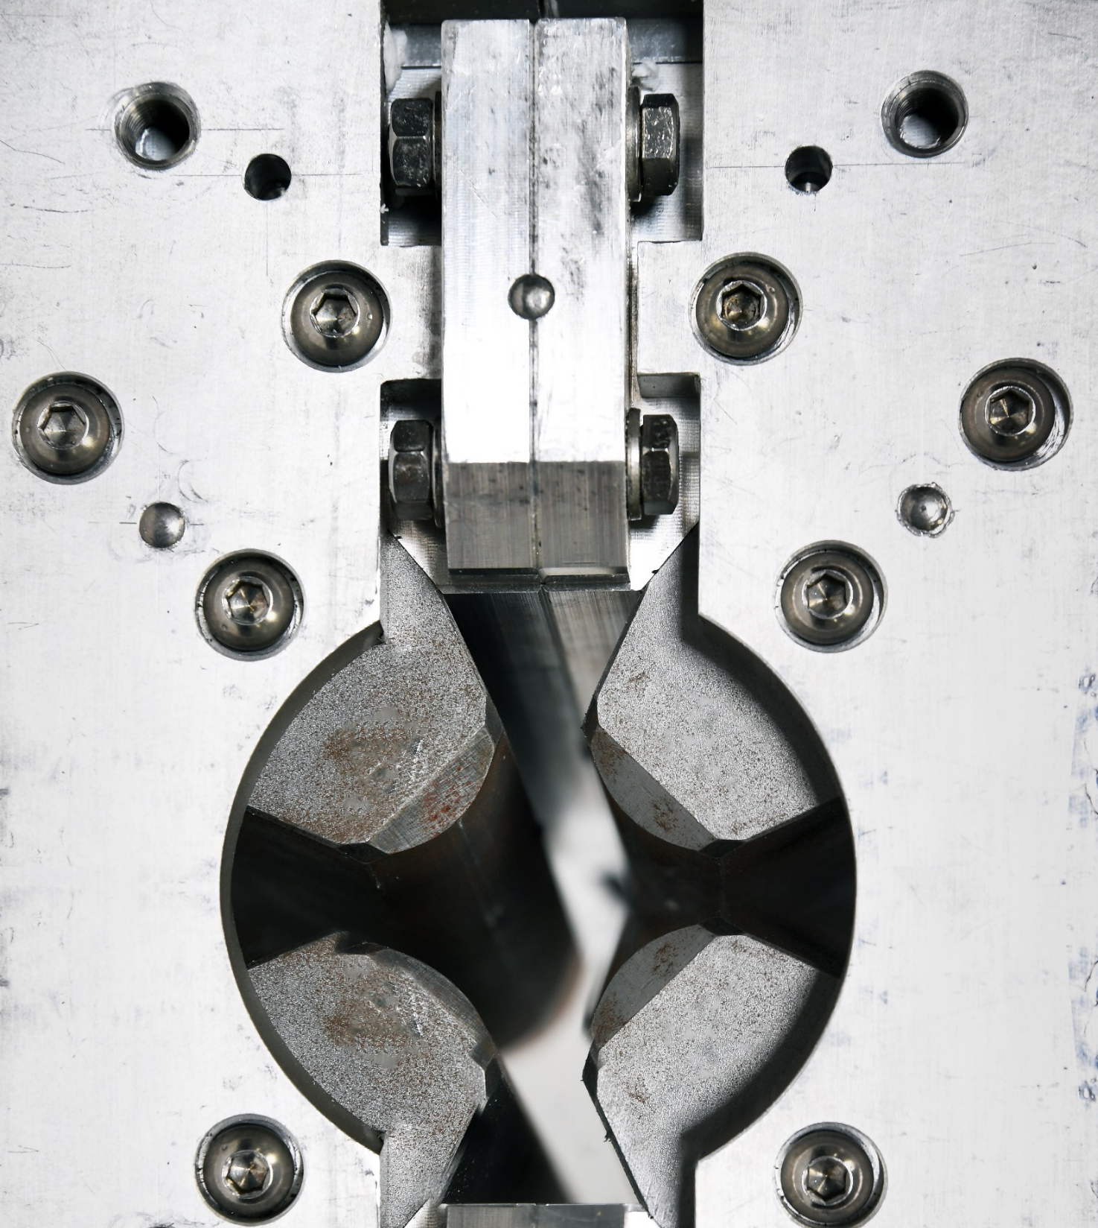
Overview
1 Introduction
Permanent magnets in accelerators;
advantages and disadvantages.
2 Adjustable PMs
Projects to develop and extend the use of PMs.
3 The ZEPTO project
Tunable PM-based quadrupole and dipole magnets at STFC.
4 Conclusions
Image © STFC Alan Ford

Slide 3

Introduction
Permanent magnets in accelerators
Notes:
The abstract pattern can be removed or repositioned if required. Be careful to ‘Send to Back’ so that it does not obscure any important information.

Slide 4
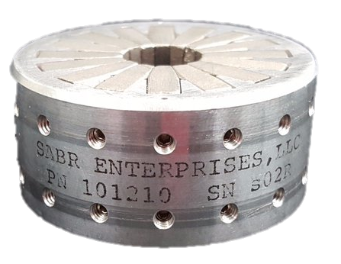
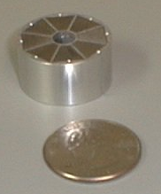
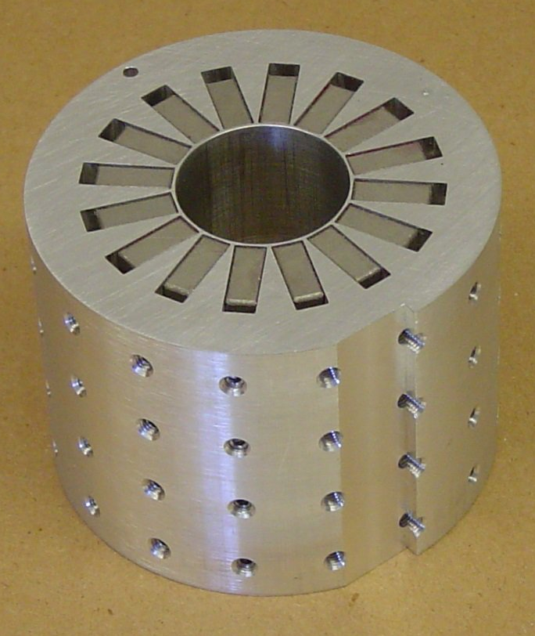
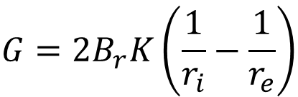
Permanent Magnet Quadrupoles
Halbach, NIM 169, p. 1-10 (1980)
Benabderrahmane, IPAC2017 THYB1
r_{i}
Halbach array
Typically small aperture
Fixed (and quite high) gradient
  For r_{i} = 10 mm, r_{e} = 20 mm, B_{r} = 1.38 T, M = 16 ➔ G = 130 T/m
Widely used
Also dipoles, sextupoles…
$$G=2B_{r}K\left(\frac{1}{r_{i}}−\frac{1}{r_{e}}\right)$$
Number of segments M | 4 | 8 | 12 | 16 | 20 | 24
Efficiency factor K | 0.32 | 0.77 | 0.89 | 0.94 | 0.96 | 0.97
r_{e}
SABR Enterprises LLC

Slide 5
Beamline Magnets
Chavanne, ESSRI workshop 2019
Reduce the size of EMs → field decreases
  To regain field: increase current density by 1/k (and power by 1/k²) or coil cross section
Reduce the size of PM-based magnets
→ field stays constant
Lower apertures favour PM magnets
PMs
field B₀
field B₀
coils
current density J
field k.B₀
field B₀
scale factor k
scale factor k

Slide 6
PM magnets for nanobeams
Advantages
No electricity
No heat load
Lower running costs
Lower CO₂ emissions
No water cooling
No vibration
Disadvantages
Tuning
Handling
Radiation resistance
Temperature stability
Cost
Block tolerances

Slide 7

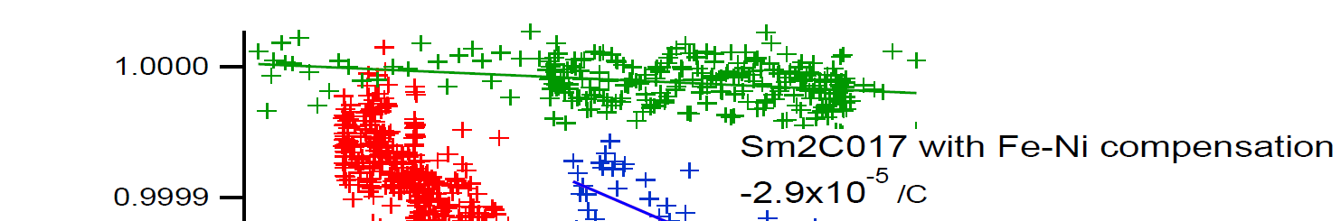
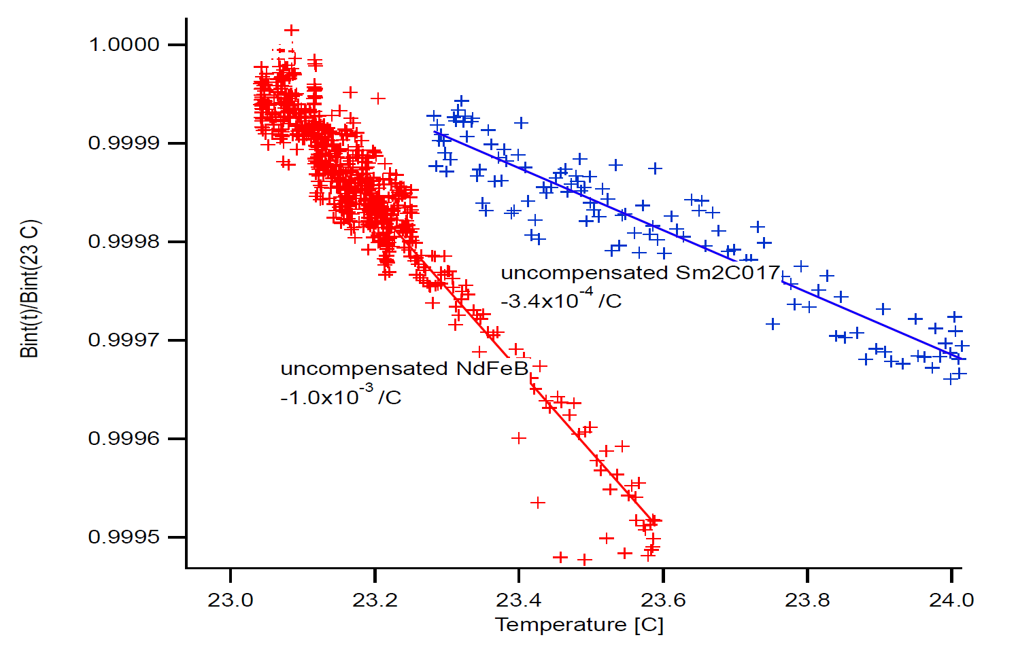
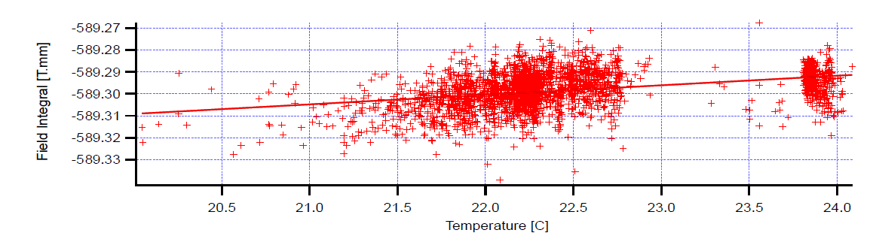
Temperature stability
Data from Vacuumschmelze
Bødker et al, IPAC2013 THPME001
Kim & Doose, PAC97 2P001
Chavanne, ESSRI workshop 2019
Magnet block B_{r} changes with temperature
NdFeB has a higher temperature coefficient than SmCo (closer to Curie point ~300°C)
  NdFeB: -1x10⁻³ /°C
  SmCo: -3x10⁻⁴ /°C
Add shunt material with opposite sign coefficient
  Temperature increases → less flux goes through shunt
  Typically FeNi “Thermoflux”
shunt
PM
Danfysik “Green Magnet”
18 ppm/°C
ESRF-EBS LG dipoles
10 ppm/°C
field B₀

Slide 8

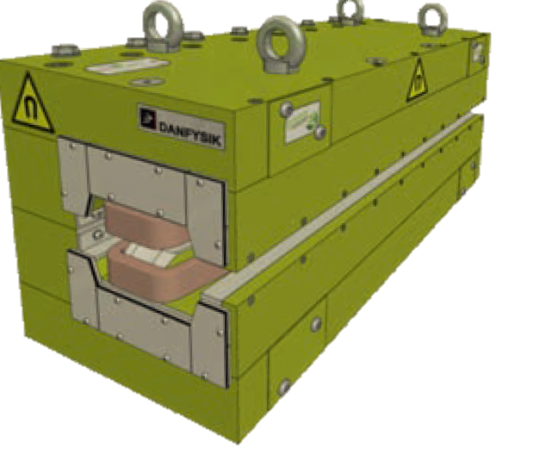



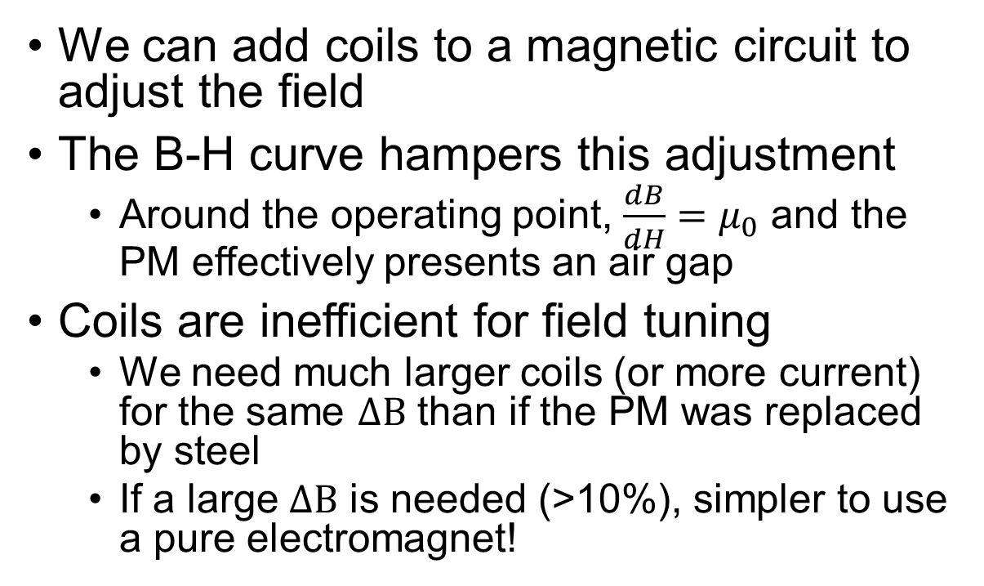



Tuning
Normal curve
(i.e. including a ferromagnet)
$$B=μ\left(H+M\right)$$
We can add coils to a magnetic circuit to adjust the field
The B-H curve hampers this adjustment
  Around the operating point, $\frac{dB}{dH}=μ_{0}$ and the PM effectively presents an air gap
Coils are inefficient for field tuning
  We need much larger coils (or more current) for the same $ΔB$ than if the PM was replaced by steel
  If a large $ΔB$ is needed (>10%), simpler to use a pure electromagnet!
Free space $B=μ_{0}H$
Induction B [T]
Operating point
Intrinsic curve
Applied field H [A/m]
g
gap g
gap g
Danfysik ‘Green Magnets’
30° dipole for ASTRID2 injector, Aarhus
1 T, 30 mm gap, 1000 mm length
Adjustment: ±3%
g
$$NI=\frac{2ΔBg}{μ_{0}}$$
$$NI=\frac{6ΔBg}{μ_{0}}$$

Slide 9
Adjustable PMs for accelerators
Upgrades and new concepts
Notes:
The abstract pattern can be removed or repositioned if required. Be careful to ‘Send to Back’ so that it does not obscure any important information.

Slide 10
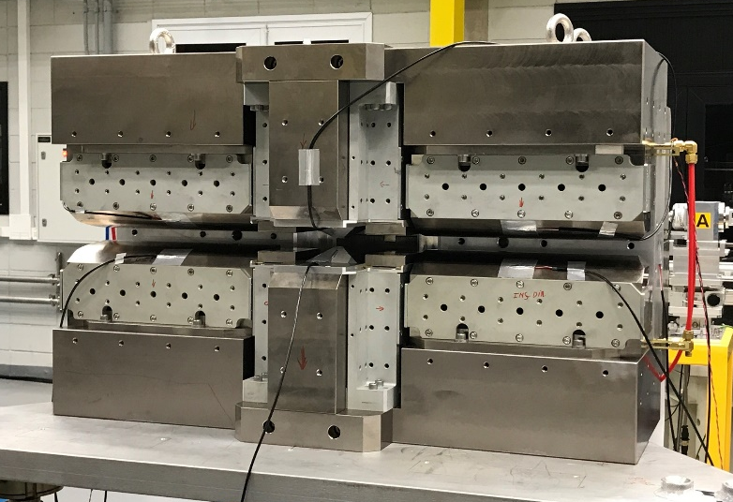

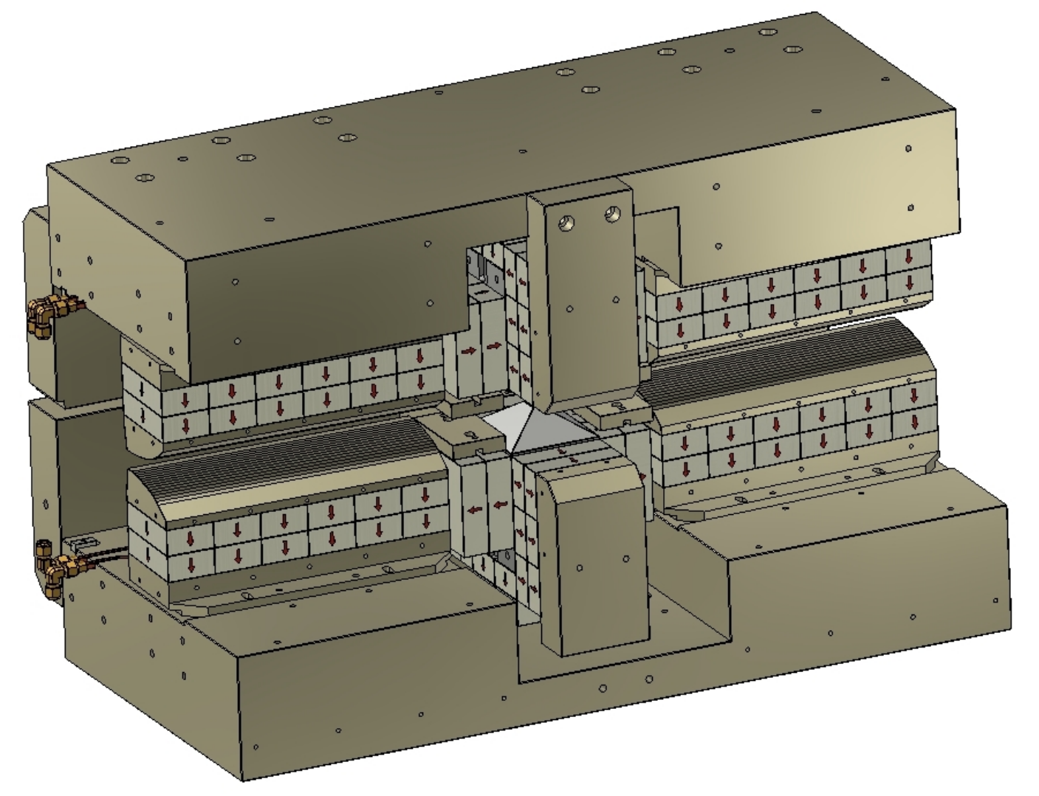
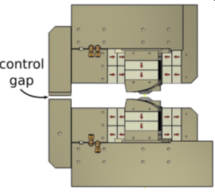
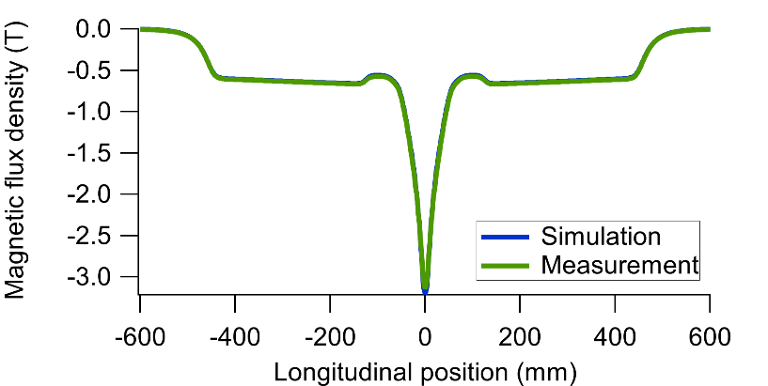
Sirius “Superbend” Dipole
Citadini, MT-25 (2017) Tue-Af-Po2.02-07
Liu et al, IPAC2020 MOVIR06
Upgrade of Sirius design from 3BA to 5BA
  Circumference: 480 m → 518 m
  Emittance: 1.7 nm → 250 pm
PM-based “Superbend”: 20 magnets
  105x55x30 mm NdFeB blocks, B_{r} 1.36 T
  3.2 T in magnet centre
  0.5 T + 9.5 T/m on flanks
  Minimum gap 11 mm
Adjustments
  Low field pole shift, ±5 mm: B ±4%
  Floating pole angle, ±3°: G ±4%
  “Control gap”, -3.2mm: 3% in B and G
floating poles

Slide 11

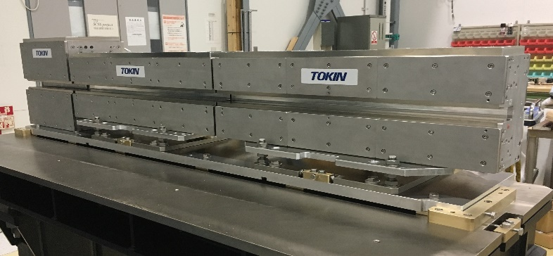
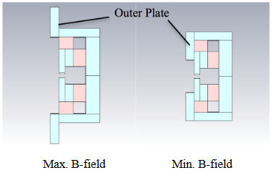
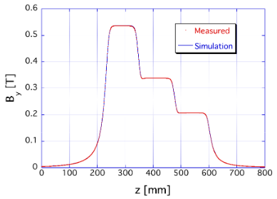
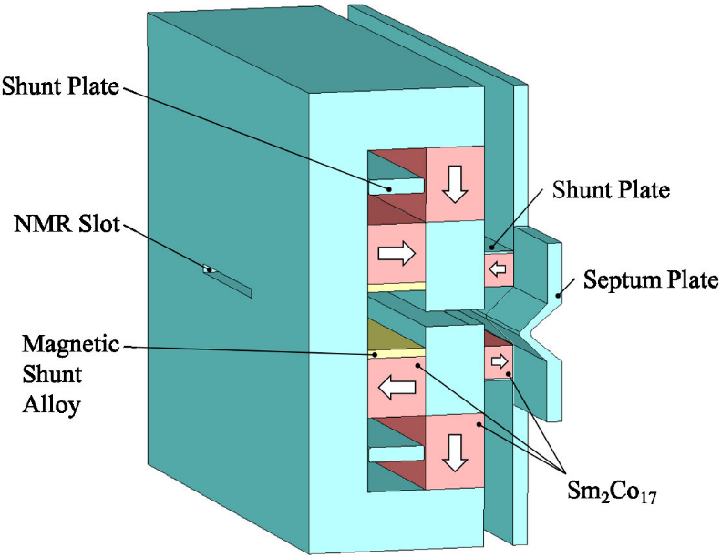
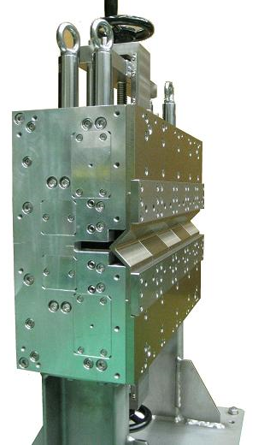
SPring-8 magnet R&D
Taniuchi et al, PR-STAB 23, 012401 (2020)
Tanaka, PSI Seminar (2019)
Taniuchi, PASJ2016 MOP109
LG dipole
NMR in the back
yokes for long-term
B-field observation
SPring-8-II CDR:
  8 → 6 GeV; DBA → 5BA; 6.6 nm → 149 pm
PM LG dipoles
  0.25-0.79 T; gap 25 mm
  Field tuning with outer plate movement
  Prototype: NdFeB blocks; 400 mm length; 0.2-0.55 T
  FeNi magnetic shunt: 5-18 mm thick, 5-10 ppm/°C
PM septum design
  1.2 T with ±2% tuning by moving plates
  Sm₂Co₁₇ blocks
  Gap 10 mm; length 400 mm
  FeNi magnetic shunt for temperature compensation:
  5.5 mm thickness, -1.2 ppm/°C at 27°C
  Septum plate 7 mm to reduce field at stored beam
3 segments with different B-fields

Slide 12
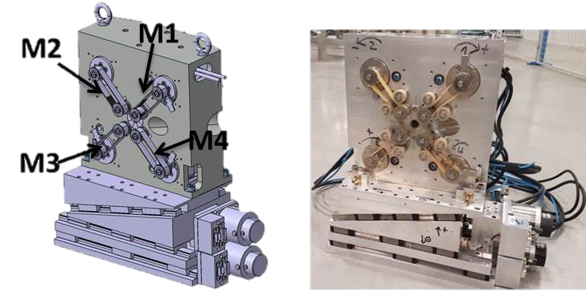


SOLEIL Tunable Quadrupole: QUAPEVA
Oumbarek Espinos et al, Appl. Sci. 2019, 9, 2447
Ghaith et al, arXiv:1712.03857v1
Marteau et al, APL (2017)
COXINEL laser-plasma experiment
  Need to focus highly-divergent beam (mrad)
  Strong quads immediately after plasma
Central Halbach array
Rotating NdFeB cylinders for adjustment
Seven magnets produced
  One prototype and two triplets
  26-100 mm length
  12 mm gap
  100-200 T/m gradient
  (factor of 2 adjustment range)
  Centre movement: ±10 µm

Slide 13

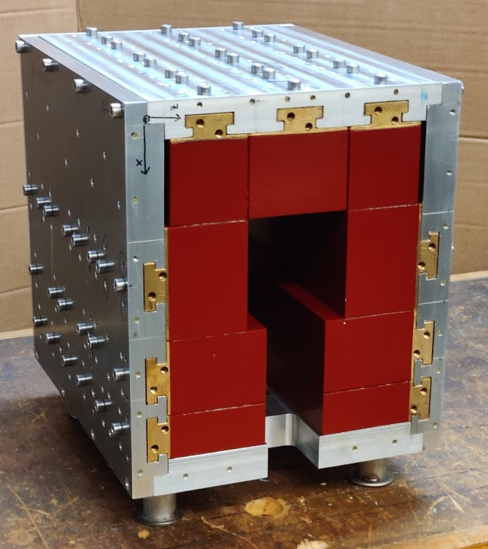
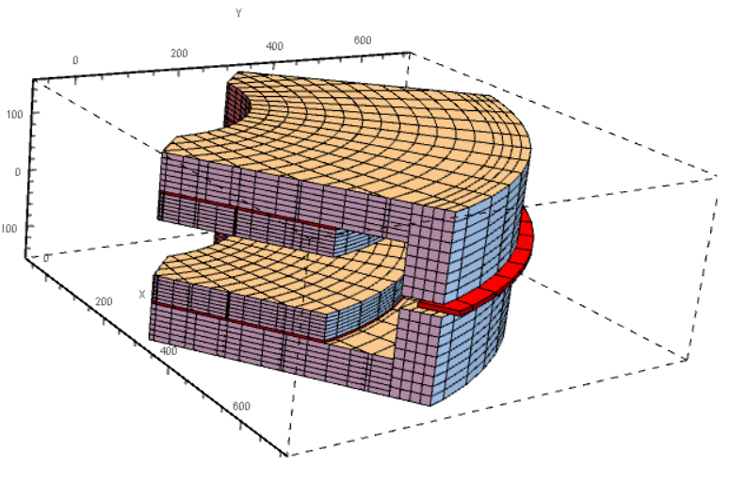
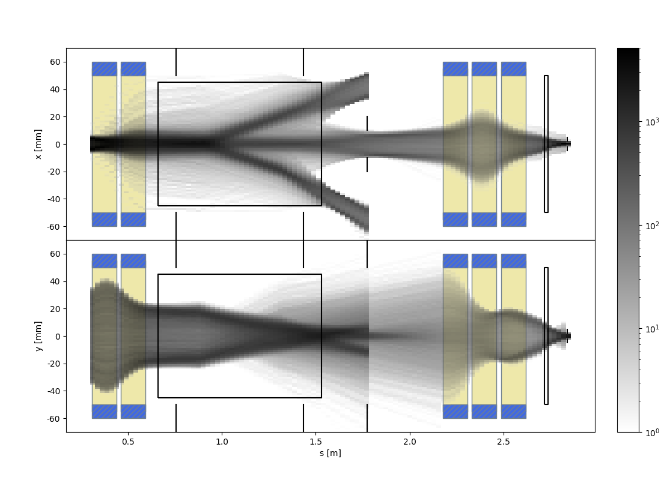
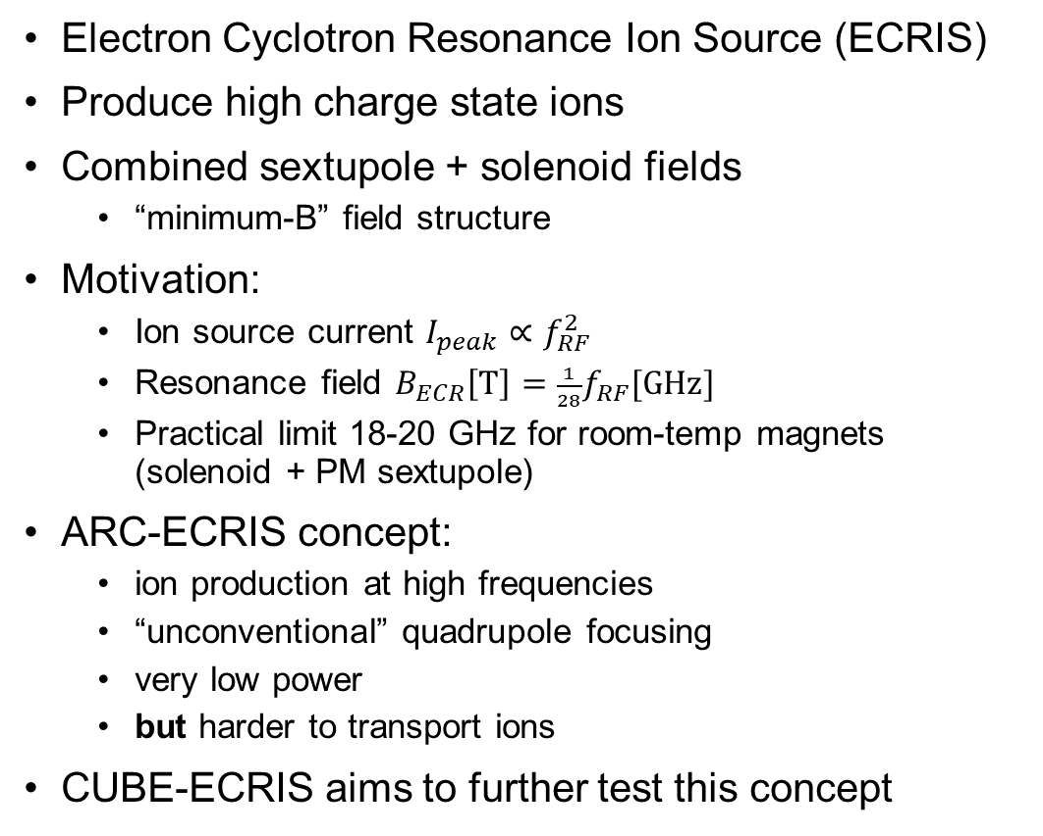
CUBE-ECRIS for Ion Sources
Kalvas et al, arXiv:2004.09917v1
Electron Cyclotron Resonance Ion Source (ECRIS)
Produce high charge state ions
Combined sextupole + solenoid fields
  “minimum-B” field structure
Motivation:
  Ion source current $I_{peak}∝f_{RF}^{2}$
  Resonance field $B_{ECR}\left[\text{T}\right]=\frac{1}{28}f_{RF}[\text{GHz}]$
  Practical limit 18-20 GHz for room-temp magnets
  (solenoid + PM sextupole)
ARC-ECRIS concept:
  ion production at high frequencies
  “unconventional” quadrupole focusing
  very low power
  but harder to transport ions
CUBE-ECRIS aims to further test this concept
Pole width = 300 mm
Pole gap = 90 mm
Pole thickness = 42 mm
Bending radius = 400 mm
Bending angle = 90°
Field = 80 mT
PM LEBT dipole design with movable PM cartridge (25mm)
Prototype built at JYFL, Sep ‘20
  NdFeB blocks
  Various sizes, 30-100 mm
  B_{min} 0.24 T for 10 GHz
  Simple configuration
Separation of charge states

Slide 14
The ZEPTO Project
From prototypes towards commercialisation
Notes:
The abstract pattern can be removed or repositioned if required. Be careful to ‘Send to Back’ so that it does not obscure any important information.

Slide 15


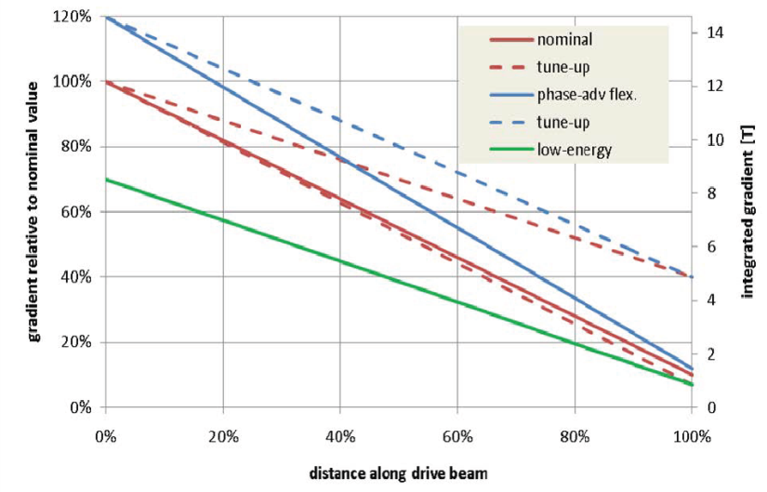
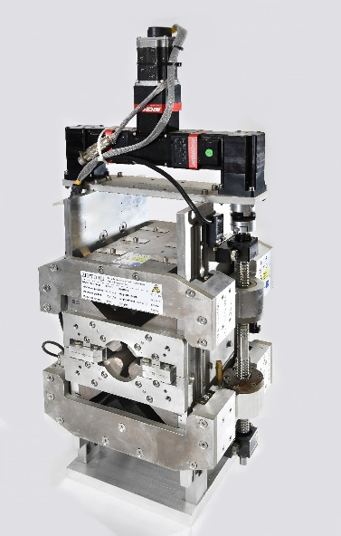
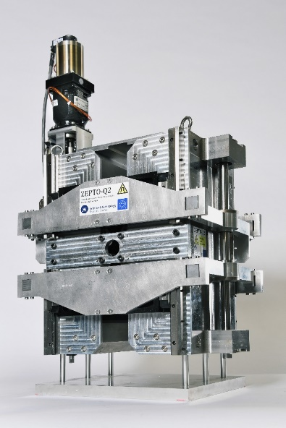
The ZEPTO project
Zero-Power Tunable Optics
Initially, collaboration between ASTeC and CERN to develop tunable PM quadrupoles for CLIC’s drive beam
Nominal 0.24-2.4 GeV, with some tuning range at each point
Two prototypes built at STFC Daresbury Laboratory
  27 mm aperture
  230 mm length
  15-60 T/m, 4-35 T/m ranges
  Fixed poles, movable PMs
  Simple control system with one motor
12.2 T
1.22 T

Slide 16
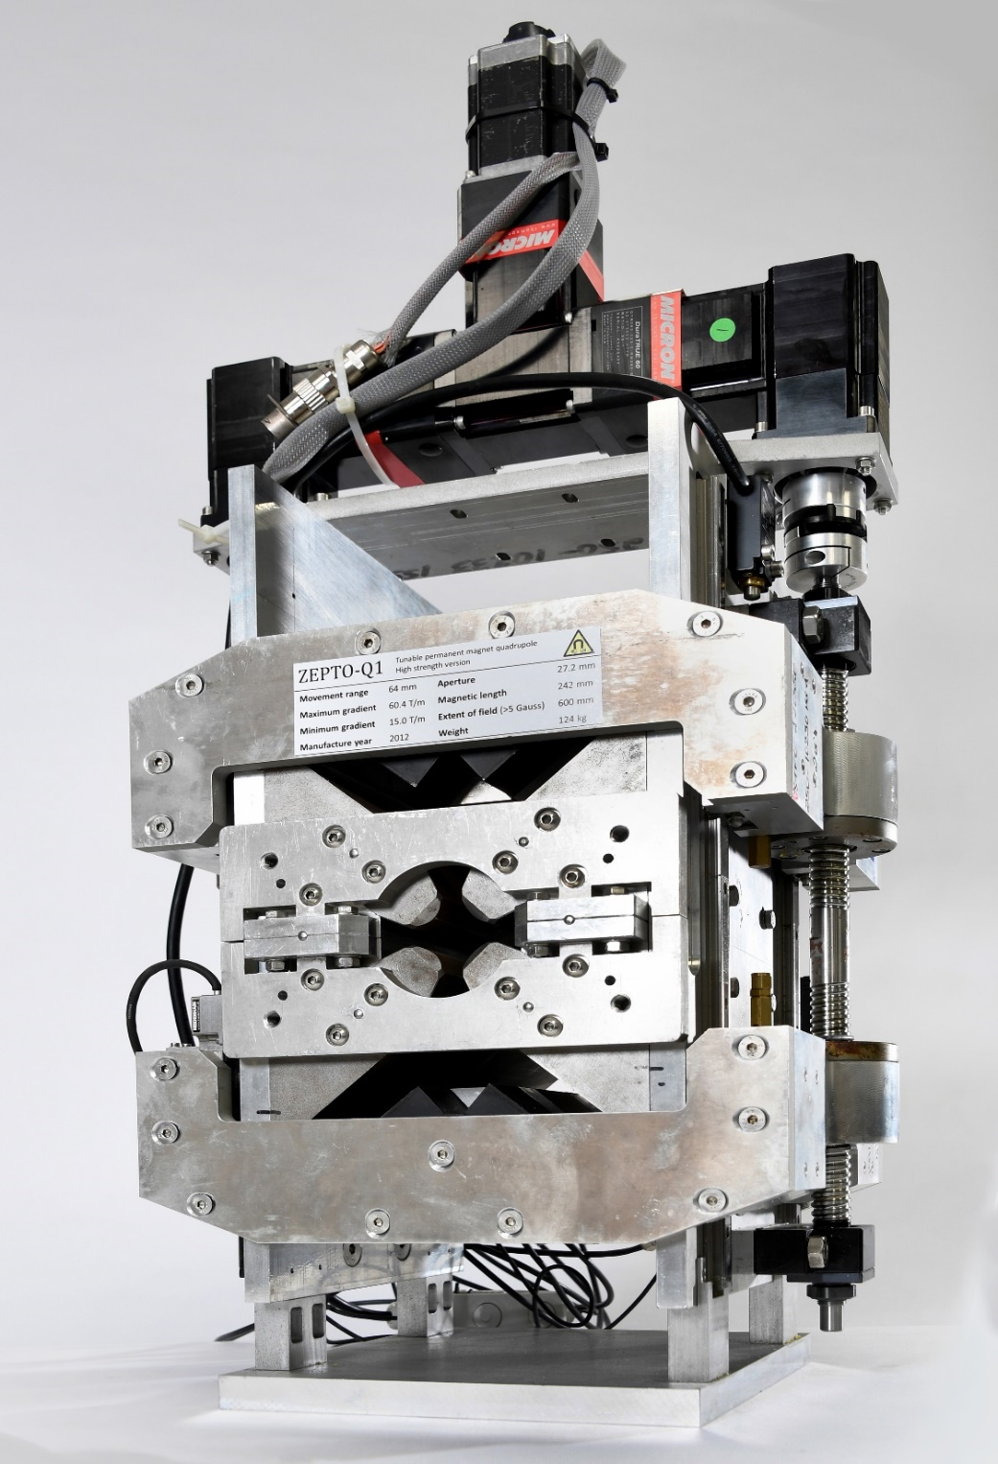
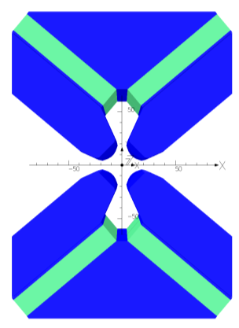
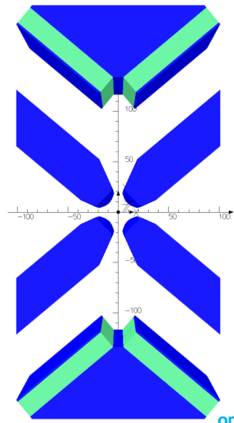
ZEPTO Q1: High Strength
Shepherd et al, IEEE Trans Appl SC, vol. 22, no. 3, p4004204 (2012)
Shepherd et al, IPAC2013 THPME043
High gradient: 60 T/m
  Can reduce to 15 T/m by moving PMs up to 64 mm
  Tuning using variable gap in magnetic circuit
Magnetic force: 16.4 kN per side
  Pulling PMs parallel to magnetic axis → large forces
Some unwanted magnetic centre movement
(100 µm) due to ferromagnetic rails
4 NdFeB blocks, each 18 x 100 x 230 mm
Gradient 15-60 T/m
Pole gap 27.2 mm
Field quality ±0.1%
over 23 mm
Length 230 mm
Max gradient
Min gradient
Fixed poles =
fixed field quality

Slide 17
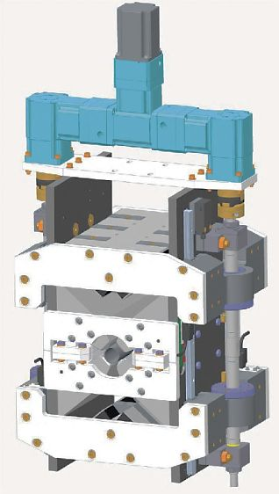
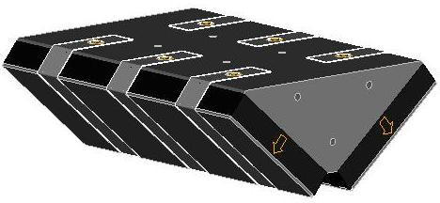
Engineering of High Strength Quad
Single axis motion with one motor and two ballscrews
Rotary encoder on motor (linear encoders used during setup to check repeatability)
Maximum force is 16.4 kN per side, reduces by x10 when stroke = 64 mm
PM blocks bonded to steel bridge piece and protective steel plate also bonded
Steel straps added as extra security

Slide 18
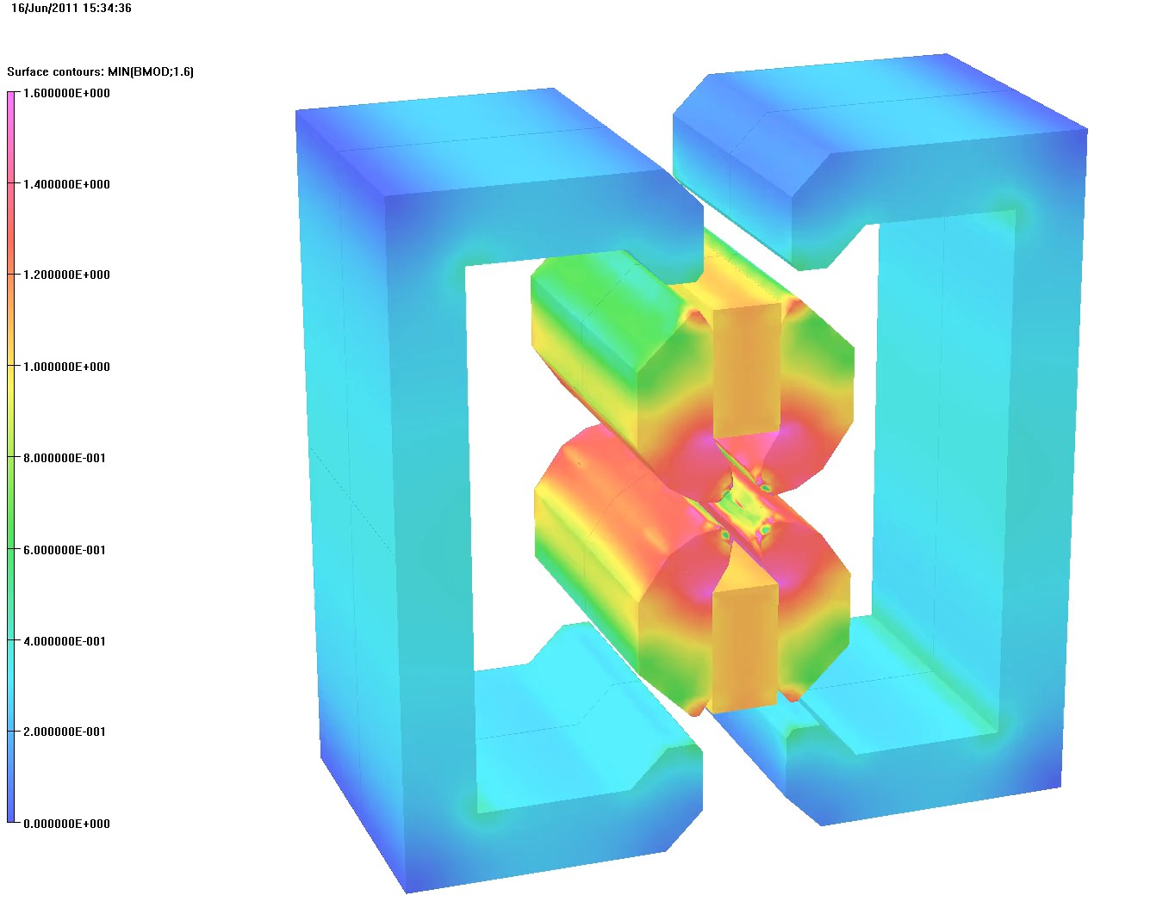
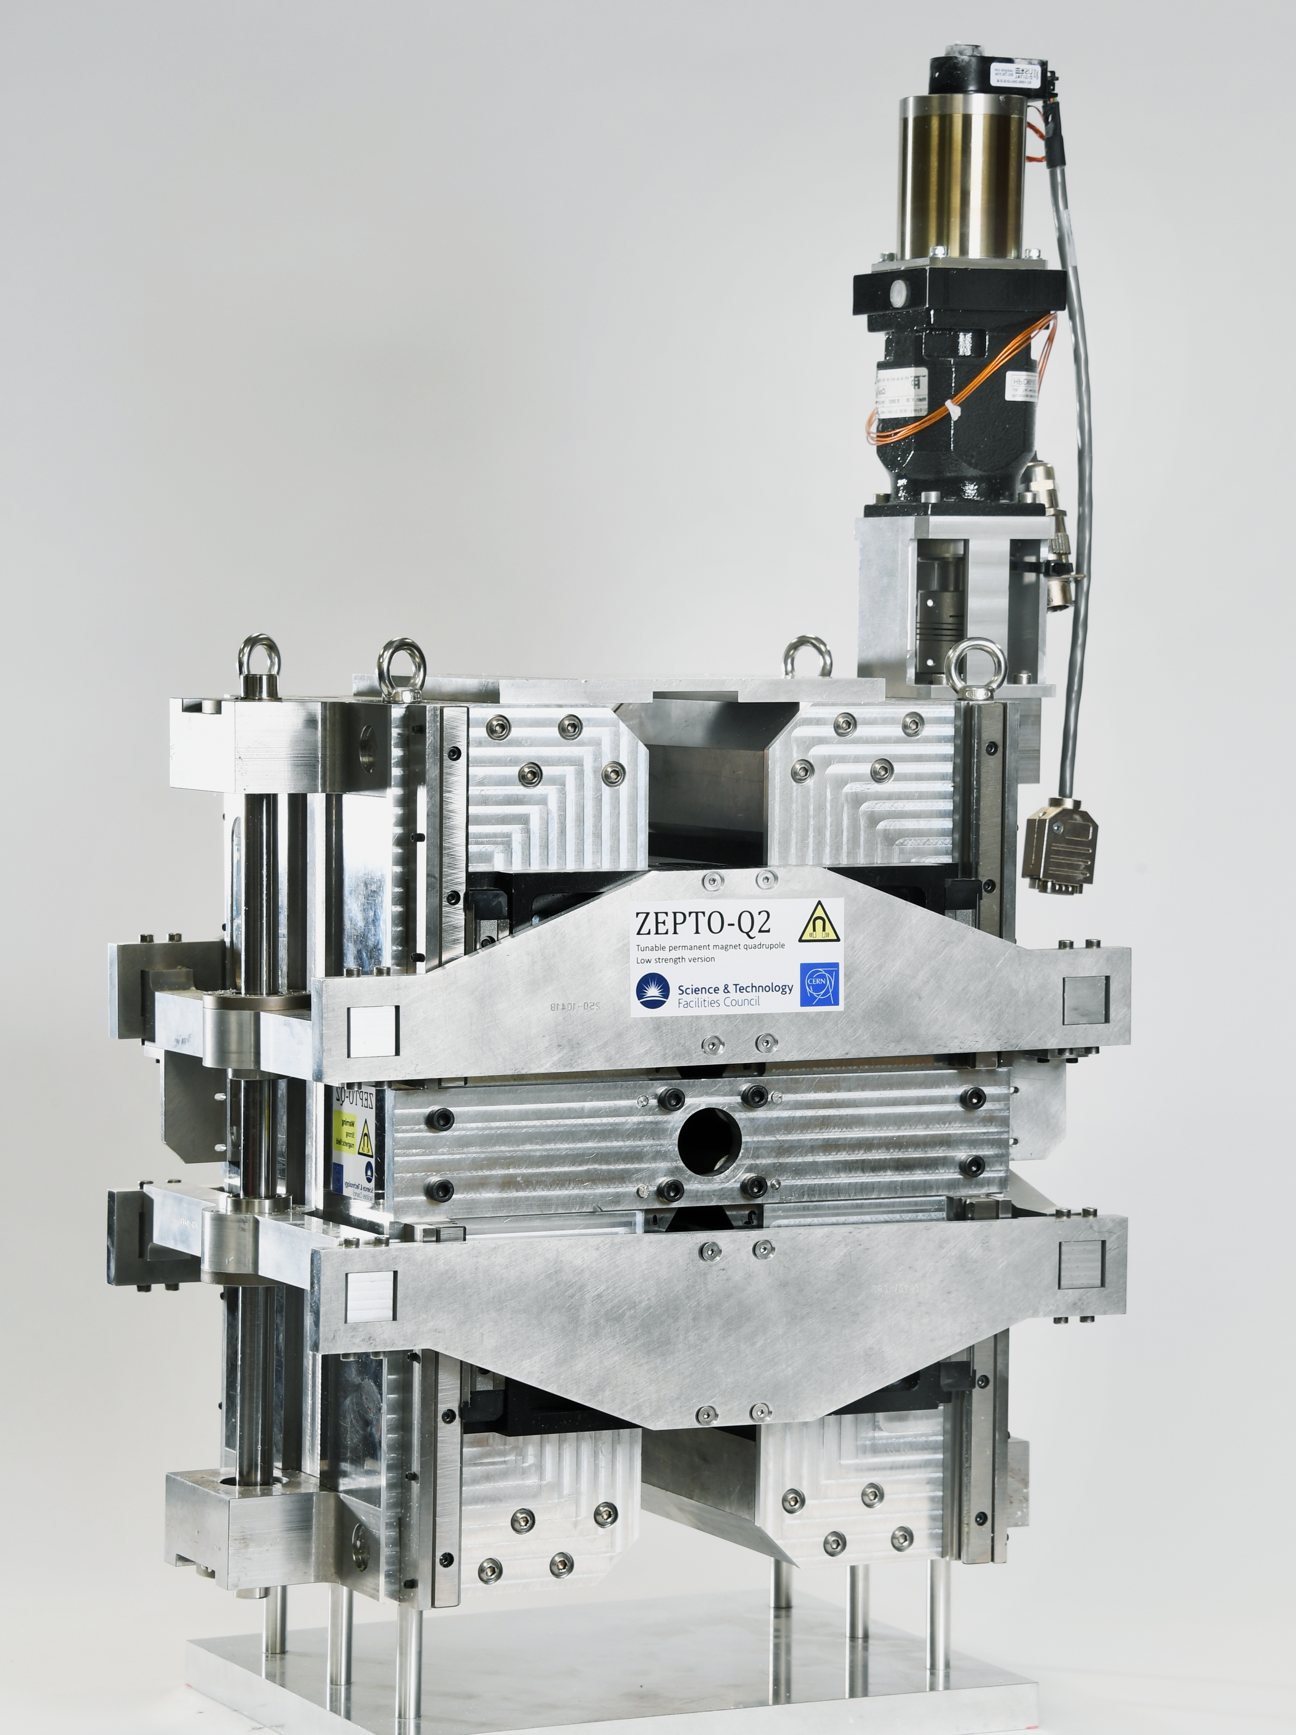
ZEPTO Q2: High Dynamic Range
Shepherd et al, IPAC2014 TUPRO113
Factor of 12 tuning range: 3.5-43 T/m
  Tuning using outer shell as secondary flux circuit
  to reduce quad strength rapidly
  PMs move perpendicular to magnetic axis → smaller forces
Smaller magnetic centre shift of 80 µm
2 NdFeB blocks, each 37.2 x 70 x 190 mm
Pole gap 27.6 mm
Field quality ±0.1% over 23 mm
Length: 190 mm

Slide 19
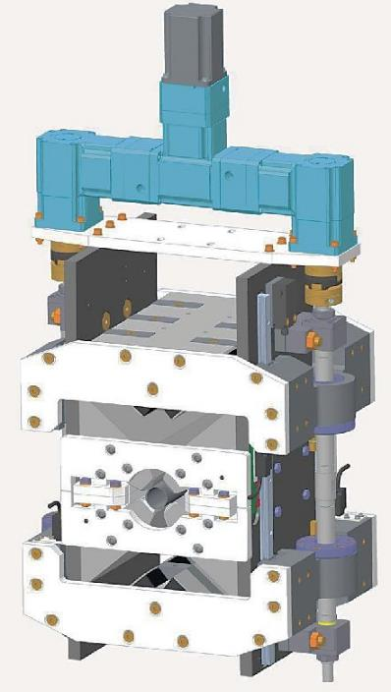
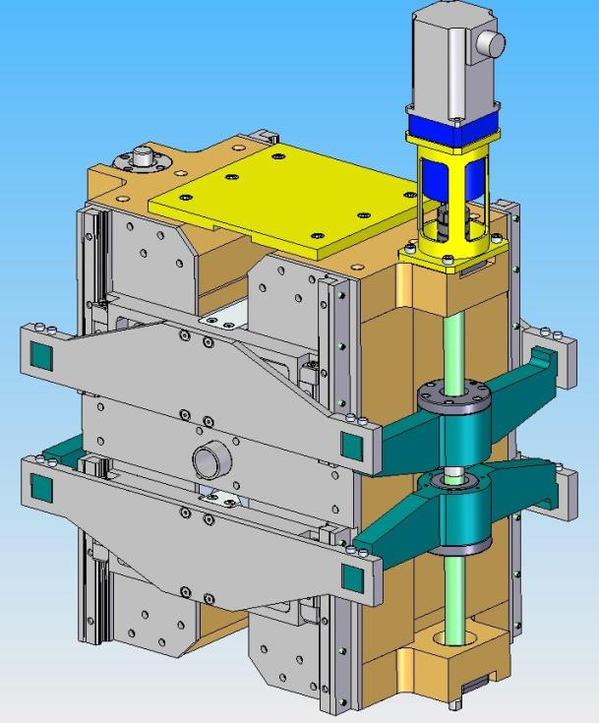
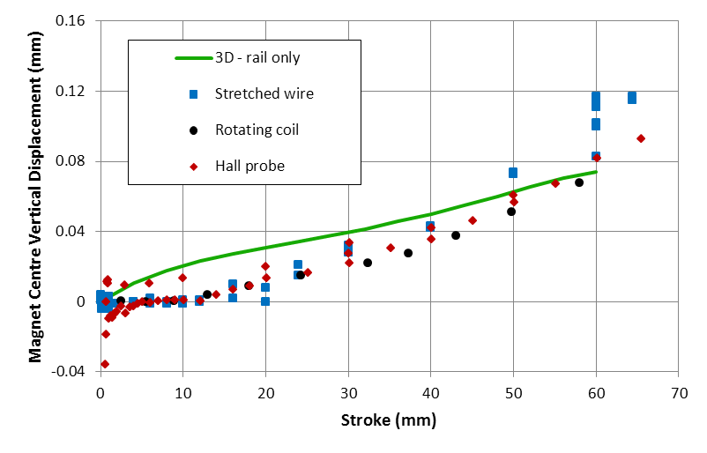
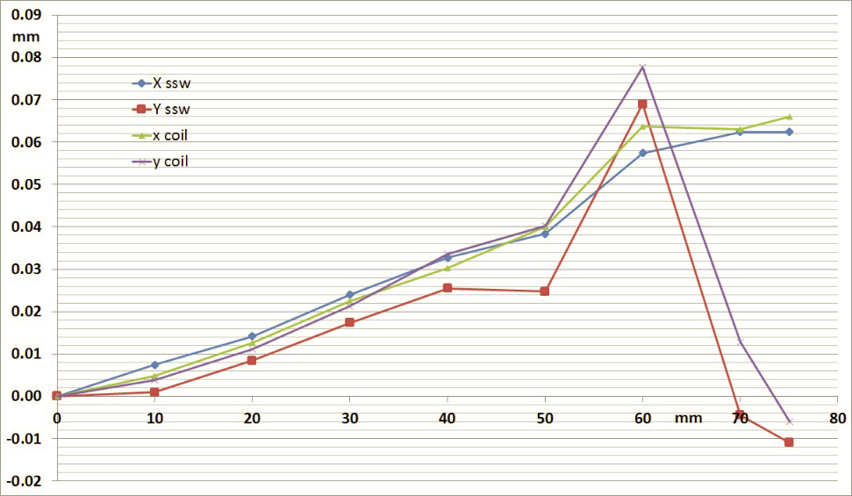
Magnet Centre Movement
The magnet centre moves upwards by ~100 µm as the permanent magnets are moved away
3D modelling suggests this is due to the rails being ferromagnetic (µ_{r} ~ 100, measured) and not mounted symmetrically about the midplane – should be easy to fix
Motor/gearbox assembly may also be a contributing factor
Q1 axis shift (vertical)
Q2 axis shift
horiz
vertical

Slide 20
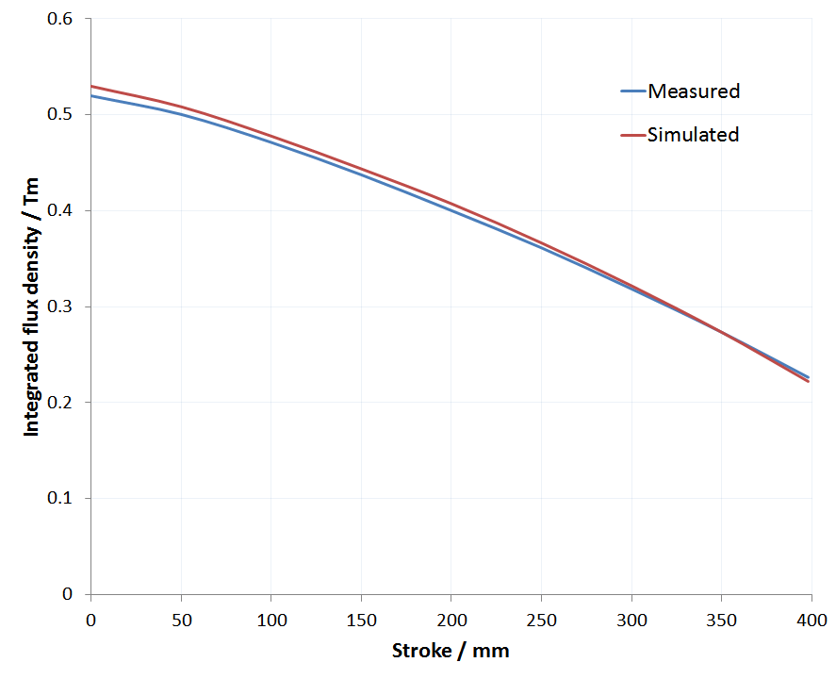
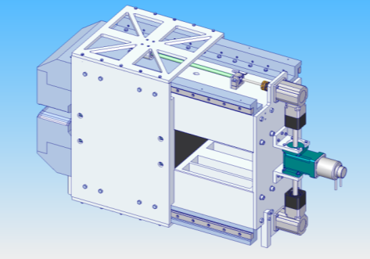
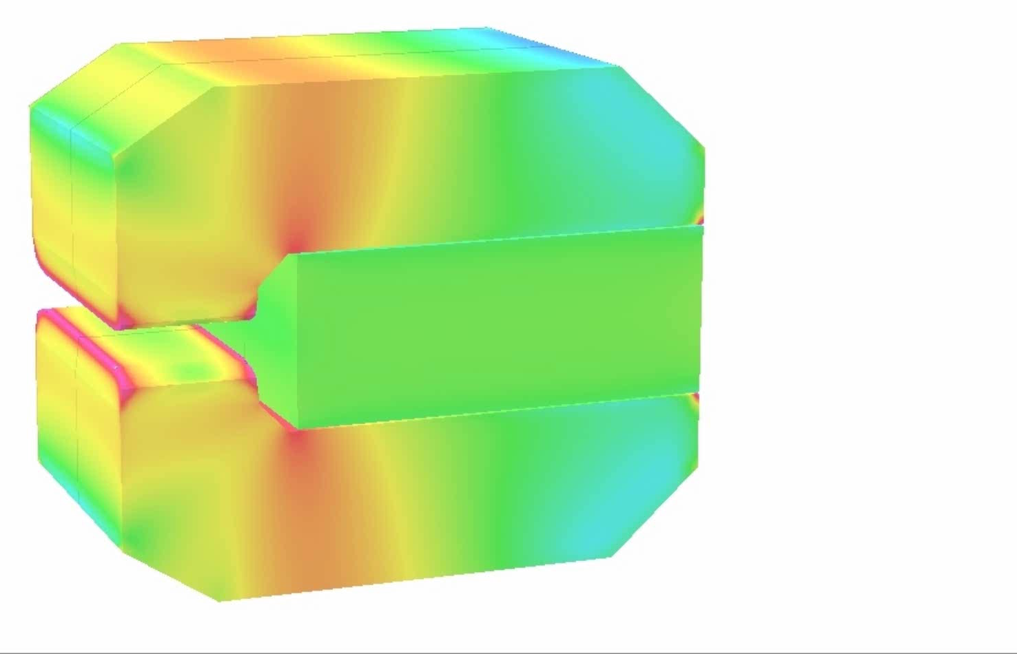
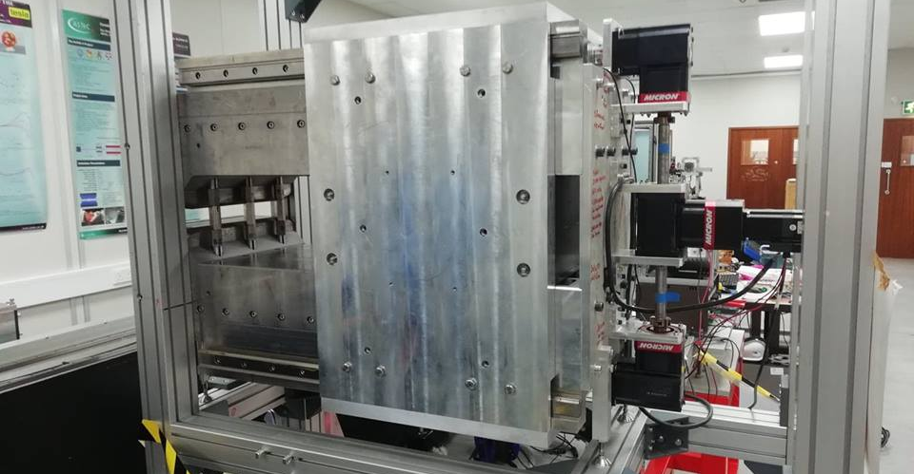
ZEPTO Dipole
Bainbridge et al, IPAC2017 THPIK105
Bainbridge, IMMW21 workshop
Prototype based on specifications for CLIC DB turnaround loops
0.46-1.1 T tuning range (355 mm stroke)
NdFeB block: 500x400x200 mm, B_{r} 1.38 T
Horizontal field quality: ±1x10⁻³ over 40 mm
Built and tested in 2019 at Daresbury Laboratory

Slide 21
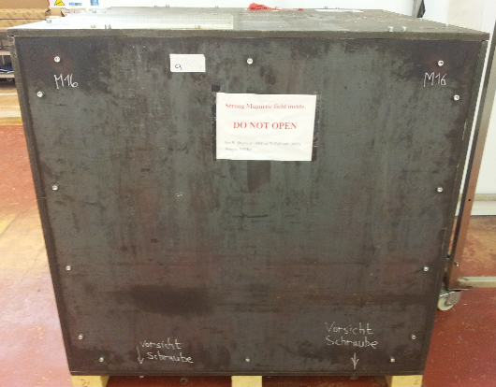
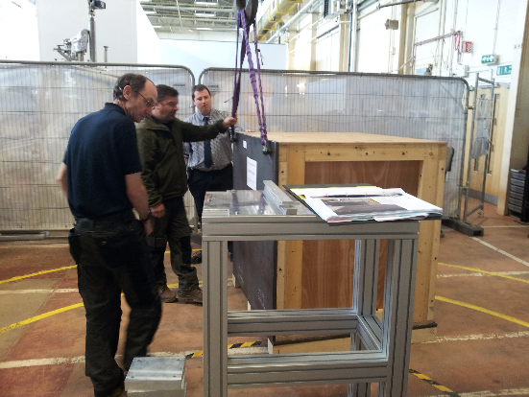
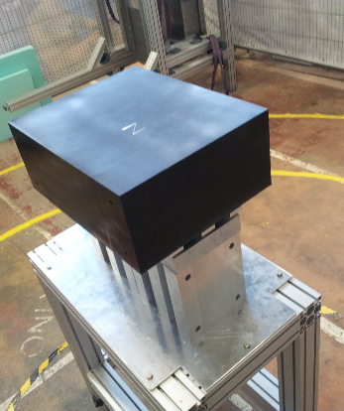

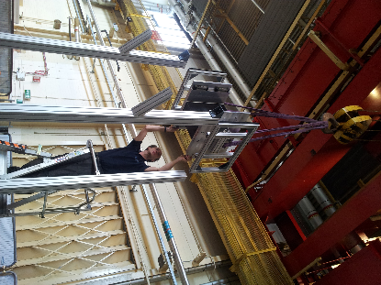
ZEPTO Dipole Construction
Extremely large PM
Lowered vertically into steel pole assembly
Mass 350kg + magnetic force 27 kN = 30.5 kN
PM became ‘wedged’ due to slight misalignment (2mm)
Frame not anchored to floor correctly
Not enough fine control on crane ➔ frame pulled out of floor

Slide 22
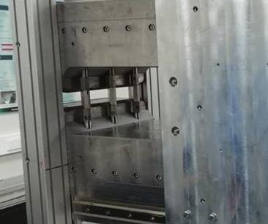
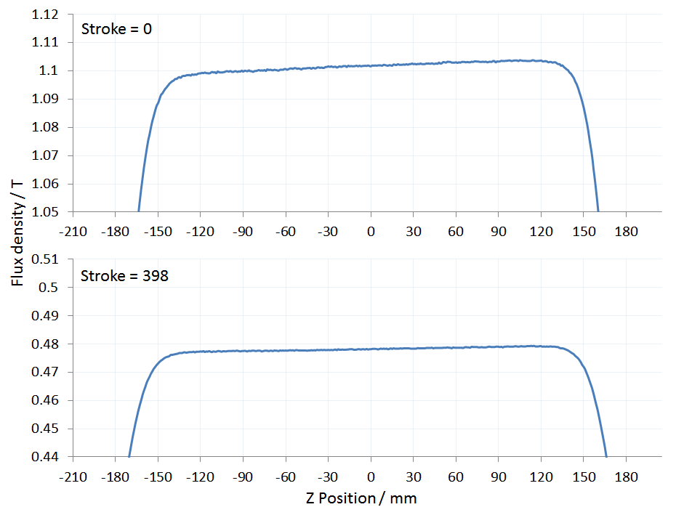
ZEPTO Dipole Measurements
Full suite of measurements performed on ZEPTO dipole, performed well but showed mechanical modifications needed:
Measurements showed 2 problems:
A longitudinal gradient in the field
The gradient changes as the block moves
Error in construction was to blame, needed adjusting and re-measuring
Cannot do any machining to pole faces once magnet is assembled.
However 3 support pillars have screw threads allowing independent adjustment with a very big (and non-magnetic!) spanner.

Slide 23
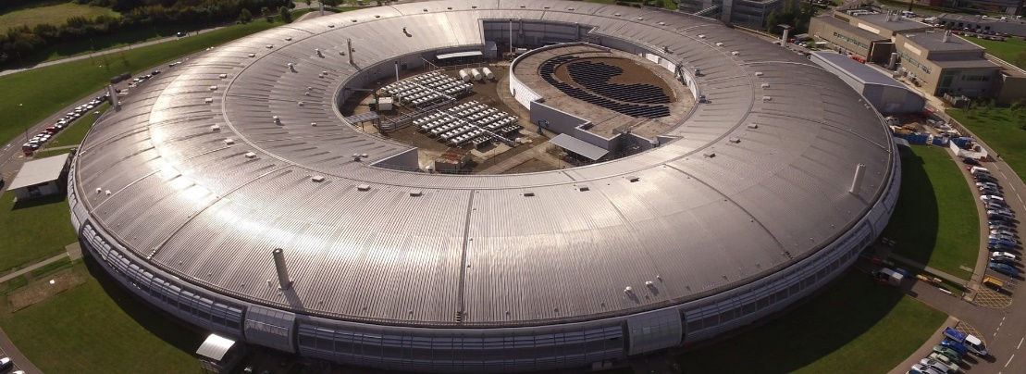



ZEPTO Diamond Quadrupole
Aim: demonstrate operation of a ZEPTO quadrupole on a working accelerator
Install a tunable PM quad as a drop-in replacement for an EM quadrupole
To be installed at Diamond Light Source, on the BTS transfer line
Enabled by STFC’s Proof of Concept Fund
  Step towards commercialisation of ZEPTO technology
Design complete
  Assembly and testing at Daresbury
  in early 2021
  Installation at Diamond
  in March 2021 shutdown
  Similar design to ZEPTO-Q2
    Outer shell for large tuning range
  SmCo blocks
    improved temperature stability
    radiation resistance
  Max gradient 19 T/m
  Min gradient 0.5 T/m
  Movement range 90 mm
  Aperture diameter 32 mm
  Splittable to allow installation around vacuum chamber
  Two independent motors for magnetic centre correction

Slide 24



Other PM applications
ASTeC’s magnet group are working on
several other projects using PM-based magnets
FEBE @ CLARA (Full Energy Beam Exploitation)
  PM spectrometer dipole for novel acceleration experiments
  C-shaped dipole, 600 MeV, 20 mm gap, 1 m length, modular
EPAC @ CLF (Extreme Photonics Application Centre)
  Investigation of ZEPTO triplet to capture
  plasma-accelerated beam immediately after IP
  10 mm gap, 200-300 T/m gradient
Diamond-II PM magnets
  PM alternative to DQ magnet: 0.7 T + 33 T/m; ~10% adjustment
  Longitudinal gradient dipoles: 0.29-0.76 T, 25 mm gap (ESRF design)
  STFC to build prototype for DLS
ILC damping rings
  ZEPTO quadrupoles and sextupoles – under discussion

Slide 25




Conclusions
Advantages of PM-based magnets
  No power
  Less infrastructure
  Smaller carbon footprint
Increasingly widespread use in accelerators
  Longitudinal gradient bends for storage ring upgrades
  High gradient focusing for laser-plasma acceleration
Obstacles can be overcome
  Several tuning mechanisms
  Cancellation of temperature effects

Slide 26




@STFC_matters
Science and Technology Facilities Council
Acknowledgements
James Citadini, Sirius
Takahiro Watanabe, JASRI
Olli Tarvainen, STFC RAL
Alex Bainbridge and the rest of STFC’s MaRS group
Jim Clarke, ASTeC
The Shepherd family for all their support
Icon credits: flaticon.com - Freepik, monkik, Smashicons, DinosoftLabs, Alfredo Hernandez, Prosymbols
Notes:
The abstract pattern can be removed or repositioned if required. Be careful to ‘Send to Back’ so that it does not obscure any important information.

