Slide 1
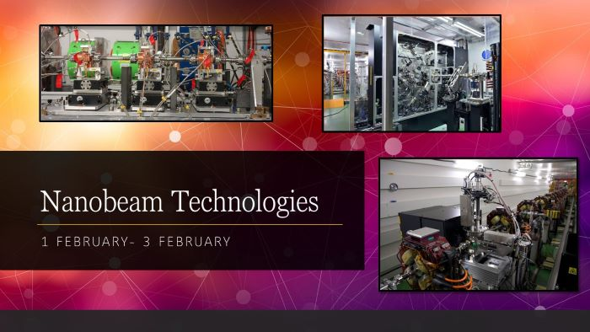
Developments in Superconducting Final Focus Technology
Magnets Session at the Workshop on Nanobeam Technologies, a CERN Virtual Meeting, 1-3 February 2021
https://indico.cern.ch/event/980103/timetable/#20210201.detailed
Brett Parker, Superconducting Magnet Division (SMD)
BNL Advanced Technologies Research Office (ATRO)
February 1, 2021
Notes:
Please use the Notes field for each slide to prepare the course instructor guide as you go

Slide 2
†
Developments in Superconducting Final Focus Technology
ILC Final Focus TDR Design and (a possible) ILC preEDR Restart
  Recap the ILC Final Focus TDR design concept and QD0 R&D history
  Uses actively shielded QD0 produced via BNL Direct Wind technology
  And Introduces the ILC force neutral anti-solenoid concept
  We now look to restart the QD0 vibration measurement R&D for EDR (Work related to planned SuperKEKB IR QCS in situ measurements)
New Approaches to Deal with Final Focus Magnetic Crosstalk
  Introduce Tapered, Constant Gradient, Double Helical Coils for BNL EIC
  Direct Wind Double Helical Coils are Applicable to FCC-ee Final Focus
  Direct external field cancellation à la SuperKEKB Cancel Coils
  Sweet Spot concepts for BNL’s EIC and the ILC Final Focus designs
†This presentation is organized as a personal exploration of ways to deal with magnetic cross talk.
ATRO

Slide 3
Topic 1: ILC Final Focus TDR Design & EDR Restart (7 Slides)
3
ATRO

Slide 4
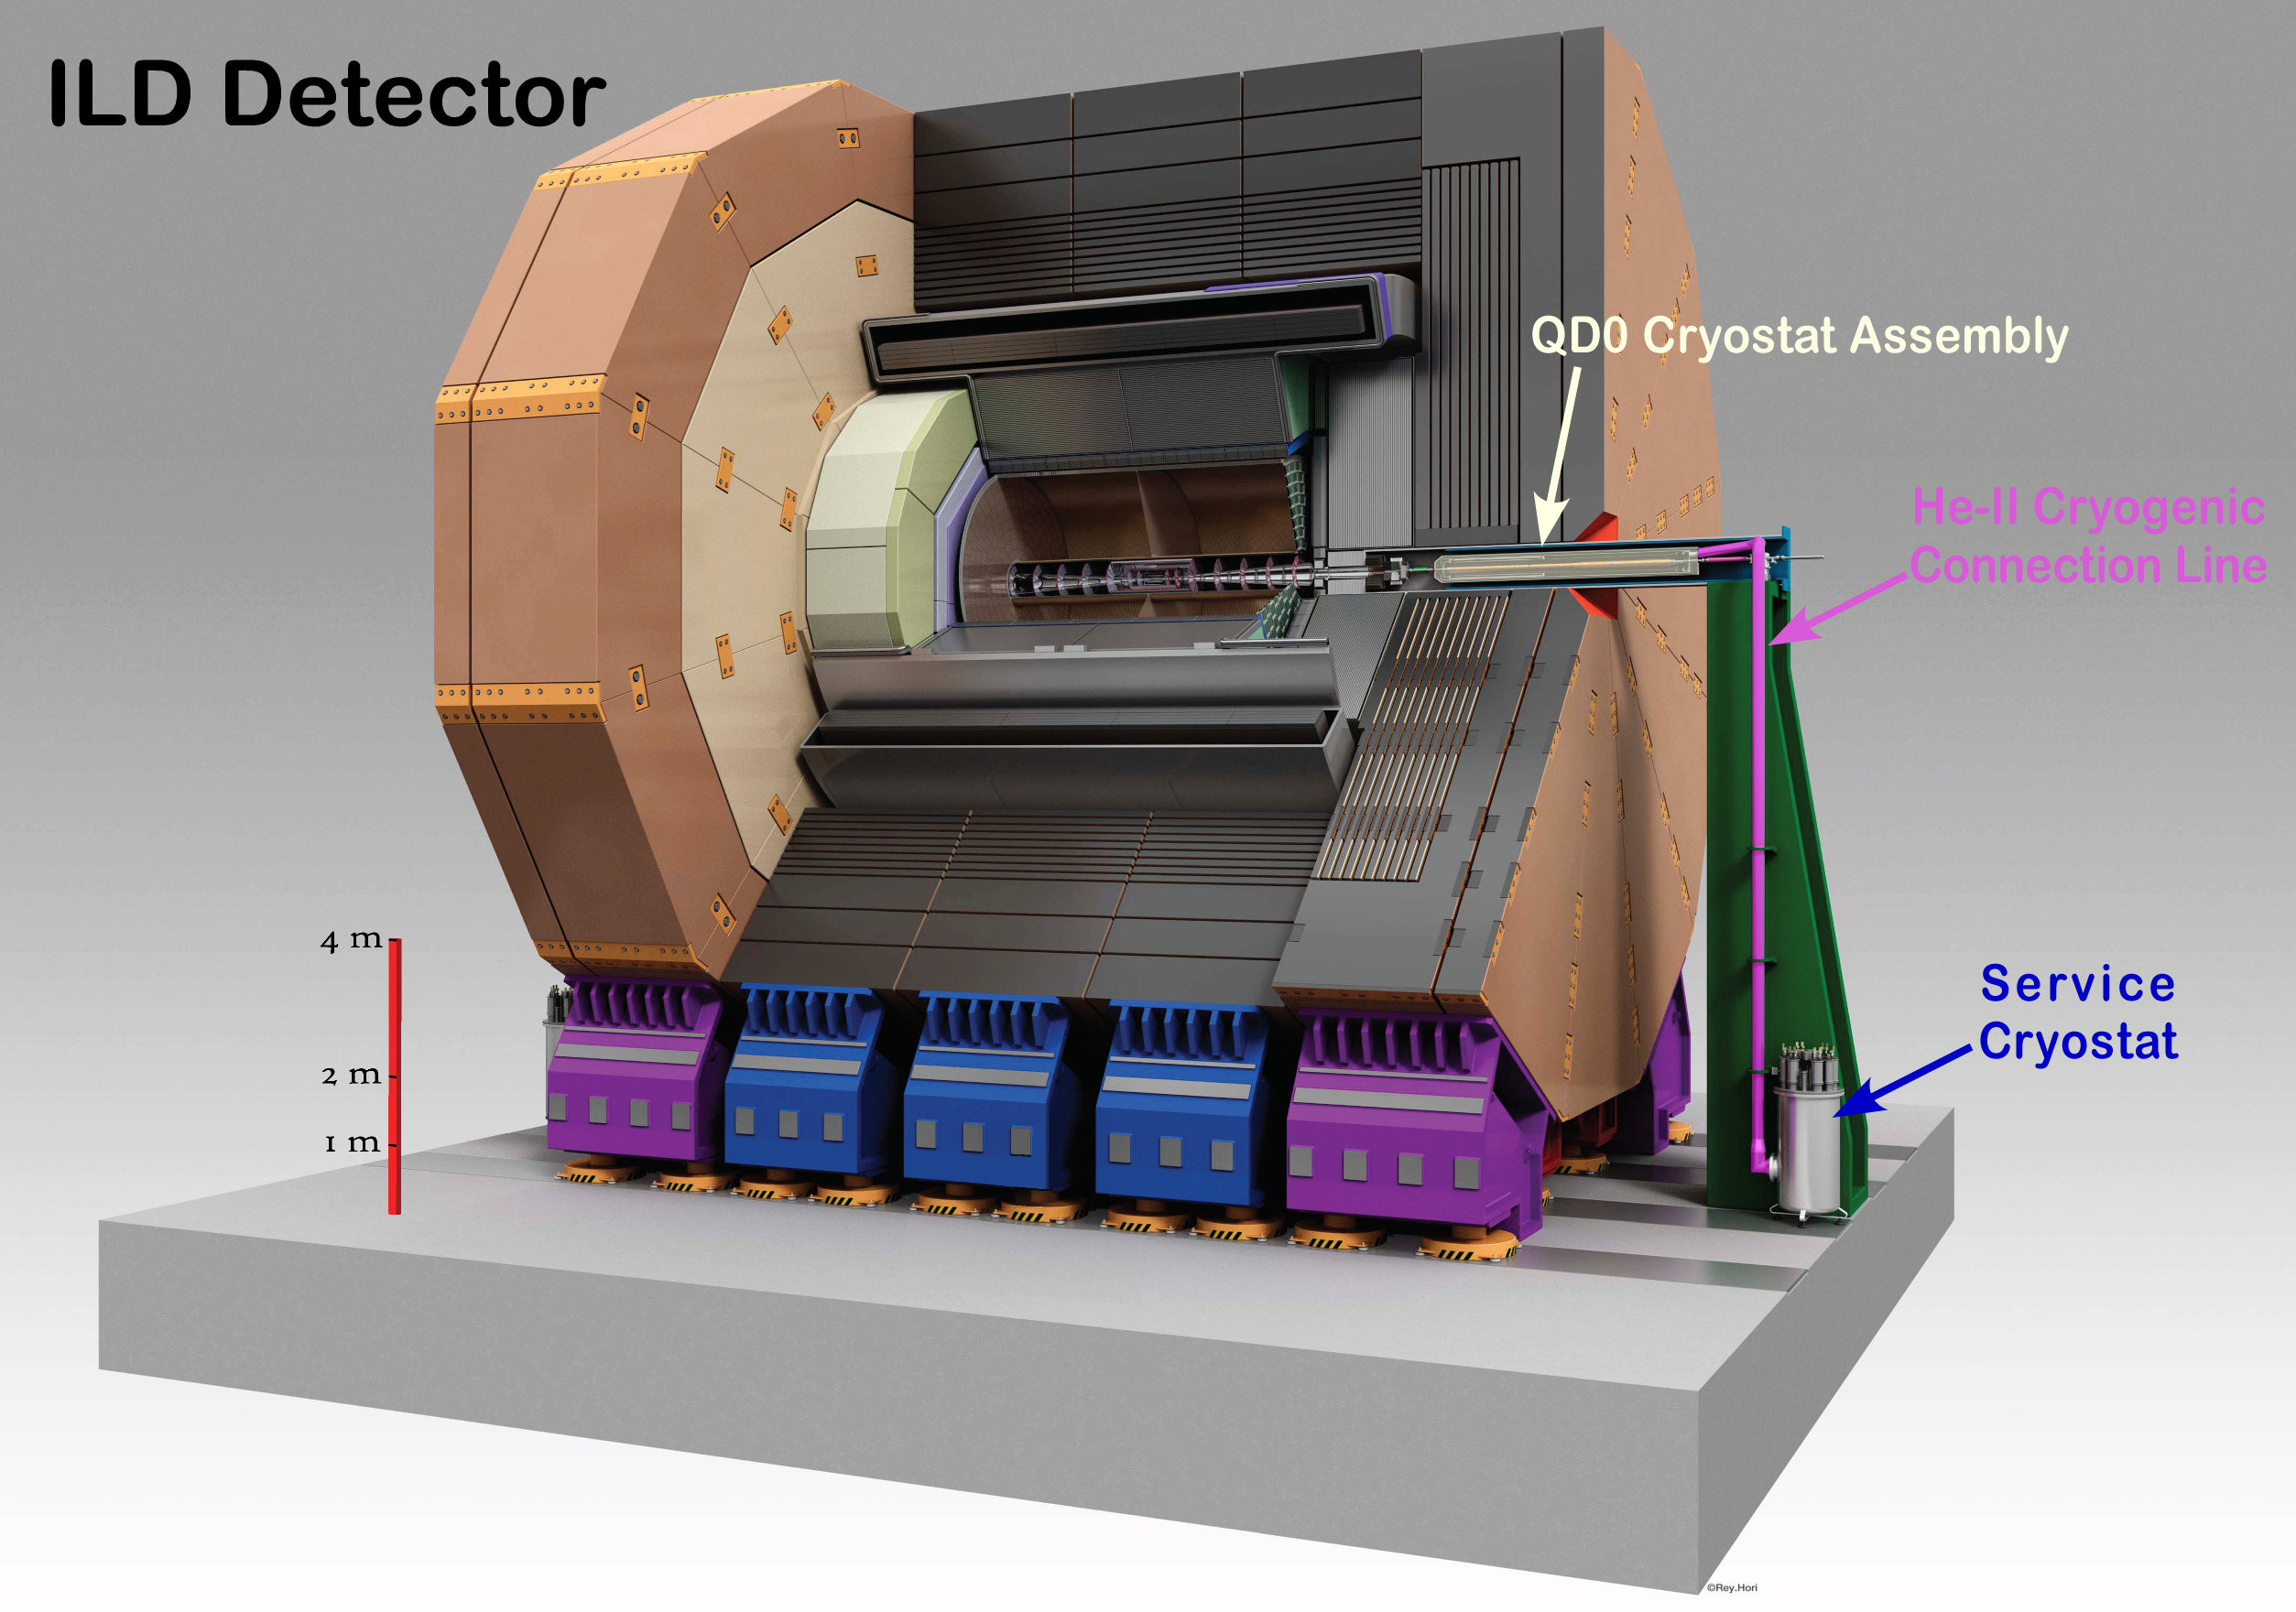
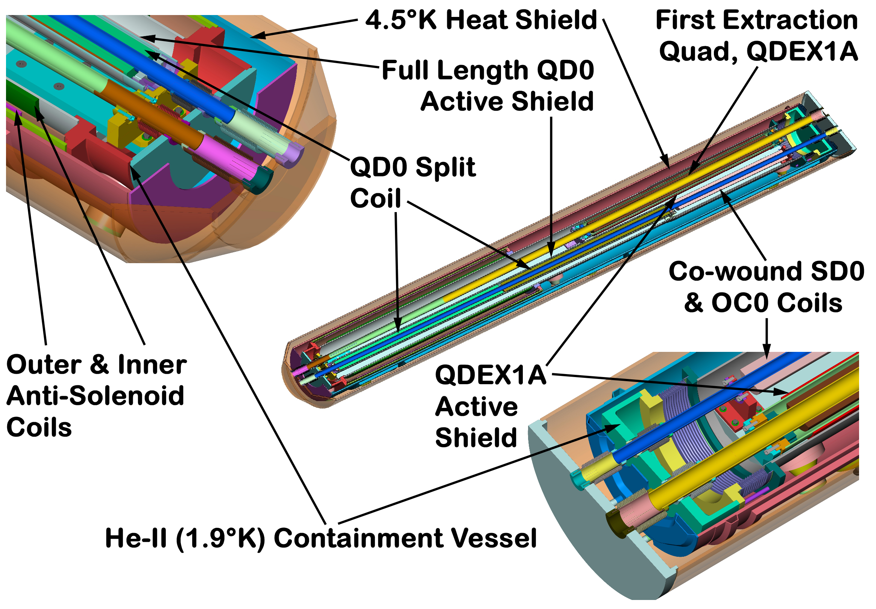
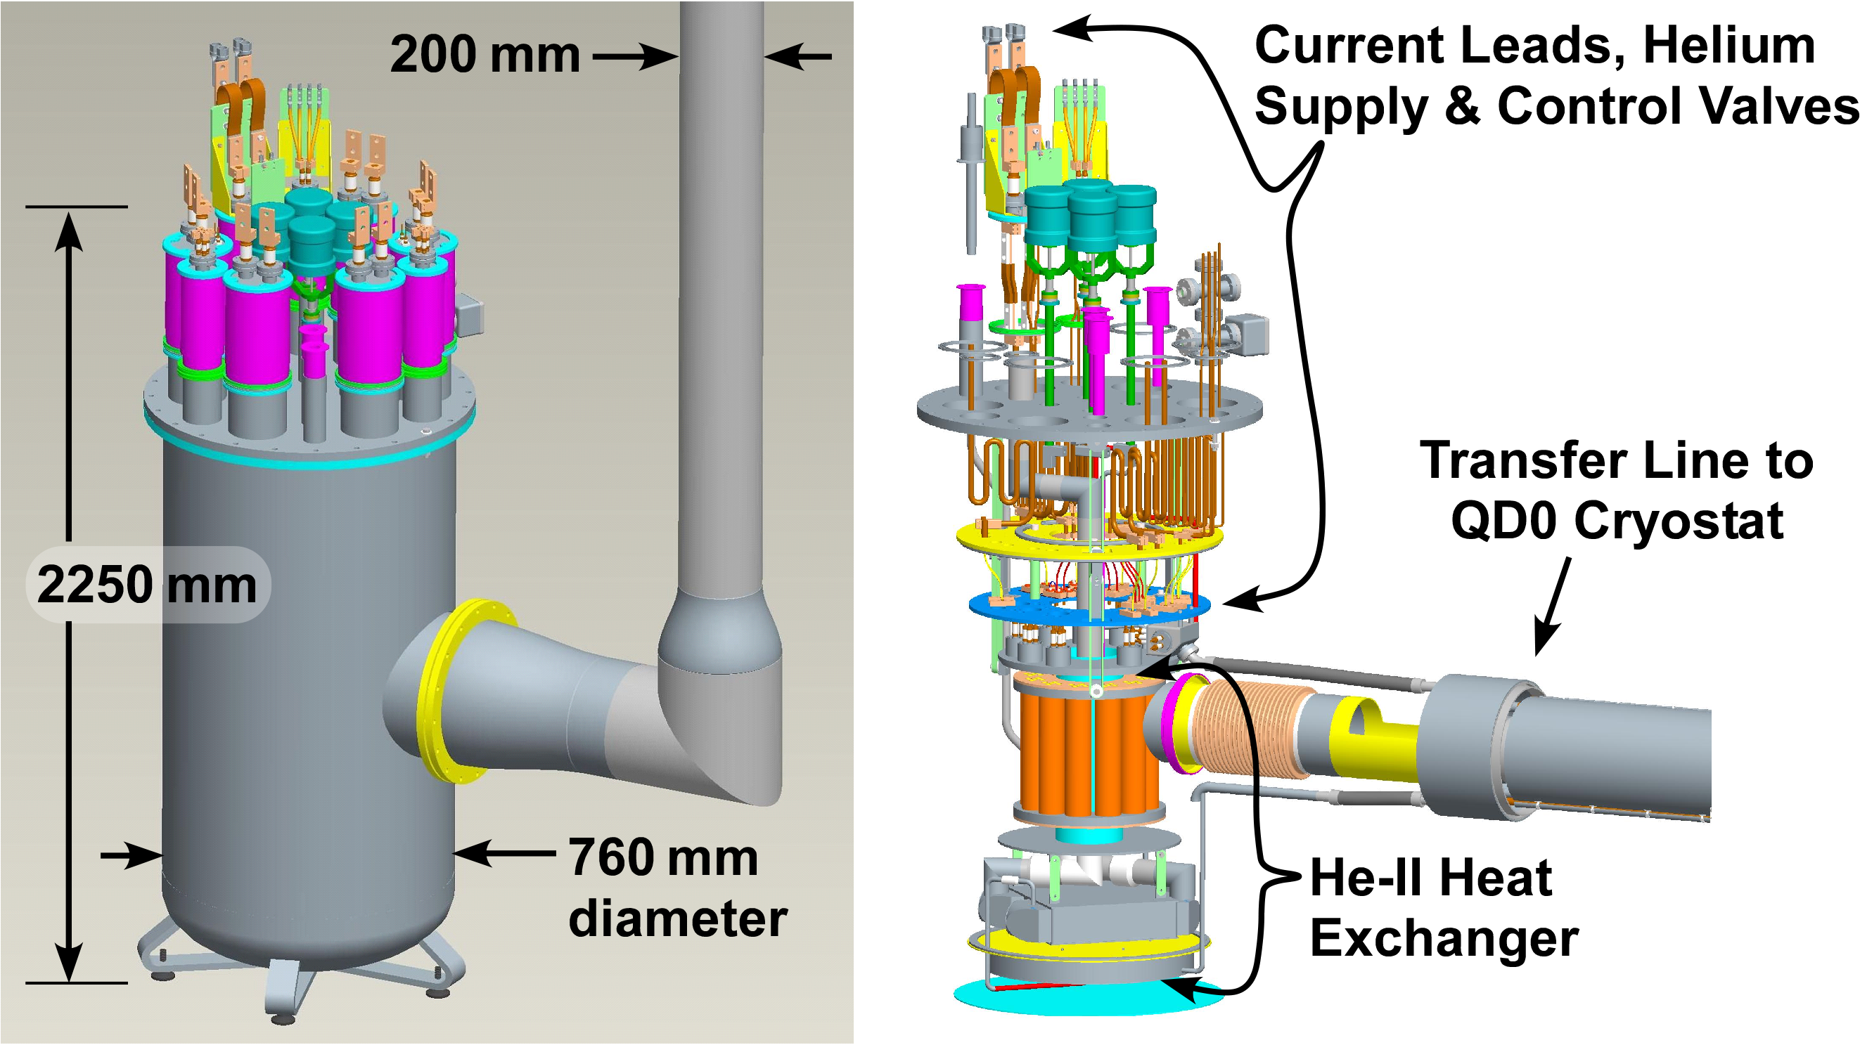
ILC Final Focus Magnets: TDR R&D Review
We use 1.9 K pressurized superfluid helium cooling in order not to have “flowing cryogens” (avoid vibrations).
ATRO

Slide 5
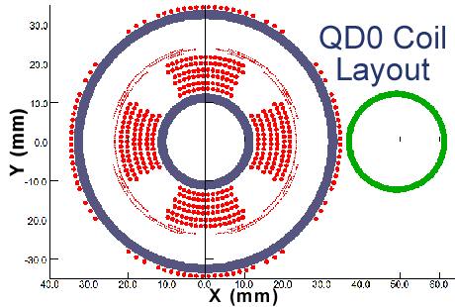
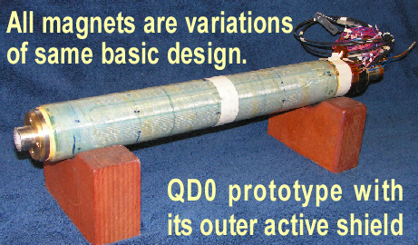
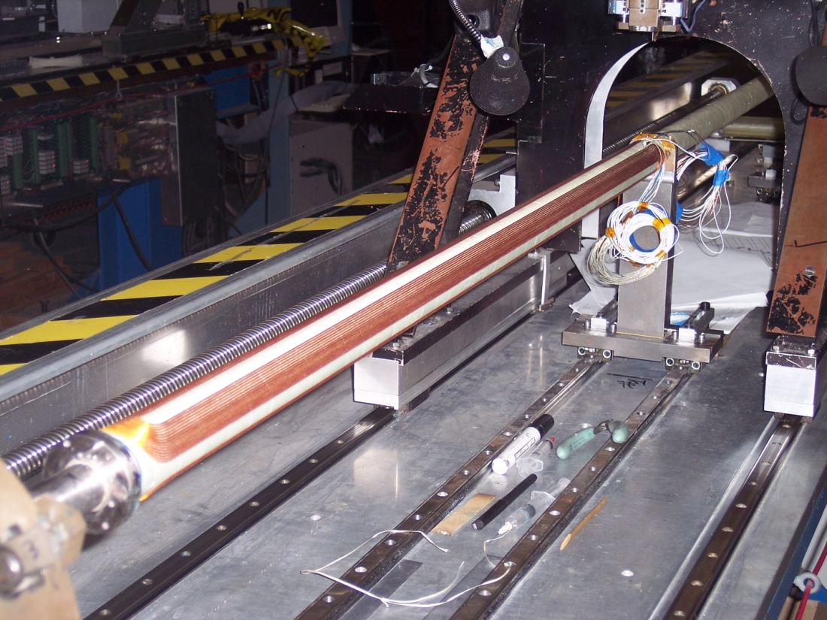
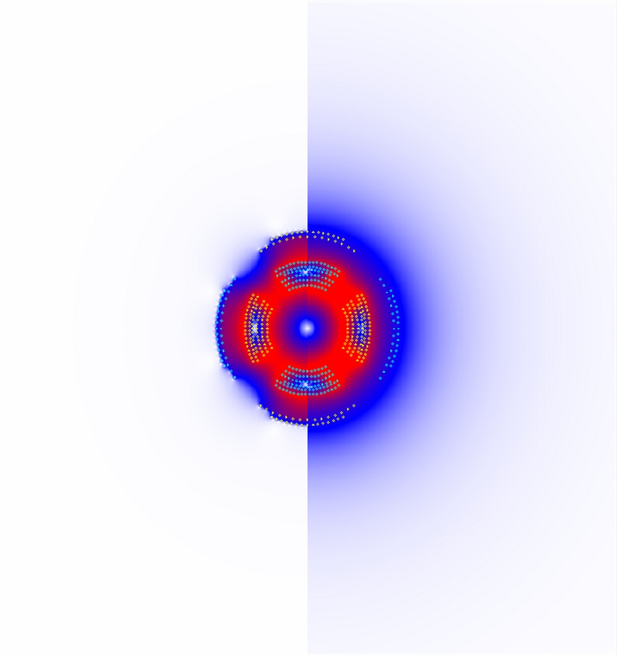
ILC Final Focus Magnets: TDR R&D Review
QD0 Split Coil Winding
Incoming Beam
Outgoing Disrupted Beam
Main coils & correctors are wound on common support tube.
For the ILC IR we only need to pass the outgoing highly disrupted beams cleanly on to the beam absorbers.
Main requirement is to shield outgoing beam from any strong external fields… which is done with an active shielding coil.
Main 2.2 m QD0 coil is split in half for low energy optics flexibility and to ease manufacturing challenges.
Note there is only a partial anti-solenoid overlapping QD0 (just enough to avoid luminosity loss due too overlapping fields†).
Off
On
QD0 Prototype Test Coil with Active Shielding
†Y. Nosochkov and A. Seryi, “Compensation of Detector Solenoid Effects on the Beam Size in a Linear
Collider,” Physical Review Special Topics - Accelerators and Beams, DOI: 8. 10.2172/829740.
QD0 with Active Shield Off/On
5
ATRO

Slide 6
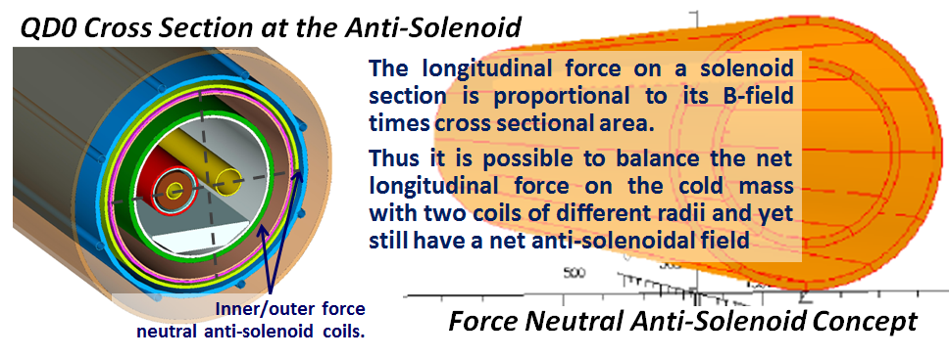
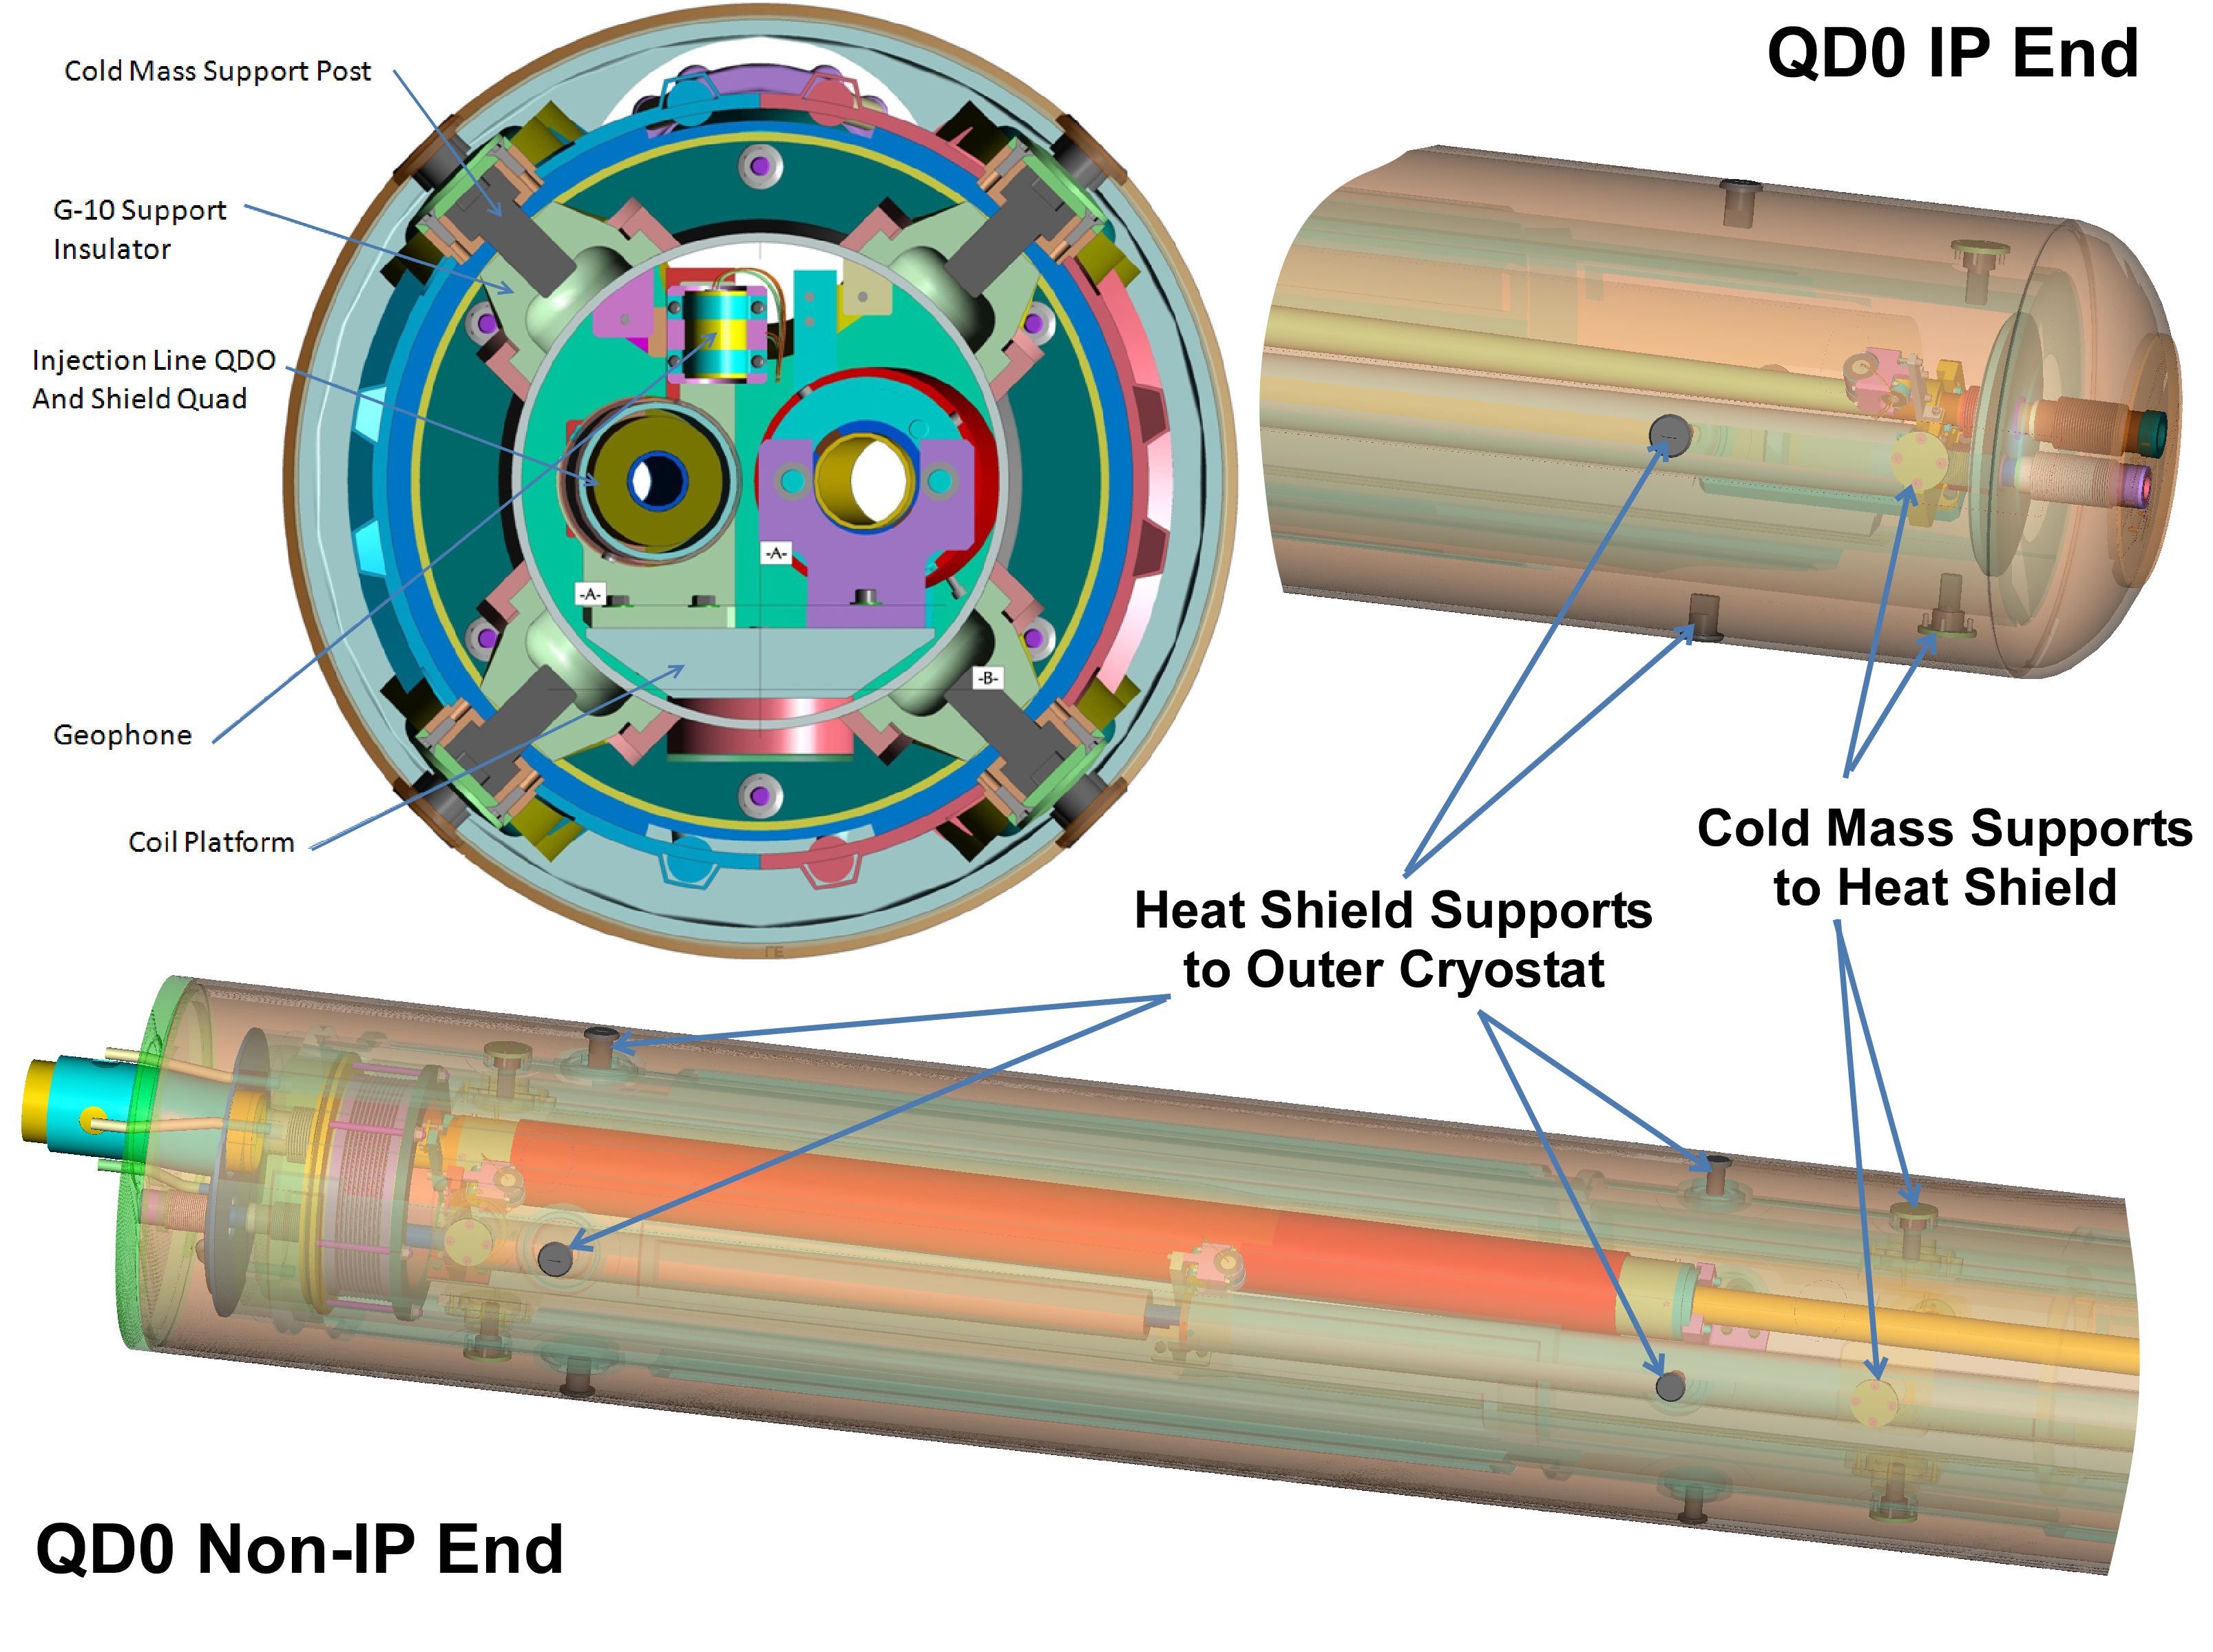
ILC Final Focus Magnets: TDR R&D Review
In order not to have to deal with 40 tons of axial force in the warm-to-cold transition we use a “force neutral” anti-solenoid coil scheme so there is no net force on the cold mass (would take up extra space and add heat load).
Note in the QD0 R&D prototype shown here, even with thin-walled shells, radial space is needed for thermal shield support structure.
Multiple IR magnets are mounted and kept in alignment on rigid sled structure (note geophones).
Use shielded bellows for the beam pipe warm-to-cold transitions (IR magnet beam pipes are cold).
In order to avoid having a large diameter “endcan region,” we need longitudinal space to interface with the cryogenic supply line, magnet leads, etc.
ATRO

Slide 7
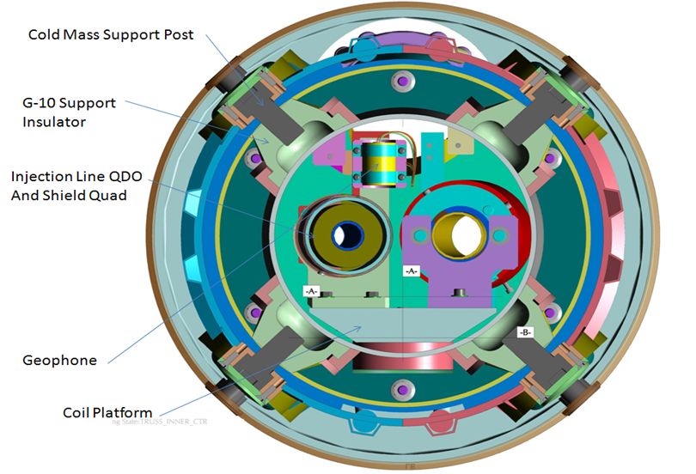
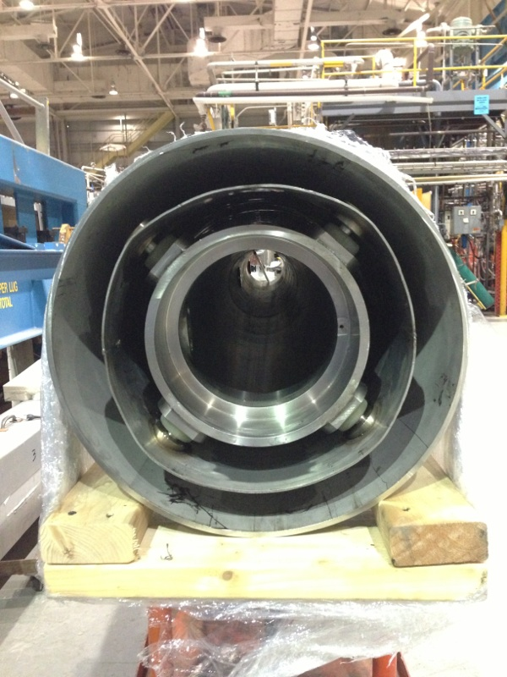
ILC QD0 R&D Magnet Cryostat Review
2014 Status
ILC QD0
The ILC QD0 R&D magnet prototype cryostat is 90% complete and almost ready for insertion of the magnet coils on the “sled assembly.”
Finishing the Magnet Cryostat was given higher priority than making the transfer line parts.
7
ILC QD0 R&D Magnet Cryostat Assembly
ATRO

Slide 8
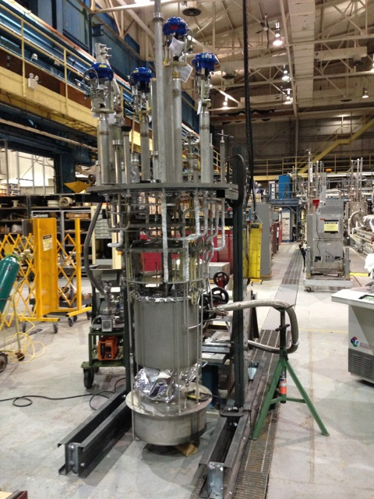
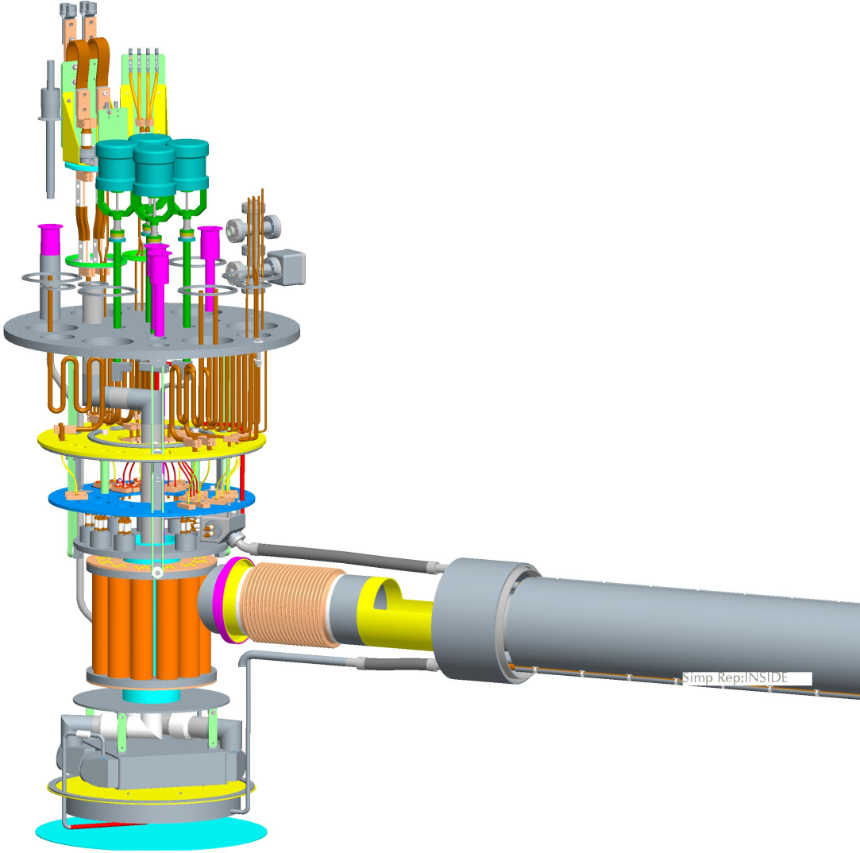
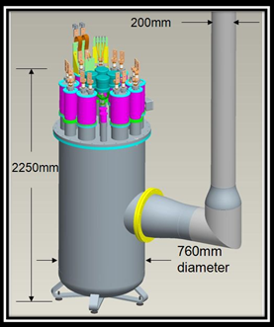
ILC QD0 R&D Service Cryostat Review
Final assembly of the R&D Service Cryostat
was proceeding.
Plan was to test it using a dummy heat load attached to where the transfer line exists.
We wanted to mount
a geophone alongside
the dummy load to characterize
sources of vibration.
Transfer line parts drawings do
exist but all work has remained
stopped due to lack of funding.
2014 Status
ILC Service Cryostat undergoing final leak testing before assembly with outer vessel.
8
ATRO

Slide 9
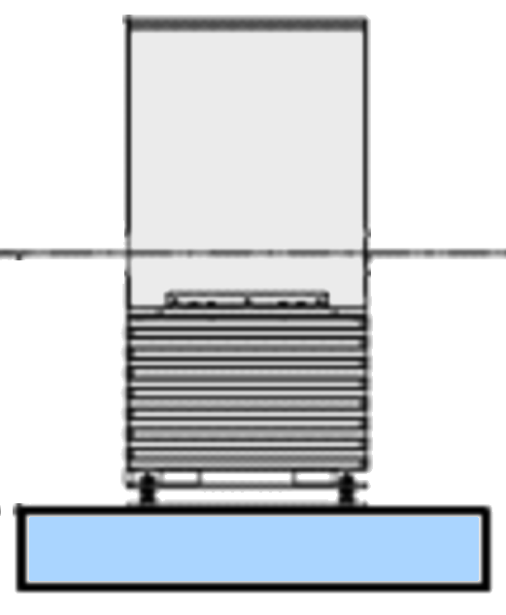
ILC QD0 Prototype R&D: Plan Proposed for IDT EDR
RHIC IR magnets have observable vibration when two-phase liquid helium flows (also observed on test stand via geophones and laser system). For the ILC QD0 we deliberately use 1.9 K superfluid He-II cooling to avoid having cryogens “flow” (cooling via long transfer line is effectively conduction cooling). For the ILC QD0 it is important to test this hypothesis as early as possible.
Laser ports with view to cold mass
BNL has already manufactured most of the parts needed for the QD0 R&D prototype vibration test (need transfer line & cryostat support).
Concept: Measure magnetic center movement via multiturn pickup coil and cross check against internal/external geophones and laser doppler vibrometer looking at cold mass inside the main cryostat.
We will take advantage of SuperKEKB developments (see next slide).
Previous work shows that it is much easier to stabilize a pickup coil with support from both ends (SuperKEKB uses single side support).
Cold and Warm Geophones
X/Y Pickup Coil
Double Sided Active / Passive Isolation Support
QD0 Cryostat
QD0 R&D Prototype Vibration Test Setup
ATRO

Slide 10
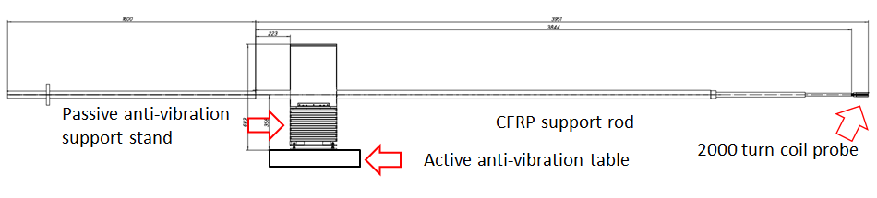
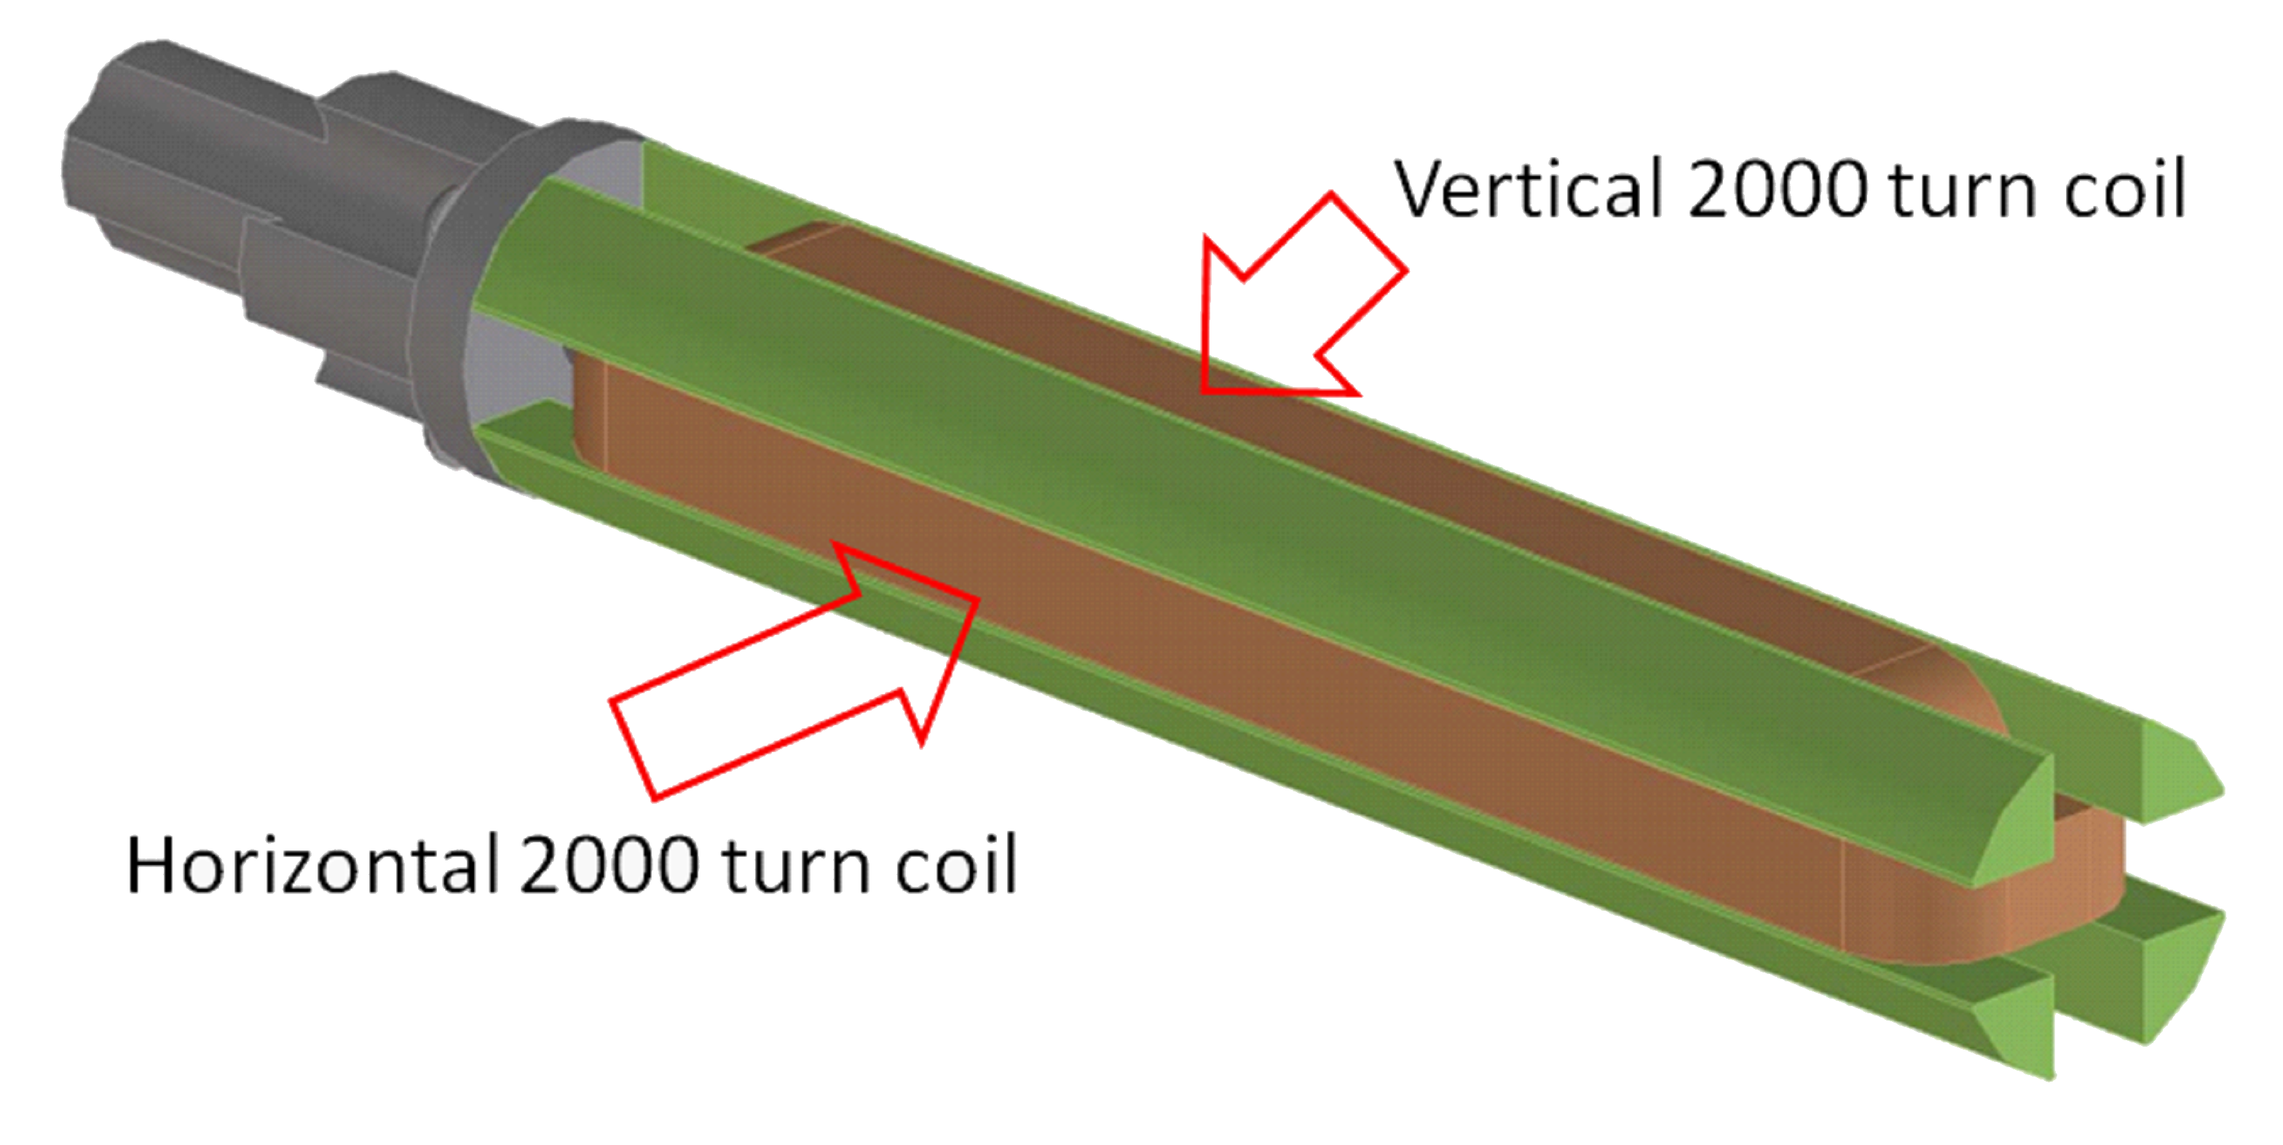
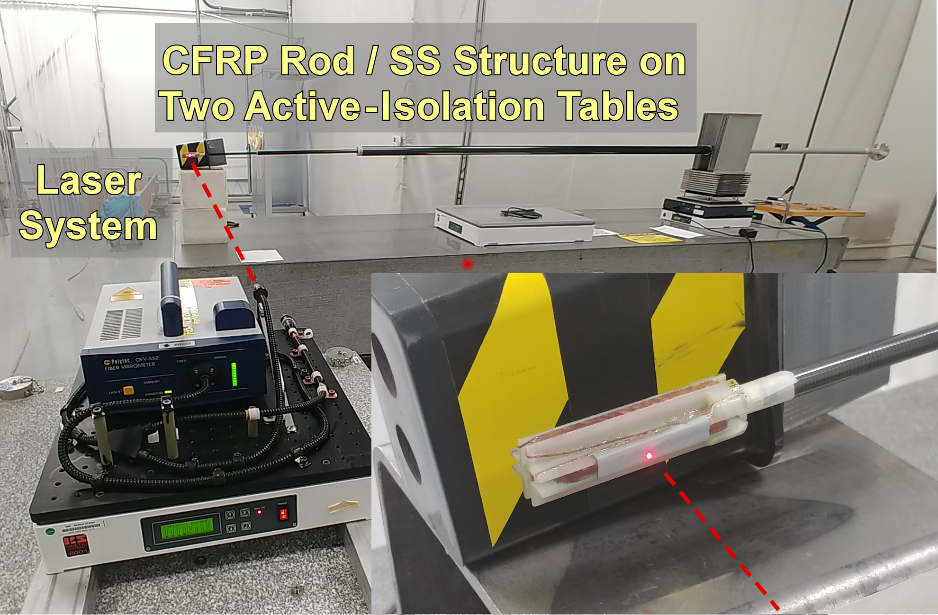
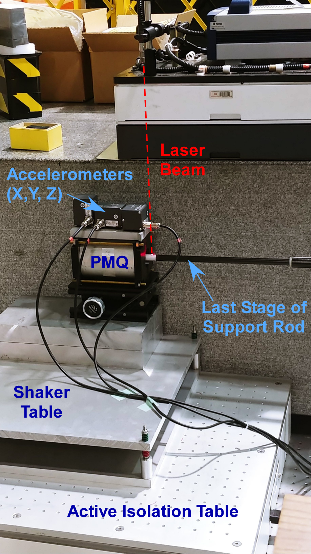
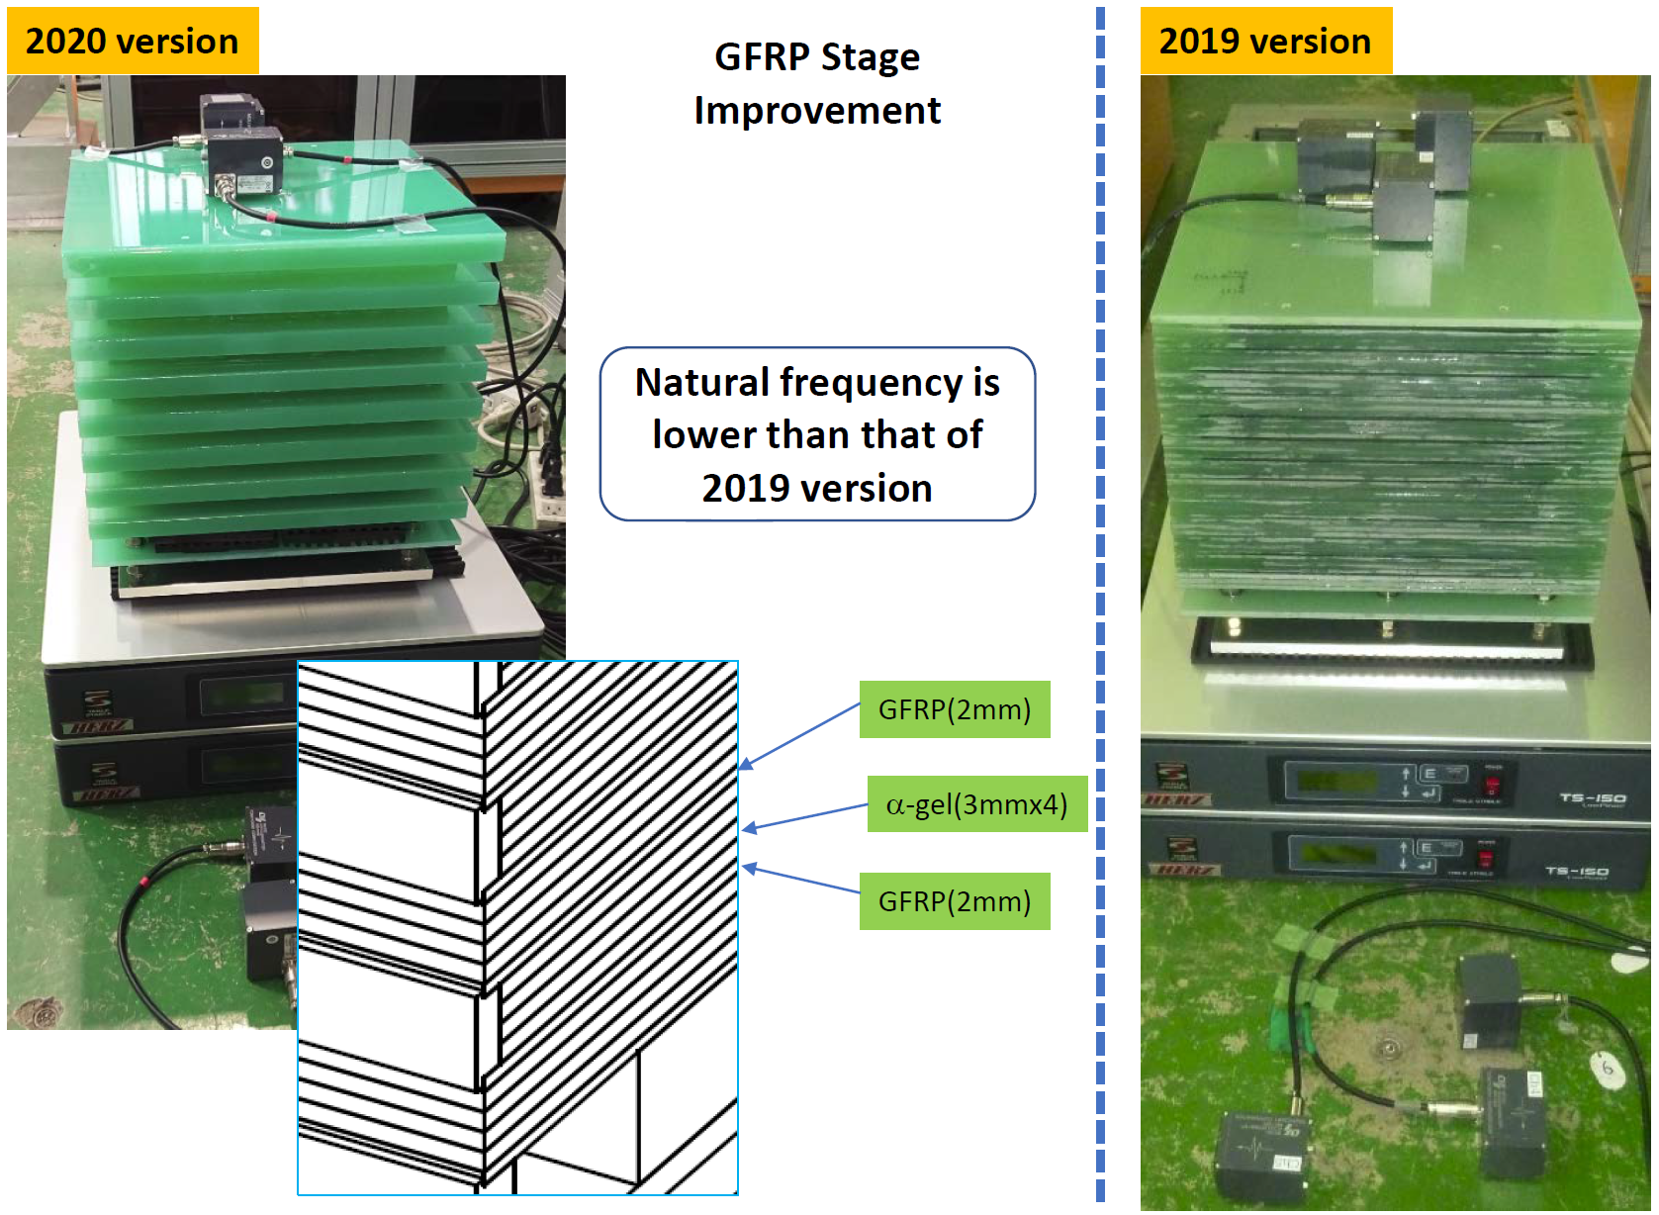
SuperKEKB IR Magnet Vibration Measurement R&D
SuperKEKB IR stability budget is 5 nm integrated motion @10 Hz (ILC QD0 is 50 nm to stay within bunch feedback capture range).
R&D is in progress to measure with 1 nm sensitivity (US/Japan).
Magnetic center change seen as voltage on multiturn probe coil.
But we must stabilize probe coil to measure the real motion.
Use laser for non-contact probe stability measurement and put the probe coil in a PMQ (IR quad stand in) to see voltage signal.
But for IR magnets in Belle-II we only have access from one side and single-sided support is more difficult than double sided support (multiple generations of support improvement).
We are close to few nm probe stability goal and look to measure SuperKEKB IR quads in situ during the summer 2022 shutdown.
ATRO

Slide 11
Topic 2: Some New, Hopefully Interesting, FF Coil Geometries
(7 Slides)
ATRO

Slide 12
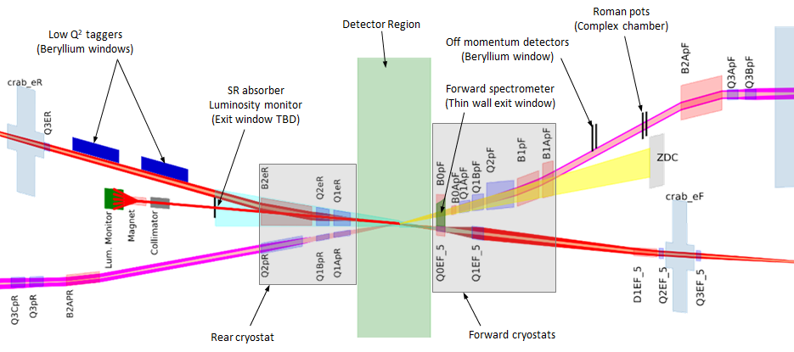
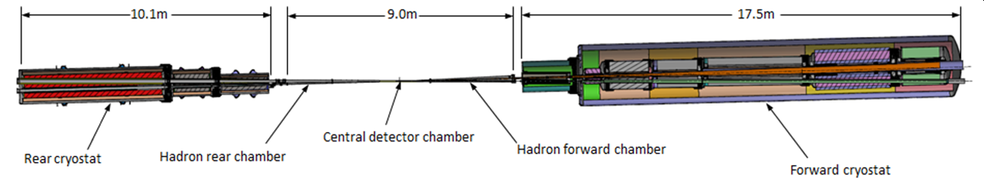
Some Special Magnets for the BNL EIC Final Focus
“Rear Side”
“Forward Side”
The first magnets on the forward side have electron coils inside the main hadron coils with space for detector elements around the hadron beam (spectrometer function).
The first magnets on the rear side have tapered quadrupole coils in order to pass synrad cleanly while leaving space for some yoke material between the beams.
Hadrons
Electrons
Q1ER / Q1APR
B0PF / Q0EF
25 mrad Crossing Angle
ATRO

Slide 13
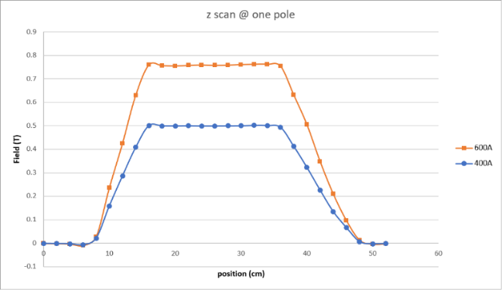
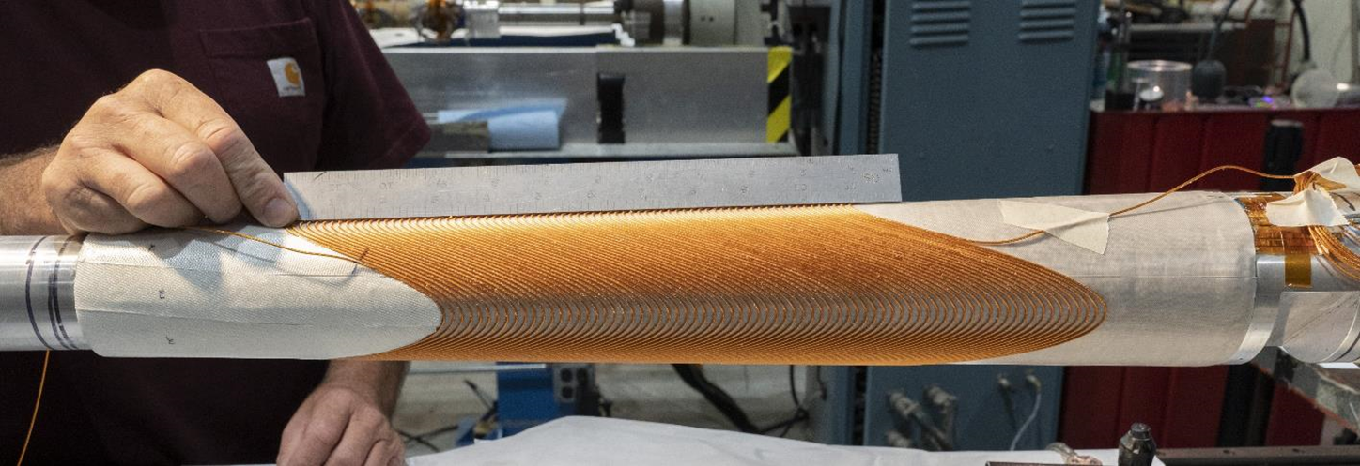
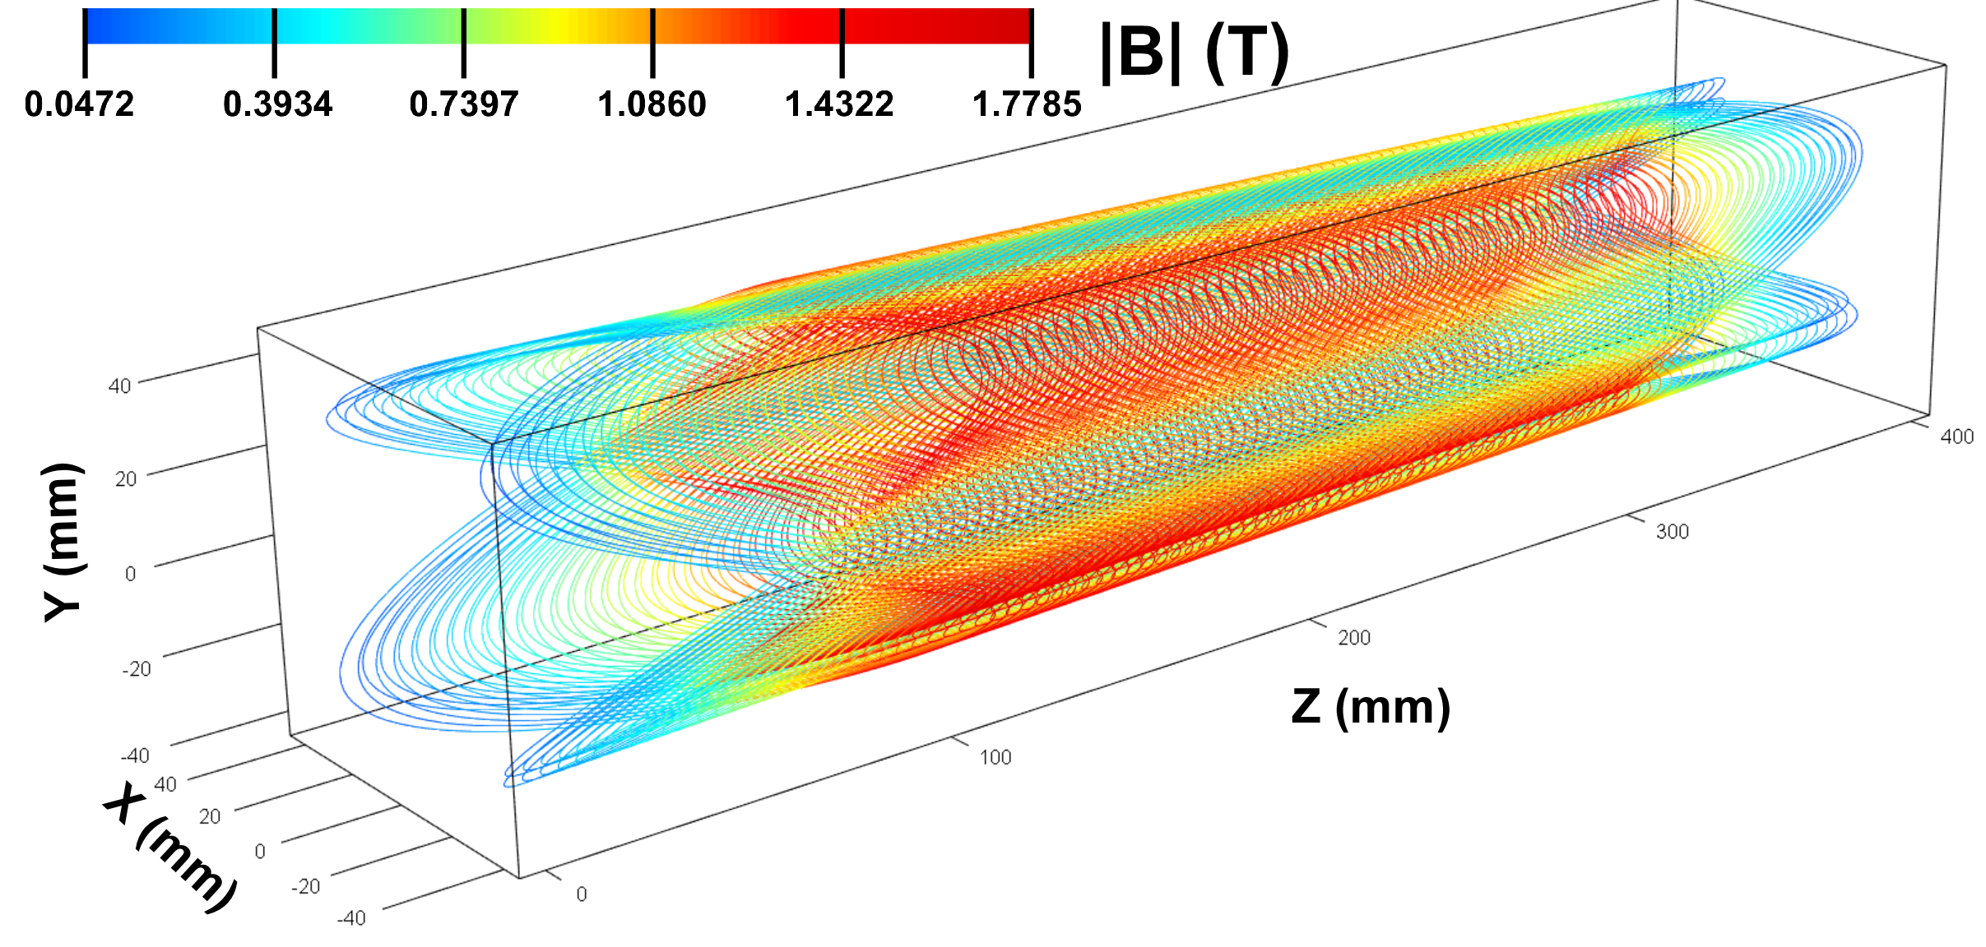
Tapered Constant Gradient Quadrupole R&D for EIC FF
Tapered coils are used for some of the EIC low-β quads that are closest to the IP (Q1APR/Q1ER).
To fit inside limited space, we use Double Helical coils produced via the BNL Direct Wind process (see below).
R&D Test Coil: 4 layers, aperture varies from 60 to 80 mm over its 0.4 m length, gradient is 43 T/m (30-40 mm inner radius).
Although aperture varies, the gradient is maintained constant.
Field Measurements
Tapered Quadrupole – no training, reached 960 A short sample
Calculated Coil Field
H. Witte et.al. http://dx.doi.org/10.1109/TASC.2019.2902982.
ATRO

Slide 14
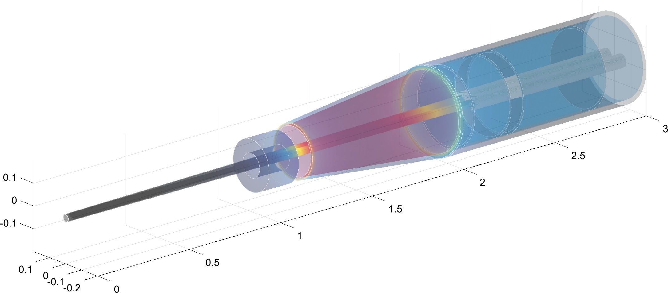
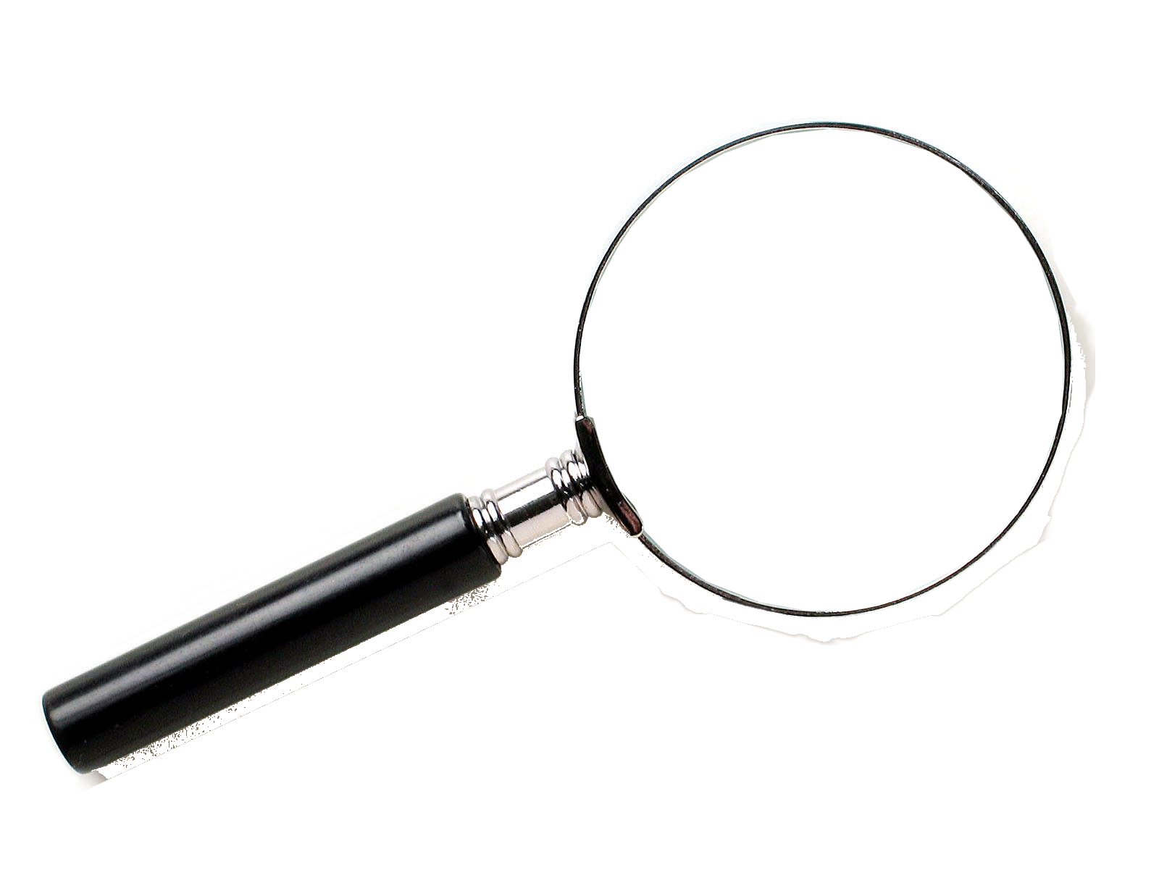
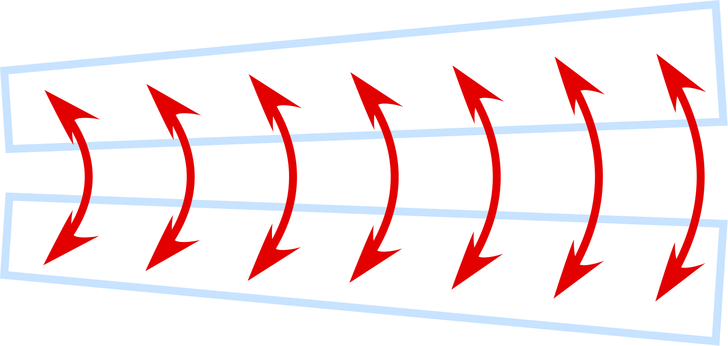
CERN FCC-ee FF Magnets: Double Helical Baseline
screening
solenoid
Challenge: Deal with magnetic crosstalk between the QC1 IR quadrupoles.
Compensating solenoid
QC1
2D-top view with expanded x-coordinate
100 mrad
Compensating solenoid
Lumical
QC1
IP
FCC-ee FF Layout
Be
shielding
Central detector
Lumical
Answer: Use flexible Double Helical coil design to locally adjust QC1 field much like we are doing for the BNL EIC IR.
HOM absorbers
L*=2.2m
L* = 2.2 m distance from IP to first quadrupole, 2 T detector
1.5 cm radius z ± 12.5 cm
Smaller central pipe: 1.0 cm for z ± 9 cm
(with taper starting at z ± 40 cm from IP)
We could use BNL Direct Wind technology to make double helical coils that by design eliminate magnetic cross talk.
ATRO

Slide 15
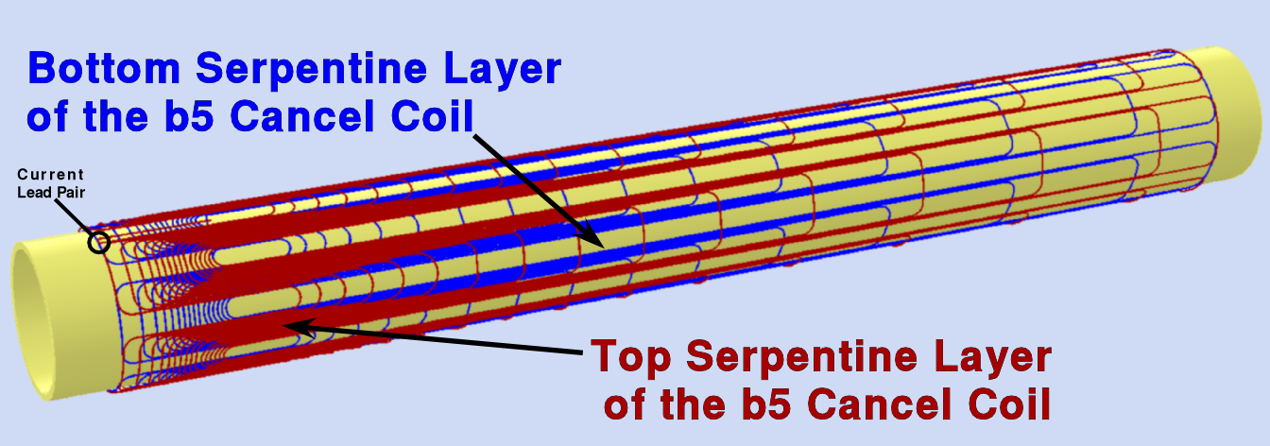
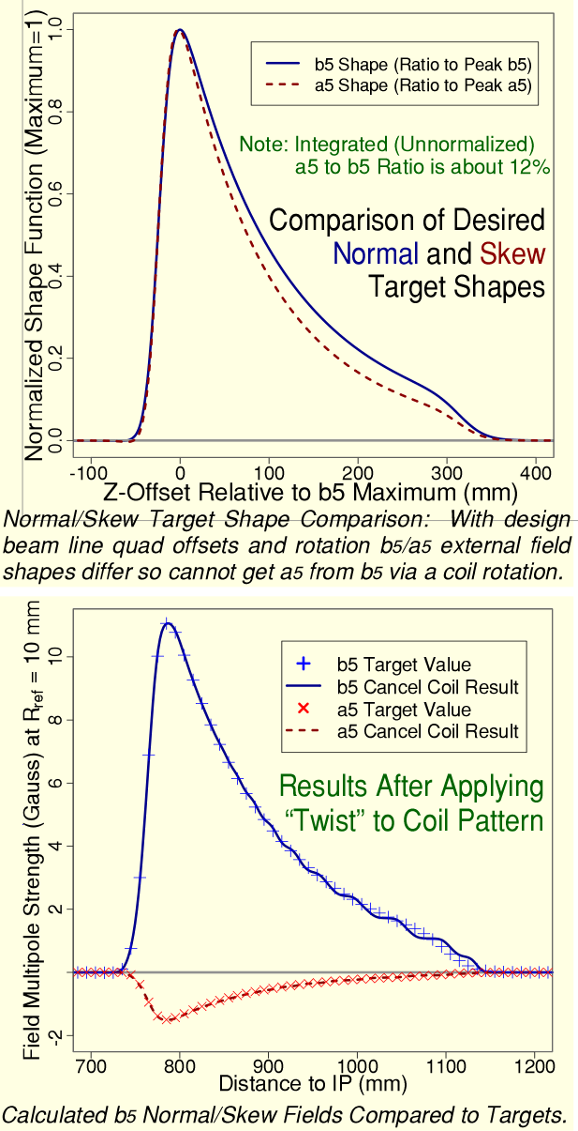
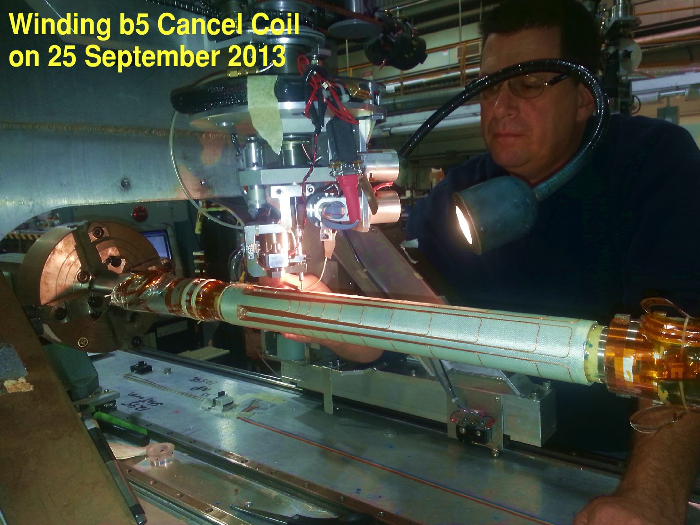
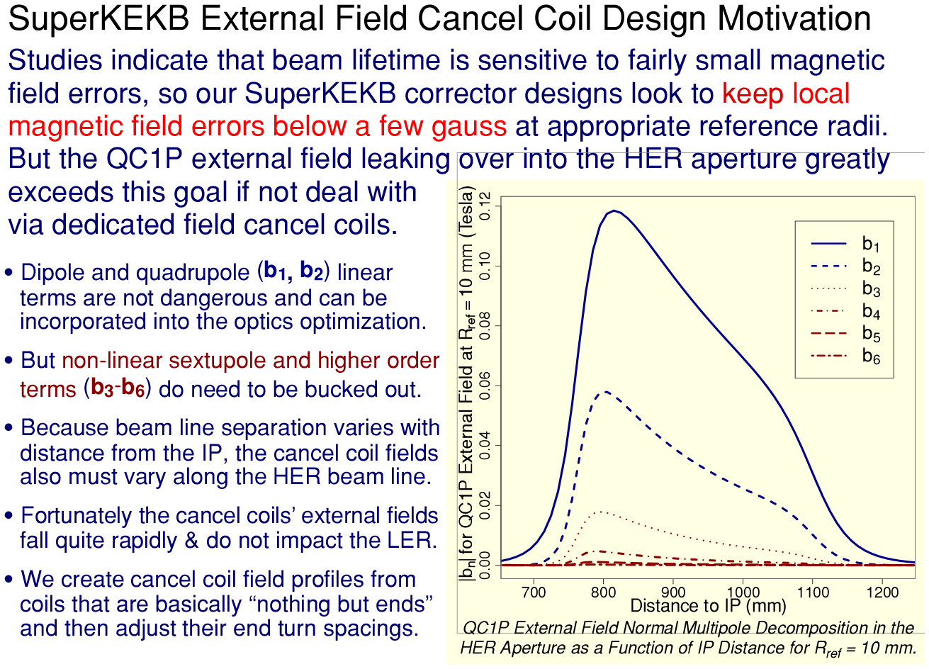
SuperKEKB IR Correctors and External Field Cancel Coils
For external field compensation, the idea was not to cancel the linear (b₁, b₂) field components, but just include there influence during the optics optimization.
The desired non-linear field profiles were then created by “stretching one Serpentine coil’s end” (now can use dual helical).
Final results for the field profile were actually very good!
15
ATRO

Slide 16
Consider This Simple Coil Layout Thought Experiment…
Quadrupole and Dipole Coils (powered in series)
Overlay a dipole coil with field, B_{o}, and a second quadrupole coil that has gradient , G_{o}.
Define the distance, X_{o} = B_{o}/G_{o}
Then B(-X_{o})= 0 and B(X_{o})= 2B_{o}
Thus, if QD0 is centered at the B=0 field point of the combined dipole and quadrupole coils, we can create an arbitrary field at some point outside QD0 without shifting QD0’s field center.
QD0
-X_{o}
X_{o}
By=2B_{o}
By=0
ATRO

Slide 17
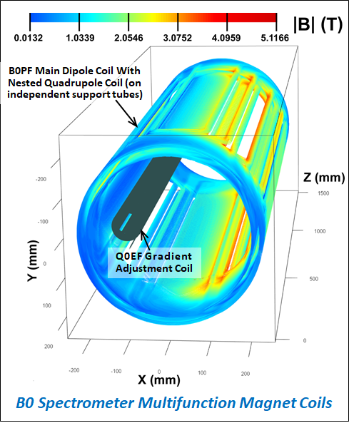
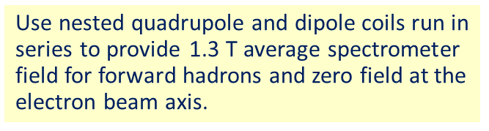
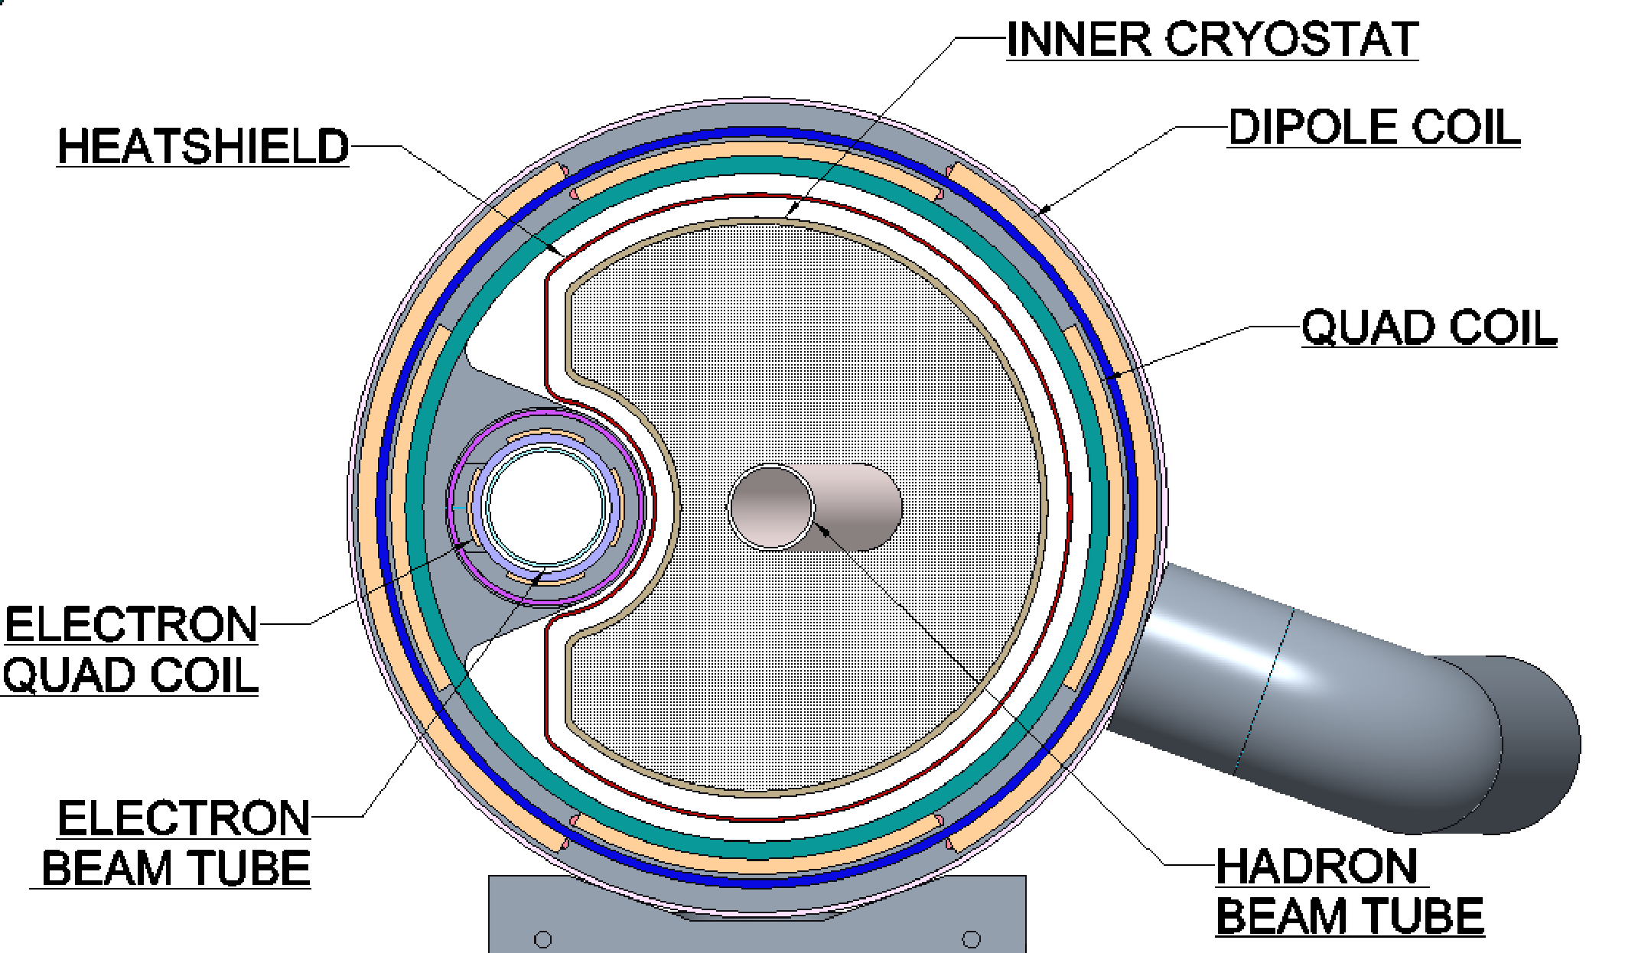
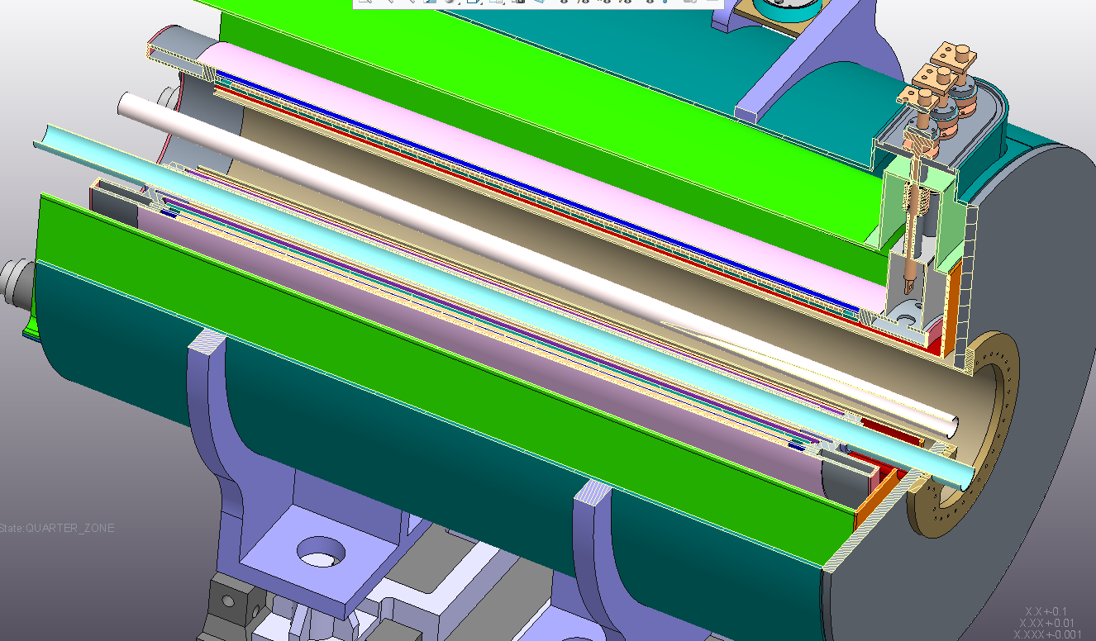
Sweet Spot Example: EIC B0 Spectrometer Magnet
Warm space available for physics detectors†
Challenge is to have warm space for physics detectors with magnetic field very close to the first electron IR quad.
Answer is to put the electron quad at a zero-field axis in the hadron combined function magnet.
Hadron Beam
Hadron coils give some focusing gradient but zero dipole field at the electron beam axis.
However, the hadron and electron beam energies must be separately adjustable to explore different kinematic regions…
Thus, we provide an electron quadrupole field adjustment coil.
Note: All coils are aligned parallel to the electron beam, so the hadron beam crosses B0 with the full 25 mrad crossing angle.
Electron Beam
†Q0EF physically covers some of the forward physics acceptance between the electron and hadron beams.
ATRO

Slide 18
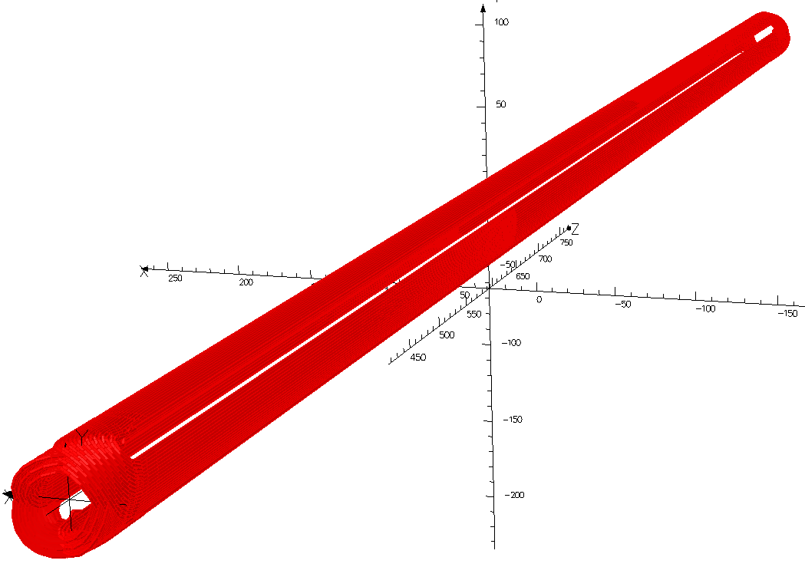
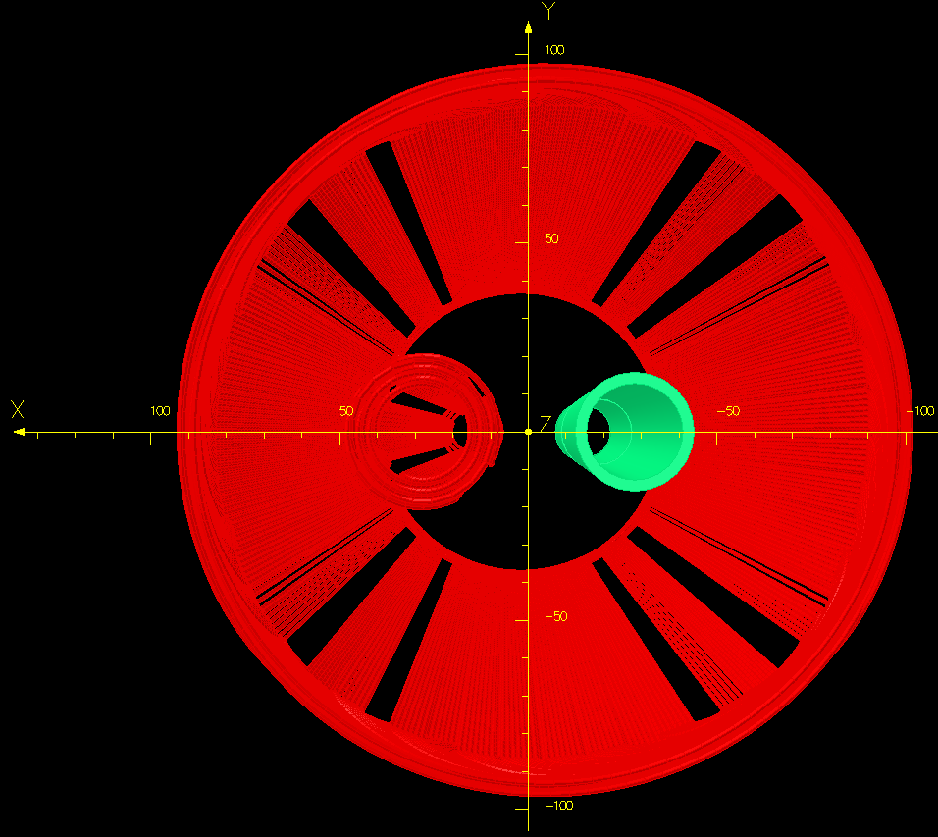
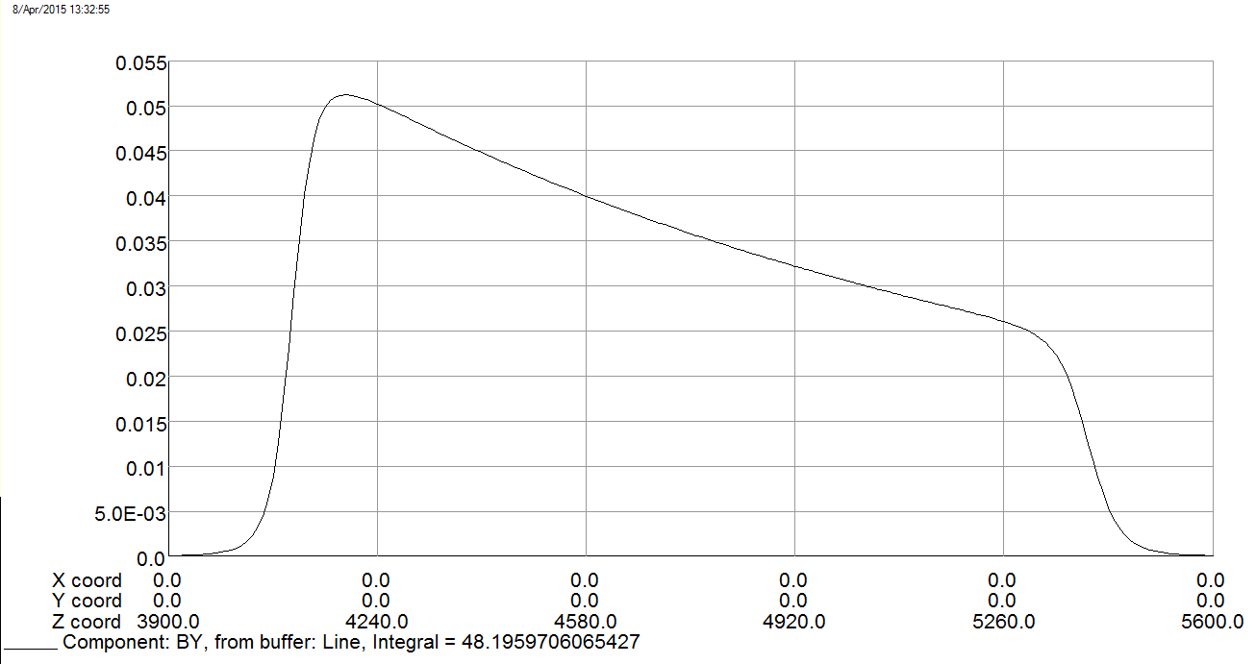
A Sweet Spot Coil Concept for QD0
Sweet Spot Coil
This previous design could be improved by using a double helical Sweet Spot coil.
QD0
ILC Layout has 14 mrad Total Crossing Angle
By (T) at Extracted Beam Position
QD0 External Field
Extraction
Beam Line
L*=4.1 m
Our Sweet Spot coil layout is compatible with smaller anti-solenoid radius to reduce the space needed for QD0 cryostat inside the detector.
This sweet spot coil has dipole and quad windings, offset but parallel to QD0, that are powered in series such that their fields cancel at QD0 and add at the extraction beam line.
X, Y, Z (mm)
ATRO

Slide 19
Summary: Developments in Superconducting FF Technology
Within the context of International Design Team activities for the ILC in Japan preEDR, we look to restart our previous QD0 prototype vibration measurement testing to see if using 1.9K superfluid helium cooling really is helpful for avoiding inducing cold mass vibration.
There has been considerable recent progress in developing tailored-field coil geometries for application to the SuperKEKB, EIC, ILC and FCC-ee colliders.
I hope to have convinced you that there is a bright future focusing nanobeams via superconducting magnets.
Thank you for your attention.
ATRO

