Slide 1
Non-invasive beam measurement using polarization radiation
Pavel Karataev
John Adams Institute for Accelerator Science at Royal Holloway, University of London

Slide 2









On Behalf of the Collaboration
D. Alves ¹, A. Aryshev⁶, M. Bergamaschi¹, M. Billing⁵,
L. Bobb⁷, J. Conway⁵, A, Curcio¹, C. Davut⁹, K. Fedorov². J. Gardelle⁴,
S.Y. Gogolev³, D. Harryman², R.O. Jones¹, R. Kieffer¹,
P. Karataev², I. Kishchin⁸, A. Kubankin⁸, K. Lasocha¹, T. Lefevre¹, S. Mazzoni¹, N. Mounet¹, R. Nazhmudinov⁸, Y.Padilla Fuentes⁵, A.P. Potylitsyn³, E. Senes¹, J. Shanks⁵, D.A. Shkitov³, N.Terunuma⁶,
G. Xia⁹
CERN, Geneva, Switzerland
John Adams Institute at RHUL, University of London, Egham, UK
Tomsk Polytechnic University, Tomsk, Russia
CEA, France
Cornell University, Ithaca, USA
KEK, High energy Accelerator Organization, Japan
Diamond Light Source, Oxfordshire, UK
Belgorod National Research University, Belgorod, Russia
Cockroft Institute at University of Manchester, Manchester, UK

Slide 3
What is Polarization Radiation?
e ⁻
a fast charged particle passes by creating a dipole;
the dipole oscillates around the nucleus emitting EM radiation;
depending on the target composition and geometry, this mechanism is responsible for the entire family of polarization radiation

Slide 4
Polarization Radiation Family
Transition Radiation
Diffraction Radiation
Smith-Purcell Radiation
Cherenkov Radiation
Cherenkov Diffraction Radiation
Parametric X-ray Radiation
Wakefield radiation

Slide 5

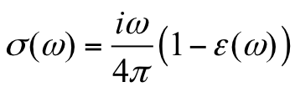
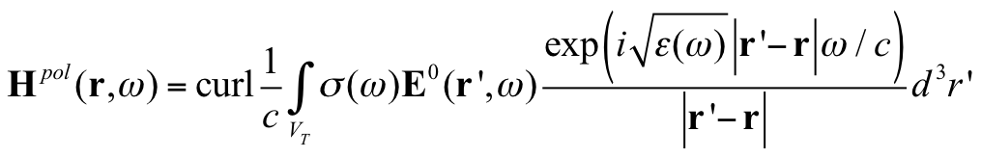
Polarization Current Approach (PCA)
The theoretical approach is based on the method of polarization currents. For a non-magnetic medium the density of the polarization currents in the right-hand side of Maxwell equations
where conductivity is
The field of the Polarization Radiation (PR) emitted by medium atoms excited (polarized) by the external field of the passing particle moving rectilinearly and with constant velocity in a substance (or in its vicinity) can be represented as a solution of Maxwell equations

Slide 6
Two mechanisms we concentrate on
Transition Radiation
Diffraction Radiation
Smith-Purcell Radiation
Cherenkov Radiation
Cherenkov Diffraction Radiation
Parametric X-ray Radiation
Wakefield radiation

Slide 7
Two mechanisms we concentrate on
Transition Radiation
Diffraction Radiation
Smith-Purcell Radiation
Cherenkov Radiation
Cherenkov Diffraction Radiation
Parametric X-ray Radiation
Wakefield radiation

Slide 8
Diffraction Radiation
T. Muto, et al., Observation of incoherent diffraction radiation from a single edge target in the visible light region, Physical Review Letters, 90 (10), p. 104801 , 2003

Slide 9
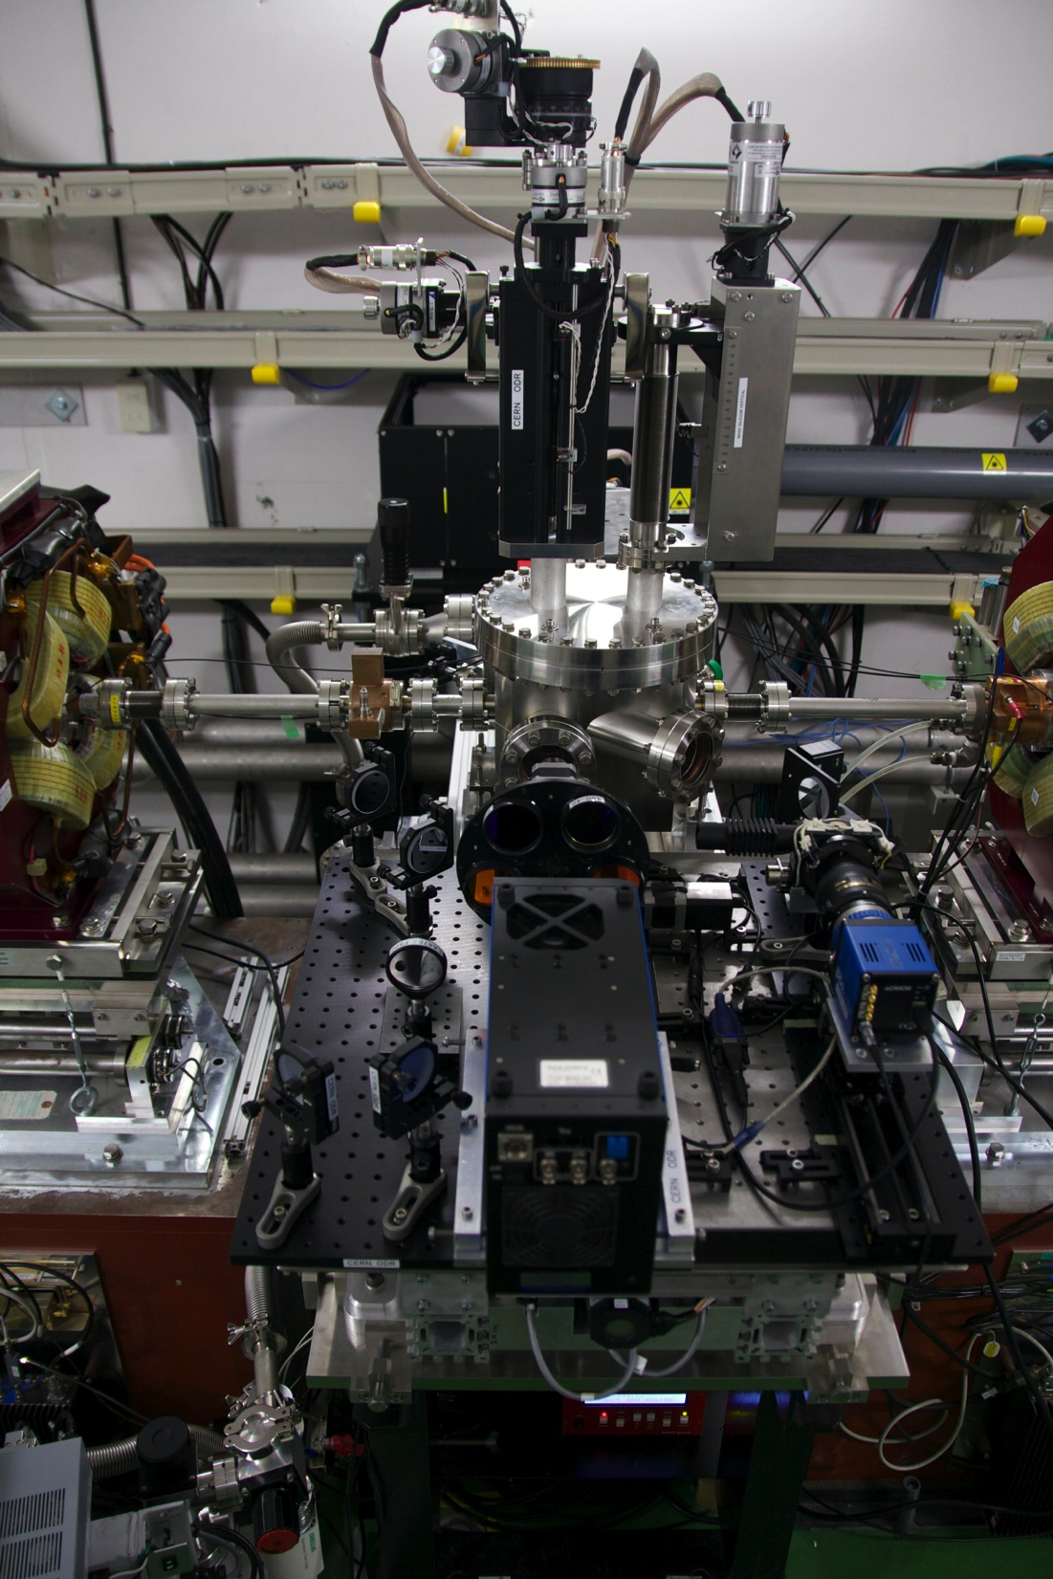
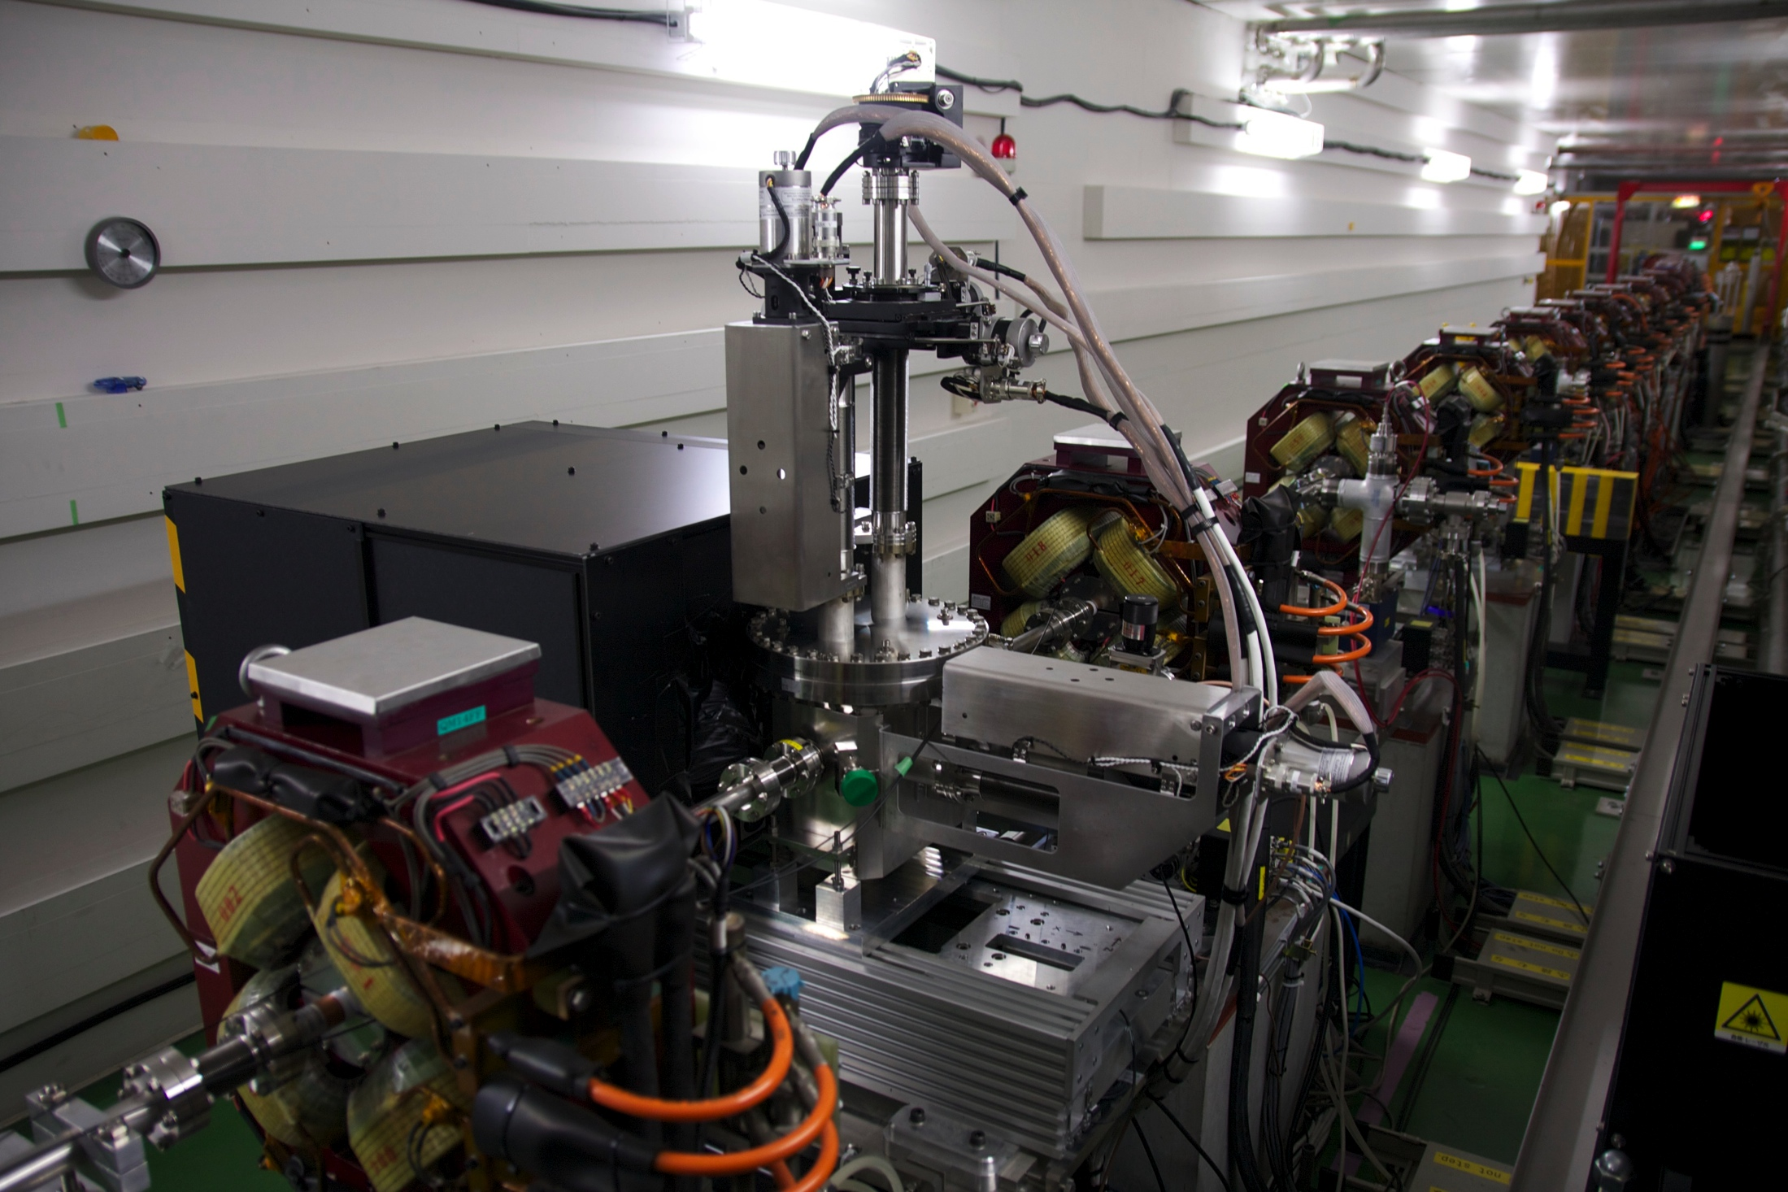
ODR experiment at KEK-ATF2 facility
The tank is installed at the virtual interaction point of ATF2 vertical beam can be focused to < 1um .

Slide 10
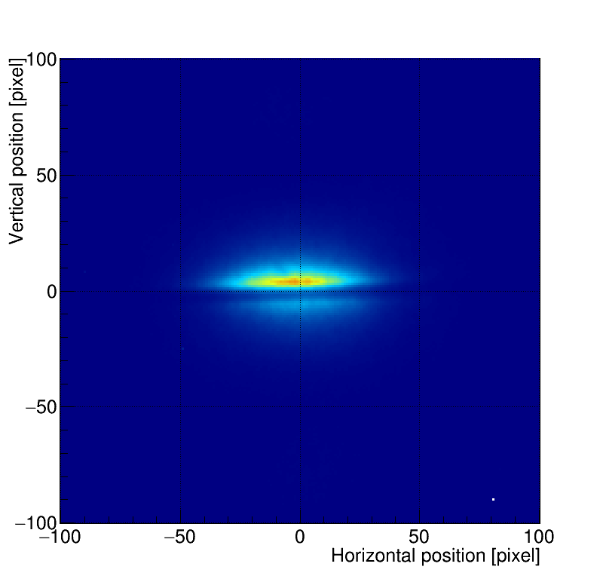
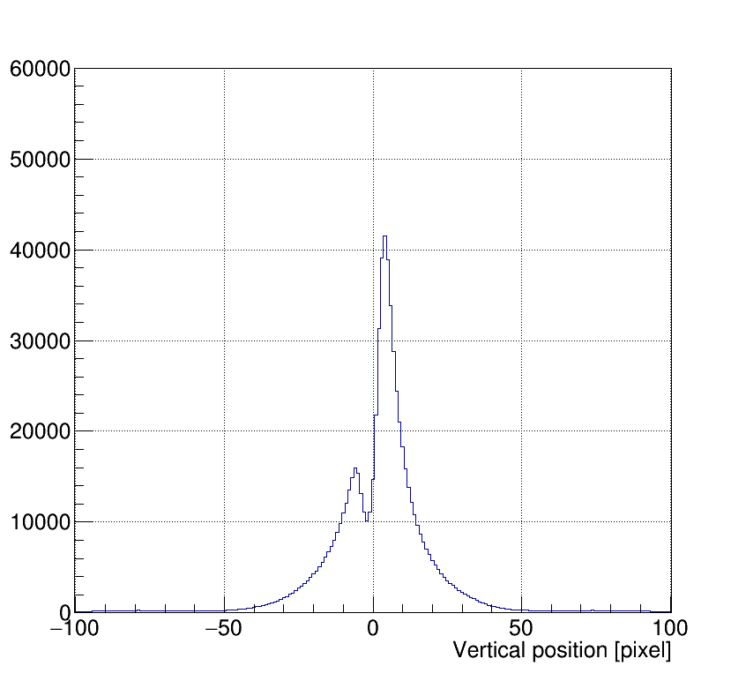
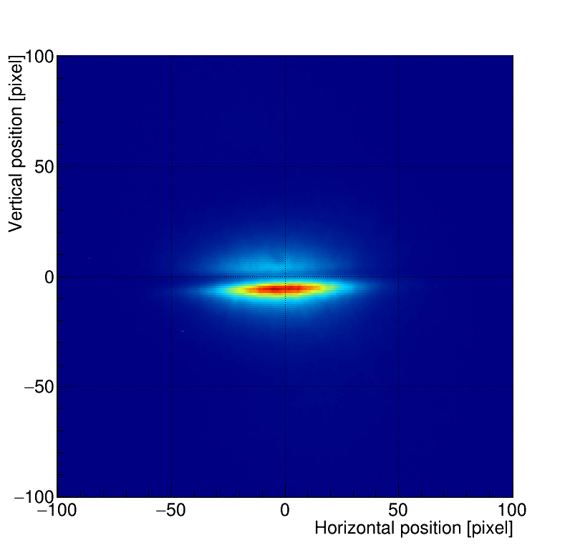
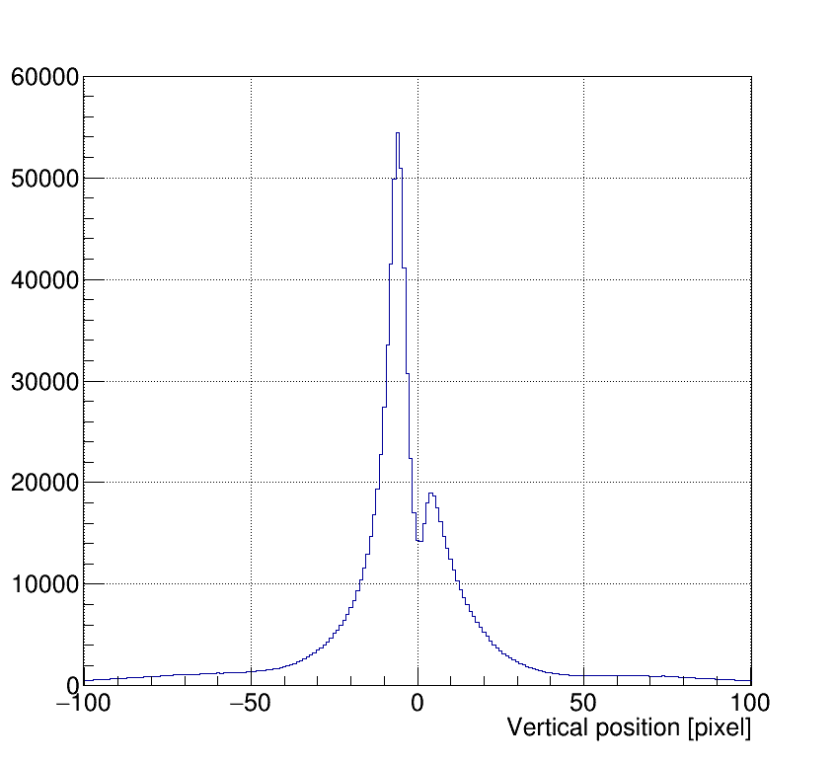
ODR imaging as an Optical BPM
There is no visible beam size dependency off the pattern in imaging.
But the vertical position into the slit change the profile asymmetry => Optical Beam Position Monitor (BPM)
Offset
KEK-ATF2 beam
Averaging 100 shots
R. Kieffer, et al., Optical diffraction radiation for position monitoring of charged particle beams, NIMB 402 (2017) 88-91

Slide 11
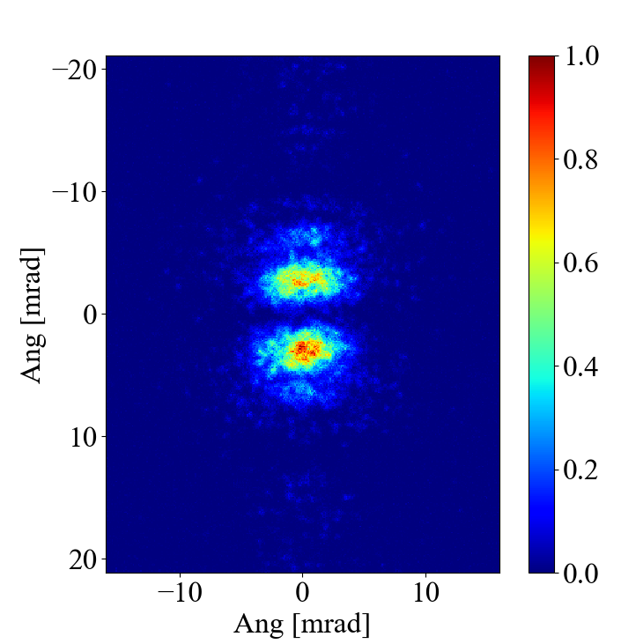
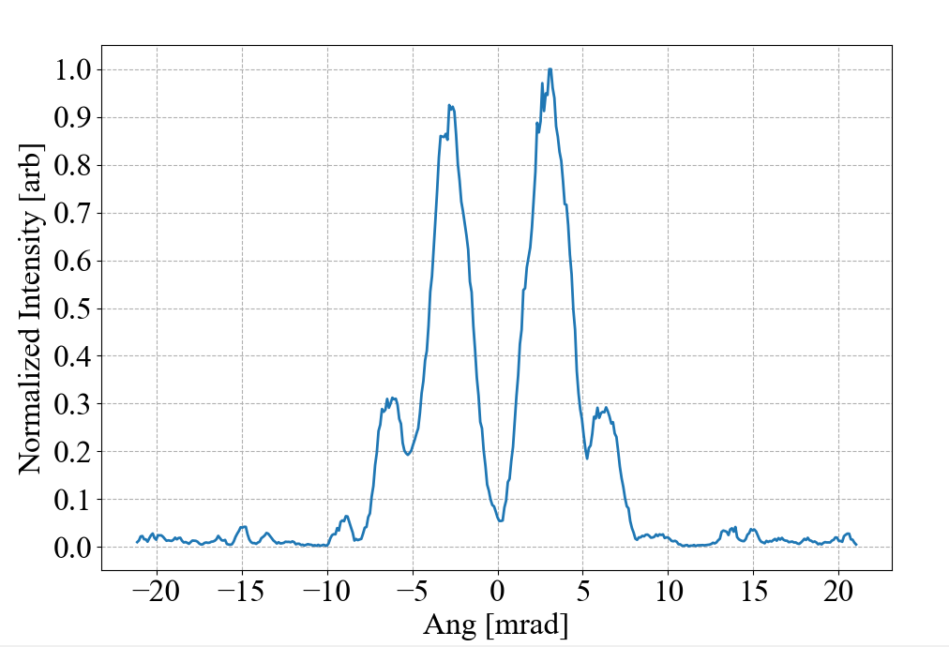
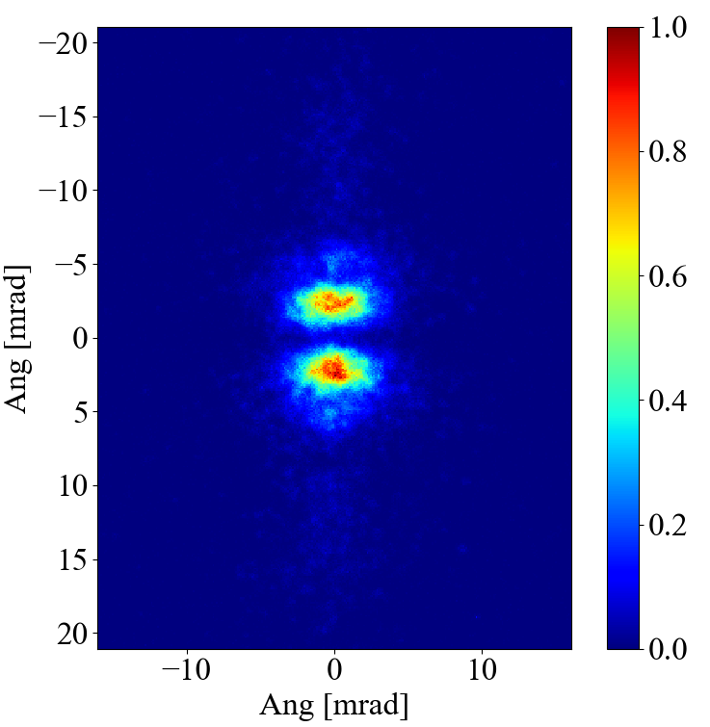
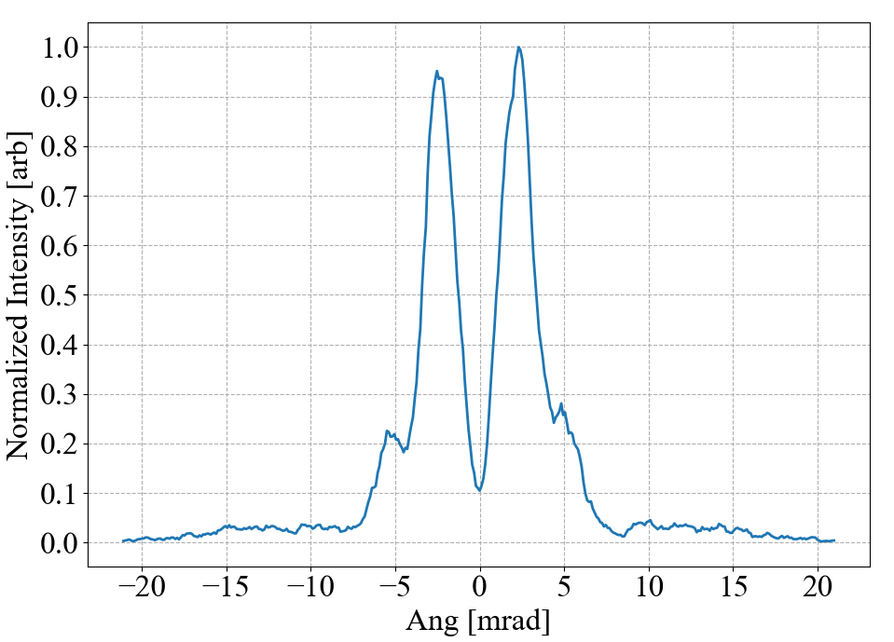
ODR angular distribution
400nm
400nm
250nm
250nm

Slide 12
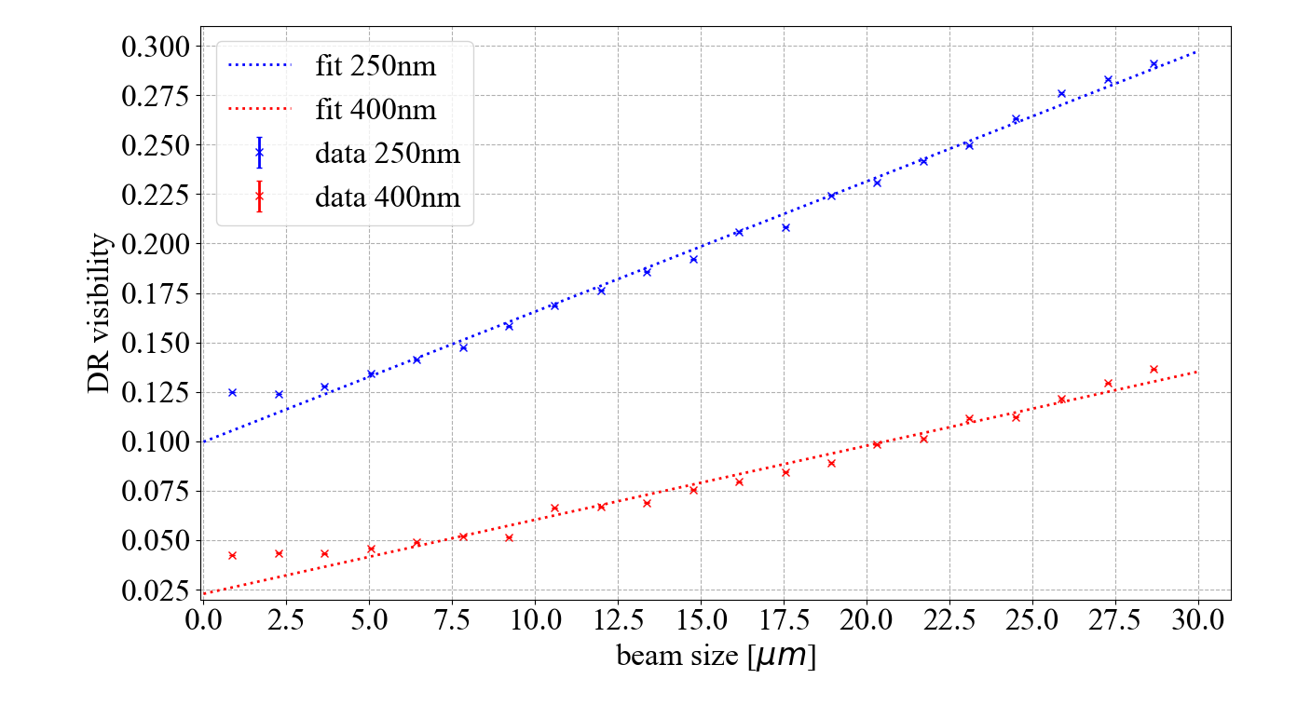
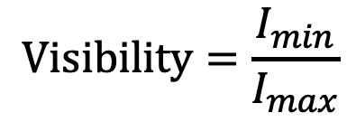
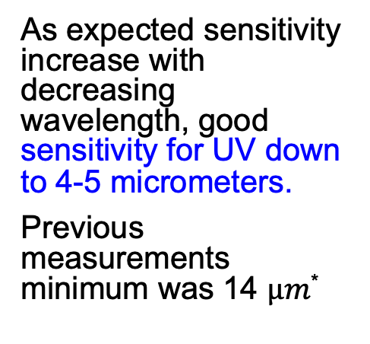
Visibility vs beam size measured with OTR
$$\text{target} =49.7 µm$$
As expected sensitivity increase with decreasing wavelength, good sensitivity for UV down to 4-5 micrometers.
Previous measurements minimum was 14 $µm\text{*}$
$$\text{Visibility}=\frac{I_{min}}{I_{max}}$$
M. Bergamaschi, et al., Non-invasive micron-scale particle beam size measurement using Optical Diffraction Radiation in the ultra violet wavelength range, Physical Review Applied 13, 014041 (2020)
*P. Karataev, et al., Beam-Size Measurement with Optical Diffraction Radiation at KEK Accelerator Test Facility, Physical Review Letters 93 (2004) 244802.

Slide 13
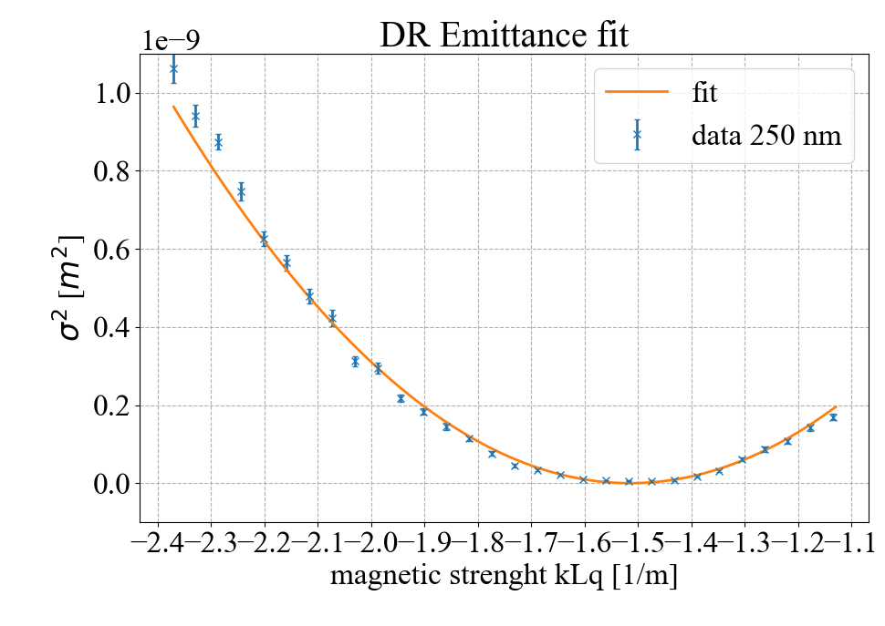
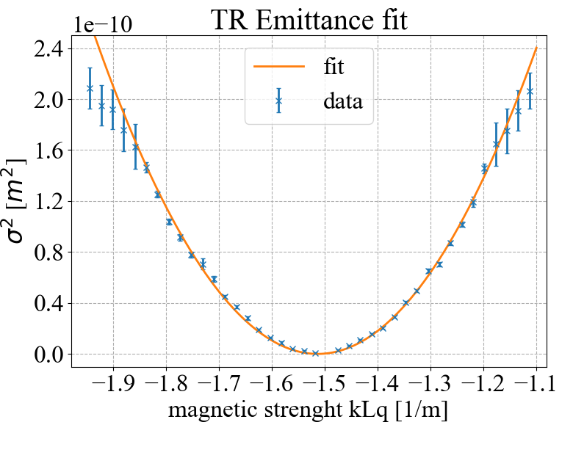
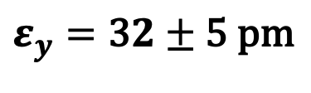
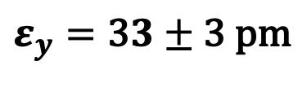
Vertical Emittance measurements
$$ε_{y}=\text{3}2±\text{5} \text{pm}$$
$$ε_{y}=\text{3}3±\text{3 }\text{pm}$$
Good agreement with simulated SAD emittance
Optical background creates difficulties
The slit is very small

Slide 14
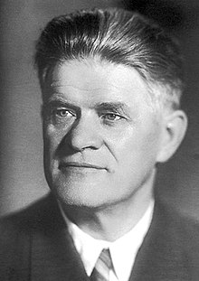
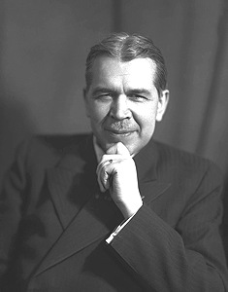
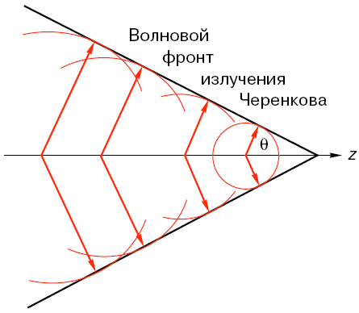
Vavilov-Cherenkov Radiation
First observation in 1934
Nobel prize in 1958
Pavel Cherenkov
Sergey Vavilov
Cherenkov Radiation is generated whenever the charged particle velocity is larger than the phase velocity of light
R(t)
O
z(t)

Slide 15
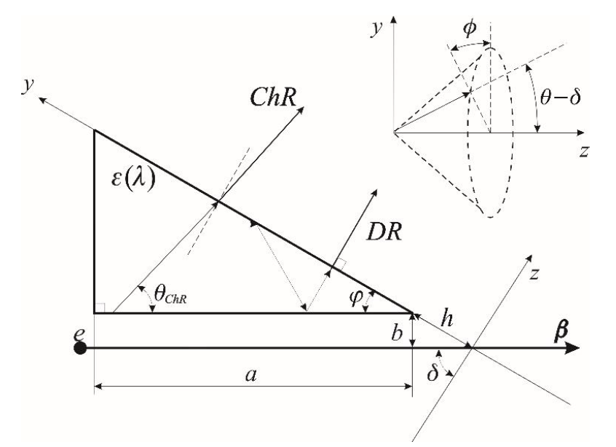
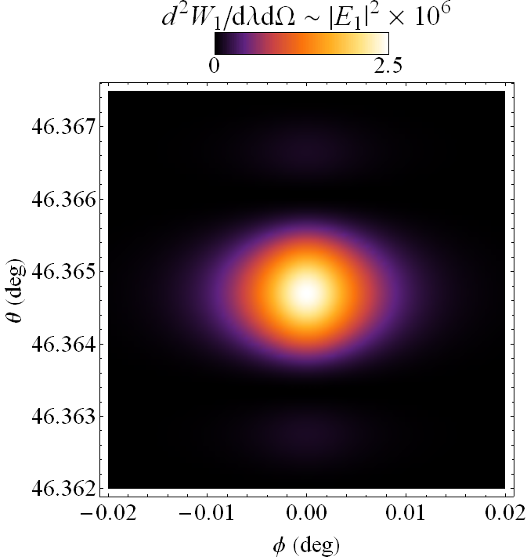
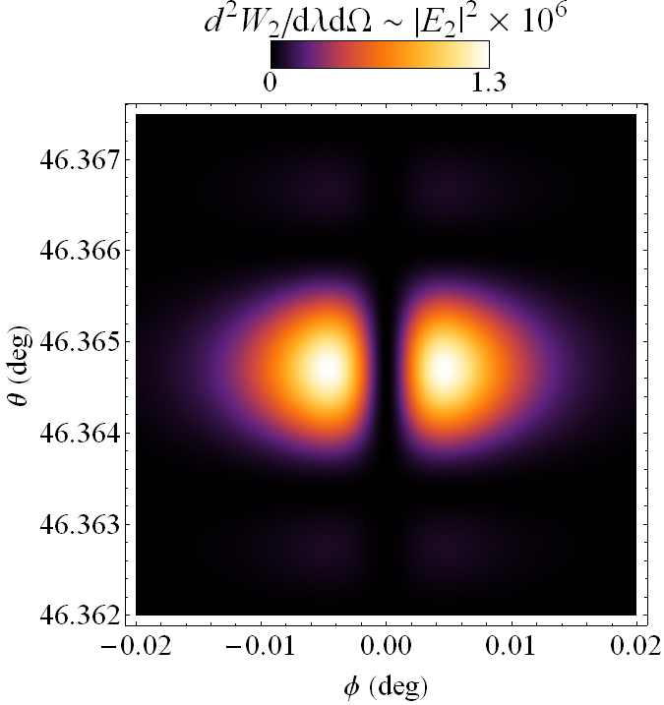
Cherenkov Diffraction Radiation
gamma = 10⁴, λ = 600 nm, b = 0.8 mm, a = 11.5 mm
Vertical polarization
Horizontal polarization

Slide 16
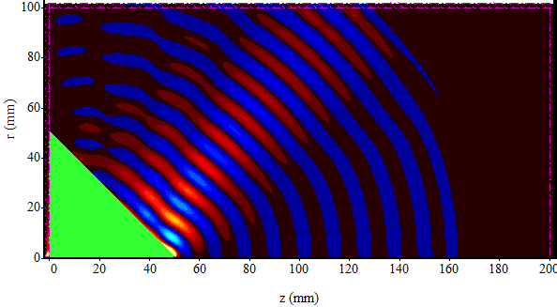
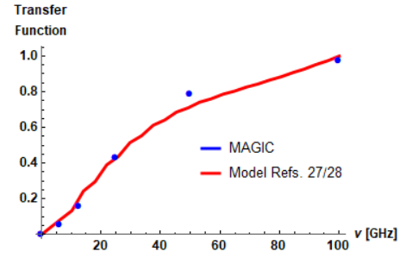
Simulations with ‘Magic’ code
Using MAGIC and an electron beam current modulated at a 25GHz propagating at the vicinity of a Teflon cone
d = 10 cm
ε = 2.1
ε = 5
A. Curcio, et al., Noninvasive bunch length measurements exploiting Cherenkov diffraction radiation, Phys. Rev. AB 23, 022802 (2020)
PCA model

Slide 17
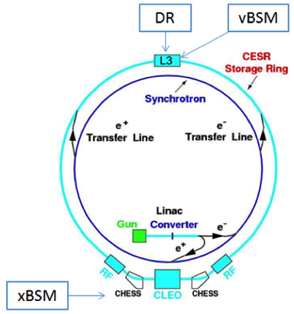
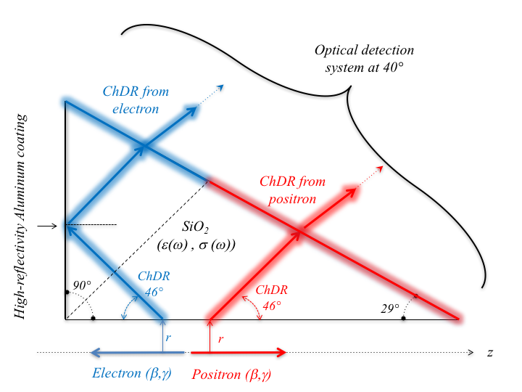
Optical/IR ChDR experiment at Cornell
ChDR
Using a 2cm long SiO₂ (n=1.46) ChDR target
L
CESR Ring Circumference | 768.4m
Revolution Time | 2.563 μs
Beam Energy | 2.1 and 5.3GeV
Beam Species | e⁻ and e⁺
Particles per bunch | 1.6 10¹⁰
R. Kieffer et al., “Direct Observation of Incoherent Cherenkov Diffraction Radiation in the Visible Range”, PRL 121 (2018) 054802

Slide 18
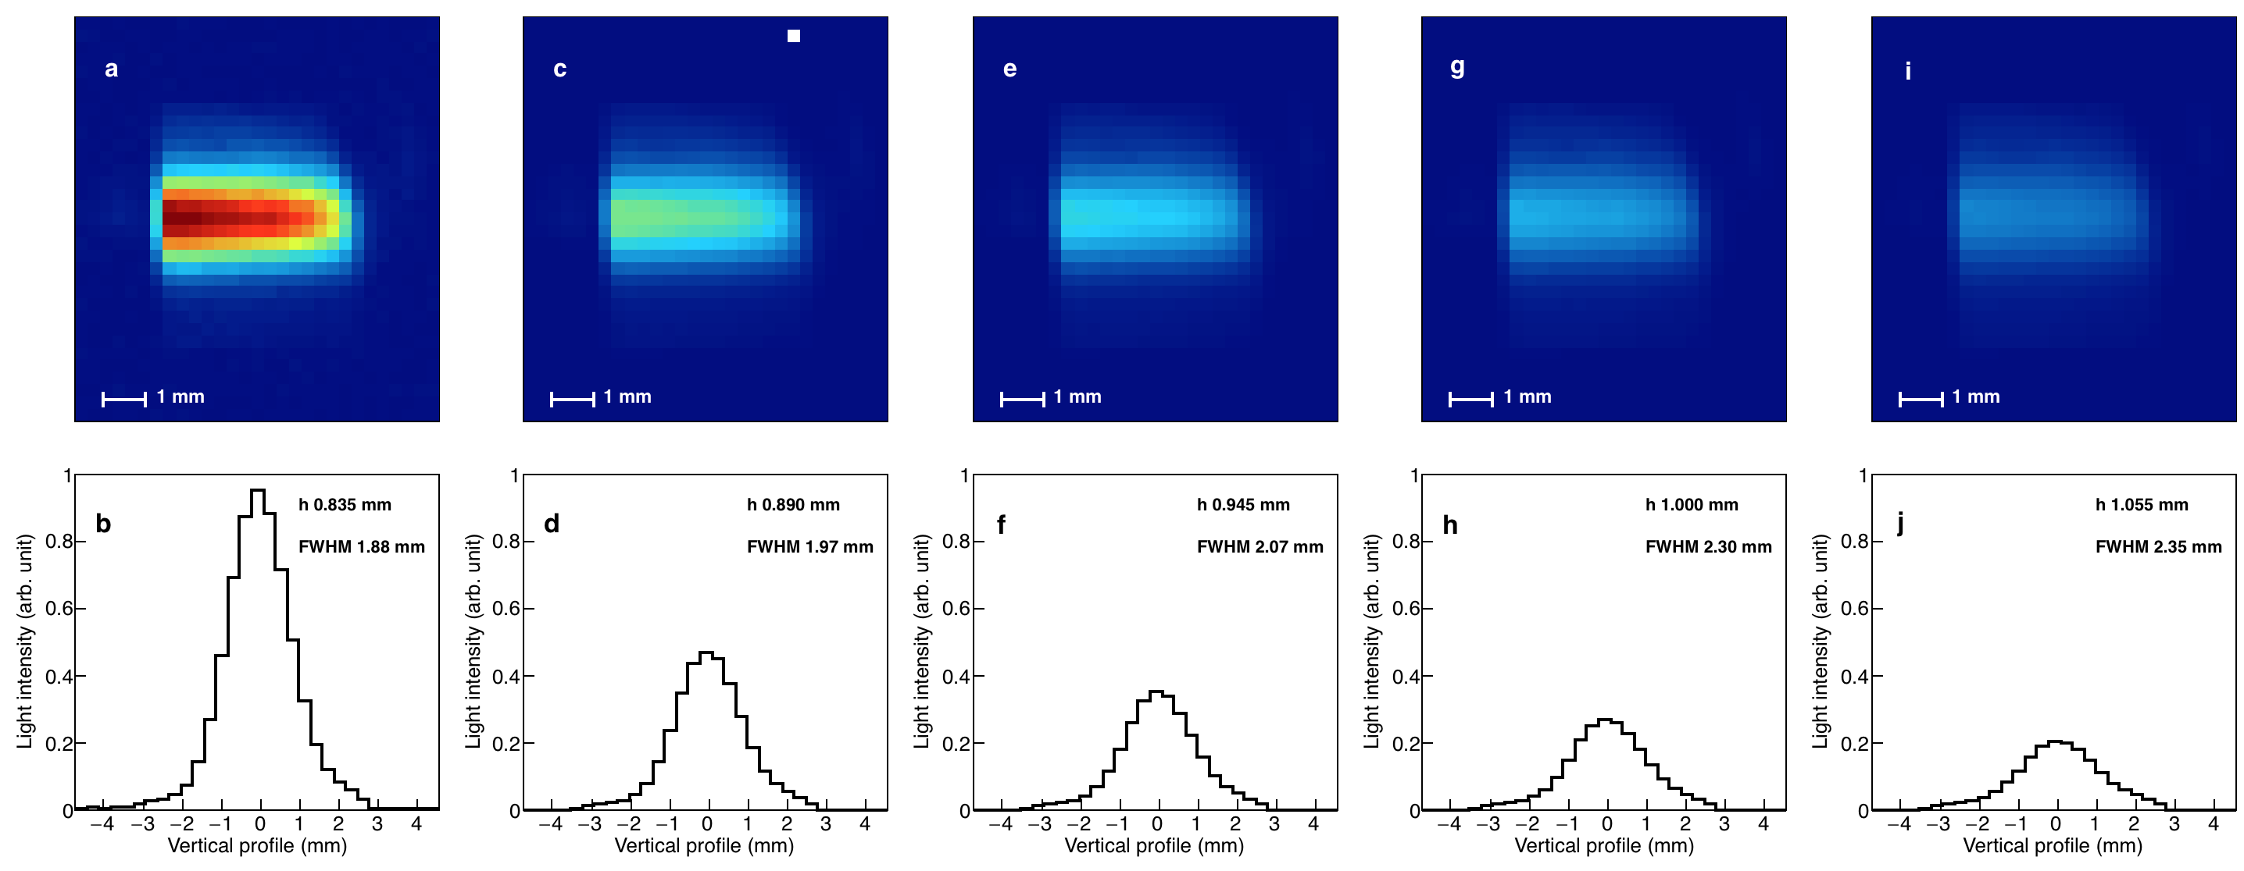
Dependence on impact parameter
  Imaging conditions and Radiation power vs Impact parameter
‘Cherenkov photons yield increasing strongly for smaller impact parameter’

Slide 19
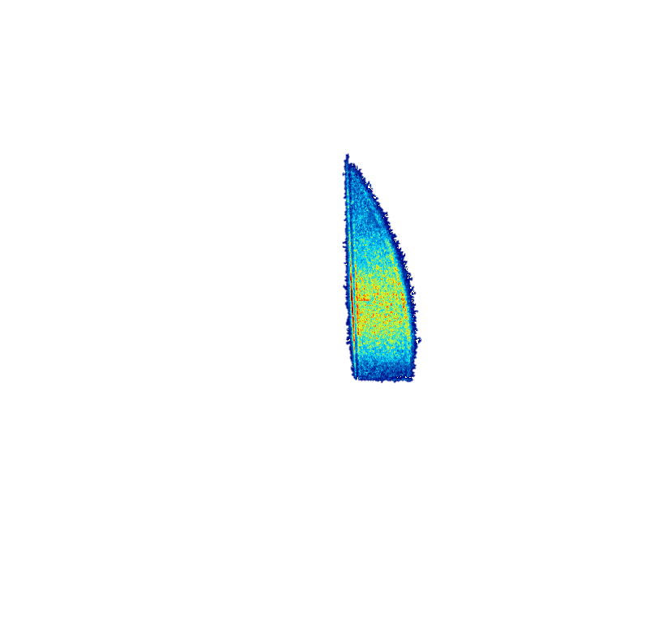
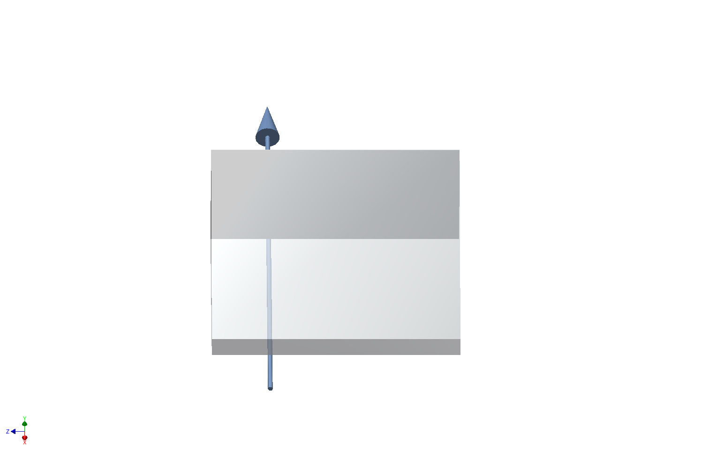
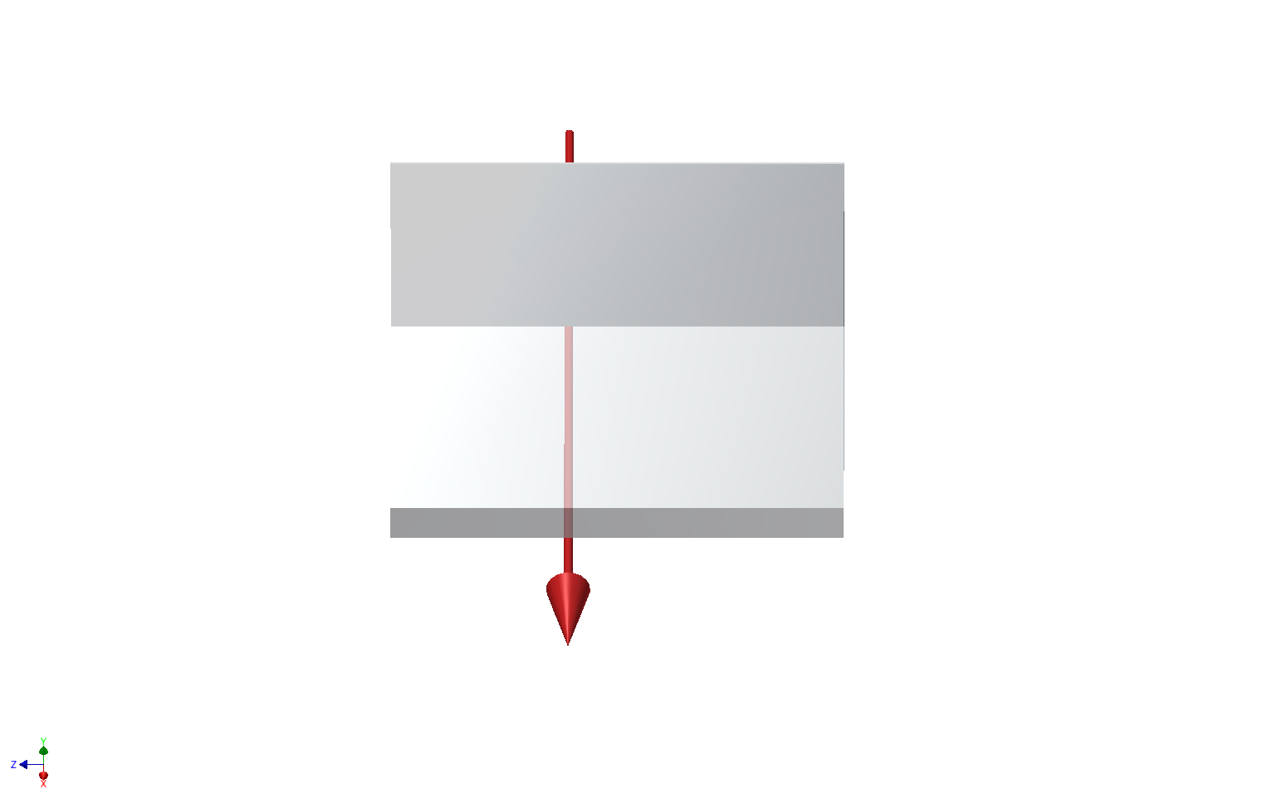
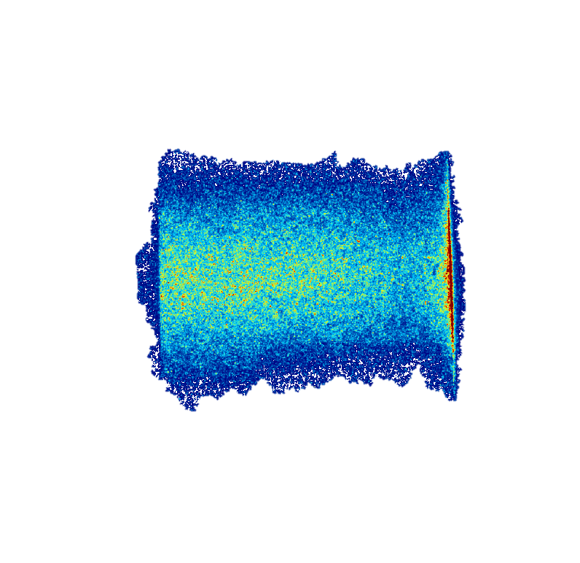
Electron and positron trajectory control
Electron Beam
The photons produced by electrons and positrons appear on a different zone of the image and give the possibility to high directivity beam measurements
Positron Beam

Slide 20
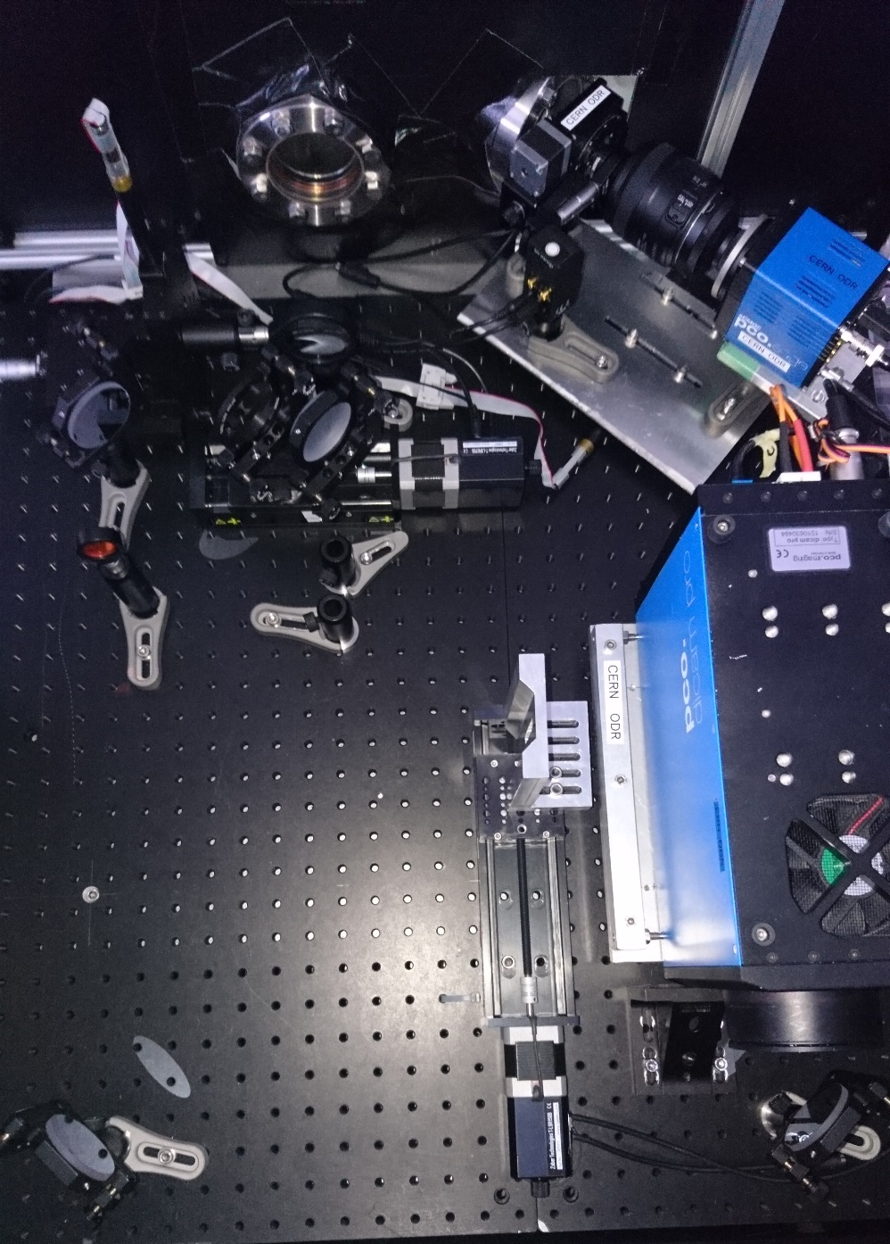
Optical ChDR experiment at KEK-ATF2
Studying the spatial resolution of ChDR at ATF2/KEK - 2018
ATF2 extraction line
Beam Energy | 1.25 GeV
Particles per bunch | 1.6 10¹⁰
Achievable beam size H/V (microns) | 100 / 1
Re-using and modifying the hardware used for Diffraction radiation studies
Optical system in the visible
OTR for cross calibration

Slide 21
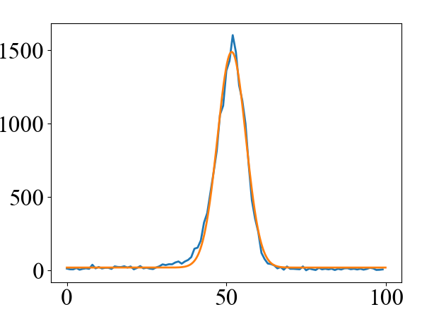
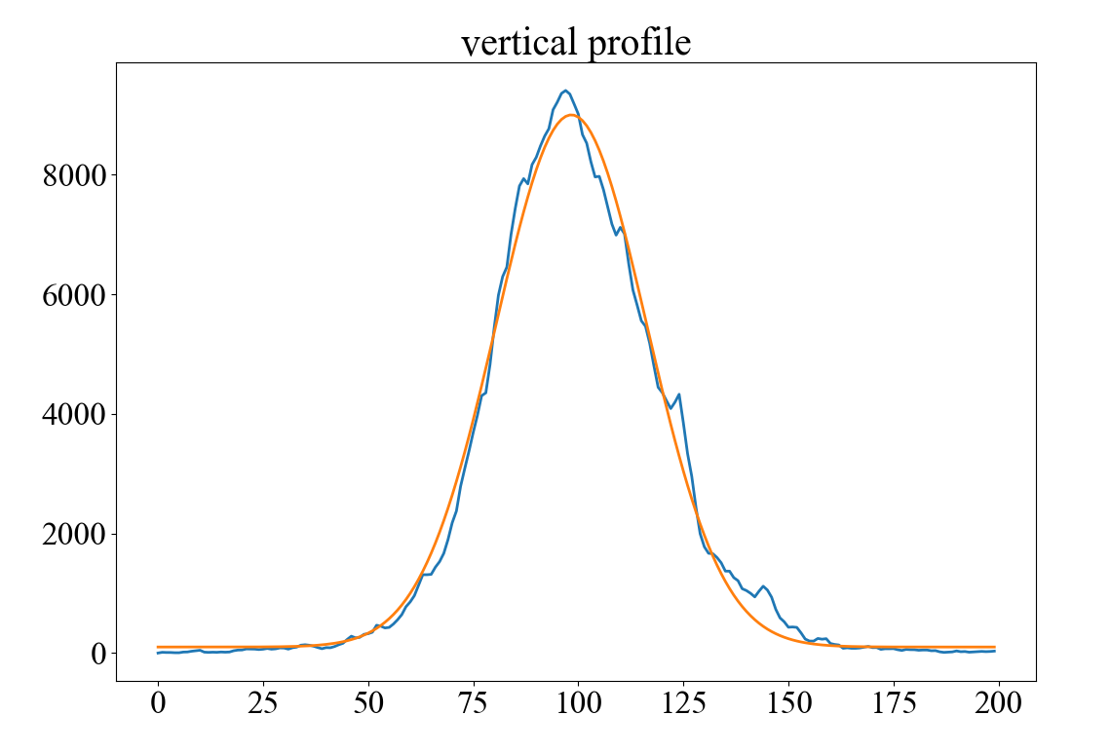
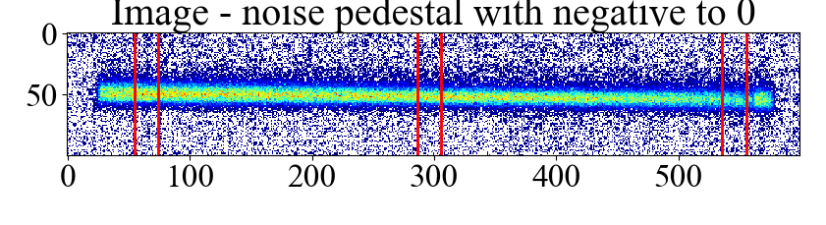
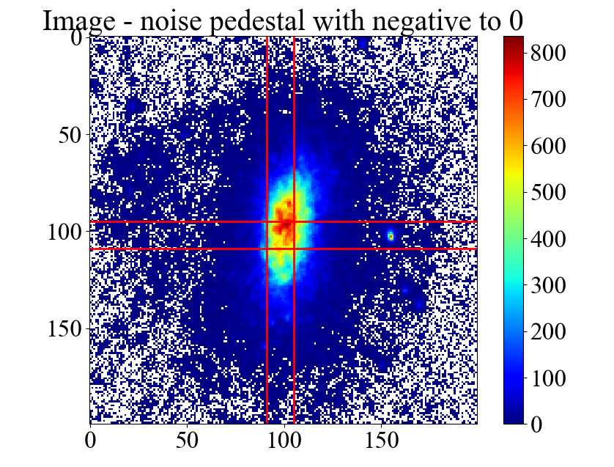
Beam profile
OTR Vertical beam profile
ChDR Vertical beam profile
Vertical rms is: 67.2 um
Vertical rms: 63.5 um

Slide 22
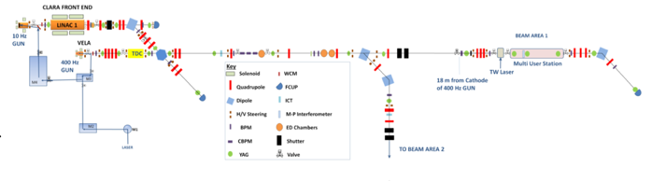
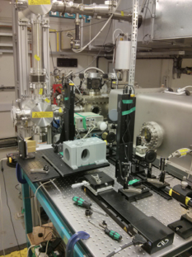
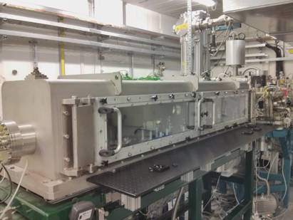
Coherent ChDR experiment at CLARA in Daresbury
S(ω) – radiation spectrum
S_{e}(ω) – single electron spectrum
N – electrons in a bunch
F(ω) – bunch form factor
f = 10Hz
E = 35 MeV
Longitudinal beam size was about 0.6 ps with charge ranging within 70 - 100 pC
200 microns RMS transversal bunch size
Martin-Puplett interferometer for spectral measurements
A. Curcio, et al., Noninvasive bunch length measurements exploiting Cherenkov diffraction radiation, Phys. Rev. AB 23, 022802 (2020)

Slide 23
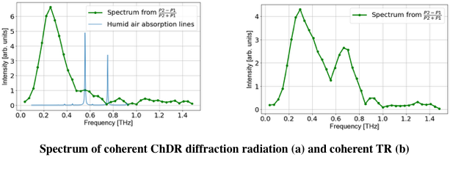
CTR and CChDR spectra
(a)
(b)
A. Curcio, et al., Noninvasive bunch length measurements exploiting Cherenkov diffraction radiation, Phys. Rev. AB 23, 022802 (2020)

Slide 24
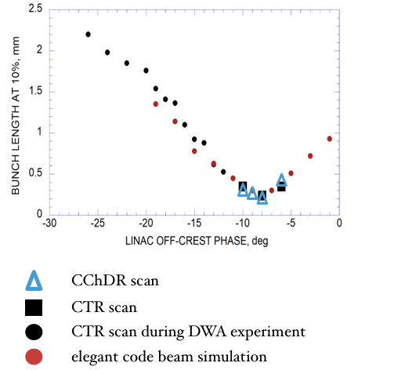
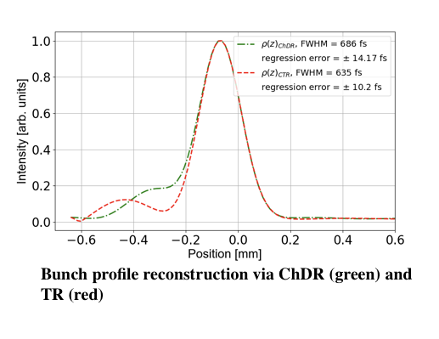
CTR and CChDR spectra
Kramers-Knronig method
Energy spread measurement method
A. Curcio, et al., Noninvasive bunch length measurements exploiting Cherenkov diffraction radiation, Phys. Rev. AB 23, 022802 (2020)

Slide 25
Coherent ChDR experiment at CLEAR in CERN
Development of Coherent ChDR for bunch length monitoring
Cross calibrating using RF deflector
Measuring beam power spectrum in 3 frequency bands
A. Curcio, et al., Noninvasive bunch length measurements exploiting Cherenkov diffraction radiation, Phys. Rev. AB 23, 022802 (2020)

Slide 26
Coherent ChDR experiment at CLEAR in CERN
Comparison between CChDR and RF deflector
A. Curcio, et al., Noninvasive bunch length measurements exploiting Cherenkov diffraction radiation, Phys. Rev. AB 23, 022802 (2020)

Slide 27
Coherent ChDR BPM for AWAKE

Slide 28
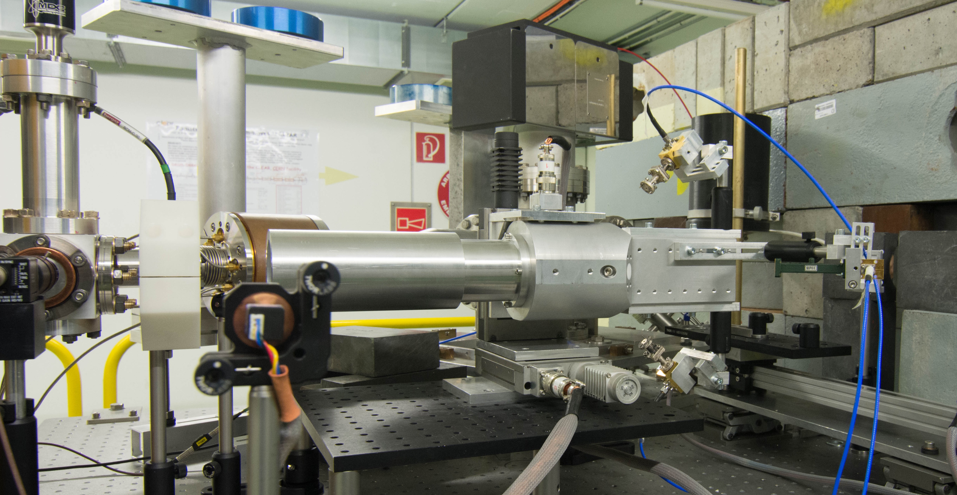
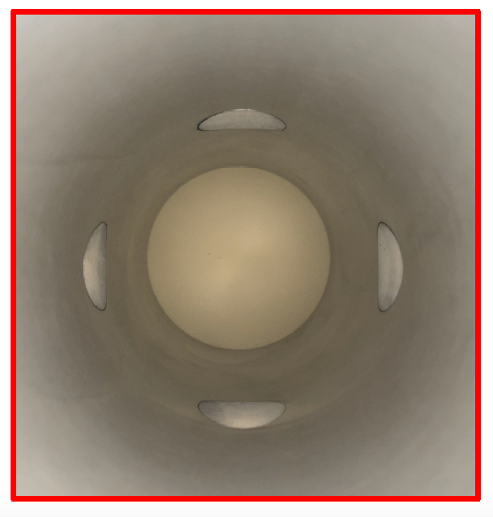
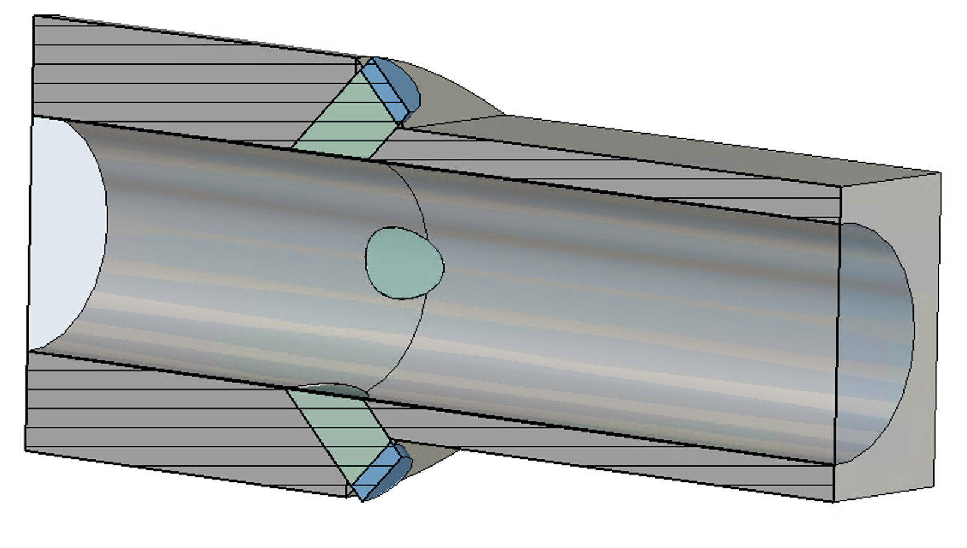
Coherent ChDR BPM test at CLEAR
Prototype in-air test:
60 mm diameter aperture (AWAKE)
PTFE radiators
Emission at 45º
In-air detection for flexibility
Zero-bias RF schottky diode detectors in the Ka-band
Motorised support, move the device, not the beam
ChDR
BEAM
ChDR
PTFE
inserts

Slide 29
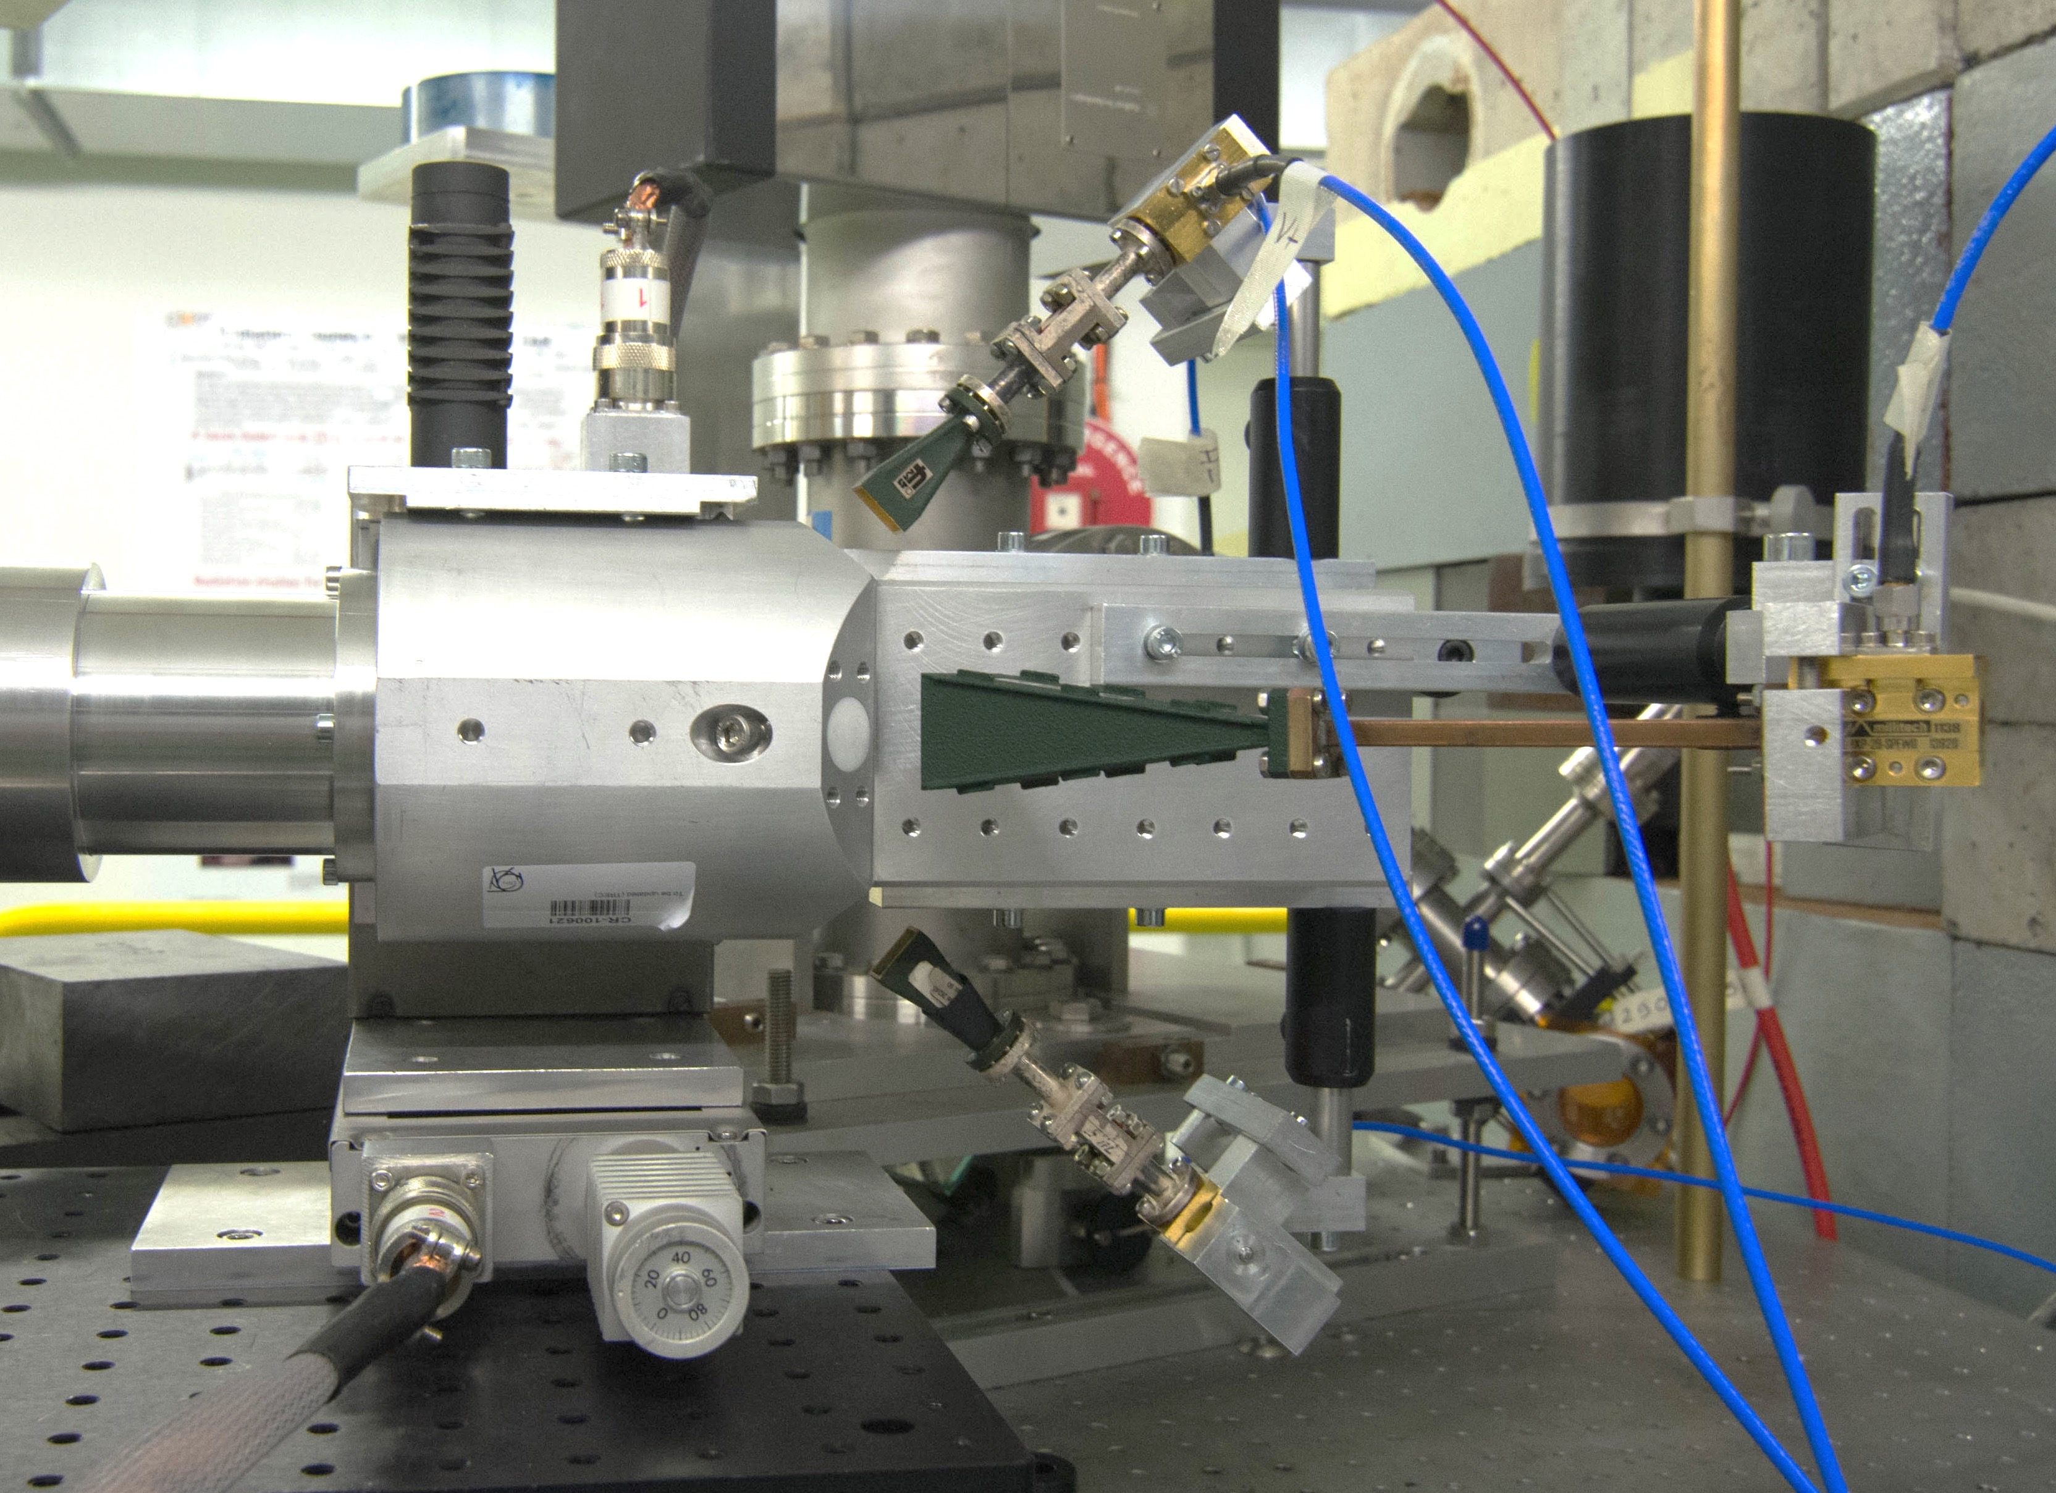
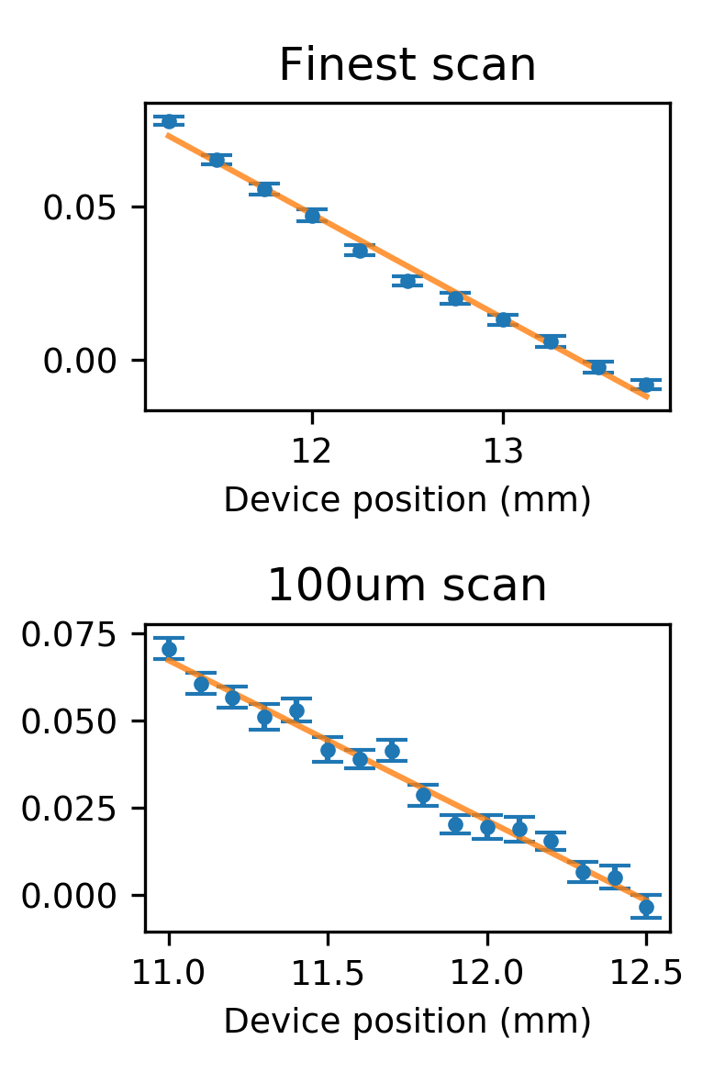

Coherent ChDR BPM test at CLEAR
BEAM
Sensing the power emitted by opposite radiators to calculate the position
Linear response around the centre

Slide 30


Bunch-by-bunch measurements
3 BUNCH TRAINS
20 BUNCH TRAINS
CHERENKOV
RESPONSE
WALL CURRENT
MONITOR

Slide 31
Coherent Smith-Purcell Radiation
Micro-bunched beam monitoring and bunch profiling using coherent radiation spectrum analysis
I.V. Konoplev , G. Doucas , H. Harrison, A. J. Lancaster
JAI at University of Oxford

Slide 32
Single Shot CSPR

Slide 33
Single shot CSPR bunch length diagnostics concept

Slide 34
Conclusion
Polarization radiation is an efficient mechanism
  Low particle energy loss
  Non-invasive nature of generation
  Large emission angles
  Low coherent radiation background for ChDR
  Multi-parameter monitoring
Beam position, trajectory, transverse and longitudinal profile measurements
  Resolution still has to be understood
  PCA model and EM simulations have to be verified to be able to optimize instruments for different accelerators
  Designs for CLIC, AWAKE and Light Sources

Slide 35
Conclusion
Short bunch length measurement needs to be verified
  Limited access to the facilities with short enough bunch
Potentially can be applied for
  THz radiation generation
  Particle acceleration
  Energy spread manipulation
  Beam cooling

Slide 36
Thank you for your time

