Slide 1
Measuring conductivity of coated surfaces at high frequency
Andrea Passarelli

Slide 2
Coatings at high frequency
Layers of coating materials can significantly increase the resistive wall impedance at high frequency
Low conductvity, thin layer coatings (NEG, a‐C)
Rough surfaces (not taken into account so far)
Surface impedance of the beam pipe depends on electromagnetic properties of coatings.
EM characterization of “coating materials” is fundamental to evaluate accelerator performance limitations and build up a machine impedance model.

Slide 3
Outline
Coating characterization for RW
From Z_{s} to Z_{wall}
Conclusion

Slide 4
Outline
Coating characterization for RW
  Proposed method
  The DUT
  Analytical evaluations
  Measurement results
  Outlook
From Z_{s} to Z_{wall}
Conclusion

Slide 5



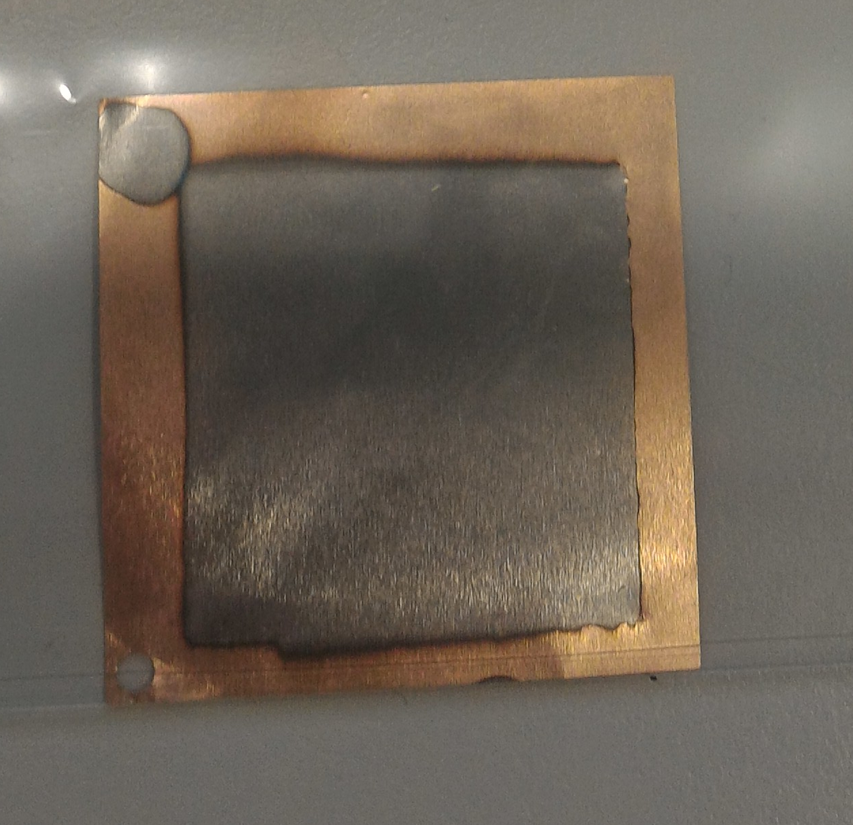
The goal of the study
To develop a reliable, handy and inexpensive system for the electromagnetic characterization
of Coating material in Sub-THz range.
NEG
Non-Evaporable Getter
TERA K15
Time-Domain THz Spectrometer

Slide 6
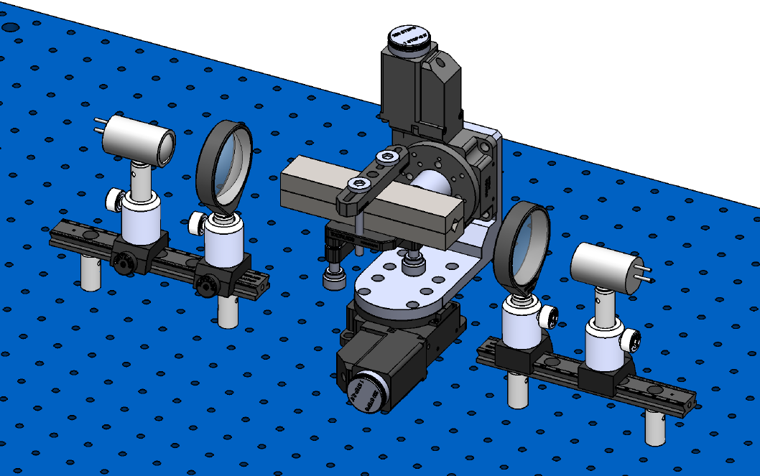
The proposed method
Evaluation of the signal attenuation inside a DUT with coating deposited.
Electromagnetic characterization
of coating material.

Slide 7

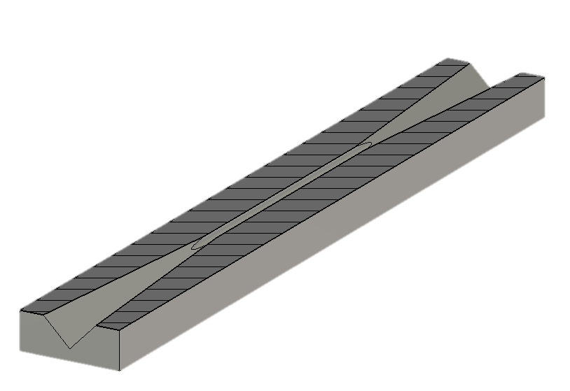
The DUT
Material | Iron
Waveguide | Circular
Length | 42
Radius | 0.9
Horns | Pyramidal
Length | 39
External side | 6
Total Length | 120
Dimension in mm
Circular waveguide
Pyramidal Horns

Slide 8
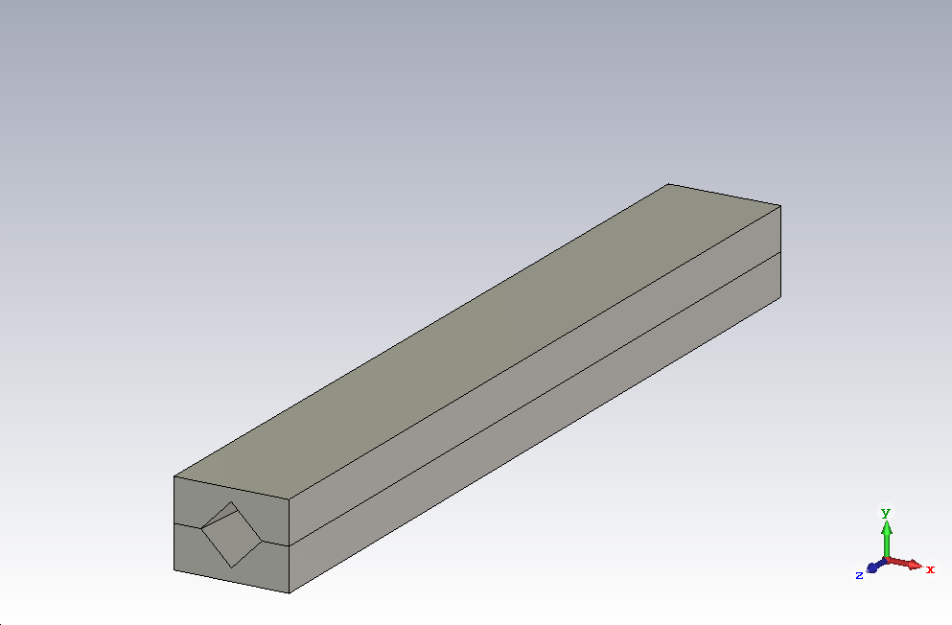
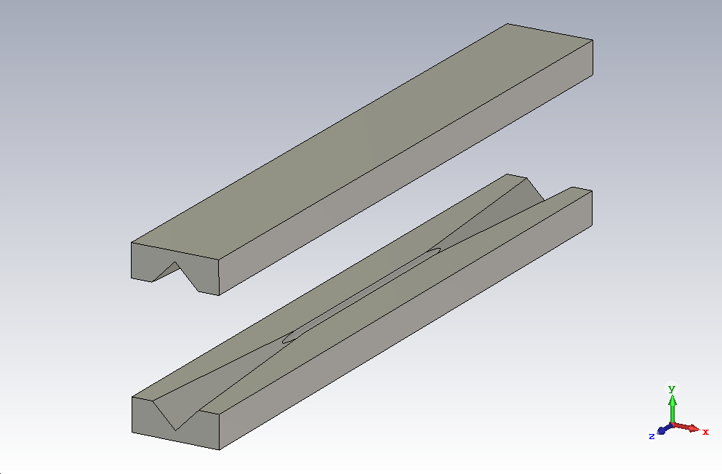
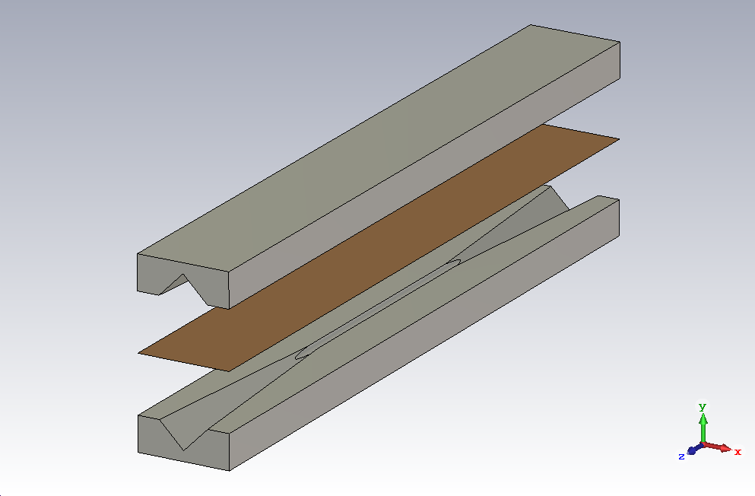
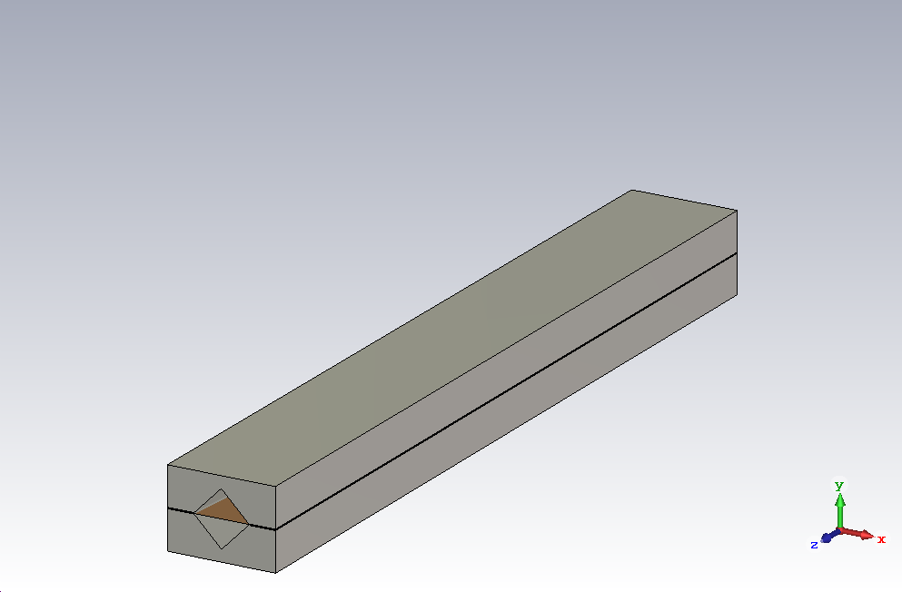
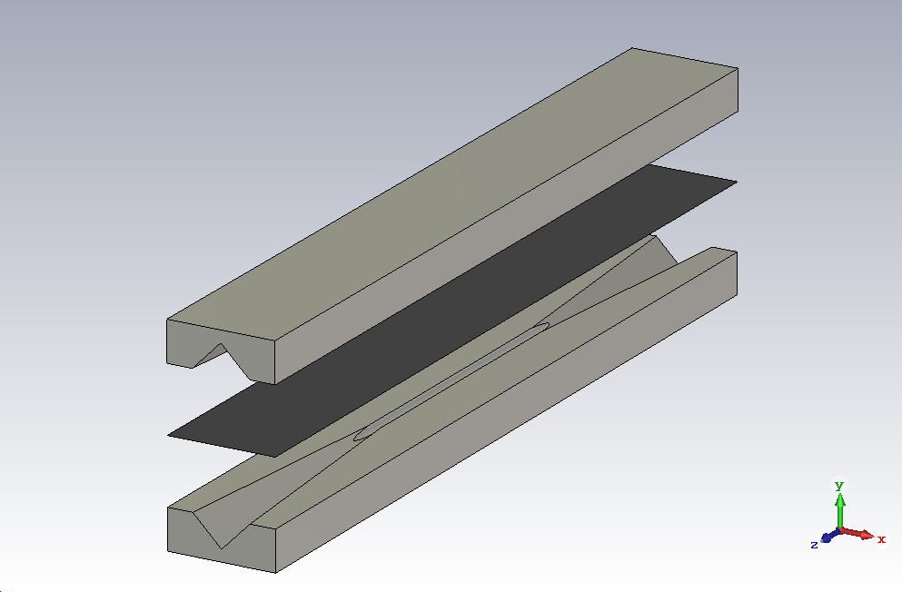


The DUT
Advantages of this setup
Homogeneous deposition
Reusability of the system
Large area coating.
Reference
Measure

Slide 9
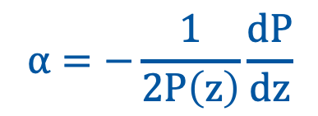
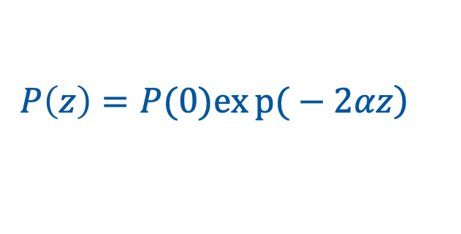
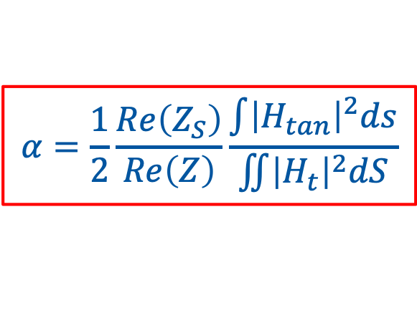
Analytical evaluations
Power attenuation per length unit α is defined by:
$$α=−\frac{1}{2P\left(z\right)}\frac{dP}{dz}$$
$$\left.P\left(z\right)=P(0)exp{(}−2αz\right)$$
The attenuation α due to the losses in the walls is:
$$α=\frac{1}{2}\frac{Re\left(Z_{S}\right)}{Re\left(Z\right)}\frac{\int{{\left|H_{tan}\right|}^{2}ds}}{\iint{{\left|H_{t}\right|}^{2}dS}}$$
Z_{s} : surf. char.imp.
Z : mode char.imp.
H_{tan} : tang. mag. field
H_{t} : trans. mag. field
N.Markuvitz – Waveguide Handbook

Slide 10



Analytical evaluations
Single-mode regime analysis
$$100 GHz$$
$$280 GHz$$
$$450 GHz$$
Waveguide radius a [mm] | Frequency range [GHz]
0.9 | 100-280
The frequency range goes from f_{TE1,1} to f_{TE1,2}

Slide 11
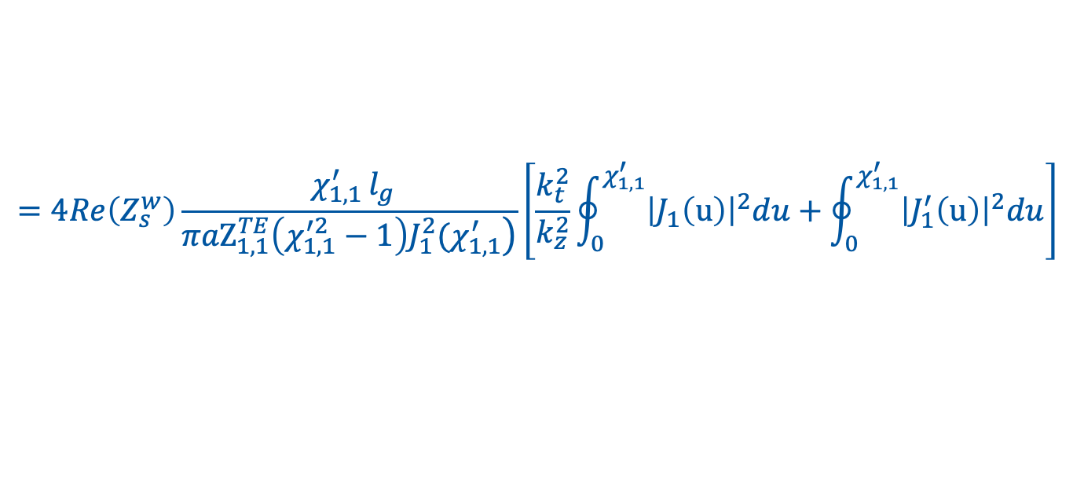
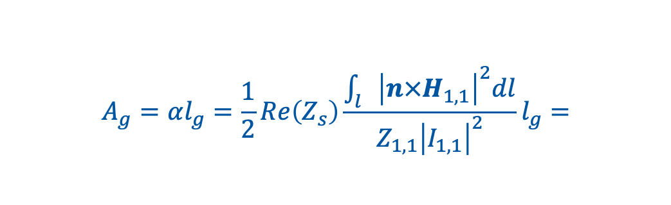
Analytical evaluations
The attenuation for TE_{1,1} mode:
Along the foil of length l_{g} :
$$A_{g}=αl_{g}=\frac{1}{2}Re\left(Z_{s}\right)\frac{\int_{l}{{\left|n×H_{1,1}\right|}^{2}dl}}{Z_{1,1}{\left|I_{1,1}\right|}^{2}}l_{g}=$$
$$=4Re\left(Z_{s}^{w}\right)\frac{{ χ}_{1,1 }^{′}l_{g}}{\left.{πaZ}_{1,1}^{TE}\left(χ_{1,1}^{′2}−1\right){J_{1}^{2}(χ}_{1,1}^{′}\right)}\left[\frac{k_{t}^{2}}{k_{z}^{2}}\oint_{0}^{χ_{1,1}^{′}}{{\left|J_{1}\left(u\right)\right|}^{2}du}+\oint_{0}^{χ_{1,1}^{′}}{{\left|J_{1}^{′}\left(u\right)\right|}^{2}du}\right]$$

Slide 12

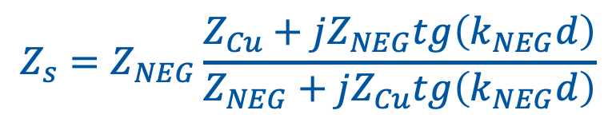


Analytical evaluations
Cu
NEG
$$Z_{s}$$
$$Z_{s}$$
d
$$Z_{s}=Z_{NEG}\frac{Z_{Cu}+jZ_{NEG}tg\left(k_{NEG}d\right)}{Z_{NEG}+jZ_{Cu}tg\left(k_{NEG}d\right)}$$
$$Z_{s}=Z_{Cu}$$

Slide 13
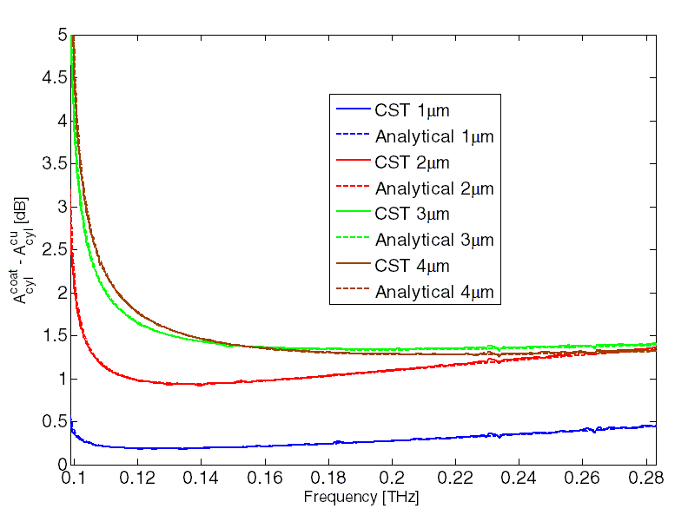
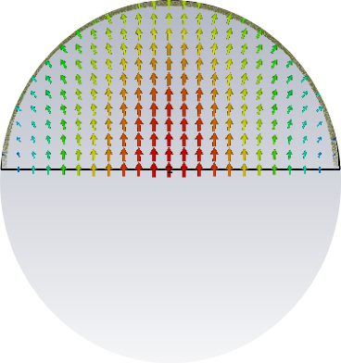
Analytical evaluations
*E. Koukovini Platia et al.
Phys. Rev. Accel.Beams 20, 011002 (2017)
Copper conductivity: σ_{cu} = 6∙10⁷ S/m NEG conductivity: σ_{NEG} = 3.5∙10⁵ S/m*
Waveguide length: 42mm
Waveguide radius: 0.9mm
Good agreement between FD CST simulations and analytical evaluations.

Slide 14
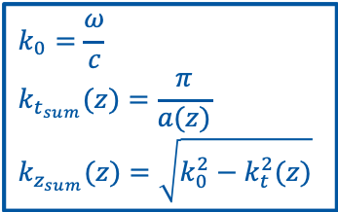
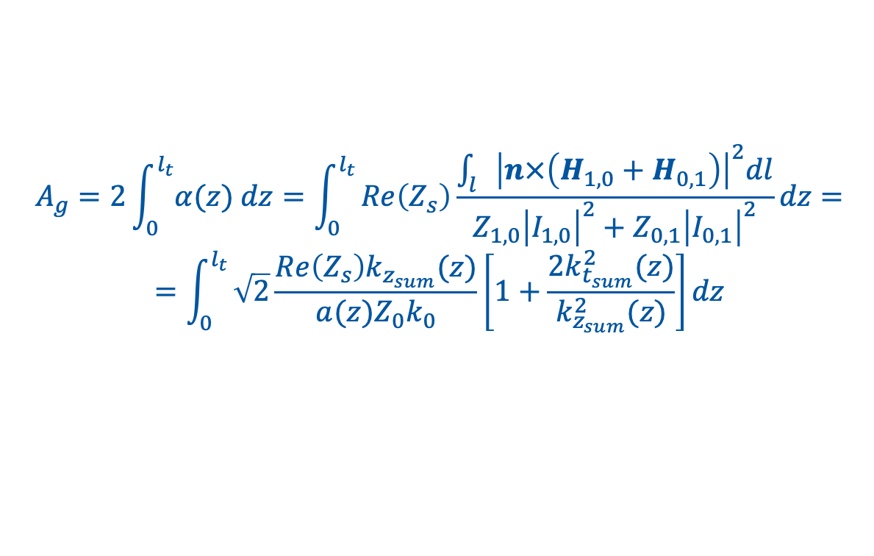
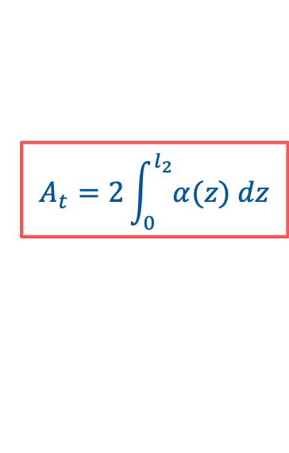
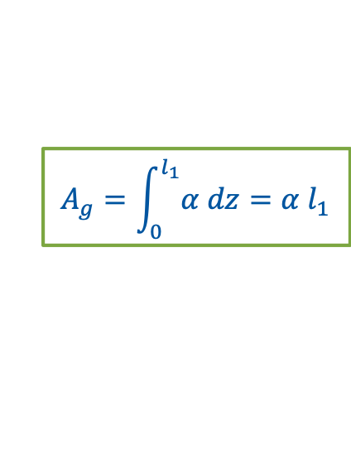
Analytical evaluations
Pyramidal transitions to enhance the signal collection.
$$A_{g}=\int_{0}^{l_{1}}{α dz=α l_{1}}$$
$$A_{t}=2\int_{0}^{l_{2}}{α(z) dz}$$
The attenuation for the sum of TE_{1,0} and TE _{0,1} modes:
Along the foil in the transitions of length l_{t}:
$$A_{g}=2\int_{0}^{l_{t}}{α(z) dz}=\int_{0}^{l_{t}}{Re\left(Z_{s}\right)\frac{\int_{l}{{\left|n×\left(H_{1,0}+H_{0,1}\right)\right|}^{2}dl}}{Z_{1,0}{\left|I_{1,0}\right|}^{2}+Z_{0,1}{\left|I_{0,1}\right|}^{2}}}dz=$$
$$=\int_{0}^{l_{t}}{\sqrt{2}\frac{Re\left(Z_{s}\right)k_{z_{sum}}(z)}{a(z)Z_{0}k_{0}}\left[1+\frac{2k_{t_{sum}}^{2}(z)}{k_{z_{sum}}^{2}(z)}\right]}dz$$
$$k_{0}=\frac{ω}{c}$$
$$k_{t_{sum}}(z)=\frac{π}{a(z)}$$
$$k_{z_{sum}}(z)=\sqrt{k_{0}^{2}−k_{t}^{2}(z)}$$

Slide 15
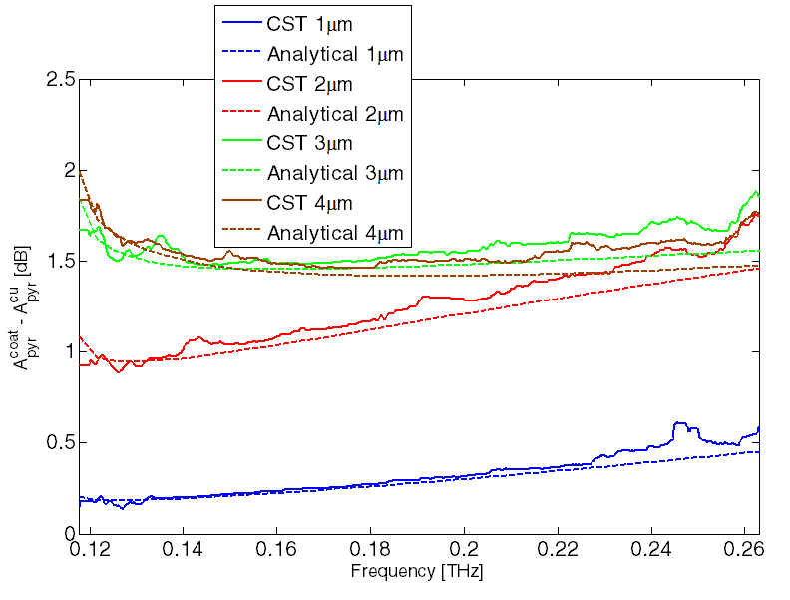
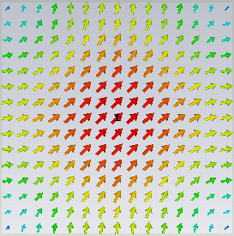
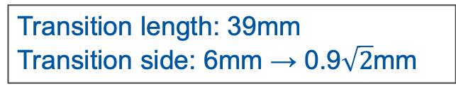
Analytical evaluations
*E. Koukovini Platia et al.
Phys. Rev. Accel.Beams 20, 011002 (2017)
Copper conductivity: σ_{cu} = 6∙10⁷ S/m NEG conductivity: σ_{NEG} = 3.5∙10⁵ S/m*
Transition length: 39mm
Transition side: 6mm → 0.9$\sqrt{2}$mm
Good agreement between FD CST simulations and analytical evaluations.

Slide 16
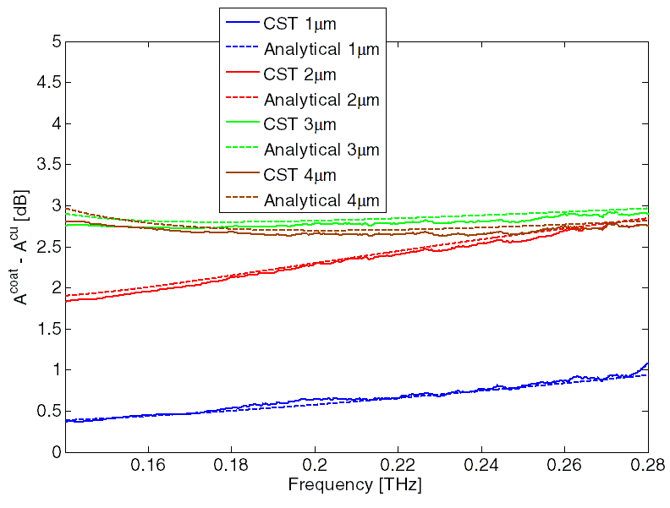
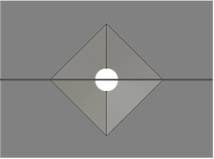
Analytical evaluations
*E. Koukovini Platia et al.
Phys. Rev. Accel.Beams 20, 011002 (2017)
Copper conductivity: σ_{cu} = 6∙10⁷ S/m NEG conductivity: σ_{NEG} = 3.5∙10⁵ S/m*
Cylindrical waveguide +
Pyramidal transition
Reliable analytical tool

Slide 17
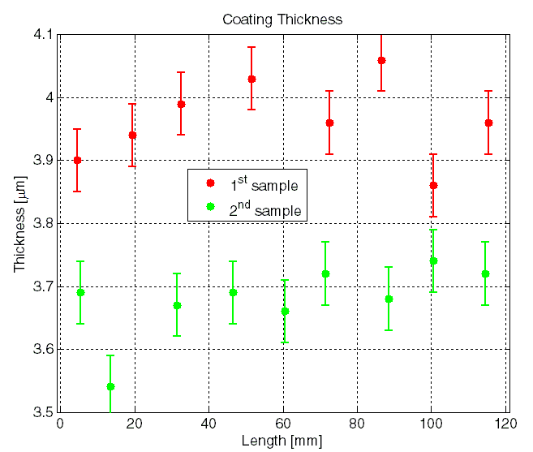
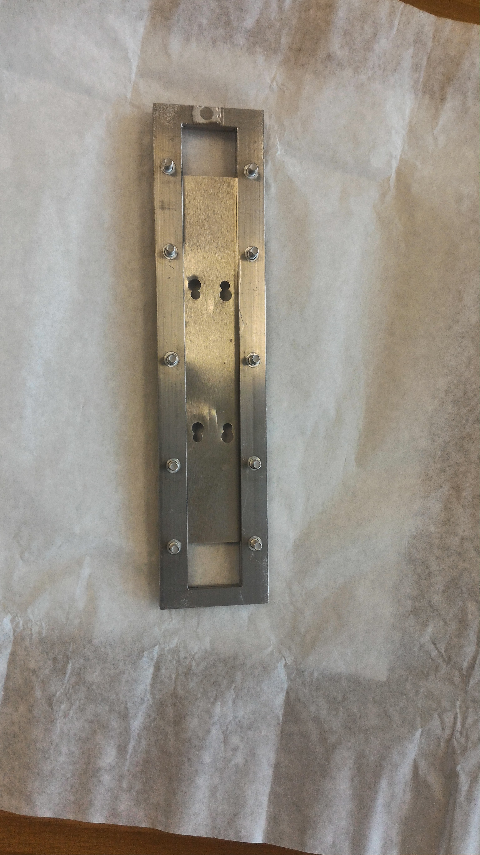
Measurement results
3.96 μm
3.68 μm
XRF in ATELIER DE TRAITEMENTS DE SURFACE

Slide 18
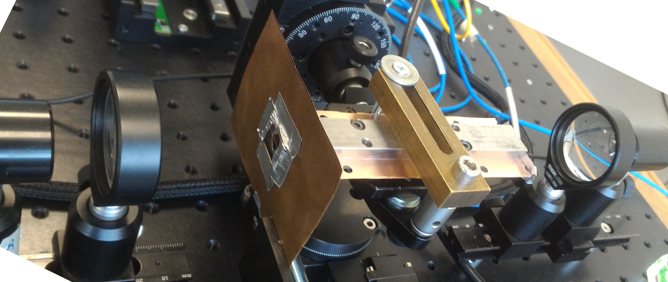
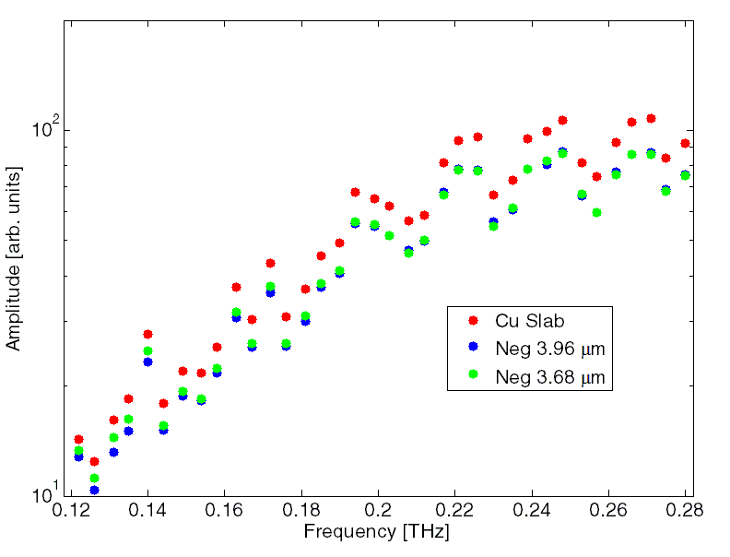

Measurement results
Average of 5 repeated measurements
$$A^{NEG}>A^{CU}$$

Slide 19
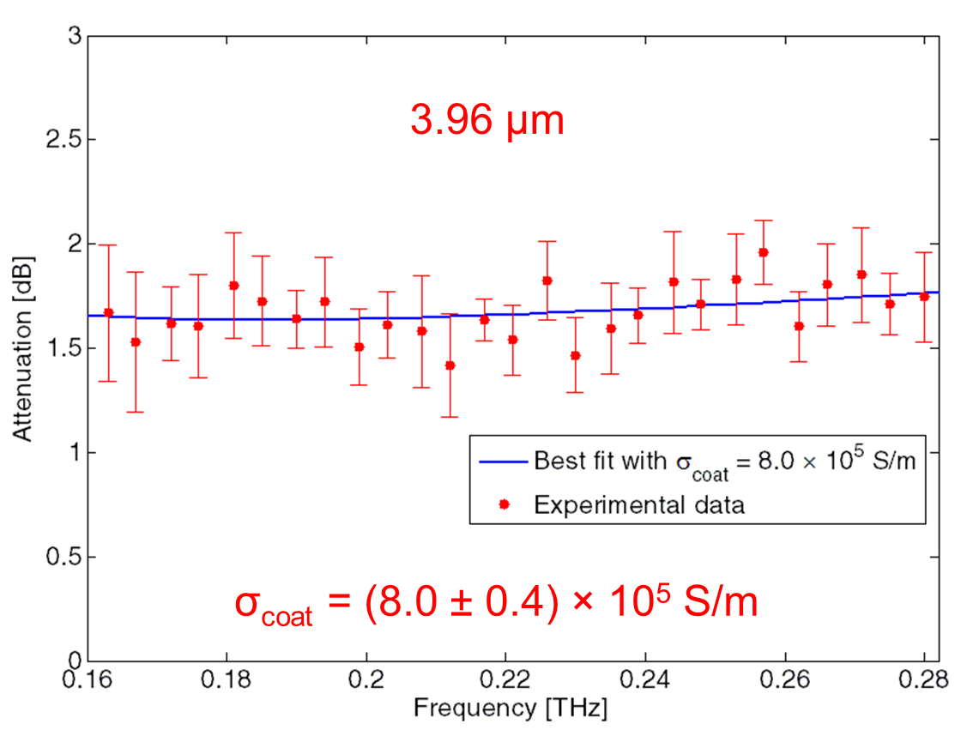
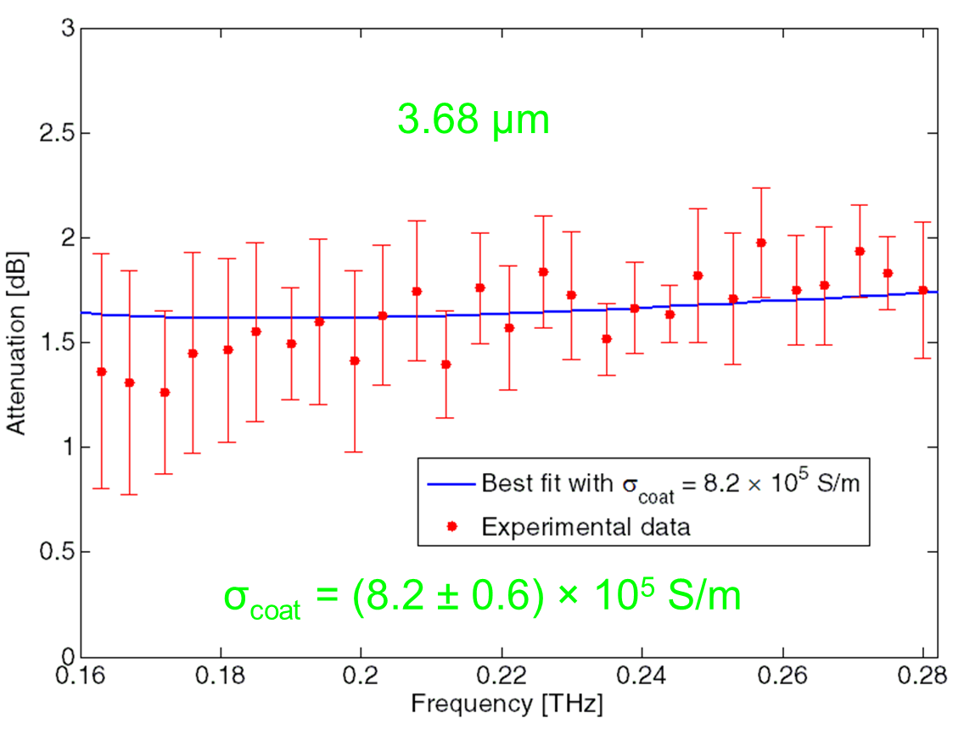


Measurement results
$$σ_{coat}$$
$$Z_{s}$$

Slide 20
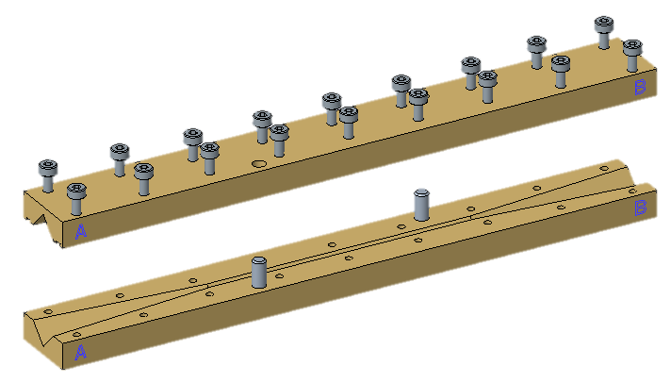


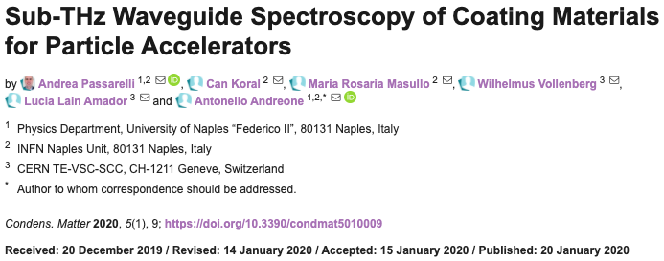
Measurement system upgrade
System specifications:
Spectral Range: > 3 THz
Dynamic Range > 70 dB
Scanning Range ~ 300 ps
Spectral Resolution < 3.5 GHz
Upgrade:
> 5 THz
> 90 dB
~ 850 ps
< 1.5 GHz
More accurate guiding system manufacturing

Slide 21
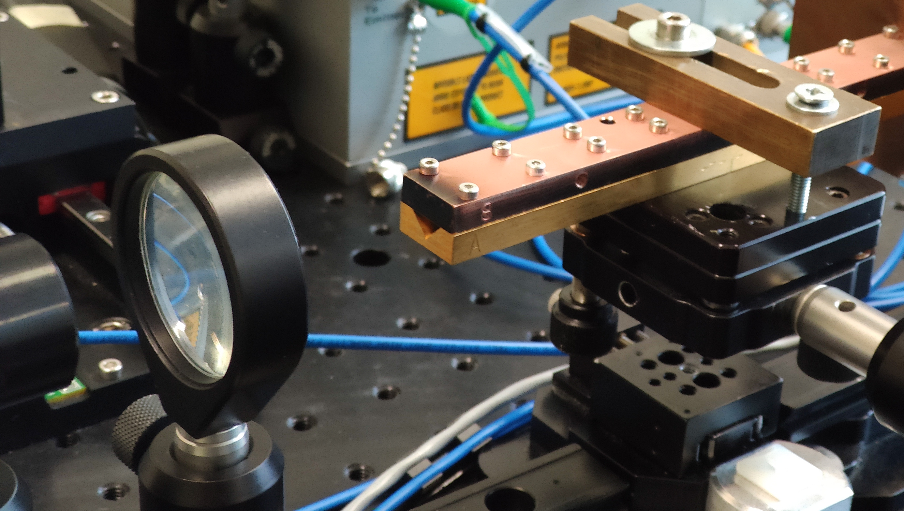
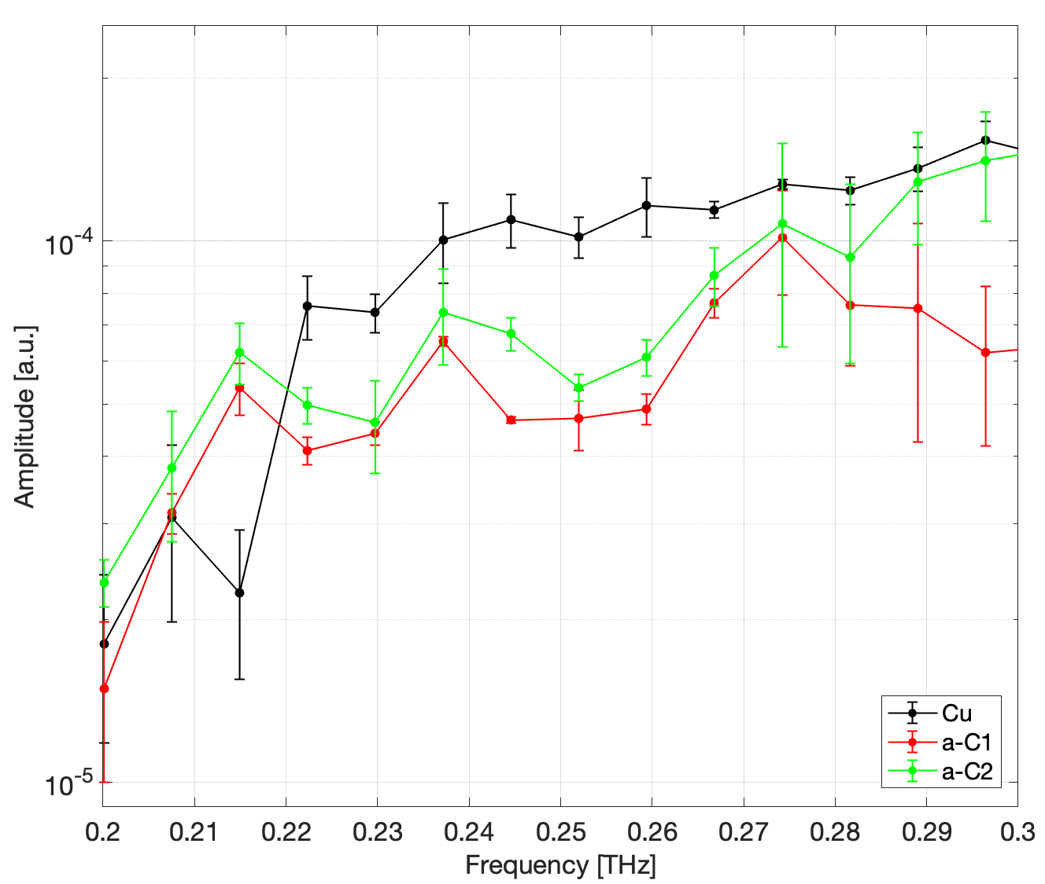
Measurement results on a-C
Two samples with 3 μm of Amorphous carbon on copper bulk
Mechanical stress with 3 μm of a-C on cu slab

Slide 22
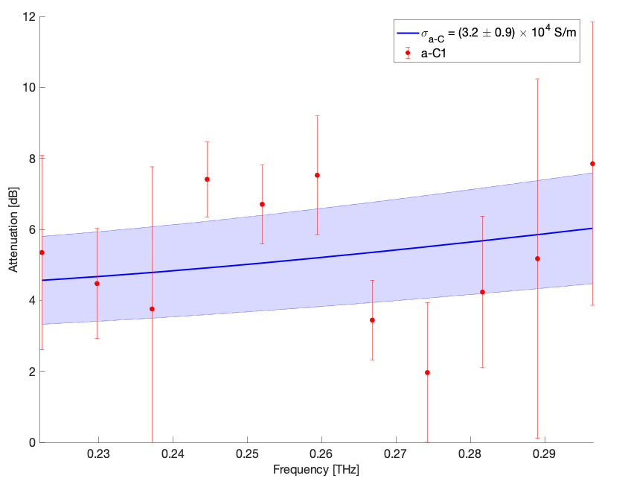
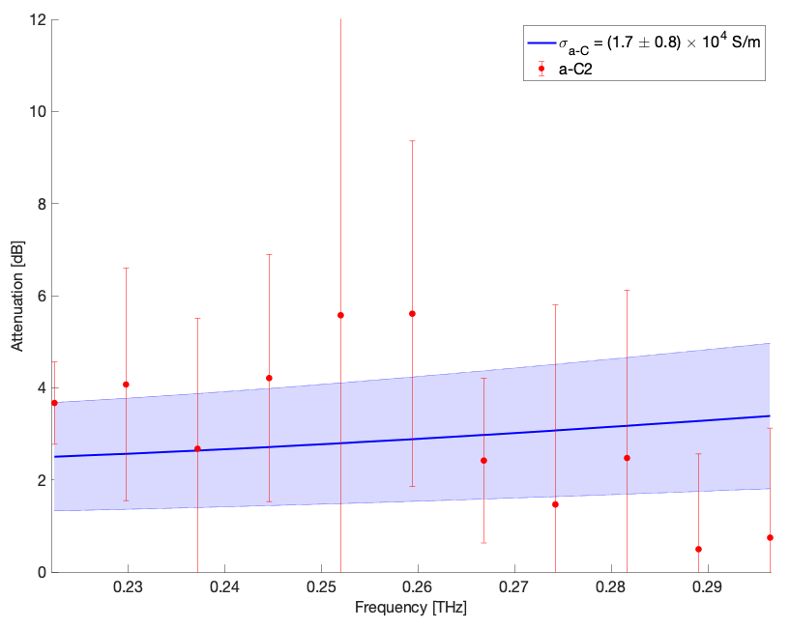
Measurement results on a-C
Shown for the first time → CERN note will be published soon

Slide 23
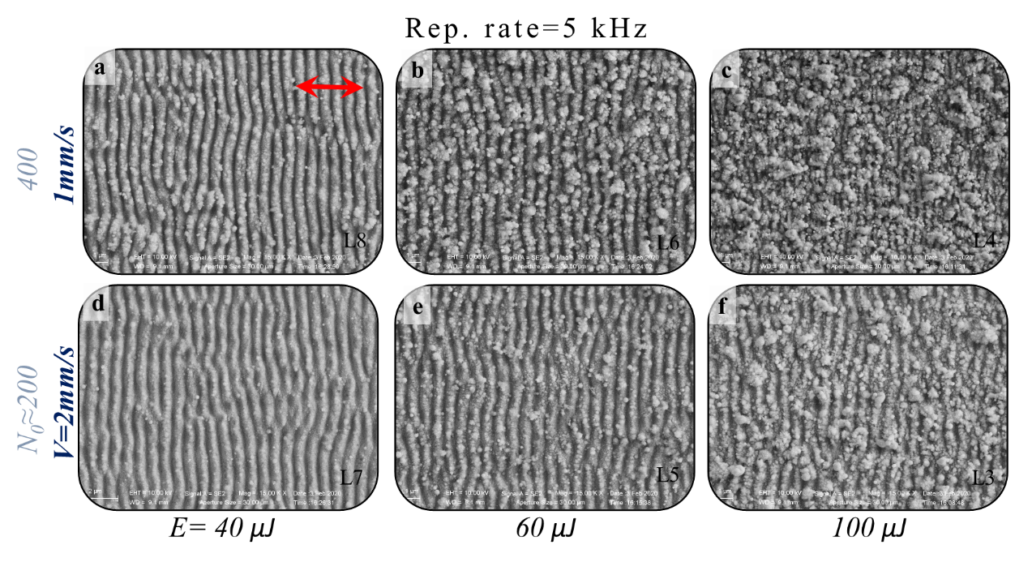
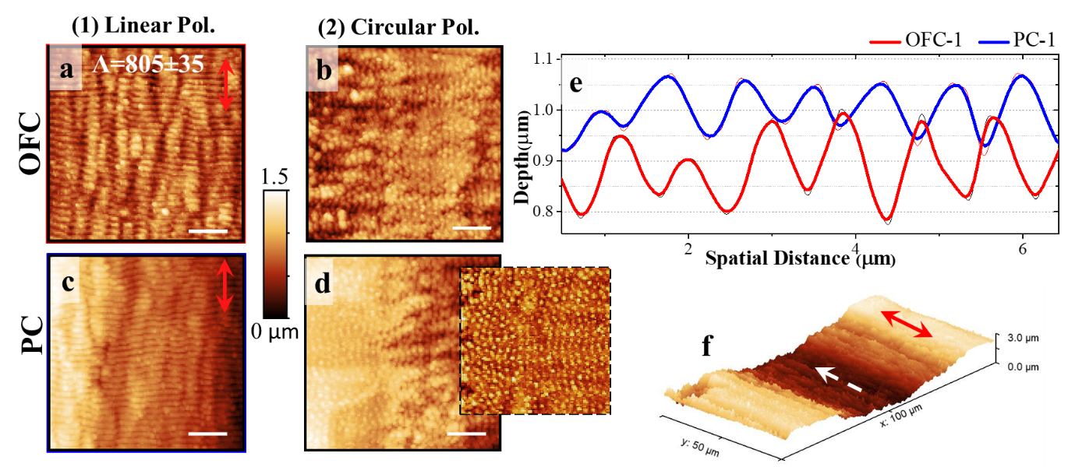
Outlook
New collaboration agreement
between CERN & INFN Naples in the framework of INFN ARYA project:
Realization of different laser surface treatments focusing on reduced nanoparticle formation (collaboration with Unina) and their EM characterization
Improving the sensitivity for the characterization of very thin structures resorting on resonant structure methodology
Dielectric resonator

Slide 24
Outline
Coating characterization for RW
From Z_{s} to Z_{wall}
  Tools and methods
  Transmission line theory
  Comparison IW2D and TL for FCC e⁺e⁻
Conclusion

Slide 25
Tools and methods
Two main tools with two different approach:
Transmission line theory
  To calculate the resistive wall impedance of a multilayer round chamber
  Can be applied recursively to take into account whatever number of layers
  Leontovich boundary condition required
  Ref: PhD thesis Carlo Zannini (EPFL 2013)
ImpedanceWake2D
  Solves Maxwell’s equation in frequency domain for a multilayer vacuum chamber made of arbitrary materials
  Field matching at all material boundaries
  Outputs the impedance contributions as a function of frequency
  Ref: PhD thesis Nicolas Mounet (EPFL 2012)

Slide 26

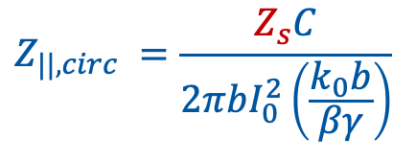
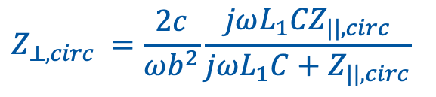


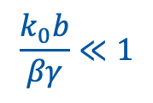
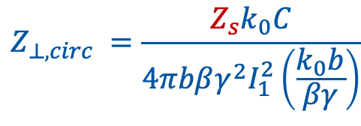
From experimental 𝜎 to Z_{wall}
The transmission line approach
EM fields ⇒ planewave orthogonal to separation surfaces.
The condition imposed only for 1st layer: for field continuity, propagation direction is orthogonal through all the media.
Leontovich boundary condition
$$E_{t}=Z_{s}H×{\hat{i}}_{n}$$
$$Z_{||,circ} =\frac{Z_{s}C}{2πbI_{0}^{2}\left(\frac{k_{0}b}{βγ}\right)}$$
$$Z_{⊥,circ} =\frac{Z_{s}k_{0}C}{4πbβγ^{2}I_{1}^{2}\left(\frac{k_{0}b}{βγ}\right)}$$
b
$$\frac{k_{0}b}{βγ}≪1$$
(in case of high energy (β=1) and relatively not too high frequency)
for
$$Z_{||,circ} =\frac{Z_{s}C}{2πb}$$
$$Z_{⊥,circ} =\frac{2c}{ωb^{2}}\frac{jωL_{1}{CZ}_{||,circ}}{jωL_{1}C+Z_{||,circ}}$$
info on $L_{1}$: L. Vos: CERN-AB-2003-005 ABP

Slide 27
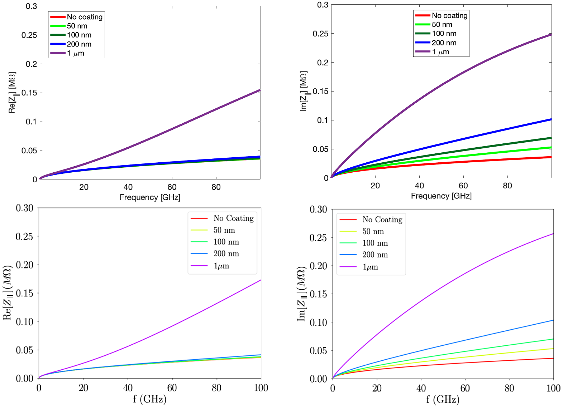
IW2D vs. TL
TL
TL
FCC e⁺e⁻
IW2D
IW2D
M. Migliorati, Phys. Rev. Accel. Beams, vol. 21, p. 041001, Apr 2018.

Slide 28
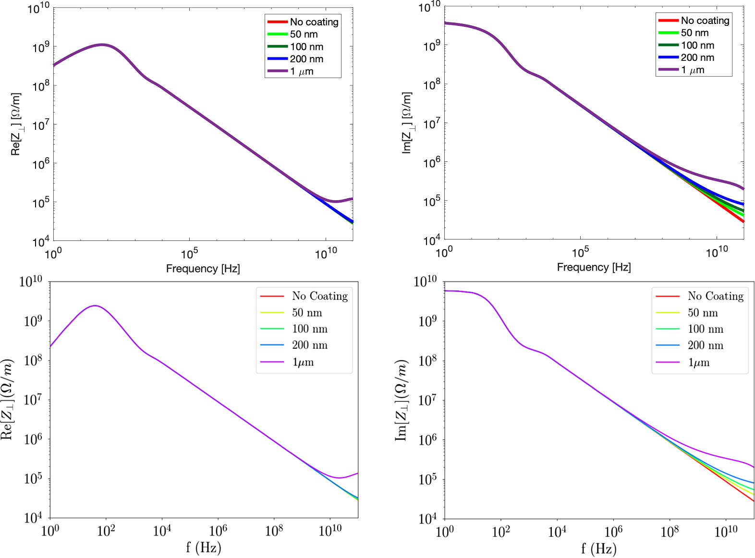
IW2D vs. TL
TL
TL
FCC e⁺e⁻
IW2D
IW2D
M. Migliorati, Phys. Rev. Accel. Beams, vol. 21, p. 041001, Apr 2018.

Slide 29
Outline
Coating characterization for RW
From Z_{s} to Z_{wall}
Conclusion

Slide 30
Conclusion
Sub-THz electromagnetic characterization of coating materials
  Reliable analytical model for the conductivity retrieval. Good agreement with CST Frequency Domain solver.
  Successful measurement campaign: reliable, handy and inexpensive method to evaluate the electromagnetic properties of samples under test.
  Published results on NEG and novel ones on a-C coatings.
  Outlook: characterization of different coating material (i.e. LESS) and extension of the frequency range.
From surface impedance Z_{s}(conductivity 𝜎) to resistive wall impedance Z_{wall}
  Transmission line theory is a flexible, stable and fast tool for resistive wall impedance evaluation (metallic boundary condition required at 1st layer)
Thank you!

Slide 31
Backup slides

Slide 32
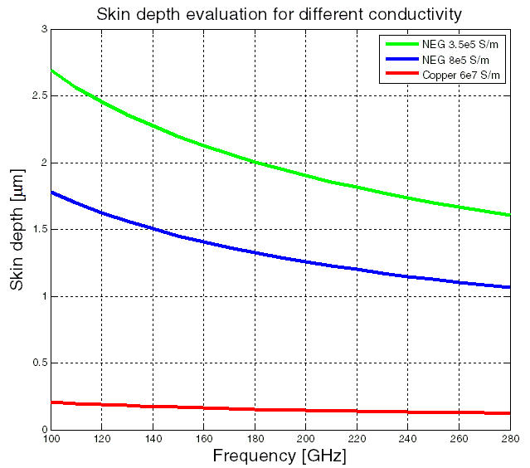
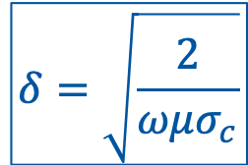
Skin depth
$$δ=\sqrt{\frac{2}{ωμσ_{c}}}$$

Slide 33
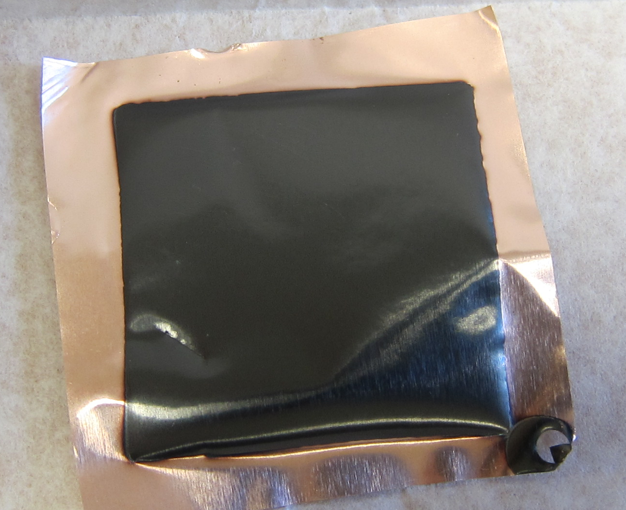
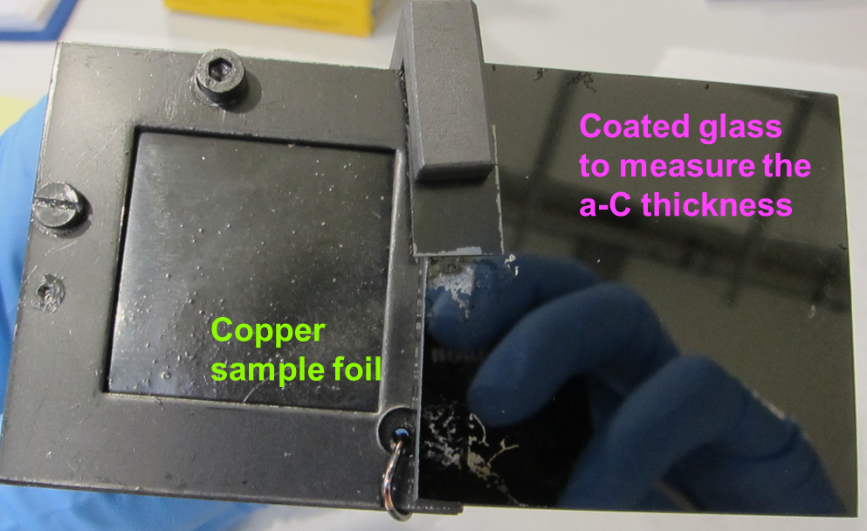
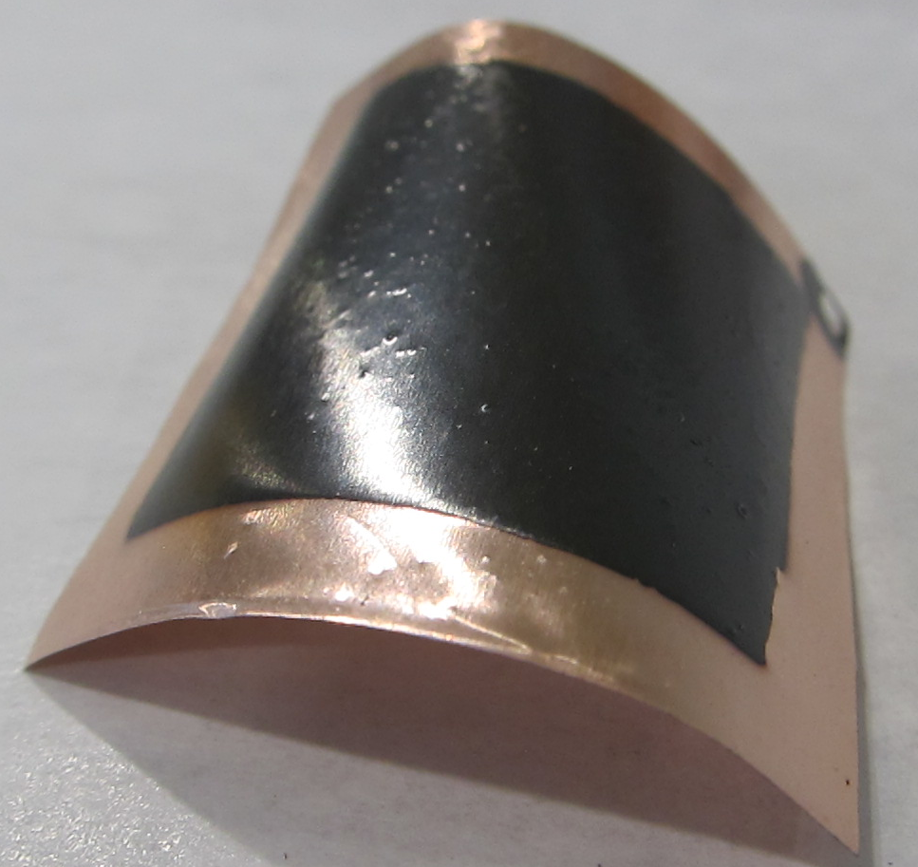





a-C Coatings
One side coating
Good thickness 5μm No Peel off
Sample under stress.
Two sides coating
Good thickness ~5μm
Peel off
No stress on foil

Slide 34

NEG Coatings
Two sides coating
No peel-off
No stress on foil
Thickness of 3.1μm
ROTATING FRAME

Slide 35










Approximation
The two transitions between the pyramidal horns and the cylindrical waveguide is neglected in the analytical evaluation.
1.2728 mm
$${{f_{c}}_{TE}}_{SUM}$$
$${{f_{c}}_{TE}}_{SUM}$$
$$118GHz$$
Square
waveguide
$$263GHz$$
0.9 mm
$${{f_{c}}_{TE}}_{1,1}$$
Circular
waveguide
$${{f_{c}}_{TE}}_{1,2}$$
$$97GHz$$
$$280GHz$$

Slide 36






Measurement system
System specifications:
Spectral Range: > 3 THz
Dynamic Range > 70 dB
Scanning Range ~400ps
Spectral Resolution < 3GHz
±15V
Supply
Vin
Out
PA310
T-Light/
FS-Laser
PortA
2F
Tx
Tera15-SL25-FC
Rx
Tera15-DP25-FC
PortB
Attenuator
1
0
Input fiber port
100
ODU
N
DDS Out1
Output fiber port
Lens1
Lens2
Lens3
Lens4

Slide 37
Previous work
E. Koukovini Platia et al.
Phys. Rev. Accel.Beams 20, 011002 (2017)
Electromagnetic characterization of NEG Coatings in waveguides at high frequency
The operating principle we are going to present
overcomes two main inconveniences of this work:
Non-homogeneous deposition
Impossibility to reuse the same
waveguide for further measurements

Slide 38
Analytical evaluations
Polarization of planar wave
Boundary conditions

Slide 39





Analytical evaluations
a
Polarization of planar wave
Boundary conditions
Waveguide side a [mm] | Frequency range [GHz]
$$0.9\sqrt{2}$$ | 118-263
The frequency range goes from f_{TE1,0}= f_{TE1,0} to f_{TE2,1} = f_{TE1,2}

