Slide 1
First thoughts about the FCC electron source WP1,Task 1.1
People:
Tomas Brezina, technical student at CERN since September
S. Doebert, CERN
J. Y. Raguin, PSI
A. Levichev, D. Nikiforov, … , BINP; first contacts concerning CDR gun
Scope of the work (proposal):
Study different electron sources up to 200 MeV and compare, define interface for LINAC’s at 200 MeV
- thermionic gun: reliable proven technology, stable, low maintenance, high emittance
- RF-gun: good emittance, medium charge stability, very good vacuum needed,
cathodes lifetime and exchange, laser operation
- BINP rf gun with PM focusing in iris, used in the CDR
- One or two guns ?

Slide 2
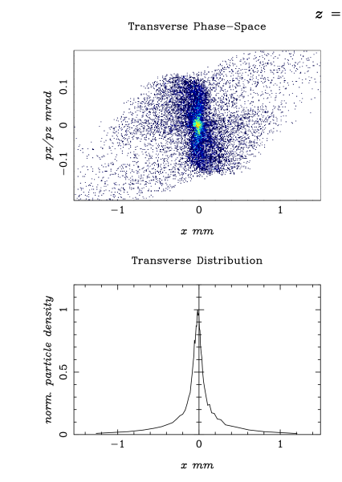
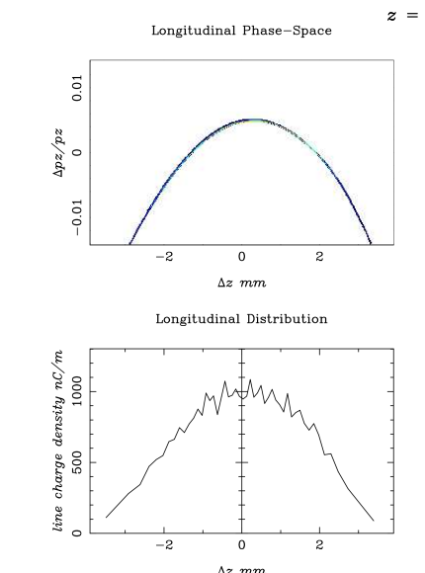
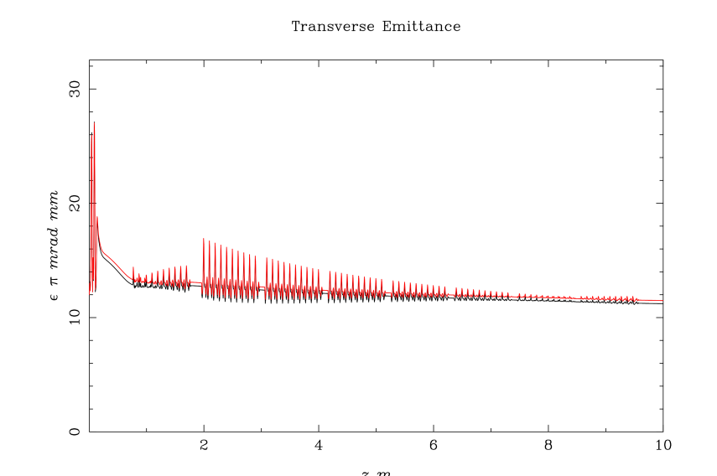
First example from Tomas
Photo injector (PHIN type)
4.5 nC

Slide 3
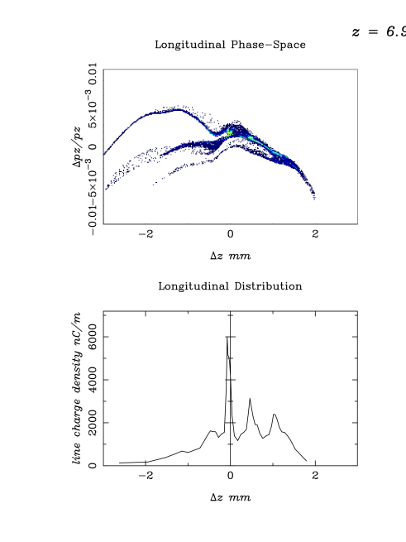
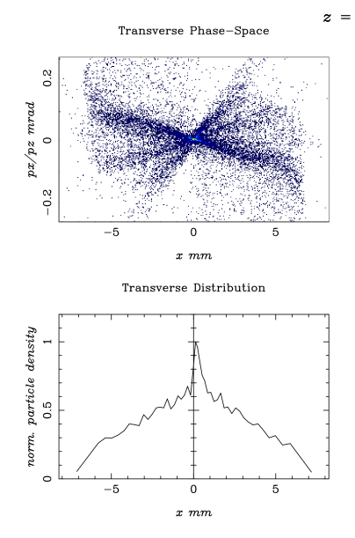
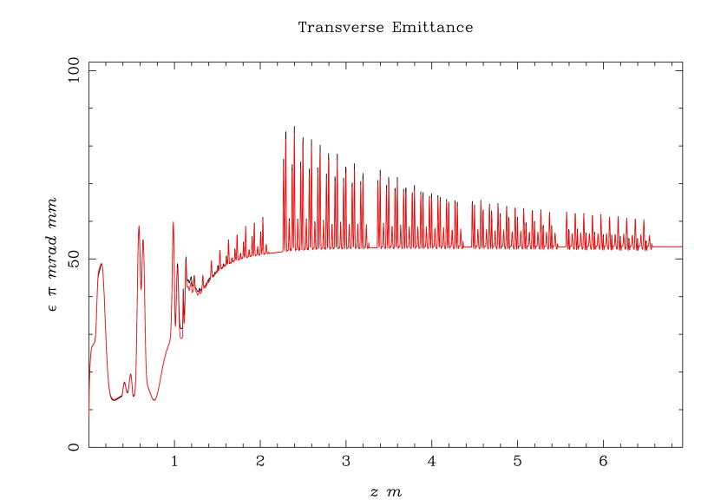
First example from Tomas
Thermionic gun with buncher (KEK type 500 kV)
5 nC

Slide 4
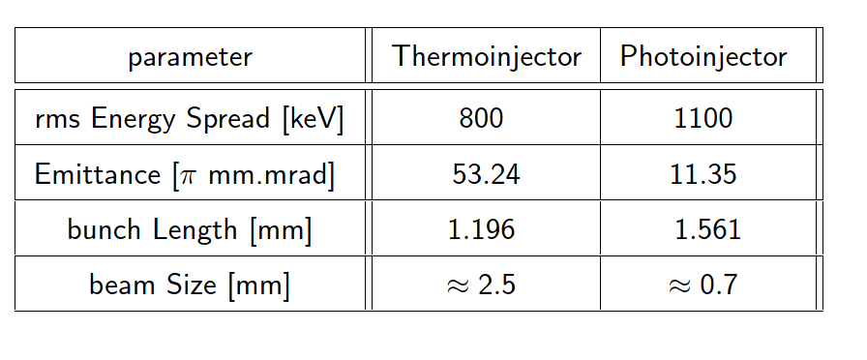
First example from Tomas
Parameters at 200 MeV
Warning: these are only indicative parameters for discussion

Slide 5
Input needed and Questions
Status BINP agreement ?
Input Parameters:
- Bunch distance, number of bunches, essential for bunching scenario and laser parameters
- Interface with LINAC, what do we optimize for, who deals with our input ?
Accelerating structure design (3 GHz), which one to start with (PSI injector structure ?)
Do we have a laser expert which can be involved to discuss feasibility/constraints of a laser system
Operational constraints, cathode lifetime and exchange, availability
Bunch to bunch charge control ? Anything else ?

