Slide 1
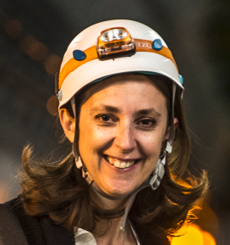
On behalf of Katy Foraz,
Head of the EN Department,
Welcome
to all of you!

Slide 2
The Engineering Department in a Nutshell
Katy Foraz

Slide 3
Where are we?

Slide 4
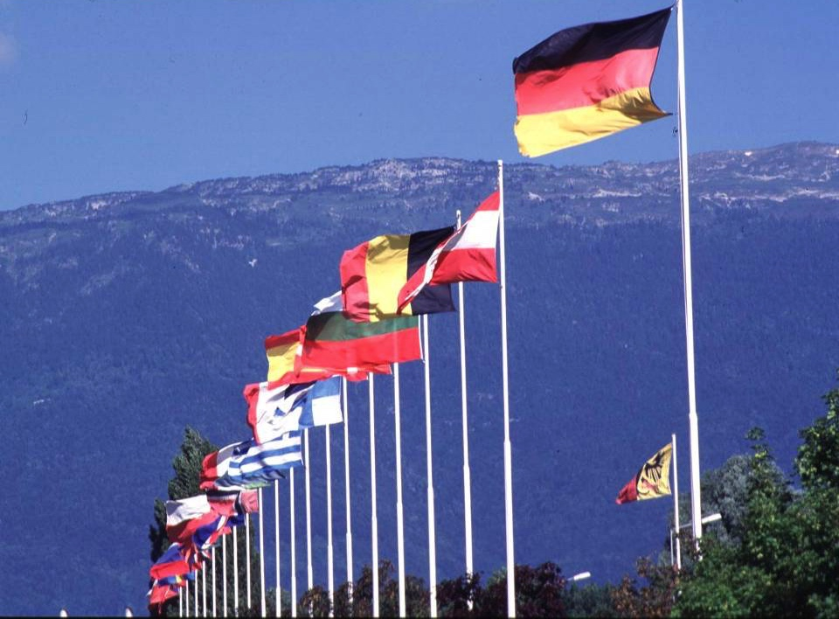
CERN: founded in 1954: 12 European States
“Science for Peace”
Today: 23 Member States
Employees: ~2 700 staff, 800 fellows
Associates: ~12 400 users, 1 300 others
Budget (2019) ~ 1 200 MCHF
Member States: Austria, Belgium, Bulgaria, Czech Republic, Denmark, Finland, France, Germany, Greece, Hungary, Israel, Italy, Netherlands, Norway, Poland, Portugal, Romania, Serbia, Slovak Republic, Spain, Sweden, Switzerland and United Kingdom
Associate Members in the Pre-Stage to Membership: Cyprus, Slovenia, Estonia, Latvia
Associate Member States: Croatia, India, Lithuania, Pakistan, Turkey, Ukraine
Applications for Membership or Associate Membership:
Brazil
Observers to Council: Japan, Russia, United States of America;
European Union, JINR and UNESCO
Notes:
Mayor experimento y el mayor instituto de investigacion del mundo del mundo
Mas de 85 paises, y mas de 10.000 cientificos e Ingenieros trabajando para una meta comun

Slide 5
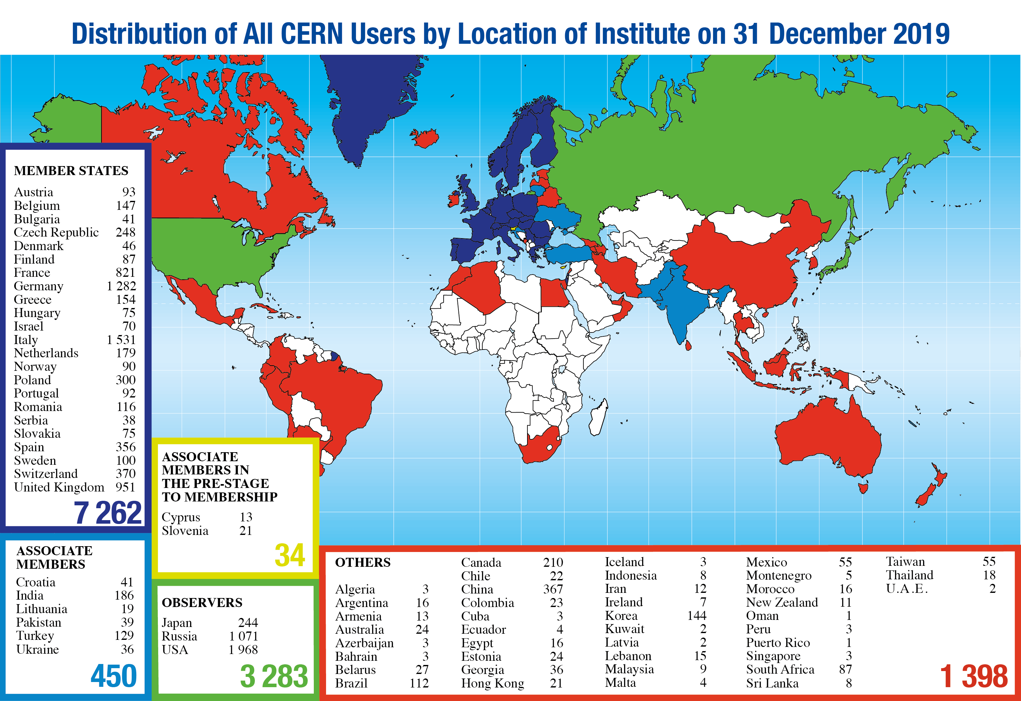
Science is getting more and more global
Notes:
Mayor experimento y el mayor instituto de investigacion del mundo del mundo
Mas de 85 paises, y mas de 10.000 cientificos e Ingenieros trabajando para una meta comun

Slide 6
What are we doing?

Slide 7
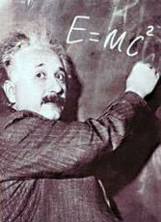



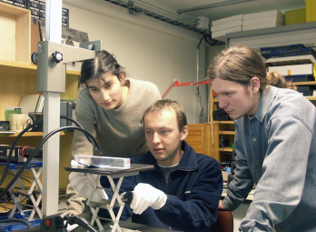
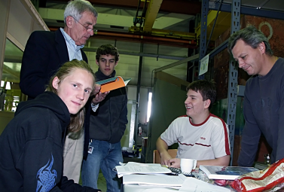
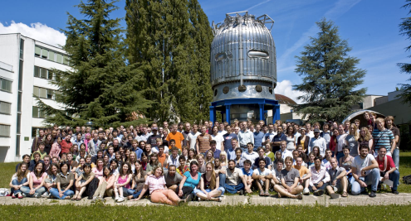
The Missions of CERN
Push forward the frontiers
of knowledge
  e.g. the secrets of the Big Bang …
  what was the matter like within
  the first moments of the Universe’s existence?
Develop new technologies
for accelerators and detectors
  Information technology - the Web and the GRID
  Medicine - diagnosis and therapy
Train the scientists and
the engineers of tomorrow
Unite people from different
countries and cultures

Slide 8
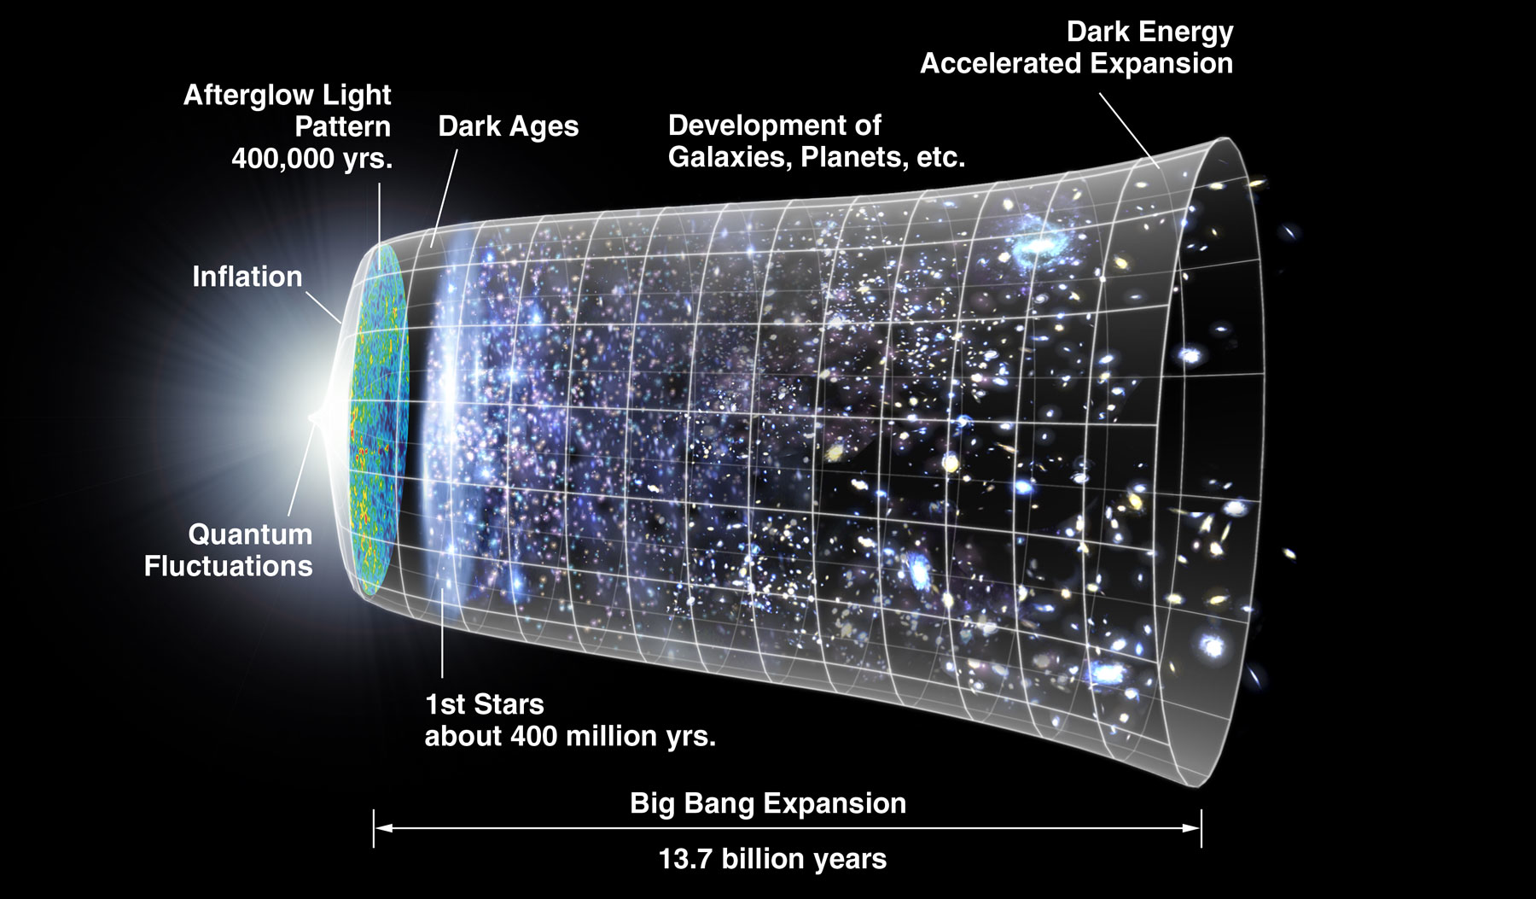
The next scientific challenge is to understand the very first moments of our Universe after the Big Bang
LHC
10⁻¹⁰s

Slide 9
How are we doing
what we are doing?

Slide 10
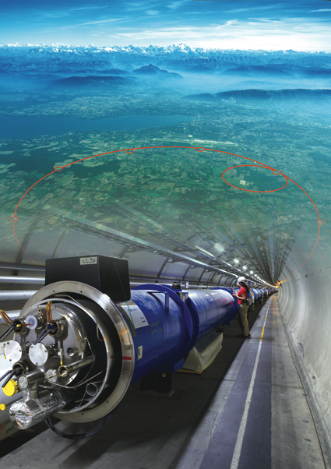
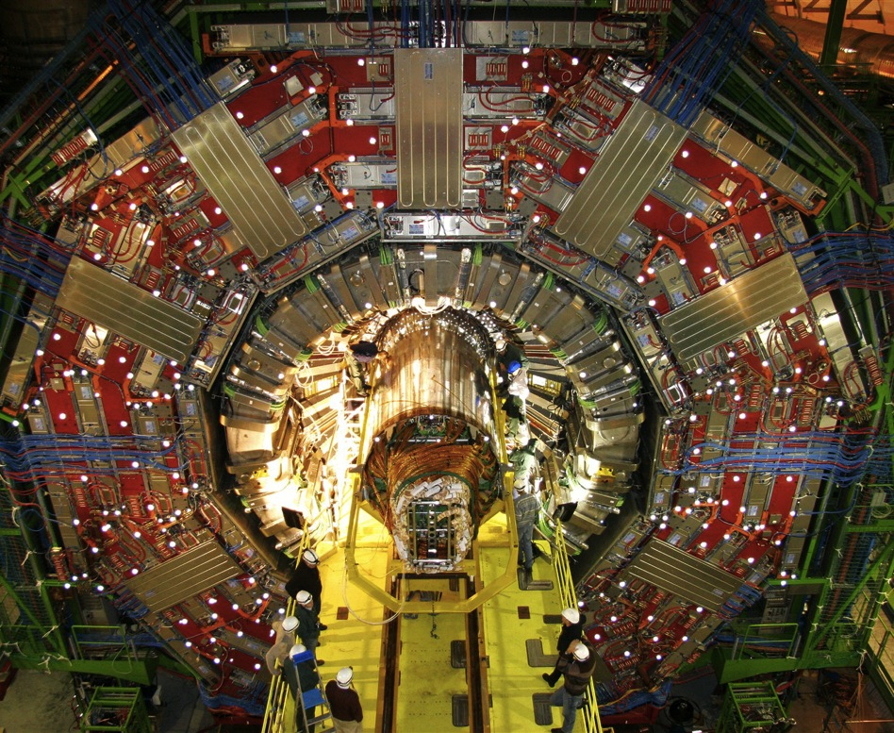
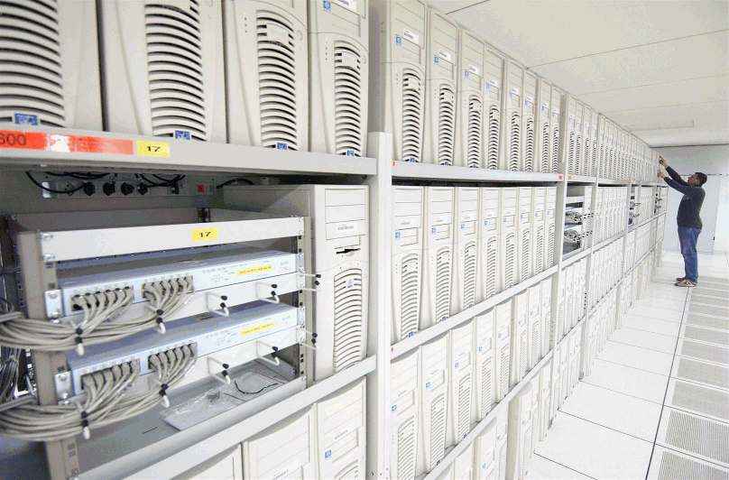
The instruments used
1. Particle accelerator :
Boost particles to high energies and make them collide
2. Detectors :
Gigantic instruments that observe and record the results of the collisions
(particle trajectories, energy, charge…)
3. Computers :
Collect, store, and send around the world the big quantity of data received from the detectors for data analysis

Slide 11
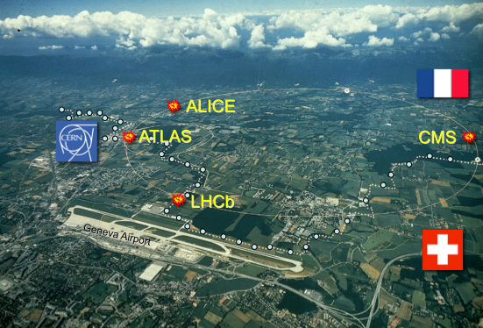

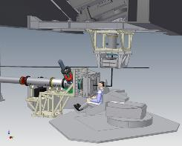
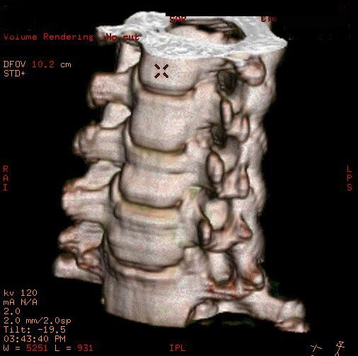
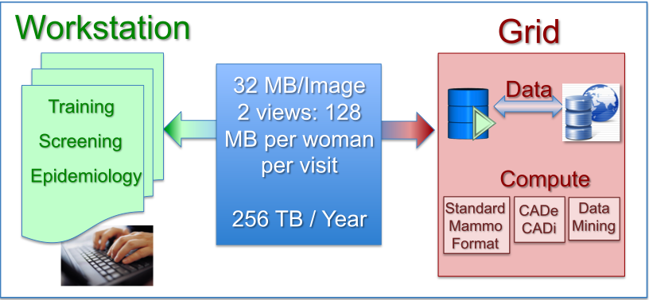
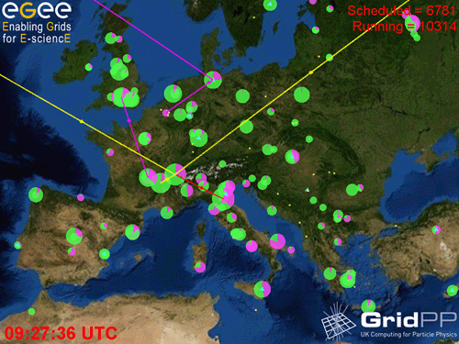
The technologies developed at CERN generate innovations
Accelerators
Detectors
CAT
Hadron therapy
The Computing Grid

Slide 12
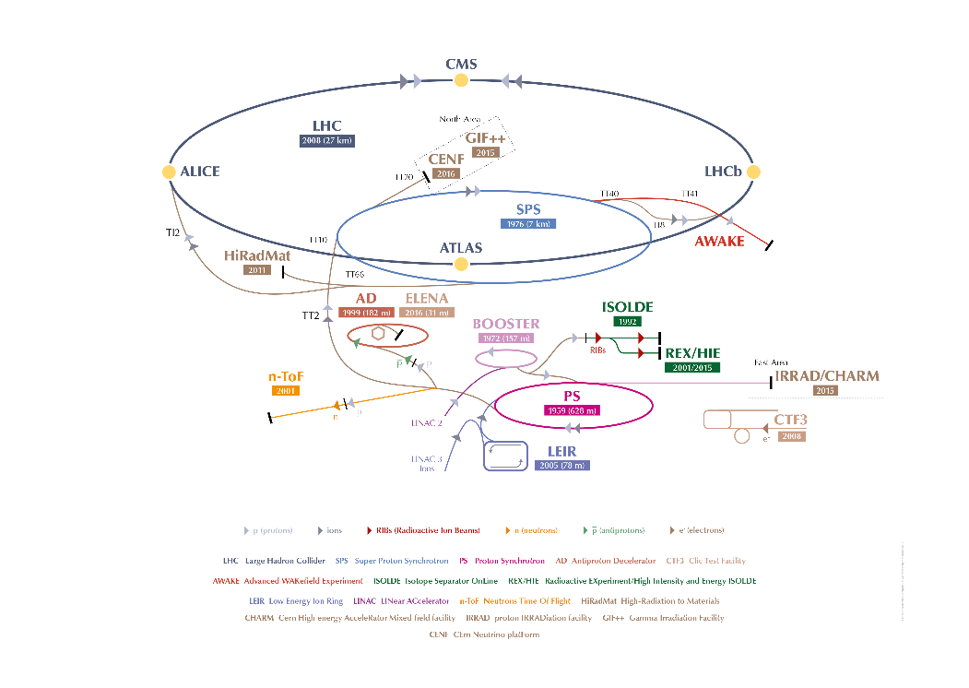
?
?
?
?

Slide 13
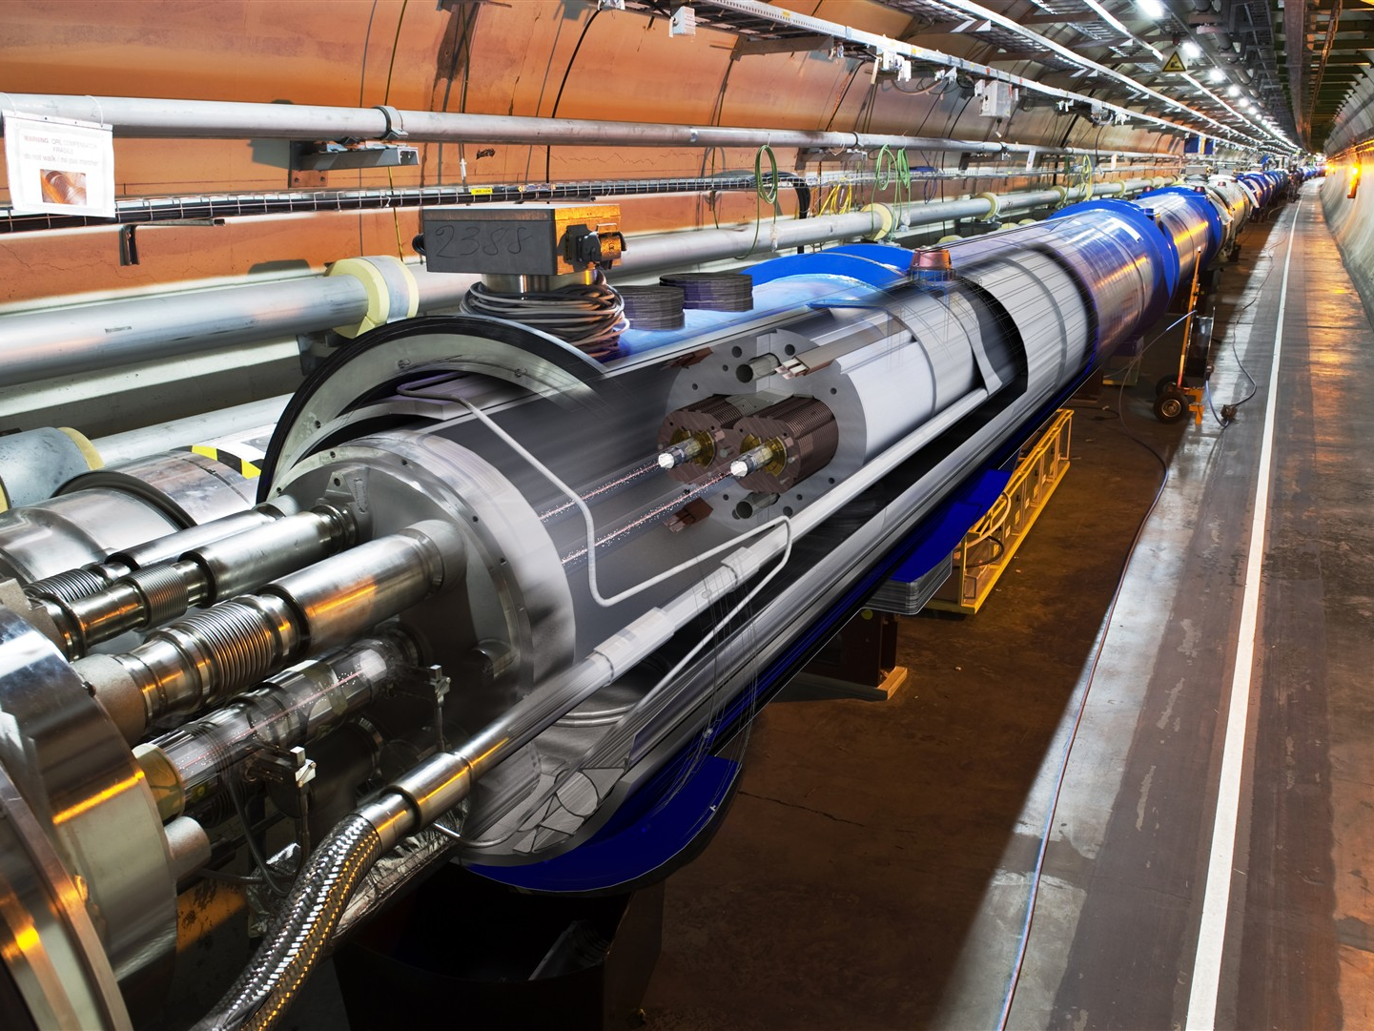

The LHC
A collider situated in an underground 27 km in an almost circular tunnel designed to accelerate two proton beams to 7 TeV
+ than 25 years
1982 : First studies
1994 : Project approved by the CERN council
1996 : Final decision and start of the construction
2004 : Installation starts
2006 : Hardware commissioning starts
2008 : End of hardware commissioning
2009-2030: Physics

Slide 14
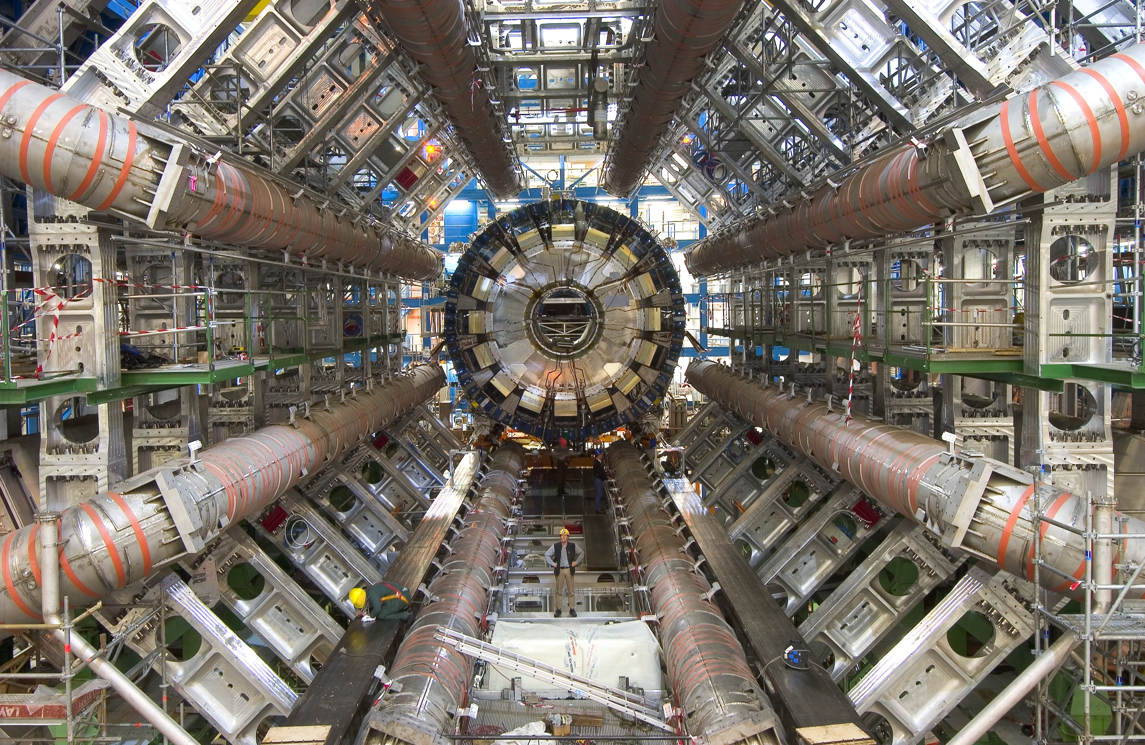
A big experiment at the LHC : ATLAS

Slide 15
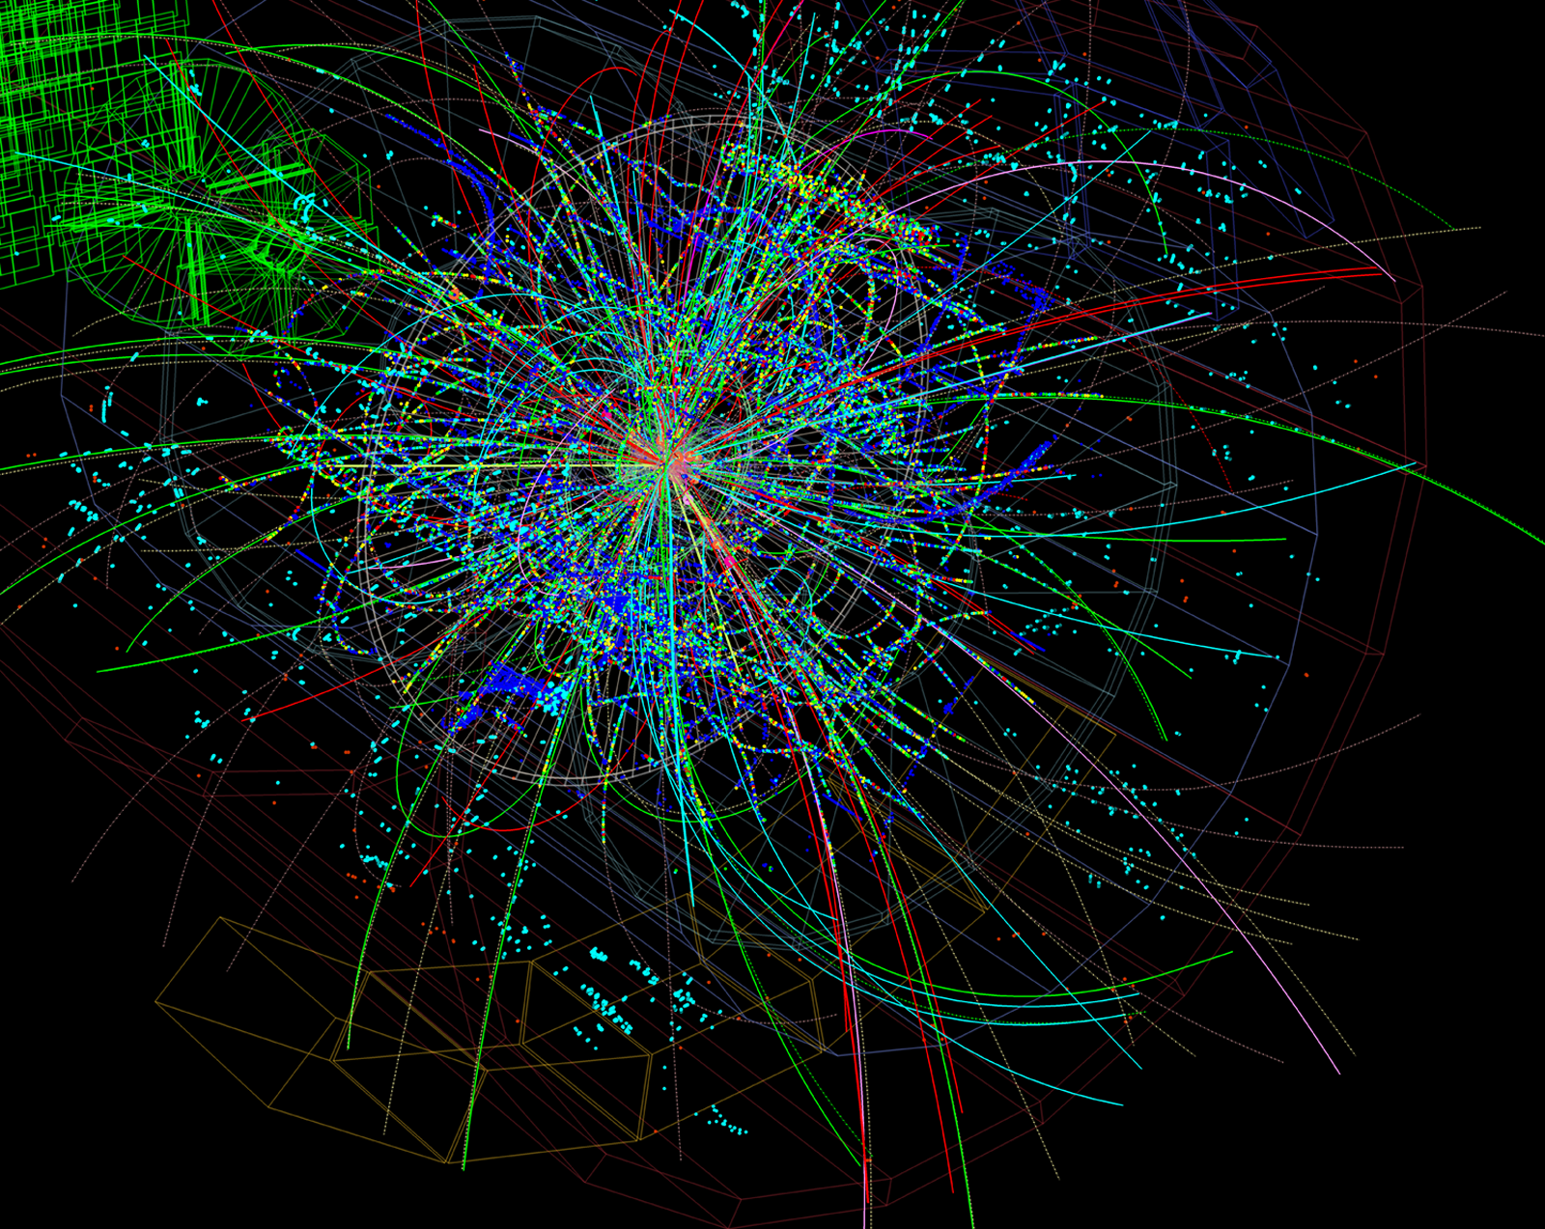
Taking pictures of particles: detectors

Slide 16
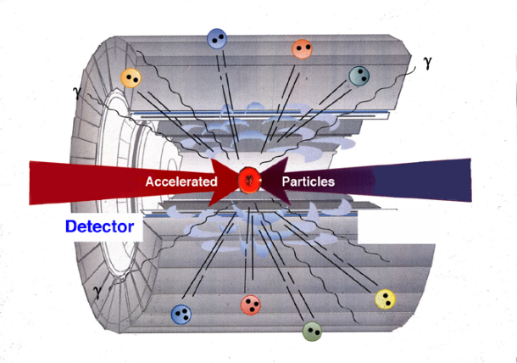

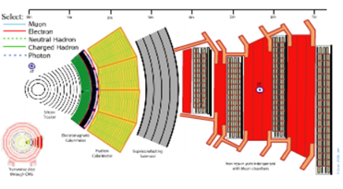
How do we study the elementary particles?
1) Accelerate protons or ions to high energy
3 Identify the particles generated by the collisions
2) Collide these head-on
4) Collect and analyze the data from many collisions

Slide 17

H ➔ γ γ

Slide 18
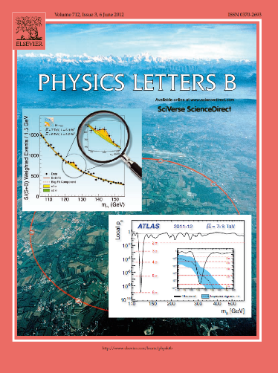

2012 : The year of the Higgs Boson

Slide 19
When will we be doing
what we are expected to do?

Slide 20
A long-term perspective
DRAFT

Slide 21
Who are we?

Slide 22
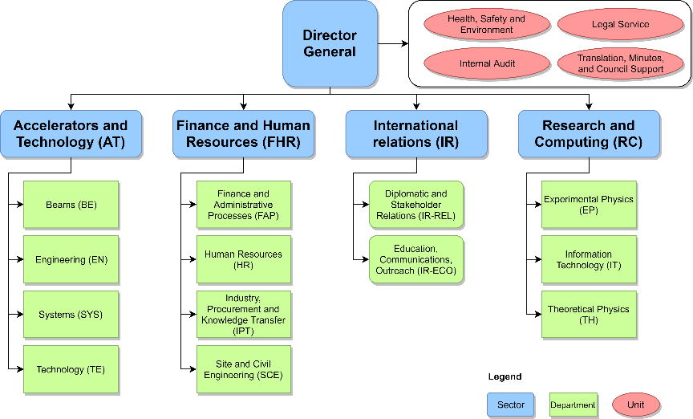
CERN Structure

Slide 23

CERN Structure
Directorate
Director-General | Fabiola Gianotti
Director for Finance and Human Resources | Raphaël Bello
Director for Accelerators and Technology | Mike Lamont
Director for Research and Computing | Joachim Mnich
Director for International Relations | Charlotte Warakaulle

Slide 24
CERN Structure
Heads of departments
Accelerator Systems | Brennan Goddard
Beams | Rhodri Jones
Engineering | Katy Foraz
Experimental Physics | Manfred Krammer
Finance and Administrative Processes | Florian Sonnemann
Human Resources | James Purvis
Industry, Procurement and Knowledge Transfer | Thierry Lagrange
Information Technology | Frédéric Hemmer
Site and Civil Engineering | Mar Capeans Garrido
Technology | José Miguel Jiménez
Theoretical Physics | Gian Francesco Giudice

Slide 25

Head of Department: K. Foraz
Deputy: M. Nonis
Access and Alarms
(EN-AA)
GL: P. Ninin
DGL: R. Nunes
Accelerator Coordination & Engineering
(EN-ACE)
GL: J.-Ph. Tock
DGL: S. Chemli
Planning, Administration & Safety
(EN-PAS)
GL: M. Nonis
DGL: S. Knoops
Cooling & Ventilation
(EN-CV)
GL: I. Ruehl
DGL: S. Deleval
Information Management
(EN-IM)
GL: D. Widegren
DGL: J. de Jonghe
Electrical Engineering
(EN-EL)
GL: N. Bellegarde
DGL: D. Ricci
Handling Engineering
(EN- HE)
GL: C. Colloca
DGL: C. Bertone
Mechanical & Materials Engineering
(EN-MME)
GL: F. Bertinelli
DGL: D. Perini
Department Head Office
(EN-HDO)
Assistant: S. Escaffre
Department Head:
Katy Foraz
Operation
  Infrastructure
  Accelerators
Projects
  Consolidation
  Upgrades
  New facilities
  Design & Manufacturing
Studies
5
61
67
11
27
32
78
76
37

Slide 26
Who are we in EN?
24 Nationalities
AT | BE | BG | BR | CH | DE | DK | ES | FI | FR | GB | GR | HU | IN | IT | NL | NO | PK | PL | PT | RO | RU | SE | SK
3 | 18 | 3 | 1 | 19 | 9 | 3 | 34 | 8 | 184 | 10 | 3 | 3 | 1 | 42 | 4 | 3 | 2 | 17 | 17 | 3 | 1 | 2 | 1
Professional Category
Administrative work | 2 | 4%
Office & Administrative work | 13
Scientific & Engineering Work | 182 | 47%
Scientific Work (Experimental & Theoretical Physics) | 5
Technical work | 195 | 49%
Manual work, Crafts & Trades | 1
F | M
14% | 86%
Status
Cooperation Associates | 7
Doctoral Students | 4
Fellows | 37
Project Associates | 17
Staff | 320
Technical Students | 6
Trainees | 6
Administrative Student | 1
TOTAL | 398

Slide 27

AA : Access and Alarms
The AA group is in charge of the specification, engineering, installation and maintenance of the systems that ensures the Safety of the CERN Personnel,
Users and Visitors, on all its site and facilities.
The Safety Systems concerns:
          Fire and Gas/ODH detection, emergency phones and evacuation, alarm transmission and monitoring,
          Interlocks to protect people radioactivity, X rays, lasers, electricity and cryogenics hazards,
          Access control to all CERN conventional or nuclear facilities and sites,
          Video surveillance, protection and intrusion detection,
          Access data management applications.
Group Leader
Pierre Ninin
Notes:
Machines & Experimental Facilities: is responsible for planning and coordinating all maintenance and installation activities in the CERN Accelerator Complex, providing support to the experiments using the CERN accelerators.

Slide 28
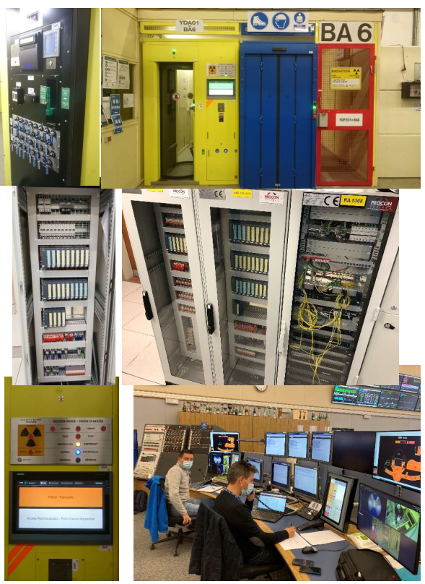
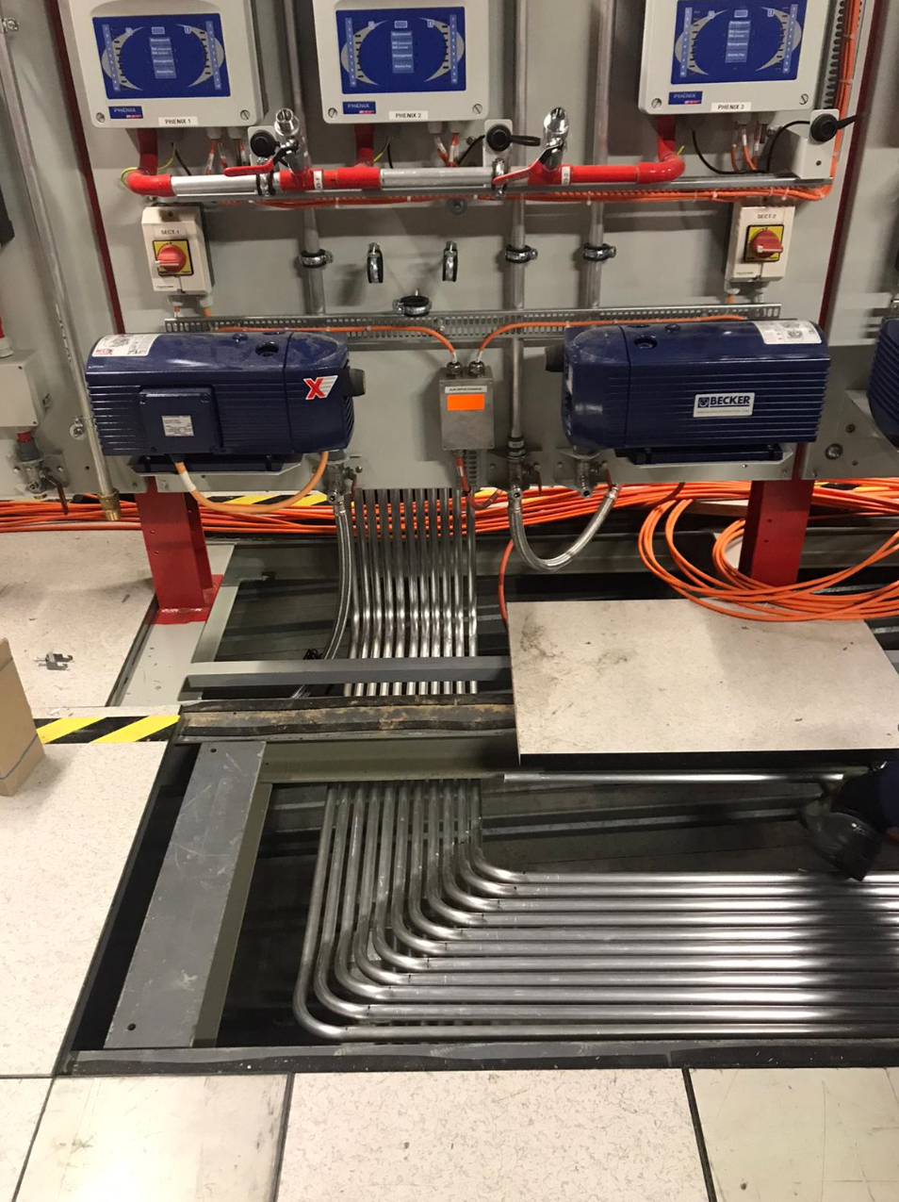
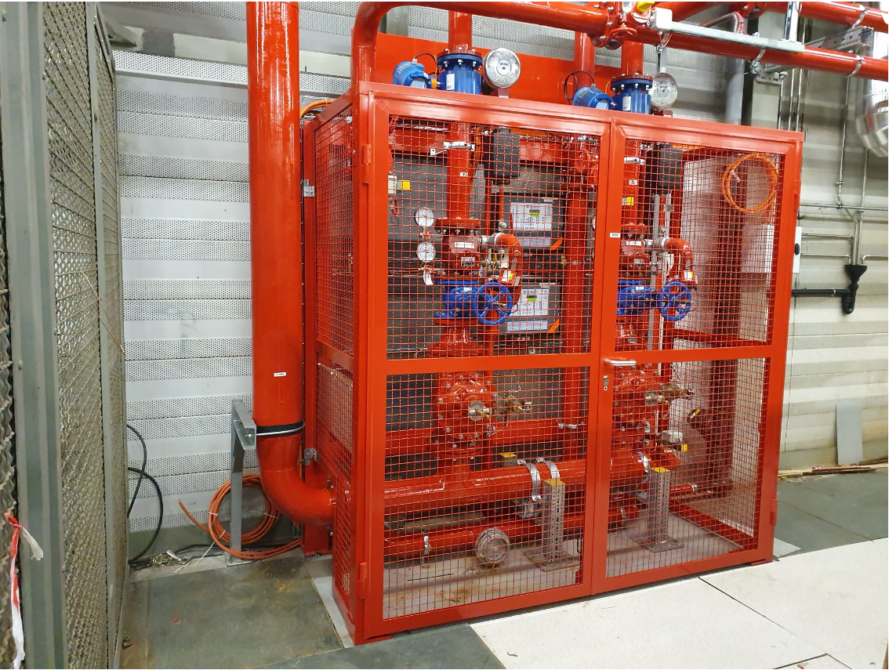
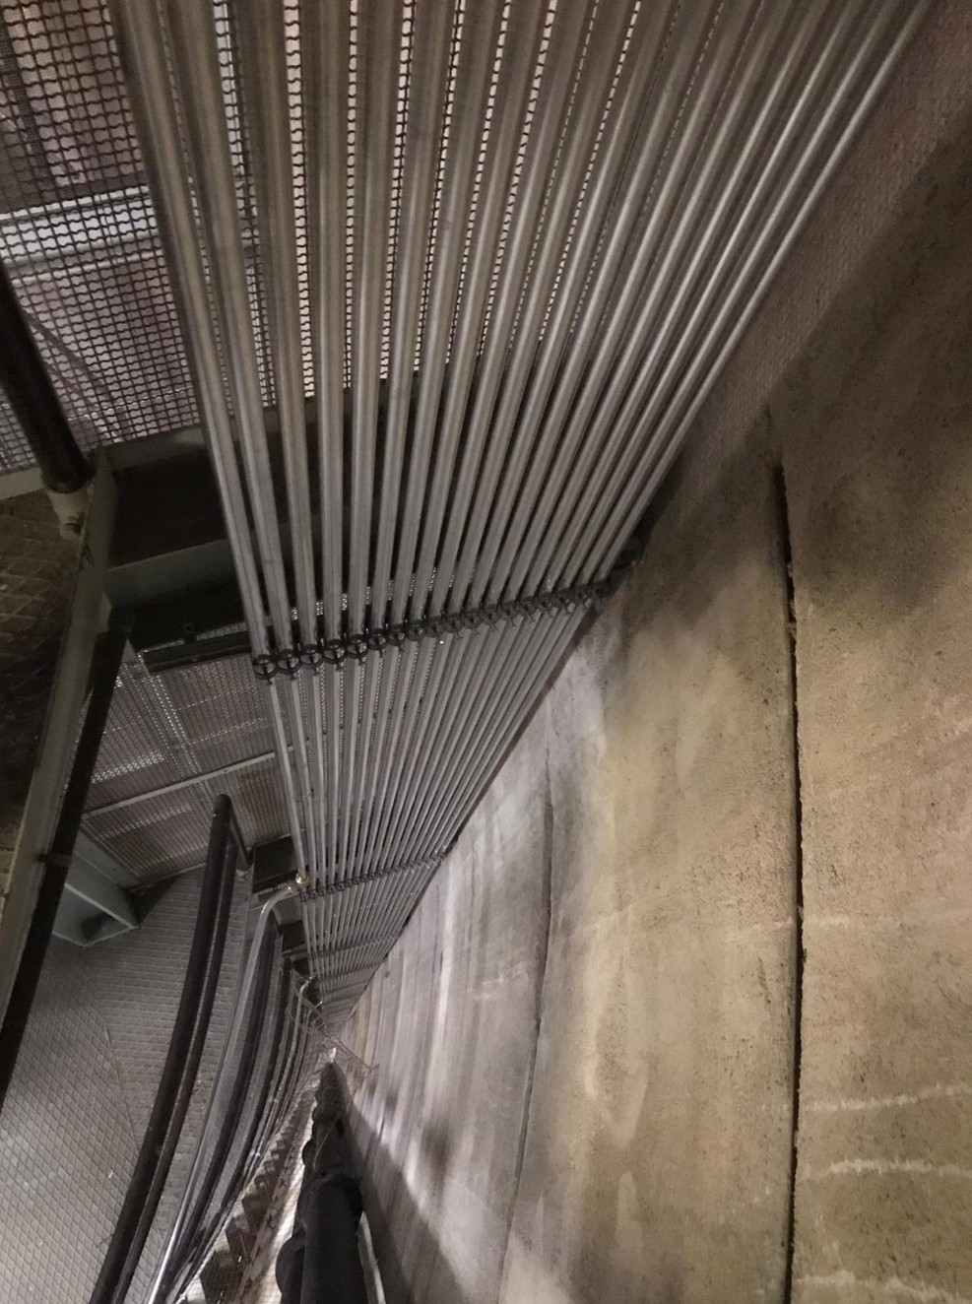
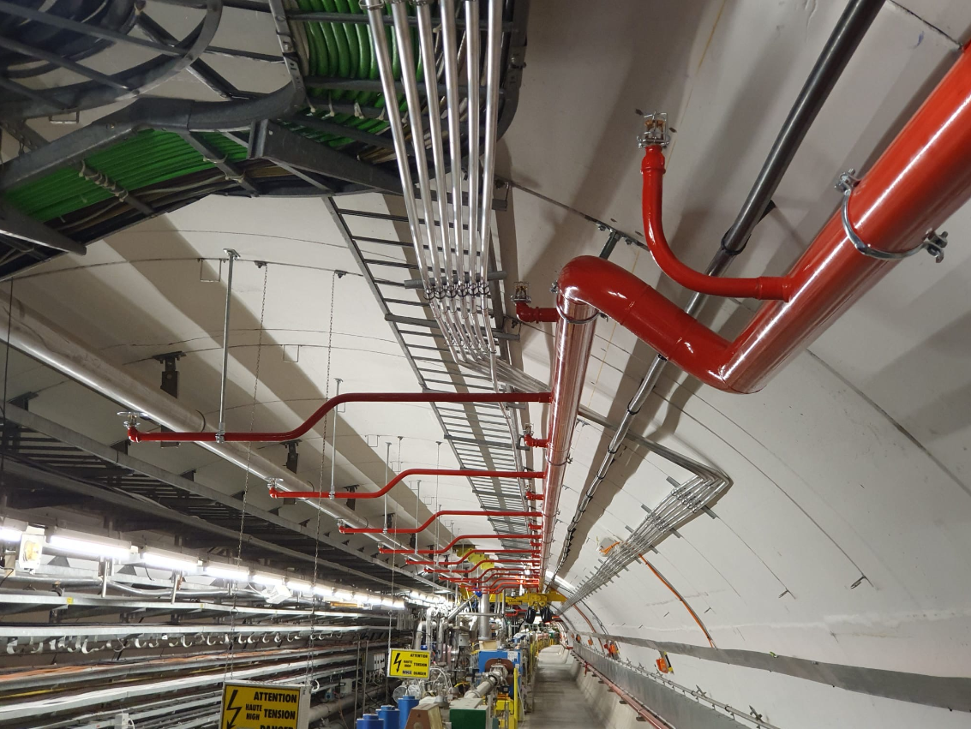
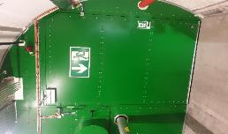
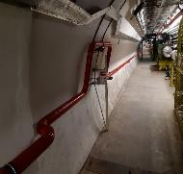
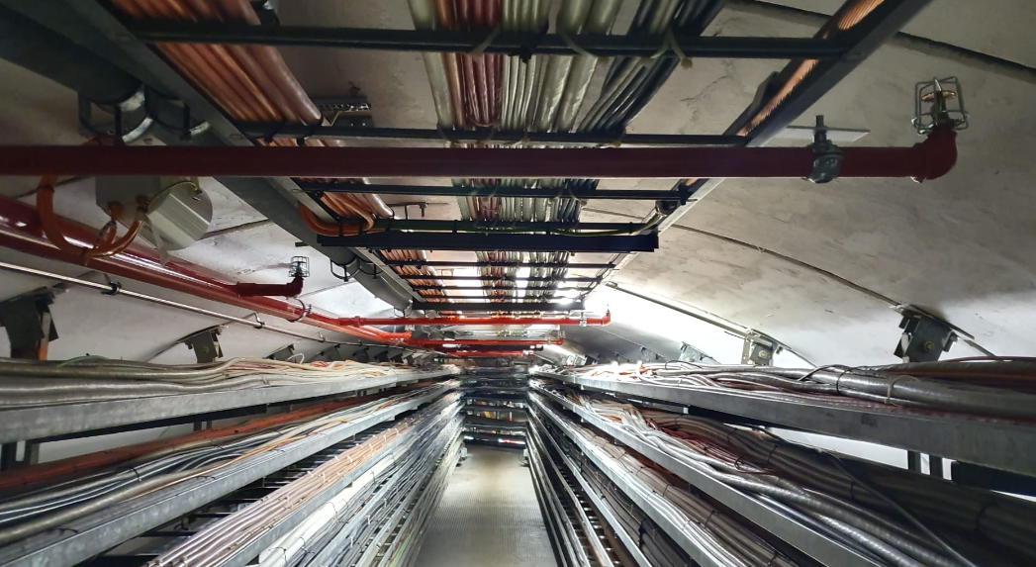
SPS-FIRE Safety Project: new automatic fire detection & fire protection
SPS-ACCESS Project: new access and safety system to the SPS underground areas
Notes:
Machines & Experimental Facilities: is responsible for planning and coordinating all maintenance and installation activities in the CERN Accelerator Complex, providing support to the experiments using the CERN accelerators.

Slide 29
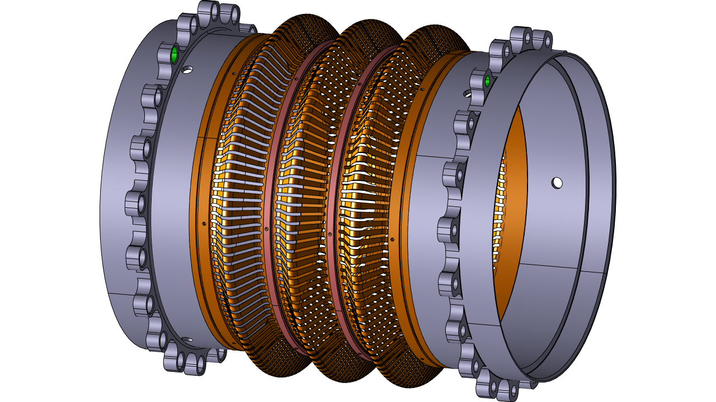
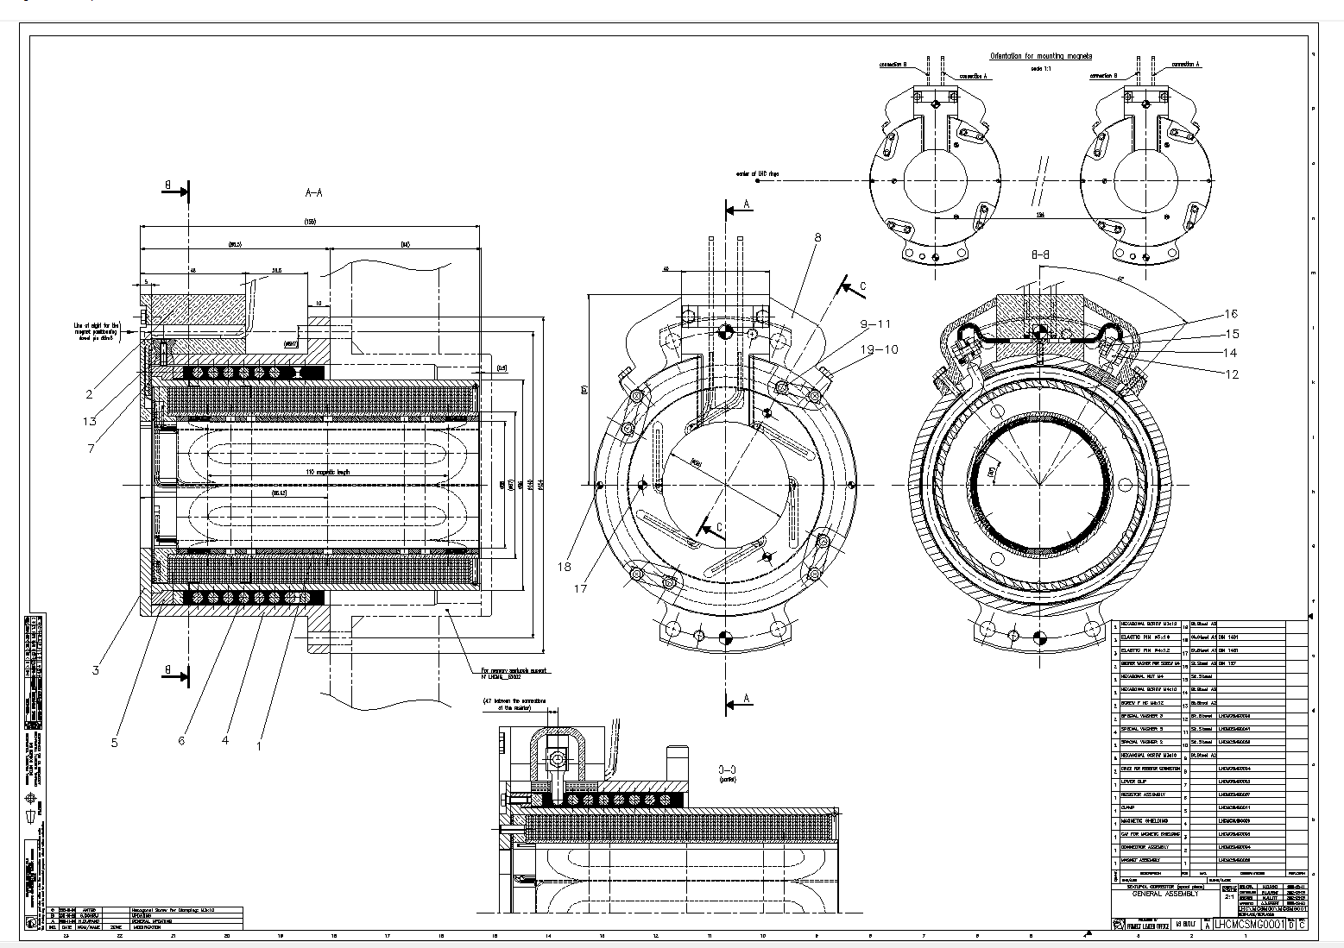

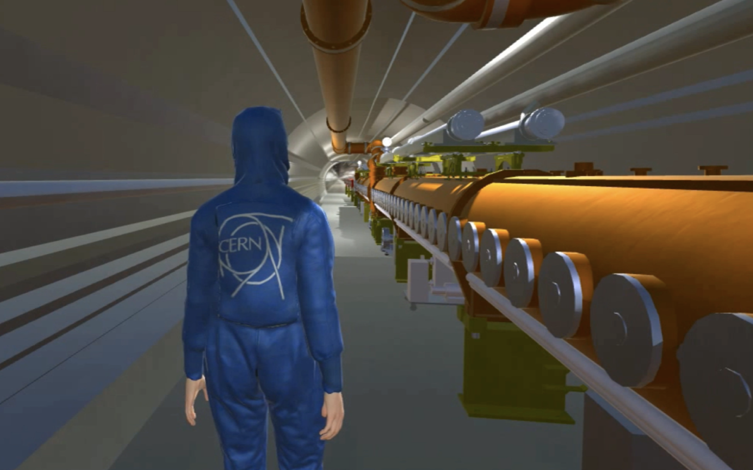

IM : Information Management
The IM group provides applications and support for engineering information management throughout the whole Organization and its different projects.
This includes for example mechanical CAD tools (such as CATIA), Product Lifecycle Management systems (Smarteam / Aras), the Engineering Data Management Service (EDMS) as well as the Enterprise Asset Management platform (Infor EAM).
The group helps implementing and configuring these tools according to user needs while ensuring that coherent processes are applied and provides user training.
Group Leader
David Widegren
Notes:
Machines & Experimental Facilities: is responsible for planning and coordinating all maintenance and installation activities in the CERN Accelerator Complex, providing support to the experiments using the CERN accelerators.

Slide 30
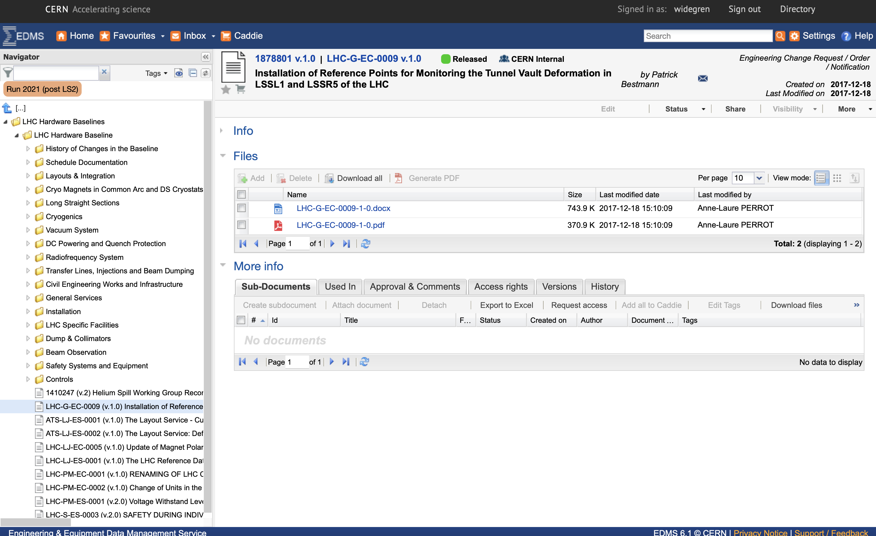
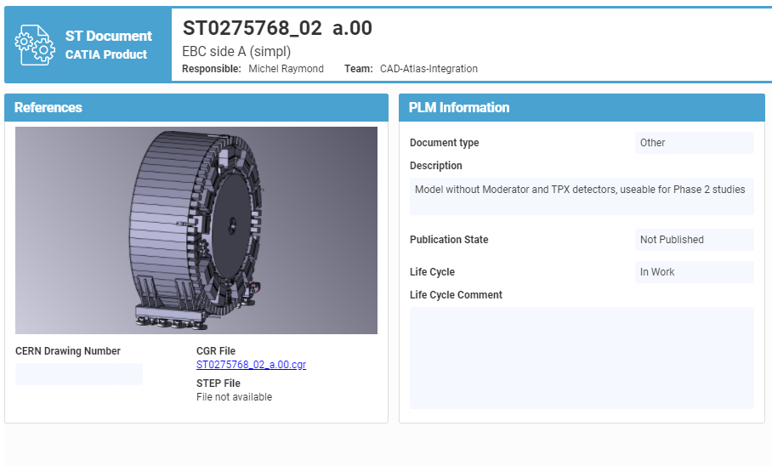
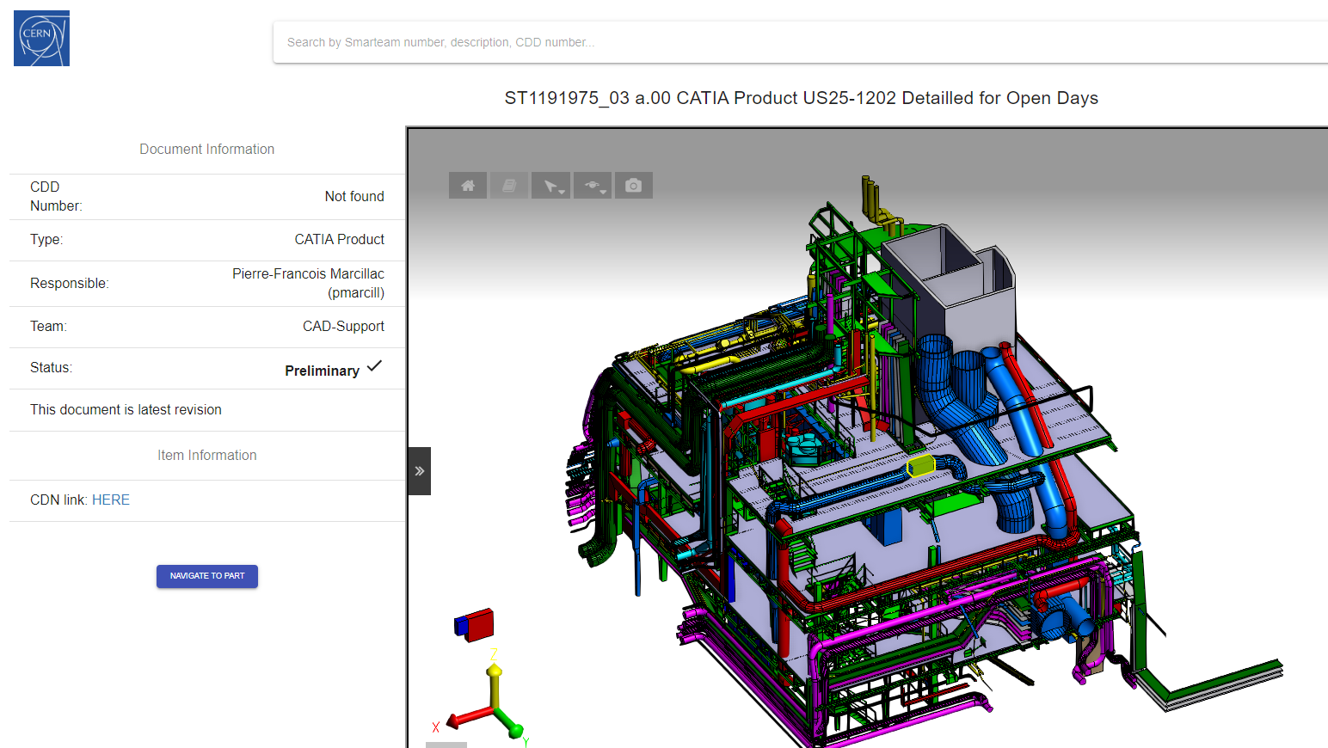
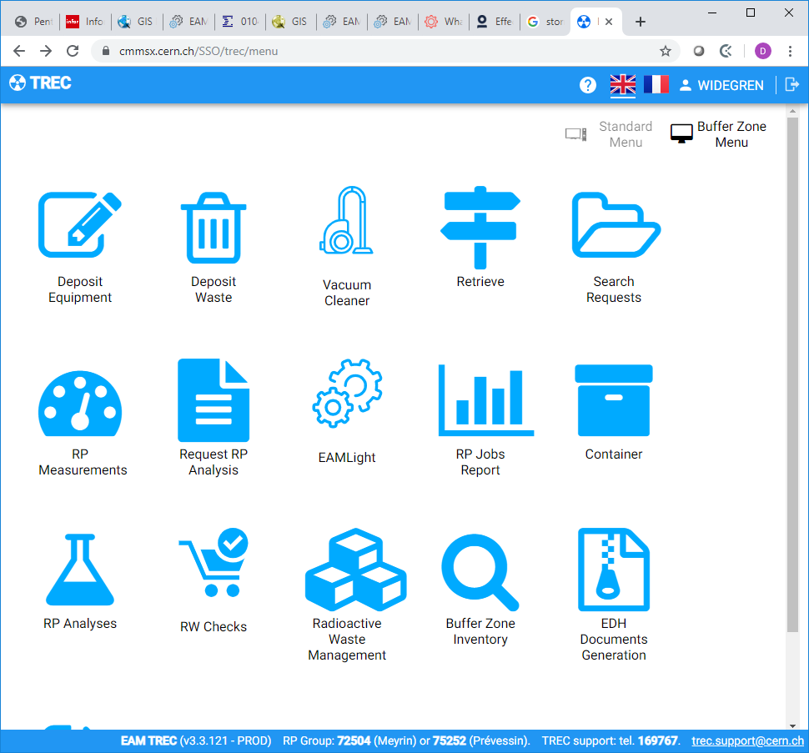

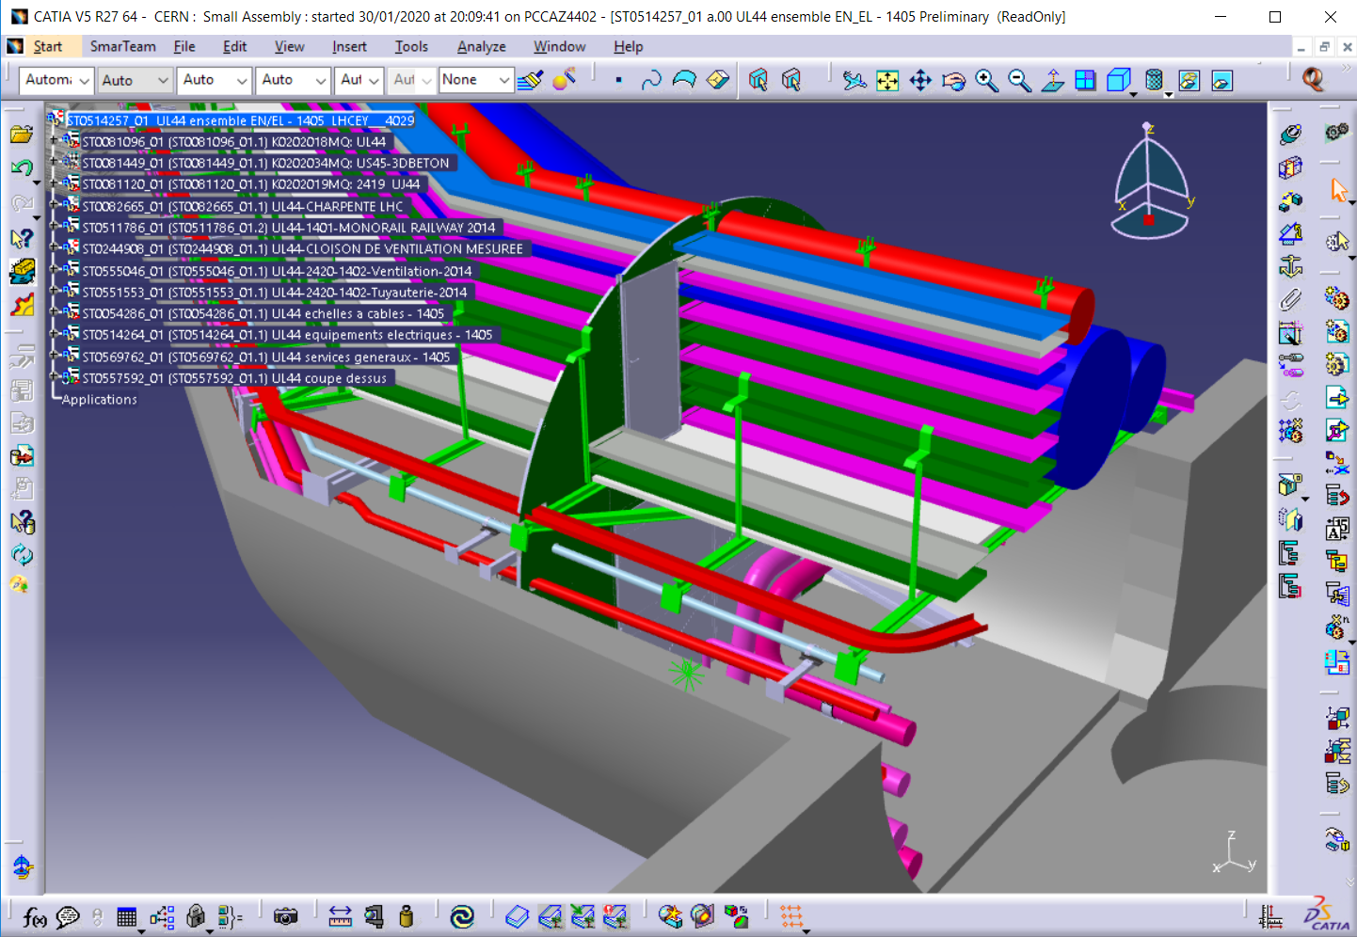
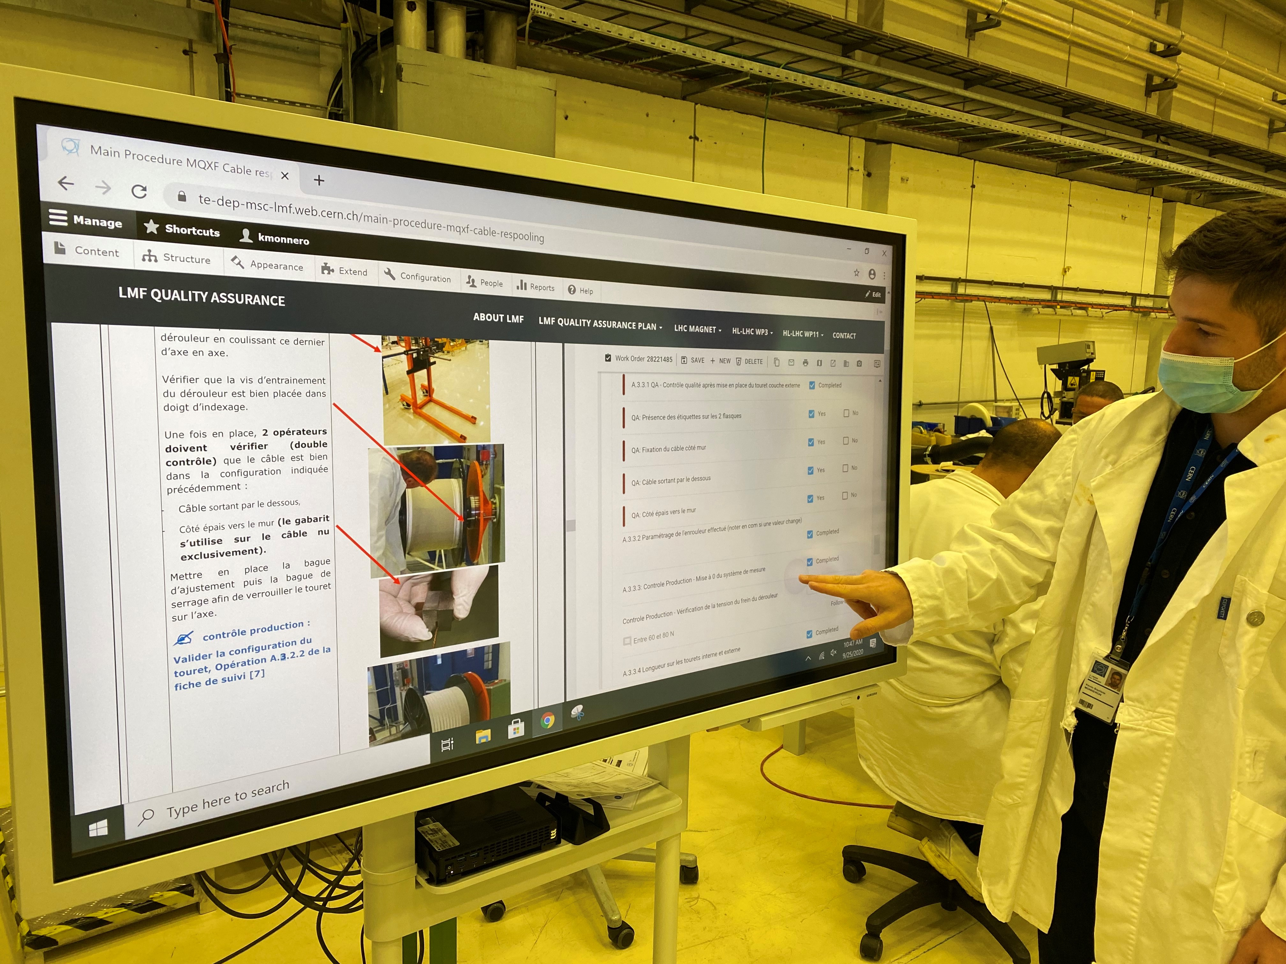
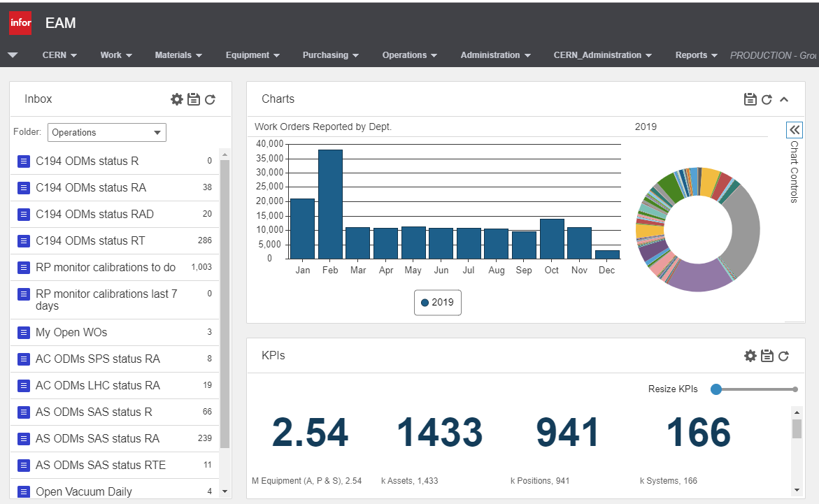
IM : Information Management
A key goal is to provide the tools required to manage and document the entire lifecycles of CERN’s equipment and installations – also known as “Digital Thread”.
Notes:
Machines & Experimental Facilities: is responsible for planning and coordinating all maintenance and installation activities in the CERN Accelerator Complex, providing support to the experiments using the CERN accelerators.

Slide 31

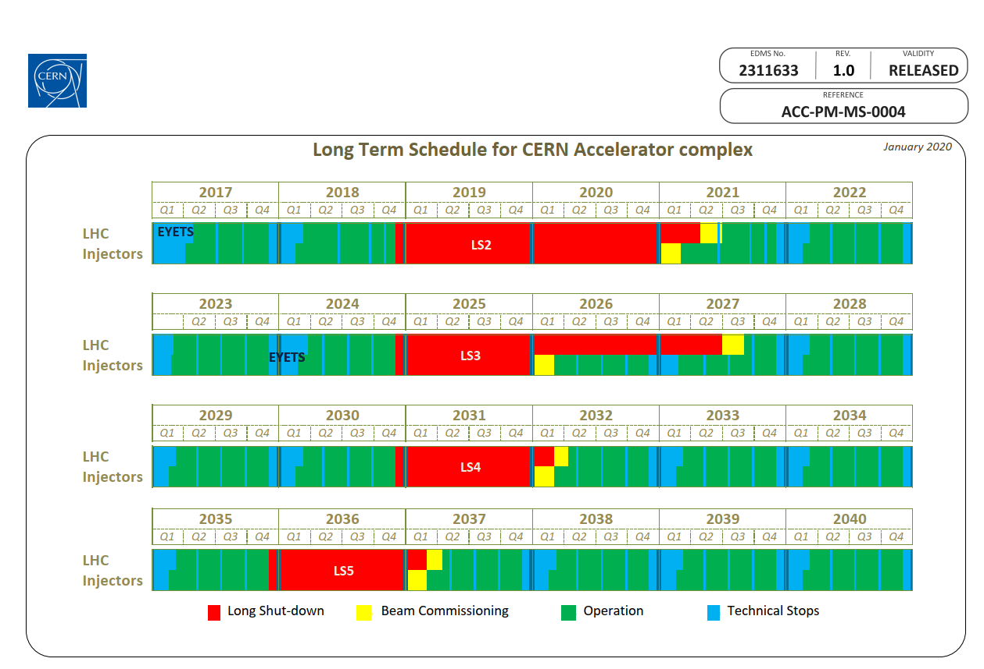
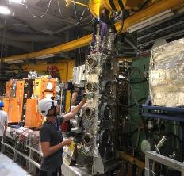
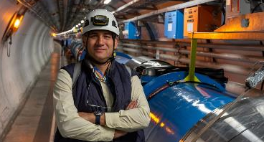
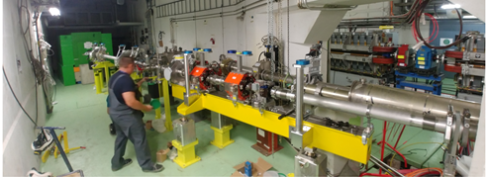
ACE : Accelerator Coordination & Engineering Group
The group coordinates the activities for the interventions and changes to the LHC and its injectors. This includes configuration & layout management, integration studies and maintenance of the related 3D-CAD representations, organization and scheduling of programmed stops, management of the mid- and long-term schedule, worksites follow-up and management of the LHC sites, management of electrical lock-out in LHC and operational safety coordination.
The group is responsible for the ATS Quality Service, giving support to the stakeholders of the ATS.
The group also provides support and/or advices in its key competencies.
Group Leader
Jean-Philippe Tock
Notes:
Machines & Experimental Facilities: is responsible for planning and coordinating all maintenance and installation activities in the CERN Accelerator Complex, providing support to the experiments using the CERN accelerators.

Slide 32
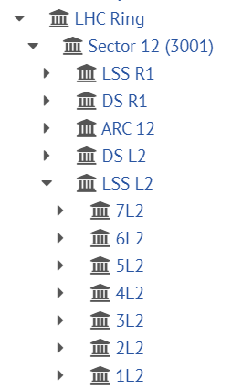
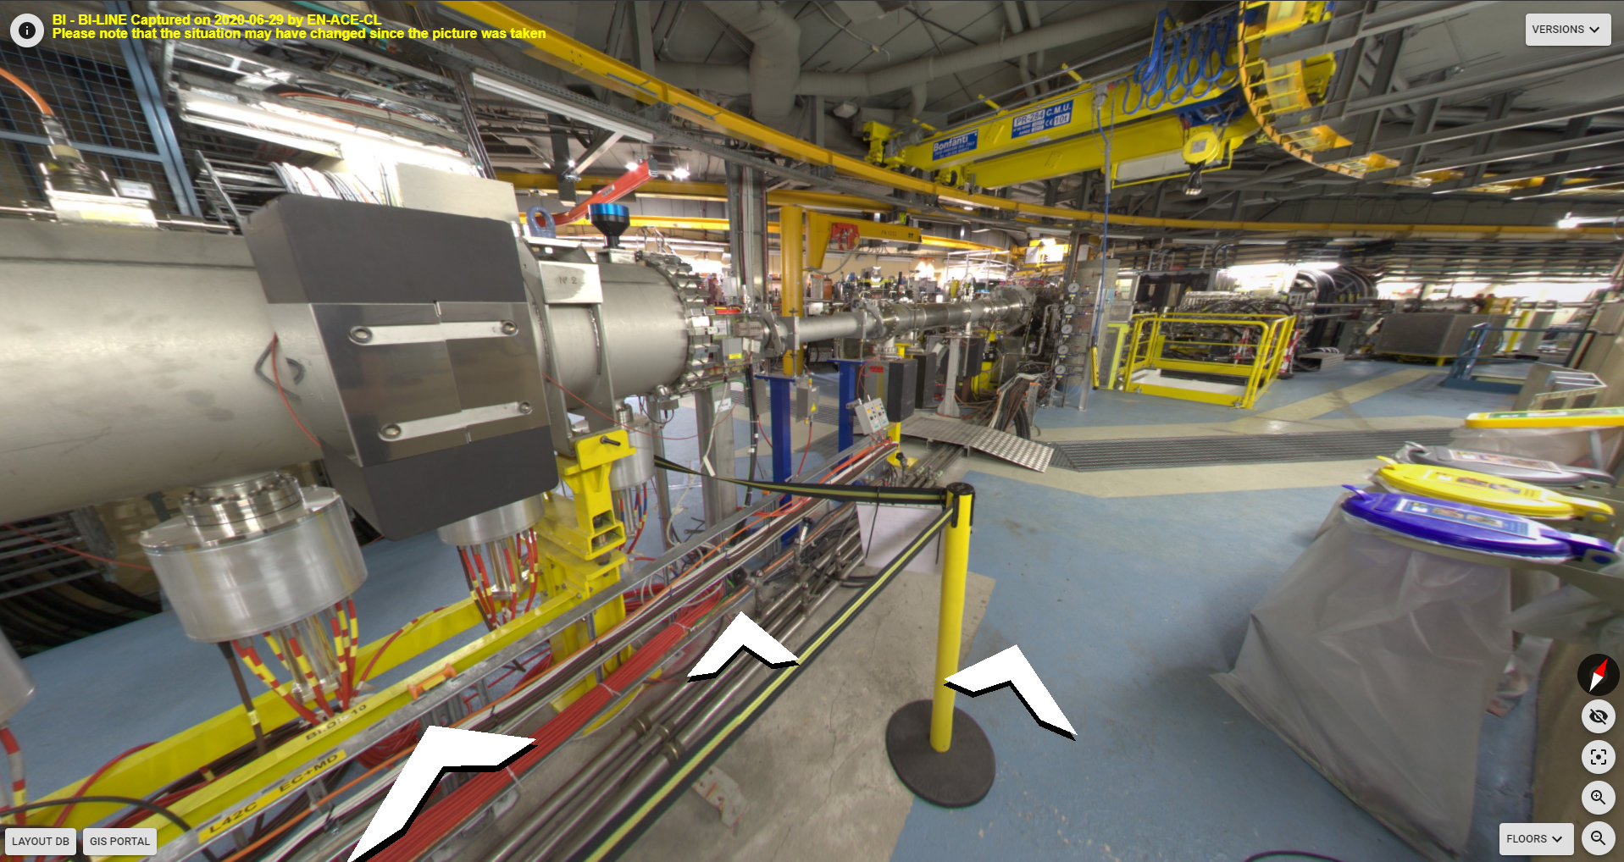
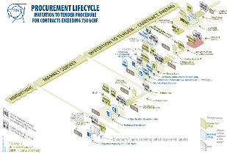
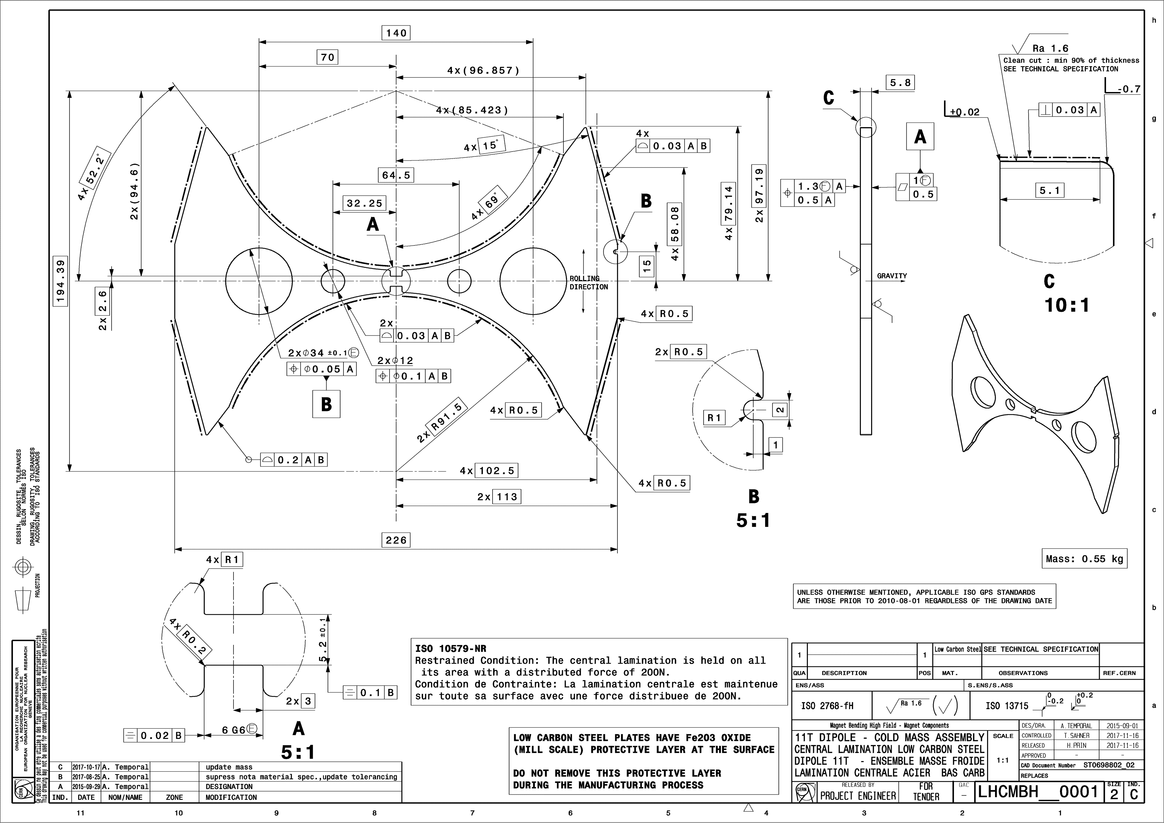









ACE : Accelerator Coordination & Engineering Group
Configuration, Layout, Naming and Integration
Specification Committee
Organisation and Scheduling
Notes:
Machines & Experimental Facilities: is responsible for planning and coordinating all maintenance and installation activities in the CERN Accelerator Complex, providing support to the experiments using the CERN accelerators.

Slide 33













ACE : Accelerator Coordination & Engineering Group
Electrical lock-out
Quality Assurance Service
Operational Safety
Worksite management
Notes:
Machines & Experimental Facilities: is responsible for planning and coordinating all maintenance and installation activities in the CERN Accelerator Complex, providing support to the experiments using the CERN accelerators.

Slide 34



PAS : Planning, Administration and Safety
The group is responsible for supporting the Department Head in the management and planning of the department’s material and personnel resources, as well as for all matters related to safety and environment. It represents the department in CERN-wide or inter-departmental bodies dealing with administrative, personnel, budget and safety matters. It also defines and implements safety and administrative procedures, for both the personnel and the material within the Department.
People
Group Leader
Mauro Nonis

Slide 35




PAS : Planning, Administration and Safety
Safety
Budget

Slide 36




CV: Cooling and Ventilation Group
The group is in charge of:
Design, installation, commissioning, operation and maintenance of the cooling systems, pumping stations, air conditioning plants and fluid distribution systems of all accelerators, their experimental areas and some of the special cooling systems of LHC sub-detectors.
Computational fluid dynamics (CFD) simulations, as well as studies on fluid dynamics, ventilation, heat transfer, smoke behavior, gas and radio nuclides propagation are performed by the group.
Group Leader
Ingo Ruehl
Notes:
Cooling & Ventilation Group (Groupe Refroidissement et Ventilation):
is in charge of the operation, maintenance and innovation of cooling systems, pumping stations, air conditioning installations.

Slide 37



Cooling
Cooling plants (raw, demin. water, C₃F₈, C₆F₁₄) | 150
Pipelines | 800 km
Hydrants | 800 points
Cooling towers (450 MW) | 22
Chilled water plants 6-12 °C (73 MW) | 35
Water consumption (peak) | 1’260 m³/h
Water network (3 pumping stations) | 5’400 m³/h
Equivalent to a small town of 25’000 inhabitants.
Annual consumption reduced by 40% in last 8 yrs.

Slide 38




Ventilation
Heating, ventilation and air conditioning | > 1’500 units from 2’000 to 120’000 m³/h each
Compressed air | 14 stations 200 km network
 | km | m³/h
Eurotunnel | 50 | 540’000
LHC | 27 | 290’000

Slide 39




EL : Electrical Engineering Group
The mandate concerns the electrical distribution network from 400 kV to 400/230 V. Its main missions are to operate, maintain, extend and renovate the network, analyse and make projections for CERN electrical energy consumption and manage relations with the energy suppliers.
Group Leader
Nicolas Bellegarde
Notes:
Electrical Engineering Group: is responsible for the CERN electrical distribution network from 400kV to 230V including all CERN cabling and fiber optic activities.

Slide 40
Electricity Distribution
Genissiat
Chamoson
Verbois
BOIS-TOLLOT
400kV - RTE
400kV - CERN
Normal source EDF > 200 MW
EHT1
90MVA
EHT2
90MVA
EHT3
90MVA
EHT4
110MVA
EHT5
110MVA
BEQ3
BEQ2
BEQ1
BE -18kV
SEH9 - 66kV
SPS
NA
MP10
G
L2
L4
L6
L8
BE – BE9
60MVA
BE91
EHT7
70MVA
EHT102
38MVA
EHT103
38MVA
EHT102
38MVA
EHT102
38MVA
EHT102
38MVA
SPS
NA
BE9 - 18kV
Prévessin
LHC2 -18kV
18kV- LHC4
LHC5 -18kV
LHC6 -18kV
18kV- LHC8
MP6
EHT102
70MVA
LHC Loop
MP7 - 30MVA
LHC1 -18kV
EHT102
70MVA
MP10
West
Area
Annual Consumption 1.2 TWh
1/3 of Geneva
ME59 - 18kV
MP5
60MVA
PS
ISOLDE
MP6
Comput.
Center
b.543
Admin.
Area
G
ME9 – 18kV
ME10 – 18kV
EHT611
63MVA
EHT612
63MVA
Poste CERN
130kV - SIG
Emergency source SIG/ALPIQ ≤ 60 MW
Zimeyza/Verbois
Verbois

Slide 41



EL : Electrical Engineering Group
The mandate also concerns the cabling activities. Its main missions are to install control cables, water cooled cables, and fibre optics for users. This activities include the management of infrastructures (cable trays, ducts, patch panels,etc.) and the necessary removal of old and unused installations.
EN-EL is also in charge of the controls of their distribution network.

Slide 42














HE : Handling Engineering Group
From enormous pieces of equipment with unconventional shapes, to extremely delicate detector parts, the careful handling and transportation of components is essential at CERN.
The Handling Engineering (HE) Group prepares, organizes and coordinates all transport and handling operations for the CERN accelerators and experiments as well as the transport of thousands of conventional items, chemical and radioactive products per year.
The Group is specialized in the design, integration and feasibility studies related to the transport and handling operations. Both standard industrial and custom-built transport and handling equipment is being procured, installed and commissioned.
The Group manages and maintains all the industrial transport, handling and lifting equipment to ensure the perfect performance all along its lifecycle.
With the accelerator complex deep underground and about 700 buildings on surface, both passenger and goods lifts are very important. The HE Group is responsible for the purchase, installation and maintenance of all of them, regularly checking their performance.
Group Leader
Cristiana Colloca
Notes:
Handling Engineering Group: provides transport and handling services for the technical infrastructure of CERN, the accelerators, the experiments.

Slide 43















HE : Handling Engineering Group
119 Lifts
88 Forklifts
372 Cranes
158 Tractors
2000 Lifting Beams
5 Mobile Cranes,
23 Mobile Working Platforms
About 6000 assets in Total
50 Special Vehicles

Slide 44





MME: Mechanical and Materials Engineering Group
The mandate of the MME group is to provide to the CERN community specific engineering solutions combining mechanical design, fabrication and material sciences, using in-house and industry facilities, for beam accelerator components and physics detectors.
Prototypes and development work
Beam
Design
Measurements
Simulations
Group Leader
Francesco Bertinelli
Fabrication & Assembly
Notes:
Mechanical & Materials Engineering: provide the CERN community specific engineering solutions combining mechanical design, production facilities and material sciences.

Slide 45

MME : Domains of activities
Design
Fabrication
Materials
Design Office
  50+ designers and 15+ engineers
  CATIA v5 / SmarTeam, ANSYS, LS-Dyna
Mechanical Measurements Lab.
Mechanical workshop (4000 m²)
  60+ technicians and 10+ engineers
  CNC machining
  Assembly & metal forming
  Metal Additive Manufacturing
  Welding (TIG, MIG, electron beam, laser, vacuum brazing)
Technical Subcontracting unit
Material science consultancy
  metallurgical analyses, microscopy including FIB, mechanical tests
NDT: UT, radiography, microtomography
Metrology: 350 m² Lab., several CMM

Slide 46
What are our priorities?

Slide 47


Our priorities
1
2
3

Slide 48

SAFETY: What do we mean?
Occupational Health, Safety and Environmental protection
We mean…
  Put in place all possible measures to prevent:
    Accidents
    Illnesses
    Impact to the environment
protection
measures
!
Trajectory of an accident
Reason Swiss Cheese Model

Slide 49


RESPONSIBILITIES
  The Director General takes appropriate measures to ensure safety of all participating
  in the activities of CERN or present in its site
  Each Member of Personnel shall actively contribute to the implementation of CERN Safety Policy through an exemplary conduct,
  in particular:
    Comply with Safety Rules and Safety Objectives
    Actively seek information to minimize risks
    Avoid hazardous situations
RESPONSIBILITIES in matters of safety CANNOT BE DELEGATED

Slide 50
MAGIC OF CERN
Science is an extraordinary human endeavor
Our understanding of nature at the fundamental level has reached astounding results
The complexity of science requires a combined effort technology + experiments + theory
CERN is a superb example of this combined effort at work
The scientific success of CERN belongs to all of us

Slide 51
Warm welcome again!

