Slide 1
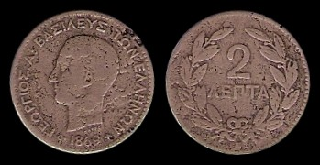
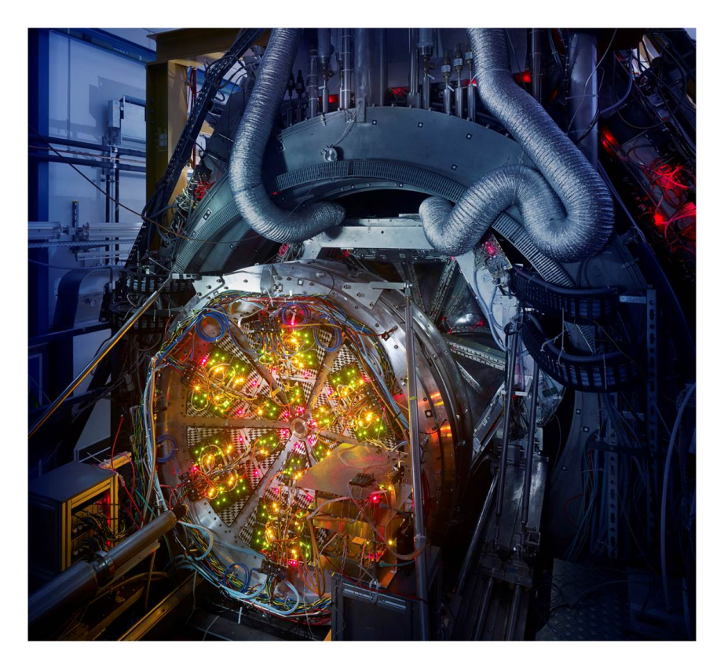
System size and centrality dependence of e⁺e⁻ radiation at E_{beam} = 1.23A GeV ((s_{NN})^{1/2} = 2.42 GeV) with HADES
Szymon Harabasz for the HADES Collaboration
Introduction
Data Analysis
Differential Spectra
Comparison Au+Au vs. Ag+Ag
Future
Summary

Slide 2
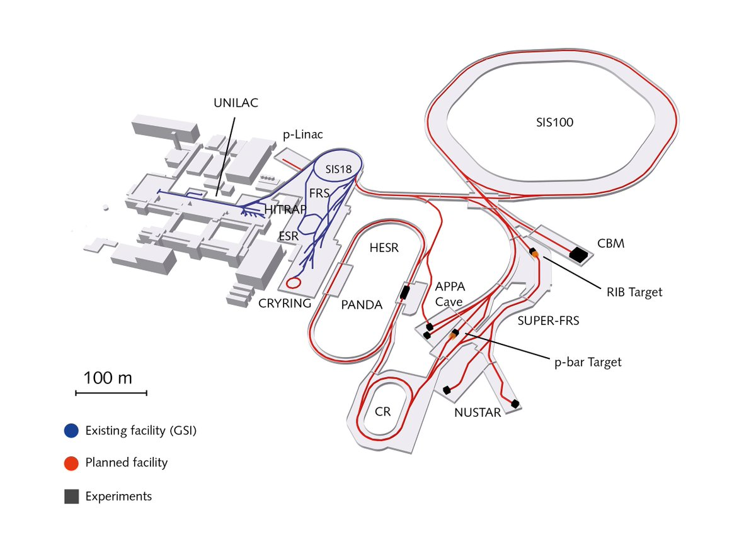
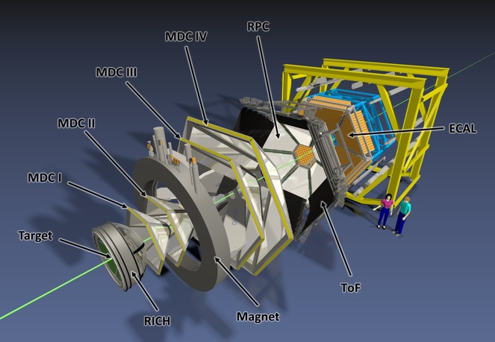
Meet the HADES
(High Acceptance Di-Electron Spectrometer)
Interaction rate:
8 kHz in Apr 2012 Au+Au (s_{NN})^{1/2} = 2.42 GeV
16kHz in Mar 2019 Ag+Ag (s_{NN})^{1/2} = 2.42 GeV and 2.55 GeV
Pion and nucleon beams:
Reference measurements (vacuum, cold QCD matter)
Electromagnetic structure of baryons and hyperons
Heavy ion collisions possible now
at (s_{NN})^{1/2} = 2-3 GeV in fixed-target mode

Slide 3
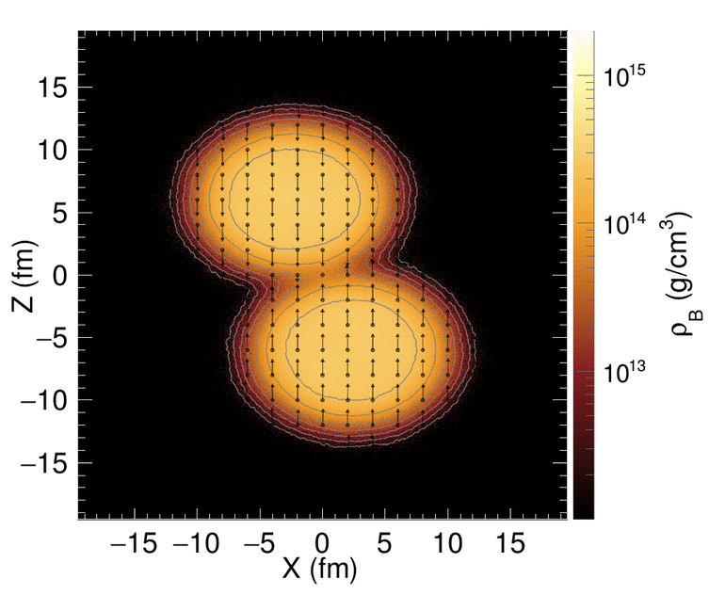
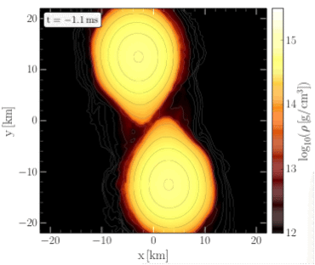

The HADES physics case
[HADES Collab., Nature Physics 15 (2019) 1040]
Au+Au, $\sqrt{s_{NN}}$ = 2.4 GeV
NS mergers
HADES
[Universe 5 (1019) 129,
Fig. credit: T. Galatyuk,
M. Hanauske, F. Seck]
High μ_{B} region of QCD phase diagram
Properties of matter occuring in neutron star mergers
T < 70 MeV, ρ ≈ 3ρ₀ in both cases

Slide 4
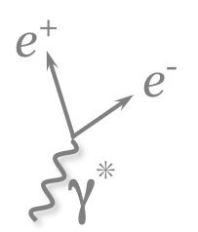
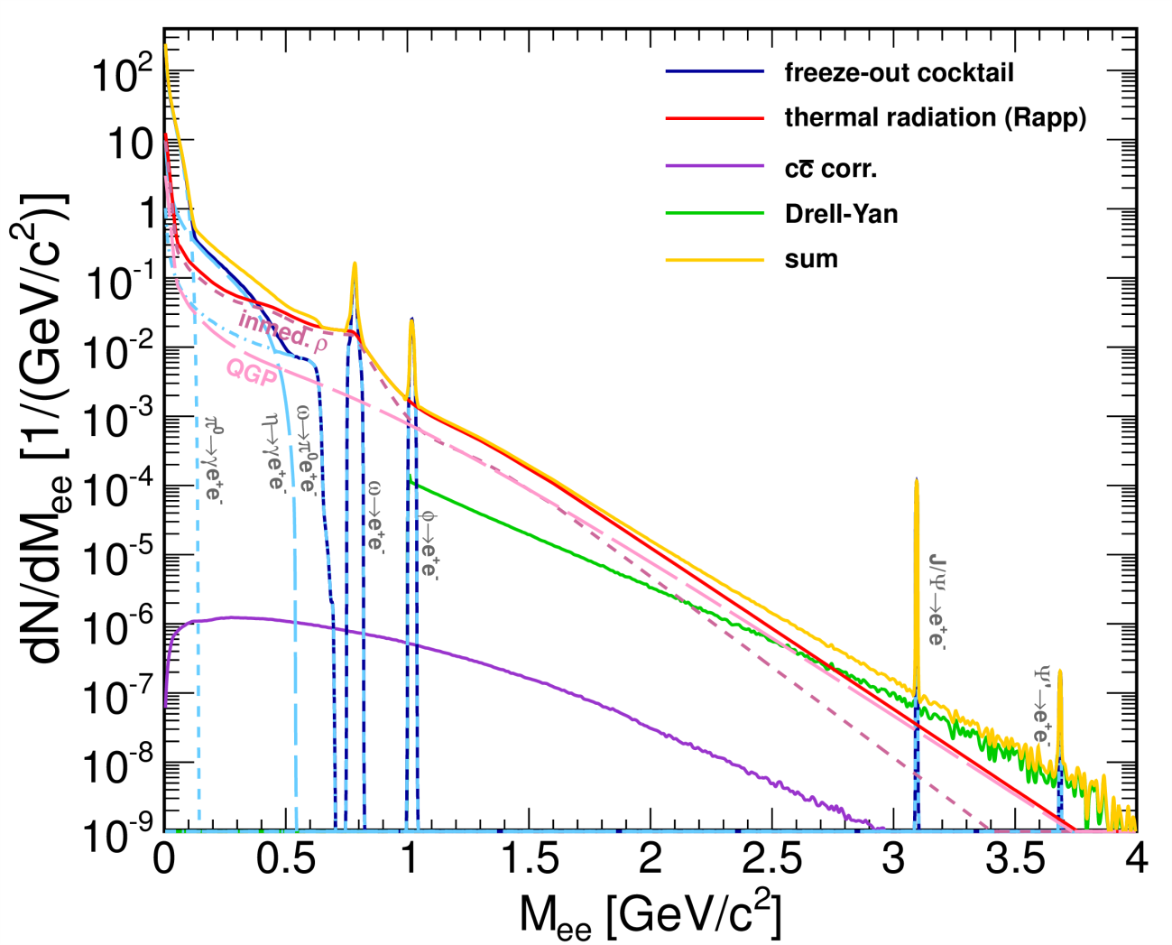
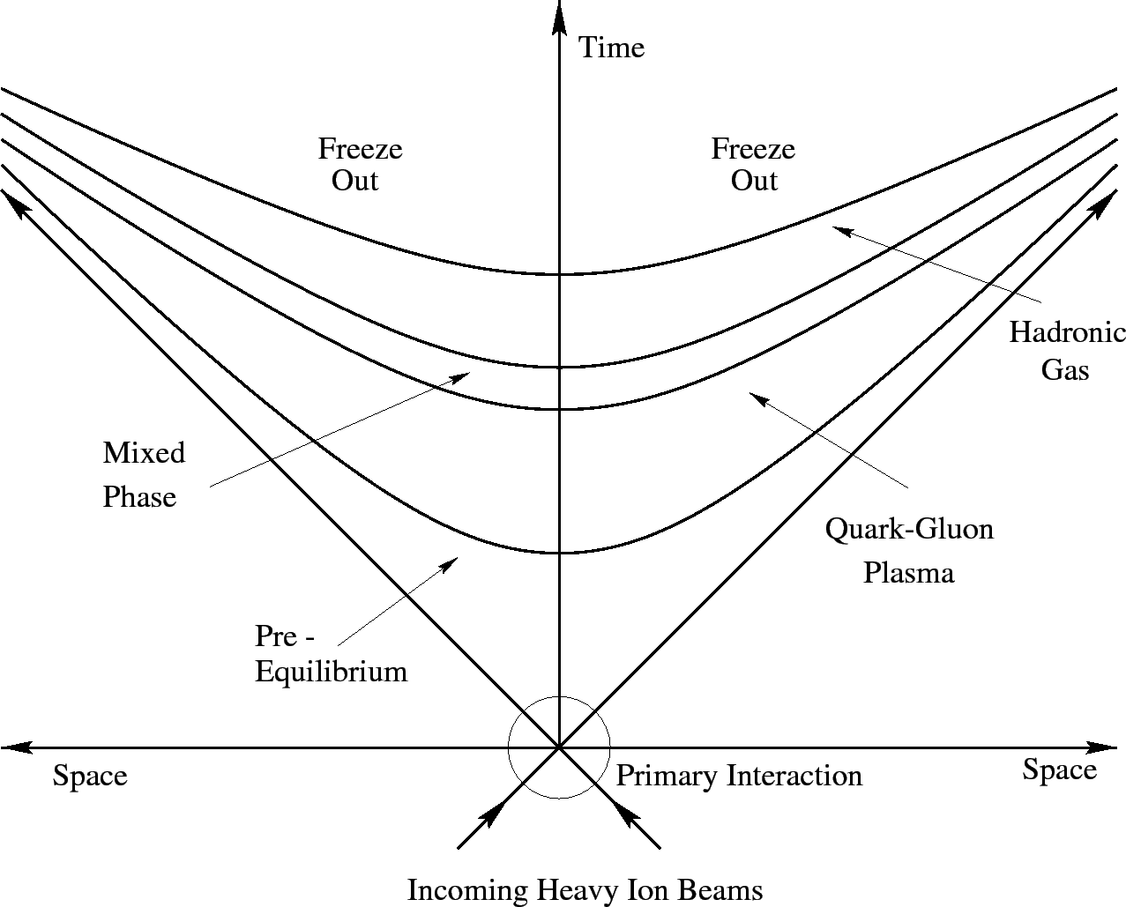


Electromagnetic probes of strongly interacting matter
Schematic spectral distribution of lepton pairs emitted in ultra-relativistic heavy ion collisions
At low E_{beam}

Slide 5
Describing the electromagnetic rate
In-medium parametrization of the spectral function
[R. Rapp, J. Wambach: Eur. Phys. J. A 6 (1999) 415]
Coupling to baryons → strong broadening of the SF
Boltzmann factor
Spectral function
Describes the dilepton
spectra from:
ALICE
[Phys.Rev.C 99 (2019) 2, 024002]
STAR
[Phys.Lett.B 750 (2015) 64-71]
[arXiv:1810.10159 [nucl-ex]]
NA60
[Phys.Rev.Lett. 96 (2006) 162302]
CERES
[Phys.Lett.B 666 (2008) 425-429]
HADES
[Nature Phys. 15 (2019) 10, 1040-1045]
In vacuum the spectral function has been precisely measured:
[Data: NA60 Collab., AIP Conf. Proc. 1322 (2010) 1-10,
Model: H. v. Hees, R. Rapp, NPA 608 (2008) 339-387]

Slide 6
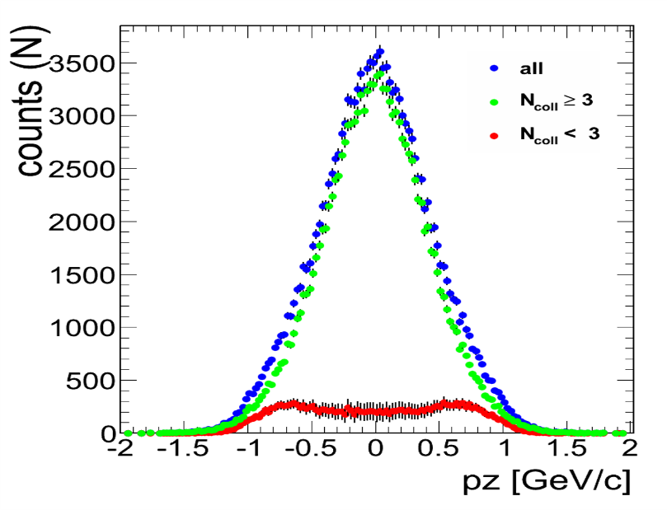
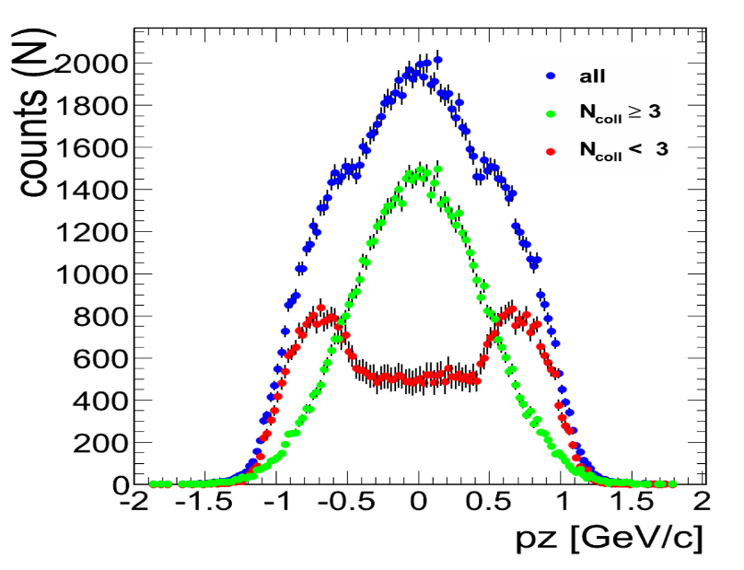
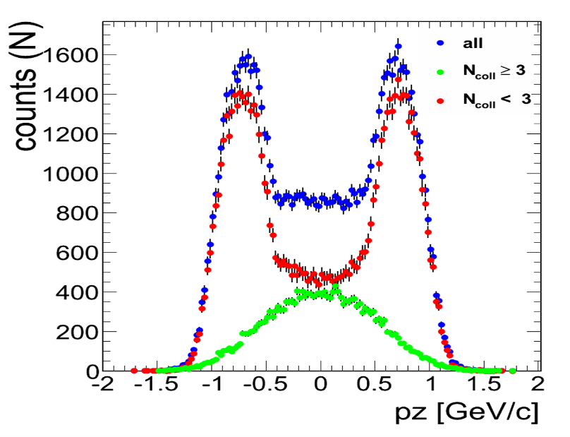
Towards the few-GeV energy regime
Lower beam energy:
Lower temperature
Less abundant meson production
Slower thermalization
Local thermal equilibrium at best
Momentum distribution of nucleons
(based on UrQMD)
τ=4 fm/c
τ=6 fm/c
τ=9 fm/c
Possibilities:
Microscopic transport models
Coarse graining of the hadronic transport
  Simulate (ensemble average of) events with transport model
  Divide the evolution in 4D spacetime cells
  Calculate bulk properties in each cell (T, ρ_{B}, v_{coll})
  Calculate thermal dilepton rates
  for these parameters
  Add up the contributions of all the cells
Phys. Rev. C 66, 014903 (2002)
Phys. Rev. C 92, 014911 (2015)
Eur. Phys. J. A, 52 5 (2016) 131
Phys. Rev. C 98, 054908 (2018)

Slide 7
Data Analysis

Slide 8
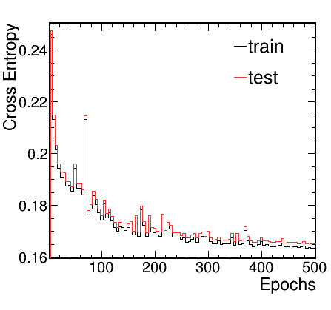
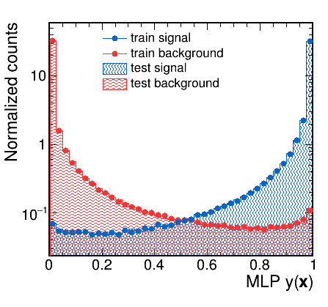
Electron Identification
Track quality selection
Energy loss
Particle velocity
Electromagnetic shower
Cherenkov radiation
All combined in a multivariate analysis (neural networks)
Purity of single lepton identification at least 98 %
PID with multi-layer perceptron (MLP)
Correlated
with momentum
Train and test do no split
→ No signal of overtraining
Plateau reached
→ Sufficient number
of training epochs
Distributions drop rapidly
→ Good discrimination power
Train and test overlap
→ Ability of the model to generalize for unseen data

Slide 9
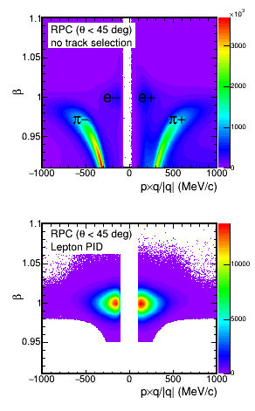
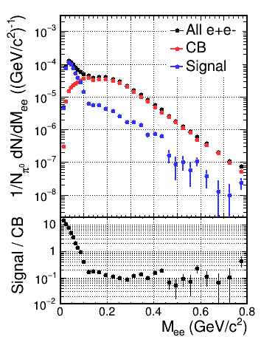
Selection of Signal Leptons
Identification of single e⁺ and e⁻
Building of e⁺e⁻ pair signal

Slide 10
Extracting in-medium radiation
[HADES Collab., MS in preparation,
cf. also Nature Physics 15 (2019) 1040]
pp and np measured at the same beam energy account
for primary interaction
Cocktail of long-lived meson sources is simulated
After subtracting the two one gets in-medium radiation
This can be extrapolated to 4π without much systematics
HADES
preliminary

Slide 11
Differential spectra

Slide 12
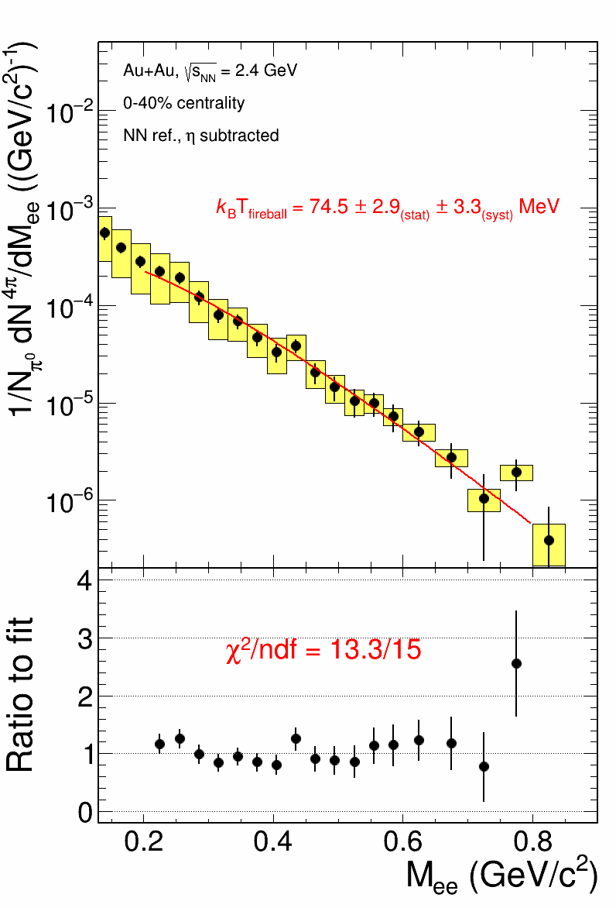
Thermal dileptons at high μ_{B}
HADES
preliminary
Thermal dilepton production rates
Boltzmann factor
[HADES Collab., MS in preparation, cf. also Nature Physics 15 (2019) 1040]
Boltzmann factor dominates the exponential shape of the spectrum if ImΠ_{EM}/M² does not change much with M
Slope of the invariant mass not affected by the fireball expansion
True measure of the (average) source temperature

Slide 13
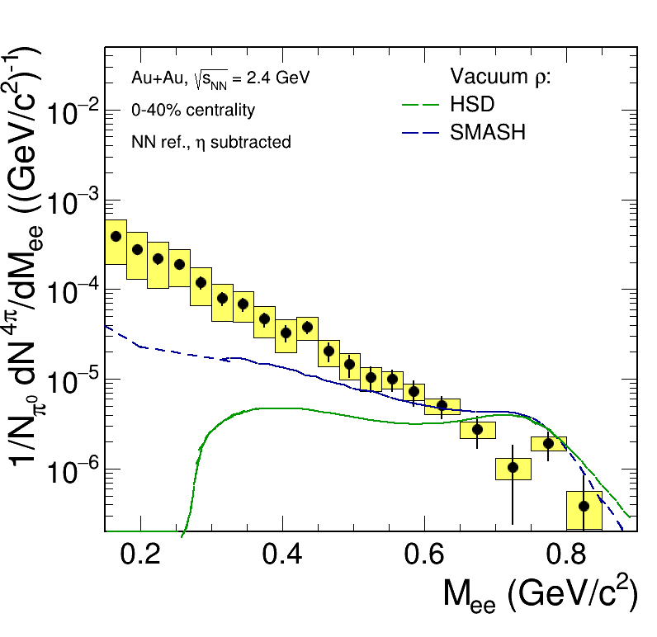
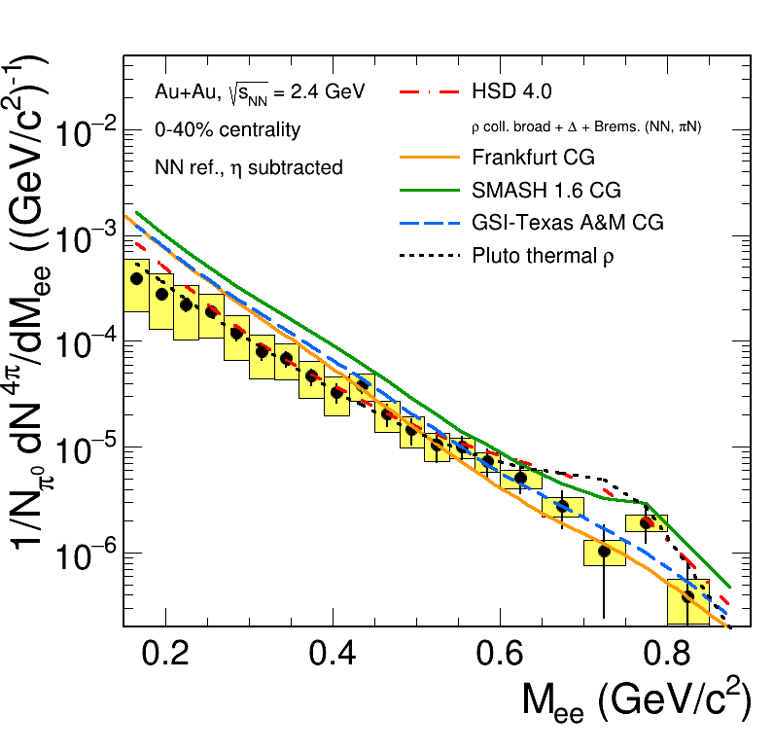
Thermal dileptons at high μ_{B}
Spectral function
Melting of ρ clearly visible
Collisional broadening is not sufficient to account for that
HADES
preliminary
ρ melting handled properly by local equilibrium (CG) approach
HADES
preliminary
CG FRA: Phys. Rev. C 92, 014911 (2015)
CG GSI-Texas A&M: Eur. Phys. J. A, 52 5 (2016) 131
CG SMASH: Phys. Rev. C 98, 054908 (2018)
HSD: Phys. Rev. C 87, 064907 (2013)
PLUTO: J. Phys. Conf. Ser 219, 032039 (2010)

Slide 14
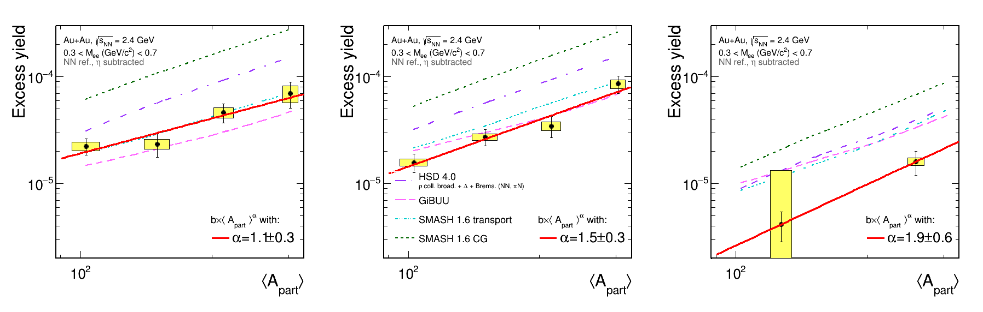
Excess yield
Dependence on the centrality and p_{t}
HADES
preliminary
HADES
preliminary
HADES
preliminary
Stronger dependence at higher p_{t}
None of the models describes all the trends fully

Slide 15
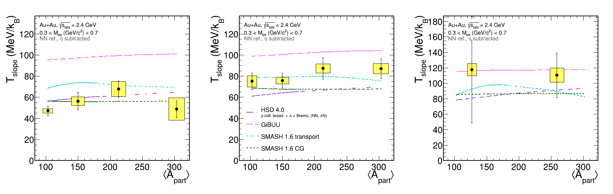
Temperature
Dependence on the centrality and p_{t}
HADES
preliminary
HADES
preliminary
HADES
preliminary
Stronger dependence at higher p_{t}
None of the models describes all the trends fully

Slide 16
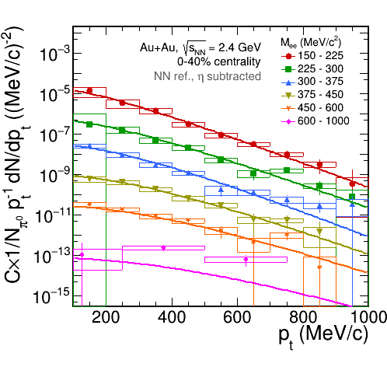
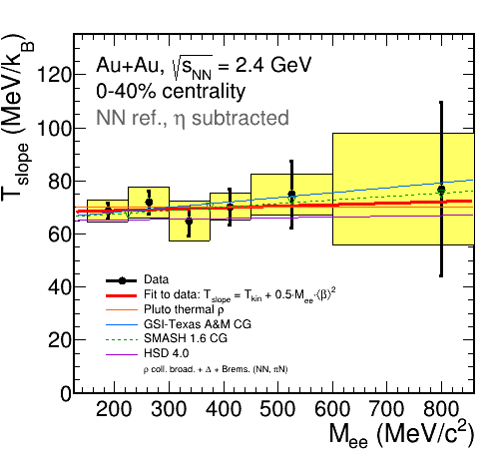
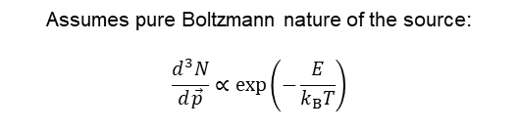

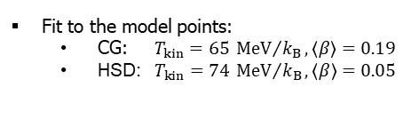

Boltzmann fits to transverse momentum
HADES
preliminary
HADES
preliminary
$$\frac{1}{p_{t}}\frac{dN}{dp_{t}}∝m_{t}K_{1}\left(\frac{m_{t}c^{2}}{k_{B}T}\right)$$
$$k_{B}T_{slope}={k_{B}T}_{kin}+\frac{1}{2}M_{ee}c^{2}{\left\langle β\right\rangle }^{2}$$
Assumes pure Boltzmann nature of the source:
$$\frac{d^{3}N}{d\vec{p}}∝\exp\left(−\frac{E}{k_{B}T}\right)$$
Fit to the model points:
  CG: $T_{kin}=65 {MeV}/{k_{B}}, \left\langle β\right\rangle =0.19$
  HSD:$T_{kin}=74 {MeV}/{k_{B}}, \left\langle β\right\rangle =0.05$

Slide 17
Towards the dilepton excitation function

Slide 18
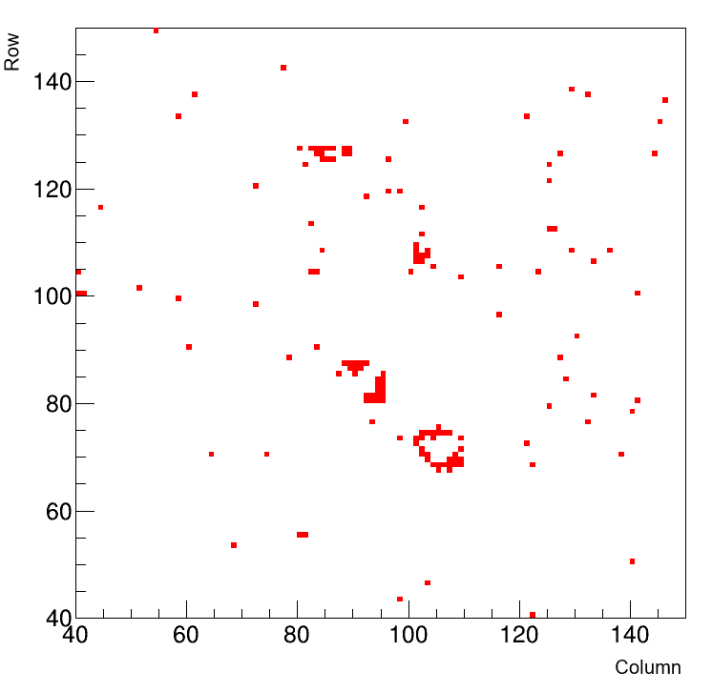
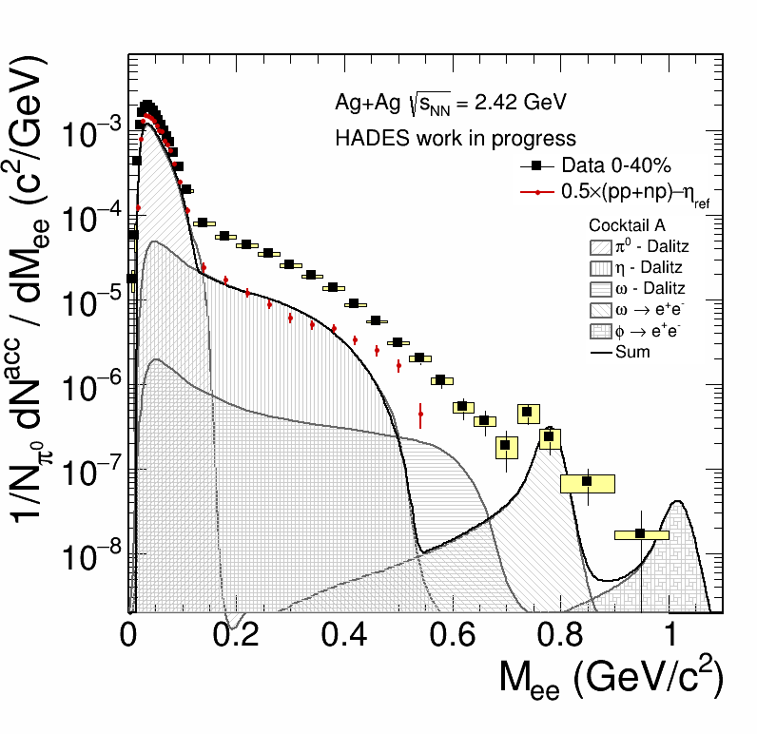
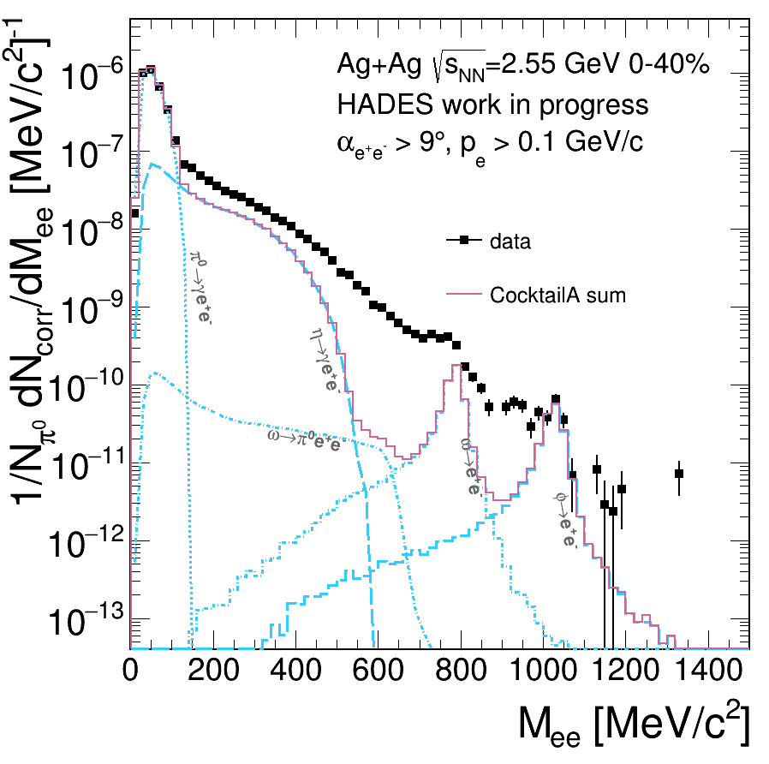
New data set from March 2019 beam time
[J. H. Otto, PhD project, JLU Gießen]
PMT-based photodetector for HADES RICH
Event display of the
RICH detector
Number of raw signal pairs
Experiment | # analyzed events | M_{ee} < 0.12 GeV/c² | 0.12 < M_{ee} < 0.45 GeV/c² | M_{ee} > 0.45 GeV/c²
Au+Au (s_{NN})^{1/2} = 2.42 GeV | 2.4 x 10⁹ | 1.15×10⁵ | 1.53×10⁴ | 581
Ag+Ag (s_{NN})^{1/2} = 2.42 GeV | 5.9 x 10⁸ | 1.12×10⁵ | 1.59×10⁴ | 901
Ag+Ag (s_{NN})^{1/2} = 2.55 GeV | 4.0 x 10⁹ | 8.80×10⁵ | 1.53×10⁵ | 10916
Very high quality of the data!

Slide 19
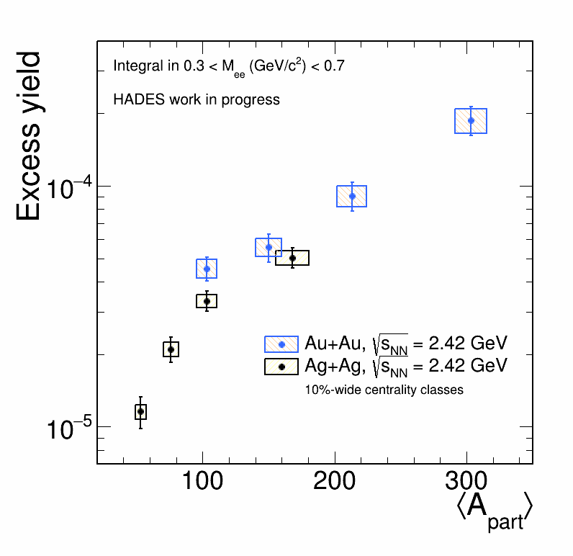
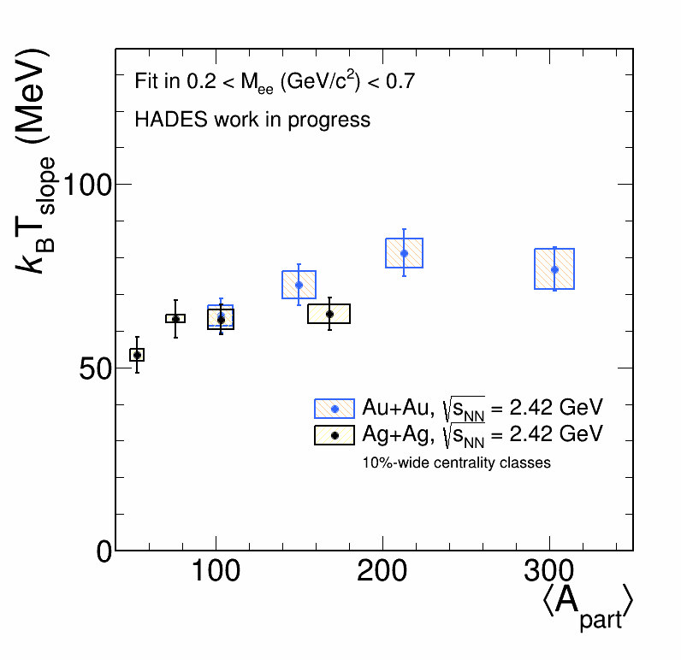
Exciting physics around the corner

Slide 20
Conclusions
  HADES explores baryon rich matter at SIS 18
  Properly extracted dilepton excess yield agrees well with theory predictions
  Differential spectra depending on p_{t} and rapidity have been presented
  Boltzmann temperature and characteristics of the spectra function are studied
  Upgraded RICH photodetector (FAIR Phase 0, together with CBM) allows for unprecedented precision of dielectron data

Slide 21
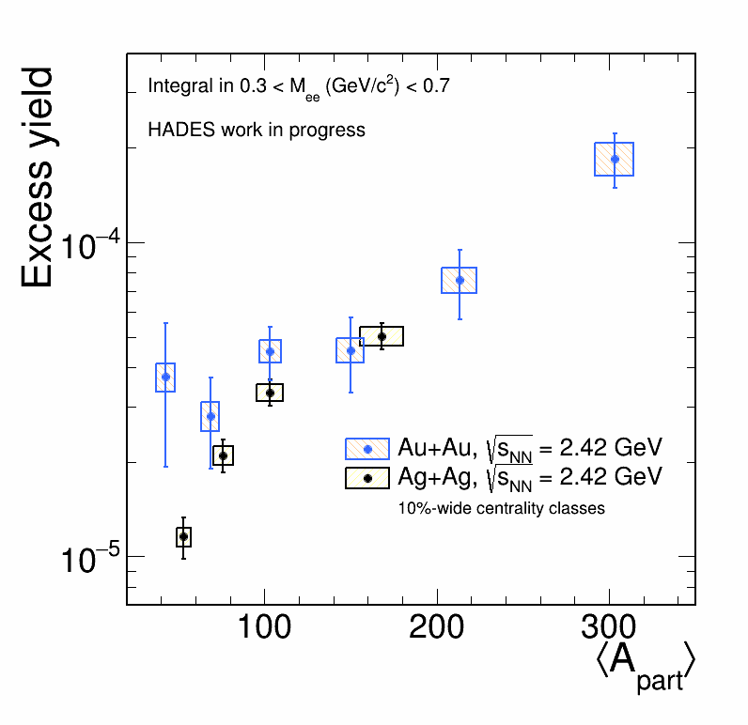
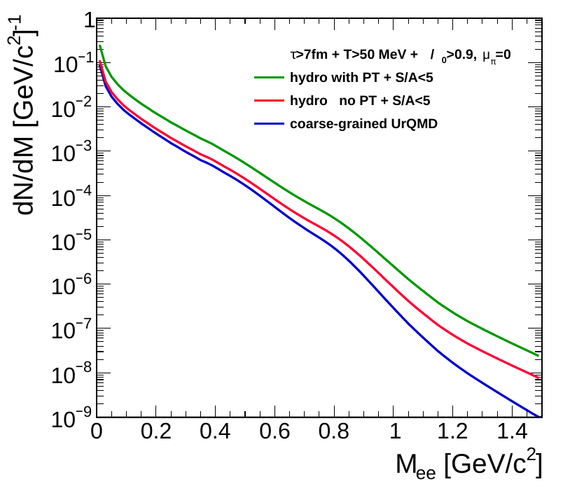
Stay tuned for...
Sensitivity of dilepton yield to a phase transition
Extension of the Au+Au analysis to peripheral events
HADES BES 0.2-0.8A GeV
[F. Seck et al., arXiv:2010.0461]
[N. Schild, Master’s project at TU Darmstadt]
[New beam time proposal]

Slide 22
Thank you for your attention

Slide 23
EXTRA SLIDES

Slide 24
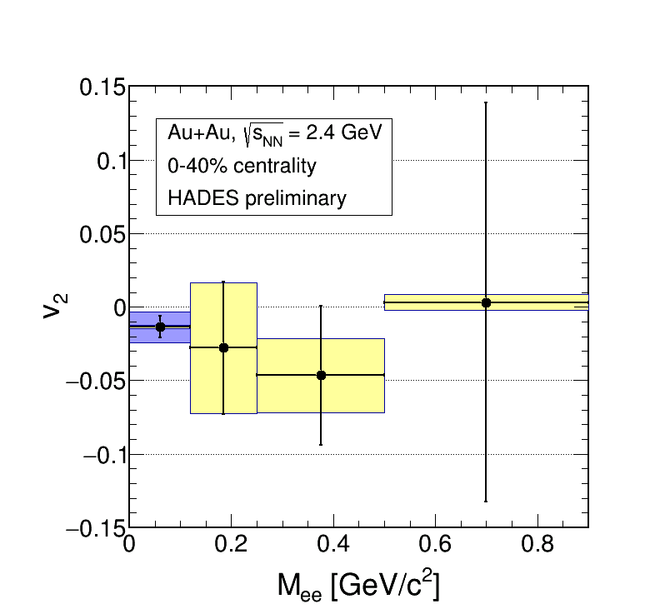
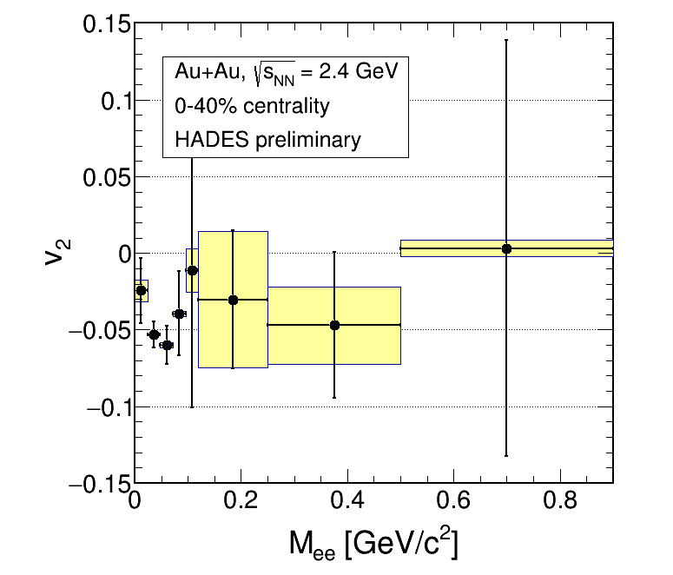
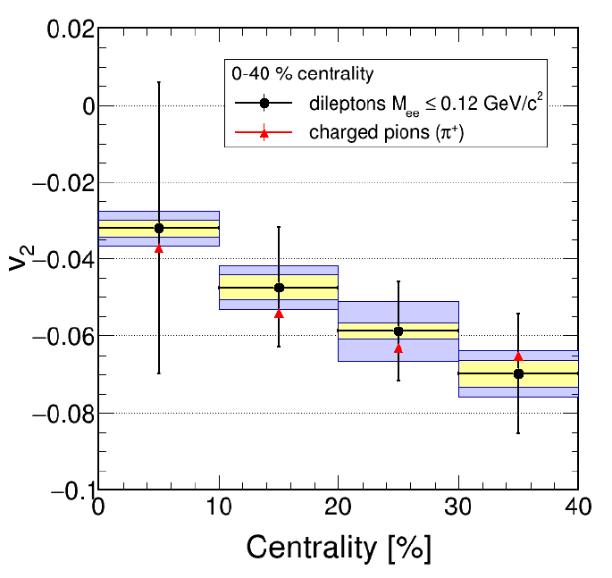
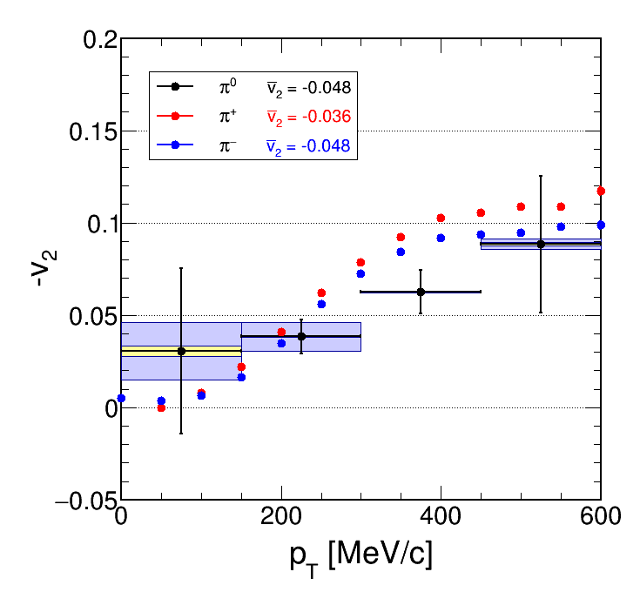
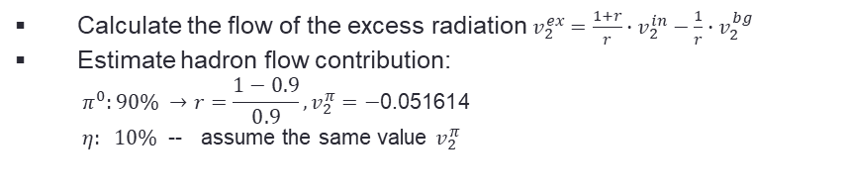
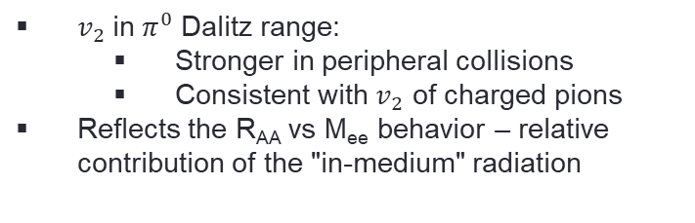
Azimuthal anisotropy of virtual photons
HADES preliminary
$v_{2}$ in $π^{0}$ Dalitz range:
  Stronger in peripheral collisions
  Consistent with $v_{2}$ of charged pions
Reflects the R_{AA} vs M_{ee} behavior – relative contribution of the "in-medium" radiation
Calculate the flow of the excess radiation $v_{2}^{ex}=\frac{1+r}{r}∙v_{2}^{in}−\frac{1}{r}∙v_{2}^{bg}$
Estimate hadron flow contribution:
  $$π^{0}:90\% →r=\frac{1−0.9}{0.9}, v_{2}^{π}=−\text{0.051614}$$
  $η: 10\%$ -- assume the same value $v_{2}^{π}$
HADES is capable of extracting v₂ of thermal dileptons
For more conclusive results larger statistics is needed

Slide 25
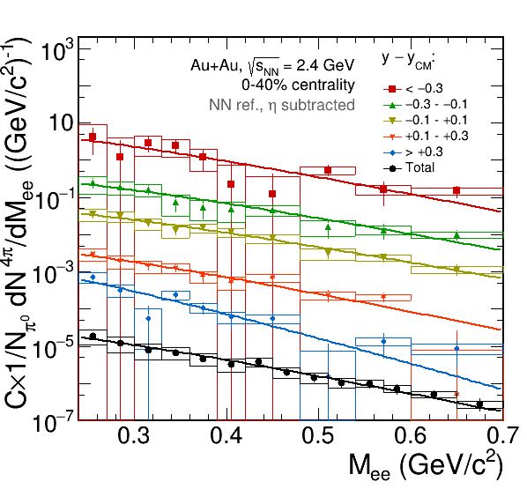
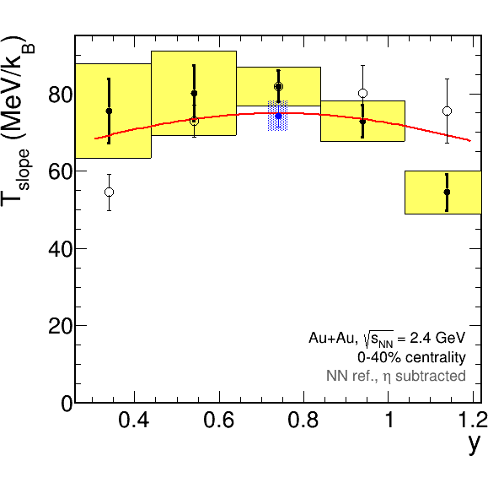
Boltzmann fits to M_{ee} as a function of rapidity
HADES
preliminary
Integrated over y
const/cosh(y)
HADES
preliminary
Consistent (within uncertainties) with thermal ansatz
T_{slope} ∝ 1/cosh(y)

Slide 26
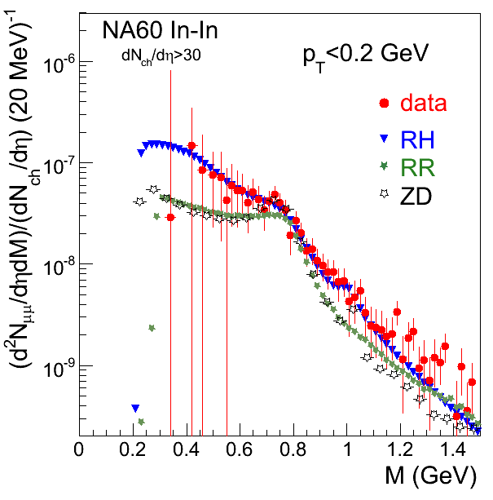
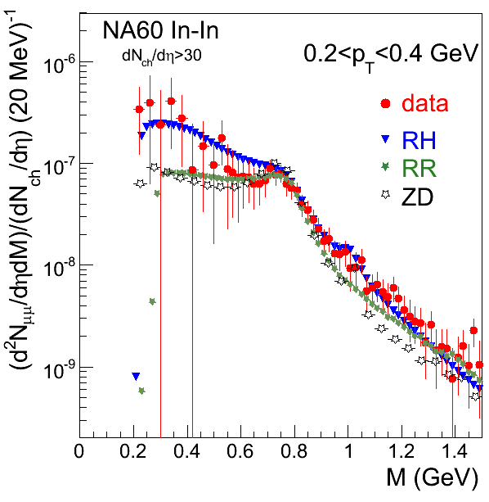
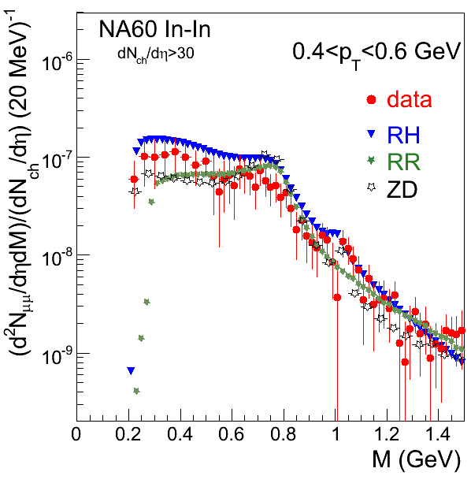
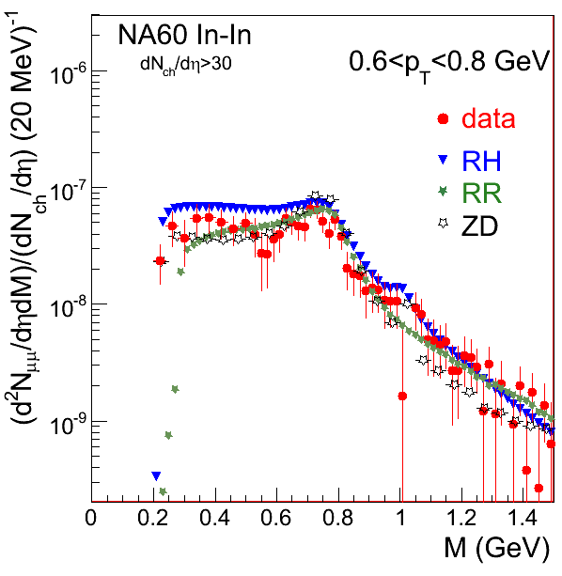
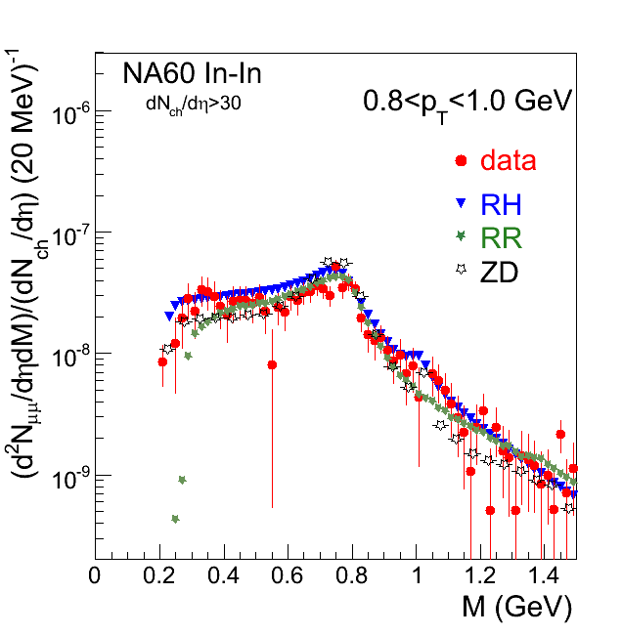
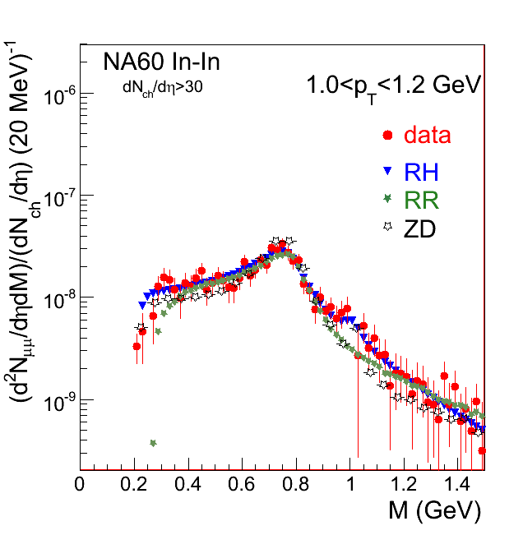
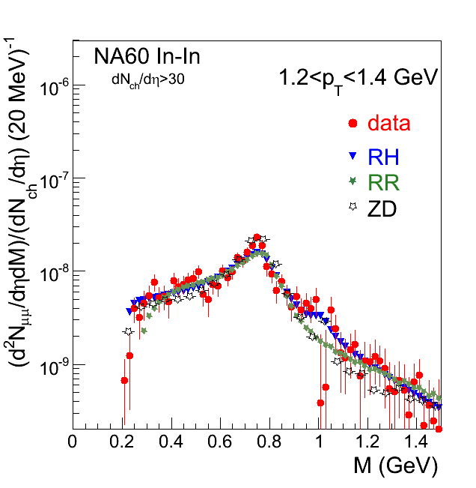
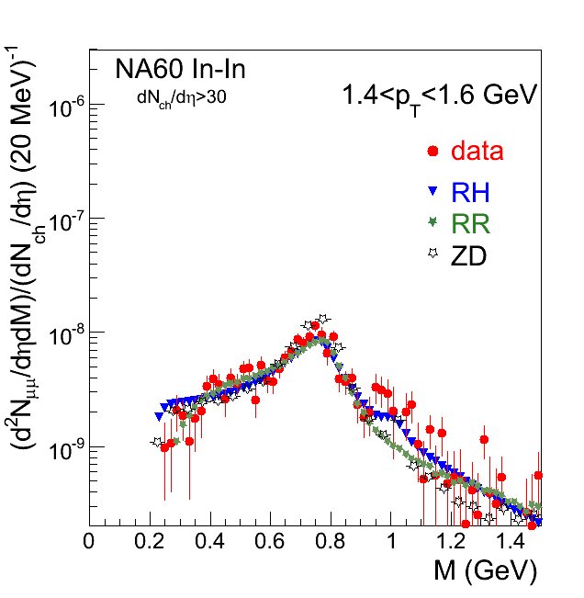
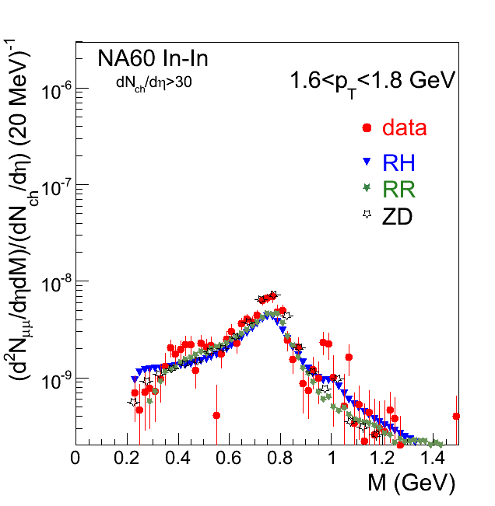
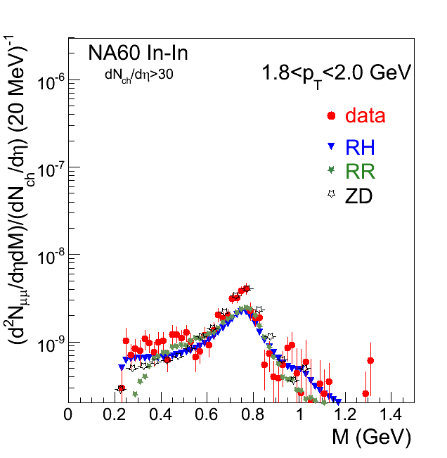


NA60 excess p_{t} dependent

