Slide 1
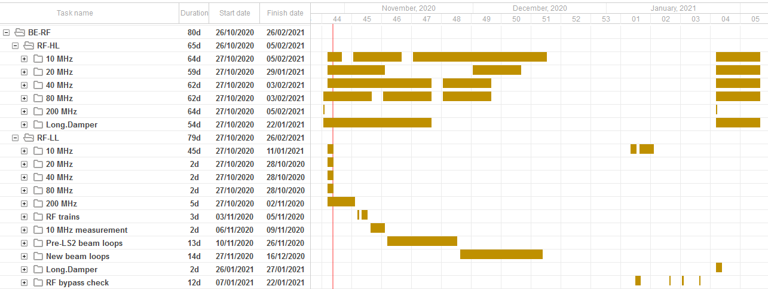
Hardware commissioning schedule
RF agenda during hardware commissioning phase
Detailed online schedule at https://oss-coordination.web.cern.ch/gantt/latest

Slide 2
Status of activities in PS CB and nearby (b. 151)
Racks for Finemet cavity (b. 151) exchanged
  Re-cabling/testing of coupled-bunch feedback ongoing
  Synchronization tests → Jan
Timing and function installation 20 MHz, 40 MHz and 80 MHz
  Installation and configuration completed
  Hardware restart timings (PAX.SBRH84/168) cabled to b. 151
  MakeRules for duplicated timings PAX.WV80, PAX.SAVCC80
Remaining cabling
  PA.GSVPC78
  Distribution of stable phase, φ_{S} program PA.GSPPROGRT
    Replace APP (Automatic Phase Program) module
  Function to control phase loop gain PA.GSPLGAIN(RT)
    Lower gain before injection (and at h = 84)
  Final validation of phase program and phase loop gain pending

Slide 3
Re-commissioning of LLRF equipment
  RF CPS eLogbook: http://elogbook.cern.ch/eLogbook/eLogbook.jsp?lgbk=382
  Ongoing and next steps
  Wall current monitor (WCM95) distribution → Ben, Pierre
    Replacement of aging distribution amplifiers
  Digital cavity controller 40 MHz and 80 MHz power systems → Ben
    Multi-harmonic feedback working
    Controls request: phase and tuning functions, acquisition timings
  2 GeV cycle with appropriate timing tree → Denis, Heiko
    BCMS setting-up
    Test of cavities with pre-/post LS2 next week

Slide 4

Re-commissioning of LLRF equipment
  RF CPS eLogbook: http://elogbook.cern.ch/eLogbook/eLogbook.jsp?lgbk=382
  Ongoing and next steps
  10 MHz cavities
    Checks of cavity returns signals (eLogbook)
    9/11 cavities pulsing on pre-LS2 BCMS
  Christmas break
    No cooling water ‘eau glacée’ for air conditioning
    Stop NIM and LHC-RF VME crates before closure
  Week 1 in 2021
    04-07/01 Controls maintenance days (‘Note de Coupure’)
    07-08/01 Final RF bypass check (with magnet covers) in
    PS switchyard

