Slide 1
20/40/80MHz testing 2020
Ben Woolley

Slide 2
Outline
High frequency systems overview
  Cavities
  Synoptics
Autotuning upgrade
  Low clock rate → New hardware
  >4 signals to acquire → RF MUX
Infrastructure installation progress
  Functions
  LTIMs
Firmware changes
  Bug fixes – see git
  MHFB areas to submodules (Nathan)
  Autotune state machine
  RF Gap – Source(ORcathode) phase measurement in Simulink
Next Steps

Slide 3
High Frequency Systems overview
Cavity List
Cavity Name | Cavity Frequency | Harmonic number | Tuning needed?
C20-80 | 20 MHz | 42 | No
C20-92 | 20 MHz | 42 | No
C40-77 | 40 MHZ | 84 | Yes
C40-78 | 40 MHZ | 84 | Yes
C80-08 | 80 MHZ | 168 | Yes
C80-88 | 80 MHZ | 168(169ions) | Yes
C80-89 | 80 MHZ | 168(169ions) | Yes

Slide 4
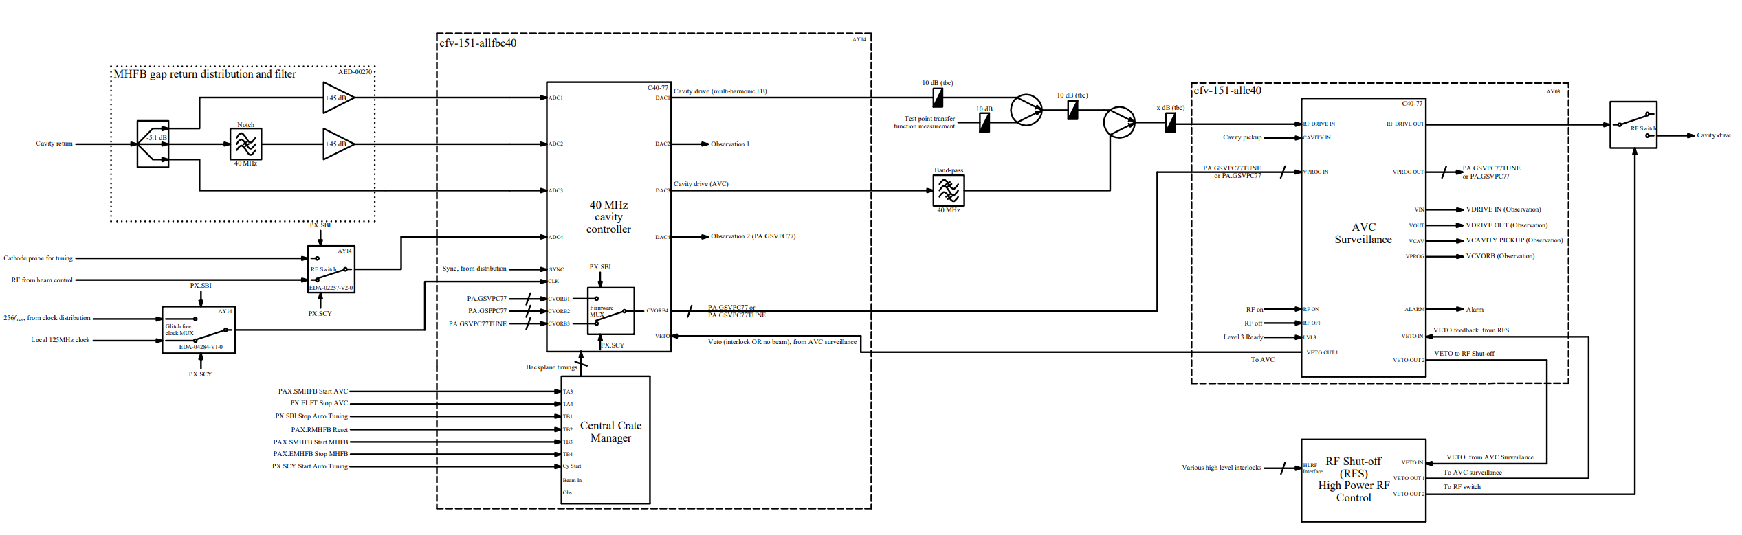
Global View of 40 MHz LLRF (C40-77)
//cern.ch/dfs/Departments/AB/Groups/RF/Machines/PS/LowLevel/BeamControlUpgrade/Synoptics/2020-11/40MHzGlobal.pdf

Slide 5
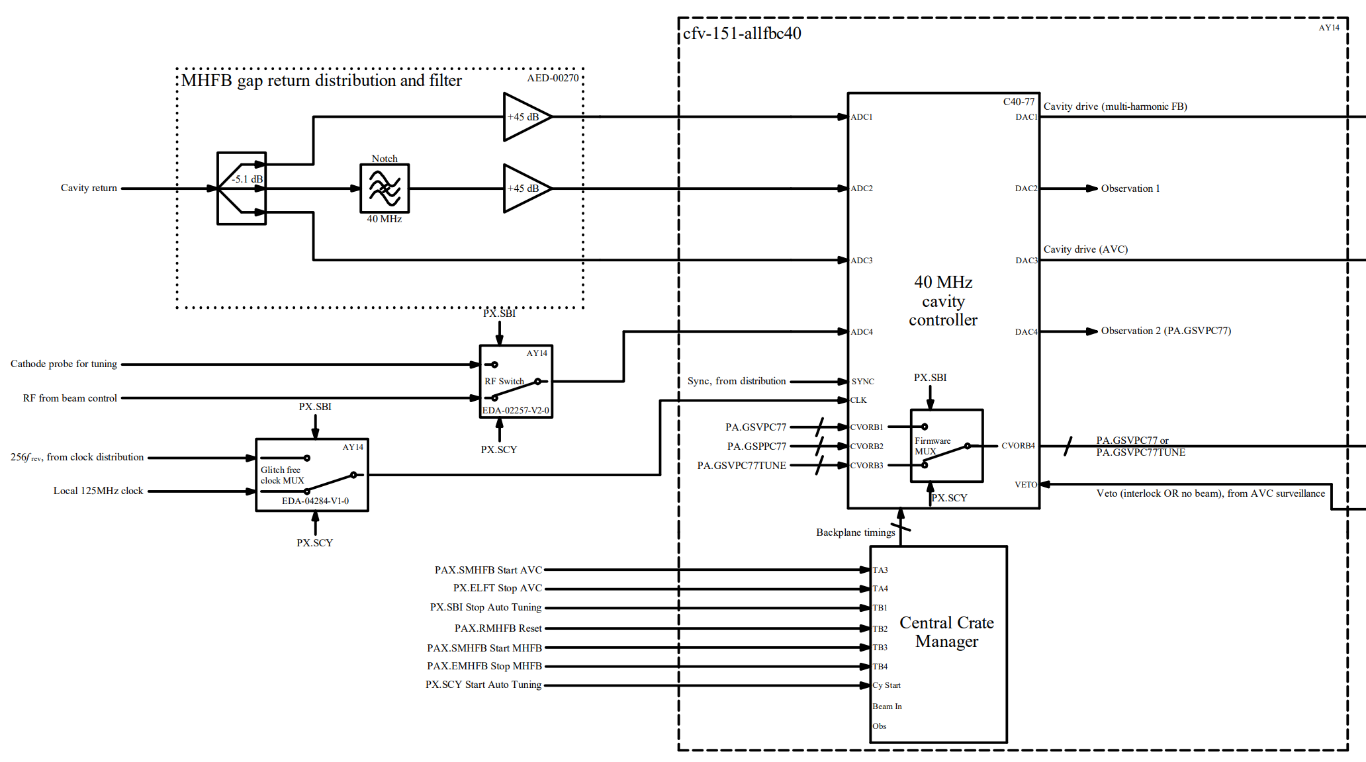
//cern.ch/dfs/Departments/AB/Groups/RF/Machines/PS/LowLevel/BeamControlUpgrade/Synoptics/2020-09/40MHzGlobal.pdf

Slide 6
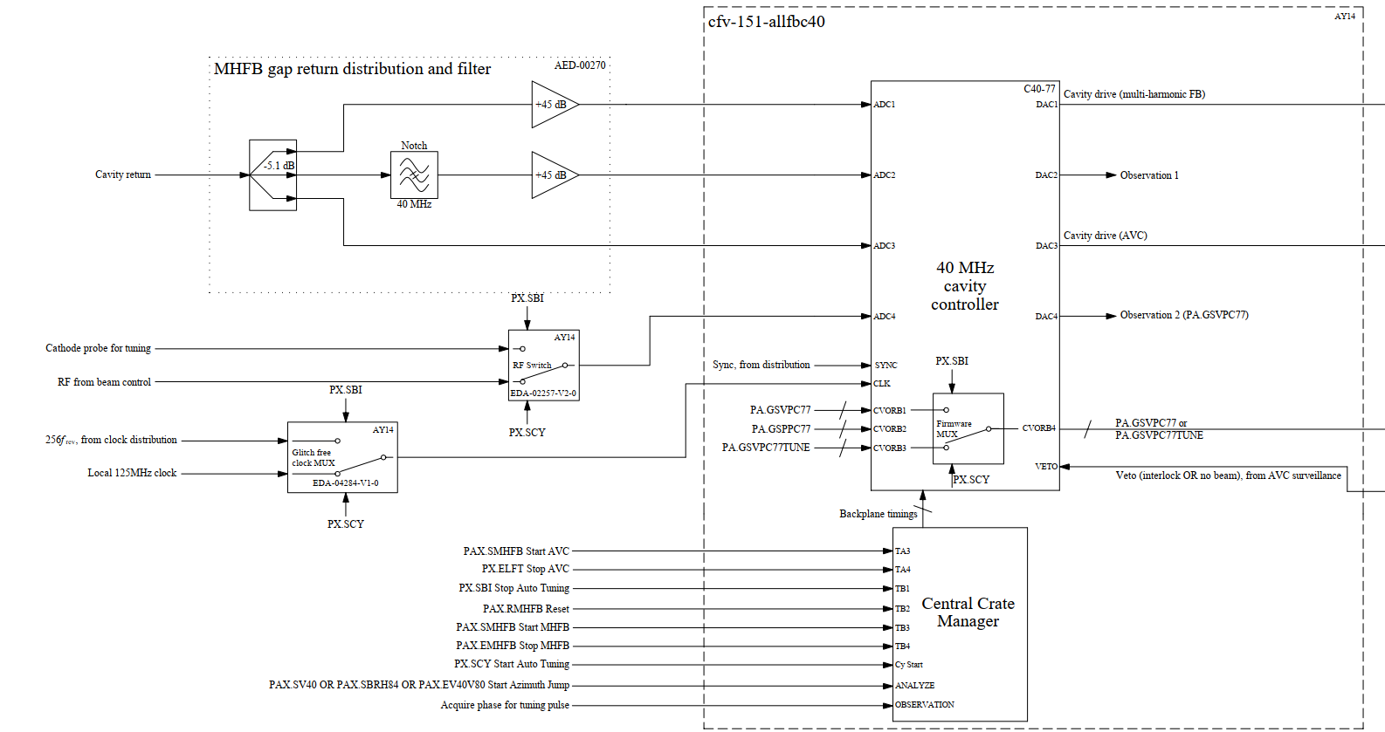
//cern.ch/dfs/Departments/AB/Groups/RF/Machines/PS/LowLevel/BeamControlUpgrade/Synoptics/2020-11/40MHzGlobal.pdf

Slide 7
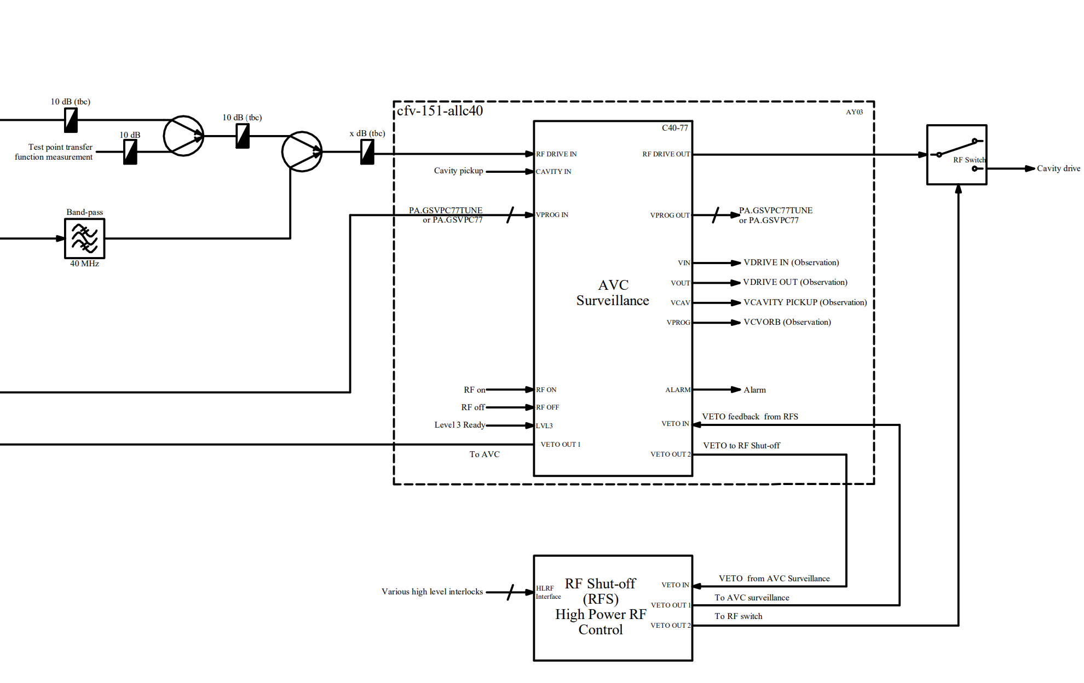
//cern.ch/dfs/Departments/AB/Groups/RF/Machines/PS/LowLevel/BeamControlUpgrade/Synoptics/2020-09/40MHzGlobal.pdf

Slide 8
AVC Tests
Selection of RF Source for AVC
  Internal MHS – Harmonic number generated by internal MHS at programmed integer harmonic.
  External RF from beam control sampled by ADC.
  External RF from beam control sampled by ADC – demodulated and regenerated at acquired phase → renormalized.
Initial test results on C40-78
  Connection of CVORB out between LLRF rack and a CVORB-DAC in the HLRF rack caused spurious noise, tripping the cavity → Looks like a ground loop. Disconnected for now but could be an issue for AVC surveillance.
  When using internal MHS there were spurs every 5 MHz @ 0dBC. → Firmware bug: multiplication by 2^15 used to convert from fixed point to int16. Should have been 2^14 so the sine wave wrapped at it’s min-max causing a strange shape. Replaced with Simulink “convert” block for proper rescaling.
  Once fixed internal MHS produced clean RF → However not used for tests on LHCIND2 due to unstable clock at end of cycle (no beam for phase loop to lock to.)
  Voltage program started too early → extra restart timing played at C15-16. Fixed by adding an extra internal stop to beginning of voltage function. However this later resolved itself…?

Slide 9
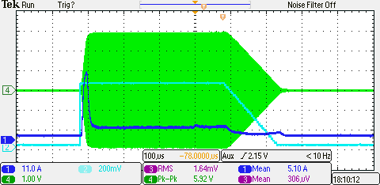
AVC pulsing C40-78
RF Source: re-normalized RF from beam control.
RF gap attenuation – 1dB at LLRF rack (AY14)
AVC parameters:
  rfGapInputGain = 4096
  rfSrcInputGain = 4096
  avcReturnGain = 3120
  avcOutputGain = 4096
  ffwdFactor = 0
  kiGain = 3600
RF Gap 1V/100kV
VREF 1V/500kV
High-voltage final amplifier current

Slide 10
Almost copy paste for C40 and C80…
C40-77 – Almost identical settings gave perfect calibration and response. Just 30% less integral gain to lower overshoot.
C80-88
  Had to add a 13 dB amplifier as not enough PSD in the 2nd Nyquist zone.
  Initial tests with 5MHz BW BPF to filter out h88 image. Later removed as there is another in the tunnel and two in series did not affect final amplifier current.
  avcReturnGain = 4752, avc.kiGain = 4000.
C80-89
  As C80-88 but avcReturnGain = 4900, avc.kiGain = 4000.
C80-08
  As C80-88 but avcReturnGain = 4700, avc.kiGain = 3800.

Slide 11
Multi-Harmonic Feedback C40-78
Timing PAX.SMHFB40 shared between start AVC and start MHFB.
  Problem, start AVC is used to switch between ADC1 and ADC2 with the notch filter. 2 possible solutions:
    Add an extra timing: No firmware modification needed. However, difficult to integrate into a timing tree, difficult t keep track of and would affect both 40 MHz cavities → not independent.
    Switch ADC when voltage program is greater than 0: Small firmware modification, but removes the issue of cavity interdependence and having to keep track another timing.

Slide 12
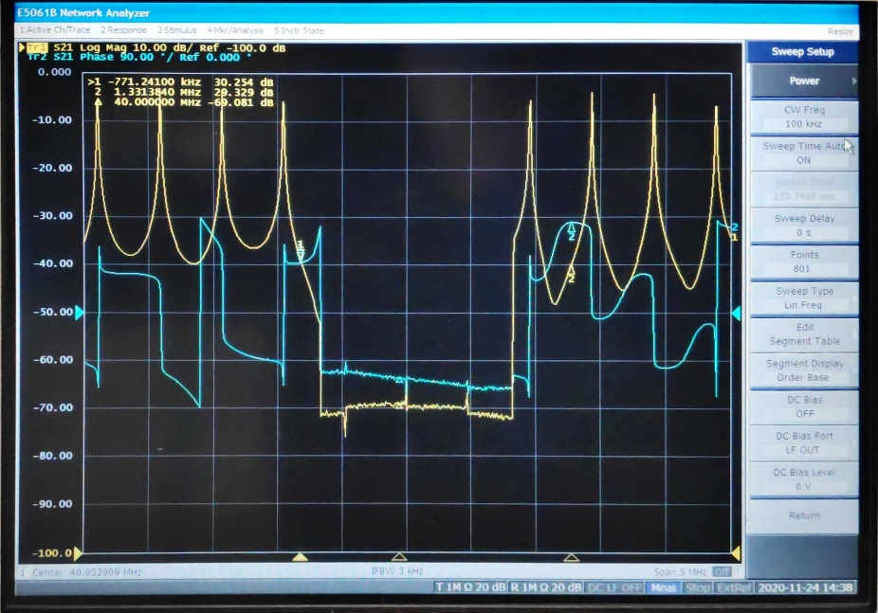
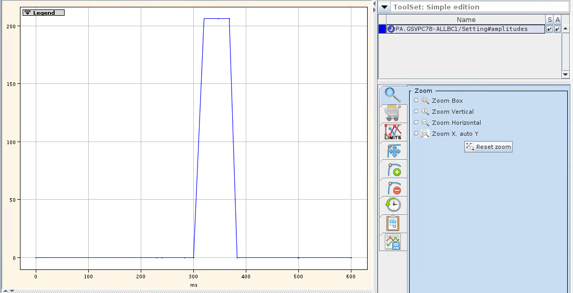
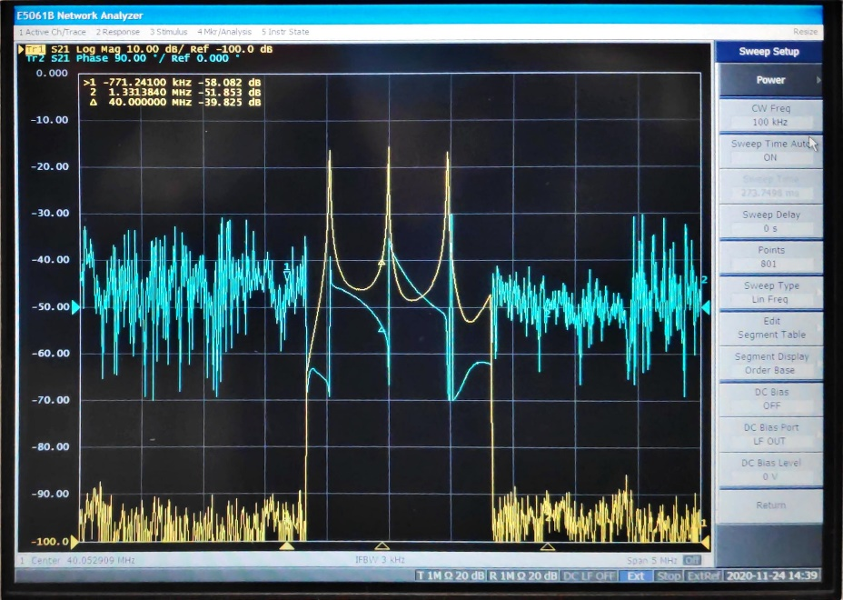
ADC switch with voltage function test
ADC1
Set VNA to start sweep at C200. Total sweep time is 273ms.
Voltage program starts at C300 and pulse width is 80ms.
VNA shows switching between 2 ADCs as expected.
Voltage program
ADC2

Slide 13
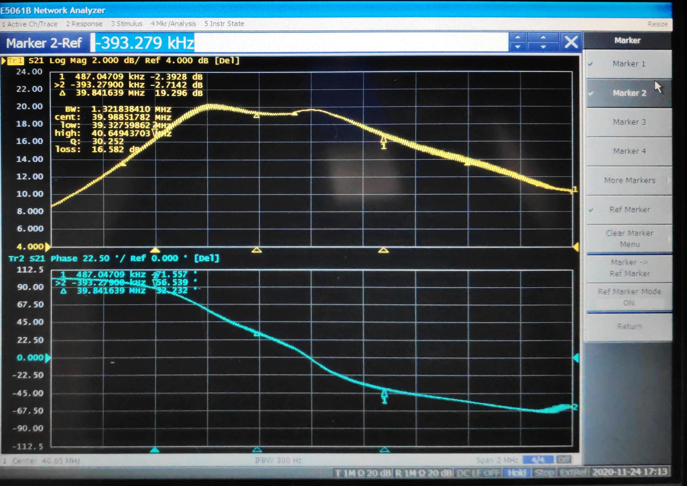
C40-78 transfer function – no MHFB

Slide 14
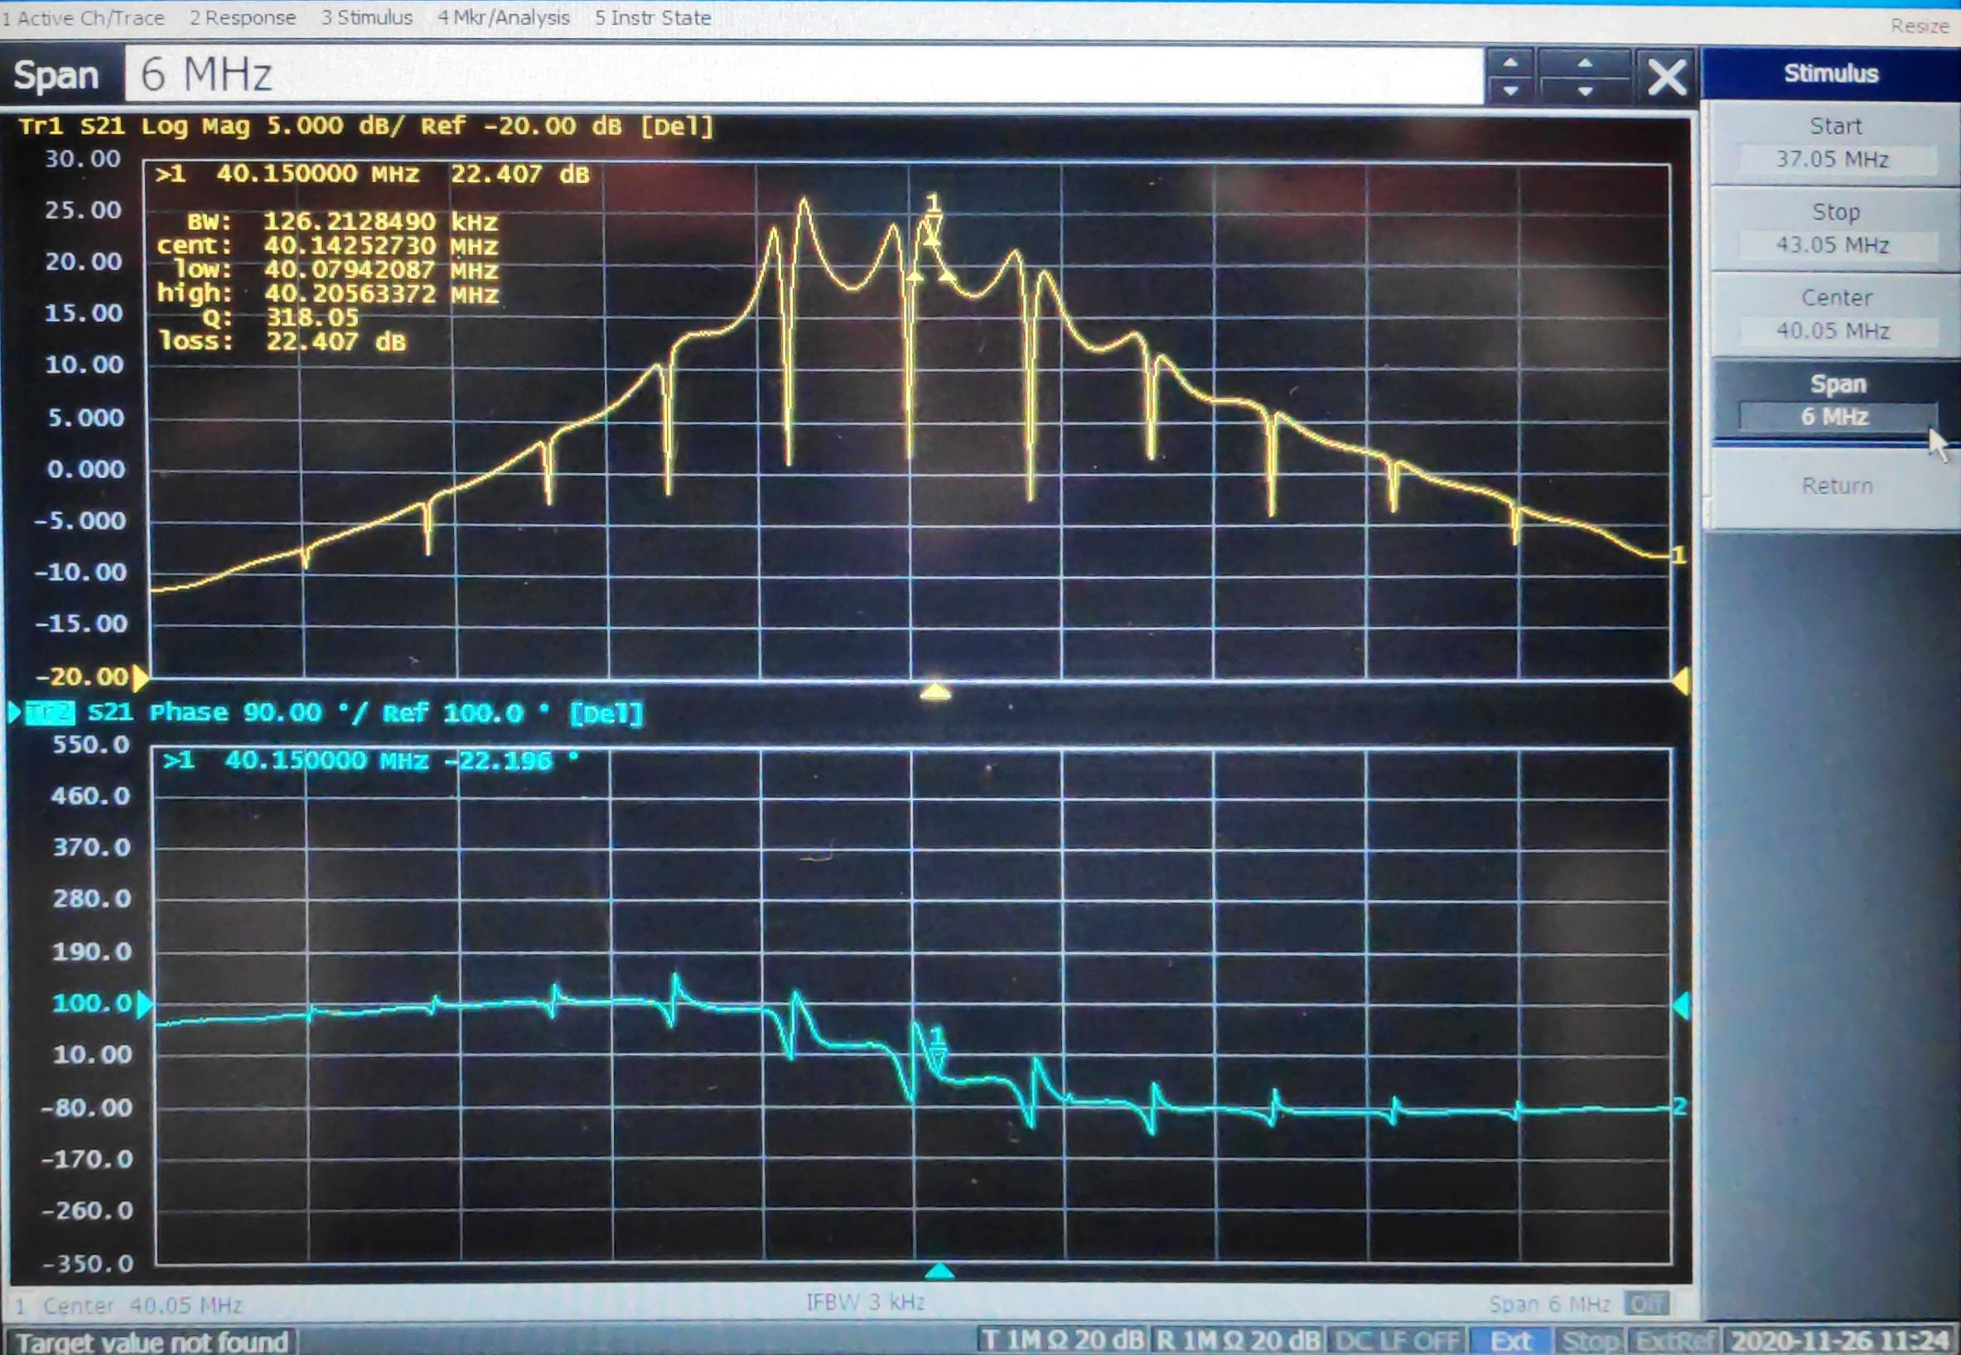
C40-78 – MHFB h79-89 Fixed Frequency

Slide 15
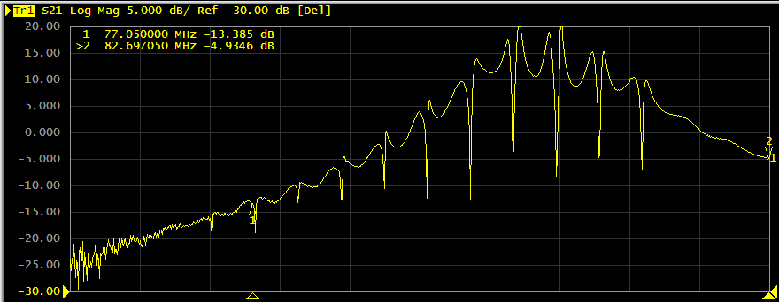
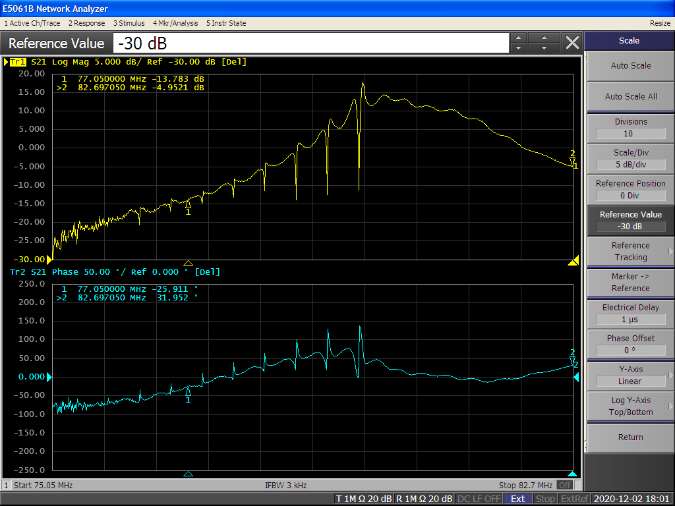
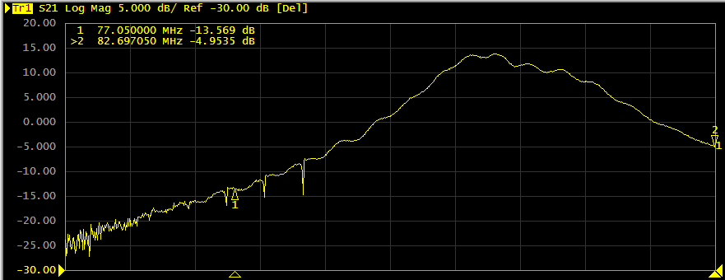
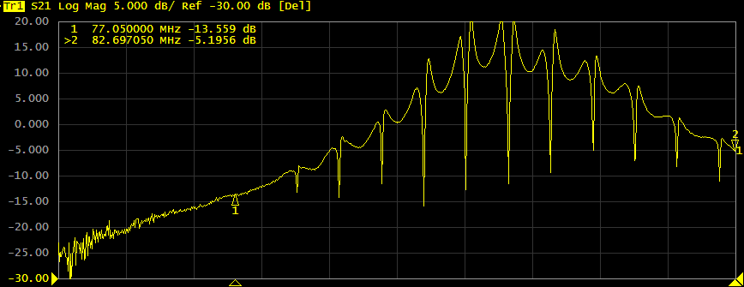
C80-89 – MHFB h79-89 Sweeping Clock
In order to keep the phase of the feedback at 180° the transfer function of the cavity needs to be measured for all harmonics during the frequency sweep.
Calibration mode is activated which drives the cavity with an excitation and measures the phase to create a phase vs frequency LUT.
The feedback can then be activated.
Small tweaks in phase offset for each harmonic can be made for best performance.
C80-89

Slide 16
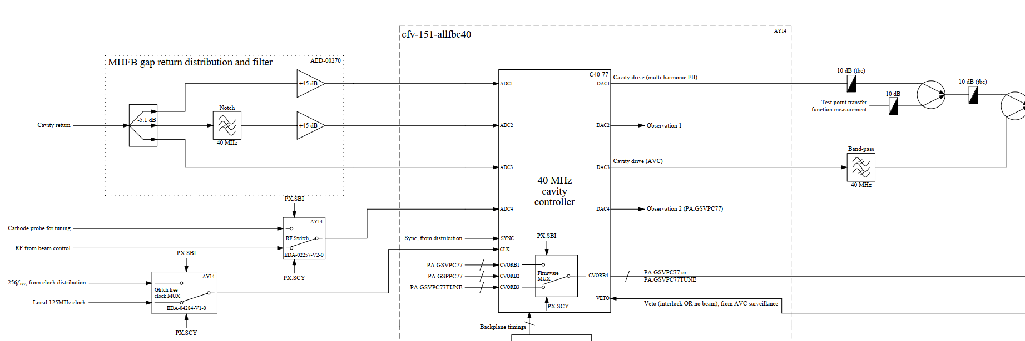
Auto-tuning function in cavity controller
Cavity controller
  Pulses the cavity corresponding to the external voltage program for tuning (tuning pulse).
  Provides phase between cavity return and cathode probe.
Implementation
  Additional CVORB channel provides voltage program for tuning pulse.
  Phase measurement published as a FESA field.
  Tuning VETO received as FESA field from PLC.

Slide 17
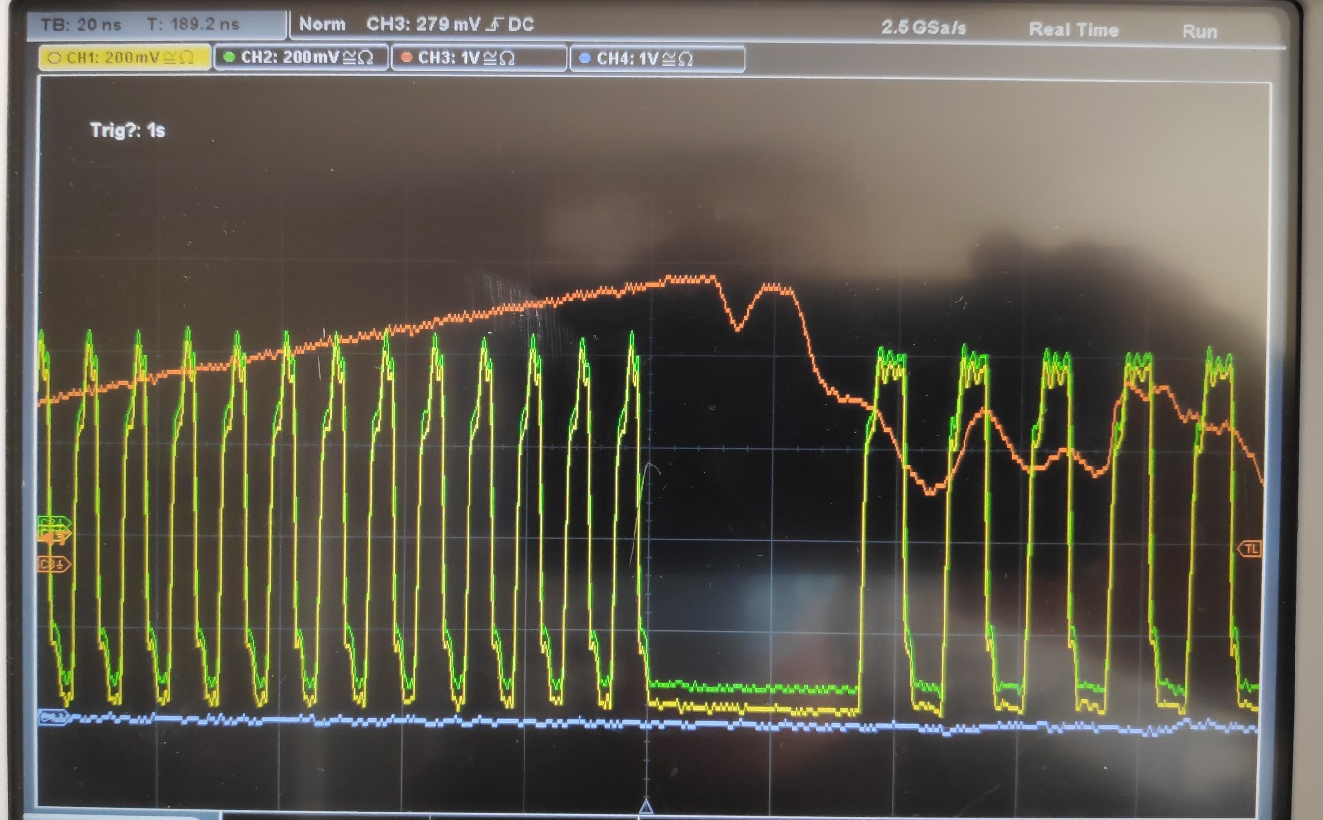
Clock switching for auto-tuning
Explored possibility of generating a clock locally on the 1TFB board.
  →Only the DAC clocks and FPGA core clock could be switched internally (not ADC)
Developed a NIM glitch-free clock MUX and distribution module https://edms.cern.ch/item/EDA-04284-V1-0/0.
  Based on ICS580-01, glitch free clock MUX IC.
  Hardware manufactured and tested.
Test performed with the 1TFB board in the lab showed no glitches on the RF output during RF pulse from AVC.
  Glitch free switching from 125MHz to 75 MHz clock

Slide 18
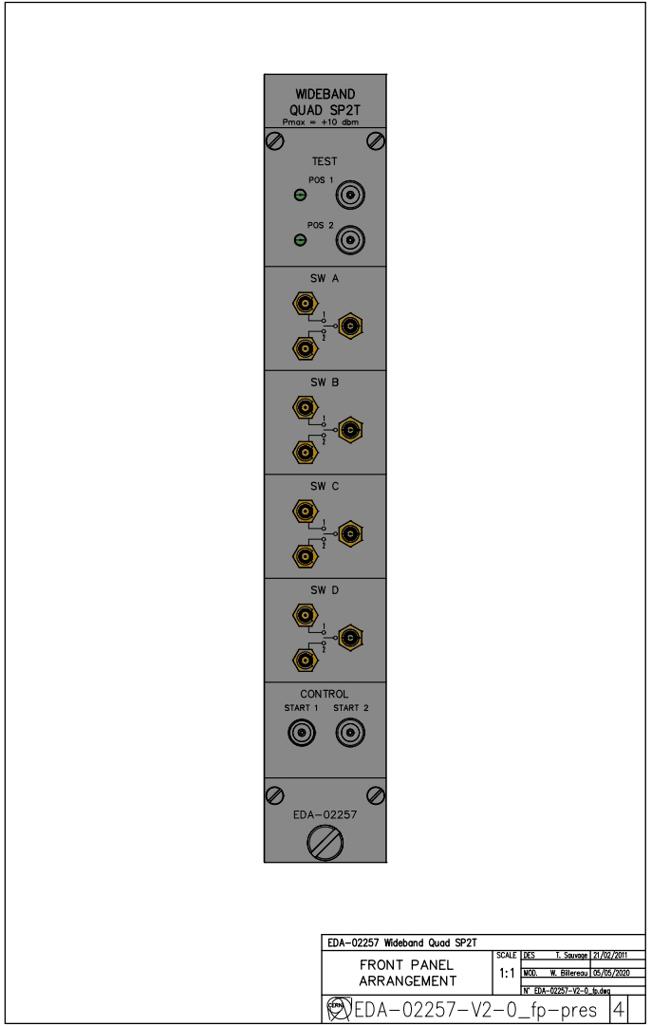
RF switch for auto-tuning
NIM module with 4x SPDT RF switches already existed as an EDA project (EDA-02257-V1-0).
Obsolete components required a small re-design at the electronics design office.
New version now available and 2 prototype units produced and successfully tested.
https://edms.cern.ch/item/EDA-02257-V2-0/0

Slide 19
Memmap auto tuning update and cleanup
Added Global and PPM harmonic number registers (int and fractional) for the auto-tuning. The autotuning FESA class will write to these to set the frequency during the tuning pulse.
For a requested RF_Tune_Freq the harmonic number for tuning (hn_tune) required is:
hn_tune=256*RF_Tune_Freq/Ext_CLK_Freq
Where Ext_CLK_Freq should be a FESA field whose default value is 120 MHz.
Added avc.OutTuningError register. This is the phase error measured during the previous tuning pulse. The format is int16 mapped to +/- pi.
Added TuningVeto to avc.control register on bit 5. The autotuning FESA class enables the veto if the frequency error is too large to pulse the cavity for the beam

Slide 20
Next Steps
Deploy FESA class.
  Allows to recycle Florian’s inspector panels.
  Allows to deploy settings in proper PPM fashion.
Wait for VTUNE functions and extra timings to be deployed.
  Test auto-tuning functionality on C40-78.
Copy-paste to all cavities and commission the high frequency cavities.

Slide 21
Questions?

Slide 22
Infrastructure installation progress
Function Name | Status
GSVPC80-ALLBC1 | Hardware tests ongoing
GSVPC92-ALLBC1 | Hardware tests ongoing
GSVPC77-ALLBC1 | Hardware tests ongoing
GSVPC78-ALLBC1 | Hardware tests ongoing
GSVPC08-ALLBC1 | Hardware tests ongoing
GSVPC88-ALLBC1 | Hardware tests ongoing
GSVPC89-ALLBC1 | Hardware tests ongoing
  All voltage functions and LTIMs have been initialised in FEC cfv-151-allbc1.
    Functions seem to have a setup problem – only outputting 0.
    LTIMs are output to hardware OK.
  Request for function restart timings made
    For 40 MHz cavitites: PAX.SV40 ORed with PAX.SBRH84 ORed with PAX.EV40V80 from central building.
    For 80 MHz cavities: PAX.SV80 ORed with PAX.SBRH168 ORed with PAX.EV40V80 from central building.
LTIM Name | Status
PX.SCY-ALLBC1 | Hardware verified
PX.SBI-ALLBC1 | Hardware verified
PX.ECY-ALLBC1 | Hardware verified
PX.ELFT-OR-ECY-ALLBC1 | Hardware verified

Slide 23
Firmware updates
General bug fixes – Typos in Simulink model and Visual meant that MHFB4 wasn’t working. → now fixed.
MHFB memap used areas for each harmonic → Now uses submodules (Nathan).
Autotune state machine added:
  At start cycle state machine tells MHS to generate different harmonic (optional), changes CVORB channel to tuning VPROG and resets RF (optional).
  At start beam injection state machine returns firmware to “normal mode” and performs RF reset (optional).
  There are two versions: with and without internal RF-reset. Both yet to be tested with the glitch free clock mux. If the firmware is happy with the clock switch then the RF reset will not be required.
New phase measurement added to Simulink model. (RF Gap – Source) phase. Output to new register on memap: outDebugRfGapMinusSrcDemodAngleLatched.
  Currently value is set by configurable internal counter → could be changed to external timing?
https://gitlab.cern.ch/BE-RF-PLDesign/PS/EDA-02175-V2-HighFrequencyCavityController

Slide 24
Next Steps
Once the functions are working (now with CO to look at), Close AVC loop around cable in bld. 151.
Test AVC with 40 MHz cavity.
Calibrate MHFB with 40 MHz cavity and measure transfer function.
If AVC and MHFB working correctly on one 40 MHz cavity, copy to second one.
Repeat for all 80 MHz cavities and finally 20 MHz cavity. – Good enough for hardware commissioning period.
Test autotuning modifications → activate clock MUX and publish phase measurement to FESA.

Slide 25
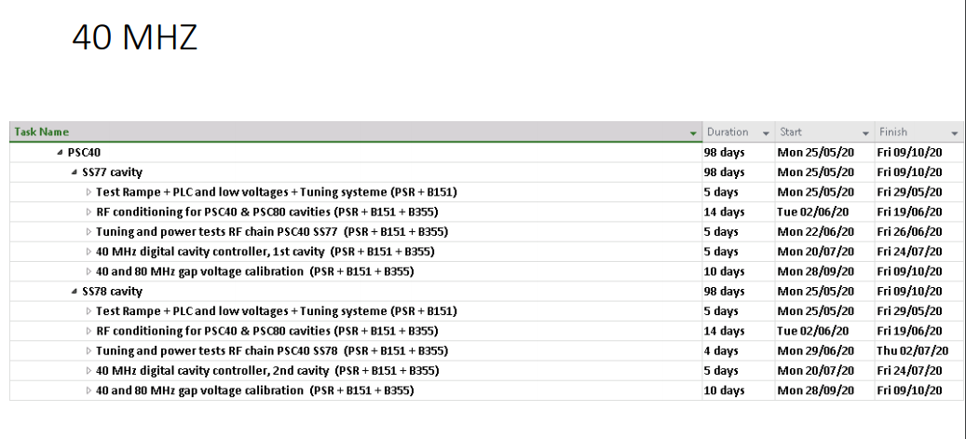
IST Dates
40 MHz Tests in next weeks possible once functions are working first Week in October week 40-41.
80 MHz and 20 MHz cavities to follow in next 2-3 weeks.

Slide 26
Questions?

Slide 27
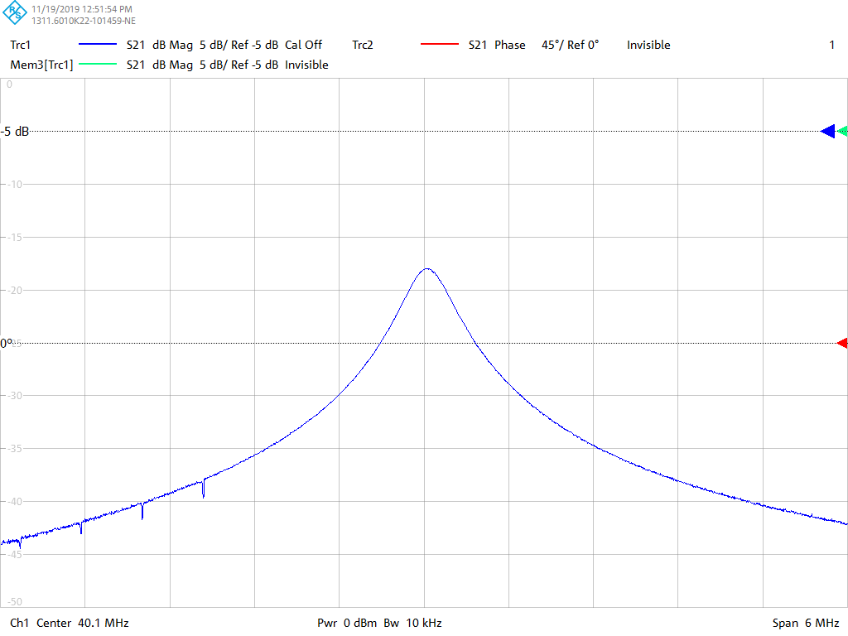
Swept Clock

Slide 28
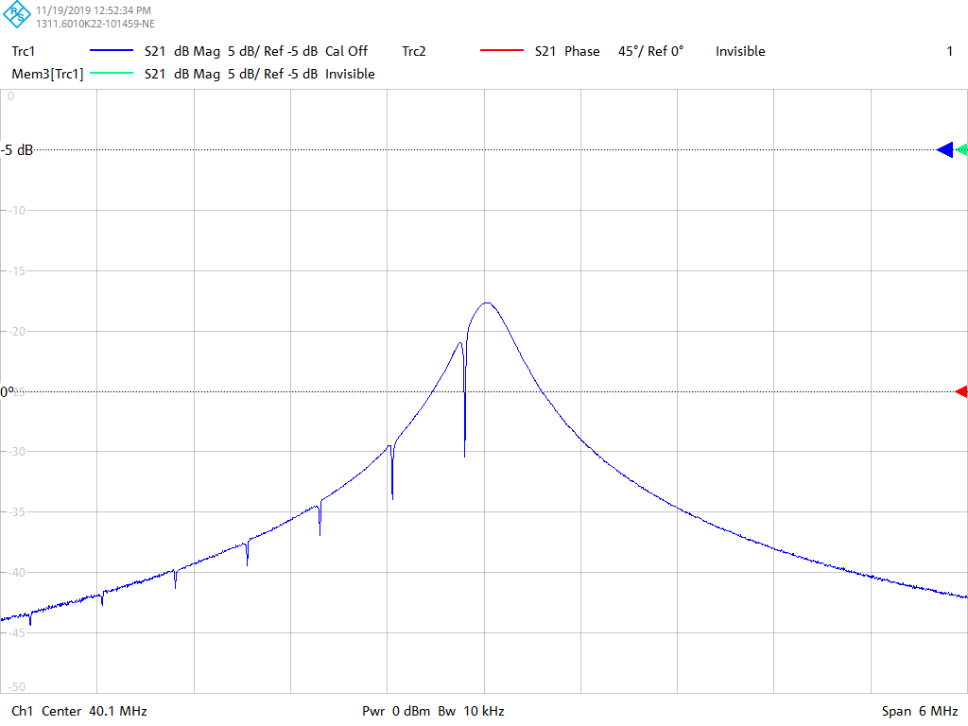
Swept Clock

Slide 29
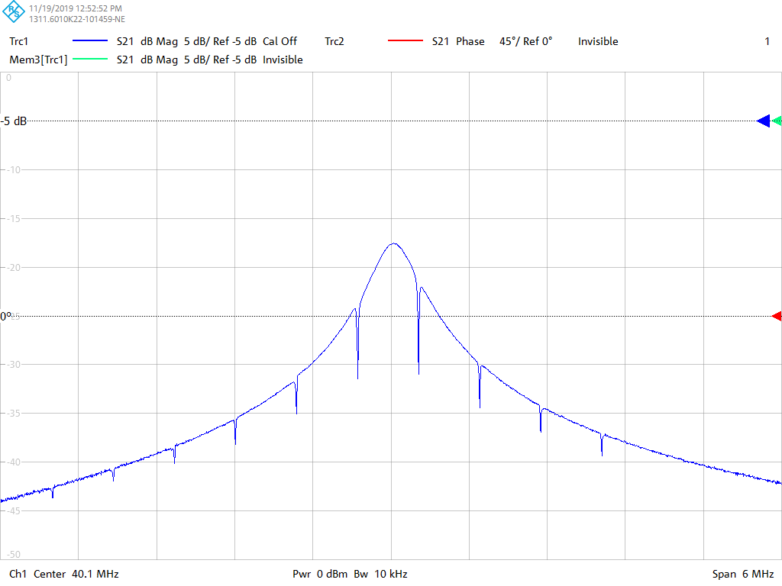
Swept Clock

Slide 30
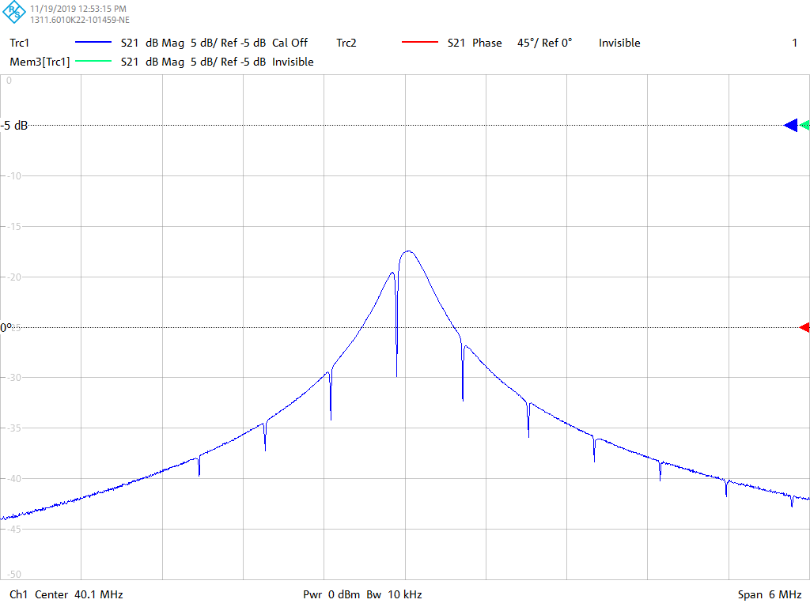
Swept Clock

Slide 31
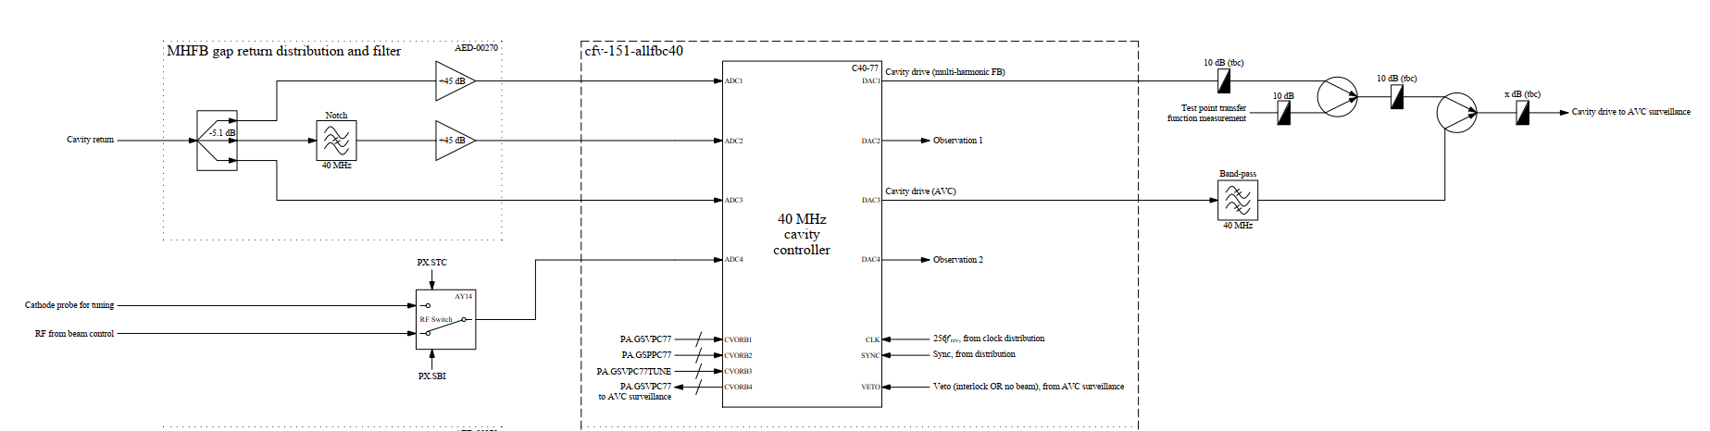
Auto-tuning function in cavity controller
Cavity controller
  Pulses the cavity corresponding to the external voltage program for tuning (tuning pulse).
  Provides phase between cavity return and cathode probe.
Implementation
  Additional CVORB channel provides voltage program for tuning pulse.
  Phase measurement published as a FESA field.
  Tuning VETO received as FESA field from PLC.

Slide 32
Technical issues
Cavity controller has insufficient inputs for all required RF signals.
  Add external RF MUX to switch between RF from beam control and cathode probe voltage.
Distributed RF clock in early part of cycle is only 25.6 MHz.
  Sample rate insufficient to pulse at 40/80 MHz.
  Firmware development → Produce clock internally.

Slide 33
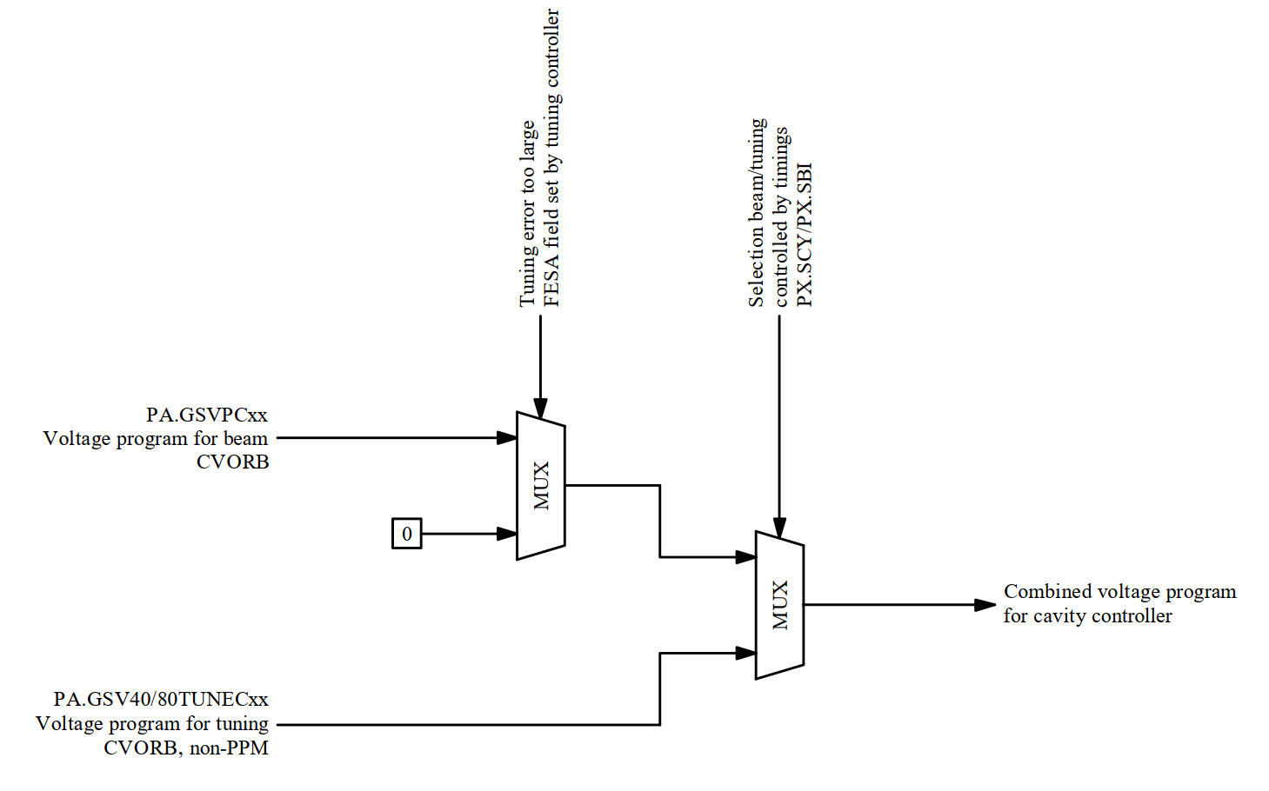
Voltage program internal logic (Firmware)
Outcome of discussion April 2019.
Implemented as a firmware block in cavity controller.

Slide 34
Status and next steps
Status
  Firmware tests in lab.
    Multi-harmonic feedback part is re-validated in the lab.
    Live phase and amplitude measurement added to the mem-map (FESA).
  Prototype hardware available.
Next Steps
  Test AVC part of the firmware in lab.
  Firmware development:
    Add internal fixed frequency clock.
    Add logic for phase measurement and voltage program selection.
  Re-Commission entire system on a single cavity.

Slide 35
Proposal for restart
Baseline:
Keep existing phase measurement and voltage program available for restart.
Review situation following recommissioning of one cavity with new cavity controller and multi-harmonic feedback.

