Slide 1
Planning for 2021 and initial priorities
H. Damerau
PS LLRF developments meeting
10/12/2020

Slide 2
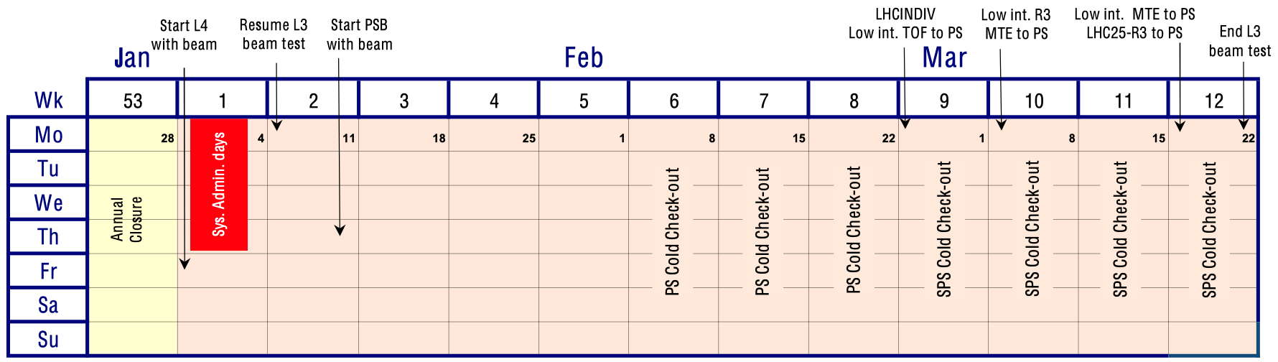
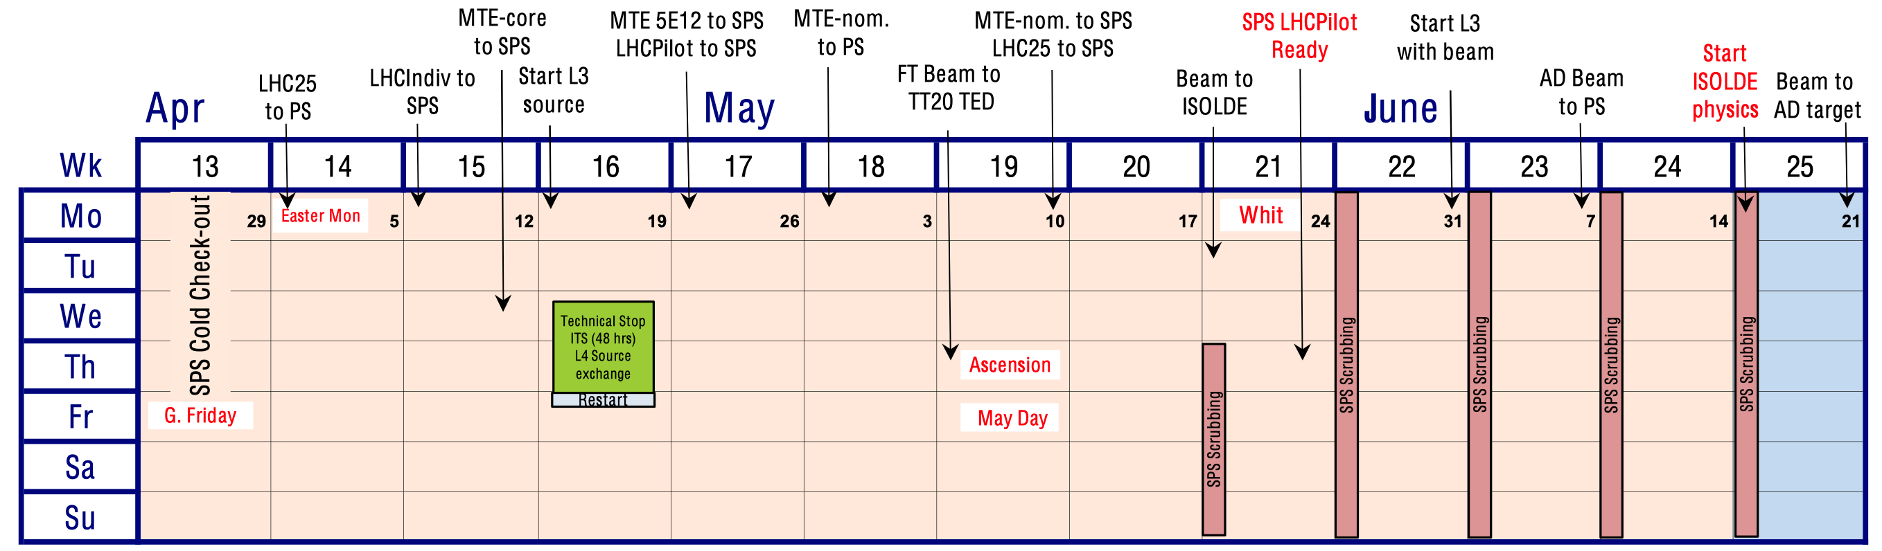
2021 accelerator schedule: Q1-Q2
Draft presented by R. Steerenberg in IEFC, IPP, FOM

Slide 3
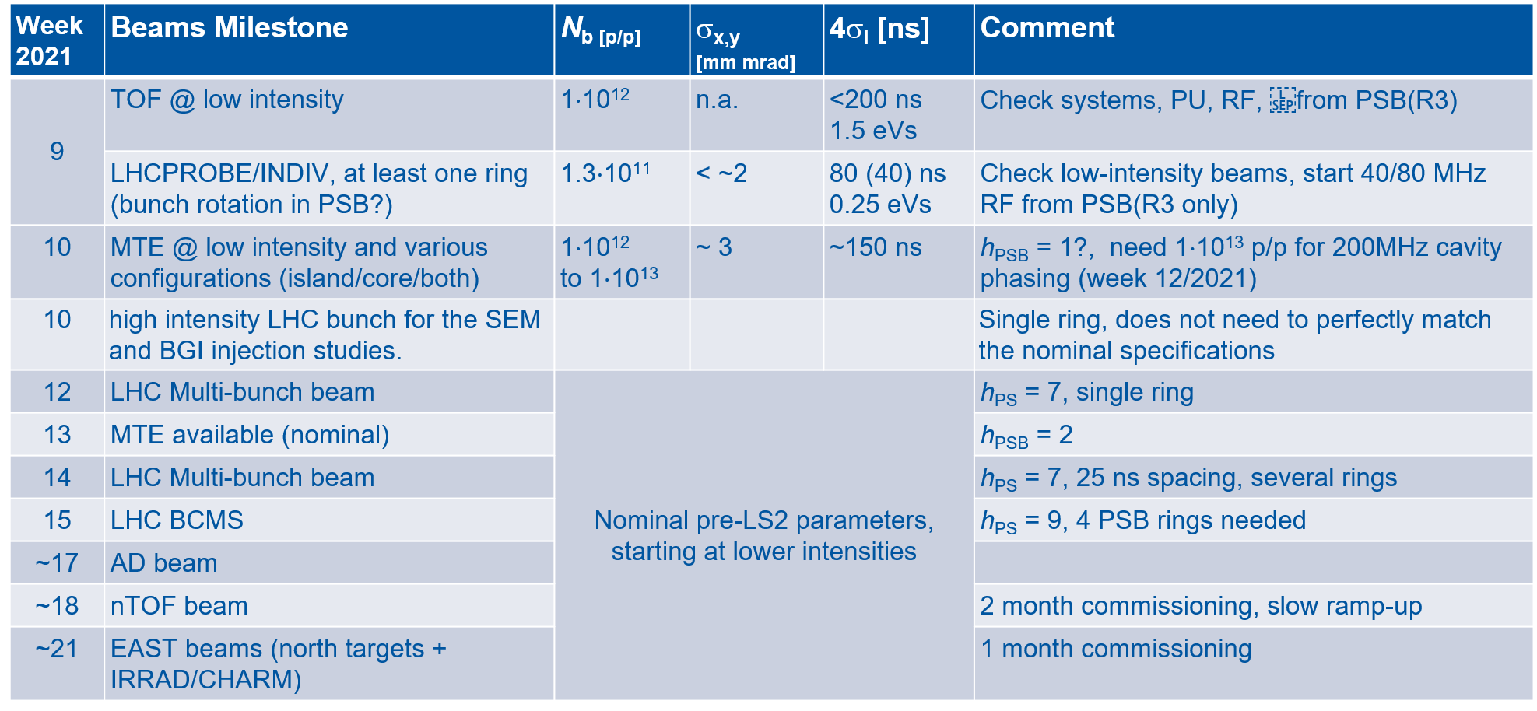
Beam parameters for beam commissioning in PS
F. Tecker (BE-OP)

Slide 4
Beam delivery sequence from PS
F. Tecker (BE-OP), updated
To SPS (from week 15/2021)
  LHCIndiv (1.2e11) Wk15
  MTE low intensity (core only, 5e11, 2µs) Wk15, after 2 days
  MTE low int (5e12, 10µs) Wk 17
  LHCProbe Wk 17
  MTE full beam Wk 19
  Multi-bunch beams (12b, 24, 36, 48, 72) Wk 19
    Standard 25ns or BCMS (not big difference for the PS RF)
  Ions Wk 41
AD from week 25/2021
NTOF from week 28/2021, on target 29/2021 (new target, 2 month commissioning)
EAST from week 37/2021 (ions to EAST might also be requested)

Slide 5
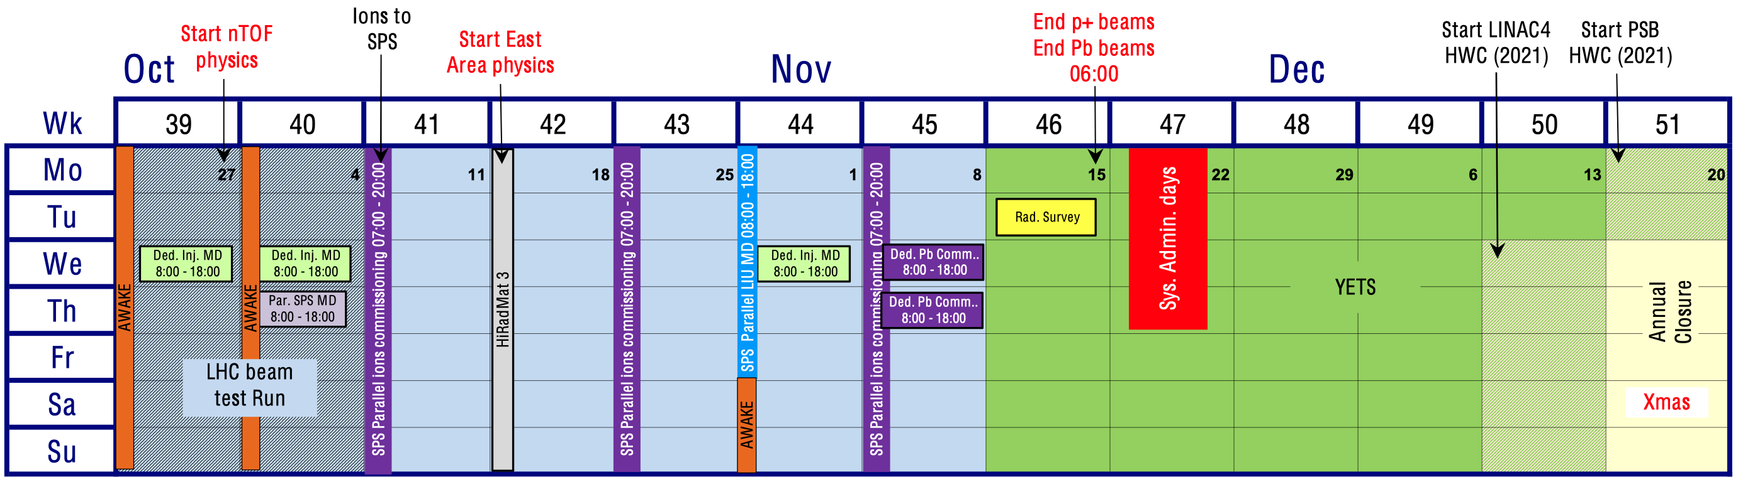
2021 accelerator schedule: Q3-4
Approved by Research Board on 02/12/2020

Slide 6
Outstanding items from ISTs
Moved from IST period to HWC:
Should have been completed during IST period (until 23/10) → PS-MPC report on 04/11
Item | Remark
New 200 MHz cavity controller | Test possible whenever ready, even after HWC
New ejection train distribution | New train distribution to be installed in parallel Move to b. 353 by end of 2020 (top of CR25?)
Digital demodulation front-end | Delayed to hardware commissioning, lab tests
Beam loops front-end | Delayed to hardware commissioning
Item | Remark
20 MHz/40 MHz/80 MHz | Final finish for 40 MHz and 80 MHz
Digital radial position detection | Compatibility with pre-LS2 beam controls PA.FGHPLRT-0/1/2 generated by MakeRule? Validation with simulated signals
Re-installation of coupled-bunch feedback | Re-cabling

Slide 7
Main priorities for early 2021
Only January and February without beam
  Ideal period for LLRF tests with power equipment
  Very difficult (if not impossible) once beam back in PS
Proposal of main priorities
  Pulse 40 MHz cavity using: early February
    Digital cavity controller
    AVC surveillance prototype module
  Pulse 200 MHz system with μTCA controller: February
    Proof-of-principle with prototypes
  Prepare phase measurement of digital beam control: beam
    Open loop phase between beam and 10 MHz cavity vector sum
    Two harmonic simultaneously
    Following harmonic number changes

Slide 8
Firmware/FESA developments for PS-LLRF
 | Hardware | FESA
Module |  | class | Remark
WR frequency program | SVEC | 12/2020 | Upgrade: redeployment/test
CTU | CTU | ✓ done | Completed
Fractional divider (AW./PS) | new | 06/2020 → 12/2020 | FESA class (completed), firmware being finalized
Radial position detection | PS 1-TFB board | ✓ done | Completed
Internal function generator | n.a. | ✓ done | Completed and tested
Internal diagnostics | n.a. | 02/2021 | Waiting for final firmware
White Rabbit frequency program
  Spare front-end to be completed and tested
  Restart firmware developments in Q3/2021
Internal diagnostics on hold
  Expect copy-paste from SPS LLRF when ready

Slide 9
Firmware/FESA developments for PS-LLRF
 | Hardware | FESA
Module |  | Class | Remark
Clock/sync adaptor | New | 12/2020 | Simple class running Firmware to be extended
20/40/80 MHz cavity contr. | PS 1-TFB board | 12/2020 | Memory map finalized
AVC surveillance | New | 02/2021 | Need prototype firmware/FESA class for power test (?)
10 MHz cavity return measurements | PS 1-TFB board | 01/2021 | Modifications of existing class
200 MHz cavity controller prototype | μTCA COTS | 06/2021 | FESA class needed for first test?
AVC surveillance test very difficult with beam
  Slot in February not to be missed
  Firmware for AVC surveillance before clock/sync adapter?
10 MHz cavity return measurements
  Which changes are required

Slide 10
VXS hardware and SVEC for beam control
Hardware (VXS) | Task | Date
PSB motherboard with ADC FMCs | PS MHS running sync. through sync/tag adapter Check receivers on two VXS mother boards | 12/2020
PSB motherboard with ADC FMCs | Phase measurement at two harmonics simultaneously with respect to clock reference Harmonics come from internal functions Internal acquisitions | 12/2020 to 01/2021
PSB motherboard with SFP FMCs | PSB mother board + SFP FMC (hardware abstraction layer) SFP streams emission and reception | 12/2020
PSB motherboard with ADC FMCs | Matrix switch together with SFP FMC controlled by internal functions | 01/2020
Hardware (SVEC) | Task | Date
SVEC with CVORB FMCs | Combination of CVORB data streams CVORB → CVORB | 02-03/2021
SVEC with CVORB and SFP FMCs | Conversion of CVORB to SFP data streams CVORB → SFP | 02-03/2021
SVEC with SFP and SerLink FMCs | Conversion of frev to SerLink format SFP → SerLink | 03/2021

Slide 11
FESA classes for beam control
 | Hardware | FESA
Module |  | class | Remark
Synchronous 4-ch. receiver | PSB mother b. | 01/2020
Fast data concentrator | PSB mother b. | 01-02/2020
Beam loops calculation | PSB mother b. | 03-04/2020
Slow data concentrator and distributor | SVEC | 03/2020 | 3 similar functionalities: CVORB → CVORB CVORB → SFP SFP → SerLink
Common firmware and FESA class for data concentrator/distributor?

Slide 12
Firmware/FESA developments: later in 2021
 | Hardware | FESA
Module |  | Class | Remark
Master clock, DDS-FMC | SVEC | Restart mid 2021 | Postponed
Master clock divider | New | Restart mid 2021 | Postponed
Coupled-bunch feedback | PS 1-TFB board | Q2/2021 | Firmware work restarted
Hereward damping | New | Q3/2021 | Hardware expected: 03-04/2021
Restart master clock system to 2nd half of 2021
  Not required for start-up
  Straightforward to validate and switch to new system
Coupled-bunch feedback
  Restart with pre-LS2 firmware
  Validate new firmware with optimized signal processing (+ diagnostics)

Slide 13
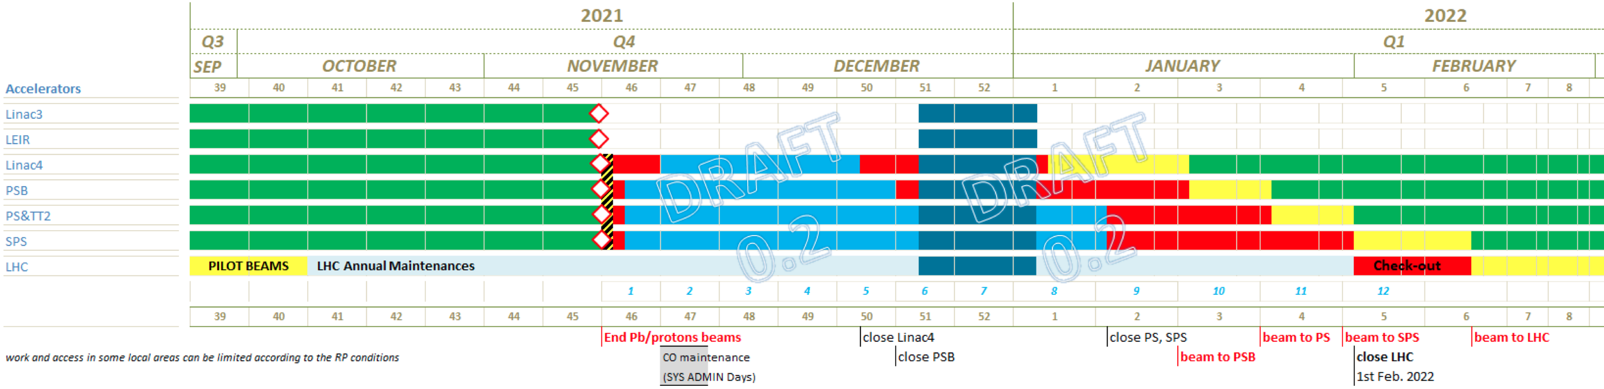
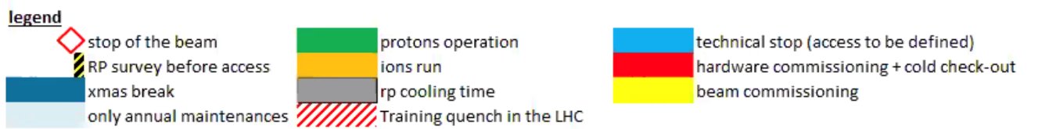
Year End Technical Stop, YETS 2021/22
Draft planning for YETS 2021/22, version 0.2
  2021 accelerator run to stop on 15/11/21
  Early restart in 2022
  Leaves little time for tests with RF cavities
https://edms.cern.ch/document/2439145

