Slide 1
Preliminary considerations/studies on WP6
R. Zennaro 19 12 2020

Slide 2
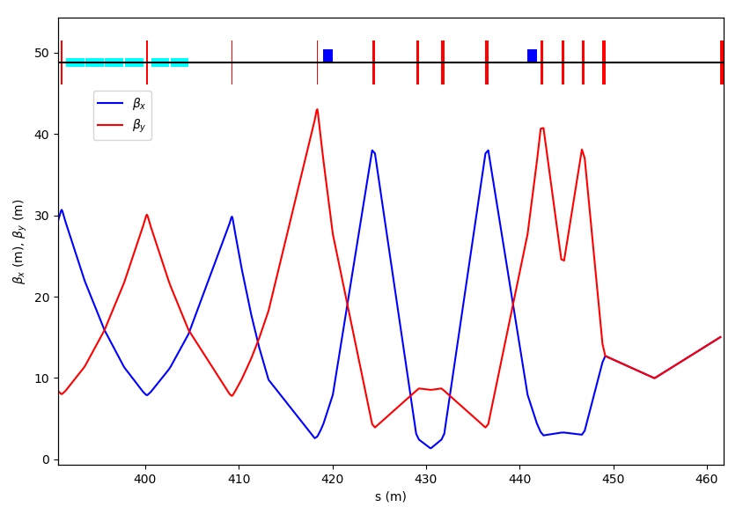
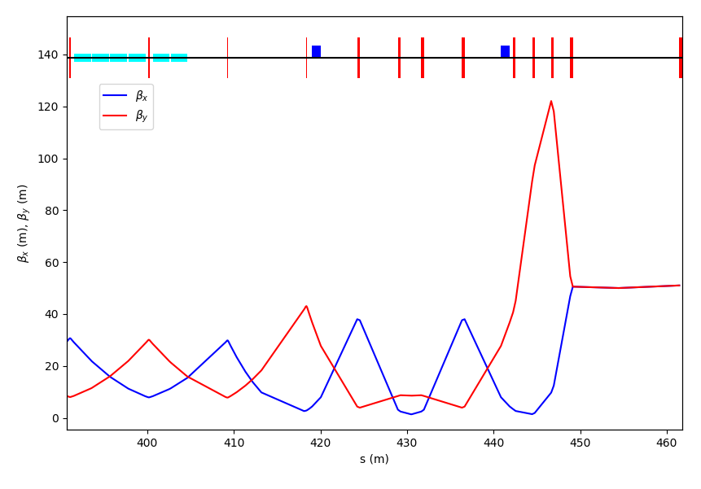
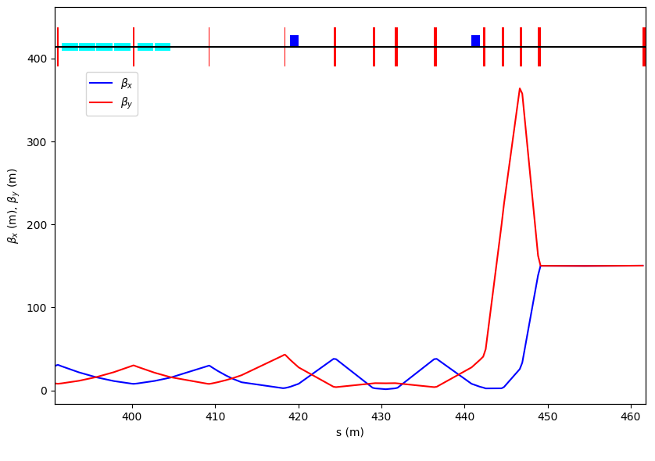
Preliminary study of the beamline optic
2 Dipoles of 1 m length to deflect a 6 GeV beam by 2 degrees
8 Quadrupoles of the type QFM till the target.
It is least invasive to the main SwissFEL line, where only the first dipole is placed in the beamline in S30CB16.
Courtesy of Sven Reiche

Slide 3
Courtesy of Sven Reiche
~ 2 m
~ 5 m
~ 30 m

Slide 4
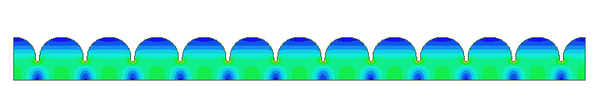
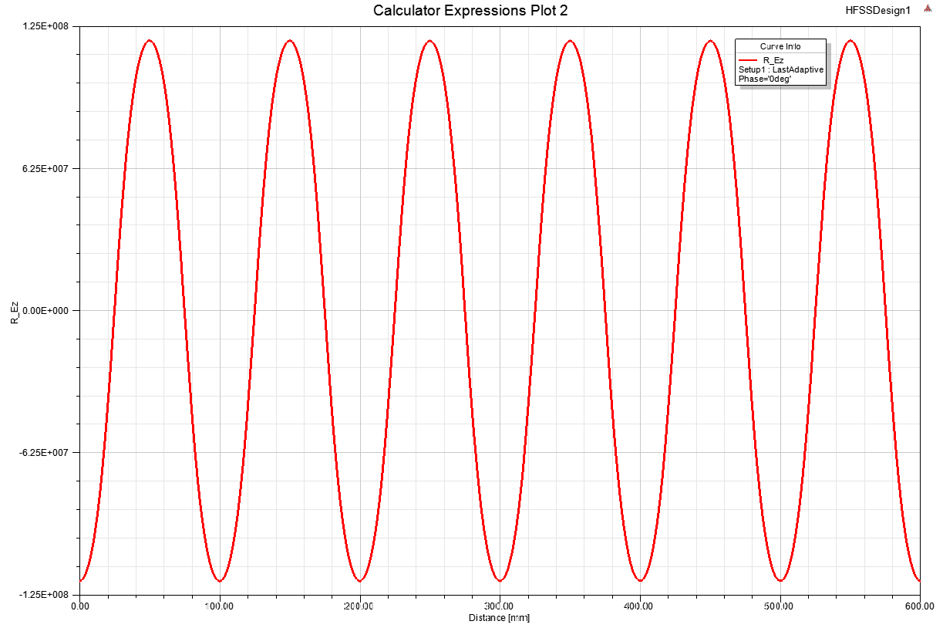
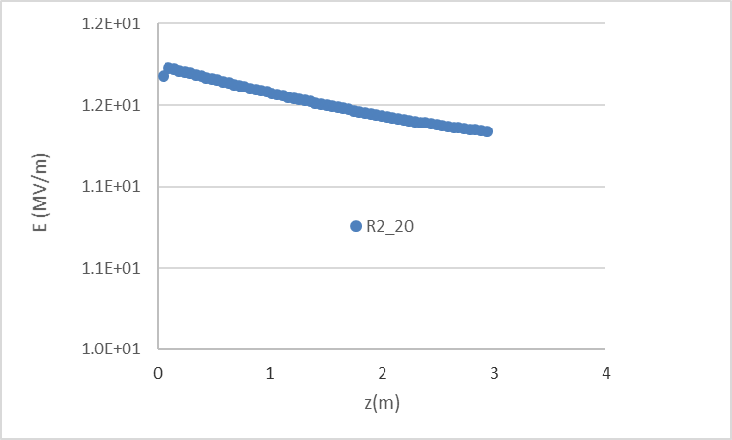
Preliminary studies of an S-band SW capture structure
600 mm
f 2998 MHz
Aperture (D) 40 mm
Q 21000
R/Q 500
P for20 MV/m 7 MW
Mode separation 3.8 MHz
Alternative solution TW with constant aperture and variable phase adv./cell
Low efficiency: ~12 MV/m for 30 MW and 40 mm aperture
~15 MV/m for 30 MW and 30 mm aperture

Slide 5
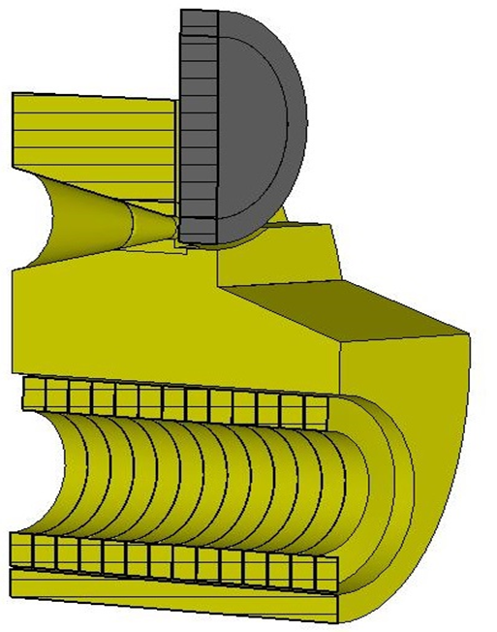
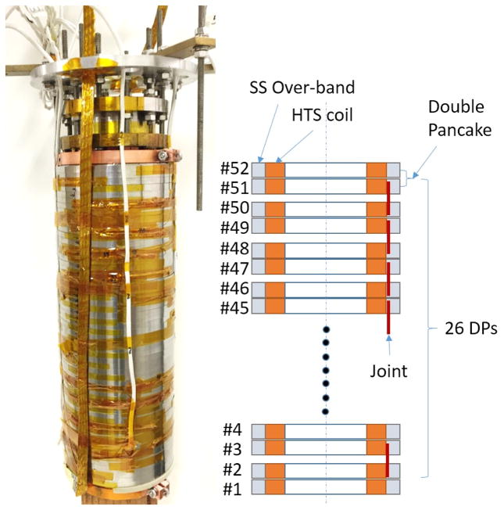
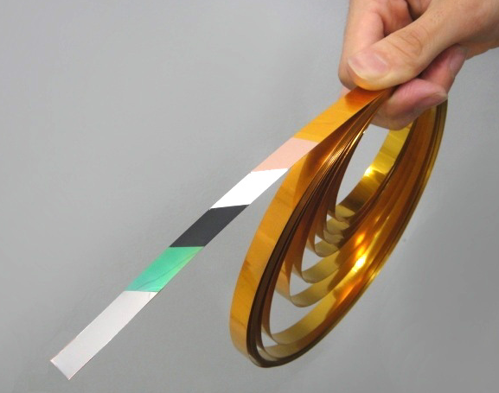
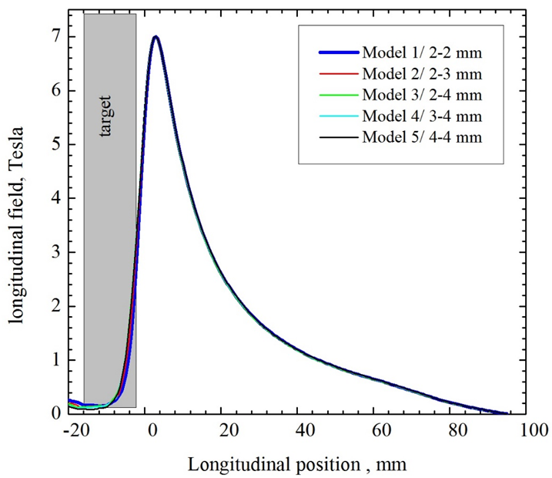
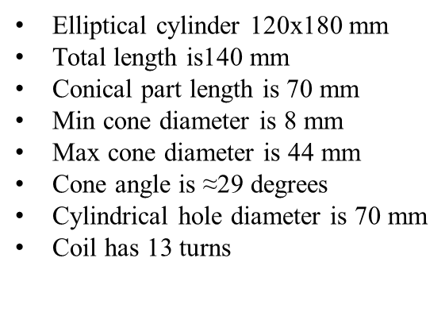
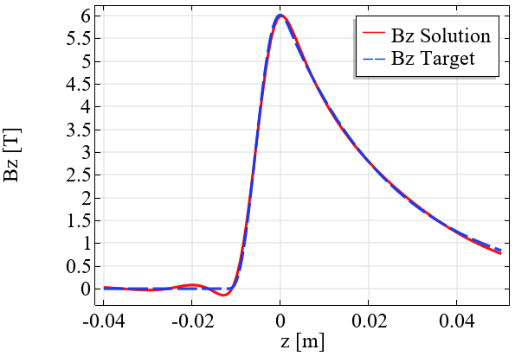
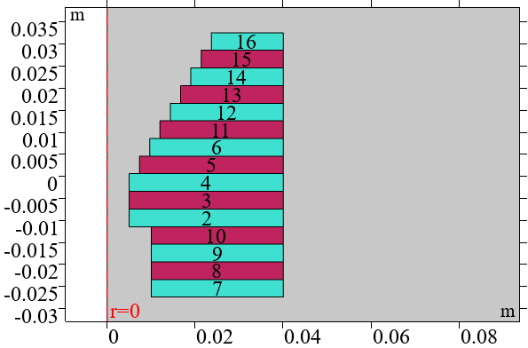
HTS solenoid
Courtesy of Jaap Kosse and Bernhard Auchmann
Magnet: Brainstorming on possible solutions
Flux concentrator
Courtesy of Pavel Martyshkin

