Slide 1
Low Energy e+e- Colliders
Ivan Koop, BINP, 630090 Novosibirsk, Russia
International Conference
on Technology and Instrumentation
in Particle Physics, TIPP 2021
May 24-29, 2021, online format, Triumf, Canada

Slide 2
Content
First generation of e-e- and e+e- colliders
Beam-beam effects and ideas on how to suppress them
Two ring approach, multibunch operation mode
Flat versus round beam optics
Crab-Waist concept and its implementation in few new designs
Prospects and Conclusion

Slide 3
First generation e+e- colliders
Colliders era begins in 60-th with ADA (Frascati, Italy), VEP-1 (BINP, Novosibirsk, Russia) and Princeton-Stanford CBX (Stanford, USA). With small delay these first colliders were followed with VEPP-2 at Novosibirsk, ACO at Orsay, France, and ADONE at Frascati, Italy.
The luminosity of first colliders did not exceed few units of 10²⁸ cm⁻²s⁻¹. This was mainly due to very high value of the vertical beta function β_{y} at IP and very low collision frequency.
The next generation of colliders pursued the idea of compressing the magnitude of the vertical beta function at IP to few centimeters: β_{y} was made comparable with the length of the bunch. That were VEPP-2M at BINP, SPEAR at SLAC, DORIS at DESY and few other colliders. This gave an increase in luminosity of about two orders of magnitude.

Slide 4
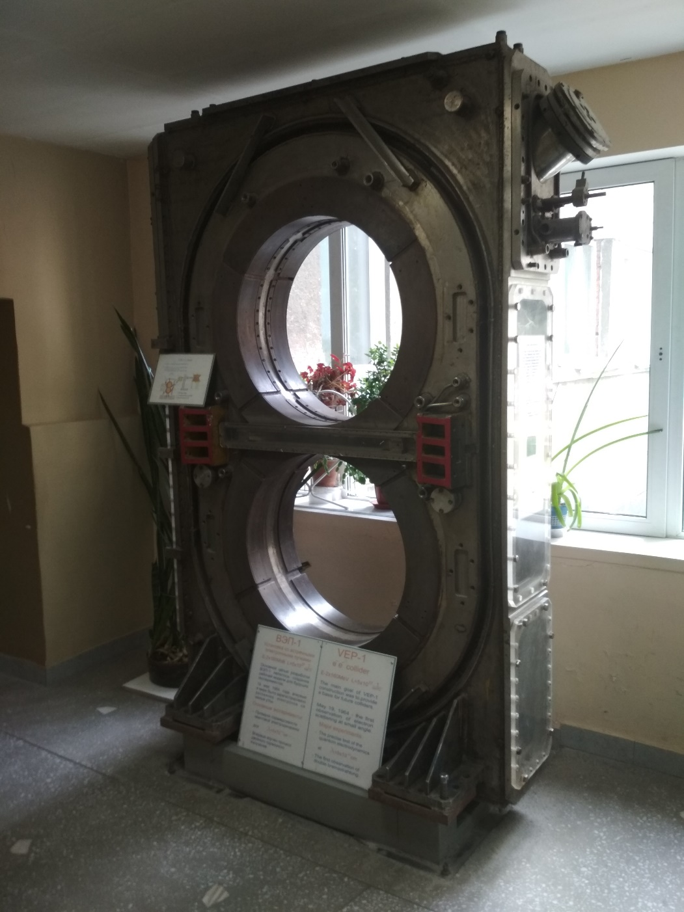
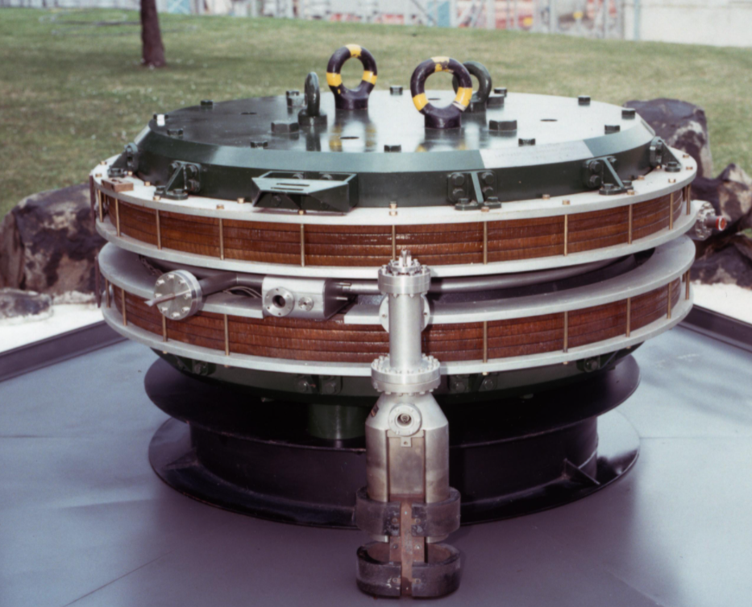
AdA and VEP-1 as museum showpieces

Slide 5
Precise energy calibration using the resonant depolarization technique
The Sokolov-Ternov mechanism provides fast enough self-polarization of e+e- beams by SR. This was confirmed experimentally at VEPP-2 and ACO in late 60-th.
At low energies the Touschek polarimeter became most suitable for the control of beam polarization. At higher energies most promising is the laser light Compton back-scattering technique.
Since 70th were measured using the resonant depolarization method the masses of all quarkonium bound states up to Y-family. This technique was developed initially in BINP at VEPP-2M and VEPP-4 and later refined and futher developed in other labs.
At VEPP-2M in 1987 it was done an experiment on comparision of anomalous magnetic moments of electrons and positrons at relativistic energies.
One of the most remarkable achievement was also an extremely precise mass determination of Z-peak at LEP in CERN.

Slide 6
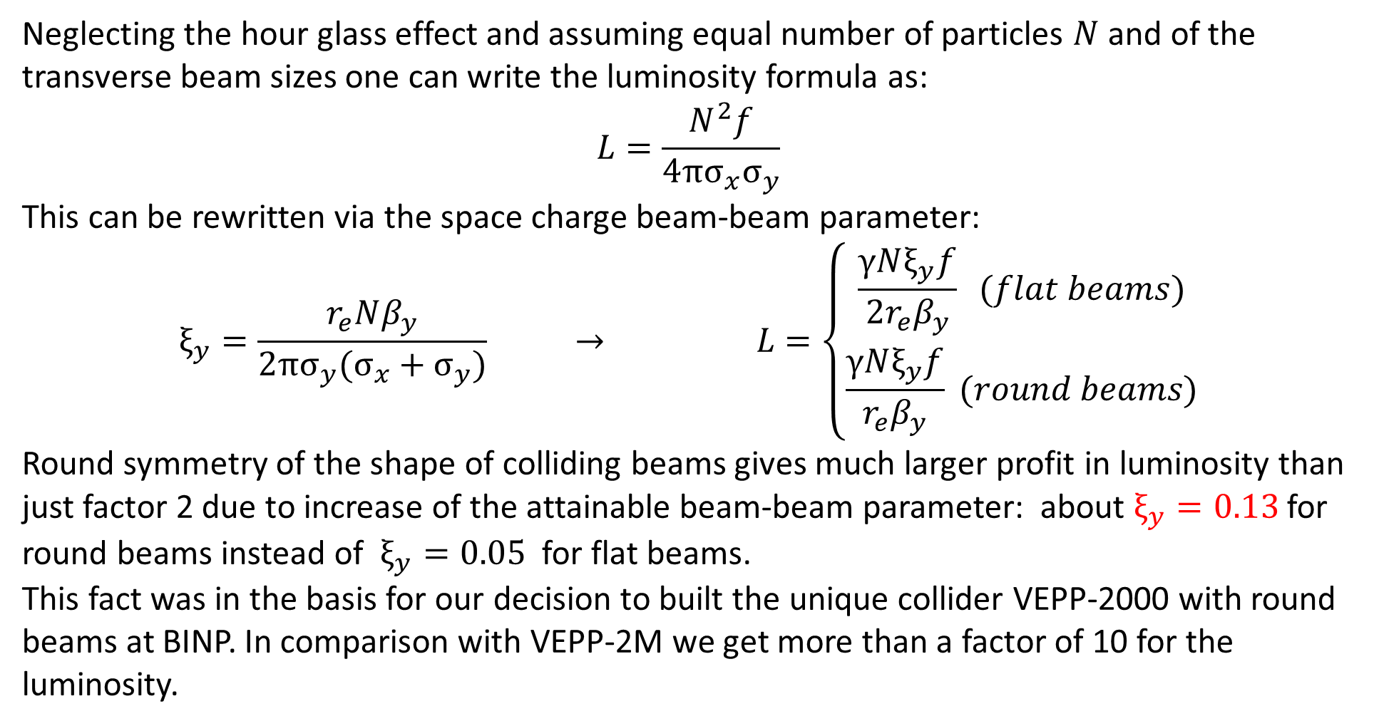
Beam-beam effects and ideas on how to suppress them
Neglecting the hour glass effect and assuming equal number of particles $N$ and of the transverse beam sizes one can write the luminosity formula as:
$$L=\frac{N^{2}f}{4π{σ_{x}σ}_{y}}$$
This can be rewritten via the space charge beam-beam parameter:
$$ξ_{y}=\frac{r_{e}Nβ_{y}}{2π{σ_{y}(σ_{x}+σ}_{y})} → L=\left\{\begin{aligned}\frac{γNξ_{y}f}{2r_{e}β_{y}} (flat beams) \\ \frac{γNξ_{y}f}{r_{e}β_{y}} (round beams)\end{aligned}\right.$$
Round symmetry of the shape of colliding beams gives much larger profit in luminosity than just factor 2 due to increase of the attainable beam-beam parameter: about $ξ_{y}=0.13$ for round beams instead of $ξ_{y}=0.05$ for flat beams.
This fact was in the basis for our decision to built the unique collider VEPP-2000 with round beams at BINP. In comparison with VEPP-2M we get more than a factor of 10 for the luminosity.

Slide 7
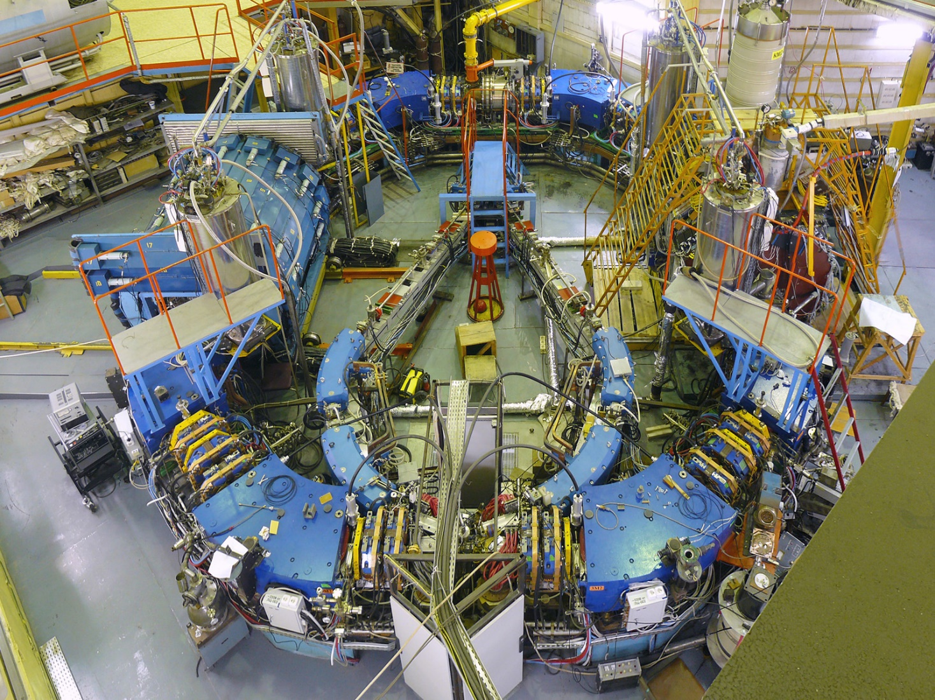
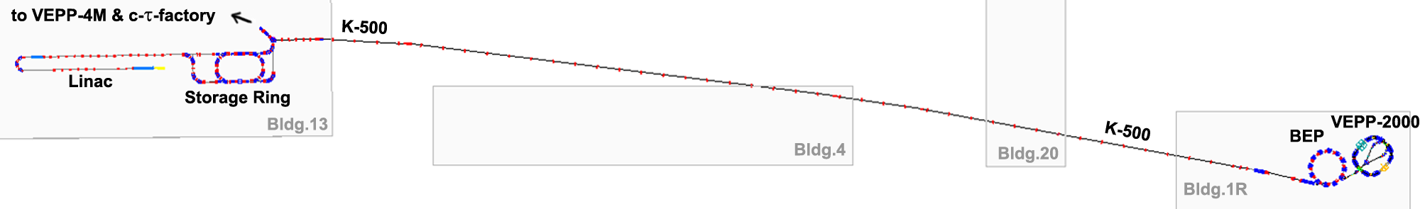
VEPP-2000 e+e- collider with 13Tesla solenoids for FF
Design parameters @ 1 GeV
Circumference | 24.388 m
Beam energy | 150 ÷ 1000 MeV
N of bunches | 1×1
N of particles | 1×10¹¹
Betatron tunes | 4.14 / 2.14
Beta* | 8.5 cm
BB parameter | 0.1
Luminosity | 1×10³² cm⁻²s⁻¹
Achieved
160-1005
SND
CMD-3
0.9×10¹¹
0.5×10³²
Round beams concept
13 T solenoids for FF
2.4 Tesla NC dipoles @ 1 GeV
Compton Back Scattering for energy control
Operating with IC#VEPP-5 since 2016

Slide 8
Round beams concept
Axial symmetry of the beam-beam kick + X-Y transport matrix symmetry from IP to IP.
Additional integral of a motion
(The longitudinal component of the angular momenta M_{z} = x′y - xy′)
Non-linear dynamics becomes one-dimentional;
The resonance chart becomes less dense;
Higher beam-beam limits!
Requirements to the optics:
Head on collision
Equal β-functions at IP:
Equal transverse emittances:
Equal fractional parts of tunes:
Round beams
T_{x} = T_{y}
F.M. Izrailev, G.M. Tumaikin, I.B. Vasserman. Preprint INP 79-74, Novosibirsk,(1979).
L.M. Barkov, et. al, Proc. HEACC’89, Tsukuba, Japan, p.1385.
S. Krishnagopal, R. Siemann, Proc. PAC’89, Chicago, p.836.
V.V. Danilov et al., EPAC’96, Barcelona, p.1149.
S. Henderson, et al., Proc. PAC’99, New York, p.410.

Slide 9
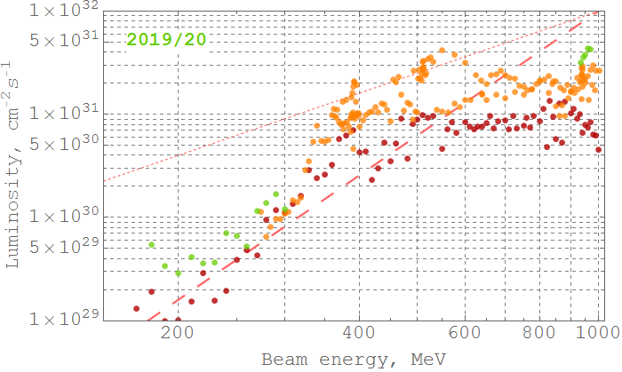
VEPP-2000 luminosity vs beam energy dependence
β* ~ 4cm @ 475 MeV
2017-2018 data
Limited by beam stored currents
(primarily caused by RF power limitation and flip-flop pheno-mena)
Variable β* scaling law
Beam shaker on:
Fixed optics scaling law
CMD-3 luminosity, averaged over 10% of best runs
Current peak luminosity record: L_{peak} = 5×10³¹ cm⁻²s⁻¹ @ 950 MeV

Slide 10
Double ring colliders: first attemps
At DESY in 70-th one of the first double ring machine was built – DORIS. H. Nesemann, et al: Particle Accelerator Conf. (1983) 1998.
In this machine beams were brought into collision with vertical dipoles in the IR and had a vertical crossing angle. Unfortunatelly, very strong synchro-betatron resonances severely limited the attainable beam-beam tune shifts and subsequently the luminosity. After these dramatic studies DORIS was converted to operation in a single ring mode and made significant contribution to B-meson physics.
An attempt to increase the luminosity via compensation of the beam-beam space charge was done at Orsay where the four bunches collision scheme at DCI was implemented. In this machine two rings were vertically separated and e+e- bunches in each ring rotate in opposite directions relative to another ring. By vertical magnetic bends four bunches (2e+ and 2e-) are merged at the IP and the total their space charge is zero. In spite of very accurate orbit tuning severe coherent and incoherent beam-beam instabilities were observed and can’t be cured. Most of the time DCI was operated with two single rings independently, doubling the luminosity. J. LeDuff, et al: XI High Energy Accelerator Conf. (1980) 566.

Slide 11
Multibunch double ring colliders
Single ring colliders, such as PEP, CESR, LEP, VEPP-4, DORIS, PETRA and few others operated very well with dozens of circulating bunches but their performance was limited by low collision frequency.
Breakthrough was done by teams at SLAC , KEK and Frascati labs with B- and Phi-factories projects: PEP-II, KEKB and DAFNE.
Multibunch operation mode supplemented with the top up injection scheme resulted in a huge luminosity increase: by 2 orders of magnitude at least in comparison with previous machines!
PEP-II and KEKB with thousands of circulating bunches in each ring reached the luminosity of up to (1.2-2.1) ·10³⁴ cm⁻²s⁻¹.
At DAFNE operated with much lower beam energies the luminosity was obtained above 4.5 ·10³² cm⁻²s⁻¹.

Slide 12
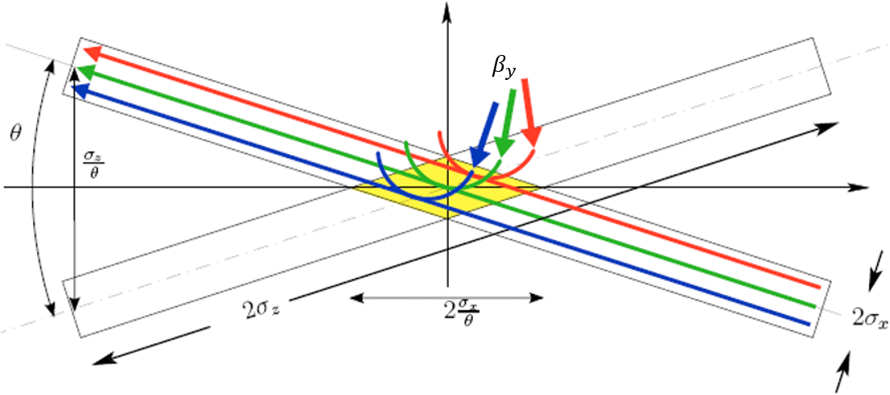
Crab Waist (CW) concept
In course of SuperB proposal P. Raimondi suggested a concept of crab waist collision scheme.
See P. Raimondi: 2nd SuperB Meeting, Frascati (2006); P. Raimondi, D. Shatilov, M. Zobov, in Proceedings of EPAC08,Genoa, Italy:2620-2622,2008.
This concept was successfully proved at DAFNE in special runs without the detector field. Now almost all new projects are relying on that approach, including FCC-ee at CERN and CEPC in China. In Novosibirsk we also intend to built the Tau-Charm factory and small mu-mu-tron collider with this principle in the basis.
Main idea of the CW is to install downstream and upstream from IP two special sextupoles which modify the vertical beta-function at IP in such a way, that longitudinal position of a waist is proportional to the x-coordinate.
Particles in one beam shall collide with other beam always at its axis. This dramatically reduces modulation of the beam-beam tune shift. That modulation is caused by crossing angle geometry.
A large intersection angle and small horizontal emittance allows us to reduce the vertical beta function value to few submillimeters!

Slide 13
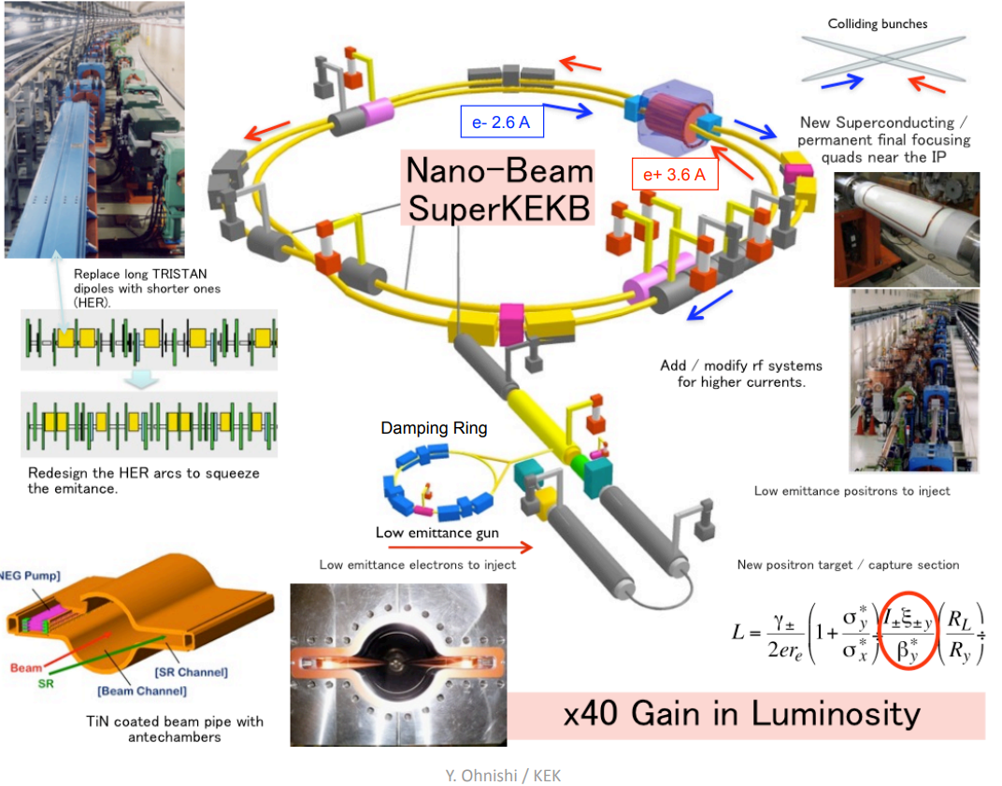
KEKB upgrade to SuperKEKB
From Y. Ohnishi report at 15-th KEKB review, Feb/15-17/2010

Slide 14
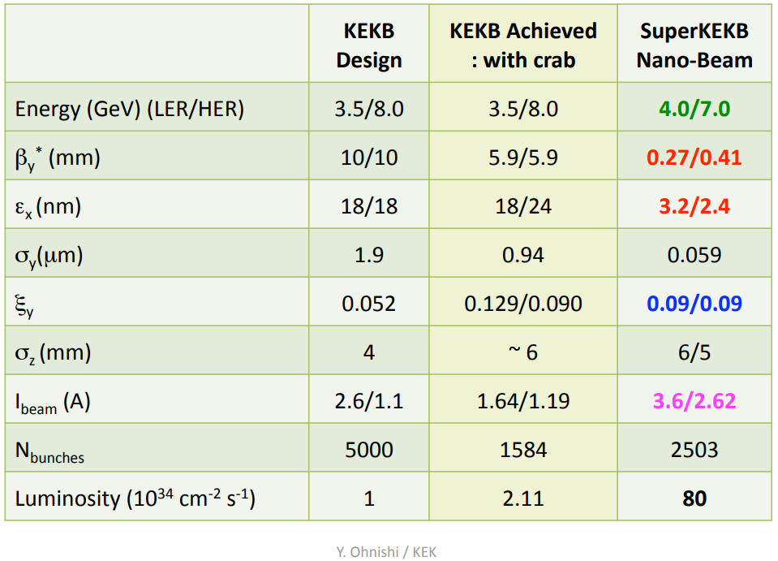
Comparison of parameters KEKB/SuperKEKB

Slide 15
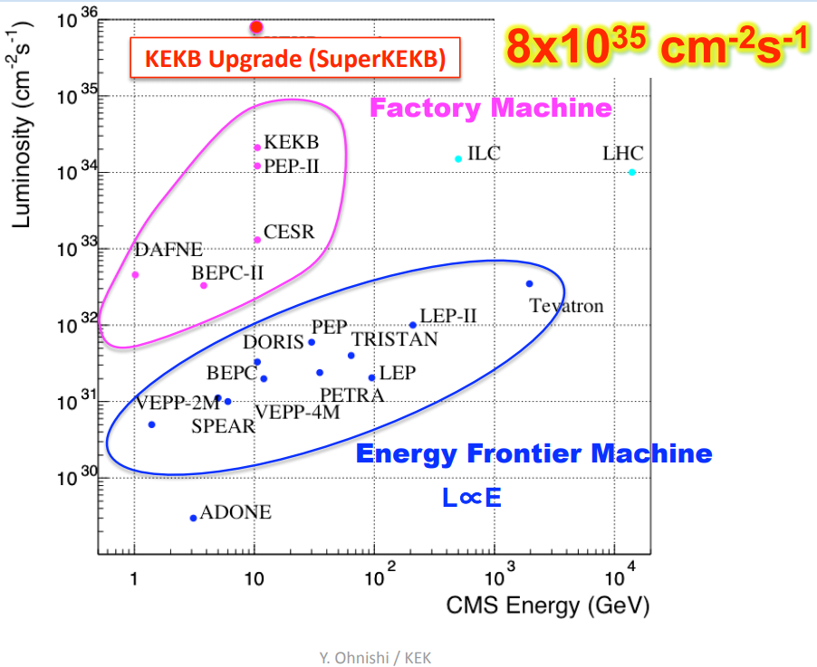
Luminosity expectations at SuperKEKB

Slide 16
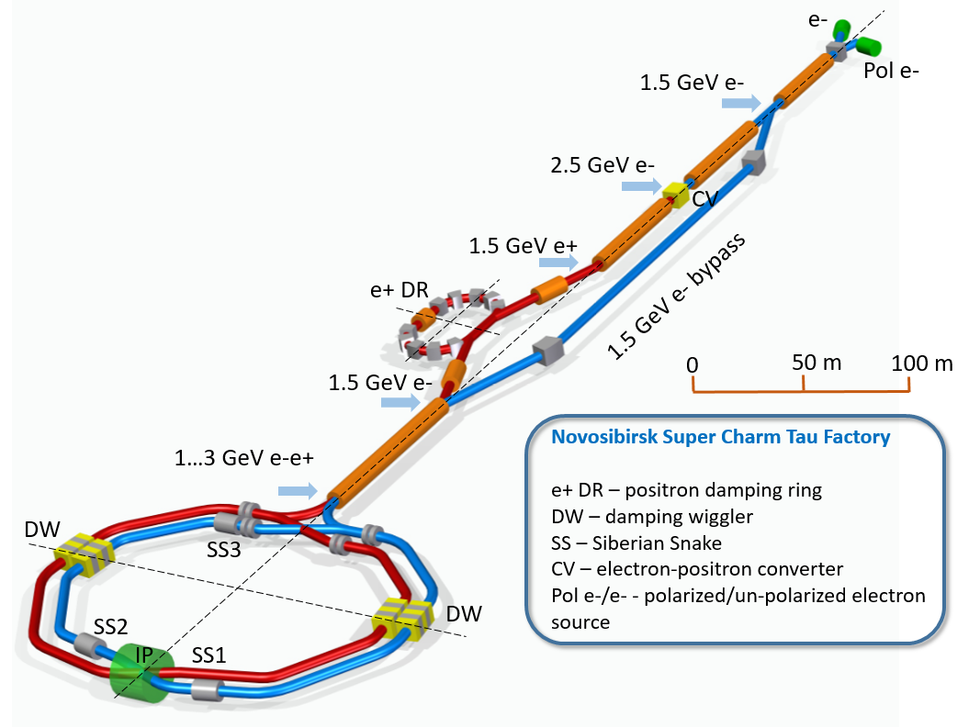
The Novosibirsk Super Charm-Tau Factory Project
A.Bogomyagkov et al., talk given at the 2020 joint international workshop for Super-Charm Tau Facility,
16-18 November 2020

Slide 17
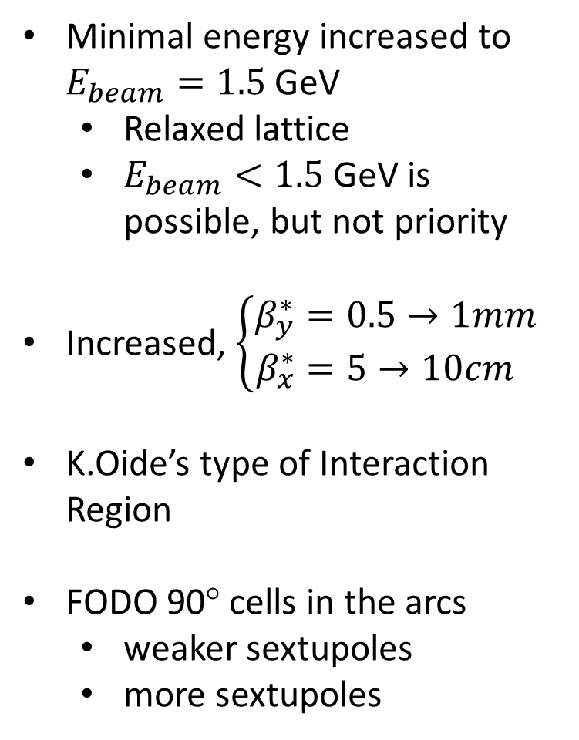
C-tau parameters 2020 vs 2019
E(MeV) | 1500 | 2000 | 3000
$Π$(m) | 622.712
$F_{RF}$(MHz) | 350
q | 727
$2θ$(mrad) | 60
$ε_{y}/ε_{x}$(%) | 0.5
$β_{x}^{∗}$(mm) | 100
$β_{y}^{∗}$(mm) | 1
$α$ | $$2.5×{10}^{3}$$
I(A) | 2 | 2 | 2
$N_{e/bunch}×{10}^{−10}$ | 8 | 6 | 10
$N_{b}$ | 323 | 431 | 259
$U_{0}$(keV) | 17 | 53 | 270
$V_{RF}$(kV) | 1200 | 1200 | 2000
$ν_{s}$ | 0.0153 | 0.0132 | 0.0139
$δ_{RF}$(%) | 1.6 | 1.4 | 1.4
$σ_{e}×{10}^{3}$ (SR/IBS) | 0.27/0.9 | 0.4/0.7 | 0.5/0.6
$σ_{s}$(mm) (SR/IBS) | 4/15 | 7/12.6 | 10/11
$ε_{x}$(nm) (SR/IBS) | 3/22 | 6/12.8 | 12/13.7
$L_{HG}×{10}^{−35}\left(cm^{−2}s^{−1}\right)$ | 0.4 | 0.5 | 1
$ξ_{x}$ | 0.005 | 0.005 | 0.007
$ξ_{y}$ | 0.08 | 0.072 | 0.09
$τ_{Touschek}$ (s) | 4200 | 2000 | 2600
$τ_{L}$ (s) | 2800 | 3200 | 1731
Minimal energy increased to $E_{beam}=1.5$ GeV
  Relaxed lattice
  $E_{beam}<1.5$ GeV is possible, but not priority
Increased, $\left\{\begin{aligned}β_{y}^{∗}&=0.5→1mm \\ β_{x}^{∗}&=5→10cm\end{aligned}\right.$
K.Oide’s type of Interaction Region
FODO 90° cells in the arcs
  weaker sextupoles
  more sextupoles

Slide 18
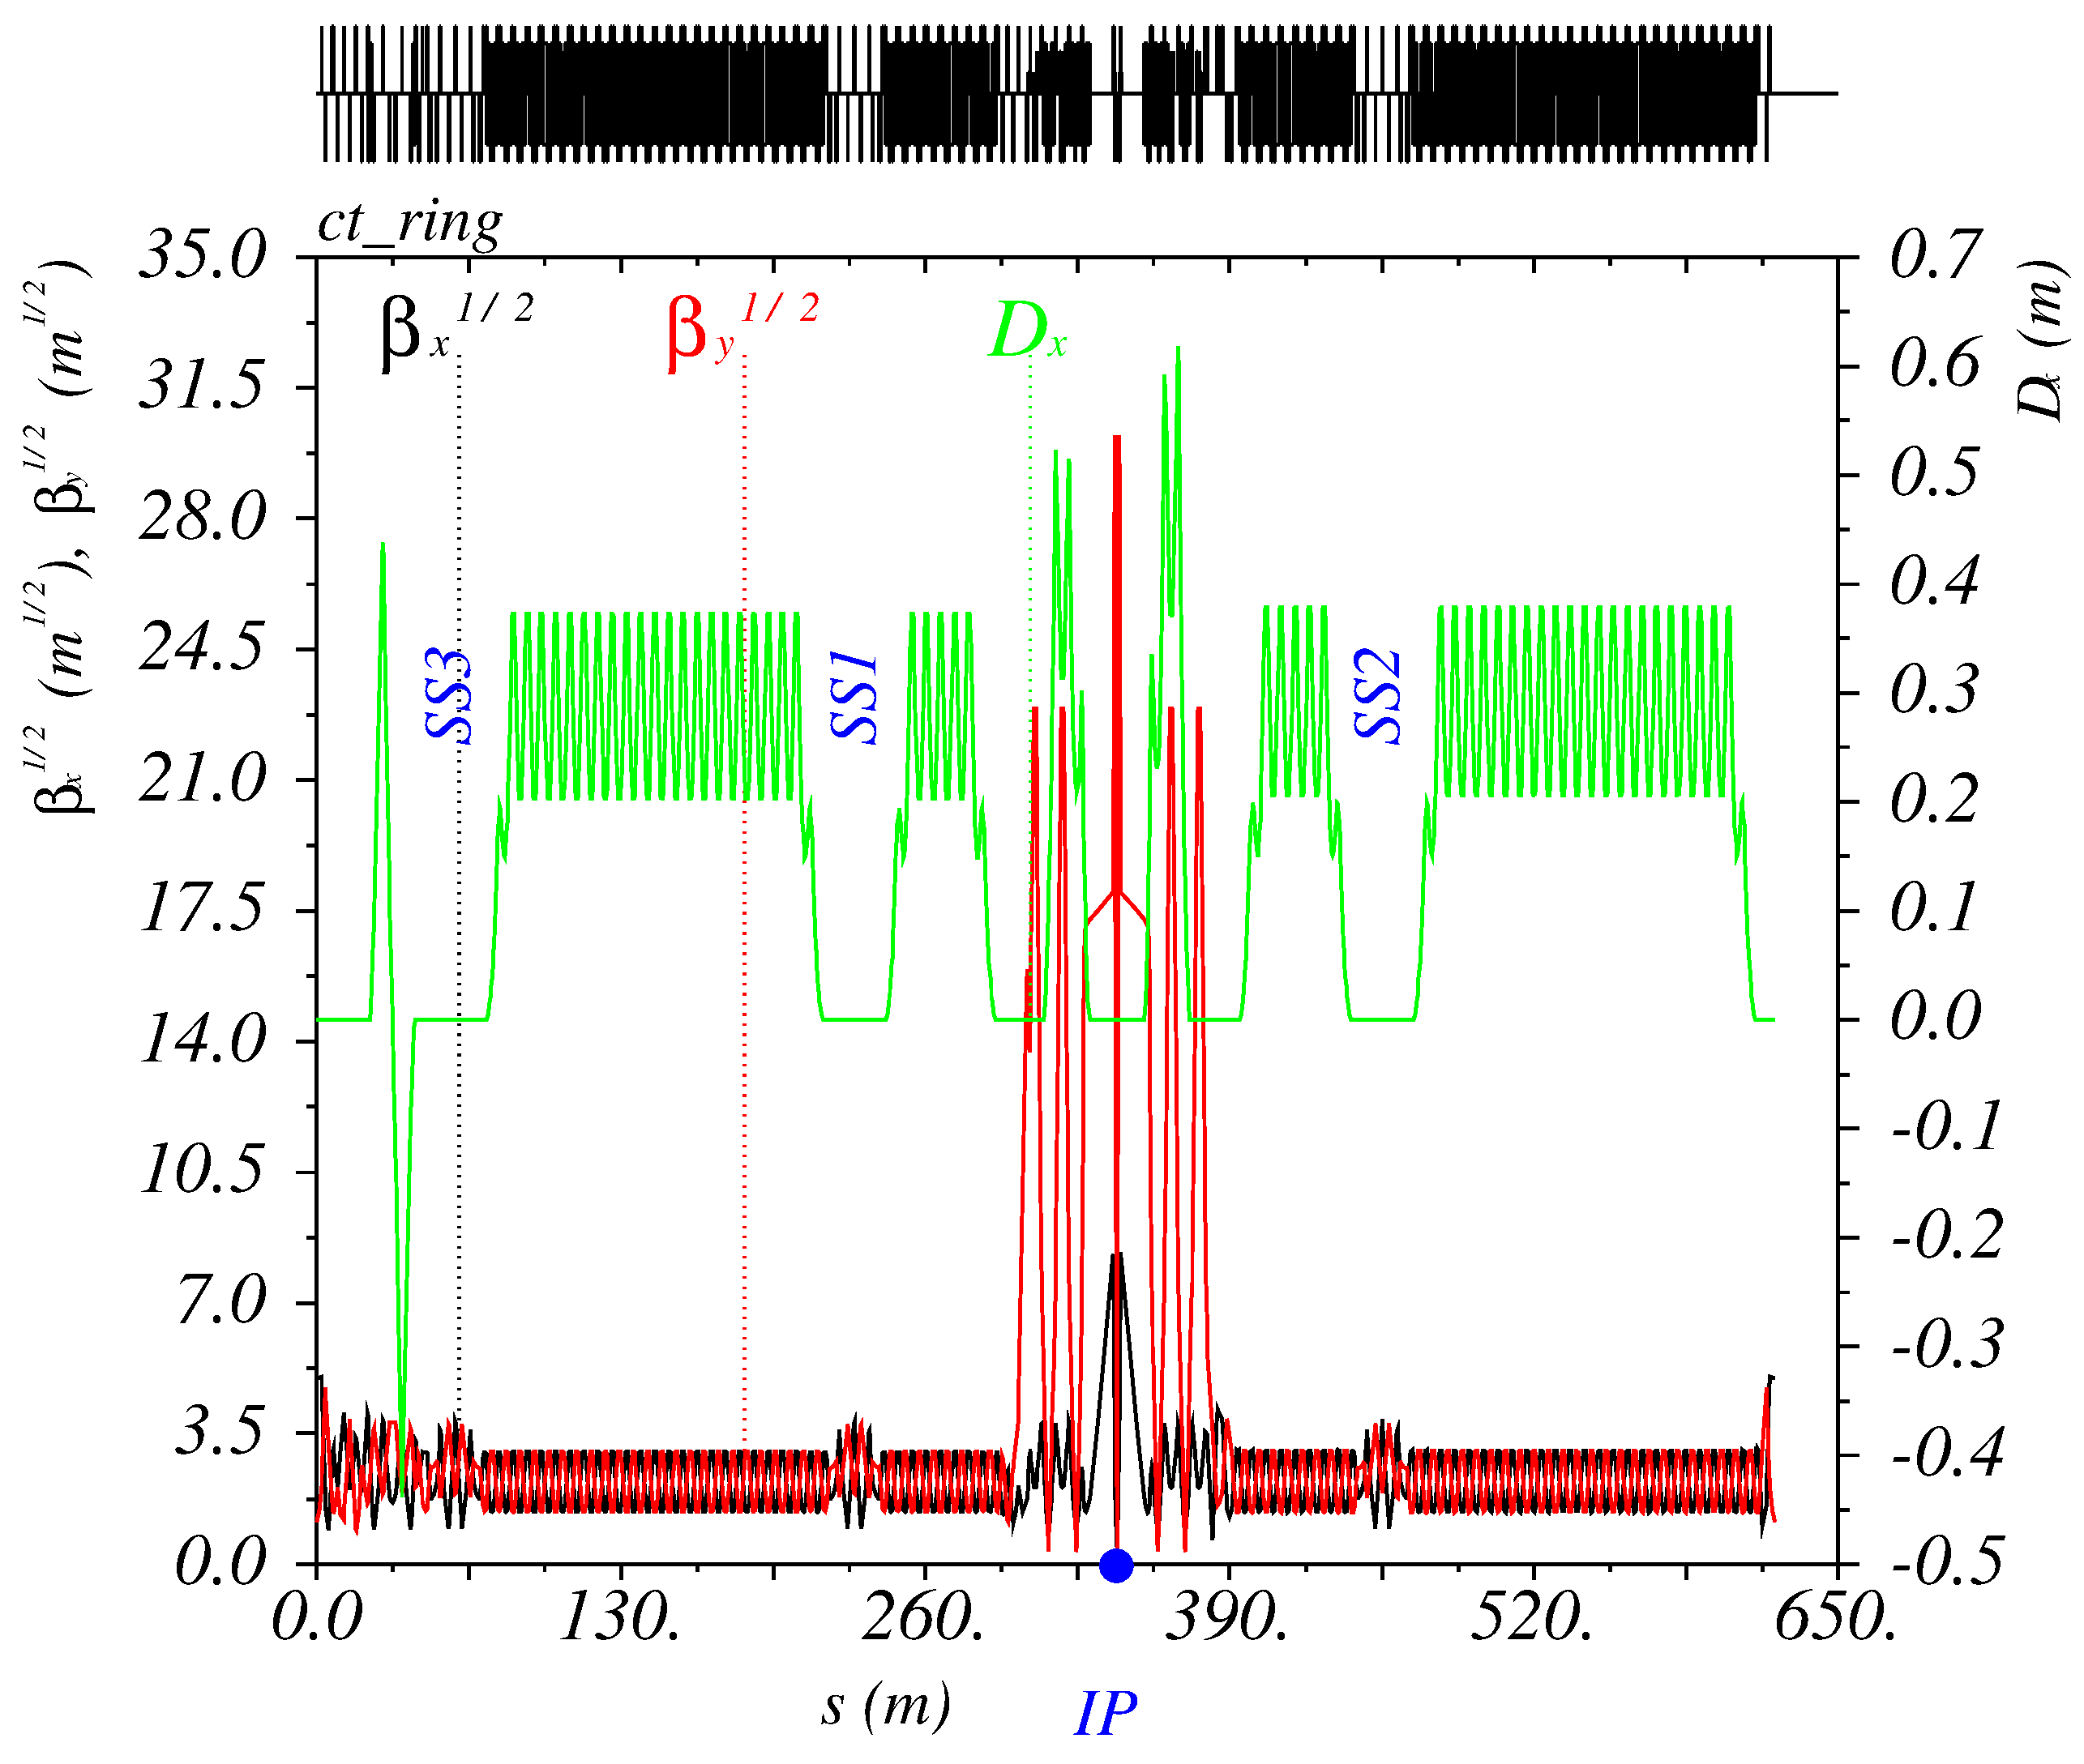
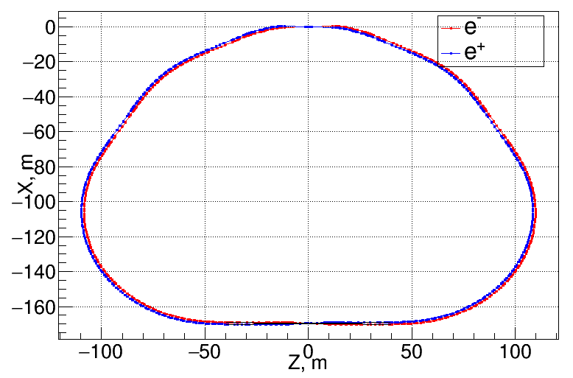
C-tau: Lattice and layout
IP
Interaction Region
SS
SS
Siberian Snakes
SS
Xing
Inj

Slide 19
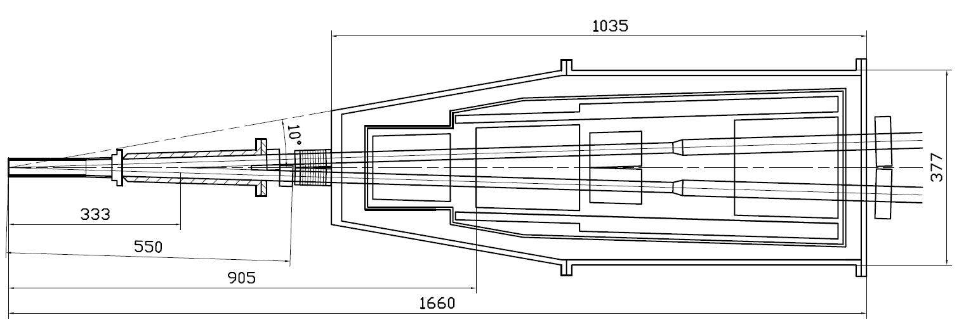
C-tau: Machine-detector interface
Compensating solenoid
Gradients for 3 GeV
Be-tube ±150 mm,
∅30 mm, cooled
QD0, 200 mm
–100 Т/m
QF1, 200 mm
70 Т/m
Corr. coils
Screening solenoid
BPMs
Y-chamber,
cooled
BPMs
e+
IP
∅ 417
e-
L* =
FF vacuum chamber
Cryostate with FF magnets

Slide 20
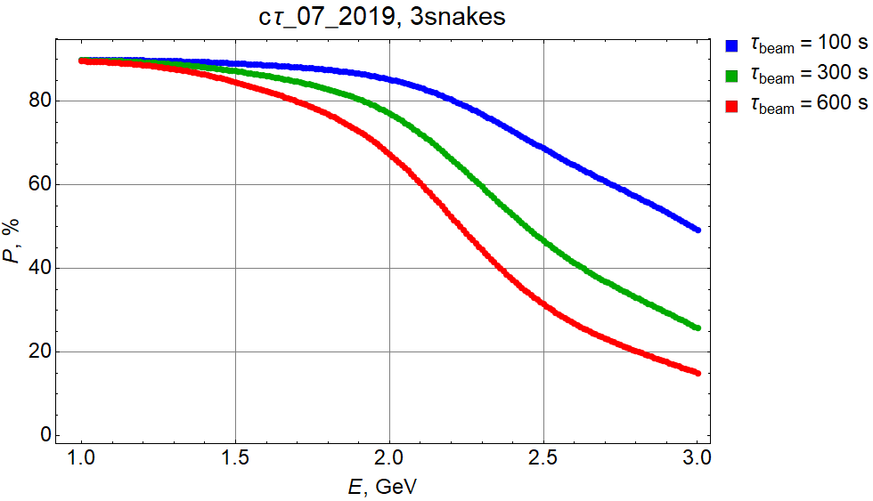
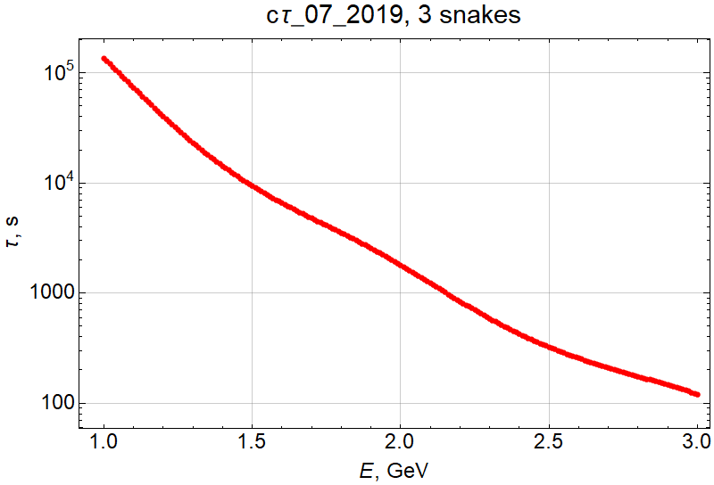
C-tau: Longitudinal Polarization vs e-beam energy
An equilibrium beam polarization strongly depends on energy and of a beam lifetime
(top up injection regim is assumed).
Polarization could be kept higher with faster replacement of depolarized bunch by fresh one with high initial 90% polarization level.

Slide 21
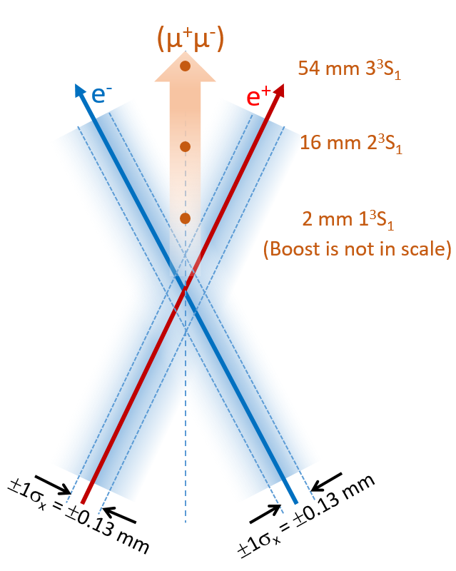
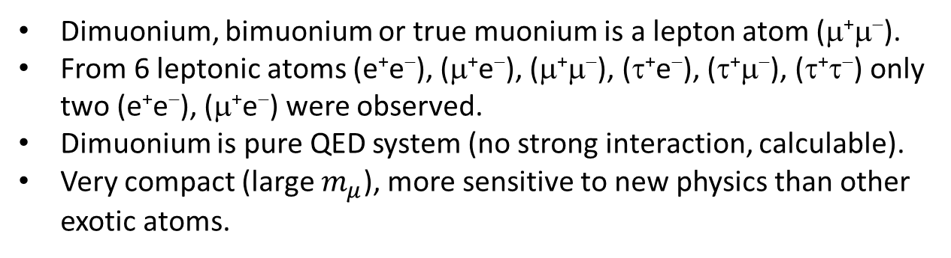
mu-mu-tron: Low-energy electron-positron collider to search and study μ+μ- bound state
A.V. Bogomyagkov, V.P. Druzhinin, E.B. Levichev, A.I. Milstein, S.V. Sinyatkin, https://arxiv.org/abs/1708.05819
Dimuonium, bimuonium or true muonium is a lepton atom (μ⁺μ⁻).
From 6 leptonic atoms (e⁺e⁻), (μ⁺e⁻), (μ⁺μ⁻), (τ⁺e⁻), (τ⁺μ⁻), (τ⁺τ⁻) only two (e⁺e⁻), (μ⁺e⁻) were observed.
Dimuonium is pure QED system (no strong interaction, calculable).
Very compact (large $m_{μ}$), more sensitive to new physics than other exotic atoms.
V.N.Baier and V.S.Synakh, Bimuonium production in electron-positron collisions,
SOVIET PHYSICS JETP, 14, № 5, 1962, pp.1122-1125
  Properties of the bound state, probability of observation
S.J. Brodsky and R.F. Lebed. Production of the Smallest QED Atom: True Muonium (μ⁺μ⁻). Phys. Rev. Lett., 102:213401, 2009
  Very large crossing angle in order to eliminate background
H. Lamm and R.F. Lebed, True Muonium (μ⁺μ⁻) on the Light Front, arXiv 1311.3245v3, 12 Nov 2014
  Spectrum
H. Lamm, True muonium: the atom that has it all, arXiv 1509.09306v1, 30 Sep 2016
  Novel properties

Slide 22
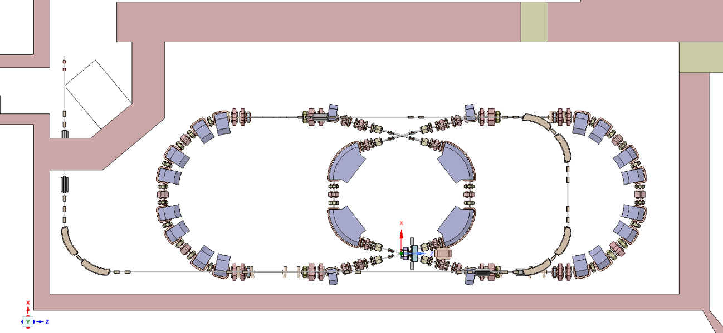
mu-mu-tron: e+e- large crossing angle collider project at BINP
A.V. Bogomyagkov, V.P. Druzhinin, E.B. Levichev, A.I. Milstein, S.V. Sinyatkin, https://arxiv.org/abs/1708.05819
Almost comoving beams cross at Θ=30⁰, E_{beam}=408 MeV, E_{c.m}.=211.3 MeV
Injection
RF cavities
IP1
IP2
Outer arc
Inner arc
Inner arc
Outer arc
RF cavities
IP1
Injection

Slide 23
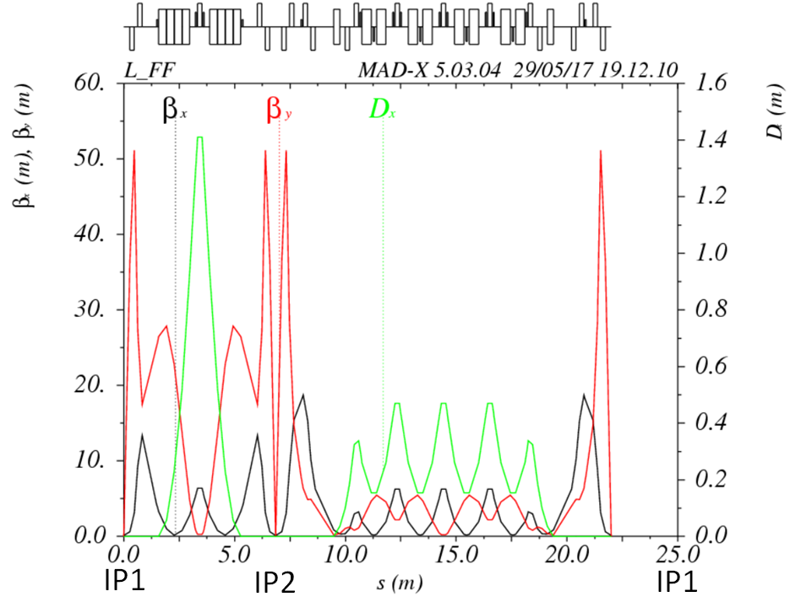
Mu-mu-tron optics – implementation of Crab-Waist concept
Beam energy | 408 MeV
Circumference | 23 m
Momentum compaction | 6.4×10⁻²
Bunch intensity | 3.5×10¹⁰ / 73 mA
Horizontal emittance | 26 nm 90 nm (IBS)
Energy spread | 4×10⁻⁴ 8.4×10⁻⁴ (IBS)
β_{x} / β_{y} | 200 mm / 2 mm
Luminosity | 4×10³⁰ cm⁻²s⁻¹, Nb=1 8×10³¹ cm⁻²s⁻¹, Nb=20

Slide 24
Prospects and Conclusion
FCC-ee at CERN and CEPC in China with beam energies up to 2 x 180 GeV, both having 100 km circumference, are expecting to be the next discovery machines at and beyond the Higgs boson threshold.
SuperKEKB team consider future upgrade with longitudinally polarirized electrons. That will significantly widen the collider’s capability to examine the electroweak sector.
Tau-Charm factories in Novosibirsk and Hefei will perform experiments in very rich energy range with beam energies up to 2 x 3 GeV. The longitudinal polarization of the electron beam shall provide complementary possibilities to study CP-violation.
Crab-Waist approach became the key technology in reaching the highest luminosity of future e+e- colliders.
New ideas and diagnostic tools will help futher increase the collider’s luminosity.

