Slide 1

Evaluation of nuclear data using the Half Monte Carlo technique
Erik Andersson Sundén, Tyra Axén, Olle Diös, Alf Göök, Viktor Lindström, Henrik Sjöstrand, Axel Wohlin
Uppsala University
(1)
Erik Andersson Sundén - Wonder 2023

Slide 2
OVERVIEW
Random files – how we make them
Halfway Monte Carlo (HMC) technique
  A comparison to the Total Monte Carlo (TMC) technique
Inclusion of integral experiments in the evaluation
In this presentation, we will use GODIVA, an integral experiment with mainly U-235 in it, as an example on how the suggested framework could be applied.
(2)
Erik Andersson Sundén - Wonder 2023

Slide 3
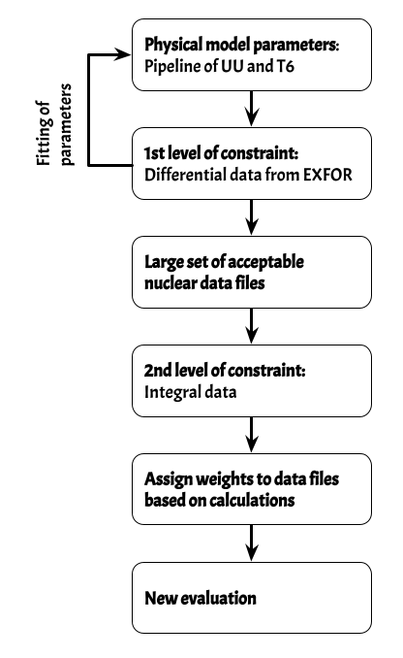
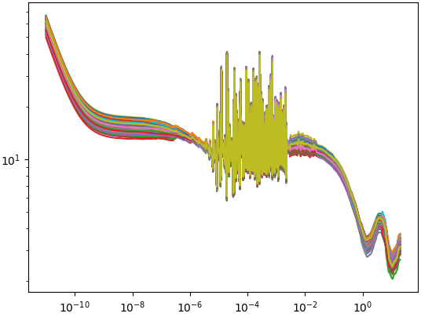
How to generate random files describing the uncertainty of data
Use a parametrized model for cross sections.
  In Uppsala Pipeline, TALYS is used with added model defects corrections among other things.
  See talk by Alf Göök later today.
Fit the model to differential data (EXFOR).
We can use the UU pipeline to generate a large set of random files.
The distribution of the random files describe the uncertainty of the nuclear evaluation.
Here we use the Random files of Tendl 2021
U-235(n,elastic)
Cross section
(3)
E_{n} [MeV]
Notes:
\displaystyle{\displaylines{\begin{cases}
Q_i &= \frac{\left( k_{eff,i} - k_{exp}\right)}{\Delta k_{eff}}\\
w_i &= \text{exp} \left( -\frac{Q^2}{2} \right )
\end{cases}}}

Slide 4
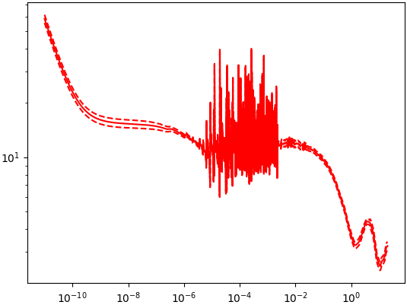
How to generate random files describing the uncertainty of data
Use a parametrized model for cross sections.
  In Uppsala Pipeline, TALYS is used with added model defects corrections among other things.
  See talk by Alf Göök later today.
Fit the model to differential data (EXFOR).
We can use the UU pipeline to generate a large set of random files.
The distribution of the random files describe the uncertainty of the nuclear evaluation.
Here we use the Random files of Tendl 2021
U-235(n,elastic)
Cross section
(4)
E_{n} [MeV]
Notes:
\displaystyle{\displaylines{\begin{cases}
Q_i &= \frac{\left( k_{eff,i} - k_{exp}\right)}{\Delta k_{eff}}\\
w_i &= \text{exp} \left( -\frac{Q^2}{2} \right )
\end{cases}}}

Slide 5
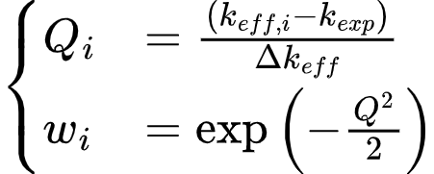
Inclusion of integral data in the evaluation procedure
We propose a way to include integral data into the pipeline evaluation.
We will use calculations, typically neutron transport calculations, to see how well the random files describe the macroscopic measures of the integral experiments.
Give each random file a weight, w, based on the “closeness” to the experiment:
Total Monte Carlo
Half Monte Carlo
(5)
Notes:
\displaystyle{\displaylines{\begin{cases}
Q_i &= \frac{\left( k_{eff,i} - k_{exp}\right)}{\Delta k_{eff}}\\
w_i &= \text{exp} \left( -\frac{Q^2}{2} \right )
\end{cases}}}

Slide 6
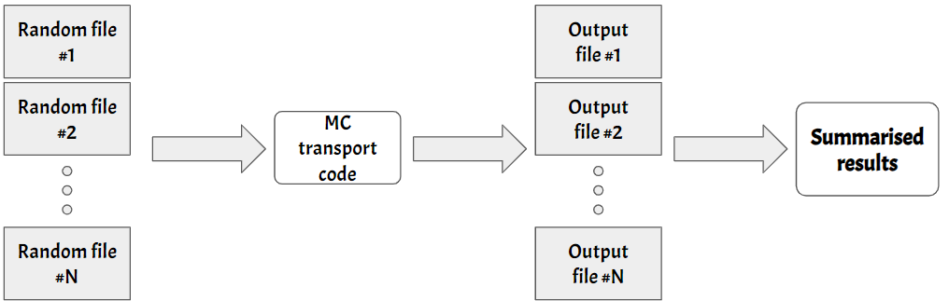
Total Monte Carlo (TMC) technique
Will result in a spread of the macroscopic quantity due to the spread in the cross section.
This technique results in precise estimates of the quantity and can handle non-Gaussian correlations that the covariance matrices are unable to describe.
This technique is time consuming.
(6)
Erik Andersson Sundén - Wonder 2023
A.J. Koning, D. Rochman, Nucl. Data Sheets 113, 2841 (2012)
Notes:
The Total Monte Carlo (TMC) technique:
TMC uses the randomly generated cross section files.
A transport code, such as OpenMC, MCNP or SERPENT, uses one set of random files to calculate a macroscopic quantity (e.g. k_{eff}).
Repeat for a new set of random files.
Will result in a spread of the macroscopic quantity due to the spread in the cross section.
This technique results in precise estimates of the quantity and can handle complex covariances that the covariance matrices are unable to describe.
This technique is time consuming.

Slide 7
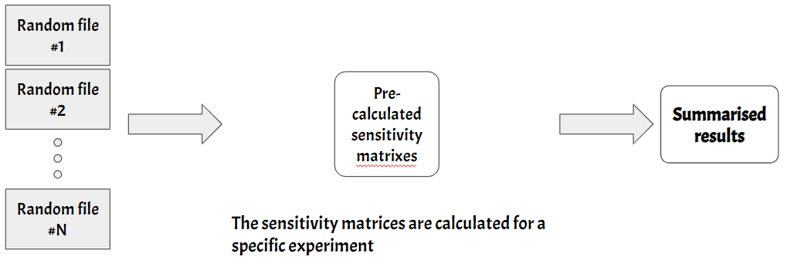
Halfway Monte Carlo (HMC) technique
This calculation is based on the assumption that the Monte Carl transport code can be replaced with a first order Taylor expansion.
Less precise than TMC, but much faster.
(7)
J. Dyrda et al.: EPJ Nuclear Sci. Technol. 4, 14 (2018)
Notes:
The Half Monte Carlo (HMC) technique replaces the transport code used in TMC with sensitivity matrices.
Each integral experiment has a set of sensitivity matrices describig the changes
The sensitivity matrices describes how a macroscopic quantity changes when the cross section changes.
[Insert equation]
This calculation is based on the assumption that the Monte Carl transport code can be replaced with a first order Taylor expansion.
The sensitivity matrices can be found in e.g. DICE or be calculated using neutron transport tools.
Less precise than TMC, but much faster.

Slide 8
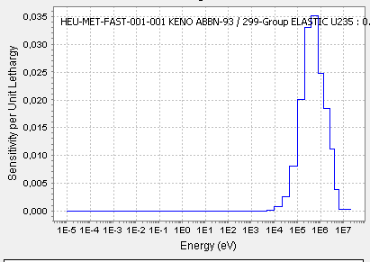
Sensitivity matrices, J_{i}
Sensitivity matrices can be obtained for different experiments in various ways:
  Sensitivity matrices can be calculated by brute force using a MC transport code, or
  downloaded via DICE
To the right, the sensitivity vector for elastic scattering of neutrons in U-235 in the GODIVA experiment is shown
  From DICE
(8)
Ali Nouri, Pierre Nagel, J. Blair Briggs & Tatiana Ivanova (2003) DICE: Database for the International Criticality Safety Benchmark Evaluation Program Handbook, Nuclear Science and Engineering, 145:1, 11-19, DOI: 10.13182/NSE03-15
Hill, I., Gulliford, J., Soppera, N., & Bossant, M. (2015). DICE 2013. New capabilities and data (No. JAEA-CONF--2014-003)

Slide 9
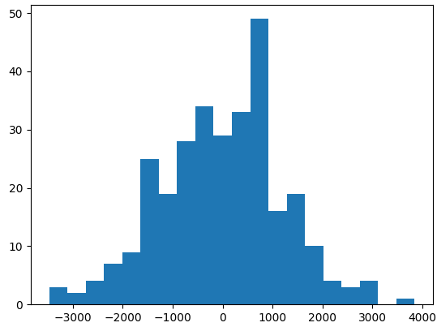

Giving weights to random files
Each random file is given a weight based on its deviation from the experimental value.
is given a value to compensate for inconsistencies in data and models.
  See ref below for more details.
k_{eff,i} [MeV]
(9)
H. Sjöstrand and G. Schnabel E Web of Conferences 211, 07070 (2019)
Notes:
\displaystyle{\displaylines{\begin{cases}
Q_i &= \frac{\left( k_{eff,i} - k_{exp}\right)}{\Delta k_{eff}}\\
w_i &= \text{exp} \left( -\frac{Q^2}{2} \right )
\end{cases}}}
\sum_{i}\sum_{j}\sum_{k}\left[J_i \cdot \left\{\text{ND}_j\left(E_k\right)-\text{ND}_{central}\left(E_k\right)\right\} \right]

Slide 10
Comparison of cross sections before and after usage of integral data
Before integral data is included
After integral data is included
U-235(n,elastic)
U-235(n,elastic)
Cross section
Cross section
E_{n} [MeV]
E_{n} [MeV]
The difference at most about 1% from before integral data is included in the (n,elastic) scattering
Differs less than 0.1% in the (n,fission) channel.
(10)
Erik Andersson Sundén - Wonder 2023

Slide 11
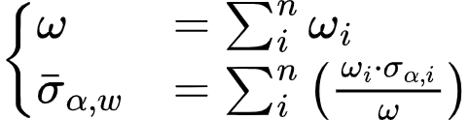
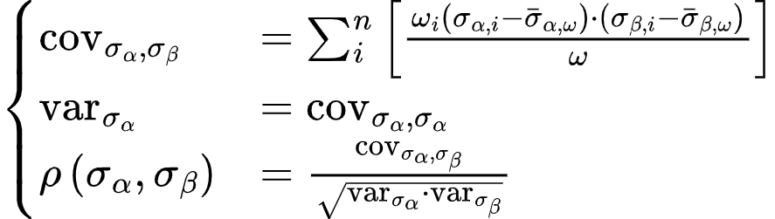
Weighted averages and weighted correlations
(11)
Erik Andersson Sundén - Wonder 2023
D. Rochman, et al., EPJ Nuclear Sci. Technol., 4 (2018) 7
Notes:
\displaystyle{\displaylines{\begin{cases}
\text{cov}_{\sigma_{\alpha},\sigma_{\beta}} &= \sum_{i}^{n} \left[\frac{\omega_i\left( \sigma_{\alpha,i}-\bar{\sigma}_{\alpha,\omega}\right)\cdot\left( \sigma_{\beta,i}-\bar{\sigma}_{\beta,\omega}\right)}{\omega}\right]\\
\text{var}_{\sigma_{\alpha}} &=\text{cov}_{\sigma_{\alpha},\sigma_{\alpha}}\\
\rho\left(\sigma_{\alpha},\sigma_{\beta}\right) &= \frac{\text{cov}_{\sigma_{\alpha},\sigma_{\beta}}}{\sqrt{\text{var}_{\sigma_{\alpha}}\cdot\text{var}_{\sigma_{\beta}}}}
\end{cases}}}

Slide 12
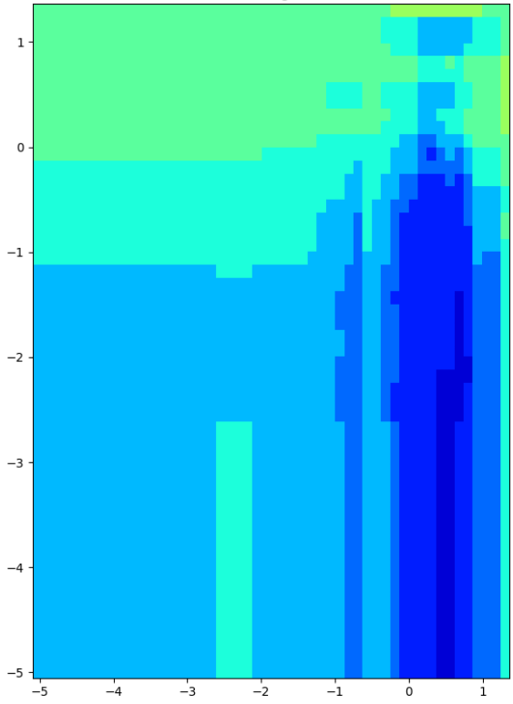
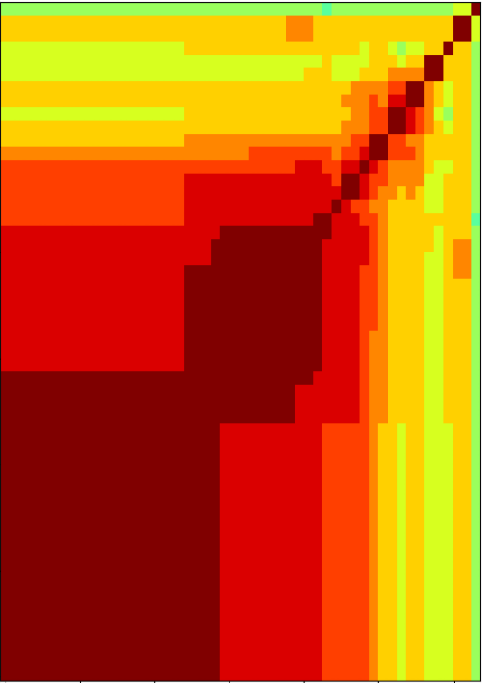
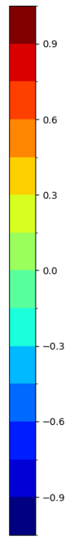
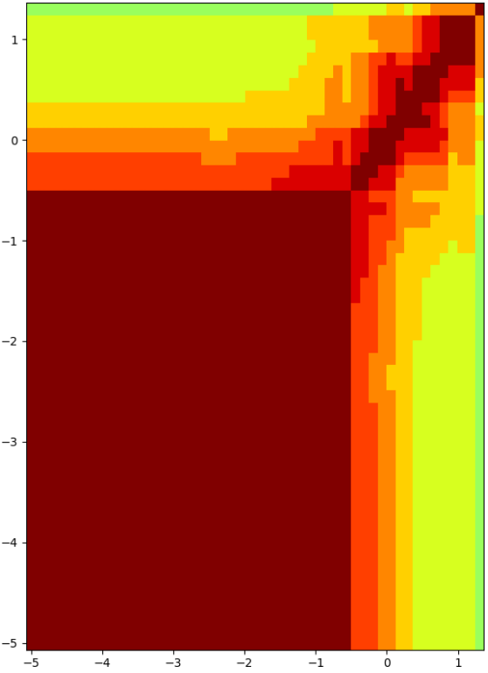
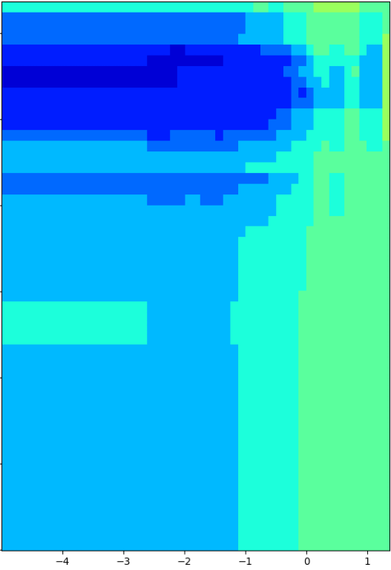
Before integral data is included in evaluation
Fission,Fission
As we include the integral data in the evaluation the correlation between the reaction channels changes.
(12)
Elastic Elastic

Slide 13
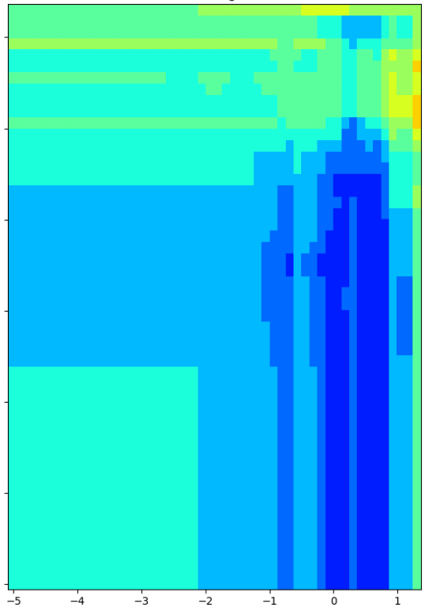
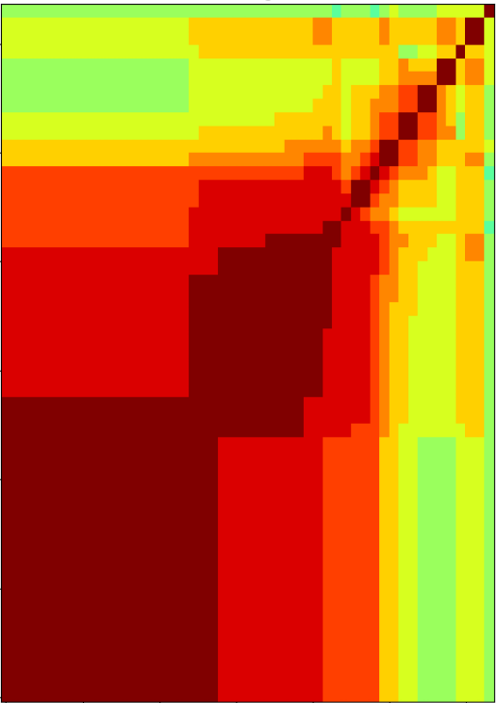
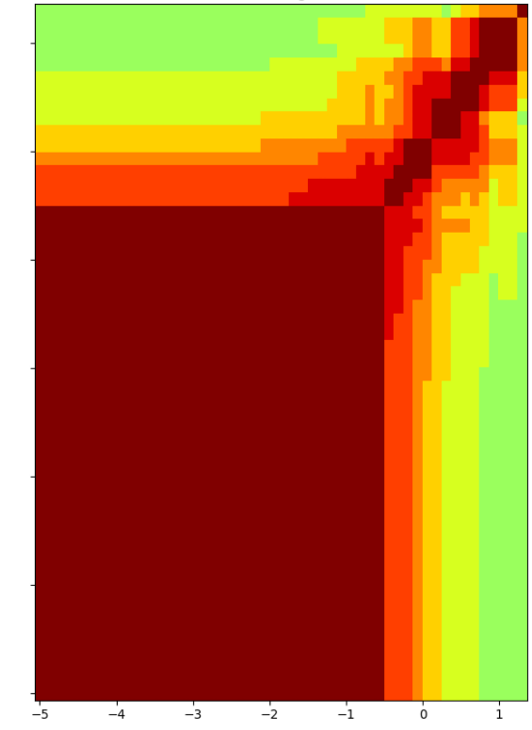
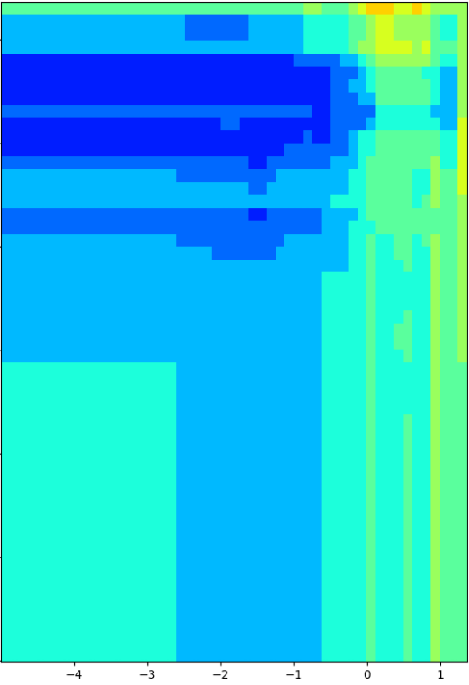
After integral data is included in evaluation
Fission,Fission
As we include the integral data in the evaluation the correlation between the reaction channels changes.
(13)
Elastic Elastic

Slide 14
Conclusions and looking forward
We have a method of including Integral data
… while being restrained by the differential measurements
The Half Monte Carlo method has been implemented and is ready to be included into the pipeline of Uppsala University.
The inclusion of integral data in the evaluation does not affect the central values of the cross sections more than 1% in a bin.
  It does however affect the correlation between the reaction channels.
Looking for future use of the HMC framework
  Includes work on Shielding experiments.
(14)
Erik Andersson Sundén - Wonder 2023

Slide 15
THANK YOU FOR LISTENING!
(15)
Erik Andersson Sundén - Wonder 2023

Slide 16
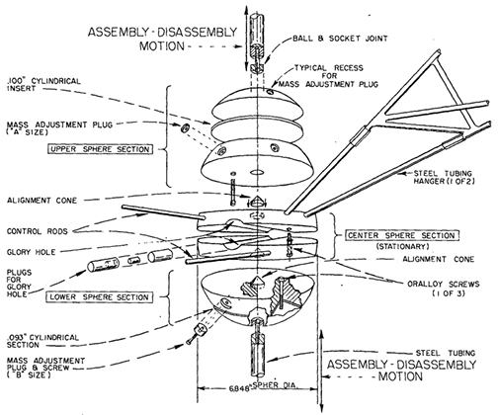
Godiva - a criticality experiment
52.6 kg Uranium sphere
235-U: 92.7%
238-U: 5.2%
234-U: 1.0%

