Slide 1






























Update of the U238 (and Pu239) RRR to
improve burnup and lattice criticality
R. Capote, A. Trkov, M.T. Pigni, G. Noguere, D. Bernard,
J. Malec, O. Cabellos on behalf of the INDEN collaboration
https://www-nds.iaea.org/INDEN

Slide 2
Outlook
U-238 changes, validation and comments
Pu-239 changes, validation and outlook

Slide 3
U-238 new INDEN evaluation (post-B8b1)

Slide 4
INTRODUCTION
Loss of reactivity with burnup for
PWR with ENDF/B-VIII.0 library
compared to ENDF/B-VII.1
Reported by Kang Seong Kim at CSEWG 2019
Extensive analysis by Kang Seong Kim and William A. Wieselquist in J. Nucl.Eng. 2021,2, pinpointing the problem to U-238
  Criticality prediction of U-238 was benchmarked
  extensively – small differences overall
  Problems appear with burnup:
    FP yields library unchanged from ENDF/B-VII.1
    Major FP cross section not so different
    Focus on Pu-239 production
Monte Carlo code Serpent was used
(at least for validation)

Slide 5
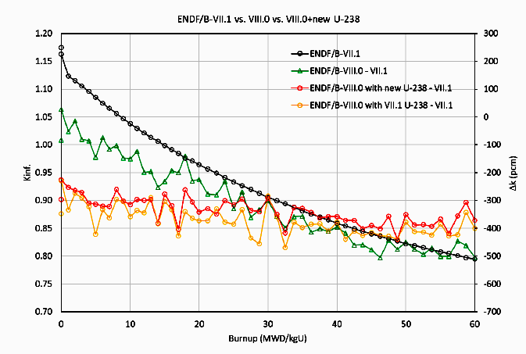
Depletion vs criticality: Reactivity rates in VERA
Kang Seog Kim et al, CSWEG2019
Kang Seog Kim calculations, 2022, priv. comm.
INDEN u238_e80V02 (B81beta1) practically eliminates the ENDF/B-VIII.0 trend with burnup, but reduces criticality at BOC by 250pcm.

Slide 6
Cumulative U-238 capture reaction rate integral in a PWR spectrum
Thermal part of the spectrum in a PWR is suppressed due to boron in the coolant, emphasizing the importance of the epithermal energy range.
Importance of the resonance range up to 200eV emphasized by D. Bernard and O. Cabellos at the INDEN IAEA TM (Nov. 2021)
Cumulative reaction rate integral ratio of U-238 capture (at infinite dilution) between ENDF/B-VIII.0 (label “e80”) and “e80V02” (with resolved resonance data substituted from ENDF/B-VII.1) increases up to ~200 eV, except at the 6eV resonance.
The opposite effect of the 6eV resonance diminishes when self-shielding is considered

Slide 7
Overview of INDEN U238 file V02
nds.iaea.org/INDEN/data/u238e80V02_ENDF.zip (B81beta1)
The ENDF/B-VIII.0 RRR is replaced by ENDF/B-VII.1 RRR evaluation (fission background in URR preserved). This update increases the calculated criticality at high burnup (due to higher Pu-239 accumulation)
INDEN workgroup did not reach a consensus on this issue. It is to be evaluated whether this change is worth taking considering the lack of direct experimental evidence.

Slide 8
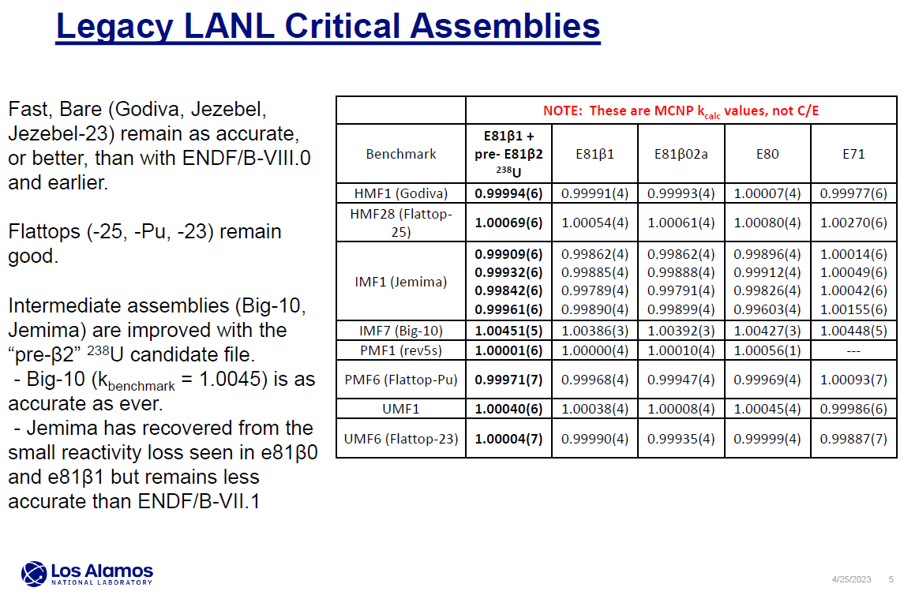
Legacy LANL assemblies: validation
BigTen lowish !
@LANL, calculated by S.Kahler & N. Kleedtke miniCSWEG 2023

Slide 9
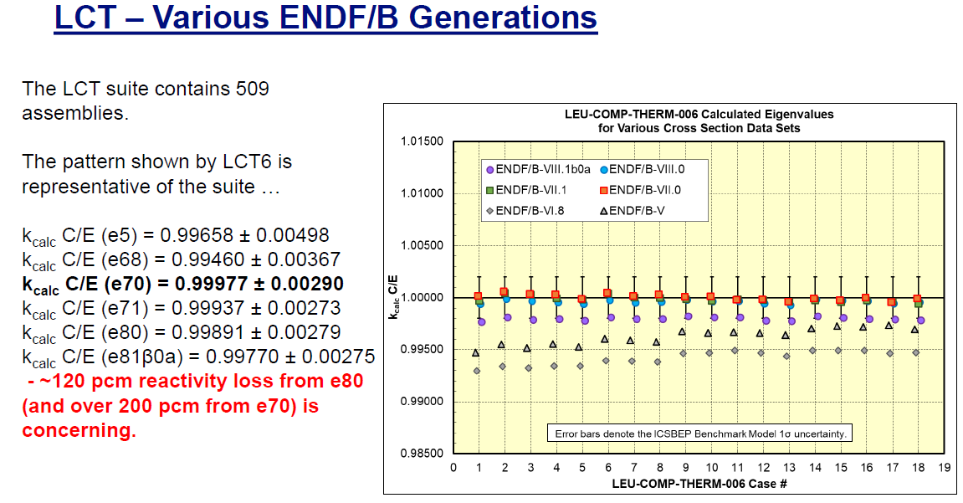
Lattice criticality: LCT006 representative
@LANL, calculated by S.Kahler & N. Kleedtke miniCSWEG 2023

Slide 10
Summary: INDEN e80V03i4 evaluation
Update of the ENDF/B-VIII.0 evaluation (IAEA CIELO)
INDEN e80V03i4 @ https://www-nds.iaea.org/INDEN/data/u238e80u8V03i4_ENDF.zip
The ENDF/B-VIII.0 RRR is replaced by JENDL-5 RRR evaluation
This update preserves the ENDF/B-VIII.0 BOC criticality but eliminates the U-238 linked depletion trend at high burnup (due to higher Pu239 accumulation).
A new U-238 nubar evaluation was produced by LANL colleagues (Neudecker et al). Nubar was tweaked to better reproduce Jemima trend (tweaked ≡ change of mean values within uncertainties)

Slide 11
INDEN e80V03i4 adopted JENDL-5 RRR changes
O. Iwamoto et al, JNST (Japan) 60 (2023) 1-60, JENDL-5 paper

Slide 12
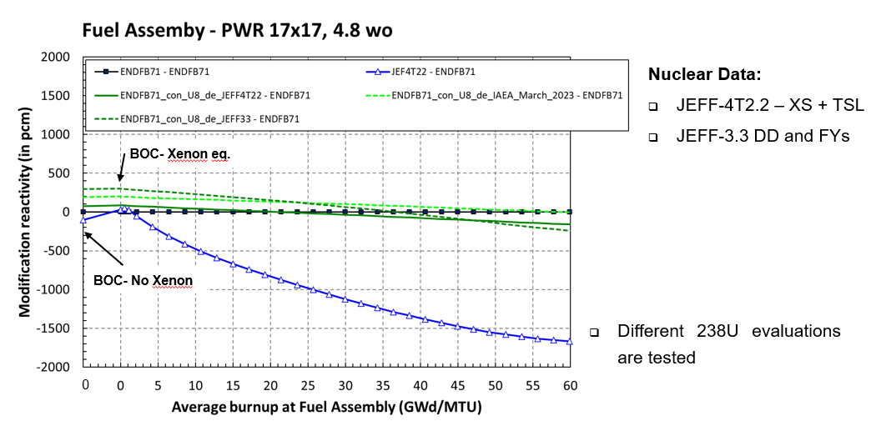
INDEN e80V03i4: Depletion studies
=U238 B8
=INDEN U238 (post b1)
Uses U238 from B8
JEF-DOC-2239, M. Astigarraga @JEFF meeting 04/2023

Slide 13
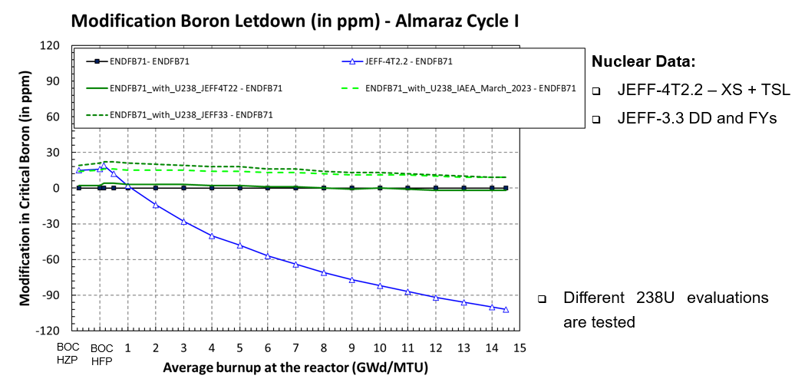
INDEN e80V03i4: Depletion studies
JEF-DOC-2239, M. Astigarraga @JEFF meeting 04/2023

Slide 14
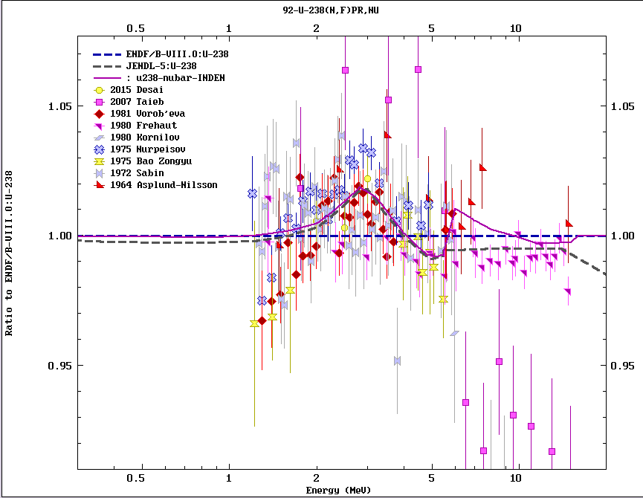
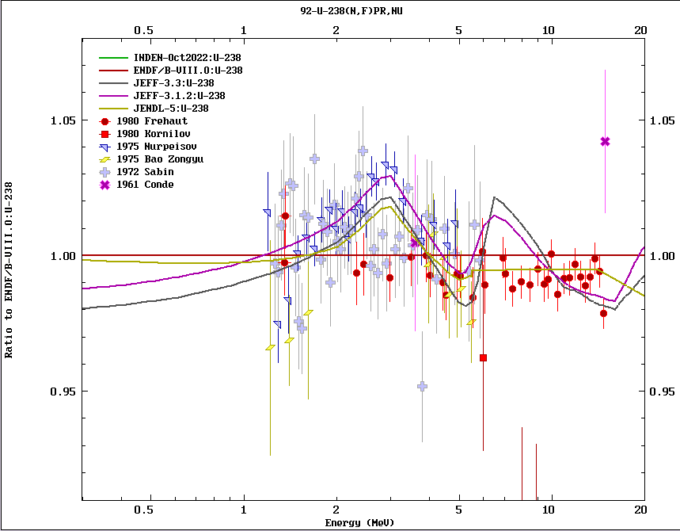
U-238 e80V03i4 nubar dependence
u238e80u8V03i4 | (recommended) RRR evaluation taken from JENDL-5, u238 nubar from LANL-INDEN collaboration
Convergence between JEFF & JENDL & INDEN evaluations observed
INDEN latest : u238e80u8V03i4

Slide 15
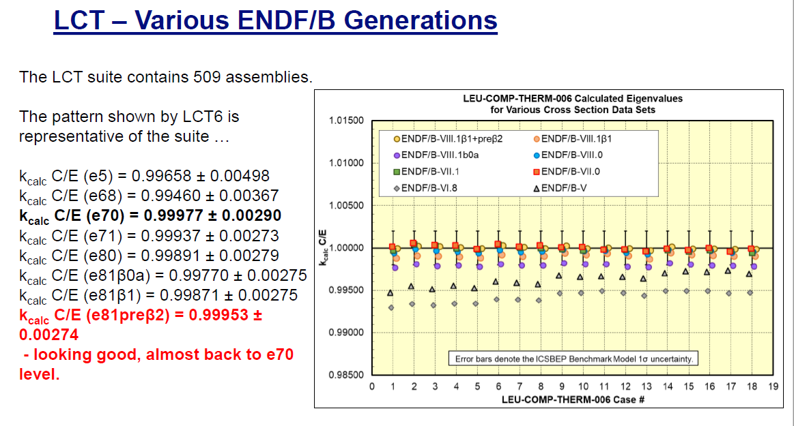
Lattice criticality: LCT006 representative
@LANL, calculated by S.Kahler & N. Kleedtke miniCSWEG 2023

Slide 16
Legacy LANL assemblies: validation
@LANL, calculated by S.Kahler & N. Kleedtke miniCSWEG 2023

Slide 17
Pu-239 evaluations
JEFF-4T – Noguere et al
ENDF/B-VIII.1 – ORNL/IAEA collaboration
Similar approaches, underlying data and validation discussed at INDEN meetings

Slide 18
New integral constraints for RP fit fissile targets
All measured ToF
high-resolution data
(1955-2019)
Derived σ_{f}(th)
Duran et al TNC
533.0(0.7) 533.0(2.2)
586.1(2.6) 587.3(1.4)
751.0(1.9) 752.4(2.2)
1019(3) 1024(11)
Good consistency with TNC
(slightly lower)
Similar to libraries !!
Duran et al, 2021 (submitted to NDS)
Discussed at INDEN CM November 2021

Slide 19
New integral constraints for RP fit fissile targets
All measured ToF
high-resolution data
(1955-2019)
used to derive:
I₁, I₃, I₃ /I₁, σ_{f}(th)/I₁
May require small revision of
RP fits for all fissiles
Derived σ_{f}(th) consistent with TNC
Duran et al, 2021 (submitted to NDS)
Discussed at INDEN CM November 2021

Slide 20
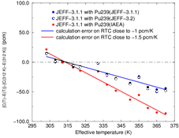
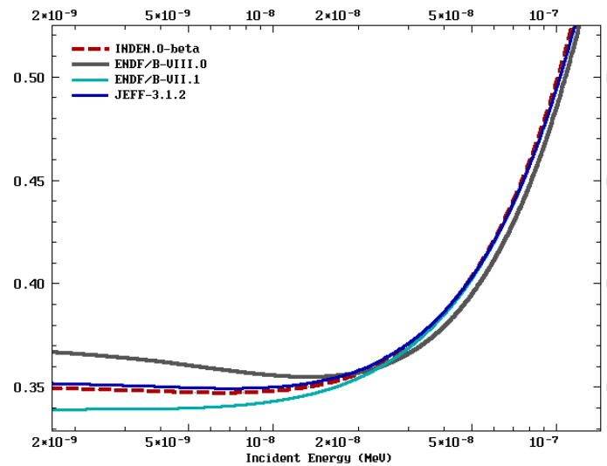
²³⁹Pu RTC-MISTRAL2 experiment, CEA
²³⁹Pu α( E)
Pu-239 INDEN 2021
(=B81beta1)
Presented by G. Noguere @ INDEN meet.
Modifications to the RR fit required:
↑subthermal α, ↓ α till 1eV (closer to B8)
To improve RTC and ↑ crit. @ high burnup
NOTE: In the light of latest U-238, we have to solve Pu239!

Slide 21
Depletion studies
Burnup dependence (Pu-239 INDEN 2021)
OpenMC calculations by J. Malec & A. Trkov
endfb8_orig(average) | Original OpenMC library based on ENDF/B-VIII.0 data
endfb8+P9(run 6) | Original endfb8+ INDEN Pu239
endfb8+U8e71(run 7) | Original endfb8+U238 from ENDF/B-VII.1
endfb71(run8) | Pure endfb71
 | Bu[GWd/tU] | 0 | 0.925 | 5.3 | 30.3 | 60.3
 | Case | Delta_Rho
endfb8_orig(average) | Case 14-5 | 42 | -1 | -14 | 97 | 41
endfb8+P9(run 6) | Case 15-14 | 0 | -26 | -33 | -476 | -688
endfb8+U8e71(run 7) | Case 16-14 | -181 | -149 | -84 | -184 | 1
endfb71(run8) | Case 17-14 | 79 | 115 | 158 | -35 | 318

Slide 22
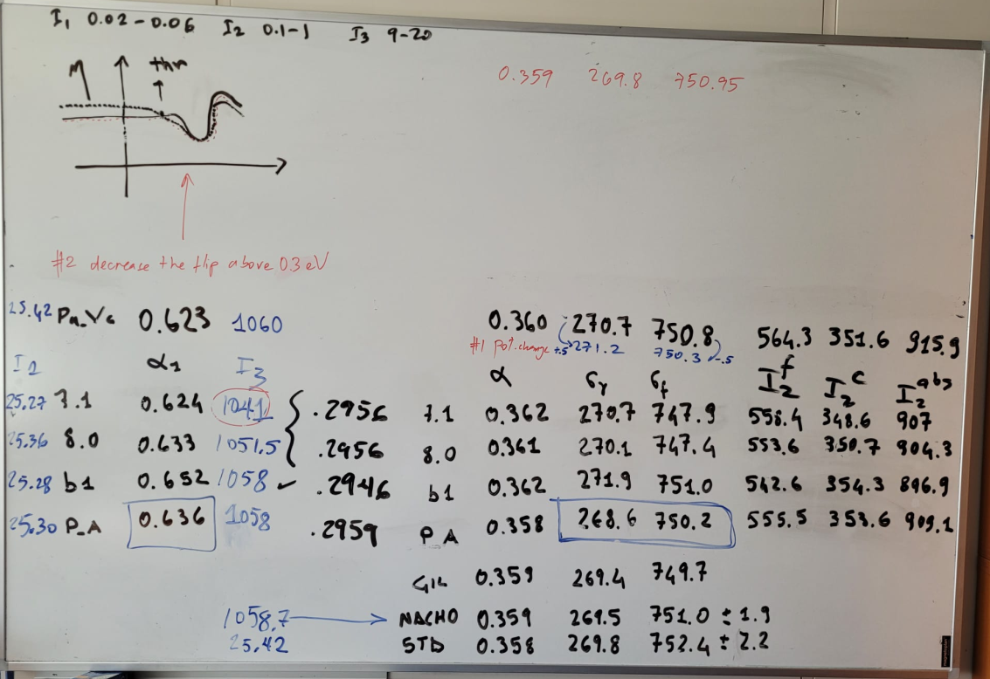
New INDEN ²³⁹Pu file (Pu9 Vc), May 2023
Board learning
TNC

Slide 23
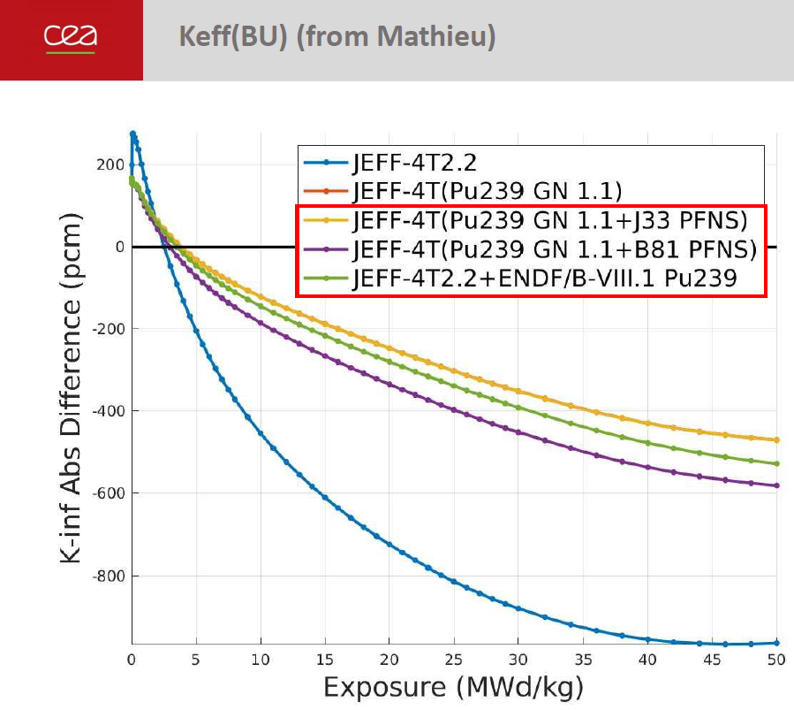
New INDEN ²³⁹Pu file (Pu9 Vc), May 2023
@50GWd/t CONVERGENCE !
Pu9Vc (B81) +400pcm gain
JEFF-4T similar
INDEN ²³⁹Pu file labelled ENDF/B-VIII.1
@EPFL/CEA, M. Hursin, provided by G. Noguere

Slide 24
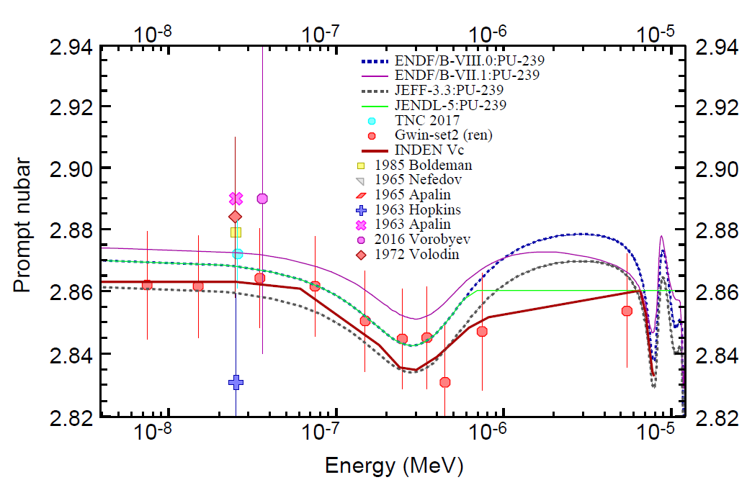
New INDEN ²³⁹Pu file (Pu9 Vc), nubar

Slide 25
²³⁹Pu RTC-MISTRAL2 experiment, CEA
²³⁹Pu α( E)
²³⁹Pu Vc ~ -0.8 pcm/K
Presented by G. Noguere @ INDEN meet.
Modifications to the RR fit done, B8 bound states adopted:
↑subthermal α, ↓ α till 1eV (closer to B8)
G. Noguere (priv.comm.): Pu9 production is acceptable (-0.7% JEFF-311)

Slide 26
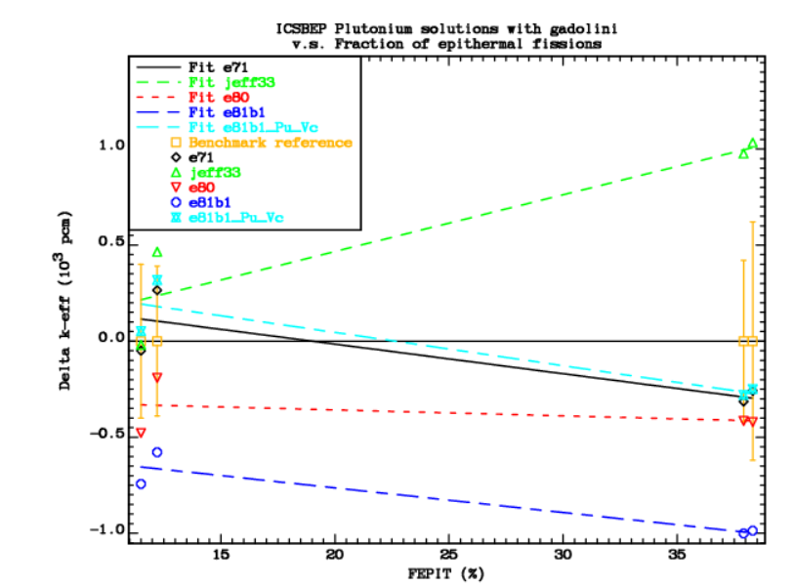
INDEN ²³⁹Pu in PST034 benchmark (Gd)
jeff33
INDEN - postβ1
e81β1
more thermal spectrum (less Gd)

Slide 27
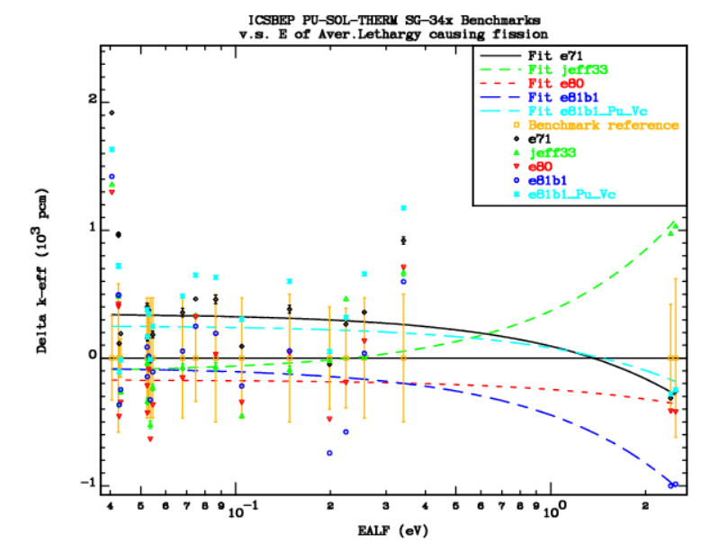
INDEN ²³⁹Pu in PST034 benchmark (Gd)
JEFF-33
INDEN –
postβ1
e81β1
more thermal spectrum (less Gd)

Slide 28
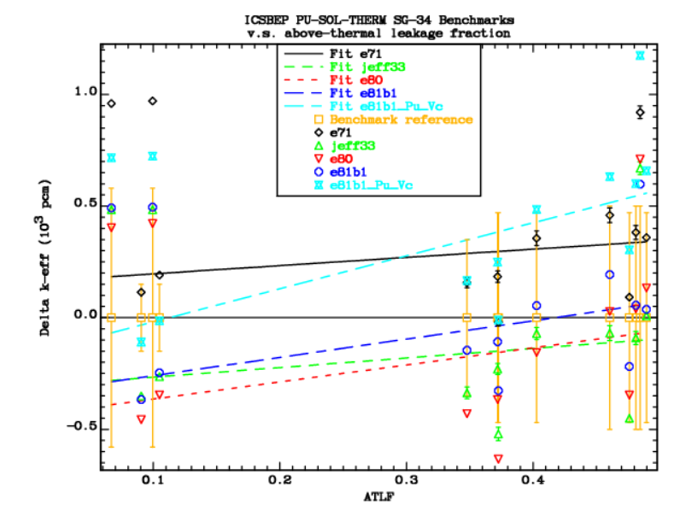
INDEN ²³⁹Pu in WPEC-SG34 benchmarks
PST
INDEN –
postβ1
e81β1
JEFF-33
Very low leakage high leakage
more thermal spectrum (ATLF)

Slide 29
INDEN ²³⁹Pu in WPEC-SG34 benchmarks
PST
INDEN –
postβ1
e81β1
JEFF-33
Very low leakage high leakage
more thermal spectrum (ATLF)

Slide 30
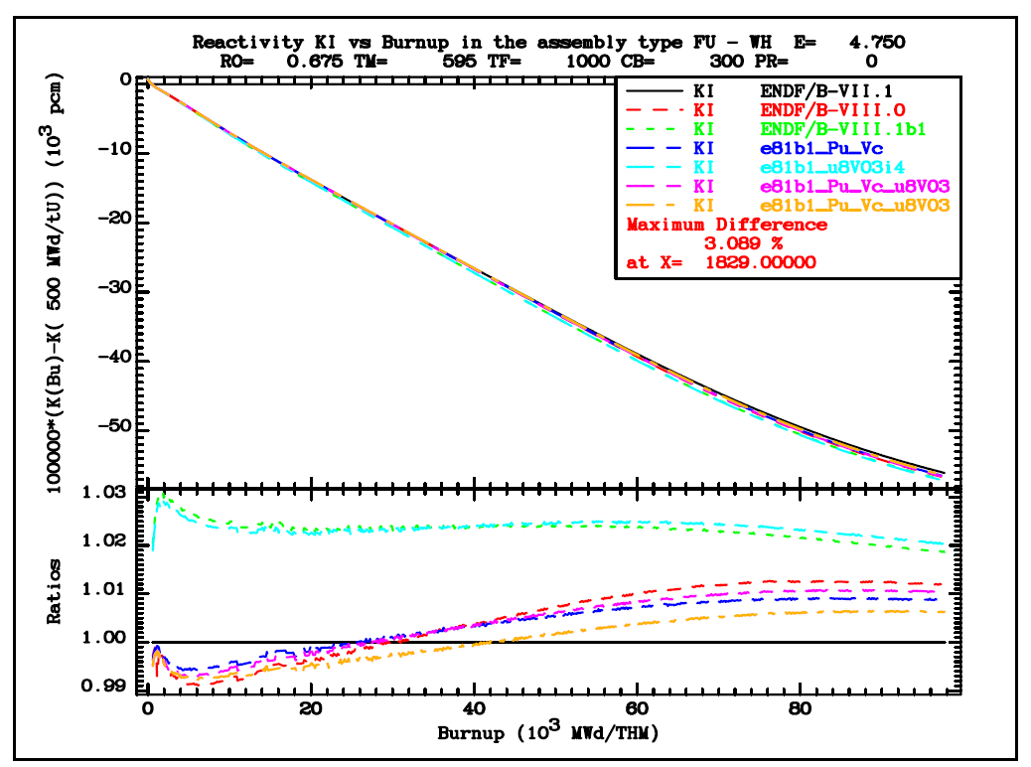
INDEN ²³⁹Pu in depletion studies
PWR 3x3 cell
4.75% U5
@50GWd/thm
Pu9Vc ~-300pcm
+Pu241 ~-100pcm
Pu9 β1
Pu9 Vc
criticality
decreases
+Pu241

Slide 31
INDEN Summary @nds.iaea.org/INDEN/
Pu-239 INDEN (B8b1) evaluation is shown to decrease criticality at
60GWD/tU by ~ -600pcm.
A similar effect is seen in JEFF-4T2.
A solution much closer to B/VII.1 achieved (Pu239 Vc).
Recommended to be updated in B81b3.
Changes to Pu-240/241 from JEFF-4T2 highly desirable
Similar updated possible in JEFF4Tx.
U-238 (https://www-nds.iaea.org/INDEN/data/u238e80u8V03i4_ENDF.zip)
Latest U-238 iteration with modified nubar and JENDL-5 RRR.
(loss of criticality at high burnup solved, lattice criticality increased).
Recommended to be updated in B81b3.
Similar updated possible in JEFF4Tx.

