Slide 1


Looking for integral references for the (n,f) reaction in actinides above 1 MeV
Ignacio DURAN
USC/IAEA
Roberto CAPOTE
IAEA-NDS
Georg SCHNABEL
IAEA-NDS
WONDER-2023, Aix-en-Provence

Slide 2
Introduction
From several decades, and all around the world, there are number of nuclear data laboratories with a neutron white source producing high-resolution XS spectra by the ToF method.
The majority of such experimental data is archived in EXFOR including
heading records that provide as much information as the authors declared,
what it is very often insufficient at the evaluation time.
Original data were normalized by the authors, at the time they published it. Sometimes, either the beam monitor or the reference used, changed from past to the current Standards.
The final accuracy of the evaluations relies on the quality of the experimental datasets being used, but also on the information that the authors provide. Very often a way to overcome the lack of information is by renormalizing the original dataset, but this operation requires having well stablished references, in order to be easily traceable by further evaluators.
.
I. Durán Wonder 2023 2.
Notes:
2

Slide 3
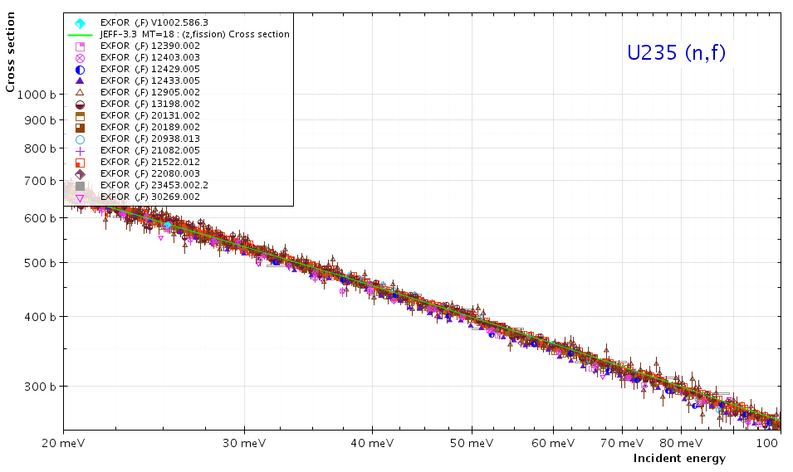
Integration interval in the thermal energy region
In the frame of the IAEA INDEN project it was decided to select the energy interval from 20 to 60 meV as integral reference.
Experimental data on the four fissile actinides in the TNC table were analysed by fitting it to straight-lines in log-log scale. Renormalization and energy calibration was eventually used [Ref].
I. Durán WONDER-2023 3.
Notes:
3

Slide 4
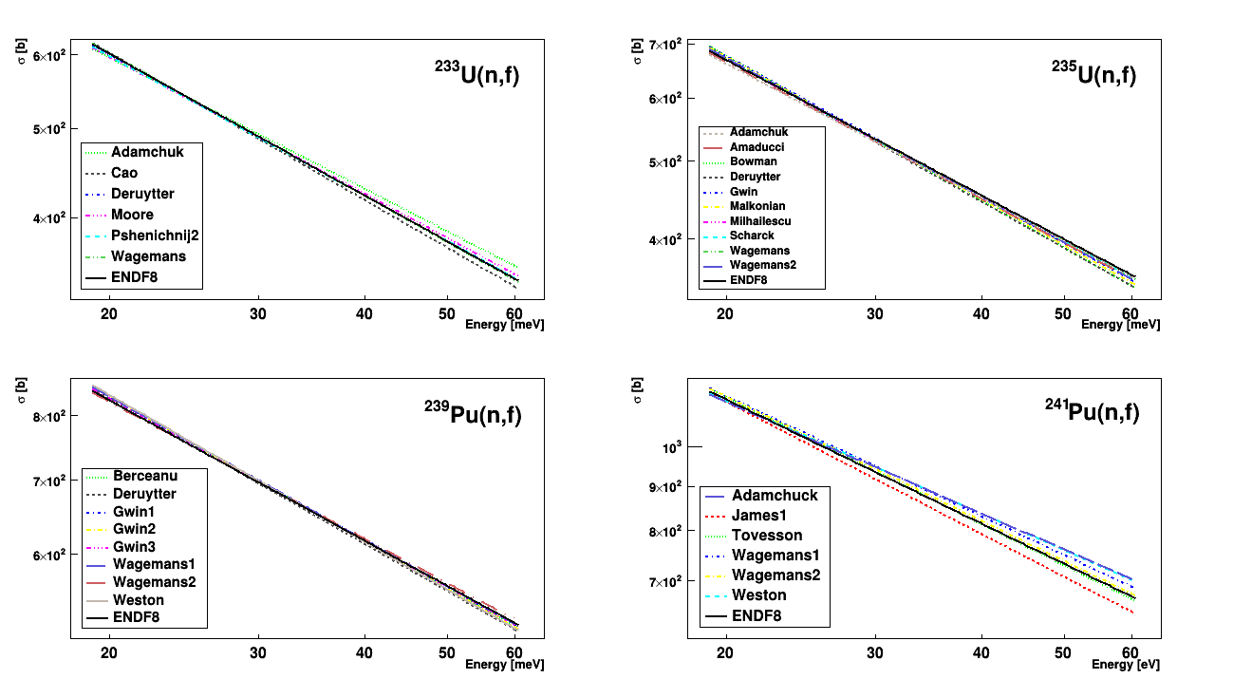
Fitting in the termal range
Fits in the thermal range after renormalization (the worst case is for Pu241).
It is worth mentioning that the actual slope in log-log scale is not 0.5 (that correspond to the 1/v law) but, nevertheless, the straight-line approximation remains to be very accurate.
I. Durán Wonder-2023 4.
Notes:
4

Slide 5
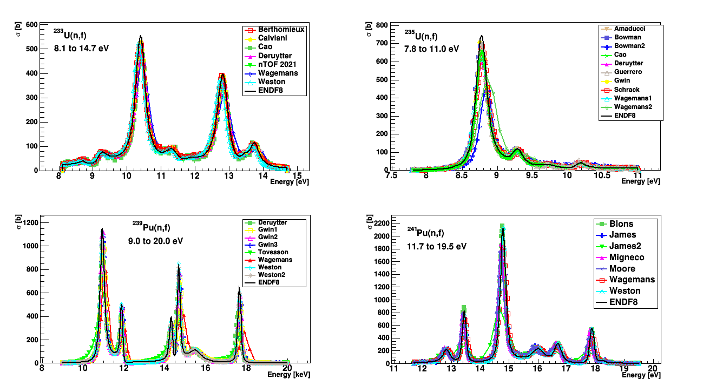
Integral references in the RRR
Integration limits in the RRR were also agreed in the IAEA meetings and has been used for the actinides (n,f) reaction analysis.
The U5(n,f) integral value from 7.8 to 11 eV has been adopted as standard in NDS18.
The same intervals have been adopted too as reference for (n,tot) and (n,g) reactions.
I. Durán Wonder-2023 5.
Notes:
5

Slide 6
The integral reference method
Now the question is to look for high quality references for
fission above 1 MeV, in order to improve the present
standards and, in consequence, the evaluation of those
actinides involved in the fast-reactors cycle.
Therefore, the first step is to adopt the integration limits.
Ideally, the integration value should be high enough to
minimise the statistical uncertainties, and to be very
independent of eventual energy miscalibrations.
Above 1 MeV there are two plateaus fulfilling these
requirements:
I. Durán Wonder 2023 6.
Notes:
6

Slide 7
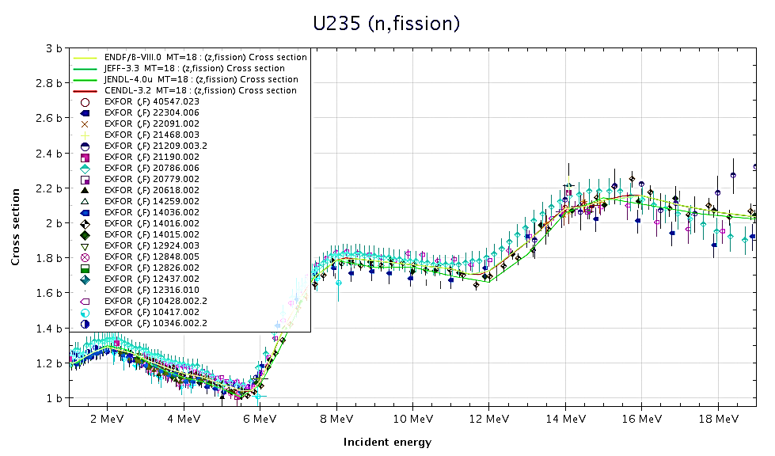
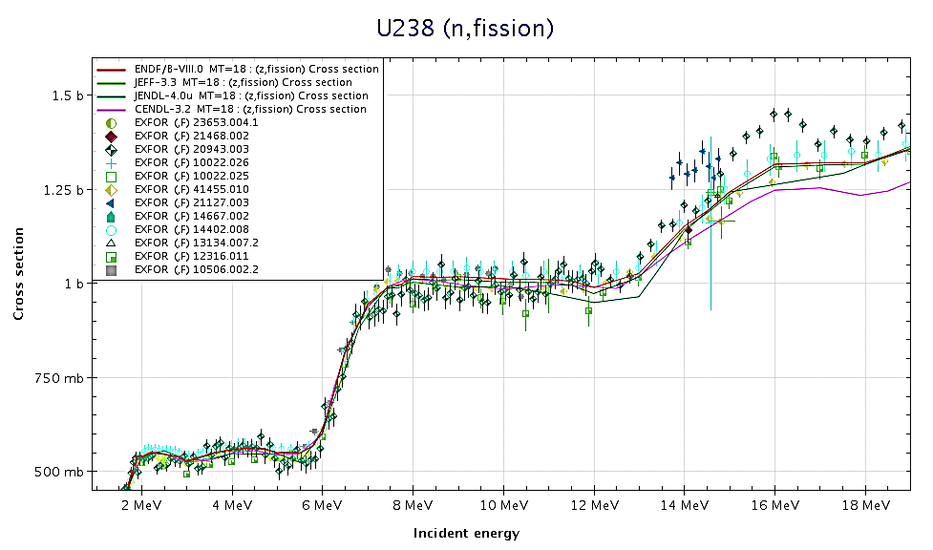
Two plateaus
The first plateau has been more widely measured and it is always
very useful for absolute measurements using the well known
self-fission spectrum of Cf252 sources.
On the other hand, the XS values are lower and the sharp changes
of the FF anisotropy observed in this region is a challenge for the
detectors.
I. Durán Wonder 2023 7.
Notes:
7

Slide 8
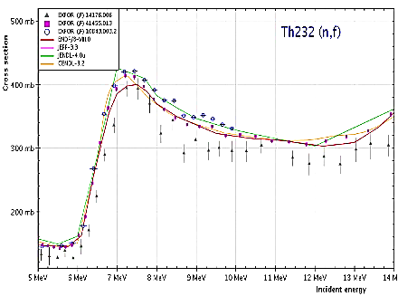
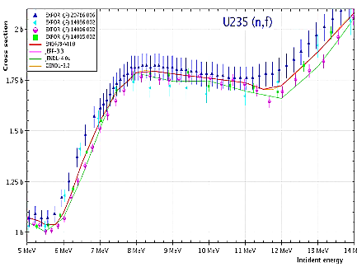
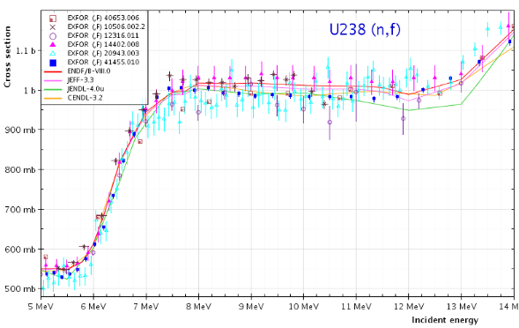
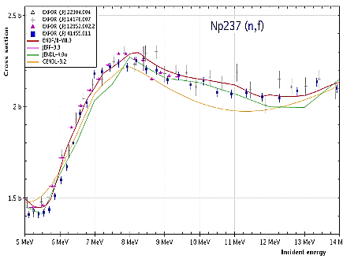
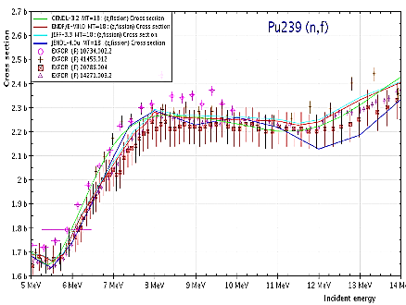
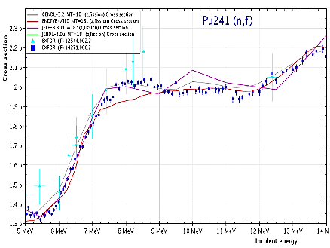
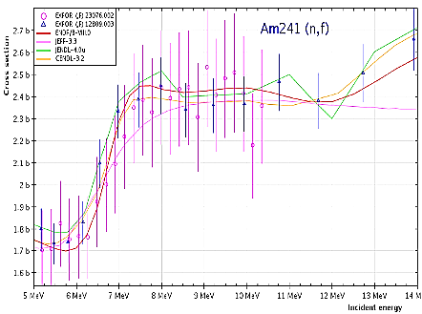
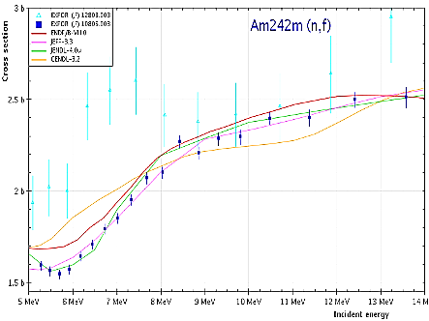
Plateau at 9 MeV
This general trend around 9MeV for the whole group of actinides makes
useful to define a unique interval of integration.
In this preliminary work the interval from 8 to 10 MeV is proposed.
I. Durán Wonder 2023 8.
Notes:
8

Slide 9
Measuring ratios
Once adopted the same integration interval for the whole set, their ratios become important constraints at the evaluation time.
It is worth noting that both U5(n,f) and U8(n,f) are IAEA Standards, and as a matter of fact, the best-known quantity is the ratio of both XS.
This ratio was analyzed in detail in the Carlson et al. paper on the USU [Ref]. Different statistical models were used, giving finally a value at 9 MeV of 0.572, with an uncertainty of 0.3%.
This ratio taken from the IAEA Standards (NDS2018) at 9 MeV is 0.571
In a recent paper of Capote et al [Ref] on the evaluation of Cf SACS in the 1 to 5 MeV interval, a renormalization is proposed, giving a ratio of 0.573
In the present work we evaluate the mean value of the ratios at 9 MeV obtained by fitting to straight-lines the 19 datasets retrieved from EXFOR giving us a value of 0.570, with 0.4% statistical uncertainty.
This is showing that the method of fitting to straight lines
(as it was done in the thermal energy range) is reliable enough.
I. Durán Wonder 2023 9.
Notes:
9

Slide 10
Three step method
The second step after adopting the integration limits is to
select those high-resolution datafiles to be used to obtain the
integral reference value.
All the selected datafiles have been retrieved from EXFOR,
rejecting as outliers, eventually, those showing either
anomalous dispersion or an integral value not compatible with
the mean value of the others.
Every experimental datafile has been, eventually, renormalized
using as factor the ratio of its declared monitor/reference to
the present Standards.
Finally, the points in every dataset falling in the selected
interval have been fitted to straight-lines, giving so the fitted
value at 9 MeV and the integral value.
Durán Wonder 2023 10.
Notes:
10

Slide 11
The case of U8(n,f)
Six XS datafiles retrieved from EXFOR:
The fitted values at 9 MeV are renormalized;
The uncertainties have been calculated from
the standard deviation to the non-weighted
mean values.
The first column shows the point-values
at 9 MeV in the evaluated libraries, and in the
second one are the values after fitting in the
same way that for the experimental datasets.
The same procedure is applied to the 12 ratio
datasets retrieved from EXFOR.
In column (1) are the XS values obtained after
multiplying by 1.768 b and in column (2) are
their corresponding integrals.
Why 1.768 b?
I. Durán Wonder 2023 11.
Notes:
11

Slide 12
Wich value is the best STANDARD?
Actually, we have three values derived from different experiments (not fully uncorrelated): the XS of U5, the XS of U8 and their ratio:
but only one should be the “primary” !
Let’s take the U5(n,f) @ 9 MeV because there are many ratios to them of the whole set of actinides measurements.
Let’s take this XS as 1.768 b , a value derived from the renormalized
fits of the U5(n,f) experimental datasets, following the present method (that can be improved, obviously!).
It is worth mentioning that no matter this number is, what it is important is to have a first reference (to be changed, eventually).
So, if the ratio U8/U5 is 0.572, the U8(n,f) XS @ 9 MeV becomes 1.008 b, to be compared with the point-wise value given by GMA for the NDS of 1.017(14) b, and the mean value of the evaluated libraries of 1.003 b.
I. Durán Wonder 2023 12.
Notes:
12

Slide 13
Table of XS at 9 MeV
By applying the same method to other actinides we have the following values of the XS @ 9 MeV
 | XS [b] at 9 MeV
 | From EXFOR (XS renorm.) | From EXFOR (Ratios to U5) | Evaluated libraries Point value | Fitted value
Th232 | 0.339(6) | 0.345(5) | 0.339(4) | 0.342(4)
U233 | 2.287(18) | 2.291(24) | 2.262(13) | 2.259(10)
U235 | 1.768(17) | ----- | 1.771(13) | 1.769(7)
U238 | 1.003(9) | 1.008(5) | 1.004(9) | 1.003(6)
Np237 | 2.245(55) | 2.234(29) | 2.166(35) | 2.180(32)
Pu239 | 2.273(21) | 2.237(23) | 2.253(11) | 2.260(5)
Pu241 | 2.016(##) | 1.992(14) | 1.970(9) | 1.994(15)
Am241 | 2.416(3) | 2.570(264) | 2.395(20) | 2.397(24)
Am242m | 2.329(80) | 2.324(84) | 2.273(28) | 2.257(31)
By applying the same method to other actinides we have the following values of the XS @ 9 MeV
I. Durán Wonder 2023 13.
Notes:
13

Slide 14
Table of integral values
There is a general good agreement with the mean value of the evaluated libraries.
Uncertainties are derived from the standard deviation from the mean values.
Therefore, it takes the higher values where the number of datasets is lower.
 | Integral 8-10 MeV [b·eV]
 | From EXFOR | From EXFOR (Ratios to U5) | Evaluated libraries
Th232 | 0.678(12) ^{2%} | 0.689(9) ^{1.4 %} | 0.684(8)
U233 | 4.573(38) ^{0.8%} | 4.581(48) ^{1%} | 4.519(19)
U235 | 3.535(35) ^{1%} | ----- | 3.537(13)
U238 | 2.006(18) ^{0.9%} | 2.016(8) ^{0.4%} | 2.007(13)
Np237 | 4.417(82) ^{2%} | 4.404(59) ^{1.4%} | 4.360(65)
Pu239 | 4.546(42) ^{1%} | 4.474(46) ^{1%} | 4.521(10)
Pu241 | 4.032(##) | 3.983(28) ^{0.7%} | 3.988(31)
Am241 | 4.832(6) ^{0.14%} | 5.140(528) ^{10%} | 4.794(48)
Am242m | 4.658(160) ^{3.5%} | 4.648(168) ^{3.4%} | 4.514(63)
I. Durán Wonder 2023 14.
Notes:
14

Slide 15
Quick remarks
At a first glance, just looking at the previous tables and at
the evaluated XS shapes - here shown in the slide # 8 – it
can be remarked that some datapoints in the evaluated files,
in this energy range, are worth of improvement. Namely:
ENDF in U233 and Pu241;
CENDL in U233, Np 237 and Am241;
JENDL in U233.
I. Durán Wonder 2023 15.
Notes:
15

Slide 16
CONCLUSIONS
Integral references in both the thermal energy range and in
the RRR were defined, probing to be very useful for evaluators.
They are easy to be used for normalizing both old and new
experimental datasets.
Now is the turn to define a new integrating interval above 1 MeV
in order to better normalize the evaluated datafiles, that are
of interest for the new nuclear technology.
An interval is proposed in the second plateau, showing that the
fitting to straight-lines provide good enough values in a
coherent landscape including most of the actinides involved in
the fast-neutron reactors.
I. Durán Wonder 2023 16.
Notes:
16

