Slide 1




Direct radiative capture calculations on ⁵⁶Fe
G. Gkatis^{1,2}, M. Diakaki², A. Mengoni^{3,4,5}, G. Noguere¹
¹CEA/DES/IRESNE/DER/SPRC/LEPh, Cadarache, F-13108 Saint Paul Lez Durance, France
²Department of Physics, National Technical University of Athens (NTUA), GR-15780 Athens, Greece
³European Organization for Nuclear Research (CERN), CH-1211 Geneva, Switzerland
⁴Istituto Nazionale di Fisica Nucleare (INFN), IT-40127 Sezione di Bologna, Italy
⁵Agenzia nazionale per le nuove tecnologie (ENEA), IT-00196 Roma, Italy

Slide 2
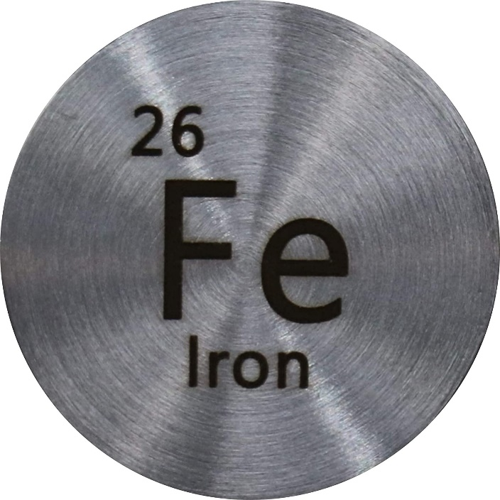
Motivation
Iron is a major structural material widely used in nuclear facilities and nuclear technology applications
In nuclear power reactors, iron is used to make pressure vessels that contain the coolant, core shroud, and the reactor core
  Accurate neutron cross section data are indispensable for the design and reliable operation of such facilities
Uncertainties on the current evaluated nuclear data libraries of Fe do not meet yet the target requirements for the development of advanced reactor systems
Further study of the iron cross-section evaluated data is needed!

Slide 3
Why study direct capture on ⁵⁶Fe?
Neutron reactions on iron isotopes were studied extensively under the CIELO pilot project [1].
In the case of the ⁵⁶Fe(n,γ) cross section two major issues were discovered and changes were implemented in ENDF/B-VIII.0:
  A background cross section component was added in the energy range between 10 eV – 100 keV, supported by criticality benchmark HEU-MET-INTER-001 (ZPR-9/34) (a very sensitive benchmark to capture around the 24 keV region)
  A “bump” in the capture cross section around 850 keV was observed in experiments performed at RPI[4]
[1] M. Herman et al., Nucl. Data Sheets 148 (2018)
[2] M.B. Chadwick et al., Nucl. Data Sheets 112 (2011)
[3] D.A. Brown et al., Nucl. Data Sheets 148 (2018)
[4] B. McDermott et al., EPJ Web of Conf. 146 (2017)

Slide 4
Why study direct capture on ⁵⁶Fe?
Cross sections of iron isotopes are now under study by the INDEN (IAEA) [5]
In the latest evaluation release by INDEN (Oct. 2022) the background component in the 10 eV – 100 keV was reduced by more than 50% of what was introduced in ENDF/B-VIII.0, this reduction was also supported by JENDL-5 [6]
The new cross section is still able to reproduce HMI001 (ZPR-9/34) – iron benchmark.
This intermediate choice for this background component is optimal for the ASPIS/Fe-88 benchmark
[5] INDEN at https://www-nds.iaea.org/INDEN/
[6] O. Iwamoto et al., J. Nucl. Sci. Technol. 60 (2023)

Slide 5
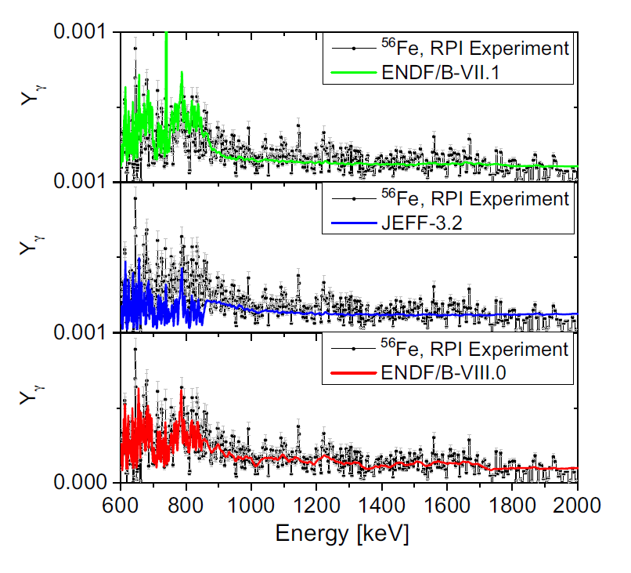
Why study direct capture on ⁵⁶Fe?
  The background from 700 to 850 keV was readjusted to reproduce the semi-integral experiments performed at RPI [4]. In this measurement, a “bump” in the capture yield was observed at around 850 keV . This increase of the (n,γ) cross section in this region cannot be described via R-Matrix theory + the ⁵⁶Fe(n,n’γ) channel opens in this energy → capture cross section should decrease
Need for a physical interpretation of these issues What about direct capture?
[4] B. McDermott et al., EPJ Web of Conf. 146 (2017)

Slide 6
What is direct capture?
Compound capture: the incident neutron is captured and a long-lived compound system is formed. The quasi-stationary state decays be γ-ray emission. The capture cross section can be represented by the R-Matrix formalism. *
Direct capture: the incident neutron is captured by the target without any compound state formation. The capture cross section is proportional to the single-level electromagnetic transition matrix element (DRC model).
*At high energies, a continuum of overlapping resonances is formed – the capture cross section is described by average quantities related to the optical model transmission coefficients (Hauser-Feshbach theory)

Slide 7
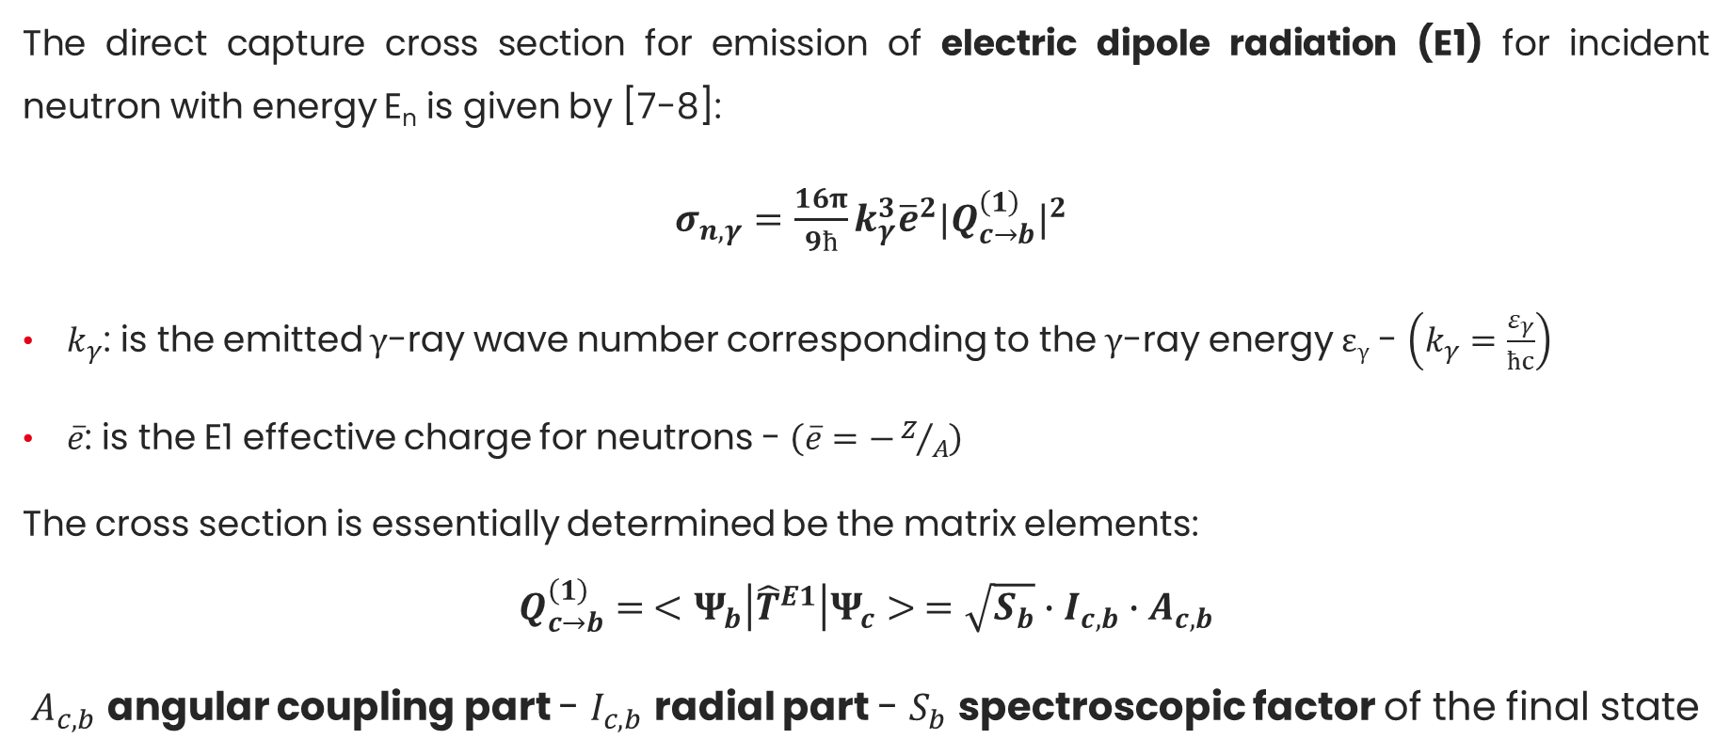
DRC cross section
The direct capture cross section for emission of electric dipole radiation (E1) for incident neutron with energy E_{n} is given by [7-8]:
$σ_{n, γ}=\frac{16π}{9ħ}k_{γ}^{3}{\overline{e}}^{2}{|Q_{c→b}^{\left(1\right)}|}^{2}$
$k_{γ}$: is the emitted γ-ray wave number corresponding to the γ-ray energy ε_{γ} - $\left(k_{γ}=\frac{ε_{γ}}{ħc}\right)$
$\overline{e}$: is the E1 effective charge for neutrons - $\left(\overline{e}=−Z/A\right)$
The cross section is essentially determined be the matrix elements:
$$Q_{c→b}^{\left(1\right)}= <Ψ_{b}\left|{\hat{T}}^{E1}\right|Ψ_{c}> =\sqrt{S_{b}}∙I_{c, b}∙A_{c, b}$$
$A_{c, b}$ angular coupling part - $I_{c, b}$ radial part - $S_{b}$ spectroscopic factor of the final state
[7] A. Mengoni et al., Phys. Rev. C 52 (1995)
[8] T. Kikuchi et al., Phys. Rev. C 57 (1998)

Slide 8
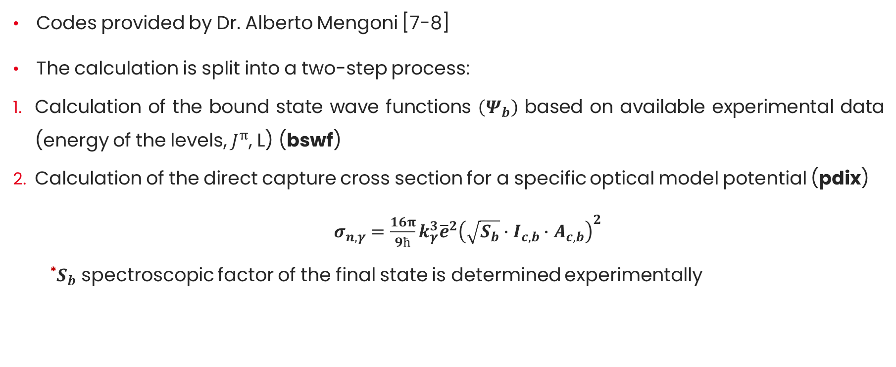
Calculation of the direct capture cross section
Codes provided by Dr. Alberto Mengoni [7-8]
The calculation is split into a two-step process:
  Calculation of the bound state wave functions $\left(Ψ_{b}\right)$ based on available experimental data (energy of the levels, $J^{π}$, L) (bswf)
  Calculation of the direct capture cross section for a specific optical model potential (pdix)
  $σ_{n, γ}=\frac{16π}{9ħ}k_{γ}^{3}{\overline{e}}^{2}{\left(\sqrt{S_{b}}∙I_{c, b}∙A_{c, b}\right)}^{2}$
  *$S_{b}$ spectroscopic factor of the final state is determined experimentally
[7] A. Mengoni et al., Phys. Rev. C 52 (1995)
[8] T. Kikuchi et al., Phys. Rev. C 57 (1998)

Slide 9
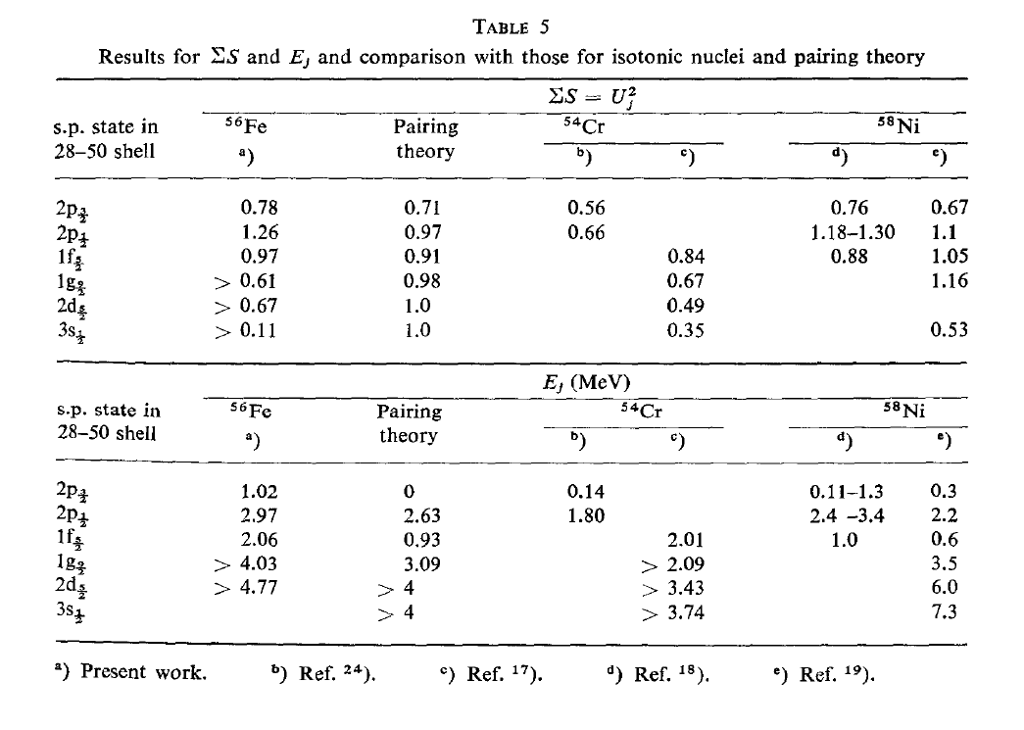
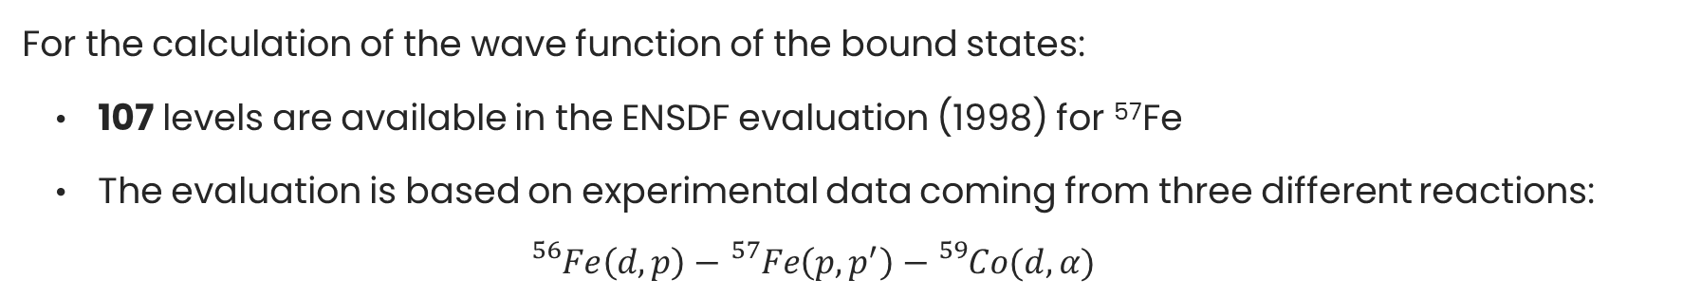
The bswf code
For the calculation of the wave function of the bound states:
    107 levels are available in the ENSDF evaluation (1998) for ⁵⁷Fe
    The evaluation is based on experimental data coming from three different reactions:
  $${}_{}^{56}{Fe}\left(d,p\right)−{}_{}^{57}{Fe\left(p,p^{′}\right)−{}_{}^{59}{Co(d,α)}}$$
In this work, a “grouped” version of the levels by H.M. Gupta [9] was used for the calculation of the wave functions.
A test was made with all 106 levels and the results were the same.
[9] H. M. Gupta et al., Nucl. Phys. A160 (1971)

Slide 10
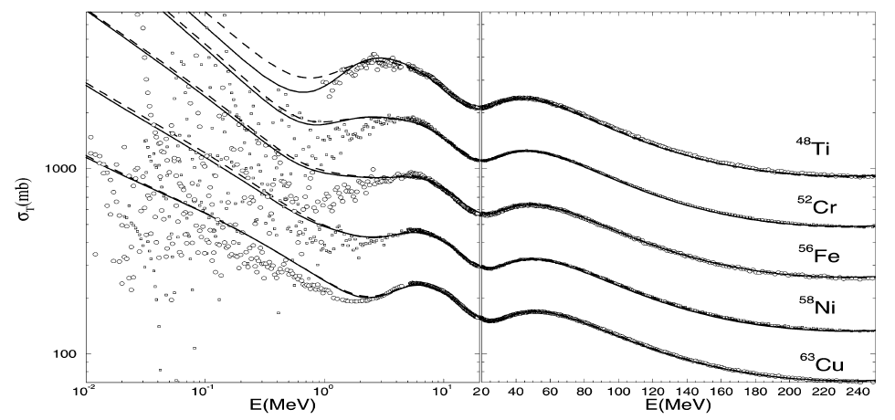
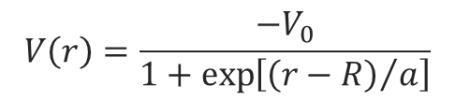
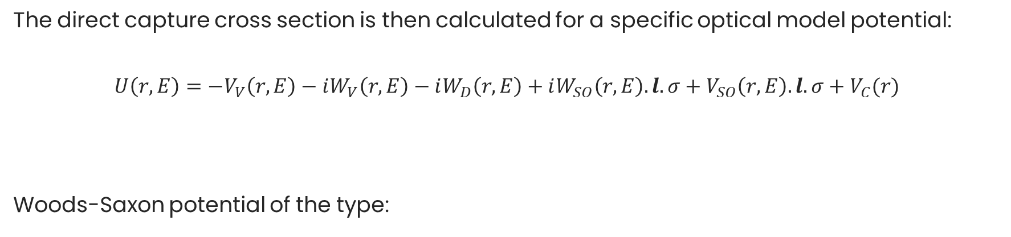

The pdix code
The direct capture cross section is then calculated for a specific optical model potential:
$$U\left(r,E\right)=−V_{V}\left(r,E\right)−iW_{V}\left(r,E\right)−iW_{D}\left(r,E\right)+iW_{SO}\left(r,E\right).l.σ+V_{SO}\left(r,E\right).l.σ+V_{C}(r)$$
Woods-Saxon potential of the type:
the imaginary part of the OMP is zero because we don’t have the formation of a compound nucleus
the Coulomb potential is zero because our projectile are neutrons
$$V\left(r\right)=\frac{{−V}_{0}}{1+\exp\left[{\left(r−R\right)}/a\right]}$$
In our calculations, the OMP parameters were based on the ones proposed by Koning [10] for ⁵⁶Fe:
$$V_{0}=53 MeV − r=1.244 fm$$
$a=0.603 fm −$ $V_{SO}=6 MeV$
[10] A. J. Koning et al., Nucl. Phys. A713 (2003)

Slide 11
First results
No interference effect between direct and compound capture was taken into account
  s-wave direct capture seems able to partially reproduce the 1/v background that was added in the 10 eV – 100 keV region
d-wave direct capture might be a good candidate for the “bump” in the capture cross section around 850 keV
The model is sensitive to changes in the optical model parameters

Slide 12
Comparison with TALYS
TALYS has the option of calculating direct capture. The code calculates direct + semi-direct (not included in pdix) capture for all transitions [11]
The TALYS calculations illustrates that the E1 transitions are contributing the most in DC, where E2 and M1 are negligible
For this comparison the default OMP parameters of TALYS were used in both calculations:
    The 1/v (s-wave) component of both codes are in agreement
    The “bump” (d-wave) of the cross section is shifted (probably due to differences in the used formalisms)
[11] Yi Xu et al., Phys. Rev. C 86 (2012)

Slide 13
Compound + Direct capture (pdix code)
Resonance model available in the pdix code (Single-Level Breit-Wigner) – CC+DC can be calculated
Resonance parameters by JEFF3.1.1 – 320 resonances in total (317 positives – 3 negative) going as high as 850 keV
Only positive resonances where used in the first calculation
The direct capture is not enough to reproduce the cross section at thermal energy
The pdix code calculates the cross section at 0 K - Doppler broadening is needed

Slide 14
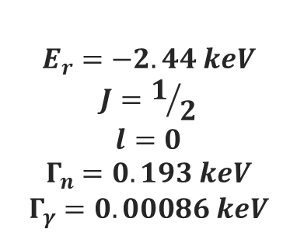
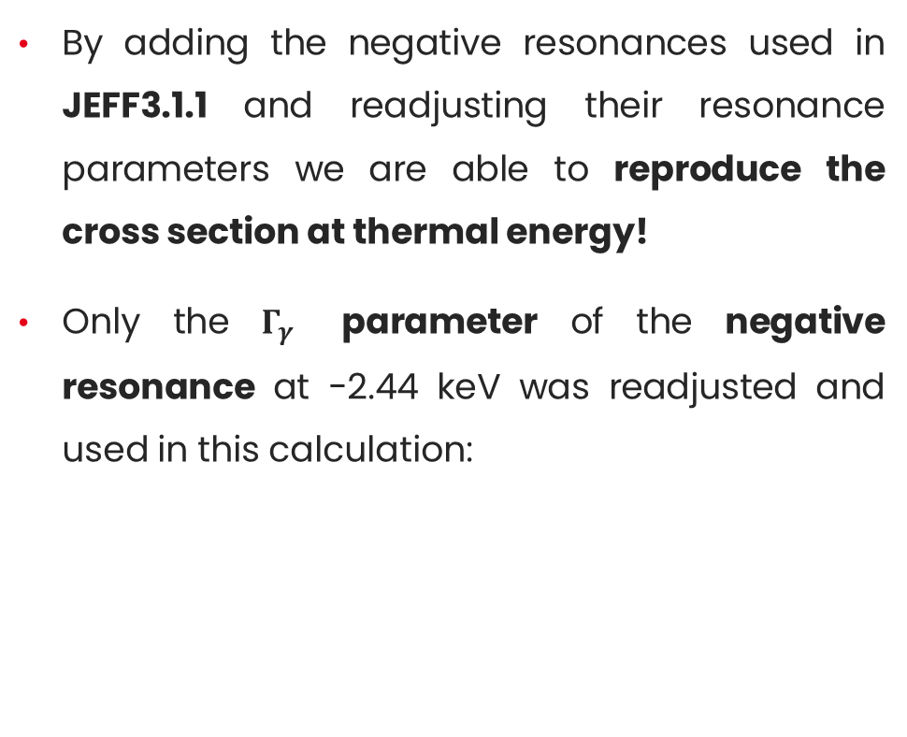
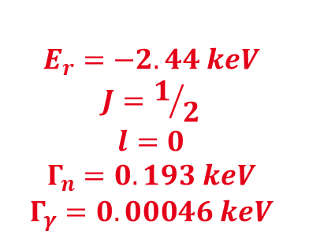
Compound + Direct capture (pdix code)
By adding the negative resonances used in JEFF3.1.1 and readjusting their resonance parameters we are able to reproduce the cross section at thermal energy!
Only the $Γ_{γ}$ parameter of the negative resonance at -2.44 keV was readjusted and used in this calculation:
JEFF3.1.1
pdix
$$E_{r}=−2.44 keV$$
$$J=1/2$$
$$l=0$$
$$Γ_{n}=0.193 keV$$
$$Γ_{γ}=0.00086 keV$$
$$E_{r}=−2.44 keV$$
$$J=1/2$$
$$l=0$$
$$Γ_{n}=0.193 keV$$
$$Γ_{γ}=0.00046 keV$$
The coherent scattering length at thermal energy is reproduced!

Slide 15
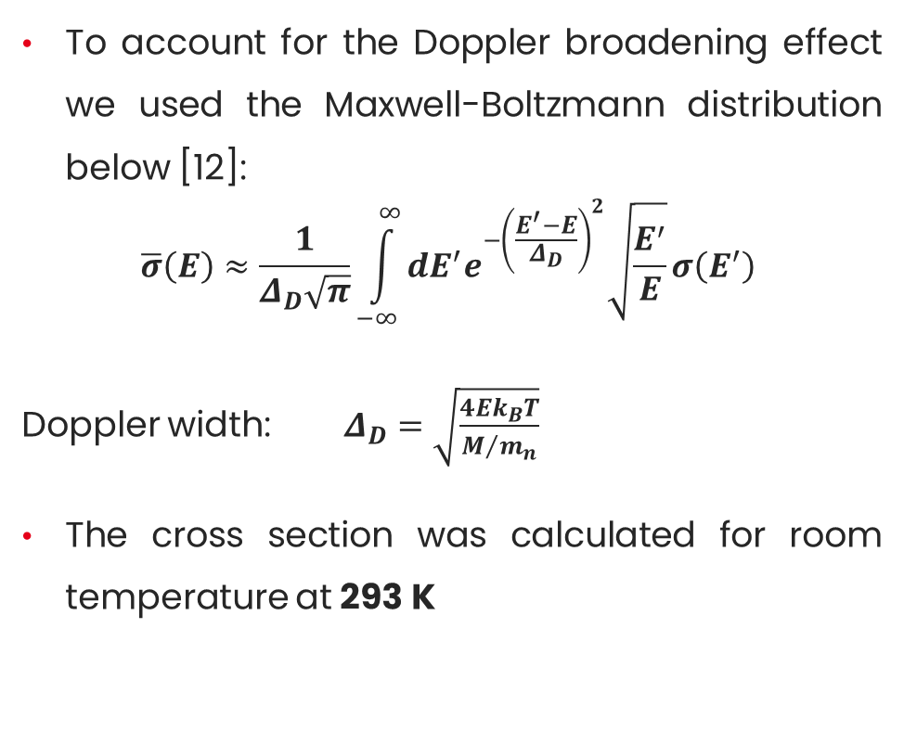
Doppler broadening
To account for the Doppler broadening effect we used the Maxwell-Boltzmann distribution below [12]:
$$\overline{σ}\left(E\right)≈\frac{1}{Δ_{D}\sqrt{π}}\int_{−∞}^{∞}{dE^{′}e^{−{\left(\frac{E^{′}−E}{Δ_{D}}\right)}^{2}}\sqrt{\frac{E^{′}}{E}}σ\left(E^{′}\right)}$$
Doppler width: $Δ_{D}=\sqrt{\frac{4Ek_{B}T}{M/{m_{n}}}}$
The cross section was calculated for room temperature at 293 K
[12] F.H. Fröhner JEFF Report 18, NEA/OECD (2000)

Slide 16
Preliminary results (10 eV – 100 keV)

Slide 17
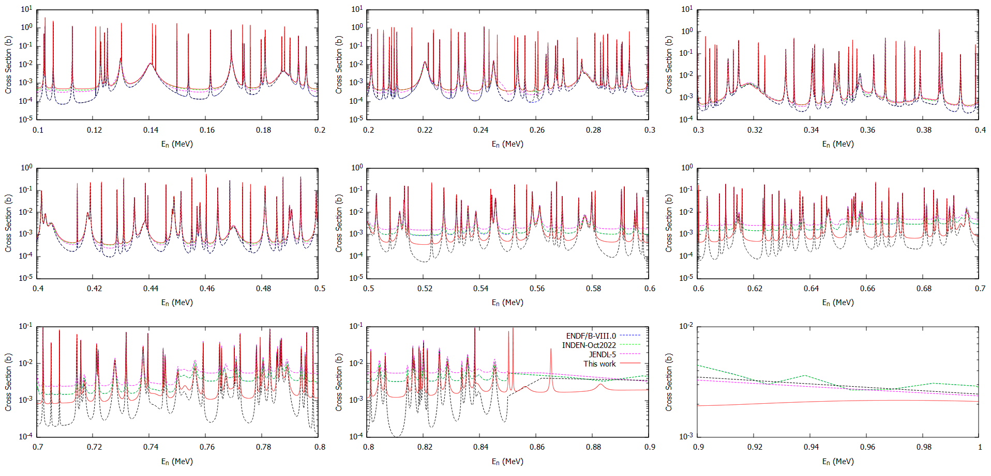
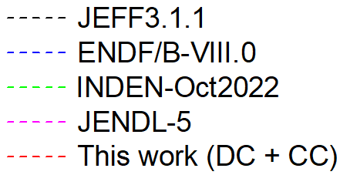
Preliminary results (100 kev – 800 keV)

Slide 18
Conclusions - Perspectives
The direct capture mechanism was explored for the case of ⁵⁶Fe
s-wave direct capture seemed able to reproduce the 1/v background component that was added in the 10 eV – 100 keV region
d-wave direct capture is a good candidate for the increase of the cross section in the 700 – 850 keV region
A first attempt to calculate the total capture cross section (Direct + Compound) was performed using the SLBW formalism
Implement the DRC mechanism in a code that is able to do a full resonance shape analysis and cross-check the results with a different formalism (CONRAD)

Slide 19
Thank you for your attention!

Slide 20
Back-up

Slide 21
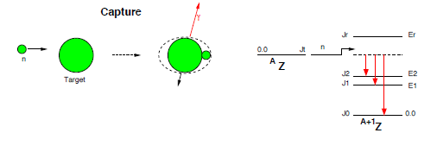

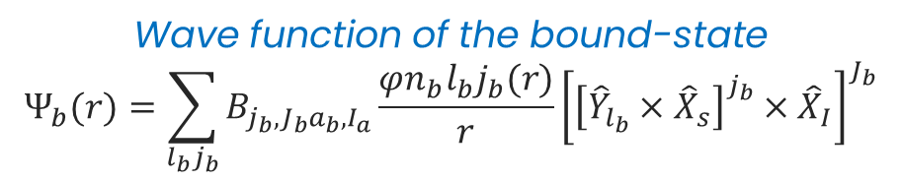
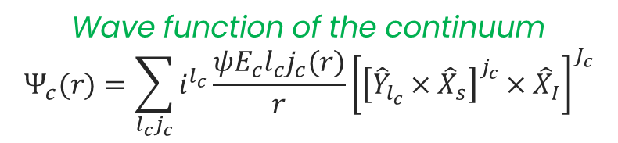
DRC cross section
$$Q_{c→b}^{\left(1\right)}=<Ψ_{b}\left|{\hat{T}}^{E1}\right|Ψ_{c}>$$
$$Q_{c→b}^{\left(1\right)}=<Ψ_{b}\left|{\hat{T}}^{E1}\right|Ψ_{c}> = \sqrt{S_{b}}∙I_{c, b}∙A_{c, b}$$
$A_{c, b}$ angular coupling part - $I_{c, b}$ radial part - $S_{b}$ spectroscopic factor of the final state
Electric dipole operator
Wave function of the bound-state
$$Ψ_{b}(r)=\sum_{l_{b}j_{b}}{B_{j_{b},J_{b}a_{b},I_{a}}\frac{φn_{b}l_{b}j_{b}(r)}{r}{\left[{\left[{\hat{Y}}_{l_{b}}×{\hat{X}}_{s}\right]}^{j_{b}}×{\hat{X}}_{I}\right]}^{J_{b}}}$$
Wave function of the continuum
$$Ψ_{c}(r)=\sum_{l_{c}j_{c}}{i^{l_{c}}\frac{ψE_{c}l_{c}j_{c}(r)}{r}{\left[{\left[{\hat{Y}}_{l_{c}}×{\hat{X}}_{s}\right]}^{j_{c}}×{\hat{X}}_{I}\right]}^{J_{c}}}$$
21

Slide 22
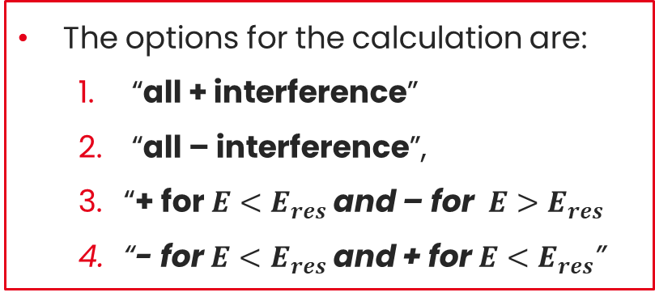
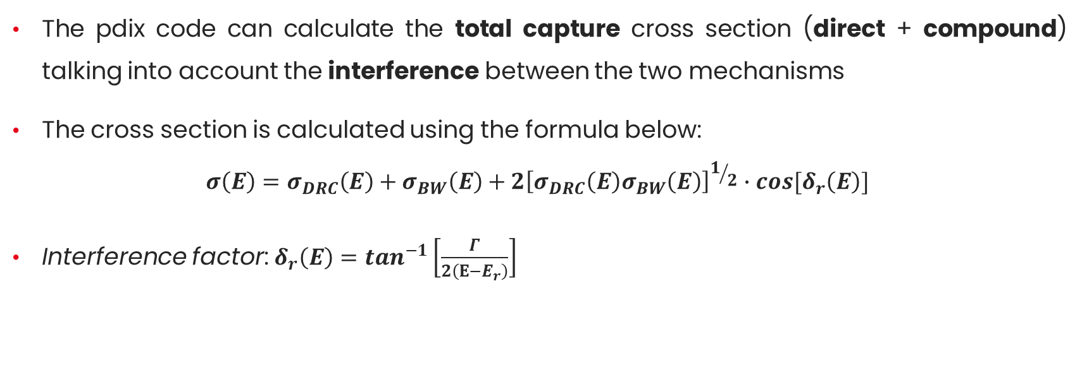
Interference between DC and CC
The pdix code can calculate the total capture cross section (direct + compound) talking into account the interference between the two mechanisms
The cross section is calculated using the formula below:
$$σ\left(E\right)=σ_{DRC}\left(Ε\right)+σ_{BW}\left(E\right)+2{\left[σ_{DRC}\left(Ε\right)σ_{BW}\left(E\right)\right]}^{1/2}∙cos⁡[δ_{r}\left(E\right)]$$
Interference factor: $δ_{r}\left(E\right)=\tan^{−1}\left[\frac{Γ}{2\left(Ε−Ε_{r}\right)}\right]$
The options for the calculation are:
  “all + interference”
  “all – interference”,
  “+ for $E<E_{res}$ and – for $E>E_{res}$
  “- for $E<E_{res}$ and + for $E<E_{res}$”

