Slide 1
Measurement of
²⁴²Pu(n,f) cross section
between 0.9 and 2 MeV neutron energy
L. Mathieu¹, P. Marini¹, M. Aïche¹, O. Bouland², C. Chatel³, S. Czajkowski¹, D. Kattikat-Melcom¹, T. Kurtukian¹, S. Oberstedt⁴, I. Tsekhanovich¹
¹ Laboratoire de Physique des 2 infinis de Bordeaux
² CEA/DEN/DES/DER/SPRC/LEPh Cadarache
³ Institut Pluridicsiplinaire Hubert Curien, Strasbourg
⁴ Joint Research Center Geel, Belgium

Slide 2
I- Context and motivations
²⁴²Pu in reactor
The ²⁴²Pu is an essential step in the formation of heavy actinides (²⁴¹Pu capture path)
²⁴²Cm
²⁴³Cm
²⁴⁴Cm
²⁴⁵Cm
Multi recycling Pu in fast reactor requires more accurate data in the fast energy range (~ MeV)
²⁴¹Am
²⁴²Am
²⁴³Am
²⁴³Am
²³⁸Pu
²³⁹Pu
²⁴⁰Pu
²⁴¹Pu
²⁴²Pu
²⁴³Pu
β
²⁴²Pu(n,f) [200keV;20MeV]
included in the HPRL
²³⁷Np
²³⁸Np
²³⁹Np
β
²³⁵U
²³⁶U
²³⁷U
²³⁸U
²³⁹U
+ n

Slide 3
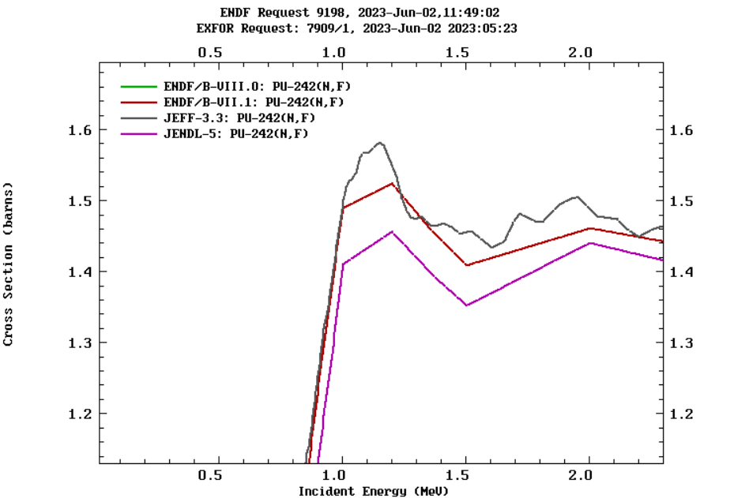
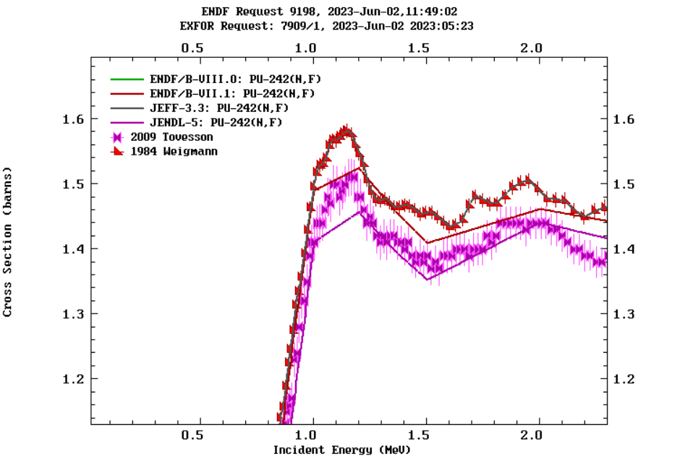
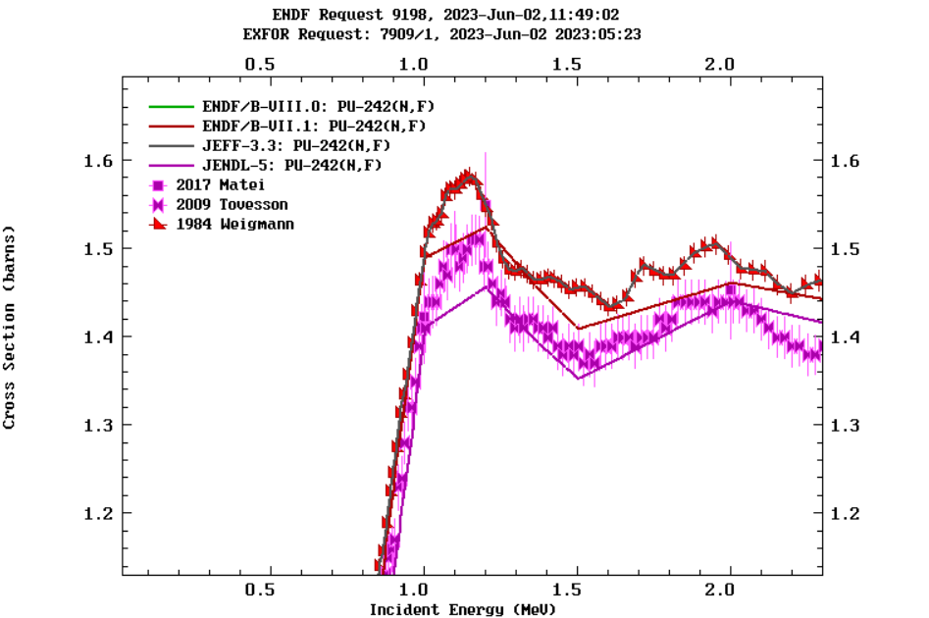
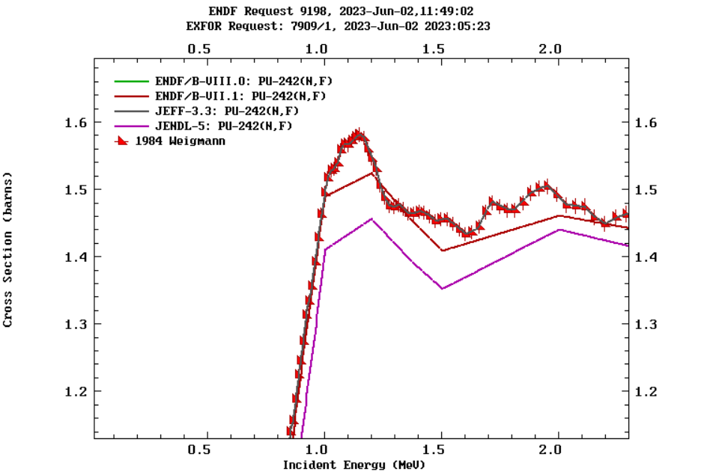
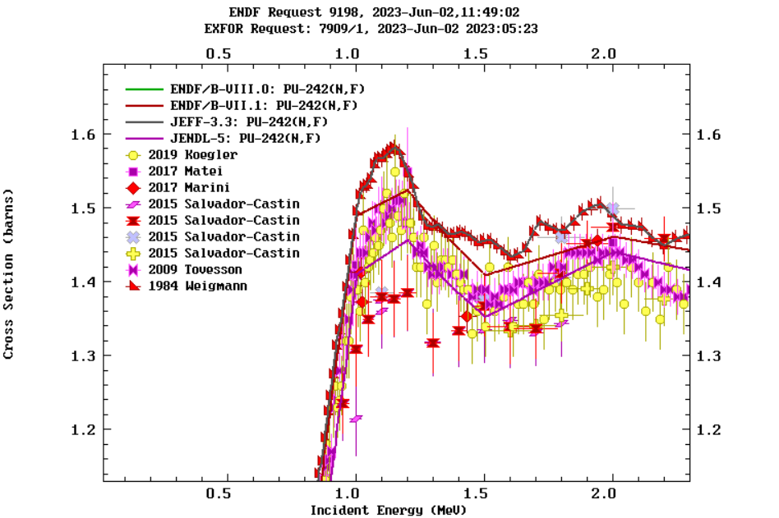
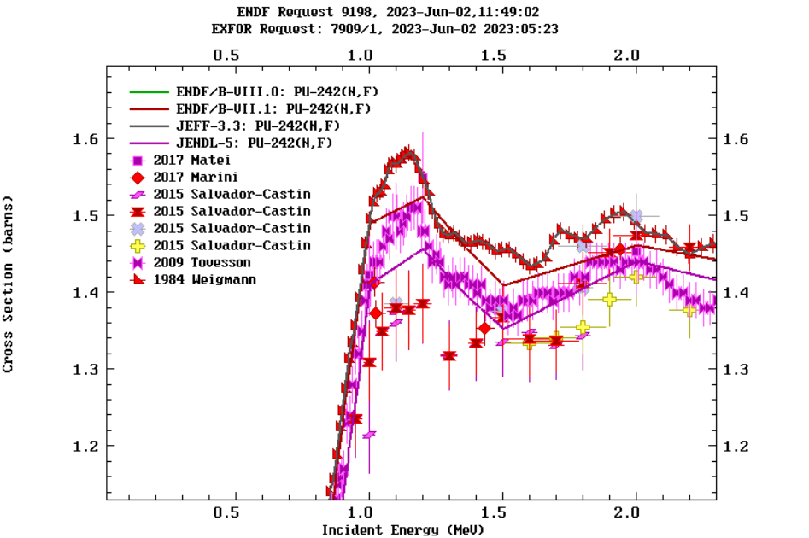

I- Context and motivations
²⁴²Pu(n,f) existing data
Questions about the structure around 1.2 MeV
JEFF-3.3
Consensus on :
- Weigman overestimation
- the maximum at 2 MeV
ENDF/B-VII & -VIII
JENDL
Measurement campaign in LP2i started in 2012.

Slide 4
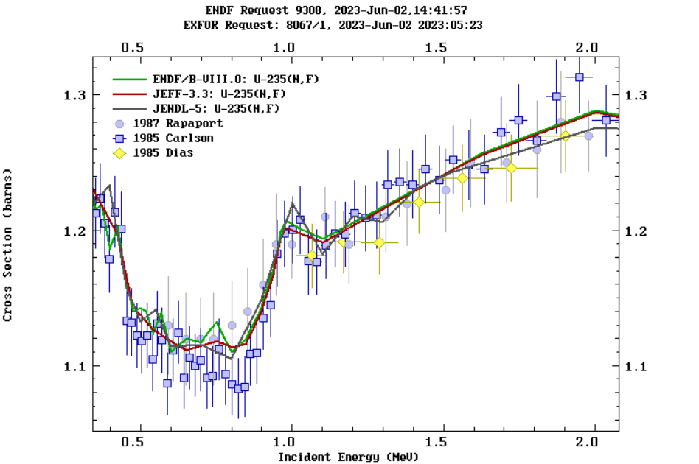
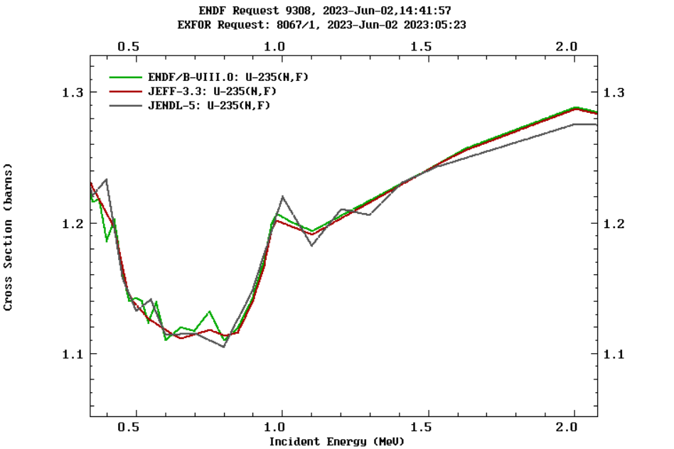
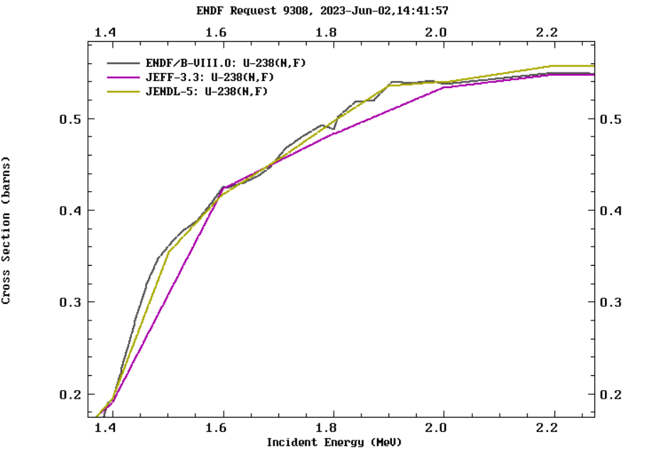
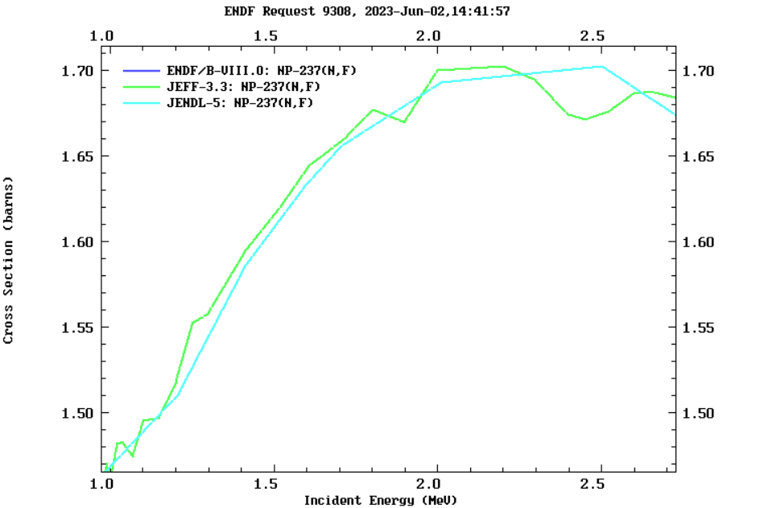
II- Measurement method and setup
Specific feature #1: Neutron flux measurement via H(n,p)
Habitual use of secondary standards
Measurements are usually carried out relative to secondary standards: ²³⁵U(n,f), ²³⁸U(n,f) or ²³⁷Np(n,f)
Discrepancies up to few percent
Uncertainties are not only libraries discrepancies
²³⁵U(n,f)
²³⁸U(n,f)
There are structures
All measurements
using these references are correlated
²³⁷Np(n,f)

Slide 5
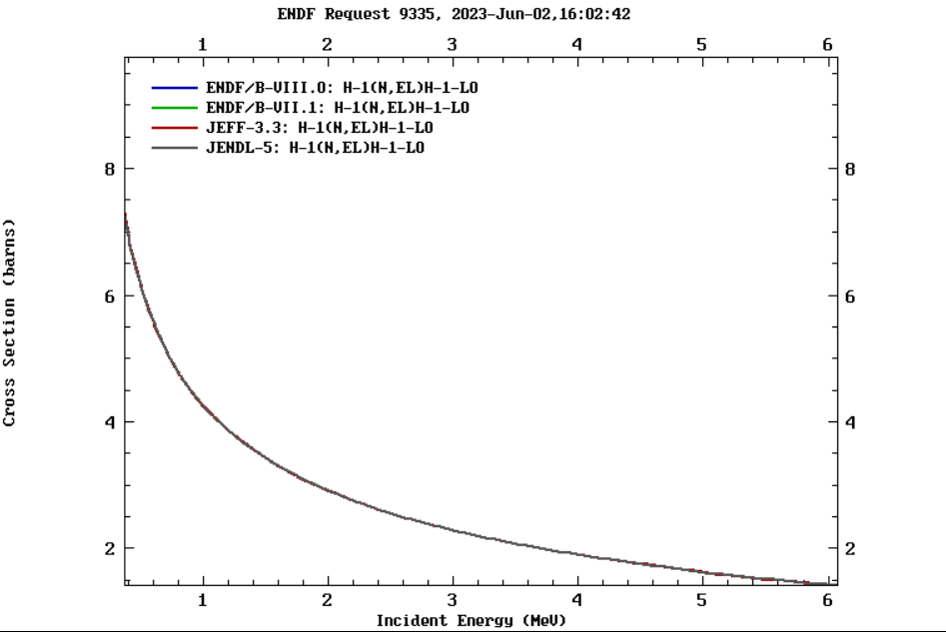
II- Measurement method and setup
Specific feature #1: Neutron flux measurement via H(n,p)
Proton recoil technique
- Primary standard H(n,p)
- Very good accuracy (< 0.5%) on a large energy range
- No structure
Specific experimental setup:
- Secondary standard requires
the same experimental setup as sample measurement
(targets placed back-to-back in ionisation chambers)
- Recoil protons detected with a completely different setup
(different systematic uncertainties from secondary standards)
Completely independent measurement

Slide 6
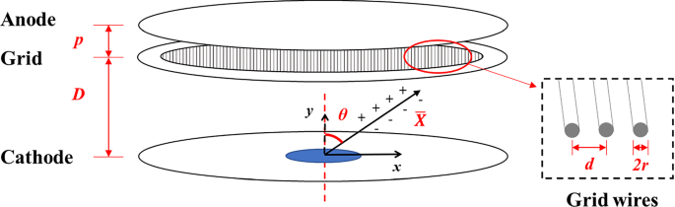
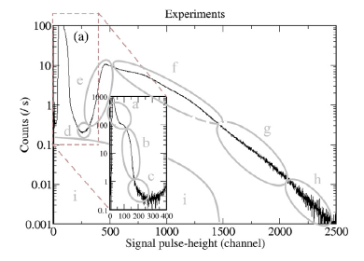
II- Measurement method and setup
Specific feature #2: Fission detection via solar cells
Habitual use of Ionisation Chamber to detect fission
Very efficient device
Can measure FF angle
Issue with α-FF discrimination:
- IC can detect α-particules (and α pile-up in highly radioactive samples)
- FF in IC doesn’t have a minimum deposition energy
=> detection threshold issue (proportion of missing FF, evolution with time)

Slide 7

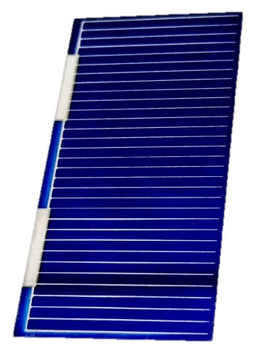
II- Measurement method and setup
sample
Specific feature #2: Fission detection via solar cells
Use of solar cells to detect FF
Easy to use, compact geometry
Well defined geometric efficiency (via solid angle)
Low sensitivity to α-particle
=> no issue with α-FF discrimination
solar cells
Challenge with intrinsic efficiency < 100% (grid shadow)
²⁴²Pu has a strong SF emission
SF measurement gives us the detection efficiency including:
(i) the real sample distribution
(ii) the intrinsic cells efficiency
This auto-normalization procedure helps to reduce systematic uncertainties (no impact of sample uncertainty).

Slide 8
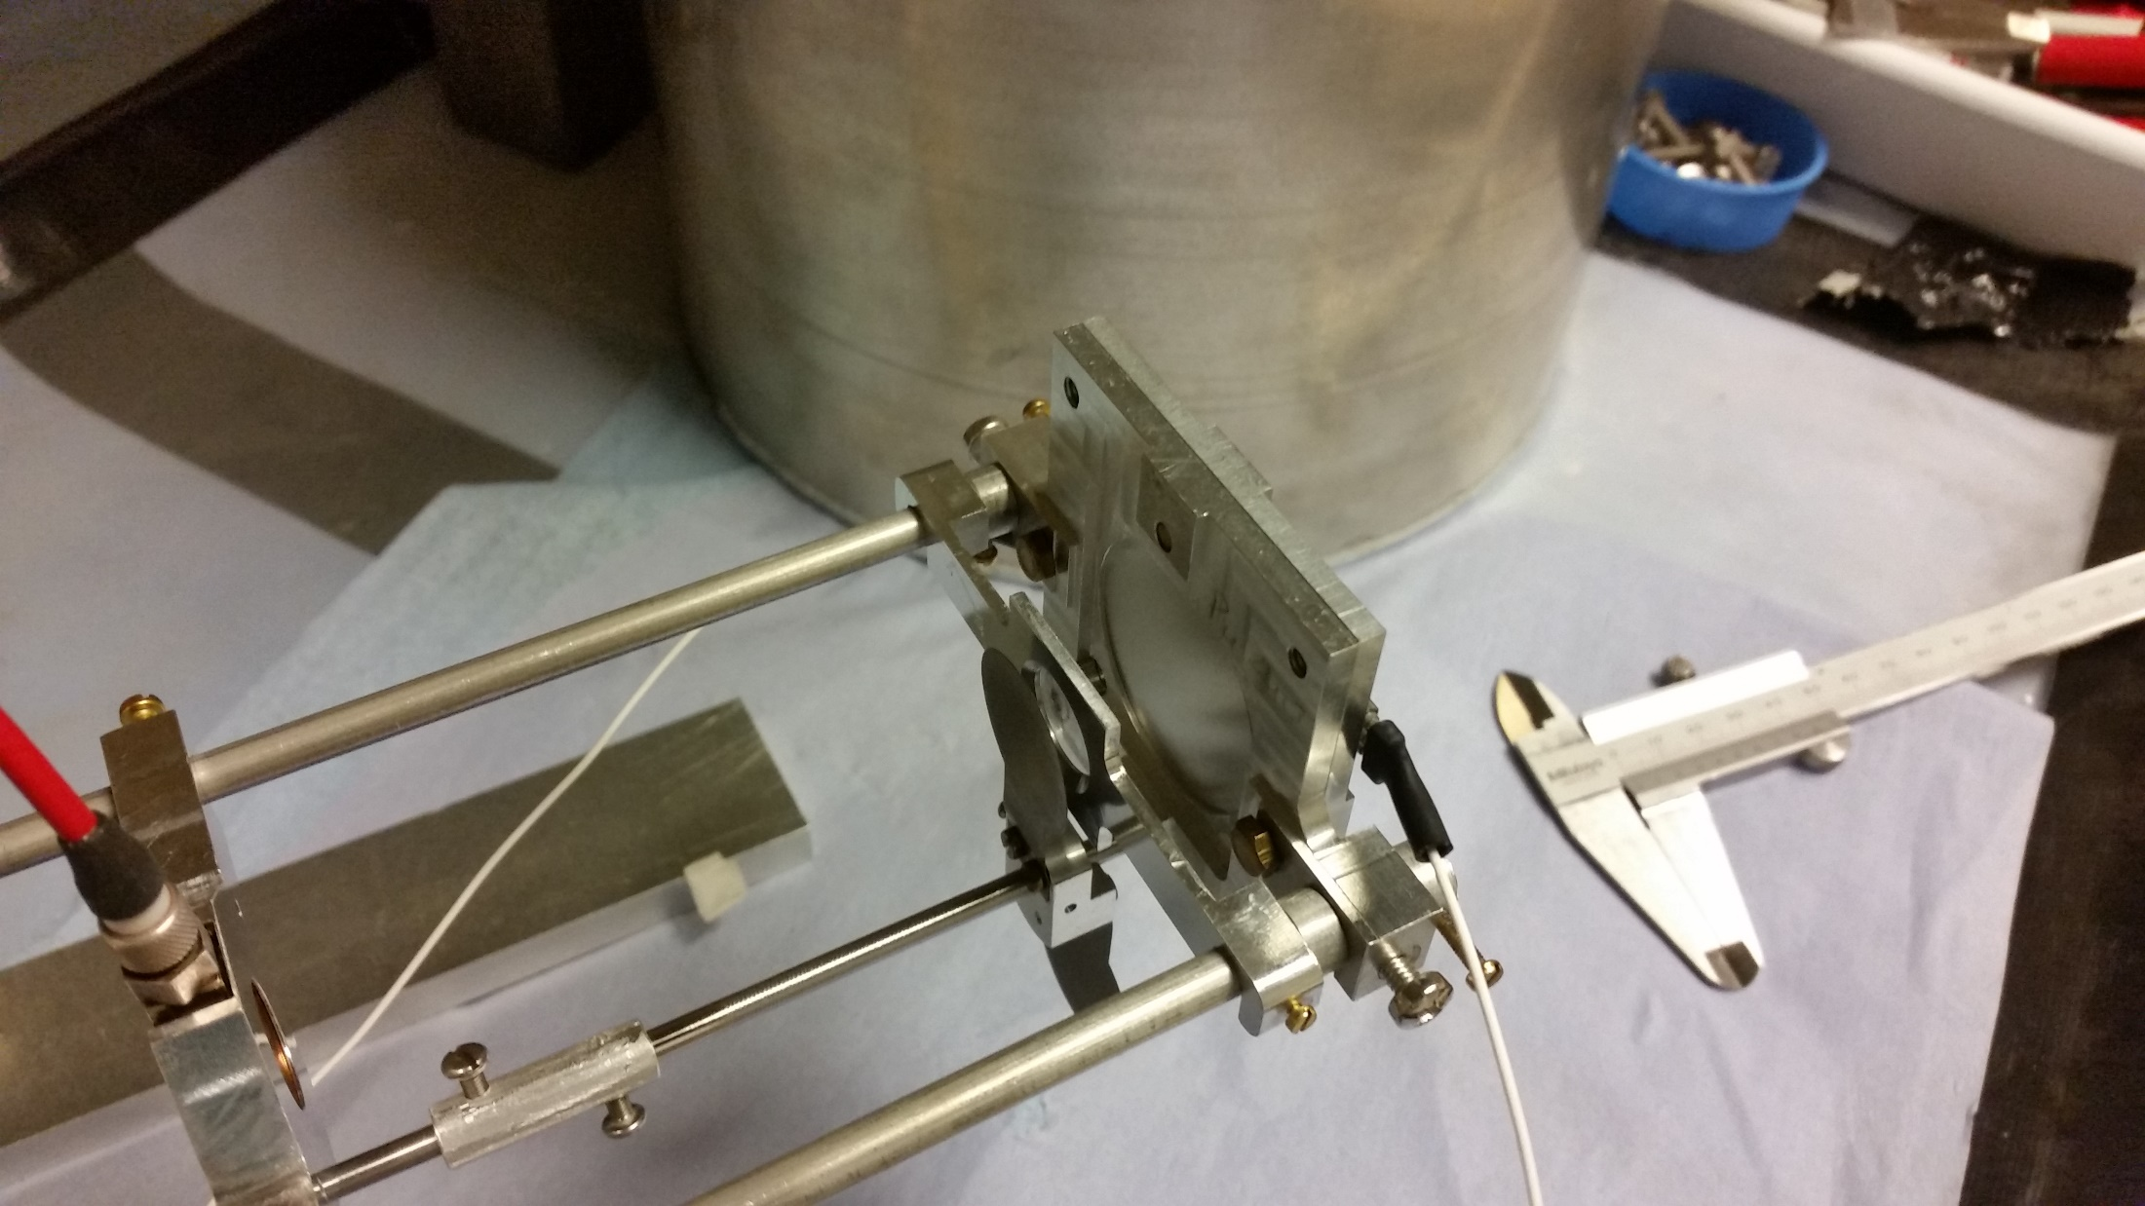
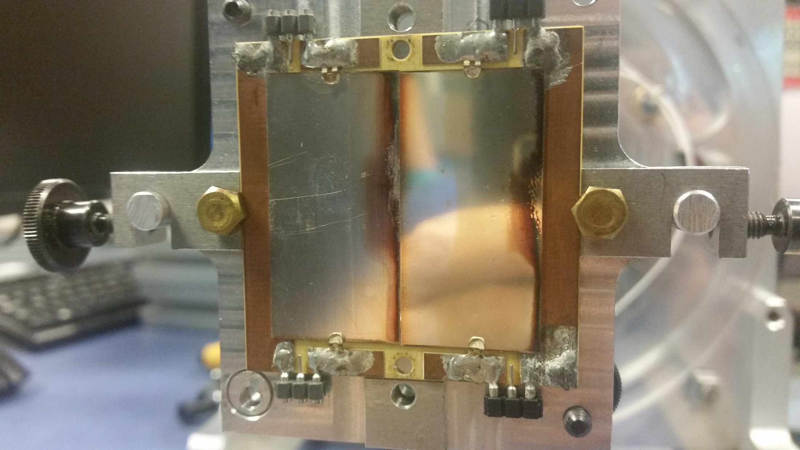
II- Measurement method and setup
Experimental Setup
A very simple setup
H-rich sample
(PP foil)
H-rich sample mask
Si detector
solar cells
²⁴²Pu sample
Special attention to every distance measurements

Slide 9
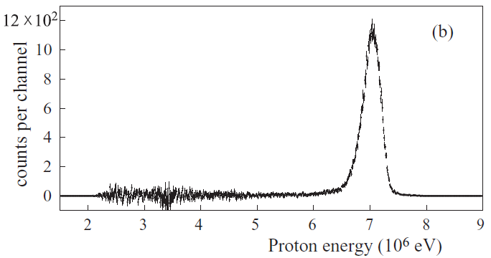
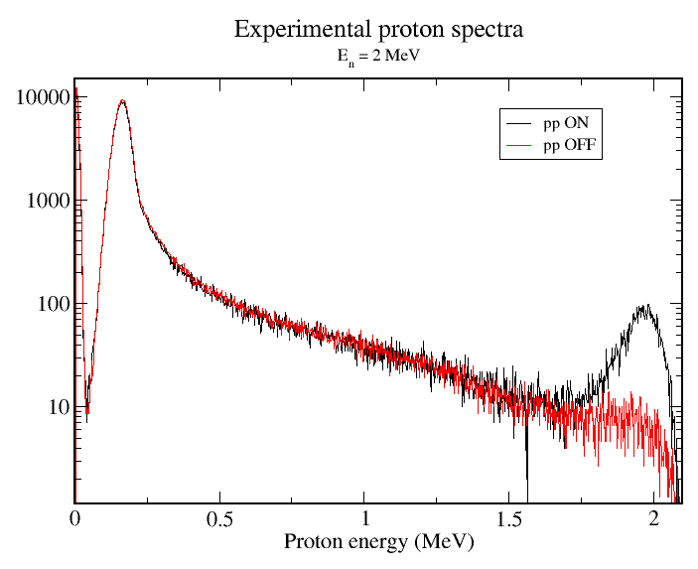
II- Measurement method and setup
Experimental Setup
proton peak (N_{proton})
Proton recoil principle:
Ta screen
E_{p} ~ E_{n}
E_{n}
recoil protons
E_{p}
Si
neutrons
Well defined efficiency
H-rich foil
E_{p}
E_{p}
net Si spectrum at high E_{n}
Usual background :
Other signals in Si detector have to be subtracted
Background measurement by masking H-rich foil
Precise neutron flux (ΔN_{p}~1%) requires the background to be low
For E_{n} > 1 MeV, a Si detector is suitable
ON and OFF Si spectra
for E_{n}~ 2 MeV

Slide 10
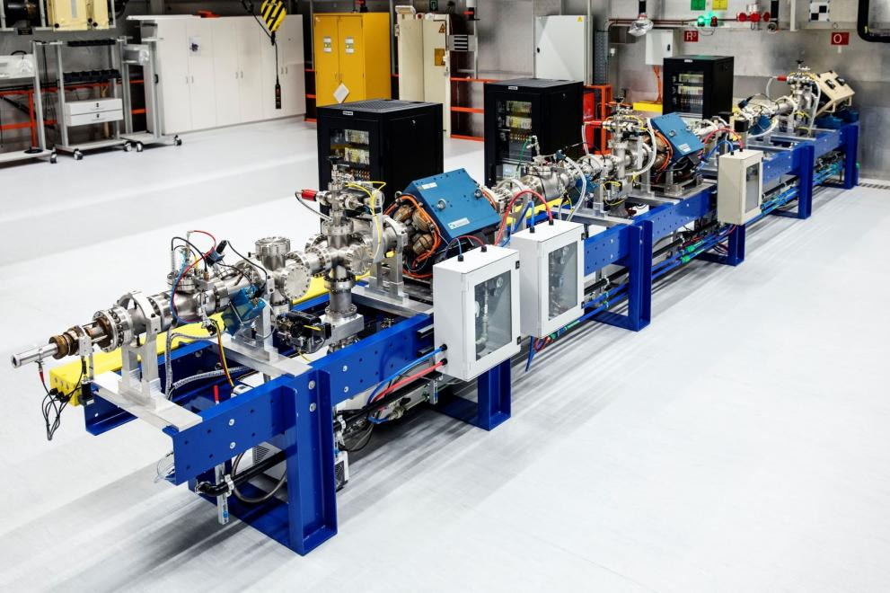
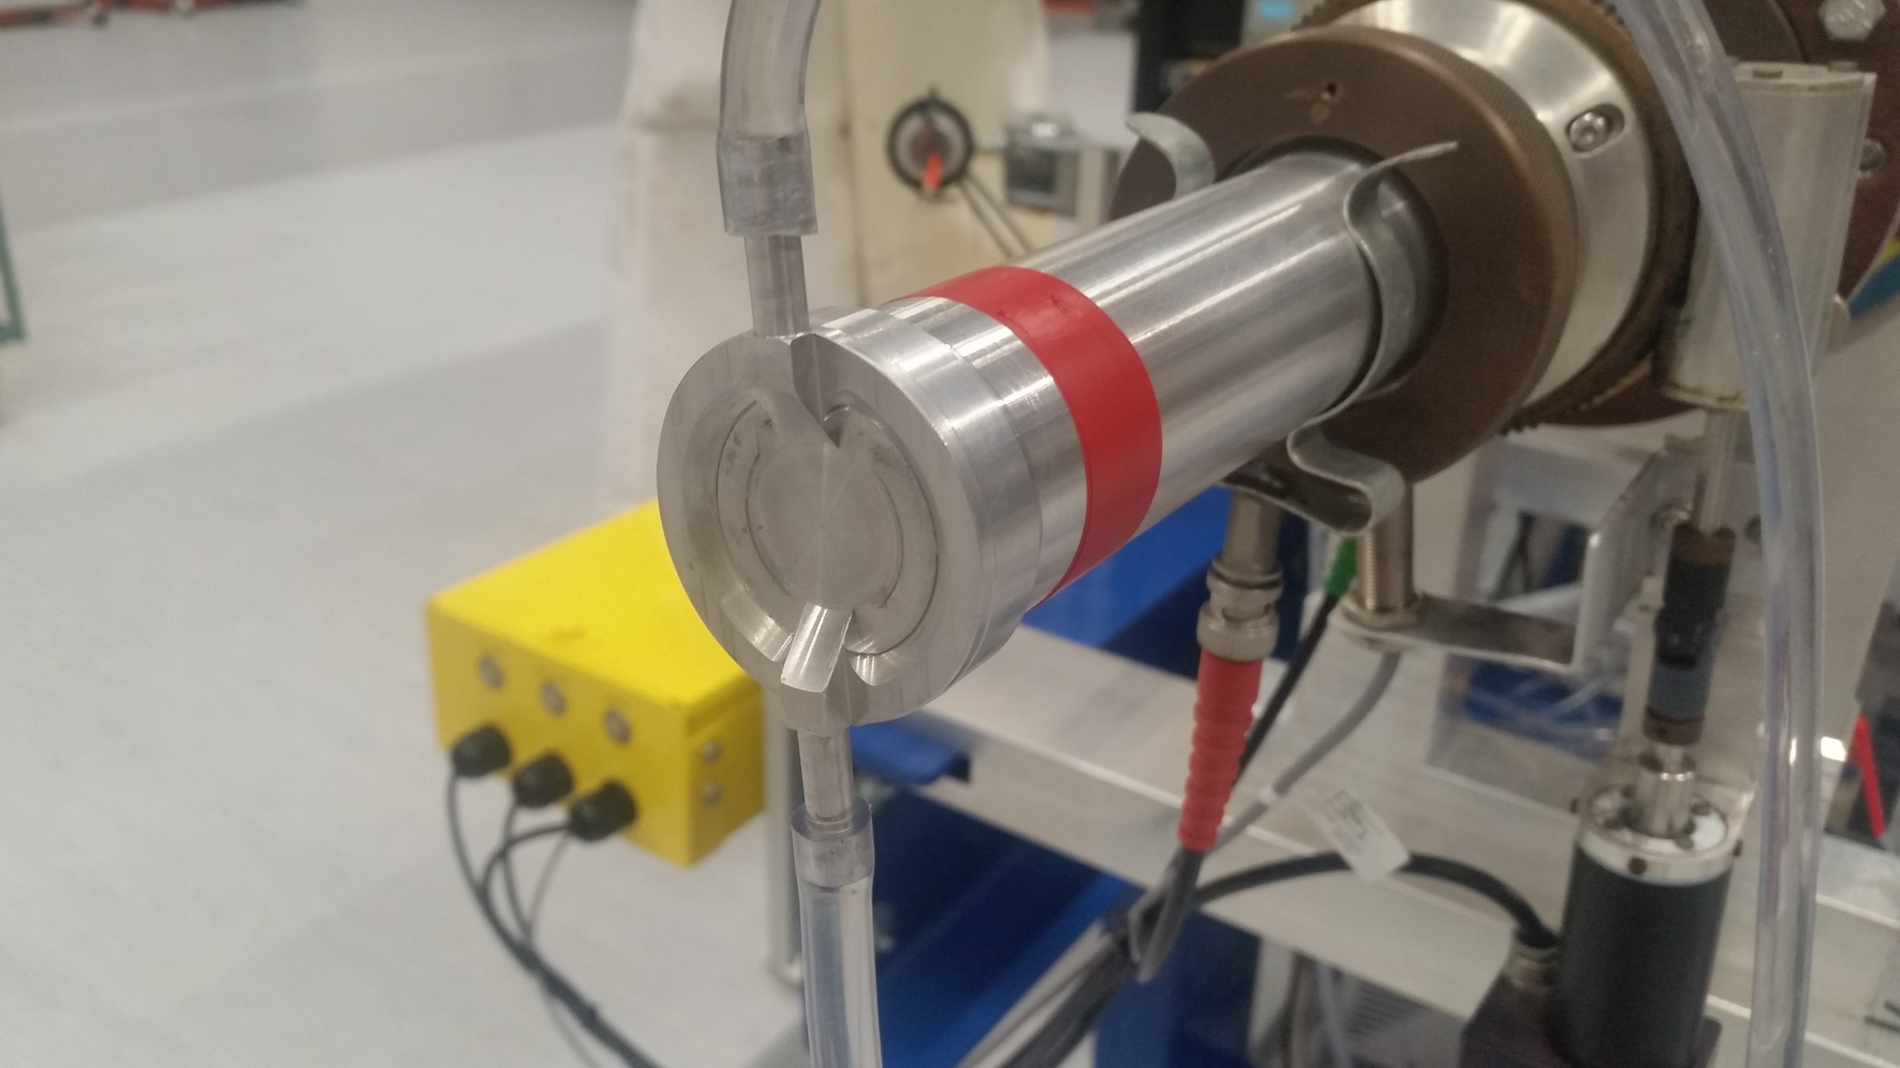
II- Measurement method and setup
The Monnet Facility
A brand new facility for quasi mono-energetic neutron beam
³H targets available
JRC-Geel samples available
(much less paperwork than importing radioactive actinide samples)
Beam available during night if needed (but nobody on site)
Efficient radiation protection service
Very light water cooling system (important to reduce neutron scattering)
Native neutron detectors for flux monitoring (some issues)

Slide 11
II- Measurement method and setup
Cross section calculation
N_{FF}
ε_{p}
Ω_{PP}
N_{H}
σ_{242Pu(n,f)} = x x x x σ_{H(n,p)}
N_{p}
ε_{FF}
Ω_{242Pu}
N_{242Pu}
primary standard
Counting rates ratio
- for p: clean background subtraction
- for FF: scattered neutrons subtraction (simulation)
Solid angles ratio
- accurate distance measurements
- anisotropic neutron production
Efficiencies ratio
- for p: calculated by simulation
- for FF: based on SF measurements, additional effect:
. kinematic effect
. anisotropy (not well known)
Material quantities ratio
- for ²⁴²Pu: α spectrometry
- for H:
. H-contamination prevention
. micro mass measurement

Slide 12
III- Analysis and preliminary results
Spontaneous Fission runs
SF run (no beam) nearly every night
A_{SF} (²⁴²Pu) ~ 0.5 Bq
< ε > = (66.53 +/- 0.16)%
Good accuracy
Constant or decreasing behavior ?
Several runs still to be analysed

Slide 13
III- Analysis and preliminary results
Preliminary Results
Quick and dirty analysis:
- shape normalised to previous data
- aberrant points to be analysed properly
- statistical uncertainties only
15 different neutron energies measured
Two ³H targets used:
- one data set with a 930 µg/cm² target (with additional distance)
- one data set with a 260 µg/cm² target (no additional distance)
PRELIMINARY
Global shape begins to appear

Slide 14
III- Analysis and preliminary results
Preliminary Results
Quick and dirty analysis:
- shape normalised to previous data
- aberrant points to be analysed properly
- statistical uncertainties only
Corrections to be applied to obtain the shape:
- scattered neutrons
- proton efficiency calculations
- FF efficiency calculations for special effects (kinematic boost, anisotropic n production, FF anisotropy...)
- ²⁴²Pu vs PP irradiation correction (solid angle + anisotropic n production)
PRELIMINARY
Corrections to be applied to obtain the absolute value:
- ²⁴²Pu vs PP material quantities
- clean fission background subtraction

Slide 15
Conclusions
Measurement method:
- measurement relative to H(n,p) => independent measurement
- use of solar cells => different systematic uncertainties
- auto-normalization with SF => discard some systematic uncertainties
Experiment:
- carried out in fall 2022 @MONNET facility in JRC-Geel
- measurement with T(p,n): E_{n} from 0.9 MeV to 2 MeV
Results:
- coherent SF results: good stability and good accuracy
- preliminary results show global cross section shape
- a lot of corrections to take into account to obtain the real shape
- additional measurements needed to obtain absolute value

