Slide 1
Total and Double Differential Scattering Cross-Section Measurements of Isotropic Graphite
Atsushi Kimura, Shunsuke Endo, Shoji Nakamura
Japan Atomic Energy Agency

Slide 2
Contents
Introduction
Samples
J-PARC Facilities
Double differential Scattering Cross-Section Measurement
Total Cross-Section Measurement
Summary

Slide 3
Introduction
Nuclear-grade graphite has been considered as an efficient neutron moderator and reflector for the following reasons:
low atomic mass number
small neutron capture cross-section,
high neutron scattering cross-section,
⇒Sufficient neutron moderation capability
easy availability, and
comparatively low cost.
⇒Engineering Advantages
Notes:
First, I’ll show you the introduction of this presentation.
As you know, graphite has been considered as an efficient neutron moderator and reflector.
This is because,
Graphite has ……
These mean graphite has sufficient neutron moderation capability.
Overmore, graphite is easy availability and low cost.
They are big advantages for engineering.

Slide 4
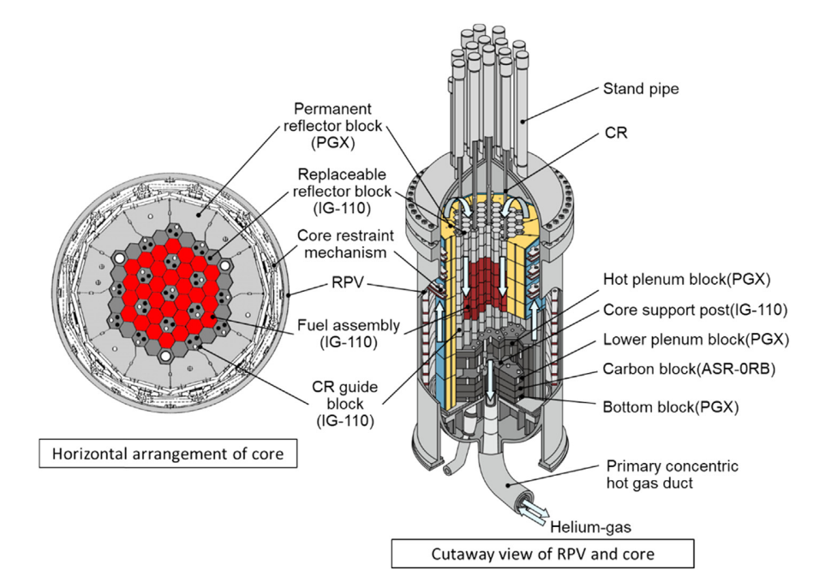
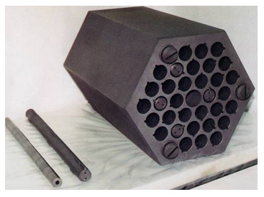
Introduction②
Graphite has been used in many reactors.
For example, in the case of High Temperature Engineering Test Reactor (HTTR)…
HTTR is the high-temperature gas-cooled reactor in JAEA.
The first criticality of the HTTR was achieved in 1998.
The reactor outlet coolant temperature was 950℃ under full thermal power of 30MW.
Schematic view of components and reactor core vessel of HTTR[1]
Fuel assembly
[1] T. Nishihara, et al., Excellent Features of Japanese HTGR Technologies, JAEA-Technology 2018-004, 2018.
Notes:
Therefore, Graphite has been used in many reactors.
For example in the case of High temperature engineering test reactor, HTTR,
Graphite is used in these reflector block, fuel assembly and upper and lower plenum.
This photo shows the fuel assembly of HTTR.
This is made by fine graphite.

Slide 5
Introduction③
Graphite is widely used in many reactors as a moderator and reflector.
To obtain low energy (E < 1 eV) neutron spectrum accurate neutron total and DDSCS are required.
Unfortunately, in this energy region, the cross sections are affected by the thermal neutron scattering law.
The results in large differences between samples in the case of graphite.
The total cross-section and DDSCS of graphite samples with different properties have been measured in the Materials and Life Science Experimental Facility (MLF) in the J-PARC.
Notes:
As you seen, graphite widely used in many reactors as moderator and reflector.
Accurate cross section of the graphite in the low energy region is very important to deduce neutron spectrum.
However, in this energy region, the cross sections are affected by the thermal neutron scattering law due to the crystal structure.
The reported results have large discrepancies.
Therefore, we have measured total C.S. and DDSCS of graphite in the Materials and Life Science Experimental Facility (MLF) in the J-PARC.

Slide 6
Samples

Slide 7

Samples①~What is Isotropic Graphite?~
Five isotropic graphite samples with different porosities, densities and grain sizes were selected as samples.
~What is Isotropic Graphite?~
Isotropic graphite is a graphite that is isotropically formed by cold isostatic pressing (CIP) method.
Isotopic graphite has:
high density, high strength,
uniform characteristics in three dimensions.
Isotropic graphite is widely used for general industrial components such as semiconductor manufacturing equipment.
Many suppliers sell many types of isotropic graphite.
(Easy to choice)
The raw material is filled into a rubber mold, placed in a pressure vessel filled with water or oil, and pressurized to form the product.
[1]Jun Tojo, TANSO, Vol.2008, pp.234, (2008).
Notes:
In the measurements, we have used Five isotropic graphite samples with different porosities, densities and grain sizes.
First, I’ll show you “What is isotropic graphite?”.
Isotropic graphite is a graphite that is isotropically formed with cold isostatic pressing (CIP).
In cold isostatic pressing, as shown here,
the raw material is filled into a rubber mold,
placed in a pressure vessel filled with water or oil, and pressurized to form the product.
As a result, Isotopic graphite has high density, high strength, and uniform characteristics in three dimensions.
Using these excellent properties, Isotropic graphite widely used for general industrial components.
Furtermore, Many suppliers sell many types of isotropic graphite.
We can choice several properties.

Slide 8
Samples ~Properties~
Difference of typical properties between isotropic graphite and nuclear grade graphite and carbon
 | ET-34 (Isotropic graphite) | PGX graphite (WG)[1] | ASR-0RB carbon[1]
Bulk density (g/cm) | 1.86 | 1.73 | 1.69
Tensile strength (MPa) | 50 | 8.1 | 6.8
Compressive strength (MPa) | 120 | 30.6 | 50.4
Young’s modulus (GPa) | 11 | 6.5 | 8.7
Thermal expansion coefficient | 3.9 | 2.3 | 4.4
Thermal conductivity (W/(mK)) | 150 | 75 | 10
Ash (ppm) | Max. 100 | Max. 7000 | Max. 5000
Grain size (μm) | Mean 15 | Max 800 | Max 2000
[1]M. Ishihara et al. / Nuclear Engineering and Design 233 (2004) 251–260
Notes:
This table shows difference of typical properties between isotropic graphite and nuclear grade graphite and carbon.
As you can see, Isotropic graphite has higher density, strength thermal conductivity, and high purity and low grain size.

Slide 9
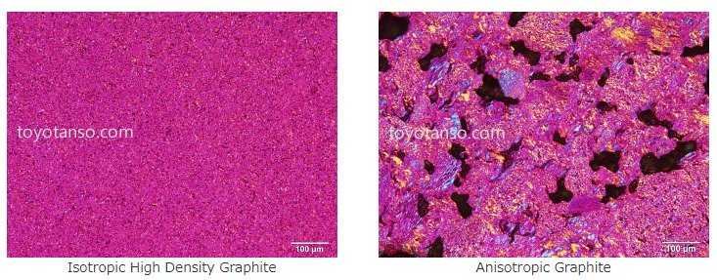
Samples ~X-ray photo~
Photo of typical isotropic and anisotropic graphite
https://www.toyotanso.com/Products/Special_graphite/
Isotropic graphite has a high density and a micro particle structure comparison to anisotropic graphite.
Demerit: Cost and Size (Largest size is typically 1m x 50cm x 50cm)
Four Japanese companies, Toyo Tanso, Ibiden, Tokai Carbon, and Shin Nippon Techno Carbon, hold approximately 65% of the world's isotropic graphite market share.
Notes:
These pictures are X-ray photo of typical isotropic carbon and traditional carbon.
The pictures are taken from this HP.
This is not a picture of our samples.
However, as you can see, isotropic graphite has a high density and a micro particle structure comparison to anisotropic graphite.
Of course, Isotropic graphite has disadvantage.
One is cost and the other one is size.

Slide 10
Samples ~Isotropic graphite in reactors~
Thanks to its excellent properties:
Easy to Machine
Ultra Heat Resistance,
Sufficient strength and
Highly consistent quality,
Isotropic graphite was used as moderators in the HTTR.
Schematic view of HTTR[1]
Fuel assembly made of isotropic graphite
Isotropic graphite used in Chinese HTRs, HTR-10 and HTR-PM, and first wall of fusion reactors.
[1] T. Nishihara, et al., Excellent Features of Japanese HTGR Technologies, JAEA-Technology 2018-004, 2018.
Notes:
Using these excellent properties, isotpropic graphite is used in HTTR.
IN this fugure, these parts are made of isotropic graphite.
This Fuel assembly made of isotropic graphite
Isotropic graphite used in Chinese HTRs, HTR-10 and HTR-PM, and first wall of fusion reactors.

Slide 11
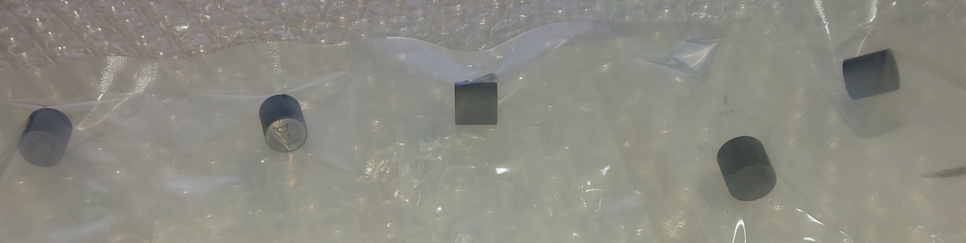
Samples
Five isotropic graphite samples were prepared for the experiments.
The samples have different densities, porosities and grain sizes.
Shape: cylindrical: 10mmφ, 10mmH
The samples were supplied by Ibiden Co. Ltd.
Impurities are less than 100 ppm.
 | Density (g/cm³) | Porosity※ （％） | Grain size※ (μm) | Purpose ※Typical (nominal) value
ET-10 | 1.75(1.75)※ | 15 | 15 | Graphite for general purposes: Industrial furnaces, and reactors (Made with similar process)
ET-11 | 1.76(1.77)※ | 14 | 13
ET-34 | 1.84(1.86)※ | 11 | 15
ED4 | 1.90(1.90)※ | 9 | 1 | Graphite for EDM （Electrical Discharge Machining）
T-8 | 1.88(1.85)※ | 9 | 5 | Graphite for ion implanters (High purity < 5ppm)
Notes:
Therefore, we have prepared Five isotropic graphite samples with different densities, porosities and grain sizes.
This picture shows the samples.
The samples are cylindrical shape and diameter of 10mm and height is 10mm
The table show a properties of the samples.
In the table, the values are typical value except for density without brackets.
These, ET-10, -11 and 34, are graphite for general industrial purposes.
These are made by similar process.
ED-4 is a very small grain size sample.
That is used for EDM.
T-8 is high purity sample.
Impurity is less than 5 ppm.
Impurities of the other samples are less than 100 ppm.
The samples were supplied by Ibiden Co. Ltd.

Slide 12
Facilities

Slide 13
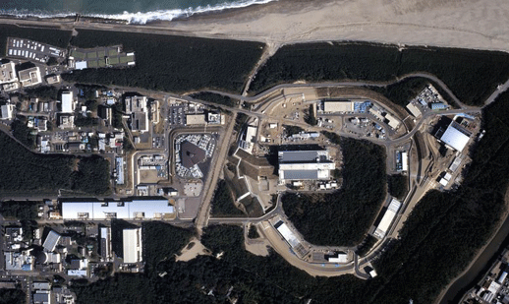
Facility J-PARC : Japan Accelerator Research Complex
MR
30GeV
RCS
3GeV
Hadron physics
LINAC
180MeV
MLF
(neutron exp.)
Neutrino experiment
4
Notes:
First I will show you a out line of J-PARC.
*There are three proton accelerators in J-PARC.
*One linear accelerator and two synchrotrons.
*180MeV protons from the linear accelerator are injected into RCS and accelerated up to 3 GeV.
*3GeV protons are transported to MLF or MR for high energy experiment such as hadron physics or neutrino experiment.
*This experiment was done in MLF.

Slide 14
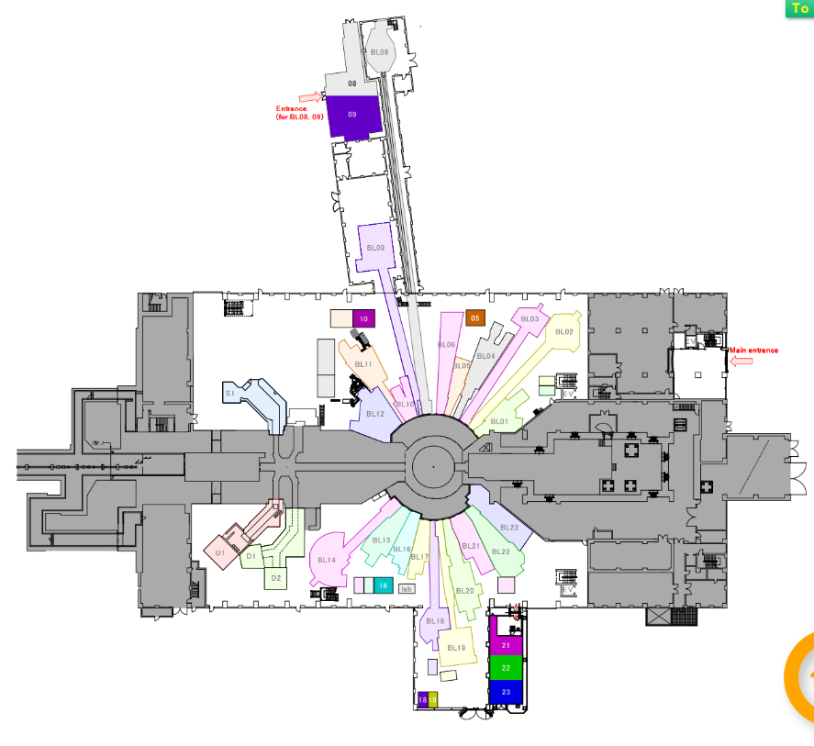
Facility ~MLF~
In the MLF, there are 23
neutron beam ports, and
21 beam lines are working.
Inelastic scattering
6 beam lines (BL14)
Diffraction
8 beam lines
Small angle scattering and
reflection
3 beam lines
Capture gamma-ray
1 beam line (BL04)
Imaging and the other
3 beam lines
Transmission experiment
BL04 ANNRI
Pulsed neutron source
Muon beam lines
Entrance
Scattering C.S. experiment
BL14 AMATERAS
J-PARC MLF,
Taken from HP of J-PARC
Notes:
This figure shows floor map of the MLF.
In the MLF, there 23 beam ports and 21 beam lines are working.
The transmission experiment were performed in BL04 ANNRI.
And the elastic C.S. measurements were performed in BL14 named AMATERAS.

Slide 15
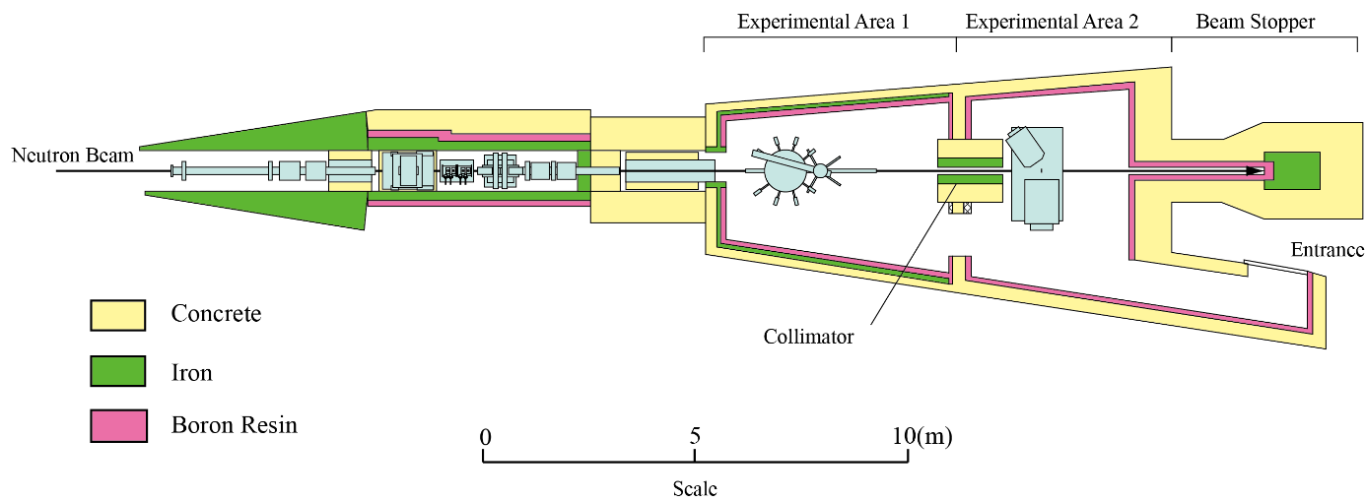
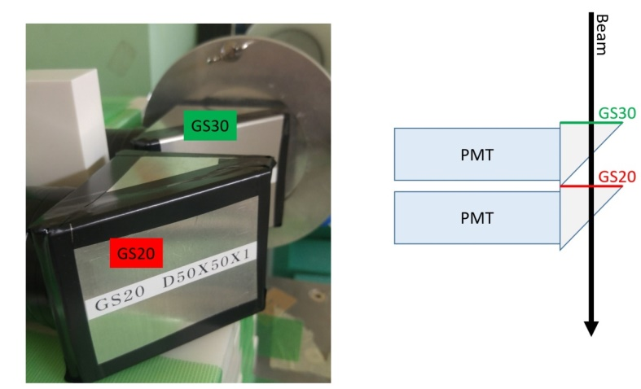
ANNRI (For transmission experiment)
BL04: ANNRI (Accurate Neutron Nucleus Measurement Instrument)
NaI(Tl) Spectrometer
Ge Spectrometer
^{6 and 7}Li Glass detectors
A ⁶Li-glass scintillation detector for neutron
a ⁷Li-glass scintillation detector for γ-ray B.G
were installed at the flight length of 28.7m
Notes:
First, I’ll show you the outline of ANNRI for transmission experiment
ANNRI is located on Beam Line NO.4 of MLF.
This figure shows a schematic view of ANNRI.
In ANNRI, we have two gamma-ray spectrometers for capture cross section measurements.
One is Ge detector array and the other one is NaI detectors.
Also, Li-Glass detectors for total cross section measurements are also equipped.

Slide 16
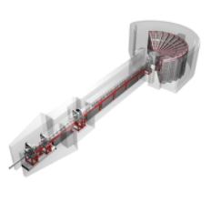
AMATERAS (For scattering C.S. measurement)
BL14: AMATERAS, Cold-Neutron Disk-Chopper Spectrometer
Array of ³He tube detectors
(Position sensitive)
AMATERAS is a disk-chopper type spectrometer.
The spectrometer is designed for inelastic neutron scattering experiments in the range from cold to sub-thermal neutron energy.
Sample position
Disk choppers
neutrons
Incident neutron energy 1 < Ei < 80 meV
Detection angle
Horizontal: 3.4 deg. ~ 116 deg.
Vertical: -16 deg. ~ 23 deg.
Resolution (ΔE/Ei) ~2% at Ei < 3 meV
~3-4% at Ei < 20 meV
~4-10% at Ei < 80 meV
Neutron intensity (@sample position)
6 ×10⁴ n/s/cm2 (@ Ei = 20 meV)
Neutrons were monochromatized with disk choppers.
The neutrons are scattered by the sample.
The scattered neutrons were detected with arrays of He-3 tubes.
Derive the position and energy of the scattered neutrons.
Notes:
For the elastic C.S. measurement, we used Cold-Neutron Disk-Chopper Spectrometer named AMATERAS.
AMATERAS is a disk-chopper type spectrometer.
Neutrons were monochromatized with disk choppers.
The neutrons are scattered by the sample
The scattered neutrons were detected with arrays of He-3 tubes.
Calculate the neutron energy of the scattered neutrons.
Using this spectrometer, we can obtain the scattered angle and energy of scattered neutrons.
Characteristics of the spectrometer are shown here.
Incident neutron energy 1 < Ei < 80 meV
Detection angle
Horizontal: 3.4 deg. ~ 116 deg.
Vertical: -16 deg. ~ 23 deg.

Slide 17
DDSCS measurement

Slide 18
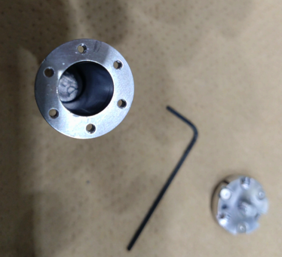
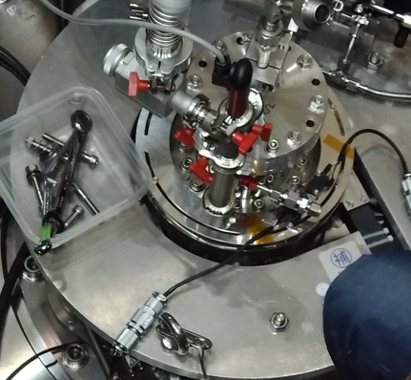
Scattering C.S. measurements
~Experimental set-up~
J-PARC MLF
BL14: AMATERAS
The graphite samples are placed in an aluminum cell and placed in a refrigerator.
The refrigerator was installed at the sample position.
The temperature was controlled at 300 K.
(100 K and 485 K are measured for ET-34 only).
A blank cell was measured for B.G.
A Vanadium sample was measured for normalization.
An incoherent cross section of 5.08b (NIST) was used.
Incident neutron energy:
Filter ① :5.93，10.53，23.65，93.95 meV
Filter ② :3.14，7.74，15.15，41.98 meV
Filter ③ :1.17，1.48，1.94，2.64 meV
Measurement time:
2~3 hours for each sample and condition.
Sample Holder cell
Top of the refrigerator
Notes:
For DDSCS experiments, the graphite samples are placed in an aluminum cell and placed in a refrigerator.
Temperature was controlled at 300 K, 100K, and 485K.

Slide 19
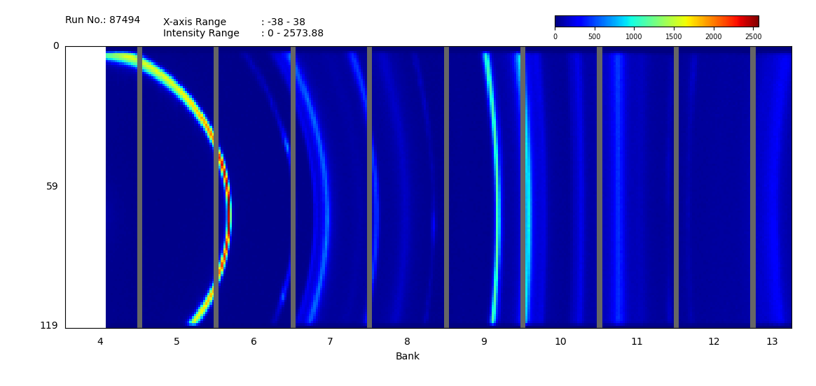
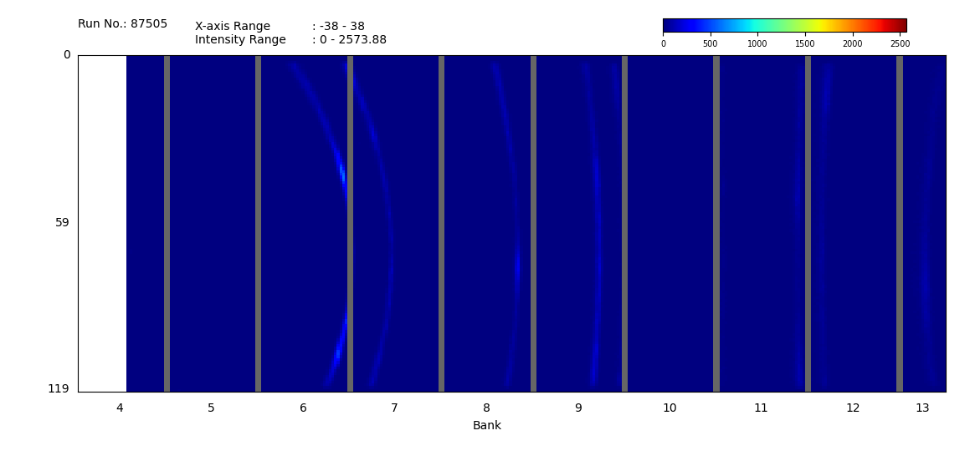
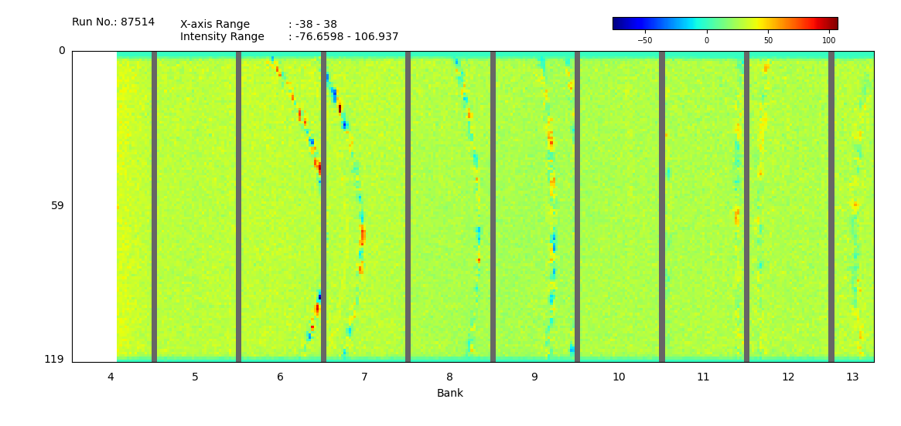
Scattering C.S. measurements
~Result1 (Ein =41.98meV)~
ET-34 (Ein =42meV)
Distribution of detected neutron Position.
(Integral of all scattered neutron energies)
23°
B.G. due to the Al cell
Height
An array of ³He tube detectors
-16°
Vanadium has large incoherent C.S.
Neutrons are scattered isotropically.
->Relative efficiency was deduced.
3°
Vertical Angle
116°
Blank (Ein =42meV)
Vanadium (Ein =42meV)
23°
23°
Height
Height
-16°
-16°
3°
Vertical Angle
116°
3°
Vertical Angle
116°
Notes:
These pictures show the Distribution of detected neutron Position.
That means Sum of all scattered neutron energies.
This ax shows the vertical angle from 3 to 116 degree.
This ax shows the horizontal angle from -16 to 23 degree.
This block shows an array of He-3 tubes.
Due to the support of the detector array, sum vertical angle is missing.
This is a result of graphite sample and this is a result of blank.
As you can see, these are paterns due to Bragg edge and these are B.G. due to the Al cell.
This is a result of vanadium sample.
Vanadium has large incoherent C.S. comparison to the coherent C.S.
Neutrons are scattered isotropically.
Detector efficiency was corrected using the result of the Vanadium measurements.

Slide 20
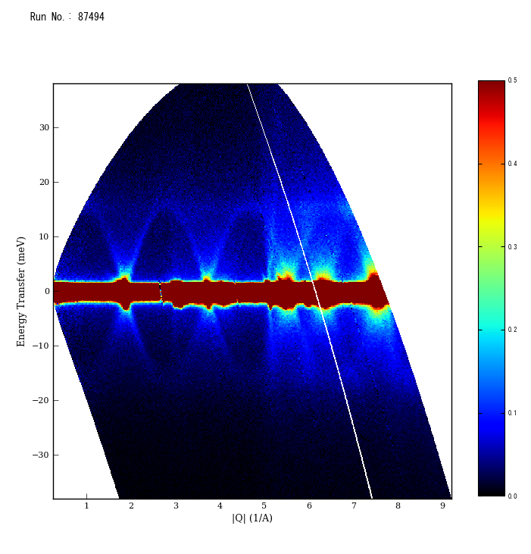
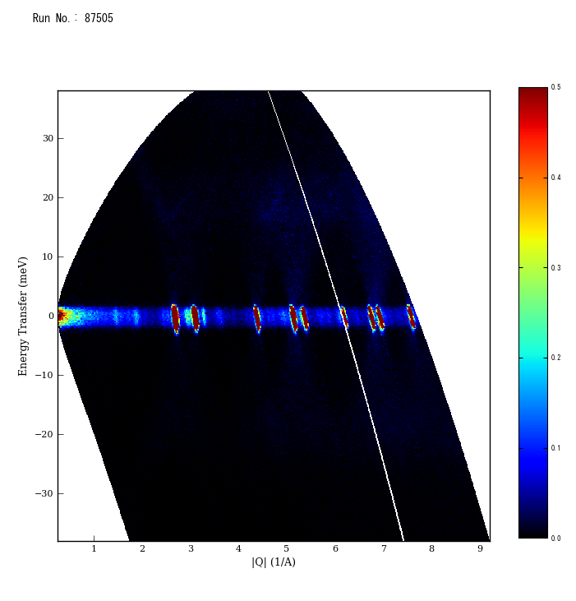
Scattering C.S. measurements
~ Result1 (Ein =41.98meV)~
Q
Eout
2Θ
Ein (wave number)
With considering dead time, neutron detection efficiency of each detector and solid angle, ΔE-Q distribution of each sample was obtained.
ET-34
Blank
30
30
Elastic Scattering
20
20
10
10
Ein-Eout（meV）
0
Ein-Eout（meV）
0
-10
-10
-20
-20
-30
-30
1.5
3
4.5
6
7.5
9
1.5
3
4.5
6
7.5
9
|Q| (1/Å)
|Q| (1/Å)
No detectors
Bragg Edges of graphite and Al are clearly observed.
Notes:
With considering dead time, neutron detection efficiency of each detector and solid angle, ΔE-Q distribution of each sample was obtained.
These graph shows the ΔE-Q distribution of ET-34 and Blank.
X ax shows Q value in other word difference between the wavenumber vector of incident neutrons and the wavenumber vector of scattered neutrons.
Y ax shows E-in minus E-out.
That means if Y ax is positive, neutron loss the energy and if Y ax is negative, neutrons gain energy.
As you can see, Bragg Edges of graphite and Al are clearly observed.

Slide 21
Scattering C.S. measurements
~ Result1 DDSCS of E-34 (Ein =41.98meV)~
0.005
Preliminary
ET-34
30
Subtract Blank from each sample,
Normalized by the vanadium result
-> DDSCS is derived.
0.004
20
10
0.003
Ein-Eout（meV）
Cross Section (b/Sr/meV)
0
0.002
-10
-20
0.001
-30
0.0
1.5
3
4.5
6
7.5
9
|Q| (1/Å)
Notes:
Subtract Blank from each sample,
Normalized by the vanadium result,
DDSCS of each sample was derived.
Elastic and inelastic cross section was obtained.

Slide 22
Elastic C.S. measurements
~ Result1: DDSCS of E-34 (Ein =41.98meV)~
Preliminary
Detailed Analysis for multiple scattering correction and systematic uncertainties is ongoing.
Notes:
To discuss easily, the DDSCS was re-bundled into 6 parts.
From 5 to 20 degree to 100 to 115 degree.
X-ax shows the scattered angle.
Y-ax shows the DDSCS.
The results is shown here.

Slide 23
Elastic C.S. measurements
~ Result1: Temperature dependence (Ein =41.98meV)~
20°~40°
60°~80°
Cross Section (b/Sr/meV)
Energy Transfer (Ein-Eout:meV)
The inelastic scattering cross section decreases with decreasing temperature.
Energy increasing side > Energy loss side.
Notes:
Temperature dependence was shown in these graph.
This side is form 20 to 40degree and this side shows from 60 to 80 degree.
With degreasing the temperature, the inelastic scattering cross section decreases.
Up scattering side is much degreasing comparison to the slowing down side.
This is a reasonable result.

Slide 24
Elastic C.S. measurements
~ Result1: Sample dependence(Ein =41.98meV)~
Sample dependence of the Inelastic C.S.
Preliminary
20°~40°
60°~80°
Cross Section (b/Sr/meV)
Energy Transfer (Ein-Eout:meV)
There’s no clear differences (less than 10%) in inelastic C.S.
Notes:
Sample dependence is shown in these graphs.
This side is form 20 to 40degree and this side shows from 60 to 80 degree.
As you can see, the result of each sample agrees very well.
There’s no clear difference between the samples.
The difference is less than 10 %.

Slide 25
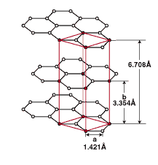
Elastic C.S. measurements
~ Result1: Elastic Cross Section (Ein =41.98meV)~
Preliminary
002
002
101
110
100
112
101
006
004
114
103
In some Bragg edges, cross sections are different between the samples.
-> Discuss later
Notes:
This graph shows the elastic scattering C.S.
This Ax shows scattered angle and this ax shows C.S.
As you can see, many Bragg edges are clearly observed and shape of the Bragg edges are different between the samples.

Slide 26
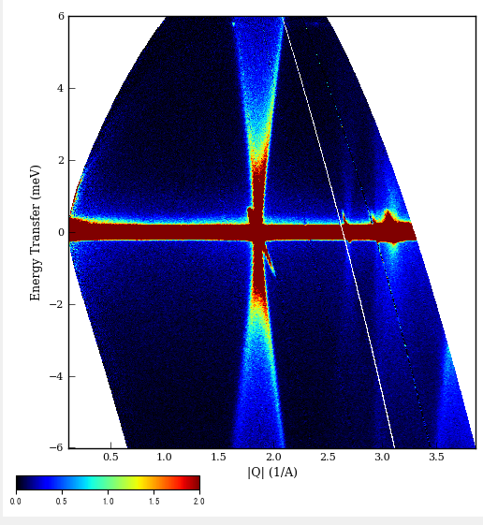
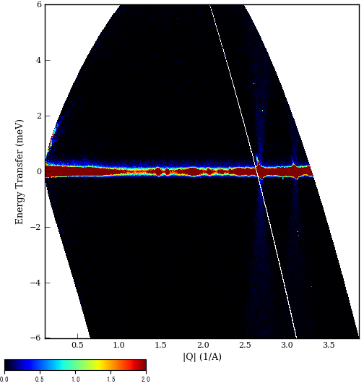
Scattering C.S. measurements
~ Result2 (Ein =7.74meV)~
Q
Eout
2Θ
Ein
ET-34
Bragg Edge(0,0,2)
Blank
Bragg Edges due to the Al cell
6
6
4
4
2
2
Ein-Eout（meV）
Ein-Eout（meV）
0
0
-2
-2
-4
-4
-6
-6
0.5
1
1.5
2
2.5
3
3.5
0.5
1
1.5
2
2.5
3
3.5
|Q| (1/Å)
|Q| (1/ Å)
Dead time, neutron detection efficiency of each detector and solid angle are corrected
Notes:
For neutron incident energy of 7.74 meV, we have done same steps.
These graph shows the ΔE-Q distribution of ET-34 and Blank.

Slide 27
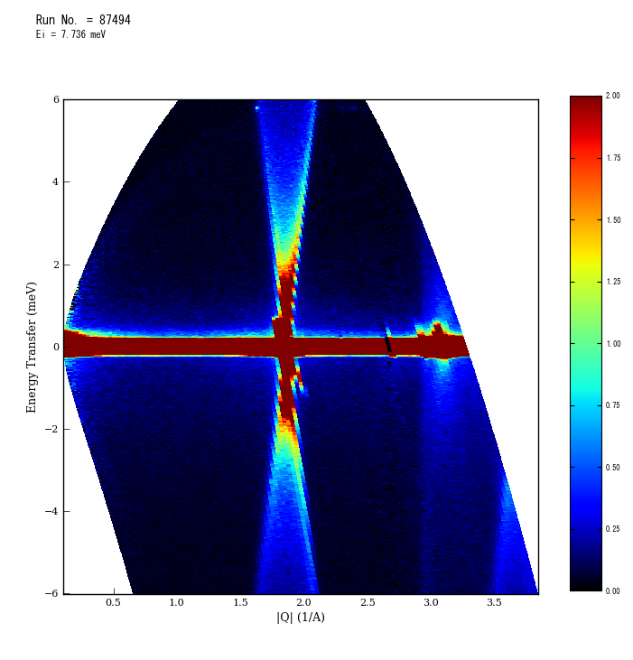
Scattering C.S. measurements
~ Result2 DDSCS of ET-34 (Ein =7.74meV)~
6
2
Preliminary
4
1.5
2
Ein-Eout（meV）
Cross Section (mb/Sr/meV)
0
1
-2
0.5
-4
(0,0,2) Brag edge is clearly observed.
-6
0
0.5
1.0
1.5
2.0
2.5
3.0
3.5
|Q| (1/Å)
Notes:
This graph shows DDSCS of ET-34.
Strong (0,0,2) Bragg edge is clearly observed.

Slide 28
Elastic C.S. measurements
~ Result2: Sample dependence(Ein =7.74meV)~
Preliminary
40°~60°
60°~80°
Cross Section (b/Sr/meV)
Energy Transfer (Ein-Eout:meV)
There’s no clear differences (less than 15%) in inelastic C.S.
Notes:
Sample dependence is shown in these graphs.
This side is form 20 to 40degree and this side shows from 60 to 80 degree.
As same as the results of 41.98meV, the result of each sample agrees very well.
There’s no clear difference between the samples.
The difference is less than 10 %.

Slide 29
Elastic C.S. measurements
~ Result2: Elastic Cross Section (Ein =7.74meV)~
Preliminary
002
002
101
101
Large small angle neutron scattering (SANS) is clearly
observed.
At some Bragg edges, cross sections are different between the samples.
Notes:
This graph shows the elastic scattering C.S.
This Ax shows scattered angle and this ax shows C.S.
As you can see, large small angle neutron scattering (SANS) is clearly observed.
At some Bragg edges, cross sections are different between the samples.

Slide 30
Elastic C.S. measurements
~ Result: Bragg Edge~
 | Grain Size(μm) | Porosity (%)
ET-34 | 15 | 11
ET-10 | 15 | 14
ET-11 | 13 | 15
T-8 | 5 | 9
ED-4 | 1 | 9
(0,0,2)
Ein=7.74meV
(1,0,1)
Ein=7.74meV
Cross Section(b/Sr)
Sharp(High)<------>(Low)Broad
ET-34<ET-10<ET11<T-8<ED-4
This trend seems to depend on the grain size.
(1,1,2)Ein=41.98meV
(1,1,4)Ein=41.98meV
Scattering Angle 2Θ(degree)
Notes:
These graphs show the sample dependence of the elastic C.S. at some Bragg Edges.
Bragg Edge is broadened from ET-34, ET-10<ET11<t-8<ED-4 become broader and broader in that order.
This trend seems to depend on the size of the grain size, but additional experiments and studies are required.

Slide 31
Total C.S. measurement

Slide 32
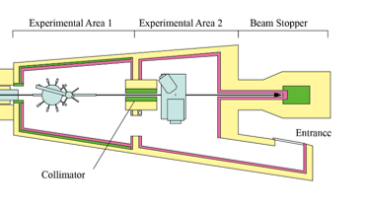
Total C.S. measurements
~Experimental set-up~
J-PARC MLF
BL04 ANNRI
In every 5.2 seconds (130 shot), the first 126 shots were delivered to the MLF, and the other 4 shots were supplied to the hadron facility.
This means that a wide range TOF experiment (200 ms) is possible in every 5.2 seconds.
To Hadron Facility (4shot)
To Hadron (4shot)
Delivered to MLF (126shot)
To MLF (126shot)
・・・・
・・・・
Wide range TOF
Wide range TOF
⁶Li glass detector
Detector: ⁶Li and ⁷Li glass detectors
Sample thickness: 10mm
Measurement time: 12~16hours
Scattered neutrons with scattering angles of less than 0.25°are transmitted.
Sample position
*
Notes:
Total cross section measurement was performed in ANNRI with Li-6 and Li-7 detectors.
Measurement time: 12~16hours.
In-J-PARC, In every 5.2 seconds (130 shot), the first 126 shots were delivered to the MLF, and the other 4 shots were supplied to the hadron facility.
This means that a wide range TOF experiment (200 ms) is possible in every 5.2 seconds.
We used this wide range TOF is used for C.S. measurement.

Slide 33
Total C.S. measurements
~Raw TOF spectrum (dead time corrected)~
10⁻⁵
10⁻⁶
10⁻⁷
10⁻⁸
10⁻⁹
10⁻¹⁰
0
40
80
120
160
200
Triger is created by delaying the previous pulse by 40 ms.
The first shot to MLF is observed here because there is no previous
~120 ms : Data after 40 ms is used as B.G.
160 ms~: Exp + Constant is used as B.G.
γ-ray B.G. was derived from the ⁷Li-glass spectrum.
Notes:
This graph shows TOF spectra with dead time correction.
In ANNRI, Triger is produced from the previous neutron pulse with delaying 40 ms.
Therefore, The first shot to MLF is observed here because there is no previous
In the analysis,
In the TOF range before 120 ms, Data after 40 ms is used as B.G.
After 160 ms, Exp + Constant function is used as B.G.
The parameters were obtained by fitting the spectra from 120 ms to 160 ms.
γ-ray B.G. was derived from the ⁷Li-glass spectrum.

Slide 34
Total C.S. measurements
~Transmission Ratio~
Notes:
After subtracting B.G., Transmission ratio was calculated.
Black line shows the transmission ratio of ET-34 sample and red line shows its uncertainty.
From this ratio, C.S. is calculated.

Slide 35
Total C.S. measurements
~Total C.S.~
Preliminary
Notes:
This graph shows prerliminary C.S. of ET-34 sample with comparison to the deduced uncertainty.
As you can see some Bragg Edge is clearly observed.
However, in the energy range below 10 meV, deduced total C.S. is much higher than the previous measurement by Petriw.

Slide 36
Total C.S. measurements
~Sample dependence~
In the epithermal range (over 40 meV), all samples tended to have same values. Close to the free atom cross-section of graphite.
Preliminary
Under 10 meV, the total cross sections of the samples separate from each other.
⇒Influence of SANS
* * *
Notes:
This graph shows the difference of deduced total C.S.
In the epithermal range (over 40 meV), all samples tended to have values. Close to the free atom cross-section of graphite.
Under 10 meV, the total cross sections of the samples separate from each other.
It’s influence of small angle neutron scattering.

Slide 37
Influence of SANS
Ein＝1.17meV
Cross-section and Q have a linear relationship in Log-Log scale
⇒ Characteristics of SANS
0.7°
7.6°
83°
Q^-3.4
SANS of the samples are very large comparison to the reported experiments [1].
⇒ Caused by the uniformity of the grain size of the isotropic graphite.
Q^-3.6
SANS has very little impact on criticality calculations!!
Scattered neutrons with angles of less than 0.25°are transmitted.
Additional correction is required.
[1] S. Petriw et al., Journal of Nuclear Materials 2010; 396: 181–188.
Notes:
This graph shows elastic C.S. with incident energy of 1.17meV.
As you can see, in Log-Log graph, elastic C.S. has a linear relation ship.
It is a characteristics of SANS.
The difference below 10 meV is considered to be the influence of SANS.
In this setting, Scattered neutrons with angles of less than 0.25°are transmitted.
Additional correction is required.
SANS of isoprtopic graphite samples are very large comparison to the traditional nuclear grade graphite reported by Petriw.
This is due to uniformity of the grain size in the isotropic graphite.
However, fortunately, SANS has very little impact on criticality calculations!!
This is because, neutron energy is not changed (SANS is elastic scattering) and only angle is slightly changed.

Slide 38
Total C.S. measurements
~Around (0,0,2) edge~
(0,0,2)
Ein=7.74meV
Scattering Angle 2Θ(degree)
Shape of the (0,0,2) Bragg Edge varies with the samples.
The ET-34 sample has the sharpest slope, which is consistent with the smallest width in the elastic scattering.
Notes:
This graph shows the total C.S. around (0,0,2) Bragg edge.
Shape of the (0,0,2) Bragg Edge varies with the samples.
As you can see, The ET-34 sample has the sharpest slope.
This graph shows the elastic C.S. around this Bragg Edge.
ET-34 is the smallest width.
These are consistent.

Slide 39
Summary and Future Plans
The total C.S. and DDSCS of isotropic graphite have been performed in the MLF in the J-PARC.
The preliminary DDSCS were derived with nine incident neutron energies ranging from 1.2 to 94 meV.
Large small angle scattering and Bragg edges were observed.
The preliminary total C.S. was derived in the energy region from 1 to 1000 meV.
In the epithermal range, all samples agreed with the free atom cross-section of graphite. In the low-energy region, large SANS were observed.
Detailed analysis for uncertainties and some corrections are ongoing.
Comparisons of our results to calculations will be presented by Dr. Nakayama on Friday.

Slide 40
Thank you for your kind attention.
The present study includes the result of ‘Development of Nuclear Data Evaluation Framework for Innovative Reactor’ founded by the Ministry of Education, Culture, Sports, Science and Technology of Japan.
The neutron experiments at the MLF of the J-PARC were performed under the user programs (Proposal No. 2022B0109, 2022P0301).

Slide 42
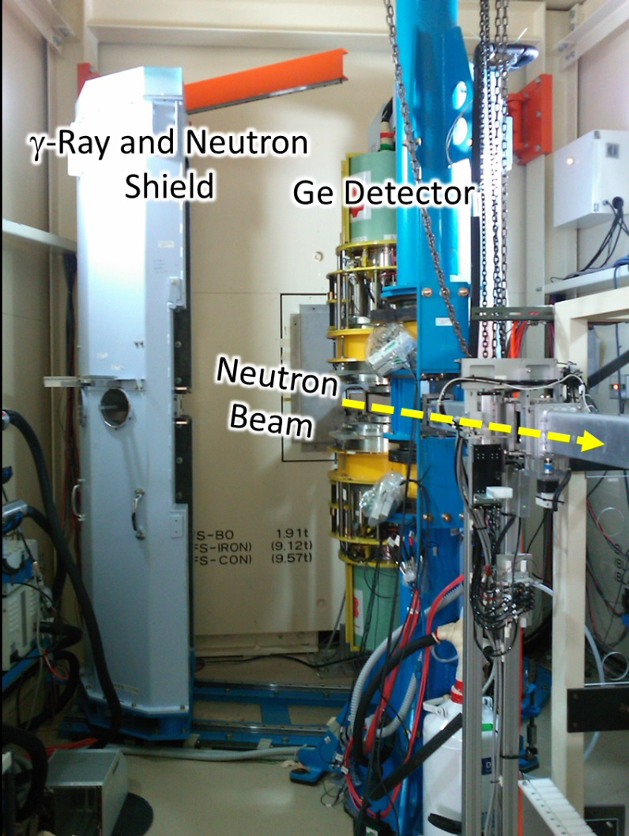
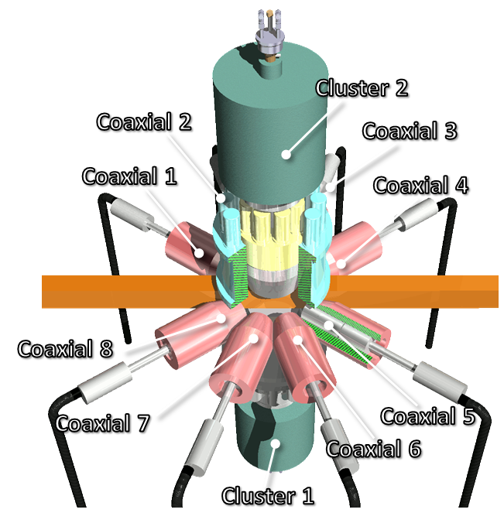
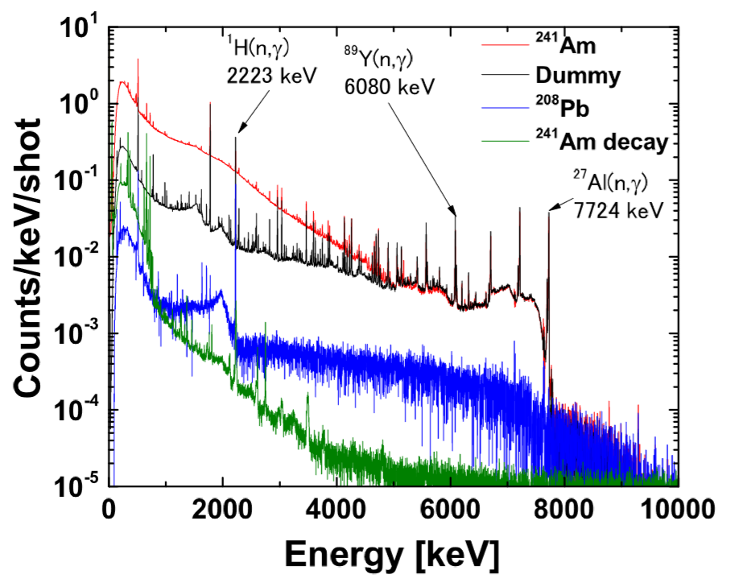
Ge Spectrometer
(FYI)
2 cluster-Ge detectors
(7 Ge crystals are installed in the detector)
8 coaxial-Ge detectors
->Peak efficiency for 1.33MeV γ-rays: 3.64 ± 0.11 %
New DAQ System (CAEN 1724,1720) is installed in 2017.
Measurements of neutron capture cross sections of ^{241,243}Am, ^{137,135}Cs, ^{244,246}Cm and stable isotopes have performed.
TOF spectra for ²⁴³Am Samples

Slide 43
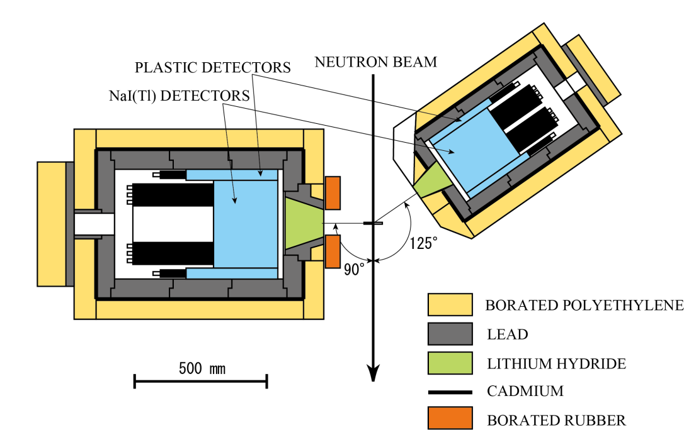
NaI detectors (FYI)
The NaI spectrometer consists of two NaI detectors.
Size: 330 mmϕ 203 mmL 90◦
203 mmϕ 203 mmL 125◦
Surrounded by plastic scintillator.
(The plastic scintillators were used to eliminate events triggered by cosmic rays. )
These scintillators were shielded from background rays and neutrons using the layers of lead, cadmium and borated polyethylene.

Slide 44
Elastic C.S. measurements
~ Result1: Inelastic Cross Section (Ein =41.98meV)~
Ein=41.98 meV
60~80 degree

Slide 45
Elastic C.S. measurements
~ Result1: Inelastic Cross Section (Ein =41.98meV)~
Ein=41.98 meV
60~80 degree

Slide 46
Elastic C.S. measurements
~ Result2: DDSCS of ET-34 (Ein =7.74meV)~
Preliminary
Detailed Analysis for multiple scattering correction and systematic uncertainties was ongoing.

Slide 47
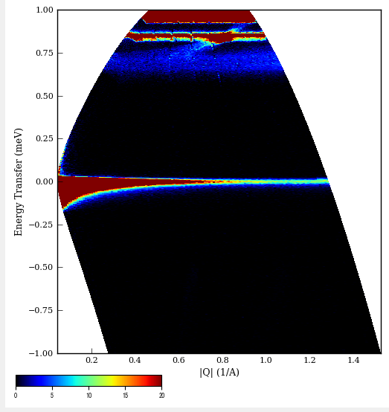
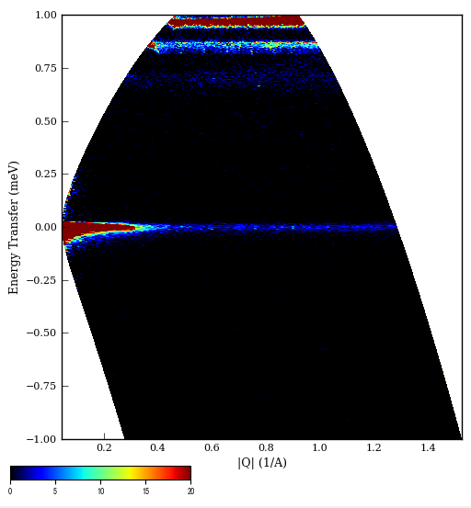
BL14での測定 （Ein＝ 1.17 meV)
ET-34
Blank
別のフレーム
が見えている
Eout
Q
Θ
Ein

Slide 48
各測定におけるBragg Edge の形状
試料依存性
温度依存性（ET-34）
粒径の小さいED-4（1μm）が最小。
ET10≒ET34（15μm）＞ET11（13μm）
温度上昇とともに幅が太く、
散乱角は小さくなる。

Slide 49
BL14での測定（Ein＝ 1.17 meV)
低エネルギーでは小角散乱の影響が大きくなる。

Slide 50
Sample
Elastic Scattering
Ein = 7.74 meV
We have measured 2 ED-4 samples. The results agree very well.

Slide 51
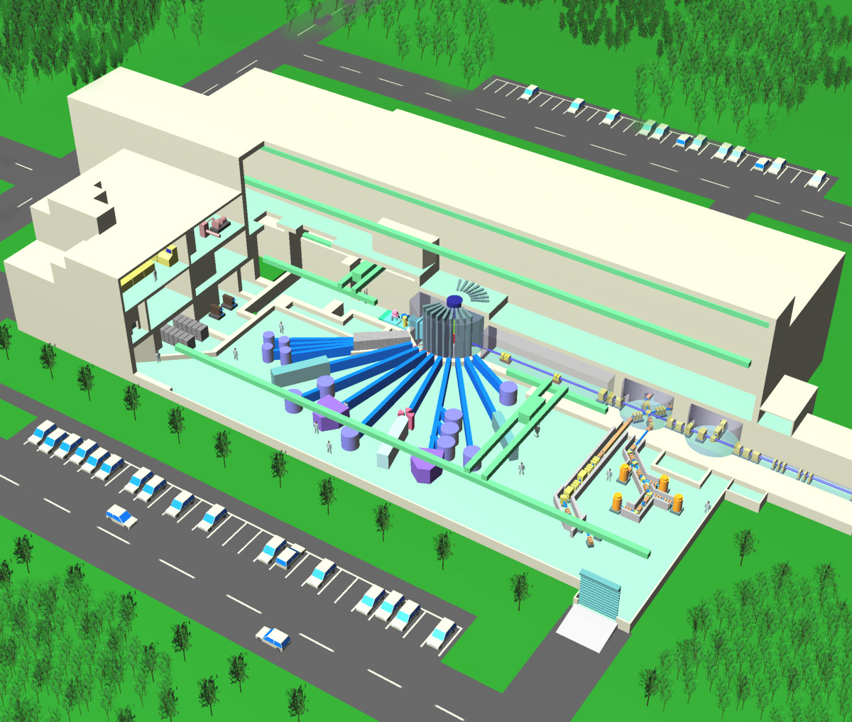
Facility ~Materials and Life Science Experimental Facility: MLF~
Building dimension :
Width : 70m
Length : 146m
Height : 30m
Exp. Hall Height : 22m
Target remote handling room
1MW Spallation Target Station
(Mercury Target)
Cooling systems
(Basement)
Proton beam line
BL04: Nuclear
Data Beam Line
Spallation Mercury target
3GeV,
proton beam
Experimental hall
J-PARC MLF,
Taken from HP of J-PARC

Slide 52
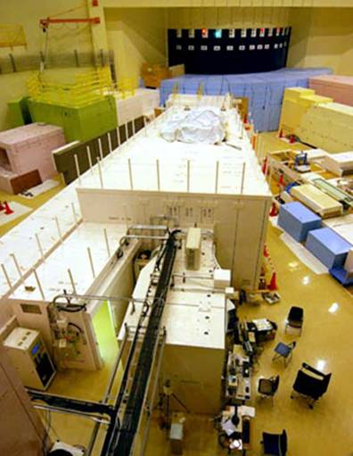
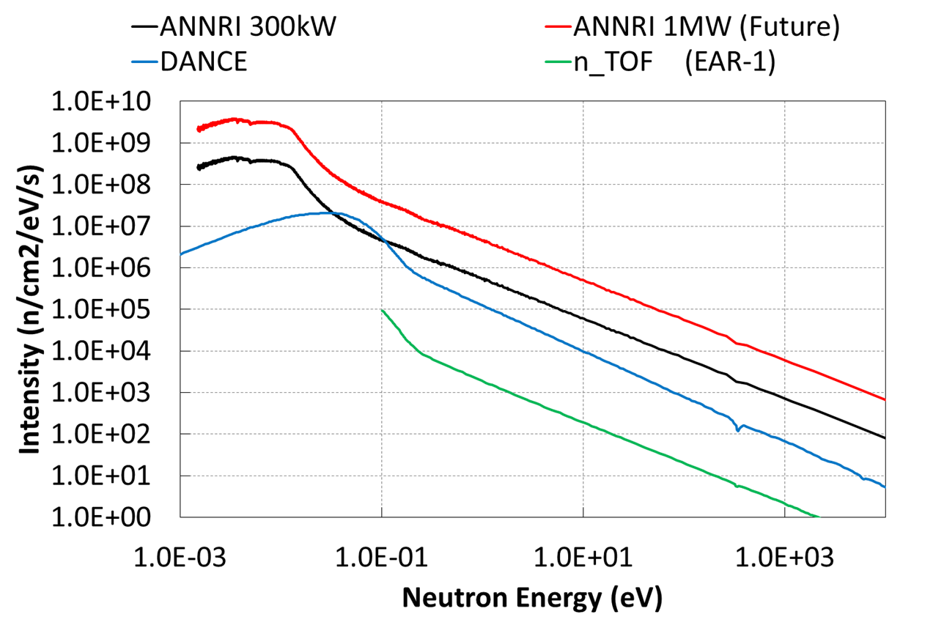
ANNRI (For transmission experiment)
BL04: ANNRI (Accurate Neutron Nucleus Measurement Instrument)
NaI(Tl) Spectrometer
Ge Spectrometer
^{6 and 7}Li Glass detectors
Notes:
First, I’ll show you the outline of ANNRI for transmission experiment
ANNRI is located on Beam Line NO.4 of MLF.
This figure shows a schematic view of ANNRI.
In ANNRI, we have two gamma-ray spectrometers for capture cross section measurements.
One is Ge detector array and the other one is NaI detectors.
Also, Li-Glass detectors for total cross section measurements are also equipped.

Slide 53
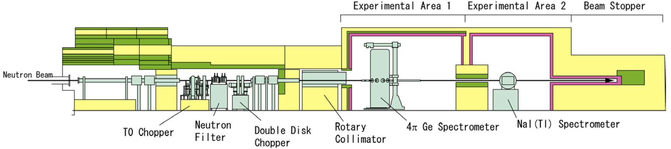
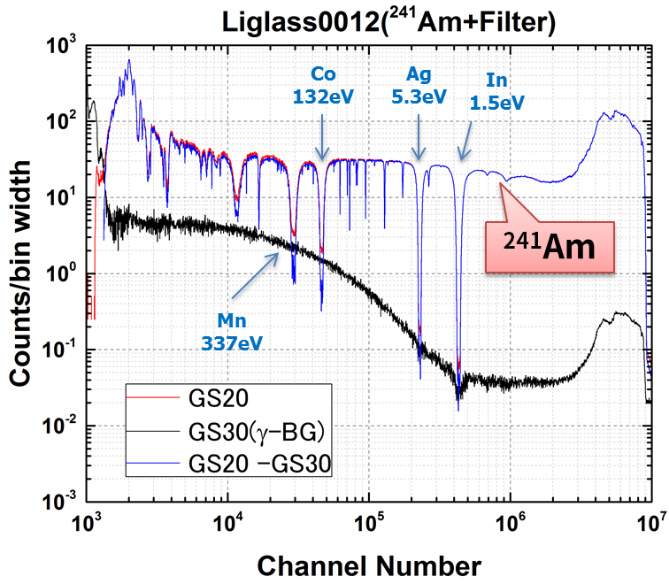
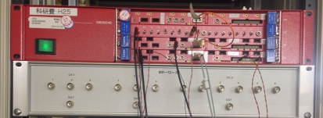
Li Glass detectors for total cross section measurement
Sample
Li-glass detector
A ⁶Li-glass scintillation detector for neutron and a ⁷Li-glass scintillation detector for γ-ray B.G. were installed at the flight length of 28.7m
Measurements of neutron total cross sections of ^{241,243}Am and ^{155,157}Gd have been finished.
DAQ
( CAEN V1720)
TOF spectra for ²⁴¹Am

