Slide 1


Investigation of the structure of ²³⁵U(n_{th},fis) prompt gamma energy spectrum by FIFRELIN
T. OgawA^{1,2}, O.Litaize³, D.Mancusi², A.Chebboubi³, O.Serot³
1, JAEA, Research group for radiation transport and analysis
2, Université Paris-Saclay, CEA, SERMA
3, CEA, DES, IRESNE, DER, Cadarache
Notes:
プレゼン25分、質疑5分。

Slide 2

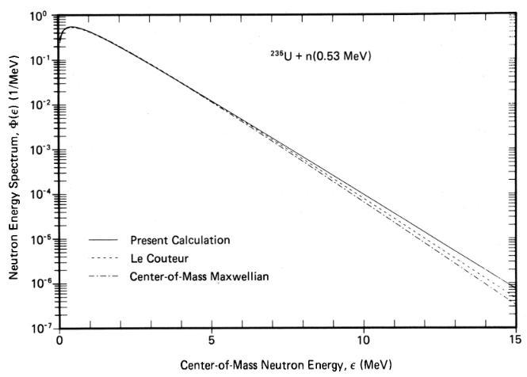

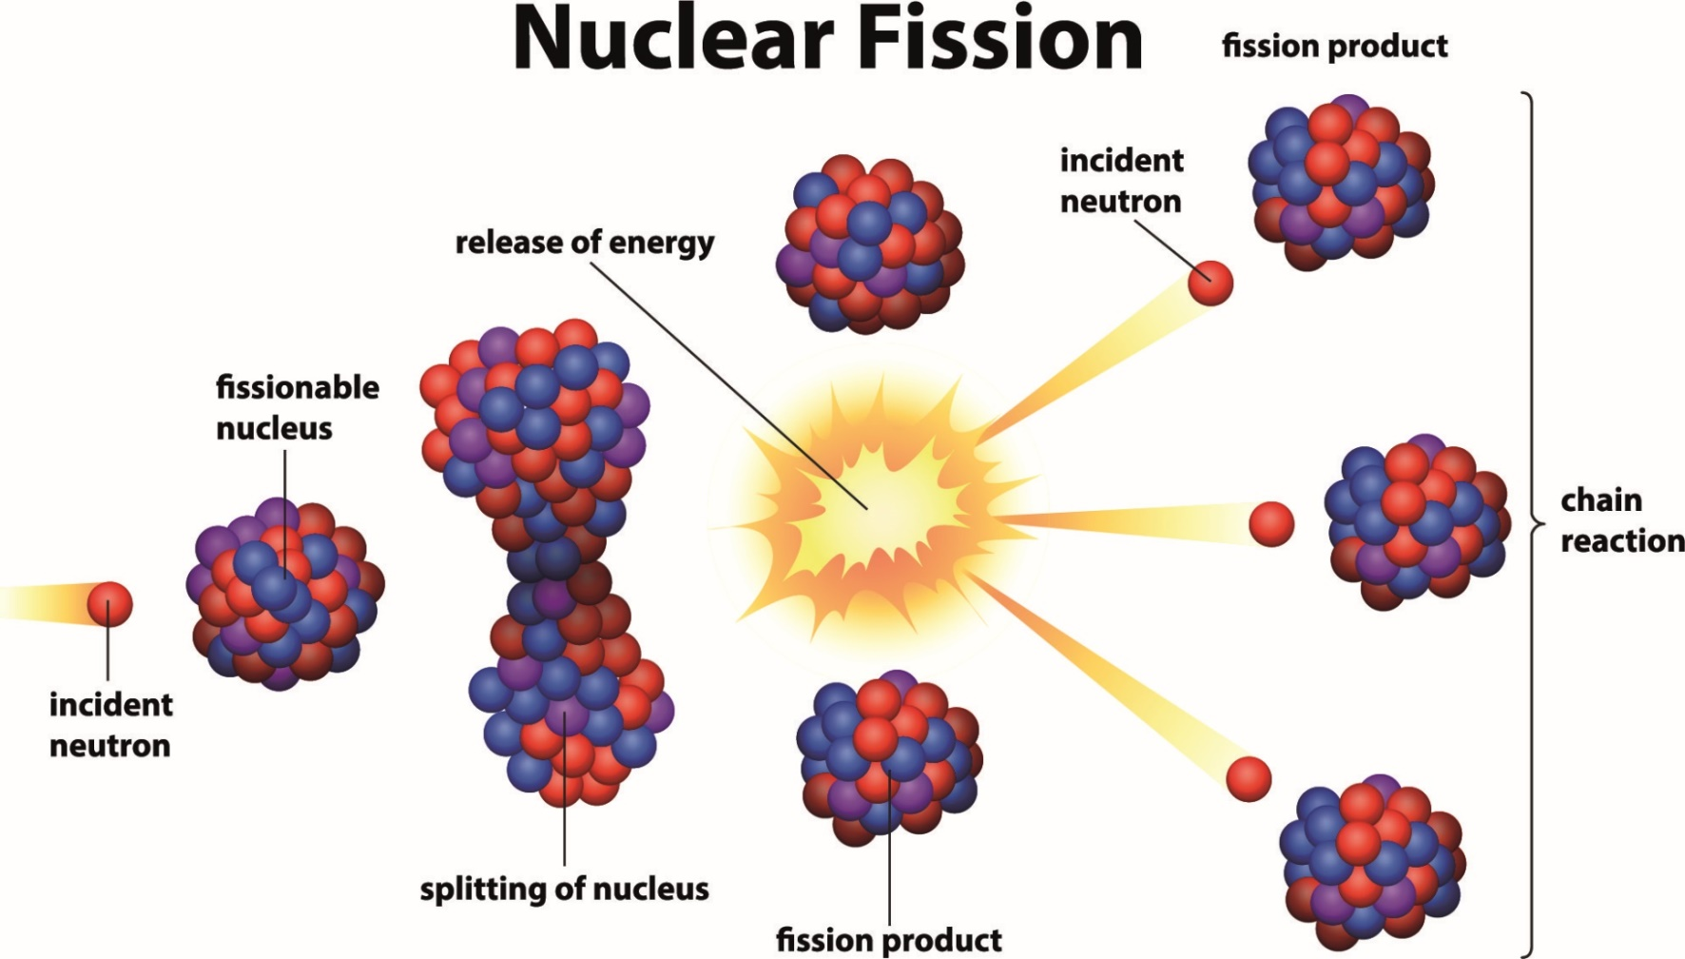
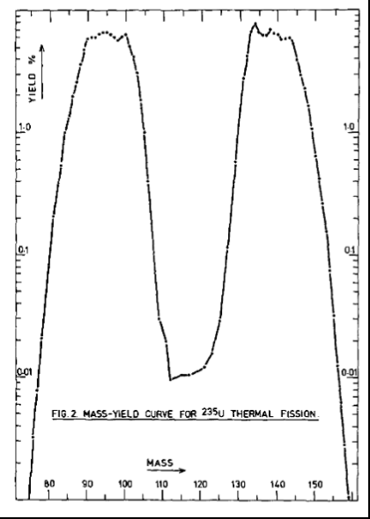
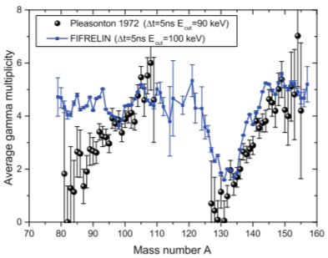

Probes to understand fission
Neutron spectra***
Fission yields**
Gamma multiplicity*
By observing fission with various probes,
we can understand it better
* Olivier Litaize, Olivier Serot, and Léonie Berge, Fission modelling with FIFRELIN , Eur. Phys. J. A (2015) 51: 177
** E. A. C. Crouch, Atomic Data and Nuclear Data Tables, 19, 5, 1977
*** MAD LAND and NIX, NUCLEAR SCIENCE AND ENGINEERING: 81, 213-271 (1982)

Slide 3
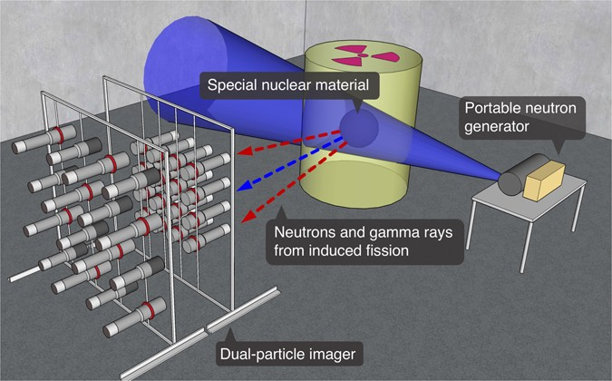
High energy gamma-rays from fission
γ
〇Fundamental Science
Gamma-rays > 10 MeV are likely from
highly-excited fragments immediately after scission
-> Good probe to get insight into scission
γ
Energy
〇Application
Low environmental background in high energy regime
-> Non-desctructive fissile materials assay*
Starting point
~ Some 10 MeV
Barrier
Compound
γ
Fission fragment
* Hamel, M.C., et al. Sci Rep 7, 7997 (2017).

Slide 4
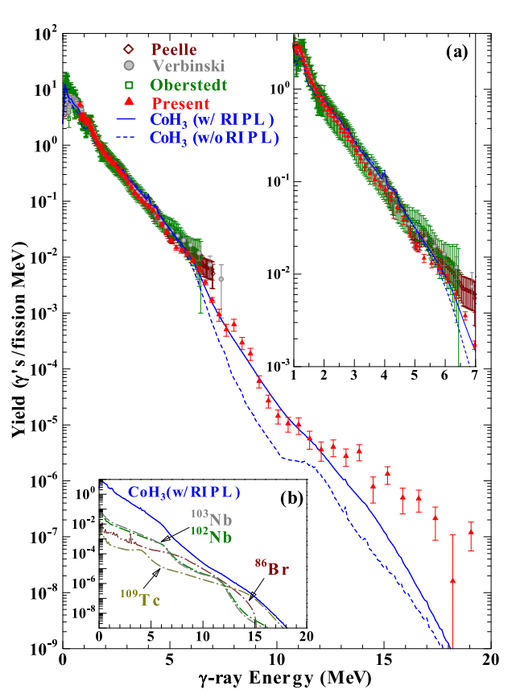
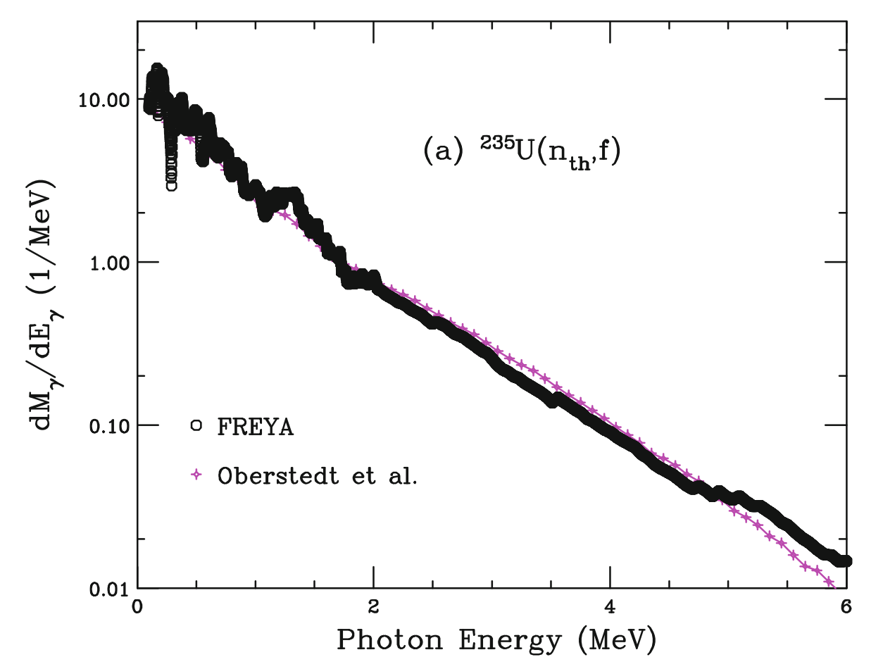
Recent relevant works
²³⁵U(n_{th},fis) gamma-ray measurement in the range E_{γ} = 0.8-20 MeV^{*1}
  Highest energy so far
CoH₃ ^{*2}
  Statistical Hauser-Feshbach reaction simulation code
  Used to simulate gamma spectrum of above study
  Origin of high energy γ-rays is disputable
Other codes (FIFRELIN^{*3}, FREYA^{*4}, GEF^{*5})
  Fission reaction event generator
Cast a light of FIFRELIN to highlight the origin of high-energy gamma
²³⁵U(n_{th},fis) γ spectrum
Comparison with CoH3^{*1, *2}
Comparison with FREYA ***
* H. Makii et al., PHYSICAL REVIEW C, 100, 044610 (2019)
*2 T.Kawano, Springer Proceedings in Physics, 254, 27-34, (2021)
*3 O. Litaize, O. Serot, L. Berge, Eur. Phys. J. A 51(12), 1 (2015)
*4 JM Verbeke, J Randrup, R Vogt, Comp. Phys. Com., 191, 178-202, (2015)
*5 K.H. Schmidt, B. Jurado, C. Amouroux, C. Schmitt, Nucl.Data Sheets 131, 107 (2016).

Slide 5
FIFRELIN is….
Fission reaction model
  Event-by-event calculation
Upgraded in 2021 incorporating…
  Pre-neutron (before n emission) mass yield and kinetic energy of Geltenbort^{*1}
  The latest Wahl Zp model^{*2} to determine fission fragment charge
  RIPL-2021 nuclear structure data and
  AME-2020 nuclear mass table ^{*3}
  γ/IC decay model update
  BRICC code^{*4} to calculate internal conversion
0, Bynary fission is assumed
1, Sample Z, A, and E_{kin} from given distribution or systematics
2, Sample J from Exp[ -(J+0.5)²/(2σ)²]
3, Determin rotational E* as ℏ²J(J+1)/2I
4, Determin intricsic E* by dividing the rest of energy assuming E* ∝ aT²
γ
Features relevant to gamma emission
γ
n
Statistical decay by Hauser-Feshbach
(level scheme + partial width)
*1 P. Geltenbort, F. Gonnenwein, A. Oed, Radiat. Effects 93(1–4), 57(1986).
*2 A.C. Wahl, Technical Report 1168, IAEA - TECDOC Series, (2000)
*3 Capote et al. , Nuclear Data Sheets, 110(12):3107–3214, dec 2009.
*4 T. Kibedi, T. Burrows, M. Trzhaskovskaya, P. Davidson, C.Nestor, Nucl. Instrum. Methods Phys. Res. Sect. A. 589(2), 202 (2008).
RIPL, HFB (or CGCM) model

Slide 6
Results

Slide 7
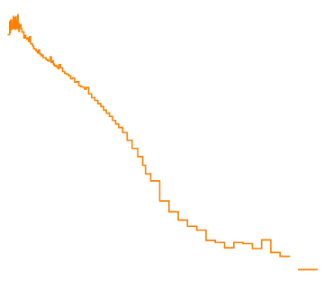
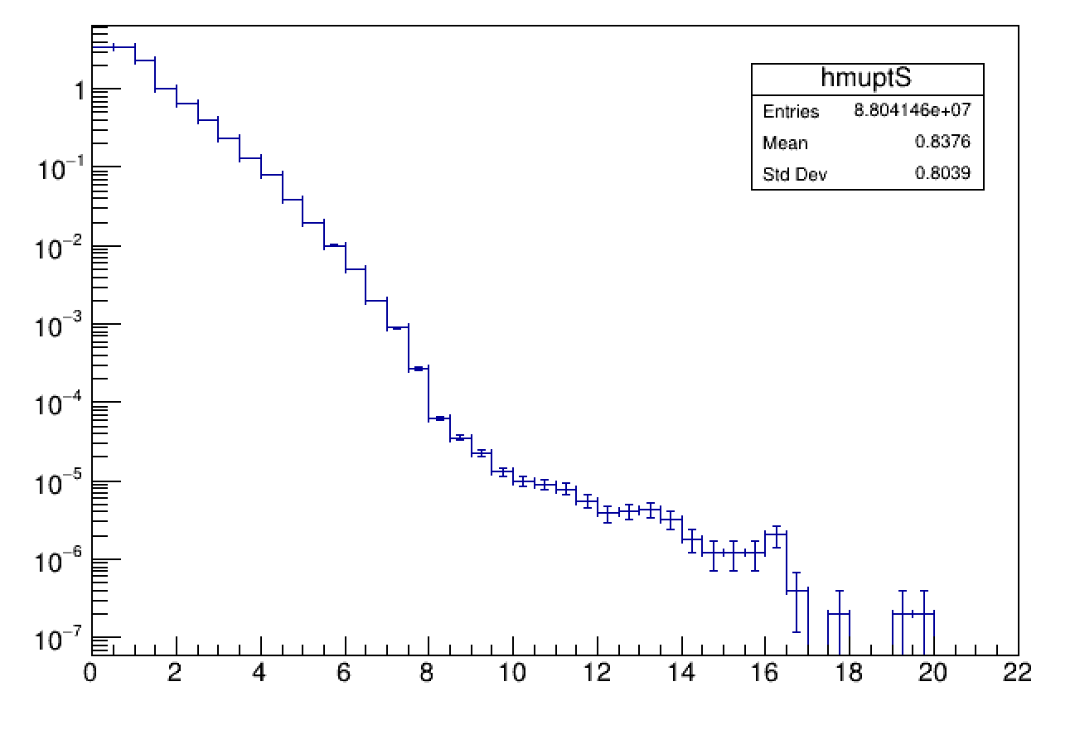
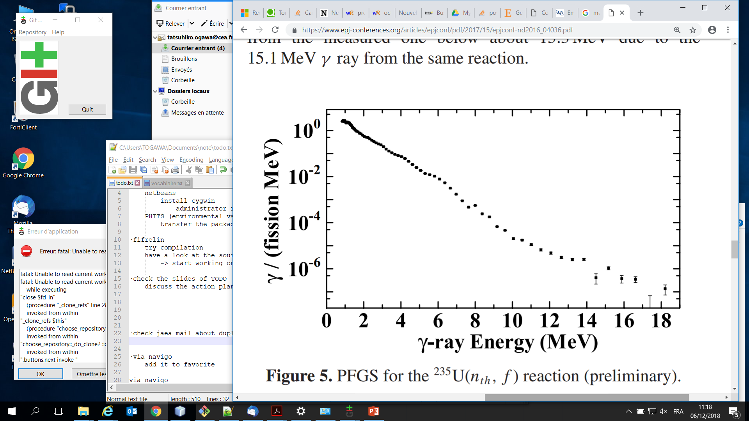
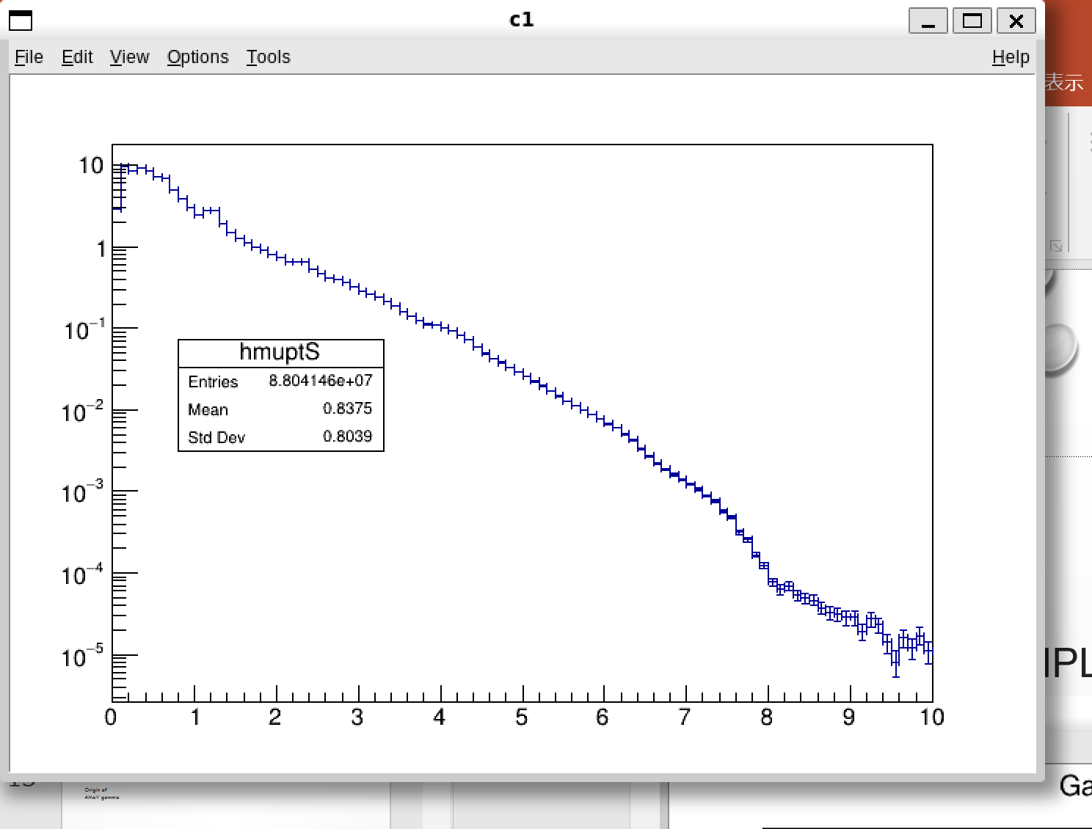
Gamma-ray spectra
TChain* tree2=new TChain("tree0")
tree0->Add("U235HFB_April2023seedB_fifrelin_ArbreMCALL.root")
tree0->Add("U235T_HFB2_cp_R32021_updateApril2023_fifrelin_ArbreMCALL.root")
TChain* tree2=new TChain("tree0")
tree0->Add("U235_CGCM_April2023_seedB_fifrelin_ArbreMC_ALL.root")
tree0->Add("U235_CGCM_UpdateAvril2023_fifrelin_ArbreMCALL.root")
Gamma spectrum in lab frame
Measurement(Makii et al.)
FIFRELIN2021
FIFRELIN2018
CoH3 (with RIPL)
CoH3 (without RIPL)
Without RIPL :
Used systematics instead of RIPL,
for bound state level scheme
〇 Measurement and FIFRELIN
All data are in good agreement up to 8MeV.
FIFRELIN-2018 and CoH₃ underestimated beyond 8 MeV
Except the dip abound 9 MeV, FIFRELIN-2021 agrees globally
〇 Features of spectra
Bump near 4 MeV
Shoulder at 8 MeV
Tail beyond 10 MeV
bump
Measurement(Makii et al.*)
FIFRELIN-2021
FIFRELIN-2018
CoH₃ (in Makii’s paper*)
shoulder
Yield (gamma/MeV/fission)
Gamma yield (/MeV/fission)
tail
Identify their origins
by FIFRELIN
Energy (MeV)
Energy (MeV)
* H. Makii et al., PHYSICAL REVIEW C, 100, 044610 (2019)

Slide 8
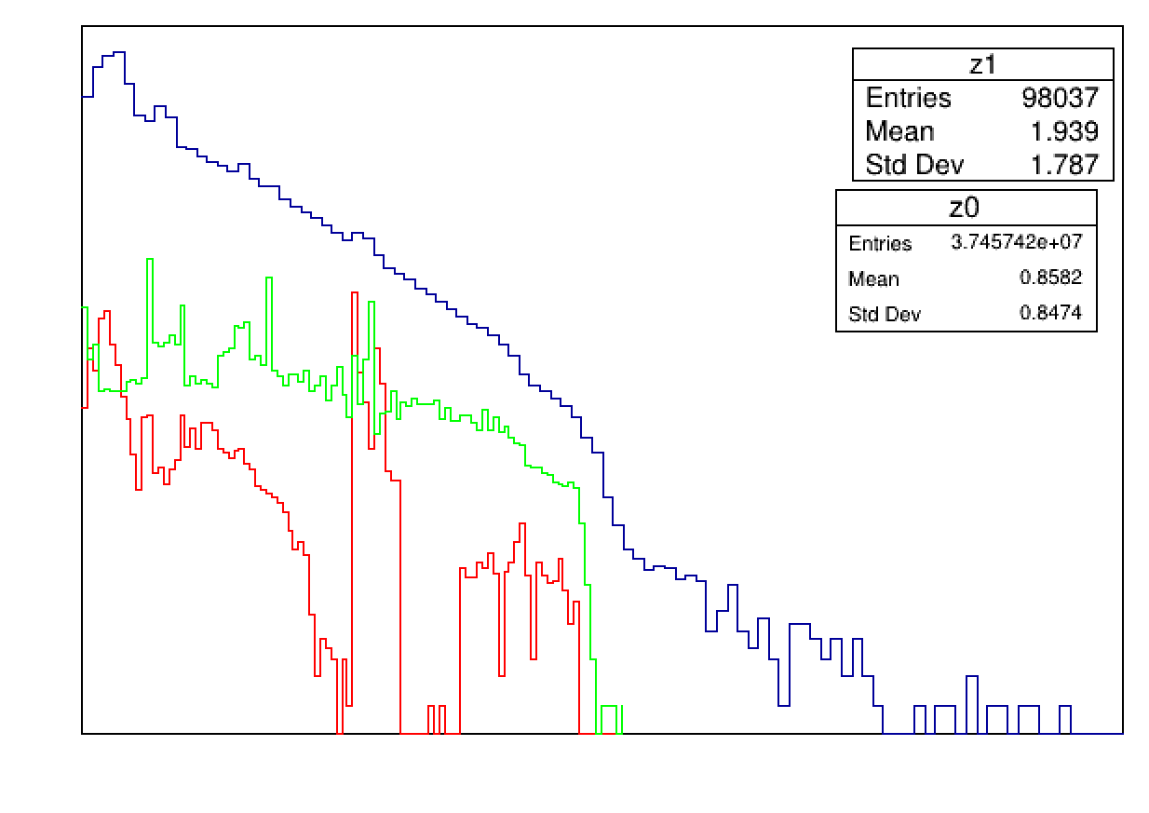
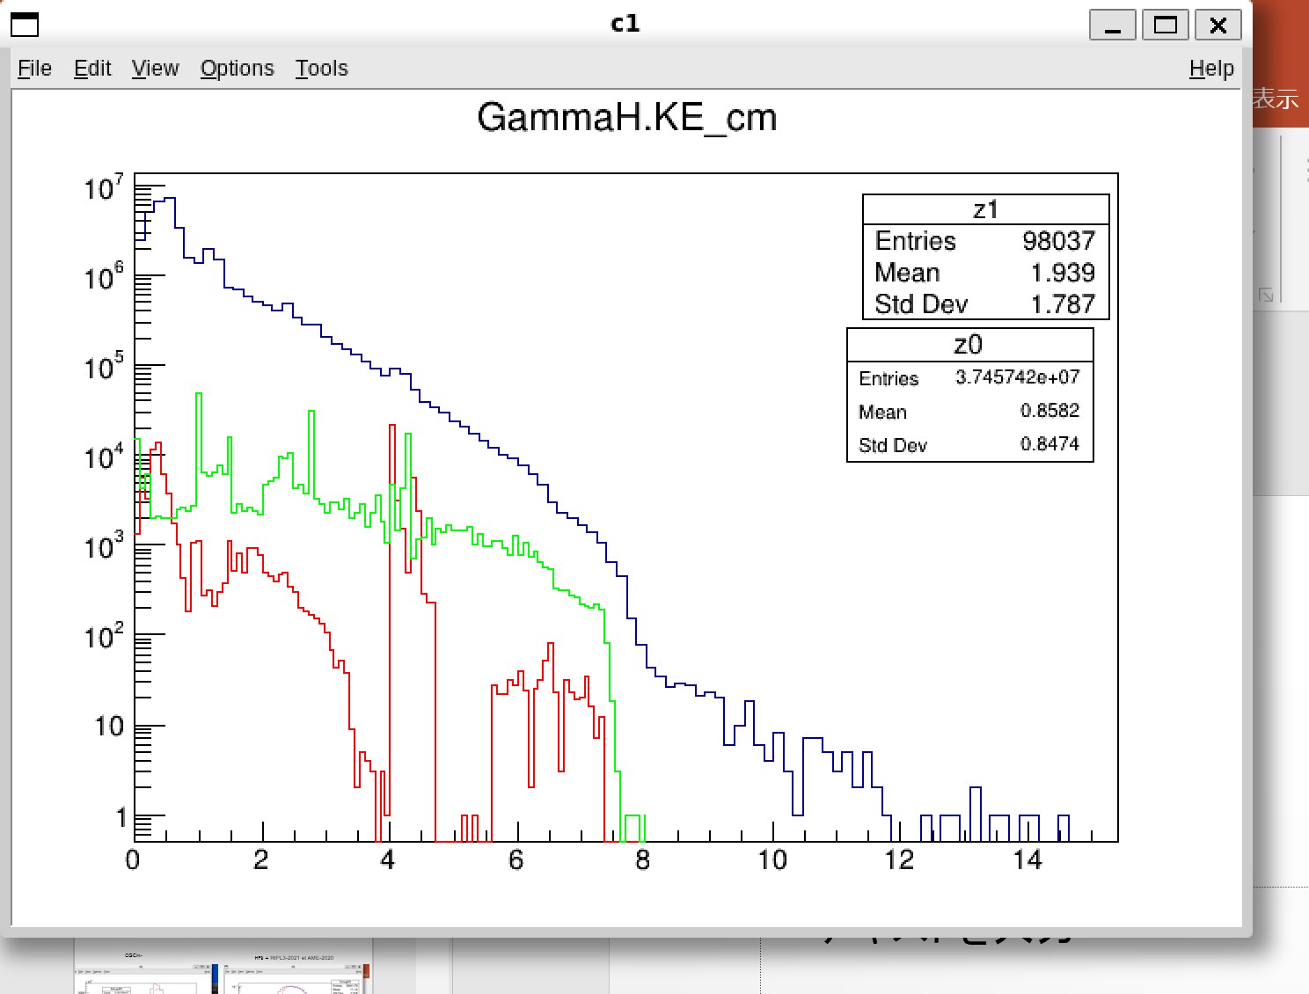
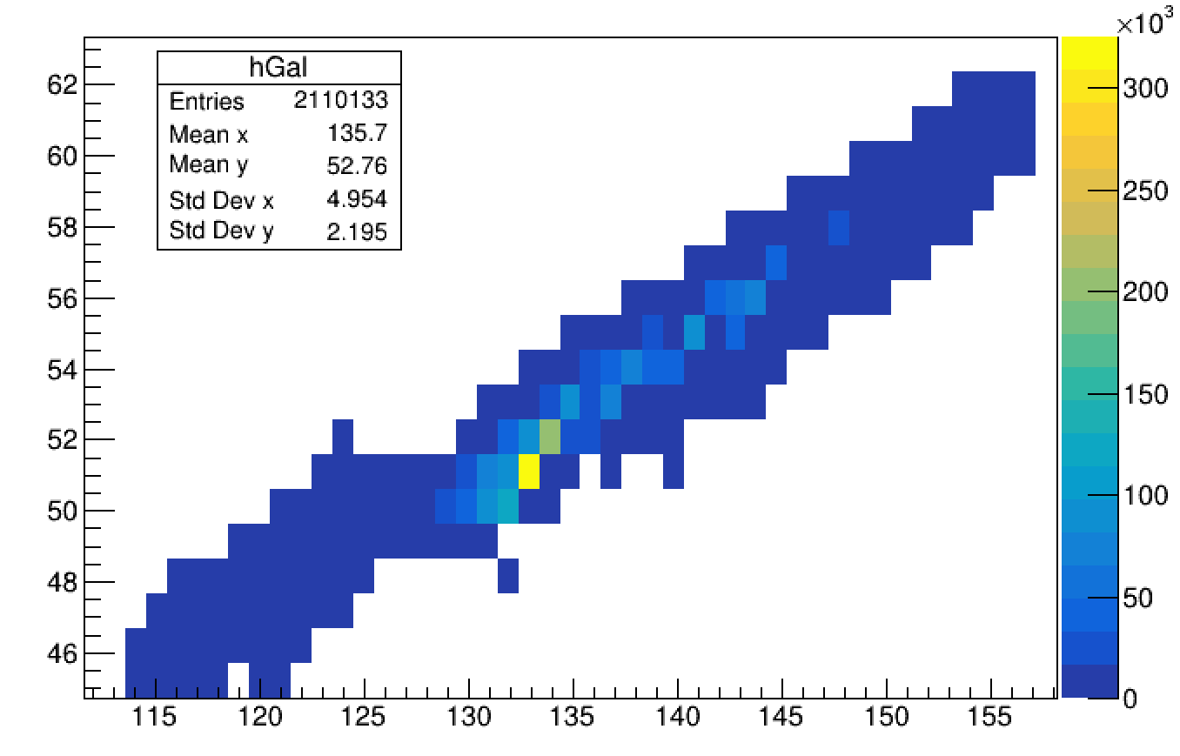
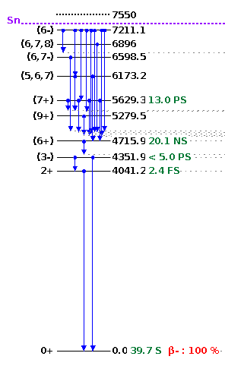
Bump around 4 MeV
Gamma spectrum in fragments’ frame
Nuclei responsible for gammas 3.8-4.5MeV
10⁰
10⁻¹
10⁻²
Sb-133
Heavy fragment
10⁻³
Gamma yield (/MeV/fission)
Atomic Number
10⁻⁴
10⁻⁵
Sn-132
Sb-133
10⁻⁶
Sn-132
10⁻⁷
2
4
6
8
10
12
14
16
Energy (MeV)
Mass number
The bump around 4 MeV, seen as a bump, is a fingerprint of Sn-132 and Sb-133
They have few states below ~4 MeV owing to their closed shells -> Emit 4MeV gamma
Sn-132 states
Notes:
tree0->Draw("GammaH.KE_cm>>z0","","AH")
tree0->Draw("GammaH.KE_cm>>z1","FragmentH_Post.Mass==132&FragmentH_Post.Charge==50","same")
tree0->Draw("GammaH.KE_cm>>z2","FragmentH_Post.Mass==133&FragmentH_Post.Charge==51","same")
z1->SetLineColor(2)
z2->SetLineColor(3)
gPad->SetLogy(1)
tree0->Draw(“FragmentH_Post.Charge:FragmentH_Post.Mass>>hGal(100,71,170,50,31,80)”,“GammaH.KE>3.8&&GammaH.KE<4.5", “colz")

Slide 9
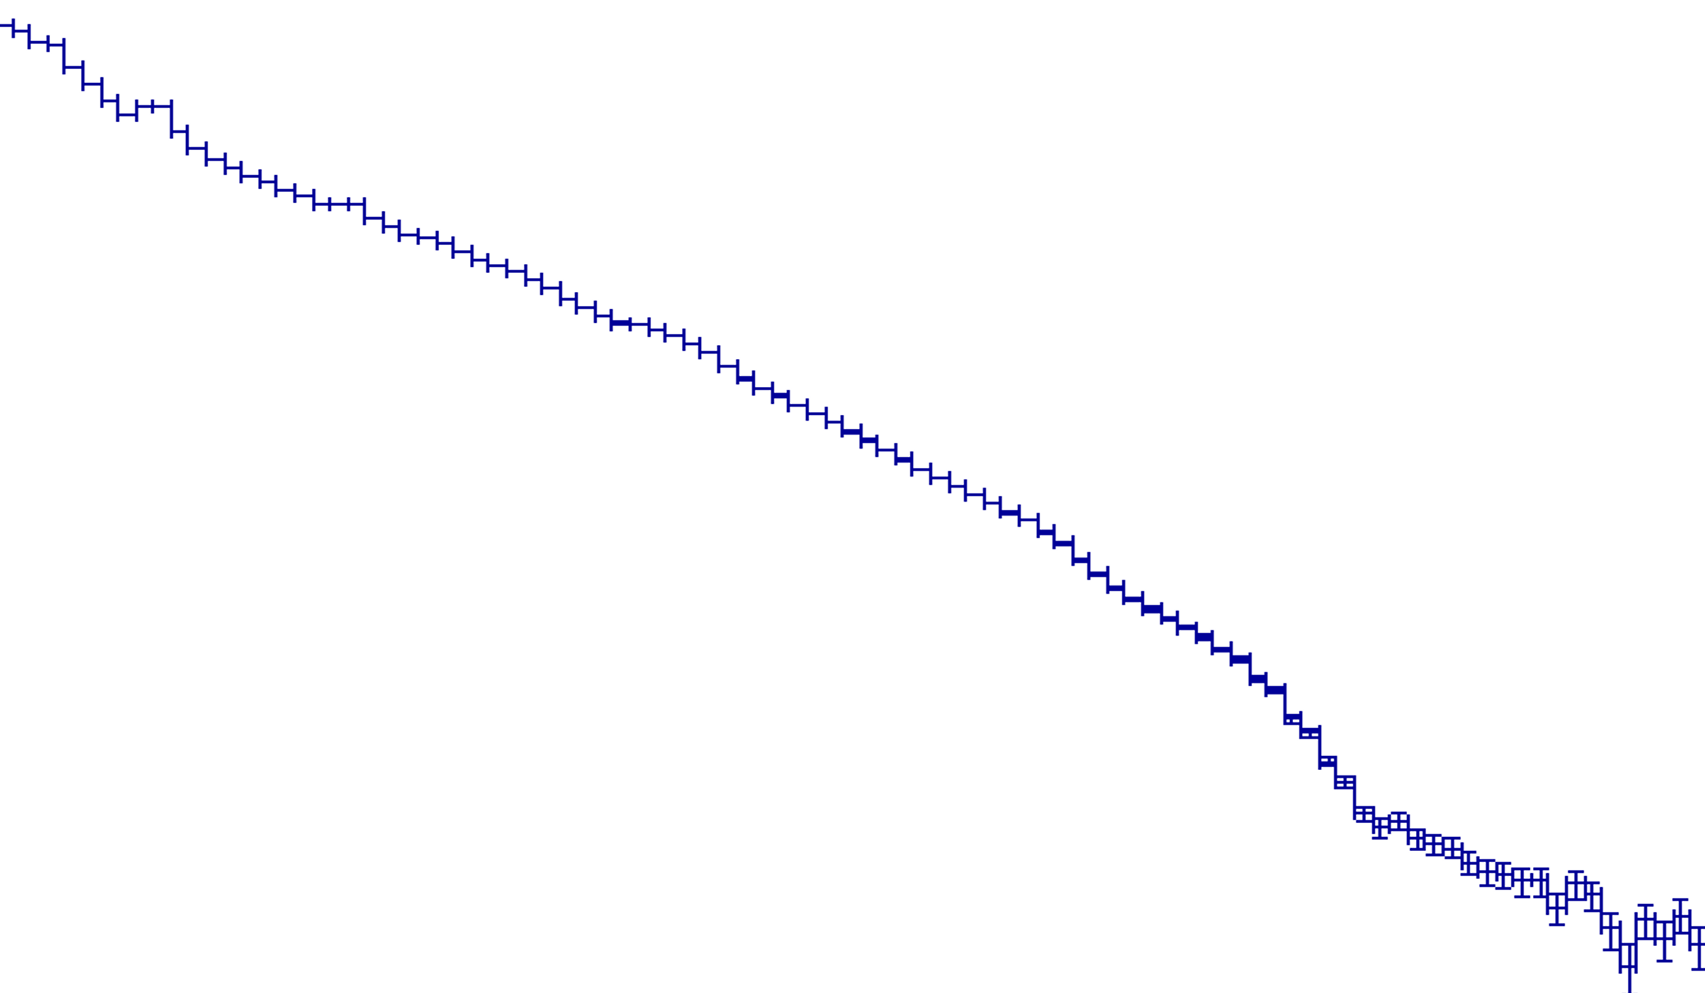
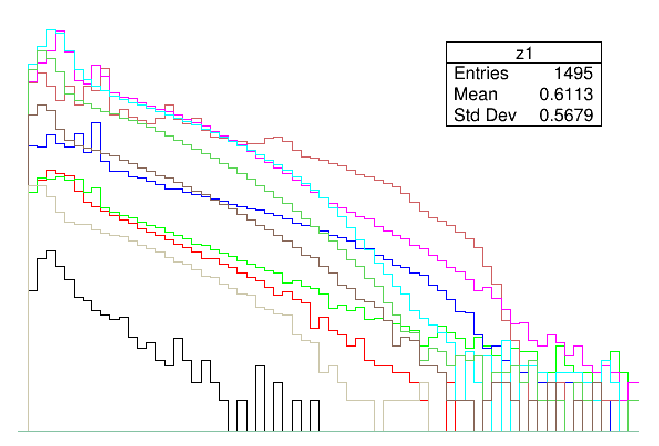

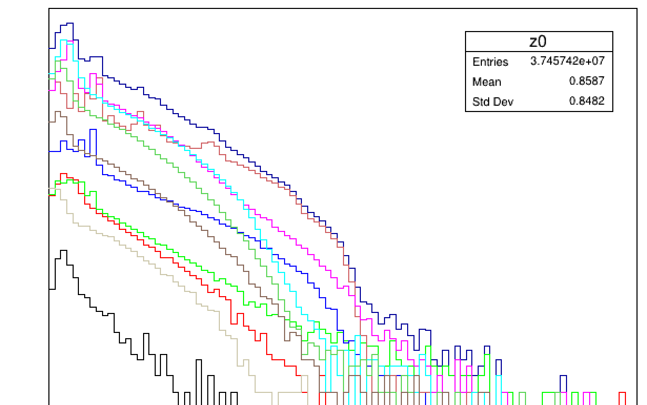
Shoulder at 8 MeV
tree0->Draw("GammaH.KE>>z0","","AH")
tree0->Draw("GammaH.KE>>z1","FragmentH_Post.Mass>=110&FragmentH_Post.Mass<115","same")
tree0->Draw("GammaH.KE>>z2","FragmentH_Post.Mass>=115&FragmentH_Post.Mass<120","same")
tree0->Draw("GammaH.KE>>z3","FragmentH_Post.Mass>=120&FragmentH_Post.Mass<125","same")
tree0->Draw("GammaH.KE>>z4","FragmentH_Post.Mass>=125&FragmentH_Post.Mass<130","same")
tree0->Draw("GammaH.KE>>z5","FragmentH_Post.Mass>=130&FragmentH_Post.Mass<135","same")
tree0->Draw("GammaH.KE>>z6","FragmentH_Post.Mass>=135&FragmentH_Post.Mass<140","same")
tree0->Draw("GammaH.KE>>z7","FragmentH_Post.Mass>=140&FragmentH_Post.Mass<145","same")
tree0->Draw("GammaH.KE>>z8","FragmentH_Post.Mass>=145&FragmentH_Post.Mass<150","same")
tree0->Draw("GammaH.KE>>z9","FragmentH_Post.Mass>=150&FragmentH_Post.Mass<155","same")
tree0->Draw("GammaH.KE>>z10","FragmentH_Post.Mass>=155&FragmentH_Post.Mass<160","same")
tree0->Draw("GammaH.KE>>z11","FragmentH_Post.Mass>=160&FragmentH_Post.Mass<165","same")
z1->SetLineColor(1)
z2->SetLineColor(2)
z3->SetLineColor(3)
z4->SetLineColor(4)
z5->SetLineColor(46)
z6->SetLineColor(6)
z7->SetLineColor(7)
z8->SetLineColor(8)
z9->SetLineColor(28)
z10->SetLineColor(20)
z11->SetLineColor(30)
gPad->SetLogy(1)
Gamma spectra from FF within 5 mass units (lab frame)
Shoulder comes from A = 130-134 nuclei
  Despite mass yield less than 3.2%
Low level density owing to closed shells → direct leap from E≃7.35 to ground state
Total
10⁰
A=130-134
10⁻¹
A=135-139
10⁻²
A=140-144
10⁻³
E(MeV)
Gamma yield (/MeV/fission)
A=125-129
10⁻⁴
Unbound continuum state
10⁻⁵
7.35
Sparce discrete states
10⁻⁶
4.04
→Little chance
to caught up
10⁻⁷
2
4
6
8
10
0
J
Energy (MeV)
Sn-132
Very interesting. Previous ‘historic’ works from Glassel 1989 ( Nuclear Physics A502 1989 p 315) or Hotzel 1996 ( Z. Phys. A 356, 299–308 (1996)) could be mentioned … ok it was about Cf252 but high energy tail for symmetric fission is compared with asymmetric splits. Quite comparable to this work.
10⁰
Heavy Total
10⁻¹
A=130-134
A=135-139
10⁻²
A=140-144
10⁻³
Gamma yield (/MeV/fission)
A=125-129
10⁻⁴
10⁻⁵
10⁻⁶
10⁻⁷
2
4
6
8
10
12
14
16
Energy (MeV)

Slide 10
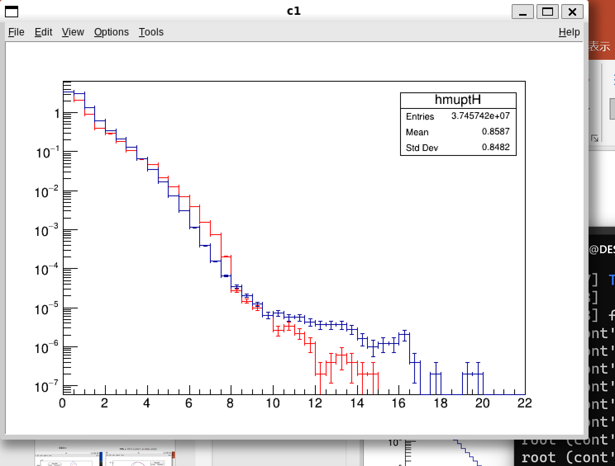





Where are High Energy γ-rays from? heavier fragments or lighter fragments
Gamma spectra (lab frame)
Light fragments tend to take away more excitation energy
Around closed shell (Z=50 & N = 82), nucleus is spherical → low temperature
Light fragments take more excitation energy
10⁰
10⁻¹
$$\frac{T_{L}^{}}{T_{H}^{}}$$
$$\frac{E_{L}^{∗}}{E_{H}^{∗}}=\frac{a_{L}T_{L}^{2}}{a_{H}T_{H}^{2}}$$
10⁻²
1
10⁻³
≳1
Gamma yield (/MeV/fission)
$${A_{CN}^{}}/2$$
$$132$$
$$A_{H}^{}$$
10⁻⁴
10⁻⁵
Light fragments
10⁻⁶
Heavy fragments
10⁻⁷
0
2
4
6
8
10
12
14
16
18
20
22
Energy (MeV)

Slide 11
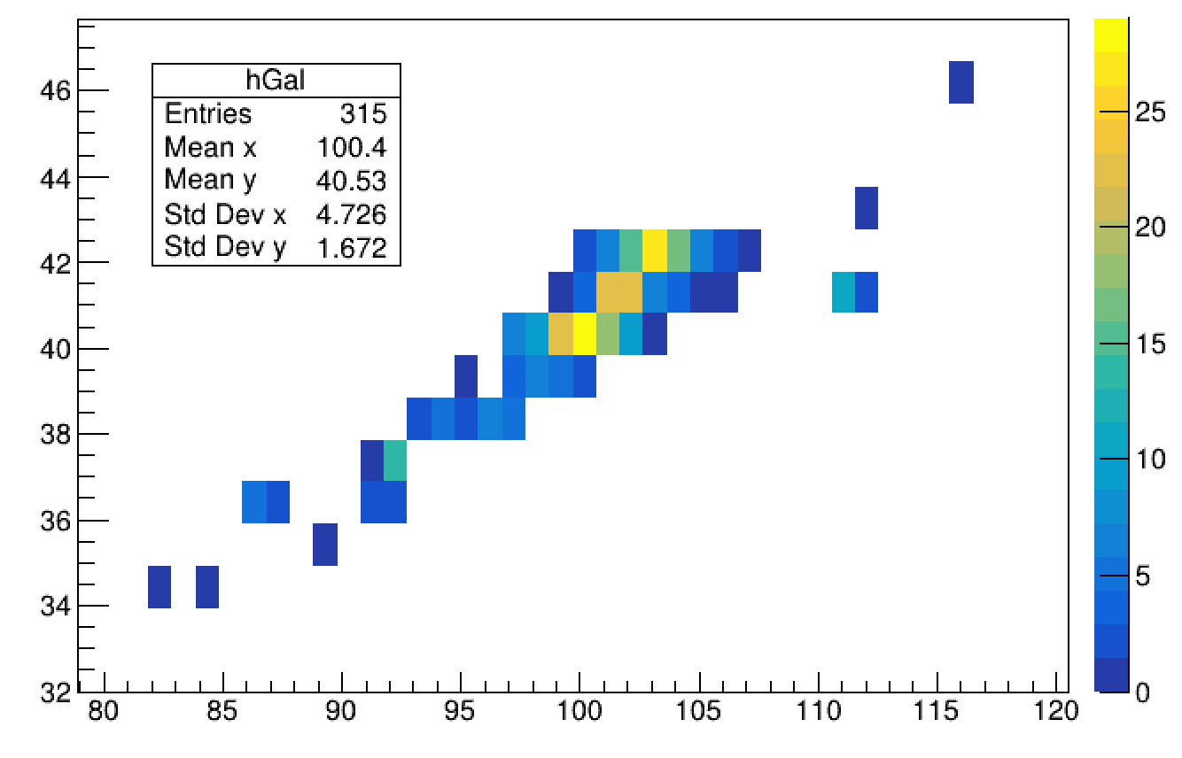
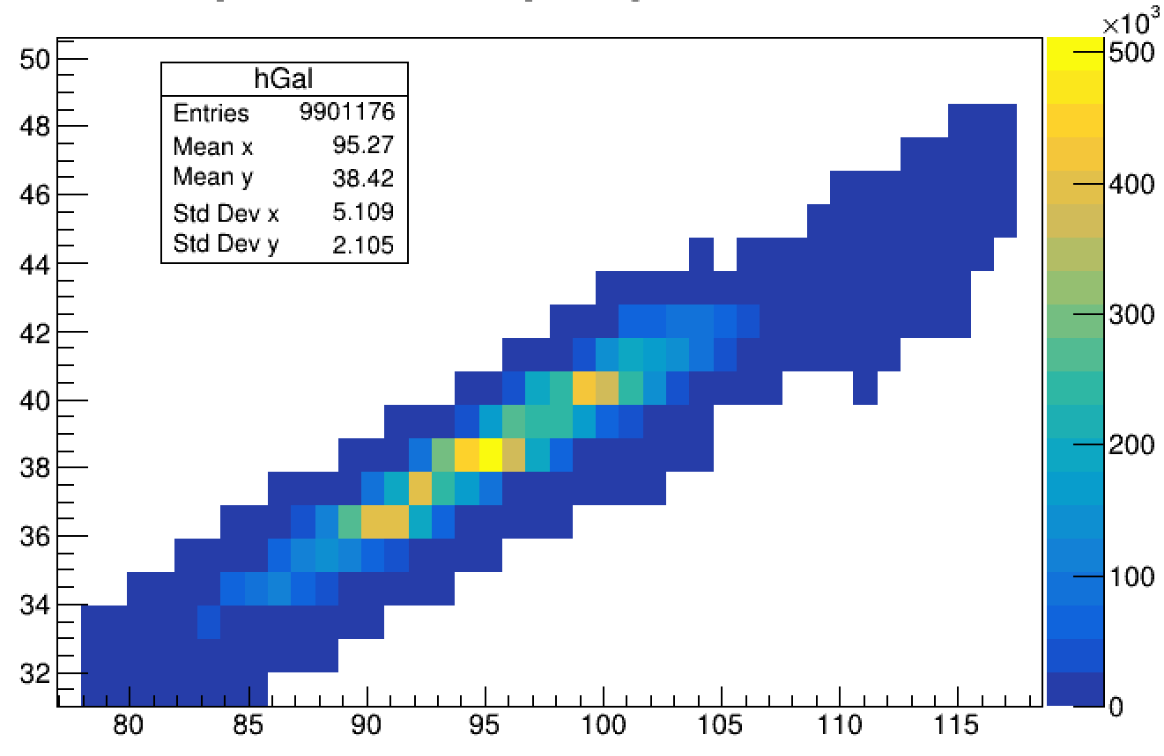
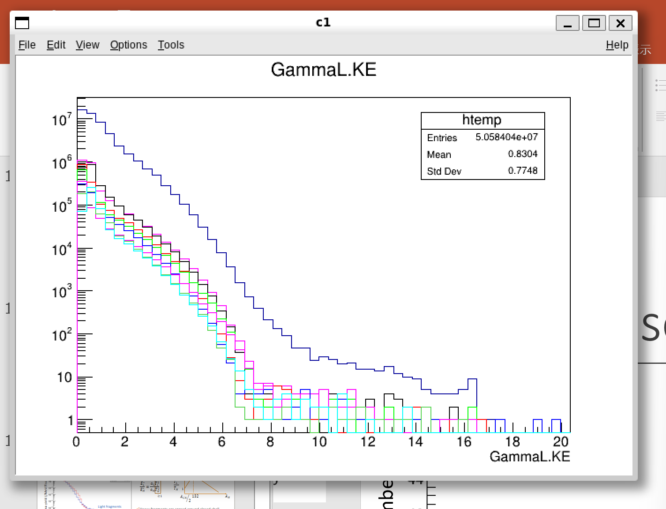
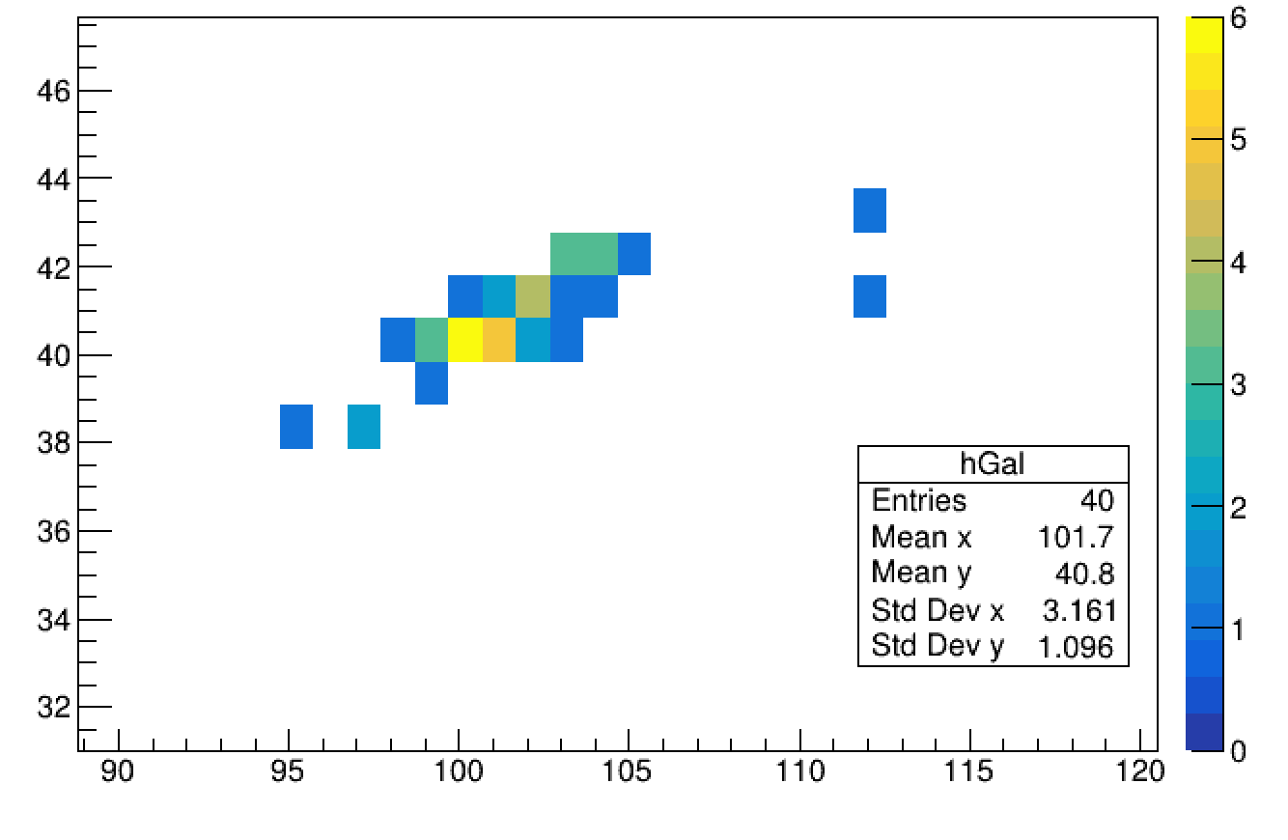
Which isotopes are high E γ-rays from?
>9 MeV gamma rays
Nb-101,2
Mo-103
tree0->Draw("GammaL.KE","","")
tree0->Draw("GammaL.KE>>z1","FragmentL_Post.Mass==99&FragmentL_Post.Charge==40","same")
tree0->Draw("GammaL.KE>>z2","FragmentL_Post.Mass==100&FragmentL_Post.Charge==40","same")
tree0->Draw("GammaL.KE>>z3","FragmentL_Post.Mass==101&FragmentL_Post.Charge==40","same")
tree0->Draw("GammaL.KE>>z4","FragmentL_Post.Mass==101&FragmentL_Post.Charge==41","same")
tree0->Draw("GammaL.KE>>z5","FragmentL_Post.Mass==102&FragmentL_Post.Charge==41","same")
tree0->Draw("GammaL.KE>>z6","FragmentL_Post.Mass==102&FragmentL_Post.Charge==42","same")
tree0->Draw("GammaL.KE>>z7","FragmentL_Post.Mass==103&FragmentL_Post.Charge==42","same")
tree0->Draw("GammaL.KE>>z8","FragmentL_Post.Mass==104&FragmentL_Post.Charge==42","same")
z1->SetLineColor(1)
z2->SetLineColor(2)
z3->SetLineColor(3)
z4->SetLineColor(4)
z5->SetLineColor(5)
z6->SetLineColor(7)
z7->SetLineColor(8)
z8->SetLineColor(9)
gPad->SetLogy(1)
Atomic Number
Fragment abandance (Light fragment. No filtering)
Zr-100
2x10⁻¹
2x10⁻²
Contributors
> 9MeV
2x10⁻³
Light nuclei total
Mass Number
2x10⁻⁴
Atomic Number
Gamma yield(/MeV/fission)
2x10⁻⁵
⁹⁹⁻¹⁰¹Zr,
¹⁰¹⁻¹⁰²Nb,
¹⁰²⁻¹⁰⁴Mo,
>14 MeV
2x10⁻⁶
2x10⁻⁷
2x10⁻⁸
0
2
4
6
8
10
12
14
16
18
20
Energy (MeV)
Mass Number
tree0->Draw("FragmentL_Post.Charge:FragmentL_Post.Mass","","colz")
tree0->Draw("FragmentL_Post.Charge:FragmentL_Post.Mass","GammaL.KE>9","colz")
tree0->Draw("FragmentL_Post.Charge:FragmentL_Post.Mass","GammaL.KE>14","colz")
Light fragments around A≈100 are the source of high energy γ-rays
Zr-100
Gamma yield (/MeV/fission)
Energy (MeV)

Slide 12
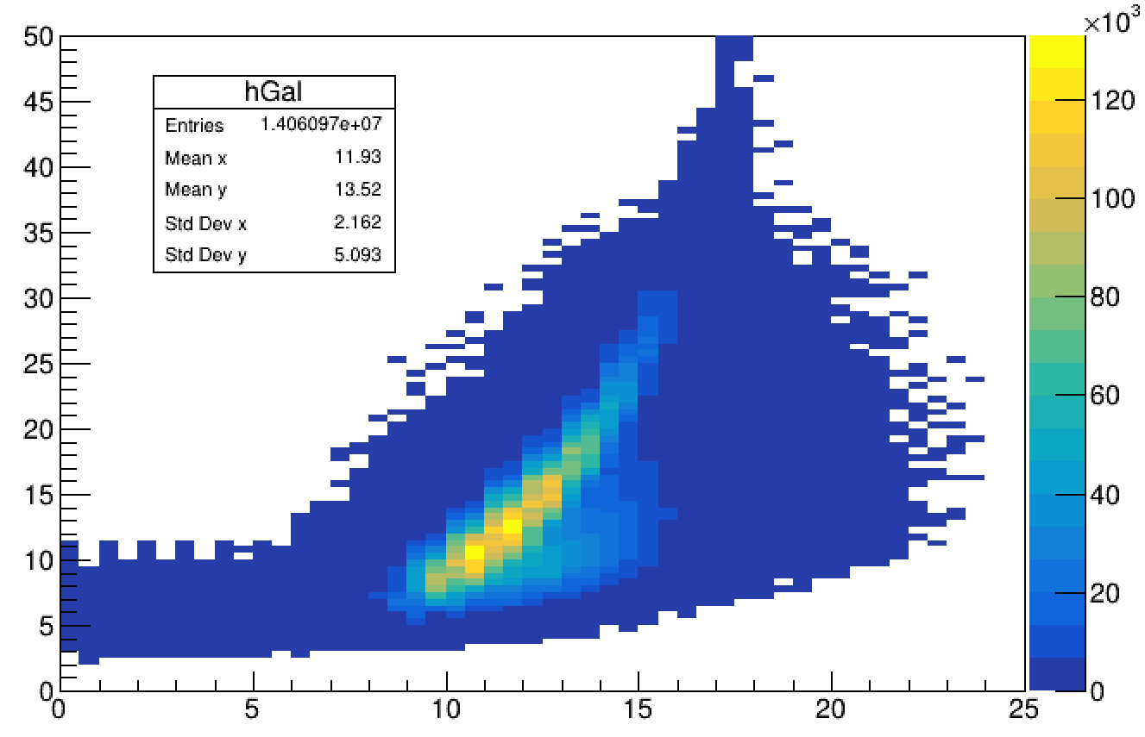
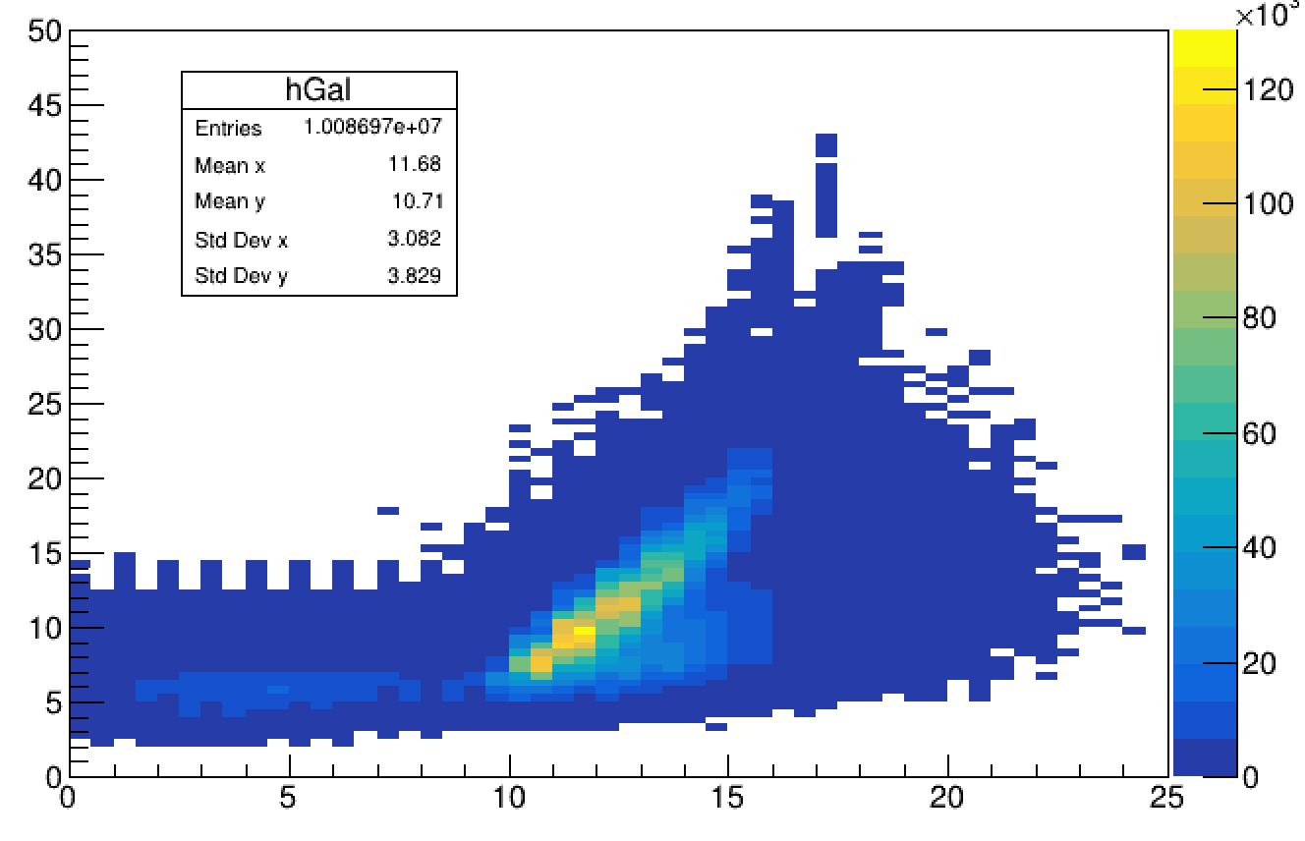
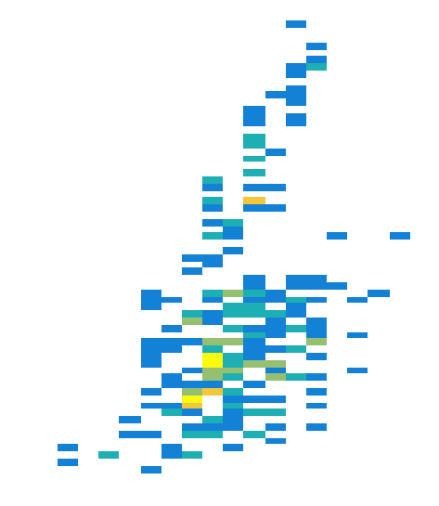
Where are High Energy γ-rays from?
Spin / Excitation energy of contributors
Light Fragments
Heavy Fragments
Source of gammas > 9MeV
Source of gammas > 9MeV
Excitation energy (MeV)
Excitation energy (MeV)
Excitation energy (MeV)
Spin (ℏ)
Spin (ℏ)
Spin (ℏ)
Light fragments have higher excitation energy
Origin of high energy gammas is skewed towards high spin fragments
Notes:
tree0->Draw("NeutronCascadeL.EI:NeutronCascadeL.JI>>hGal(50,0,25,100,0,50)","","colz")
tree0->Draw("NeutronCascadeH.EI:NeutronCascadeH.JI>>hGal(50,0,25,100,0,50)","","colz")
tree0->Draw("NeutronCascadeL.EI:NeutronCascadeL.JI>>hGal(50,0,25,100,0,50)","GammaL.KE>9","colz")

Slide 13
How High J states emit high E γ-rays?
Typical histories of high E γ-ray emission
High E γ-rays are
  first γ after scission
  Followed by a neutron emission
  Further followed by γ/e emissions along Yrast line
What’s important for high E γ-rays are
  n/γ competition by HF deexcitation model
  Level density at energy ~10 MeV and J ~15 ℏ
  HFB model is used here (not RIPL database)
If neutron first, no chance for gamma to be high energy
γ
Excitation energy (MeV)
γ
n
n
e-
Spin (ℏ)

Slide 14
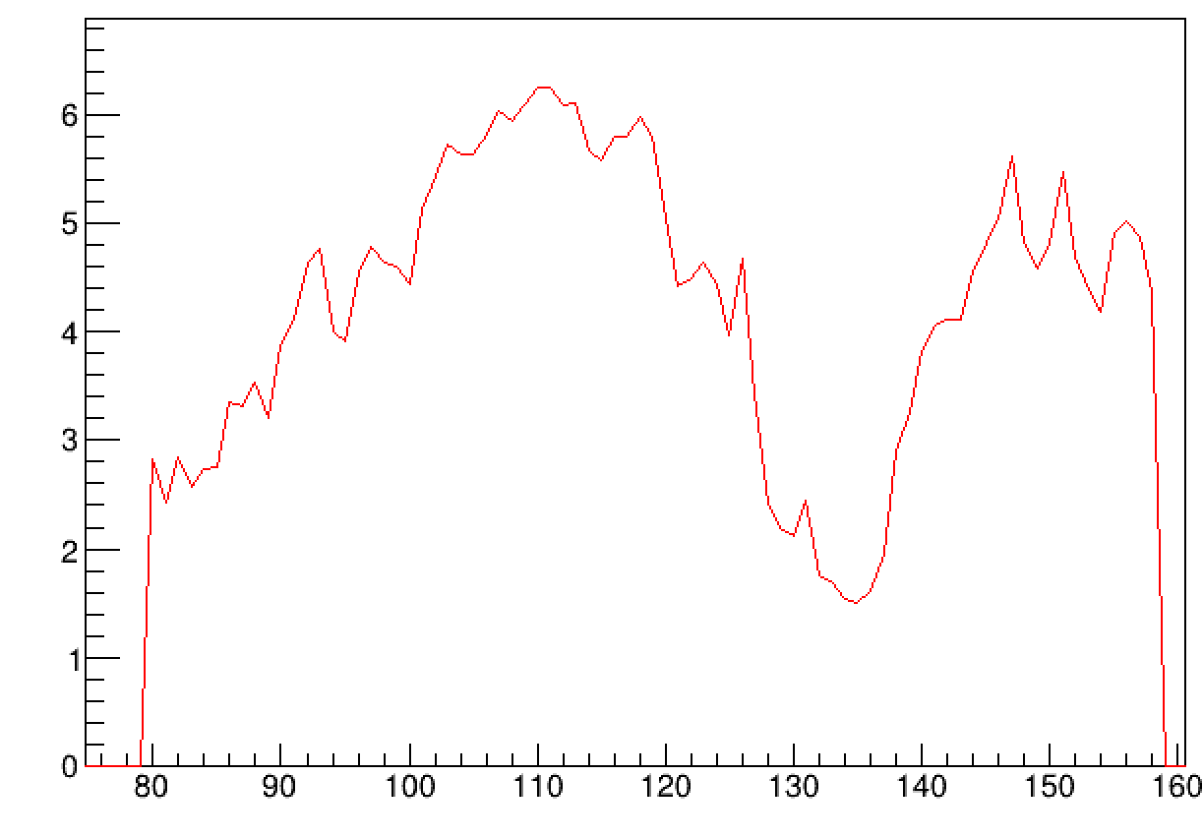
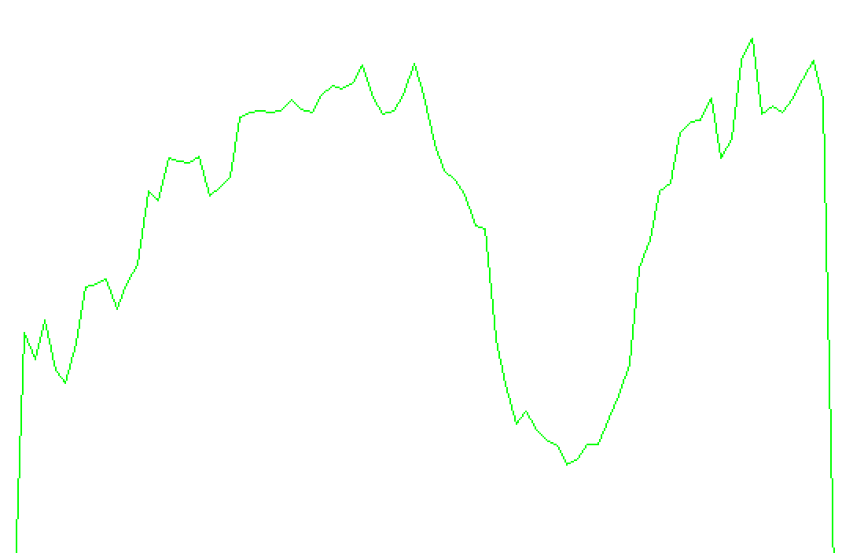
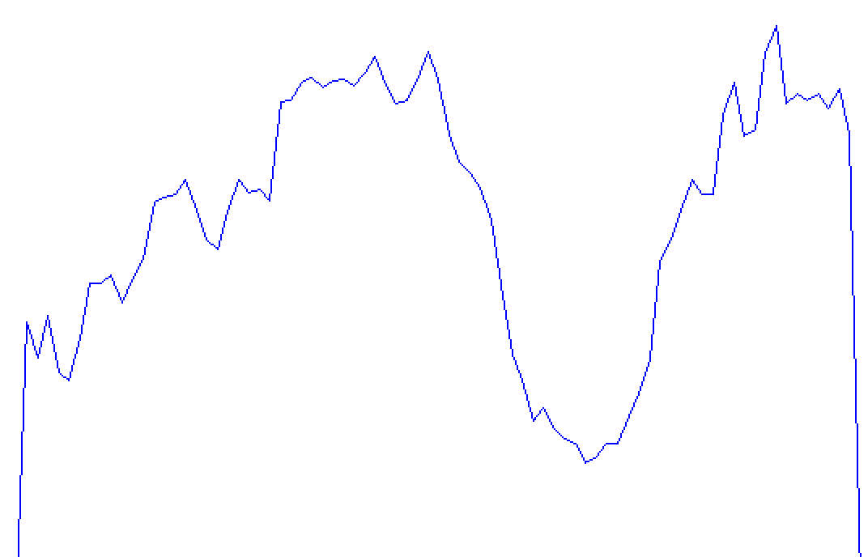
Gamma multiplicity
Int_t masL=0;
Int_t masH=0;
Int_t mulL=0;
Int_t mulH=0;
Float_t engL[20]={0};
Float_t engH[20]={0};
Float_t timL[20]={0};
Float_t timH[20]={0};
Float_t mul[200]={0};
Float_t num[200]={0};
Float_t dis[200]={0};
tree0->SetBranchAddress("GammaL.KE",&engL);
tree0->SetBranchAddress("GammaH.KE",&engH);
tree0->SetBranchAddress("GammaL.T",&timL);
tree0->SetBranchAddress("GammaH.T",&timH);
tree0->SetBranchAddress("GammaL.Mult",&mulL);
tree0->SetBranchAddress("GammaH.Mult",&mulH);
for(Int_t i=0;i<tree0->GetEntries();i++){
tree0->GetEntry(i);
masL=tree0->GetBranch("FragmentL")->GetLeaf("Mass")->GetValue();
masH=tree0->GetBranch("FragmentH")->GetLeaf("Mass")->GetValue();
for(Int_t j=0;j<mulL;j++){
if(engL[j]>0.1 & timL[j]<5.e-9){
mul[masL]++;
}
}
num[masL]=num[masL]+1.0;
for(Int_t j=0;j<mulH;j++){
if(engH[j]>0.1 & timH[j]<5.e-9){
mul[masH]++;
}
}
num[masH]=num[masH]+1.0;
}
Float_t x[200]={0};
for(Int_t k=0;k<200;k++){
x[k]=k+1;
if(num[k]>0){
dis[k]=mul[k]/num[k];
}
}
gr1=new TGraph(200,x,dis)
gr1->GetXaxis()->SetRangeUser(75,160)
gr1->SetLineColor(8)
gr1->Draw("AL")
~How can we achieve even better agreement? ~
Gamma with E > 100keV and T < 5ns
Multiplicity ∝ 1/ γ-ray energy
Overestimated by ~1 in A < 130.
    99-104 : Origin of high energy gamma
    130-135 : Origin of bump and shoulder
Decrease multiplicity → better agreement of shoulder and high E tail?
FIFRELIN-2021 is better than FIFRELIN-2018
  agrees better in 80 ~ 95 range.
  Increasing trend in 80-105 range also agrees better
2021-CGCM-RIPL20
FIFRELIN-2021
2018-CGCM-RIPL15
2021-HFB-RIPL21
FIFRELIN-2018
2021-CGCM-RIPL21
Gamma-rayMultiplicity
Gamma-ray Multiplicity
Measurement
(Pleansonton et al.)
Measurement
(Pleasonton et al.*)
Mass
Mass
* F. Pleasonton, R.L. Ferguson, H.W. Schmitt, Phys. Rev. C 6, 1023 (1972).

Slide 15
Two findings about high E γ-rays and codes
Before conclusion…
Notes:
プレゼン25分、質疑5分。
20分話すくらいの想定で

Slide 16
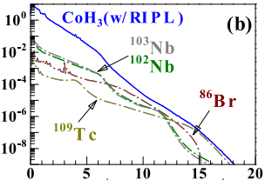
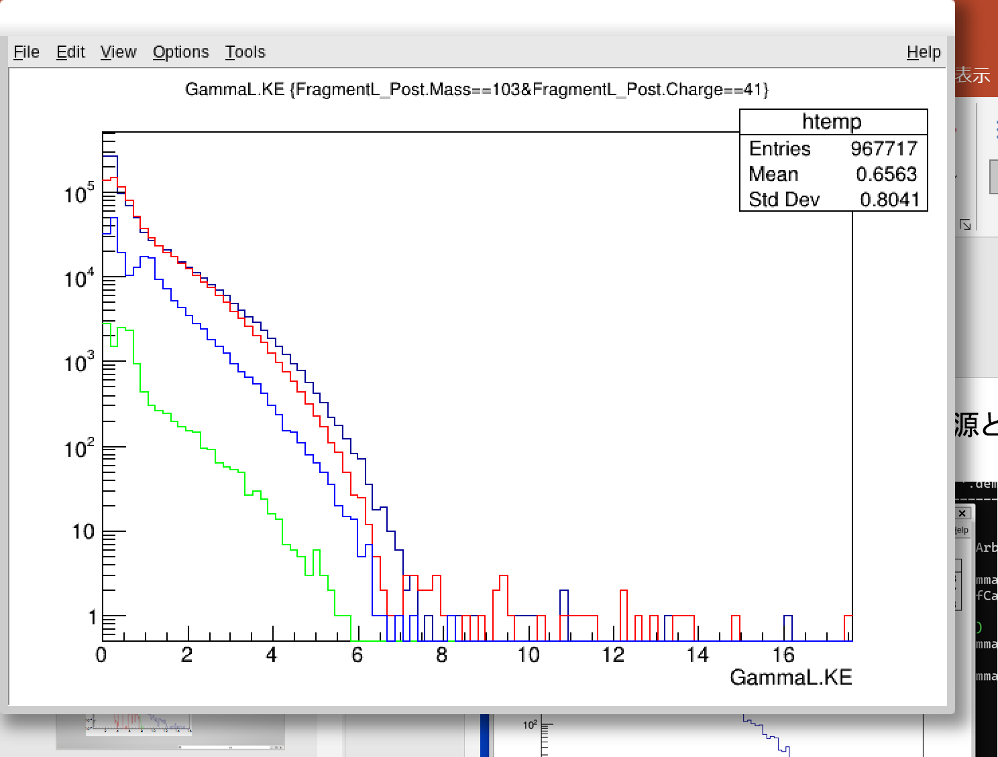
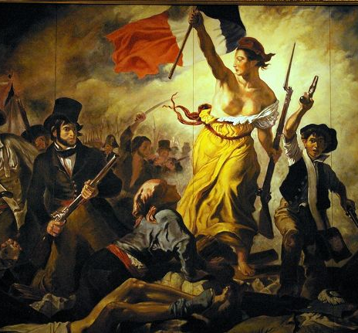

Comparison with CoH₃
tree0->Draw("GammaL.KE","FragmentL_Post.Mass==103&FragmentL_Post.Charge==41")
tree0->Draw("GammaL.KE>>z2","FragmentL_Post.Mass==102&FragmentL_Post.Charge==41","same")
tree0->Draw("GammaL.KE>>z3","FragmentL_Post.Mass==109&FragmentL_Post.Charge==43","same")
tree0->Draw("GammaL.KE>>z4","FragmentL_Post.Mass==86&FragmentL_Post.Charge==35","same")
z2->SetLineColor(2)
z3->SetLineColor(3)
z4->SetLineColor(4)
gPad->SetLogy(1)
FIFRELIN
CoH₃ (in Makii et al., PRC, 100, 044610 (2019))
2x10⁻¹
2x10⁻²
2x10⁻³
Light nuclei total
Gamma yield
(/MeV/fission)
2x10⁻⁴
2x10⁻⁵
⁹⁹⁻¹⁰¹Zr,
¹⁰¹⁻¹⁰²Nb,
¹⁰²⁻¹⁰⁴Mo,
Gamma yield(/MeV/fission)
2x10⁻⁶
2x10⁻⁷
¹⁰²Nb
2x10⁻⁸
0
2
4
6
8
10
12
14
16
18
20
Energy (MeV)
Energy (MeV)
Main Contributors :
Transition to :
Abundant nuclei with mass 99-104. ⇔ A few dominant nuclei including Br-86.
High J, unbound states. ⇔ High J, lowE discrete states
⁸⁶Br
¹⁰³Nb
¹⁰⁹Tc

Slide 17
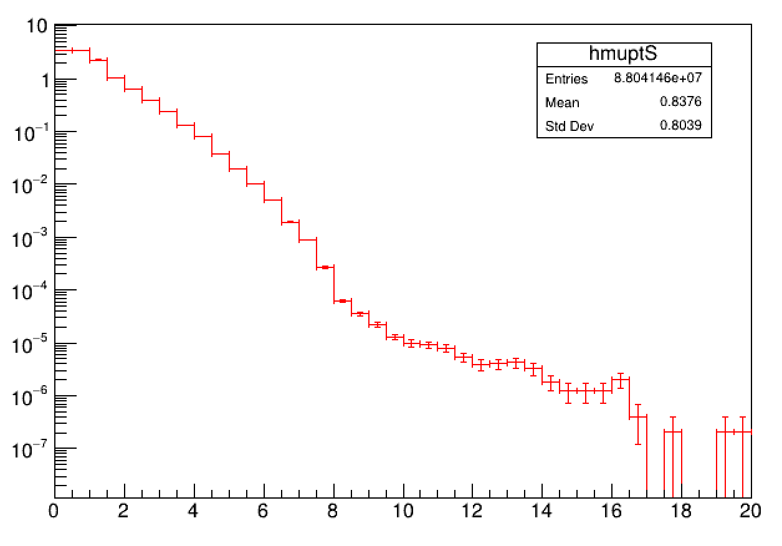
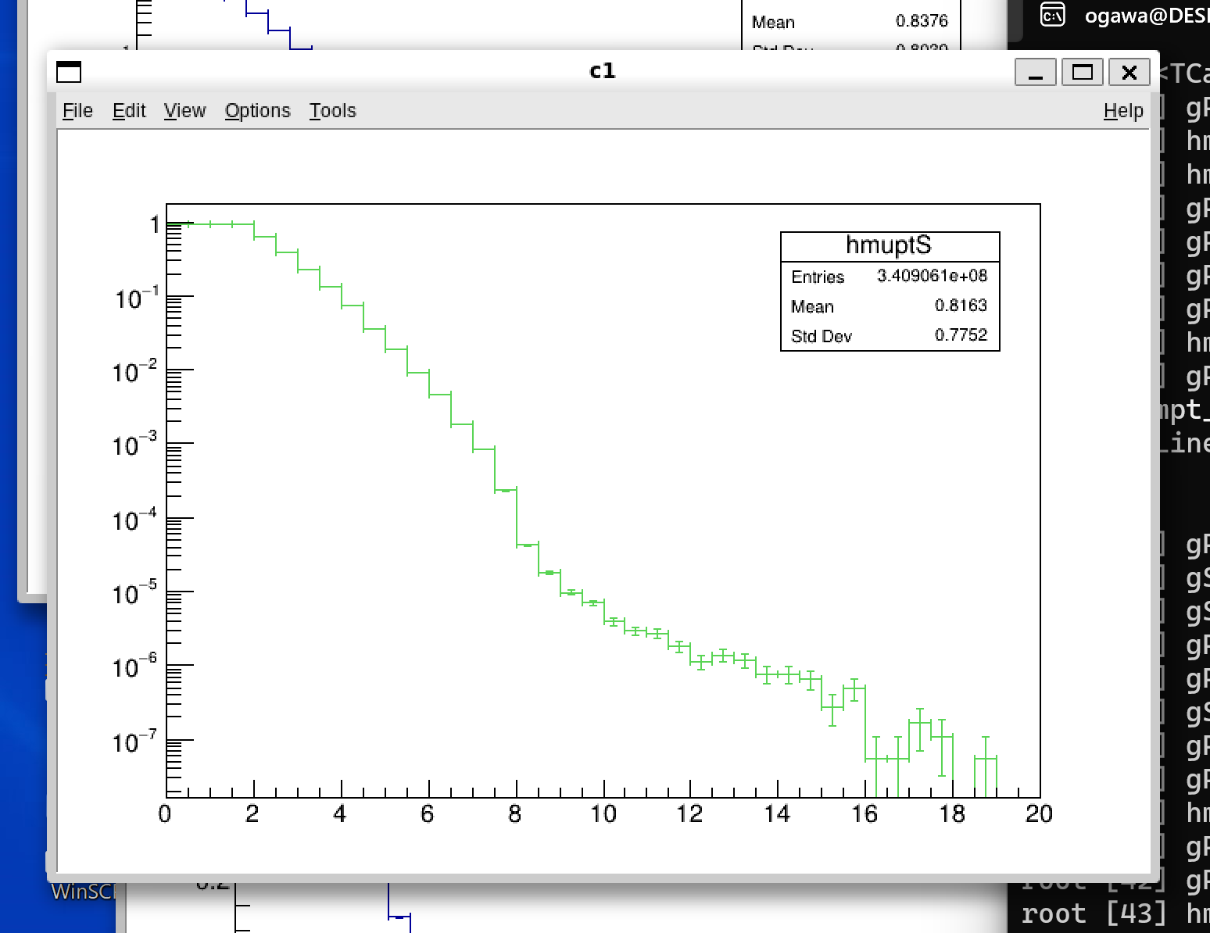
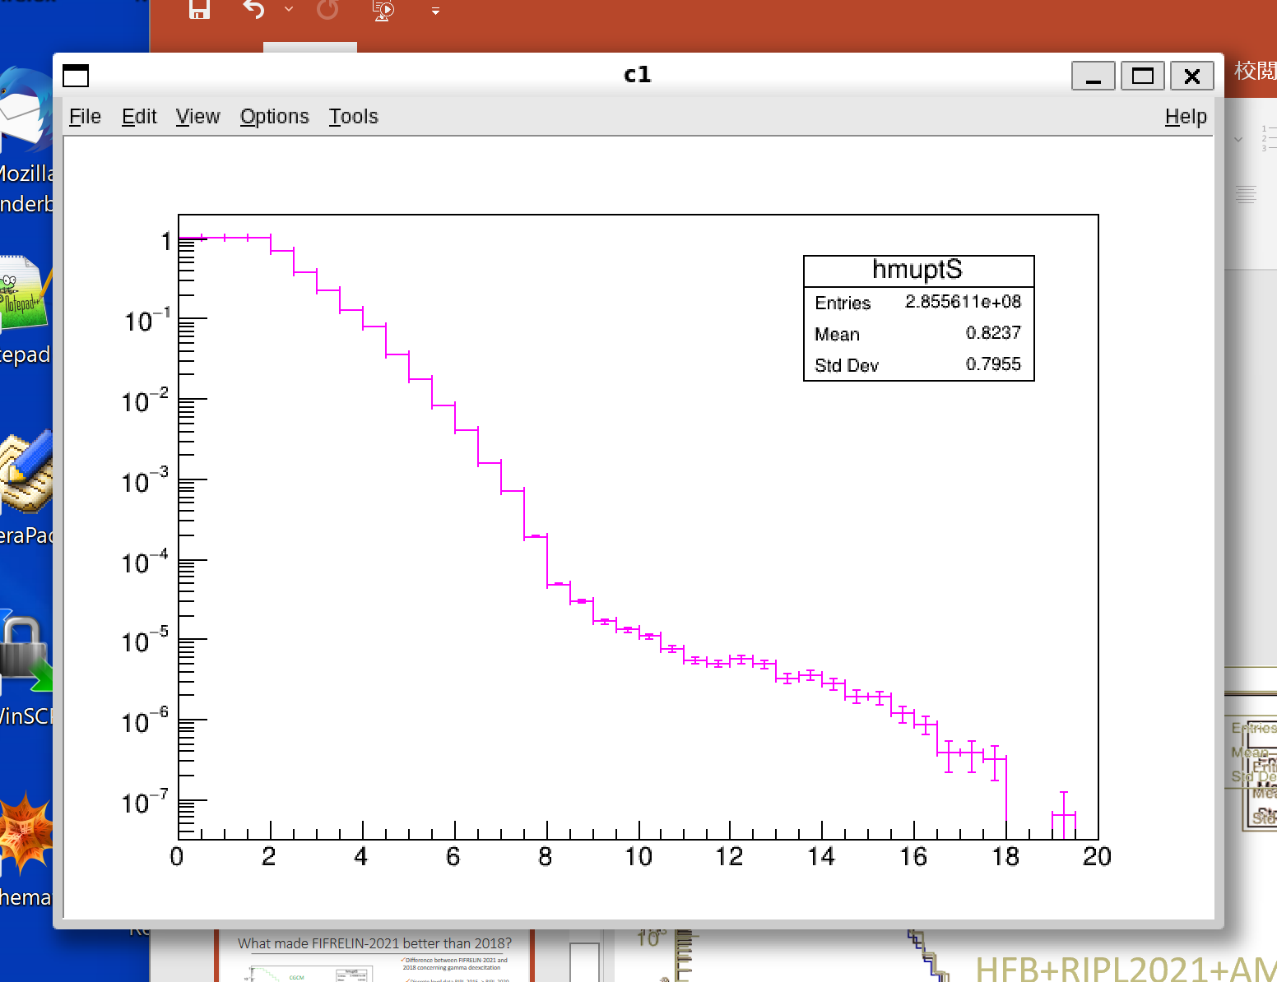
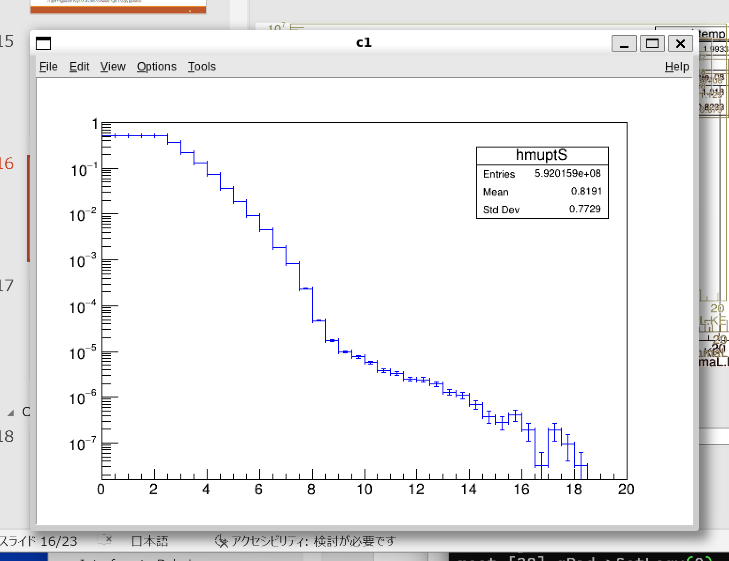
What made FIFRELIN-2021 better than 2018?
Difference between FIFRELIN-2021 and 2018 concerning gamma deexcitation
  Discrete level data RIPL-2020 -> RIPL-2021 and Atomic mass evaluation AME2012->AME2020
  γ/IC decay model upgrade
  (Level density model CGCM -> HFB)
2021-HFB-RIPL21 > 2021-CGCM-RIPL21
  HFB is the key
2021-HFB-RIPL20 = 2021-HFB-RIPL21
  RIPL or AME are not the points
  ↑ High energy γ are from unbound states
2018-CGCM-RIPL15 ≈ 2021-CGCM-RIPL21
  RIPL or Version can not cover CGCM disadvantages
Gamma yield (/MeV/fission)
2018-CGCM-
RIPL15
2021-HFB-
RIPL20
2021-HFB-RIPL21
2021-CGCM-
RIPL20
2021-CGCM-
RIPL21
Energy (MeV)
Notes:
Float_t LEI[20]={0};
tree0->SetBranchAddress("GammaL.KE", &LEI);
Float_t HEI[20]={0};
tree0->SetBranchAddress("GammaH.KE", &HEI);
Int_t HM;
tree0->SetBranchAddress("GammaH.Mult", &HM);
Int_t LM;
tree0->SetBranchAddress("GammaL.Mult", &LM);
TH1F hmuptS("hmuptS", " ", 40, 0, 20);
for(Int_t i=0;i<tree0->GetEntries();i++){
tree0->GetEntry(i);
for(Int_t j=0;j<HM;j++){
hmuptS.Fill(HEI[j]);
}
for(Int_t j=0;j<LM;j++){
hmuptS.Fill(LEI[j]);
}
}
hmuptS.Sumw2();
hmuptS.Scale(2.0/tree0->GetEntries());
hmuptS.SetLineColor(8)
gPad->SetLogy(1)
hmuptS.Draw("hist e1");

Slide 18
Summary
High energy γ-rays from fission are important tools for fundamental and applied fission studies
One measurement up to 20 MeV. Origin of high energy γ-rays is not yet clear.
Objective : Cast a light of FIFRELIN to know where they are from.
FIFRELIN and measurement agree except 8-10 MeV dip.
  4 MeV bump owing to Sn-132 and Sb-133.
  8 MeV shoulder owing to fragments with mass 130-134.
  → coherent with earlier studies
Calculation by FIFRELIN indicates that high E γ-rays….
  Are from nuclei Z=41±1, A=101±3, J ≂ 15±3
  First decay after scission
  Reproduced thanks to HFB level density and n/γ competition by HF
bump
Measurement(Makii et al.)
FIFRELIN2021
CoH3 (in Makii’s paper)
shoulder
tail
Gamma yield (/MeV/fission)
Energy (MeV)

Slide 19
FIFRELIN is….
Physics-wise
  Fission reaction model
  Event-by-event calculation
  Parameterised Fission
  + Statistical (n, g ,e-) decay by Hauser-Feshbach (level scheme + partial width)
Informatically
  Method : Monte-Carlo
  Language : C++ (GNU C++)
Administratively
  Maintained and mainly developped by CEA-Cadarache
    Namely by Olivier Litaize, Abdelhazise Chebboubi, Olivier Serot.
  Property of CEA
Upgraded in 2021 incorporating…
  mass and kinetic energy of ²³⁵U(n_{th},fis) considering data of Geltenbort^{*1}
  the latest Wahl Zp model^{*2} to determine fission fragment charge
  RIPL-2021 nuclear structure data and
  AME-2020 nuclear mass table ^{*3}
  γ/IC decay model
  BRICC code^{*4} to calculate internal conversion
Features relevant to gamma emission
*1 P. Geltenbort, F. Gonnenwein, A. Oed, Radiat. Effects 93(1–4), 57(1986).
*2 A.C. Wahl, Technical Report 1168, IAEA - TECDOC Series, (2000)
*3 Capote et al. , Nuclear Data Sheets, 110(12):3107–3214, dec 2009.
*4 T. Kibedi, T. Burrows, M. Trzhaskovskaya, P. Davidson, C.Nestor, Nucl. Instrum. Methods Phys. Res. Sect. A. 589(2), 202 (2008).

Slide 20
Where are High Energy γ-rays from?
From conclusion,
  they are from light fission fragments
  In particular Z=41±1, A=101±3
  Transition from high J ≂ 15±4
  First decay after scission

Slide 21
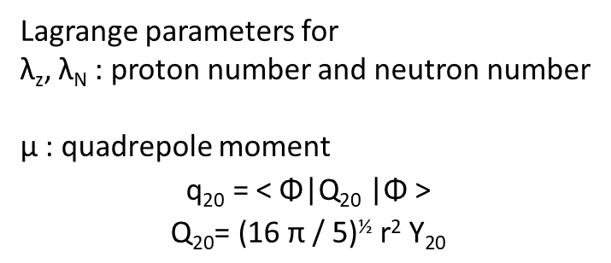
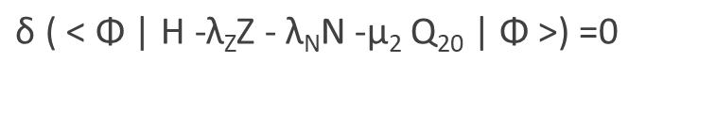
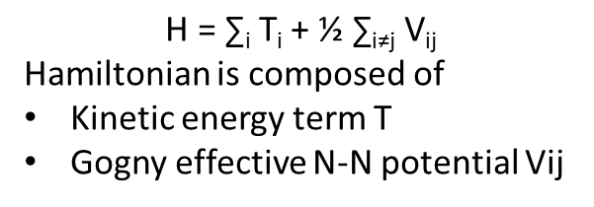
HFB(Hartree-Fock-Bogoliubov) level density
$\text{δ}\text{ ( < }\text{Φ}\text{ | }\text{H}\text{ −}\text{λ}\text{Z}\text{Z}\text{ − }\text{λ}\text{N}\text{N}\text{ −}\text{μ}\text{2} \text{Q}\text{20}\text{ | }\text{Φ}\text{ >) =0}$
Φ=HFB wave function
Determined so as to minimize the total energy
$$\text{H}\text{ = ∑}\text{i} \text{Ti}\text{ + ½ ∑}\text{i}\text{≠}\text{j} \text{Vij}$$
Hamiltonian is composed of
Kinetic energy term T
Gogny effective N-N potential Vij
Lagrange parameters for
λ_{z}, λ_{N} : proton number and neutron number
μ : quadrepole moment
$$\text{q}\text{20}\text{ = < }\text{Φ}\text{|}\text{Q}\text{20}\text{ |}\text{Φ}\text{ >}$$
$$\text{Q}\text{20}\text{= (16 }\text{π}\text{ / 5)½ }\text{r}\text{2} \text{Y}\text{20}$$

Slide 22
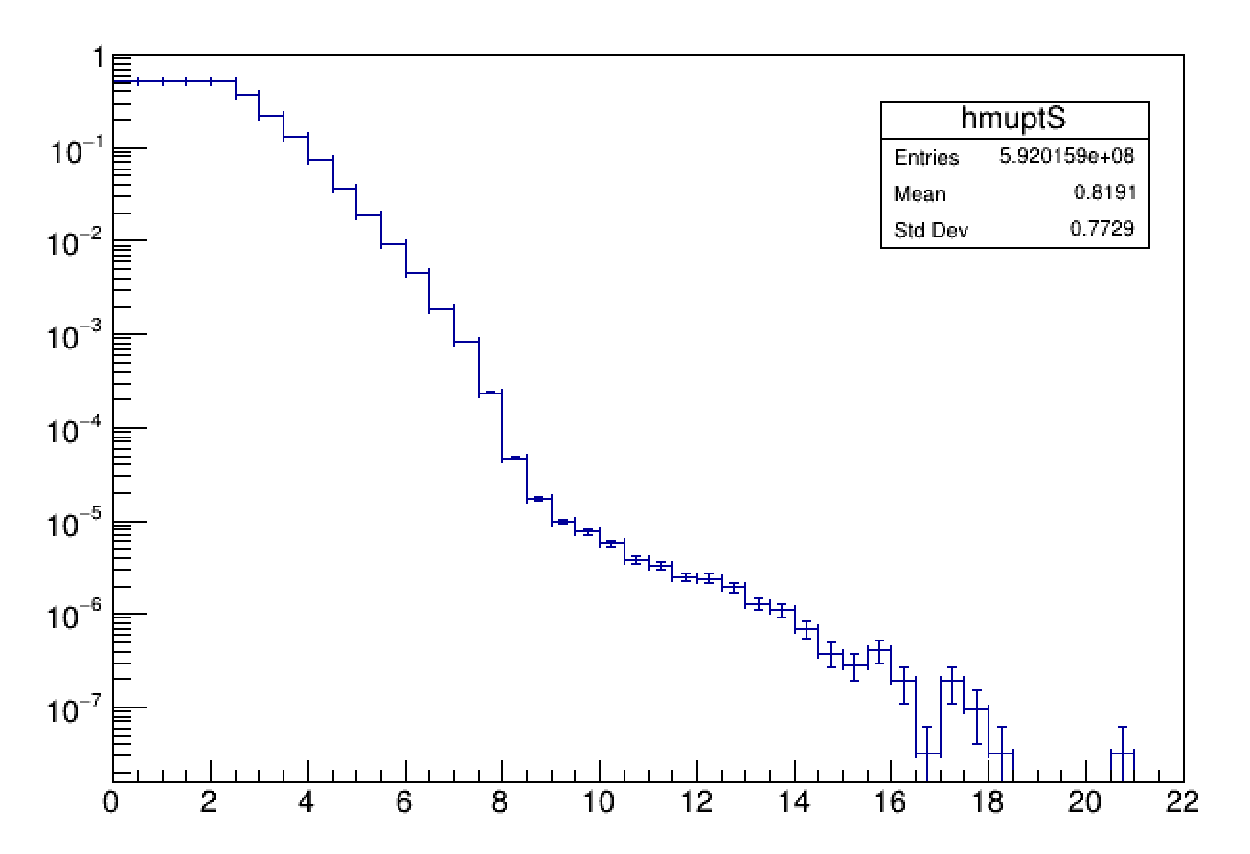
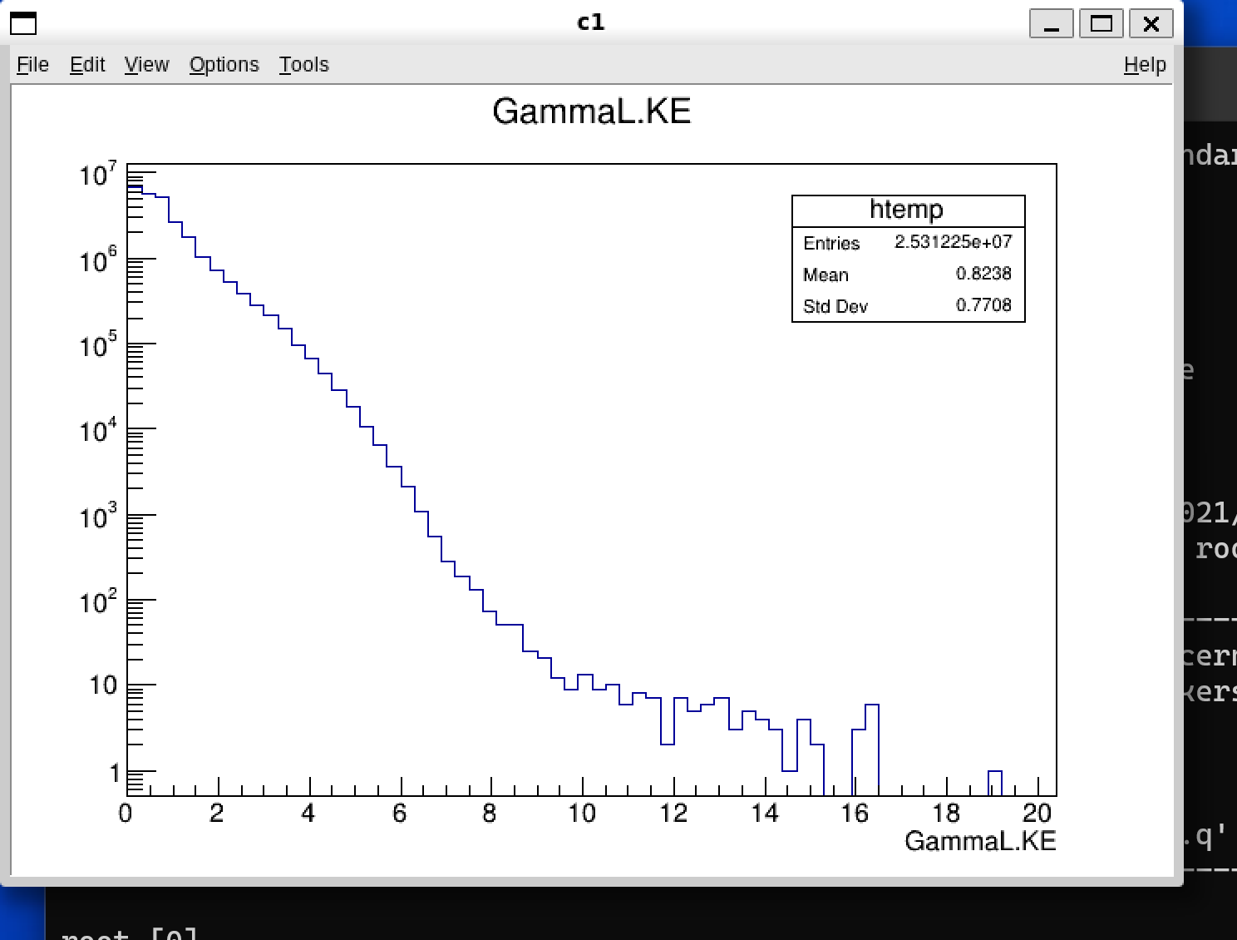
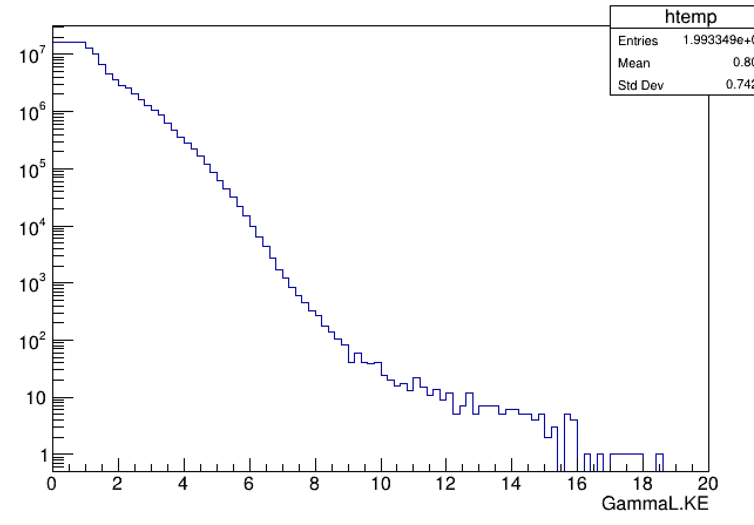
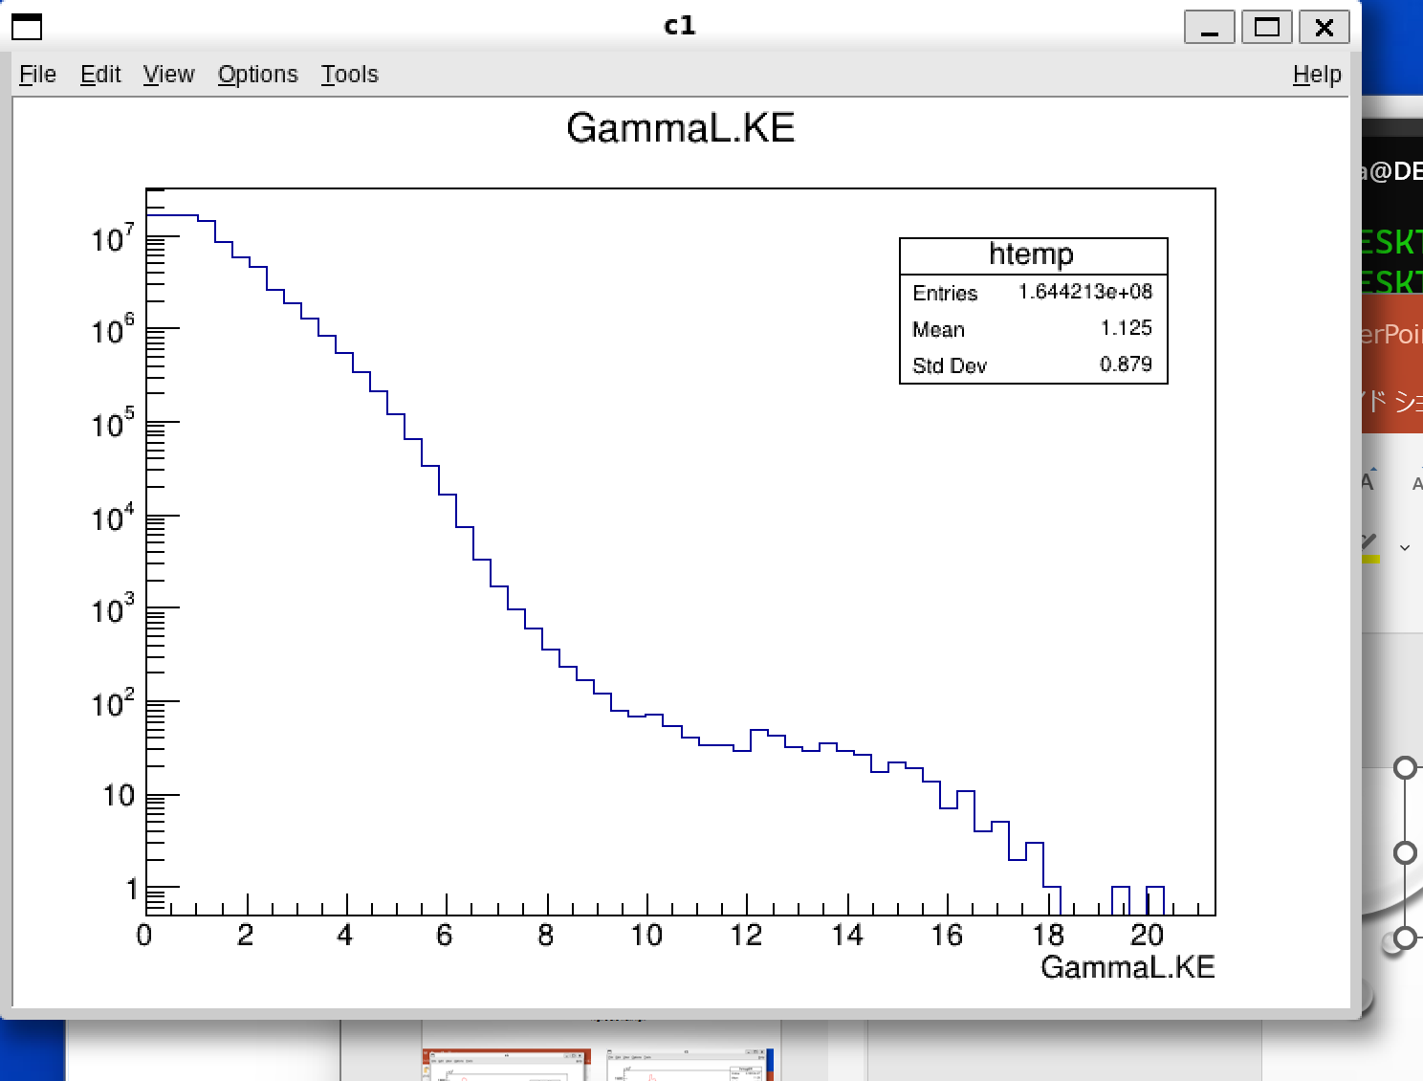
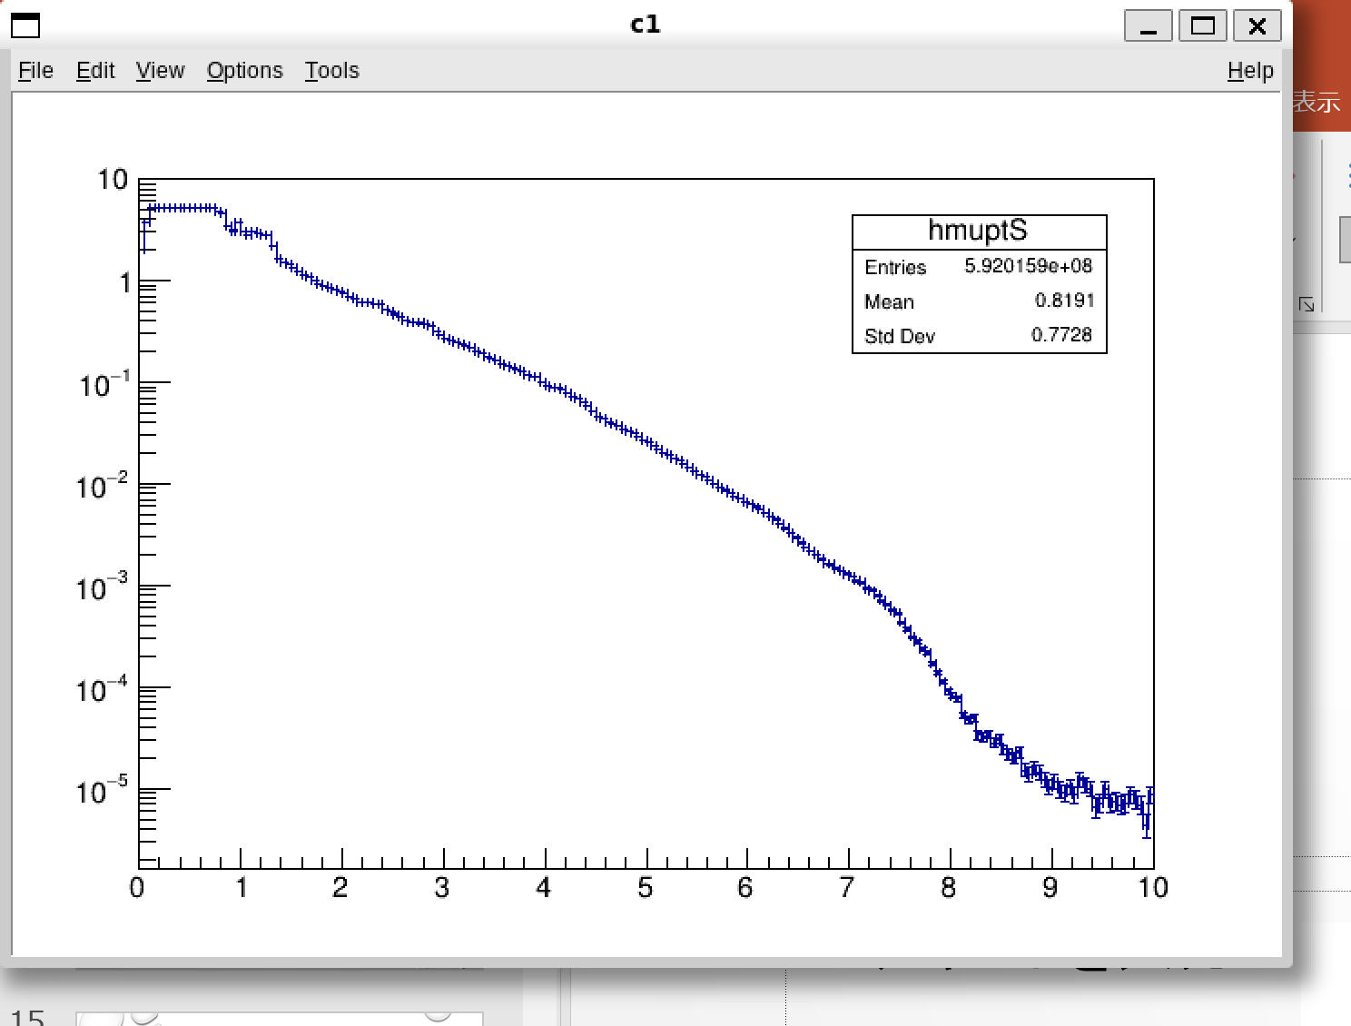
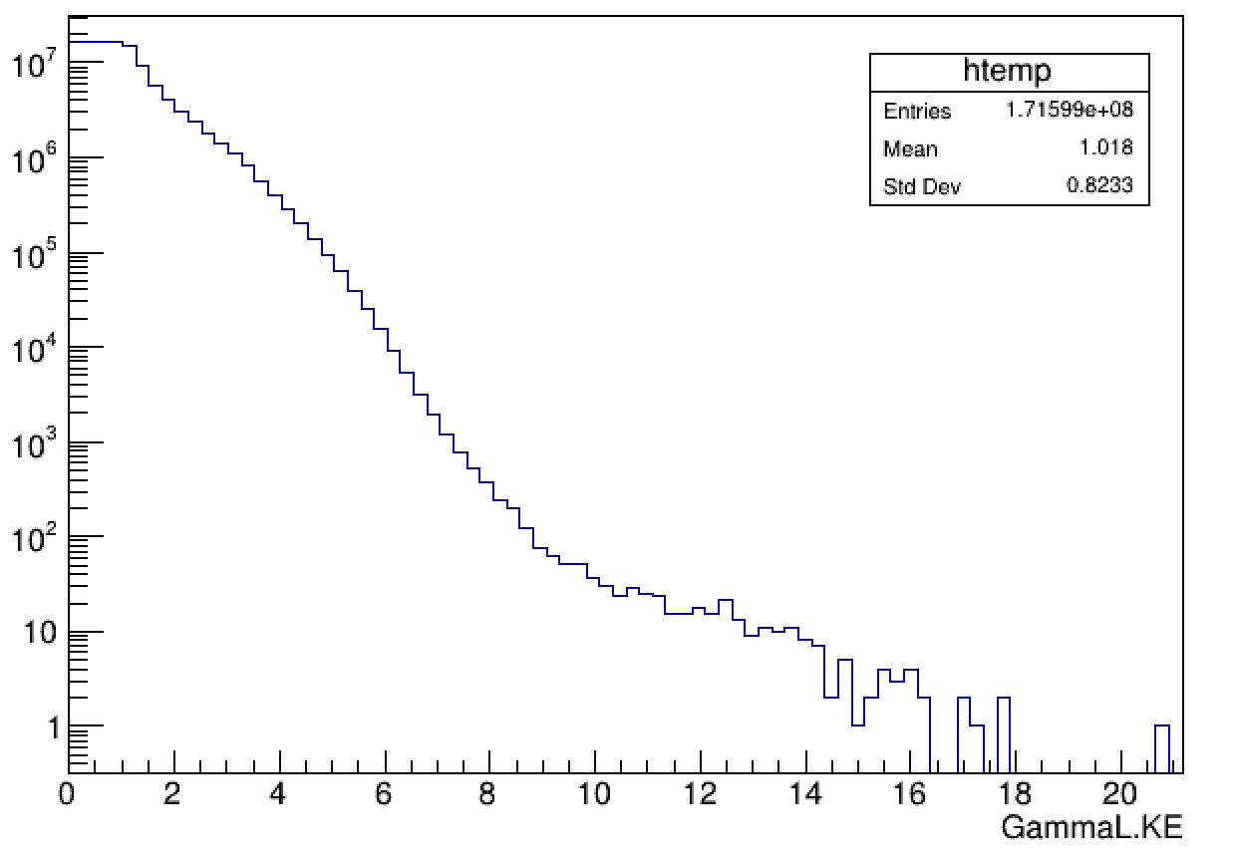
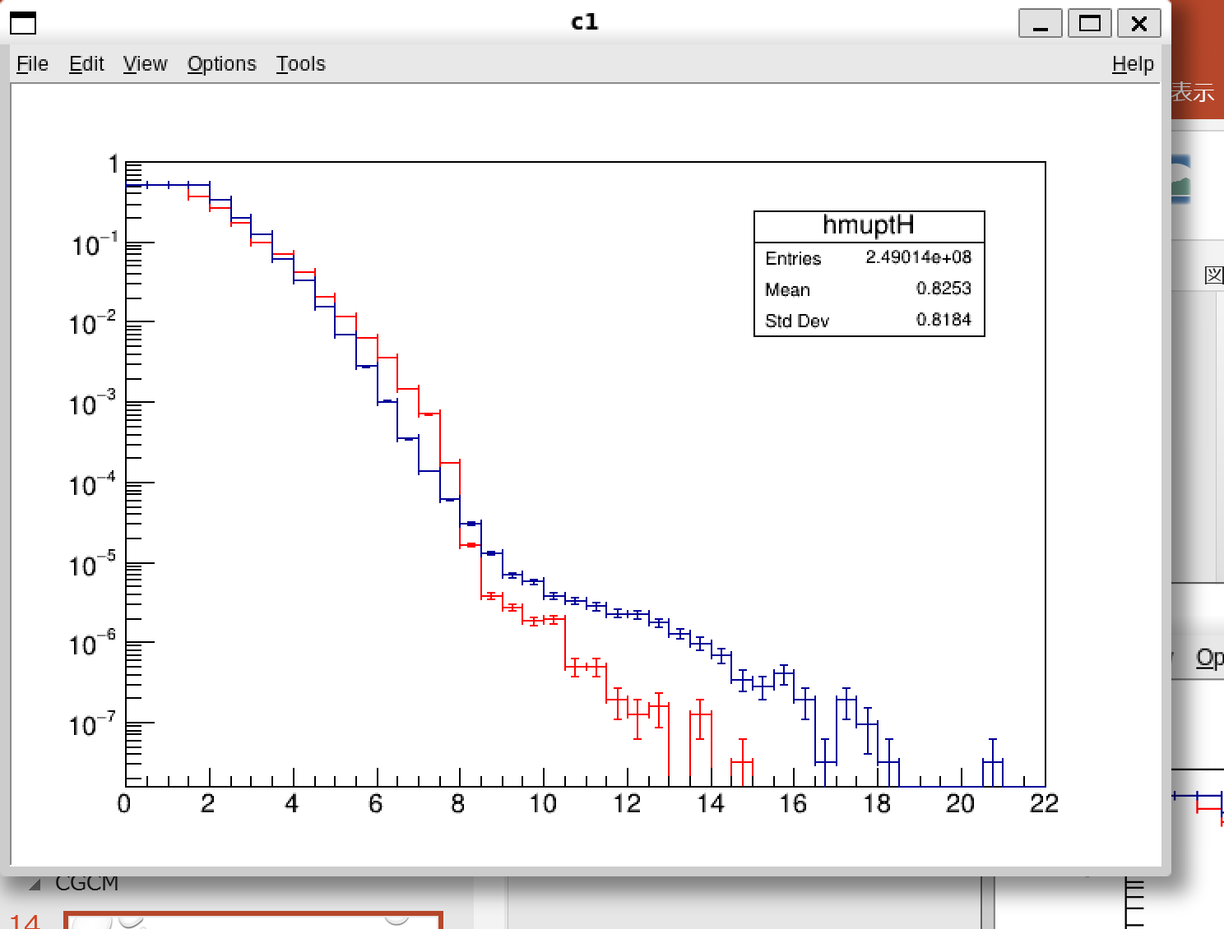
CGCM+ RIPL3-2021 et AME-2020
HFB + RIPL3-2021 et AME-2020
CGCM
HFB+RIPL2021+AME2020
HFB
CGCM+RIPL2021+AME
Notes:
(Low energy resolution)
Float_t LEI[20]={0};
tree0->SetBranchAddress("GammaL.KE", &LEI);
Float_t HEI[20]={0};
tree0->SetBranchAddress("GammaH.KE", &HEI);
Int_t HM;
tree0->SetBranchAddress("GammaH.Mult", &HM);
Int_t LM;
tree0->SetBranchAddress("GammaL.Mult", &LM);
TH1F hmuptL("hmuptL", " ", 44, 0, 22);
TH1F hmuptH("hmuptH", " ", 44, 0, 22);
TH1F hmuptS("hmuptS", " ", 44, 0, 22);
for(Int_t i=0;i<tree0->GetEntries();i++){
tree0->GetEntry(i);
for(Int_t j=0;j<HM;j++){
hmuptH.Fill(HEI[j]);
hmuptS.Fill(HEI[j]);
}
for(Int_t j=0;j<LM;j++){
hmuptL.Fill(LEI[j]);
hmuptS.Fill(LEI[j]);
}
}
hmuptH.Sumw2();
hmuptL.Sumw2();
hmuptS.Sumw2();
hmuptH.Scale(2.0/tree0->GetEntries());
hmuptL.Scale(2.0/tree0->GetEntries());
hmuptS.Scale(2.0/tree0->GetEntries());
hmuptS.Draw("hist e1");
gPad->SetLogy(1)
hmuptH.Draw("hist e1");
hmuptH.SetLineColor(kRed);
hmuptL.Draw("same hist e1");
(High energy resolution)
Float_t LEI[20]={0};
tree0->SetBranchAddress("GammaL.KE", &LEI);
Float_t HEI[20]={0};
tree0->SetBranchAddress("GammaH.KE", &HEI);
Int_t HM;
tree0->SetBranchAddress("GammaH.Mult", &HM);
Int_t LM;
tree0->SetBranchAddress("GammaL.Mult", &LM);
TH1F hmuptL("hmuptL", " ", 200, 0, 10);
TH1F hmuptH("hmuptH", " ", 200, 0, 10);
TH1F hmuptS("hmuptS", " ", 200, 0, 10);
for(Int_t i=0;i<tree0->GetEntries();i++){
tree0->GetEntry(i);
for(Int_t j=0;j<HM;j++){
hmuptH.Fill(HEI[j]);
hmuptS.Fill(HEI[j]);
}
for(Int_t j=0;j<LM;j++){
hmuptL.Fill(LEI[j]);
hmuptS.Fill(LEI[j]);
}
}
hmuptH.Sumw2();
hmuptL.Sumw2();
hmuptS.Sumw2();
hmuptH.Scale(20.0/tree0->GetEntries());
hmuptL.Scale(20.0/tree0->GetEntries());
hmuptS.Scale(20.0/tree0->GetEntries());
hmuptS.Draw("hist e1");
gPad->SetLogy(1)

Slide 23
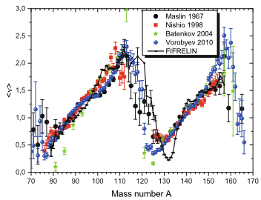
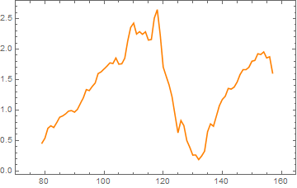
Neutron Multiplicity
Neutron multiplicity
Almost no effects on neutron multiplicity
FIFRELIN2021
Notes:
tree0->SetScanField(0);
.>treeH.log
tree0->Scan("FragmentH_Post.Mass:GammaH.Mult");
.>
tree0->SetScanField(0);
.>treeH.log
tree0->Scan("FragmentH_Post.Mass:NeutronH.Mult");
.>
ターミナルで
cut -b 19-23,33-35 treeL.log > treecutL.log
sed 1,4d treecutL.log >treecutL1.log
あとはMathematicaで
軽核のほうは
tree0->SetScanField(0);
.>treeL.log
tree0->Scan("FragmentL_Post.Mass:GammaL.Mult");
.>
中性子が
tree0->SetScanField(0);
.>treeHn.log
tree0->Scan("FragmentH.Mass:NeutronH.Mult");
.>
tree0->SetScanField(0);
.>treeLn.log
tree0->Scan("FragmentL.Mass:NeutronL.Mult");
.>

Slide 24
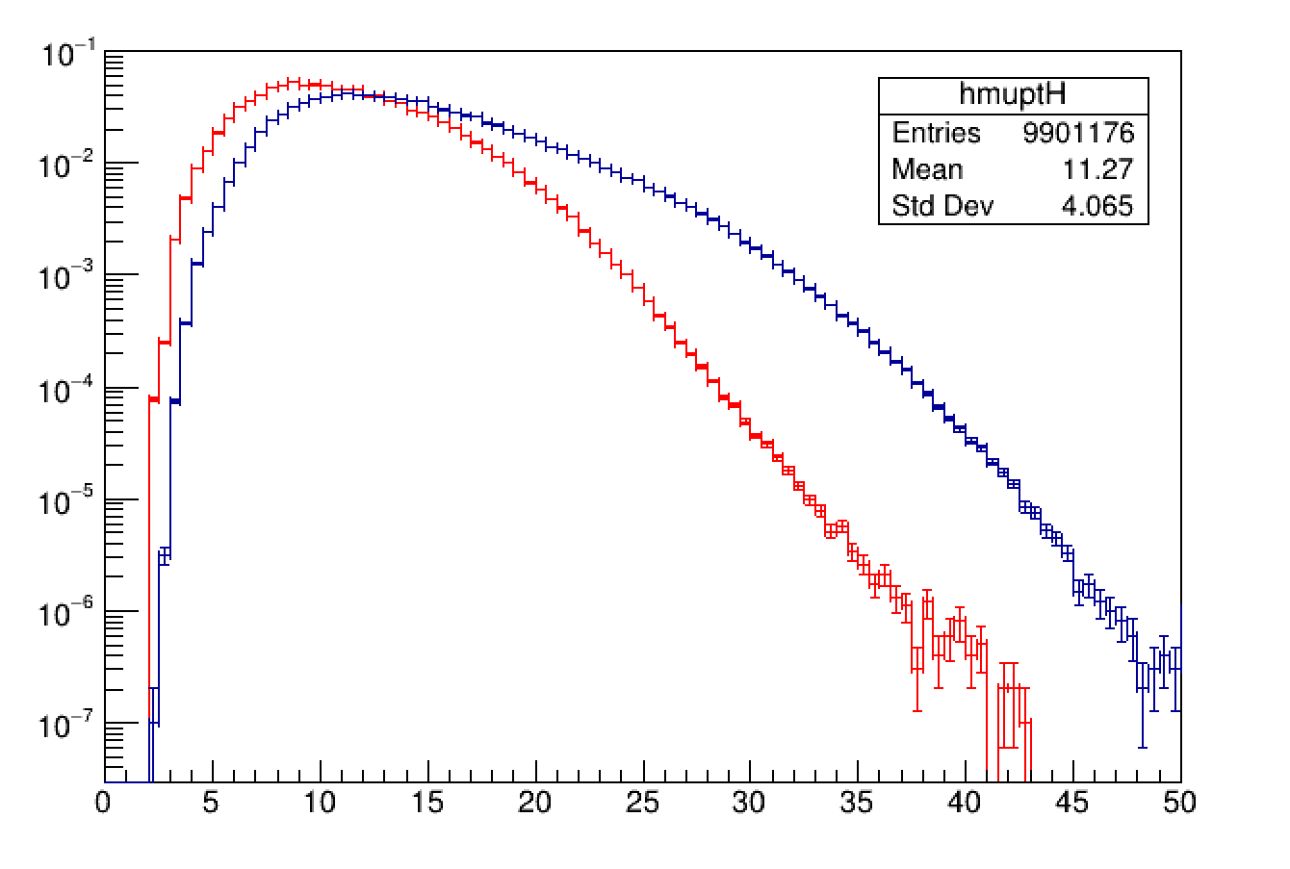


Excitation energy after scission
・Compare Heavy and Light in Lab
High E are from light
HFB + RIPL3-2021 et AME-2020
HFB
CGCM
Notes:
Float_t LEI;
tree0->SetBranchAddress("NeutronCascadeL.EI", &LEI);
Float_t HEI;
tree0->SetBranchAddress("NeutronCascadeH.EI", &HEI);
TH1F hmuptL("hmuptL", " ", 100, 0, 50);
TH1F hmuptH("hmuptH", " ", 100, 0, 50);
for(Int_t i=0;i<tree0->GetEntries();i++){
tree0->GetEntry(i);
hmuptL.Fill(LEI);
hmuptH.Fill(HEI);
}
hmuptH.Sumw2();
hmuptL.Sumw2();
hmuptH.Scale(1.0/tree0->GetEntries());
hmuptH.Draw("hist e1");
hmuptH.SetLineColor(kRed);
gPad->SetLogy(1)
hmuptL.Scale(1.0/tree0->GetEntries());
hmuptL.Draw("same hist e1");

Slide 25


Spin after scission
CGCM-
HFB + RIPL3-2021 et AME-2020
Notes:
Float_t LEI;
tree0->SetBranchAddress("NeutronCascadeL.JI", &LEI);
Float_t HEI;
tree0->SetBranchAddress("NeutronCascadeH.JI", &HEI);
TH1F hmuptL("hmuptL", " ", 50, 0, 25);
TH1F hmuptH("hmuptH", " ", 50, 0, 25);
for(Int_t i=0;i<tree0->GetEntries();i++){
tree0->GetEntry(i);
hmuptL.Fill(LEI);
hmuptH.Fill(HEI);
}
hmuptH.Sumw2();
hmuptL.Sumw2();
hmuptH.Scale(1.0/tree0->GetEntries());
hmuptL.Scale(1.0/tree0->GetEntries());
hmuptH.Draw("hist e1");
hmuptH.SetLineColor(kRed);
gPad->SetLogy(1)
hmuptL.Draw("same hist e1");

