Slide 1
Integrated, Automated, and Reproducible Nuclear Data Processing at the NEA
Daniela FOLIGNO
NEA / Data Bank
6th International Workshop On Nuclear Data Evaluation for Reactor applications, 5-9 June 2023

Slide 2
Outline
The need for modernization
The NEA Processing pipeline
The NEA Verification and Validation pipelines
Conclusions and future work

Slide 3
1) The need for modernization

Slide 4
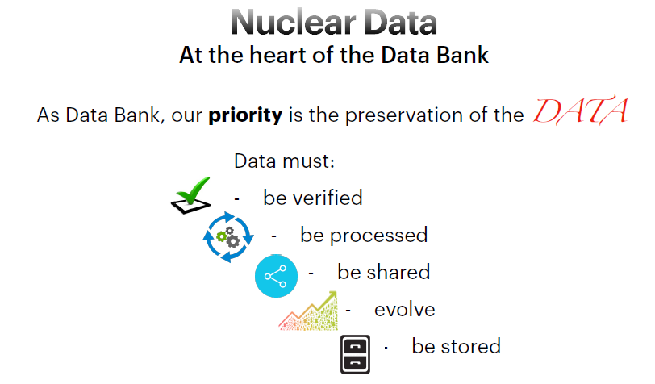


Preservation of the Data
One of the top priorities of the NEA Data Bank is the preservation of the data, which includes:
Processing
Verification
Distribution
Evolution
Storage
- Documentation

Slide 5
Preservation of the Data
One of the top priorities of the NEA Data Bank is the preservation of the data, which includes:
Processing
Verification
Distribution
Evolution
Storage
- Documentation

Slide 6

The FAIR principles
To accomplish this, the NEA has dedicated substantial efforts to implement strategies that align with the FAIR principles

Slide 7
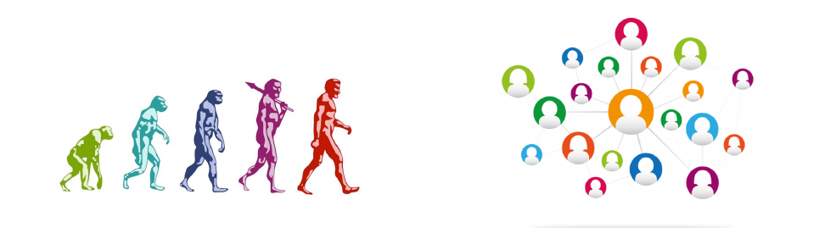
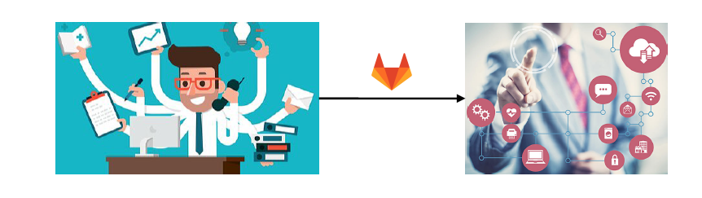
The GitLab platform
GitLab is Web-based Distributed Version Control System that allows to track changes over time and across different users
Using the CI/CD (Continuous Integration / Continuous Deployment) we want to automatically trigger unit tests on every commit, giving immediate preliminary feedbacks on the quality of the data

Slide 8

Before the modernization effort
Evaluators
FEEDBACKS
Evaluators would send their evaluations anytime to
NEA Secretariat
Specific users
JEFF Community
Who would collect them for the official release, published on the
Users could download
the evaluations
Processing
NEA Website
V&V

Slide 9
Before the modernization effort
Only specific users had access to the data (not transparent)
The JEFF community could test the data only after the official release
(slow process)
The processing was done by the users (potential bias)
Evaluators
Evaluators would send their evaluations anytime to
NEA Secretariat
Specific users
1
JEFF Community
2
Who would collect them for the official release, published on the
Processing
Users could download
the evaluations
3
NEA Website
V&V

Slide 10


After the modernization effort
Evaluators
FEEDBACKS
Evaluators upload their evaluations on the JEFF-Lab
JEFF-Lab
Users can download
the evaluations
JEFF community
FEEDBACKS
Files are moved into the official repository, where the processing pipeline is automatically triggered
Users perform tests and benchmarks
Users can download
the processed files
SharePoint
Automatic processing
Processing (optional)
And share the results on the NEA SharePoint
V&V

Slide 11
After the modernization effort
The whole community has access to the data (transparent)
The JEFF community can test the data at any time
(faster process)
The processing is automatically done by the NEA pipeline
(automated, transparent, and reproducible)
The preliminary results are immediately available to the whole community
(fast and transparent)
Evaluators
FEEDBACKS
Evaluators upload their evaluations on the JEFF-Lab
JEFF-Lab
Users can download
the evaluations
JEFF community
1
2
FEEDBACKS
Files are moved into the official repository, where the processing pipeline is automatically triggered
Users perform tests and benchmarks
Users can download
the processed files
SharePoint
4
Automatic processing
Processing (optional)
And share the results on the NEA SharePoint
2
3
V&V

Slide 12
2) The NEA Processing pipeline

Slide 13
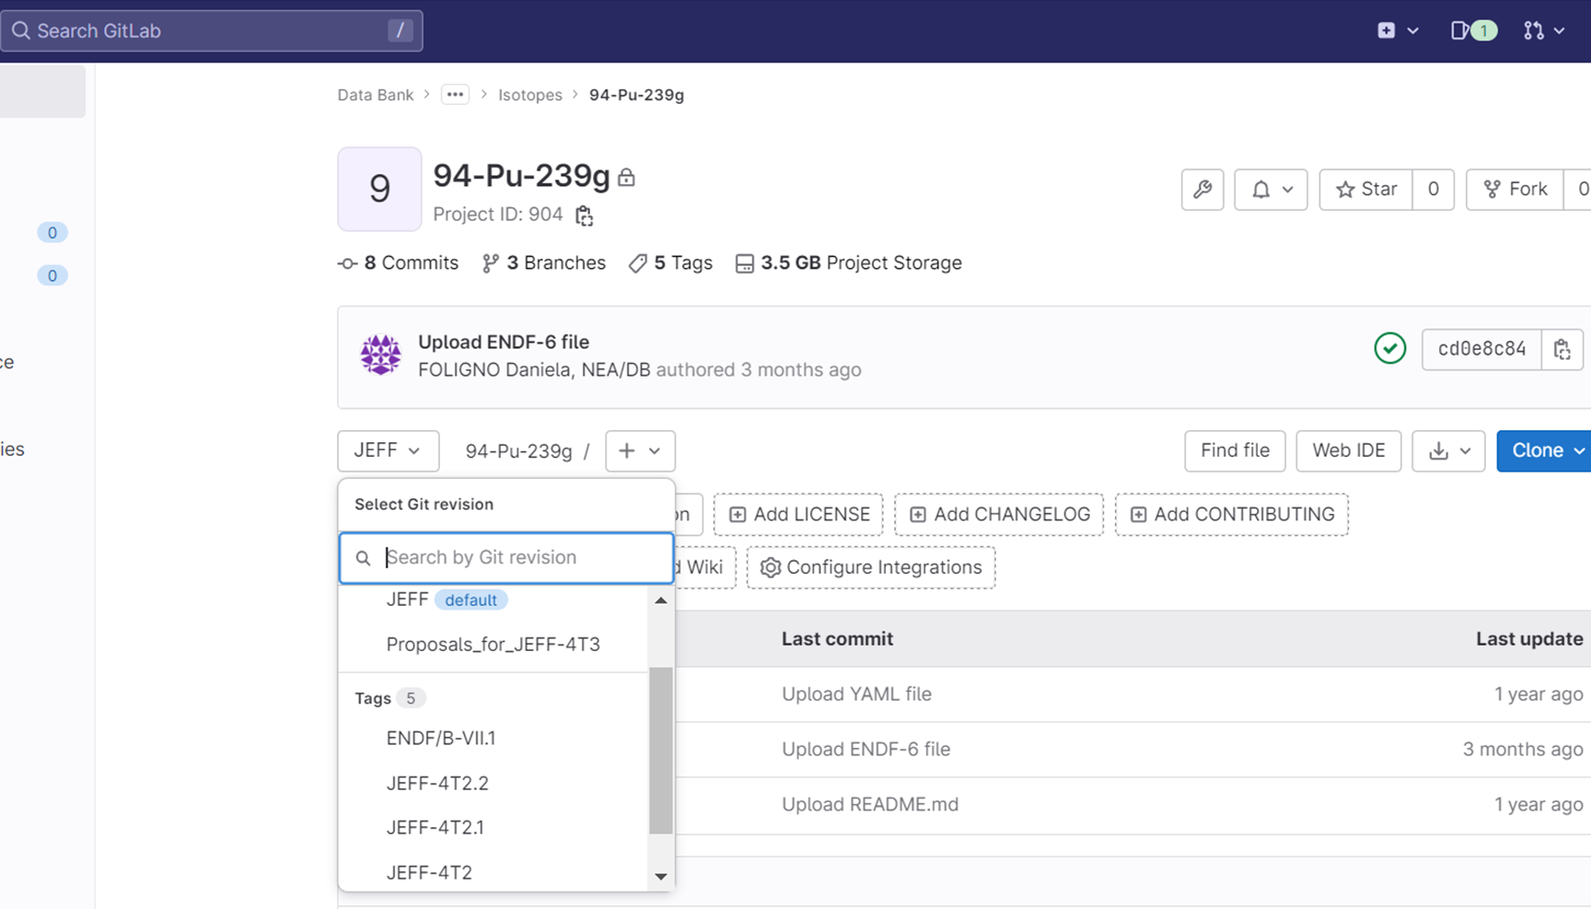
The NEA Processing pipeline
Project = Isotope
(e.g. 94-Pu-239)
Branch = Version under development
(e.g. JEFF)
Tag = Unmodifiable version
(e.g. JEFF-4T2)

Slide 14
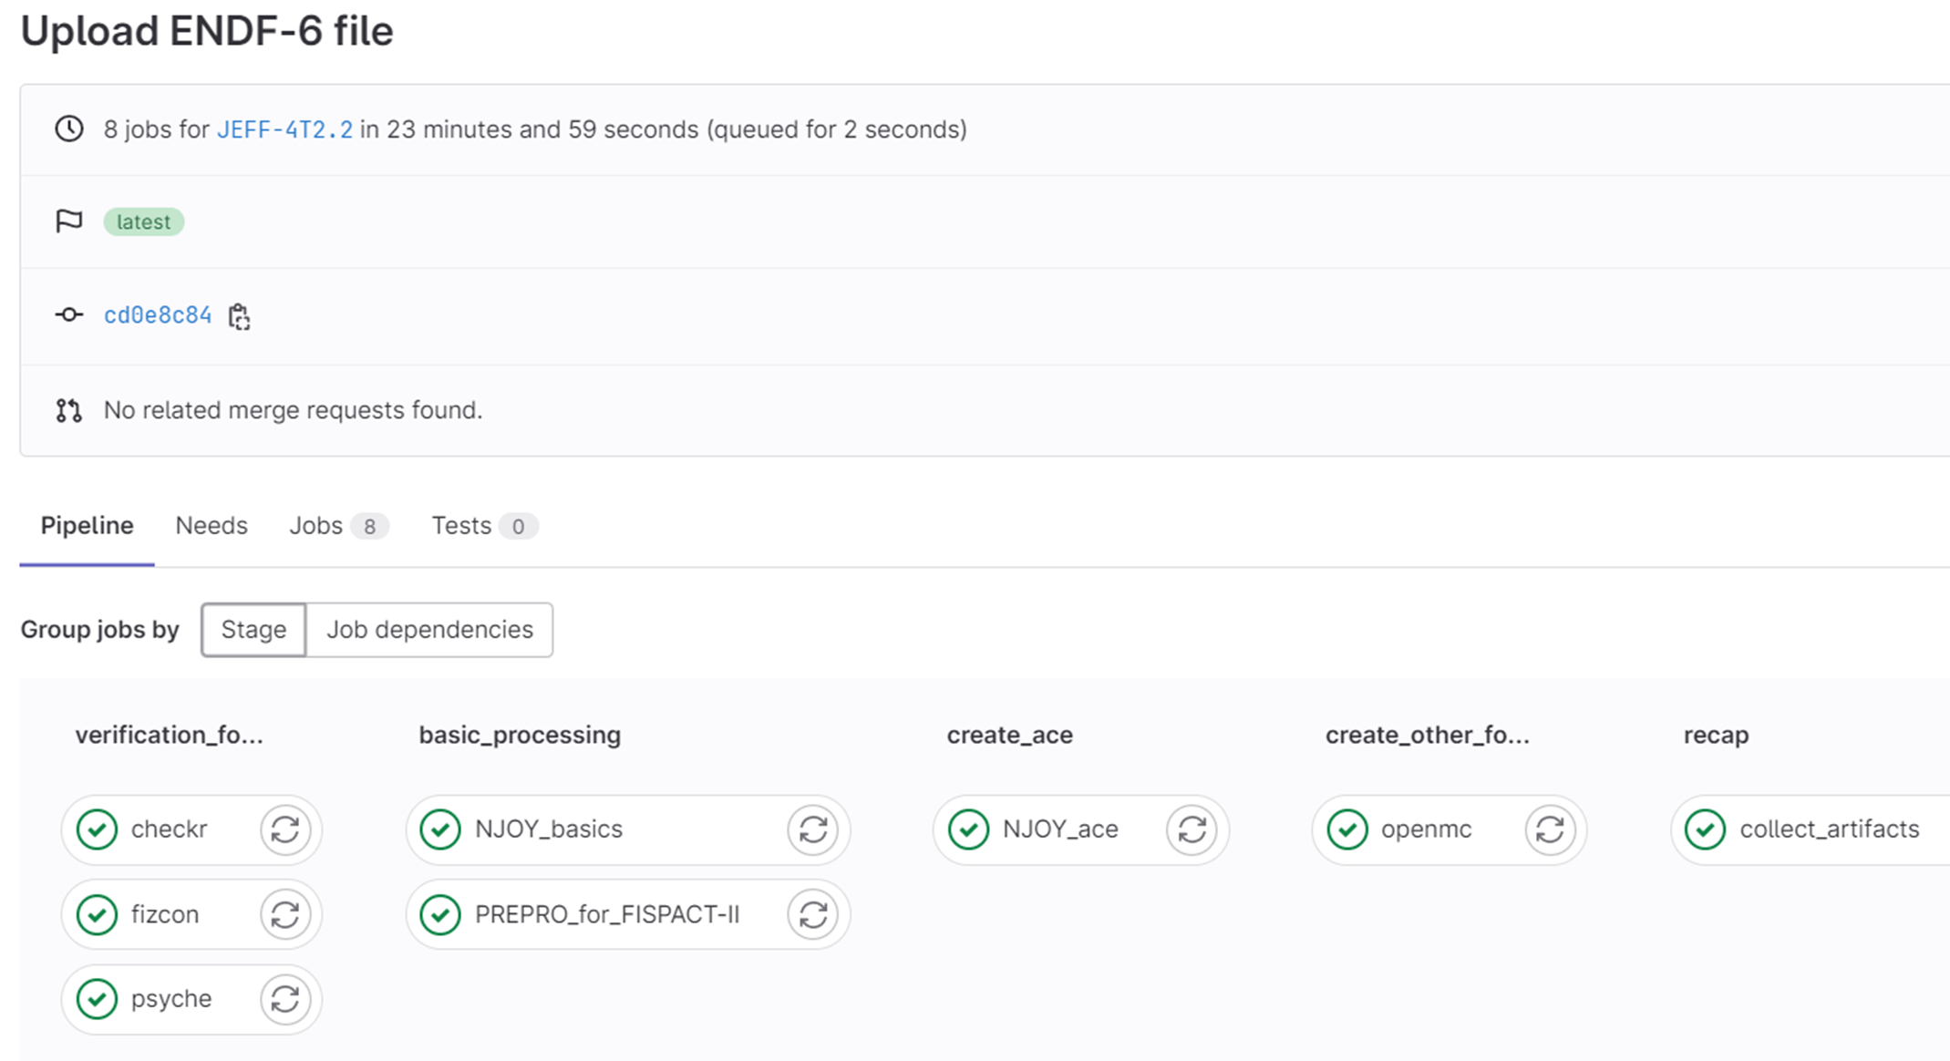

The NEA Processing pipeline
The main YAML (pipeline definition) is maintained in its own repository
After every commit, the pipeline is automatically triggered
The pipeline is identical for all isotopes
Codes are built into Docker images, stored in the Harbor, and pulled by the pipeline

Slide 15
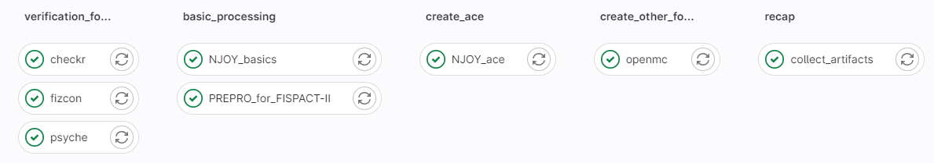
The NEA Processing pipeline

Slide 16
The NEA Processing pipeline
Format checks
Internal consistency checks
Additional checks

Slide 17
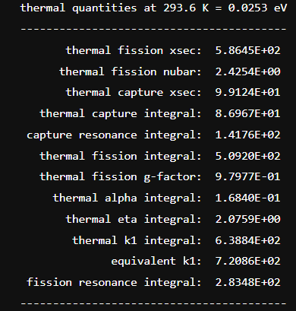
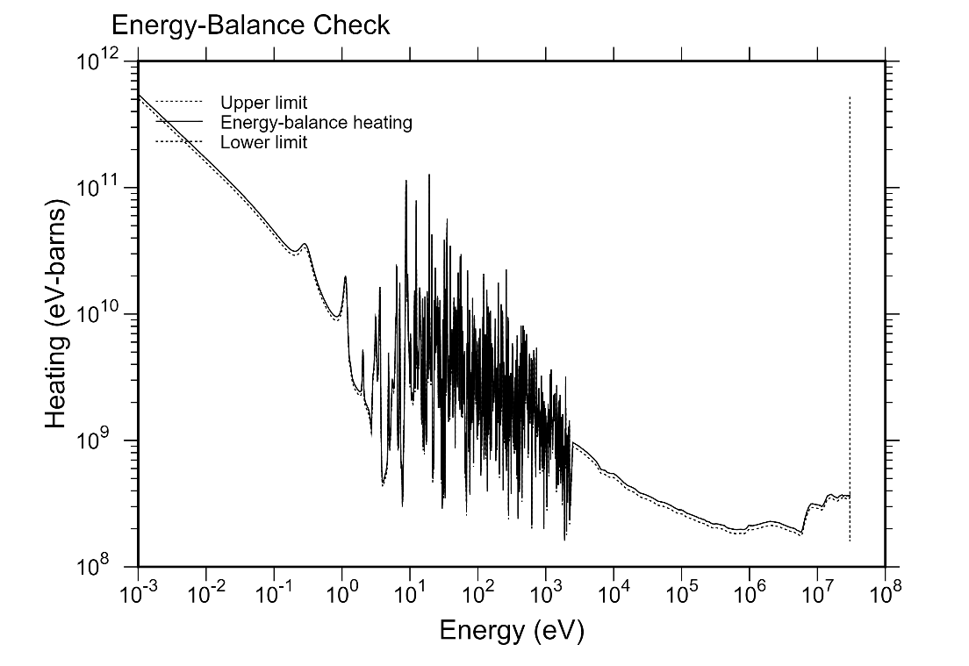
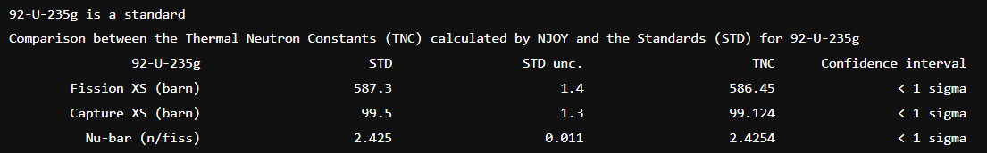
The NEA Processing pipeline
Reconstruction of cross sections from RP
Creation of PENDF on a unionized energy grid
Doppler-broadening of the cross sections in PENDF
Self-shielding in the URR
Generation of heat production XS and radiation damage energy production

Slide 18
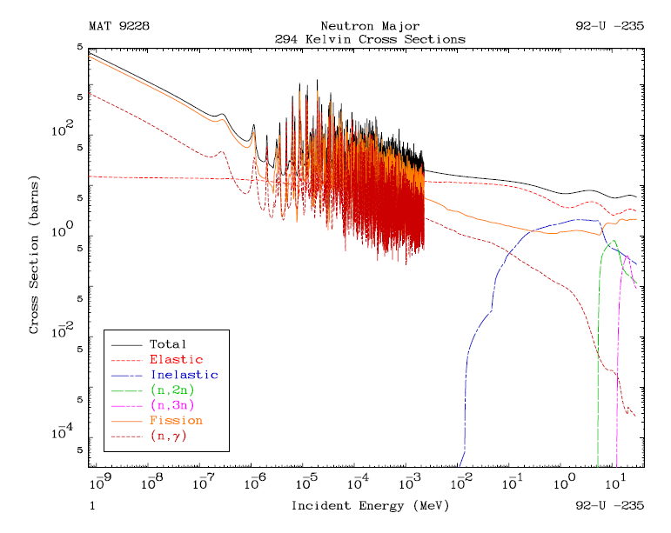
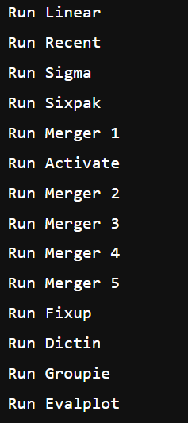
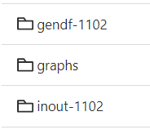
The NEA Processing pipeline
Reconstruction of cross sections from RP
Doppler-broadening of the cross sections in ENDF-6
Generation of activation cross sections (MF=10)
Calculation of self-shielded, multigroup cross sections and multi-band parameters in the ENDF format

Slide 19
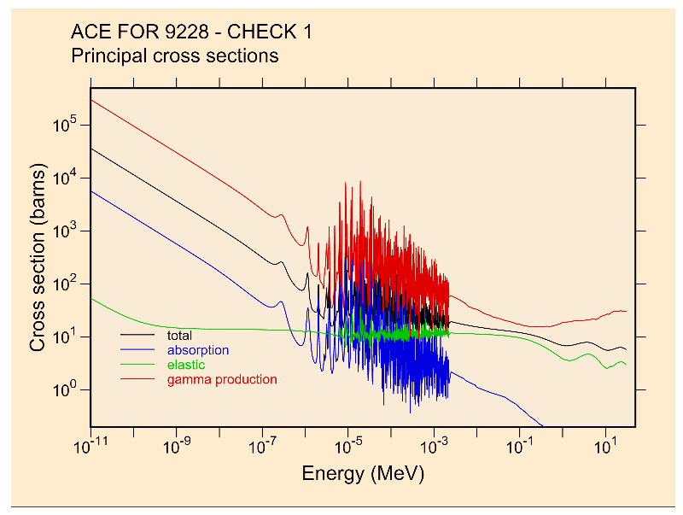
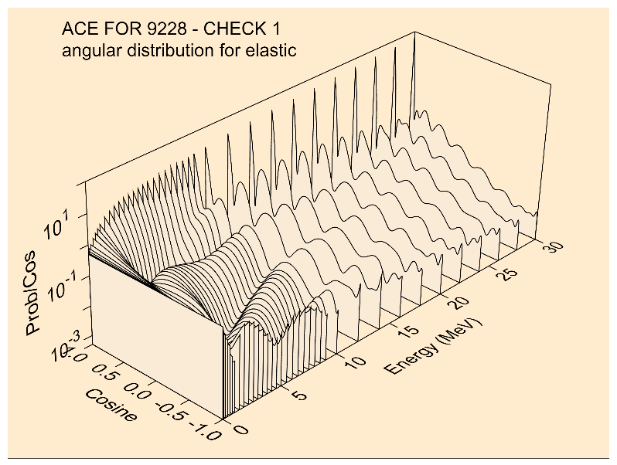
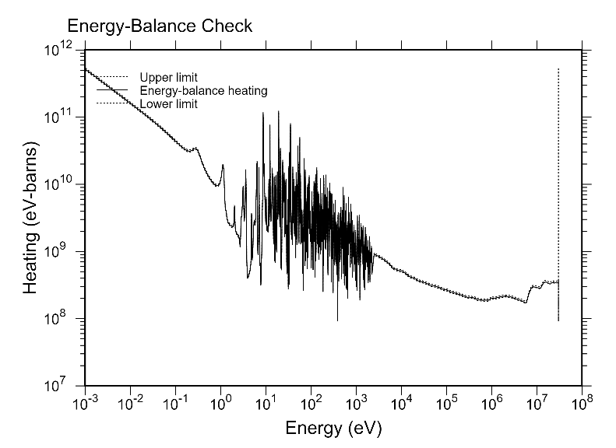
The NEA Processing pipeline
Produce probability tables for the URR self-shielded XS
Create the ACE file

Slide 20

The NEA Processing pipeline
Convert the ACE files into HDF5 format

Slide 21
The NEA Processing pipeline
Format checks
Internal consistency checks
Additional checks
Reconstruction of cross sections from RP
Creation of PENDF on a unionized energy grid
Doppler-broadening of the cross sections in PENDF
Self-shielding in the URR
Generation of heat production XS and radiation damage energy production
Produce probability tables for the URR self-shielded XS
Create the ACE file
Reconstruction of cross sections from RP
Doppler-broadening of the cross sections in ENDF-6
Generation of activation cross sections (MF=10)
Calculation of self-shielded, multigroup cross sections and multi-band parameters in the ENDF format
Convert the ACE files into HDF5 format
Thanks to J-C Sublet for providing his processing routine

Slide 22
The NEA Processing pipeline
TRIPOLI-4
MCNP
Serpent
FISPACT-II
OpenMC

Slide 23
The NEA Processing pipeline
TRIPOLI-4
MCNP
Serpent
AMPX
FISPACT-II
SCALE
OpenMC
For further information about AMPX processing, contact andrew.holcomb@oecd-nea.org

Slide 24
The NEA Processing pipeline
MCNP
Serpent
The pipeline is designed by the JEFF community for the JEFF community
TRIPOLI-4
AMPX
FISPACT-II
SCALE
OpenMC
For further information about AMPX processing, contact andrew.holcomb@oecd-nea.org

Slide 25
3) The NEA Verification and Validation pipelines

Slide 26

The NEA Verification pipeline
Verify that the processed data can be loaded and used by the codes
Currently, the NEA has verification tests configured for SCALE and Serpent
Note that this kind of tests does not provide any information about the quality of the data
For further information about the NEA Verification pipeline, contact andrew.holcomb@oecd-nea.org

Slide 27
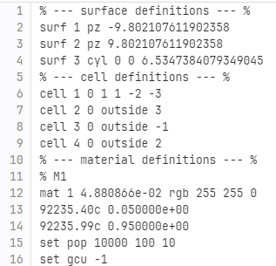
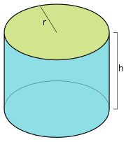
The NEA Verification pipeline
SERPENT
Continuous energy keff calculation
95 at% of U-235 from ENDF/B-VII.1
5 at% of the isotope to test
Simple geometry (cylinder)
SCALE
For thermal spectra:
Infinite homogeneous configuration
U-235
H in H2O
Isotope to test
For fast spectra:
Cf-252 source
Sphere of the isotope to test
Leakage through the sphere
This work will be presented by Andrew Holcomb at the 12th International Conference on Nuclear Criticality Safety (ICNC 2023), 1-6 October 2023, Sendai, Japan

Slide 28

The NEA Validation pipeline
Assess the quality of the nuclear data through comparison with experimentally measured quantities of interest
ICSBEP: International Criticality Safety Benchmark Evaluation Project
SINBAD: Shielding Integral Benchmark Archive and Database
SFCOMPO: Spent Fuel Isotopic Composition database
For further information about the NEA Validation pipeline, contact andrew.holcomb@oecd-nea.org

Slide 29
The NEA Validation pipeline
In the framework of WPEC-SG-45 (Validation of Nuclear Data Libraries project), about 5000 ICSBEP MCNP inputs were collected
About 600 of them were automatically converted to Serpent input using the csg2csg tool and are fully functional
Many others were partially converted but require further work to become functional
For further information about the NEA Validation pipeline, contact andrew.holcomb@oecd-nea.org

Slide 30
The NEA Validation pipeline
In the framework of WPEC-SG-45 (Validation of Nuclear Data Libraries project), about 5000 ICSBEP MCNP inputs were collected
About 600 of them were automatically converted to Serpent input using the csg2csg tool and are fully functional
Many others were partially converted but require further work to become functional
Available in the NEA GitLab to all users having a valid Serpent license
For further information about the NEA Validation pipeline, contact andrew.holcomb@oecd-nea.org

Slide 31
4) Conclusions and future work

Slide 32

Conclusions
The NEA has invested considerable resources and time to modernize the evaluation, processing, verification, validation, and distribution of nuclear data

Slide 33

Conclusions
The files are processed according to community-approved methods, incorporating the most up-to-date knowledge. As a result, the processed files offered by the NEA represent the highest quality available
To date, the NEA system can been used to process, test, and deploy neutron cross-section libraries for MCNP, Serpent, TRIPOLI-4, FISPACT-II, OpenMC, and SCALE

Slide 34

Conclusions
The implementation of the NEA pipeline for file processing eliminates potential bias and ensures that comparisons solely concentrate on the actual data
By prioritizing transparency and reproducibility at every stage of the process, the NEA has paved the way for a more reliable and accessible data
Thanks to GitLab and SharePoint, the JEFF community benefits from immediate access to preliminary data and results, promoting fast and transparent information sharing.

Slide 35
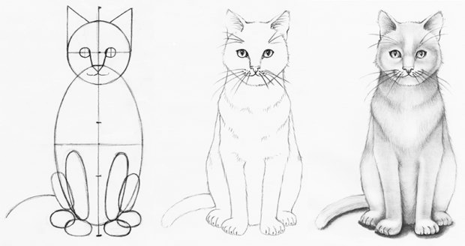
Future work
The NEA Databank aims to broaden the scope of its system to encompass additional:
  nuclear data processing codes (GALILEE-1)
  neutron codes for V&V (MCNP, TRIPOLI-4)
  validation suites (SINBAD, SFCOMPO)
  nuclear data libraries (ENDF, JENDL)
This expansion is intended to offer the international nuclear engineering community the most comprehensive and inclusive publicly accessible data.

Slide 36
Thank you for your attention
Please contact daniela.foligno@oecd-nea.org if you have any questions or comments regarding this presentation.

