Slide 1

Improvements on the damage calculations using evaluated nuclear data and NJOY
Shengli Chen¹, David Bernard²
¹ Sino-French Institute of Nuclear Engineering & Technology, Sun Yat-sen University, China
² CEA, IRESNE, DER/SPRC/LEPh, Cadarache, France
June 7, 2023
Aix-en-Provence, France

Slide 2
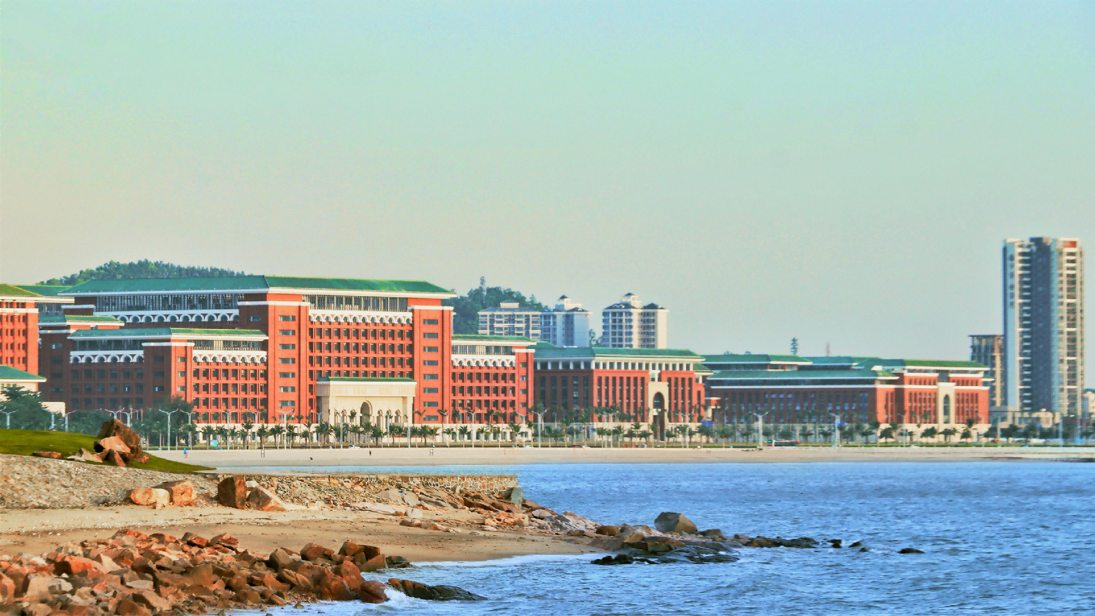
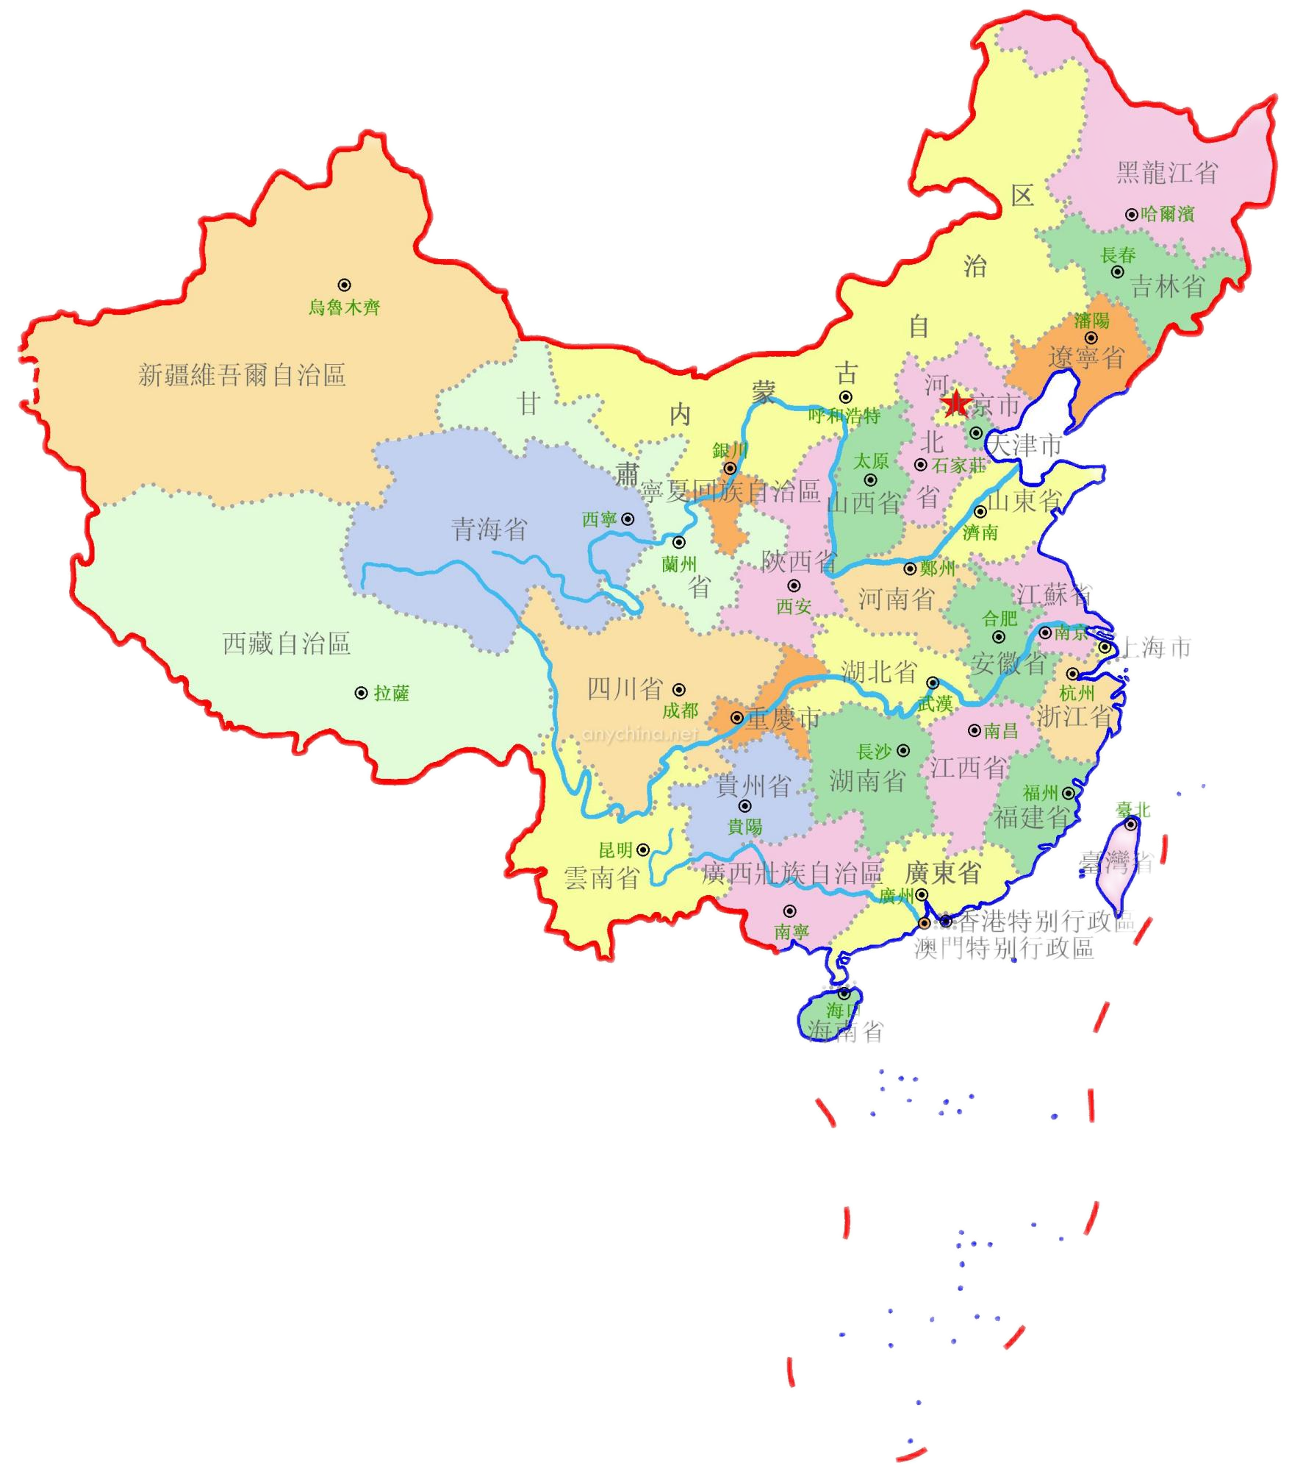
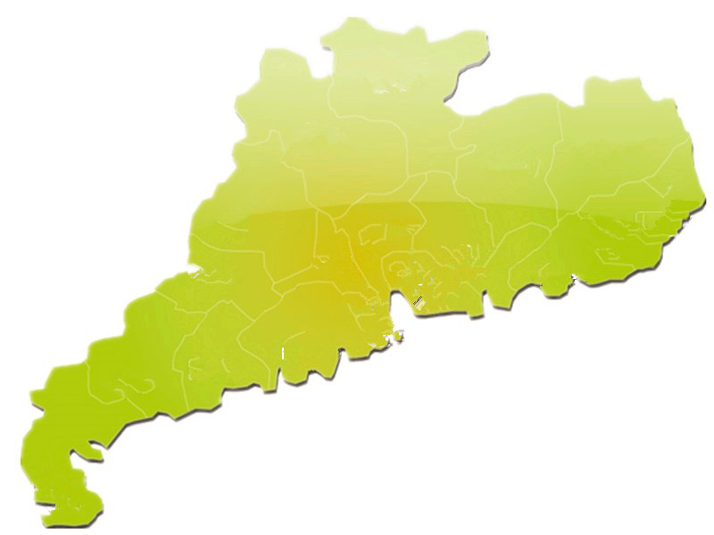
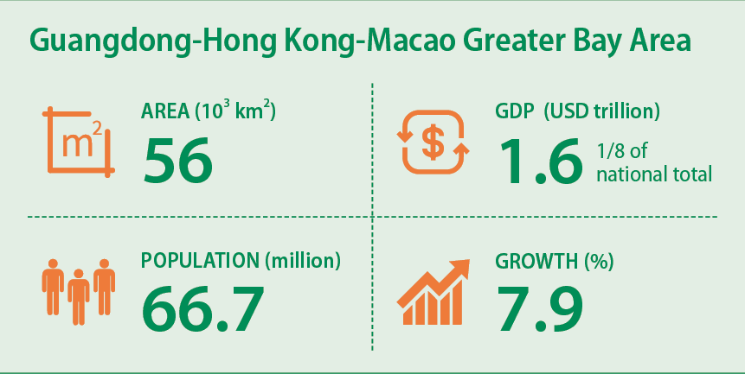
Institut franco-chinois de l'énergie nucléaire (IFCEN)
Sun Yat-sen University
1 University, 3 Cities & 5 Campuses
广州
Guangzhou
深圳
Shenzhen
珠海
Zhuhai
IFCEN in Zhuhai
Sino-French Institute of Nuclear Engineering &Technology (IFCEN) (Zhuhai)

Slide 3
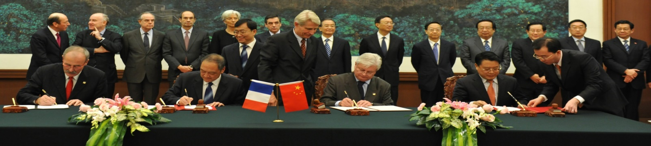




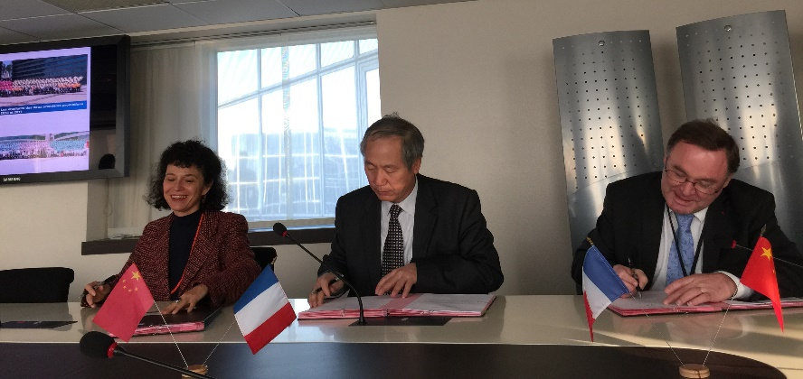

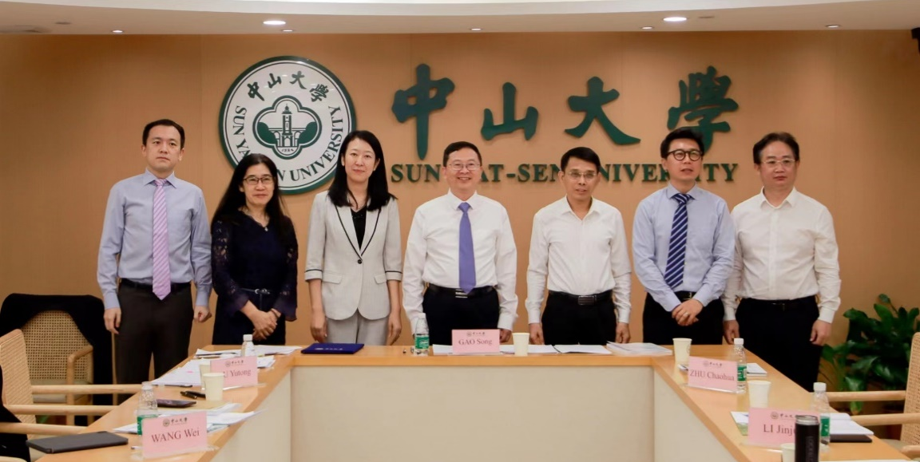

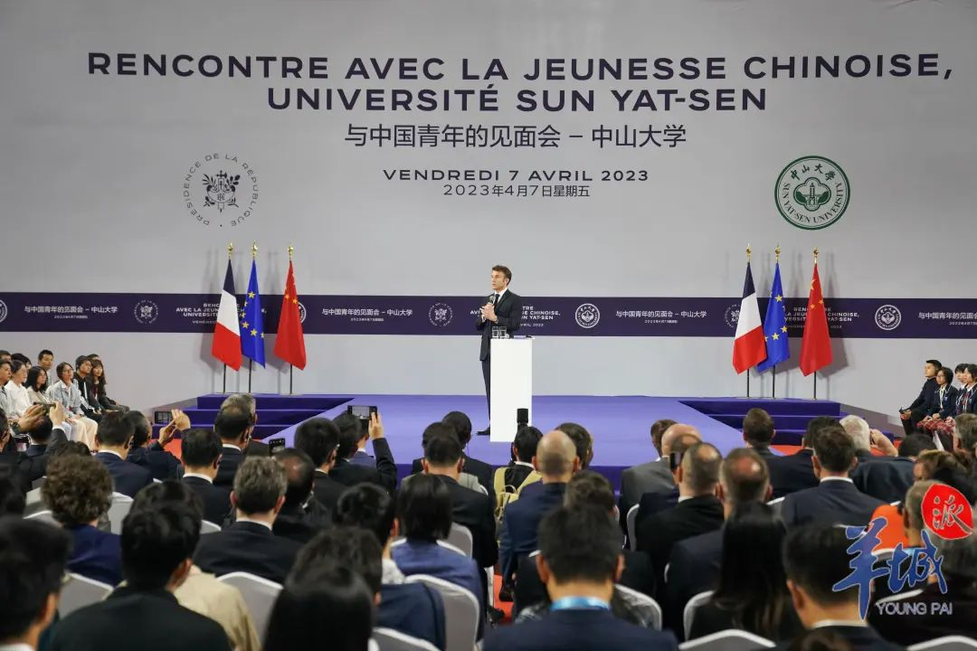
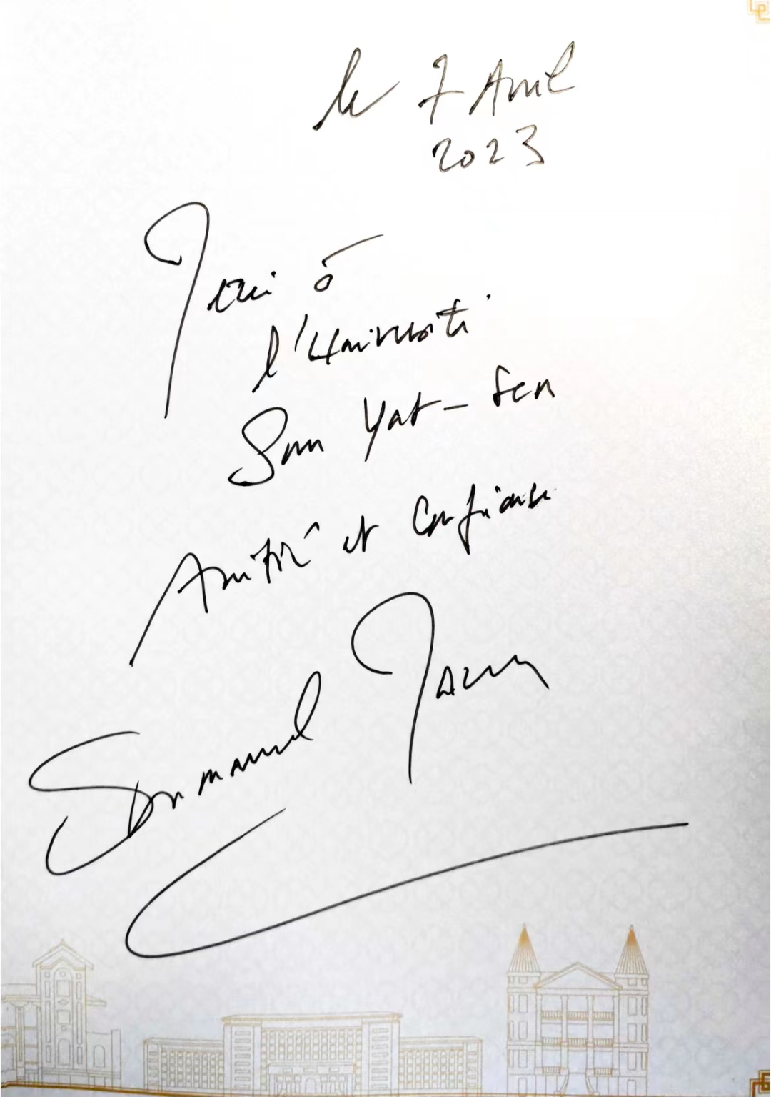

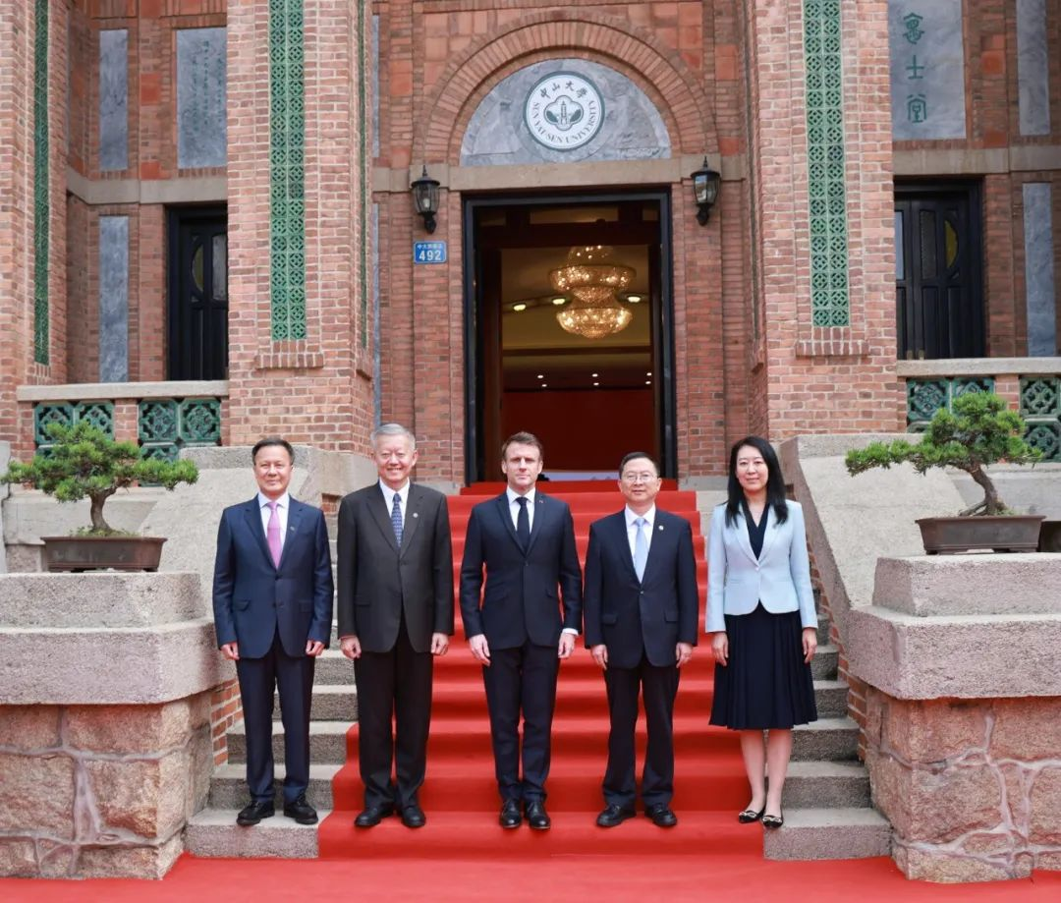
  Grenoble INP-UGA
  CEA-ISTN
2009：Witnessed by prime ministers of both China and France, SYSU and FINUCI Created IFCEN Jointly on SYSU Zhuhai Campus
  IMT Atlantique
  Ecole de Chimie
  de Montpellier
2015
Phase II agreement signed
  Ecole de Chimie
  de Paris
2022
Phase III agreement signed

Slide 4
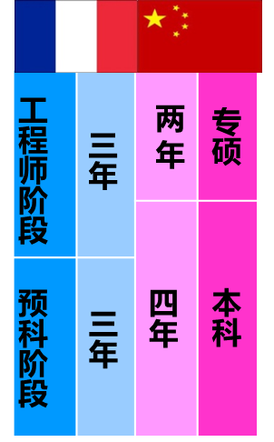
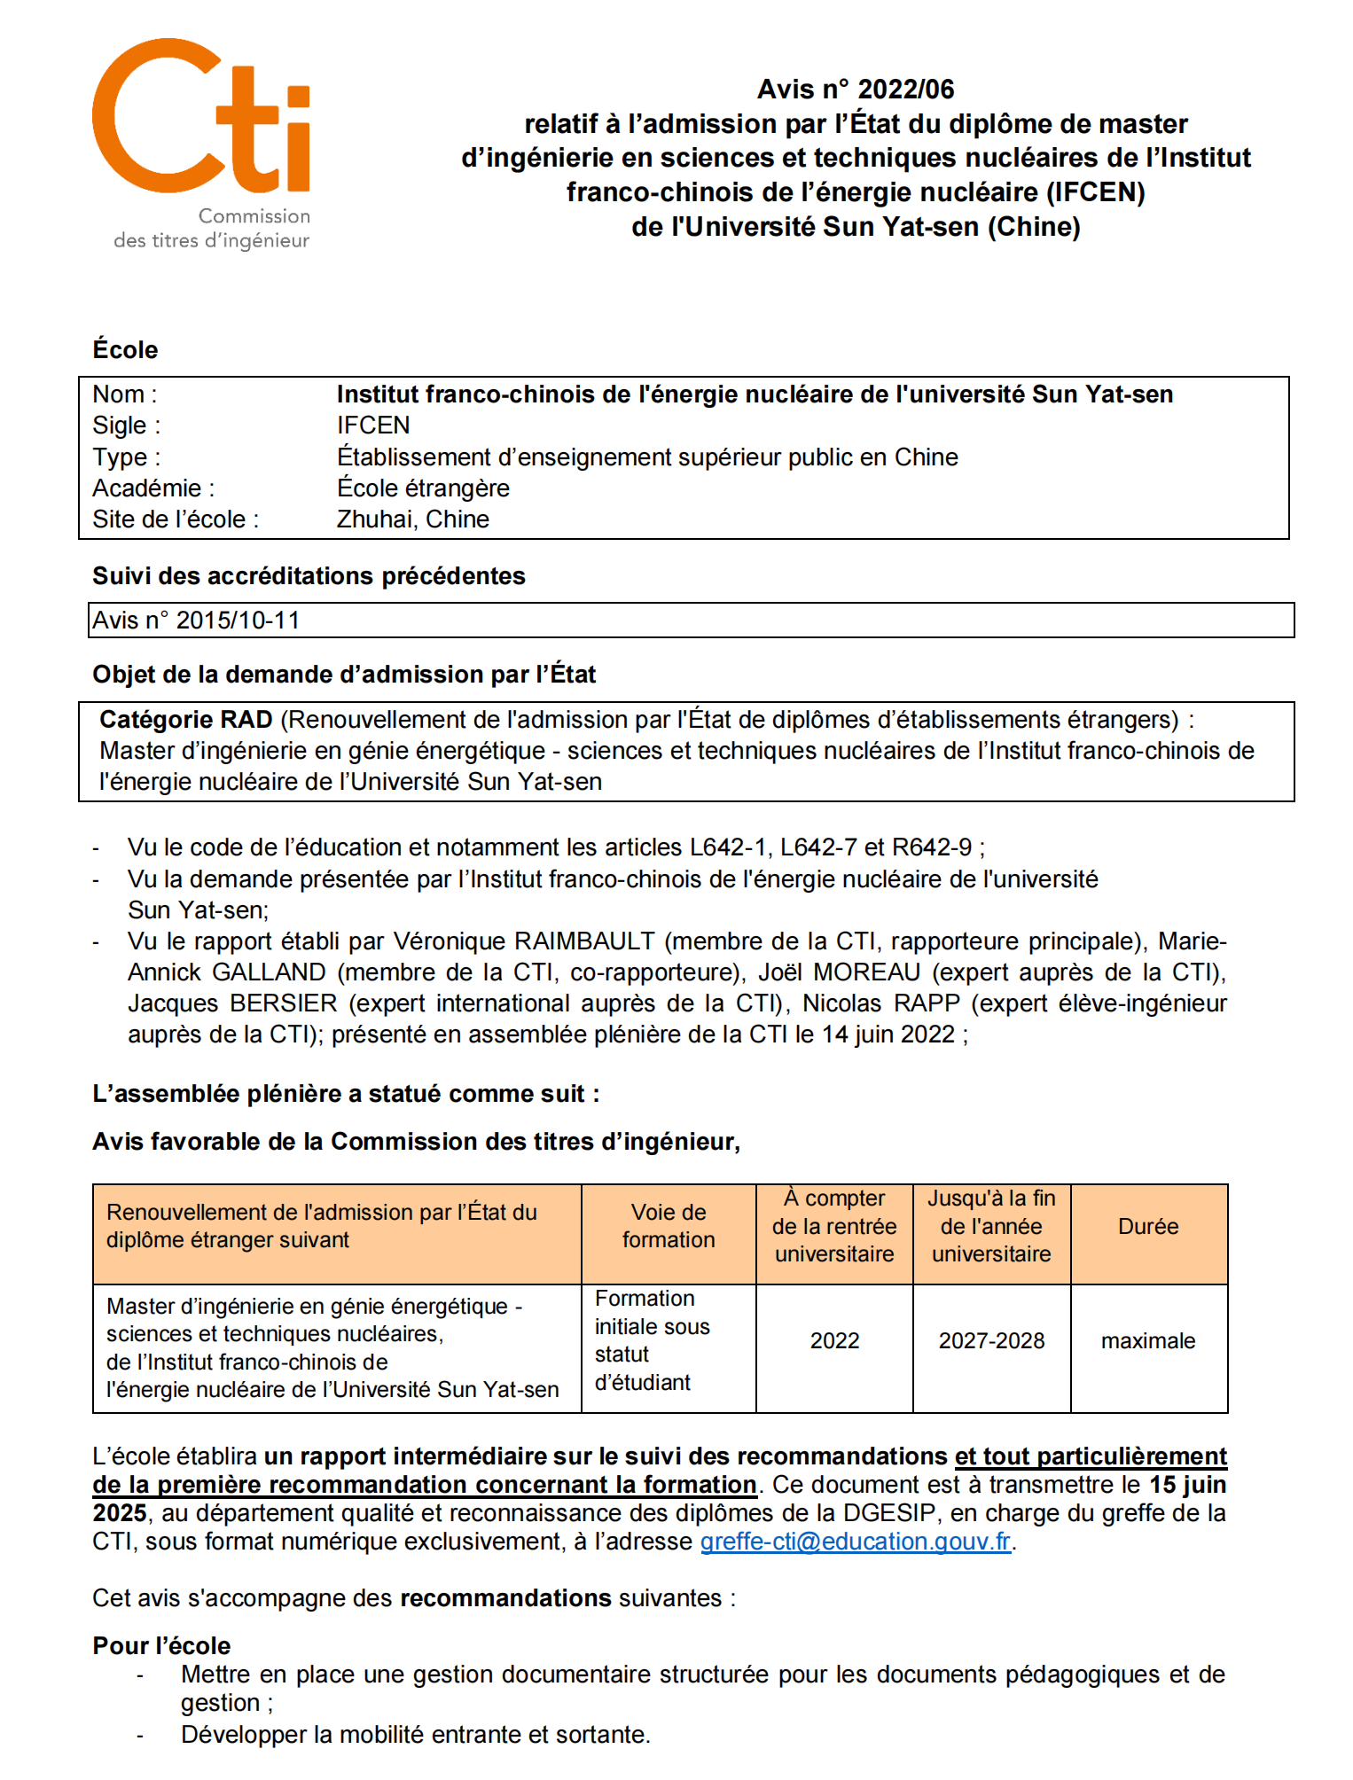
A Fused Sino-French System
卢鹤绂院士
Sino-French Cooperation
(French as the first foreign language)
3+3 4+2
2010-2020
Training in big academic subjects
Sino-French cooperation integration
（French as a second foreign language）
1+3+3 since 2021
Improvement:
A Fused System
中国“核能之父”
3 years preparatory cycle
1 year undergraduate
Training in Guangzhou south campus
“第一个揭露原子弹秘密的人”
3 years engineering cycle
3 years undergraduate college training
Sino-French cooperation integration
3 years master
From other bachelor program
SYSU
Characteristics
卢鹤绂教授坪石授课
Professional
Master
Undergraduate
Professional
Master
Undergraduate
Two-year
system
Four-year system
Three years
In China
Three years
In China
One year
Training in
big academic
subjects
(south campus
in Guangzhou)
3 years
3 years
3 years of Sino-
French excellence
3 years of Sino-
French excellence
Engineering cycle
Preparatory cycle
Engineering
Preparatory
French preparatory
& engineering education model
China undergraduate
& master
education model
CTI Accreditation Renewal in 2022:
A 6-Year accreditation received --- the longest possible!
The high-quality of the IFCEN program fully recognized!

Slide 5
ND @ IFCEN: Summary and Prospect
IFCEN is prepared for nuclear data education and research (theory, experiment, structure and decay, fission and reaction), chance to construct the unique sub-major in China
Hope to obtain help from other collaborators
Education:
  Introduction to Nuclear Physics and Nuclear Data: 14 sessions for nuclear data part
  Introduction and Application of Nuclear Data: 36 sessions
  Nuclear Data Acquisition and Processing: 54 sessions
  Lectures to colleagues and students for general introduction to nuclear data
Research:
  Nuclear structure data evaluation system
  Machine learning based nuclear data evaluation and application
  Macroscopic validation
  Associate Professor (9): Cenxi YUAN, Jun SU, Long ZHU, Wei HUA, Bo MEI
  Assistant Professor (2): Shengli CHEN

Slide 6
Outline
Introduction of damage cross section
Two-body reaction-induced
Neutron capture reaction-induced
N-body reaction-induced
Conclusions

Slide 7
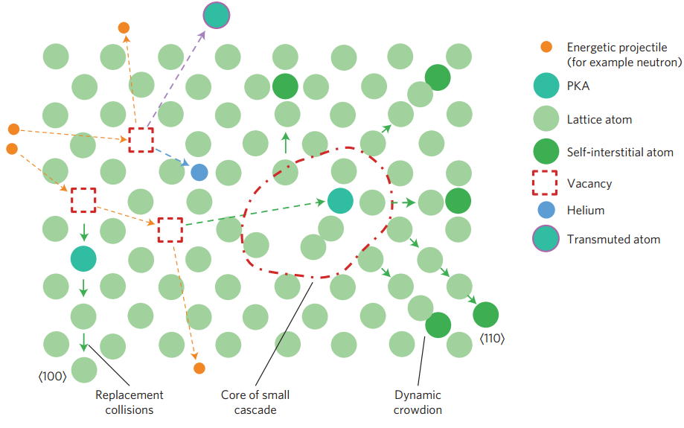
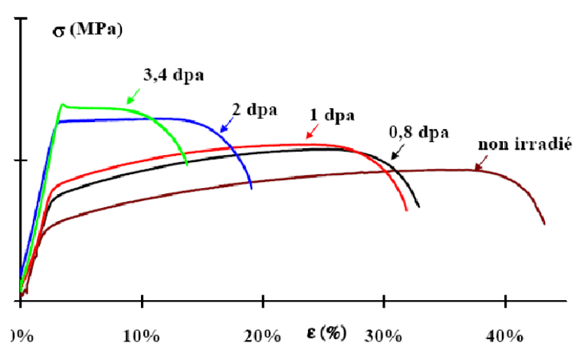
(Neutron) irradiation damage
Atomic displacements
Light emitted particle
Incident particle
Target nucleus
(e.g., n, γ e⁻, e⁺, X^{n+})
Recoil nucleus (= PKA)
@Knaster2016NatPhys
304 stainless steel irradiated in OSIRIS at 330 ℃ and tested at 330 ℃
Atoms in lattice
Displacement per Atom (DPA)
PKA: Primary Knock-on Atom
@Averty1998Fontevraud4

Slide 8
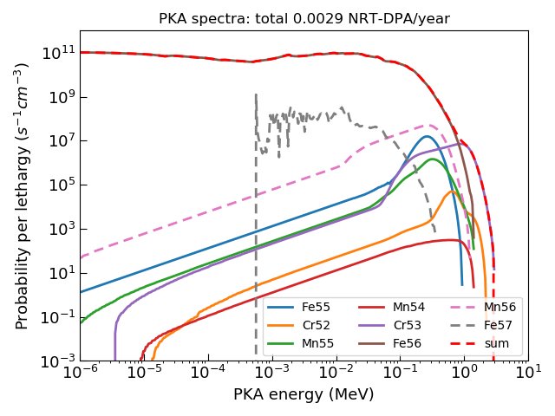


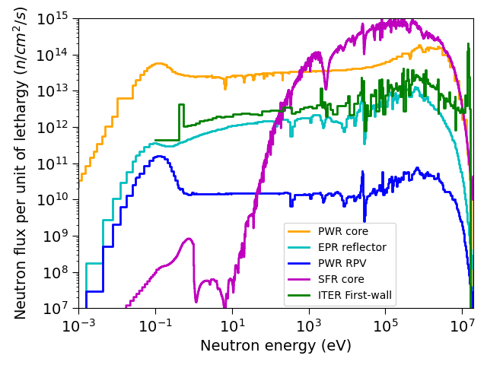
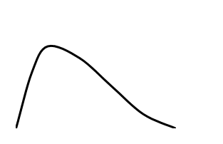
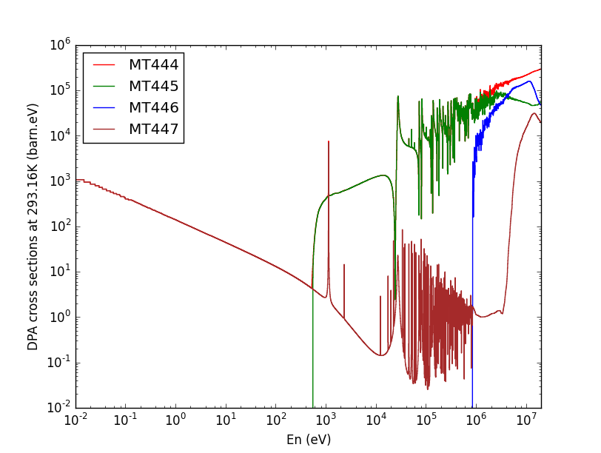
Two paths to compute neutron irradiation damage
PKA spectra
channel 1
Radiation damage model
Recoil energy
channel 2
Incident neutron
Target nucleus
Recoil energy
Neutron flux
…
…
channel n
Radiation damage
Recoil energy
Radiation damage model
Damage cross sections
Flux independent
Chen, Nucl. Instrum. Methods B, 508: 41-48, 2021
8

Slide 9
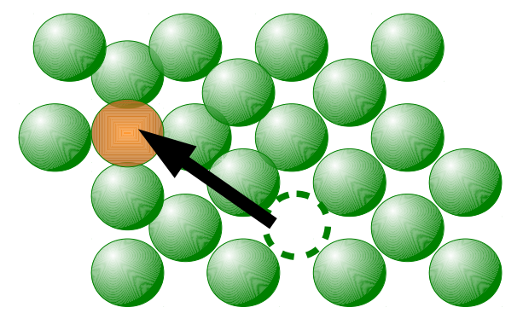
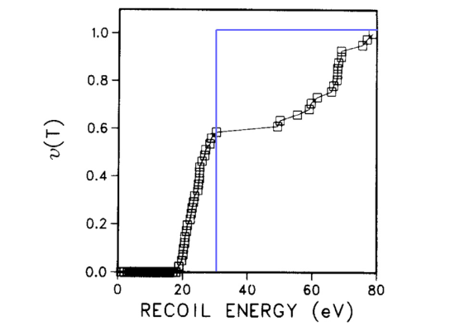
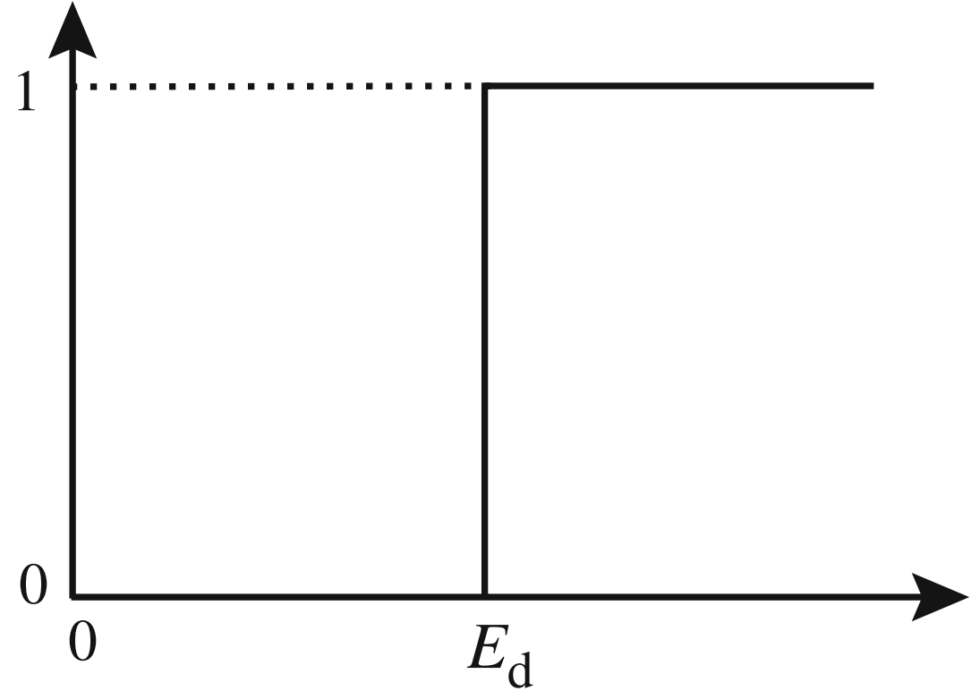
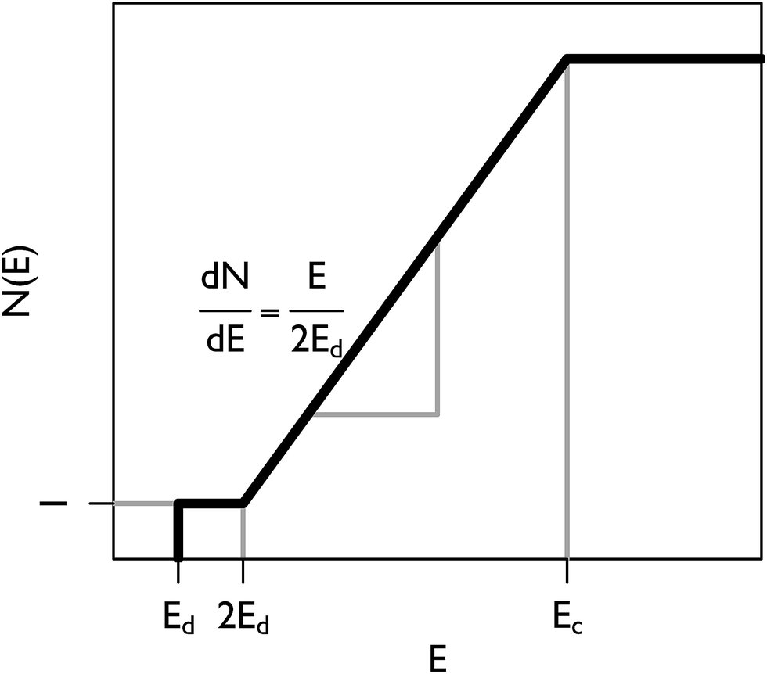
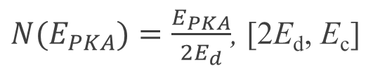
Threshold displacement energy and Kinchin-Pease model
Probability of displacement
Step function approach
Exp. Data of Cu
E-E_{d}
E
@King1983JNM
E_{d}
PKA
Number of displacement
Boundary condition:
N(2E_{d}) = 1
E - E_{d} < E_{d}
2E_{d} Energy
$N(E_{PKA})=\frac{E_{PKA}}{2E_{d}}$, [2E_{d}, E_{c}]

Slide 10
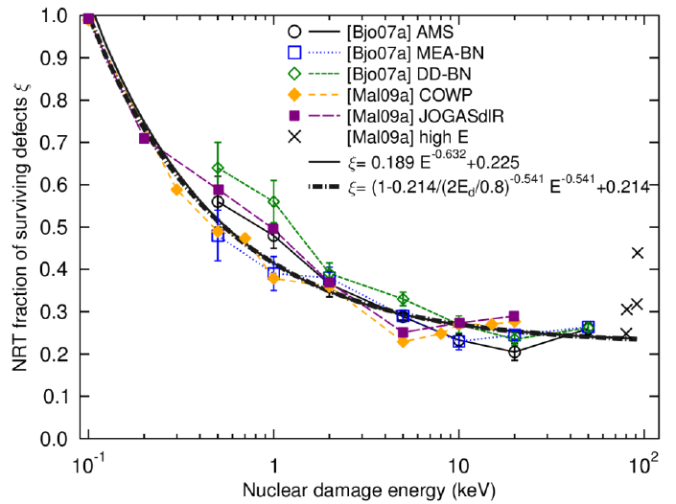


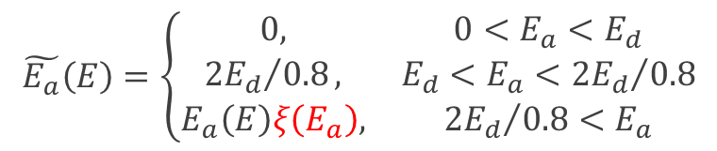

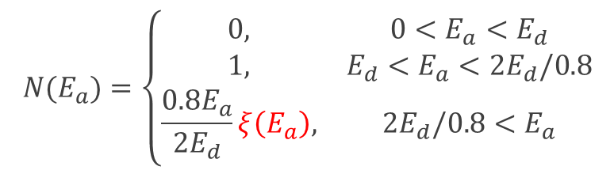
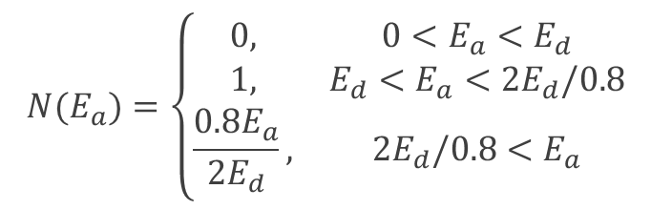
Currant DPA formulae and generalized damage energy
Norgett-Robinson-Torrens (NRT-DPA) (1975)
Damage energy: $E_{a}=E_{PKA}×PF\left(E_{PKA}\right)$
$$N(E_{a})=\left\{\begin{matrix}0, & 0<E_{a}<E_{d} \\ 1, & E_{d}<E_{a}<{2E}_{d}/0.8 \\ \frac{{0.8E}_{a}}{2E_{d}}, & {2E}_{d}/0.8<E_{a}\end{matrix}\right.$$
PF: atomic displacement
$$E_{PKA}$$
(1 – PF): electronic excitation/ionization
Athermal Recombination-Corrected (ARC-DPA) (2015)
$$N(E_{a})=\left\{\begin{matrix}0, & 0<E_{a}<E_{d} \\ 1, & E_{d}<E_{a}<{2E}_{d}/0.8 \\ \frac{{0.8E}_{a}}{2E_{d}}ξ\left(E_{a}\right), & {2E}_{d}/0.8<E_{a}\end{matrix}\right.$$
Use of generalized damage energy (GDE):
$$\tilde{E_{a}}\left(E\right)=\left\{\begin{matrix}0, & 0<E_{a}<E_{d} \\ {{2E}_{d}}/{0.8}, & E_{d}<E_{a}<{{2E}_{d}}/{0.8} \\ E_{a}\left(E\right)ξ\left(E_{a}\right), & {{2E}_{d}}/{0.8}<E_{a}\end{matrix}\right.$$
$$N=0.8\tilde{E_{a}}/2E_{d}$$
A unique form!

Slide 11
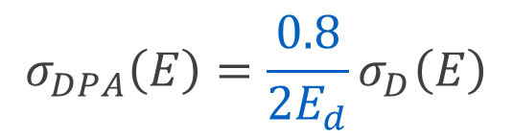
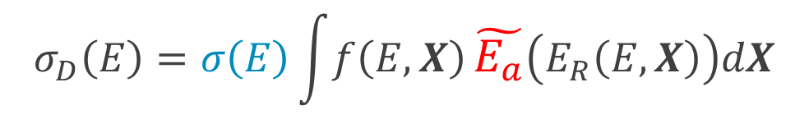

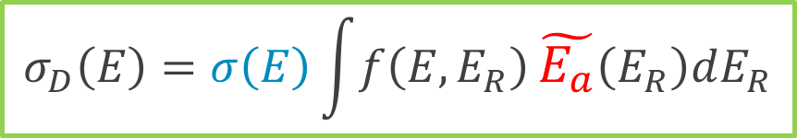
Damage cross section based on GDE
Damage (energy) cross section:
Vector including all free parameters
Reaction XS
$$σ_{D}\left(E\right)=σ\left(E\right)\int{f\left(E,X\right)}\tilde{E_{a}}\left(E_{R}\left(E,X\right)\right)dX$$
Normalized differential XS
$$σ_{D}\left(E\right)=σ\left(E\right)\int{f\left(E,E_{R}\right)}\tilde{E_{a}}\left(E_{R}\right)dE_{R}$$
With reliable recoil spectra
DPA XS and damage XS for monatomic materials:
$$σ_{DPA}\left(E\right)=\frac{0.8}{2E_{d}}σ_{D}\left(E\right)$$
$$N=0.8\tilde{E_{a}}/2E_{d}$$

Slide 12

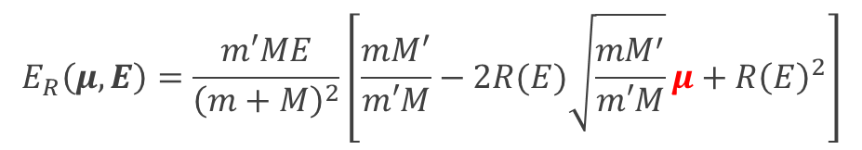

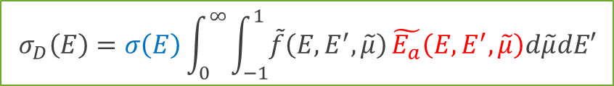
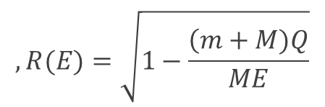

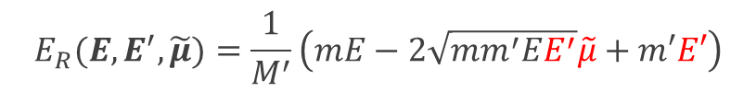


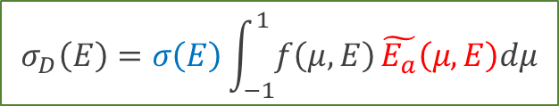

Two-body reaction-induced: theory
Discrete reactions:
$$E_{R}\left(μ,E\right)=\frac{m′ME}{{\left(m+M\right)}^{2}}\left[\frac{mM^{′}}{m′M}−2R(E)\sqrt{\frac{mM^{′}}{m′M}}μ+{R\left(E\right)}^{2}\right]$$
$$,R(E)=\sqrt{1−\frac{\left(m+M)Q\right.}{ME}}$$
Calculation of damage cross section:
m', u₁
u₁
v'
$$σ_{D}\left(E\right)=σ\left(E\right)\int_{−1}^{1}{f\left(μ,E\right)}\tilde{E_{a}}\left(μ,E\right)dμ$$
$$μ=cosθ$$
$$θ$$
$$φ$$
m, v₁
CM
v_{CM}
M, v₂
$$θ$$
M’, u₂
u₂
v_{R}
Angular distribution
Continuum reactions:
$$E_{R}(E,E^{′},\tilde{μ})=\frac{1}{M^{′}}\left(mE−2\sqrt{mm^{′}EE^{′}}\tilde{μ}+m′E′\right)$$
$$\tilde{μ}=cosφ$$
m’, E’
$$φ$$
$$σ_{D}\left(E\right)=σ\left(E\right)\int_{0}^{∞}{\int_{−1}^{1}{\tilde{f}\left(E,E^{′},\tilde{μ}\right)}}\tilde{E_{a}}\left(E,E^{′},\tilde{μ}\right)d\tilde{μ}dE′$$
m, E
M, 0
M', E_{R}
Energy-angular distribution
(i.e., double differential cross section, = DDXS)
Chen et al., Nucl. Instrum. Methods B, 456: 120–132, 2019

Slide 13
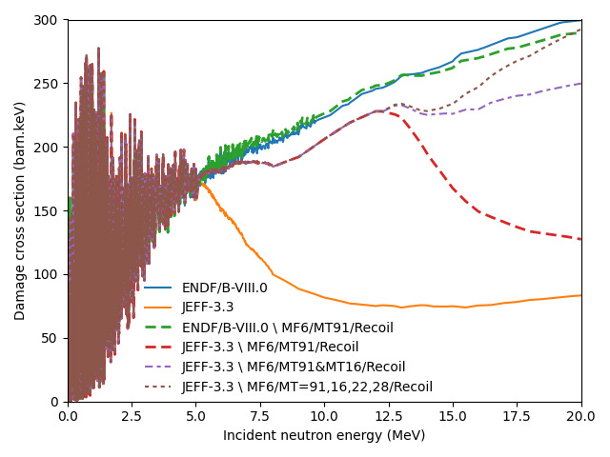
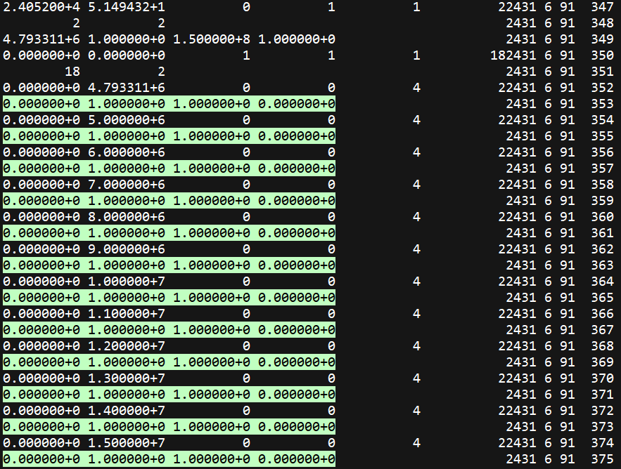
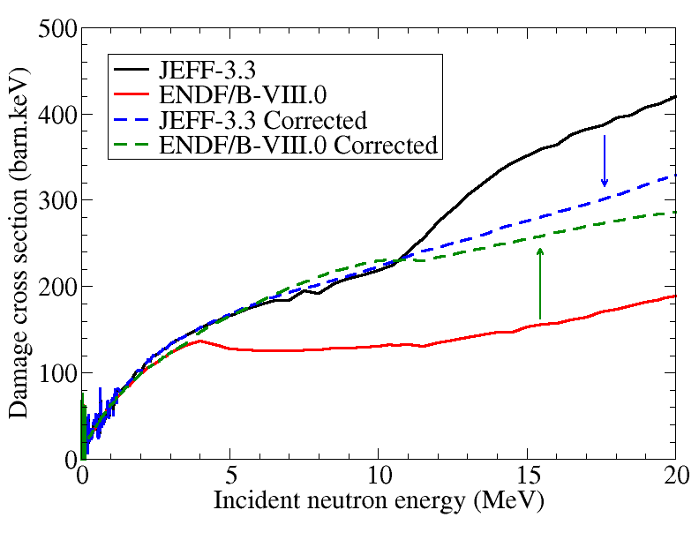
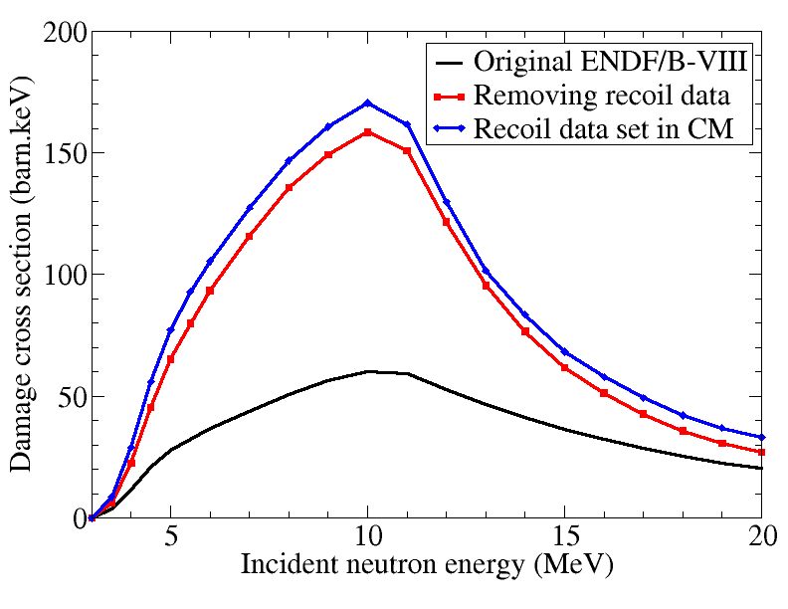
Two-body reaction-induced (1)
⁵²Cr
Incorrect recoil data!
⁵⁵Mn MT91
⁵⁵Mn
Wrong frame
Chen and Bernard, J. Nucl. Mater., 562: 153610, 2022

Slide 14
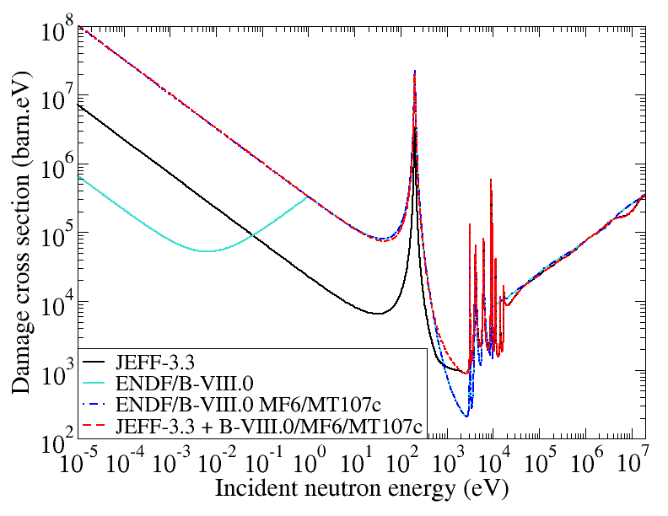
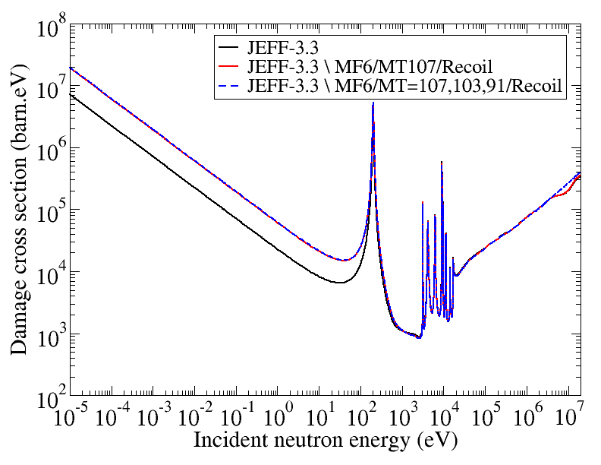
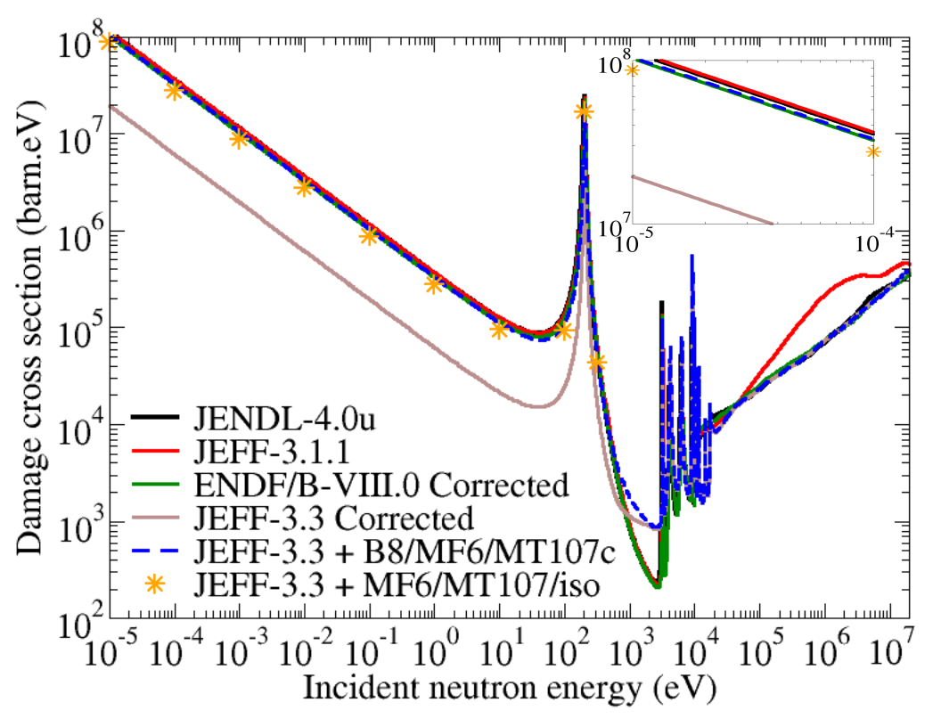
Two-body reaction-induced (2): ⁵⁹Ni
Further (experimental) investigation on the DDXS of the (n,α) reaction
Chen and Bernard, J. Nucl. Mater., 562: 153610, 2022

Slide 15
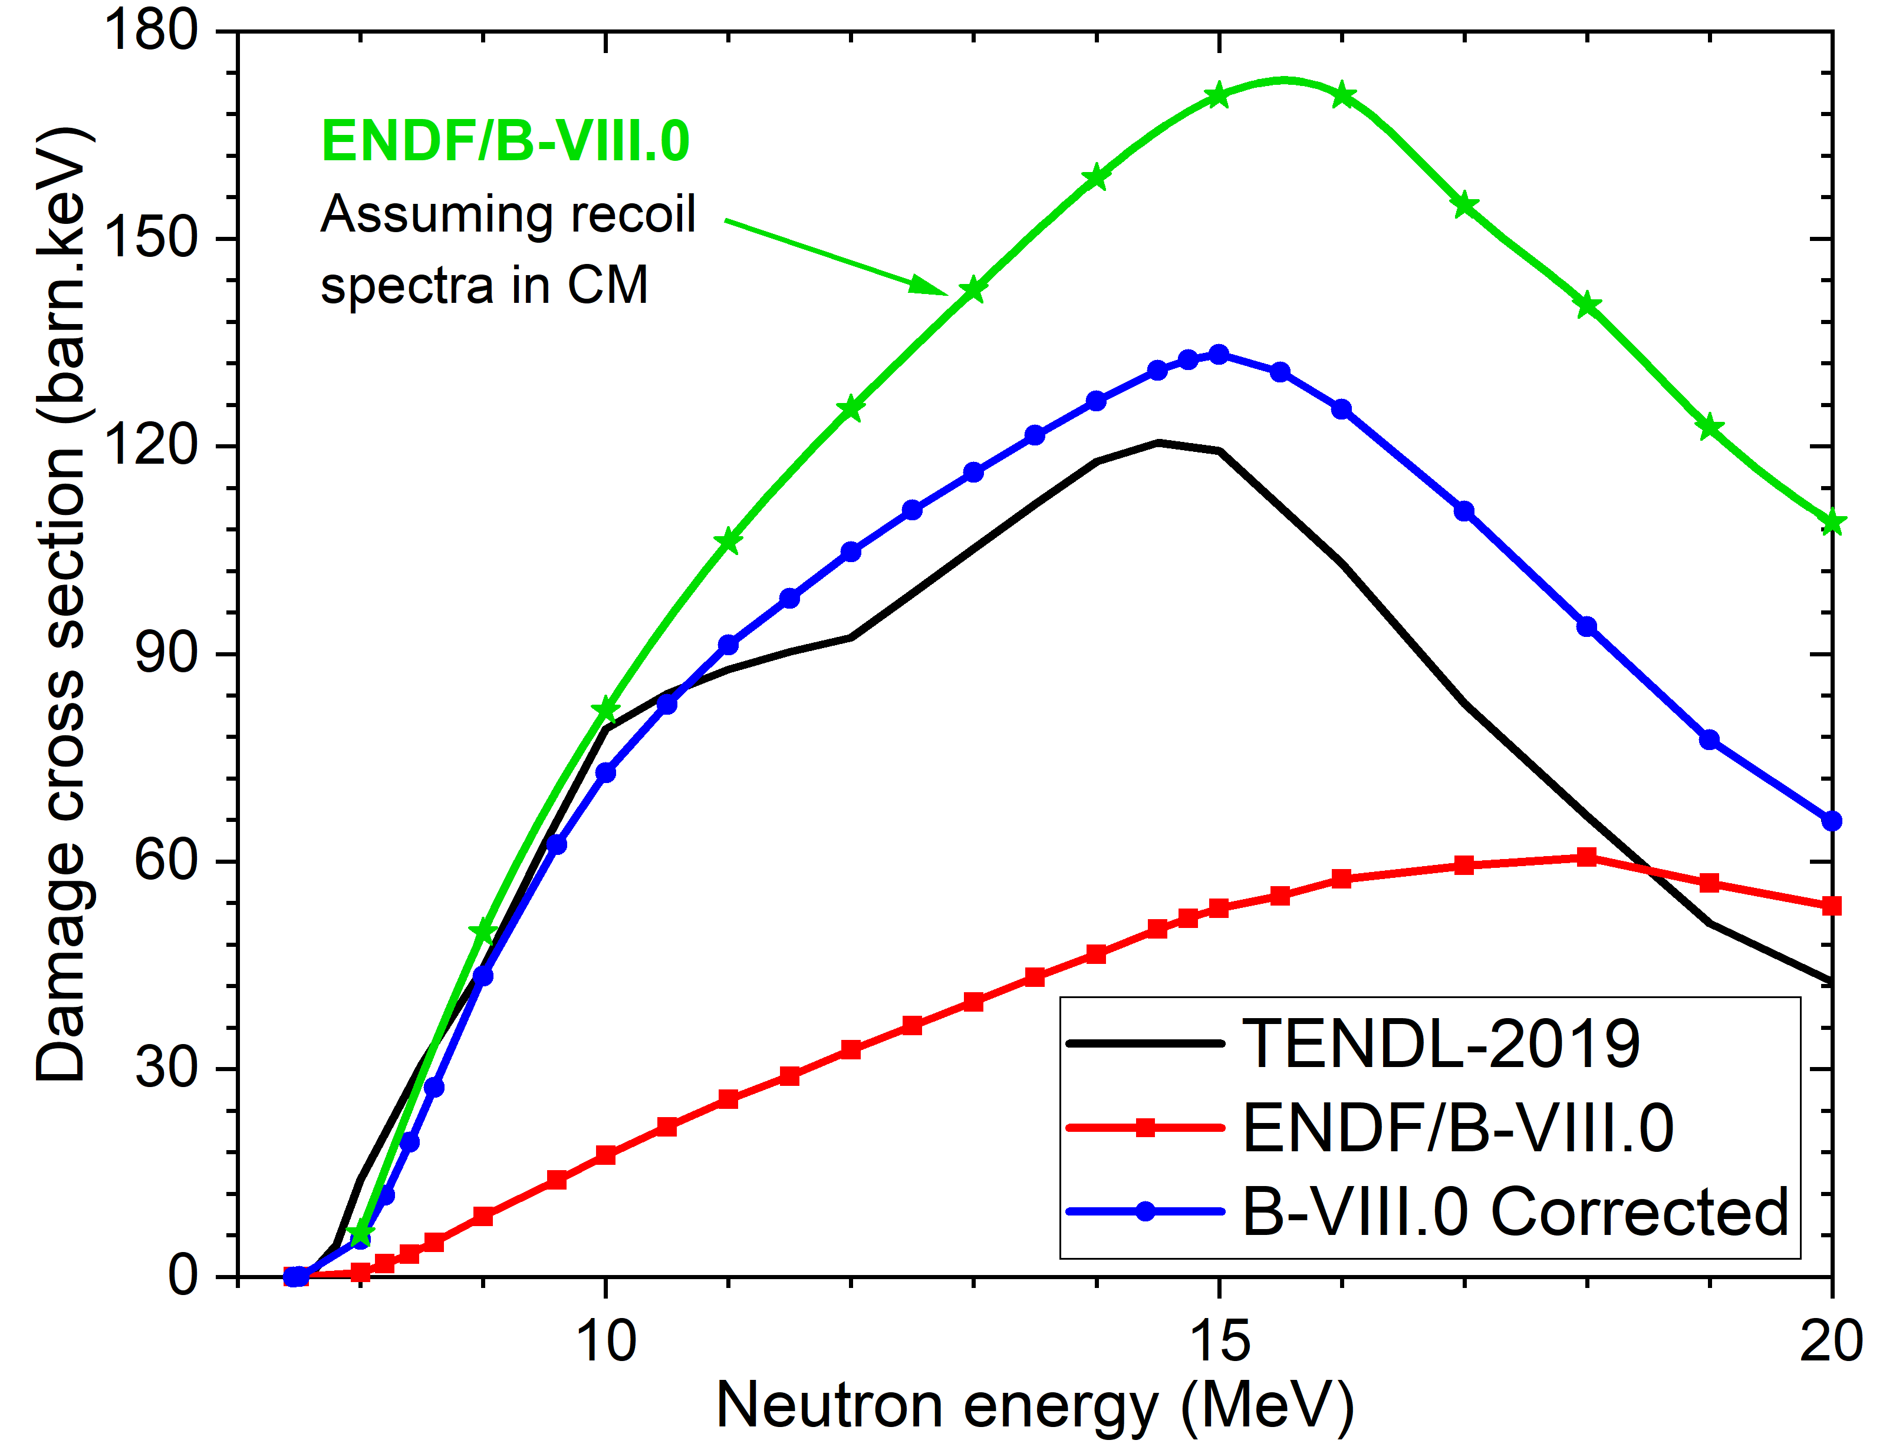
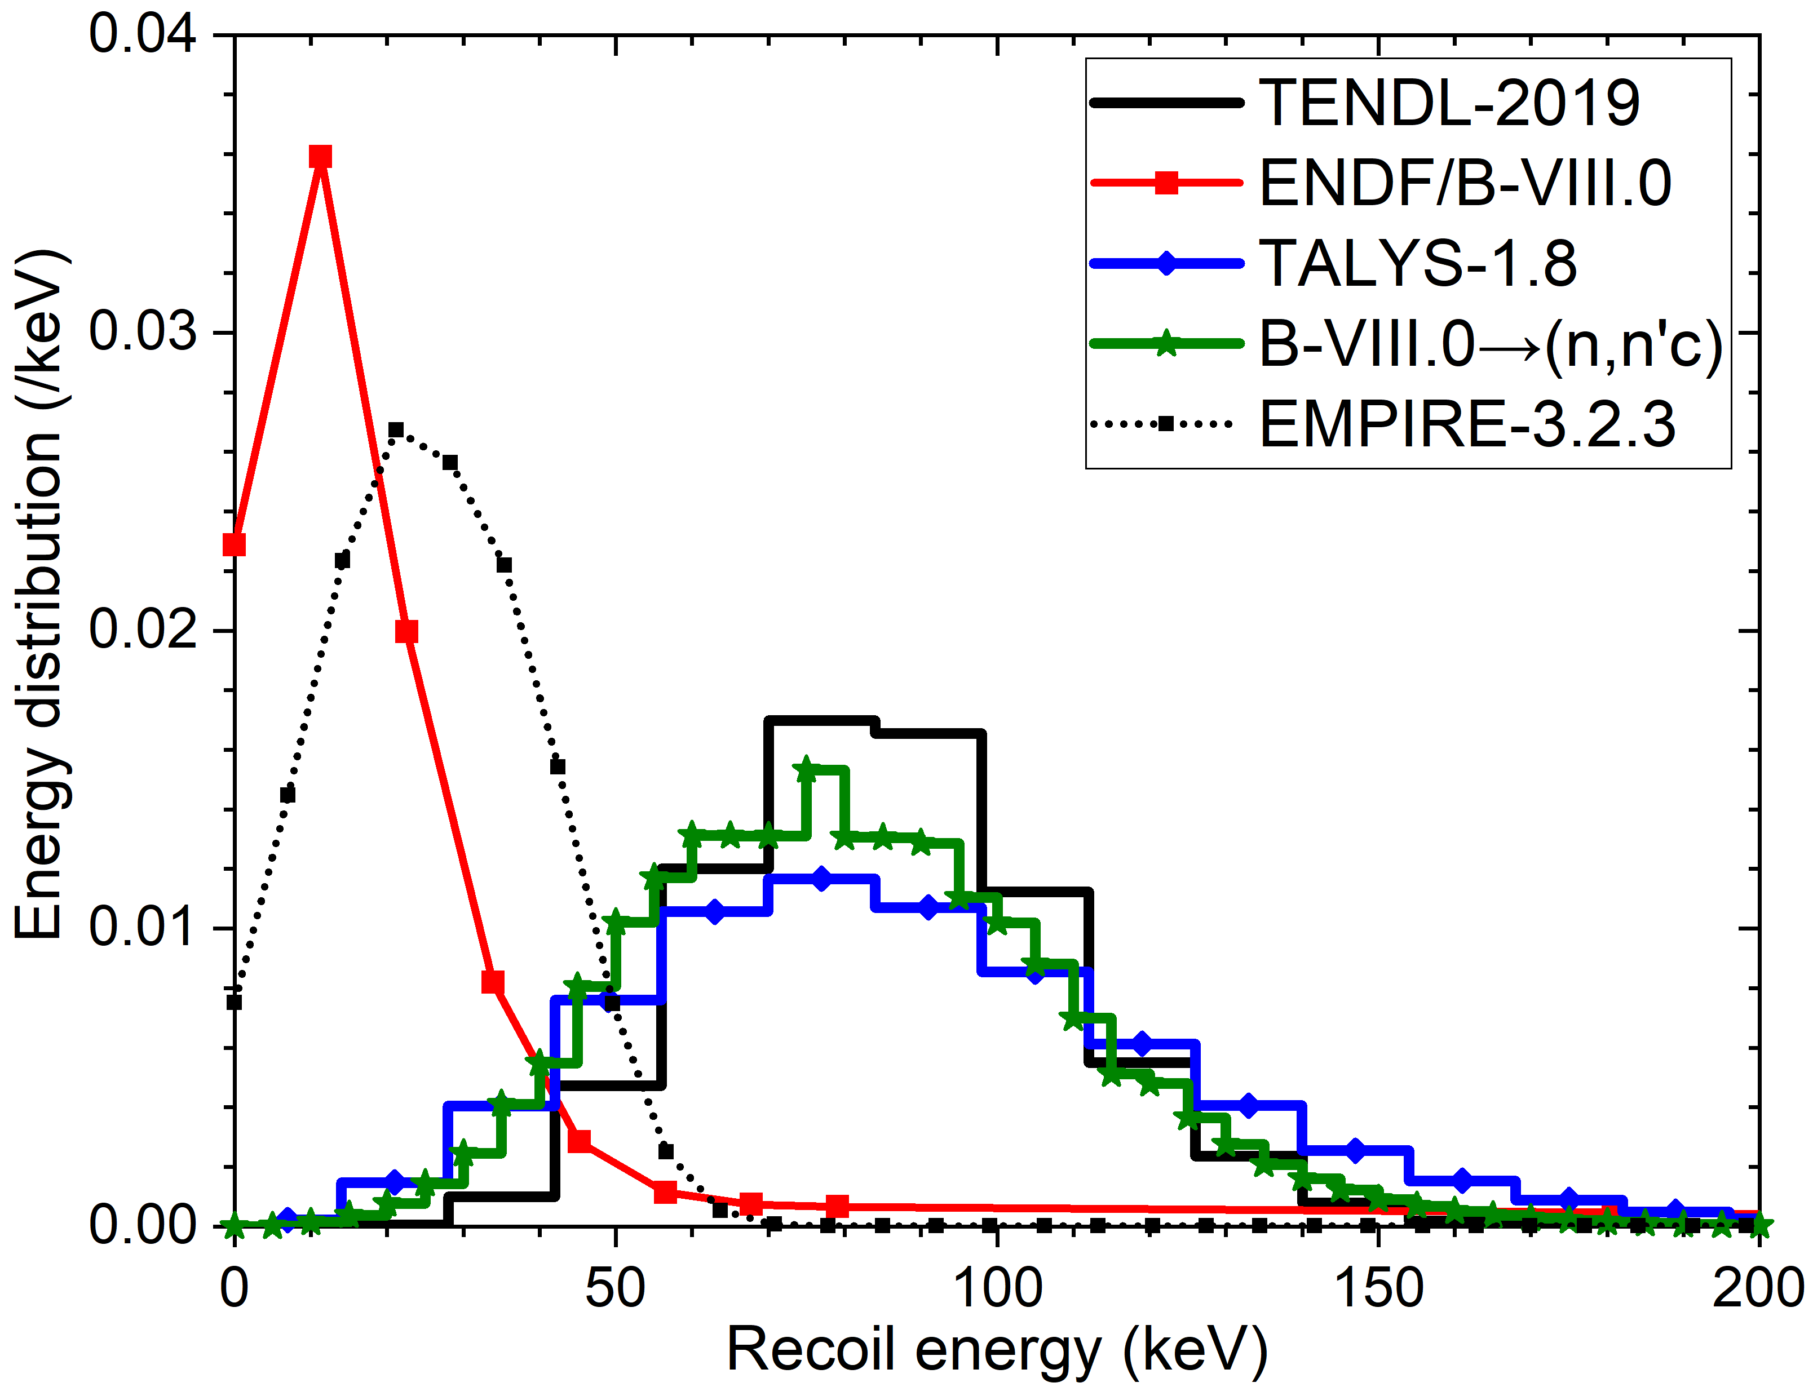
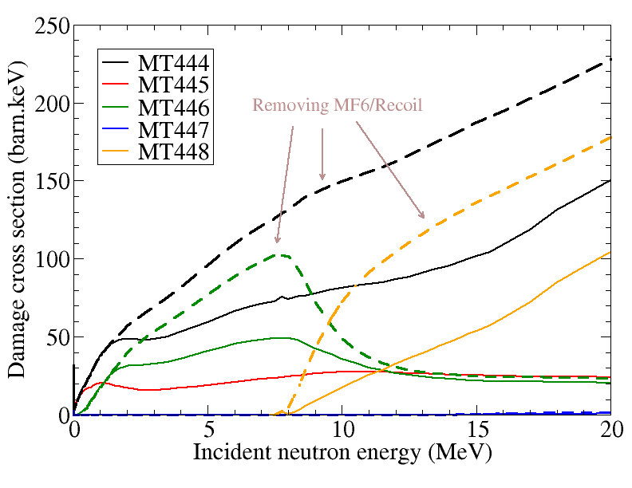
Two-body reaction-induced (3): W in ENDF/B-VIII.0
¹⁸⁴W(n,2n)
14 MeV
Wrong frame?
DPA rates / JEFF-3.1.1 calculation (^{Nat}W)
Spectrum | JEFF-3.3 | JENDL-4.0u | ENDF/B-VIII.0 | Modif. MF6 | Max. Diff.
First mirror unit | 1.009 | 1.072 | 0.647 | 0.958 | 66→11%
Inner vertical target | 1.022 | 1.085 | 0.640 | 0.964 | 70→13%
Chen et al., Fusion Eng. Des., 171: 112594, 2021
Chen and Bernard, J. Nucl. Mater., 562: 153610, 2022

Slide 16
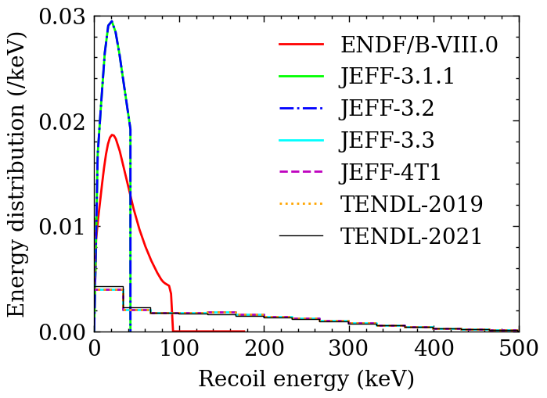
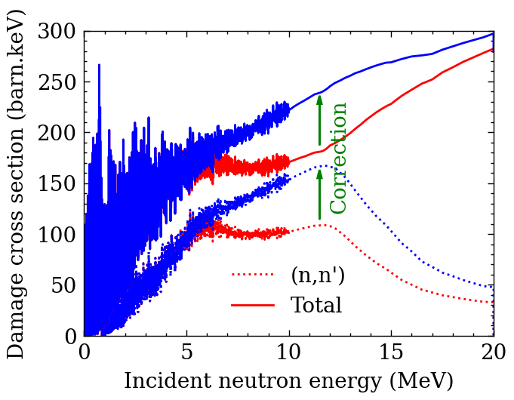
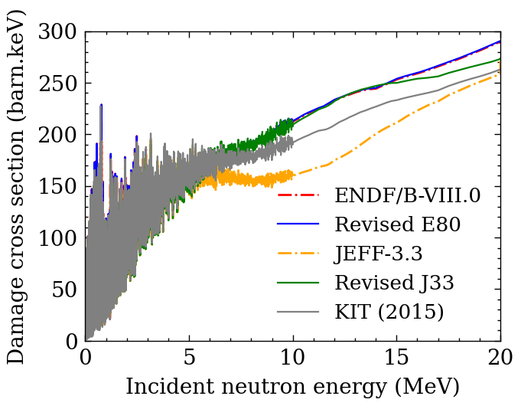
Two-body reaction-induced (4): ⁵⁶Fe in JEFF-3.3
10 MeV
⁵⁶Fe
EUROFER97
665 keV max. recoil in ENDF
> kinematics limit 523 keV!
Chen, Nucl. Mater. Energy, 33: 101284, 2022

Slide 17
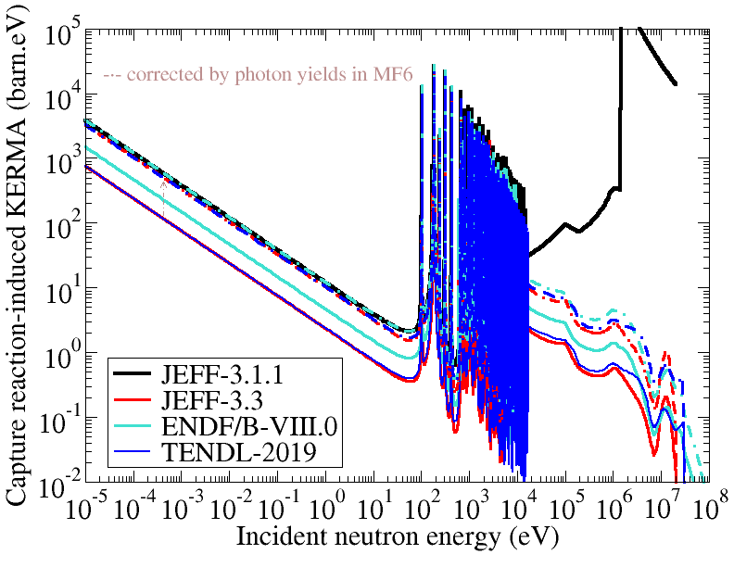
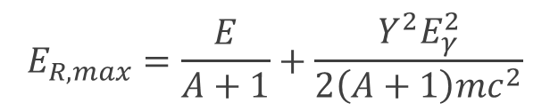




Neutron capture reaction-induced: theory
Average recoil energy:
$$E_{R}=\frac{E}{A+1}+\frac{YE_{γ}^{2}}{2\left(A+1\right)mc^{2}}$$
$$E_{R,max}=\frac{E}{A+1}+\frac{Y^{2}E_{γ}^{2}}{2\left(A+1\right)mc^{2}}$$
NJOY for MF6:
$$E_{R}=\frac{E}{A+1}+\frac{YE_{γ}^{2}}{2\left(A+1\right)mc^{2}}$$
$⇒E_{R}≈YE_{R,NJOY}$!
$$⇒KERMA\left(E\right)=Y\left(E\right)×{KERMA}_{NJOY}\left(E\right)$$
¹⁸⁴W(n,γ)¹⁸⁵W
NJOY for MF12-15:
$$E_{R}=\frac{E}{A+1}+\frac{YE_{γ}^{2}}{2\left(A+1\right)mc^{2}}$$
Chen, Nucl. Instrum. Methods B, 513: 1–8, 2022

Slide 18




Neutron capture reaction-induced (1): ⁵⁶Fe and ⁵⁸Ni
Discrepancy is significantly reduced
Chen, Nucl. Instrum. Methods B, 513: 1–8, 2022

Slide 19




Neutron capture reaction-induced (2): ¹⁸⁴W
TALYS-1.9
$$E_{R}=\frac{E}{A+1}+\frac{YE_{γ}^{2}}{2\left(A+1\right)mc^{2}}$$
$$E_{R}≈YE_{R,NJOY}⇒KERMA\left(E\right)≈Y\left(E\right){KERMA}_{NJOY}\left(E\right)$$
$E_{R}≈YE_{R,NJOY}⇏{\tilde{E}}_{a}\left(E\right)≈Y\left(E\right)×{\tilde{E}}_{a,NJOY}\left(E\right)$ !
$$\tilde{E_{a}}\left(E\right)=\left\{\begin{matrix}0, & 0<E_{a}<E_{d} \\ {2.5E}_{d}, & E_{d}<E_{a}<{2.5E}_{d} \\ E_{a}\left(E\right)ξ\left(E_{a}\right), & {2.5E}_{d}<E_{a}\end{matrix}\right.$$
GDE:
More accurate photon data
Stochastic sampling of photon kicks
Chen, Nucl. Instrum. Methods B, 513: 1–8, 2022

Slide 20


N-body reaction-induced
For N > 2 emission nuclear reaction：
Scalar variables: 3N
Scalar equations: conservation of momentum 3 (+ energy 1)
$⟹$ Degree of freedom (DOF): 3N-3 (or 3N-4)
DOF in evaluated files: ≤ 2N
without recoil spectra:
$⟹$ DOF ≤ 2N-1 < 3N-3
$⟹$ Approximation required!

Slide 21

For (n,2n) reaction
N = 3, DOF：3$×$3-3 = 6
Indistinguishable 2 neutrons
Without recoil spectrum, DOF in ENDF ≤ 3 $⟹$ Approximation
Symbol | Method for computing recoil energy
R | Recoil energy directly retrieved from ENDF
INL | Treating (n,2n) reaction as continuum inelastic scattering
B1 | Binary approximation using a = 1
B2 | Binary approximation using a = 2
KCM2 | Kinematics using secondary data in the CM frame twice
KCM1 | Kinematics using secondary data in the CM frame once
KLab2 | Kinematics using secondary data in the Lab frame twice
KLab1 | Kinematics using secondary data in the Lab frame once
Chen, Nucl. Instrum. Methods B, 508: 41–48, 2021

Slide 22




(n,2n) reaction-induced damage cross section
Reasonable agreement between different methods
Chen, Nucl. Instrum. Methods B, 508: 41–48, 2021

Slide 23
Conclusions & outlook
NJOY prefers using (not well verified) recoil data in MF6
Verification using max. & min. recoil energies
(n, γ): more accurate photon data; sampling of photon emissions
(n,2n): agreement between different approaches
$$σ\left(E\right)\tilde{E_{a}}\left(1,E\right)<σ_{D}\left(E\right)<σ\left(E\right)\tilde{E_{a}}\left(−1,E\right)$$
Adding verification option in NJOY HEATR
Implementing stochastic sampling for (n, γ) (e.g., TRIPOLI, PHITS)?
Evaluation: verifying recoil data & photon data

Slide 24
References
S. Chen, D. Bernard, P. Tamagno et al., Calculation and verification of neutron irradiation damage with differential cross sections, Nucl. Instrum. Methods B, 456: 120–132, 2019
S. Chen, Methods for calculating the (n,2n) reaction-induced damage cross section with different approaches of kinematics, Nucl. Instrum. Methods B, 508: 41–48, 2021
S. Chen, D. Bernard, Y. Peneliau, Comparison of evaluated nuclear data for neutron irradiation damage calculation in fusion spectra, Fusion Eng. Des., 171: 112594, 2021
S. Chen, Study of neutron capture reaction-induced displacement damage cross section and KERMA factor, Nucl. Instrum. Methods B, 513: 1–8, 2022
S. Chen and D. Bernard, Recommendation for computing neutron irradiation damage from evaluated nuclear data, J. Nucl. Mater., 562: 153610, 2022
S. Chen, New evaluation of neutron-induced displacement damage cross section for EUROFER97, Nucl. Mater. Energy, 33: 101284, 2022

Slide 25





Thank you!
Shengli Chen (陈胜利)
chenshli23@mail.sysu.edu.cn

Slide 26


