Slide 1
Application of nuclear data covariance matrices to representativity calculations for fast reactors
Federico Grimaldi - 9/06/2023

Slide 2
Context and motivation

Slide 3
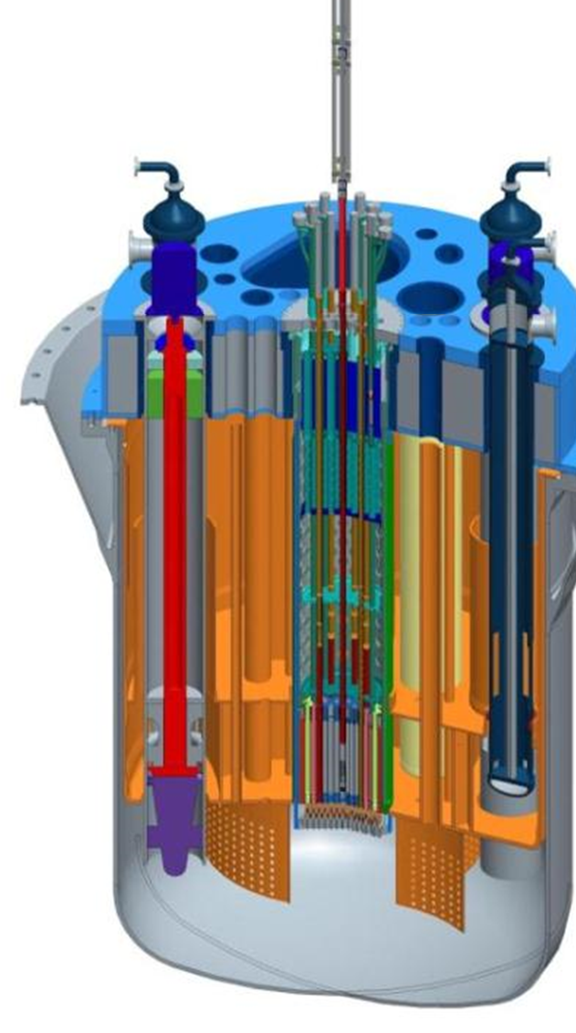
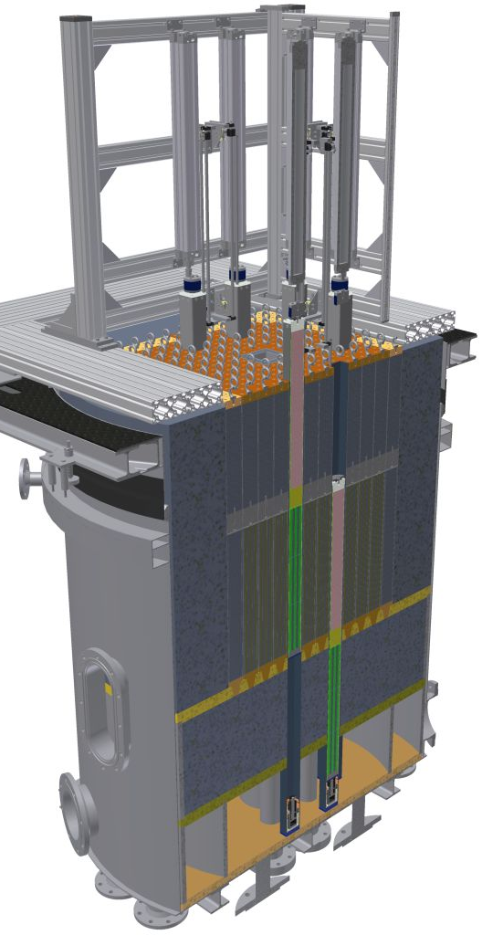
MYRRHA v1.8
VENUS-F
M
hY
R
R
H
A
ultipurpose
brid
esearch
eactor for
igh-Tech
pplications
ADS
VENUS
Fast
Zero power
ADS
LBE
30% U
Fusion
source
30% MOX
Spallation
source
Pb + Bi

Slide 4
A big difference is in the fuel composition.
This reflects on the fuel dependent parameters.
<generated automatically>
altenative reference
ISC: Restricted

Slide 5
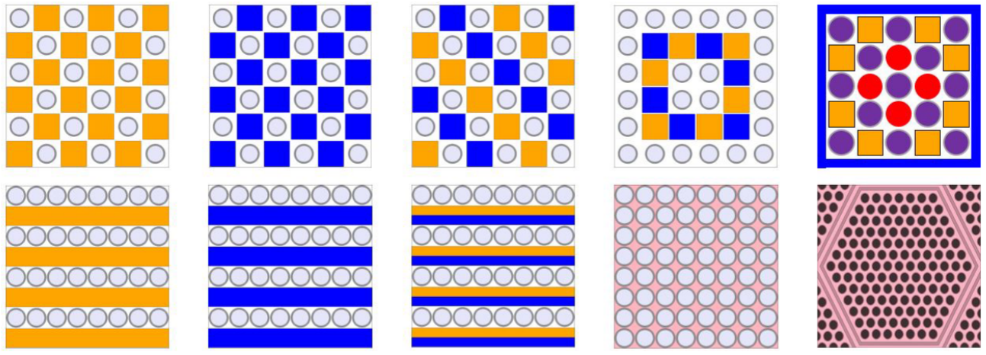
MOX fuel loading investigation
30% U
14% MOX
Al₂O₃
Bi
Pb
LBE
30% MOX

Slide 6
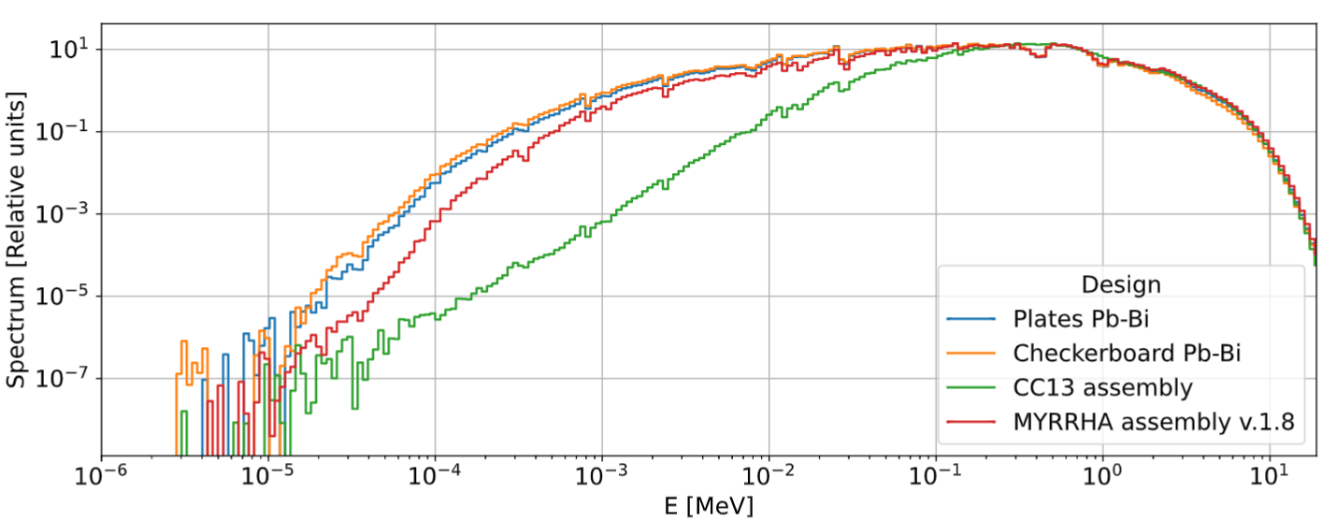
Spectra
²⁰⁹Bi
¹⁶O

Slide 7
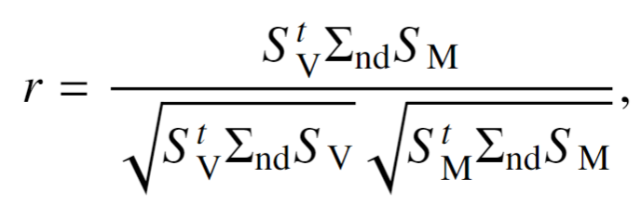
Design selection: representativity
Sensitivity
Nuclear data covariance matrix

Slide 8

Scope of the study
Checkerboard
$k_{∞}$ representativity
Impact of the nuclear data library choice on the representativity:
  Sensitivity vectors
  Covariance matrices
Plates

Slide 9
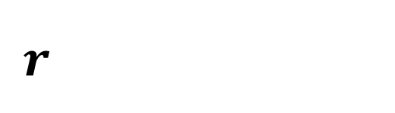

Methodology
JEFF-4.0t2
JENDL-4.0u
ENDF/B-VIII.0
$k_{∞}, β_{eff}$
$S\left(k_{∞}\right), S(β_{eff})$
Stat. err.
$$r$$
SERPENT 2

Slide 10
Results

Slide 11
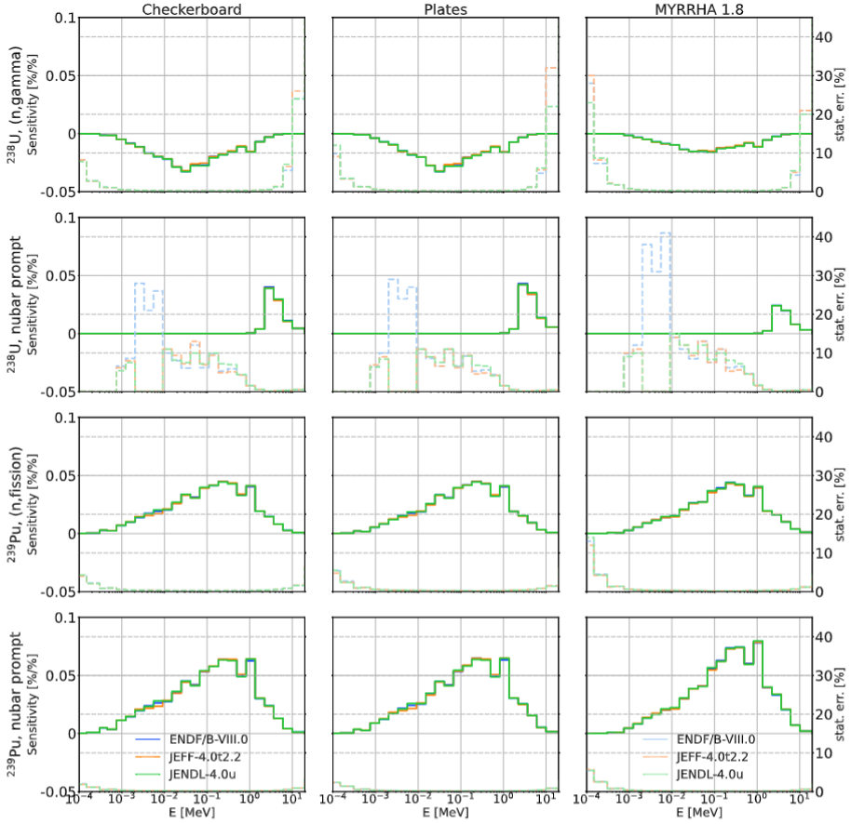
Results
Design
Sensitivity
Reaction
Reaction

Slide 12
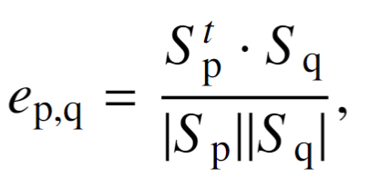
Results
Sensitivity
p | q | Checkerboard | Plates | MYRRHA
ENDF/B-VIII.0 | JEFF-4.0t2.2 | 0.9992 | 0.9994 | 0.9997
JENDL-4.0u | ENDF/B-VIII.0 | 0.9995 | 0.9996 | 0.9997
JEFF-4.0t2.2 | JENDL-4.0u | 0.9990 | 0.9991 | 0.9996
<generated automatically>
altenative reference
ISC: Restricted

Slide 13

The nuclear data library practically does not affect $S(k_{∞})$.
<generated automatically>
altenative reference
ISC: Restricted

Slide 14
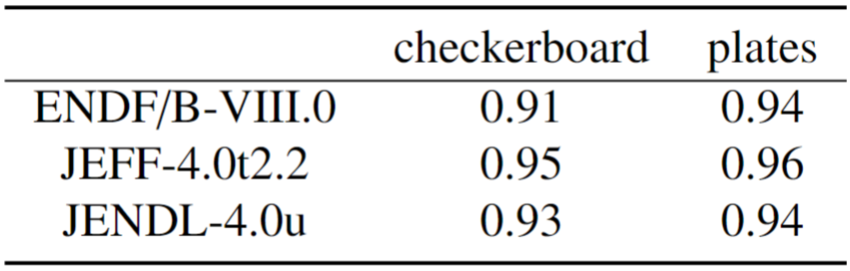
Results
Representativity
*
* JEFF-3.3 covariances were used
The differences should come from
the covariance matrices
<generated automatically>
altenative reference
ISC: Restricted

Slide 15
Intermezzo
Cross section covariance matrices
 | ²⁴²Pu | ²⁴¹Am | ²⁰⁹Bi
ENDF/B-VIII.0
JENDL-4.0u
JEFF-3.3 |  | �
Inl
Inl
<generated automatically>
altenative reference
ISC: Restricted

Slide 16
Completeness of the sensitivity vectors and of covariance matrices is key to full representativity.
<generated automatically>
altenative reference
ISC: Restricted

Slide 17
Open questions

Slide 18
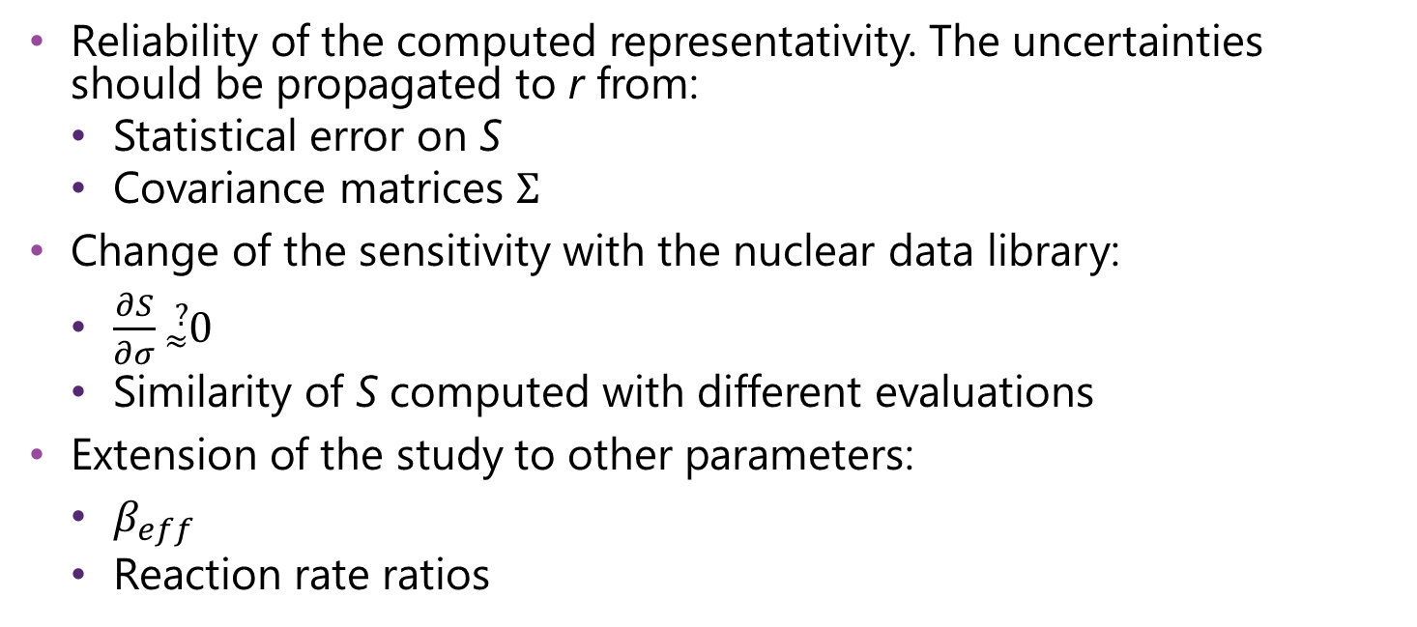
Outlook
Many items are still open for discussion
Reliability of the computed representativity. The uncertainties should be propagated to r from:
  Statistical error on S
  Covariance matrices $Σ$
Change of the sensitivity with the nuclear data library:
  $\frac{∂S}{∂σ}{}_{≈}^{?}0$
  Similarity of S computed with different evaluations
Extension of the study to other parameters:
  $β_{eff}$
  Reaction rate ratios

Slide 19
Copyright © SCK CEN
PLEASE NOTE!
This presentation contains data, information and formats for dedicated use only and may not be communicated, copied, reproduced, distributed or cited without the explicit written permission of SCK CEN.
If this explicit written permission has been obtained, please reference the author, followed by ‘by courtesy of SCK CEN’.
Any infringement to this rule is illegal and entitles to claim damages from the infringer, without prejudice to any other right in case of granting a patent or registration in the field of intellectual property.
SCK CEN
Belgian Nuclear Research Centre
Foundation of Public Utility
Registered Office: Avenue Herrmann-Debrouxlaan 40 – BE-1160 BRUSSELS
Operational Office: Boeretang 200 – BE-2400 MOL

