Slide 1

Nuclear Data Uncertainty Quantification for Reactor Physics Parameters in Fluorine-19-based Molten Salt Reactors
Sigfrid Stjärnholm¹
Zsolt Elter^{1,2}
Henrik Sjöstrand¹
1) Uppsala University, Sweden
2) Seaborg ApS, Copenhagen, Denmark
Master Thesis Project
WONDER-2023, Aix-en-Provence, France
5th – 9th of June 2023

Slide 2
Table of Contents
Why Uncertainty Quantification?
The Role of F-19 in Reactor Physics
Methodology
  The Total Monte Carlo Approach
  Sampling of Nuclear Data
  The Molten Salt Reactor At Hand
Results
  Reactivity Uncertainty
  Individual Reaction Channels
Conclusions and Outlook

Slide 3
Why Uncertainty Quantification?

Slide 4
The Role of F-19 in Reactor Physics
Currently: Fuel enrichment (UF₆)
Potential future use cases: Fluorine-based salts in MSRs
  MSRE (1960s) used FLiBe as coolant and solvent for fissile fuel
  Fluorine-based U salts
  Fluorine-based Th salts
The nuclear data of F-19 needs to understood and investigated – especially uncertainties!
  Where does more work need to be done for experimentalists and theoreticians?
  At what level can we trust simulations and criticality calculations when F-19 is involved?

Slide 5
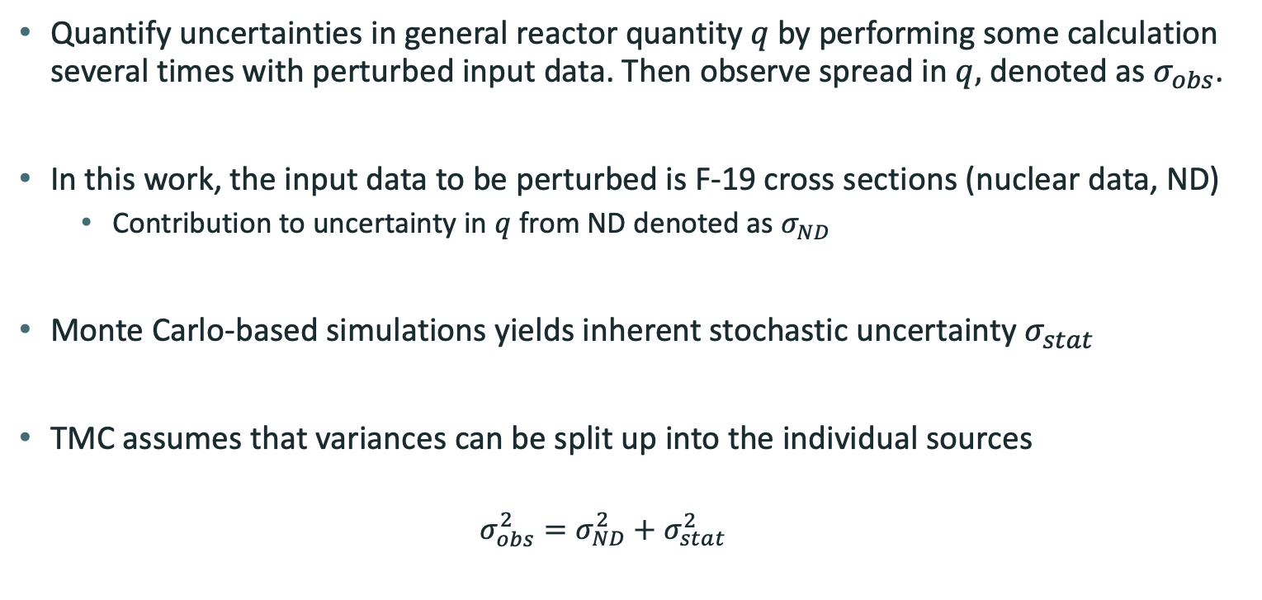
Methodology – Total Monte Carlo (TMC)
Quantify uncertainties in general reactor quantity $q$ by performing some calculation several times with perturbed input data. Then observe spread in $q,$ denoted as $σ_{obs}$.
In this work, the input data to be perturbed is F-19 cross sections (nuclear data, ND)
  Contribution to uncertainty in $q$ from ND denoted as $σ_{ND}$
Monte Carlo-based simulations yields inherent stochastic uncertainty $σ_{stat}$
TMC assumes that variances can be split up into the individual sources
  $$σ_{obs}^{2}=σ_{ND}^{2}+σ_{stat}^{2}$$

Slide 6



$$σ_{obs}^{2}=σ_{ND}^{2}+σ_{stat}^{2}$$
$$σ_{stat}$$
$$σ_{obs}$$

Slide 7
Methodology – Sampling of Nuclear Data
In this work, the input data to be perturbed is F-19 cross sections
Sample 500 ENDF files from JEFF-3.3 using SANDY & NJOY
  RECONR – Reconstructs resonances
  BROADR – Doppler-broadens the resonances
  THERMR – Produces scattering cross sections in thermal region
  UNRESR & PURR – Produces cross sections in unresolved resonance range
  ERRORR – Considers covariance data in the ENDF file (MF32, MF33, MF34, MF35)
  …
Sampling of individual reaction channels is also possible

Slide 8
Methodology – Sampling of Nuclear Data
MT2 – Elastic scattering

Slide 9
Methodology – Sampling of Nuclear Data
MT102 – Neutron capture

Slide 10


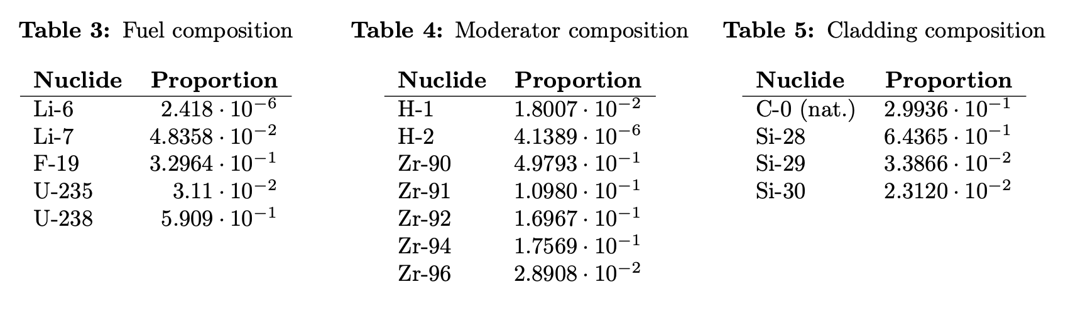
Methodology – The Molten Salt Reactor At Hand
Reactor modelled in OpenMC
  Monte Carlo-based neutron transport code
  Based on open-source Transatomic Power designs
Fluorine-based Molten Salt Reactor (MSR)
ULiF fuel (green), 5 % enrichment
ZrH moderator (blue)
SiC cladding (gray), hard to see here

Slide 11
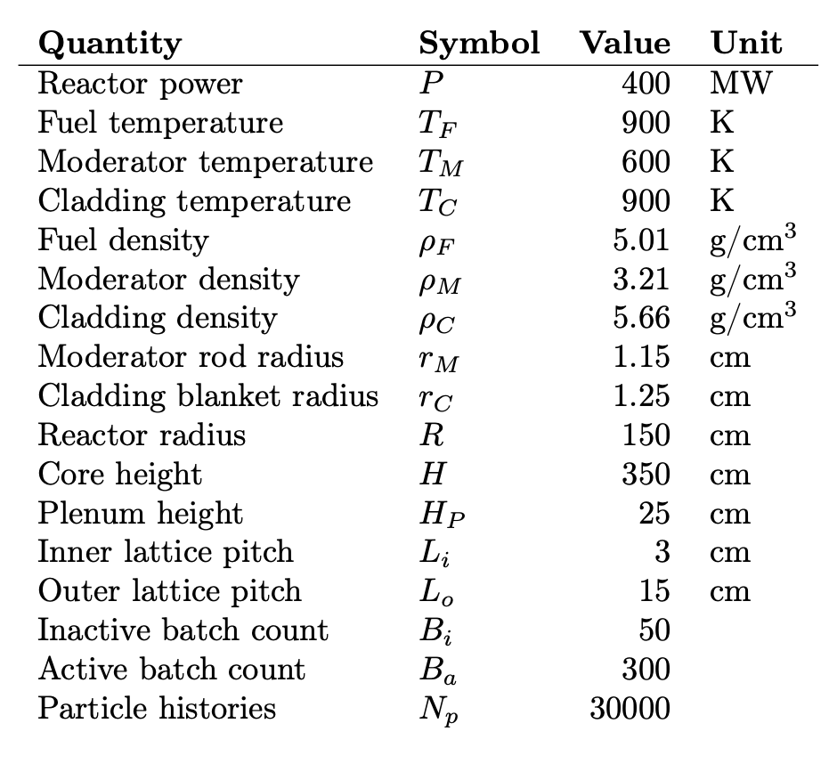
Methodology – The Molten Salt Reactor At Hand

Slide 12

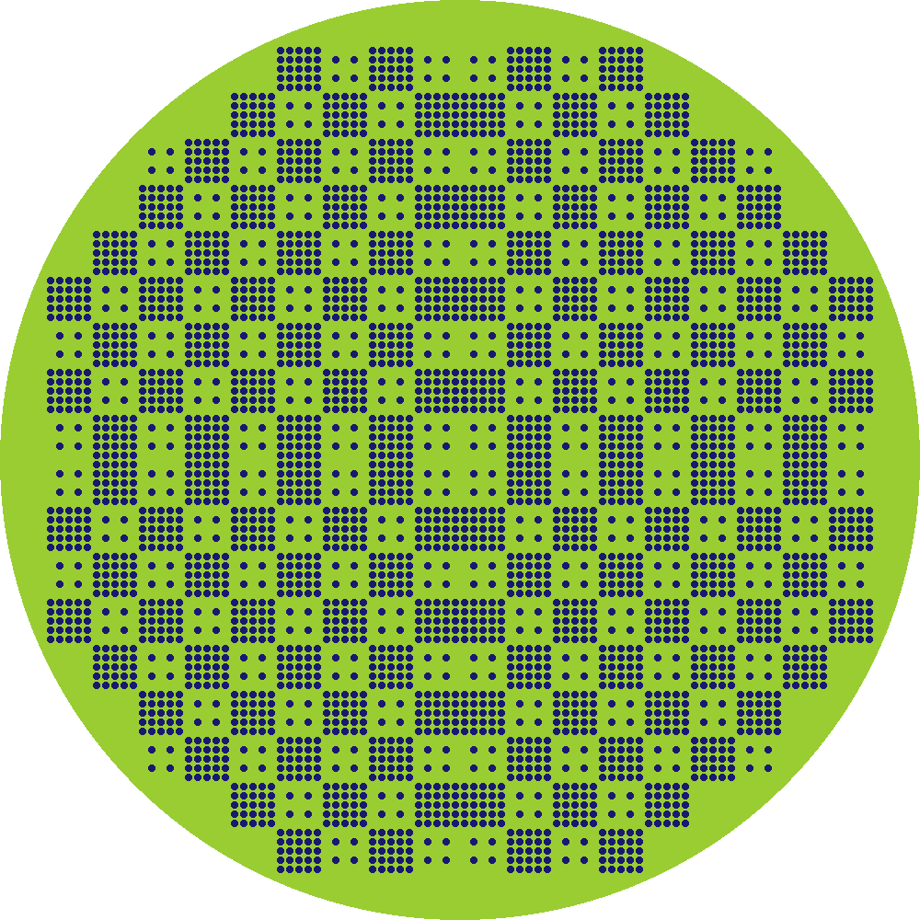


Methodology – The Molten Salt Reactor At Hand
Thermal
Semiepithermal
Epithermal

Slide 13
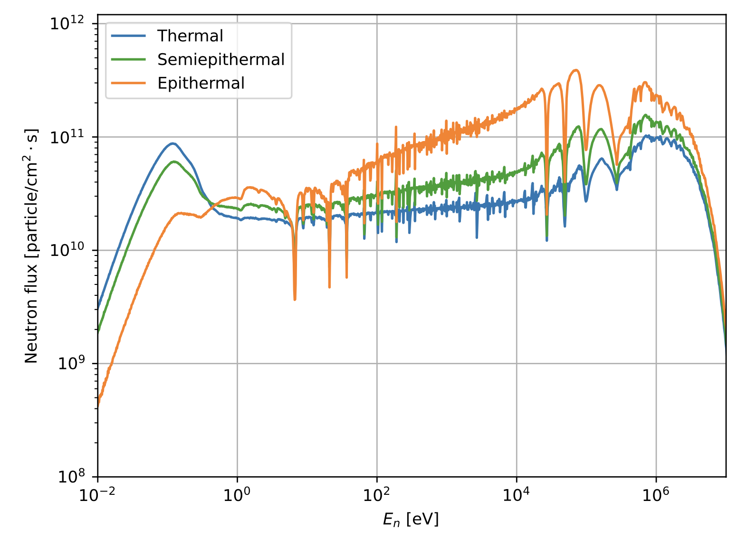
Results – Neutron Flux

Slide 14



Results – Reactivity Uncertainty
Thermal
Semiepithermal
Epithermal
$$σ_{ρ}=62 pcm$$
$$σ_{ρ}=103 pcm$$
$$σ_{ρ}=213 pcm$$
Less moderated core has higher uncertainty in reactivity due to F-19
Possible reason: A larger fraction of reactor volume is F-19 when less moderator rods are used
Possible reason: The relative cross section uncertainties are generally larger at higher energies

Slide 15
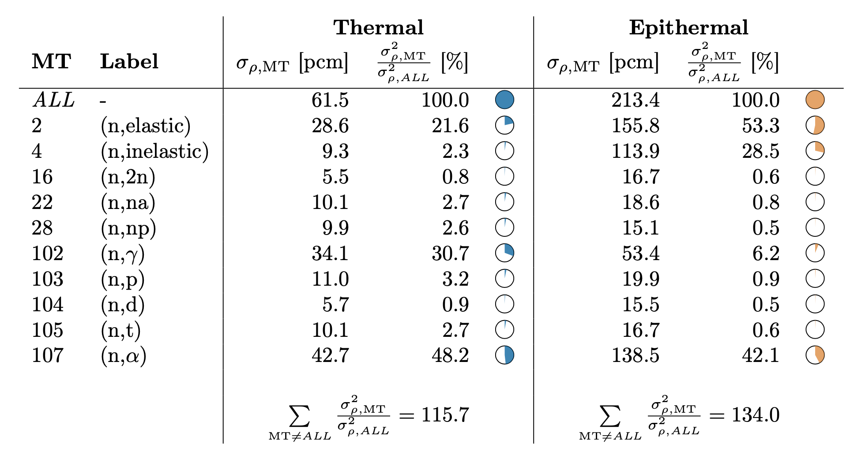
Results – Individual Reaction Channels

Slide 16
Results – Individual Reaction Channels
Main contributions
  Thermal: elastic scattering (MT2), neutron capture (MT102), alpha production (MT107)
  Epithermal: elastic scattering (MT2), inelastic scattering (MT4), alpha production (MT107)
Scattering plays a bigger role for epithermal
  Possible explanation: F-19 plays a bigger role in thermalization when less moderator rods are present
  ⇒ uncertainties from MT2 and MT4 contribute more for epithermal reactor
  Also, relative cross section uncertainties are larger at higher energies
Unexpectedly large contribution from alpha production (MT107)
  MT107 is an important channel with regards to reaction rates

Slide 17
Conclusions and Outlook
Uncertainties from F-19 nuclear data ranges from 62 pcm to 213 pcm, depending on the level of moderation in the core
  Less moderation yields a higher uncertainty due to F-19 data
  Other studies of Cl-35 showed 1500 pcm (worst case) uncertainties due to missing nuclear data
Roughly half of the uncertainty comes from (n, 𝛼), MT107
  Improvements in evaluation for MT107 is needed
JEFF-3.3 does not contain covariances for resonance peaks (MF32), angular distributions (MF34) or energy distributions (MF35)
  How large would this contribution be?
  Other ND libraries, eg ENDF/B-VIII.0, also don’t contain MF32, MF34, MF35 for F-19
Other reactor quantities should be investigated, e.g. power distribution
  Power distribution was investigated in this work, but OpenMC for 2-group cross sections at assembly level gave rise to large uncertainties or long computation times. Should investigate deterministic methods!

Slide 18
Thanks for your attention!
This work has been partially supported by the ENEN2plus project (HORIZON-EURATOM-2021-NRT-01-13 101061677) founded by the European Union.
Sigfrid Stjärnholm¹
Zsolt Elter^{1,2}
Henrik Sjöstrand¹
1) Uppsala University, Sweden
2) Seaborg ApS, Copenhagen, Denmark
Master Thesis Project
WONDER-2023, Aix-en-Provence, France
5th – 9th of June 2023

Slide 19
Backup Slides

Slide 20
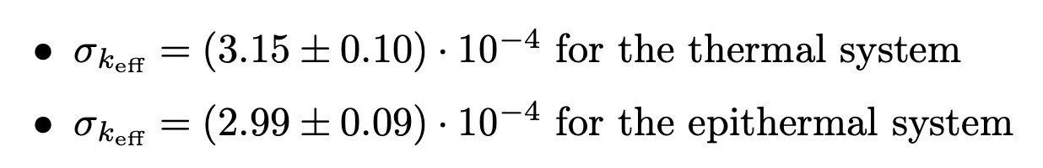
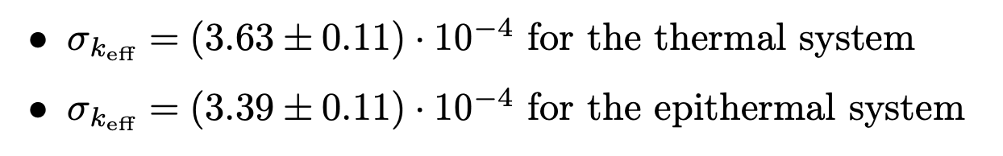



Backup Slides - Interesting Find: OpenMC Uncertainty Discrepancy
$σ_{stat}$ for $k_{eff}$ seems to be underestimated by OpenMC
In this work, it only caused a ~1 % difference in reactivity uncertainty, but it could become important in cases where $σ_{ND}$ is almost as small as $σ_{stat}$
OpenMC – Estimation of $σ_{stat}$
Calculating $σ_{stat}$ using normal STD calculation

Slide 21
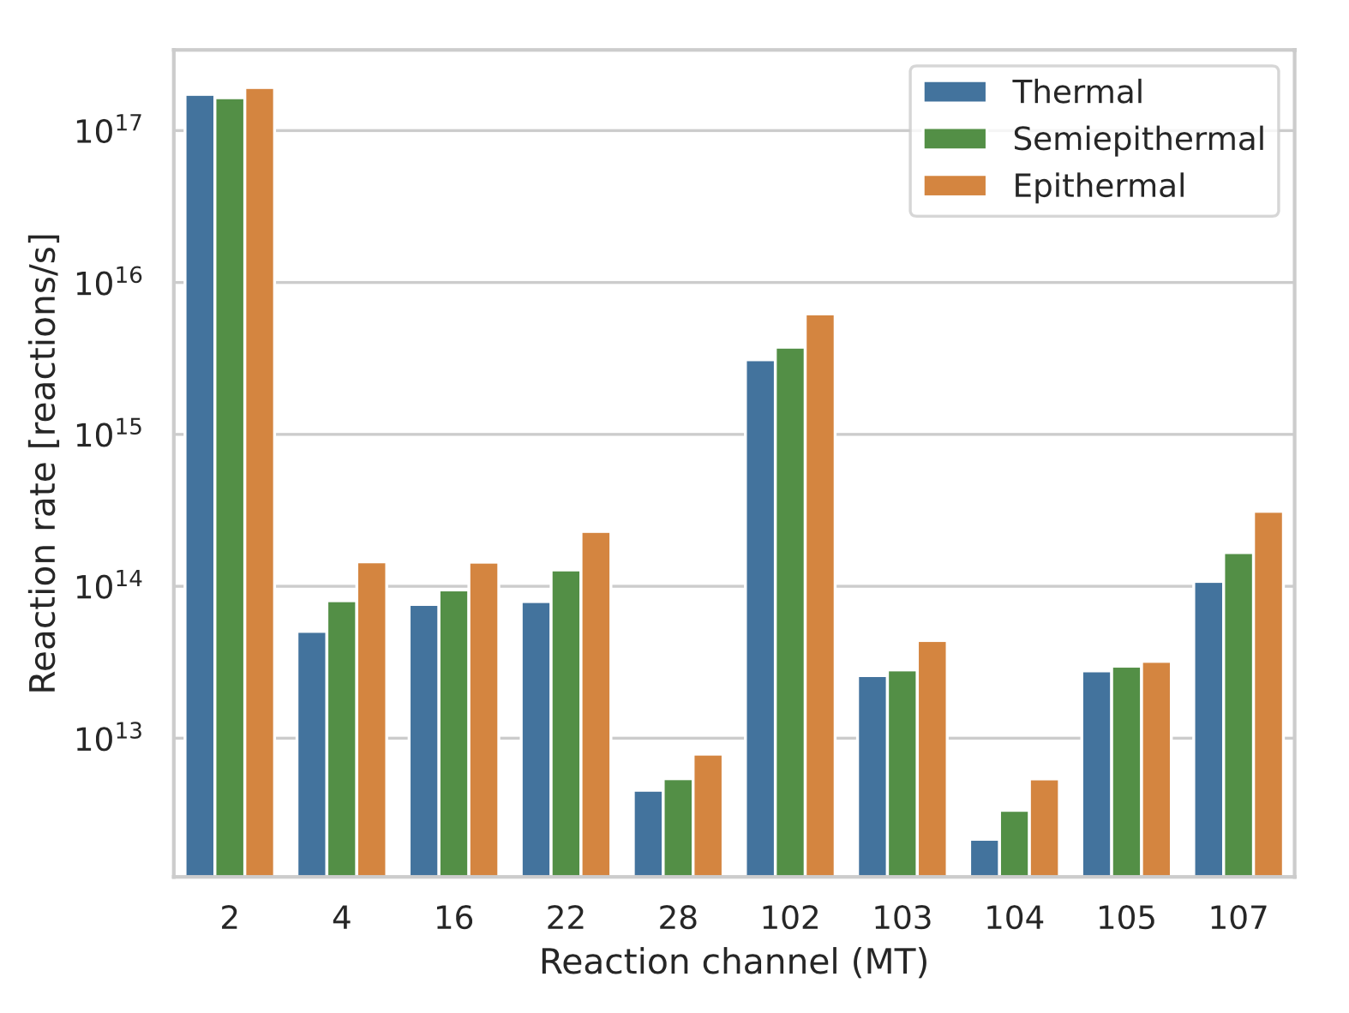
Backup Slides – Reaction Rates

Slide 22
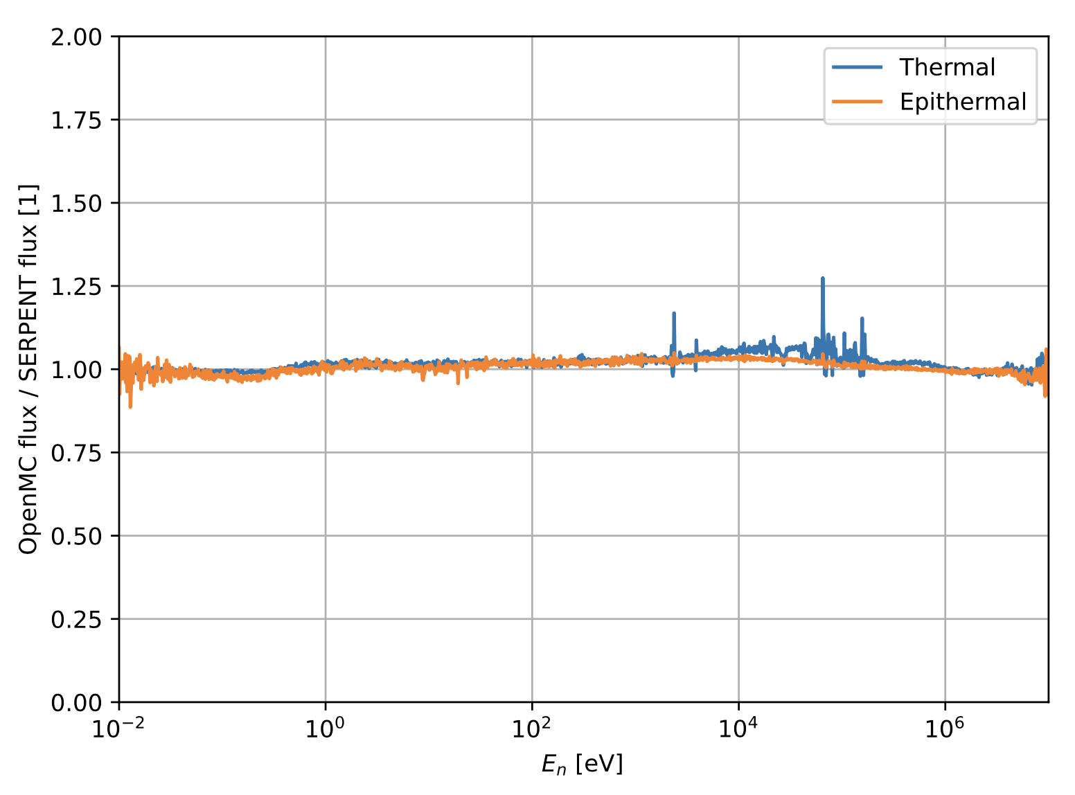
Backup Slides – OpenMC vs Serpent Flux

Slide 23
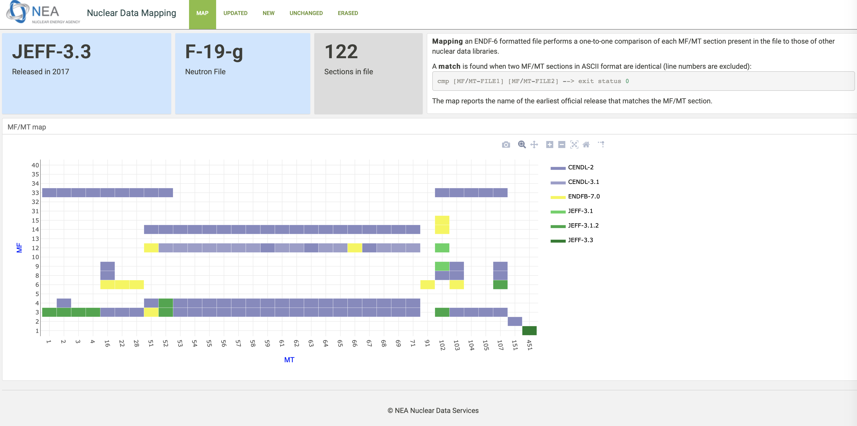
Backup Slides – Nuclear Data Mapping
https://www.oecd-nea.org/dbdata/jeff/jeff33/maps/9-F-19g.jeff33.mapping_output.html

Slide 24
Backup Slides – Outer Lattices
Thermal
Semiepithermal
Epithermal

Slide 25




Backup Slides – Inner Lattices
Thermal
Epithermal

Slide 26
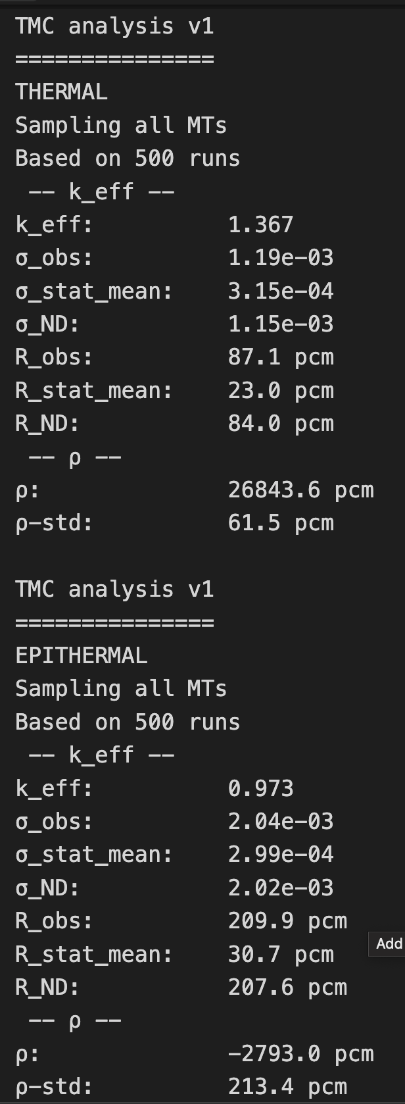
Backup Slides – TMC Output

Slide 27
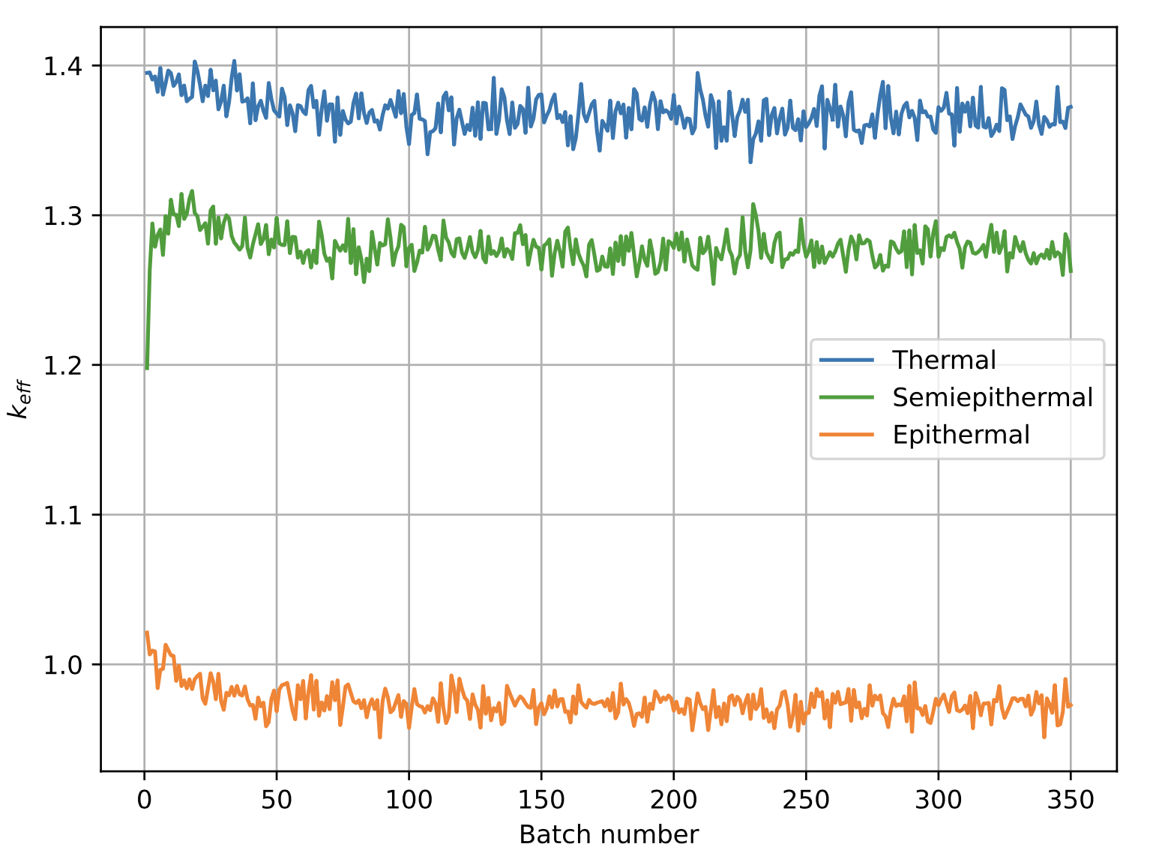
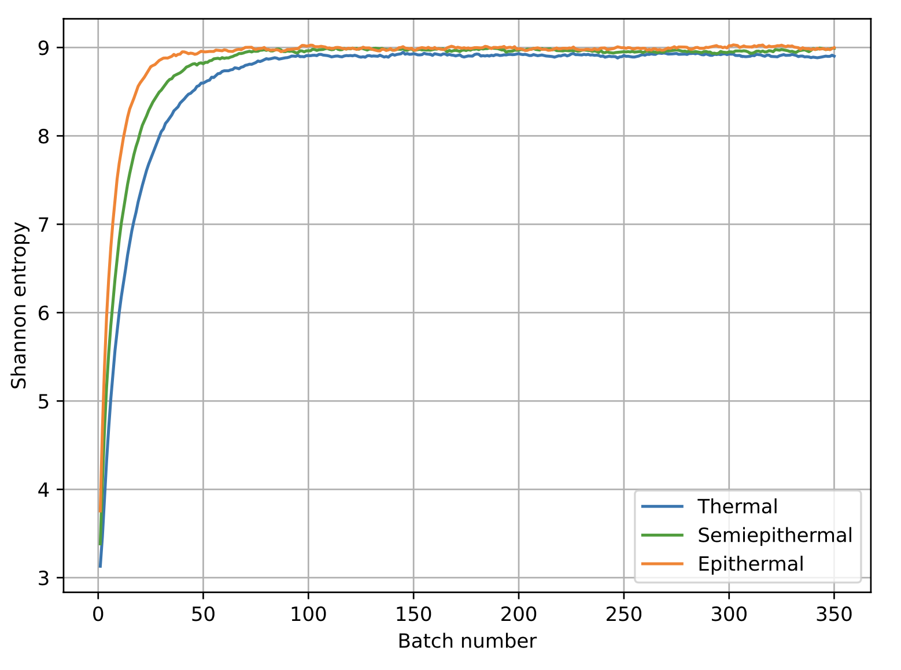
Backup Slides – Source Distribution Convergence
Neutron multiplication factor
Shannon entropy

Slide 28
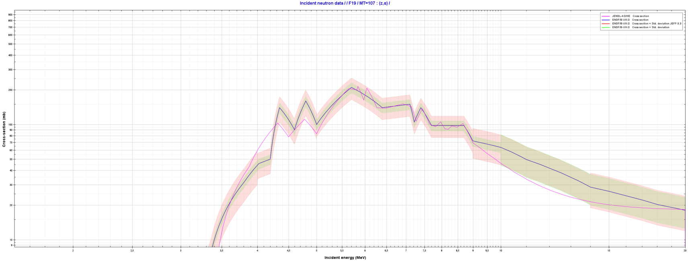
Backup Slides – Data

Slide 29
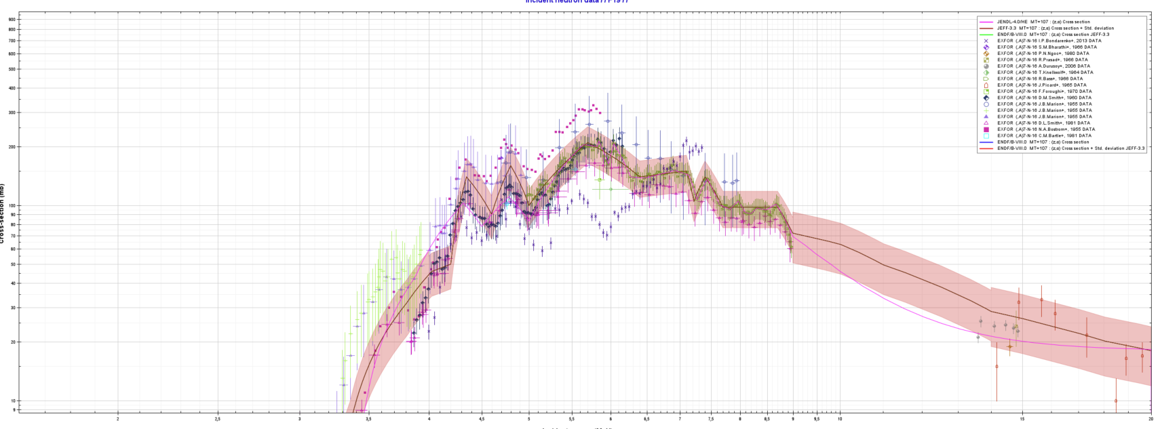
Backup Slides – Data

Slide 30
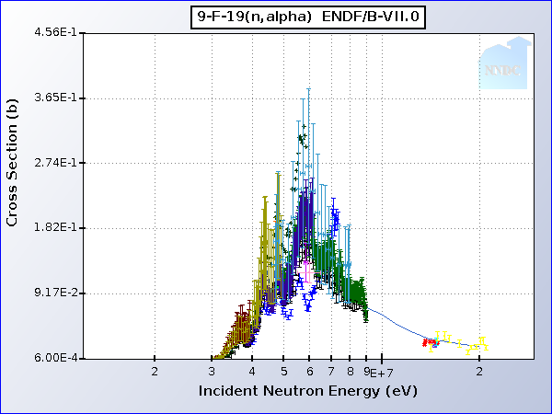
Backup Slides – Data

