Slide 1
News on Analytical Emittance Estimates
Léon van Riesen-Haupt, Tessa Charles, Rogelio Tomás, Frank Zimmermann, Katsunobu Oide

Slide 2
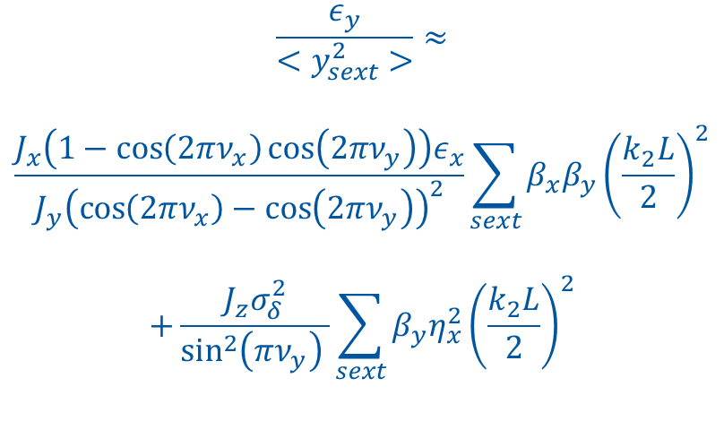
Recap Analytical Formulas
Formulas well documented in various papers by A Wolski and T Raubenheimer (e.g. SLAC-PUB-4937)
$$\frac{ε_{y}}{<y_{sext}^{2}>}≈$$
$$\frac{J_{x}\left(1−\cos\left(2πν_{x}\right)\cos\left(2πν_{y}\right)\right)ε_{x}}{J_{y}{\left(\cos\left(2πν_{x}\right)−\cos\left(2πν_{y}\right)\right)}^{2}}\sum_{sext}{β_{x}β_{y}{\left(\frac{k_{2}L}{2}\right)}^{2}}$$
$$+\frac{J_{z}σ_{δ}^{2}}{\sin^{2}\left(πν_{y}\right) }\sum_{sext}{β_{y}η_{x}^{2}{\left(\frac{k_{2}L}{2}\right)}^{2}}$$
Coupling contribution
Dispersion contribution
$\frac{k_{2}L}{2}→k_{1}L$ and $<y_{sext}^{2}>→<θ_{quad}^{2}>$ for quads

Slide 3
Recap Simulations vs Equations
Good agreement between equations and simulations for sextupoles
  Both for arc and IR sextupoles separately
Results did not seem to agree well for arc quadrupoles
  Off by an order of magnitude

Slide 4
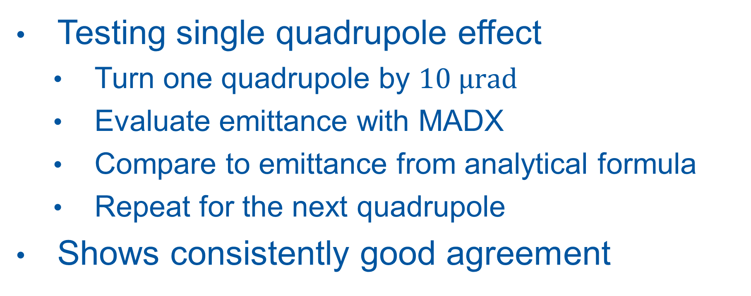
Testing Quadrupole Equations
Testing single quadrupole effect
  Turn one quadrupole by $10 μrad$
  Evaluate emittance with MADX
  Compare to emittance from analytical formula
  Repeat for the next quadrupole
Shows consistently good agreement

Slide 5
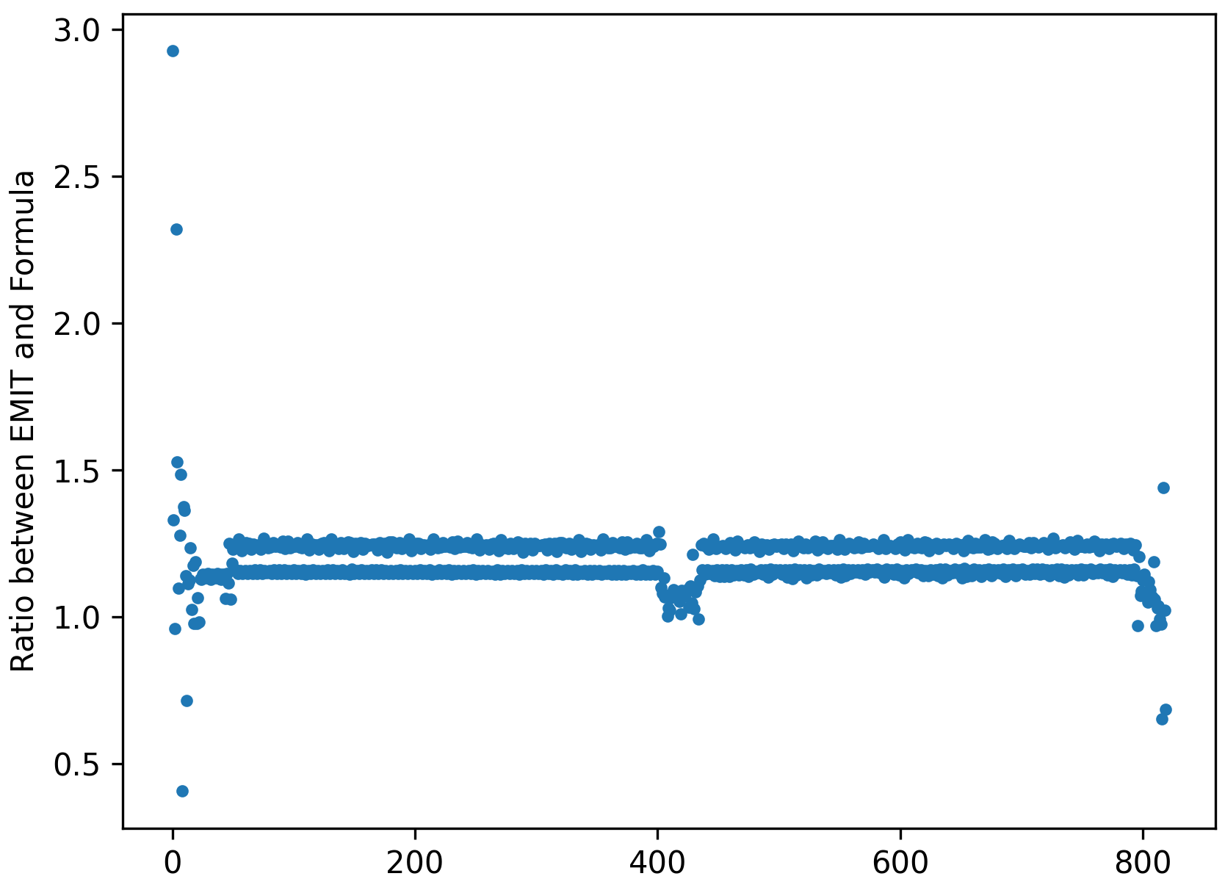

Slide 6
Testing Equations for Quadrupole Groups
Possible by using ABP’s optics server
  Scheduling and parallelisation using OMC’s PyLHC submitter (J Dilly, M Hofer)
  Using 30 cores allows 10,000 MADX scripts to run in about 15 min
Python Scripts:
  Create 100 groups of 41 randomly chosen quads (out of c.a. 3200)
  Compute analytical emittance for all 100 groups
  For each group generate and run 100 MADX scripts that
    Apply random errors to the 41 quads (Based on error application scripts by T Charles)
    Compute and save emittance in MADX
  Read out MADX emittance and take averages
  Compute average Ratio of MADX emittance / Analytical Prediction

Slide 7
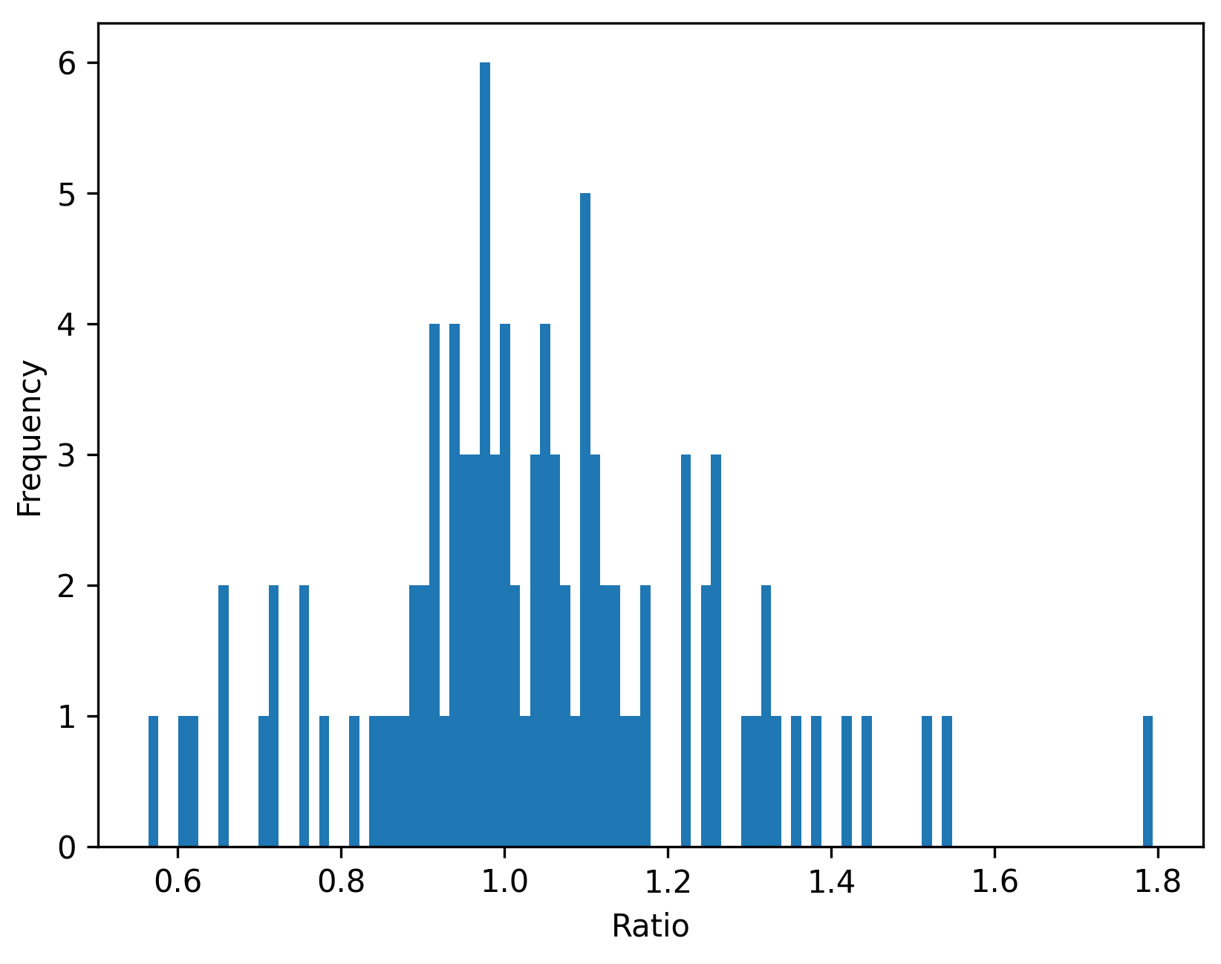
Very Good Agreement

Slide 8
Arc Quadrupoles Revisited
Repeated studies with roll errors on arc quadrupoles
Double checking definitions of what is counted as arc quadrupole
Double checking how errors are applied
Simulations with 1000 seeds for each error size
Determine mean emittance and standard error of the mean

Slide 9
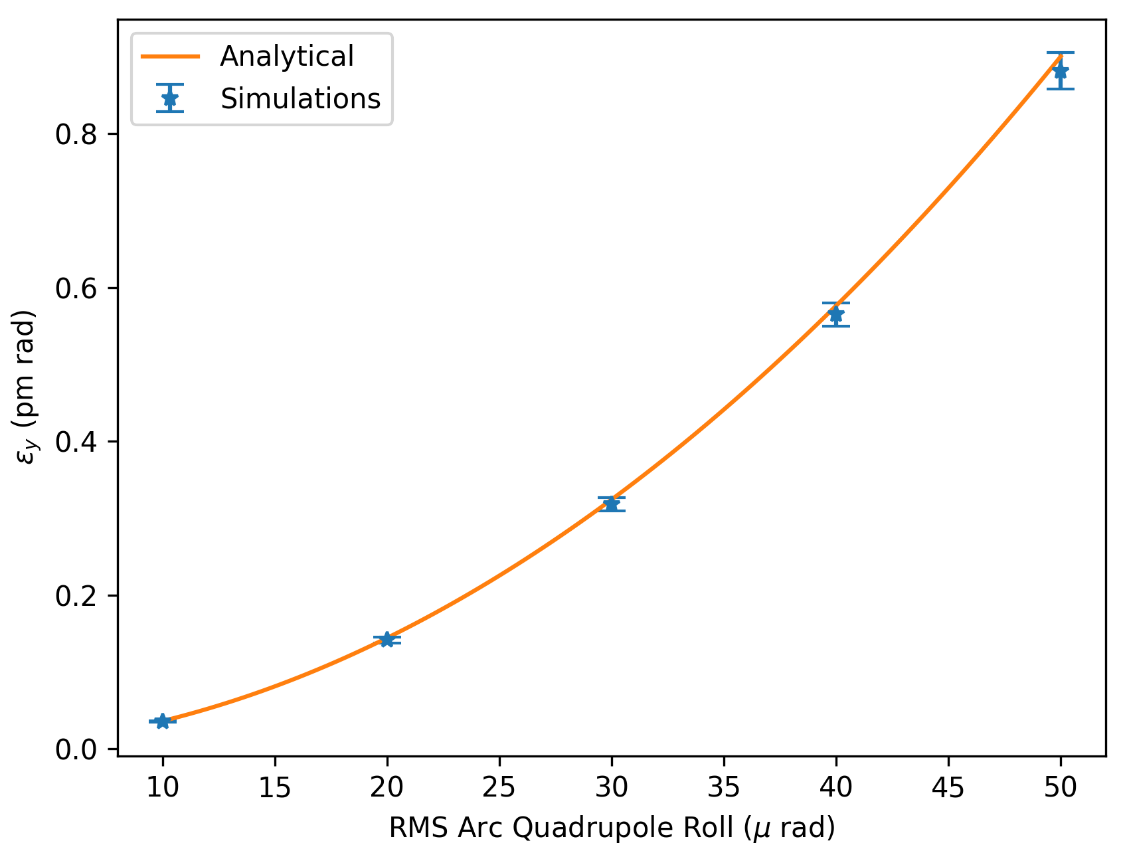

Slide 10
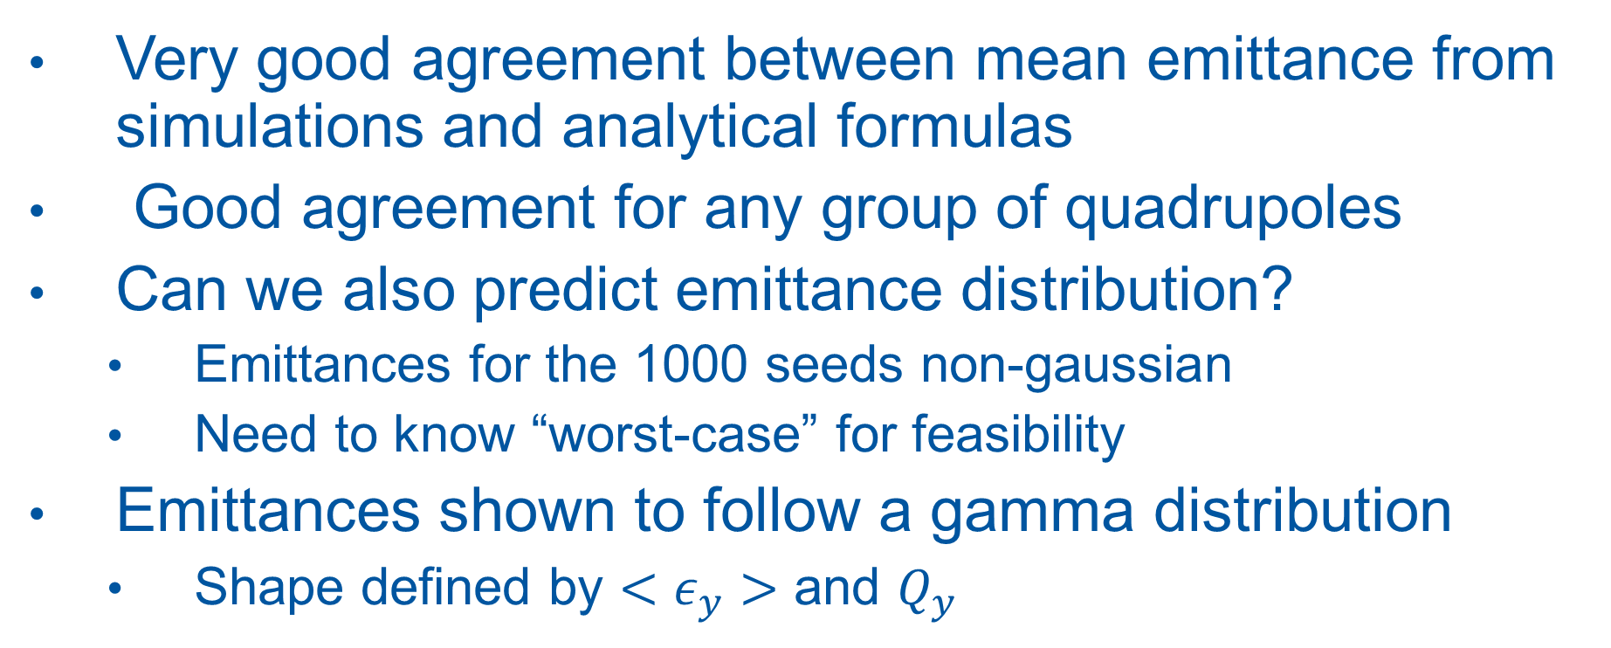
Emittance Distribution
Very good agreement between mean emittance from simulations and analytical formulas
Good agreement for any group of quadrupoles
Can we also predict emittance distribution?
  Emittances for the 1000 seeds non-gaussian
  Need to know “worst-case” for feasibility
Emittances shown to follow a gamma distribution
  Shape defined by $<ε_{y}>$ and $Q_{y}$

Slide 11
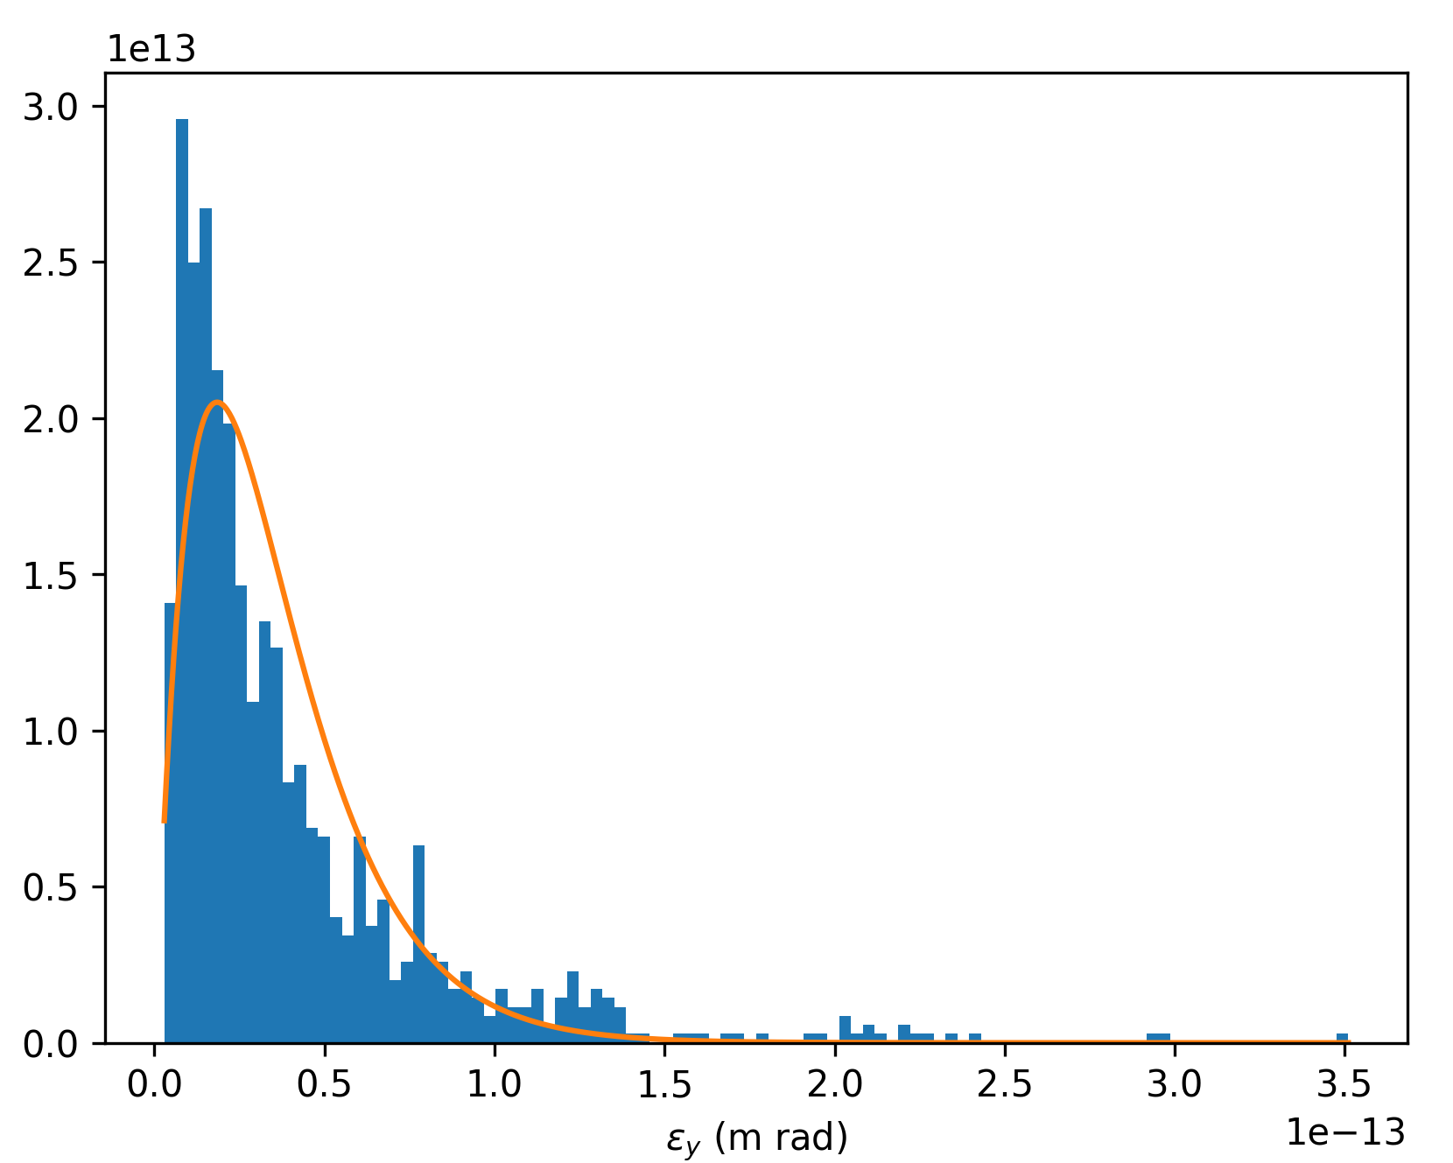



Emittance Distribution PDF
$10 μ rad$ error
$50 μ rad$ error

Slide 12
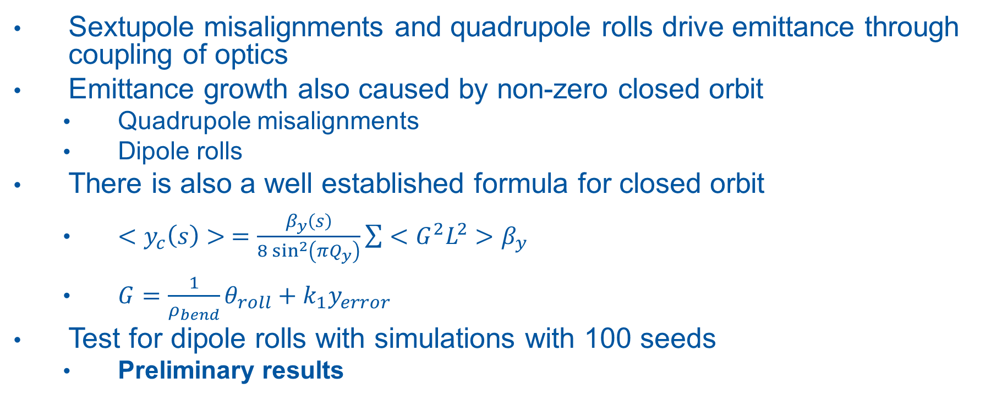
Closed Orbit
Sextupole misalignments and quadrupole rolls drive emittance through coupling of optics
Emittance growth also caused by non-zero closed orbit
  Quadrupole misalignments
  Dipole rolls
There is also a well established formula for closed orbit
  $<y_{c}\left(s\right)> =\frac{β_{y}\left(s\right)}{8\sin^{2}\left(πQ_{y}\right)}\sum{<G^{2}L^{2}>β_{y}}$
  $G=\frac{1}{ρ_{bend}}θ_{roll}+k_{1}y_{error}$
Test for dipole rolls with simulations with 100 seeds
  Preliminary results

Slide 13
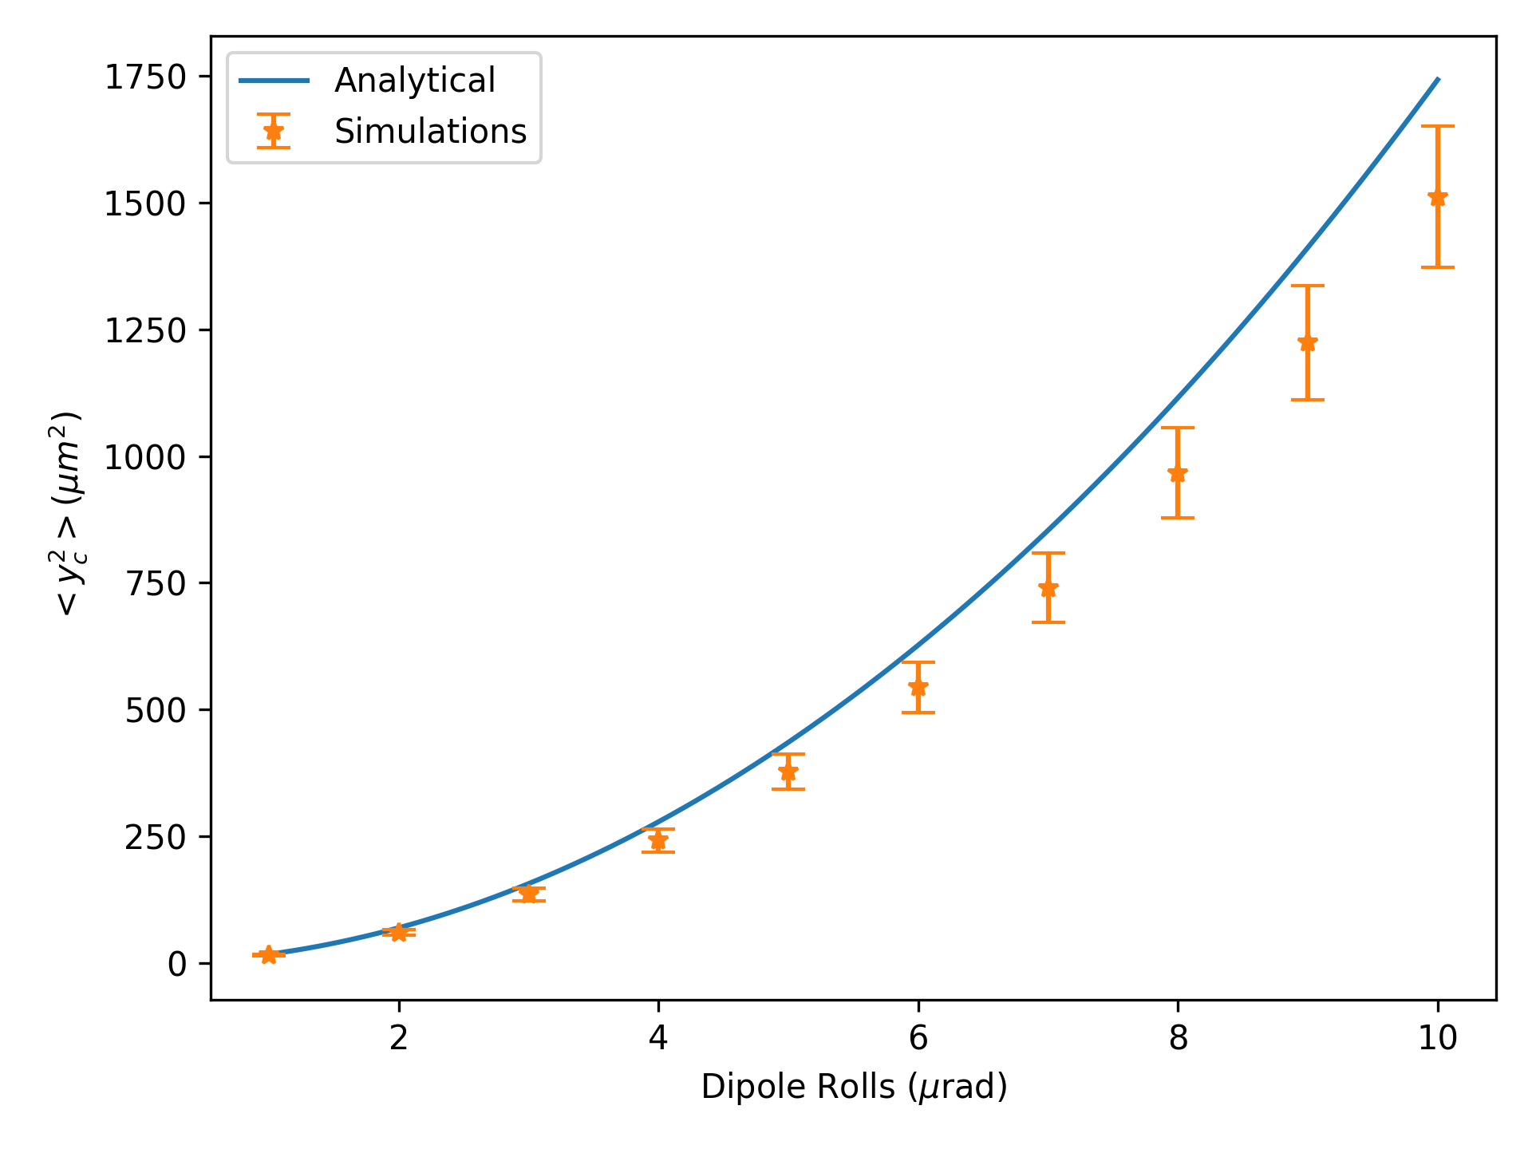
Closed Orbit

Slide 14
Outlook and Next Steps
Closed orbit from quadrupole misalignments
Emittance from closed orbit
  Dispersion
  Higher order chromatic effects
  Coupling from orbit through sextupoles
Estimate emittance with correctors
  Formulas exist for such estimates
  Rely on many assumptions about the nature of the corrections

