Slide 1


Anomalies and their implications
Bhupal Dev
Washington University in St. Louis
bdev@wustl.edu
May 25, 2021

Slide 2
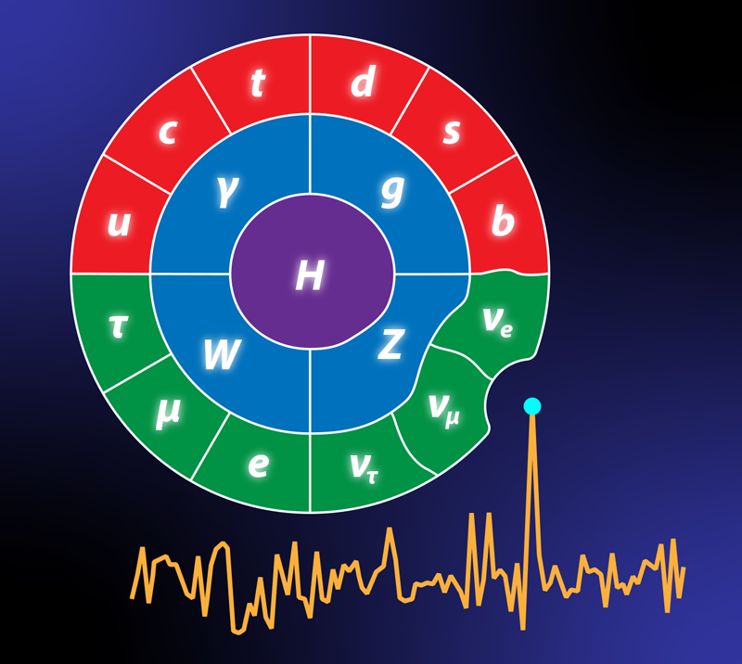
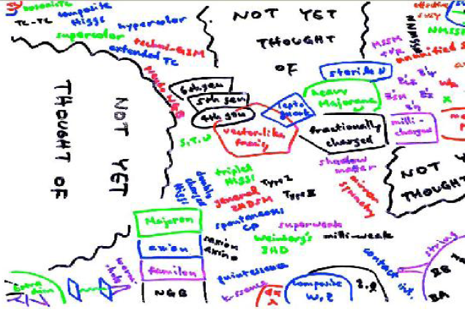
An Era of Anomalies
A growing list of “anomalies”.
Could be due to
  statistical fluctuations (e.g. 750 GeV diphoton)
  systematics or background uncertainties (e.g. KOTO)
  experimental error (e.g. OPERA)
  unknown issues (e.g. DAMA?), or
  genuine new physics signal?
A good driver of scientific creativity (not just ‘ambulance-chasing’).
Figure credit: APS/Alan Stonebraker
Figure credit: Quantum Diaries

Slide 3

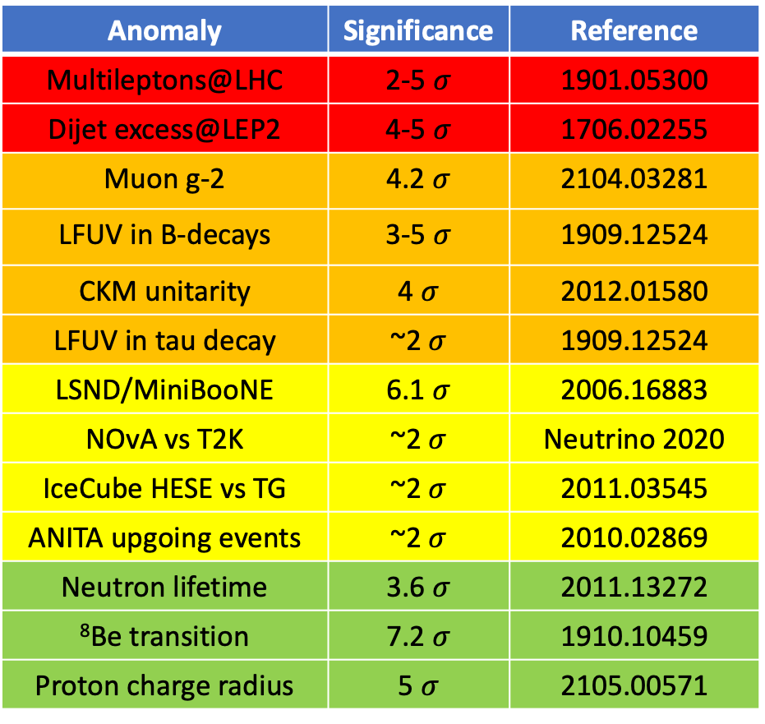
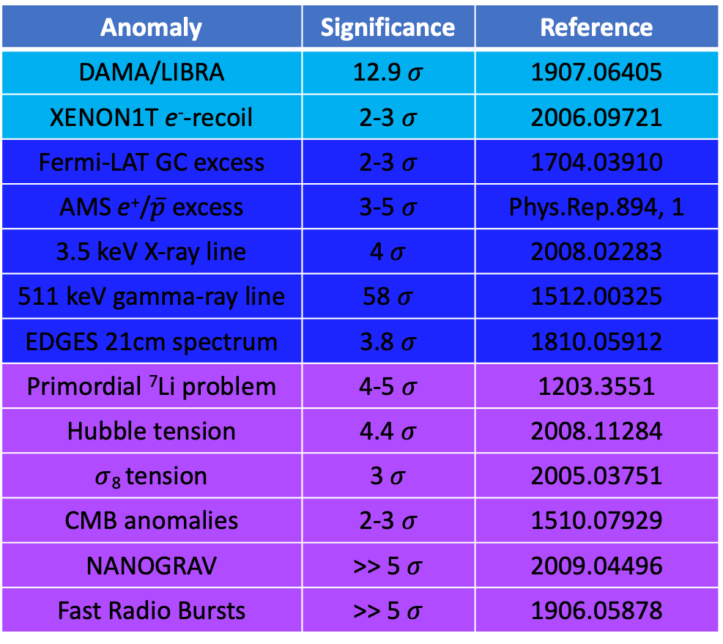
(Partial) List of Existing Anomalies
Anomaly | Significance | Reference
Multileptons@LHC | 2-5 $σ$ | 1901.05300
Dijet excess@LEP2 | 4-5 $σ$ | 1706.02255
Muon g-2 | 4.2$σ$ | 2104.03281
LFUV in B-decays | 3-5 $σ$ | 1909.12524
CKM unitarity | 4 $σ$ | 2012.01580
LFUV in tau decay | ~2$σ$ | 1909.12524
LSND/MiniBooNE | 6.1$σ$ | 2006.16883
NOvA vs T2K | ~2$σ$ | Neutrino 2020
IceCube HESE vs TG | ~2$σ$ | 2011.03545
ANITA upgoing events | ~2$σ$ | 2010.02869
Neutron lifetime | 3.6$σ$ | 2011.13272
⁸Be transition | 7.2$σ$ | 1910.10459
Proton charge radius | 5 $σ$ | 2105.00571
Anomaly | Significance | Reference
DAMA/LIBRA | 12.9 $σ$ | 1907.06405
XENON1T e⁻-recoil | 2-3$σ$ | 2006.09721
Fermi-LAT GC excess | 2-3$σ$ | 1704.03910
AMS e⁺/$\overline{p}$ excess | 3-5$σ$ | Phys.Rep.894, 1
3.5 keV X-ray line | 4$σ$ | 2008.02283
511 keV gamma-ray line | 58 $σ$ | 1512.00325
EDGES 21cm spectrum | 3.8$σ$ | 1810.05912
Primordial ⁷Li problem | 4-5$σ$ | 1203.3551
Hubble tension | 4.4$σ$ | 2008.11284
$σ$₈ tension | 3 $σ$ | 2005.03751
CMB anomalies | 2-3 $σ$ | 1510.07929
NANOGRAV | >> 5$σ$ | 2009.04496
Fast Radio Bursts | >> 5$σ$ | 1906.05878
Repository: https://github.com/hepcomm/hepmist

Slide 4
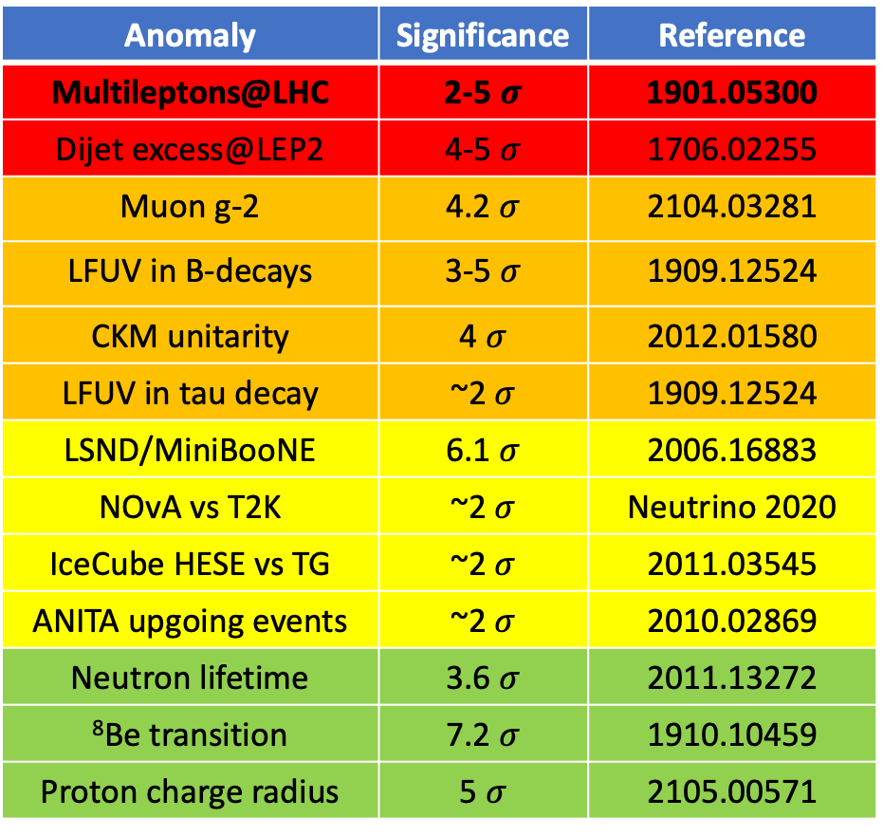
(Partial) List of Existing Anomalies
Anomaly | Significance | Reference
Multileptons@LHC | 2-5 $σ$ | 1901.05300
Dijet excess@LEP2 | 4-5 $σ$ | 1706.02255
Muon g-2 | 4.2$σ$ | 2104.03281
LFUV in B-decays | 3-5 $σ$ | 1909.12524
CKM unitarity | 4 $σ$ | 2012.01580
LFUV in tau decay | ~2$σ$ | 1909.12524
LSND/MiniBooNE | 6.1$σ$ | 2006.16883
NOvA vs T2K | ~2$σ$ | Neutrino 2020
IceCube HESE vs TG | ~2$σ$ | 2011.03545
ANITA upgoing events | ~2$σ$ | 2010.02869
Neutron lifetime | 3.6$σ$ | 2011.13272
⁸Be transition | 7.2$σ$ | 1910.10459
Proton charge radius | 5 $σ$ | 2105.00571
Anomaly | Significance | Reference
DAMA/LIBRA | 12.9 $σ$ | 1907.06405
XENON1T e⁻-recoil | 2-3$σ$ | 2006.09721
Fermi-LAT GC excess | 2-3$σ$ | 1704.03910
AMS e⁺/$\overline{p}$ excess | 3-5$σ$ | Phys.Rep.894, 1
3.5 keV X-ray line | 4$σ$ | 2008.02283
511 keV gamma-ray line | 58 $σ$ | 1512.00325
EDGES 21cm spectrum | 3.8$σ$ | 1810.05912
Primordial ⁷Li problem | 4-5$σ$ | 1203.3551
Hubble tension | 4.4$σ$ | 2008.11284
$σ$₈ tension | 3 $σ$ | 2005.03751
CMB anomalies | 2-3 $σ$ | 1510.07929
NANOGRAV | >> 5$σ$ | 2009.04496
Fast Radio Bursts | >> 5$σ$ | 1906.05878
See BSM V parallel talk by Bruce Mellado
Repository: https://github.com/hepcomm/hepmist

Slide 5

(Partial) List of Existing Anomalies
Anomaly | Significance | Reference
Multileptons@LHC | 2-5 $σ$ | 1901.05300
Dijet excess@LEP2 | 4-5 $σ$ | 1706.02255
Muon g-2 | 4.2$σ$ | 2104.03281
LFUV in B-decays | 3-5 $σ$ | 1909.12524
CKM unitarity | 4 $σ$ | 2012.01580
LFUV in tau decay | ~2$σ$ | 1909.12524
LSND/MiniBooNE | 6.1$σ$ | 2006.16883
NOvA vs T2K | ~2$σ$ | Neutrino 2020
IceCube HESE vs TG | ~2$σ$ | 2011.03545
ANITA upgoing events | ~2$σ$ | 2010.02869
Neutron lifetime | 3.6$σ$ | 2011.13272
⁸Be transition | 7.2$σ$ | 1910.10459
Proton charge radius | 5 $σ$ | 2105.00571
Anomaly | Significance | Reference
DAMA/LIBRA | 12.9 $σ$ | 1907.06405
XENON1T e⁻-recoil | 2-3$σ$ | 2006.09721
Fermi-LAT GC excess | 2-3$σ$ | 1704.03910
AMS e⁺/$\overline{p}$ excess | 3-5$σ$ | Phys.Rep.894, 1
3.5 keV X-ray line | 4$σ$ | 2008.02283
511 keV gamma-ray line | 58 $σ$ | 1512.00325
EDGES 21cm spectrum | 3.8$σ$ | 1810.05912
Primordial ⁷Li problem | 4-5$σ$ | 1203.3551
Hubble tension | 4.4$σ$ | 2008.11284
$σ$₈ tension | 3 $σ$ | 2005.03751
CMB anomalies | 2-3 $σ$ | 1510.07929
NANOGRAV | >> 5$σ$ | 2009.04496
Fast Radio Bursts | >> 5$σ$ | 1906.05878
See also plenary talk by James Mott, mini-review by Hartmut Wittig and parallel talks by Bigaran, Darme, Ghosh, Jana, Melo, Sun, Thapa, Xu
Repository: https://github.com/hepcomm/hepmist

Slide 6

(Partial) List of Existing Anomalies
Anomaly | Significance | Reference
Multileptons@LHC | 2-5 $σ$ | 1901.05300
Dijet excess@LEP2 | 4-5 $σ$ | 1706.02255
Muon g-2 | 4.2$σ$ | 2104.03281
LFUV in B-decays | 3-5 $σ$ | 1909.12524
CKM unitarity | 4 $σ$ | 2012.01580
LFUV in tau decay | ~2$σ$ | 1909.12524
LSND/MiniBooNE | 6.1$σ$ | 2006.16883
NOvA vs T2K | ~2$σ$ | Neutrino 2020
IceCube HESE vs TG | ~2$σ$ | 2011.03545
ANITA upgoing events | ~2$σ$ | 2010.02869
Neutron lifetime | 3.6$σ$ | 2011.13272
⁸Be transition | 7.2$σ$ | 1910.10459
Proton charge radius | 5 $σ$ | 2105.00571
Anomaly | Significance | Reference
DAMA/LIBRA | 12.9 $σ$ | 1907.06405
XENON1T e⁻-recoil | 2-3$σ$ | 2006.09721
Fermi-LAT GC excess | 2-3$σ$ | 1704.03910
AMS e⁺/$\overline{p}$ excess | 3-5$σ$ | Phys.Rep.894, 1
3.5 keV X-ray line | 4$σ$ | 2008.02283
511 keV gamma-ray line | 58 $σ$ | 1512.00325
EDGES 21cm spectrum | 3.8$σ$ | 1810.05912
Primordial ⁷Li problem | 4-5$σ$ | 1203.3551
Hubble tension | 4.4$σ$ | 2008.11284
$σ$₈ tension | 3 $σ$ | 2005.03751
CMB anomalies | 2-3 $σ$ | 1510.07929
NANOGRAV | >> 5$σ$ | 2009.04496
Fast Radio Bursts | >> 5$σ$ | 1906.05878
See also plenary talk by Christoph Schwanda and parallel talks by Darme, Ghosh, Kumbhakar, Li, Loladze, Mitra, Thapa, Xu
Repository: https://github.com/hepcomm/hepmist

Slide 7
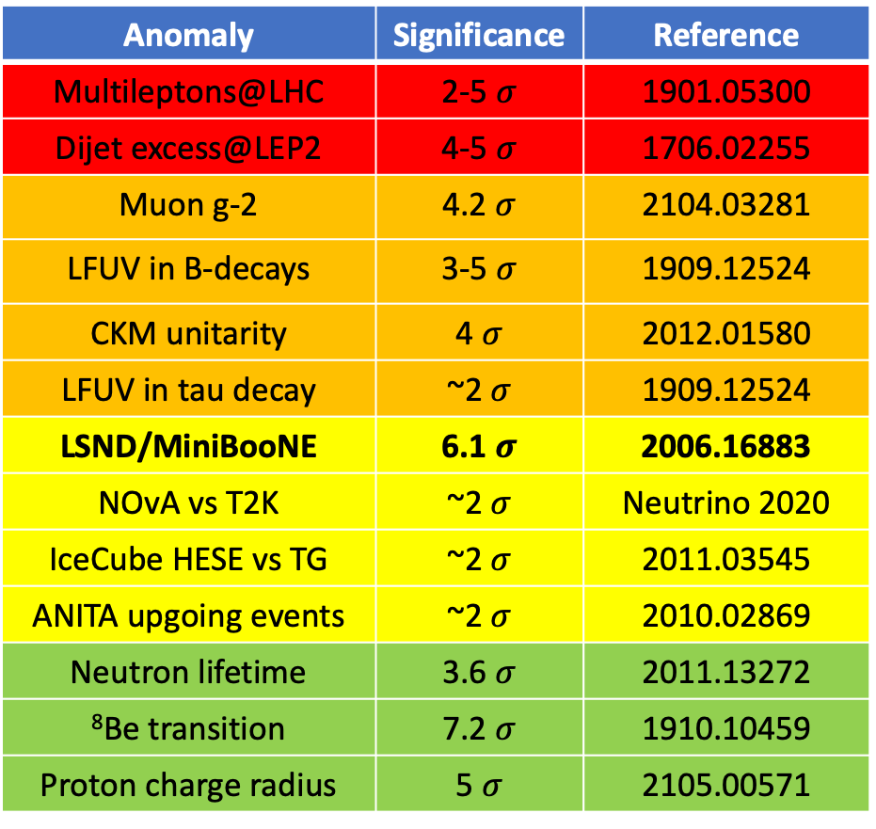
(Partial) List of Existing Anomalies
Anomaly | Significance | Reference
Multileptons@LHC | 2-5 $σ$ | 1901.05300
Dijet excess@LEP2 | 4-5 $σ$ | 1706.02255
Muon g-2 | 4.2$σ$ | 2104.03281
LFUV in B-decays | 3-5 $σ$ | 1909.12524
CKM unitarity | 4 $σ$ | 2012.01580
LFUV in tau decay | ~2$σ$ | 1909.12524
LSND/MiniBooNE | 6.1$σ$ | 2006.16883
NOvA vs T2K | ~2$σ$ | Neutrino 2020
IceCube HESE vs TG | ~2$σ$ | 2011.03545
ANITA upgoing events | ~2$σ$ | 2010.02869
Neutron lifetime | 3.6$σ$ | 2011.13272
⁸Be transition | 7.2$σ$ | 1910.10459
Proton charge radius | 5 $σ$ | 2105.00571
Anomaly | Significance | Reference
DAMA/LIBRA | 12.9 $σ$ | 1907.06405
XENON1T e⁻-recoil | 2-3$σ$ | 2006.09721
Fermi-LAT GC excess | 2-3$σ$ | 1704.03910
AMS e⁺/$\overline{p}$ excess | 3-5$σ$ | Phys.Rep.894, 1
3.5 keV X-ray line | 4$σ$ | 2008.02283
511 keV gamma-ray line | 58 $σ$ | 1512.00325
EDGES 21cm spectrum | 3.8$σ$ | 1810.05912
Primordial ⁷Li problem | 4-5$σ$ | 1203.3551
Hubble tension | 4.4$σ$ | 2008.11284
$σ$₈ tension | 3 $σ$ | 2005.03751
CMB anomalies | 2-3 $σ$ | 1510.07929
NANOGRAV | >> 5$σ$ | 2009.04496
Fast Radio Bursts | >> 5$σ$ | 1906.05878
See Neutrino III parallel talk by Nicholas Kamp
Repository: https://github.com/hepcomm/hepmist

Slide 8

(Partial) List of Existing Anomalies
Anomaly | Significance | Reference
Multileptons@LHC | 2-5 $σ$ | 1901.05300
Dijet excess@LEP2 | 4-5 $σ$ | 1706.02255
Muon g-2 | 4.2$σ$ | 2104.03281
LFUV in B-decays | 3-5 $σ$ | 1909.12524
CKM unitarity | 4 $σ$ | 2012.01580
LFUV in tau decay | ~2$σ$ | 1909.12524
LSND/MiniBooNE | 6.1$σ$ | 2006.16883
NOvA vs T2K | ~2$σ$ | Neutrino 2020
IceCube HESE vs TG | ~2$σ$ | 2011.03545
ANITA upgoing events | ~2$σ$ | 2010.02869
Neutron lifetime | 3.6$σ$ | 2011.13272
⁸Be transition | 7.2$σ$ | 1910.10459
Proton charge radius | 5 $σ$ | 2105.00571
Anomaly | Significance | Reference
DAMA/LIBRA | 12.9 $σ$ | 1907.06405
XENON1T e⁻-recoil | 2-3$σ$ | 2006.09721
Fermi-LAT GC excess | 2-3$σ$ | 1704.03910
AMS e⁺/$\overline{p}$ excess | 3-5$σ$ | Phys.Rep.894, 1
3.5 keV X-ray line | 4$σ$ | 2008.02283
511 keV gamma-ray line | 58 $σ$ | 1512.00325
EDGES 21cm spectrum | 3.8$σ$ | 1810.05912
Primordial ⁷Li problem | 4-5$σ$ | 1203.3551
Hubble tension | 4.4$σ$ | 2008.11284
$σ$₈ tension | 3 $σ$ | 2005.03751
CMB anomalies | 2-3 $σ$ | 1510.07929
NANOGRAV | >> 5$σ$ | 2009.04496
Fast Radio Bursts | >> 5$σ$ | 1906.05878
See plenary talk by Knut Mora and DM V parallel talks by Dutta and Mahapatra
Repository: https://github.com/hepcomm/hepmist

Slide 9
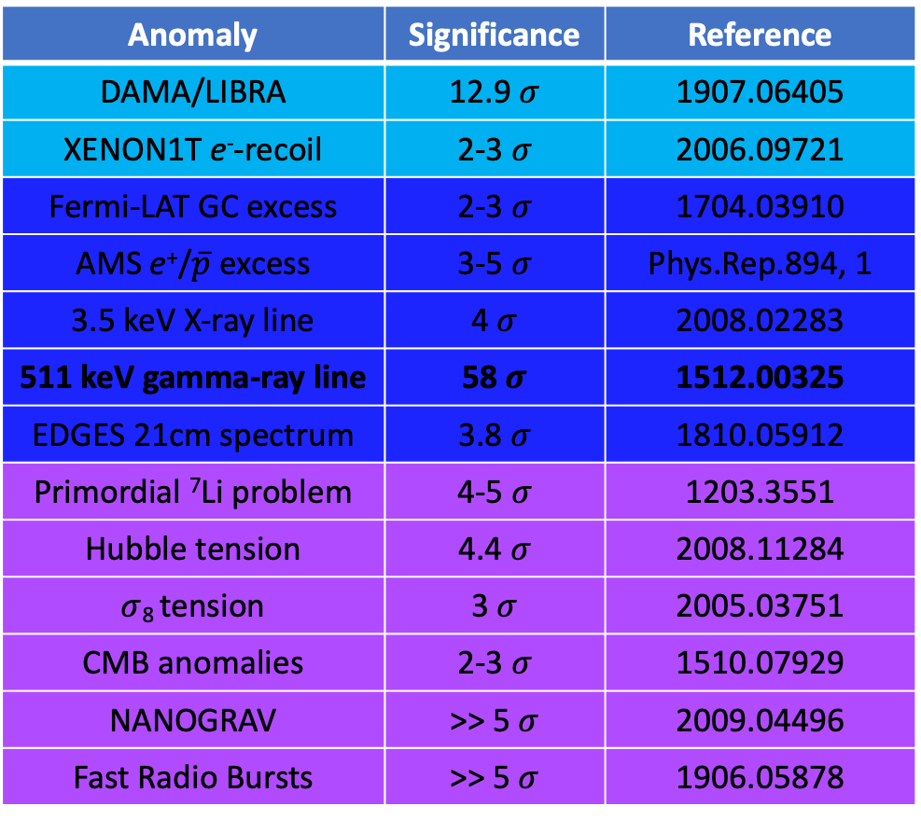
(Partial) List of Existing Anomalies
Anomaly | Significance | Reference
Multileptons@LHC | 2-5 $σ$ | 1901.05300
Dijet excess@LEP2 | 4-5 $σ$ | 1706.02255
Muon g-2 | 4.2$σ$ | 2104.03281
LFUV in B-decays | 3-5 $σ$ | 1909.12524
CKM unitarity | 4 $σ$ | 2012.01580
LFUV in tau decay | ~2$σ$ | 1909.12524
LSND/MiniBooNE | 6.1$σ$ | 2006.16883
NOvA vs T2K | ~2$σ$ | Neutrino 2020
IceCube HESE vs TG | ~2$σ$ | 2011.03545
ANITA upgoing events | ~2$σ$ | 2010.02869
Neutron lifetime | 3.6$σ$ | 2011.13272
⁸Be transition | 7.2$σ$ | 1910.10459
Proton charge radius | 5 $σ$ | 2105.00571
Anomaly | Significance | Reference
DAMA/LIBRA | 12.9 $σ$ | 1907.06405
XENON1T e⁻-recoil | 2-3$σ$ | 2006.09721
Fermi-LAT GC excess | 2-3$σ$ | 1704.03910
AMS e⁺/$\overline{p}$ excess | 3-5$σ$ | Phys.Rep.894, 1
3.5 keV X-ray line | 4$σ$ | 2008.02283
511 keV gamma-ray line | 58 $σ$ | 1512.00325
EDGES 21cm spectrum | 3.8$σ$ | 1810.05912
Primordial ⁷Li problem | 4-5$σ$ | 1203.3551
Hubble tension | 4.4$σ$ | 2008.11284
$σ$₈ tension | 3 $σ$ | 2005.03751
CMB anomalies | 2-3 $σ$ | 1510.07929
NANOGRAV | >> 5$σ$ | 2009.04496
Fast Radio Bursts | >> 5$σ$ | 1906.05878
See DM VIII parallel talk by Celeste Keith
Repository: https://github.com/hepcomm/hepmist

Slide 10
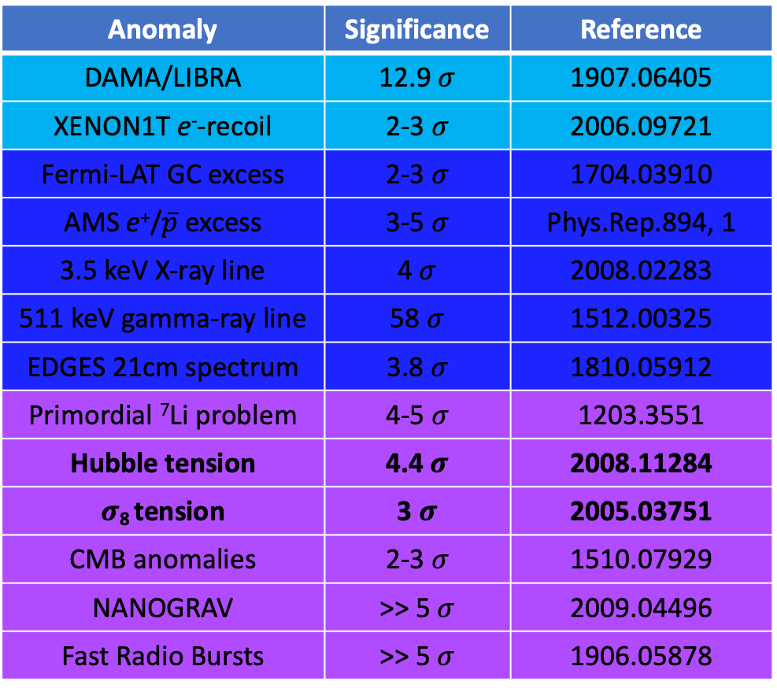
(Partial) List of Existing Anomalies
Anomaly | Significance | Reference
Multileptons@LHC | 2-5 $σ$ | 1901.05300
Dijet excess@LEP2 | 4-5 $σ$ | 1706.02255
Muon g-2 | 4.2$σ$ | 2104.03281
LFUV in B-decays | 3-5 $σ$ | 1909.12524
CKM unitarity | 4 $σ$ | 2012.01580
LFUV in tau decay | ~2$σ$ | 1909.12524
LSND/MiniBooNE | 6.1$σ$ | 2006.16883
NOvA vs T2K | ~2$σ$ | Neutrino 2020
IceCube HESE vs TG | ~2$σ$ | 2011.03545
ANITA upgoing events | ~2$σ$ | 2010.02869
Neutron lifetime | 3.6$σ$ | 2011.13272
⁸Be transition | 7.2$σ$ | 1910.10459
Proton charge radius | 5 $σ$ | 2105.00571
Anomaly | Significance | Reference
DAMA/LIBRA | 12.9 $σ$ | 1907.06405
XENON1T e⁻-recoil | 2-3$σ$ | 2006.09721
Fermi-LAT GC excess | 2-3$σ$ | 1704.03910
AMS e⁺/$\overline{p}$ excess | 3-5$σ$ | Phys.Rep.894, 1
3.5 keV X-ray line | 4$σ$ | 2008.02283
511 keV gamma-ray line | 58 $σ$ | 1512.00325
EDGES 21cm spectrum | 3.8$σ$ | 1810.05912
Primordial ⁷Li problem | 4-5$σ$ | 1203.3551
Hubble tension | 4.4$σ$ | 2008.11284
$σ$₈ tension | 3 $σ$ | 2005.03751
CMB anomalies | 2-3 $σ$ | 1510.07929
NANOGRAV | >> 5$σ$ | 2009.04496
Fast Radio Bursts | >> 5$σ$ | 1906.05878
See plenary talk by Elizabeth Krause and Cosmology II parallel talks by Roy Choudhury and Toda
Repository: https://github.com/hepcomm/hepmist

Slide 11

(Partial) List of Existing Anomalies
Anomaly | Significance | Reference
Multileptons@LHC | 2-5 $σ$ | 1901.05300
Dijet excess@LEP2 | 4-5 $σ$ | 1706.02255
Muon g-2 | 4.2$σ$ | 2104.03281
LFUV in B-decays | 3-5 $σ$ | 1909.12524
CKM unitarity | 4 $σ$ | 2012.01580
LFUV in tau decay | ~2$σ$ | 1909.12524
LSND/MiniBooNE | 6.1$σ$ | 2006.16883
NOvA vs T2K | ~2$σ$ | Neutrino 2020
IceCube HESE vs TG | ~2$σ$ | 2011.03545
ANITA upgoing events | ~2$σ$ | 2010.02869
Neutron lifetime | 3.6$σ$ | 2011.13272
⁸Be transition | 7.2$σ$ | 1910.10459
Proton charge radius | 5 $σ$ | 2105.00571
Anomaly | Significance | Reference
DAMA/LIBRA | 12.9 $σ$ | 1907.06405
XENON1T e⁻-recoil | 2-3$σ$ | 2006.09721
Fermi-LAT GC excess | 2-3$σ$ | 1704.03910
AMS e⁺/$\overline{p}$ excess | 3-5$σ$ | Phys.Rep.894, 1
3.5 keV X-ray line | 4$σ$ | 2008.02283
511 keV gamma-ray line | 58 $σ$ | 1512.00325
EDGES 21cm spectrum | 3.8$σ$ | 1810.05912
Primordial ⁷Li problem | 4-5$σ$ | 1203.3551
Hubble tension | 4.4$σ$ | 2008.11284
$σ$₈ tension | 3 $σ$ | 2005.03751
CMB anomalies | 2-3 $σ$ | 1510.07929
NANOGRAV | >> 5$σ$ | 2009.04496
Fast Radio Bursts | >> 5$σ$ | 1906.05878
See plenary talk by Maura Mclaughlin
Repository: https://github.com/hepcomm/hepmist

Slide 12
Outline
B-anomalies: R_{D}^{(*)} and R_{K}^{(*)}
  Common NP explanation
  Complementary high-p_{T} LHC tests
Muon g-2 anomaly:
  Connection to B-anomalies?
  Tests at LHC and future colliders
Connection to neutrino mass

Slide 13


Muon Anomalous Magnetic Moment
Two remarks:
If a change in HVP brought SM value close to expt, problems might arise in global EW fit.
  Crivellin, Hoferichter, Manzari, Montull, 2003.04886 [PRL]
(Related) unresolved issues in the electron g-2 sector:
Parker, Yu, Zhong, Estey, Mueller,
1812.04130 (Science)
-2.4 $σ$
Recent development:
2104.03281 [PRL]
More updates expected soon!
Morel, Yao, Clade, Guellati-Khelifa,
Nature 588, 61 (2020)
+1.6 $σ$
See plenary talk by James Mott and mini-review (Flavor III) by Hartmut Wittig

Slide 14
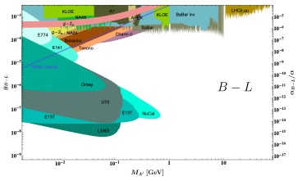
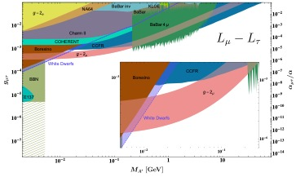
New Physics Solutions to Muon g-2
Essentially two choices:
  Superweak interaction, small mass (e.g. ALP, dark photon, light Z’)
  Stronger interaction, large mass (e.g. 2HDM, SUSY, leptoquark)
New particle(s) in the loop can be anything: neutral/charged scalar, fermion or gauge boson. Lindner, Platscher, Queiroz, 1610.06587 (Phys. Rep.)
Need to be careful about the sign of the BSM contribution.
Also need flavor non-universal couplings to avoid other expt constraints.
Bauer, Foldenauer, Jaeckel, 1803.05466 [JHEP]

Slide 15
R_{D}^{(*)} Anomaly
Altmannshofer, BD, Soni, Sui, 2002.12910 [PRD]
All experimental measurements to date are consistently above the SM prediction.
Flavor-changing charged current: happens at tree-level in the SM.
No such deviations in charmed meson decays:
NP particle(s) must be
light, i.e.
below ~TeV scale.
BESIII, 2002.10578 [PRD]

Slide 16
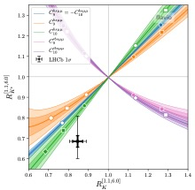
R_{K}^{(*)} Anomaly
Altmannshofer, Stangl, 2103.13370
Flavor-changing neutral current:
Loop-suppressed in the SM.
NP can be heavy.
Best fit:
Li, Shi, Geng, 2105.06768

Slide 17
Common New Physics Solution?
A popular choice: Leptoquarks.
Single scalar LQ solution? Bauer, Neubert, 1511.01900 [PRL]
Now disfavored by global fits.
  Angelescu, Becirevic, Faroughy, Jaffredo, Sumensari, 2103.12504
Single vector LQ still a viable option, but must be embedded into some UV-completion.
  Crivellin, Greub, Mueller, Saturnino, 1807.02068 [PRL];
  Fornal, Gadam, Grinstein, 1812.01603 [PRD];
  Cornella, Fuentes-Martin, Isidori, 1903.11517 [JHEP];
  BD, Mohanta, Patra, Sahoo, 2004.09464 [PRD];
  Iguro, Kawamura, Okawa, Omura, 2103.11889;
  Perez, Murgui, Plascencia, 2104.11229; …
Or invoke more than one scalar LQ.
  Chen, Nomura, Okada, 1703.03251 [PLB];
  Bigaran, Gargalionis, Volkas, 1906.01870 [JHEP];
  Saad, 2005.04352 [PRD];
  Babu, BD, Jana, Thapa, 2009.01771 [JHEP]; …

Slide 18
Chiral Enhancement for Muon g-2
Connection with Higgs decay to dileptons
Crivellin, Mueller, Saturnino, 2008.02643
Depends on quartic couplings
LQ solution to muon g-2 can be tested in precision Higgs data at LHC and future colliders.
Babu, BD, Jana, Thapa, 2009.01771 [JHEP]
See BSM IX parallel talk (today 5.30pm) by Anil Thapa

Slide 19
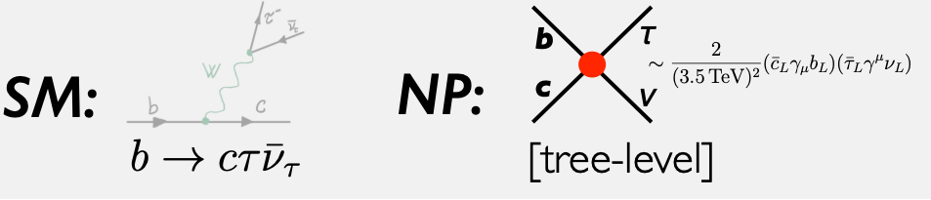
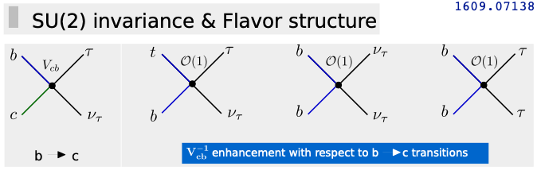
High-p_{T} LHC Tests
Greljo, Marzocca, 1704.09015 [EPJC]
Greljo, Camalich, Ruiz-Alvarez, 1811.07920 [PRL]
Faroughy, Greljo, Kamenik, 1609.07138 [PLB]
Recent CMS analysis: 2103.02708
(mild discrepancy at 1.8 TeV)
A. Greljo, CERN Implications Workshop 2018
See plenary talk by Tulika Bose

Slide 20
Implications for LQ Models
Babu, BD, Jana, Thapa, 2009.01771 [JHEP]
Non-resonant dilepton searches at LHC severely restrict
the allowed LQ parameter space for B-anomalies.
See BSM IX parallel talk (today 5.30pm) by Anil Thapa

Slide 21
Another NP Solution: RPV SUSY
Natural SUSY:
Only 3rd generation sfermions light.
Deshpande, He, 1608.04817[EPJC];
Altmannshofer, BD, Soni, 1704.06659 [PRD].
Das, Hati, Kumar, Mahajan, 1605.06313 [PRD];
Earl, Gregoire, 1806.01343 [JHEP];
Trifinopoulos, 1807.01638 [EPJC];
Altmannshofer, BD, Soni, Sui [PRD].

Slide 22
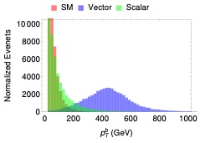
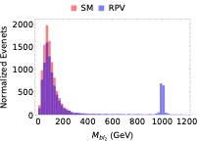
Distinct LHC Signals
Altmannshofer, BD, Soni, 1704.06659 [PRD];
Altmannshofer, BD, Soni, Sui, 2002.12910 [PRD]
See Flavor III parallel talk (today 2.30pm) by Fang Xu

Slide 23
An LHC Test of Muon g-2
ATLAS-CONF-2021-011
See Flavor III parallel talk (today 2.30pm) by Fang Xu

Slide 24
Connection to Neutrino Physics
RPV SUSY
Singlet-doublet LQ
Doublet-triplet LQ
Neutrino NSI
Babu, BD, Jana, Thapa, 1907.09498 [JHEP]

Slide 25
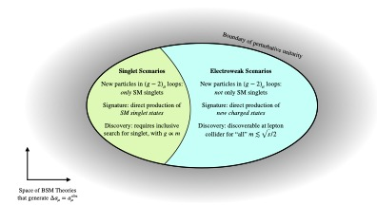
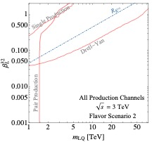
Far into the Future:
No-Lose Theorem for Muon Collider
Capdevilla, Curtin, Kahn, Krnjaic, 2006.16277; 2101.10334
Asadi, Capdavilla, Cesarotti,
Homiller, 2104.05720
See BSM V parallel talk (Wednesday 3.15pm) by Cari Cesarotti

Slide 26


Conclusion
More conspicuous paths to new physics have remained stubbornly out of reach so far.
Following the bread crumbs (i.e. looking for inspiration from anomalies) might lead us on the right path to new physics.
Lepton Flavor Universality Violation is a strong hint in that direction.
Need coherent community effort, active theory-experiment collaborations and open-access data to resolve the existing anomalies.
Important to establish independent tests (at colliders and elsewhere).

