Slide 1
Resonant neutrino self-interactions in astrophysical spectra
Pheno 2021, May 25, 2021
Jeff Hyde
Bowdoin College
Work w/
Cyril Creque-Sarbinowski
& Marc Kamionkowski
CCS, JH, MK, Phys. Rev. D 103, 023527, arXiv:2005.05332

Slide 2
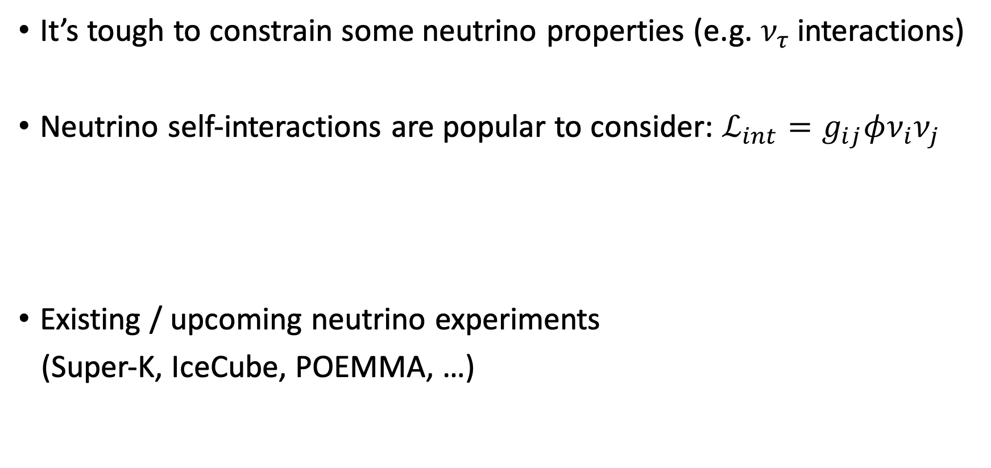
Motivations
It’s tough to constrain some neutrino properties (e.g. $ν_{τ}$ interactions)
Neutrino self-interactions are popular to consider: $ℒ_{int}=g_{ij}φν_{i}ν_{j}$
Existing / upcoming neutrino experiments
(Super-K, IceCube, POEMMA, …)
e.g. Araki et al. 1409.4180 & 1508.07471, Barenboim et al. 1903.02036, Jones & Spitz 1911.06342,
Ng & Beacom 1404.2288, Bustamante et al. 2001.04994, Blinov et al. 1905.02727,
Mazumdar et al. 2011.13685, Carpio et al. 2104.15136, Das & Ghosh 2011.12315, Choudhury et al. 2012.07519

Slide 3
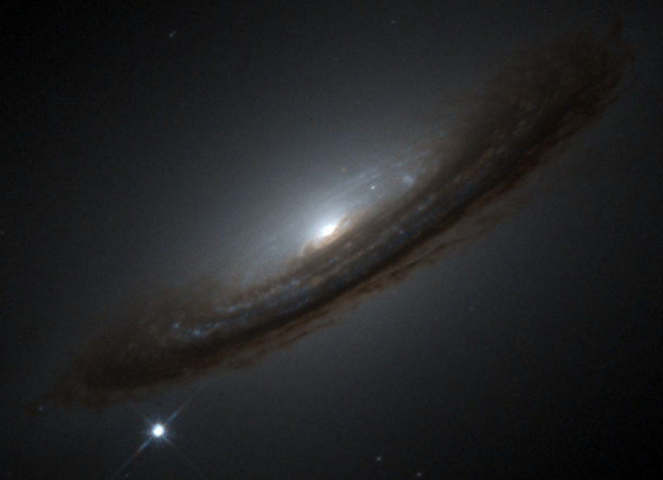
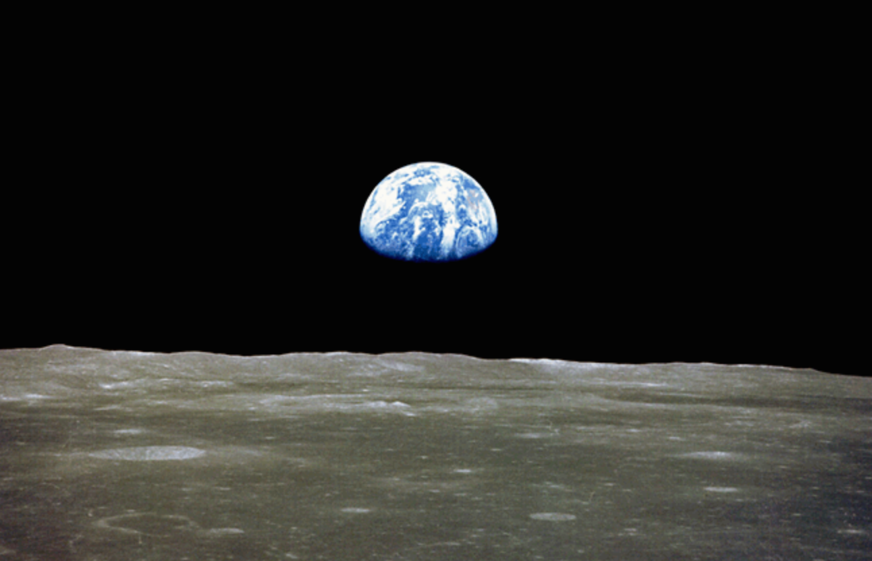

https://apod.nasa.gov/apod/ap000312.html
$$ν$$
https://nssdc.gsfc.nasa.gov/imgcat/html/object_page/a11_h_44_6552.html
Source of primary flux
Propagation
Flux spectrum at Earth

Slide 4
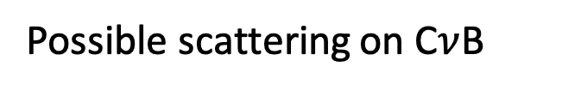
https://apod.nasa.gov/apod/ap000312.html
$$ν$$
https://nssdc.gsfc.nasa.gov/imgcat/html/object_page/a11_h_44_6552.html
Source of primary flux
Propagation
Flux spectrum at Earth
Possible scattering on C$ν$B

Slide 5

Cosmic background neutrinos (C$ν$B)

Slide 6
Neutrino from some astrophysical source
Cosmic background neutrinos (C$ν$B)

Slide 7
Neutrino from some astrophysical source
Two outgoing neutrinos
(lowers energy but adds a neutrino to spectrum)
Cosmic background neutrinos (C$ν$B)

Slide 8
Also considered in:
Farzan & Palomares-Ruiz 1401.7019, Ibe & Kaneta 1407.2848, Jeong et al. 1803.04541
We generalize to:
Arbitrary self-coupling matrix
Closed-form solution (avoids time-intensive numerics).
Neutrino from some astrophysical source
Two outgoing neutrinos
(lowers energy but adds a neutrino to spectrum)
Cosmic background neutrinos (C$ν$B)

Slide 9
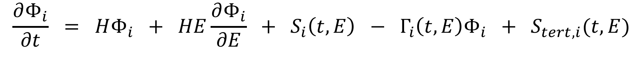
Boltzmann equations for evolution of neutrino flux
$$\frac{∂Φ_{i}}{∂t} = HΦ_{i} + HE\frac{∂Φ_{i}}{∂E} + S_{i}\left(t,E\right) − Γ_{i}\left(t,E\right)Φ_{i} + S_{tert,i}(t,E)$$
CCS, JH, MK, Phys. Rev. D 103, 023527, arXiv:2005.05332

Slide 10
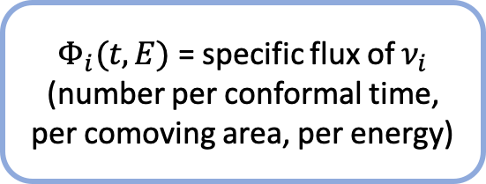
Boltzmann equations for evolution of neutrino flux
$$\frac{∂Φ_{i}}{∂t} = HΦ_{i} + HE\frac{∂Φ_{i}}{∂E} + S_{i}\left(t,E\right) − Γ_{i}\left(t,E\right)Φ_{i} + S_{tert,i}(t,E)$$
Expansion
$Φ_{i}(t,E)$ = specific flux of $ν_{i}$
(number per conformal time, per comoving area, per energy)
Source term for primary flux.
CCS, JH, MK, Phys. Rev. D 103, 023527, arXiv:2005.05332

Slide 11
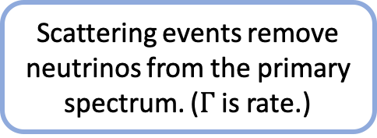
Boltzmann equations for evolution of neutrino flux
$$\frac{∂Φ_{i}}{∂t} = HΦ_{i} + HE\frac{∂Φ_{i}}{∂E} + S_{i}\left(t,E\right) − Γ_{i}\left(t,E\right)Φ_{i} + S_{tert,i}(t,E)$$
Expansion
Scattering events remove neutrinos from the primary spectrum. ($Γ$ is rate.)
$Φ_{i}(t,E)$ = specific flux of $ν_{i}$
(number per conformal time, per comoving area, per energy)
The tertiary source term represents reinjection of neutrinos after scattering.
Source term for primary flux.
CCS, JH, MK, Phys. Rev. D 103, 023527, arXiv:2005.05332

Slide 12
Boltzmann equations for evolution of neutrino flux
$$\frac{∂Φ_{i}}{∂t} = HΦ_{i} + HE\frac{∂Φ_{i}}{∂E} + S_{i}\left(t,E\right) − Γ_{i}\left(t,E\right)Φ_{i} + S_{tert,i}(t,E)$$
Expansion
Scattering events remove neutrinos from the primary spectrum. ($Γ$ is rate.)
$Φ_{i}(t,E)$ = specific flux of $ν_{i}$
(number per conformal time, per comoving area, per energy)
The tertiary source term represents reinjection of neutrinos after scattering.
Source term for primary flux.
Neutrino self-interactions found here
CCS, JH, MK, Phys. Rev. D 103, 023527, arXiv:2005.05332

Slide 13
Resonant $ν−ν$ scattering
Resonant scattering dominant – we take a Breit-Wigner form.
In many cases, this can be well-approximated as a delta function (e.g. width less than detector energy resolution).

Slide 14

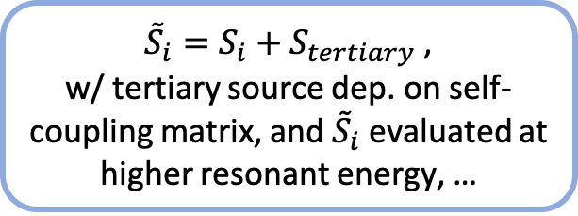
Result for multiple flavors, arbitrary self-coupling matrix
$$Φ_{i}\left(t,E\right) = \int_{−∞}^{t}{dt^{′} \left(\frac{a\left(t\right)}{a\left(t^{′}\right)}\right){ e}^{−τ_{i}\left(t^{′}, t , E\right)}{ \tilde{S}}_{i}\left(t^{′},\frac{a(t)}{a(t^{′})}E\right)}$$
${\tilde{S}}_{i}=S_{i}+S_{tertiary}$ ,
w/ tertiary source dep. on self-coupling matrix, and ${\tilde{S}}_{i}$ evaluated at higher resonant energy, …
Optical depth depends on form of neutrino self-coupling matrix...
CCS, JH, MK, Phys. Rev. D 103, 023527, arXiv:2005.05332

Slide 15

Result for multiple flavors, arbitrary self-coupling matrix
$$Φ_{i}\left(t,E\right) = \int_{−∞}^{t}{dt^{′} \left(\frac{a\left(t\right)}{a\left(t^{′}\right)}\right){ e}^{−τ_{i}\left(t^{′}, t , E\right)}{ \tilde{S}}_{i}\left(t^{′},\frac{a(t)}{a(t^{′})}E\right)}$$
${\tilde{S}}_{i}=S_{i}+S_{tertiary}$ ,
w/ tertiary source dep. on self-coupling matrix, and ${\tilde{S}}_{i}$ evaluated at higher resonant energy, …
Optical depth depends on form of neutrino self-coupling matrix...
Details here are pretty involved for such a short talk... See paper.
CCS, JH, MK, Phys. Rev. D 103, 023527, arXiv:2005.05332

Slide 16
Result for multiple flavors, arbitrary self-coupling matrix
Inputs: Result:
Primary source term – depends on physics of source (e.g. supernova neutrinos)
Analytic calculation
Spectrum that arrives at Earth
Neutrino self-coupling matrix – depends on new physics model
CCS, JH, MK, Phys. Rev. D 103, 023527, arXiv:2005.05332

Slide 17
Result for multiple flavors, arbitrary self-coupling matrix
Inputs: Result:
Could apply to a wide range of scenarios.
Primary source term – depends on physics of source (e.g. supernova neutrinos)
Analytic calculation
Spectrum that arrives at Earth
Neutrino self-coupling matrix – depends on new physics model
CCS, JH, MK, Phys. Rev. D 103, 023527, arXiv:2005.05332

Slide 18
Result for multiple flavors, arbitrary self-coupling matrix
Inputs: Result:
Could apply to a wide range of scenarios.
Primary source term – depends on physics of source (e.g. supernova neutrinos)
Not a time-intensive Monte Carlo, etc.
Analytic calculation
Spectrum that arrives at Earth
Neutrino self-coupling matrix – depends on new physics model
Is it really a closed-form solution?
CCS, JH, MK, Phys. Rev. D 103, 023527, arXiv:2005.05332

Slide 19
Result for multiple flavors, arbitrary self-coupling matrix
Inputs: Result:
Could apply to a wide range of scenarios.
Primary source term – depends on physics of source (e.g. supernova neutrinos)
Not a time-intensive Monte Carlo, etc.
Analytic calculation
Spectrum that arrives at Earth
Neutrino self-coupling matrix – depends on new physics model
Is it really a closed-form solution?
Yes! But have to be careful with implementation…
CCS, JH, MK, Phys. Rev. D 103, 023527, arXiv:2005.05332

Slide 20
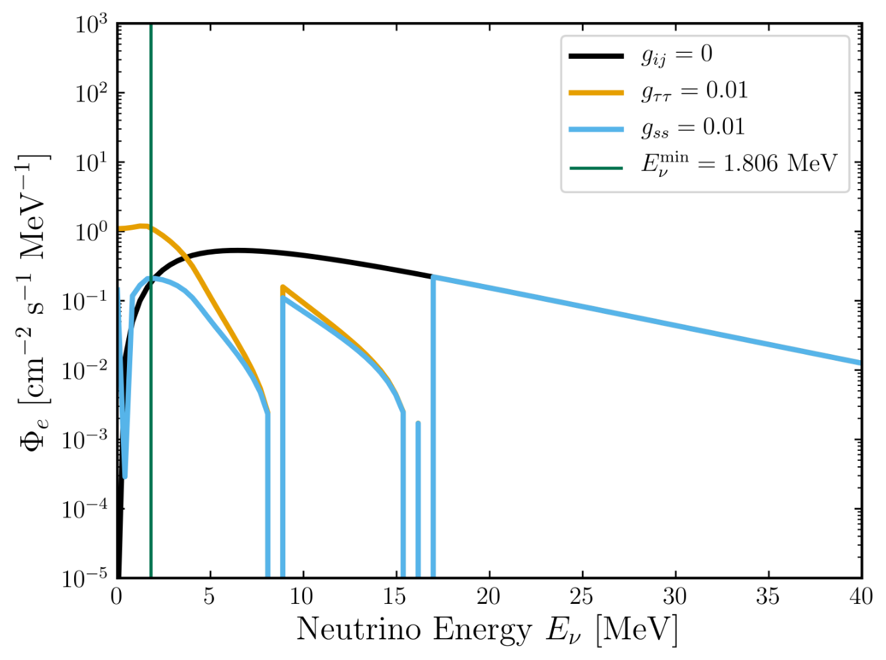
Example: Diffuse Supernova Neutrino Background (DSNB)
CCS, JH, MK, Phys. Rev. D 103, 023527, arXiv:2005.05332

Slide 21
Example: Diffuse Supernova Neutrino Background (DSNB)
Above highest resonant energy, spectrum unaffected by self-interactions.
CCS, JH, MK, Phys. Rev. D 103, 023527, arXiv:2005.05332

Slide 22
Example: Diffuse Supernova Neutrino Background (DSNB)
Above highest resonant energy, spectrum unaffected by self-interactions.
Scattering at the highest resonant energy used in (tertiary) source for injection at lower energies.
CCS, JH, MK, Phys. Rev. D 103, 023527, arXiv:2005.05332

Slide 23
Example: Diffuse Supernova Neutrino Background (DSNB)
Neutrinos removed from spectrum at resonances, injected at lower energies.
Above highest resonant energy, spectrum unaffected by self-interactions.
Scattering at the highest resonant energy used in (tertiary) source for injection at lower energies.
CCS, JH, MK, Phys. Rev. D 103, 023527, arXiv:2005.05332

Slide 24
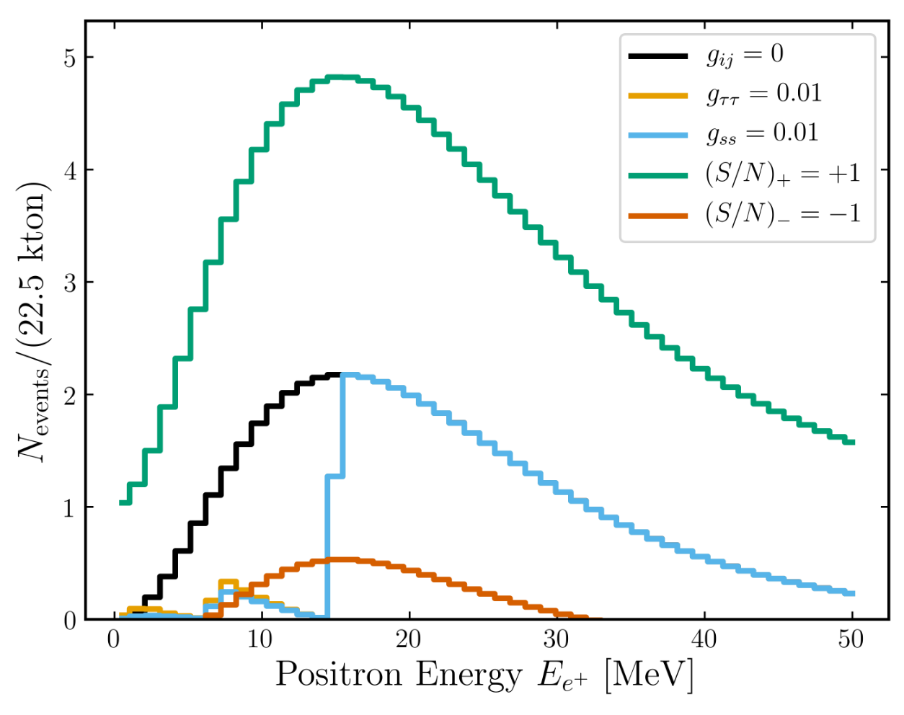
Event rates, +/- 1 sigma for 10 years at Super-K w/ gadolinium.
Comparison with expected spectrum at T = 8 MeV in absence of self-interactions.
CCS, JH, MK, Phys. Rev. D 103, 023527, arXiv:2005.05332

Slide 25
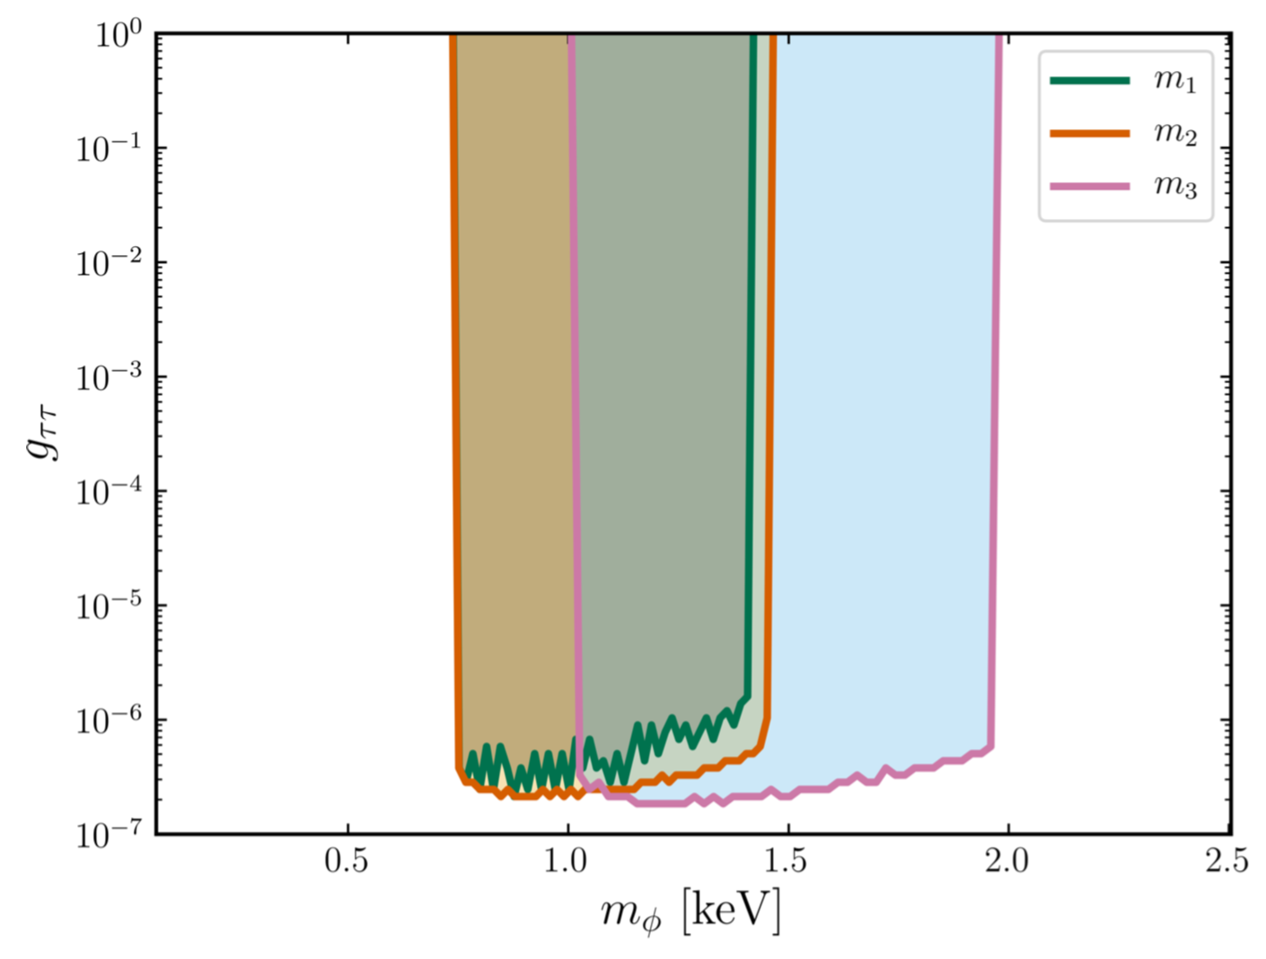
Forecasted 1-sigma constraints on coupling & scalar mediator, for 10 years at Super-K w/ gadolinium.
CCS, JH, MK, Phys. Rev. D 103, 023527, arXiv:2005.05332

Slide 26
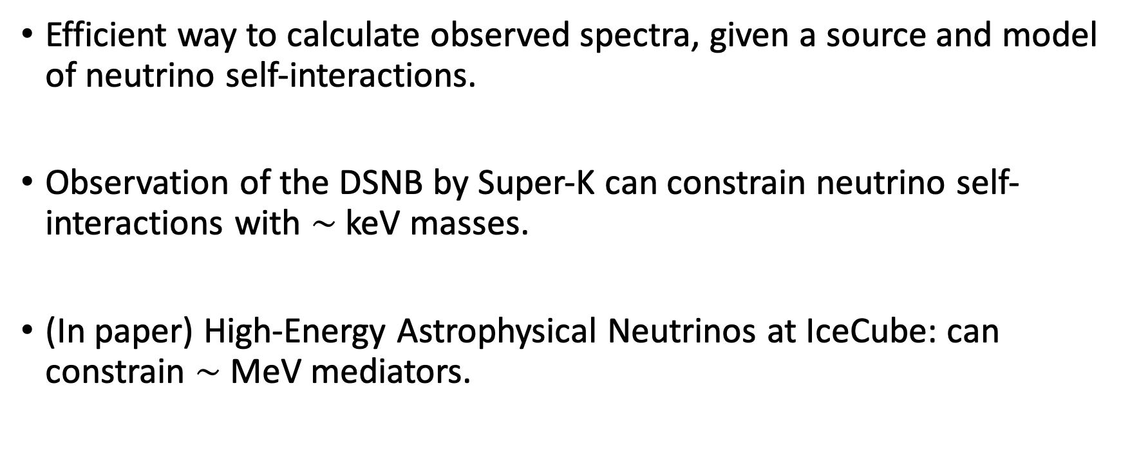
Summary
Efficient way to calculate observed spectra, given a source and model of neutrino self-interactions.
Observation of the DSNB by Super-K can constrain neutrino self-interactions with $\sim$keV masses.
(In paper) High-Energy Astrophysical Neutrinos at IceCube: can constrain $\sim$ MeV mediators.
CCS, JH, MK, Phys. Rev. D 103, 023527, arXiv:2005.05332

