Slide 1

Phenomenology of Magnetic Black Holes with Electroweak-Symmetric Coronas
Mrunal Korwar
Physics Department, University of Wisconsin-Madison
Email:- mkorwar@wisc.edu
Phenomenology 2021 Symposium
2007.03703 (JHEP 10 (2020) 210) with Yang Bai, Joshua Berger, and Nicholas Orlofsky
2012.15430 (JHEP 04 (2021) 119) with Yang Bai

Slide 2
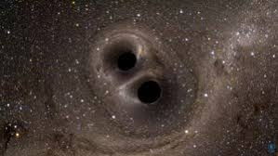
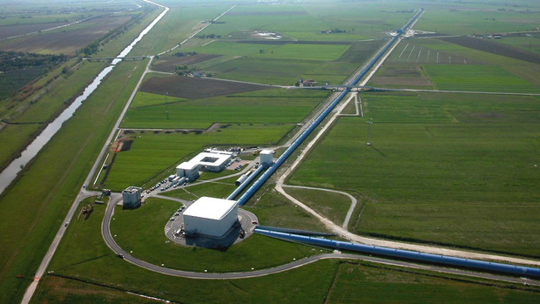
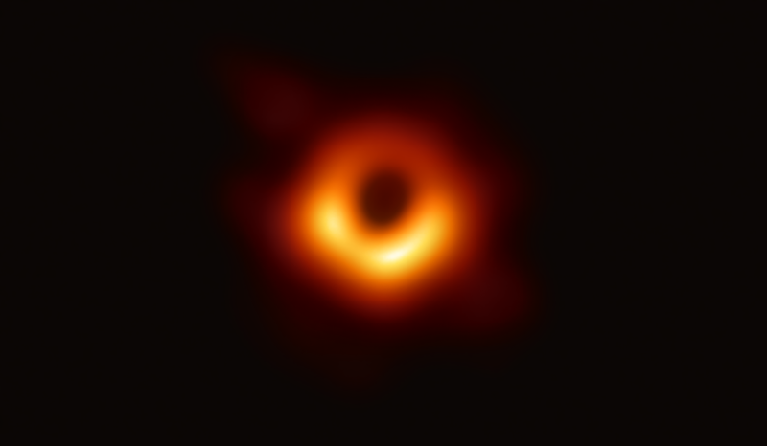
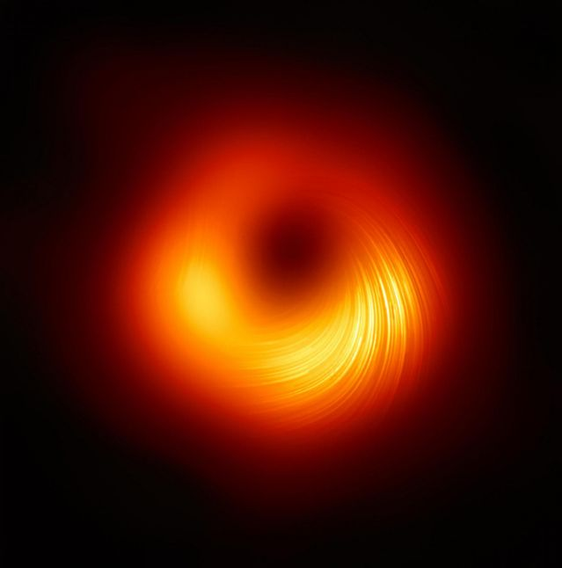
Introduction
Open Problems in Fundamental Physics:
1) Nature of Dark Matter and Dark Energy
2) Baryogenesis
3) Naturalness/Hierarchy Problem
…..
n) Exotic Objects or states in the SM or BSM
Observational probes for BHs:
Magnetic BH with Electroweak- Symmetric Hair
(LIGO collaboration, EHT Collaboration)

Slide 3
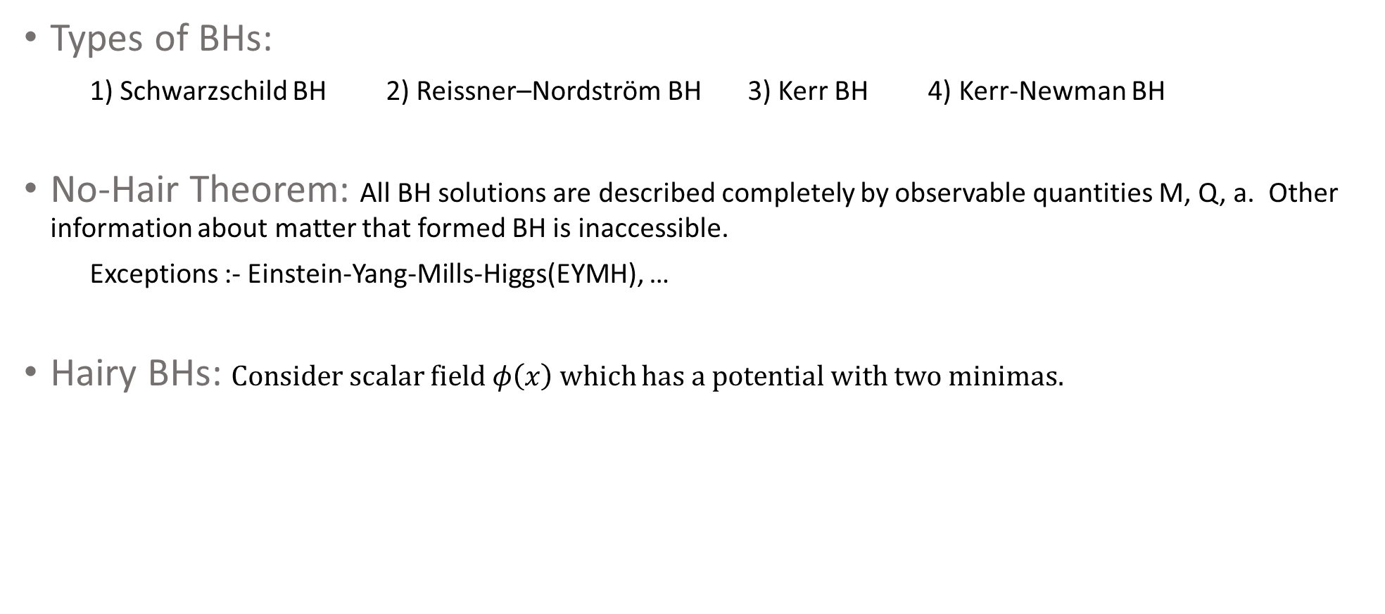



Hairy Black Holes
Types of BHs:
1) Schwarzschild BH 2) Reissner–Nordström BH 3) Kerr BH 4) Kerr-Newman BH
No-Hair Theorem: All BH solutions are described completely by observable quantities M, Q, a. Other information about matter that formed BH is inaccessible.
Exceptions :- Einstein-Yang-Mills-Higgs(EYMH), …
Hairy BHs: Consider scalar field $φ\left(x\right)$which has a potential with two minimas.
(Lee, Nair, E. Weinberg’ 91 (hep-th:9112008))
$$V(φ)$$
BH
Solution
$<φ$(r)$> ↔$
Scalar Hair
$<φ$(r)$>$

Slide 4







Electroweak Monopoles?
Lagrangian:
Ansatz: Spherically symmetric ansatz in hedgehog gauge (Cho & maison’96 (hep-ph:9601028))
Mass: (Lee & E. Weinberg’94 (hep-th:9406021))
$$SU\left(2\right)L×U\left(1\right)Y→U{\left(1\right)}_{EM}$$
Divergent.
No Finite Energy Electroweak Monopoles in SM
Magnetic BH with Electroweak Hair
Hide Singularity behind event horizon of BH

Slide 5
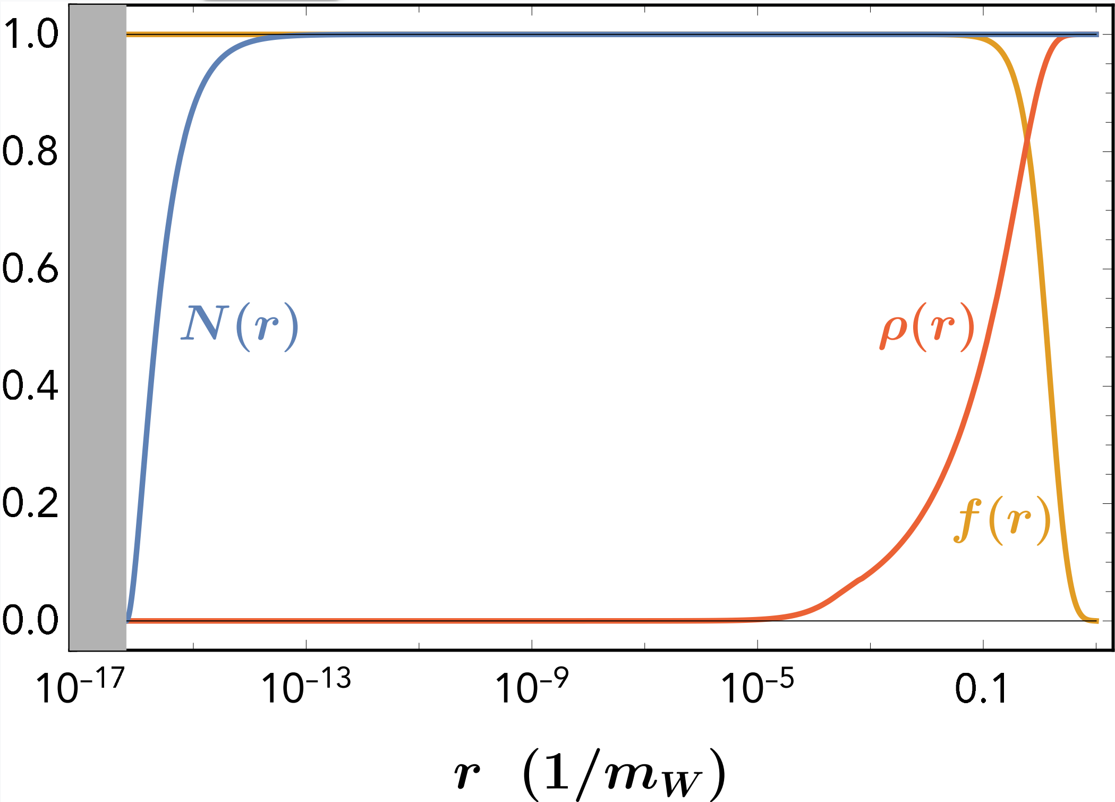




Hairy Magnetic Black Holes
Action:
Profile of Electroweak hair:
Normal Vacuum
Electroweak Symmetric
$$m_{f}∝(r)$$
(Bai & MK, 2012.15430)
Q = 2
masses vanish
Extremal Hairy magnetic BH

Slide 6


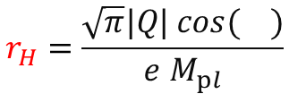
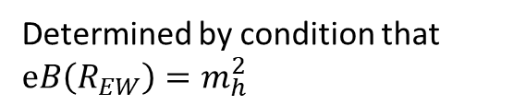


Higher charged Hairy Magnetic Black Holes
Mass and Radius:
$$r_{H}=\frac{\sqrt{π}|Q| cos( )}{e M_{pl}}$$
$$R_{EW}=\frac{\sqrt{|Q|/2} }{ mh}$$
$Mext$ $=\frac{\sqrt{π}|Q|M_{pl}cos( )}{e }$
Q
Determined by condition that $eB\left(R_{EW}\right)=m_{h}^{2}$
$$r_{H}(Q_{max})=R_{EW}(Q_{max})$$
$$2 <Q <Q_{max}≅ {10}^{32}$$
$$0.1 mg< M< {10}^{28}gm$$
For $Q>Q_{max}$ electroweak symmetric region does not exist, so no hairy magnetic BHs
(Maldacena, 2004.06084)

Slide 7




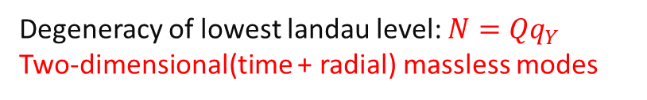



2-D Hawking Radiation
2-D massless modes: Landau levels in presence of magnetic fields
Hawking Radiation: (Maldacena, 2004.06084)
for s=1/2 fermions
in EW symmetric region
Q
Degeneracy of lowest landau level: ${N=Qq}_{Y}$
Two-dimensional(time + radial) massless modes
Q = 2
$$T>m_{e}$$
$$T<m_{e}$$
$g_{∗}$=2Q for electrons
$g_{∗}$=2 for photon and $\frac{21}{4}$ for neutrinos
For phenomenological purpose BHs can be taken to be extremal.

Slide 8


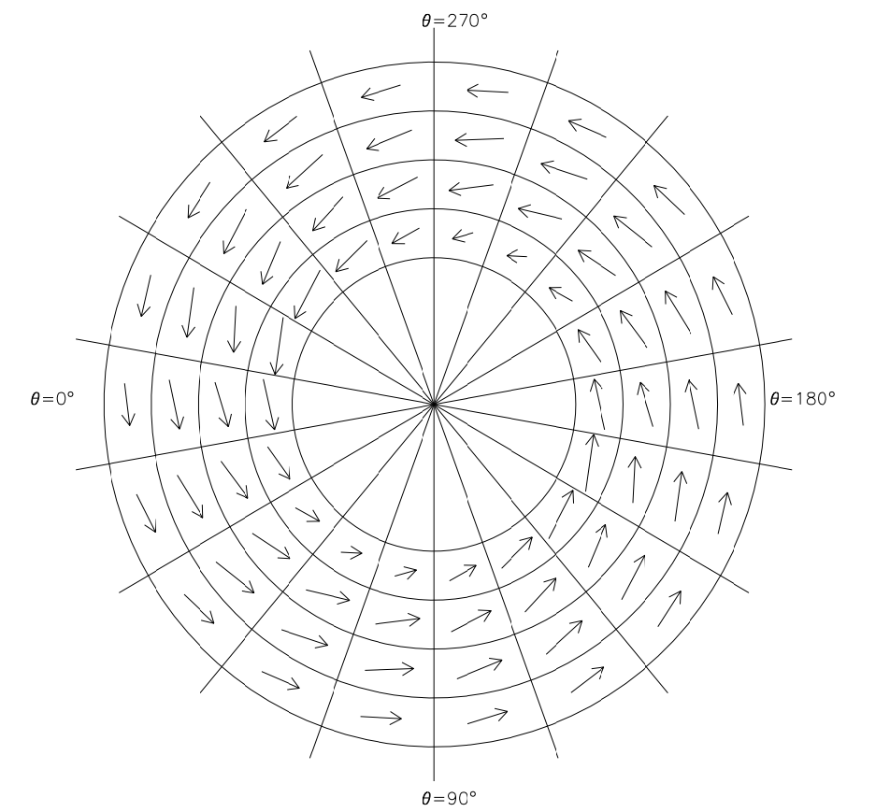


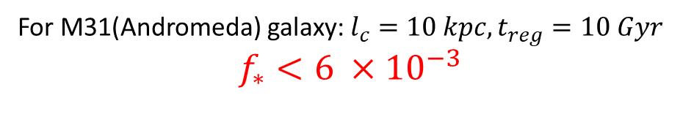





Parker Limit
Magnetic BHs get accelerated and extract energy from large coherent magnetic fields present in galaxies
$$l_{c}$$
$$\vec{B}$$
$$\vec{v}$$
$$F={Qe}_{M}B$$
$${\vec{v}}_{f}$$
$$\vec{v}$$
$$\vec{v}$$
Q = 2
For M31(Andromeda) galaxy: $l_{c}=10 kpc, t_{reg}=10 Gyr$
$$f_{∗}<6 ×{10}^{−3}$$
(Fletcher et al.
Astro-ph/0310258)
(Bai, Berger, MK, Orlofsky; 2007.03703)
( Turner, Parker, Bogdan’1982)

Slide 9
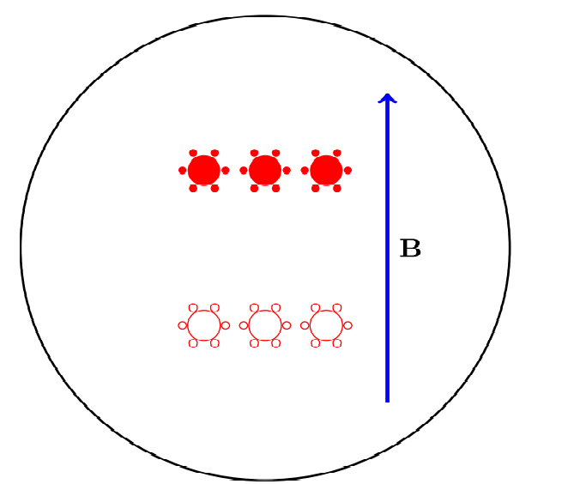









Limits from Sun and Earth
MBHs with Q>30 (sun) and 1900(earth) can be stopped.
For $N>N_{∗}^{crit}$ the Coulomb attractive force dominates the repulsive force
Annihilation produce neutrino flux
Earth Heat
$$+$$
$$+$$
$$+$$
$$−$$
$$−$$
$$−$$
$$I_{ν}= \frac{N_{ν} Γ_{A}}{4π d^{2} }$$
$$N_{ν}= η_{ν}\frac{M_{BH}}{T_{BH}}$$
(Bai, Berger, MK, Orlofsky; 2007.03703)

Slide 10
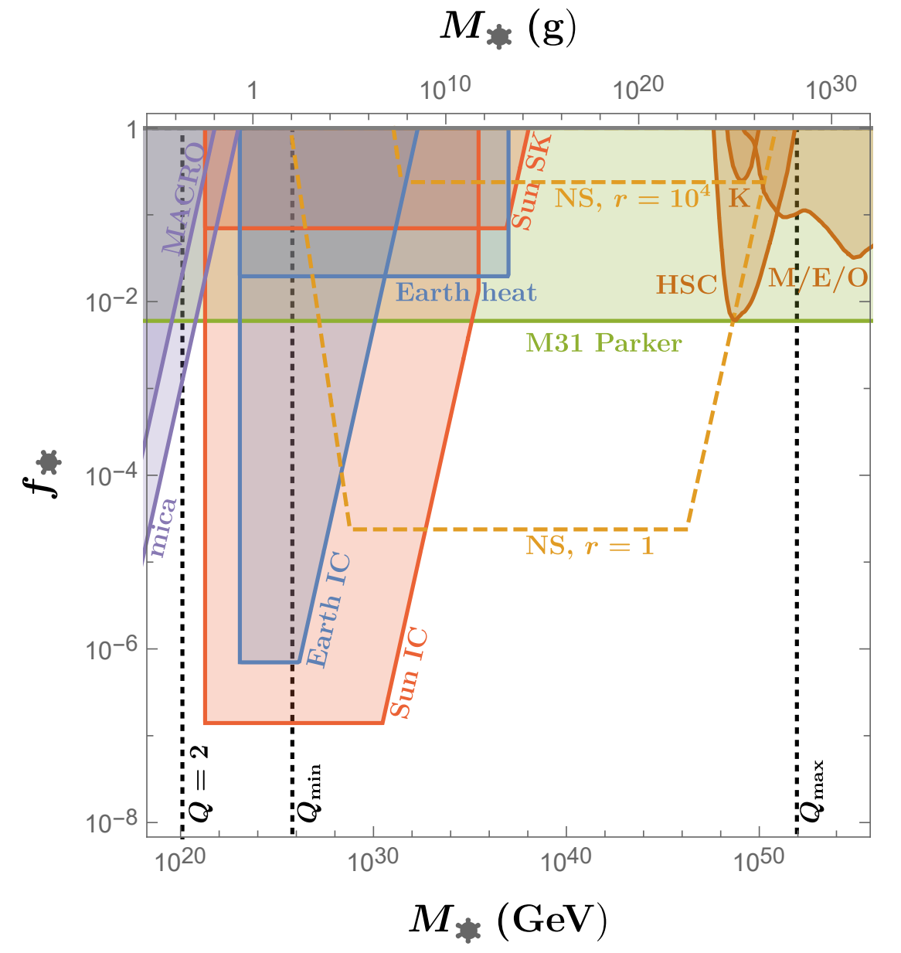
Final Plot
MACRO: Magnetic monopole search
Mica: Track of monopoles in ancient mica
HSC, MACHO/EROS/OGLE, Kepler(K)
Neutron Star:
Here r is ration of total luminosity going to photon luminosity. With r=1 (proton superconductor) and r=10⁴ (pion superconductor).
(Bai, Berger, MK, Orlofsky; 2007.03703)

Slide 11
Summary
New types of Black Holes (Hairy Magnetic BHs) exist in SM + GR, which have Electroweak Symmetric Vacuum around them where the elementary particles are massless.
This BHs hawking radiate efficiently via a new type of 2-D hawking radiation.
Annihilation of such BHs produce neutrinos and heat which can probed using current observations. Also see (Ghosh, Thalapillil, Ullah 2009.03363) and (Diamond, Kaplan 2103.01850) for other interesting constraints.
Thank
Q

