Slide 1
Hyperloop Datasets
Jan Fiete Grosse-Oetringhaus (CERN)
08.12.2020

Slide 2

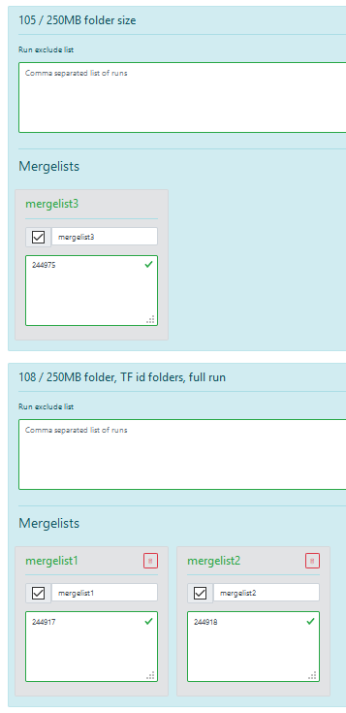
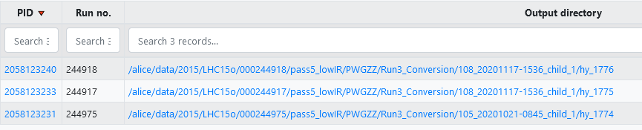
Hyperloop Datasets
3 Types
Production
Hyperloop train
LEGO train (train: Run3_Conversion)
Each dataset, can contain several elements (of the same type)
Each element processes either all runs, or a subset
Dataset
Element 1
Element 2
List of directories
(code that extracts directory list
from dataset exists in ML)
File pattern
(for now fixed to: AO2D.root)
Run lists
Run lists
NB. The hyperloop database is change aware (we store the full history, and the timestamp of the last change)

Slide 3
Requirements
Staging should be for entire Hyperloop datasets
Staging status of a Hyperloop dataset needs to be available machine readable (we have to restrict submission to where the dataset is)
Changes of Hyperloop datasets should be taken into account
  Database contains already history and last change data of a dataset
  Typical use case (Run 2 example): Dataset “LHC15o” always traces the last related production
There can be overlaps between datasets (data should only be staged once)
  Example:
    LHC15o_test (few runs for pilot trains)
    LHC15o_af (10% of the runs of the full production, each run is fully available)
    LHC15o (all runs)

Slide 4
Example
Yesterday: Dataset A : 1 2 3 | Pin (set by op.): Yes/No | Status: Ready/In Progress
Today: Dataset A : 1 2 3 | Pin (set by op.): Yes/No | Status: Ready/In Progress
  Train run 7, 8, 9
Operator change dataset A → A’: (add run 4) | Pin: Yes | Status: In Progress
Tomorrow: Dataset A’: 1 2 3 4
  Train run 10, 11, 12

Slide 5
Some notes on staging tool
Datasets retrieved from hyperloop database (current state)
Each dataset
  Can be pinned to AFs (one pin per AF)
  Total size displayed
  Status of staging (one status per AF)
Available space displayed per AF
Staging tool
  Generates the necessary (copy, remove) operations to achieve the pinning status
    Take into account that a directory can be pinned by several datasets
  Processes them in the order of request
  Updated the pinning status when transfers are done
Display what a change of pin status will imply wrt available space

