Slide 1
Plans for FPGA for Caribouv2 and FETB2
Mathieu Benoit, Shaochun Tang, Hongbin Liu

Slide 2
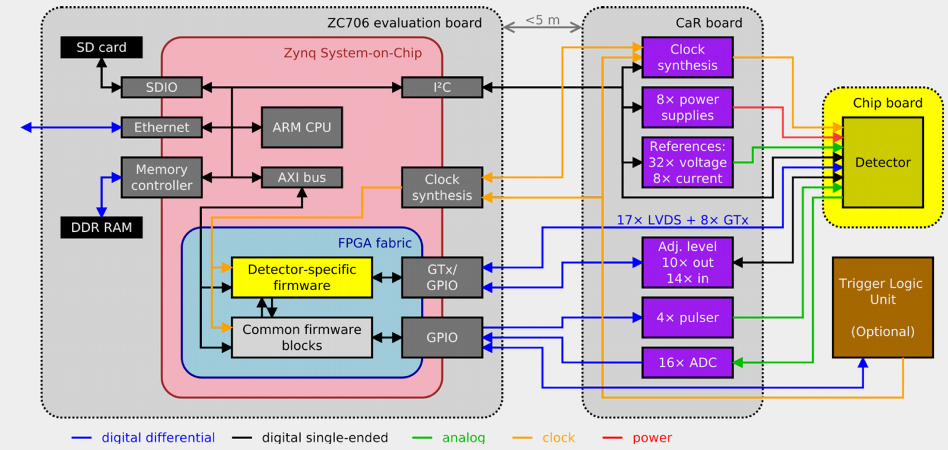
Current Caribou
Most resources can be accessed via the main ZC706 FMC HPC
Extra resources from the LPC connectors can be accessed with the adapter board
  1 Full LA LVDS Bus, connecting for ADC

Slide 3
Resource Usage - CaRIBOu
CaR Board
ZC706
FMC Adapter
ZC706 | FMC1-LA[0:33] | FMC2-LA[0:33]
FMC Adapter FMC-B | LA[0:33] | HA[0,2:23], 10 x HB pairs, I2C
CaR Board |  | 15 x ADC_OUT, 3 x INJ_CTRL, 4xLVDS, 12xCMOS
Current CaR board differential pair requirements: 68， two full LA bus needed
  ADC(AD9249): 20
  LVDS: 17
  CMOS_IN: 8, CMOS_OUT: 14
  INJ_CTRL: 4
  TLU: 4
  I2C: 1
ZCU102/ZCU106 is not compatible with the current system, even we design a new FMC Adapter
We can design a new CaR board with some resource reduction to make it compatible with ZCU102

Slide 4
Resource Usage - FETB
Current FETB board differential pair requirements: 68 pairs used
  ADC(AD9249):18 + 18 （4 x DCLK via M2C_CLK)
  Reference clock: 1
  DAQ CFG CMOS signal: 32 single-ended, 16 pairs used
  Power enable: 10 single-ended, 6 pairs used
  DAC_CFG: 4 single-ended, 2 pairs used
  ADC_CFG: 2 x 4 single-ended, 4 pairs used
  Pulse_ctrl: 2 single-ended, 2 pairs used
  I2C: 1 pair
ZC706
FETB
ZCU106 is not compatible with the current FETB
ZCU102 will miss the ref_clk, FMC_I2C, so it also doesn’t compatible with current FETB
A new FETB with only one 16-ch ADC and less CFG signals should be compatible with both ZCU102 and ZCU106

Slide 5
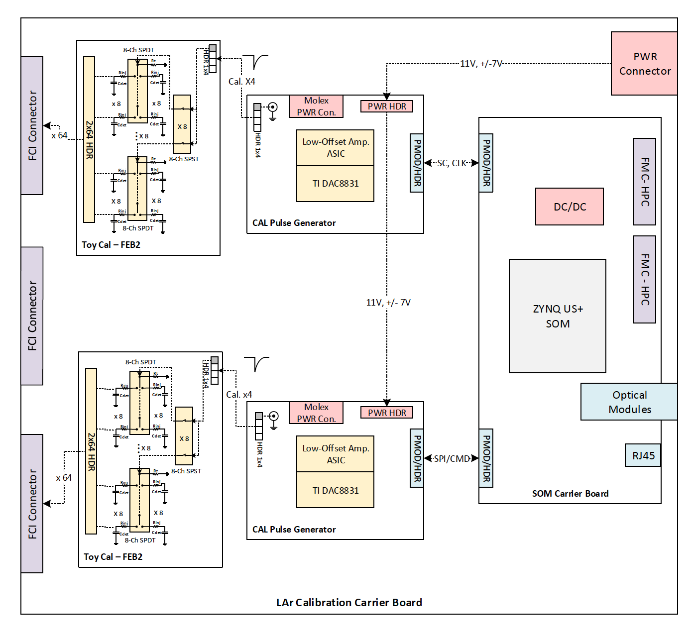
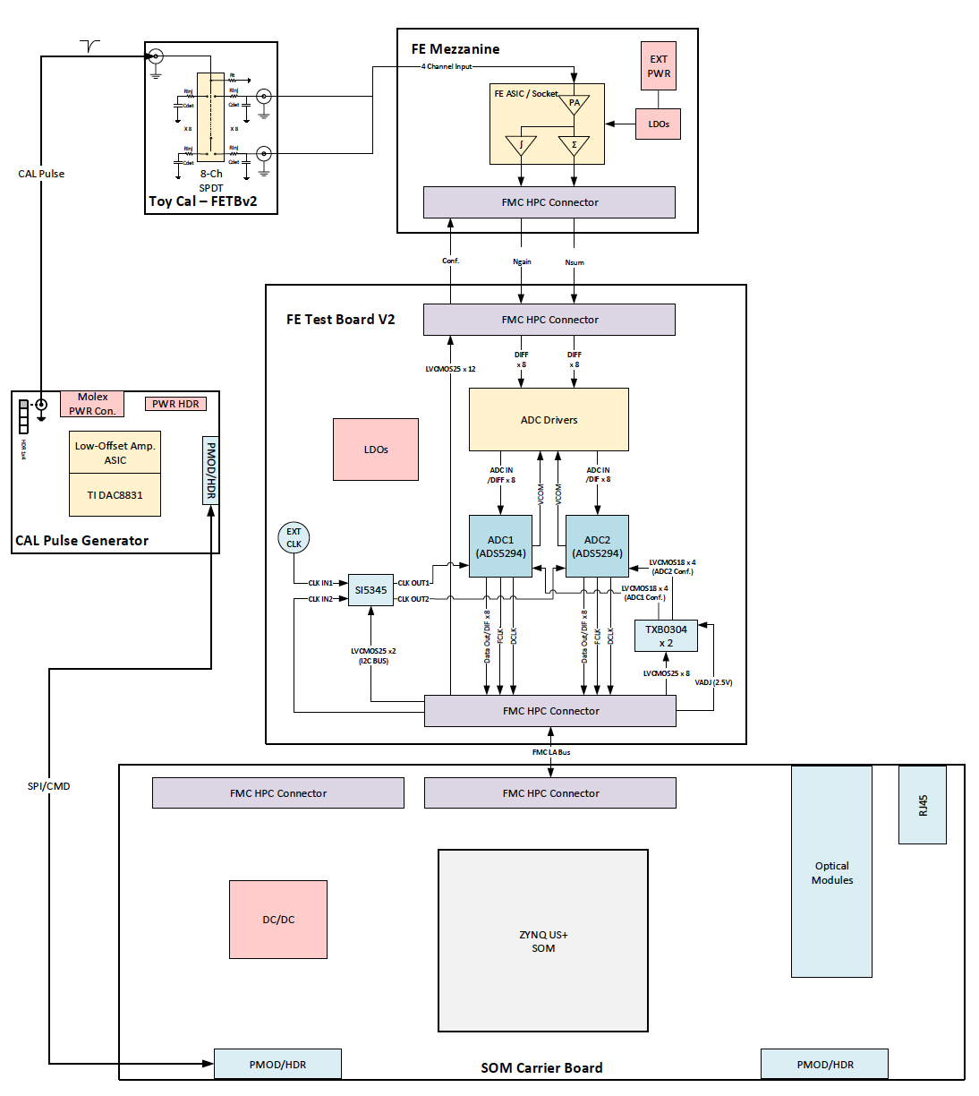
FETB Standalone

Slide 6
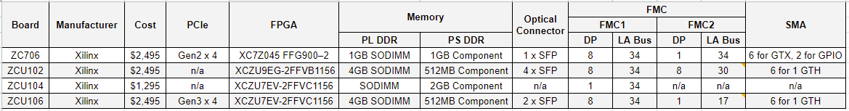
Xilinx EVM Comparison
FMC2-LA[30:33] on ZCU102 not connected
FMC2-LA[17:33] on ZCU106 not connected

Slide 7
SOM
Avnet/Trenz/Enclustra/REFLEX CES/iWave
SOM Module | FPGA | MGT | PL I/O pins | DRAM (DDR4)
Avnet UltraZed-EV | ZU7EV | 16 | 152 | 4GB PS
Mercury+ XU1 | ZU6EG/15EG | 12/16 | <200 | 2/4GB PS
REFLEX CES Zeus | ZU11EG | 48 | 304 SE IOs total (96 LVDS) | 16GB
TE0807/TE0808 | XCZU7EV/9EG | 16 | 156+48 | 4GB
iW-RainboW-G30/5M | ZU4/5/7/11/17/19 | 48/16 | 142 | 8GB
>=16 MGTs (8 on each FMC HPC)
>=144 HP GPIOs (68 two full LA bus and 4 for clocks)
Memory DDR4 >= 2 GB PS side. PL is a plus.

Slide 8
SOM Carrier
Carrier | SOM Module | Interfaces
UltraZed-EV Carrier | Avnet UltraZed-EV | 1 HPC FMC
Mercury+ PE1-200/300/400 | Mercury+ XU1 | 1 LPC/1 HPC/2 LPC
Mercury+ ST1 | Mercury+ XU1 | 1 HPC/SFP+
Zeus Carrier Board | REFLEX Zeus | FMC+ HPC: 16 transceivers @12.5Gbps, 58x LVDS, 44x SE FMC+ LPC: 16 transceivers @12.5Gbps, 34x LVDS
UltraITX+ baseboard | TE0807-03-7DE21-A | Dual SFP+ connector (2x1 Cage)/ 1HPC FMC
iWave KIT | iW-RainboW-G30/5M | 1 FMC HPC 1 LPC/ SFP+

Slide 9
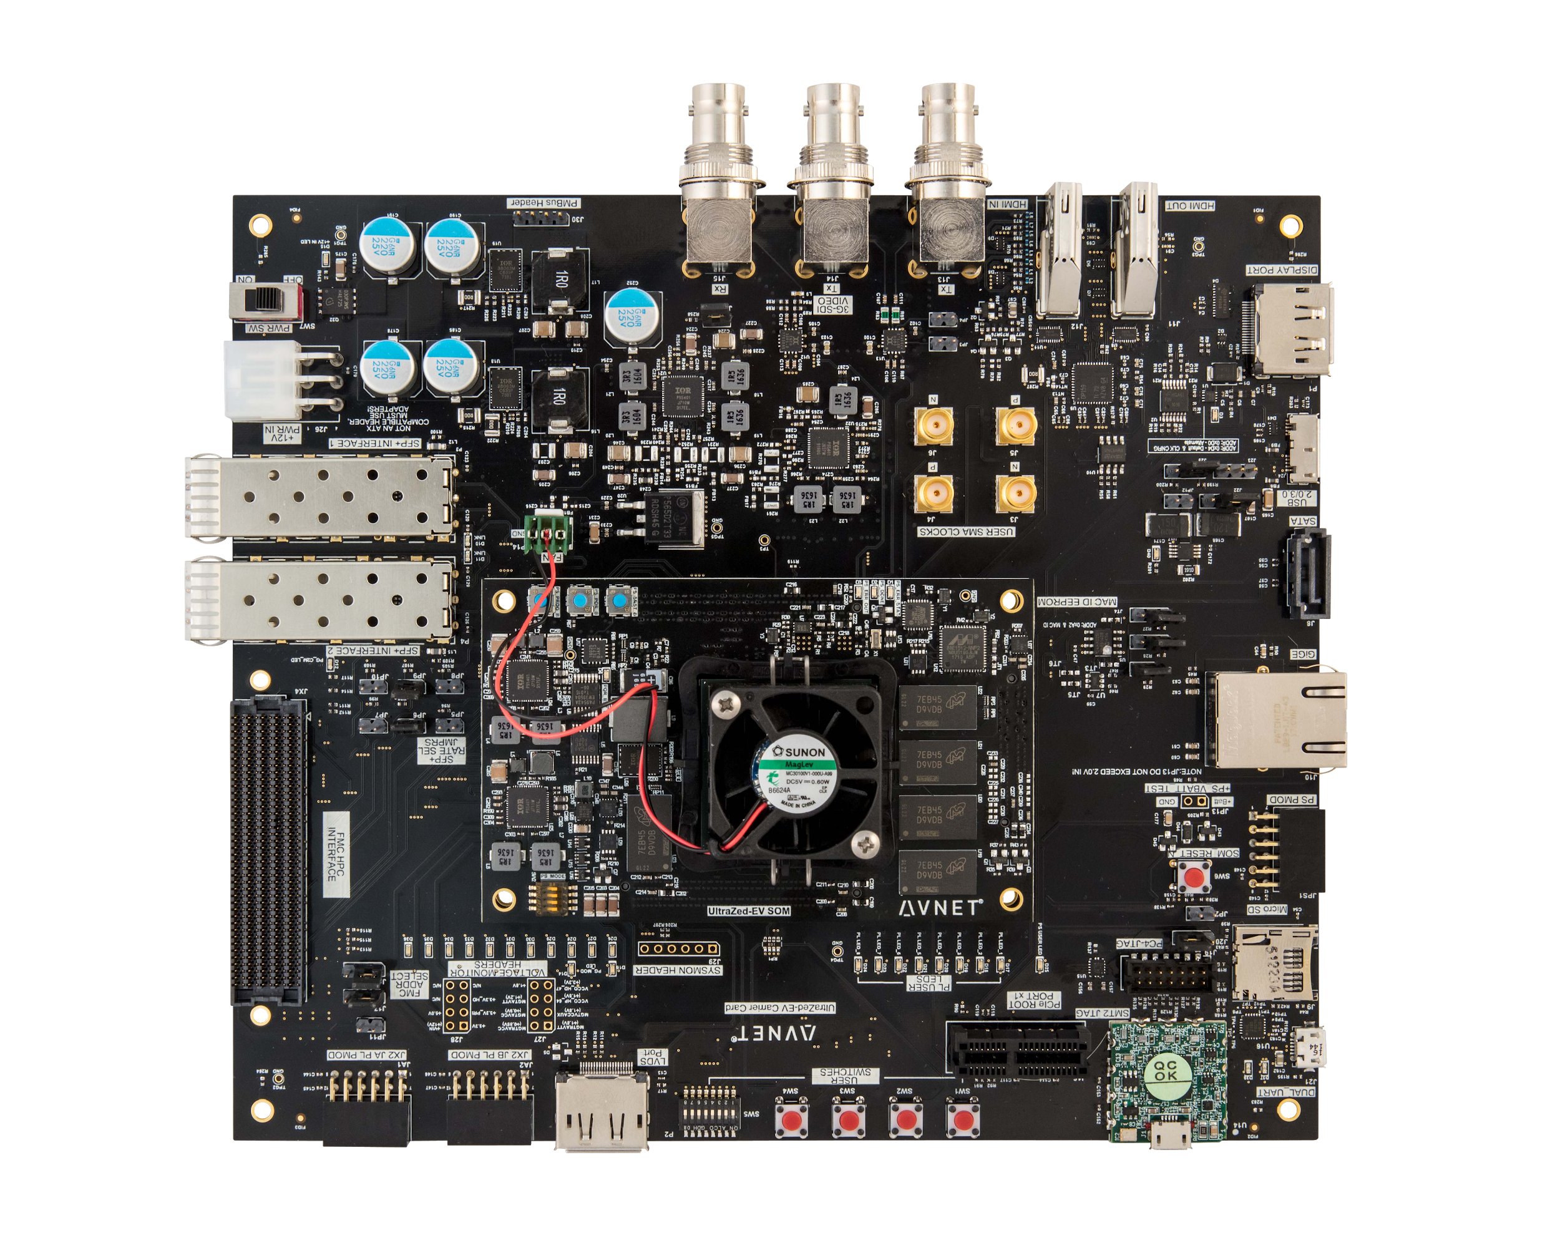
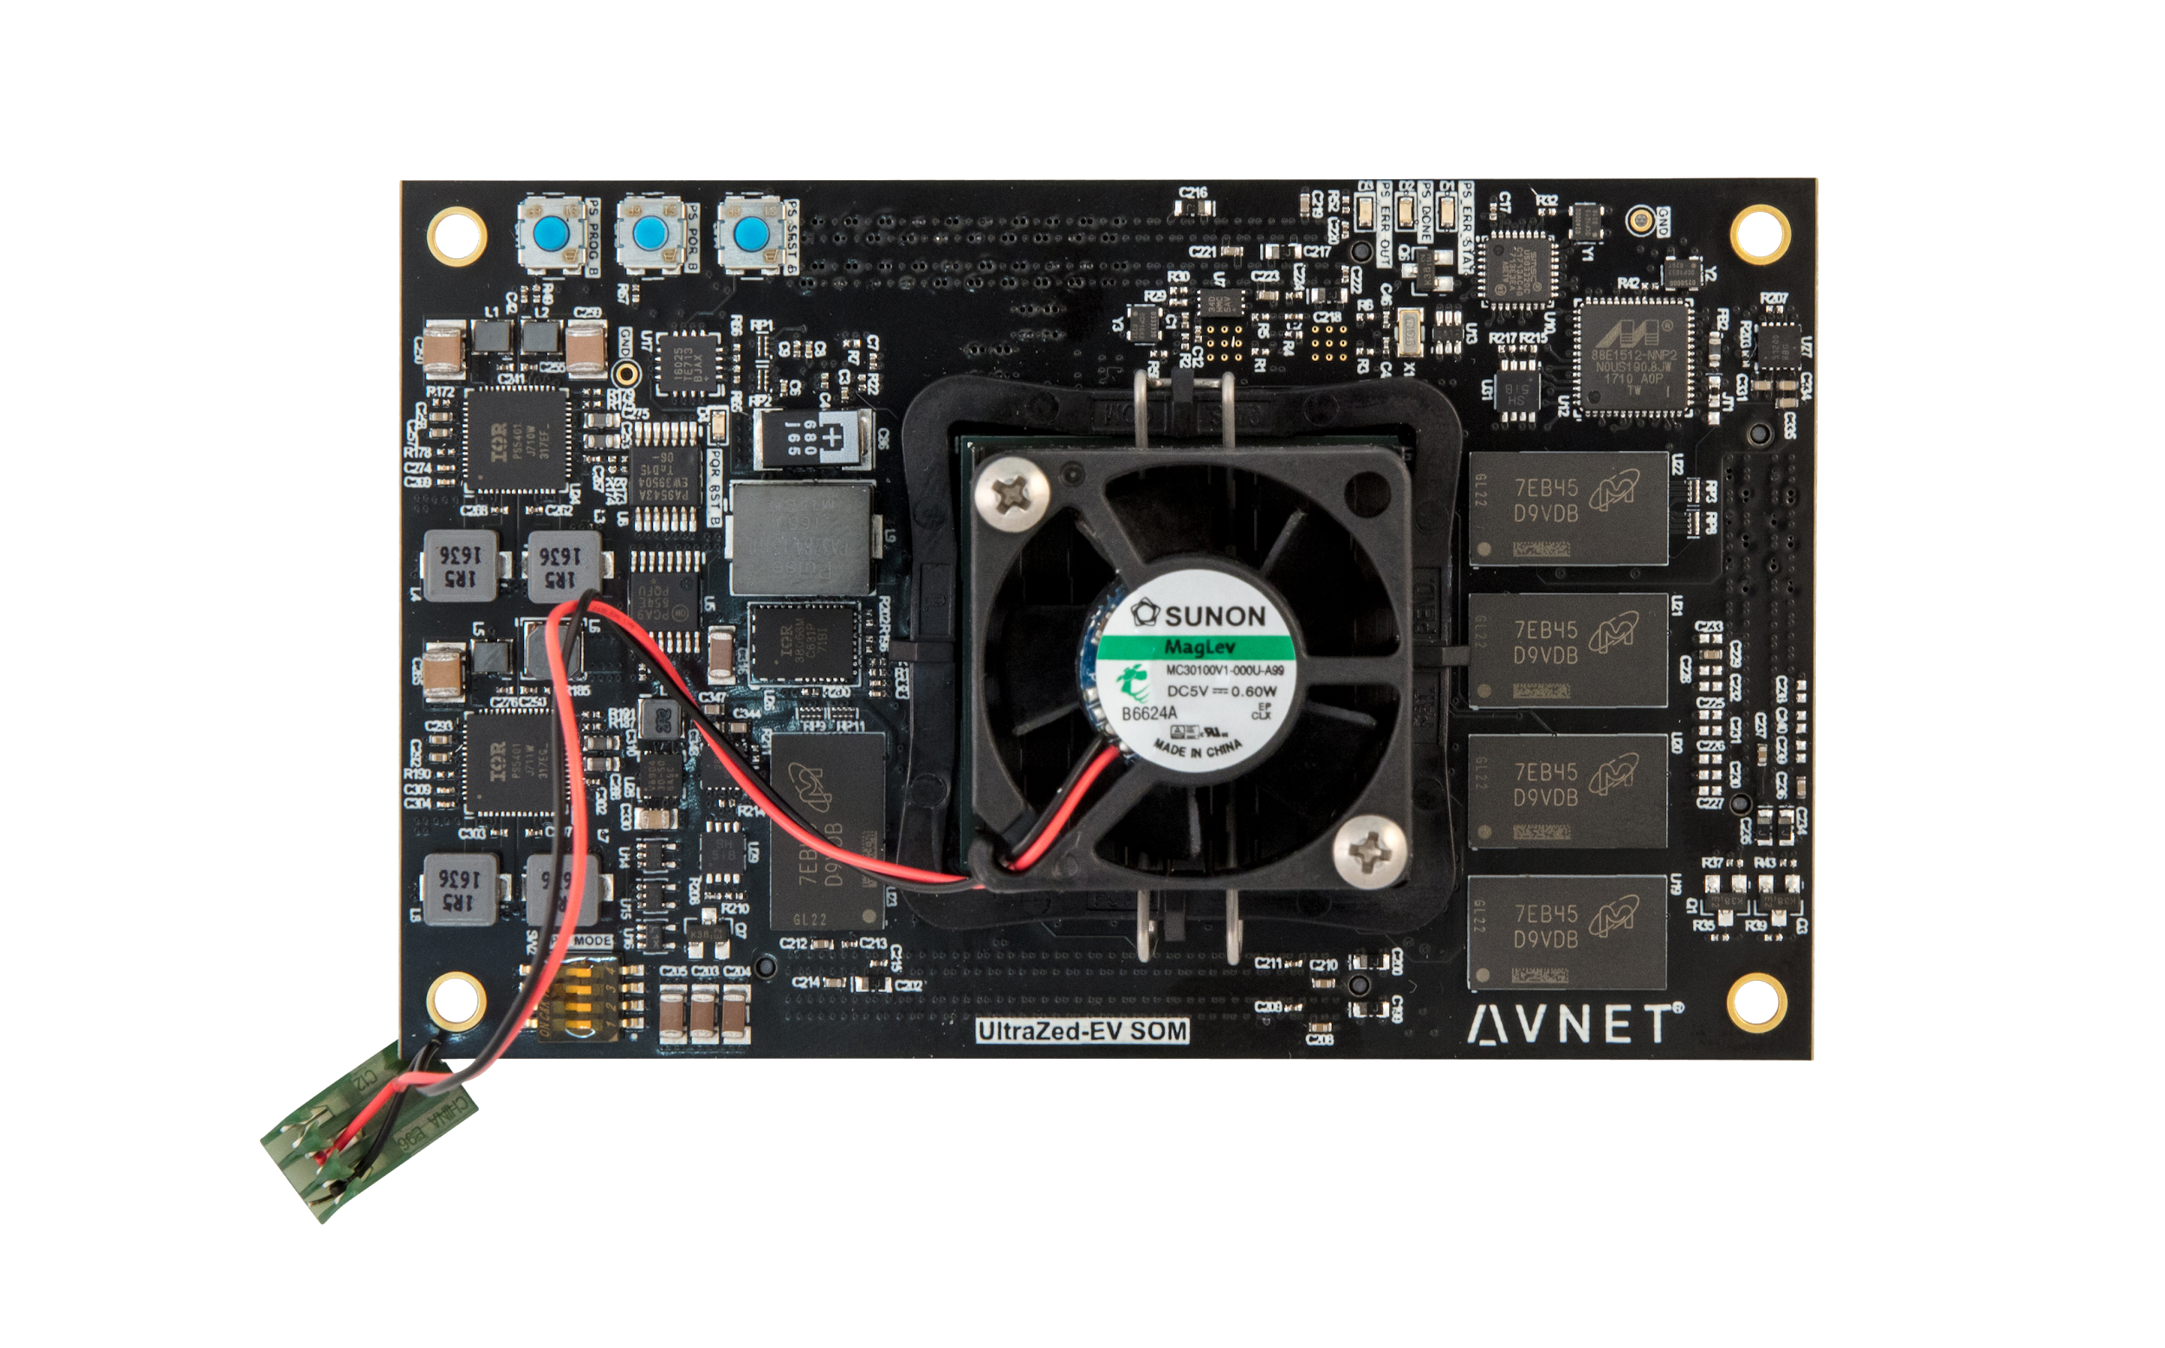
Avnet UltraZed-EV

Slide 10
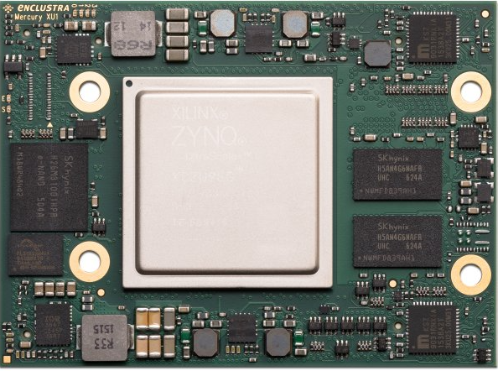
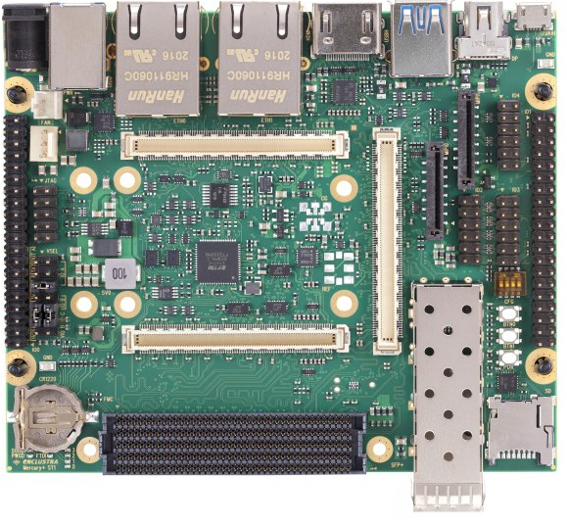
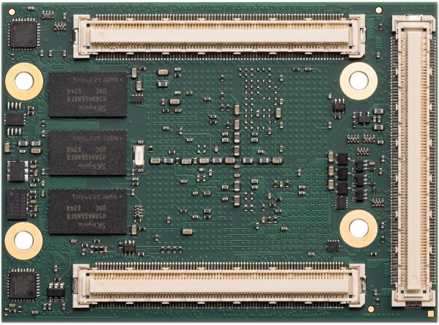
Mercury+ ST1 + XU1

Slide 11
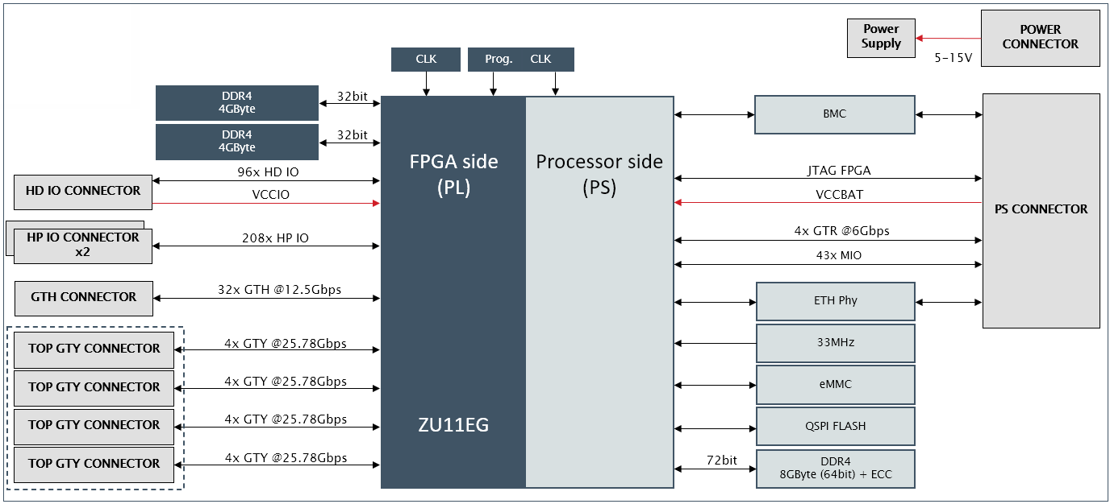
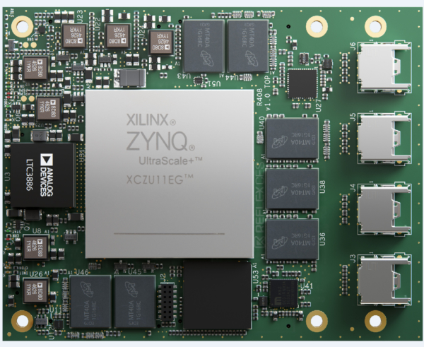
REFLEX Zeus SOM

Slide 12
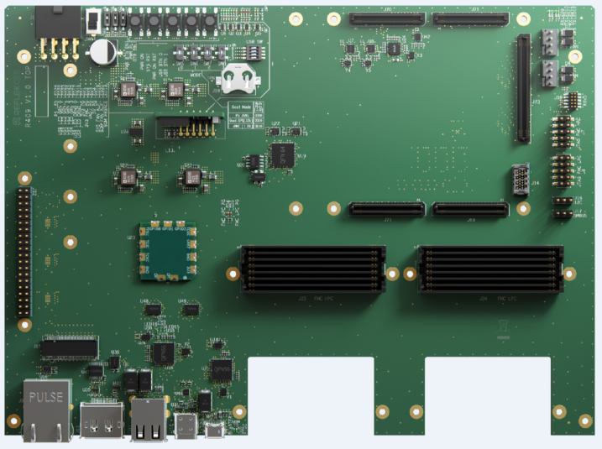
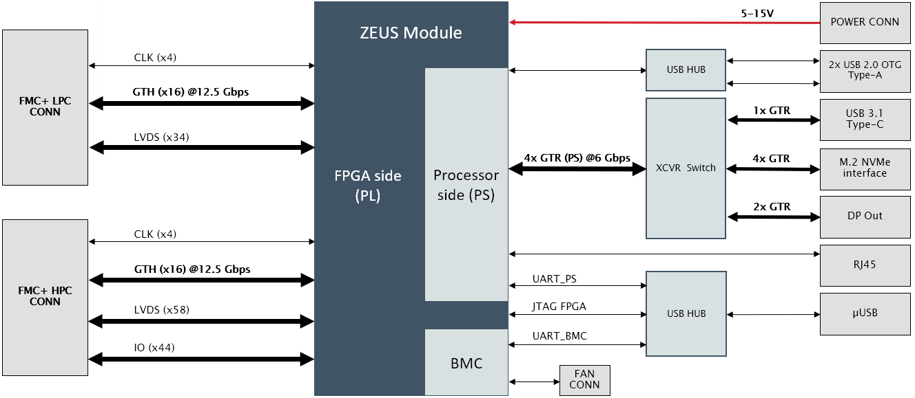
REFLEX Zeus Carrier

Slide 13
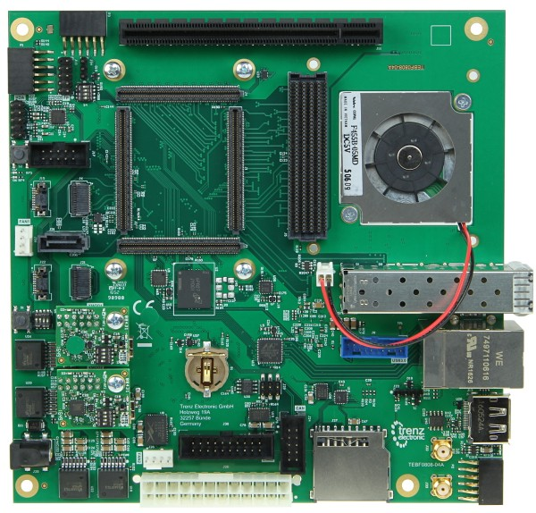
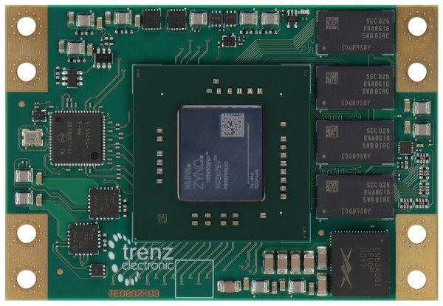
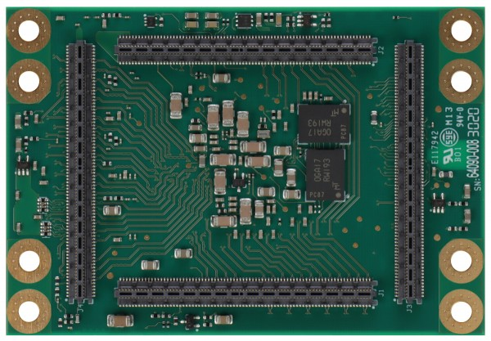
Trenz
TE080x

Slide 14
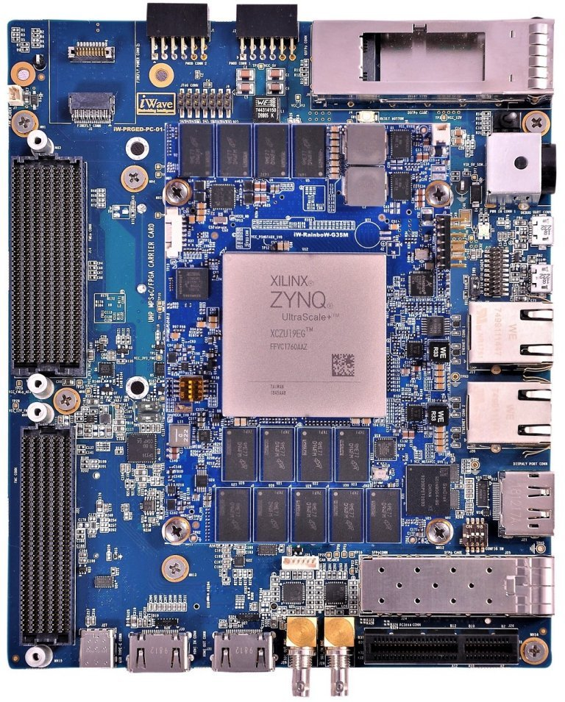
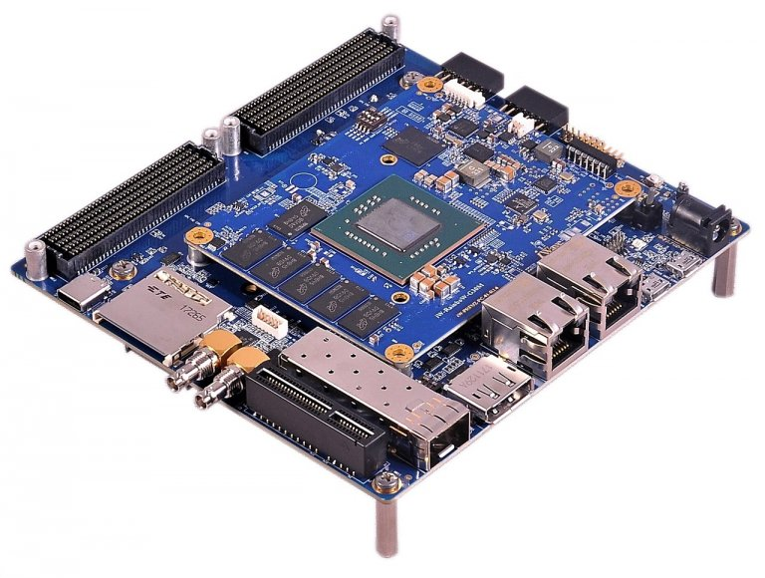
iWave
iW-RainboW-G30M Kit
iW-RainboW-G35M Kit

Slide 15
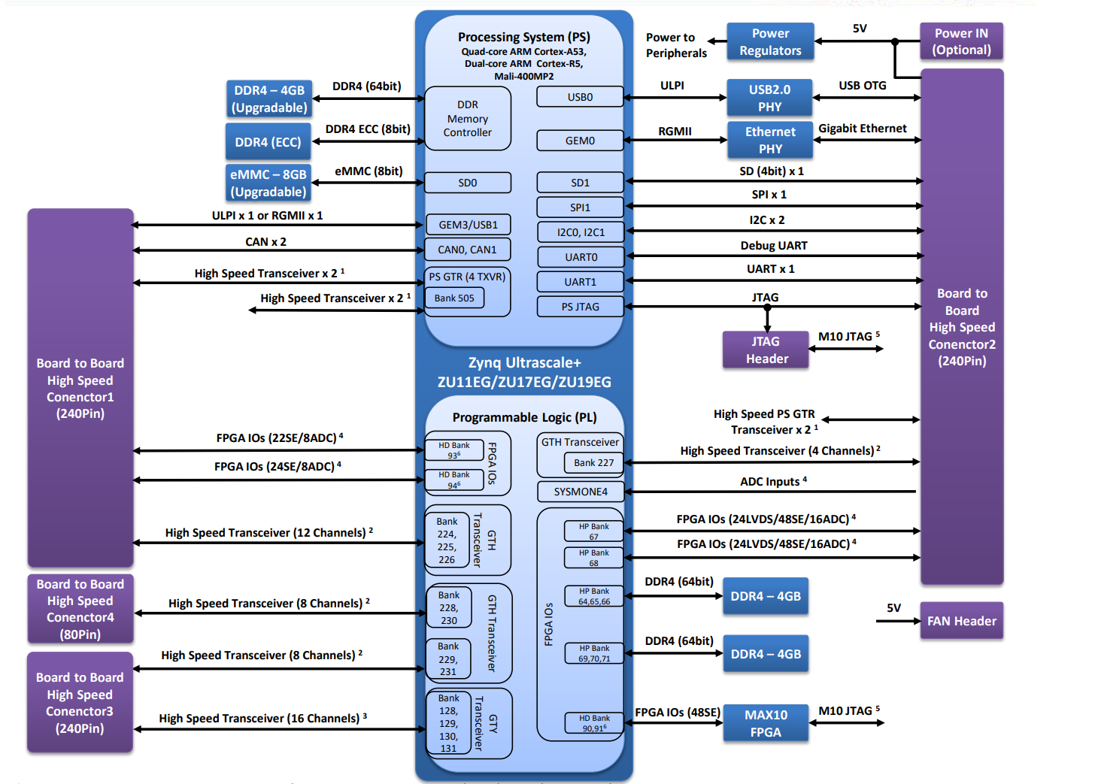
iWave

