Slide 1
Layout choices for AC-LGADs
for large-scale
high-precision time
and position measurements
Hartmut Sadrozinski
SCIPP- UC Santa Cruz
AC-LGAD Operational Goals vs. Sensor Layout
Consideration of Power density
Investigation of Performance Parameters with IR Laser Scans

Slide 2
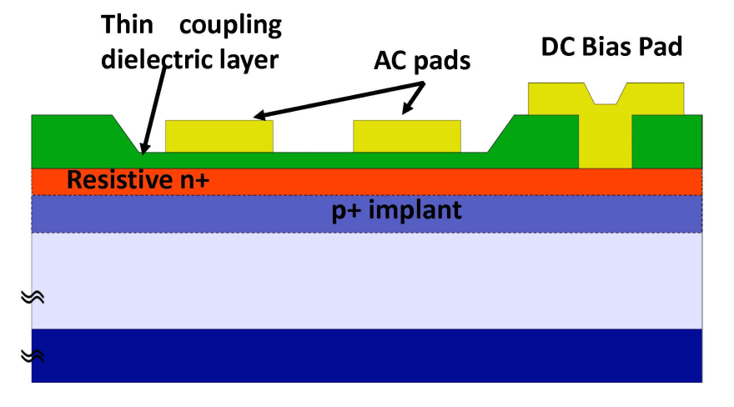
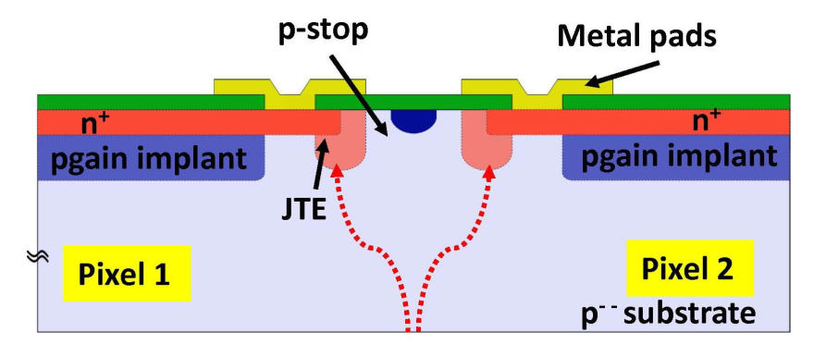



From LGAD to AC-LGAD (aka RSD)
Remove physical pixelation of LGAD
make n++-implant at the junction slightly resistive and extend it as a continuous sheet over the gain layer across the entire sensor-> resistive silicon detector RSD
add di-electric layer for isolation and AC-coupling into readout pads
              Result:
              Sparse readout with maximal pulse sharing adds precision spatial resolution
              and lowered power
              Simplification of design and production (no p-stop, JTE, inter-pad gap)
              100% Fill-factor
M. Mandurrino et al., "Demonstration of 200-, 100-, and 50- micron Pitch Resistive AC-Coupled Silicon Detectors (RSD) with 100% Fill-Factor for 4D Particle Tracking“, IEEE Electron Device Letters, vol. 40, no. 11, pp. 1780-1783, Nov. 2019.
US patent No.: 9,613,993 B2 “Segmented AC-coupled readout from continuous collection electrodes in semiconductor sensors”, H. Sadrozinski, A. Seiden (UC Santa Cruz) and N. Cartiglia (INFN Torino), granted on April 4, 2017

Slide 3
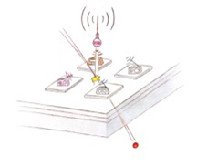
AC-LGAD (RSD) Response in a single Figure
The generated charge is collected locally in the n+ layer after internal amplification .
The signal is then shared among a few metal pads (4-6) allowing to determine the location of the impact and the time of arrival of the particle.
Normally sharing a small signal among 4 channels leads to inefficiency or low spatial precision, but here the gain of 10-20 makes it possible
n+
Note that the shape and separation of the metal pads can be selected to optimize the performance of the detector.

Slide 4
Operational Goals for AC-LGADs
For large-scale applications of LGAD, we had early on a set of criteria
for the geometry and performance of the sensors which guided the R&D program.
So here is a first set for applications where radiation levels are moderate,
but excellent timing and position resolution are required :
e.g. Electron-Ion Collider (eIC)
Criteria: Value:
Power per 2x2 cm² ASIC [W]: 1
Time resolution [ps]: 15
Position resolution [µm]: 15
Radiation hardness [Neq/cm² ]: 1E15 ?, TID ?
Max Operating Bias [V]: 400 V
Max next neighbor pick-up [%]: 1
Area of large position resolution (pad/pitch)² : < 10% ?
Bump Bondability pad size [µm] : > 80
Non-uniformity in signal propagation (N⁺, oxide) ?

Slide 5



Layout Dependencies for AC-LGADs
Criteria: Sensor Section:
Power: AC-Pads, Gain Layer
Time resolution : AC-Pads, Gain Layer, Bulk
Position resolution : AC-Pads, Gain Layer, Bulk
Radiation hardness : Gain Layer, Dielectric
Operating Bias [V]: Gain Layer, Bulk
Next neighbor pick-up: AC-Pads
Non-Uniformity of response: AC-Pads
Bump Bondability: AC-Pads
Delay of signal N⁺ layer , Dielectric
AC-Pads:
Pitch, Size,
Shape
Dielectric:
Type
Thickness
N⁺ layer :
Sheet Resistance
Termination
Uniformity
Gain layer :
Doping Profile
Depth
Carbon
Bulk:
Thickness
Resistivity

Slide 6
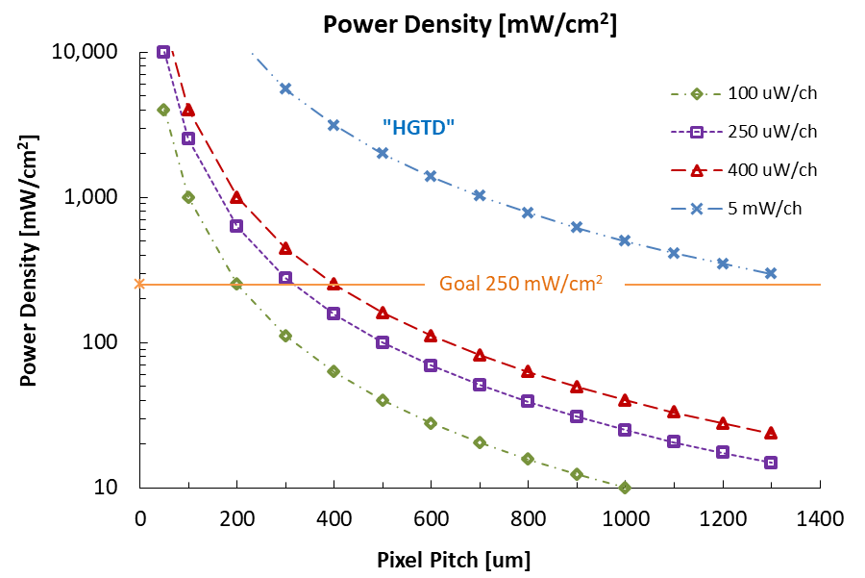
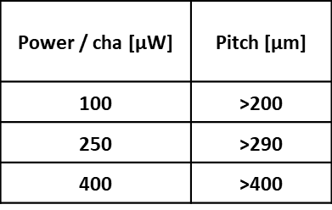
Criteria I: Power
Acceptable power level of the readout:
We are guided by our experience with recent large-scale timing detectors:
The readout of both the ATLAS HGTD and the CMS ETL have a power density of 200 - 300 mW/cm² with 1.3x1.3 mm² pixels, about 5 mW/channel, close to 1W per 2x2 cm² ASIC .
We will assume the same goal of 250 mW/cm², i.e. 1W for the power of a 2x2 cm² AC-LGAD ASIC, yet for much smaller pitch detectors.
The allowed power consumption per ASIC then constrains the pixel pitch depending on the power consumption per channel.

Slide 7
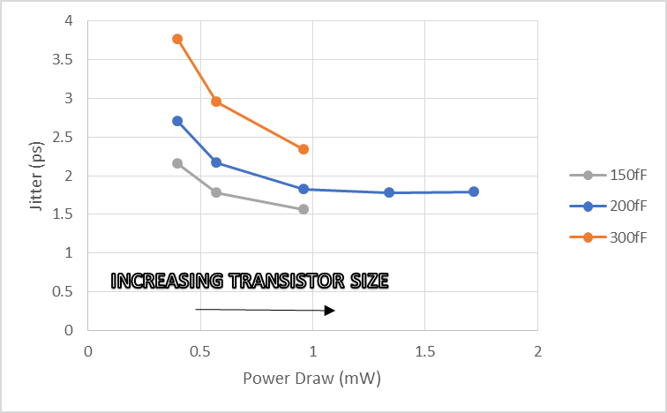
Circuit Simulation: Power / Pad-size / Capacitance
Smaller pads have less capacitance, and the wide separation (at fixed pitch) reduces the inter-pad capacitance.
For 50um thick sensors,
the HGTD pads have a capacitance of about 4pF,
the FBK RSD pads have a capacitance of between 100 fF and 200 fF.
Simulations with a SiGe frontend indicate that for the same jitter the power consumption can be reduced drastically for smaller capacitance.
(Courtesy Gabe Saffier-Ewing, Anadyne Inc)

Slide 8
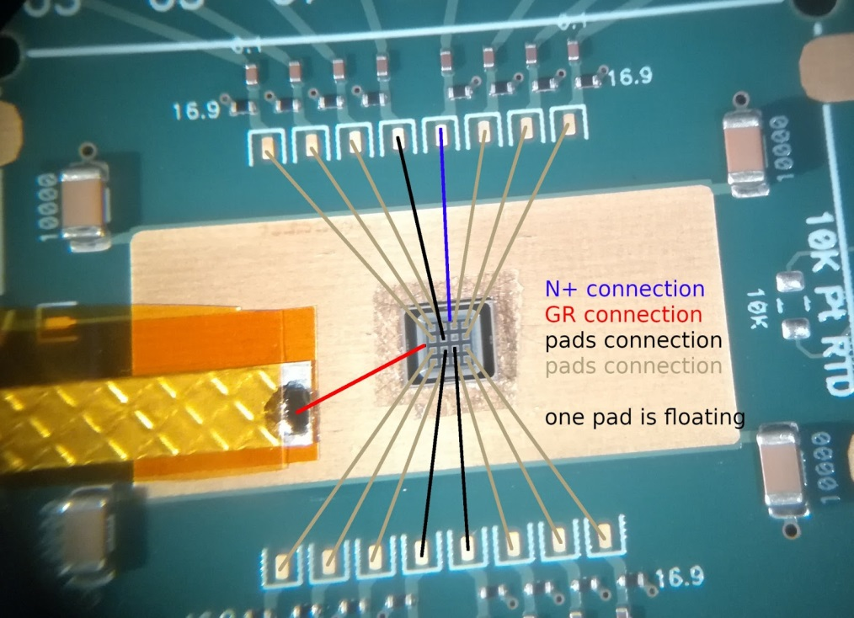
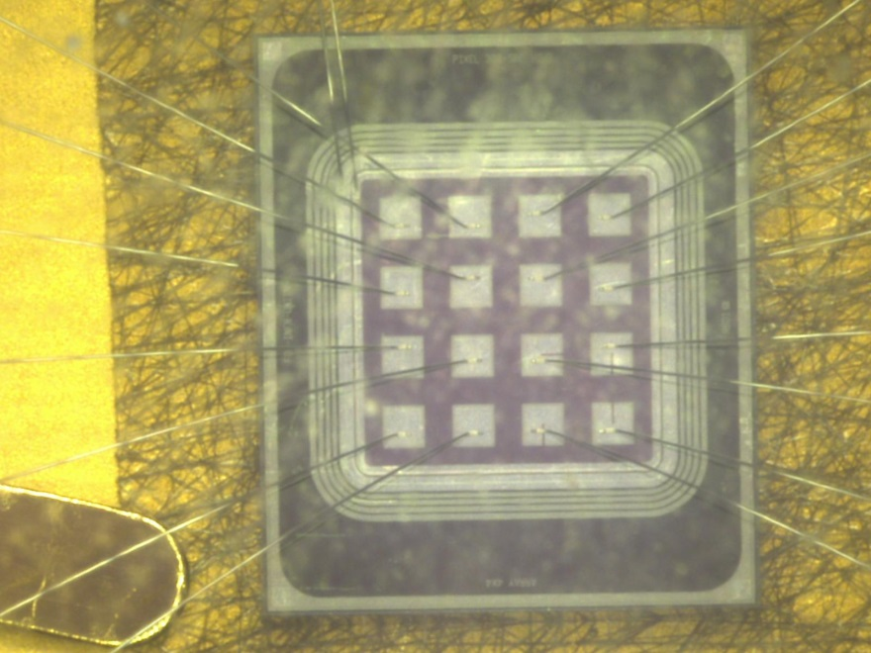
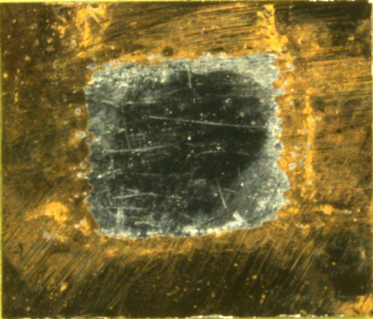
AC-LGAD Setup for IR Laser scan
16 channel board curtesy FNAL
Laser scans were performed with the Particulars IR laser (~ 10 μm pulse)
For some sensors, the backside metal was removed and scans from the backside were performed.

Slide 9
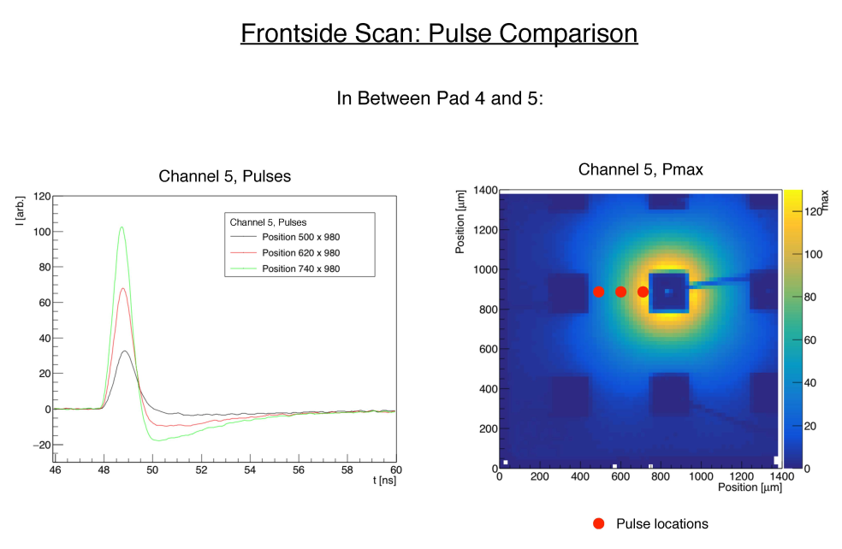
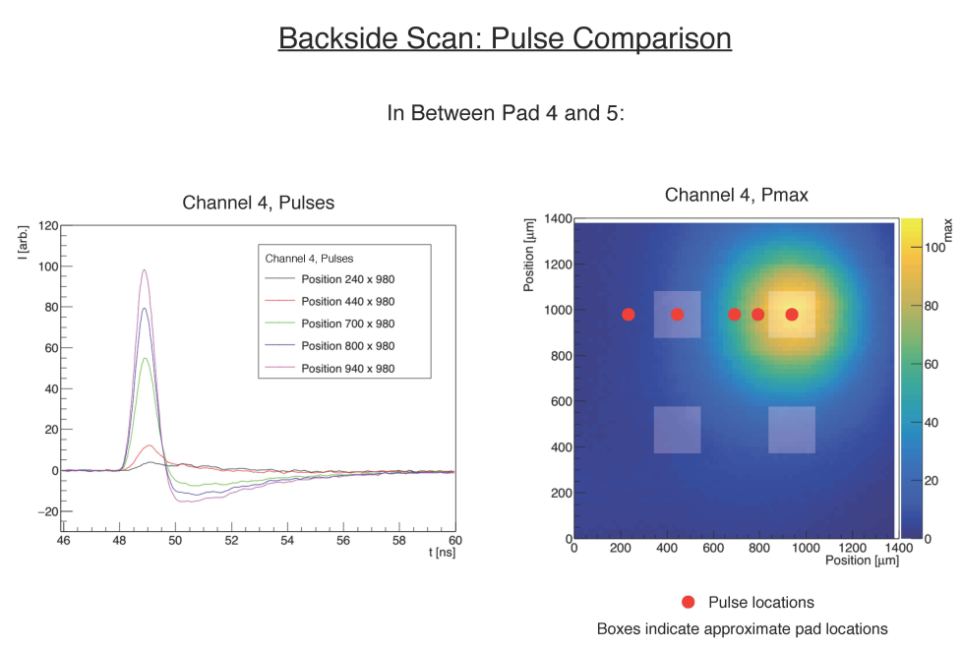
Front-Back Pulse Shapes FBK RSD1 500-200
500-200
500-200
(Pitch = 500µm, Pad Size = 200µm)
-> Pmax under next neighbor pad: ~ 10%
-> Pmax beyond next neighbor pad: ~ 2%
No pick-up!

Slide 10
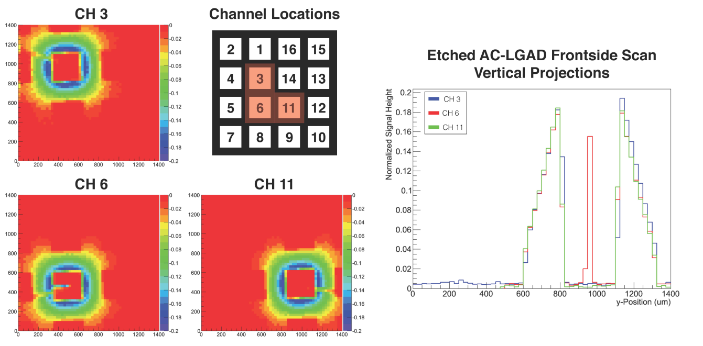
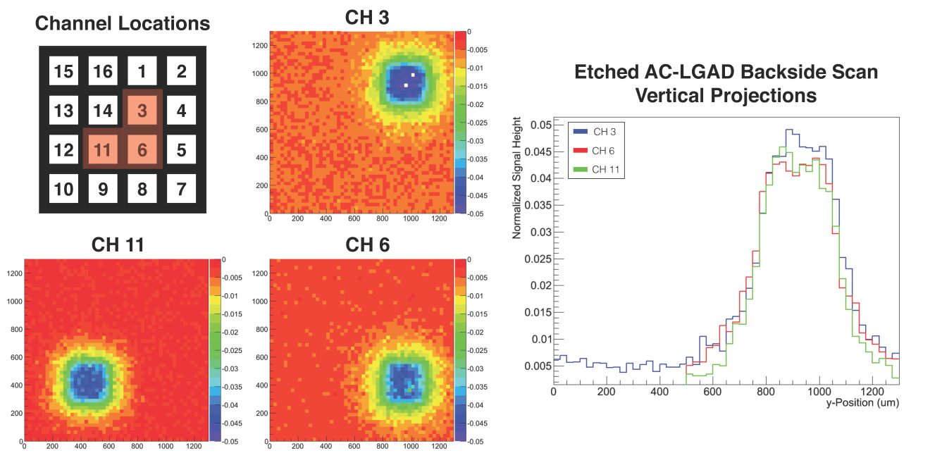
IR Laser Scan Pmax ( FBK RSD1 500-300)
Laser from Front
Off-pad the PMAX falls off
almost linearly with position
-> good position resolution
Laser from Back
PMAX ~ constant under pad
-> position resolution worse

Slide 11
Criteria VII: Uniformity of Position Response
With sparse readout, the precision of the timing depends on the position dependence of the signal.
Signals below the pad metal are ~ constant thus the correlation of position and Pmax is lost.
The position resolution Sig(x) is then pad size/sqrt(12).
The fraction of events below the pads is (pad size/pitch)² .
Pitch [μm] | Pad [μm] | (Pad/Pitch)^2 | Sig(x) [μm]
500 | 490 | 96% | 140
500 | 300 | 36% | 87
500 | 200 | 16% | 58
500 | 100 | 4% | 29
-> For square pads, this means that the pad size should be less than 30% of the pitch to keep the fraction of events below the pads below 10%.
-> One can avoid this problem with pads shaped in different way:
rectangular with smaller length in a critical direction (in a magnet)
with open geometrical shapes ….and there is rigorous R&D in it

Slide 12
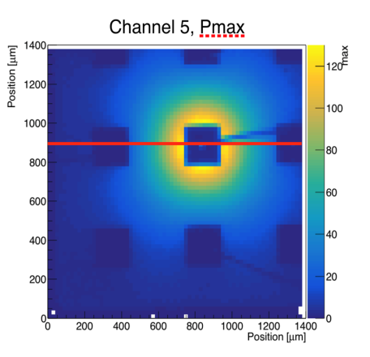
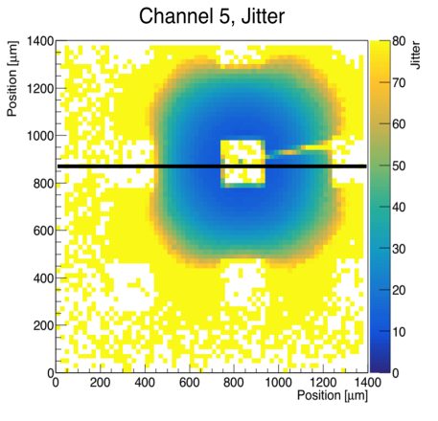
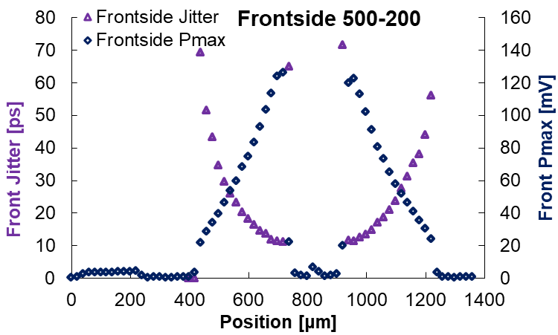
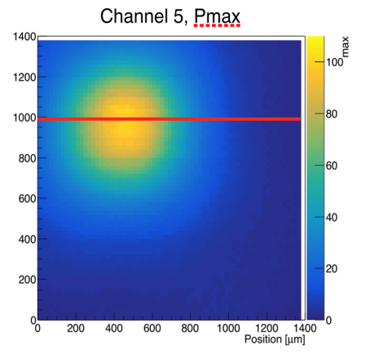
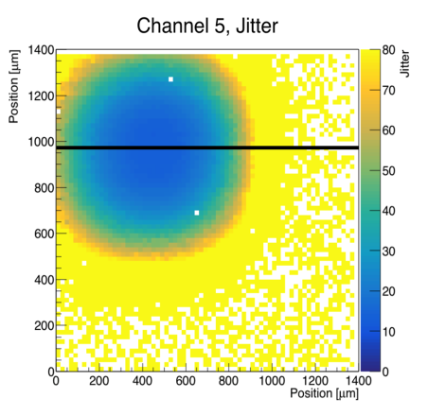
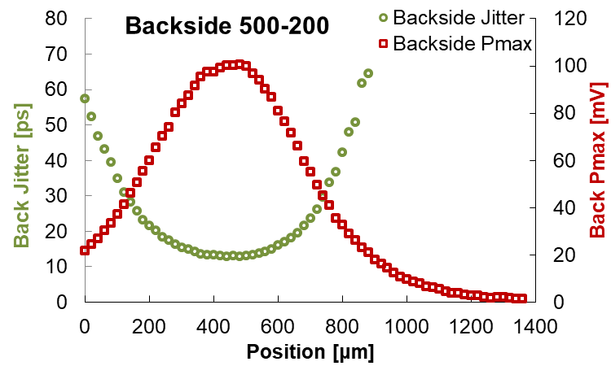
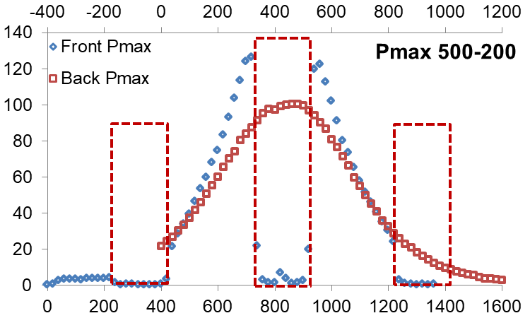
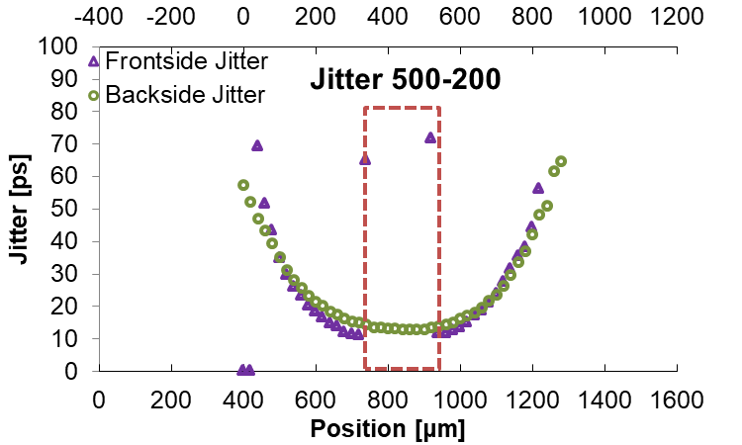
Pmax & Jitter $\frac{t_{rise}}{S/N}$ : FBK RSD 500-200
Front
Back
-> Good agreement
Front vs. Back
for Pmax & Jitter

Slide 13
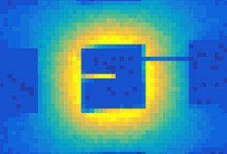

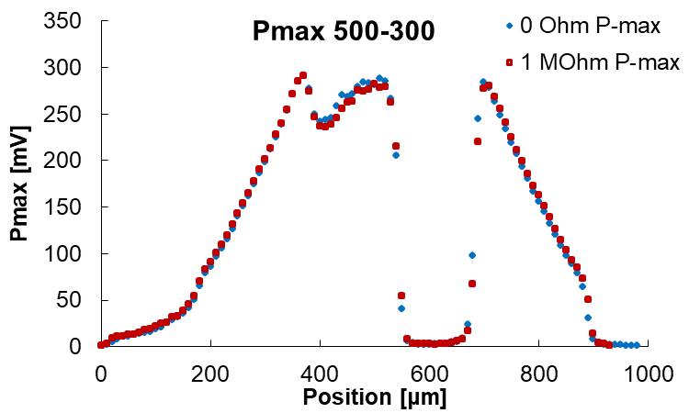
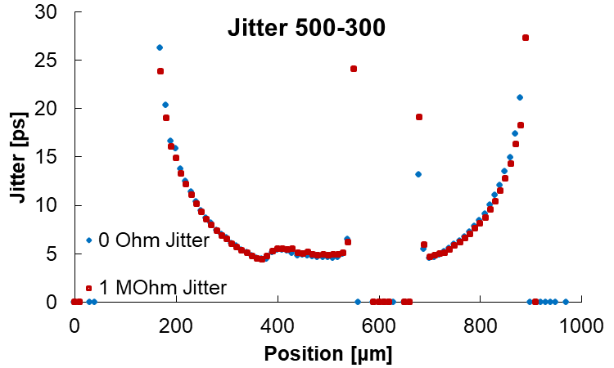
N⁺ Termination of FBK RSD 500-300
500-300 Front
2 different N+ termination resistors :
0 Ω (blue) and 1 MΩ (red)
Identical Pmax
Identical Jitter
-> N+ termination resistor has
no influence on timing resolution

Slide 14
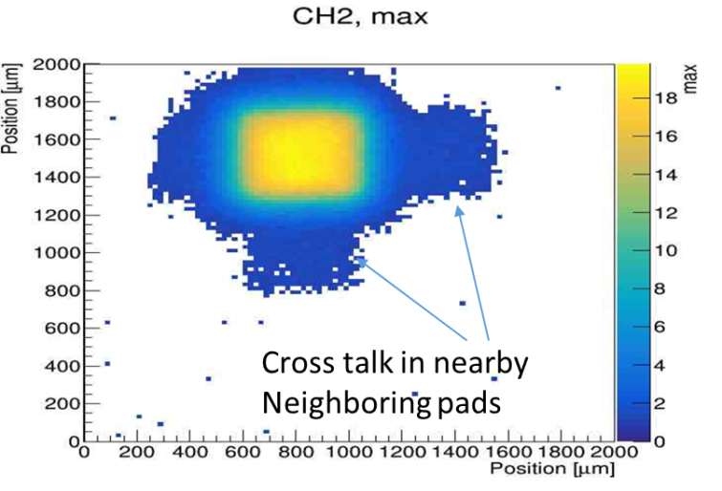
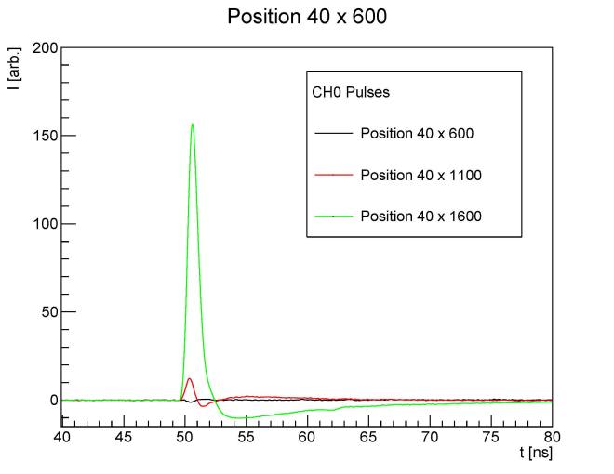
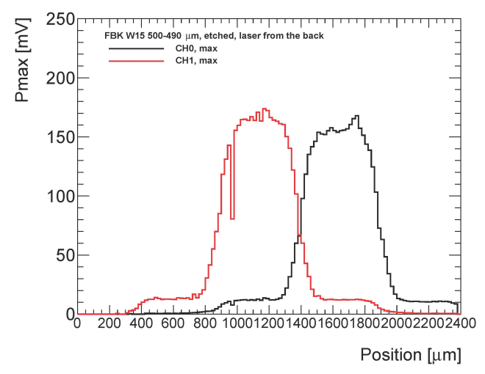
Criteria VI: Cross talk
Cross talk between pads needs to be minimized since it deteriorates the real charge sharing.
Thus the capacitance between pads needs to be minimized:
Laser scan: FBK W13 Pitch: 500um – pad: 490um etched back
-> 10% cross talk signal underneath
the neighboring pad
-> No signal in diagonal pads or 2nd neighbors
(small capacitance)
-> Need > 50 um space between pads

Slide 15
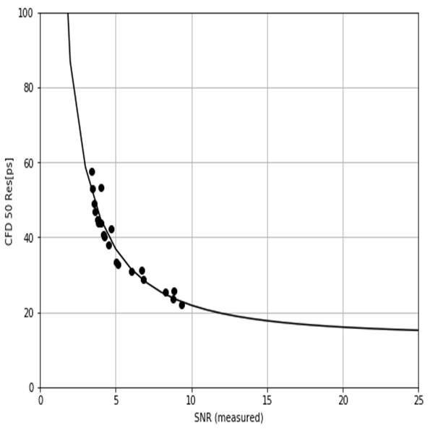

Criteria II: Time Resolution
The time resolution of AC-LGADs depends on both the jitter and the Landau fluctuation
In the AC-LGAD the distortions are minimized and the time walk can be corrected for e.q. CFD.
Thus we are left with the Landau Noise and the Jitter.
The Landau fluctuation is a function of the LGAD thickness ,
and is about 35 ps for 50um sensors and 15 ps for 20um sensors.
Data on ordinary LGADs using β’s suggest this number, and we are
planning to fabricate 20 µm thick AC-LGAD to confirm it.
When a laser is used to measure the time resolution, the Landau term is zero and the bias dependent Jitter is left:
The challenge is to fabricate readout ASICs which afford a large signal-to-noise ratio SNR.
We are participating in two DoE Small Business Innovation Research (SBIR) proposals for the development of fast low-power ASICs for AC-LGAD.
$$σ_{t}^{2}=σ_{TimeWalk}^{2}+σ_{LandauNoise}^{2}+σ_{Distortion}^{2}+σ_{Jitter}^{2}$$
Time Resolution
HPK 20μm LGAD
Jitter
Landau fluctuation
$σ_{Jitter}= \frac{N}{dV/dt}$≈ $\frac{t_{rise}}{S/N}$

Slide 16
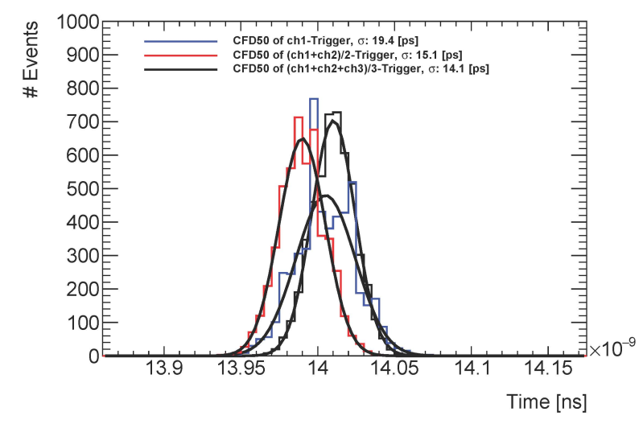
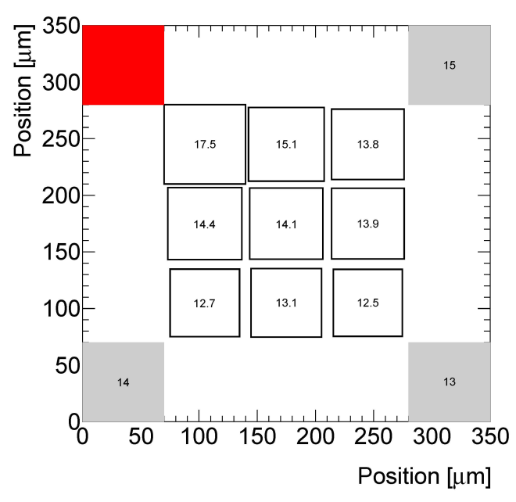
Time Resolution with Laser (just starting…)
Time resolution CFD50 (really the jitter)
at the center between 4 pads (worst case)
(reconstructed from 1000 laser pulses)
1 pad: 19 ps
2 pads: 15 ps
3pads: 14 ps
4pads: ??
Jitter using 3 pads is quite uniform,
with 4 pads a value < 10 ps likely

Slide 17
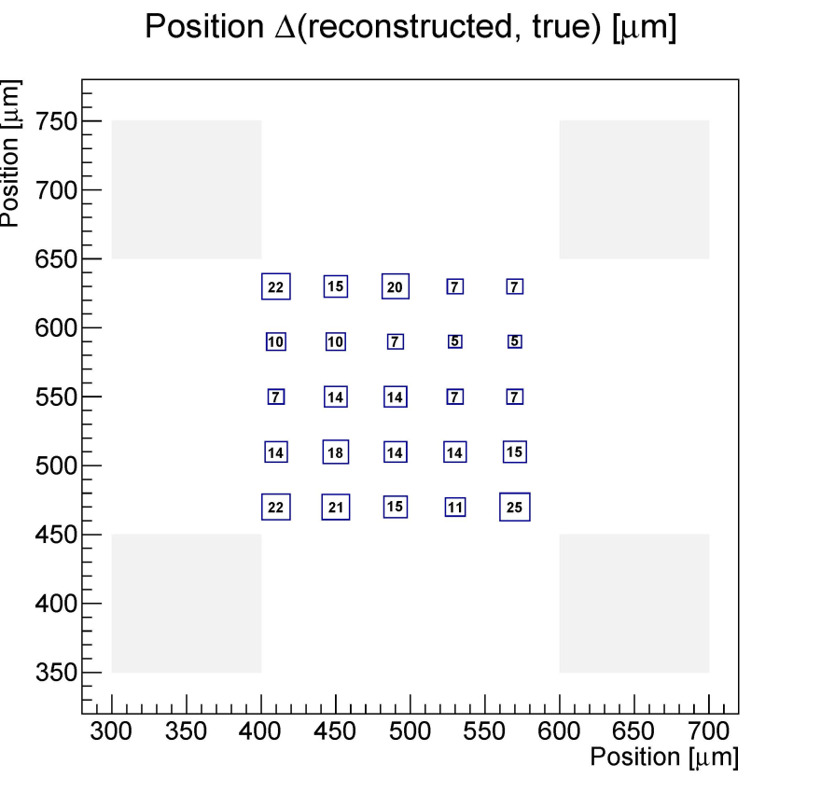
Position Resolution (work in progress…)
Make use of all shared pulses
to get the position
from the pulse imbalance
Expect position resolution of about
5% of the distance from a pad *
i.e.
for 500-300 expect RMS of ~10 μm:
Software needs a bit of tweaking!
for 500-200 expect RMS of ~15 μm
500-300 Position Difference
* M. Tornago et al, et al. “Resistive AC-Coupled Silicon Detectors principles of operation and first results from a combined laser - beam test analysis”, https://arxiv.org/abs/2007.09528

Slide 18
First Layout Choices for AC-LGADs
Sensor Part | Parameter | Value | Criterion
Pad layout | Min. Pitch [µm] | 400 | I
 | Min Pad size [µm] | 80 | VII, VIII
 | Max Pad size, C [µm] | 200 | I, VII
 | Shape | Rectangular ? | III, VI, VII, VIII
 | Min. pad distance [µm] | 50 | VI
Bulk | Resistivity | FZ | I, V
 | Thickness [µm] | 20-30 | II, V
Gain Layer | Max Doping | 2E16 | II, III, IV
 | Depth [µm] | 2 | II, III, IV
 | Carbon | Y
N⁺ Layer | Sheet resistance [Ω/] | 100 ? | II, III, IX
 | Termination Resistor [Ω] | 0 – 1E6 | II, III, IX
Di-electric | Type | Oxide/nitrite | III
 | Thickness [µm] | ? | III

Slide 19
Conclusions
In view of planned large-scale application (e.g. eIC) started to look at
design choices of AC-LGADs for high-precision timing and tracking
The required time resolution of ~15 ps will require sensors with 20 um active thickness
Initial estimates of a realistic power consumption leads to a sparse readout design
with ~ 500µm pitch
Investigation of FBK RSD1 with laser scans from both the back and front
  sheds light at the pulse height of the shared charge over the entire sensor
Since the signals underneath the pad metal are ~ independent of the position,
  the metal coverage of the pads needs to be minimized, which will also
  reduce the pad capacitance.
Minimizing the crosstalk requires separation of the pads by 50 µm or more
No effect of the size of the termination resistor was detected (GND vs 1 MΩ)
We started to use the shared signals to reconstruct both time and position
One parameter under investigation is the effects of the
doping concentration of the N⁺-layer
Radiation studies are needed (TID for oxide, ..
Urgent need to develop fast low-power ASIC for pixels of ~500 µm size.

Slide 20
Acknowledgement
E. Ryan, B. Darby, J. DeWitt, Z. Galloway, C. Gee, S. Hyslop, Y. Jin, R. Johnson, M. Lockerby, F. Martinez-Mckinney, S. Mazza, R. Padilla, E. Potter, H. Ren, H. F.-W. Sadrozinski, B. Schumm, A. Seiden, M. Tarka, N. Tournebise, M. Wilder, Y. Zhao
SCIPP, Univ. of California Santa Cruz, CA 95064, USA
R. Arcidiacono^{ab} , G-F Dalla Betta^{ae}, G. Borghi^{fa}, M. Boscardin^{fa}, M. Costa^{ac}, F. Fausti^{ac}, F. Ficorella^{fa}, M. Ferrero^{ab}, M. Mandurrinoª, J. Olaveª, L. Pancheri^{ae}, F. Sivieroª, V. Solaª, M. Tornago^{ac,} ,G. Paternoster^{f}, M. Centis Vignali^{fa}
ª INFN, ^{b} Università del Piemonte Orientale, ^{c} Università di Torino,
^{e} Università di Trento, ^{f} FBK
Thanks to the organizers:
Gian-Franco Dalla Betta
Giovanni Paternoster
Maurizio Boscardin
This work was supported by the United States Department of Energy, grant DE-FG02-04ER41286.
Part of this work has been financed by the European Union’s Horizon 2020 Research and Innovation funding program, under Grant Agreement no. 654168 (AIDA-2020) and Grant Agreement no. 669529 (ERC UFSD669529), and by the Italian Ministero degli Affari Esteri and INFN Gruppo V.
This work was partially performed within the CERN RD50 and ATLAS HGTD collaborations.

