Slide 1
Overview of sigraflex
J. Maestre and C. Torregrosa
On behalf of EN-STI-TCD

Slide 2
Agenda
Summary of previous meetings
Experimental characterization and numerical model of sigraflex
Introduction to the future HRMAT-HED: sigraflex target
Further discussions and Next steps

Slide 3


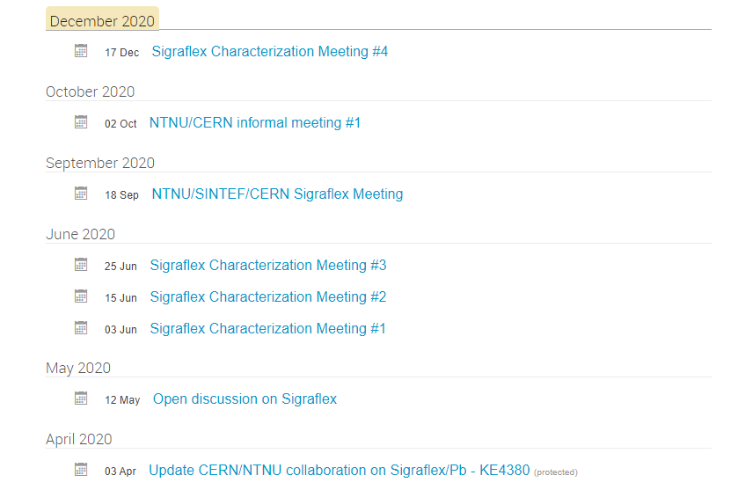
Summary of previous meetings
Review of the current status about:
Modeling
Experimental tests
Summary of previous experimental tests and findings; new proposal tests and discussion about possible numerical models.
Series of meetings with SGL-NTNU-CERN in order to enhance the understanding of the sigraflex and how it is made. Additional meeting with UKAEA aiming for discussing about last findings on HRMAT-43
Discussion on possible models for sigraflex and in particular about the EoS.
Production of the sigraflex samples and set-up of the testing machine under controlled temp and speed rate.

Slide 4
Summary of the last meeting 18th sept 2020
Summary of findings related to HRMAT-43:
Overall dynamic response of the TDE core for RUN2-3
Last findings on the operational dump related to the fracture of the HLM disc that constrains the sigraflex core of the TDE
Modeling: it is required to define a model for the analysis of the local behavior (level of the sheets) and macro behavior (stack of sheet)→ key parameters
Estimation of the conditions at which the sigraflex can be exposed in term of: energy deposition, temp, thermal strain-rate, etc.→ useful to define the model
CERN side:
Micro-physic
Macro-physics

Slide 5
Summary of the last meeting 18th sept 2020
Extensive review of the literature and summary of known properties/parameters related to sigraflex or expanded graphite
Experimental test:
  On going test:
  Proposal test:
Modeling concepts: continuous model based on porous media
Series of tensile tests at different conditions:
Strain-rate
Air-vacuum
Pre-compression
Micro-sheet foils seems to be relevant
NTNU side:
CTE testing:
  Strain-rate
  Air-vacuum
Micro CT scan
Compression test:
  Air-Vacuum
  In-plane and out-plane

Slide 6
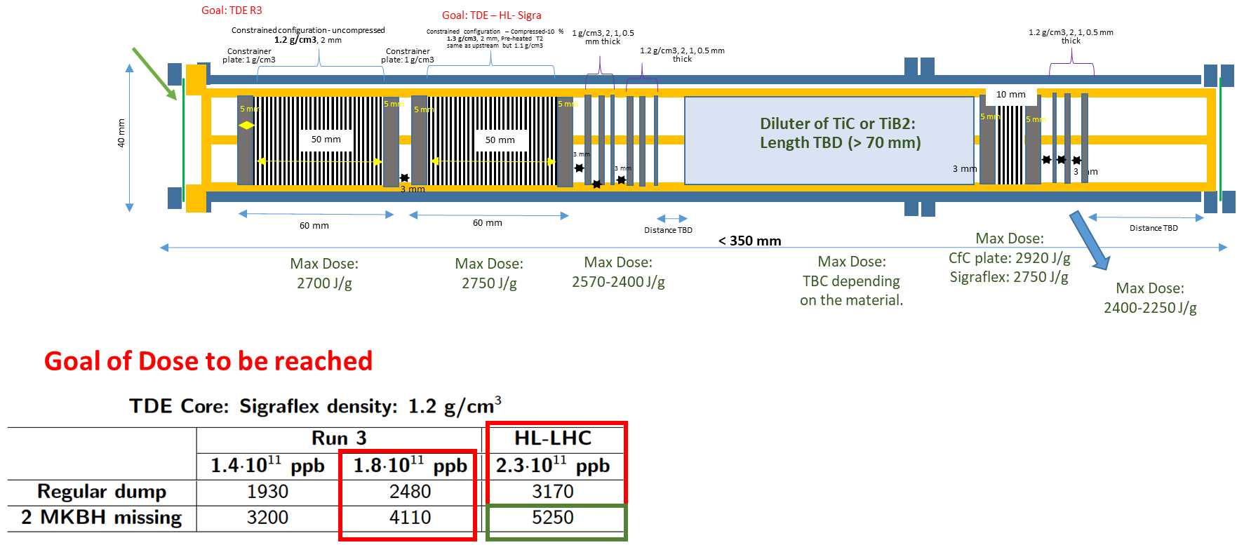
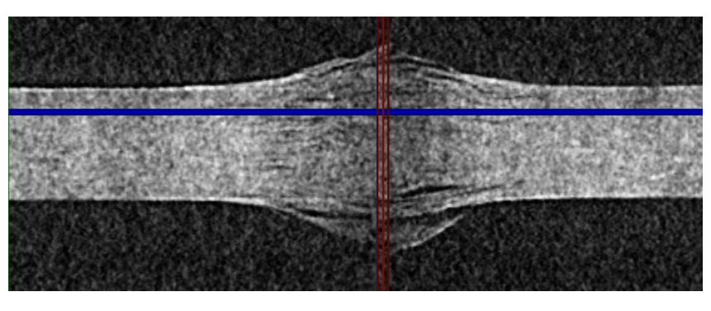
HRMAT-HED (2021)
Sigraflex Target: main goals:
Investigate further the response of Sigraflex under beam impact:
  - Gas/Vacuum
  - Constrained / unconstrained / compressed
  - Beam spot size
  - Intensity ramp-up to identify limit
Proton Beam
0.2x0.2 mm
Sample of 0.5 mm thickness tested in HRMT-43 saw 2450 J/g

Slide 7
Thank you for
your attention!

Slide 8
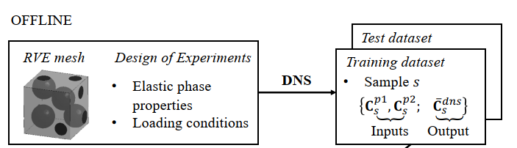
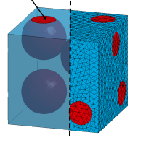
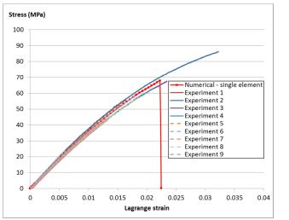

New modeling proposal
Classical constitutive eq. can be very complex to define because of the complexity of the sigraflex itself:
Orthotropic
Non-symmetrical
Strain rate/temp dependency
Trapped air? Multiphase
Micro-physics??
MICRO-FEM
Multi-scale models:
Capture the micro-physic implicitly
No-need for complex constitutive eq.
…but computational expensive
CPU expensive
DMN
Deep material network
Micro-physics is embedded
Micro-FEM
Macro-Models
DNS
ONLINE
Extrapolation
MACRO FEM

