Slide 1
Proposal for a new central + RB24 beampipe in ALICE in LS3
Corrado Gargiulo (EP-DT), Werner Riegler (EP-AIO), Arturo Tauro (EP-AIO)
TREX 10/12/2020

Slide 2
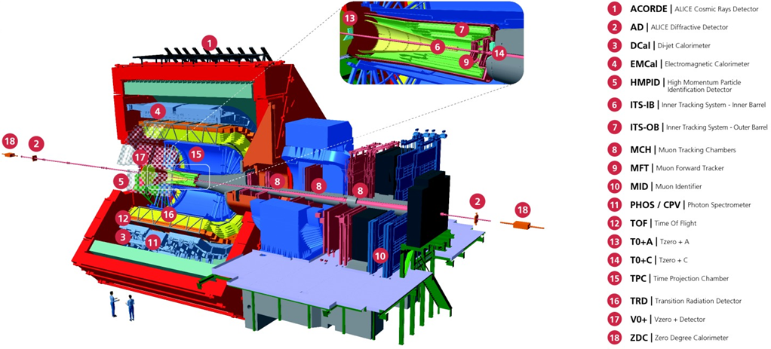
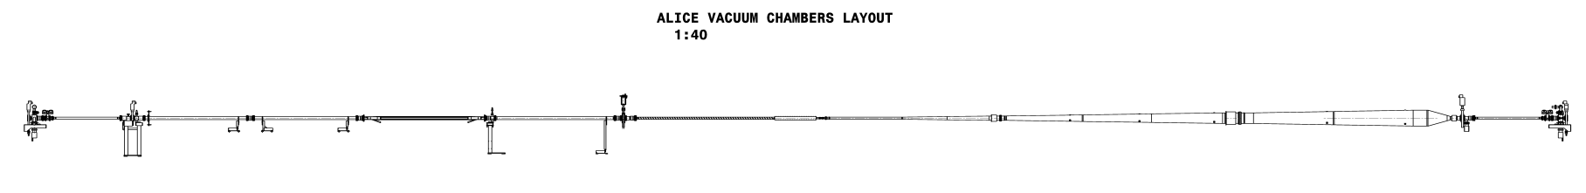
ALICE layout
RB24 beampipe
Central beampipe
RB24 beampipe
Central beampipe

Slide 3
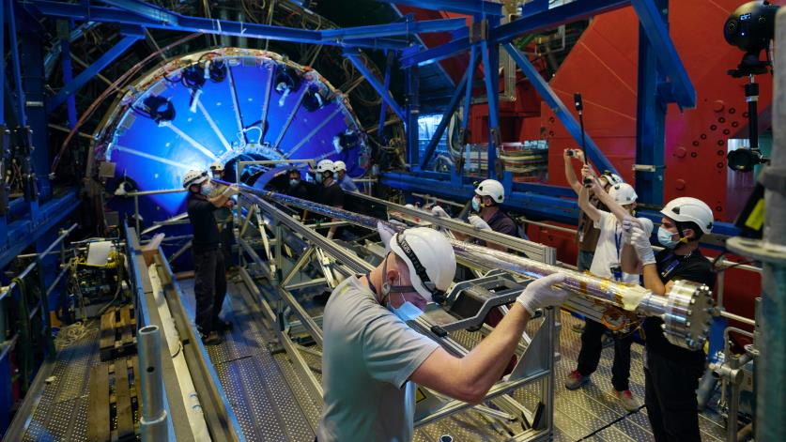
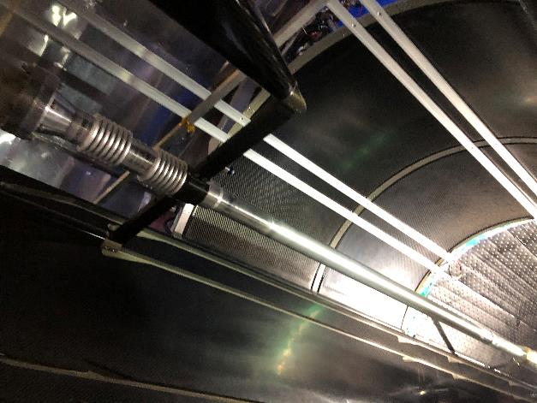
The new RUN3 central beampipe
Installed in October 2020
Central Be section 870mm long
ID 36.4mm (inner radius 18.2mm), thickness 0.8mm
Mechanical adjustment precision better than 0.2mm

Slide 4
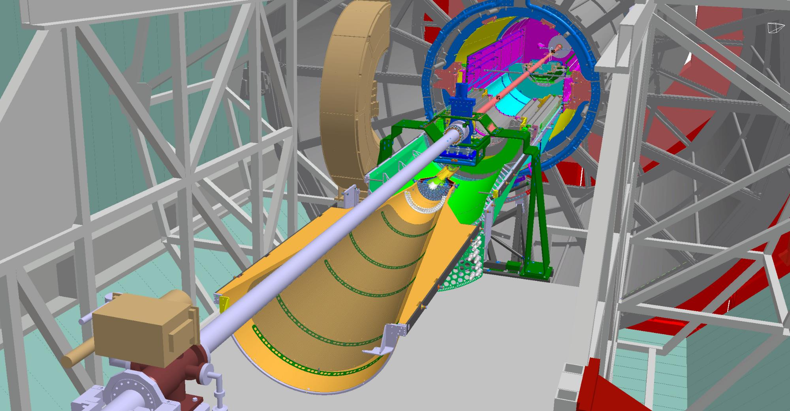
Installation layout
Cage
Central beampipe
ALICE Layout RUN3
MFT/FIT-C
ITS-OB
RB24
Bellow
ITS-IB

Slide 5
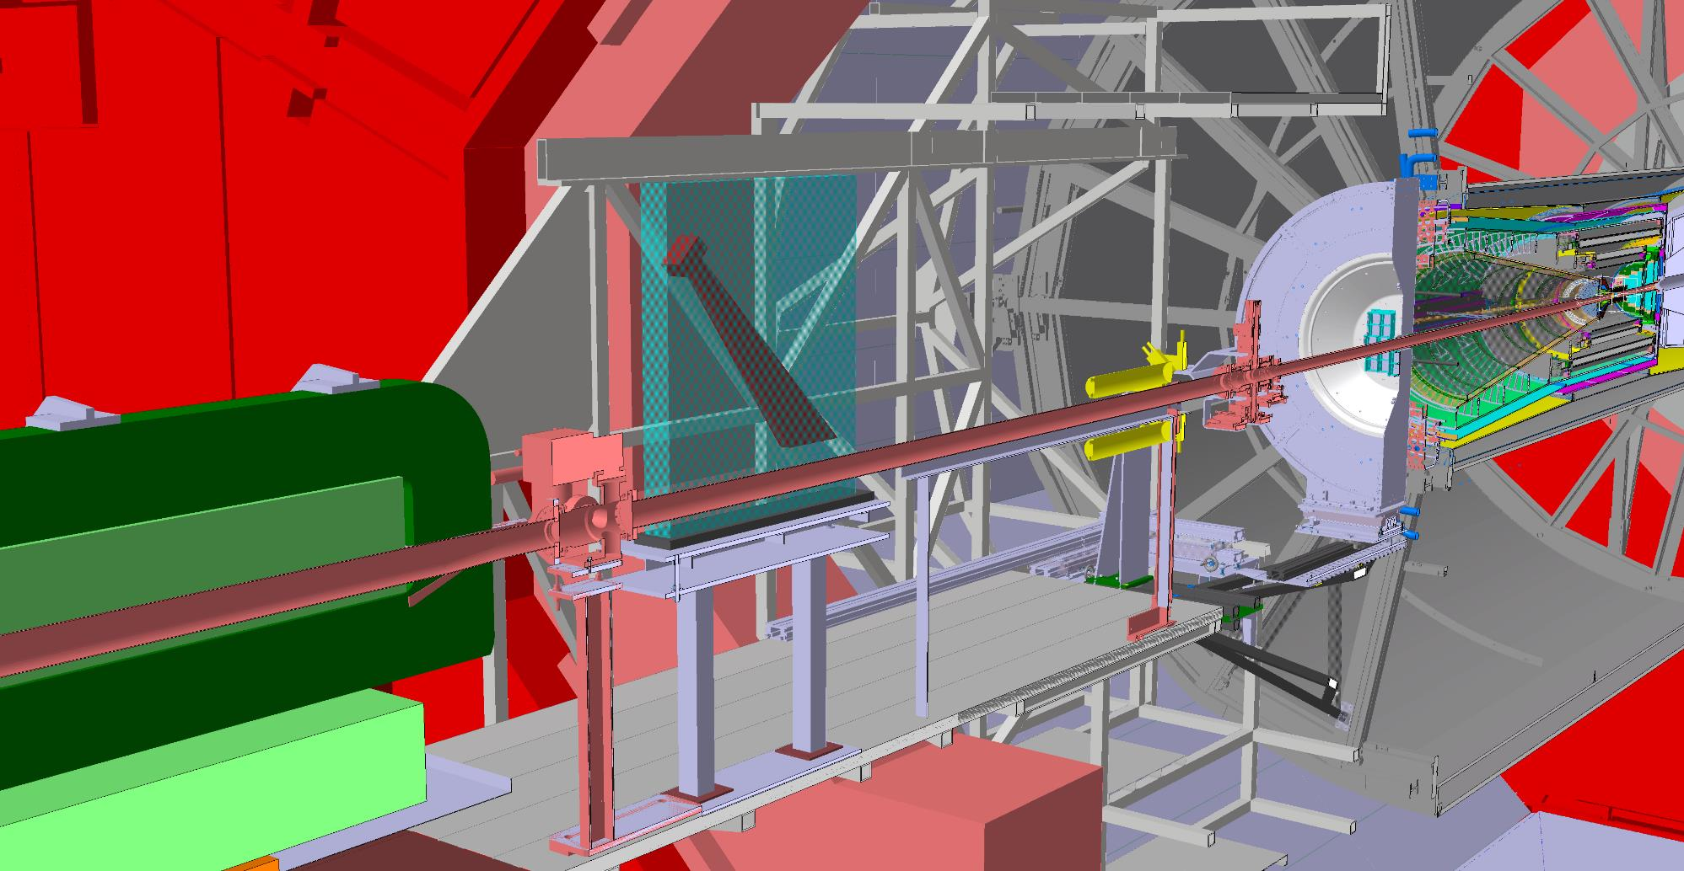
ALICE Layout RUN3
MF/FIT-C
FIT-A
ITS2
Central beam pipe
(ID 36.4)
Gate Valve
RB24
(ID 80)
Ion pump
Compensator Magnet

Slide 6
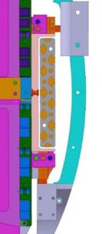
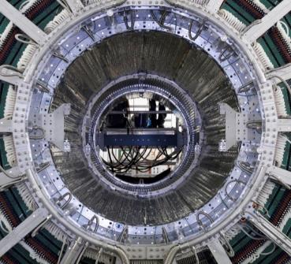
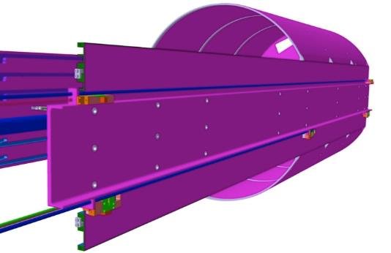
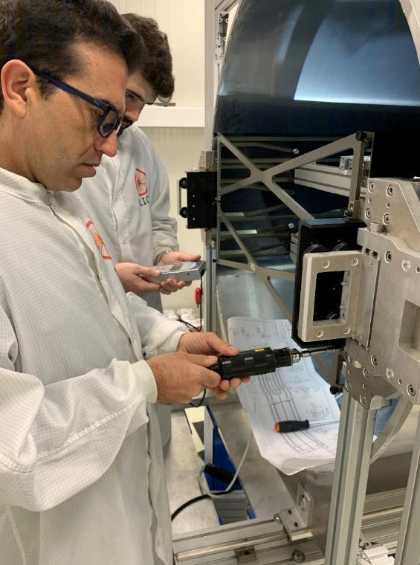
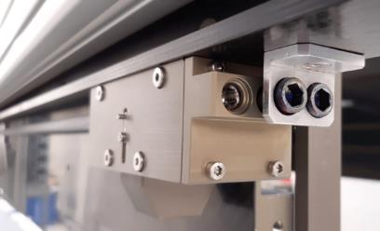


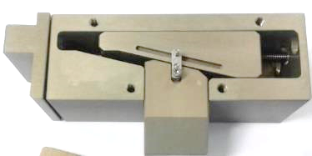
Mechanical adjustment: <0.2mm precision
C3
C3
C2
C1
C2
C1
Adjusting device
Registered Torque average | 0.7 Nm
Registered Torque Max | 1.54 Nm
Standard Torque M5 | 6 Nm
Per screw turn | 0.2mm
Total adjusting capability | +/- 4mm
C1
C2
C3
C1

Slide 7
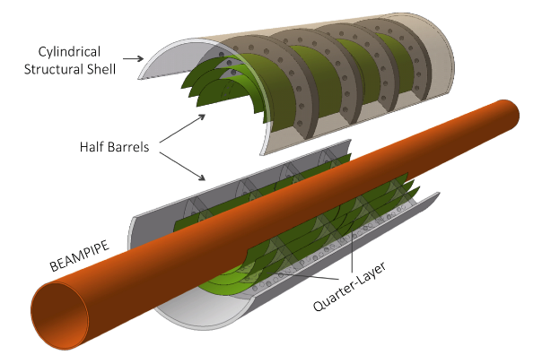
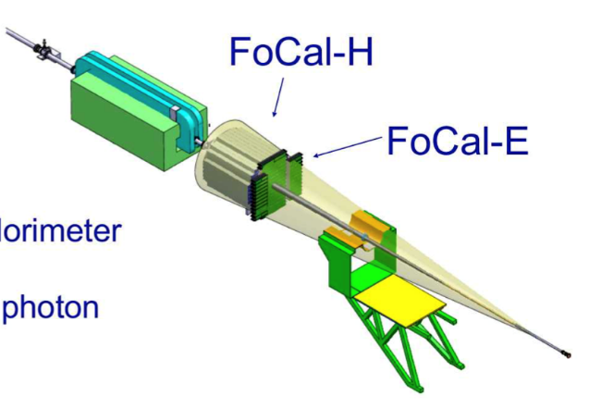
The ALICE LS3 upgrade
Novel vertex detector (ITS3) consisting of curved wafer-scale ultra-thin silicon sensors arranged in perfectly cylindrical layers, featuring an unprecedented low material budget of 0.05 % X0 per layer, with the innermost layer positioned at only 18 mm radial distance from the interaction point.
New Forward Calorimeter (FoCal), located at 7m left from IP2 and requiring low material budget in 3 < η < 6.
ITS3

Slide 8

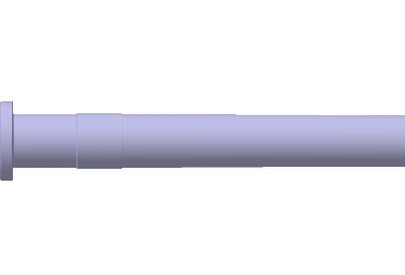
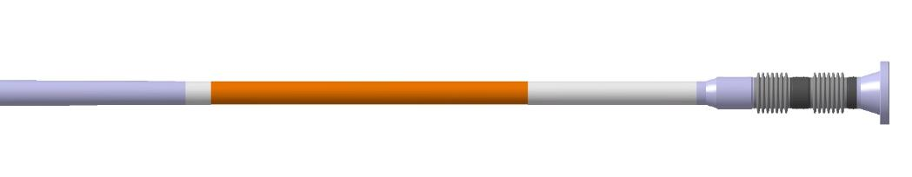


Central beampipe layout: RUN4
Dimensions in mm
Smaller central Be part: ID 32mm (inner radius 16mm)
Thinner wall of the Be part: 0.5mm
Conical A-side Al or Be section
No gate valve
RUN4
(Aluminum or Beryllium)
500 Beryllium
(Aluminum)
Angle ~0.34°/Ø wt 1
ID 31.4 wt 1
IP
ID 58; wt 1
4838
ID32 wt 0.5
820
250

Slide 9

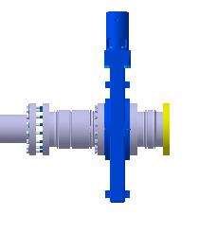
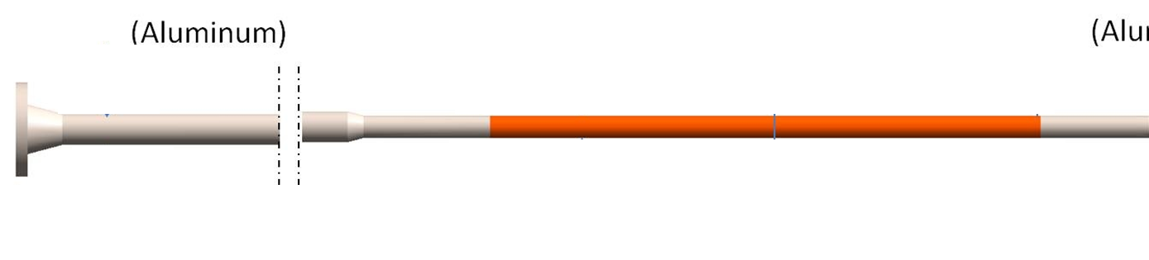
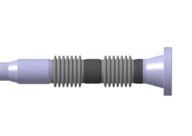
Central beampipe layout: RUN3 vs RUN4
Dimensions in mm
RUN3
OD152
870 Beryllium
(Aluminum)
OD 60
IP
ID 48.4, wt 1
ID 36.4 wt 0.8
4680
820
674
RUN4
(Aluminum or Beryllium)
500 Beryllium
(Aluminum)
Angle ~0.34°/Ø wt 1
ID31.4 wt 1
IP
ID58, wt 1
4838
ID32 wt 0.5
820
250

Slide 10
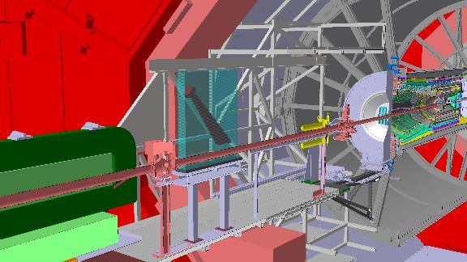
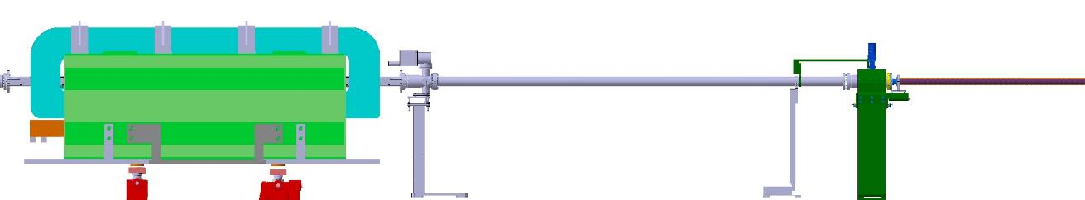
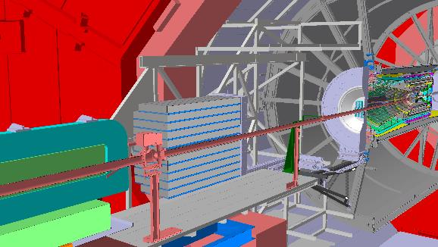
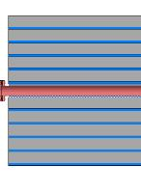
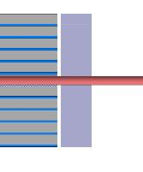
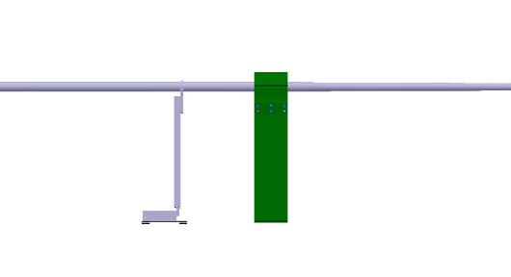
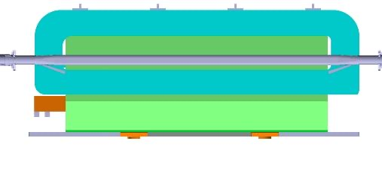


RB24 beampipe layout: RUN3 vs RUN4
Dimensions in mm
RUN3
Comp.magnet
RB24 pipe
Gate valve
Central pipe
IP2
FoCal
RUN4
~1080
No change wrt RUN3
Only this section is modified

Slide 11
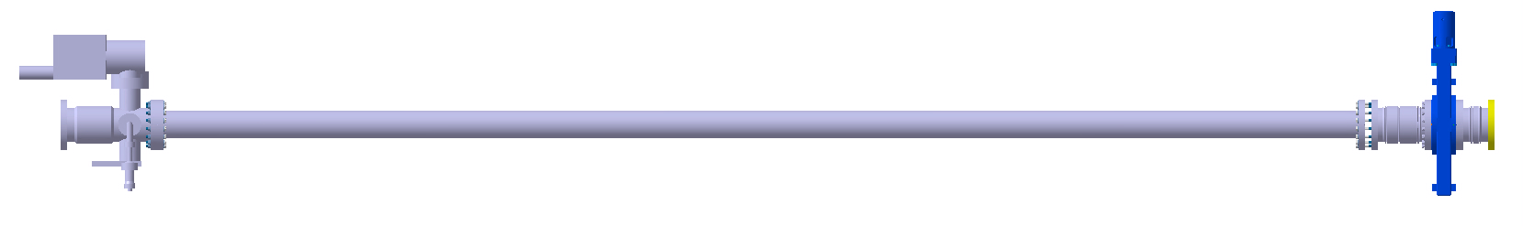
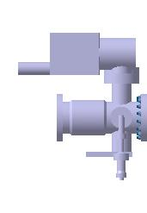
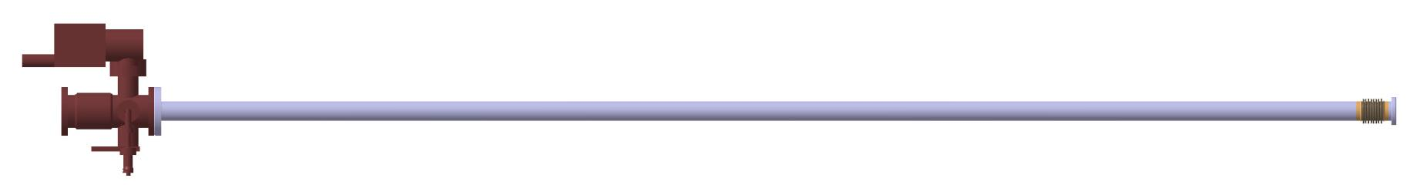
RB24 beampipe layout: RUN3 vs RUN4
Dimensions in mm
Copper pipe
ID80; wt 2
3635
IP 4680
RUN3
4030
RUN4
Aluminum flange
UHV CF Bi-metallic flange
DN100
Aluminum
Aluminum bellows
ID 58; wt 1
3872.5
IP 4838

Slide 12
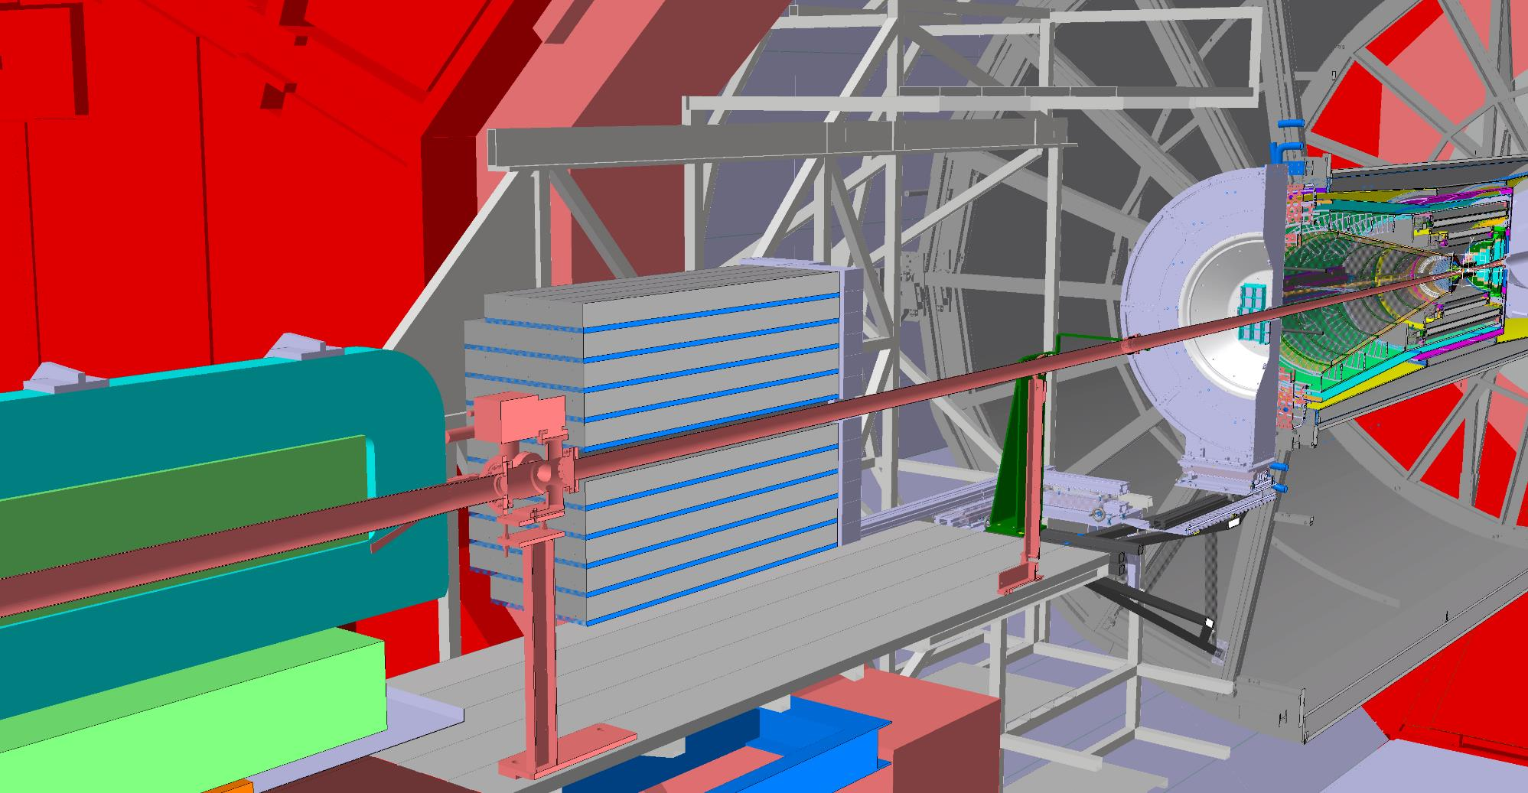
ALICE Layout RUN4
MF/FIT-C
FIT-A
ITS3
FOCAL
Central beam pipe
(ID 32mm)
Bellow
(No Gate Valve)
RB24
(ID 58mm)
Compensator Magnet
Ion pump

Slide 13
Tolerances
 | RUN3 |  |  | RUN4
Quantity | A-side section (A) | Central part (B) | C-side section (C) | A-side section (A) | Central part (B) | C-side section (C)
Construction and deflection | 1.3mm | 0.6mm | 0.5mm | 1.3mm ⁽¹ | 0.6mm ⁽¹ | 0.5mm ⁽¹
Mechanical adjustment precision | 2.5mm |  |  | 0.2mm
Survey to beamline uncertainty | 1.5mm ⁽²
Quad fiducial to beamline uncertainty | 0.5mm ⁽²
L3 movement | <0.5mm ⁽³
B field movement | <0.5mm |  | <2.5mm | <0.5mm |  | <2.5mm
Linear sum | 6.8mm | 6.1mm | 8.5mm | 4.5mm | 3.8mm | 5.7mm
Measured RUN3 BP
LEB 22.2.12
LEB 23.3.12
A
B
C
Support #1
Support #2
Support #3

Slide 14
Aperture at injection RUN3 vs RUN4 (preliminary ALICE)
n1_min 13.2
n1_min 13.7
RUN3: n1 min 13.2 sigma
RUN4 n1 min 13.7 sigma

Slide 15
Conclusions
ALICE would like to introduce these modifications in LS3:
New 32mm ID central beampipe, with thinner central Be section (0.5mm) and conical A-side section
New 58mm ID RB24 beampipe (1 section only), made of 1mm thick Al
With the presented geometry and tolerances, we have estimated the n1 min at injection of more than 13.7 sigma.

