Slide 1
LS2-LHC linear planning
Annual maintenance period
EDMS ACC-PS-MS-0018
10th December 2020
María Barberán

Slide 2
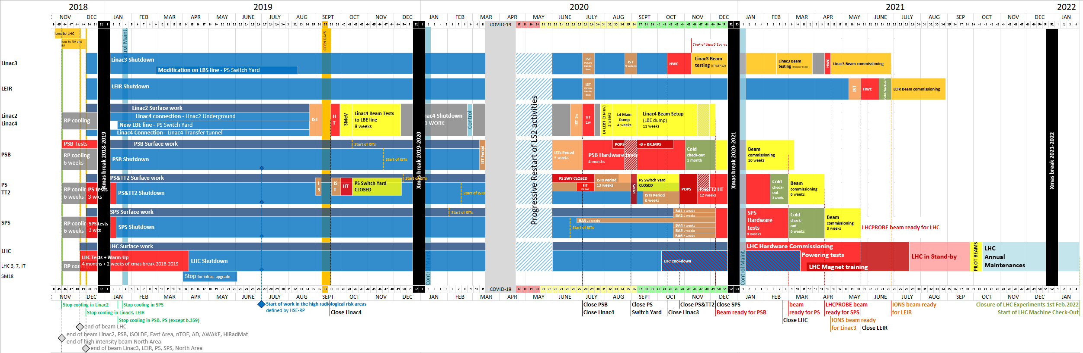
LS2 master schedule EDMS ACC-PM-MS-0002
NEW V 3.1 – UNDER APPROVAL

Slide 3
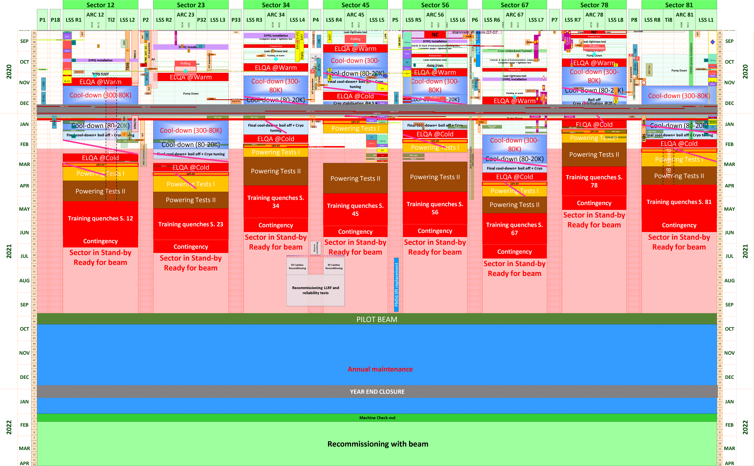
LHC-LS2 under approval EDMS LHC-PM-MS-0018 v.3.1
NEW V 3.1 –
UNDER APPROVAL
LHC-LS2, EN-ACE-OSS
3

Slide 4
Activity authorized during the Annual maintenance period
Starting from w41 until w49 2021 (Dates still TBC)
LHC machine will stay @1.9K (Liquid Helium)
Compulsory maintenances for EN-CV, TE-CRG, EN-EL and BE-ICS
Activities with no impact on the machine recommissioning
Any intervention request, other than maintenance, needs to be approved by LMC
LHC-LS2, EN-ACE-OSS
4

Slide 5
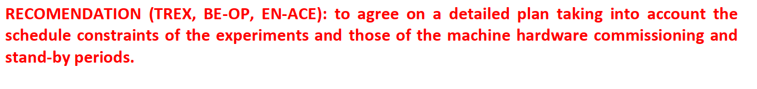
Motivation
LMC, 28th Oct 2020
https://indico.cern.ch/event/969674/

Slide 6
Activities in 2021:
During annual maintenance period:
LS2 coordination will prepare the planning & present @ TREX
Inputs will be collected at next TREX (end Jan21): Activity/estimated time/time constraints (if any)/foreseen impact on the machine

Slide 7
Activities in 2021:
Exceptionally before annual maintenance period:
Activity/estimated time/time constraints (if any)/foreseen impact on the machine
Inputs will be collected at next TREX (end Jan21): Activity/estimated time/foreseen/time constraints (if any) impact on the machine

