Slide 1
LHC Status Report
Steve Myers
(on behalf of the LHC team)
LHCC 7th July, 2010.

Slide 2
Milestones
30 March: first collisions at 3.5TeV/beam
19 April: order of magnitude increase in luminosity
    doubling the number of particles/bunch
    β * from 11 to 2m (4b/beam) L ~2x10²⁸.
    Beam lifetimes of ~1000 hours
22 May another order of magnitude:
    13 bunches in each beam (L~ 3x10²⁹)
26 May: Design intensity bunches were brought into collision at 3.5TeV/beam.
2nd July peak luminosity of 10³⁰cm⁻²s⁻¹.

Slide 3
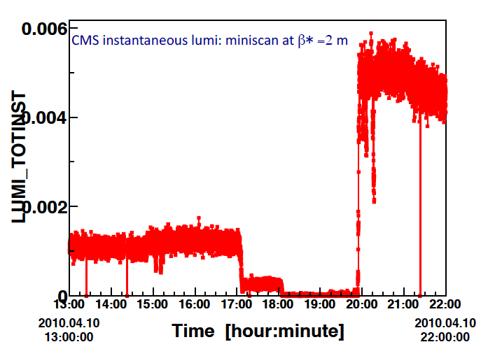
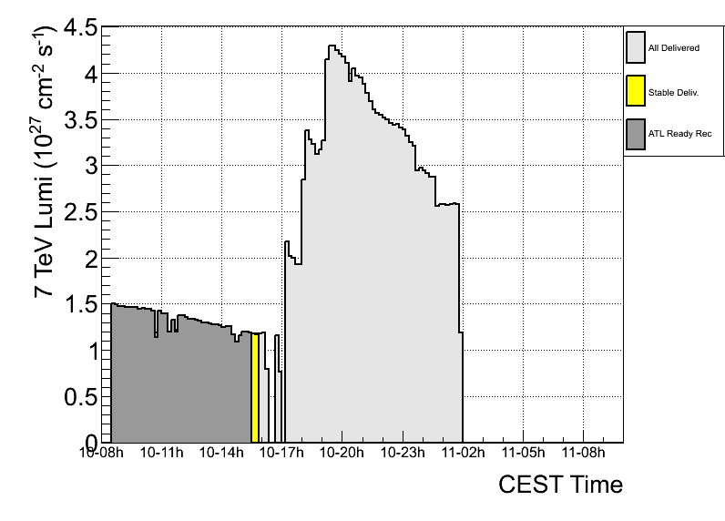
IP1&5 lumi vs squeeze
Raw (online) lumi plots on 10 apr 2010, during the squeeze to 2m in IP1 and IP5
Factor gained (raw numbers):
  ~4.5 in Pt5 (after min scan)
  ~4 in Pt1
Not corrected for lumi decay over the ~5h of squeeze and mini scans
atlas

Slide 4
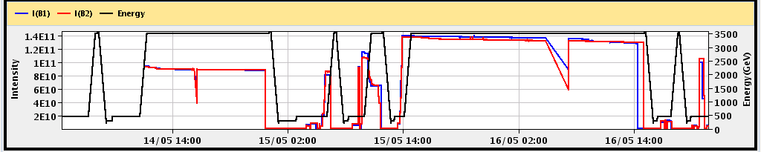
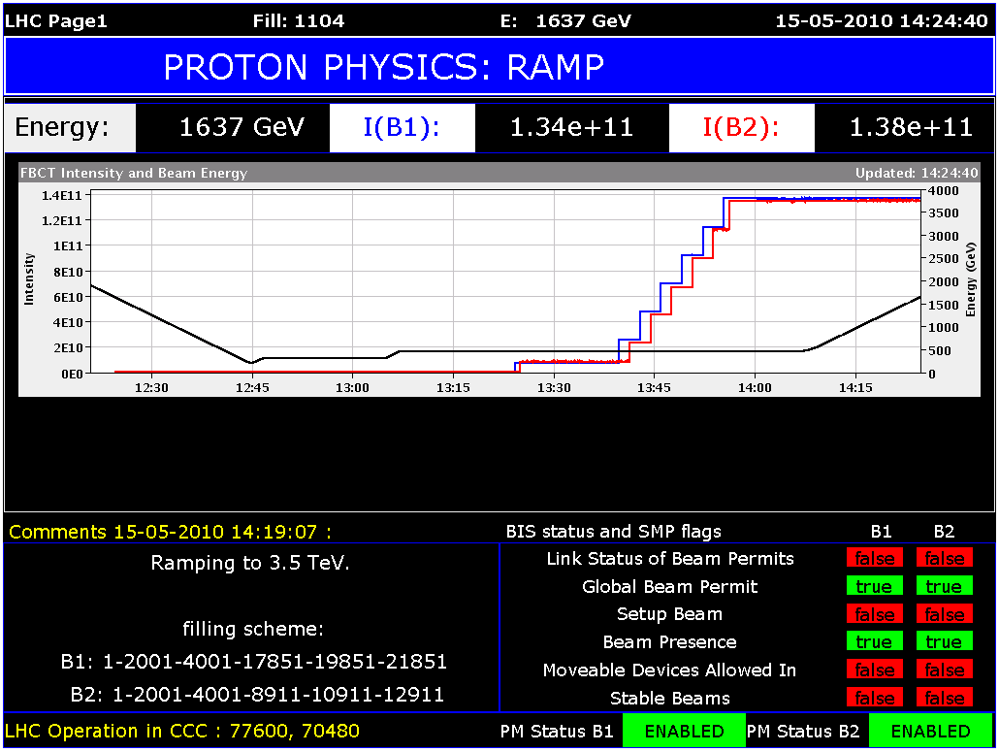
Pushing Number of 2e10 Bunches
2 x 2e10 ➔ 4 x 2e10 6 x 2e10 per beam
48 hours
Allowed doubling the integrated luminosity for 2010 within 48 hours!

Slide 5
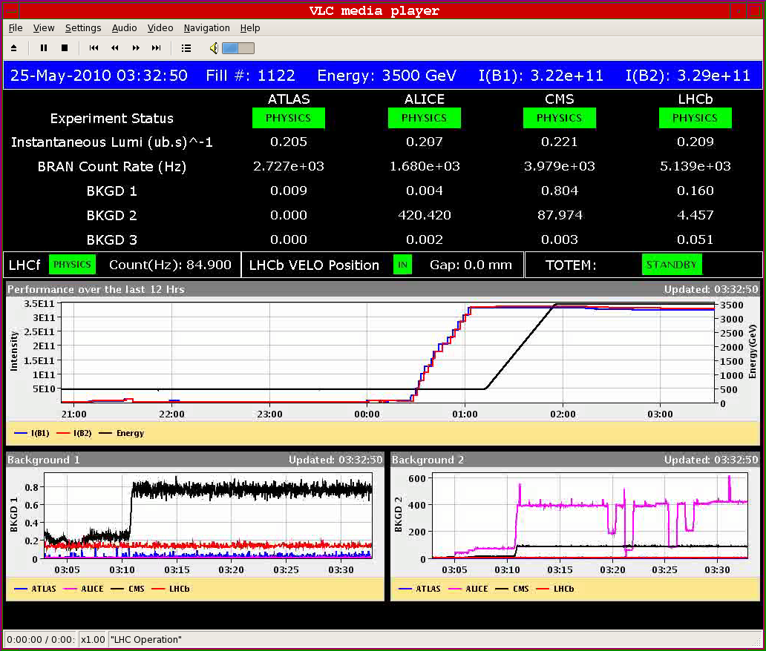
13 bunches: 3x10²⁹ !!

Slide 6
Recent progress/Changes
Until 9 June, machine time shared between physics and machine studies.
  Physics with ~2x10¹⁰ protons/bunch
  Machine studies to develop 1x10¹¹ protons per bunch
Beam Stored energy is the metre stick: (Machine Protection)
  Lost particles must end up on collimator or dump
  Following discussions with the 4 spokespersons and the physics coordinator, a decision was unanimously made on 9 June to concentrate on “Machine studies to develop 1x10¹¹ protons per bunch” until it was operational. This meant postponing physics data taking for around 3 weeks. (Minutes LMC 9th June)
2

Slide 7
Getting to Stable beams at 1.1x10¹¹.
Instabilities in Collision at 3.5TeV/beam
  longitudinal emittance control
    In the SPS
    During the ramp in the LHC
  Transverse damper working
  Collimators set up
  Injection set up for new high intensity
  Beam dump set up for higher intensity
Started physics data taking under these conditions on Saturday 26th June (almost a week ahead of estimates)

Slide 8
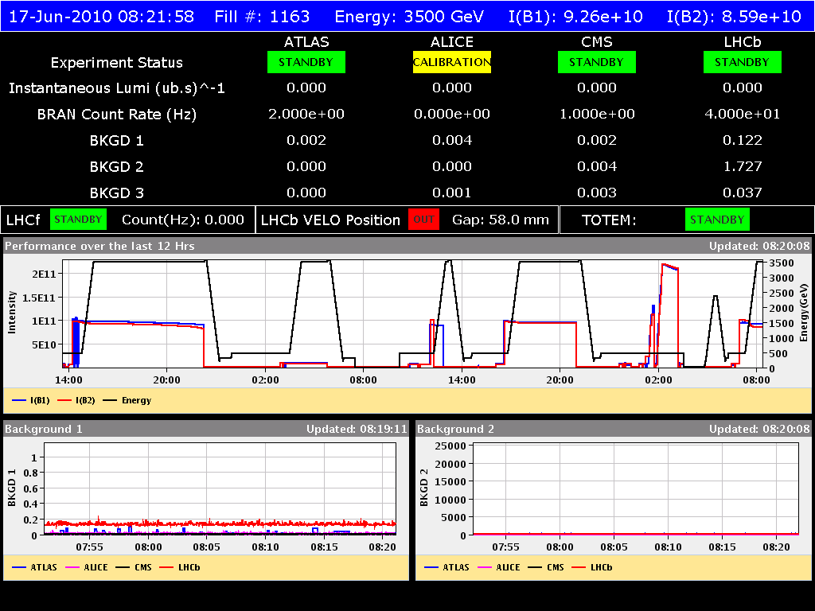
Ramps for Operations set up for 10¹¹ protons/bunch

Slide 9
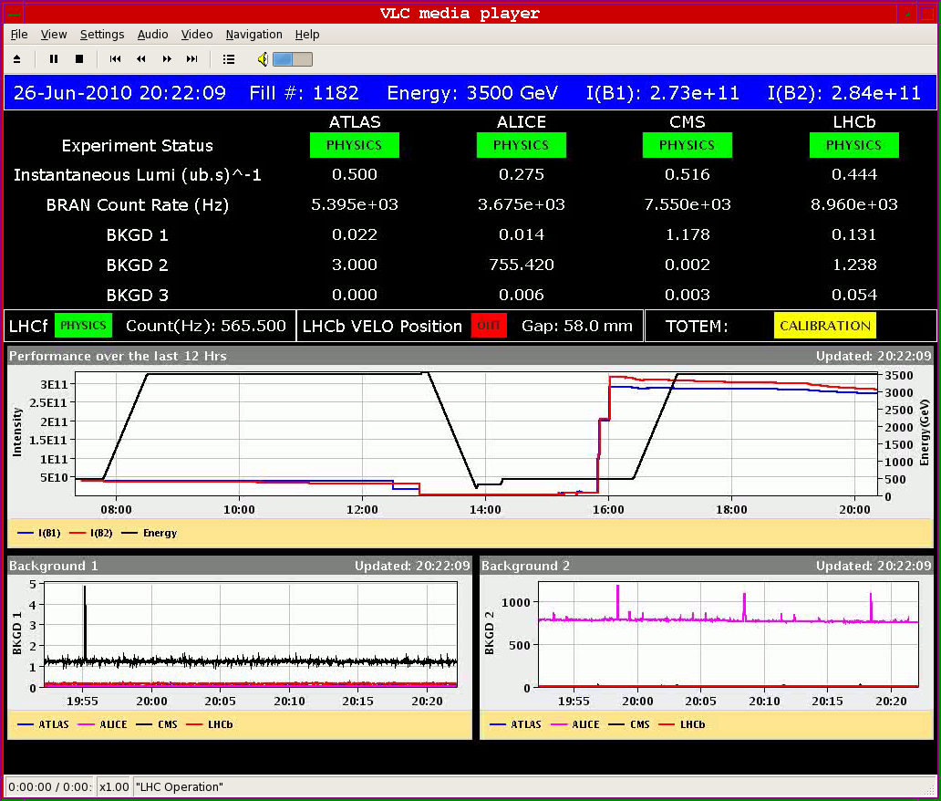
26th June: 5x10²⁹ with 3 bunches/beam; 10¹¹/b

Slide 10
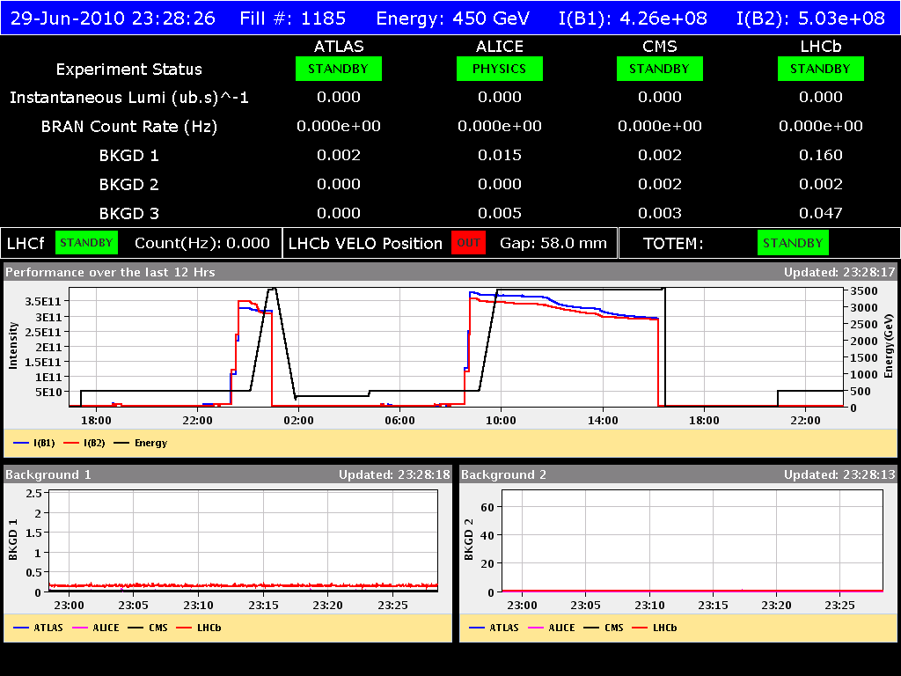
6-8x10²⁹cm⁻²s⁻¹ with 3 bunches per beam;10¹¹/b
29th June, new record

Slide 11
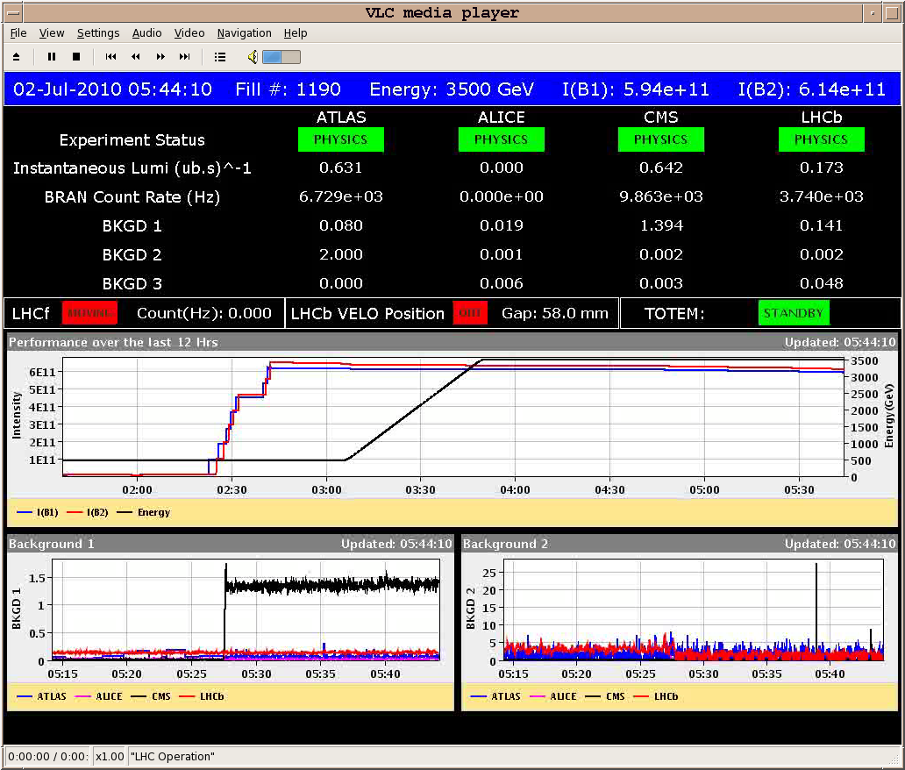
2nd July: Colliding 6 bunches per beam; 10¹¹/b

Slide 12
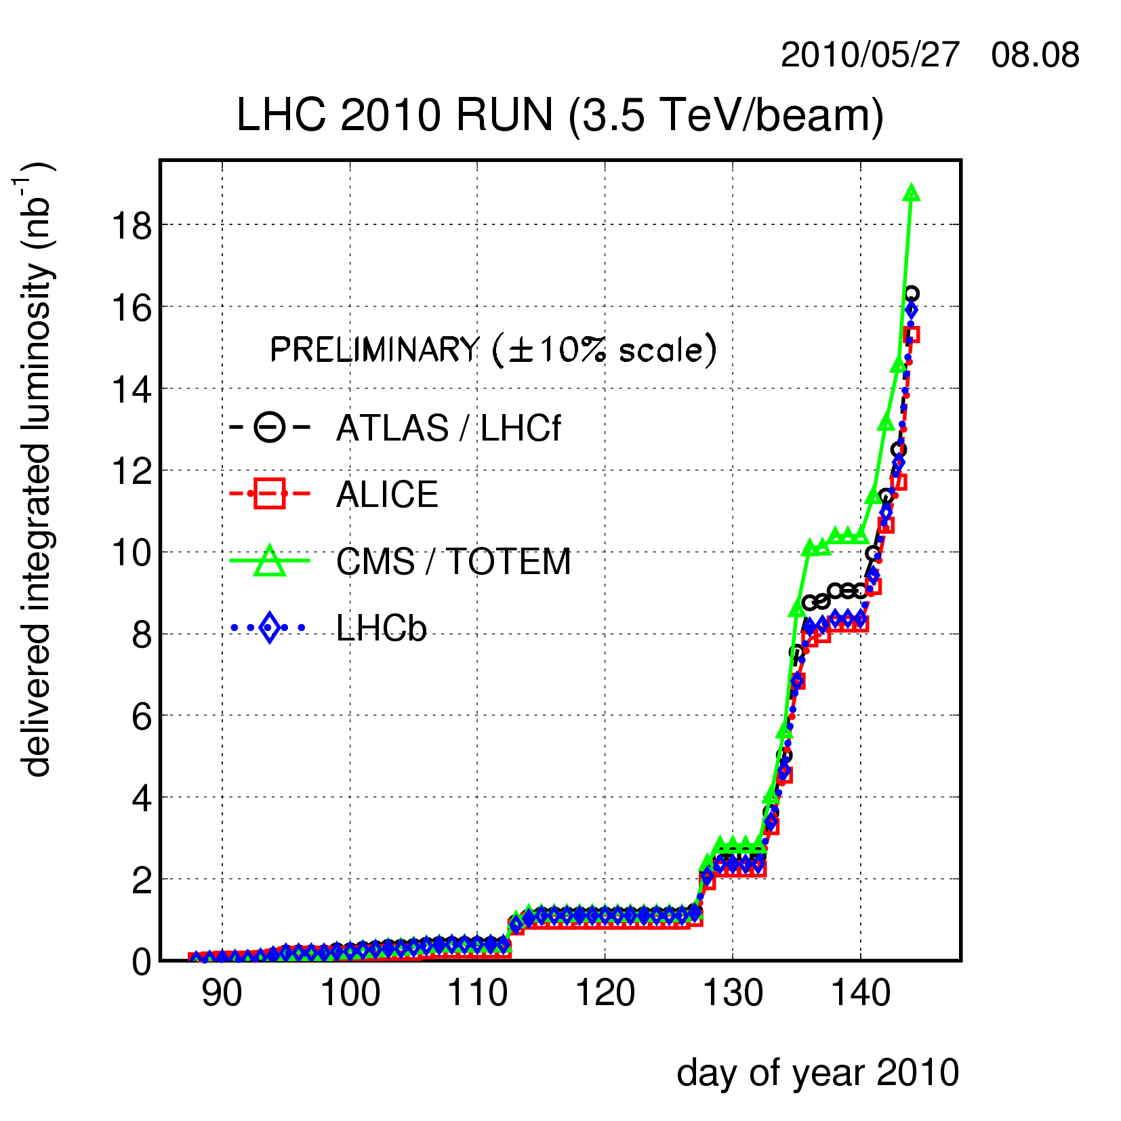
Integrated Luminosity (Linear Scale)

Slide 13
Look back over week 26 (28/6/10)
Goals of the week:
  Reach peak luminosity of 10³⁰ cm⁻² s⁻¹
  Improve operational procedures (squeeze and collision sequences)
Number of accesses: 6
Number of ramps: 12
Number of fills declared for physics: 7
Fastest turnaround: 4h48 (end stable beams to start stable beams)

Slide 14
End of fills
Reason for end of 6 physics fills:
  End of fill study and planned dump: x 2
  Electrical glitch: x 2
  Instability-induced losses
  Internal beam dump interlock
Beam dumps on 5 ramps not making it into physics:
  Losses from WS above threshold
  LSA software problems
  QPS trip
  Single collimator not ramping
  No longitudinal blowup during ramp

Slide 15
Friday 2/7/10
Went to 7 bunch scheme: 6 colliding, 1 not colliding
Bunch intensity: ~ 9e10
Used separation to limit ALICE luminosity
Achieved > 10³⁰ cm⁻² s⁻¹ in all experiments (except ALICE)
Stable for 16 min, then instabilities (mainly bunch 1)
Lost after 34 min due to beam losses

Slide 16
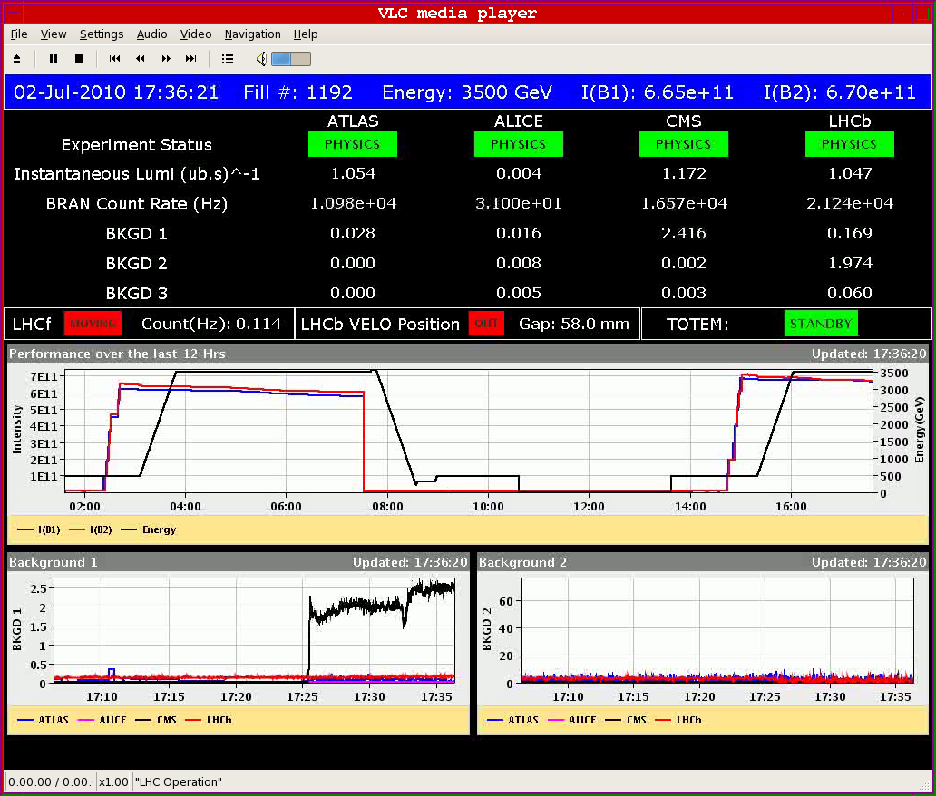
New Record Lumi > 1e30 cm-2 s-1

Slide 17
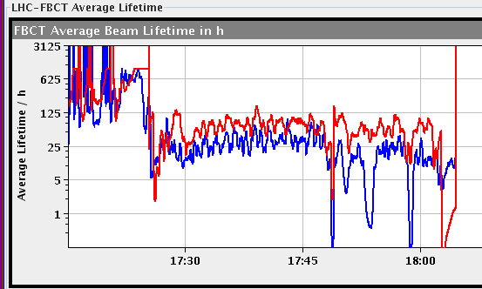
Beam Lifetime
Collisions
ALICE

Slide 18
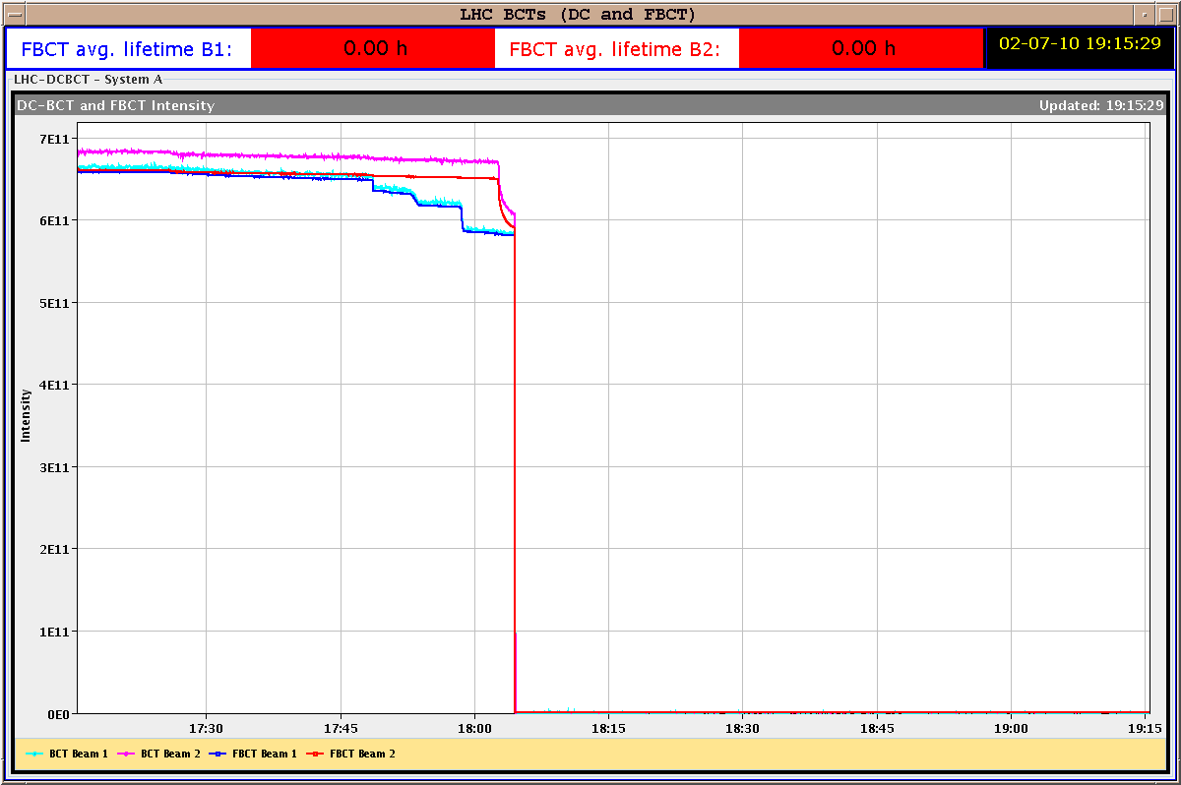
Beam Intensity

Slide 19
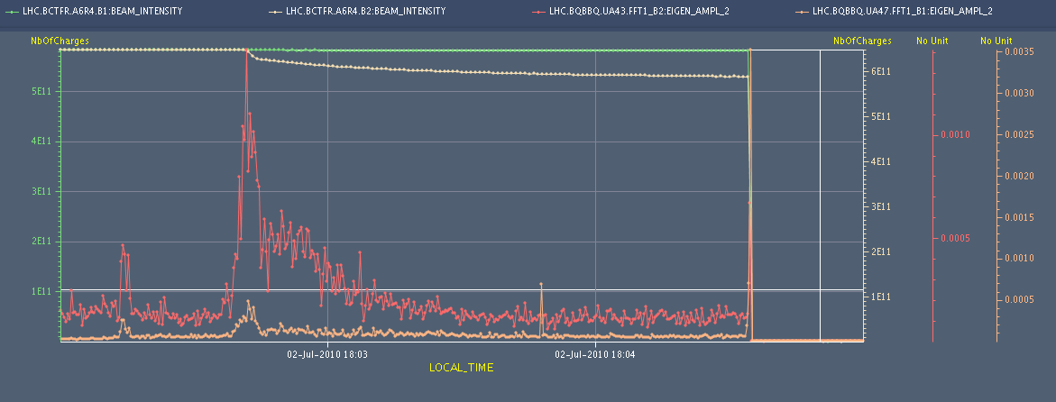
Tune: Coherent Excitation

Slide 20
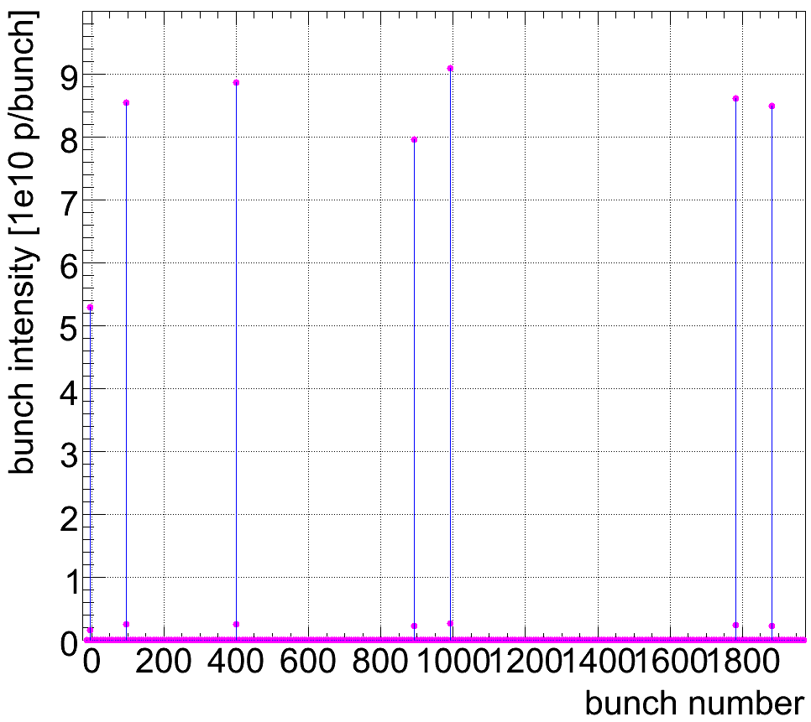
Bunch Intensity B1
Not colliding

Slide 21
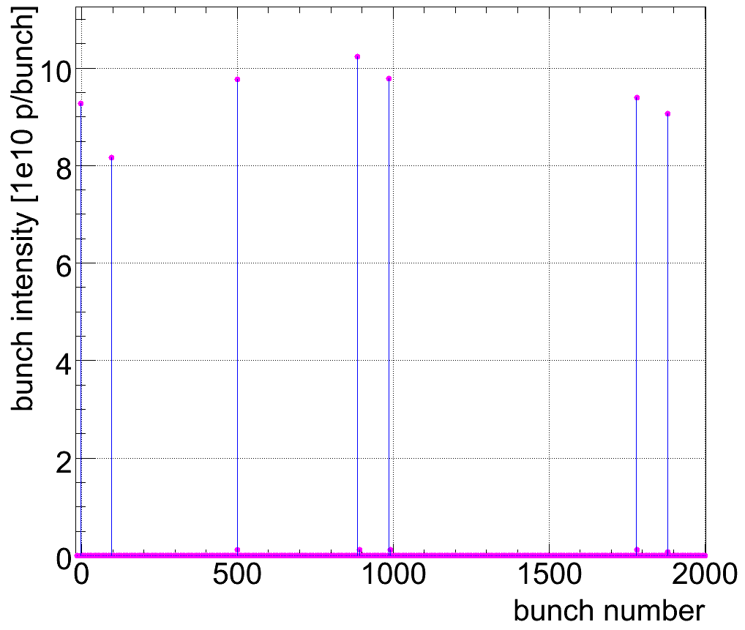
Bunch Intensity B2
Not colliding

Slide 22
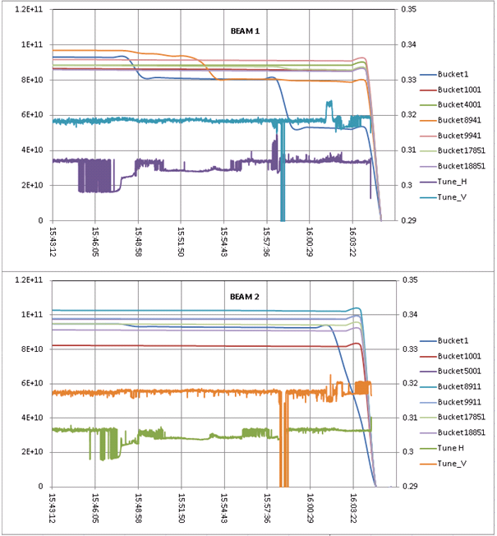
Bunch Intensity versus Time
➔ Beam-beam effects

Slide 23
Bunch Intensity versus Time
➔ Beam-beam effects

Slide 24
Saturday 3/7/10
Decided to go towards nominal emittance (3.5 um) for limiting beam-beam effects to nominal values.
Standard emittances below 2um at injection.
Attempt to blow-up emittance with transverse feedback – really needs additional software
Switch off TFB – not effective
Blow up emittances in SPS via screens in TT10
  3.6/4.4 um on offer
  TFB back on in LHC
  Too high losses on transfer line collimators
  different screens - OK
B1H | B1V | B2H | B2V
2.8 | 2.5 | 3.1 | 4.2

Slide 25
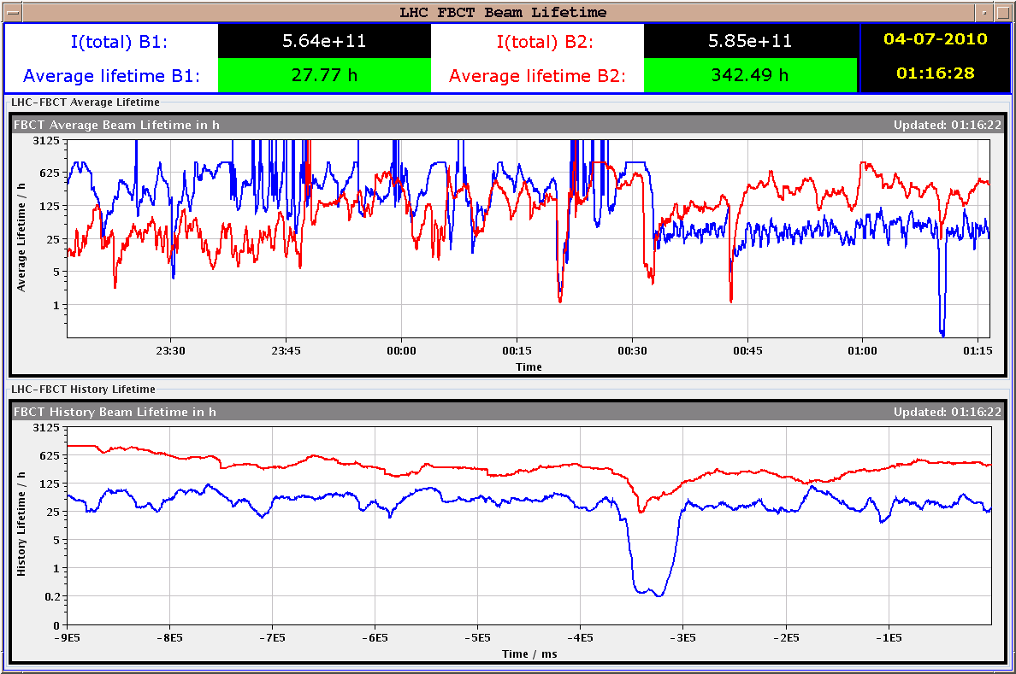
Lifetime

Slide 26
Sunday 4/7/10
Again emittance blow-up at injection.
Long physics fill started at 6h27.
Longitudinal losses for B1.
End of fill studies:
  Transverse damper: Too high gain broadens the tune peak (probably need to work on improving signal/noise in the damper)Observed about 8 dB reduction of the vertical beam 2 tune peak; little change in the tune spectra for the other beams/planes.
  Wire scanner: measurements at 3.5 TeV.

Slide 27
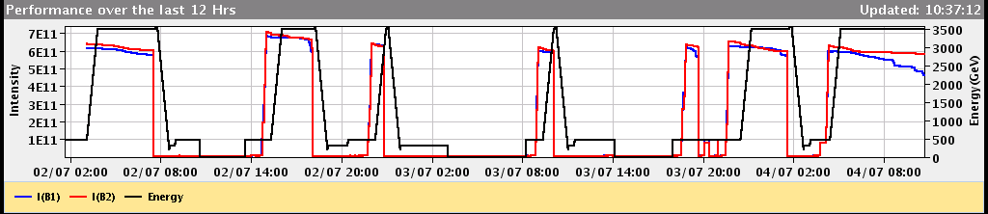
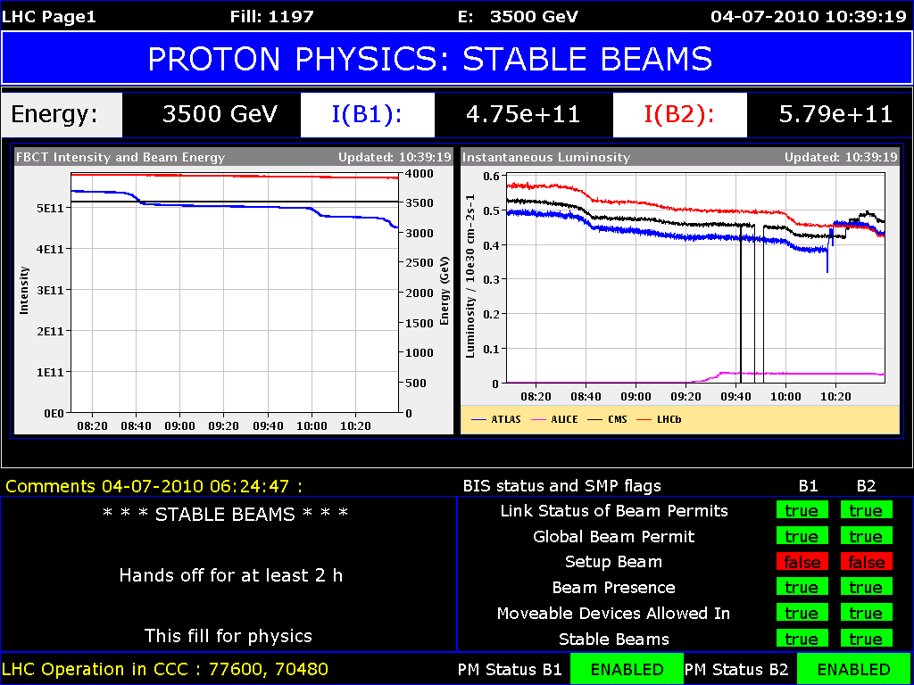
Better but not perfect stability…
Intensity
Luminosity
Tuning

Slide 28
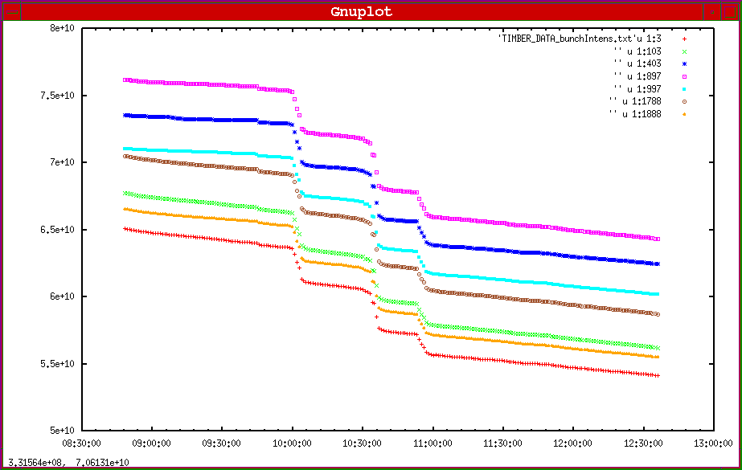
Losses in All Bunches: Not Beam-Beam

Slide 29
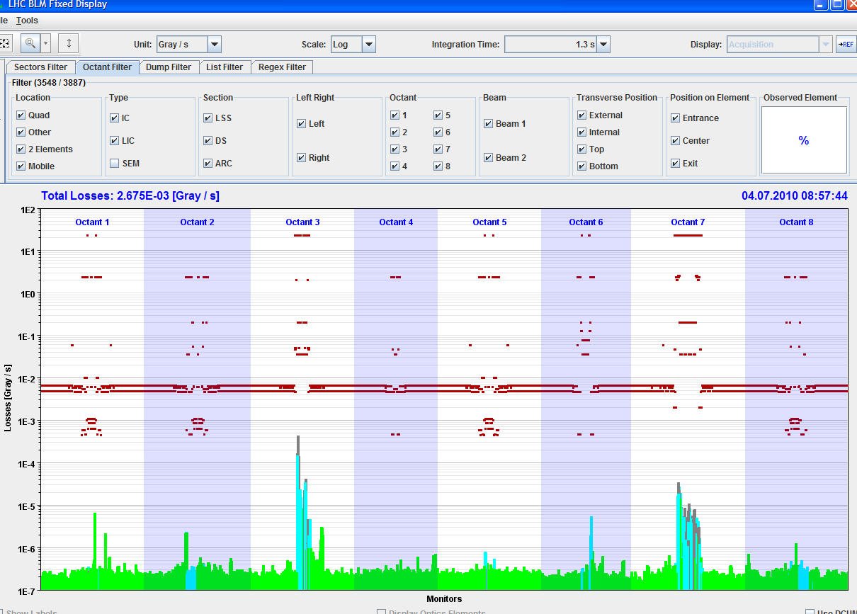
Momentum Cleaning Very Active: RF Issue

Slide 30
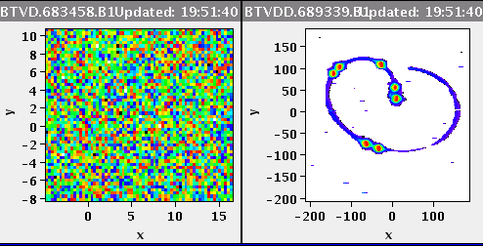
Dump of B1 Uncaptured Beam

Slide 31
Tuesday 6 July
Injection: TDI studies:
In parallel with SPS controlled transverse blowup setting-up used the LHC circulating beams to make some checks of LHC injection protection
Made scans of TDI settings with +/-1000 urad angles applied to jaws, for B1, as a function of TCP setting.
Data to be fully analysed - scale offsets seen with both angles, unlike B2. Find 0.4 mm for downstream end and 1.1 mm for upstream end.
B2 TDI scan repeated with the offsets found in previous measurements: results coherent with earlier findings.

Slide 32
Tuesday 6 July
Emittance measurements in TL: Chiarra Bracco
SPS Beam blown up to emittance of >3um.
Emittance was then measured in the TL by means of the BTV finding the following results:
TI 8: EH= 2.6um (SPS: 3um) - EV= 2.8um (SPS: 3um)
TI 2: EH= 3.4um (SPS: 3.2um) - EV= 2.2um (SPS: 2.9um)
Emittance in vertical plane was blown again in order to have > 3um and new measurements were done in TI 2:
TI 2: EH = 3.4um (SPS: 3.5um) - EV = 2.5um (SPS: 3.5um)
Vertical plane show controversial results --> measure beam in the LHC and more to be done to understand the results.

Slide 33
Tuesday 6July
Transverse blowup studies for LHCINDIV on LHCFAST2 in the SPS -
Octupoles are used in combination with an excitation by the damper around the tune frequency (small frequency modulation).
Tuned the system for providing emittances of 3 um in H and 3.5 um in V with SPS WS. Transfer lines indicate about 3 um in both planes, both beams.

Slide 34
Tuesday 6July
Injection: TDI studies: Brennan Goddard
In parallel with SPS controlled transverse blowup setting-up used the LHC circulating beams to make some checks of LHC injection protection
Made scans of TDI settings with +/-1000 urad angles applied to jaws, for B1, as a function of TCP setting.
Data to be fully analysed - scale offsets seen with both angles, unlike B2. Find 0.4 mm for downstream end and 1.1 mm for upstream end.
B2 TDI scan repeated with the offsets found in previous measurements: results coherent with earlier findings.

Slide 35
Tuesday 6July
Emittance measurements in TL: Chiarra Bracco
SPS Beam blown up to emittance of >3um.
Emittance was then measured in the TL by means of the BTV finding the following results:
TI 8: EH= 2.6um (SPS: 3um) - EV= 2.8um (SPS: 3um)
TI 2: EH= 3.4um (SPS: 3.2um) - EV= 2.2um (SPS: 2.9um)
Emittance in vertical plane was blown again in order to have > 3um and new measurements were done in TI 2:
TI 2: EH = 3.4um (SPS: 3.5um) - EV = 2.5um (SPS: 3.5um)
Vertical plane show controversial results --> measure beam in the LHC and more to be done to understand the results.

Slide 36
Tuesday 6 July
Transverse blowup studies for LHCINDIV on LHCFAST2 in the SPS
  Octupoles are used in combination with an excitation by the damper around the tune frequency (small frequency modulation).
  Tuned the system for providing emittances of 3 um in H and 3.5 um in V with SPS WS. Transfer lines indicate about 3 um in both planes, both beams.

Slide 37
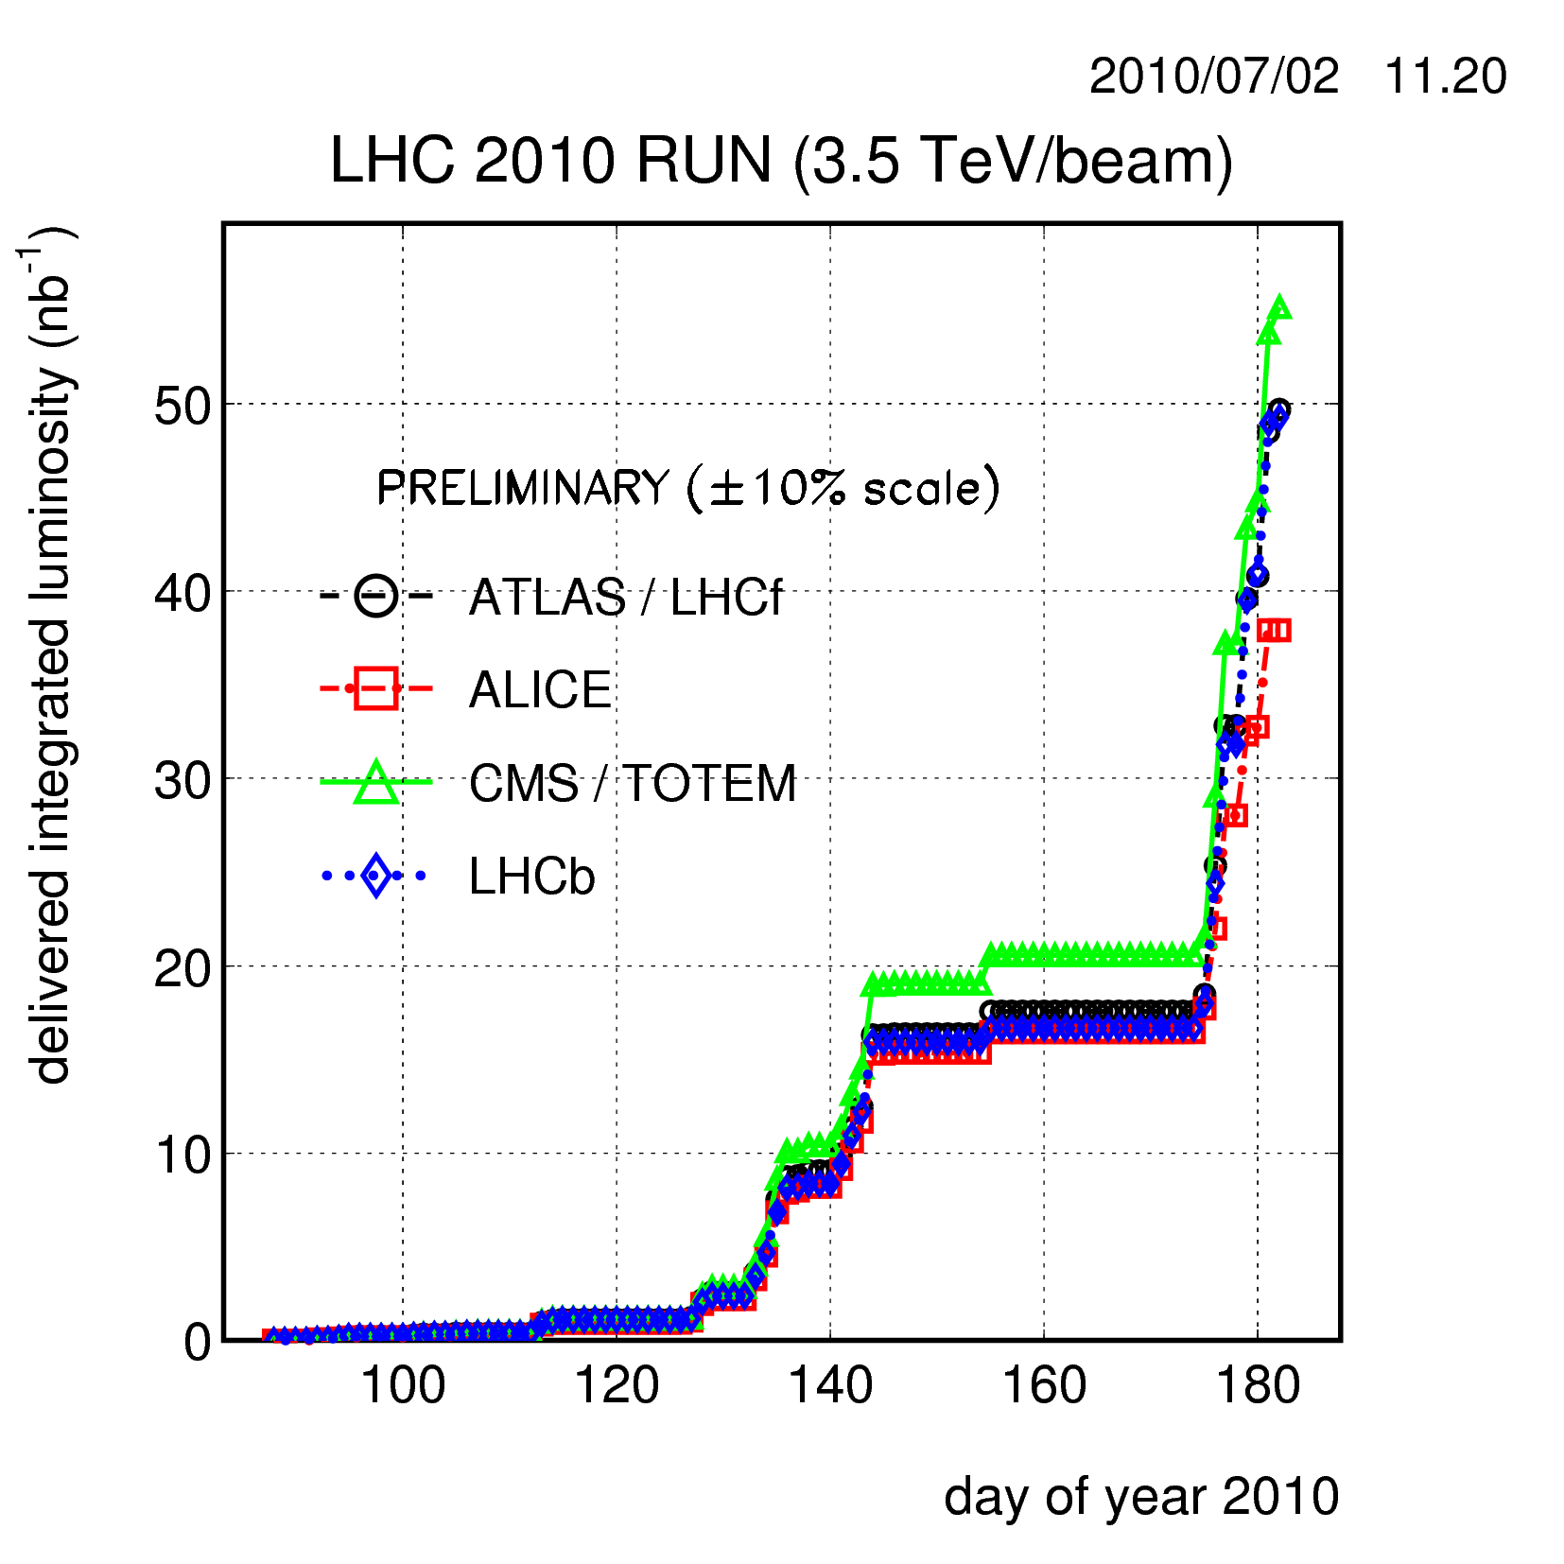
Integrated Luminosity on 2nd July

Slide 38
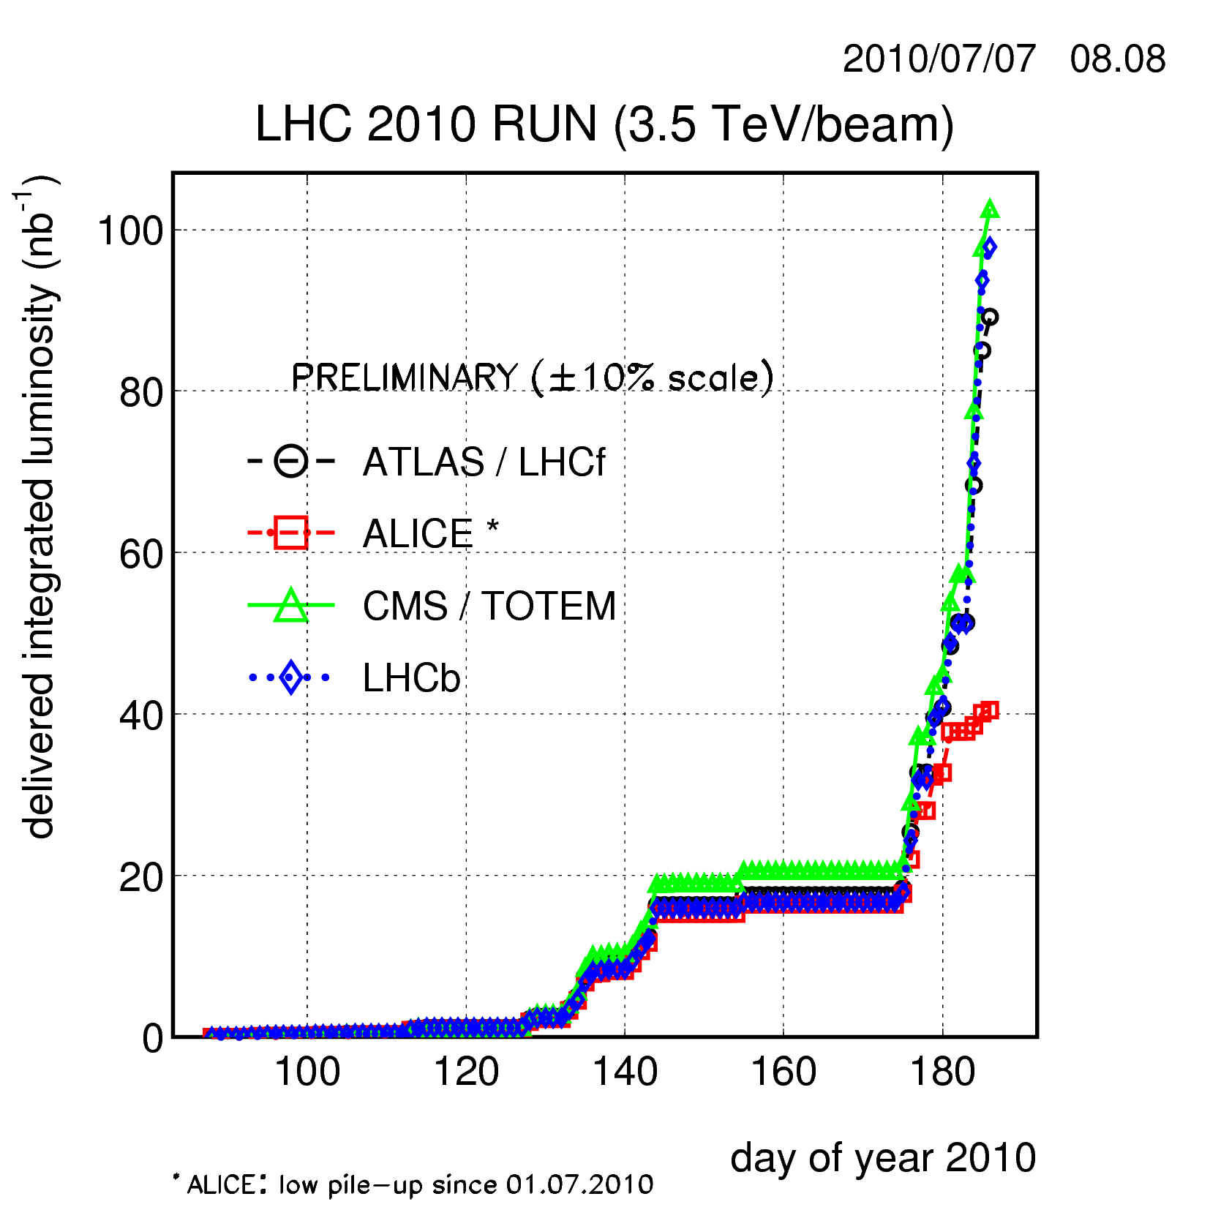
Integrated Luminosity on 7th July

Slide 39
Presently
More physics for 100 nb⁻¹ goal (ICHEP)
From experience so far
  No fundamental issue for 1e30 lumi (16 min OK).
  Further equalize beam parameters (emittance, intensity, …) while delivering luminosity. Try to get nominal beam and bunch parameters, including variations.
  As stability is improved, push up again towards 1e30 lumi.
  If problems persist, try simpler collision scheme with 2 collisions per IP. Bunches with 2 collisions seem less affected.
In addition:
  Cross calibrate emittance measurement devices.
  Push transverse damper into full operation in collision, however, possibly needs noise reduction.

