Slide 1
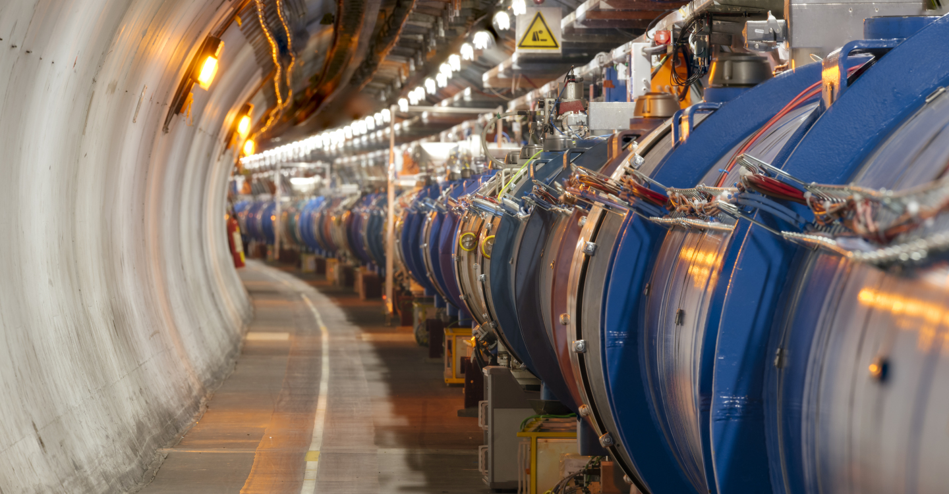
What do we buy?
Electronics and radiofrequency:
  Electronic components (active, passive)
  PCBs and assembled boards
  LV and HV power supplies
  Radiofrequency plants
  Amplifiers
Opening of the day
Session 6:
Magnets, Superconductors, Materials
Session 4: Electronics
Sensors
Power Supplies

Slide 2
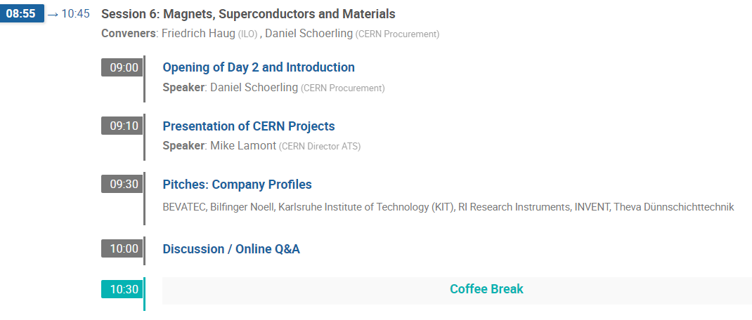
Agenda: Session 6

Slide 3
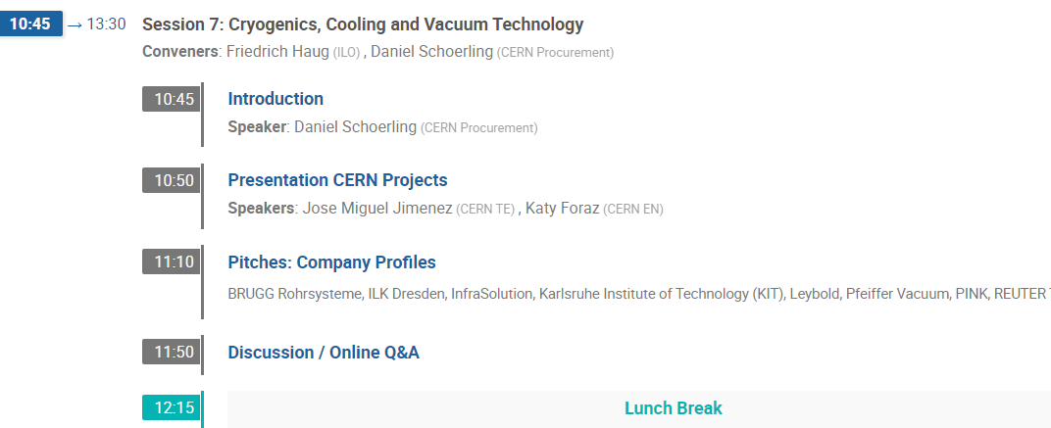
Agenda: Session 7

Slide 4
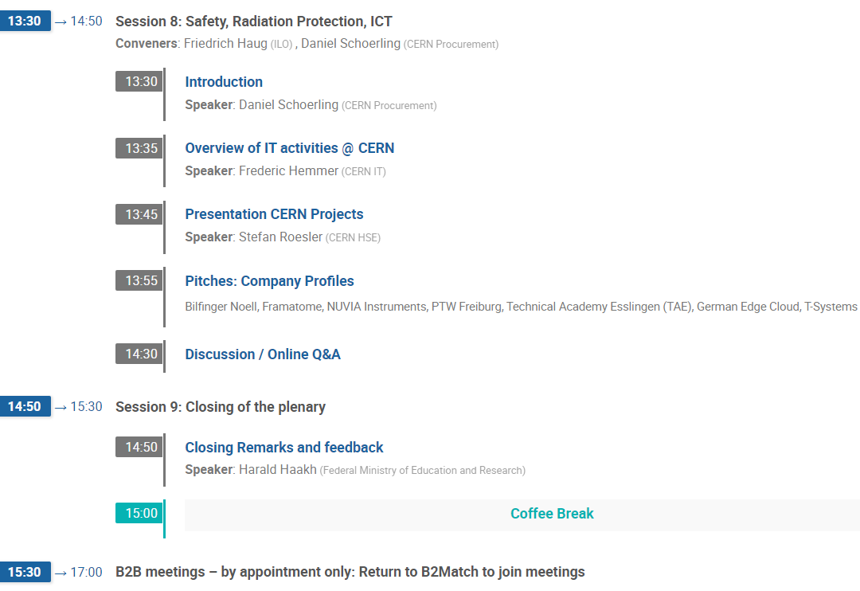
Agenda: Session 8 & 9

Slide 5

Agenda: B2B meetings
Please check your personal agenda on:
https://germanycern.cern.b2match.io

Slide 6
Spending profile

Slide 7

Collaboration partners wanted: HFM program
High-field superconducting magnets (HFM) are a key technology for future accelerators, and can have a significant impact also on societal applications such as thermonuclear fusion, ultra-high-field magnetic resonance imaging (MRI), medical accelerators, other medical applications such as gantries, etc.
This HFM R&D programme will be carried out within an expanded collaboration with research laboratories, institutes and industry in the Member States and beyond.
A significant amount of the budget will be invested in industrial procurement and collaborations with European institutes.

Slide 8
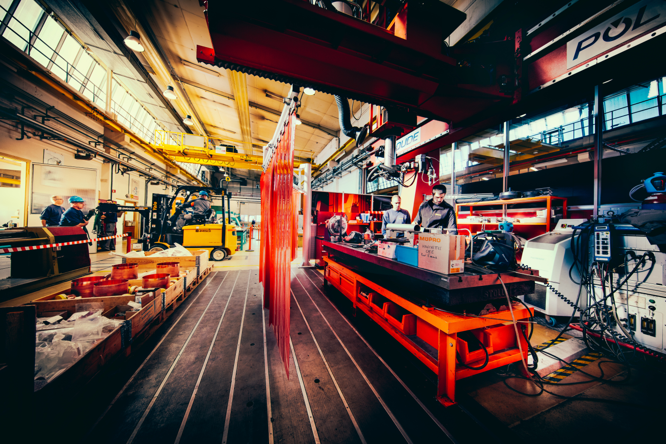
MS-4669/EN/LHC
Supply of heavy duty milling machine
Procurement Code: 05.03.01.00
Cost Range: A
Planning: MS : Sent / IT: Q4 2021
Description and Specific Condition :
Five axis Computer Numerical Control (CNC) milling machine including a rotary table in the machine bed, a HSK100 spindle taper size coupled with a high torque/power spindle.
Contact: Said.Atieh@cern.ch

