Slide 1
Investor Invitation Package
Personalized Package to engage interested investors in IdeaSquare

Slide 2
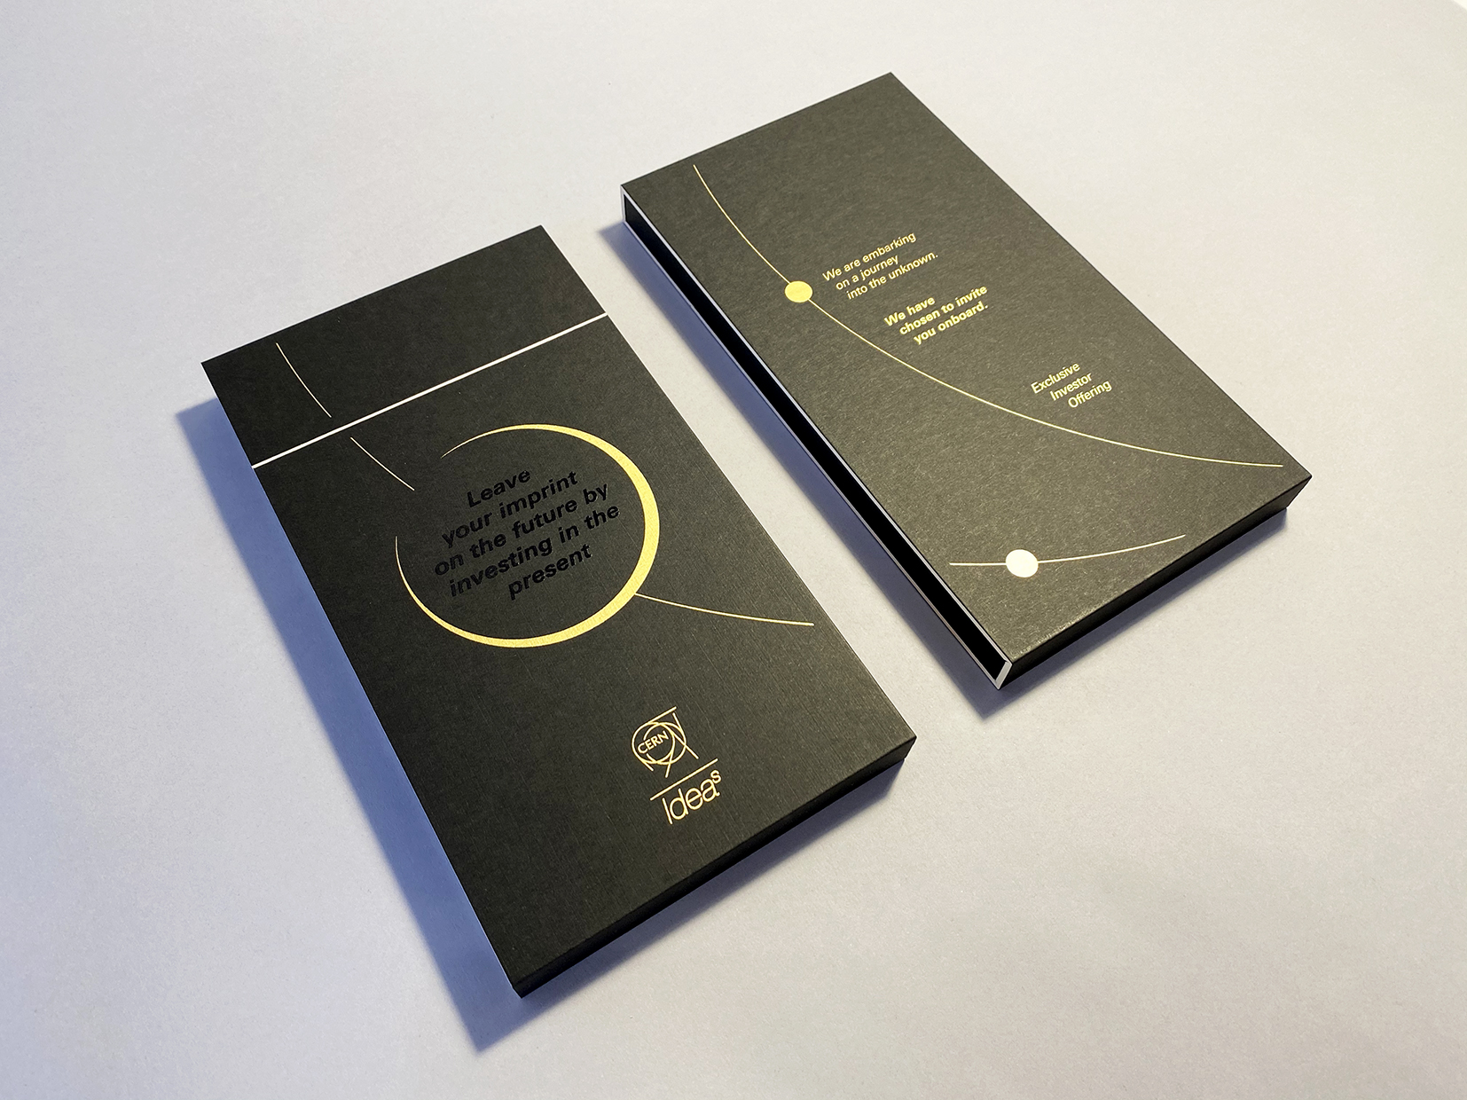

Slide 3
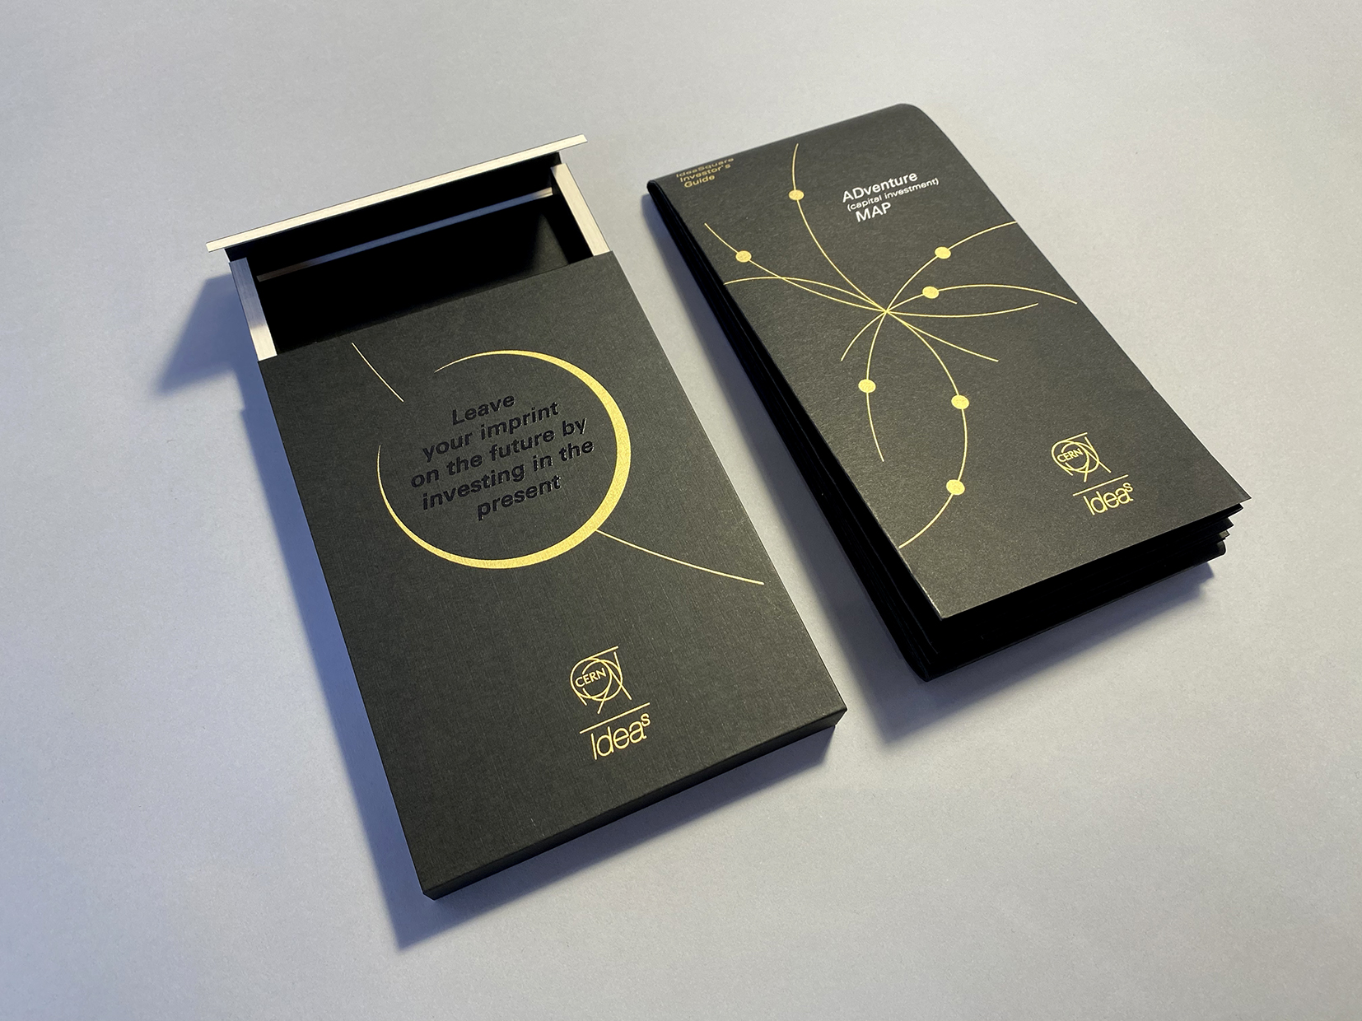

Slide 4


Slide 5


