Slide 1


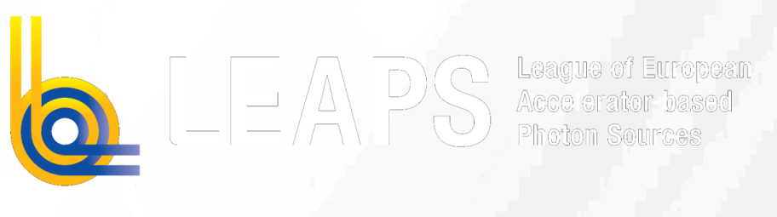

LEAPS-INNOV Annual Meeting 2023
INFN & ENEA collaboration on Apple-X undulators
March 28th 2023
A.Petralia, F.Nguyen, A.Doria (ENEA)
L.Giannessi (INFN-LNF)
This project has received funding from the European Union´s Horizon 2020 research and innovation programme under grant agreement No. 101004728

Slide 2


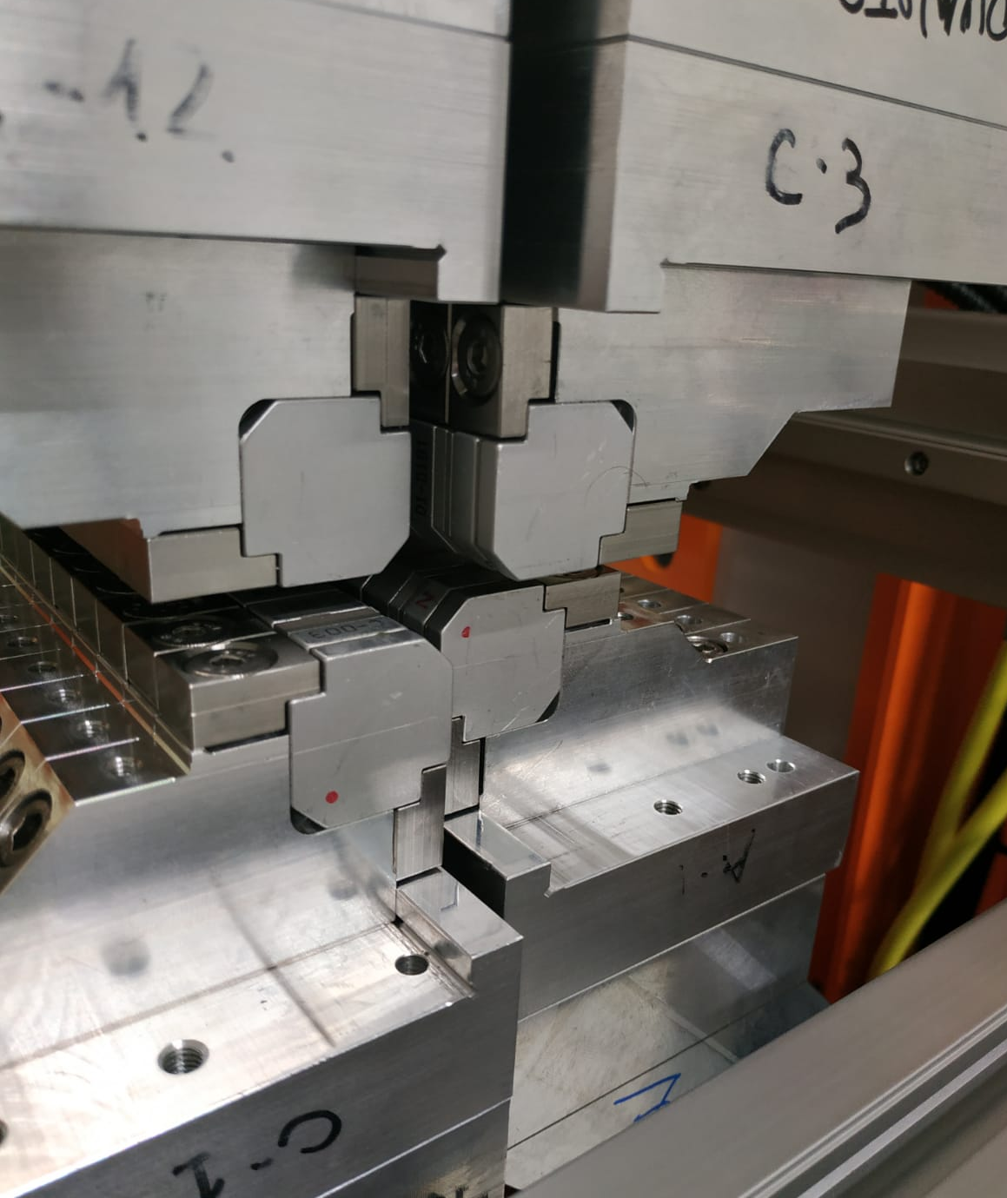
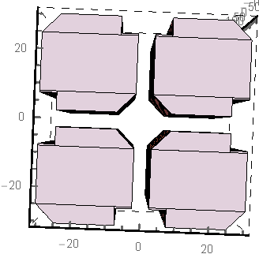
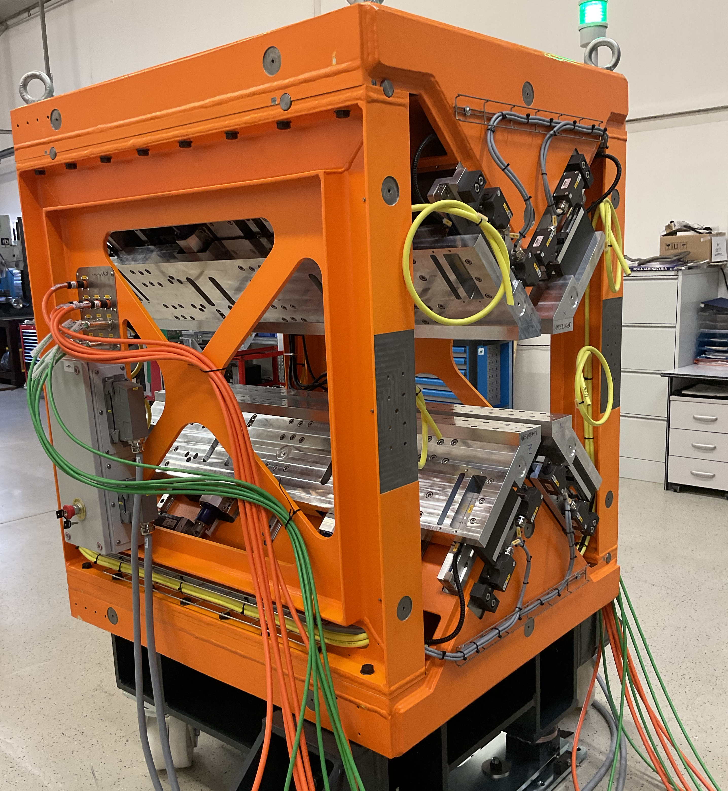
SABINA Apple-X undulator
Source of Advanced Beam Imaging for Novel Applications
Italian Regional Call
THz user facility @ λ ∼ 10-100 μm
Operating at low energy e-beam - 30-100 MeV
- NdFeB
- Circ./Linear pol.
- λ_{u} 55 mm
- Br 1.22 T
- Min gap 5 mm
- 22 periods
- Kmax 3.4 (CP), 4.8 (LP)
- Length 1.35 m
- 3 modules
- out of vacuum
pipe
φ 10 mm
B
gap
5 mm
Magnetic studies and design started by A. Petralia
Undulator realization and mechanical structure by
Detailed inspection performed at the factory
First prototype to be delivered by the 12th week of this year
Notes:
Please, state the main cutting-edge facility in your undulator lab (picture are welcome) and the main (public not confidential) development in your lab (preferably in written form)

Slide 3
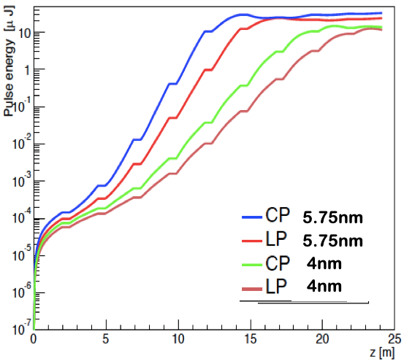
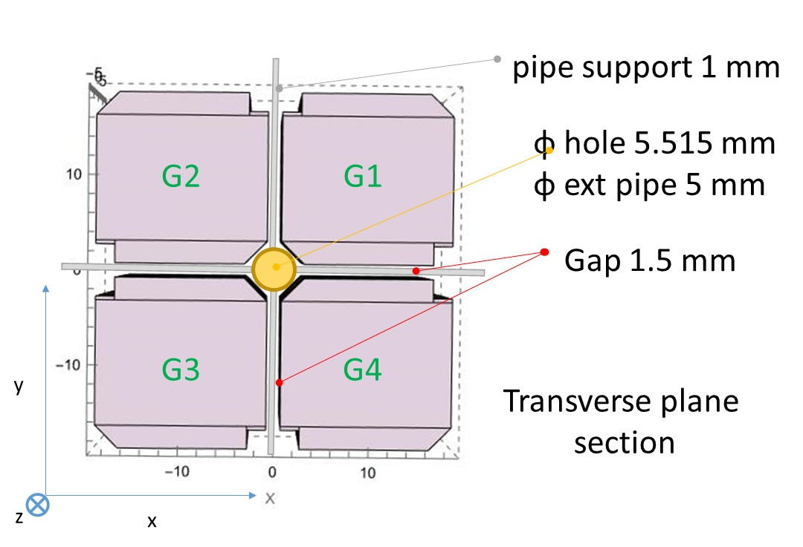
AQUA Apple-X undulator
EuPRAXIA@SPARC_LAB: FEL user facility @ λ ∼ 3-5 nm – water (AQUA in latin) window
- NdFeB
- Circ./Linear pol.
- λ_{u} 18 mm
- Br 1.35 T
- Min gap 1.5 mm
- 110 periods
- Kmax 1.15 (CP), 1.6 (LP)
- Length 2 m
- 10 modules
- out of vacuum
Mechanical structure issues can be learnt from experience with the SABINA Apple-X
Vacuum chamber structure to be decided accounting for wakefield effects on FEL performance
Magnetic errors distribution modelled from the SABINA undulator measurements
Both Apple-X undulators will be operating at INFN-LNF with the collaboration of ENEA-Frascati
Notes:
Please, state the main cutting-edge facility in your undulator lab (picture are welcome) and the main (public not confidential) development in your lab (preferably in written form)

Slide 4

Tak
Tack
Thanks
“ Foster open innovation for accelerator-based lightsources in Europe”
Bedankt
Dziękuję
Danke
Merci
Grazie
Gracias
https://leaps-initiative.eu
This project has received funding from the European Union´s Horizon 2020 research and innovation programme under grant agreement No. 101004728
شك

