Slide 1
SCU
Impact of Wakefields on FEL Performance
Neil Thompson
December 2019

Slide 2
Parameters
Parameter | Value
Undulator Type | Helical SCU
Period | 11 mm
aw | 0.7952
Module Length | 1.75 m
Inter-module Gap | 0.5 m
<β> | 5.4 m
Energy | 5.5 GeV
Energy Spread | 1e-4
Normalised Emittance | 0.2 mm-mrad
FEL Output Photon Energy | 16keV

Slide 3
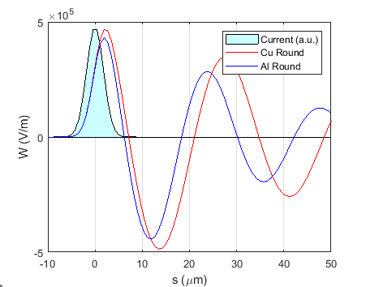
Wakefields
Calculated by Kiril Marinov, for a gaussian 75pC 6fs rms electron bunch.
  Full report here: here
  Bunch is so short that it is seen almost as a point charge.
  Reducing the bunch duration would have no effect on the wake
  Structure in the bunch profile would also not change the result compared to the gaussian bunch.
The part of the wake potential that overlaps with the FWHM centre of the bunch distribution is almost identical for Copper and Aluminium
For the FEL simulations have used the Aluminium wake for a round 4mm diameter vessel.

Slide 4
Genesis 1.3 Simulation results
Pulses shown at 20m
Taper is linear, magnitude of 0.5% over 30m
Only crudely optimised
Effect of wake is significant if uncorrected – 50% reduction in output pulse energy
Linear taper can recover pulse energy.
Bandwidth not significantly broadened.

