Slide 1
P219 Experiment at GSI-PHELIX : Proposal, Contributions and Planning
Experiment Kickoff Meeting
Online meeting - 11/12/2020
A. Bertarelli (CERN)

Slide 2
Outline
Introduction
Partners
Proposal
Some figures …
Simualations
Instrumentation
Open Questions
Tentative Timeline

Slide 3
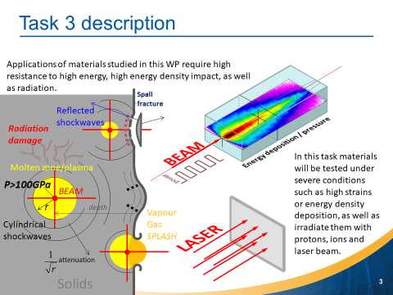
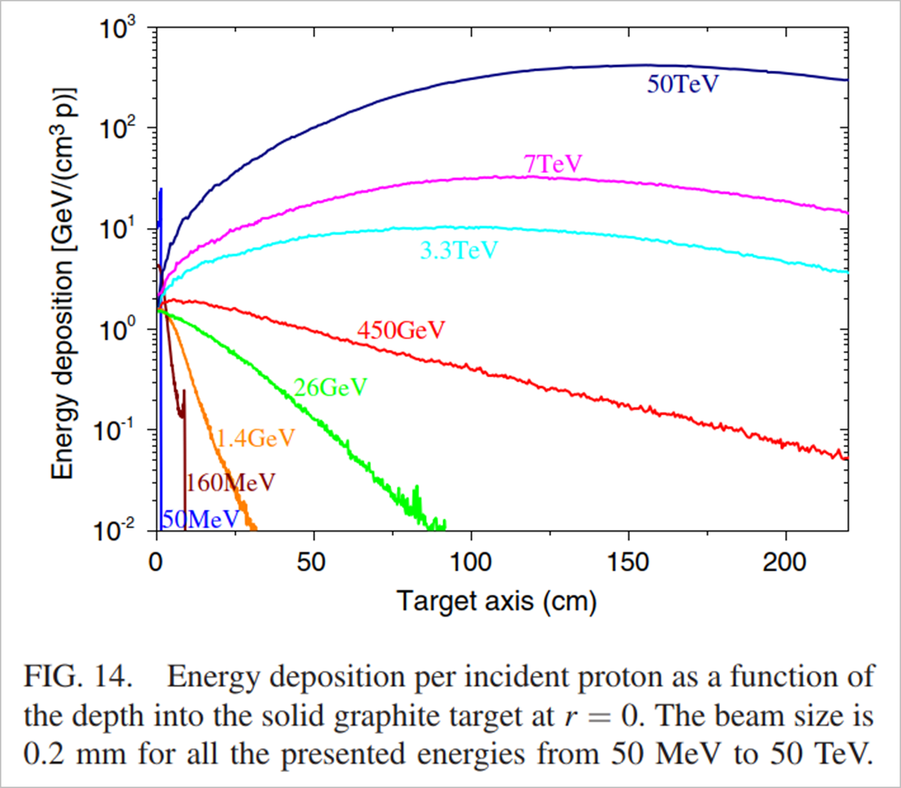
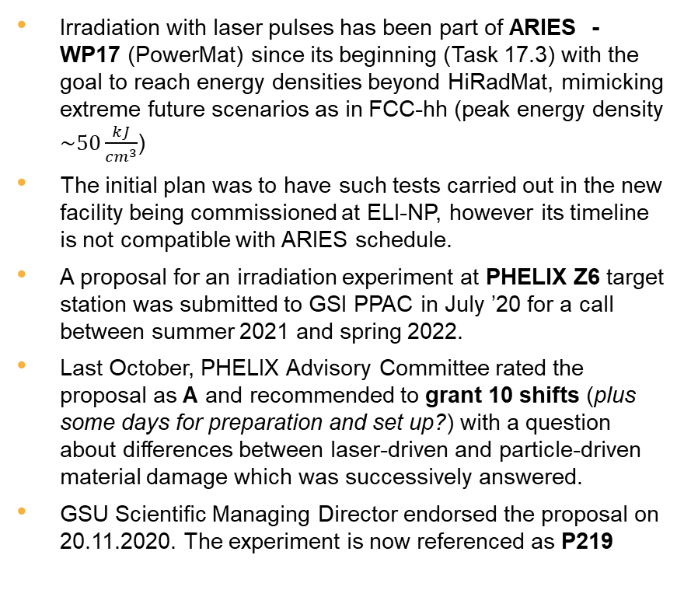
Introduction to Laser Irradiation Experiment
Irradiation with laser pulses has been part of ARIES - WP17 (PowerMat) since its beginning (Task 17.3) with the goal to reach energy densities beyond HiRadMat, mimicking extreme future scenarios as in FCC-hh (peak energy density $\sim 50\frac{kJ}{{cm}^{3}}$)
The initial plan was to have such tests carried out in the new facility being commissioned at ELI-NP, however its timeline is not compatible with ARIES schedule.
A proposal for an irradiation experiment at PHELIX Z6 target station was submitted to GSI PPAC in July ’20 for a call between summer 2021 and spring 2022.
Last October, PHELIX Advisory Committee rated the proposal as A and recommended to grant 10 shifts (plus some days for preparation and set up?) with a question about differences between laser-driven and particle-driven material damage which was successively answered.
GSU Scientific Managing Director endorsed the proposal on 20.11.2020. The experiment is now referenced as P219

Slide 4
Partners within ARIES and beyond …
WWU Münster
  Marilena Tomut – Principal Investigator
  PhD doctoral student?
GSI
  Dennis Schumacher – Local Contact Person
  Abel Blazevic
  Paul Neumayer
  Marilena Tomut
  Philipp Bolz
Politecnico di Torino
  Lorenzo Peroni
  Martina Scapin
ELI-NP
  Mihail Cernaianu
  Theodor Asavei
CERN
  Alessandro Bertarelli – Principal Investigator, Spokesperson
  Federico Carra
  Jorge Guardia Valenzuela
  Carlotta Accettura
  Michael Guinchard
  Oscar Sacristán de Frutos
Università di Roma “La Sapienza”
  Michele Pasquali
Other partners and participants may possibly join on the way …

Slide 5
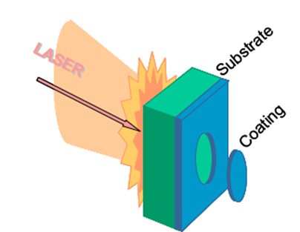
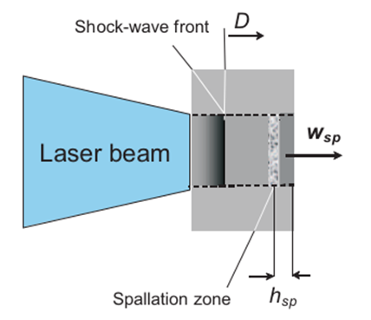
Experiment Proposal
The experiment aims at testing thin samples (disks or plates) of several materials under intense laser pulses:
  MoGr (several grades), CrGr (several grades), CFC, Graphite (several grades), CuCD, Carbon Foams … other materials also considered (e.g. bulk amorphous alloys, high entropy alloys)
  Reference targets (e.g. Al) to be foreseen for calibration purposes
  In-plane and through-plane orientation
  Back face may be coated (Mo, Cu) to probe thin film adhesion (LASAT – Laser Adhesion Test)
  In some cases, impact face may be Al coated to get rid of “messy” laser-plasma interaction and obtain a “clean” planar wave in substrate (need to be confirmed by simulations)
  Thickness varying from 0.25 mm to 2.5 mm
  Cross-section dimension 10÷20 mm
  In total ~40 specimens, including ~10 for set-up and calibration purposes (typically well-known metals as Al and/or Ta)
A strong shock wave will be generated in the impacted face, quickly decaying while moving towards the back face, possibly down to the acoustic regime (depending on sample thickness), but still strong enough to generate spallation near the back face

Slide 6
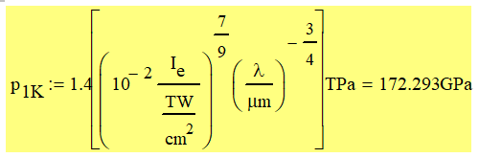
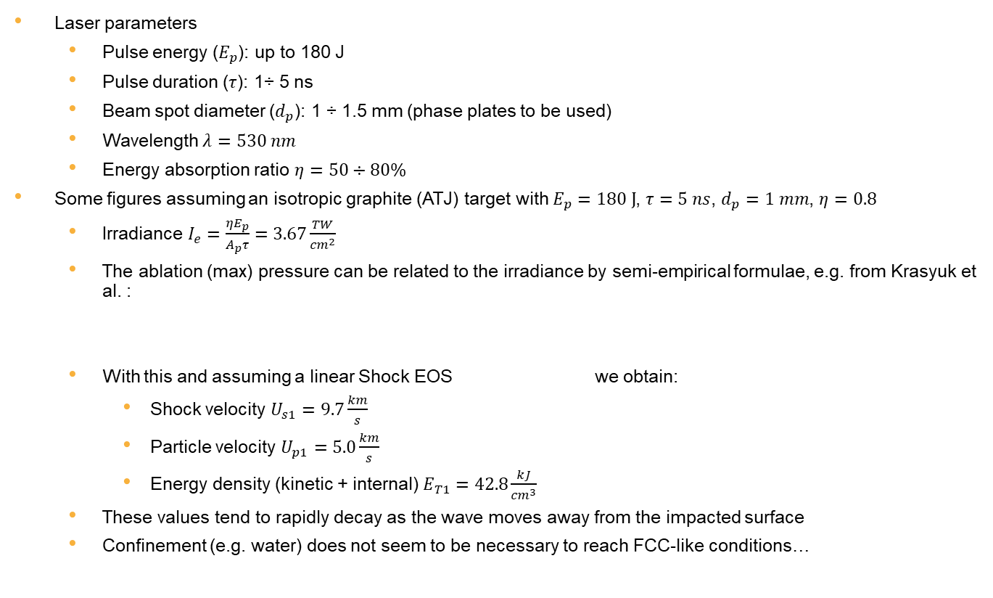
Some figures …
Laser parameters
  Pulse energy ($E_{p}$): up to 180 J
  Pulse duration ($τ$): 1÷ 5 ns
  Beam spot diameter ($d_{p}$): 1 ÷ 1.5 mm (phase plates to be used)
  Wavelength $λ=530 nm$
  Energy absorption ratio $η=50÷80\%$
Some figures assuming an isotropic graphite (ATJ) target with $E_{p}=180 J$, $τ=5 ns$, $d_{p}=1 mm$, $η=0.8$
  Irradiance $I_{e}=\frac{ηE_{p}}{A_{p}τ}=3.67\frac{TW}{{cm}^{2}}$
  The ablation (max) pressure can be related to the irradiance by semi-empirical formulae, e.g. from Krasyuk et al. :
  With this and assuming a linear Shock EOS we obtain:
    Shock velocity $U_{s1}=9.7\frac{km}{s}$
    Particle velocity $U_{p1}=5.0\frac{km}{s}$
    Energy density (kinetic + internal) $E_{T1}=42.8\frac{kJ}{{cm}^{3}}$
  These values tend to rapidly decay as the wave moves away from the impacted surface
  Confinement (e.g. water) does not seem to be necessary to reach FCC-like conditions…

Slide 7
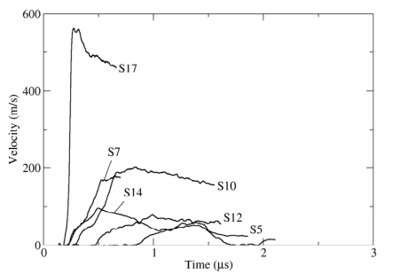
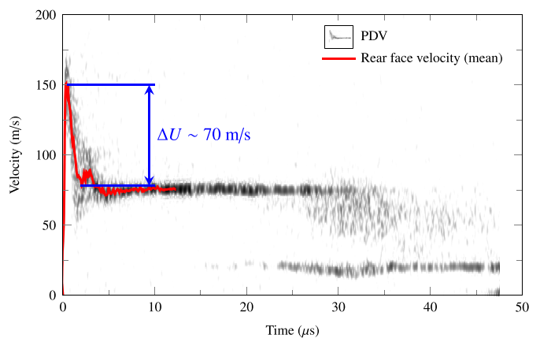
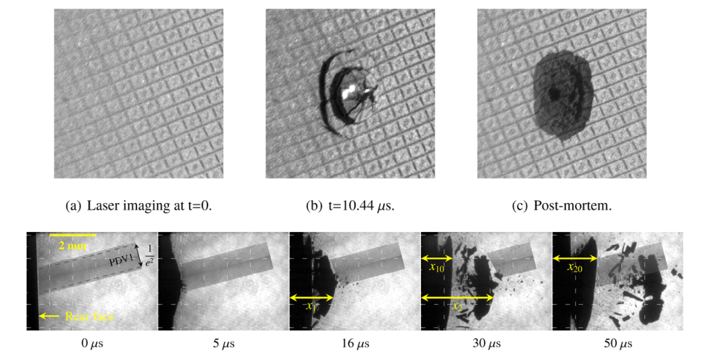
Experiment Diagnostics and PIE
The most important experimental information is the free surface velocity as a function of time. Through this parameter, a number of additional data and properties can be derived:
  Maximum pressure in spallation region
  Strain rate at back surface
  Material spall strength
  Coating dynamic adhesion strength
Online monitoring should focus on the behavior of back (free) surface.
  Free surface velocity acquired by VISAR and possibly LDV for thicker samples, where surface velocities are expected to decay below 100 m/s
  High speed photography of free surface (coated or uncoated) by High Speed Camera
Post Irradiation Examination shall complement online measurements
  SEM imaging of front and back surfaces
  Raman spectroscopy of affected regions
  Micro-tomography
  ….

Slide 8
Simulation Activities
Besides preliminary analytical estimations, simulations are necessary to predict the intensity, the profile and the time history of the response
A strong decay is expected in graphitic materials as the shock wave moves away from the impacted surface
Decay intensity is also function of the material (isotropic, orthotropic) and of the specimen thickness, tentatively 0.25 mm to 2.5 mm
A 1-D simulation is being performed at ELI-NP with HELIOS hydrodynamic code, initially using ATJ isotropic graphite
Numerical results shall allow to determine specimens thickness
When can we expect first results?
Is it possible to simulate anisotropic (i.e. MoGr, CFC, CrGr) materials?
Is it possible to simulate coatings (on one or both faces)?

Slide 9
Instrumentation List
Non-exhaustive list of possible experiment instrumentation
  GSI VISAR
  POLITO VISAR
  POLITO High Speed Camera
  CERN Laser Doppler Vibrometer
  Other instrumentation available at GSI?
Specifications of these devices to be collected

Slide 10
Open Questions
Are phase plates available?
Is the experimental vacuum chamber available at the facility? What are its dimensions? Is it compatible with the foreseen instrumentations (e.g. optical ports)? Can we get the drawings?
Is this instrumentation sufficient to acquire essential information?
Will all instrumentation be available at the time of experiment? For how long?
Does it require time-consuming calibration? How is synchronization working?
Do we have all skilled operators (e.g. for POLITO VISAR)?
What is the largest velocity which can be measured by CERN LDV?
Do we need pulse-laser illumination to support high-speed photography?
How long is the typical set-up time? One full week? Can we perform useful shots during set-up time?
Do we have enough time (80 hours) to perform all projected measurements?

Slide 11
Tentative Timeline
The experiment should be carried out before the end of WP17 (Dec. 21), i.e. late summer/early fall 2021.
My guess for experiment design and preparation:
  Nov. 20 – Feb. 21. Numerical simulations of the experiment for selected materials to select irradiation conditions and determining specimen dimensions. Who? ELI-NP (which tool?), with support from GSI, CERN (FLUKA?, Autodyn?), POLITO (LS-dyna?)
  Mar. 21 - May 21. Preparation of samples and experiment set-up
  Jun. 21 – Jul. 21. Pre-irradiation measurements and controls
  October 21. Experiment
  Nov. 21 – Feb. 22. Post-irradiation examinations and reports
October ‘21 seems an acceptable compromise between experiment timeline and personnel availability (e.g. avoid conflicts with University exam sessions …)
To be checked how to obtain Transnational support and what are the conditions and deadlines …
What are the conditions to “freeze” the experiment time window?

Slide 12
Thank you for your attention!

