Slide 1



Barium Extraction from Xe Gas and Identification for nEXO
Ba
Chris Chambers
Brunner Neutrino Lab
McGill University

Slide 2
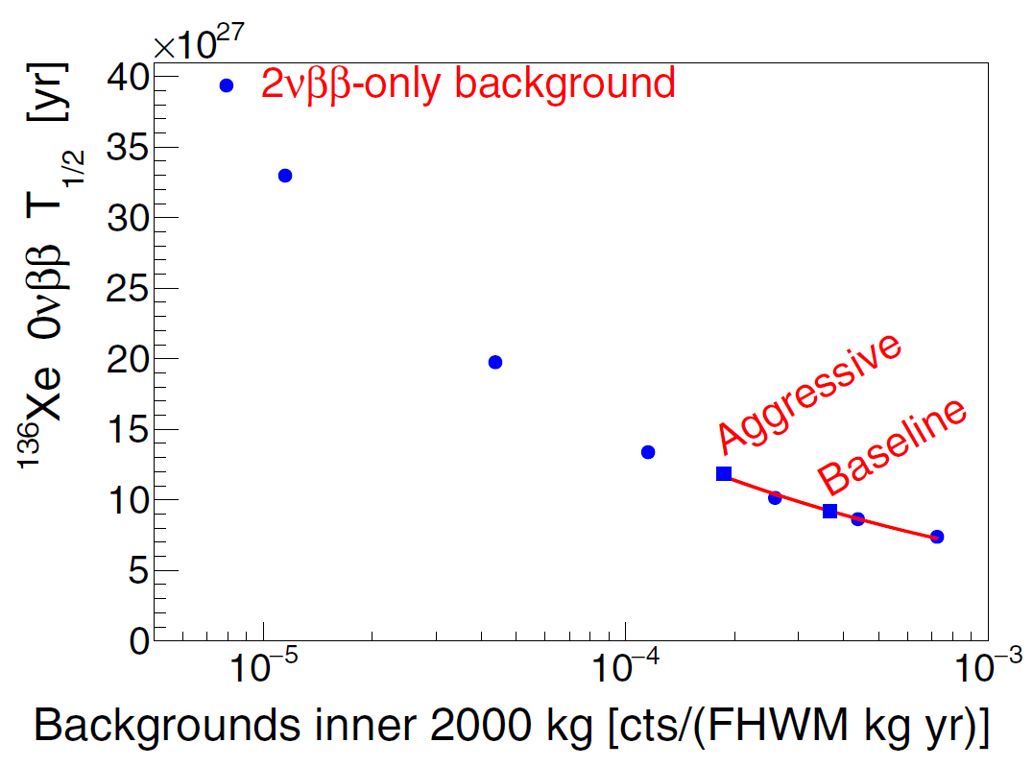
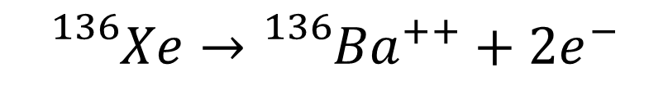
Barium Tagging as an upgrade to nEXO Experiment
nEXO Overview: Erica Caden, Session TS4-2
nEXO is a 0νββ search using a 5000kg liquid Xe TPC
100% Ba Tagging Efficiency
$${}_{}^{136}{Xe}→{}_{}^{136}{{Ba}^{++}+2e^{−}}$$
Barium Tagging: identify barium daughter at 0νββ decay site for complete background elimination
Advantages of Ba-Tagging:
Increases the projected sensitivity by factor of 3-4
Provides POSTITIVE signal of ββ decay
nEXO Collaboration
Phys. Rev. C 97, 065503 (2018)
Requires counting of single Ba daughter in macroscopic amount of Xe
Notes:
Erica Caden Overview Session TS4-2 (day before)

Slide 3
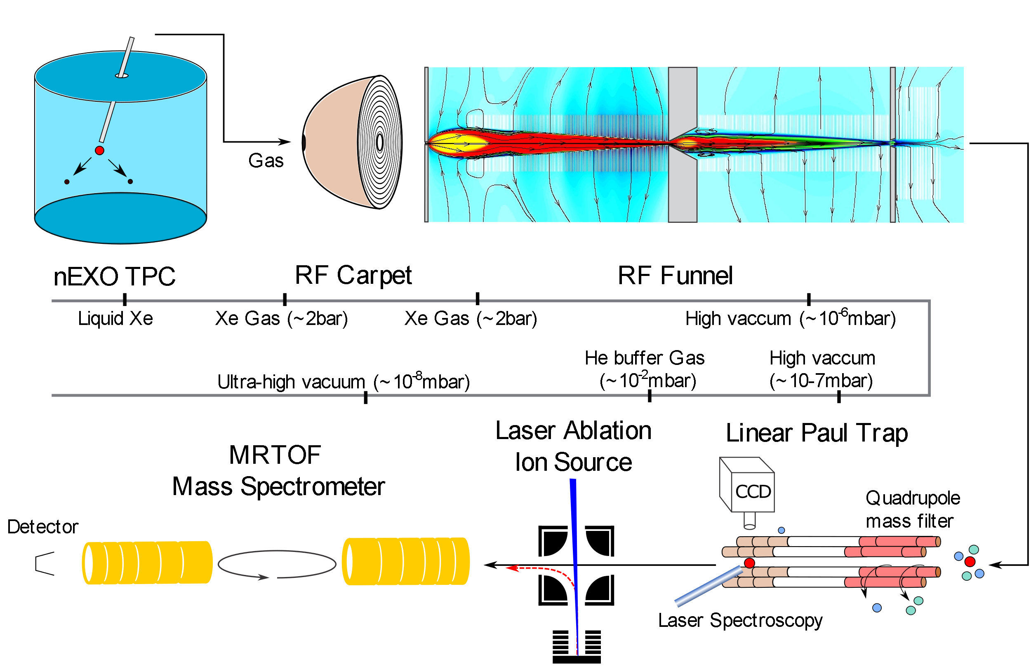
Canadian Ba Extraction and Tagging from Gas Xe
Stage2:
RF carpet for efficient transfer of ion from capillary to RF funnel
Stage1:
Extraction of detector volume around the location of the decay to gas phase using a capillary tube.
Stage3:
RF funnel facilitates separation of xenon accompanying the Barium ion.
Stage5:
Multiple Reflection TOF Spectrometer for systematic studies and determination of ion mass.
Stage4:
The Linear Paul trap for detection of barium ion via laser fluorescence
spectroscopy​.
Notes:
“Canadian Effort”
“Review of progress”

Slide 4
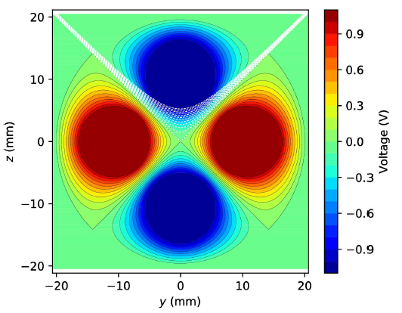
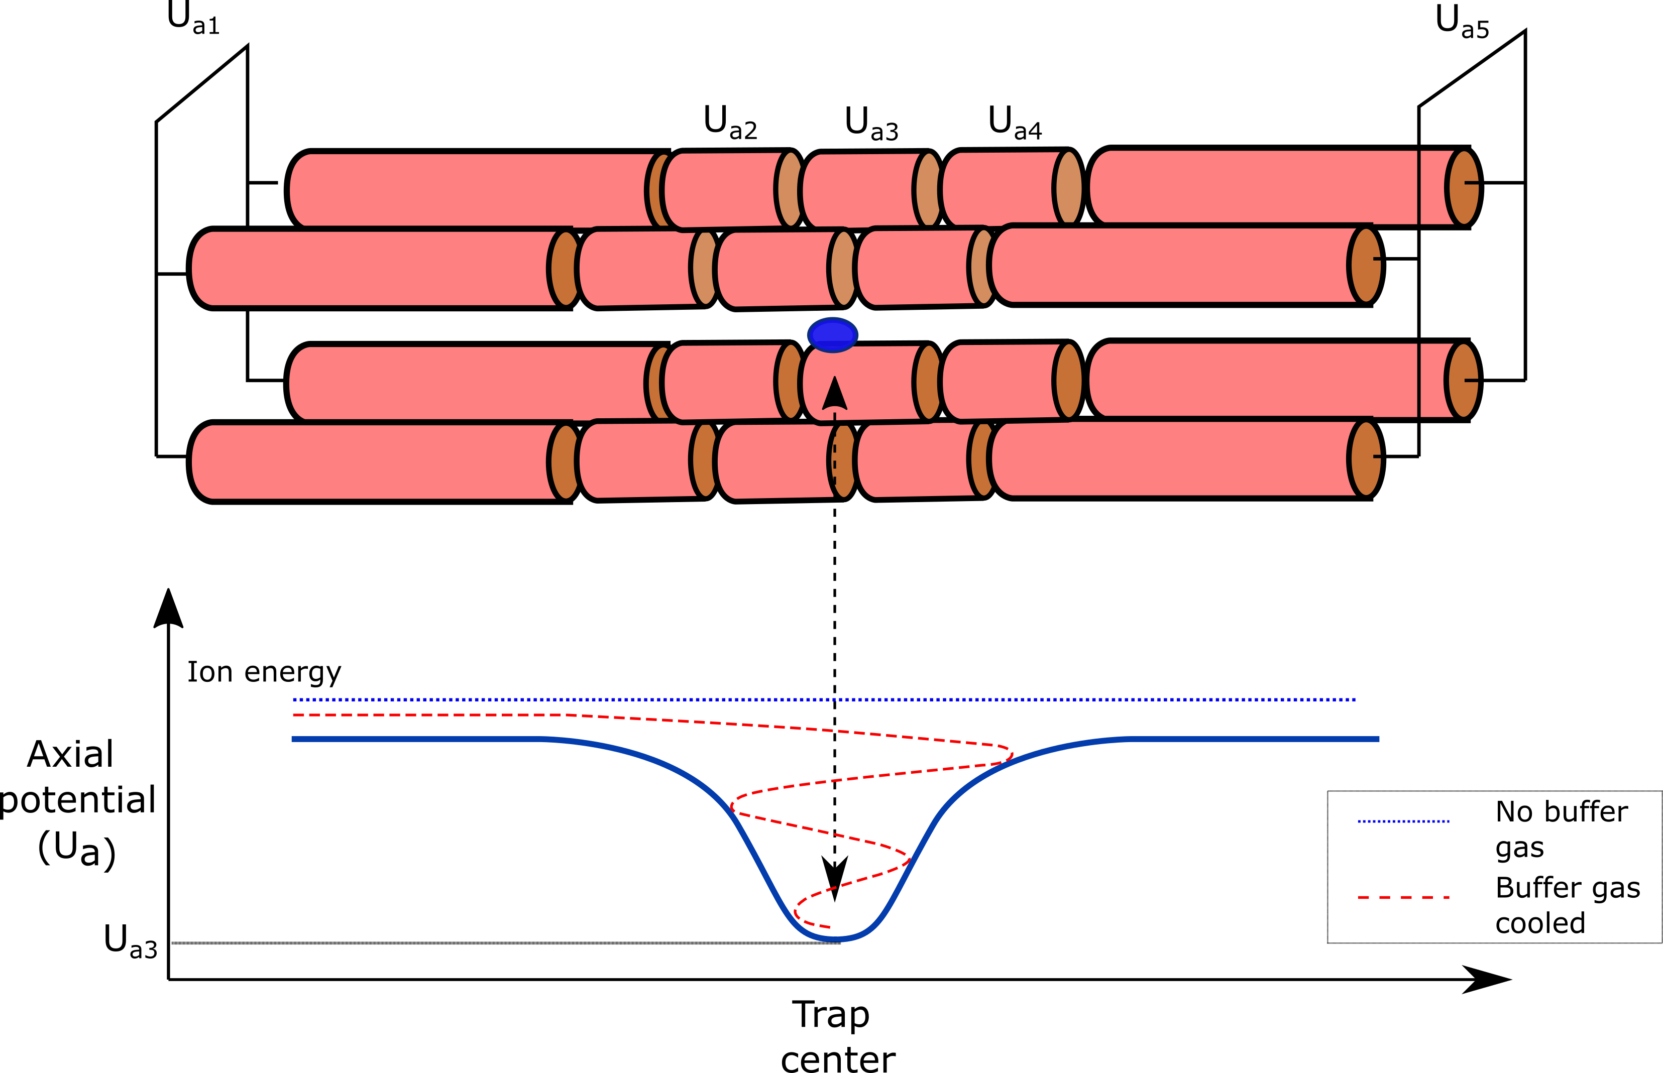
What is a Linear Paul Trap?
Design by Yang Lan @ TRIUMF
Construction by Hussain Rasiwala @ McGill
Retrieved from: PhD thesis, Y. Lan
DC electric field for directing and confining axial motion.
Quadrupolar potential
Radial confinement using radio-frequency (RF) potentials

Slide 5
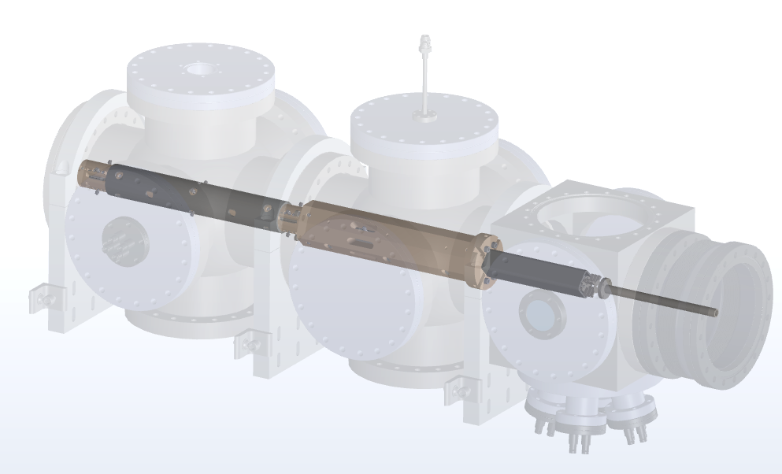
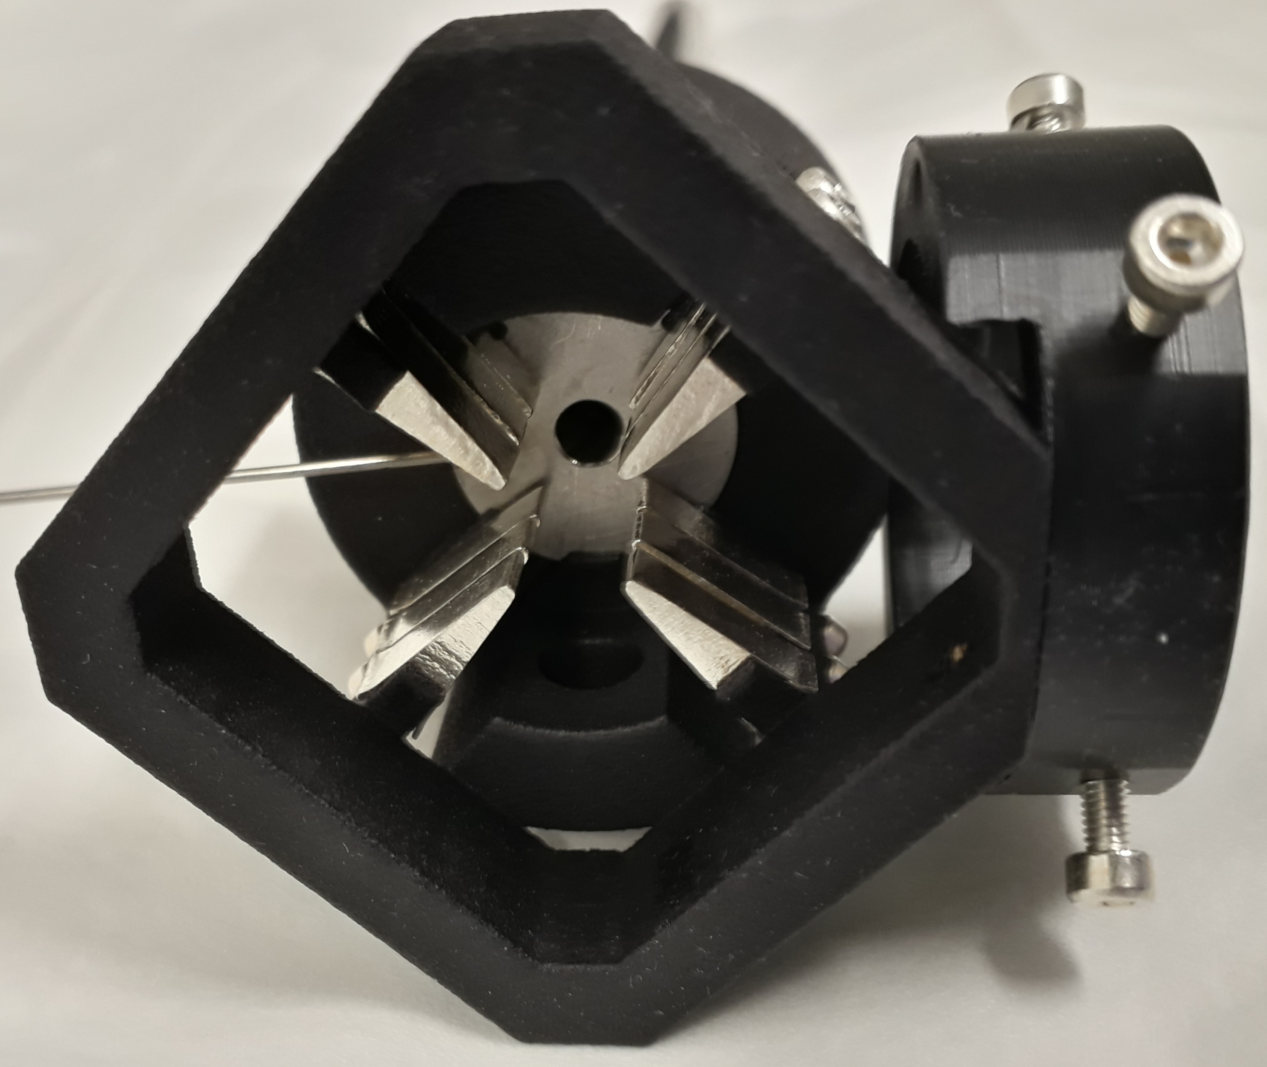
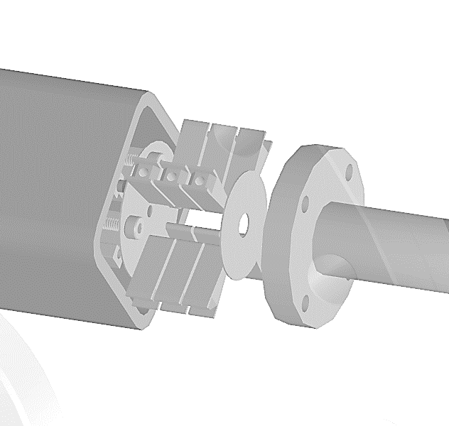
Linear Paul trap for Ba-tagging
Design by Yang Lan @ TRIUMF
Construction by Hussain Rasiwala @ McGill
QMF
Precooler
Ion injection
Cooler
Ion bunch
Ion bunch
To MR-TOF
Laser
Custom designed for Barium tagging
Composed of a quadrupole mass filter (QMF), precooler, cooler and an ion buncher.
Ion bunch
To MR-TOF
Trap/
Buncher
Laser

Slide 6
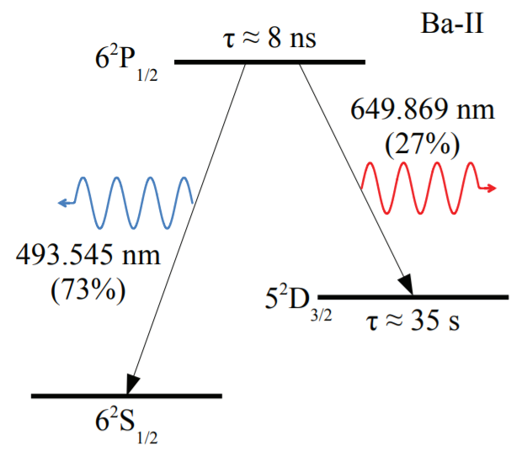
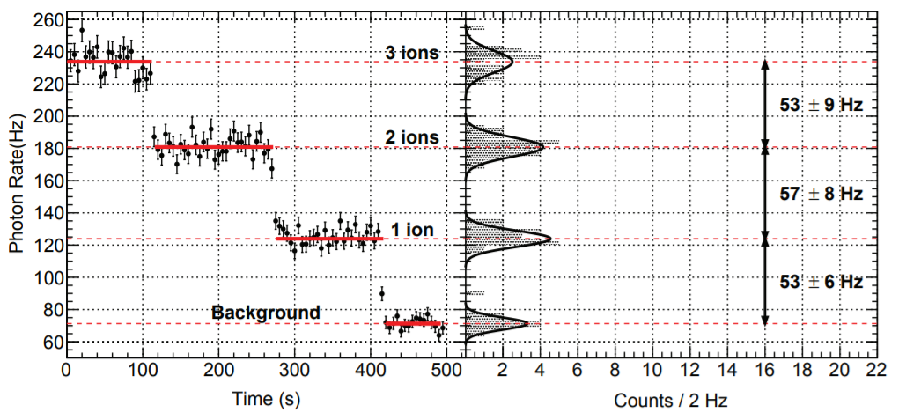
Single Barium ion detection
Matthew Green @ Stanford
Ryan Killick @ Carleton University
Retrieved from: PhD thesis, Ryan Killick (Carleton University)
Uses ion trap for confining ions and laser induced fluorescence for barium ion detection.
Single ion detection has been demonstrated by collaborators at Carleton University.
Demonstrated first by M. Green et. al by studying 493nm florescence intensity from single barium ion.
M.Green, et al., Phys.Rev.A 76 (2007) 023404

Slide 7
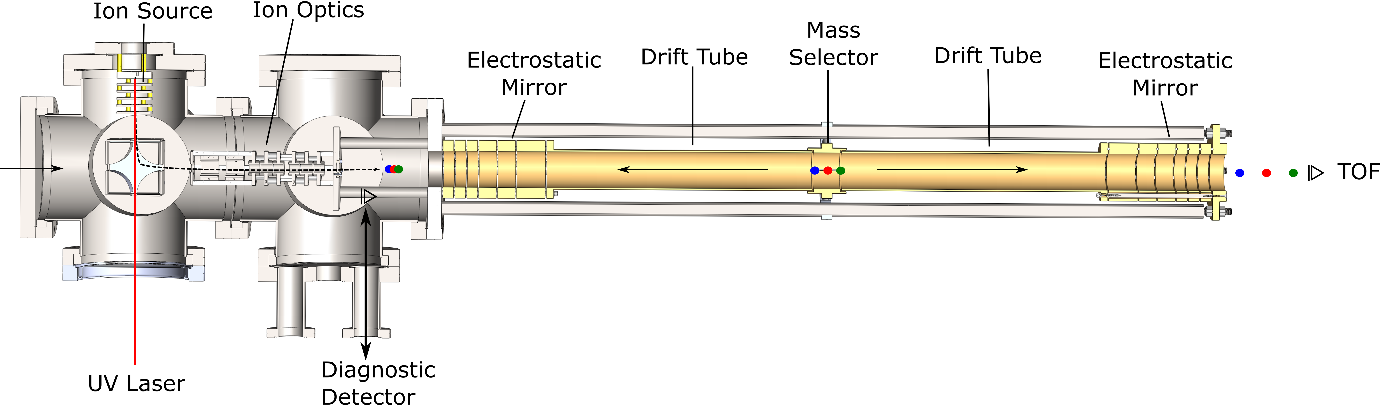
What is an MRTOF?
Design and Construction by Kevin Murray
@ McGill
Operating Principle
Ions accelerated by potential gain kinetic energy
Ions with different mass-to-charge separate in time, and can be resolved
Design
Consists of central drift-tube and 2 electrostatic mirrors formed by 6 cylindrical electrodes.
Ions are reflected between the mirrors to dramatically increase the MRP.
Goals
Perform systematic studies of the Ba-tagging extraction technique. (What ion species are present in the LPT?)
Confirm the isotope of barium identified in the LPT. (Was it really ¹³⁶Ba in the LPT?)
LPT
MR TOF
LAS

Slide 8
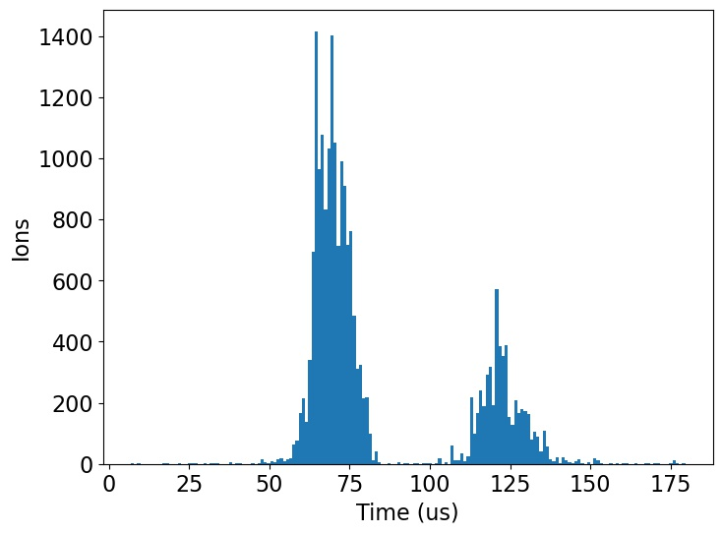
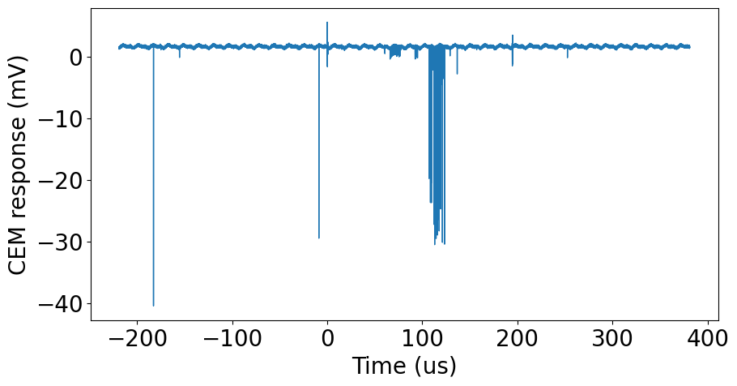
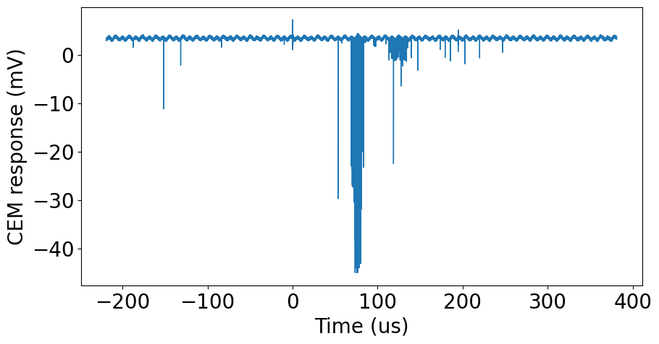
MRTOF First Ions – No Reflections
Data by Kevin Murray
@ McGill
Time of Flight Spectrum
Example Raw Waveforms
Preliminary
Copper
Gold
Single ion signal is approx. 2 mV

Slide 9
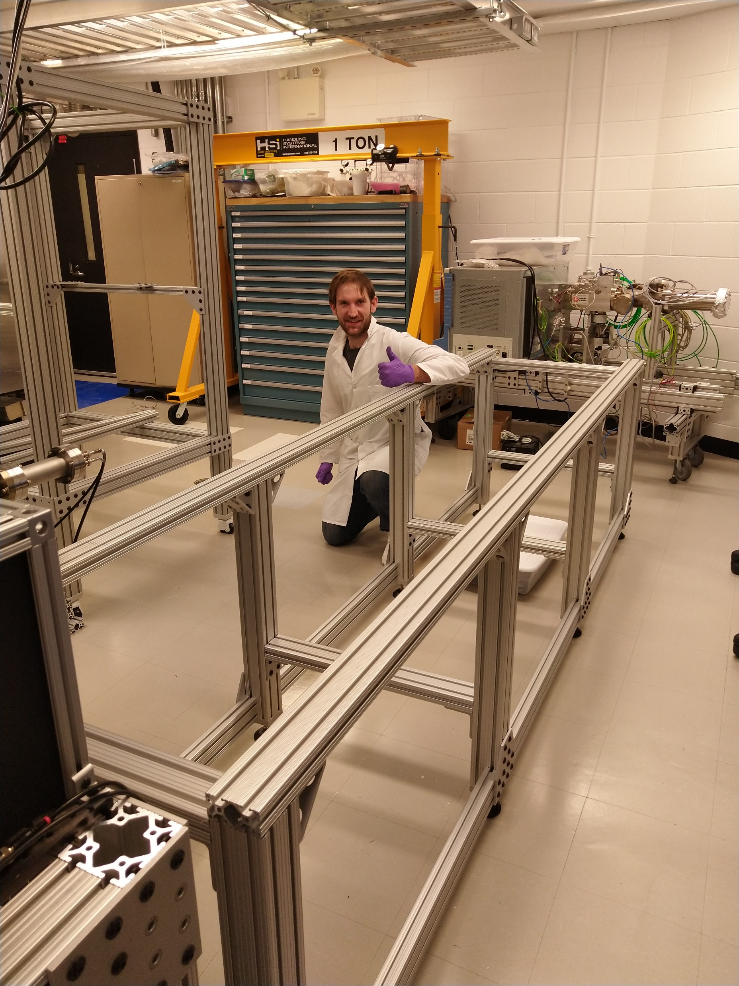
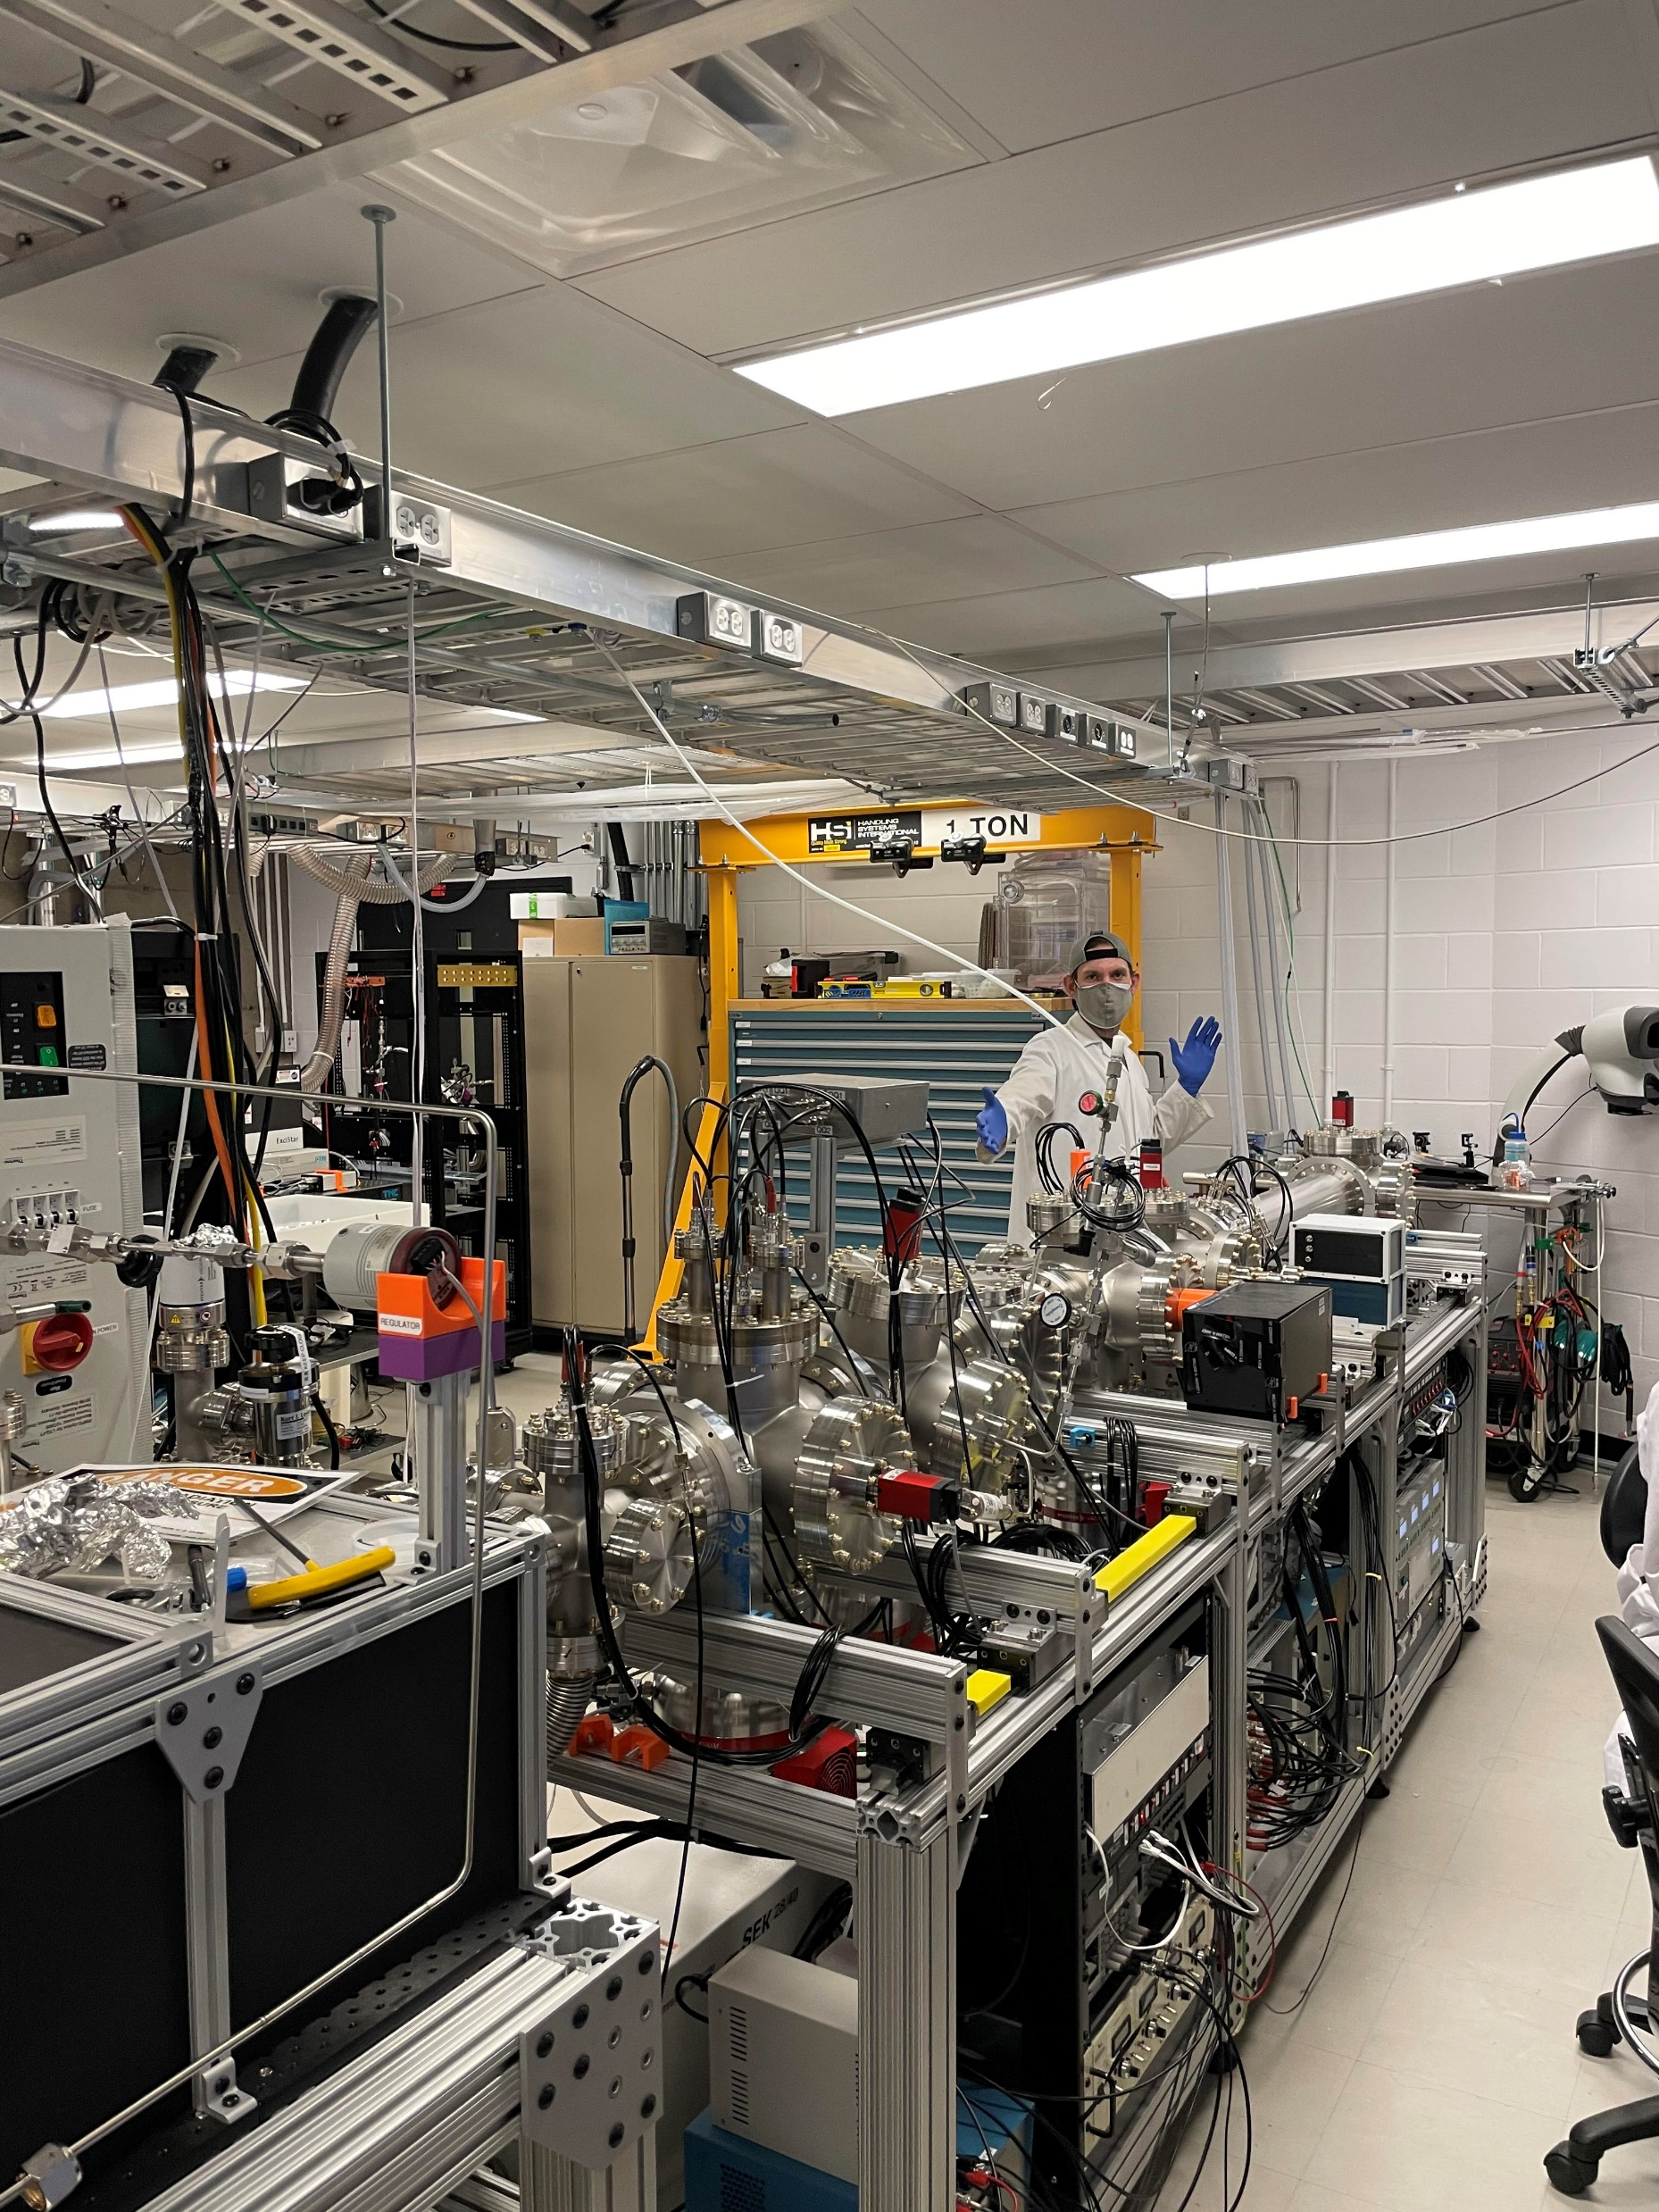
Lab Progress
18 months
Dec 2019
Jun 2021
Notes:
Dec 2019

Slide 10
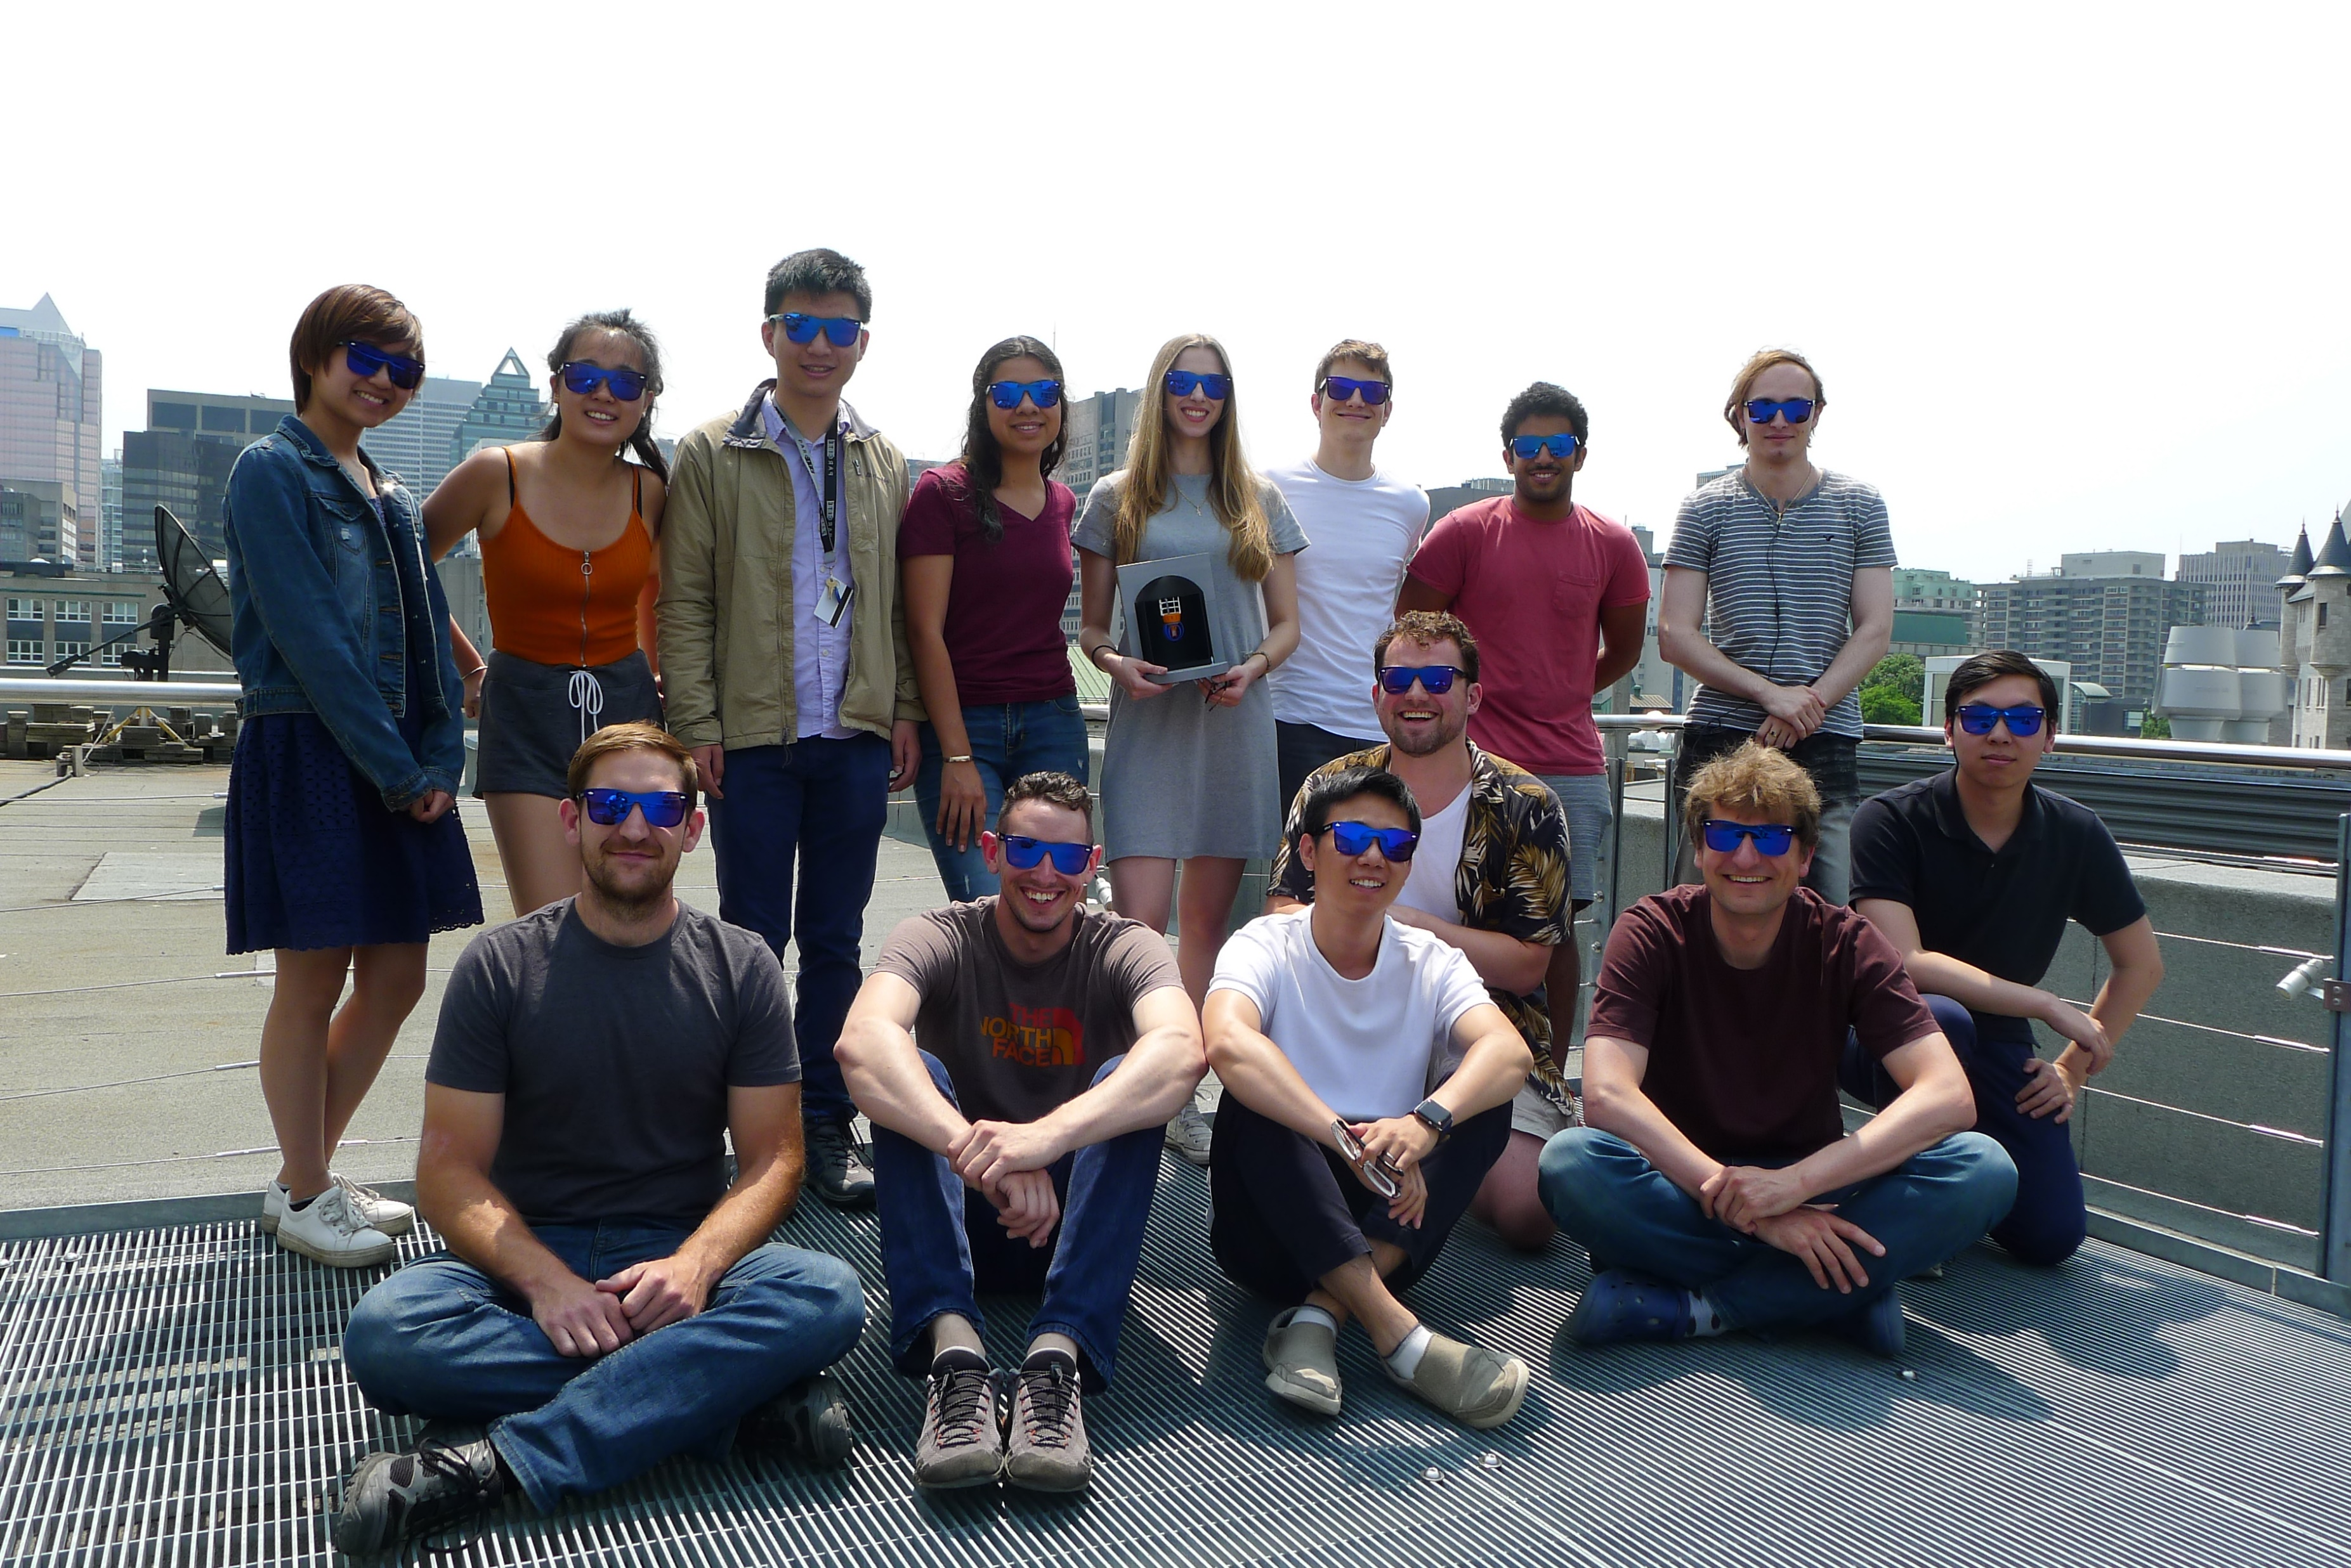

The nEXO Collaboration
McGill Experimental Neutrino Group
> 200 scientists worldwide!
Summer 2019

