Slide 1
A universal holographic wavefunction for hadrons
Ruben Sandapen
June, 2021
CAP Virtual Congress

Slide 2
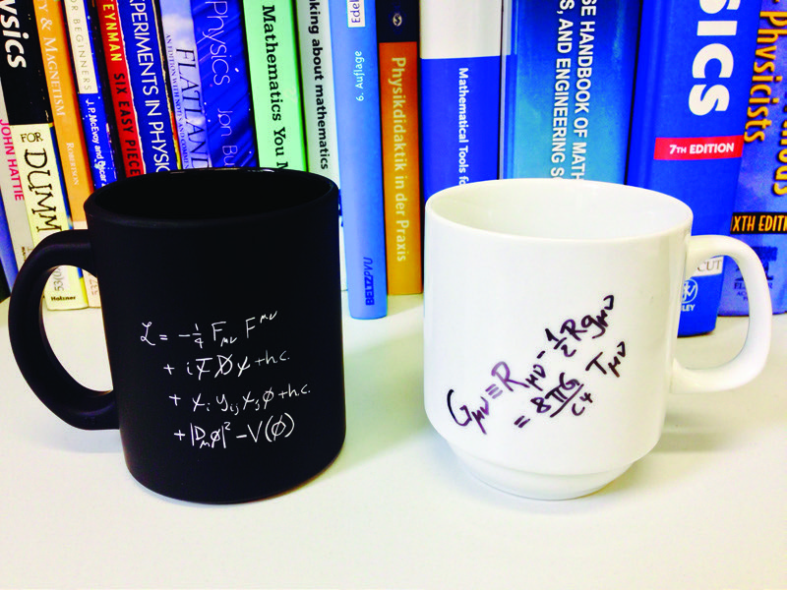
Standard Model and General Relativity
Higgs boson: 1964
Discovery: 2012 at LHC
Gravity waves: 1915
Discovery: 2016 at LIGO
Gravity: Einstein’s General Relativity
Strong, weak and EM interactions: Standard Model
GR seems incompatible with SM
Caveat: in same number of spacetime dimensions

Slide 3
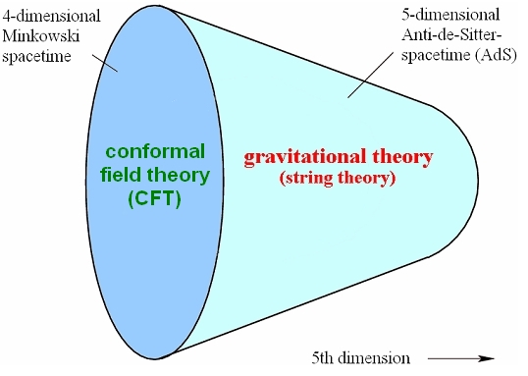
The holographic principle
Maldacena: AdS=CFT
Conformal Field Theory in 4-dim spacetime dual to string theory in higher dimensional curved spacetime
AdS₅ metric
Weak-strong duality
Conformal symmetry implies scale invariance: no mass scale in theory
When CFT is strongly coupled, gravity dual is weakly coupled and vice-versa

Slide 4



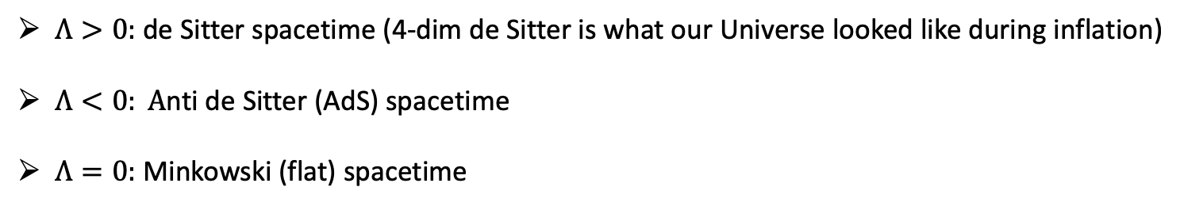
Anti de Sitter spacetime
$G_{μυ}+Λg_{μυ}$=$\frac{8πG}{c^{4}}T_{μυ}$
Cosmological constant: $Λ$
spacetime geometry
matter-energy
$$T_{μυ}=0$$
$Λ>0:$de Sitter spacetime (4-dim de Sitter is what our Universe looked like during inflation)
$Λ<0: A$nti de Sitter (AdS) spacetime
$Λ=0:$ Minkowski (flat) spacetime

Slide 5
Quantum Chromodynamics
QCD: Exact SU(3) gauge symmetry
Quarks and gluons have color charge
Quarks interact by exchanging gluons
Gluons interact by exchanging gluons
QCD is part of the SM and is the theory for the strong interaction

Slide 6
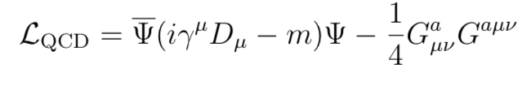
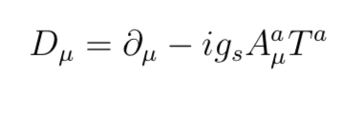

Asymptotic freedom to confinement
Nobel Prize 2004 (Politzer, Gross, Wilczek)
Weak coupling (asymptotic freedom): perturbation theory is very successful
Strong coupling (confinement): perturbation theory fails, no exact solutions
Open problem

Slide 7
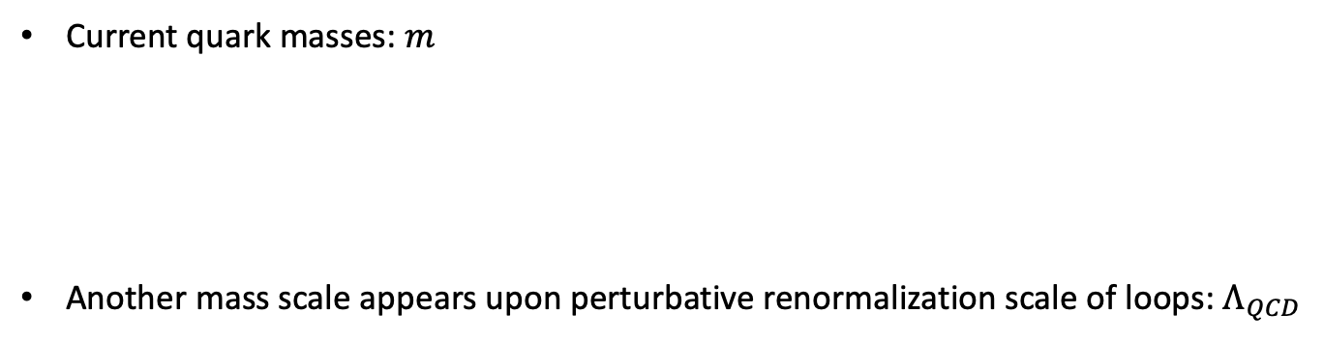
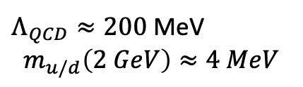
QCD has an underlying conformal symmetry
Current quark mass
Current quark masses: $m$
Another mass scale appears upon perturbative renormalization scale of loops: $Λ_{QCD}$
$Λ_{QCD}≈200$ MeV
$$m_{u/d}\left(2 GeV\right)≈4 MeV$$
Massless quarks: chiral symmetry
Massless quarks and no loops: conformal symmetry

Slide 8
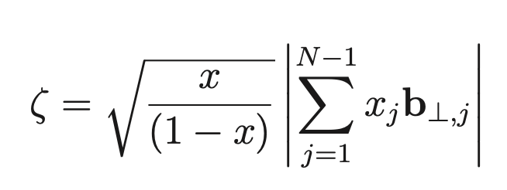
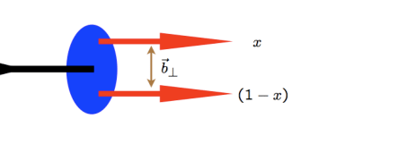
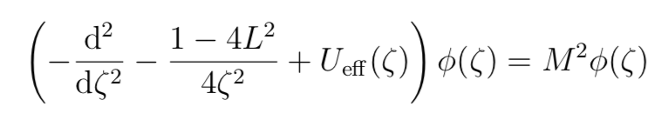
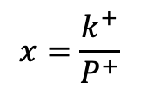

Light-front QCD
Ordinary time
Light-front time
$$x^{+}=x^{0}+x^{3}$$
LF Schrodinger-like Equation in the conformal limit
$$x=\frac{k^{+}}{P^{+}}$$

Slide 9
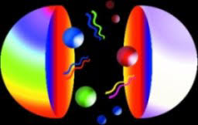


Holographic dictionary
Light front transverse distance maps onto 5th dimension of AdS
$$ζ↔z_{5}$$
(Orbital angular momentum)² maps onto (AdS mass parameter x radius)² and spin
$$L^{2}={(μR)}^{2}+{(2−J)}^{2}$$

Slide 10
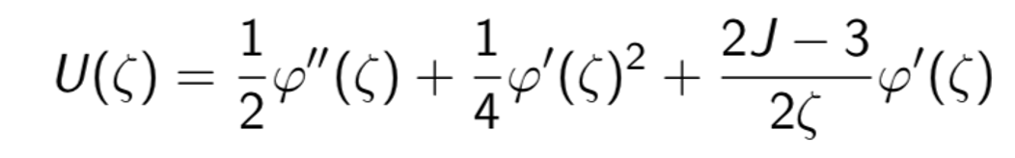

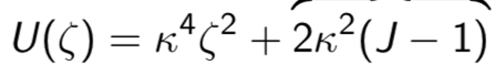

Unique confinement potential
The dilaton field distorts the pure AdS geometry and drives confinement in physical spacetime
Underlying conformal symmetry requires the dilaton to be quadratic
The confinement potential is uniquely fixed by conformal symmetry and holographic mapping
$κ$: emerging mass scale !

Slide 11
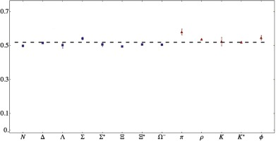

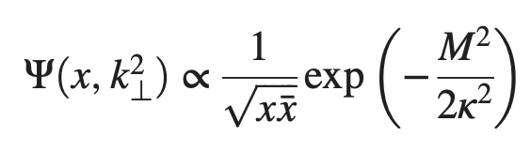


A universal holographic mass scale
Brodsky, de Teramond, Dosch, Lorce (2013)
Universal holographic wavefunction for ground state
Fourier conjugate to $ζ$

Slide 12
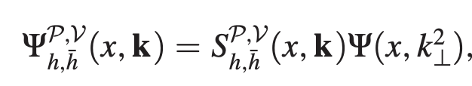
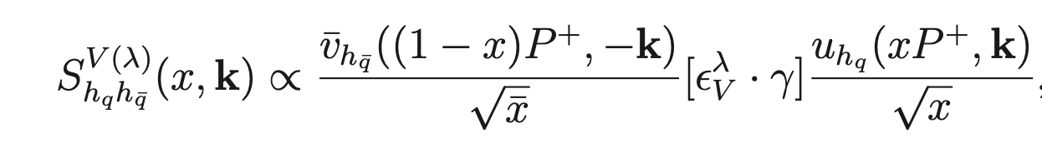
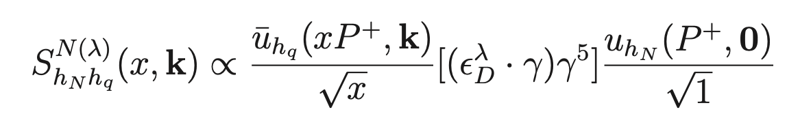
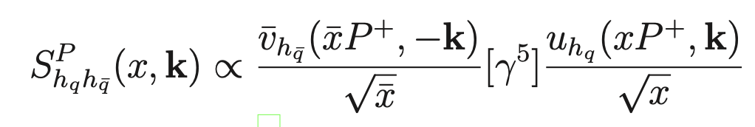
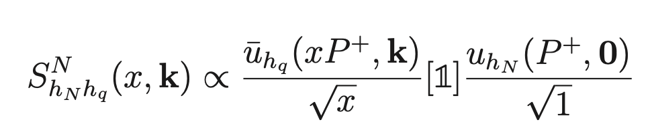
Quark masses and spins
For a successful phenomenology, we need to account for dynamical effects of quark masses and spins
Mesons (quark-antiquark)
Nucleons (quark-diquark)

Slide 13
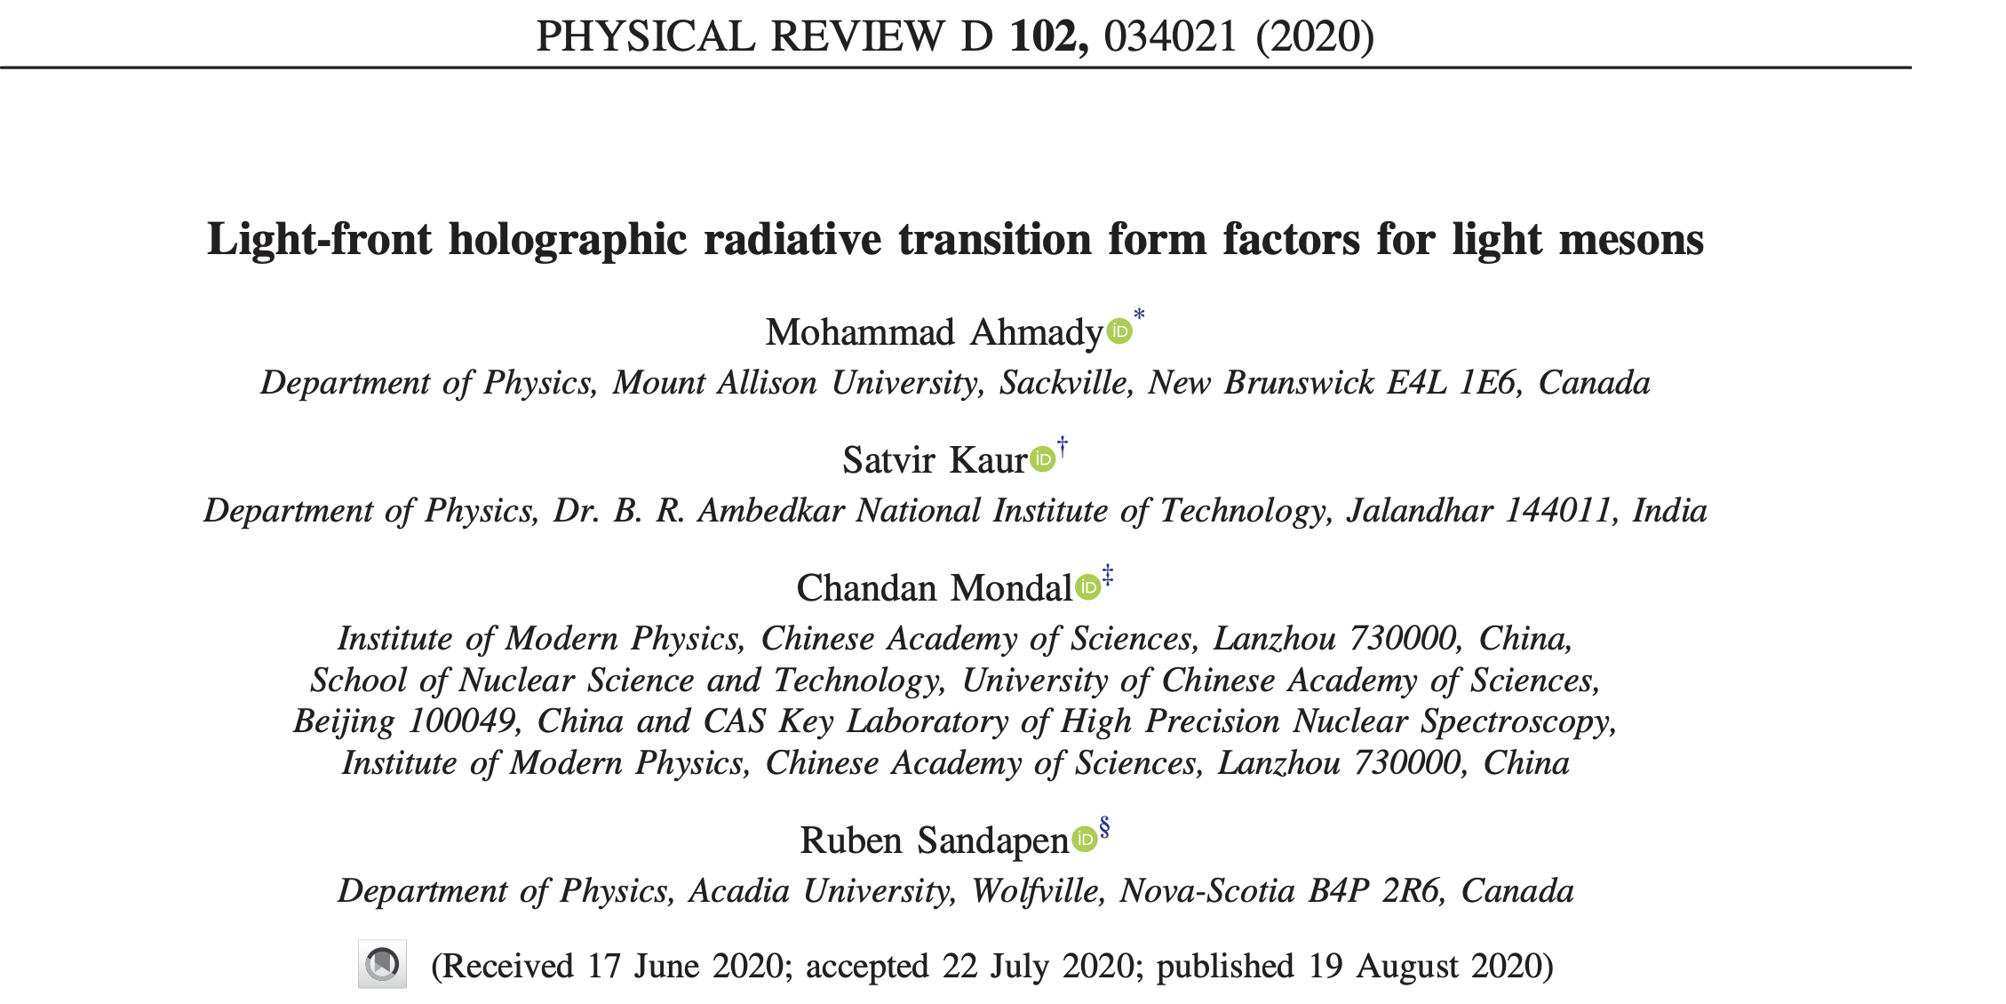
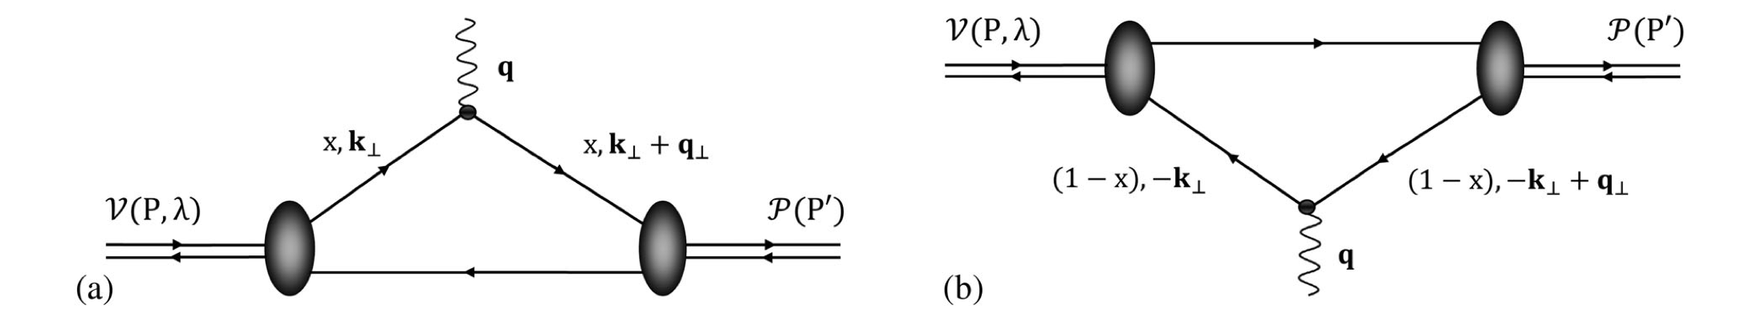

EM transition form factors
$$V→P+γ^{∗}$$

Slide 14
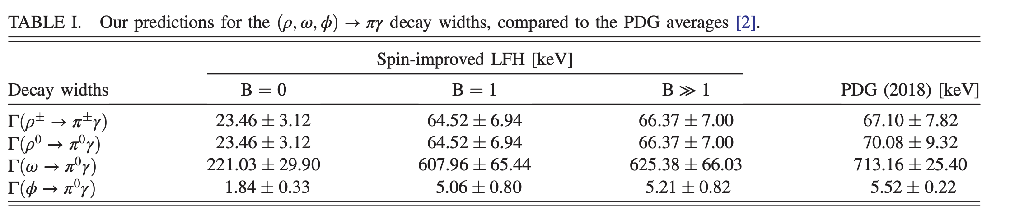
Predictions for radiative decay widths

Slide 15
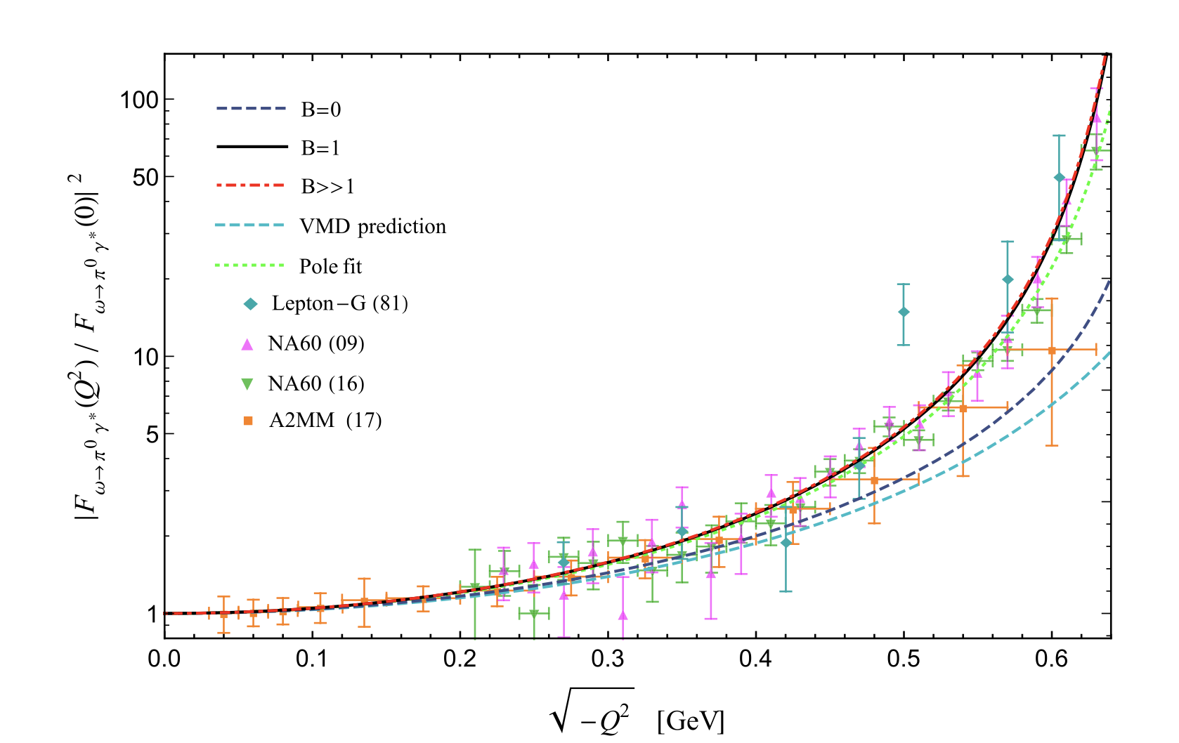
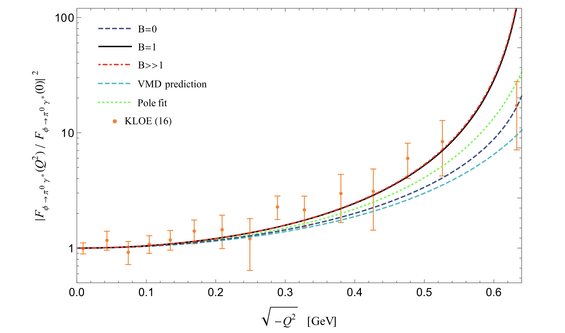


Predictions for the transition form factors
$$ω→π+γ^{∗}$$
$$φ→π+γ^{∗}$$

Slide 16
Nucleon EM elastic form factors
M. Ahmady, D. Chakraborti, C. Mondal, R. Sandapen, E-print: 2105.02213 [hep-ph]
Excellent agreement at low momentum transfer
Large uncertainties for neutron where LO contributions tend to cancel out

Slide 17
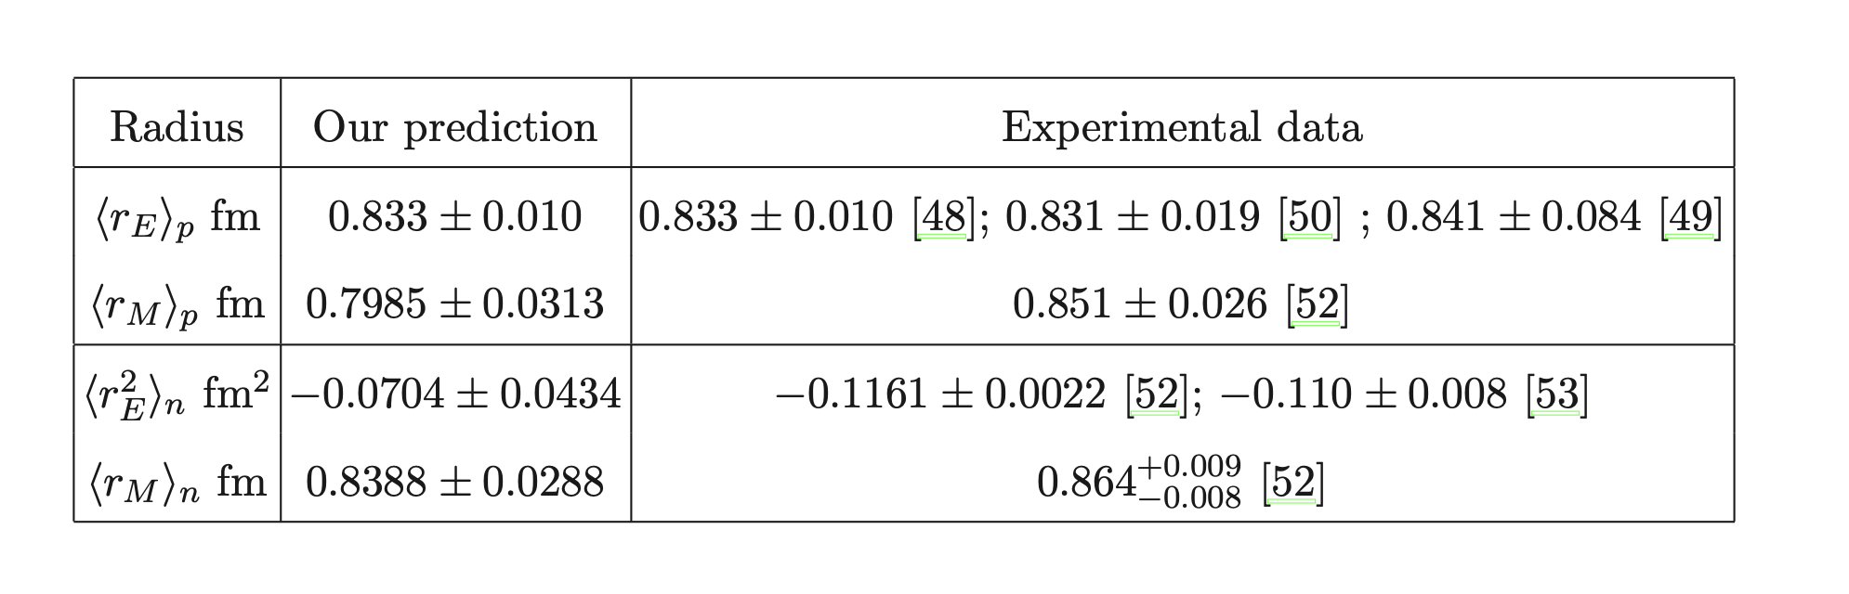
Predictions for the EM radii of nucleons

Slide 18

Conclusions & Acknowledgements
Light hadrons share a universal holographic wavefunction which is modified differently by their spin structures
Thanks to
Collaborators: M. Ahmady, D. Chakraborti, S. Kaur, C. Mondal
NSERC and Acadia University for funding

