Slide 1
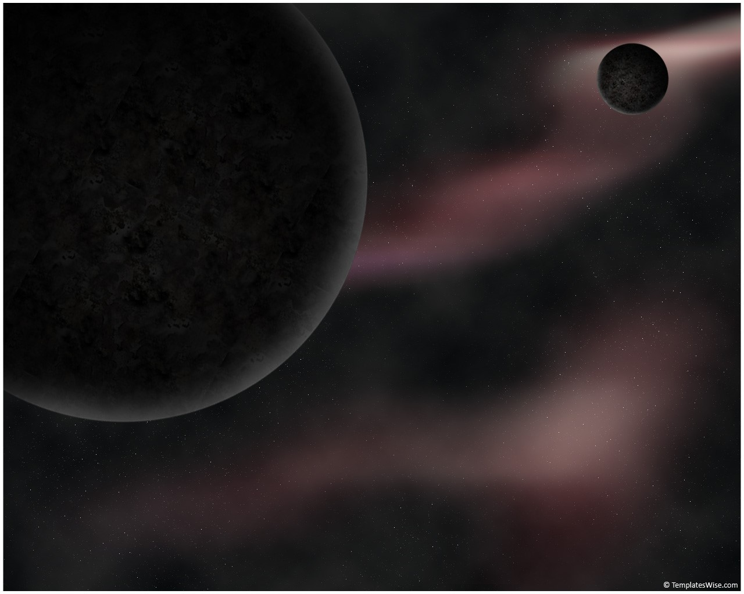

McDonald Institute Update
Tony Noble
Queen’s University Physics
Situated on traditional Anishinaabe and Haudenosaunee territory.

Slide 2















A partnership of 8 Universities and 5 institutes, the McDonald Institute is a globally recognized centre for research and learning, coalescing Canadian and international expertise in underground particle astrophysics and benefitting from the unique SNOLAB facility to deliver world-leading science focused on the big questions in particle astrophysics, cosmology and astronomy.
Supported by a $64M Canada First Research Excellence Fund 2016 - 2023

Slide 3
Current Status & Expected Timeline
Completed “Midterm Review” February 23,24, 25 2021(which was delayed by about a year due to Covid). Good feedback during session from excellent review committee. We expect full report during the summer. Indications are very favourable for continued operations with no funding decrease. Based on informal feedback, we expect comments to focus on increased effort in internationalization, and greater effort in remaining recruitment to assist with advancing EDII over the remainder of the term. Many thanks to the efforts of the community to contribute to the midterm review.
Fully Operational with 15 active faculty members hired across Canada. Currently contributing to the direct costs of research at about 10M$/a.
~150 HQP receiving support through transfers to partner institutions or through our competitive “pooled resources competitions”
Pooled resources for HQP more or less tapped out. These support M.Sc, Ph.D and postdocs at any institution in Canada, but with an end date to CFREF funding of August 2023, these generally need to be all filled by Sept 2021.
Still running several “High risk, High Reward” Frontier Research Venture Fund awards, and expect to one or two more competitions yet.
Travel and Conference awards on hold during pandemic. Anticipate new competitions once stable conditions exist again. People should be thinking about these and be prepared to apply when programs are launched.

Slide 4
Expected Timeline
End of Funding transfers from CFREF August 2023 … that’s only 2 years from now.
All faculty transitioned to host Universities by August 2023 …. And onto NSERC funding
One year to wrap up spending. August 2024
CFREF has announced the possibility of a two year “no cost extension” in order to reach key performance metrics, have sufficient time to spend the funds, and deliver on the science program. We will need little if any of this time as:
  Our budget is dominated by salaries of persons already in place, so covid has had a very minor impact on the budget
  Our scientists are very active in leadership positions across Canada …. The science is being delivered.
  We will have met all our KPI’s by the end of the granting period.
Meanwhile …. At Queen’s University we are working towards approval of the McDonald Institute as a Tier 1 Research Institute at Queen’s. (the Senate Advisory Research Committee has recommended it, to be ratified by Senate in next sitting). Assuming this is ratified by Senate, this will receive some support, but no where near the ~10 M$ current annual budget.
As the CFREF activities wind down, we expect to be ramping up/transferring operations to the McDonald Institute at Queen’s. The new Institute will have a new governance model.

Slide 5
Aug-16 | Aug-17 | Aug-18 | Aug-19 | Aug-20 | Aug-21 | Aug-22 | Aug-23 | Aug-24 | Aug-25 | Aug-26
Partners CFREF
 |  |  |  |  |  |  |  | Wind-down
Queen’s CFREF
Start |  |  |  |  |  |  |  | No cost extension |  | Wind-down
MI at Queen’s | MI at Queen’s
 |  |  |  |  | Ramping Up |  |  | Full Operations
End of Funding Date
Anticipated Partners Latest Spending Date
Anticipated CFREF end of Spending Date

Slide 6
Some Key Updates
Stricter lock-down across Ontario, inability for any substantive travel to/from Sudbury. Currently rely completely on local personnel, which is actually becoming increasingly challenging. This has made progress on experimental side somewhat slow …. But theorists going full blast!
Laurentian restructuring has led to the disappearance of the physics department. With good will and effort from the LU VPR, and financial support through SNOLAB and the McDonald Institute, a way has been found to maintain the scientific activities of the local LU groups …. Critical to the operation of the experiments.
  Ways have been found for short term support (~1 year) for the faculty, and an arrangement has been made with NSERC such that they may still use their research grants in support of students and direct costs of research.
  Mi and NSERC supported students and technical staff all protected as of now.
  Still a lot of balls in play as the previous LU personnel seek and find longer term positions.
Miners at VALE (the mine hosting SNOLAB) are now on strike (since the first of June). We are hopeful this will be a short strike, but the last one lasted a full year. Normally, SNOLAB works as a neutral third party to arrange for access through the picket lines after a few weeks, but this is a delicate operation, and access to the underground will still be very limited. As of last night, it looks like some limited access may be possible next week !

Slide 7
Other news
Three more MI Faculty at Queen’s successful on their their NSERC grant applications (more on the implications of this later)
Very successful CAPSS (undergraduate summer school just completed a week ago) remotely. Hosted by MI and SNOLAB
Graduate Instrumentation school (GRIDS) previously held at TRIUMF as a joint effort between MI and TRIUMF was cancelled this summer due to travel restrictions/covid and the need for this to be a hands on in person activity.
Lots of education and outreach programming still ongoing. I encourage all to check out our website of events, and encourage all HQP to participate in the Professional Development and Learning programming. This was highly appreciated and very successful the past summer.
Be on the lookout for upcoming announcements on:
  Ongoing long range planning exercise. Moving from the white paper (describing the current state of the field in Canada) to more active planning. How to realize the ambitions with the resources that may be attained. We imagine topical workshops on dark matter, neutrinoless double beta decay, etc to better inform the community on the respective science reach, challenges, advantages, synergies, required collaboration building, opportunities etc.
  The upcoming MI National meeting at the end of August
  The launch of new competitions in support of research, networking, collaboration building, phd exchanges…YPLC (young persons lecture competition), PD&L ~every week, summer of science for middle/high school students….

Slide 8
Funding Thoughts:
Of the 15 faculty members hired through the McDonald Institute, those at Queen’s may apply for NSERC as Queen’s has made a 7M$ contribution to the McDonald Institute, which means that while still MI faculty, their salary is not Tri-Council, and so they have been eligible to apply as PI for NSERC funding. Of the 7 faculty at Queen’s, 6 have now made that transition and have moved onto an NSERC funding model for their research.
That still leaves one at Queen’s (in a cross-disciplinary position, not SAP), and 8 across Canada. These 8 (7 experimentalists and 1 theorist) will be looking for NSERC support very soon.
Our annual science budget of ~7M$ per year in support of experiments will be difficult (impossible) to fit into the current NSERC envelope. Need support to work with NSERC and Government to get increase to SAP envelope. So far no progress on this front.
Some of the pressure may be relieved by applying for new funding from MSI/CFREF next round.
  There are tentative dates already for the launch of the next CFI – MSI program. We are looking to this as a potential source of funding for an “MRS-like” distributed pool of engineers and technicians and similar. Perhaps coupled to a research institute in Sudbury area in wake of loss of LU physics ….. Strategic planning with SNOLAB and MI on best approach is underway. This also requires 40% matching and in a distributed model we would need several provinces or other entities to be partners. We would also need to navigate some eligibility questions.
  Better would be a new vision captured in a new CFREF proposal. This would be ideal, and we expect CFREF to launch a competition soon (the risk if they don’t do this soon is that an election could be called and the program, if not already launched, would be frozen). Vert little is known about the timeline for funding through CFREF. We probably need to start application to MSI before full details of the CFREF are known.

Slide 10
MI is Supporting scientists, technicians, students, in a complete scientific environment.
47
 | 2016 “Base” | 2020 “Base” | 2020 “MI Supported”
Faculty | 22 | 33 | 14
Research Scientists | 10 | 14 | 3
RA and PDF | 16 | 14 | 35
Grad Students | 34 | 42 | 42
Engineers and Tech | 10 | 14 | 17
Total HQP | 70 | 84 | 97
In Astroparticle Physics:
The HQP community size has more than doubled since the start of MI (70 → 181)
MI is currently supporting more than ½ of the community HQP. (97 vs 84)
Faculty base in this field has doubled. MI faculty plus other new hires, research pivots (22 → 47)
181

Slide 11
Synopsis of what the MI currently supports
  Education and Outreach
  Knowledge Translation/Mobilization
  HQP Training – Professional Development
  Gov Relations
  HQP recruitment/retention
  Communication
  Networking and Connections
  EDII Best practices support
  Faculty Salaries
  Student Salaries
  Engineering and Technical Support Salaries
  Seed funding for novel R&D
These are time intensive programs.
They need significant administrative support
Enables big science by creating “the full package”
Creates highly skilled, deeply connected, community
Relatively inexpensive, but beyond scope of most individual projects
Dominates overall costs to MI.
Less overhead required to manage
Builds capacity in community and research potential

Slide 12
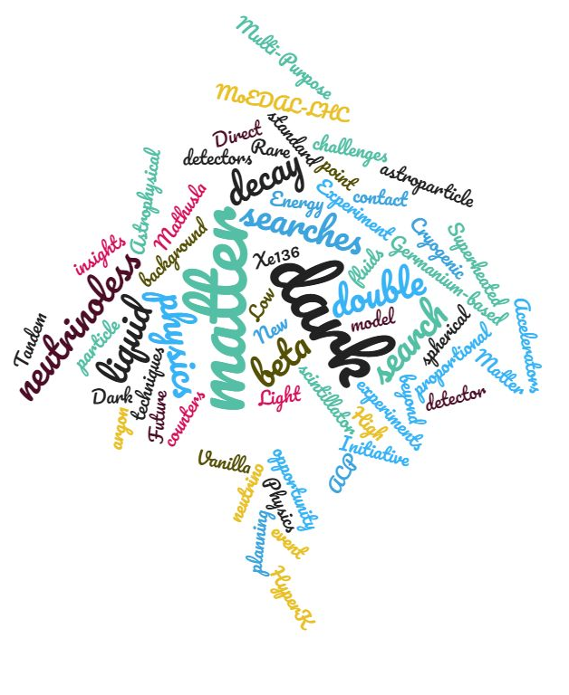


We originally received 17 briefs from the community.
Many were cross-disciplinary.
Some related to theory, others experimental.
ACP - NAS
Receive (most) community input (briefs)
Develop Draft Green Papers
1st Town Hall Meeting
Update Green Papers. Some new briefs
Merge Green Papers into White Paper.
White Paper Draft 1 Submission to IPP
2nd Town Hall Meeting
Final white paper
Ongoing Refinement / Priority Setting
Convenor co-chairs digesting briefs according to themes
Dark Matter
Neutrino Messenger
Neutrino Properties
Technologies
Prepared for the Town Hall meeting of May 6th and 7th
Draft Dark Matter
Green Paper
Draft Neutrino
Green Paper
Draft Technology
Green Paper

Slide 13
Community Aspirations | Dark Matter | Neutrino Properties | Neutrino Messengers | Technology Development | Theory in Astroparticle | EDI | Canadian Advantages | 20 Year Vision
  Community Aspirations
The community aspires to be a global leader in astroparticle physics with a view to the discovery of new particles to explain the galactic dark matter, an understanding of the intrinsic properties and nature of the neutrino, and the opening-up of new windows of intersectional astronomy and cosmology studying the sources of these particles and their influence on the evolution of the universe.
Fundamental science program focused on high priorities in physics today:
Origins of dark matter
Properties of neutrinos
Understanding of neutrino sources
In the last decade this field has evolved into a major research field. In Canada, increased capacity and capability as a consequence of significant investments:
SNOLAB: Deepest clean International facility for underground science
McDonald Institute: Centre for Astroparticle Physics building intellectual capacity across Canada.
Canada is well placed to capitalise on investments to this research field.

Slide 14
Potential Model for a Sustained MI at Queen’s University Post CFREF
  Education and Outreach ++
  Knowledge Translation/Mobilization ++
  HQP Training – Professional Development ++
  Gov Relations ++
  HQP recruitment/retention ++
  Communication ++
  Networking and Connections ++
  EDII Best practices support ++
  Faculty Salaries
  Student Salaries
  Engineering and Technical Support Salaries
  Seed funding for novel R&D
  Novel/targeted positions
These are time intensive programs.
They need significant administrative support
Enables big science by creating “the full package”
Creates highly skilled, deeply connected, community
Relatively inexpensive, but beyond scope of most individual projects
New MI Research Centre at Queen’s 1 – 1.5 M$/a
Centre at Queen’s tentatively approved !
Subsumed by universities.
Picked up by NSERC
To be funded through new MI grant to MSI, MRS, CFREF’, SNOLAB MSI’, Gov…
Ball Park: Funded externally 3 – 4 M$/a
Grass –roots effort to define what is needed in Canada, coming to your in-box soon. Expect funding program launches this summer.

