Slide 1
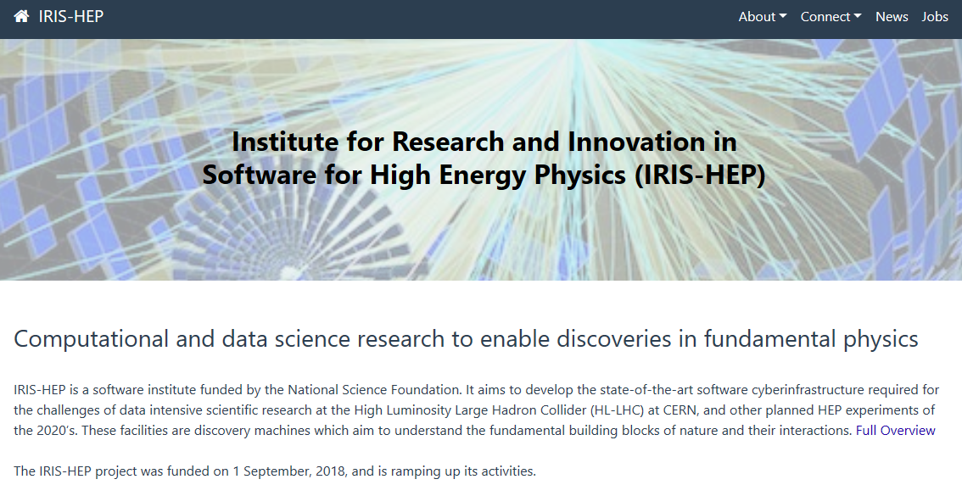

Slide 2


IRIS-HEP Steering Board
Meeting #11
G. Watts
For the IRIS-HEP Executive Board
2021-09-07
“The IRIS-HEP Steering Board represents the Institute’s stakeholders to provide, to the Executive Board, the stakeholder’s input on the priorities, execution, and strategy of the Institute.”

Slide 3
Thank You
Danilo Piparo (CERN)
CMS
Oliver Gutsche (FNAL)
US CMS Ops Program
Paolo Calafiura (LBNL)
US ATLAS Ops Program
Patrick Koppenburg (NIKHEF)
LHCb
Simone Campana (CERN)
WLCG
Graeme Stewart (CERN)
HSF
Alessandro Di Girolamo (CERN)
ATLAS
Ken Herner (FNAL)
The OSG Council

Slide 4
Welcome
steering-board@iris-hep.org
(you)
exec-board@iris-hep.org
(us)

Slide 5
Next Meeting Dates
November 30, 2021
February 15, 2022

Slide 6
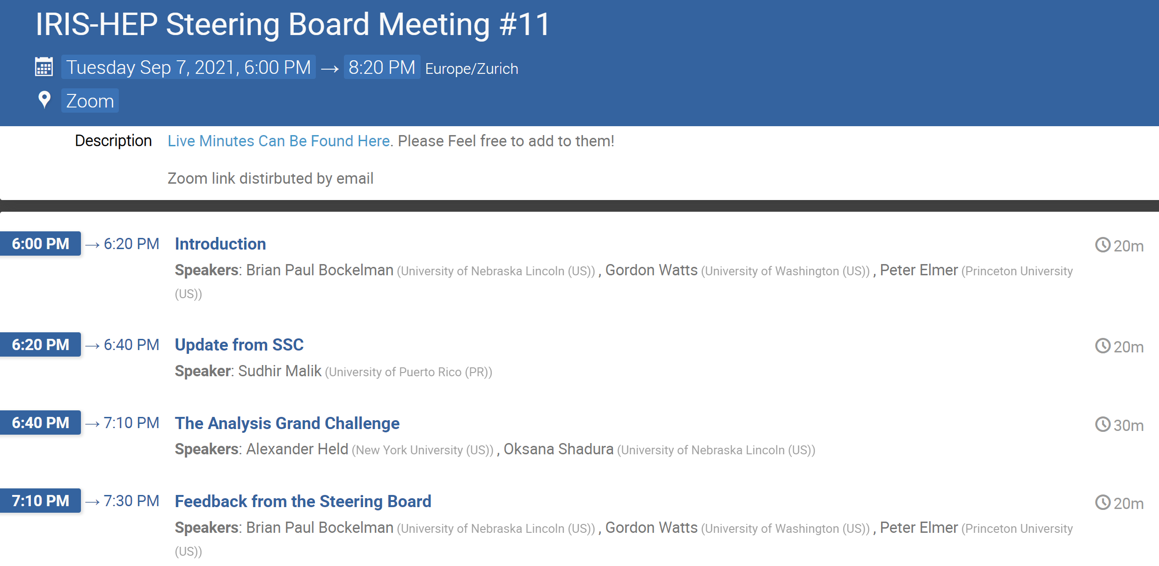
Today
Training
Analysis Grand Challenge

Slide 7
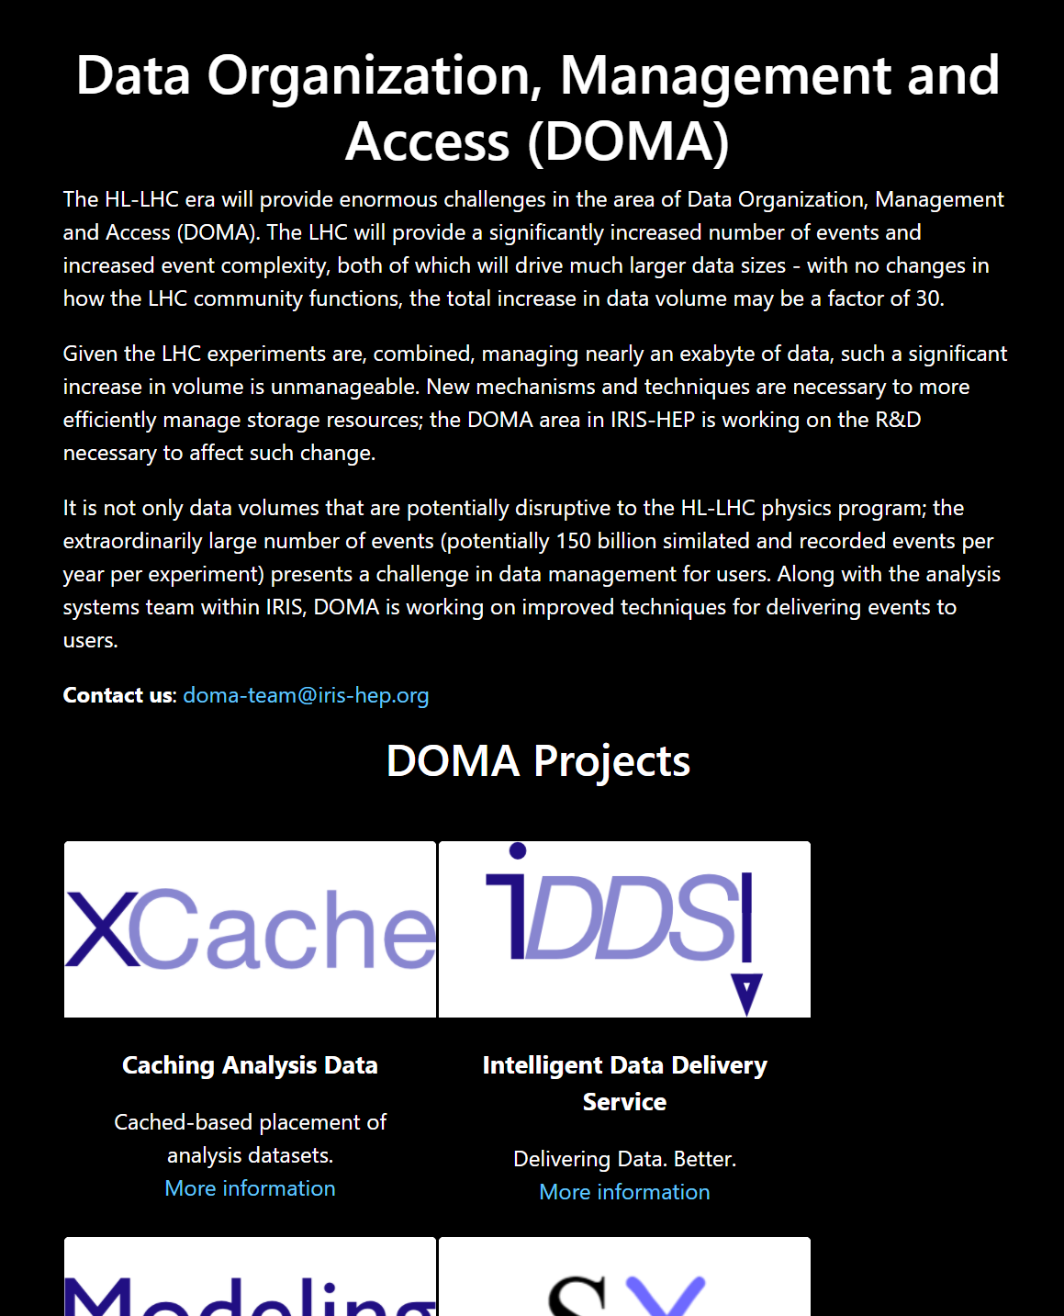
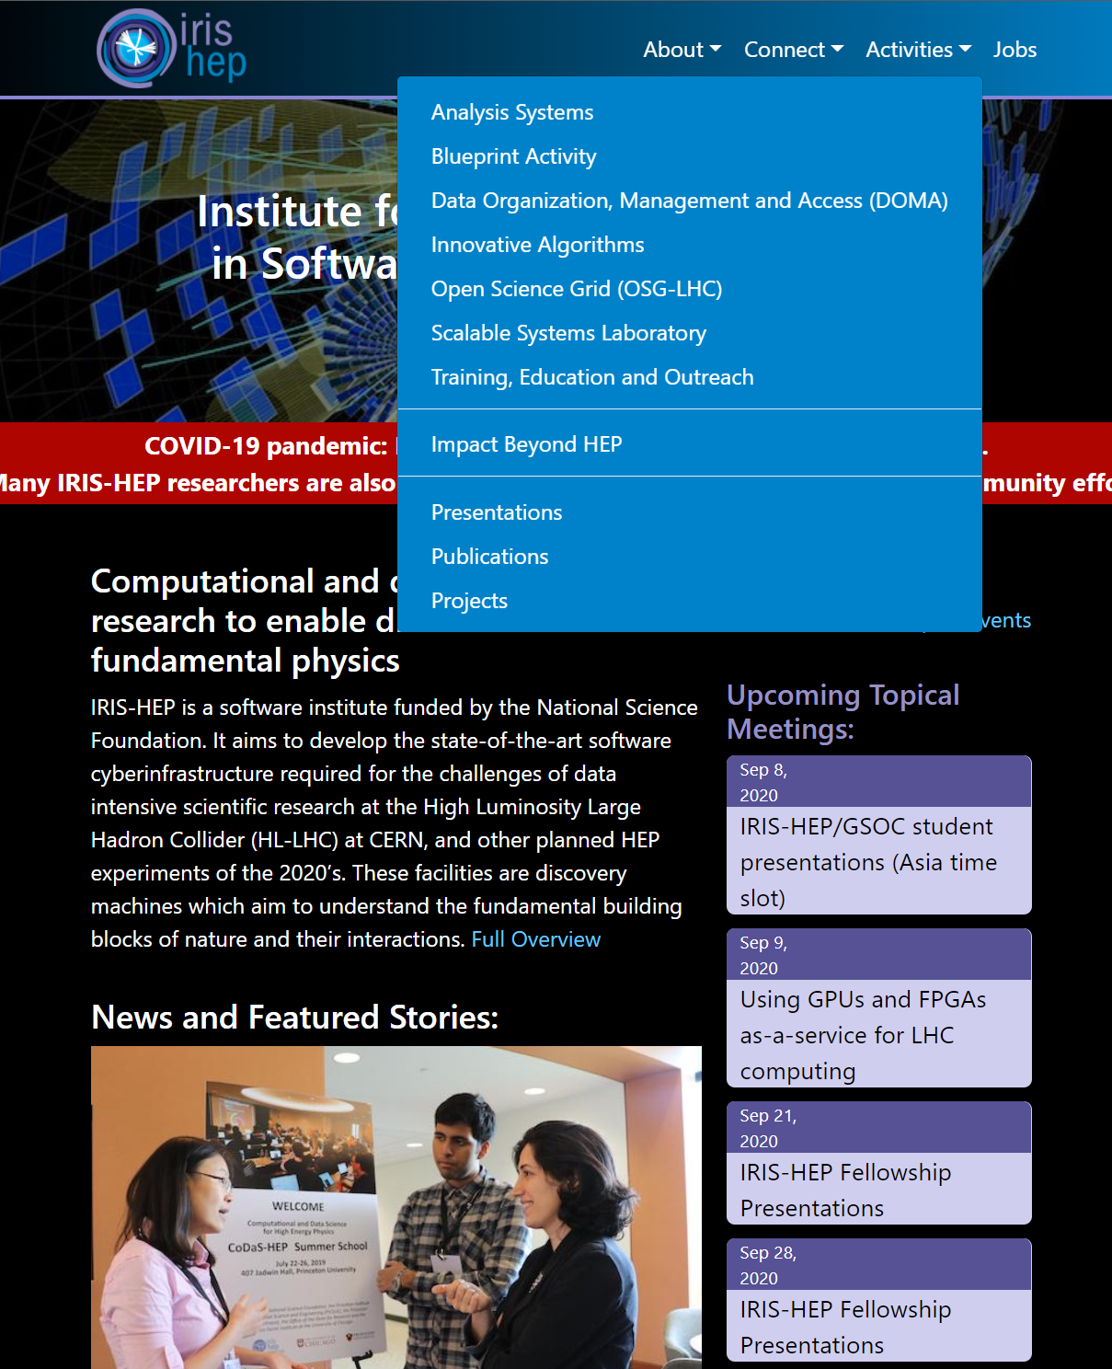
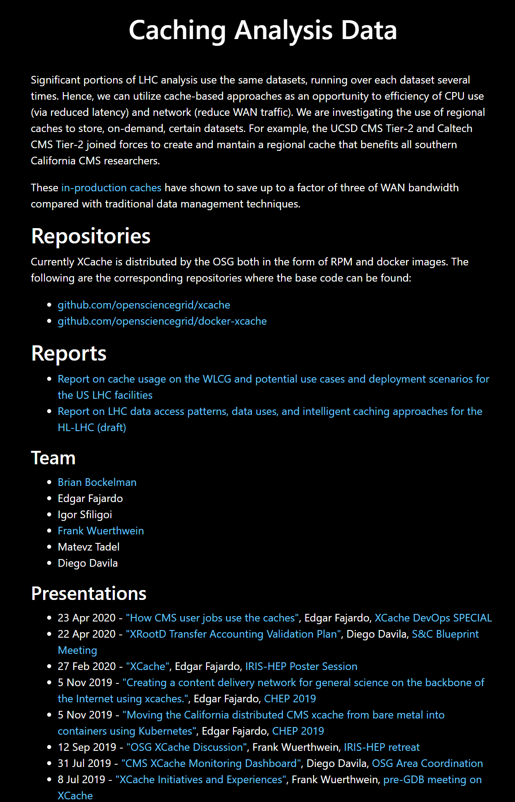
Project Information
Per-project information is available on all IRIS-HEP projects.
(often, but not always)

Slide 8
Year 4 Changes
Started on September 1, 2021
Added coordinators for the Analysis Grand Challenge (Alex Held, Oksana Shadura)
Adding a training Grand Challenge
Spending about $150K on hardware each to augment and leverage existing compute facilities to help demonstrate an Analysis Facility (Nebraska, UChicago)
Augmenting QuarkNet (high school student and teacher physics training) to support software training efforts and develop new modules.

Slide 9
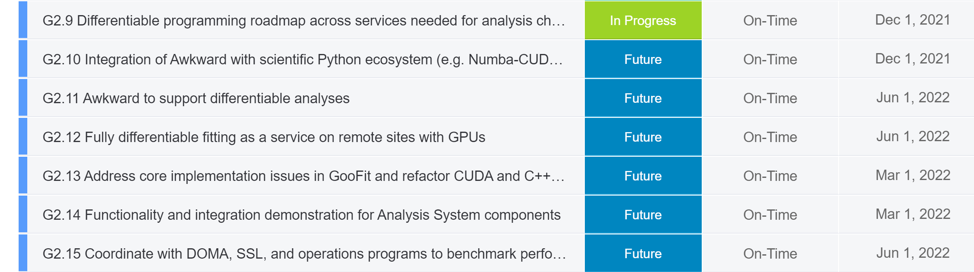
Year 4 Milestones
Current status summary is always available on the web
(quarter just ended, going through an update right now!)
Analysis Systems

Slide 10
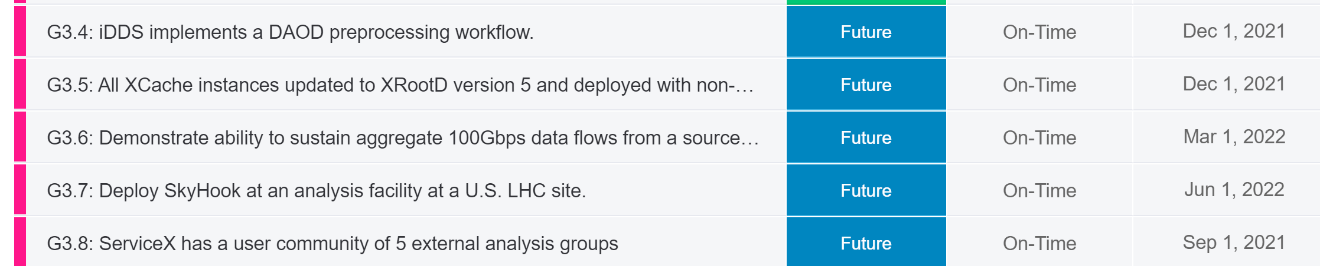
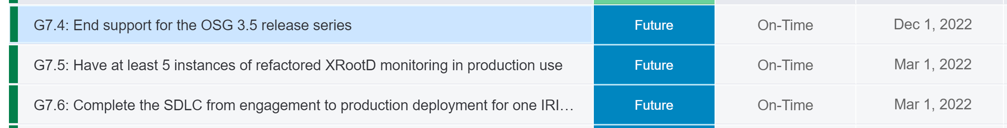
Year 4 Milestones
DOMA
IA
SSC
OSG

Slide 11
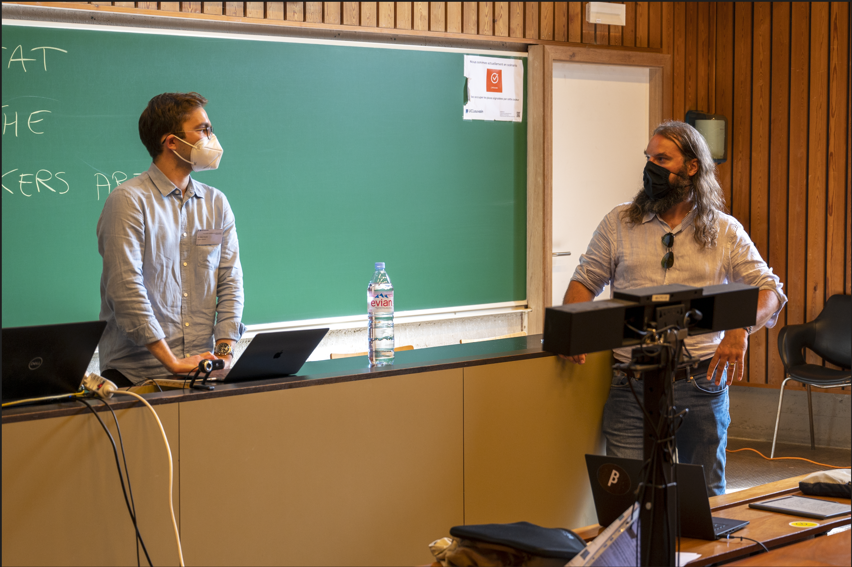
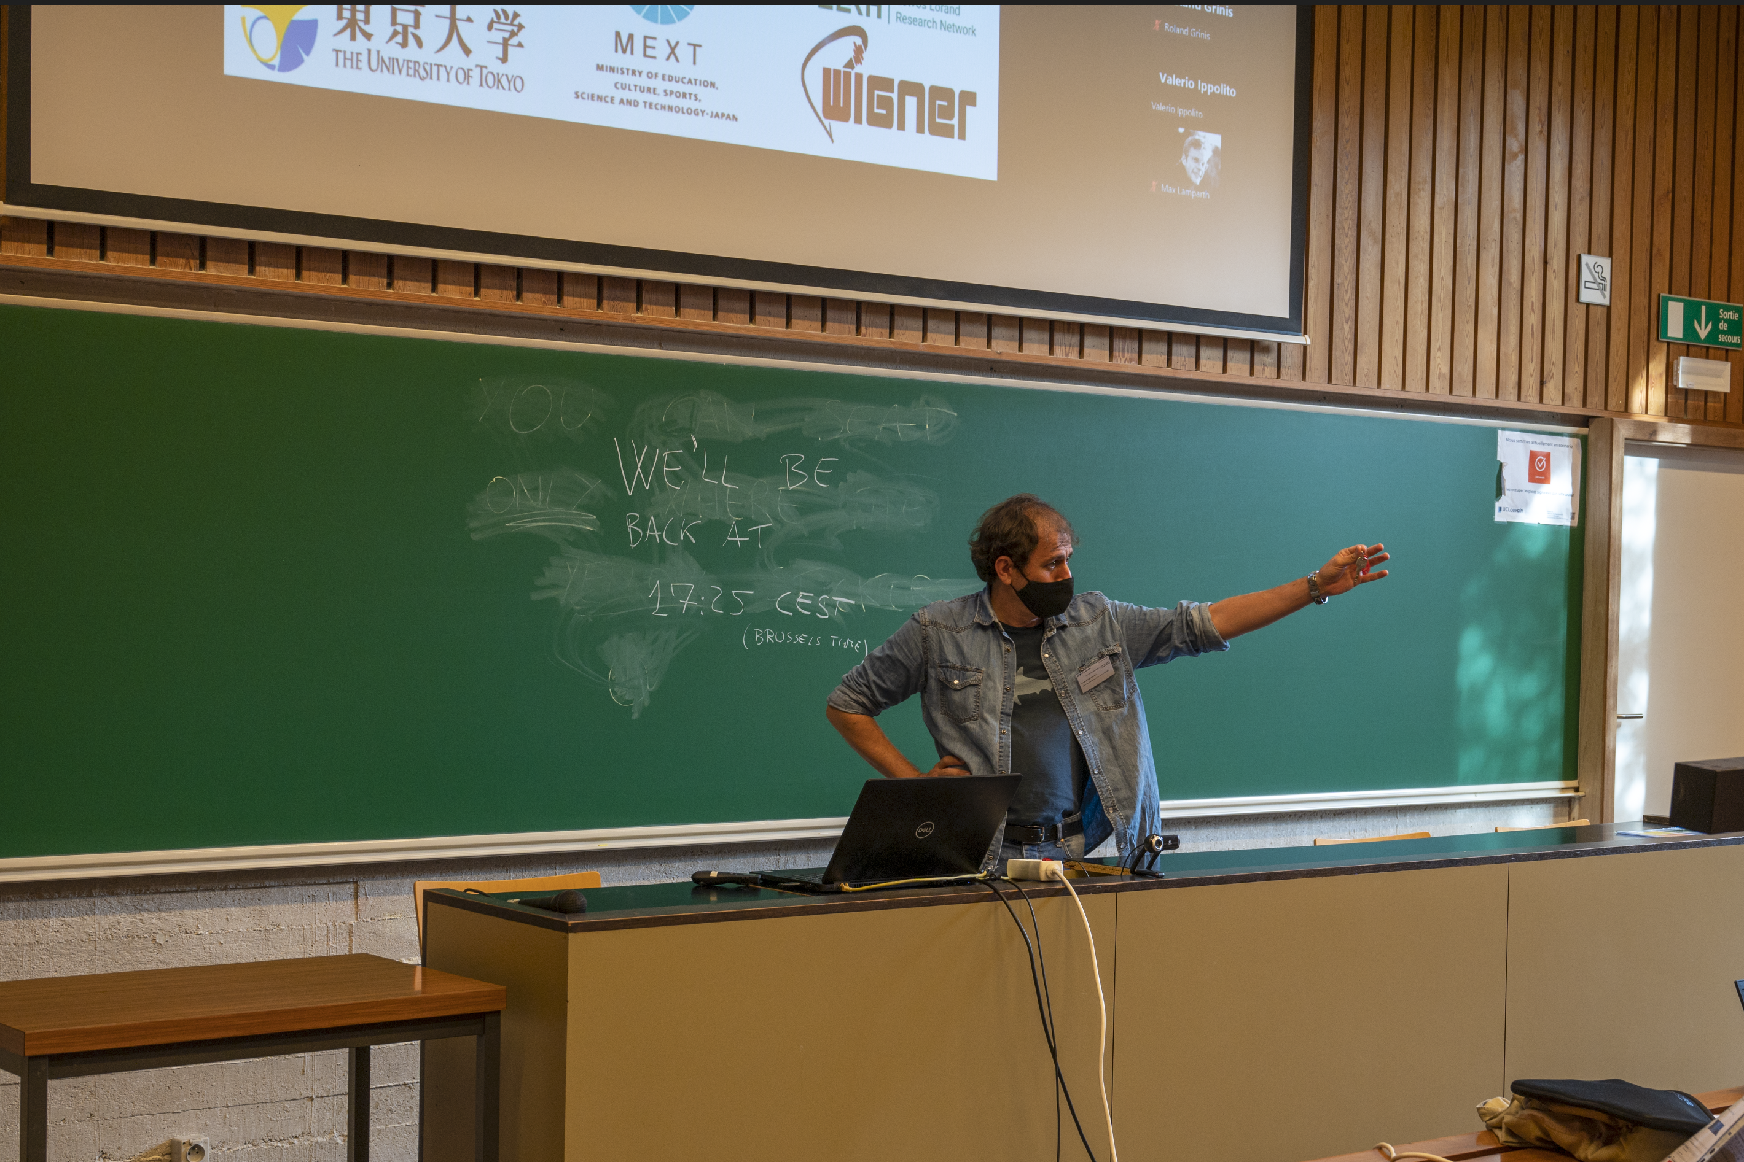
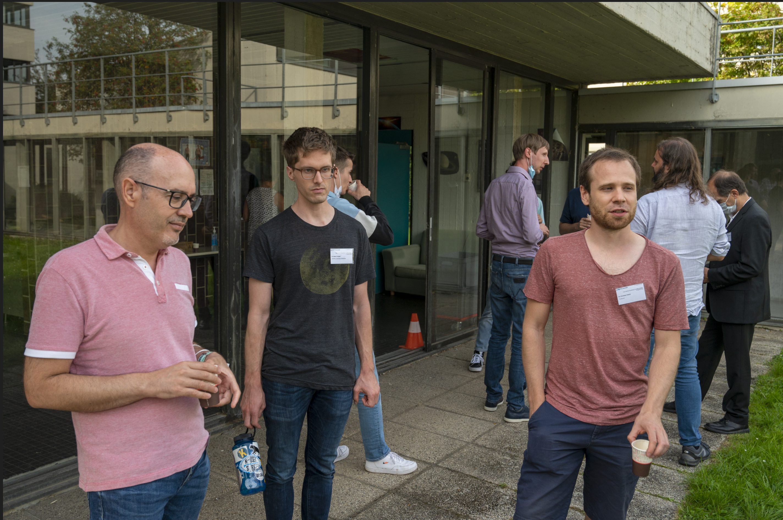
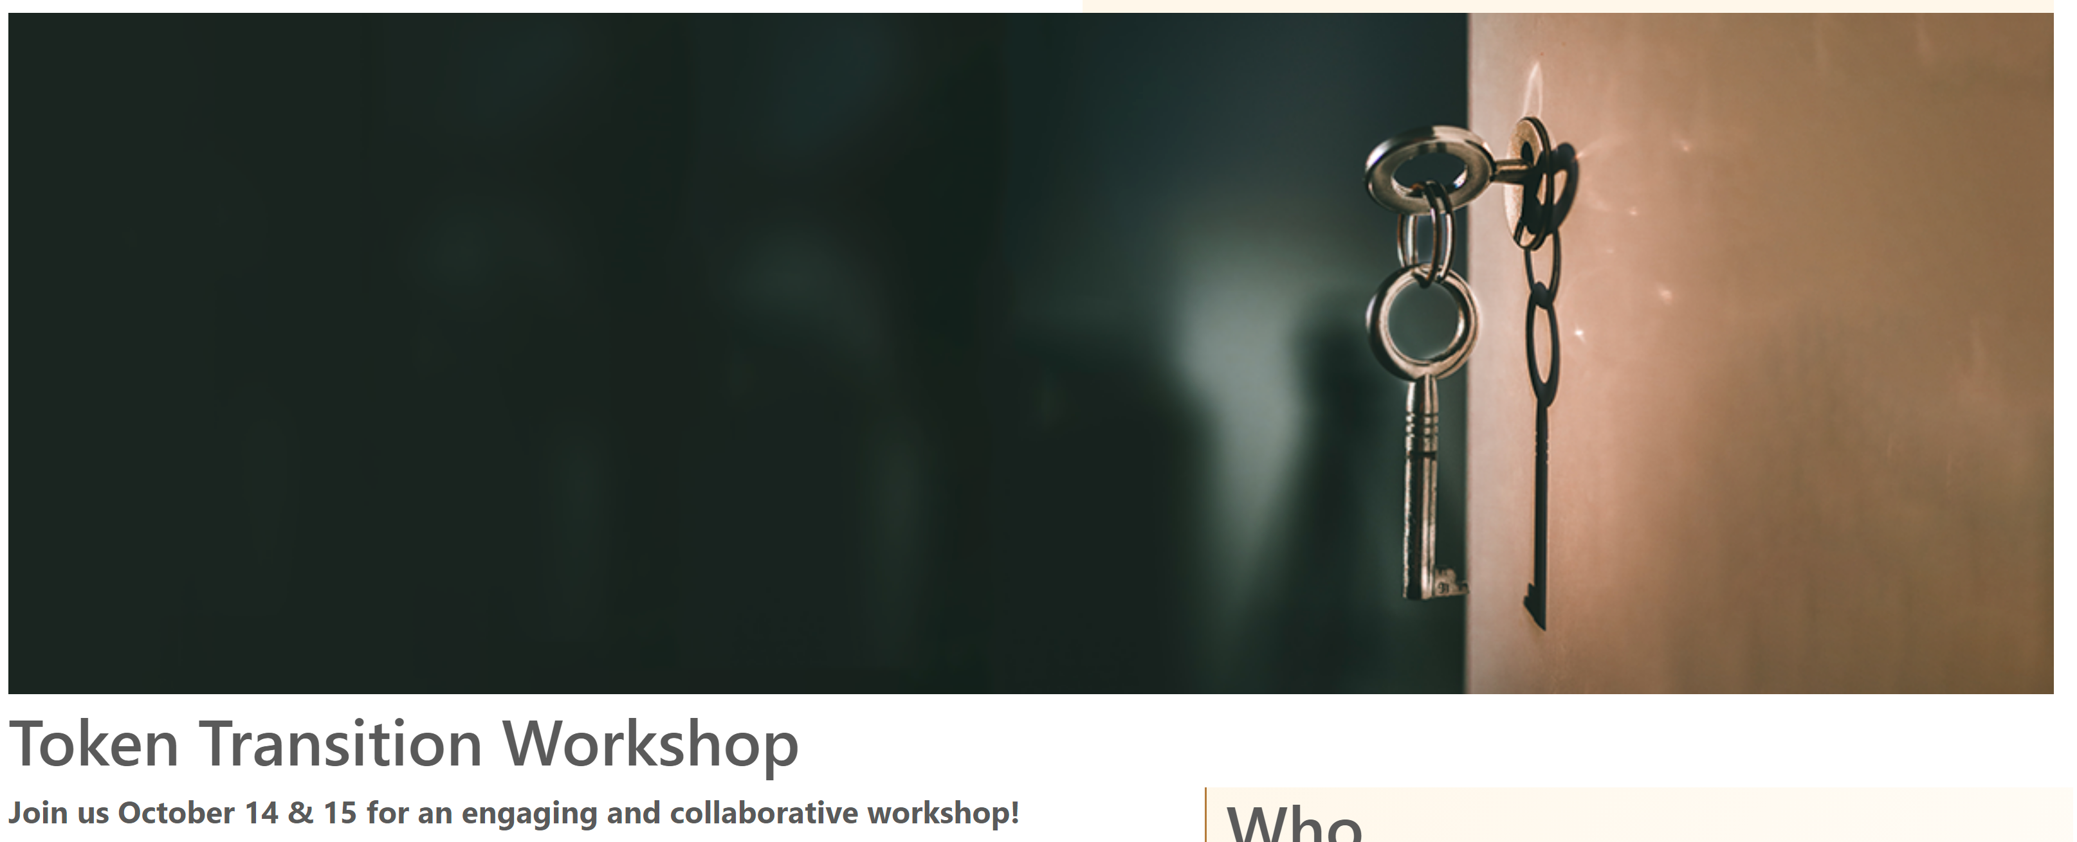
Workshops
Workshop on Differentiable Programming in the Sciences
Run by MODE collaboration, co-sponsored by IRIS-HEP
Goal of collaboration: optimize physical detector design using physics sensitivity as figure of merit, using ML techniques
Differentiable Programming well with our work on the AGC
Token Transition Workshop – Open Science Grid
Same week as the GDB pre-meeting so that as much of the LHC community can participate as possible
Discussions and planning on/for making the transition from certificates to tokens

Slide 12
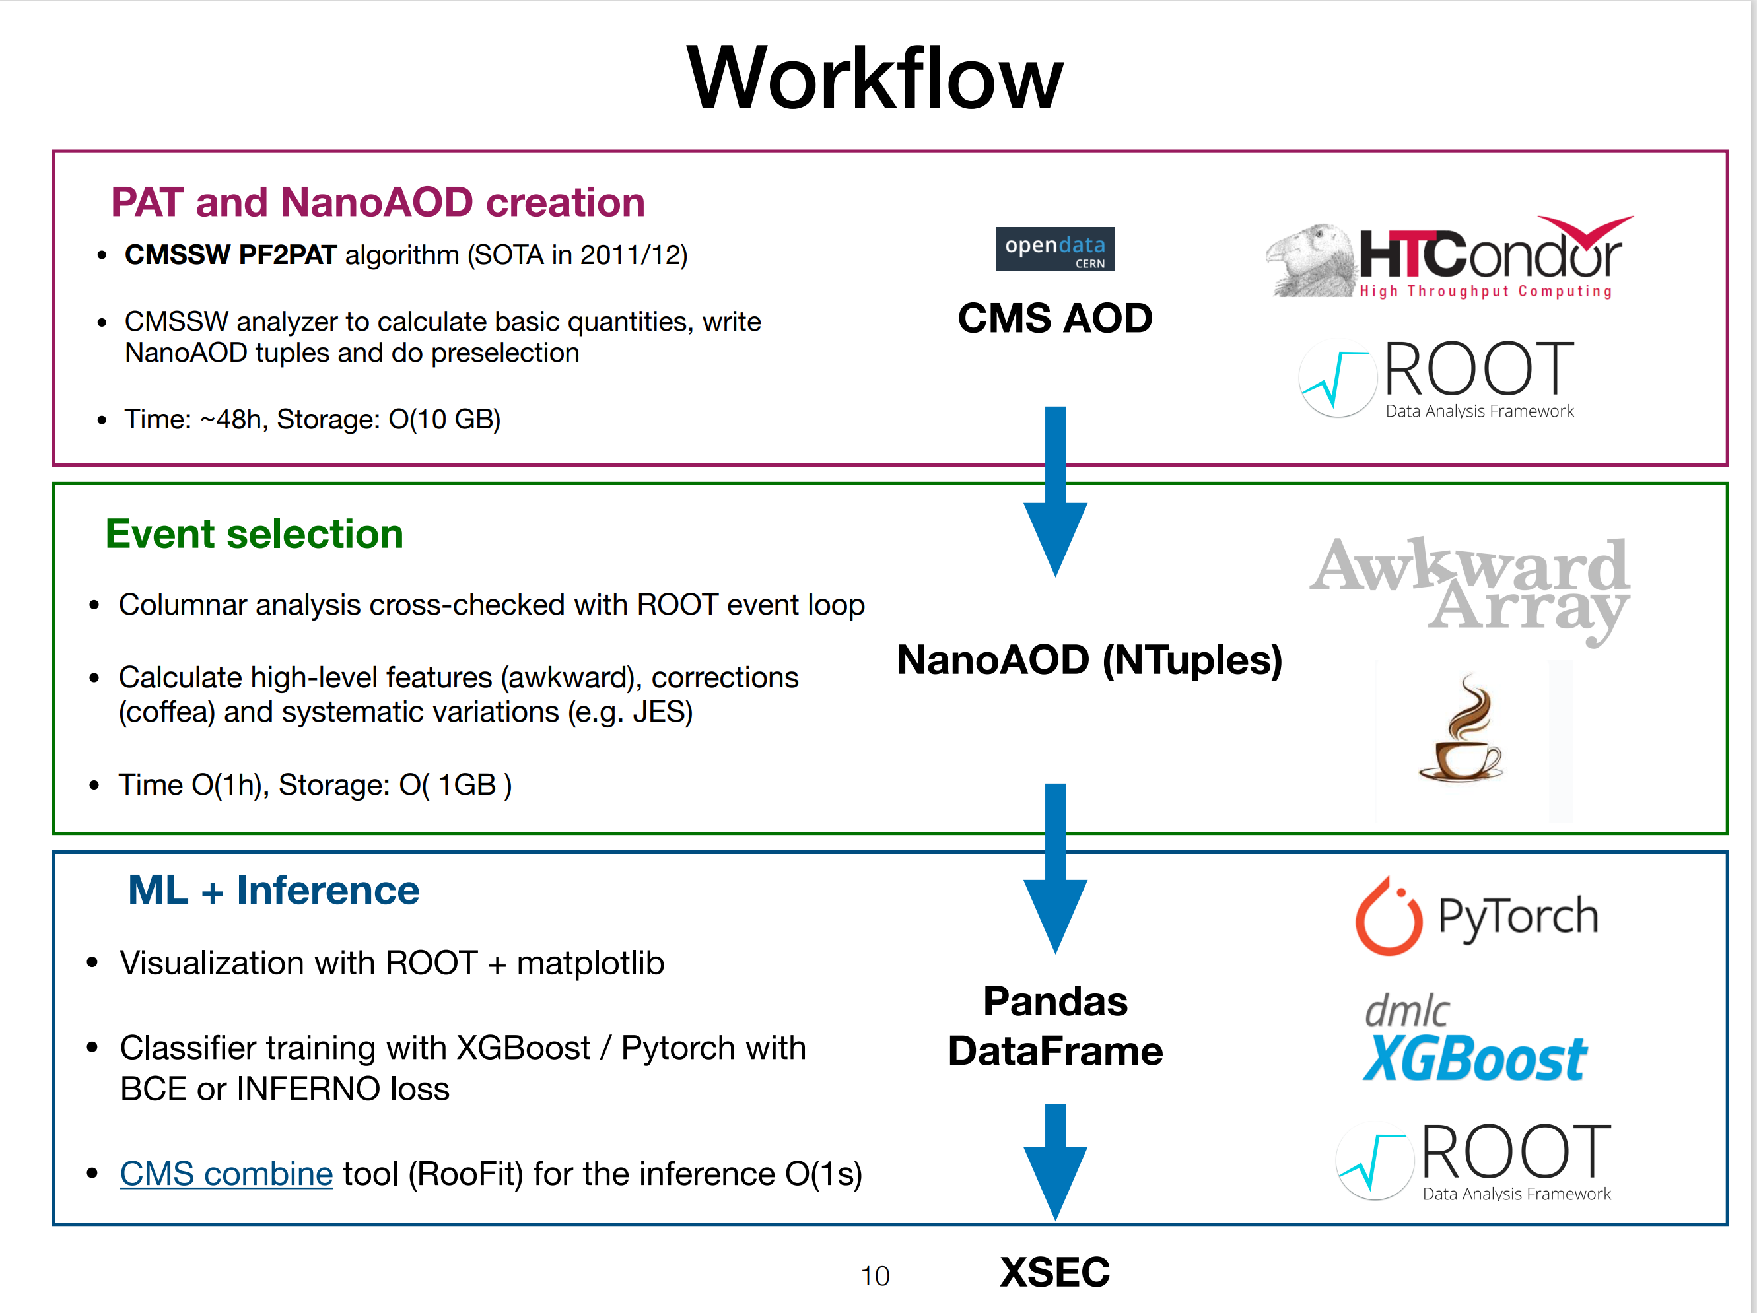
Using Analysis Tools outside of IRIS-HEP
Application of INFERNO to a CMS TTbar measurement with CMS Open Data
Uses CMS OpenData Run 1 (AOD’s!!)
Implements full analysis in PyTorch and then uses differentiable programming techniques to first reproduce a paper result of the analysis and then optimize it.
“I was really grateful for awkward and coffea, it really speeds up analysis a lot and is quite intuitive to use” – Lukas Layer (INFN)

Slide 13
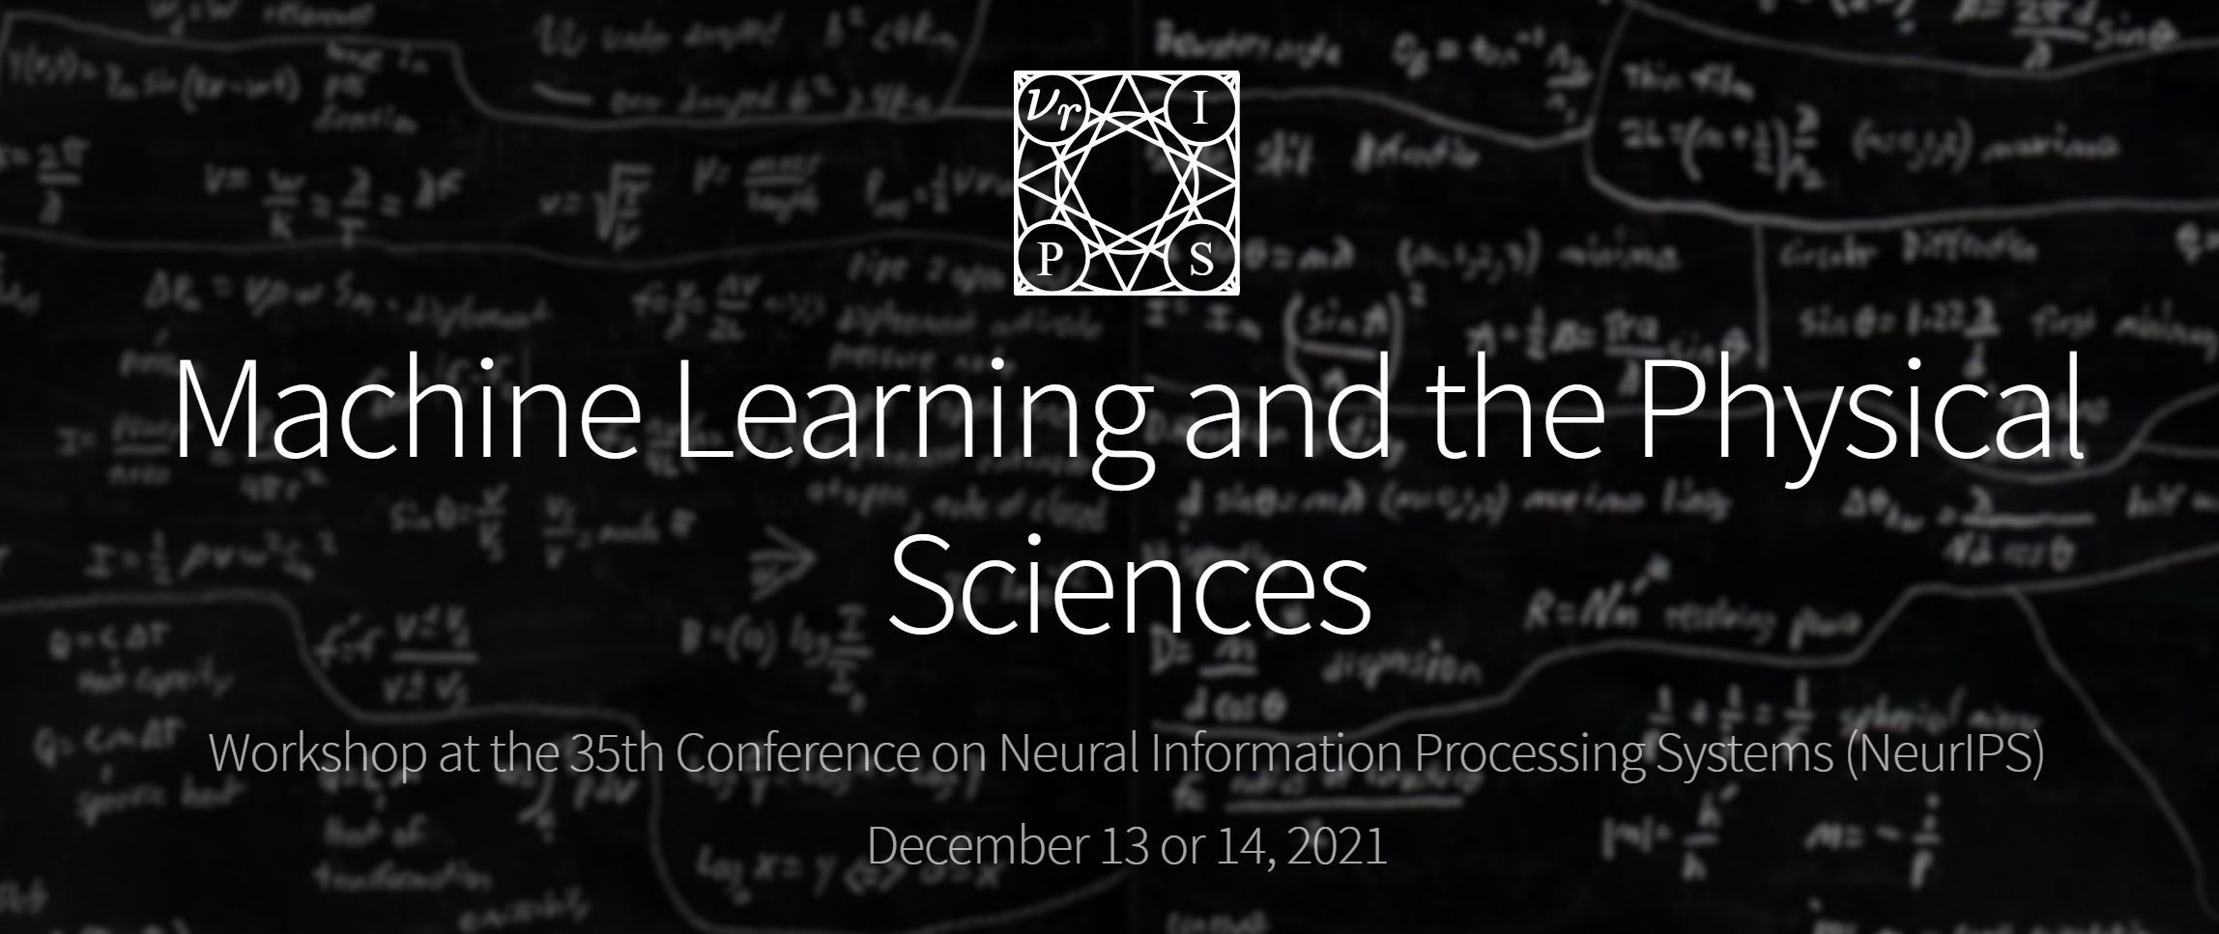
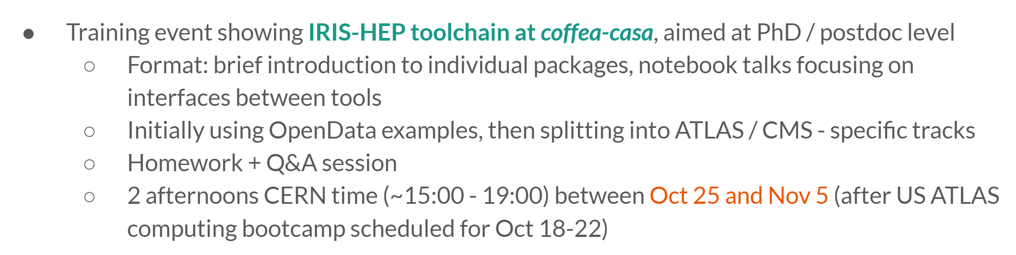
Workshops
NeuralIPS Conference Workshop
Organized by a number of people in IRIS-HEP
Continuing workshop in one of the largest ML conferences
December 13th or 14th.

Slide 14
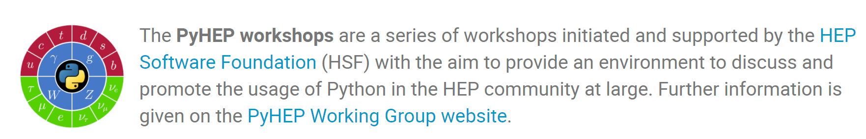

Workshops
PyHEP & SciPy (The Science Community at Large)
PyHEP is a python conference run by our community
SciPy is the big Python in Science Conference
“co-locate” them so there is cross pollination
Many talks by IRIS-HEP members at PyHEP
One of our members is part of the organization team for SciPy

Slide 15
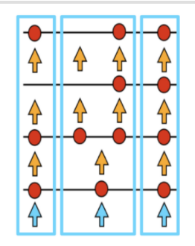

Some Other Notes
Integration of Algorithms into Reconstruction
  mkFit algorithm is now in CMSSW, ready to run in Run 3
  ACTS primary vertexing algorithms have been integrated into ATLAS RECO (x6 speedup)
BluePrint note on Virtual Meetings posted
  Has lots of suggestions for remote and hybrid meeting mechanics
  People have tried lots of different things: this is a current collection of their experiences.

Slide 16
Oustanding Action Items
HSF related feedback
  Community needs a way to strengthen C++ training
  Can we link to Carpentries better than we currently are? [Done]
    Specifically: best pedagogical practices? How do we evaluate our effectiveness
    We have renewed the sponsorship with Carpentries, and in our QuarkNet effort we have money for an external evaluation of the software efforts in QuarkNet. Will use that to understand if we can do better internal evaluations.
  Analysis Systems
    Better document sustainability post-IRIS-HEP
    Improve cooperation on declarative analysis [Done]
      Meetings with HSF DAWG with AGC and analysis benchmarks ongoing
    Common set of analysis benchmarks [Done]
      This is part of the above discussion
    More info on how we track and maintain connected with ROOT developments
  Grand Challenge
    How do you get to multi-user from single-analysis? [Done]
      The Nebraska coffea-casa AF is explicitly addressing this
  Establish discussions with HSF as they build their own plan-of-work
    Contact made – (see above)
  UW SWIFT project (Davide?) should describe their work
    Contact made – now need to actually schedule some topical meetings
  EP tasks and efforts - expose IRIS-HEP (contact: Graeme and Jacob)
    Contact made – now need to actually schedule some topical meetings
LHCb related Feedback
  Follow up on JAX work for doing particle ID (uproot -> iminuit -> JAX -> matplotlib)
  Are there analysis tool integrations with IRIS-HEP possible?
    Analysis Preservation
    REANA?
  LHCb will add a "free" discussion inside LHCb and invite some folks from IRIS-HEP

Slide 17
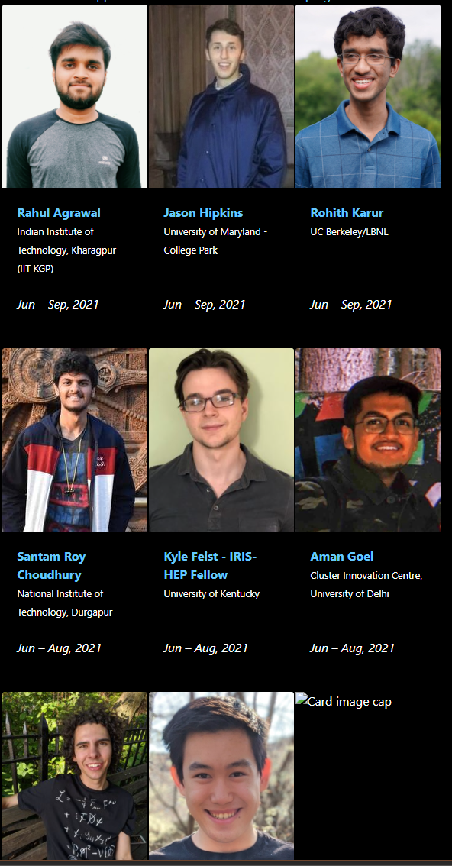
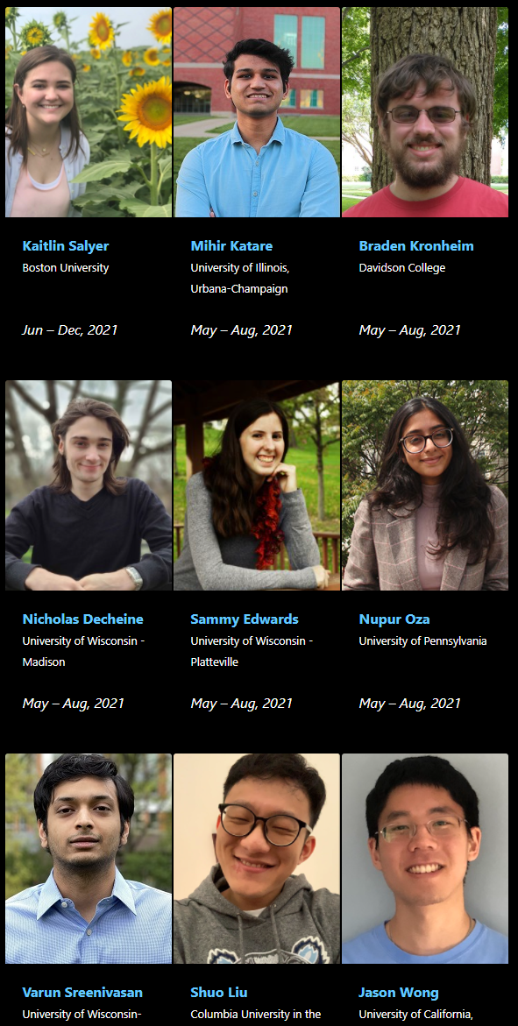
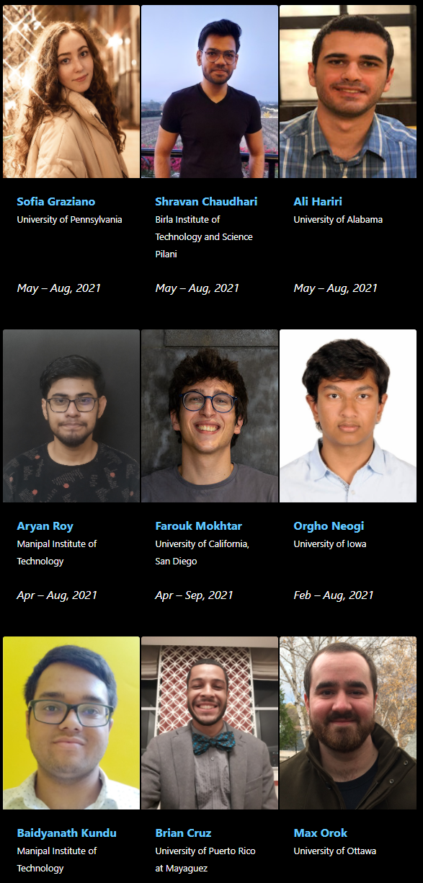
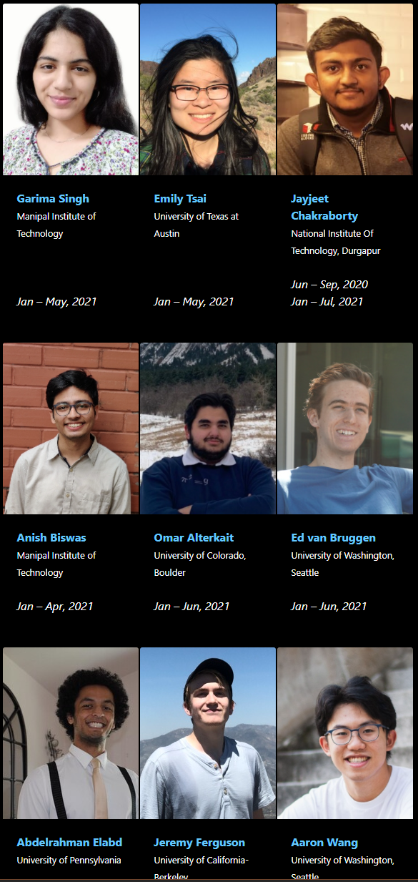
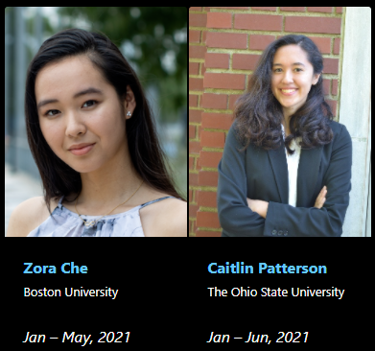
Fellows
Summer fellows are finishing up!
COVID-19 Version of Fellows:
Graduate to Undergraduate
In person to remote
Room & board to stipend
Allowed a marked increase in number of people we were able to reach.
When and how do we resume this program?
Next steps: looking for a more diverse set of mentors for the next round (fall/winter)
Summer fellow presentations starting now!

Slide 18
Questions? Comments?

