Slide 1


Slide 2


IRIS-HEP Steering Board
Meeting #13
G. Watts
For the IRIS-HEP Executive Board
2022-02-14
“The IRIS-HEP Steering Board represents the Institute’s stakeholders to provide, to the Executive Board, the stakeholder’s input on the priorities, execution, and strategy of the Institute.”

Slide 3
Thank You
Danilo Piparo (CERN)
CMS
Oliver Gutsche (FNAL)
US CMS Ops Program
Paolo Calafiura (LBNL)
US ATLAS Ops Program
Patrick Koppenburg (NIKHEF)
LHCb
Simone Campana (CERN)
WLCG
Graeme Stewart (CERN)
HSF
Alessandro Di Girolamo (CERN)
ATLAS
Ken Herner (FNAL)
The OSG Council

Slide 4
Welcome
steering-board@iris-hep.org
(you)
exec-board@iris-hep.org
(us)

Slide 5
Next Meeting Dates
(proposed)
June 7, 2022
Sept 13, 2022 (CERN VM WS Conflict)
Dec 13, 2022
February 14, 2023
Will circulate these by email after the meeting for comments!

Slide 6
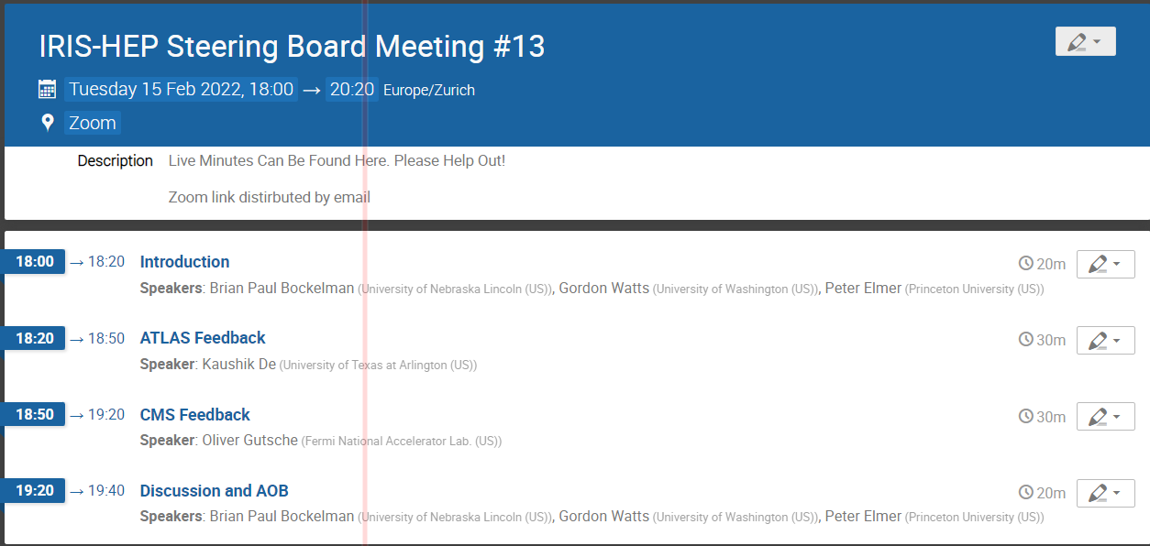
Today
Feedback from the experiments
Could we do LHCb and HSF next meeting?
Please use the google doc circulated in the email to add comments or make any notes you want us to track!

Slide 7

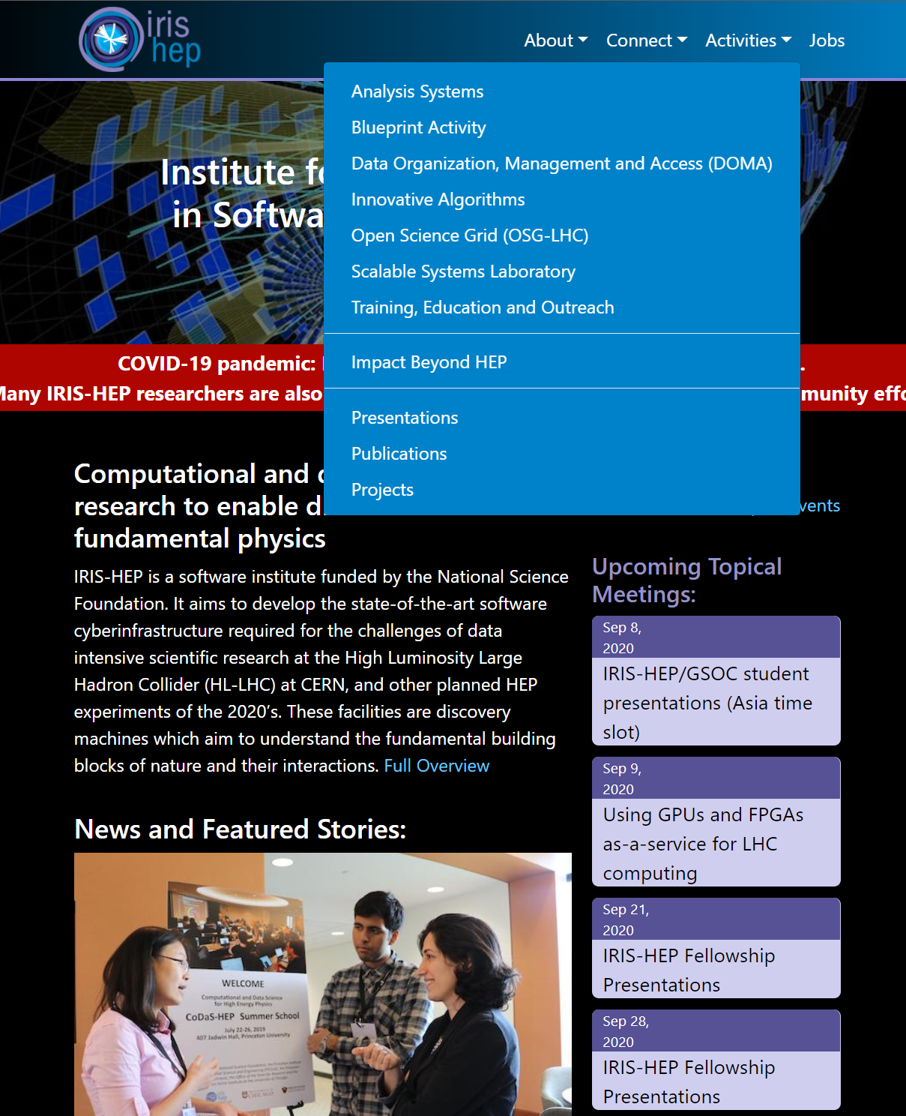
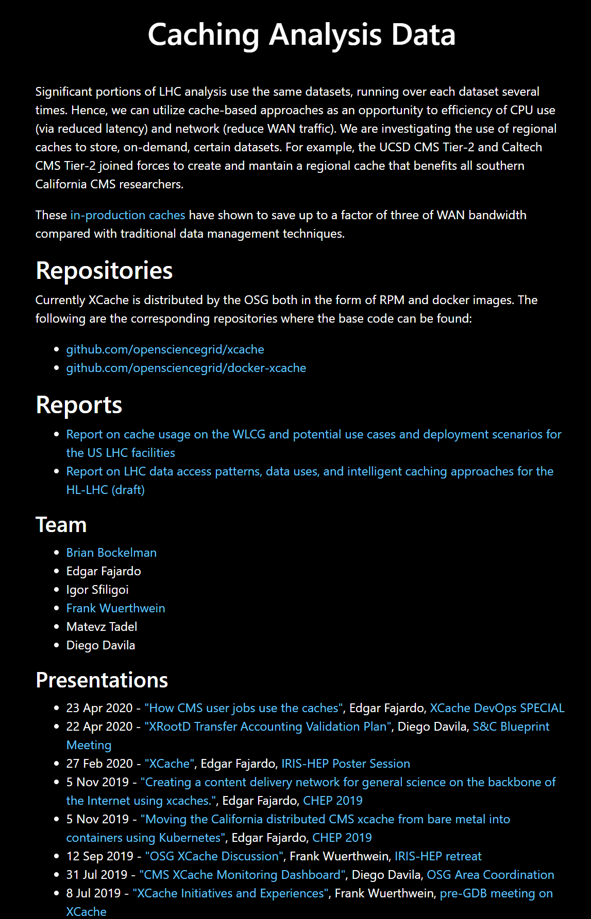
Project Information
Per-project information is available on all IRIS-HEP projects.
(often, but not always)

Slide 8

Analysis Ecosystem
Slide from SB#12
Are we ready for another Ecosystem Workshop?
2017
Some of the topics from last time:
Where we are today: tools and data formats
Covered Energy Frontier and Intensity Frontier
Out look for the next 5-7 years for hardware and software
Survey of modern tools
Missing pieces
A report was generated along with a summary slide deck
It has been almost 5 years
Python/ROOT vision for HL-LHC much more in focus
Grand Challenges
New challenges (e.g. analysis facilities, scaling, differentiability)
New languages (e.g. Julia, Go)
Snowmass
Just starting to gauge community interest
Week of canceled CHEP? (2nd Week of May)
Really wanted it hybrid!!!

Slide 9
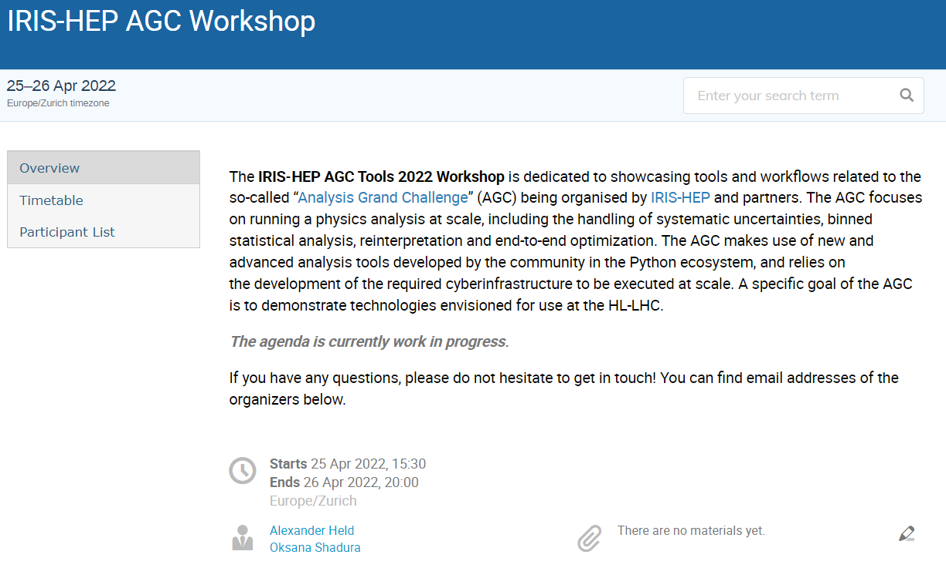
Analysis Grand Challenge Workshop #2
https://indico.cern.ch/event/1126109/
April 25-26
Virtual Only
Similar to previous workshop
Updated demos
Continued focus on getting more people introduced to new tools

Slide 10
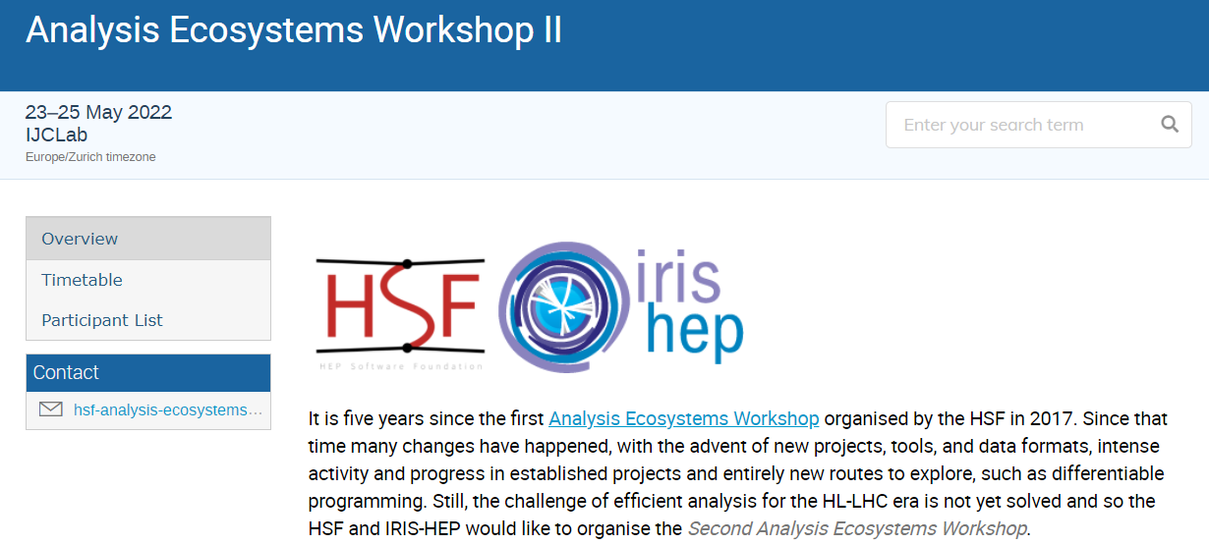
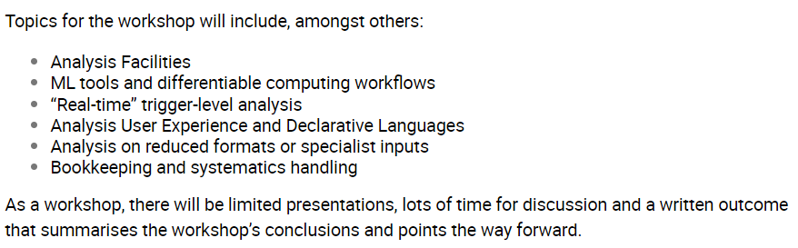
Analysis Ecosystem Workshop
https://indico.cern.ch/e/aew2
May 23-25, IJCLab, Paris
Hybrid

Slide 11
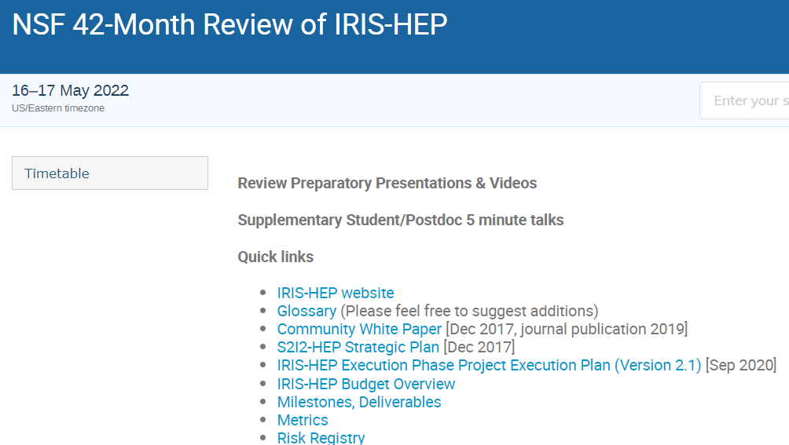
NSF Review
https://indico.cern.ch/event/1114340/
Our next “big” review is set
Will cover all aspects of the program
Likely to be online (sadly)
We are starting a full project “scrubbing”
Website Content is being refreshed
Lifecycle indications for all projects will be added
Updates to presentation lists, paper lists, and fellow’s pages (and etc.)

Slide 12

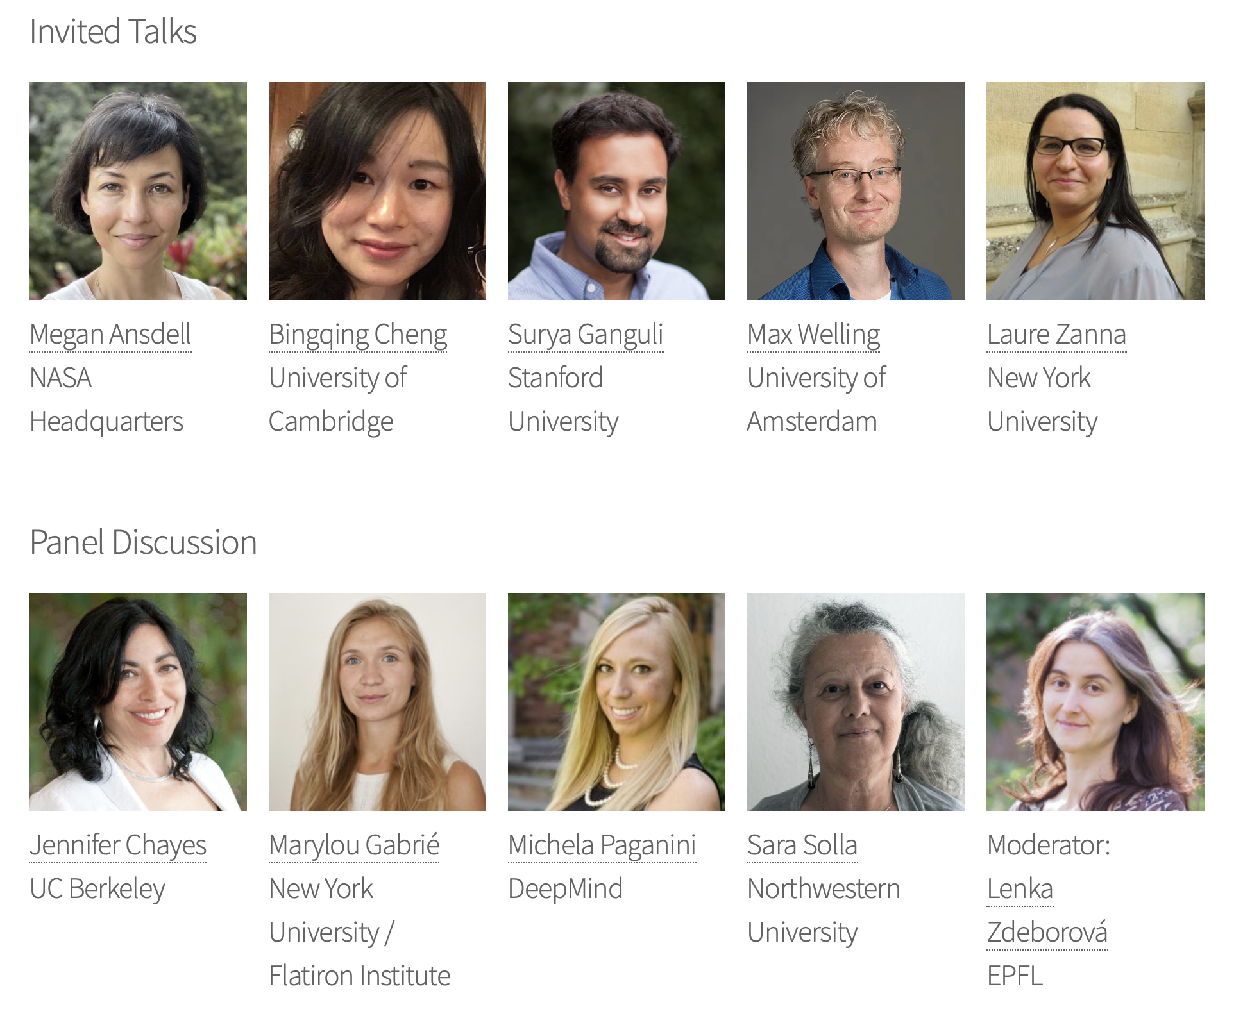
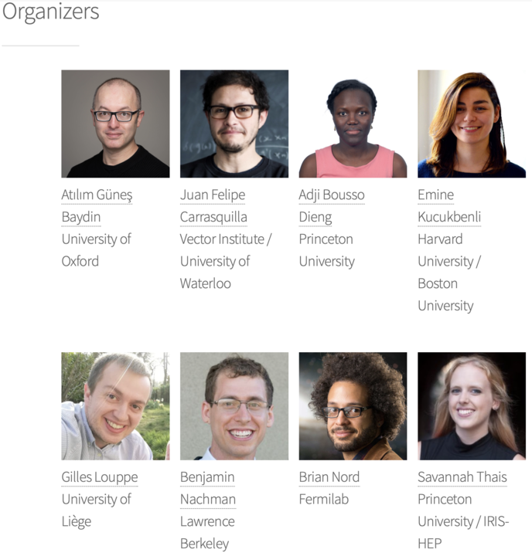
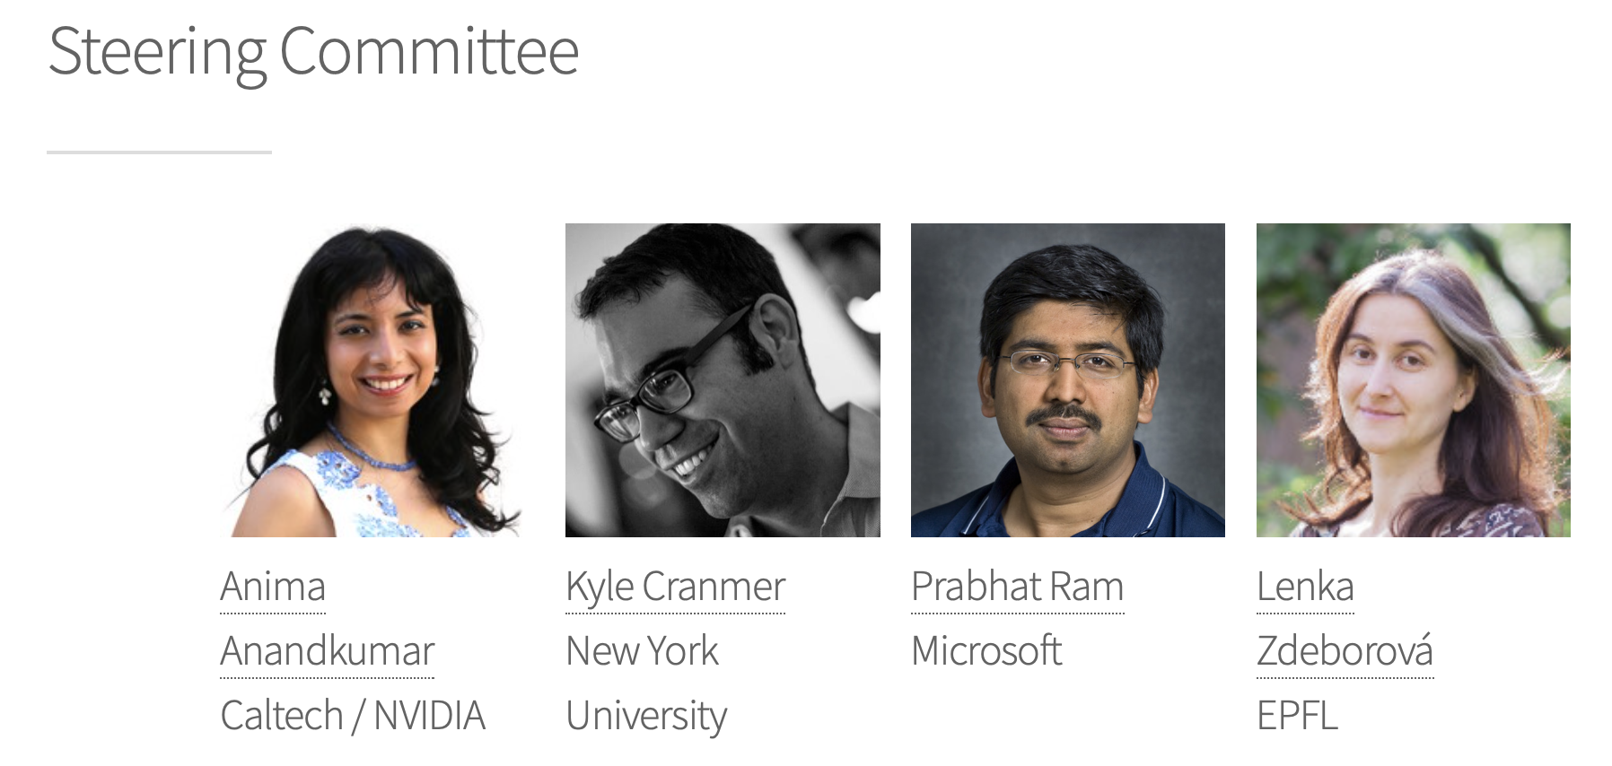
NeurlIPS: ML and the Physical Sciences
Happened on December 13th, 2021
Link
152 papers accepted for presentation and discussion
Over 200 submitted
Sponsorship from Vector Institute, APS’s Data Science group, IRIS-HEP
Last year they had in excess of 400 attendees

Slide 13
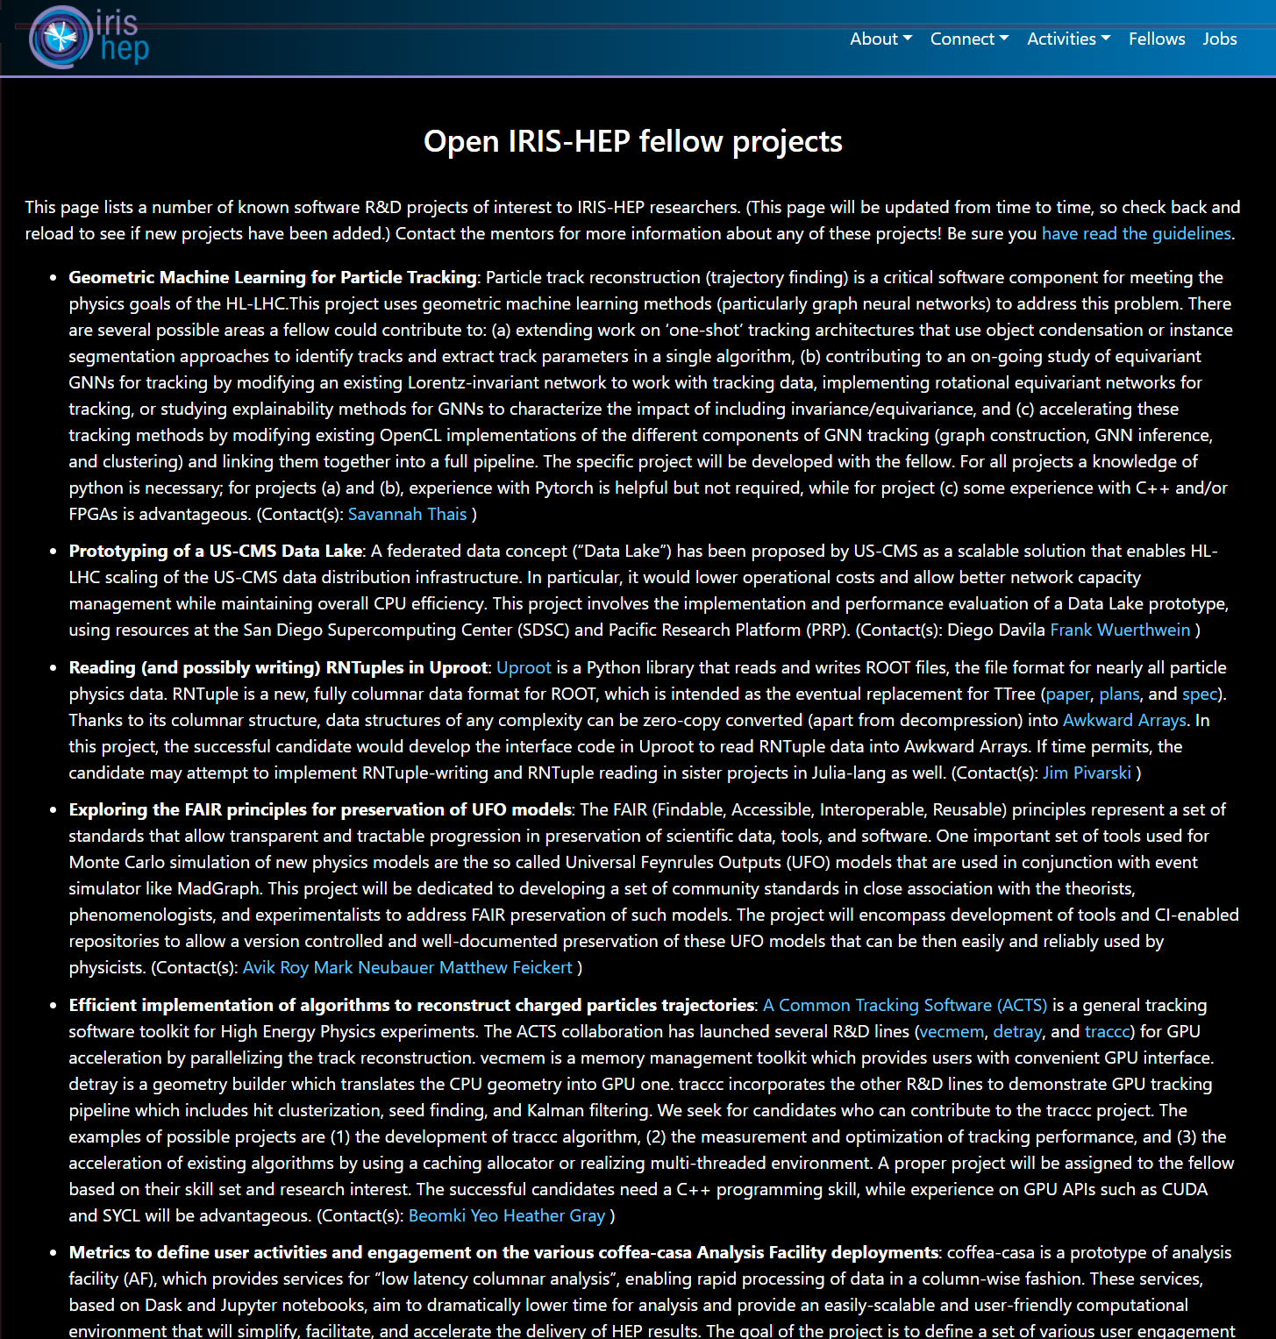
Questions? Comments?
We are about to put out our call for IRIS-HEP fellows
Lots of projects posted
From all focus areas
Know a good student? Want to distribute it to students associated with your work or experiment?
Official announcement will be sent to the iris-hep announcement list. Please do recirculate to anyone or group that might be interested!

Slide 14
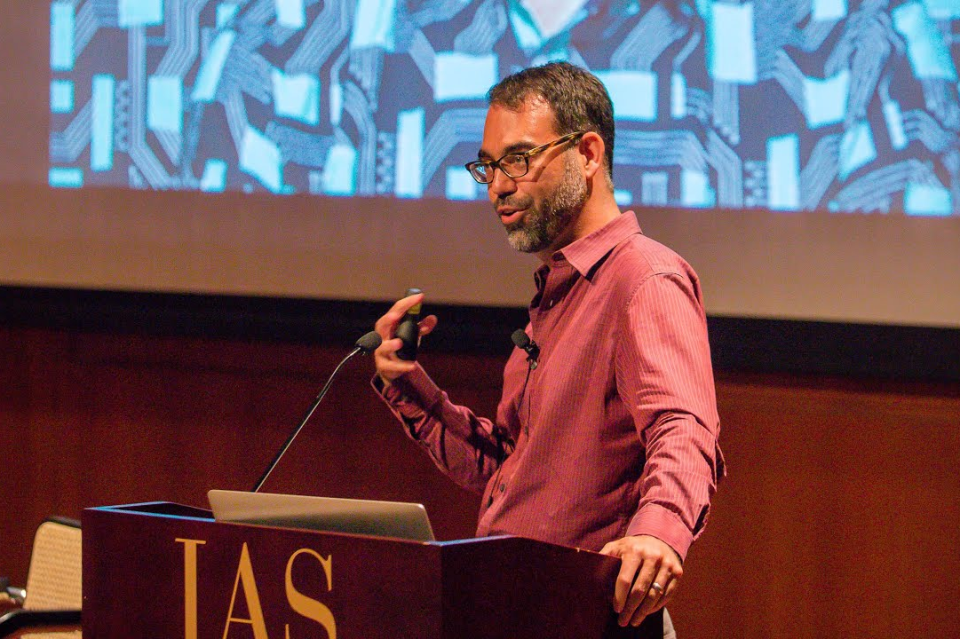
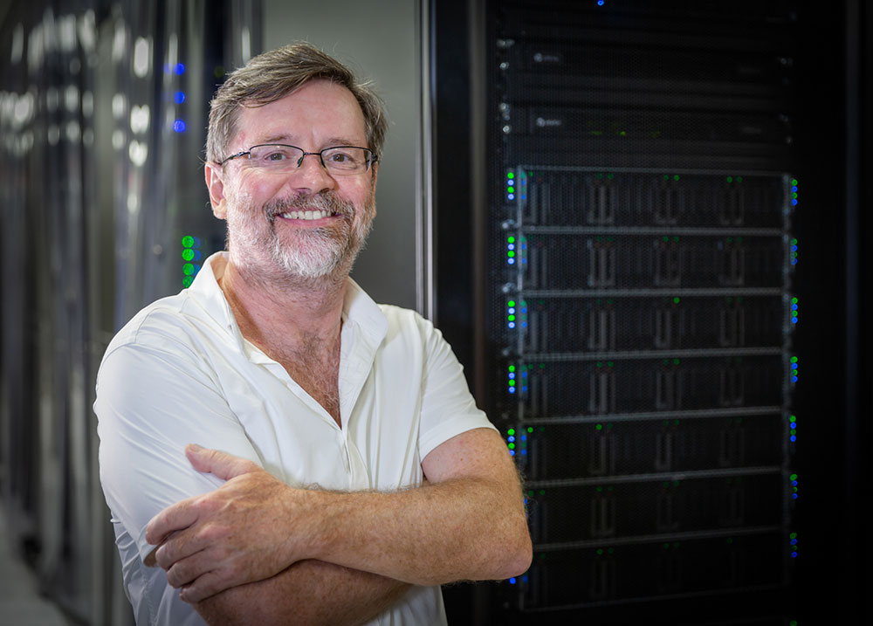
People
Kyle Cranmer is moving to the American Family Insurance Data Science Institute at the University of Wisconsin-Madison
Analysis Systems leadership:
We have a plan in place and are making sure it is ready to go.
Frank Wurthwein has been named the director of the San Diego Supercomputer Center
IRIS-HEP OSG-LHC leadership roll is unchanged.

Slide 15
Connections To Other Similar Organizations
HSF
PyHEP
HEP-CCE (USA)
FIRST-HEP (USA)
UK SWIFT (UK)
PUNCH4NFDI (Ger)
FAIR4HEP (USA)
Others that we should be connecting to?

Slide 16
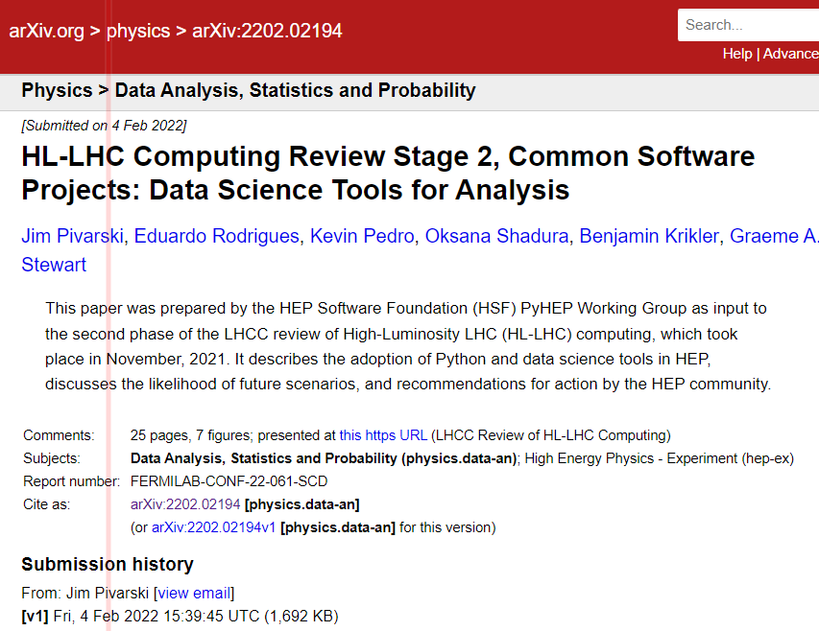
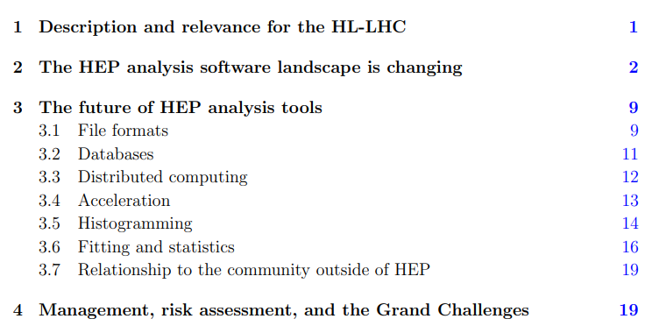
Data Science Tools for Analysis
https://arxiv.org/abs/2202.02194
Paper used as input to the HL-LHC Computing Review

Slide 17
Questions & Comments?

