Slide 1


Early Strangeness freeze-out from RHIC BES to LHC
Jia Chen （陈佳）
Shandong University (Qingdao)
Based on arXiv:2012.02986
In collaboration with: Jian Deng (SDU), Zebo Tang (USTC), Zhangbu Xu (BNL), Li Yi (SDU)

Slide 2
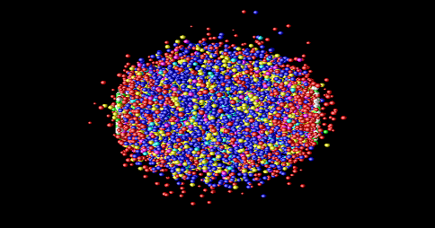
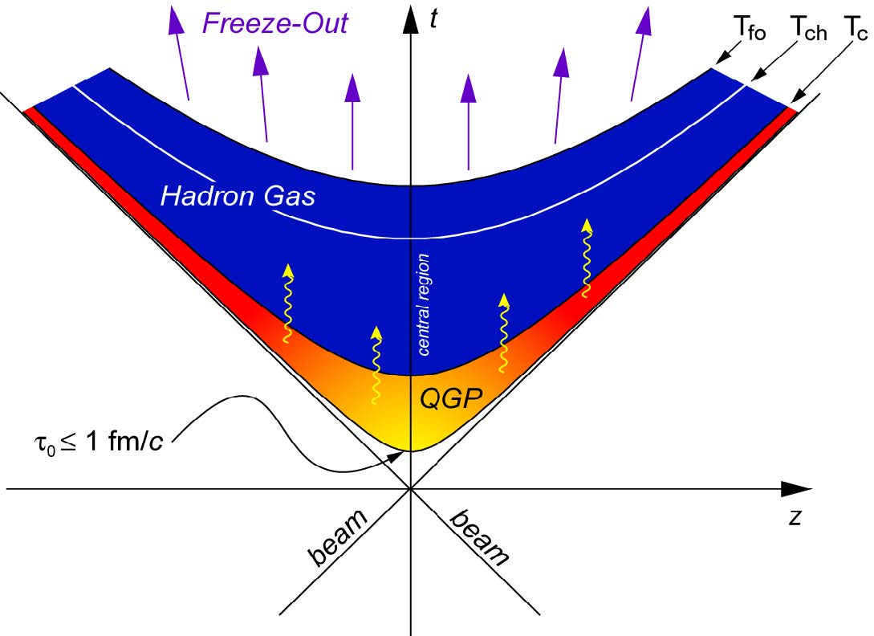
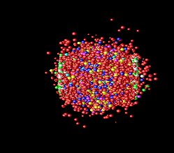
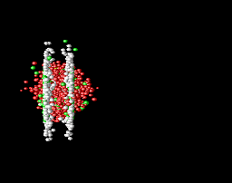
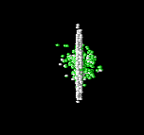

Heavy ion collision evolution
Kinetic Freeze-out
--- Interaction ceases
Chemical Freeze-out
--- formation of hadrons
C. Loizides et al. CERN summer student programme 2016
Kinetic Freeze-out properties decide final particle spectra
Energy dependence of Freeze-out properties is important for exploring QCD phase diagram

Slide 3
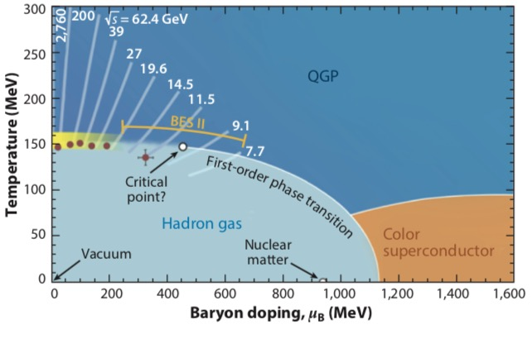
Strangeness vs Exploring QCD phase diagram
Annu. Rev. Nucl. Part. Sci. 68:339–76(2018)
Strange hadrons identifying the phase boundary and onset of deconfinement
Strangeness enhancement signature of QGP
Strangeness yields in BES better constrain chemical and kinetic freeze-out parameters

Slide 4
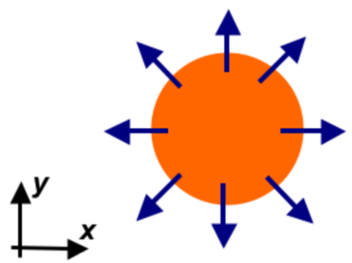
Blast-Wave Model for Particle Production
Source of particle production is assumed to be:
  Local thermal equilibrated
  Boosted radially
Radial flow
<β>
boosted
  E.Schnedermann et al. PRC 48, 2462(1993)
Boltzmann distribution
random
Extract global thermal temperature T_{fo} and velocity parameter ⟨β⟩
BGBW: Boltzmann-Gibbs Blast-Wave

Slide 5
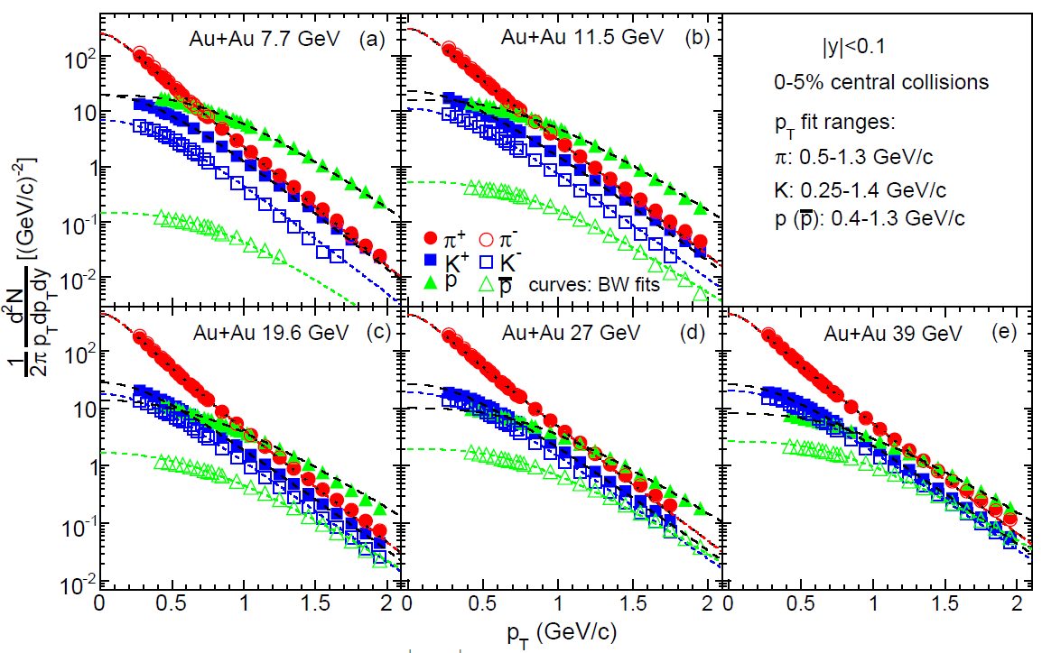
Limitation of the BGBW
Strong assumption on local thermal equilibrium
Subjective choice of p_{T} range of the spectra
Non zero flow velocity <β> in minimum bias p+p
Lack of non-extensive quantities to describe the evolution:
  m_{T} power-law spectra in p+p and peripheral A+A collisions
  m_{T} exponential spectra in central A+A collisions
STAR PRC 96, 044904 (2017)
STAR PRL. 92, 112301 (2004)

Slide 6
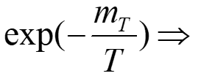
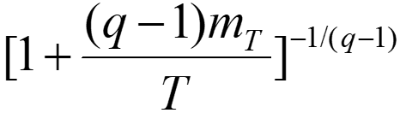


Tsallis Blast-Wave model (TBW):
Boltzmann → non-extensive Tsallis statistics
Solve Limitation of the BGBW
(q−1): degree of non-equilibrium
Strong assumption on local thermal equilibrium
Lack of non-extensive quantities to describe the evolution:
  m_{T} power-law spectra in p+p and peripheral A+A collisions
  m_{T} exponential spectra in central A+A collisions
C. Tsallis, J. Stat. Phys. 52, 479 (1988)
G. Wilk et al. EPJA 40, 299 (2009)
Particle production with Tsallis statistics:
3 parameters in TBW: global thermal temperature T_{fo} , velocity parameter ⟨β⟩ , degree of non-equilibrium (q−1) ;

Slide 7

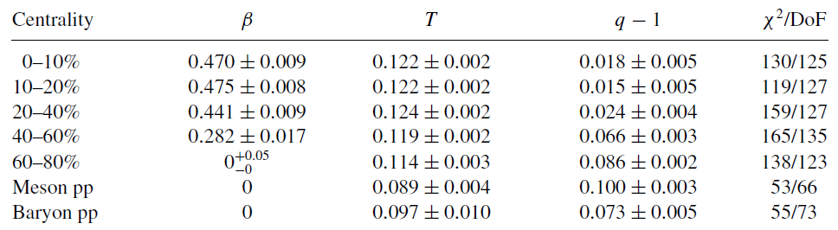
First application of Tsallis Blast-Wave model
Solve Limitation of the BGBW
Au+Au and p+p @200 GeV
Subjective choice of p_{T} range of the spectra
Non zero flow velocity <β> in minimum bias p+p
Lack of non-extensive quantities to describe the evolution:
  m_{T} power-law spectra in p+p and peripheral A+A collisions
  m_{T} exponential spectra in central A+A collisions
fit range for all species
Z. Tang et al. PRC 79, 051901 (R) (2009)
<β> ~ 0 in peripheral A+A and p+p collisions

Slide 8
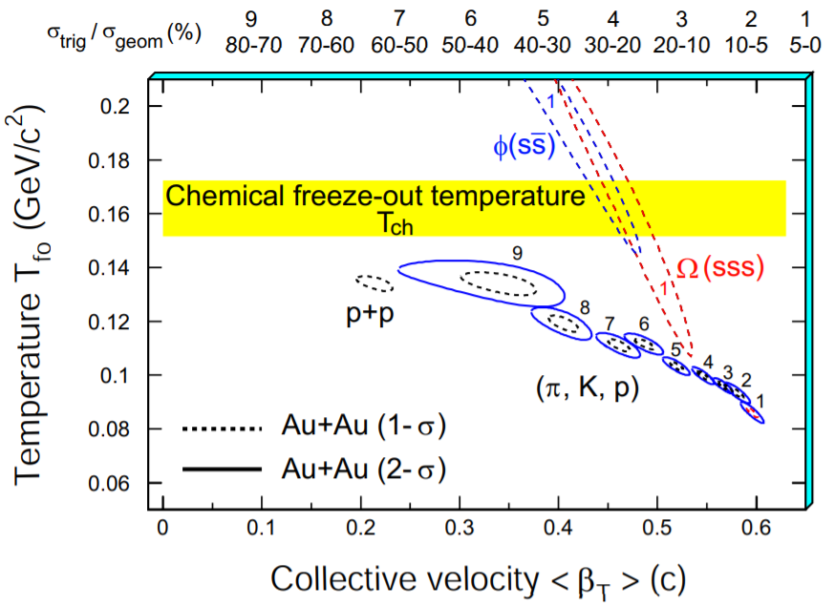
Does strangeness freeze-out earlier?
BGBW Au+Au and p+p @200 GeV
Some Paper References applied of TBW model
W. M. Alberico et al. EPJC 12, 499 (2000)
T. S. Biro et al. PLB 578, 78 (2004)
B. De et al. Int. J. Mod. Phys. E 16, 1687 (2007)
T. Osada et al. PRC 77, 044903 (2008)
M. Shao et al. J. Phys. G: Nucl. Part. Phys. 37, 085104 (2010)
K. Urmossy et al. PLB 701, 111-116 (2011)
Z. Tang et al., Chin. Phys. Lett. 30, 031201 (2013)
K. Jiang et al. PRC 91, 024910 (2015)
T. Bhattacharyya et al. EPJA 52, 30 (2016)
STAR NPA 757, 102-183 (2005)
Higher temperature of strangeness
indicating a possible early freeze-out of strangeness at RHIC.

Slide 9
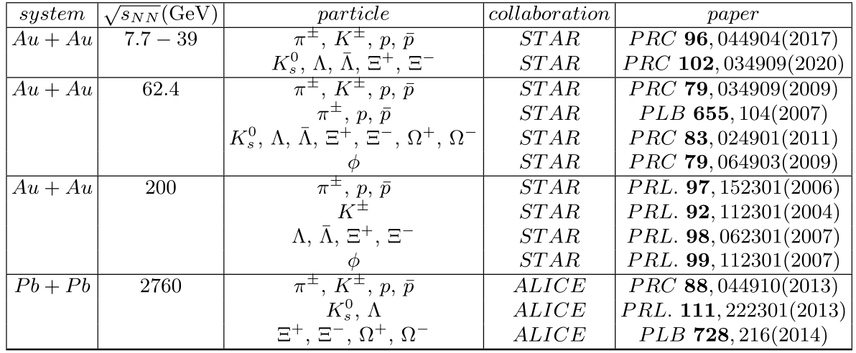
Data References from RHIC BES to LHC

Slide 10
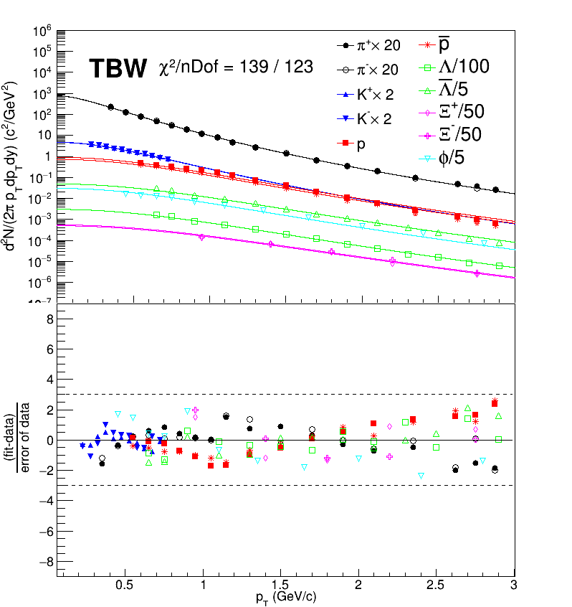
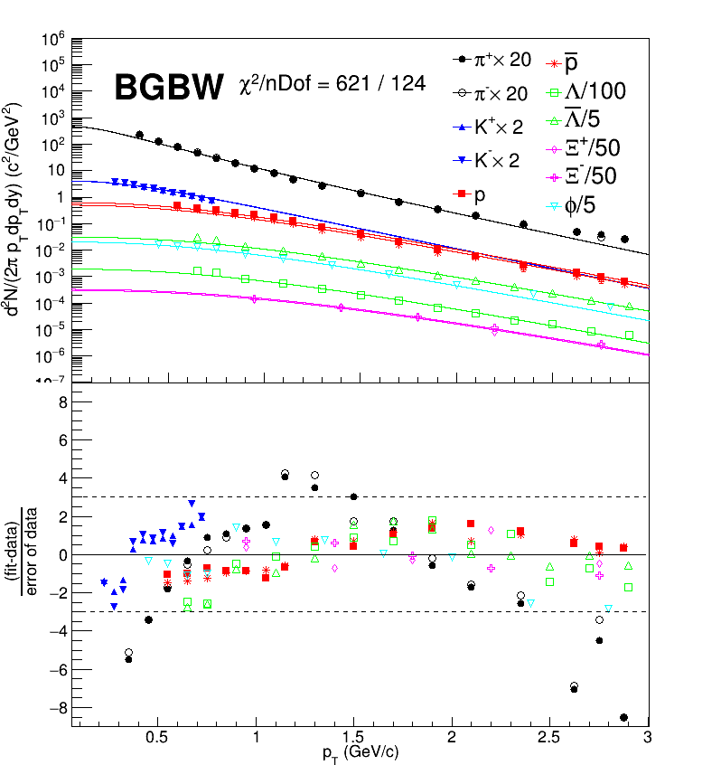

BGBW vs TBW on Particle Spectra
Au+Au @ 200 GeV
60-80% centrality
fit range for all species
TBW agrees with most data points within 3- , better than BGBW fit.

Slide 11
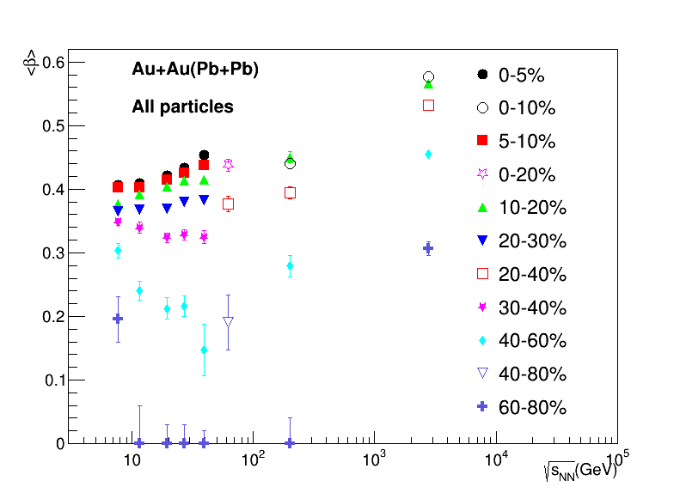
Average radial flow velocity in TBW
Radial flow velocity increases as collision energy increases in central collision

Slide 12
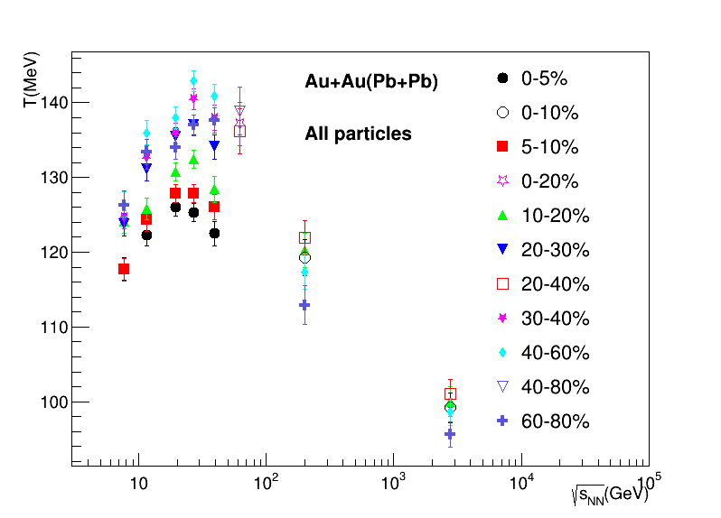
Kinetic Freeze-out Temperature in TBW
Temperature shows an increasing trend at RHIC BES, then decreases toward LHC
Temperature at RHIC
higher than that at
LHC

Slide 13
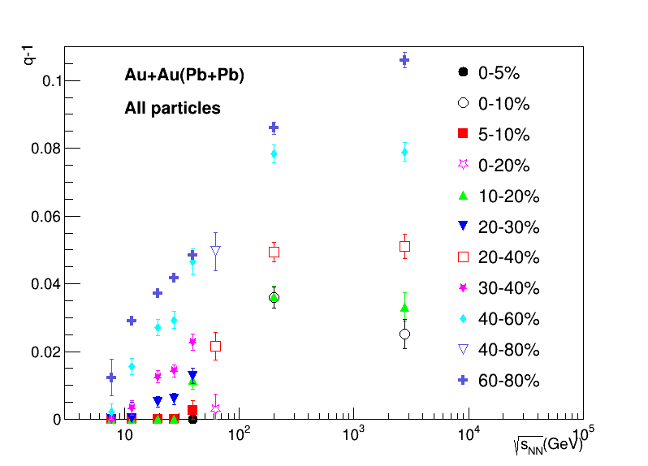
Degree of non-equilibrium in TBW
The degree of non-equilibrium (q−1) increases as collision energy increases
(q−1) ~ 0 in central collision at RHIC BES

Slide 14
What do we learn?
RHIC has lower <β> ,
higher T than LHC.
Lower radial flow and shorter time to reach kinetic freeze-out at RHIC.
A weaker expansion with smaller deviation from thermal equilibrium at lower energy.
Energy density fluctuations at initial state decrease or more washed out at later stage.
<β> and (q−1) both decreases at lower energy.

Slide 15
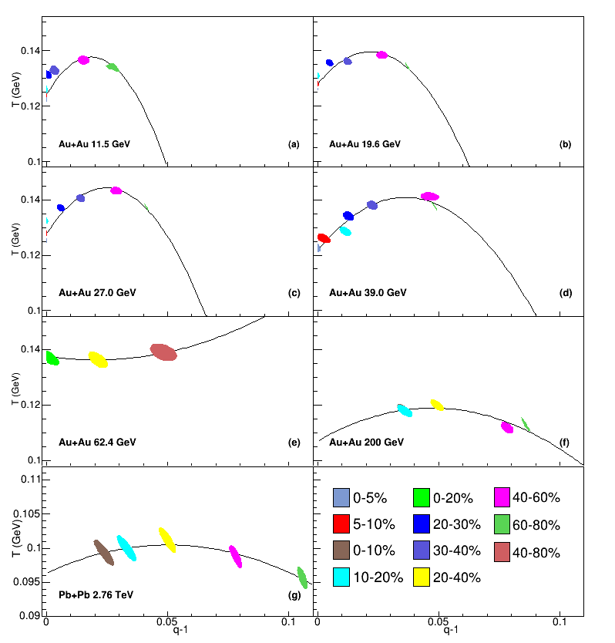


Bulk viscosity in TBW
: bulk viscosity – measures resistance to
expansion
acts against the buildup of radial flow
Polynomials fit function:
G. Wilk et al. PRL. 84, 2770 (2000)
G. Wilk et al. EPJA 40, 299 (2009)

Slide 16
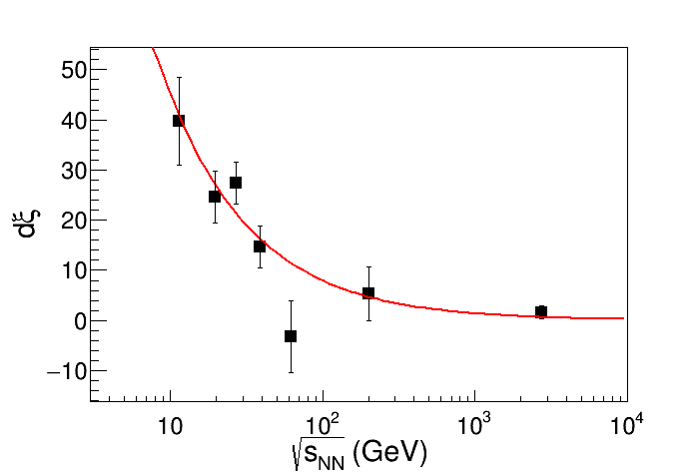
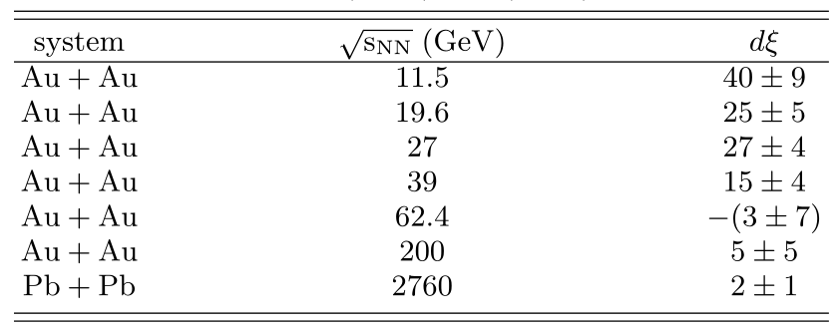

Bulk viscosity vs Collision energy
related to bulk viscosity, increases toward lower collision energies.

Slide 17
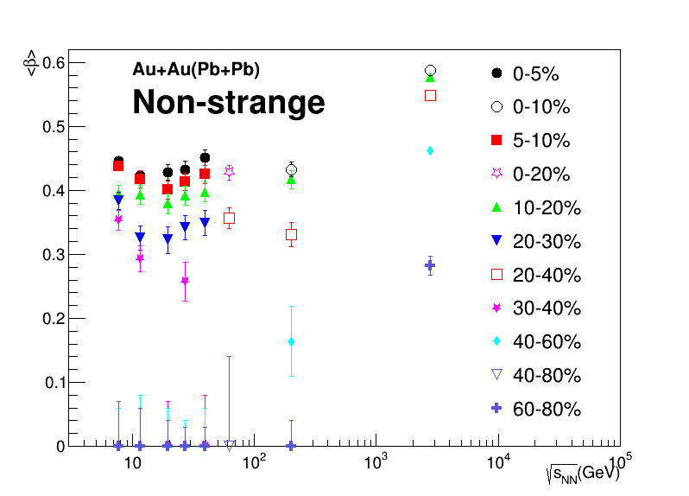
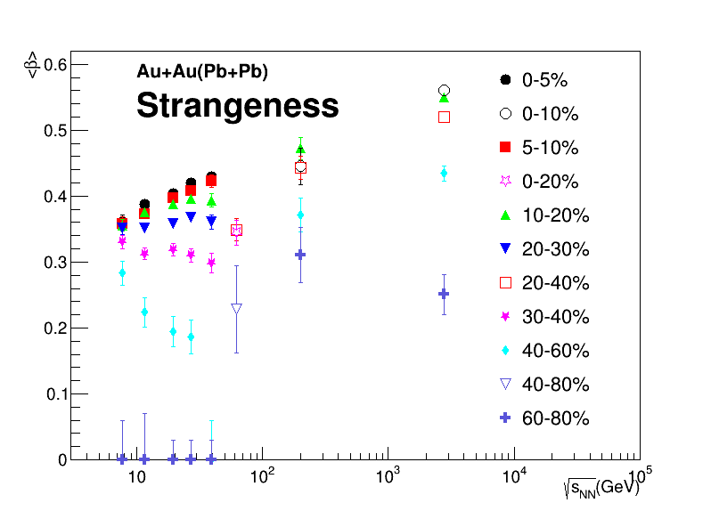
Non-strange vs strangeness for TBW：Average radial flow velocity
Similar average radial flow velocity

Slide 18
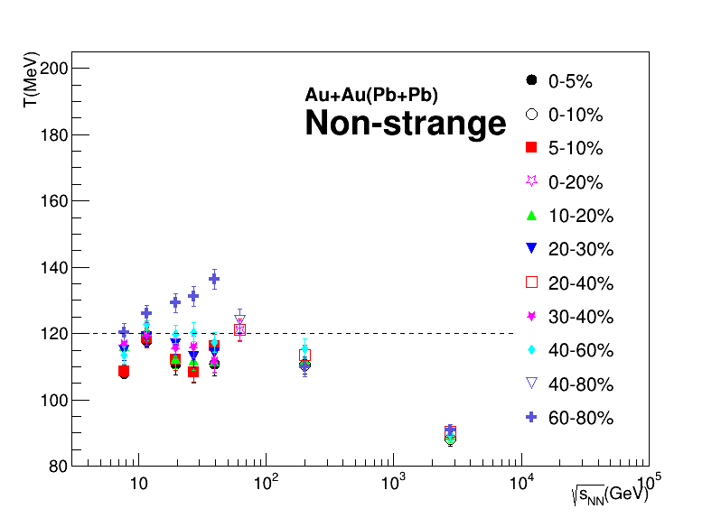
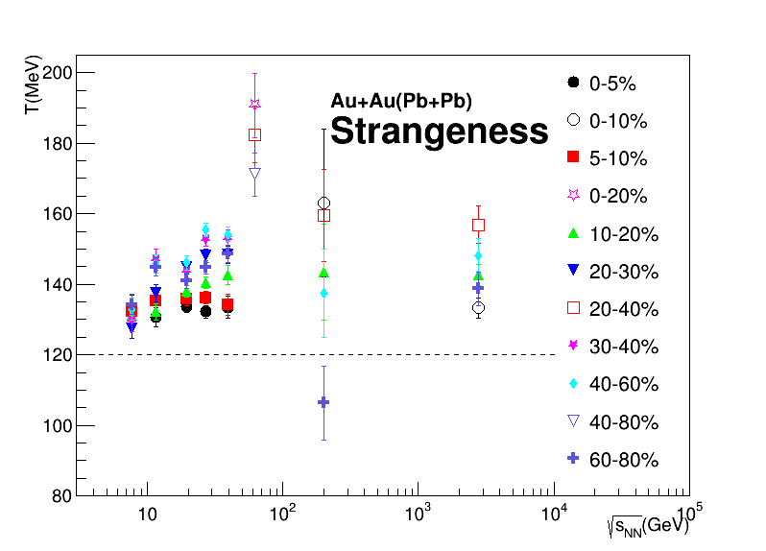


Non-strange vs strangeness for TBW：Kinetic Freeze-out Temperature
Strangeness show higher temperature than non-strange hadrons
Non-strange: Strangeness:

Slide 19
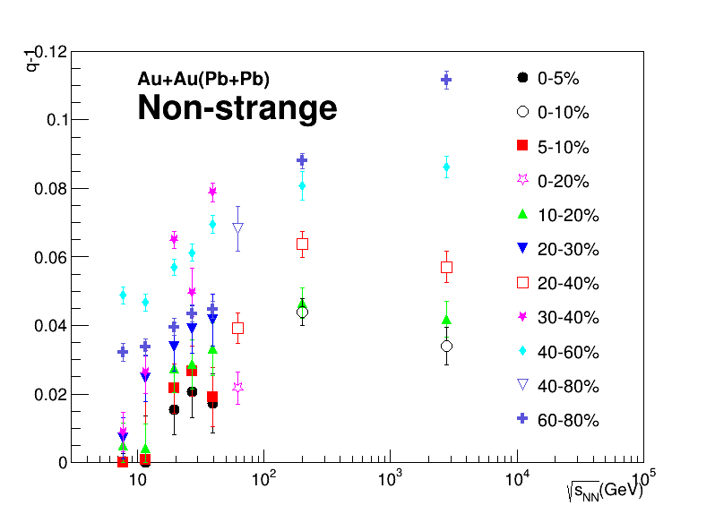
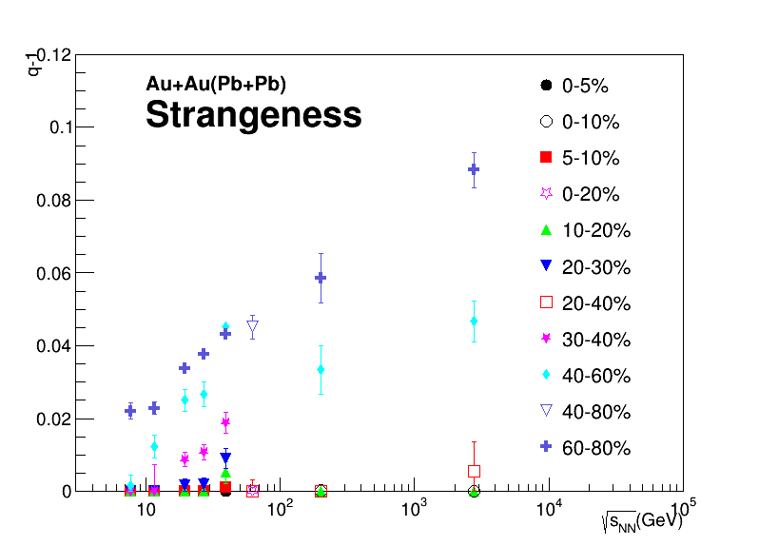
Non-strange vs strangeness for TBW：Degree of Non-equilibrium
Strangeness show smaller (q−1) value than non-strange hadrons

Slide 20


What do we learn?
Higher temperature of strangeness than non-strange.
Strangeness freeze-out earlier than light hadrons.
RHIC spends shorter time for non-strange particles to reach kinetic freeze-out than LHC.
Strangeness:
Non-strange:
Strangeness approach equilibrium more quickly from peripheral to central collisions
Smaller (q−1) of strangeness than non-strange.

Slide 21
Summary
1、 BGBW and TBW fits on spectra of Au+Au (RHIC) collisions at 7.7 - 200 GeV,
and Pb+Pb (LHC) collisions of 2.76 TeV are studied.
TBW describes experimental measurements better.
2、In TBW: T shows an increasing trend with beam energy at RHIC BES, then decreases
toward LHC;
<β> and (q-1) increase with the increase of the collision energy;
3、Parameter from the polynomials fit, related to bulk viscosity, increases toward
lower collision energies.
4、 Strangeness, approach equilibrium more quickly from peripheral to central collisions.
Strangeness freeze-out earlier than light hadrons.
RHIC spends shorter time for non-strange particles to reach kinetic freeze-out
than LHC.

Slide 22


Thank You

Slide 23
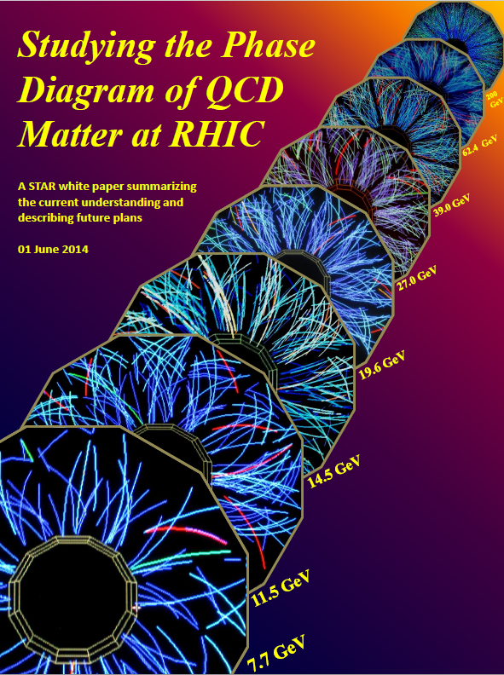
Back Up

Slide 24
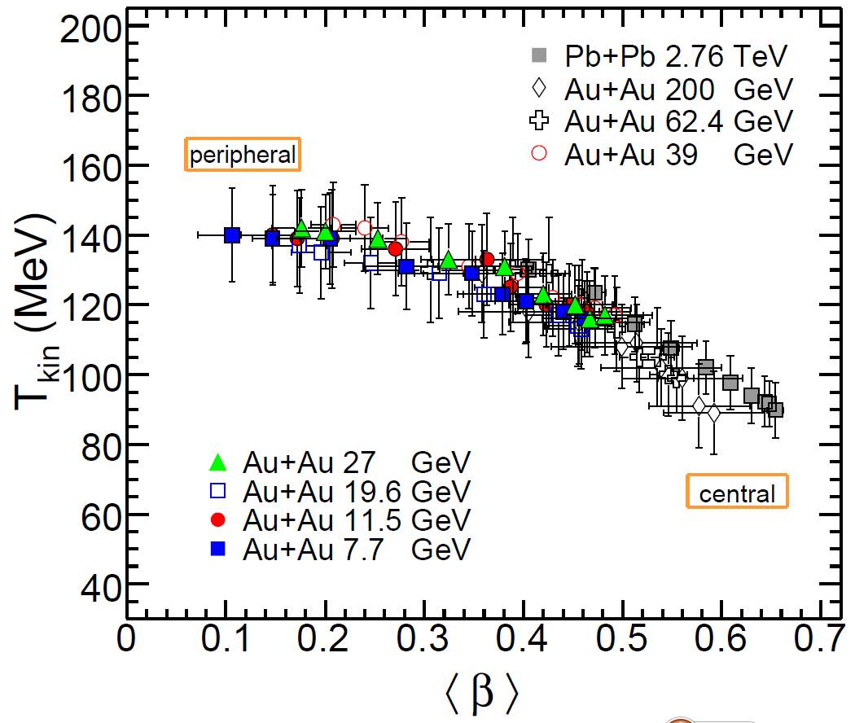
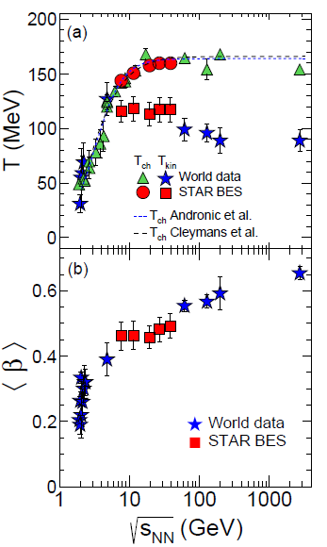
Back Up
BGBW fit results
STAR PRC 96, 44904 (2017)

Slide 25
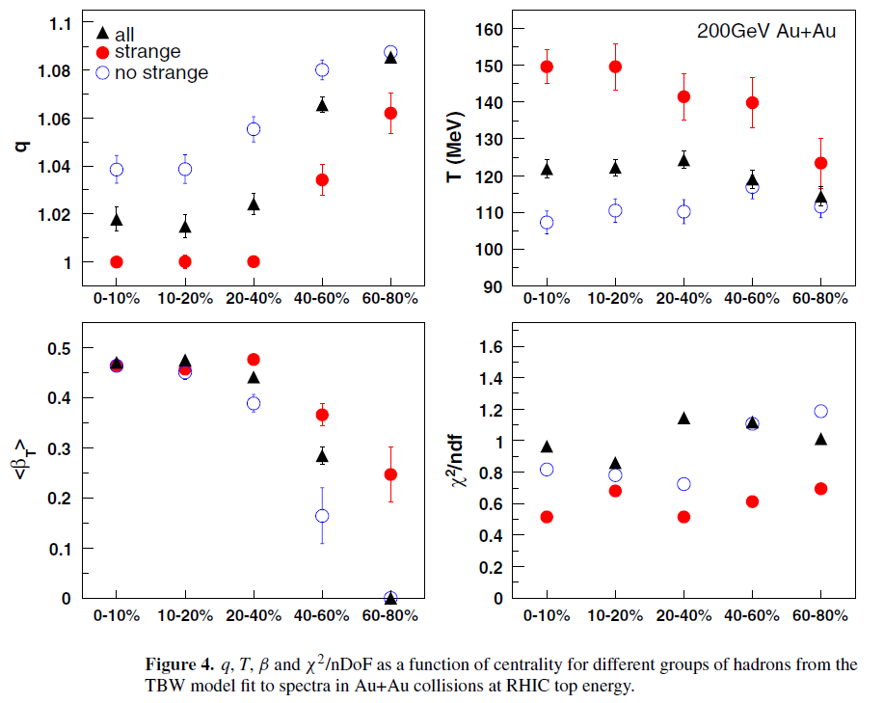
Back Up
Tsallis Blast-Wave fit results in Au+Au collisions
M. Shao et al. J. Phys. G: Nucl. Part. Phys. 37, 085104 (2010)
Off thermal equilibrium in peripheral collisions for both strange hadrons and the other hadrons.

Slide 26
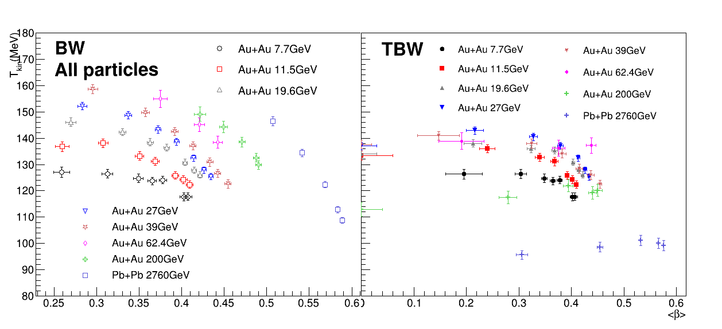
BGBW vs TBW on Variation of Temperature with Velocity
TBW results different from BGBW
TBW fit results
peripheral
central
The TBW results for the temperature of peripheral collisions is lower than the BGBW results.
Temperature of the central collisions doesn’t change obviously at RHIC, and then decreases up to LHC in TBW model.

