Slide 2

Michal Simon
The virtue of composability
02/03/2021
Michal Simon

Slide 3
Motivation
Use case: erasure coding plug-in for EOS ALICEO2
  AliceO2: 2000 data sources exporting 2GB file (time frame) every 40 seconds
  Aggregate throughput of 100GB/s
  Executing multiple operations on multiple remote files (stripes) in parallel
Problem with asynchronous operation composability and code readability
  Asynchronous Open() + Write() + Close() in the code is only visible as an Open() (rest of the workflow is in the callbacks)
02/03/2021
Michal Simon

Slide 4
Composability
Good programming model for remote I/O
  Decompose larger task (e.g. file update) into smaller ones (e.g. open + write + close)
  Program each of the primitive operations
  Trivially COMPOSE back the smaller tasks into the original one
Lazy evaluated
  First declare the operations, compose them into a pipeline and only then execute the whole pipeline
Associativeness
  (open + write) + close == open + (write + close)
02/03/2021
Michal Simon

Slide 5
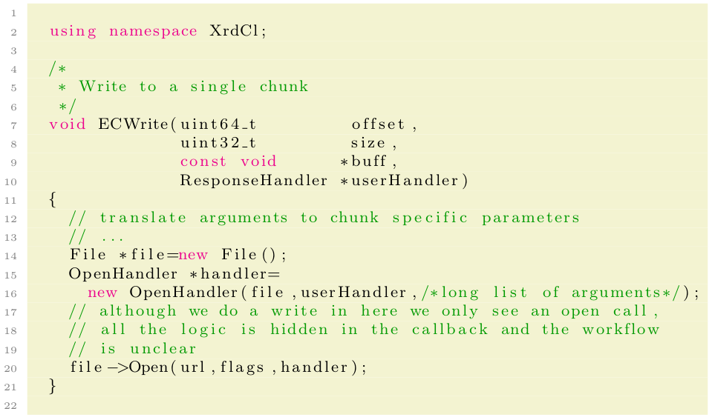
XRootD4 OO API
Update of a single stripe/chunk with standard XrdCl API ...
02/03/2021
Michal Simon

Slide 6
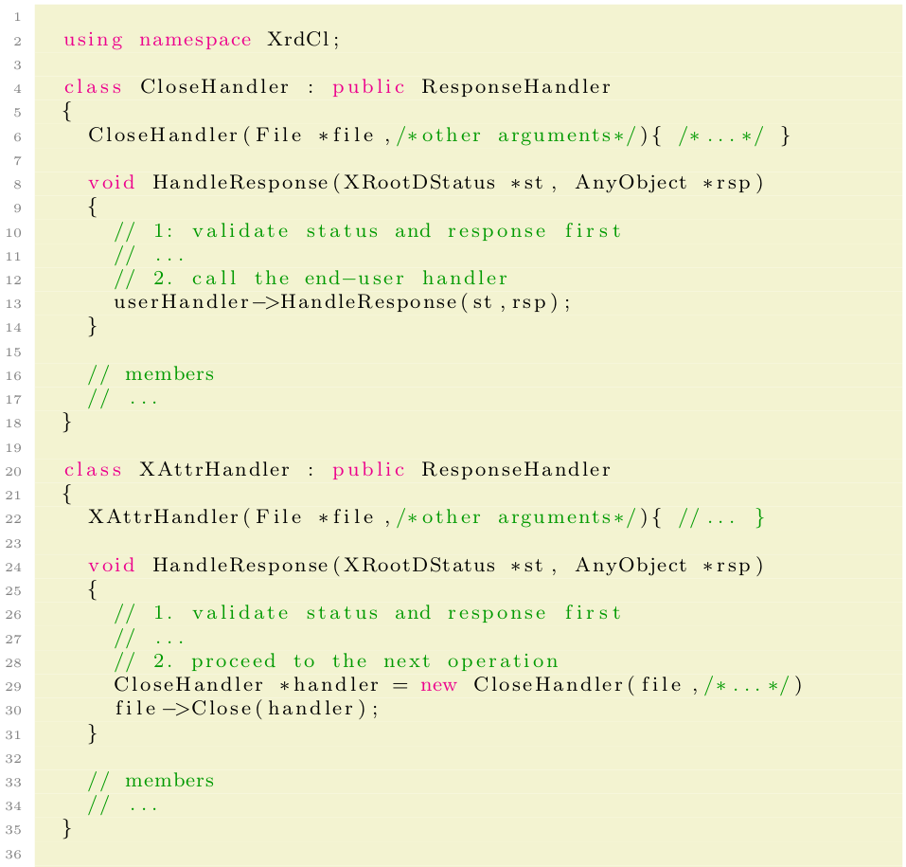
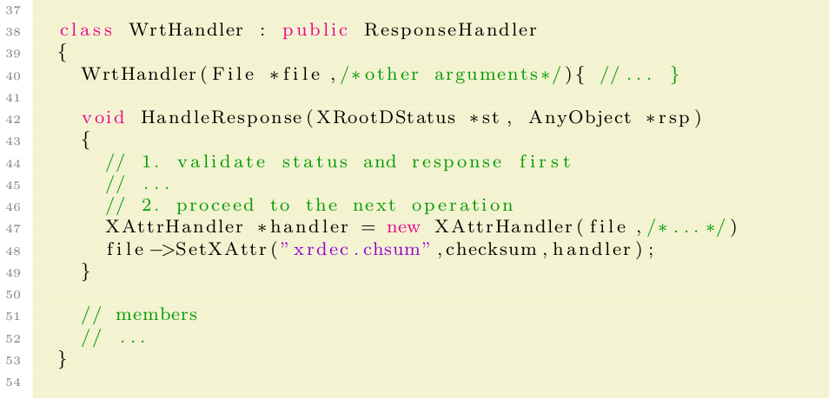
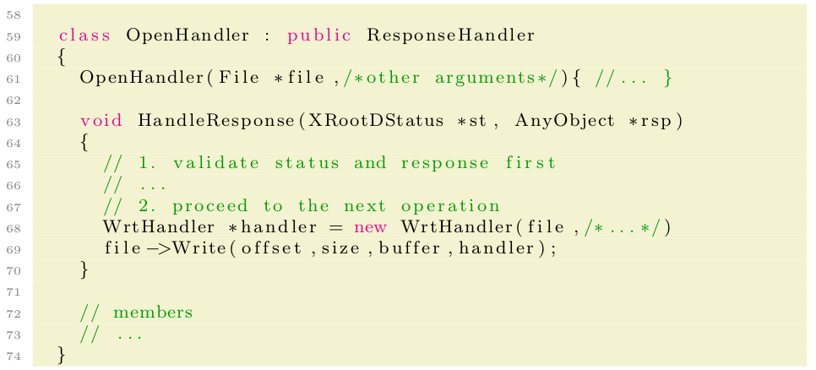
XRootD4 OO API
… also all this boilerplate code is needed!
02/03/2021
Michal Simon

Slide 7
XRootD4 OO API
What do we have so far:
We updated only one chunk
Write and SetXAttr happen sequentially (we would need yet another handler-class to aggregate the result of parallel execution)
The amount of boilerplait code is SIGNIFICANT!!!
To update all data stripes and parity stripes we will need yet another handler-class to cope with parallel execution
The boilerplait code is very repetitive!
02/03/2021
Michal Simon

Slide 8
Conclusions …
We extracted the repeating patterns, applied significant amount of template meta-programming and got a new declarative API:
Asynchronous operation composability
Code readability
Clear workflow
In line with modern c++ (ranges v3 inspired, support for lambdas, std::futures)
Released in 4.9.0 but more complete set of features available only in 5.0.0
02/03/2021
Michal Simon

Slide 9
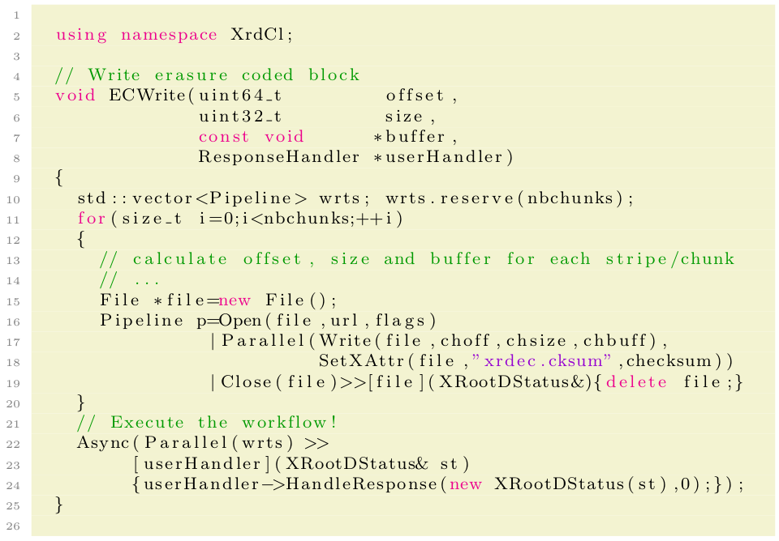
Client Declarative API
Using declarative API:
02/03/2021
Michal Simon

Slide 10
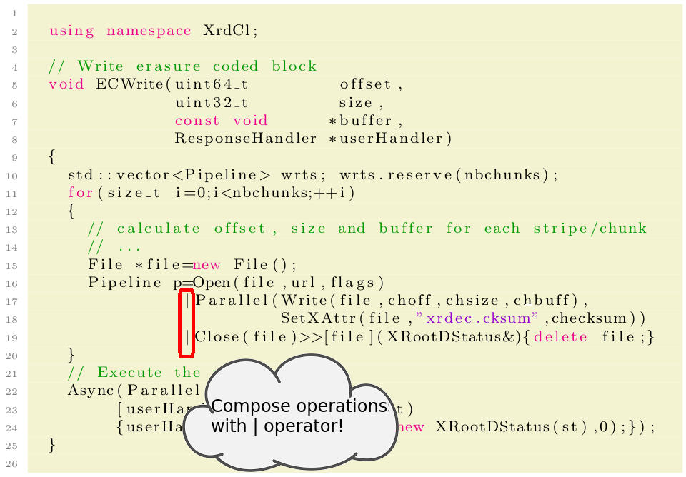
Client Declarative API
Using declarative API:
02/03/2021
Michal Simon

Slide 11
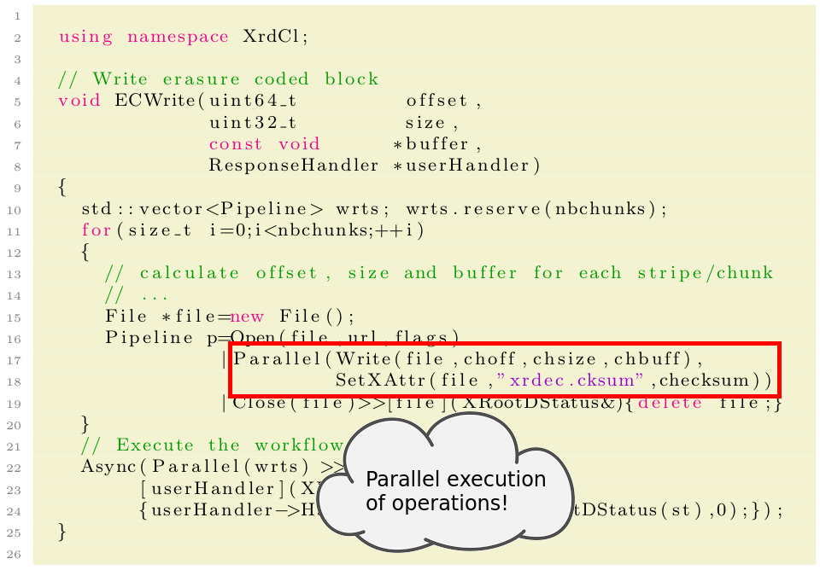
Client Declarative API
Using declarative API:
02/03/2021
Michal Simon

Slide 12
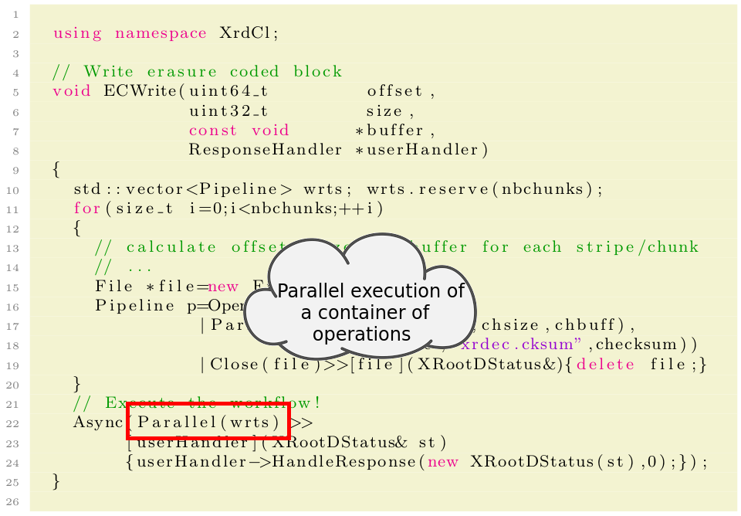
Client Declarative API
Using declarative API:
02/03/2021
Michal Simon

Slide 13
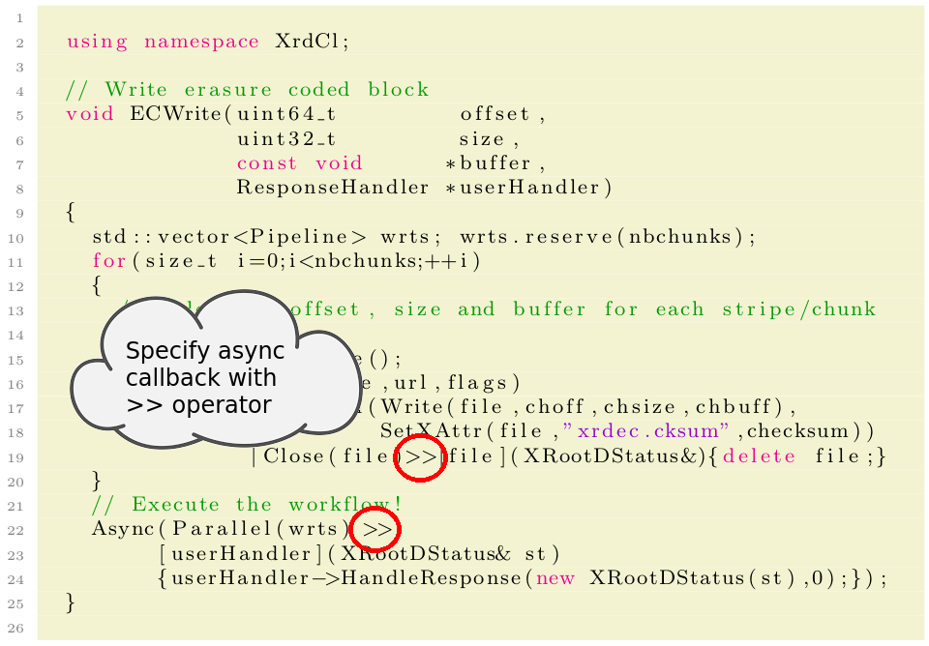
Client Declarative API
Using declarative API:
02/03/2021
Michal Simon

Slide 14
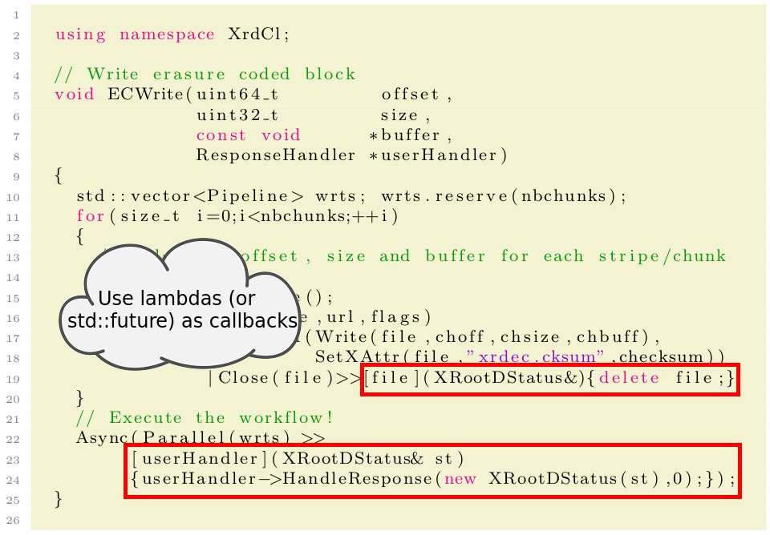
Client Declarative API
Using declarative API:
02/03/2021
Michal Simon

Slide 15
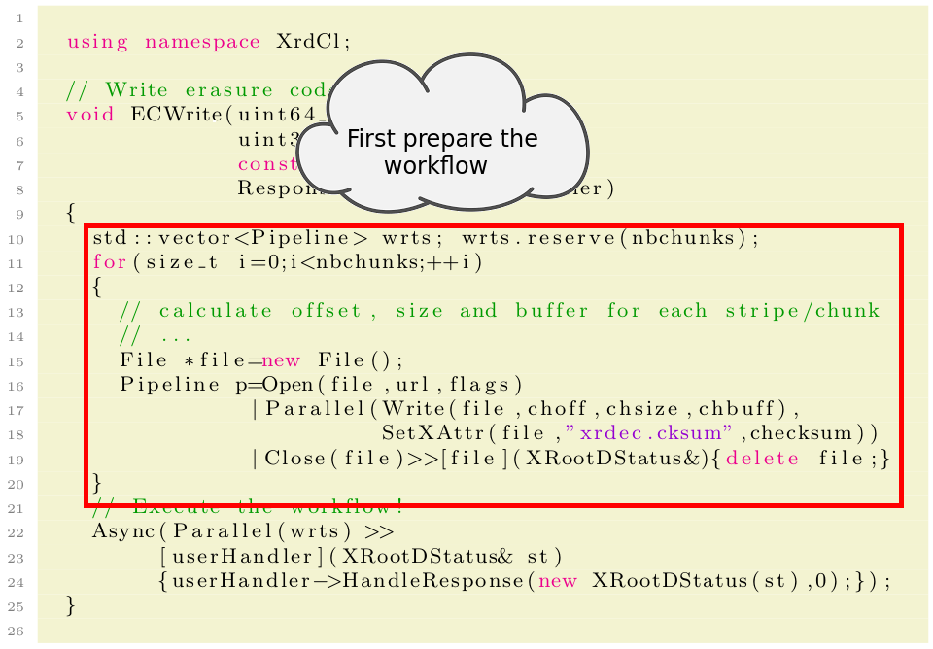
Client Declarative API
Using declarative API:
02/03/2021
Michal Simon

Slide 16
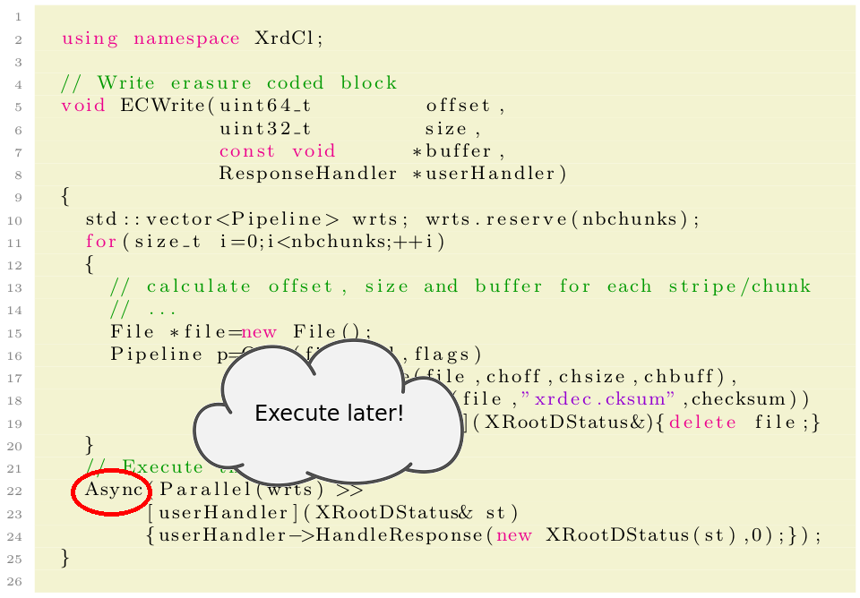
Client Declarative API
Using declarative API:
02/03/2021
Michal Simon

Slide 17
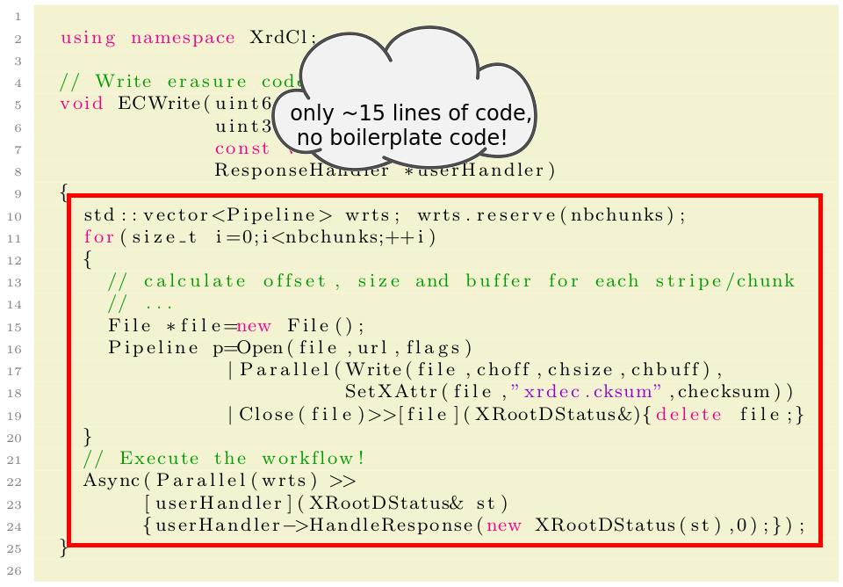
Client Declarative API
Using declarative API:
02/03/2021
Michal Simon

Slide 18
Additional utilities
Final: final operation, always executed, for resource management
Fwd: utility class for forwarding values between handlers and operations
Control directives: Stop, Ignore, Repeat and Replace
02/03/2021
Michal Simon

Slide 19
Example 2
Another example: parsing ZIP using declarative API
Open remote ZIP archive and read the Central Directory
Once we have the archive size we can make an educated guess on the offset of the Central Directory
However it might be that there is a comment at the end of the archive which will invalided our guess
  In this case we need to adjust the offset we are reading at and repeat the read request
02/03/2021
Michal Simon

Slide 20
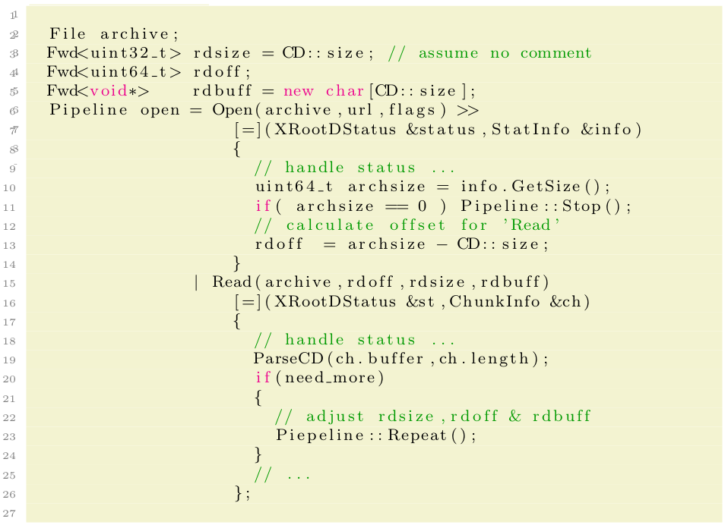
Example 2
Parsing ZIP using declarative API:
02/03/2021
Michal Simon

Slide 21
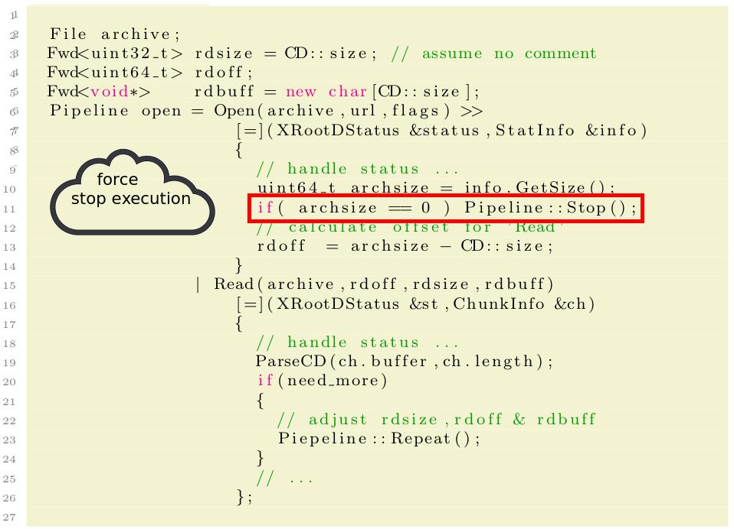
Example 2
Parsing ZIP using declarative API:
02/03/2021
Michal Simon

Slide 22
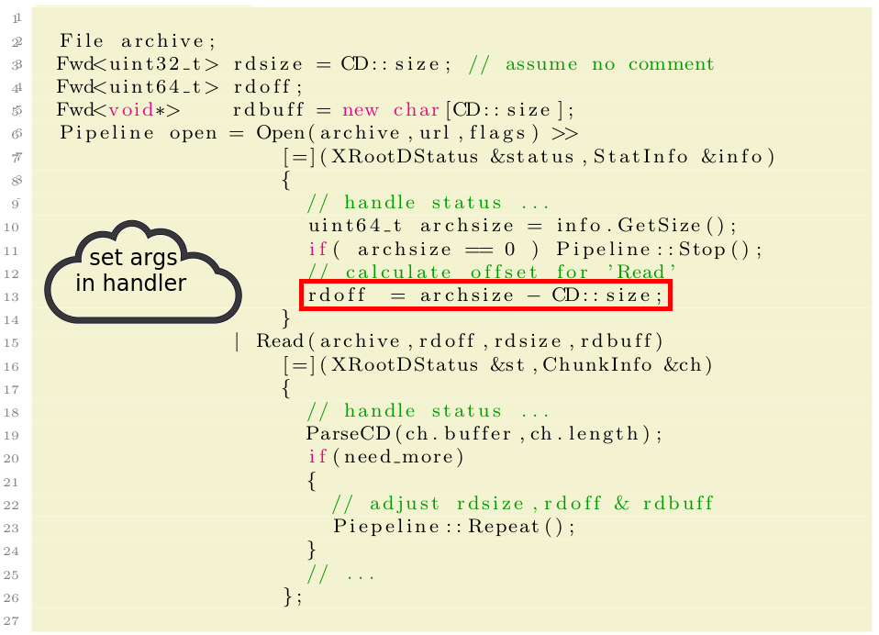
Example 2
Parsing ZIP using declarative API:
02/03/2021
Michal Simon

Slide 23
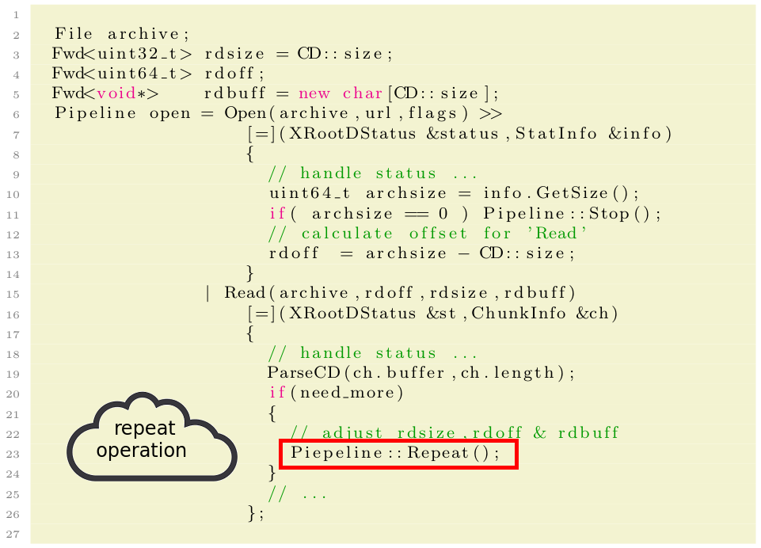
Example 2
Parsing ZIP using declarative API:
02/03/2021
Michal Simon

Slide 24
Summary & plans
Declarative API is available for File, FileSystem and ZipArchive operations
Currently used to implement XrdEc library and ZipArchive operations
Refactor xrdcp using declarative API in order to get better high level operation composability (extreme copy vs ZIP archives vs Metalinks)
Provide Python bindings for declarative API
30/11/2020
Michal Simon

Slide 25
Questions?
30/11/2020
Michal Simon

